Slide 1



Proving the dimension-shift conjecture
2011.13821 [hep-th] JHEP 04 (2021), 276
Guy R. Jehu
Trinity College Dublin
in collaboration with Ruth Britto and Andrea Orta
RadCor/LoopFest 2021
Thursday 20th May
Research funded by grant number 647356 (CutLoops)

Slide 2

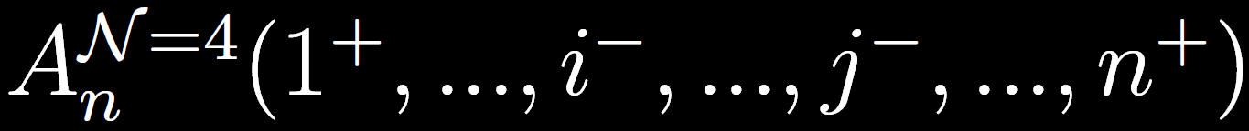
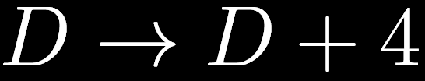
The dimension-shift conjecture
Made by Z. Bern , L. Dixon, D. C. Dunbar and D. Kosower (BDDK)
hep-th/9611127 Phys.Lett.B 394 (1997), 105-115
Simple relationship between GLUON amplitudes at ONE LOOP in different theories.
Relates all-plus-helicity QCD amplitudes to MHV amplitudes in N=4 SYM

Slide 3
The dimension-shift conjecture
BDDK verified up to n=6
Can we prove this after 25 years of advances in understanding?
THIS TALK:
  How to prove
  How to compute all-ε all-n forms in both theories
Proven!

Slide 4
The dimension-shift conjecture
How far have we come with these particular theories and helicity configurations?

Slide 5
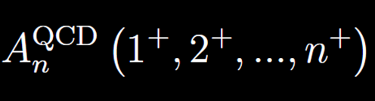
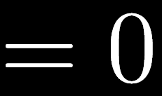
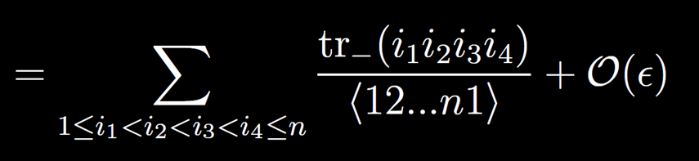
All-plus QCD
Tree-Level
One-loop
Two-loop
  Planar: First n>4 result in QCD [Badger, Frellesvig, Zhang ‘13]
  Planar: all-n for cut-constructible (n=7 full) [Dunbar, GRJ, Perkins ‘16] [Dunbar, Godwin, GRJ, Perkins ‘17]
  Non-planar: first all-n partial amplitude at 2 loops [Dunbar, Godwin, Perkins, Strong ‘20]
[Mahlon ‘93]
[Bern, Chalmers, Dixon, Kosower ‘93]

Slide 6
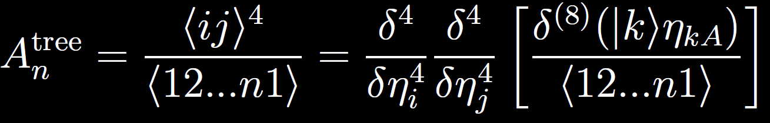

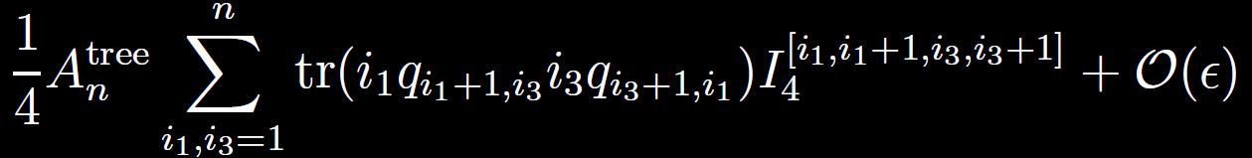

MHV in N=4
[Nair ‘88]
[Parke, Taylor ‘86]
[Bianchi, Elvang, Freedman ‘05]
Tree-Level
One-loop
[Bern, Dixon, Dunbar, Kosower ‘94]

Slide 7
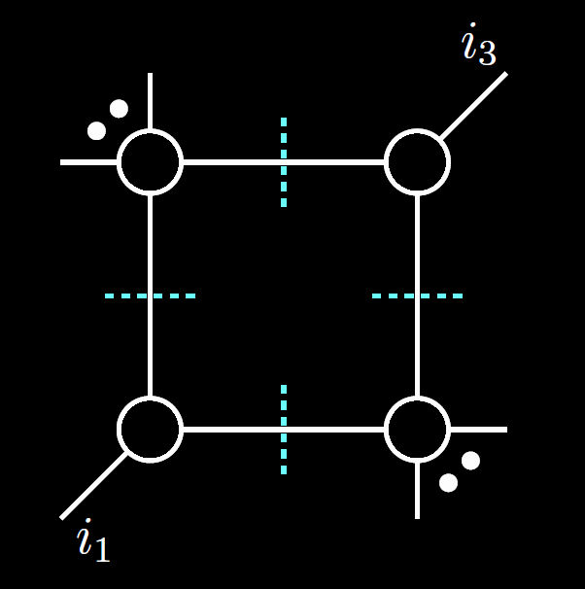
MHV in N=4
[Nair ‘88]
[Parke, Taylor ‘86]
[Bianchi, Elvang, Freedman ‘05]
Tree-Level
One-loop
Multi-loop
  BDS ansatz to all loop order (exact for n<6) [Bern, Dixon, Smirnov ‘05]
  Seven-loops n=6 [Caron-Huot, Dixon, Dulat, von Hippel, McLeod, Papathanasiou ‘19]
  Two loops n=9 [Golden, McLeod‘21]
[Bern, Dixon, Dunbar, Kosower ‘94]
[Britto, Cachazo, Feng ‘05]

Slide 8
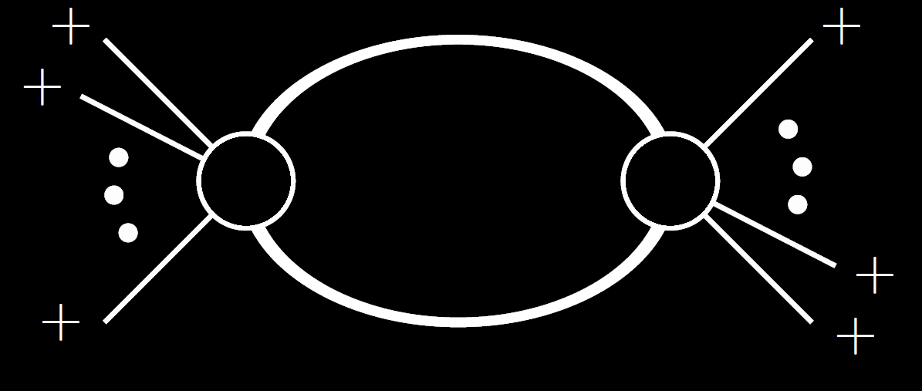
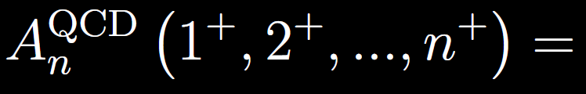
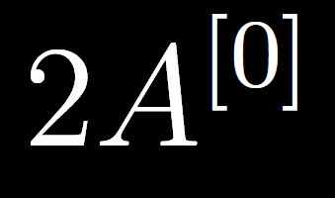
Proving the conjecture
Need to capture all-ε structure to all multiplicities
To compute up to six points, BDDK use:
  String-derived (worldline) formalism for N=4 amplitude
  D-dimensional cuts for all-plus QCD
[Bern, Kosower ‘92]
Amplitude with scalar
particle in the loop

Slide 9
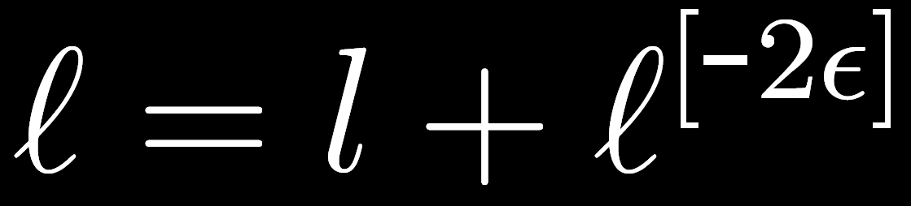
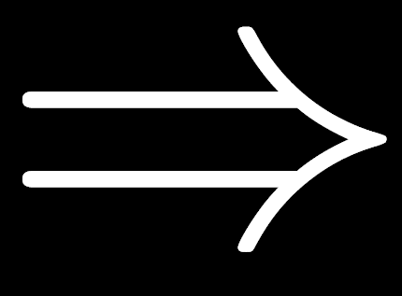
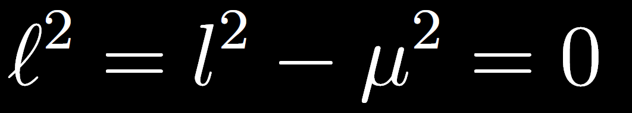
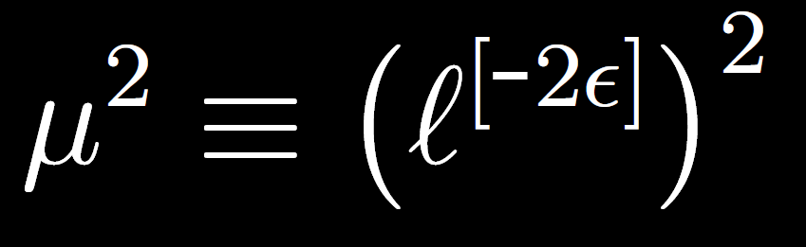
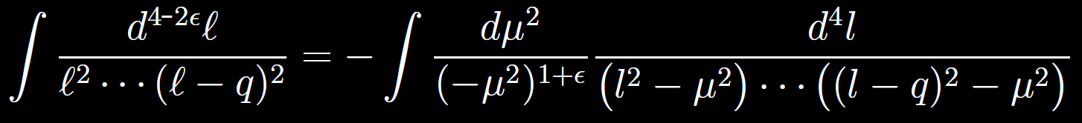
Proving the conjecture
D-dimensional cuts nicer for both sides

Slide 10
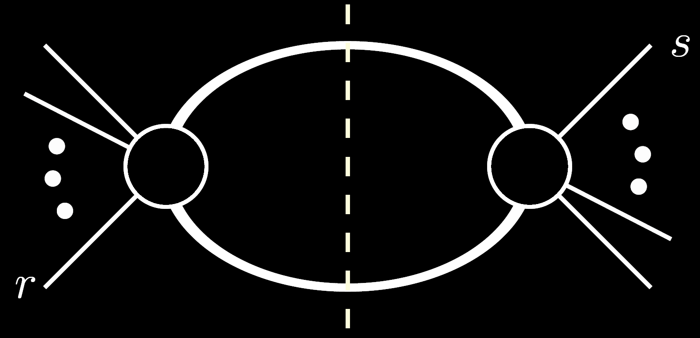
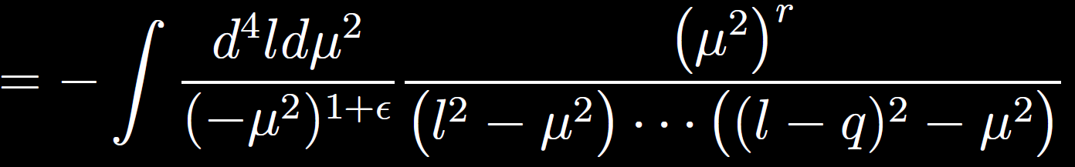
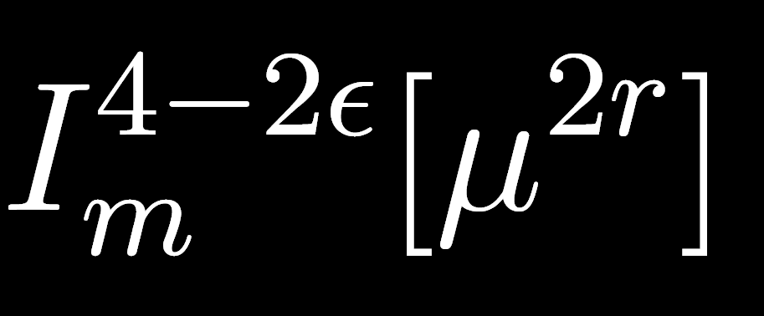
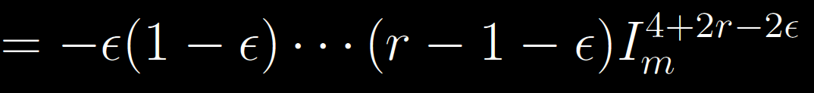
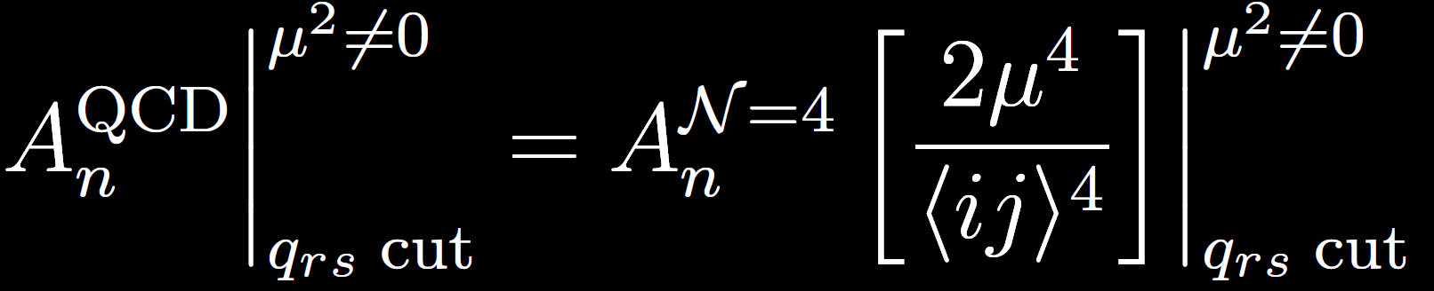
Proving the conjecture

Slide 11
Proving the conjecture

Slide 12
Proving the conjecture
Need tree amplitudes with two equally-massive legs
  Vector bosons, adjoint fermions, scalars
  Expressions available
[Forde, Kosower ‘06]
[Boels, Schwinn ‘11]
[Rodrigo ‘06]
[Craig, Elvang, Kiermaier, Slatyer ‘11]
[Ferrario, Rodrigo, Talavera ‘06]
[Kiermaier ‘11]

Slide 13
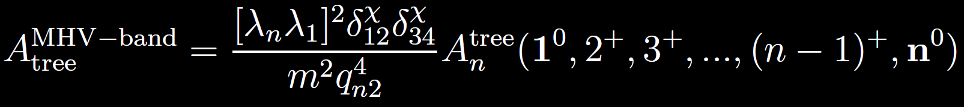
Proving the conjecture
Simple relationships between all-n amplitudes in “MHV band”
  All related to scalar amplitude
  Coulomb-branch SUSY associates spin structure
[Craig, Elvang, Kiermaier, Slatyer ‘11]
[Kiermaier ‘11]
[Elvang, Freedman, Kiermaier ‘11]

Slide 14
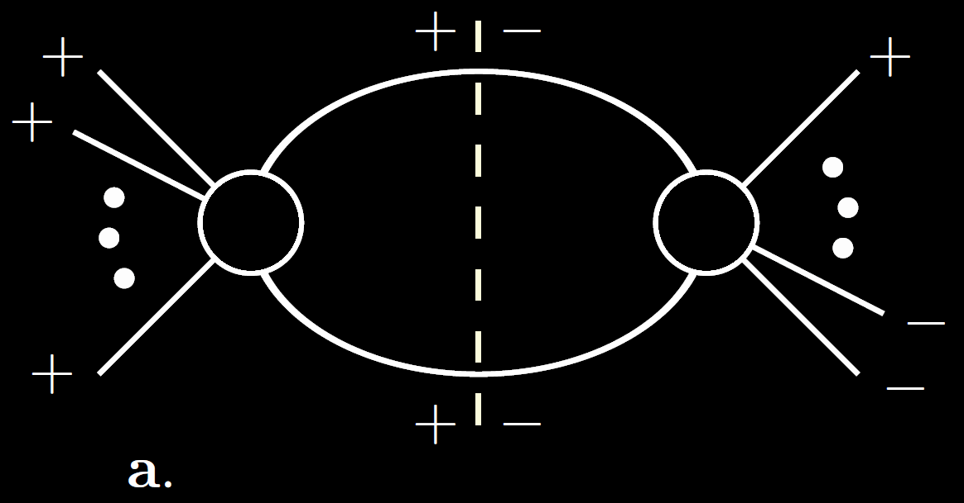
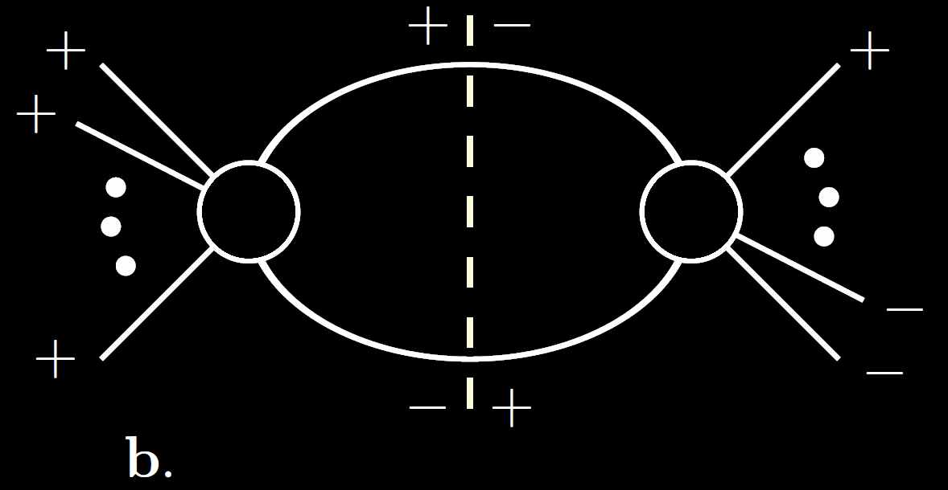
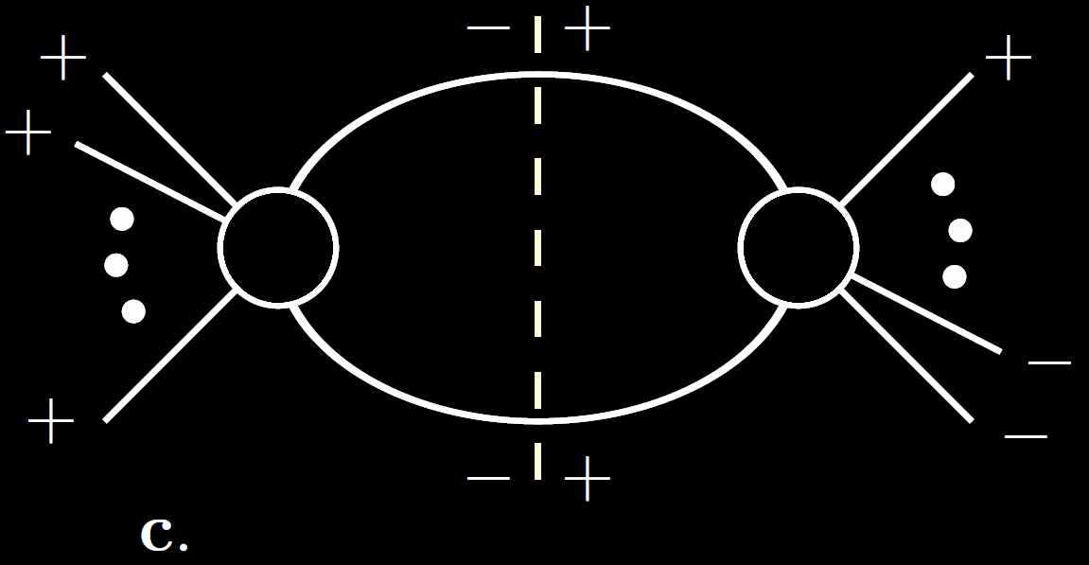
Proving the conjecture
MHV has three types of cut in a given axial gauge

Slide 15
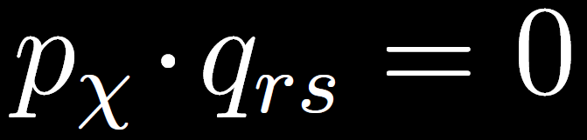
Proving the conjecture
MHV has three types of cut in a given axial gauge

Slide 16
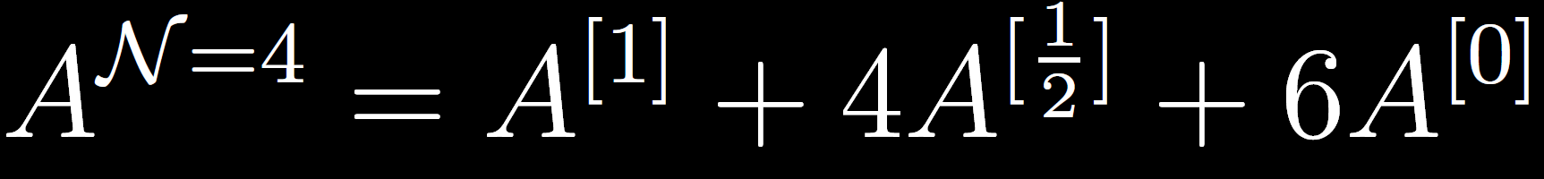
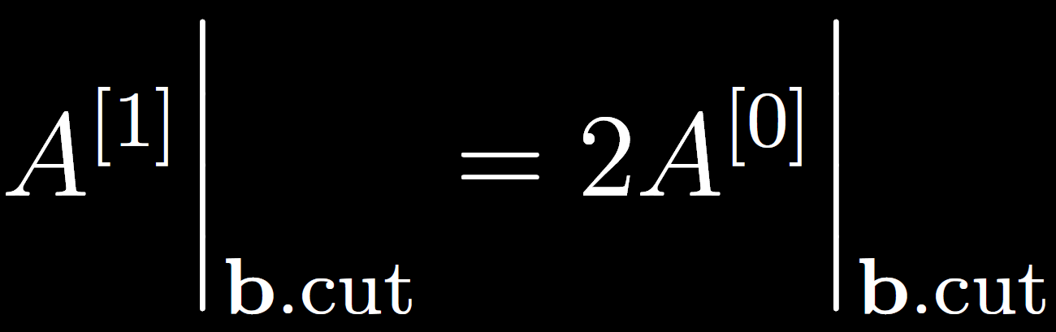
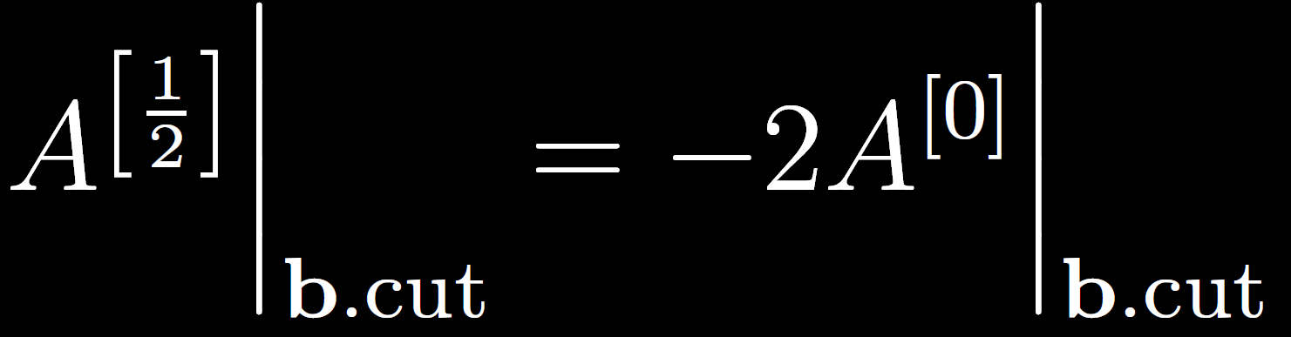
Proving the conjecture
MHV has three types of cut in a given axial gauge

Slide 17
Proving the conjecture
MHV has three types of cut in a given axial gauge

Slide 18
Proving the conjecture
MHV x MHV cut similar to massless (4D) cuts
apply functional derivatives….

Slide 19
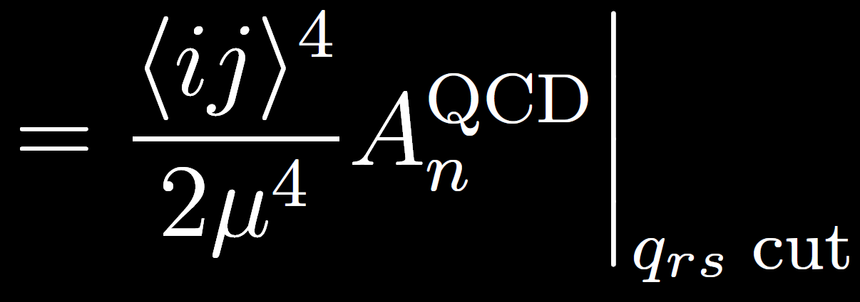
Proving the conjecture
MHV x MHV cut similar to massless (4D) cuts

Slide 20
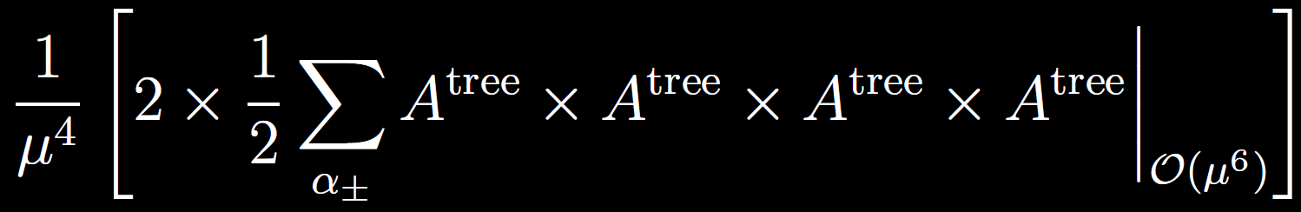
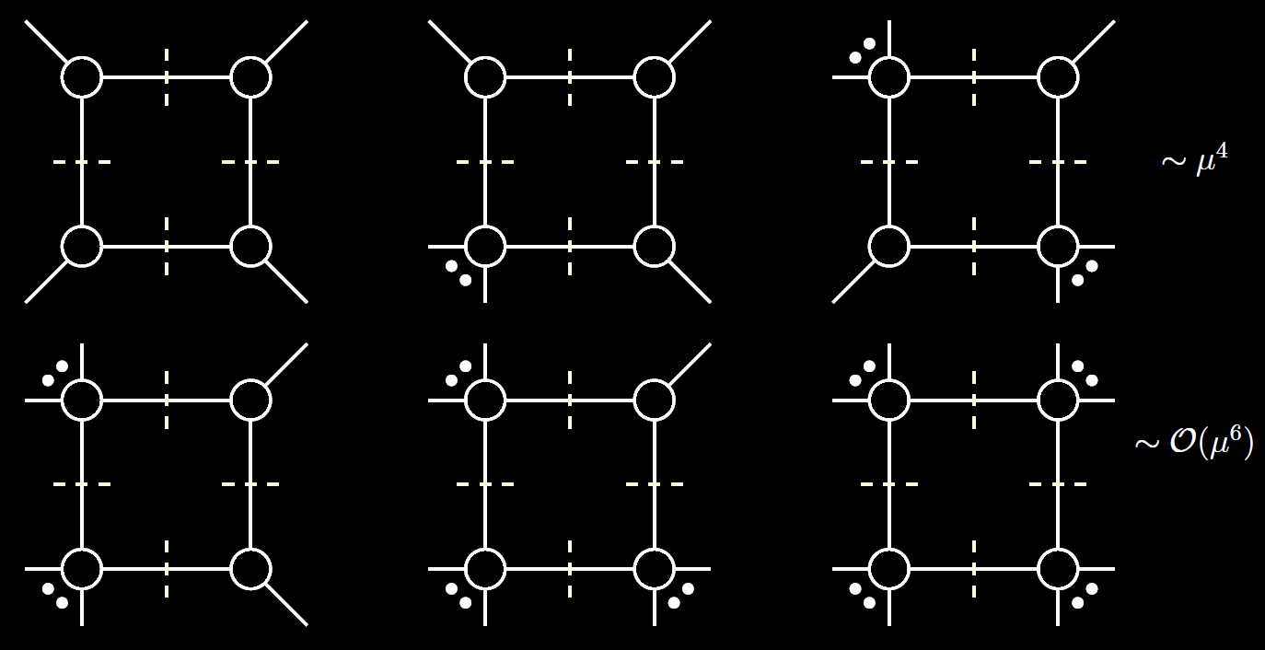
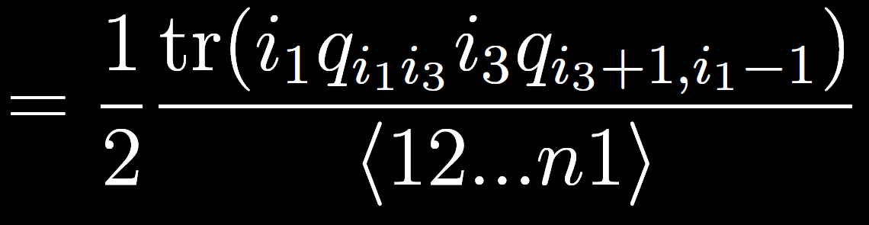
Closed forms at all-multiplicity
Boxes:
  Can simply use 4D cuts on N=4 side
  All-plus side: Two-mass easy from UV truncation

Slide 21
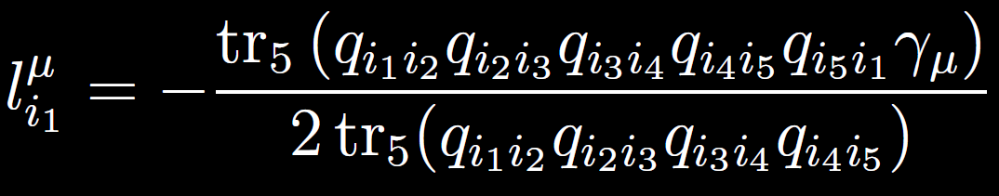
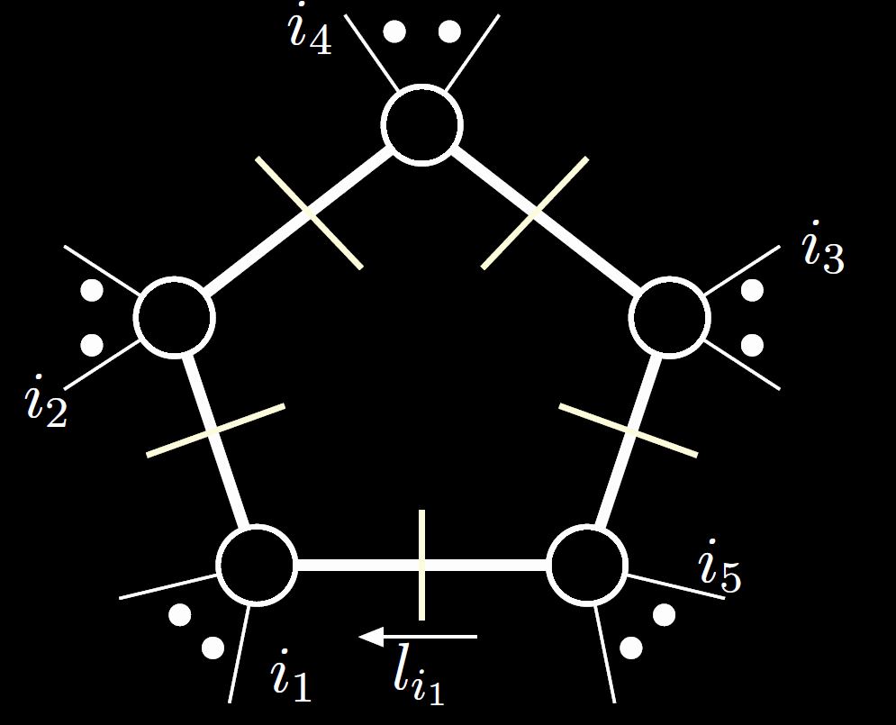
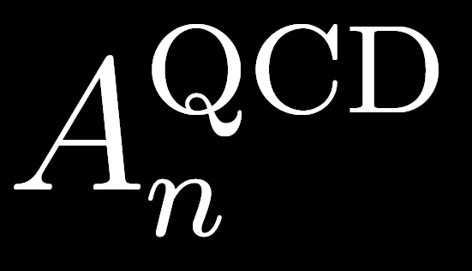
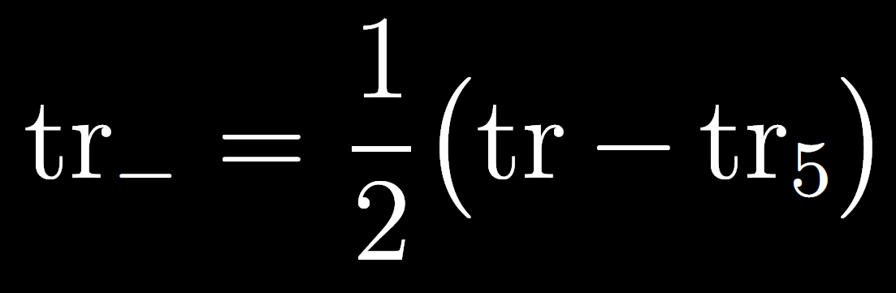
Closed forms at all-multiplicity
Pentagons:
  Generalised D-dimensional cuts
  Solution very simple, general for all-massive case
[GRJ ‘20]
NON TRIVIAL CHECK
Verified up to n=17

Slide 22
Summary
Dimension shift conjecture proven
All-epsilon, all-n forms computed
Very different cut constructions for each
  Two-mass-easy boxes: UV vs helicity
(Purity of MHV in N=4 not all-epsilon (work in progress))

Slide 23
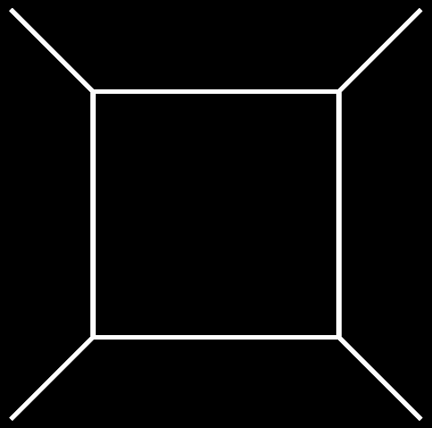

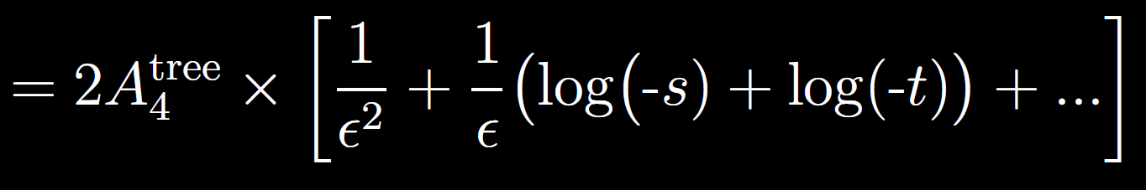
MHV in N=4
Uniformly Transcendental amplitude (UT)
Stronger property: Purity
  Integral x leading singularity
  MPLs have no kinematic coefficients
[Cachazo ‘08]
[Arkani-Hamed, Bourjaily, Cachazo, Trnka ‘12]
[Henn ‘13]

Slide 24
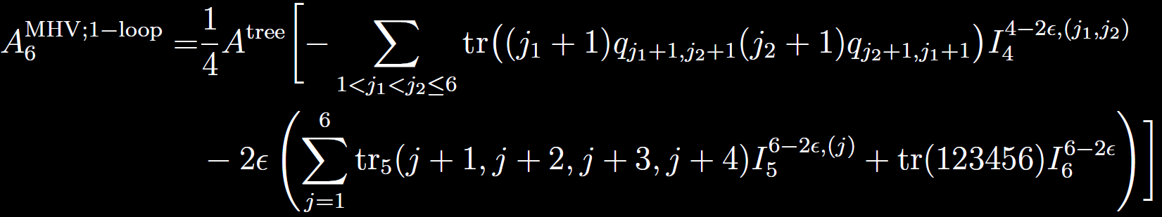

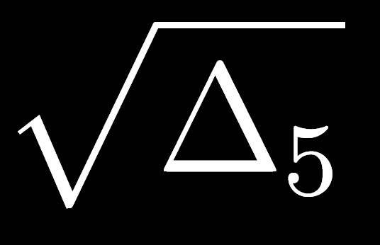

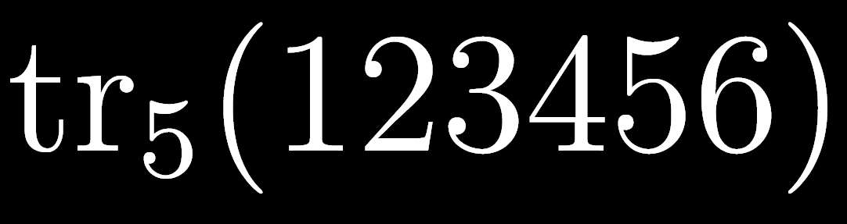
MHV in N=4
Uniformly Transcendental amplitude (UT)
  All-epsilon was computed up to n=6 by BDDK
Higher-in-epsilon
structure
NOT PURE n>5

