Slide 1
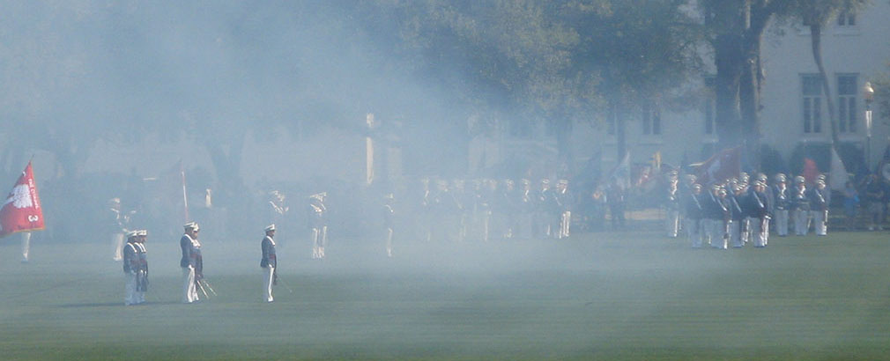
New Developments in KKMC-hh: Quark-level Exponentiated Radiative Corrections and Semi-Analytical Results
S.A. Yost
The Citadel
with S. Jadach, B.F.L. Ward, Z. Wąs
and M. Dittrich
May 18, 2021
Computational resources provided by IFJ-PAN, Kraków
and The Citadel.

Slide 2
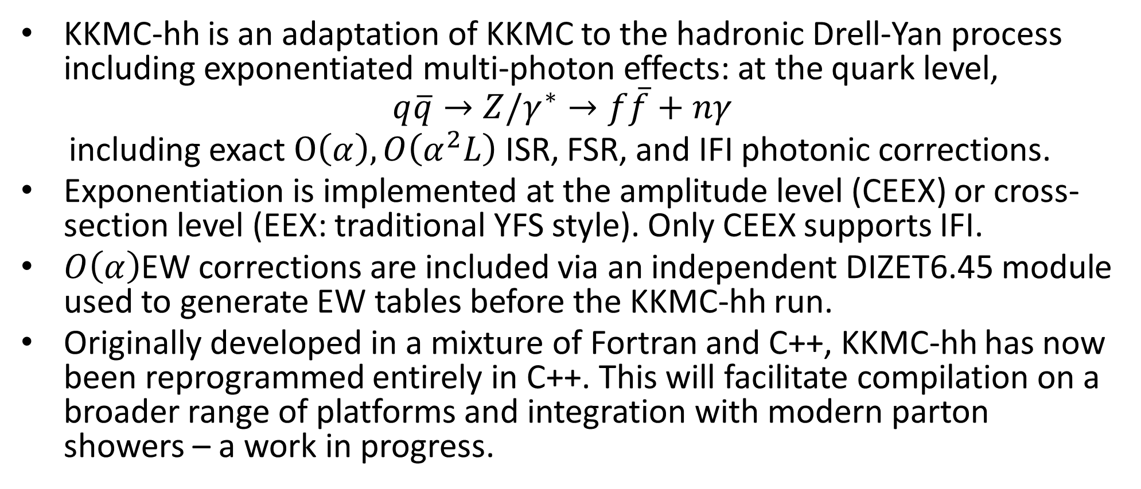
KKMC-hh for Precision EW Phenomenology
KKMC-hh is an adaptation of KKMC to the hadronic Drell-Yan process including exponentiated multi-photon effects: at the quark level,
$$q\overline{q}→Z/γ^{∗}→f\overline{f}+nγ$$
including exact $O\left(α\right), O\left(α^{2}L\right)$ ISR, FSR, and IFI photonic corrections.
Exponentiation is implemented at the amplitude level (CEEX) or cross-section level (EEX: traditional YFS style). Only CEEX supports IFI.
$O\left(α\right)$EW corrections are included via an independent DIZET6.45 module used to generate EW tables before the KKMC-hh run.
Originally developed in a mixture of Fortran and C++, KKMC-hh has now been reprogrammed entirely in C++. This will facilitate compilation on a broader range of platforms and integration with modern parton showers – a work in progress.

Slide 3
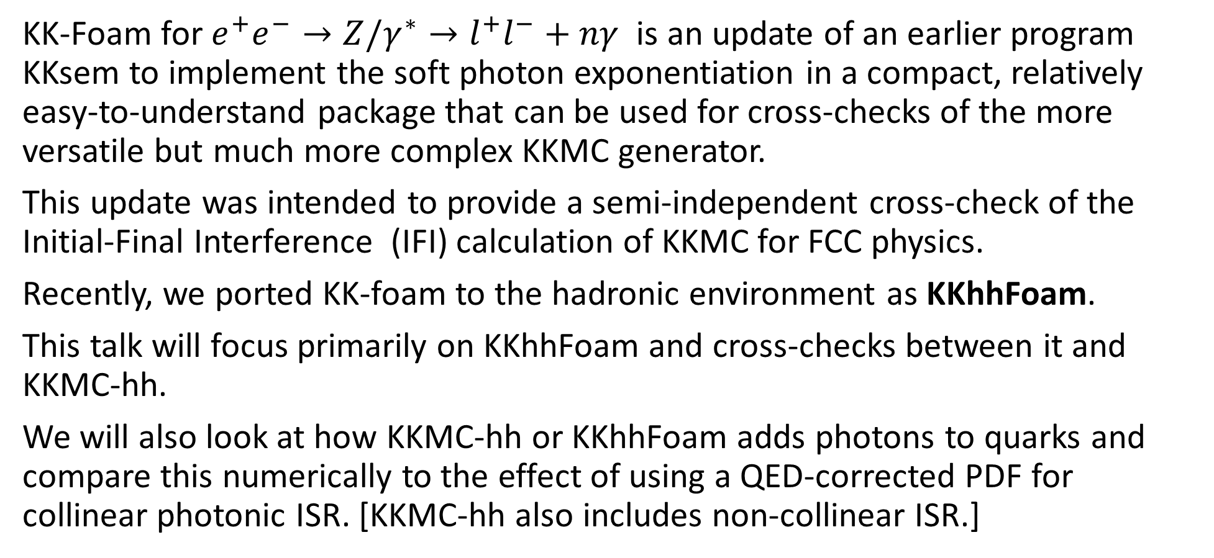
KKhhFoam: Semi-Analytical Implementation
KK-Foam for $e^{+}e^{−}→Z/γ^{∗}→l^{+}l^{−}+nγ$ is an update of an earlier program KKsem to implement the soft photon exponentiation in a compact, relatively easy-to-understand package that can be used for cross-checks of the more versatile but much more complex KKMC generator.
This update was intended to provide a semi-independent cross-check of the Initial-Final Interference (IFI) calculation of KKMC for FCC physics.
Recently, we ported KK-foam to the hadronic environment as KKhhFoam.
This talk will focus primarily on KKhhFoam and cross-checks between it and KKMC-hh.
We will also look at how KKMC-hh or KKhhFoam adds photons to quarks and compare this numerically to the effect of using a QED-corrected PDF for collinear photonic ISR. [KKMC-hh also includes non-collinear ISR.]

Slide 4
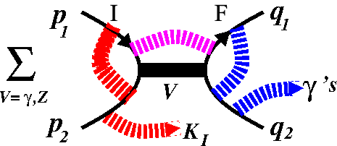
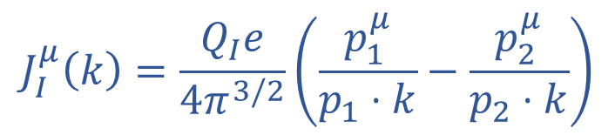
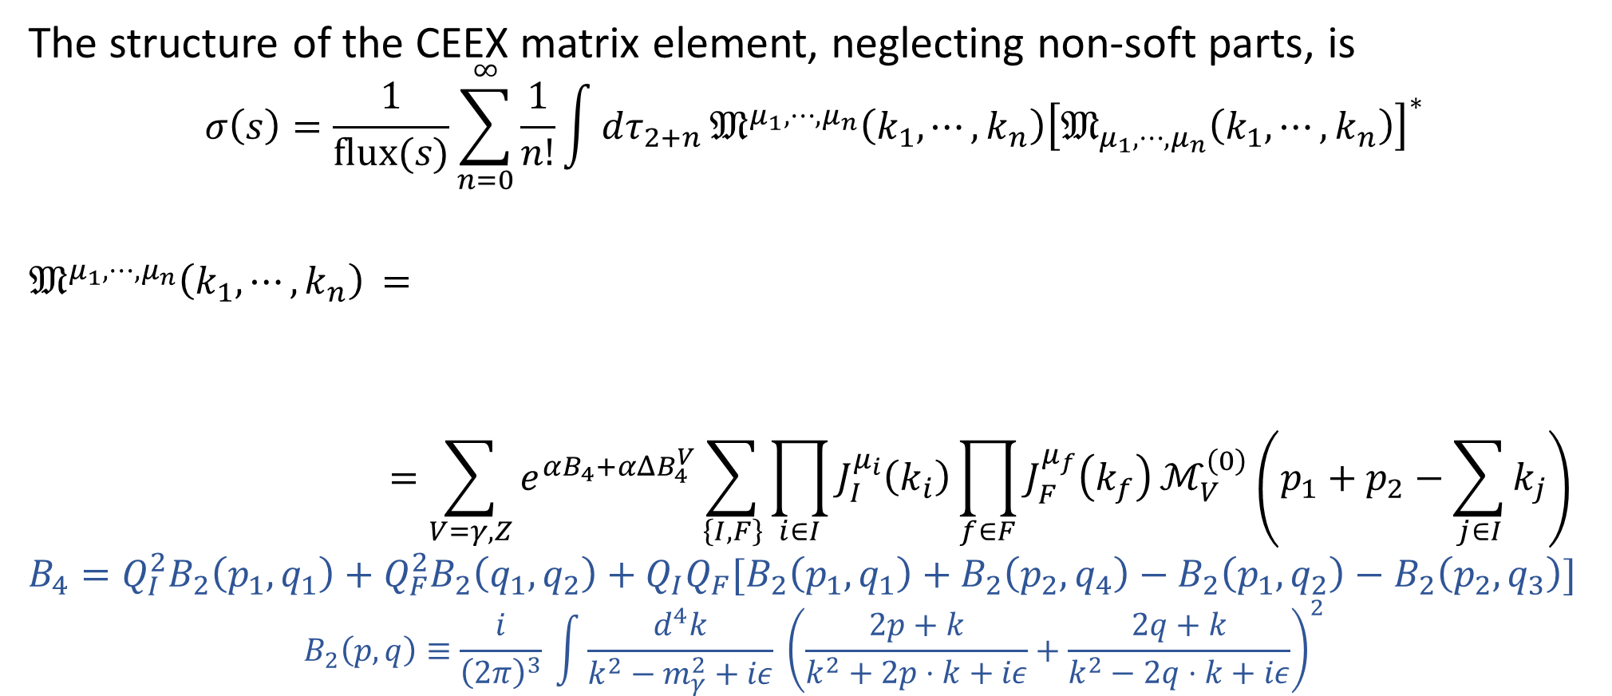
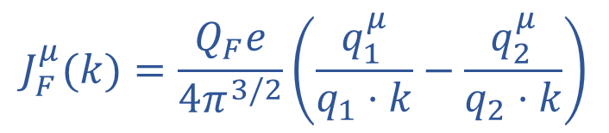
KKhhFoam: Semi-Soft Approximation for CEEX
The structure of the CEEX matrix element, neglecting non-soft parts, is
$$σ\left(s\right)=\frac{1}{flux(s)}\sum_{n=0}^{∞}{\frac{1}{n!}\int{dτ_{2+n}}{\text{𝔐}}^{μ_{1},⋯,μ_{n}}\left(k_{1},⋯,k_{n}\right){\left[{\text{𝔐}}_{μ_{1},⋯,μ_{n}}\left(k_{1},⋯, k_{n}\right)\right]}^{∗}}$$
${\text{𝔐}}^{μ_{1},⋯,μ_{n}}\left(k_{1},⋯,k_{n}\right)$ $=$
$$=\sum_{V=γ, Z}^{ }{e^{αB_{4}+αΔB_{4}^{V}}\sum_{\left\{I,F\right\}}{\prod_{i∈I}{J_{I}^{μ_{i}}\left(k_{i}\right)\prod_{f∈F}{J_{F}^{μ_{f}}\left(k_{f}\right)}}}ℳ_{V}^{\left(0\right)}}\left(p_{1}+p_{2}−\sum_{j∈I}{k_{j}}\right)$$
$$B_{4}=Q_{I}^{2}B_{2}\left(p_{1},q_{1}\right)+Q_{F}^{2}B_{2}\left(q_{1},q_{2}\right)+Q_{I}Q_{F}[B_{2}\left(p_{1},q_{1}\right)+B_{2}\left(p_{2},q_{4}\right)−B_{2}\left(p_{1},q_{2}\right)−B_{2}\left(p_{2},q_{3}\right)]$$
$$B_{2}\left(p,q\right)≡\frac{i}{{\left(2π\right)}^{3}} \int{\frac{d^{4}k}{k^{2}−m_{γ}^{2}+iε} {\left(\frac{2p+k}{k^{2}+2p⋅k+iε}+\frac{2q+k}{k^{2}−2q⋅k+iε}\right)}^{2}}$$
$$J_{I}^{μ}\left(k\right)=\frac{Q_{I}e}{4π^{3/2}}\left(\frac{p_{1}^{μ}}{p_{1}⋅k}−\frac{p_{2}^{μ}}{p_{2}⋅k}\right)$$
$$J_{F}^{μ}(k)=\frac{Q_{F}e}{4π^{3/2}}\left(\frac{q_{1}^{μ}}{q_{1}⋅k}−\frac{q_{2}^{μ}}{q_{2}⋅k}\right)$$
Resonant virtual
form factor
YFS virtual
form factor

Slide 5
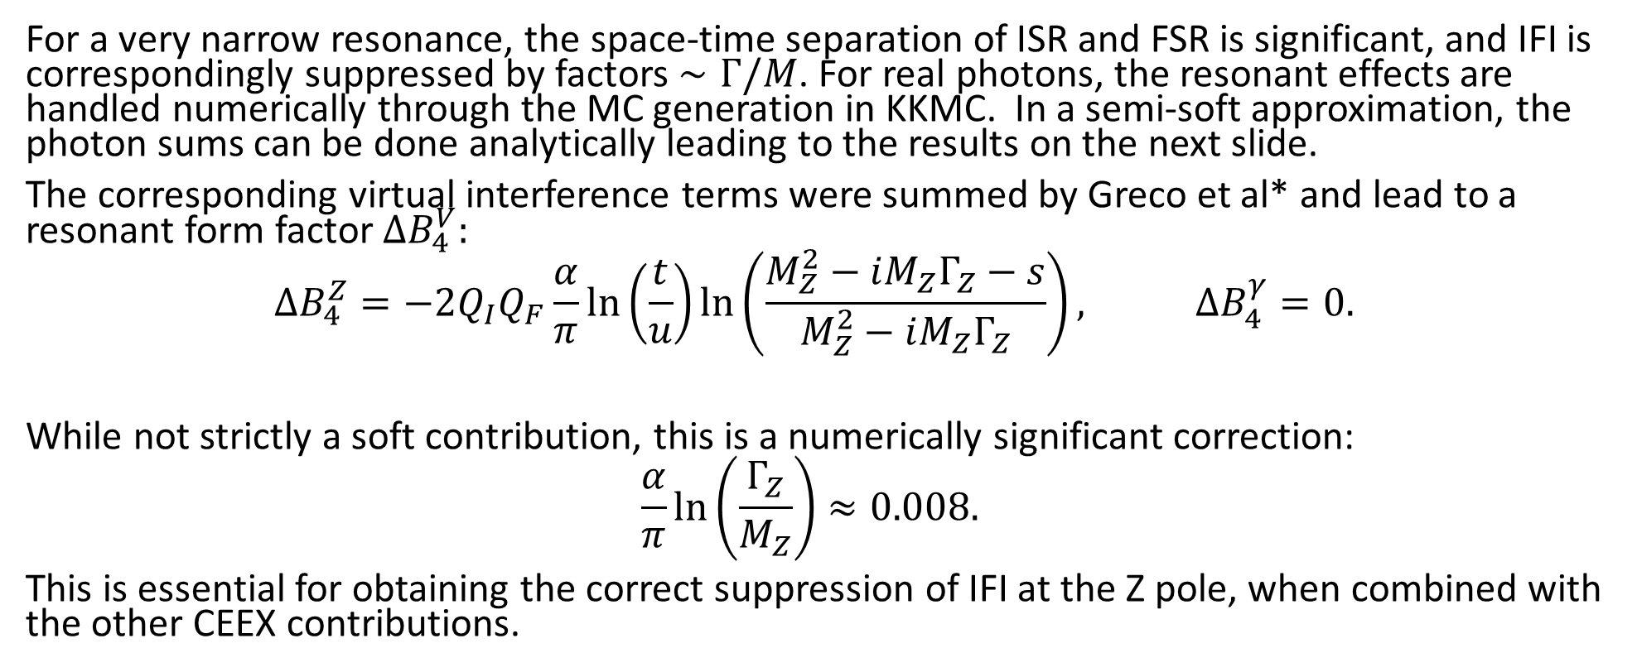
IFI Near a Narrow Resonance
For a very narrow resonance, the space-time separation of ISR and FSR is significant, and IFI is correspondingly suppressed by factors $∼Γ/M$. For real photons, the resonant effects are handled numerically through the MC generation in KKMC. In a semi-soft approximation, the photon sums can be done analytically leading to the results on the next slide.
The corresponding virtual interference terms were summed by Greco et al* and lead to a resonant form factor $ΔB_{4}^{V}:$
$$ΔB_{4}^{Z}=−2Q_{I}Q_{F}\frac{α}{π}\ln\left(\frac{t}{u}\right)\ln\left(\frac{M_{Z}^{2}−iM_{Z}Γ_{Z}−s}{M_{Z}^{2}−iM_{Z}Γ_{Z}}\right), ΔB_{4}^{γ}=0.$$
While not strictly a soft contribution, this is a numerically significant correction:
$$\frac{α}{π}\ln\left(\frac{Γ_{Z}}{M_{Z}}\right)≈0.008.$$
This is essential for obtaining the correct suppression of IFI at the Z pole, when combined with the other CEEX contributions.
*M. Greco et al., Nucl. Phys. B101 (1975) 234, Phys. Lett. B56 (1975) 367, Nucl. Phys. B171 (1980) 118 [Erratum Nucl. Phys.
B197 (1982) 543

Slide 6
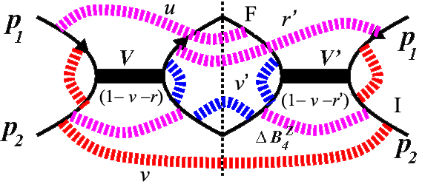

Result of Analytic Photon Integration
The integrals can be evaluated in the semi-soft limit giving a compact expression
$$\frac{dσ}{dΩ}\left(s,v_{max}\right)=\frac{3}{16}σ_{0}\left(s\right)\sum_{V,V′}^{ }{\int_{0}^{1}{dvdv′dudu′}} θ(v_{max}−v−v′−r−r′)e^{Y(p_{1},p_{2},q_{1}, q_{2})}$$
$$×ρ\left(γ_{I},1−v\right) ρ\left(γ_{F}, 1−v′\right) ρ\left(γ_{X},1−r\right) ρ\left(γ_{X},1−r′\right)$$
$$×\frac{1}{4}Re\sum_{\{λ\}}{e^{αΔB_{4}^{V}\left(s\left(1−v−r\right)\right)}𝔐_{\left\{λ\right\}}^{V}\left(s\left(v+r\right),t\right) }$$
$$×{\left[e^{αΔB_{4}^{V}\left(s\left(1−v−r′\right)\right)}𝔐_{\{λ\}}^{V^{′}}\left(s\left(v+r′\right),t\right)\right]}^{∗}$$
$ρ\left(γ, z\right)=\frac{e^{−C_{E}γ}}{Γ(1+γ)}γ{(1−z)}^{γ−1} ,$
with $Y(p_{1},p_{2},q_{1},q_{2})=$ standard YFS form factor,
$$γ_{I}=Q_{I}^{2}\frac{α}{π}\left[\ln\left(\frac{{\left(p_{1}+p_{2}\right)}^{2}}{m_{I}^{2}}\right)−1\right] ,{ γ}_{F}=Q_{F}^{2}\frac{α}{π}\left[\ln\left(\frac{{\left(q_{1}+q_{2}\right)}^{2}}{m_{F}^{2}}\right)−1\right] , { γ}_{X}=Q_{I}Q_{F}\frac{α}{π}\ln\left(\frac{1−\cos{θ}}{1+\cos{θ}}\right)$$

Slide 7
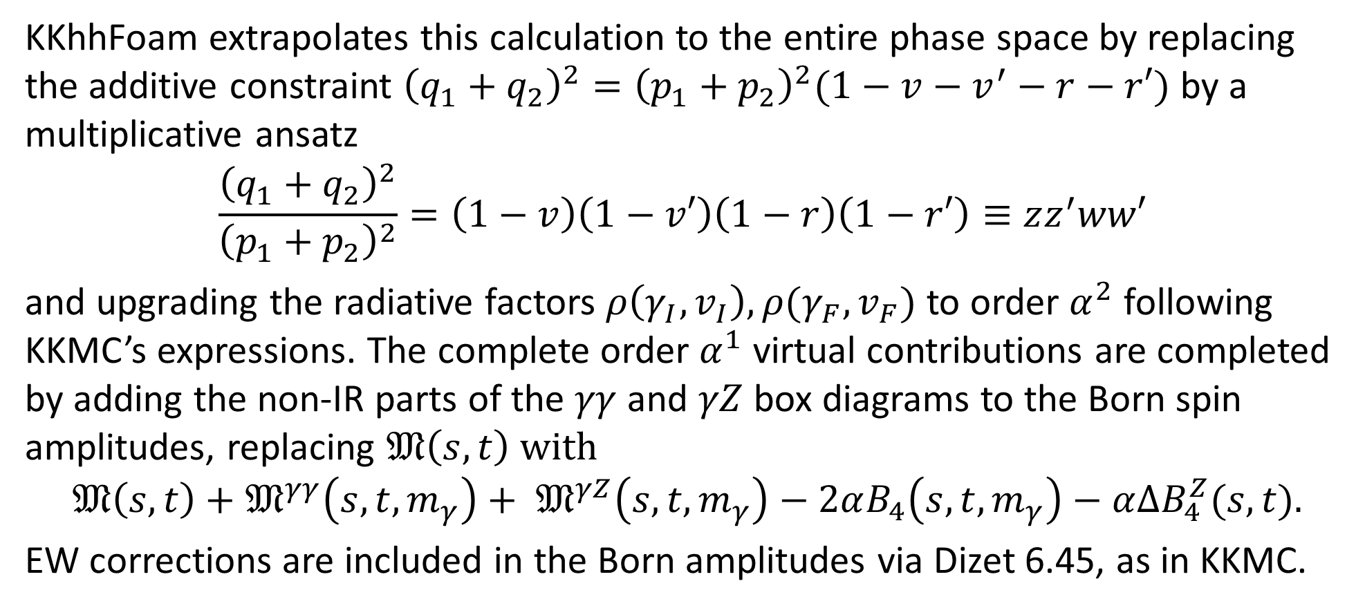
Beyond the Semi-Soft Approximation
KKhhFoam extrapolates this calculation to the entire phase space by replacing the additive constraint ${\left(q_{1}+q_{2}\right)}^{2}={\left(p_{1}+p_{2}\right)}^{2}(1−v−v^{′}−r−r′)$ by a multiplicative ansatz
$$\frac{{\left(q_{1}+q_{2}\right)}^{2}}{{\left(p_{1}+p_{2}\right)}^{2}}=\left(1−v\right)\left(1−v′\right)\left(1−r\right)\left(1−r′\right)≡zz^{′}ww′$$
and upgrading the radiative factors $ρ\left(γ_{I}, v_{I}\right), ρ(γ_{F},v_{F})$ to order $α^{2}$ following KKMC’s expressions. The complete order $α^{1}$ virtual contributions are completed by adding the non-IR parts of the $γγ$ and $γZ$ box diagrams to the Born spin amplitudes, replacing $𝔐\left(s,t\right)$ with
$$𝔐\left(s,t\right)+𝔐^{γγ}\left(s,t,m_{γ}\right)+ 𝔐^{γZ}\left(s,t,m_{γ}\right)−2αB_{4}\left(s,t,m_{γ}\right)−α{ΔB}_{4}^{Z}(s,t).$$
EW corrections are included in the Born amplitudes via Dizet 6.45, as in KKMC.

Slide 8
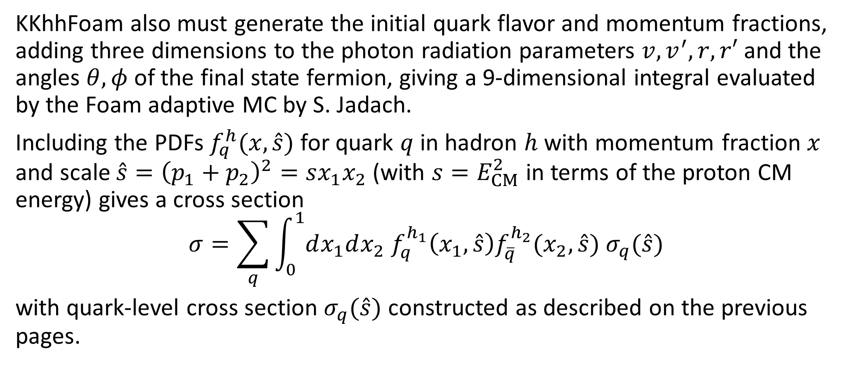
KKhhFoam Complete Cross Section
KKhhFoam also must generate the initial quark flavor and momentum fractions, adding three dimensions to the photon radiation parameters $v,v^{′},r,r′$ and the angles $θ, φ$ of the final state fermion, giving a 9-dimensional integral evaluated by the Foam adaptive MC by S. Jadach.
Including the PDFs $f_{q}^{h}(x,\hat{s})$ for quark $q$ in hadron $h$ with momentum fraction $x$ and scale $\hat{s}={\left(p_{1}+p_{2}\right)}^{2}=sx_{1}x_{2}$ (with ${s=E}_{CM}^{2}$ in terms of the proton CM energy) gives a cross section
$$σ=\sum_{q}{\int_{0}^{1}{dx_{1}dx_{2} f_{q}^{h_{1}}\left(x_{1},\hat{s}\right)f_{\overline{q}}^{h_{2}}(x_{2},}}\hat{s}) σ_{q}(\hat{s})$$
with quark-level cross section $σ_{q}(\hat{s})$ constructed as described on the previous pages.

Slide 9
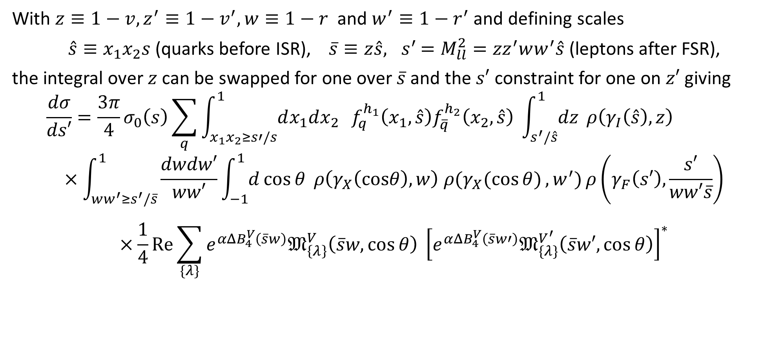
Lepton Invariant Mass² Distribution
With $z≡1−v, z^{′}≡1−v^{′}, w≡1−r$ and $w^{′}≡1−r^{′}$and defining scales
$\hat{s}≡x_{1}x_{2}s$ (quarks before ISR), $\overline{s}≡z\hat{s}{, s}^{′}=M_{ll}^{2}={zz}^{′}ww^{′}\hat{s}$ (leptons after FSR),
the integral over $z$ can be swapped for one over $\overline{s}$ and the $s′$ constraint for one on $z′$ giving
$$\frac{dσ}{ds′}=\frac{3π}{4}σ_{0}\left(s\right)\sum_{q}^{ }{\int_{x_{1}x_{2}≥s′/s}^{1}{dx_{1}dx_{2} }} f_{q}^{h_{1}}\left(x_{1},\hat{s}\right)f_{\overline{q}}^{h_{2}}\left(x_{2},\hat{s}\right) \int_{s^{′}/\hat{s}}^{1}{dz} ρ\left(γ_{I}\left(\hat{s}\right),z\right)$$
$$×\int_{ww^{′}≥s^{′}/\overline{s}}^{1}{\frac{dwdw′}{ww′}}\int_{−1}^{1}{d\cos{θ} ρ\left(γ_{X}\left(cosθ\right), w\right) ρ(γ_{X}(\cos{θ)}, w^{′})}ρ\left(γ_{F}\left(s′\right),\frac{s′}{ww′\overline{s}}\right)$$
$$×\frac{1}{4}Re\sum_{\{λ\}}{e^{αΔB_{4}^{V}\left(\overline{s}w\right)}𝔐_{\left\{λ\right\}}^{V}\left(\overline{s}w,\cos{θ}\right) }{\left[e^{αΔB_{4}^{V}\left(\overline{s}w′\right)}𝔐_{\{λ\}}^{V^{′}}\left(\overline{s}w′,\cos{θ}\right)\right]}^{∗}$$
ISR
IFI factors
FSR
Different scales
Resonant form factor

Slide 10
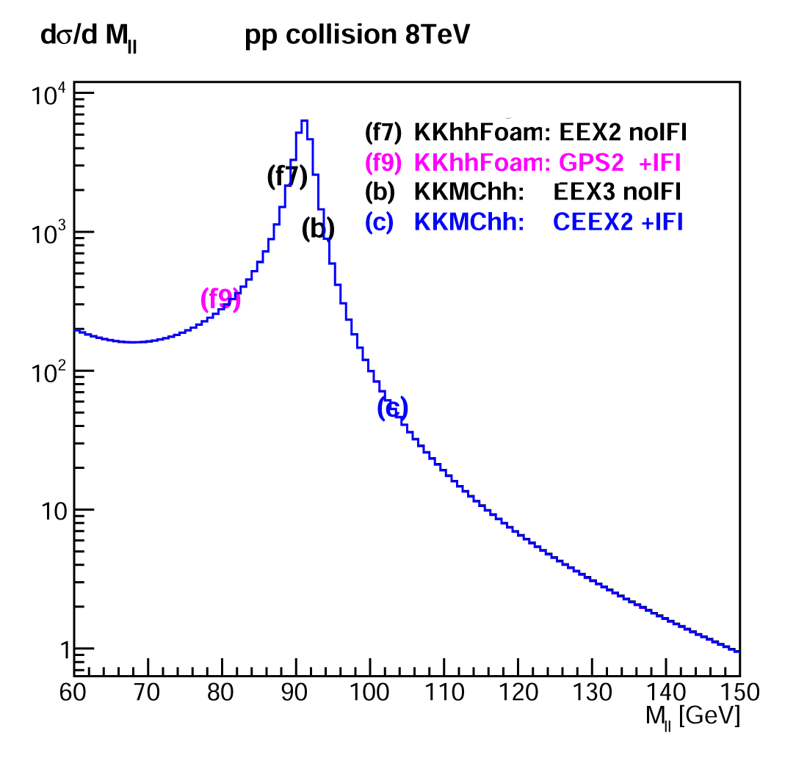
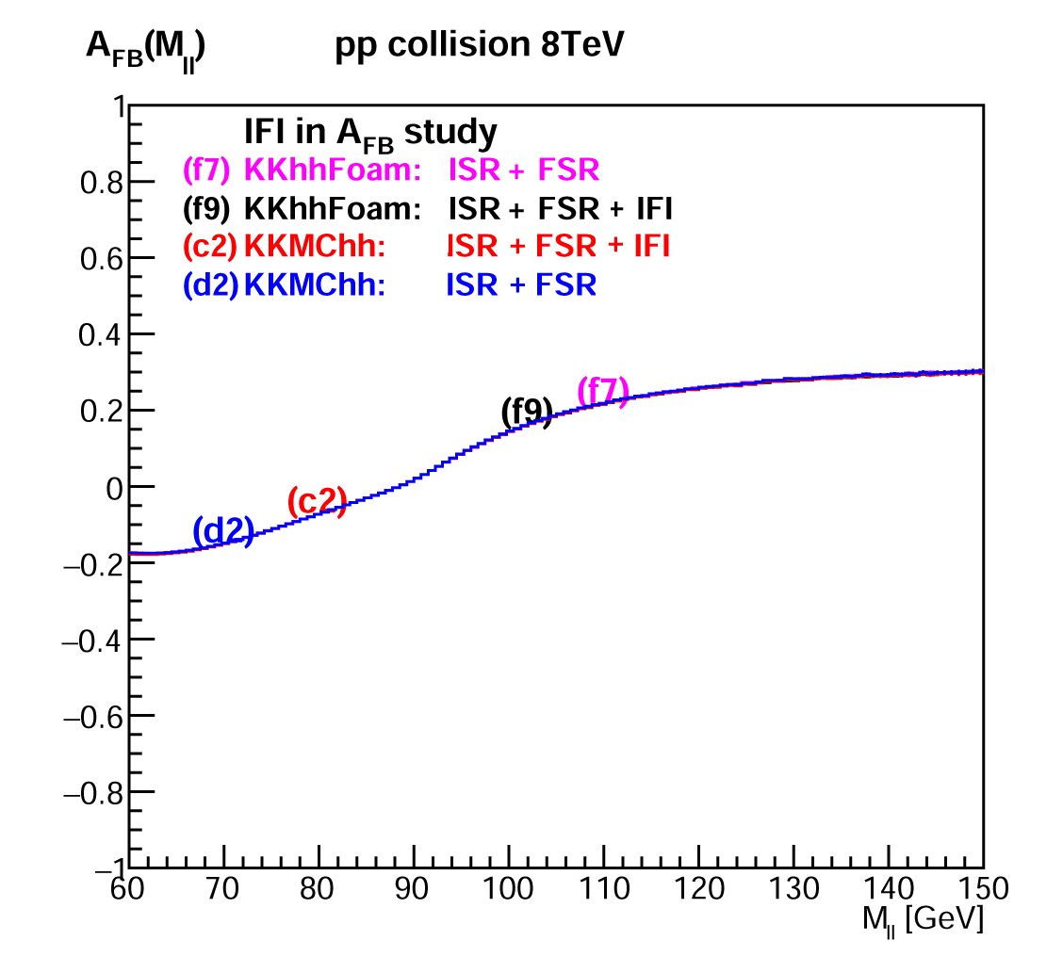


Invariant Mass Distributions, $A_{FB}$ Comparisons
The next slides will show comparisons of invariant mass distributions made with KKMC-hh and KKhhSem, with some comparisons to calculations without KKMC-hh ISR but with a QED-corrected PDF. The slides will show ratios of $M_{ll}$ or $A_{FB}$ distributions, with muon final states.
$A_{FB}$ is calculated using the Collins-Soper angle: $\cos{θ_{CS}=sgn\left(P_{ll}^{z}\right)\frac{p_{l}^{+}p_{\overline{l}}^{−}−p_{l}^{−}p_{\overline{l}}^{+}}{\sqrt{P_{ll}^{2}P_{ll}^{+}P_{ll}^{−}}}}$for $P_{ll}=p_{l}+p_{\overline{l}}^{ }$ , $p^{±}=p^{0}±p^{z}.$

Slide 11
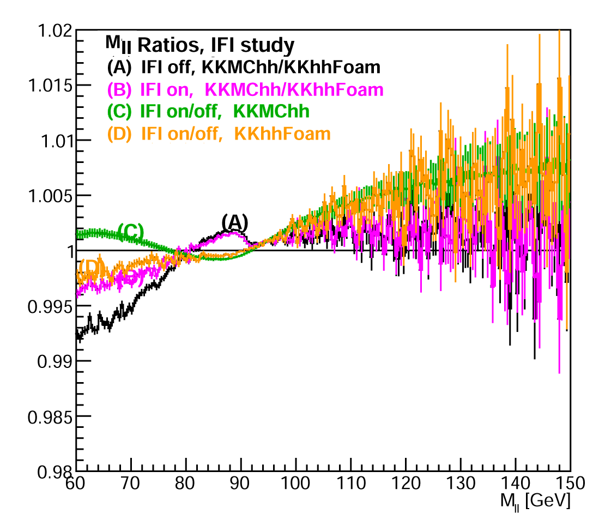
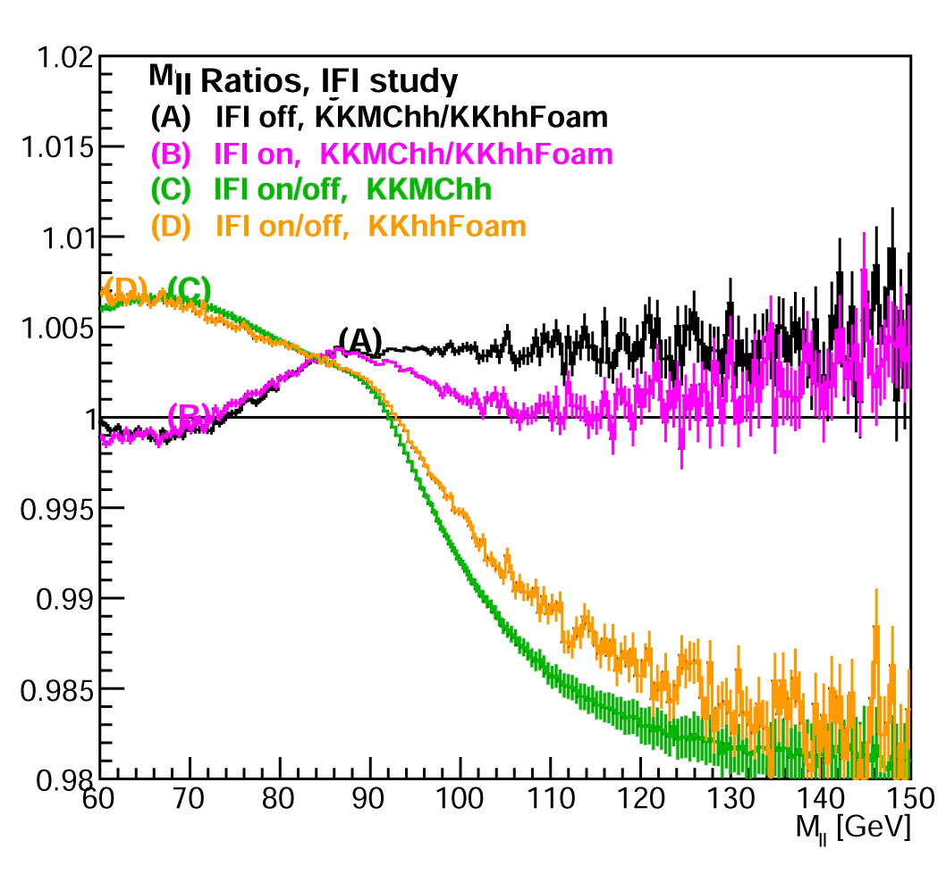
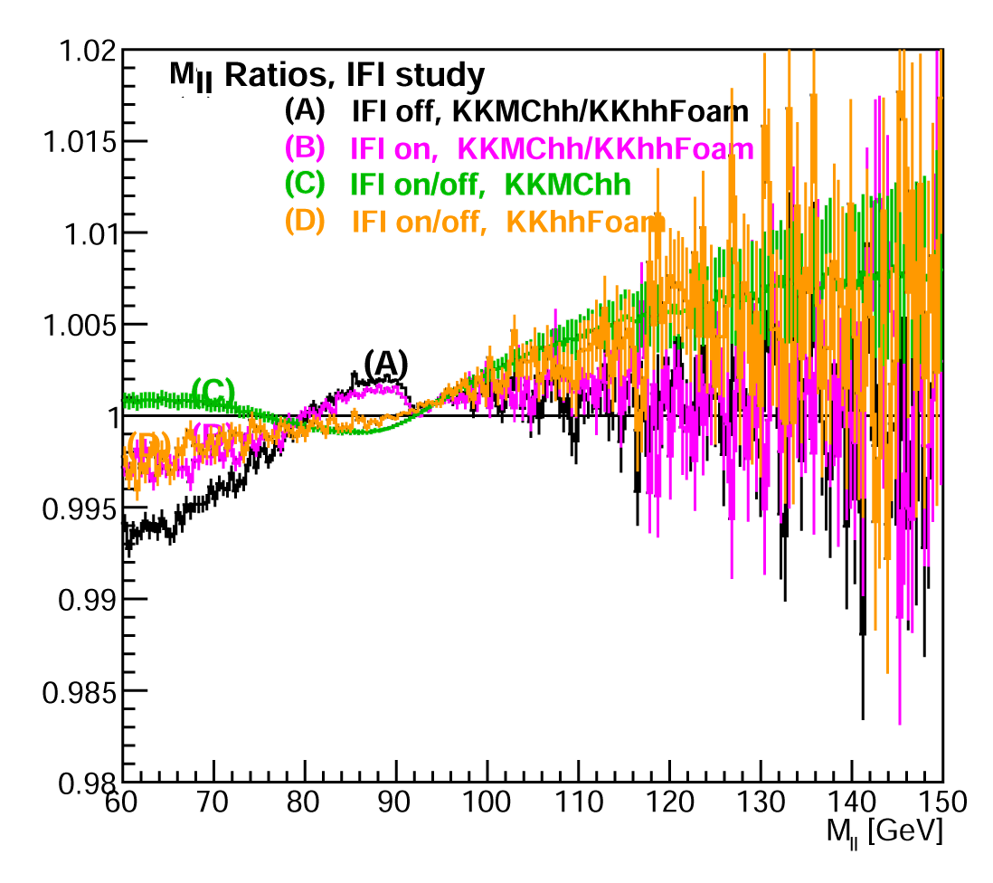
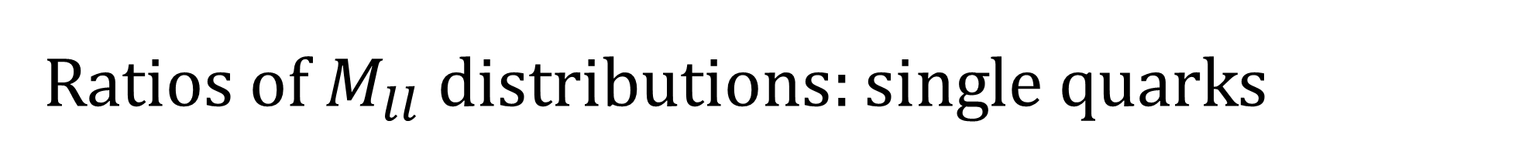
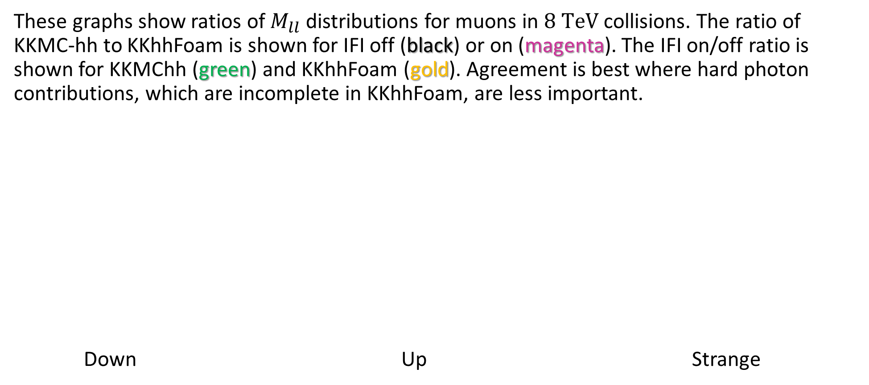
Ratios of $M_{ll}$ distributions: single quarks
These graphs show ratios of $M_{ll}$ distributions for muons in $8 TeV$ collisions. The ratio of KKMC-hh to KKhhFoam is shown for IFI off (black) or on (magenta). The IFI on/off ratio is shown for KKMChh (green) and KKhhFoam (gold). Agreement is best where hard photon contributions, which are incomplete in KKhhFoam, are less important.
Down Up Strange

Slide 12
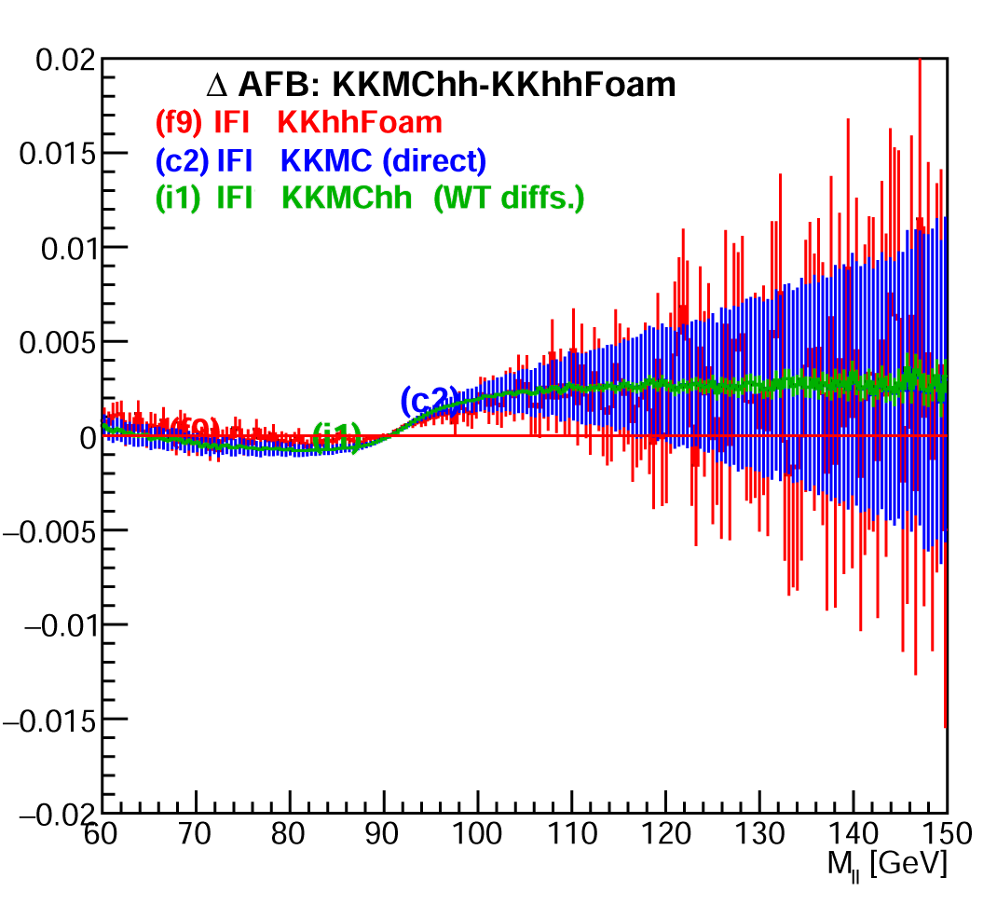
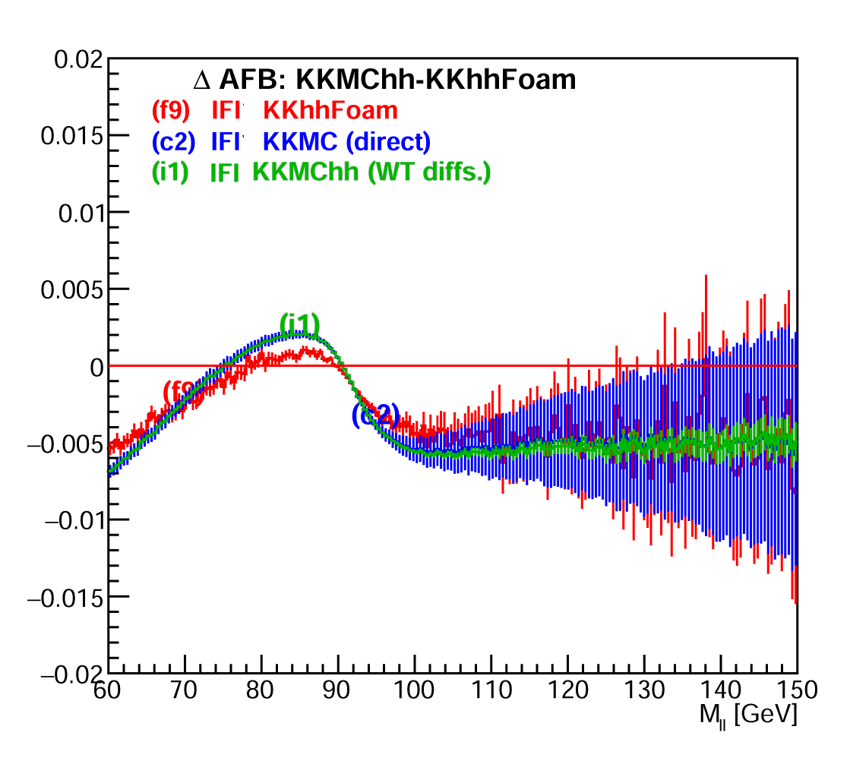
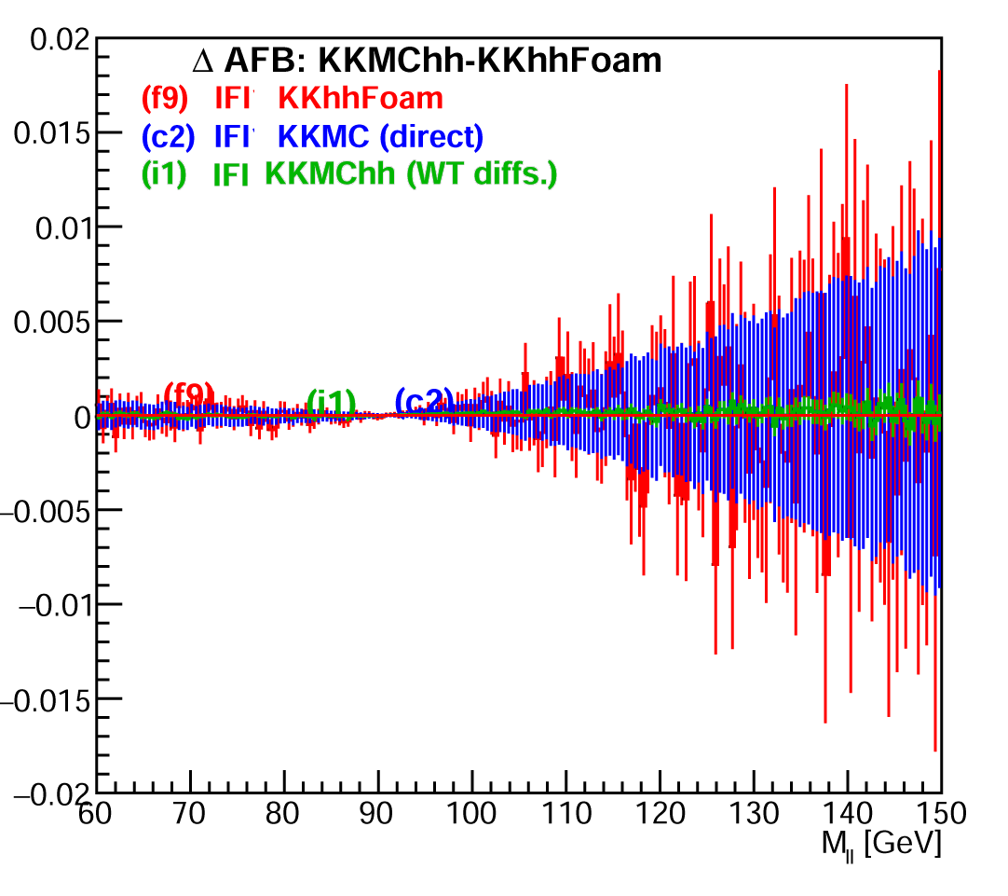
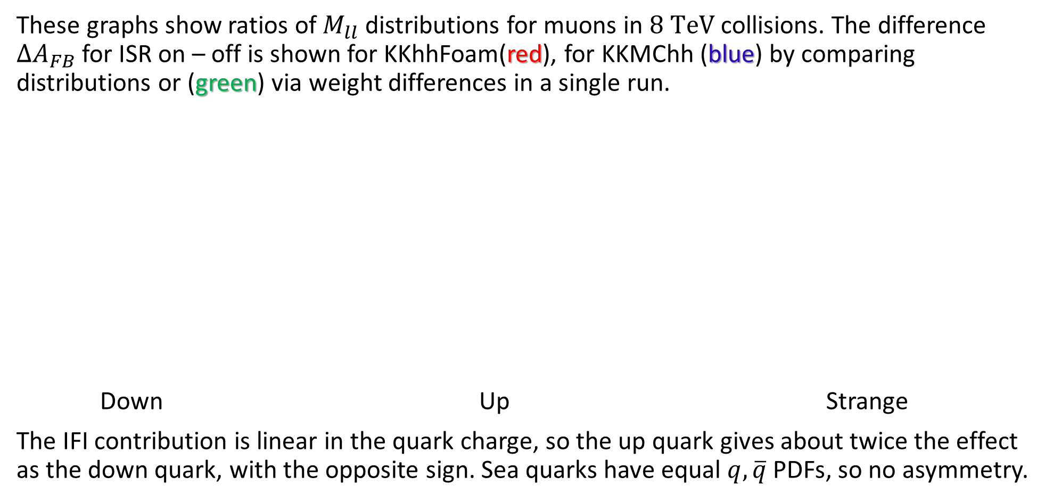
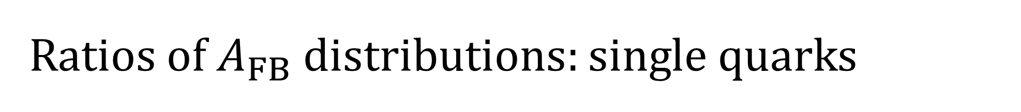
Ratios of $A_{FB}$ distributions: single quarks
These graphs show ratios of $M_{ll}$ distributions for muons in $8 TeV$ collisions. The difference $ΔA_{FB}$ for ISR on – off is shown for KKhhFoam(red), for KKMChh (blue) by comparing distributions or (green) via weight differences in a single run.
Down Up Strange
The IFI contribution is linear in the quark charge, so the up quark gives about twice the effect as the down quark, with the opposite sign. Sea quarks have equal $q, \overline{q}$ PDFs, so no asymmetry.

Slide 13
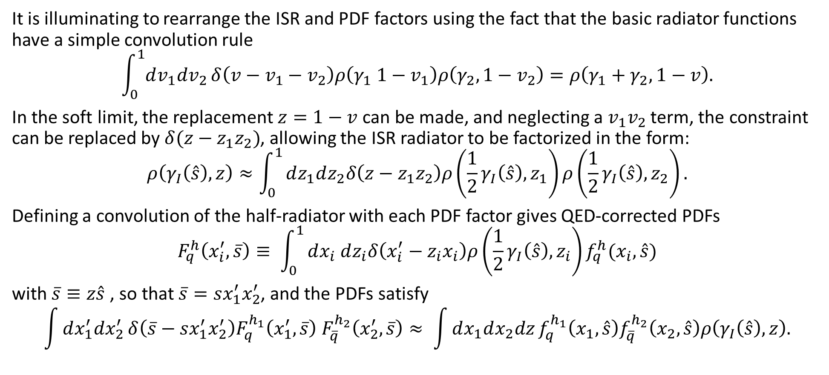
QED ISR and PDFs: Soft Collinear Limit
It is illuminating to rearrange the ISR and PDF factors using the fact that the basic radiator functions have a simple convolution rule
$$\int_{0}^{1}{dv_{1}dv_{2}}δ\left(v−v_{1}−v_{2}\right)ρ\left(γ_{1} {1−v}_{1}\right)ρ\left(γ_{2},{1−v}_{2}\right)=ρ\left(γ_{1}+γ_{2}, 1−v\right).$$
In the soft limit, the replacement $z=1−v$ can be made, and neglecting a $v_{1}v_{2}$ term, the constraint can be replaced by $δ(z−z_{1}z_{2})$, allowing the ISR radiator to be factorized in the form:
$$ρ\left(γ_{I}\left(\hat{s}\right),z\right)≈\int_{0}^{1}{dz_{1}dz_{2}δ\left(z−z_{1}z_{2}\right)ρ\left({\frac{1}{2}γ}_{I}\left(\hat{s}\right),z_{1}\right)}ρ\left({\frac{1}{2}γ}_{I}\left(\hat{s}\right),z_{2}\right).$$
Defining a convolution of the half-radiator with each PDF factor gives QED-corrected PDFs
$$F_{q}^{h}\left(x_{i}^{′}, \overline{s}\right)≡ \int_{0}^{1}{dx_{i} dz_{i}δ\left(x_{i}^{′}−z_{i}x_{i}\right)ρ\left({\frac{1}{2}γ}_{I}\left(\hat{s}\right),z_{i}\right)f_{q}^{h}(x_{i},\hat{s})}$$
with $\overline{s}≡z\hat{s}$ , so that $\overline{s}=sx_{1}^{′}x_{2}^{′}$, and the PDFs satisfy
$$\int{dx_{1}^{′}dx_{2}^{′}}δ\left(\overline{s}−sx_{1}^{′}x_{2}^{′}\right)F_{q}^{h_{1}}\left(x_{1}^{′}, \overline{s}\right){ F}_{\overline{q}}^{h_{2}}\left(x_{2}^{′}, \overline{s}\right)≈ \int{dx_{1}dx_{2}dz}f_{q}^{h_{1}}\left(x_{1},\hat{s}\right)f_{\overline{q}}^{h_{2}}\left(x_{2},\hat{s}\right)ρ\left(γ_{I}\left(\hat{s}\right),z\right).$$

Slide 14
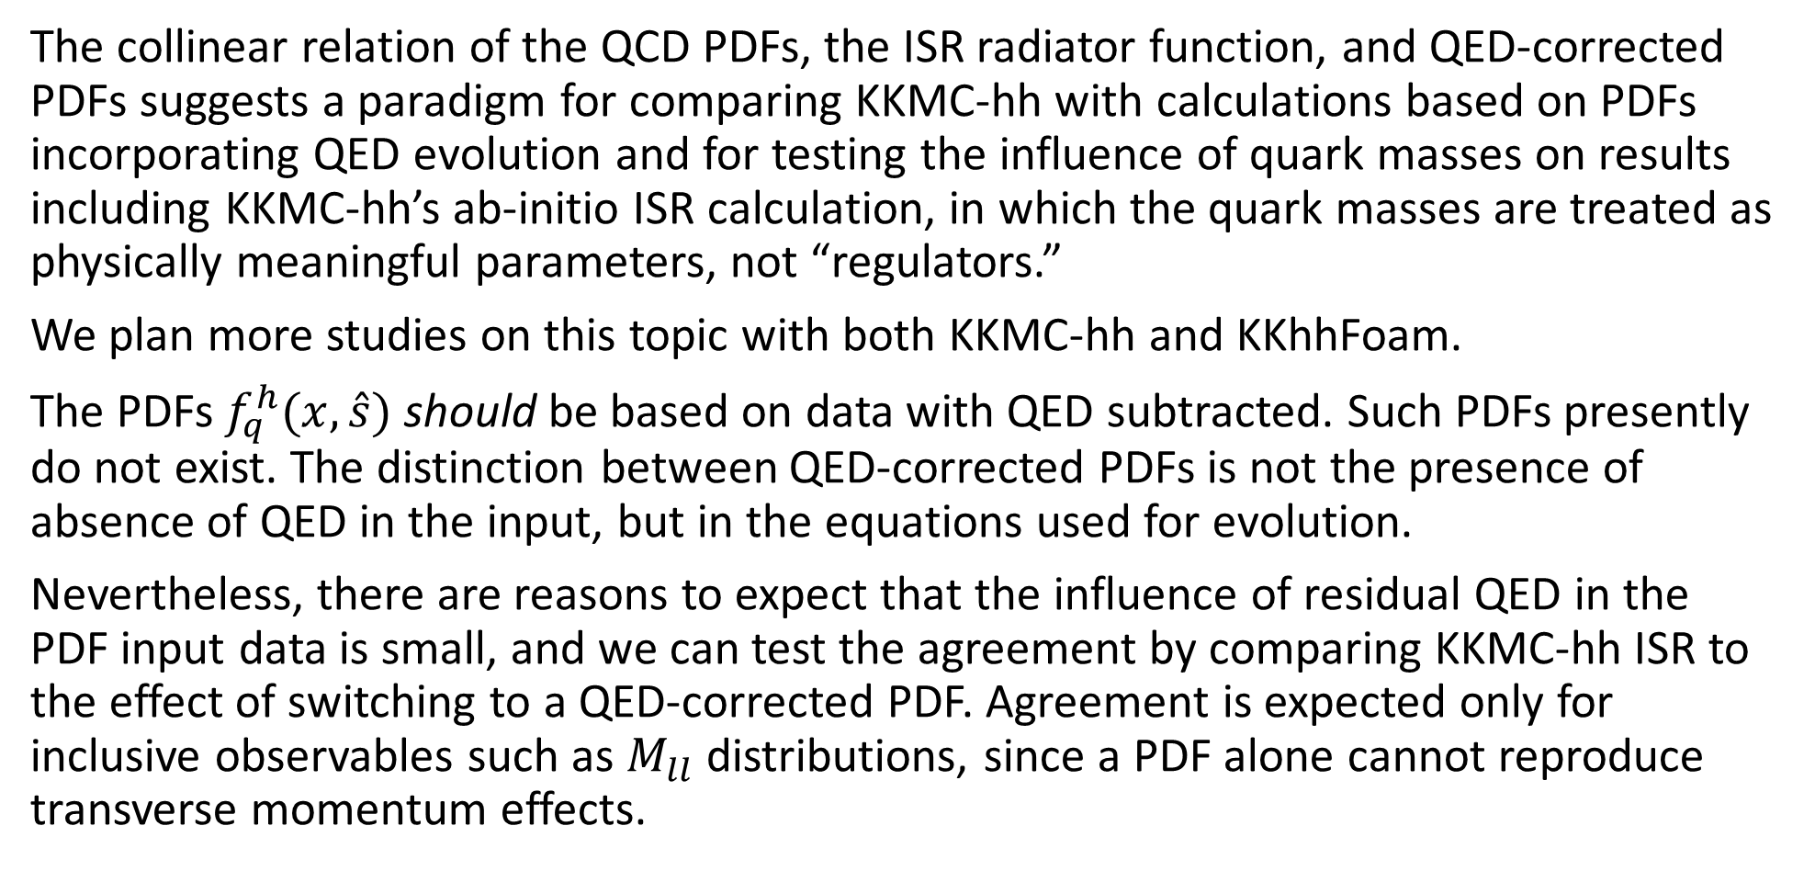
KKMC-hh ISR vs QED-Corrected PDFs
The collinear relation of the QCD PDFs, the ISR radiator function, and QED-corrected PDFs suggests a paradigm for comparing KKMC-hh with calculations based on PDFs incorporating QED evolution and for testing the influence of quark masses on results including KKMC-hh’s ab-initio ISR calculation, in which the quark masses are treated as physically meaningful parameters, not “regulators.”
We plan more studies on this topic with both KKMC-hh and KKhhFoam.
The PDFs $f_{q}^{h}(x,\hat{s})$ should be based on data with QED subtracted. Such PDFs presently do not exist. The distinction between QED-corrected PDFs is not the presence of absence of QED in the input, but in the equations used for evolution.
Nevertheless, there are reasons to expect that the influence of residual QED in the PDF input data is small, and we can test the agreement by comparing KKMC-hh ISR to the effect of switching to a QED-corrected PDF. Agreement is expected only for inclusive observables such as $M_{ll}$ distributions, since a PDF alone cannot reproduce transverse momentum effects.

Slide 15
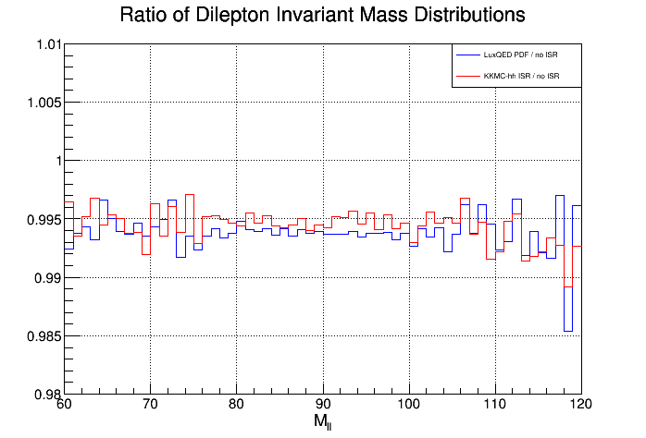
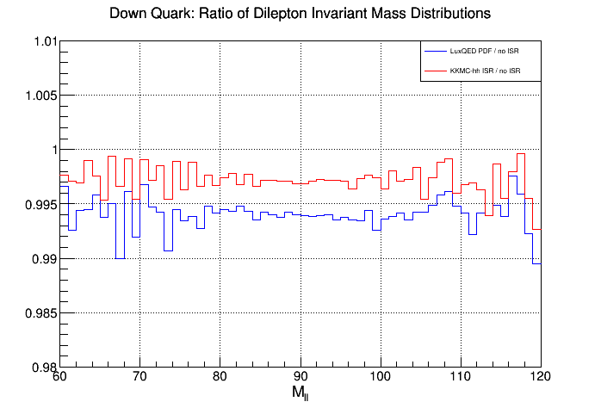
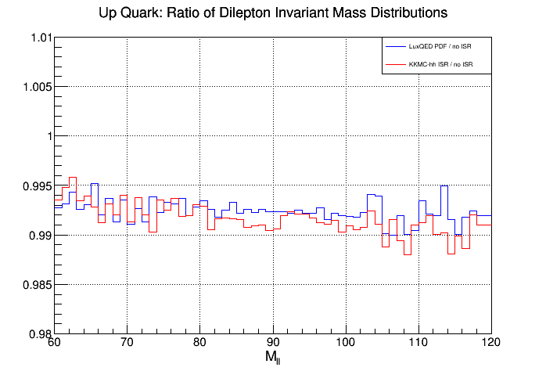
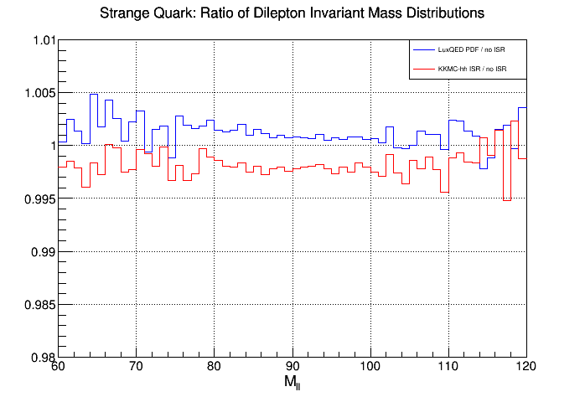
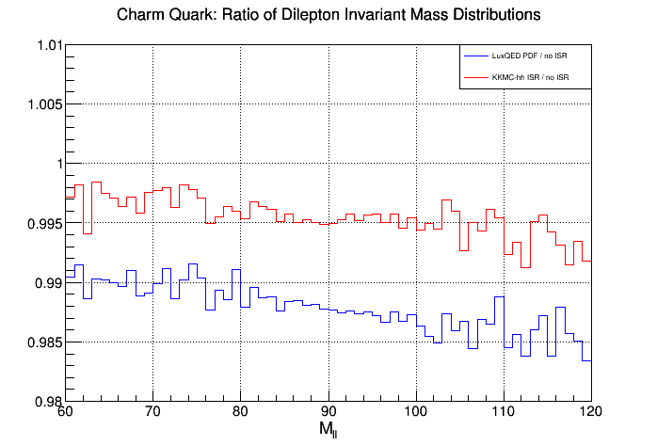
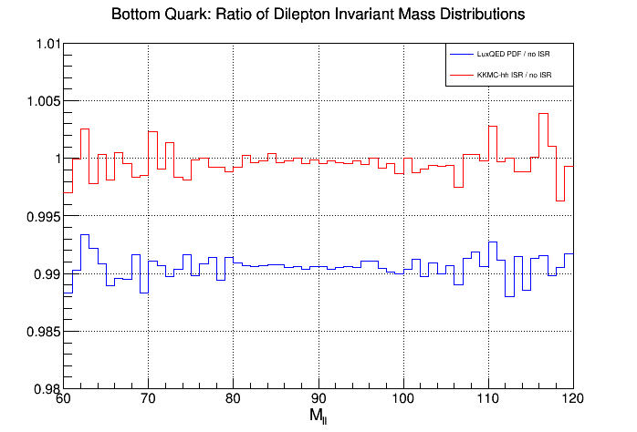

Comparison of KKMC-hh ISR to NNPDF3.1-LuxQED
These graphs show the ratio of ISR on / ISR off for $M_{ll}$ distributions in KKMC-hh (red) vs the ratio of NNPDF3.1 NLO PDFs with LuxQED / NNPDF3.1 without it (blue) [${10}^{9}$muon events, $E_{CM}=8 TeV]$
All Quarks Down Up
no FSR or IFI $m_{d}=4.7 MeV$ no FSR or IFI $m_{u}=2.2 MeV$ no FSR or IFI
Strange Charm Bottom
$m_{s}=150 MeV$ no FSR or IFI $m_{c}=1.55 GeV$ no FSR or IFI $m_{b}=4.95 GeV$ no FSR or IFI

Slide 16
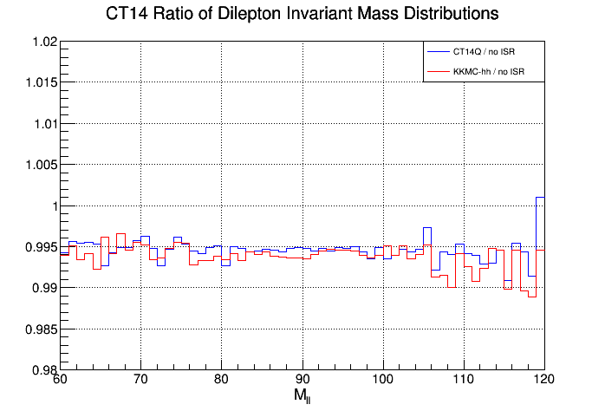
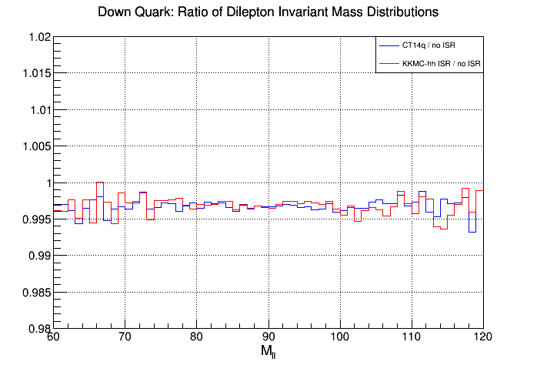
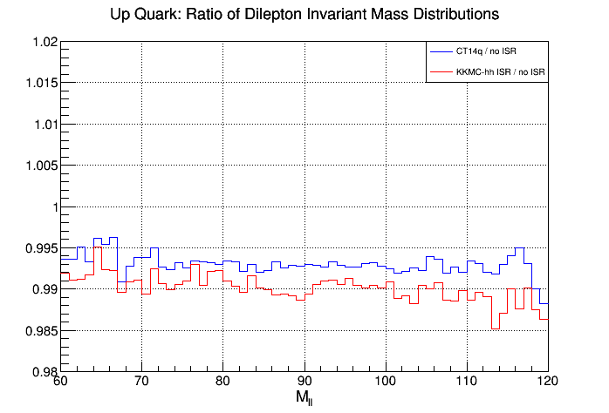
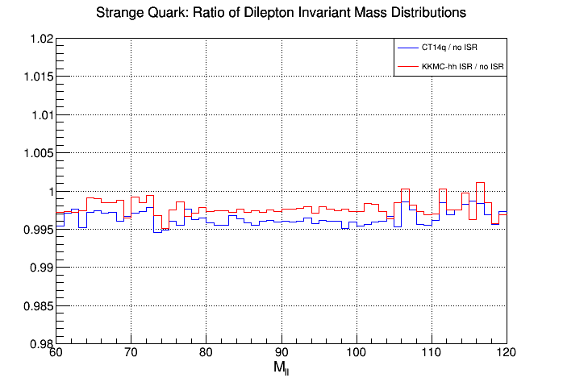
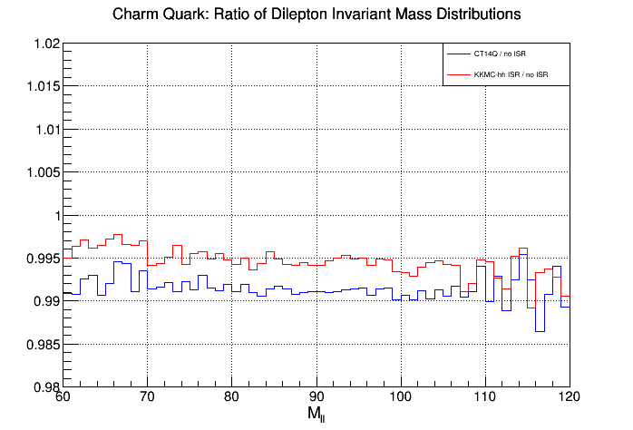
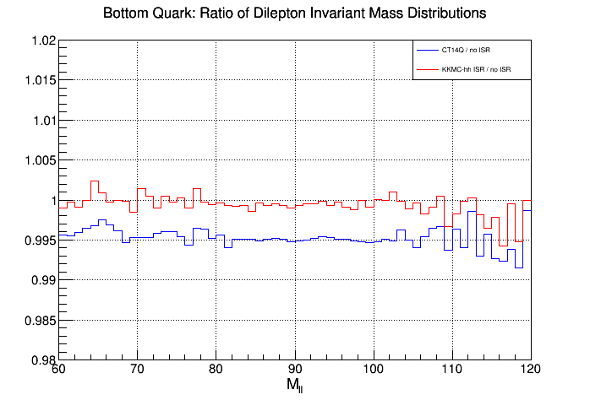

Comparison of KKMC-hh ISR to CT14qed
These graphs show the ratio of ISR on / ISR off for $M_{ll}$ distributions in KKMC-hh (red) vs the ratio of CT14qed NLO PDFs / normal CT14nlo PDFs (blue) [${10}^{9}$muon events, $E_{CM}=8 TeV]$
All Quarks Down Up
no FSR or IFI $m_{d}=4.7 MeV$ no FSR or IFI $m_{u}=2.2 MeV$ no FSR or IFI
Strange Charm Bottom
$m_{s}=150 MeV$ no FSR or IFI $m_{c}=1.55 GeV$ no FSR or IFI $m_{b}=4.95 GeV$ no FSR or IFI

Slide 17
Summary
KKMC-hh is newly re-programmed in C++, which should facilitate merger with modern showers, such as HERWIG7, facilitating the introduction of NLO QCD (in progress with A. Siódmok).
KKhhFoam is an adaptation of a semi-analytical semi-soft approximation to KKMC-hh based on an analogous program developed for the KKMC-ee. It is helpful in cross-checks of the exponentiation and understanding the role of ISR, IFI and FSR.
The interplay between KKMC-hh and PDFs, including the role of quark masses in the ab-initio ISR calculation, is an ongoing study which should be facilitated by KKhhFoam
For more details on the semi-analytical calculation described here, see S. Jadach and S.A. Yost, Phys. Rev. D100, 013002 [arXiv:1801.03560] and the original KKMC/CEEX papers.

