Slide 1



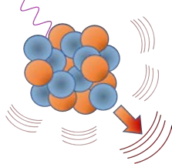



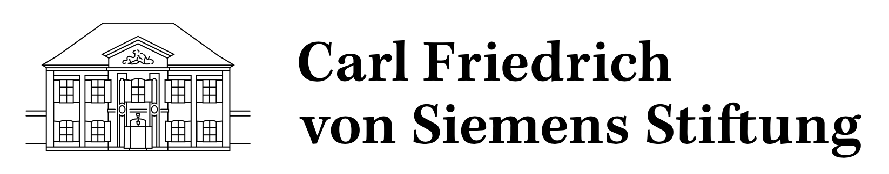
CEvNS in Munich
Victoria Wagner & Raimund Strauss
Technical University Munich
March 22nd 2023
Carl-Friedrich von Siemens Stiftung
Notes:
CEvNS belongs to Munich like Brezn and Bier – sure you will experience all three during these days.

Slide 2


… Friday is not the end …
Location: Vorhoelzer Forum
(https://goo.gl/maps/DdkDyESfyPThqRkS9 )
Location: Garching, Physics Department
(https://goo.gl/maps/vuuf7CKDhbrmCTPGA )

Slide 3
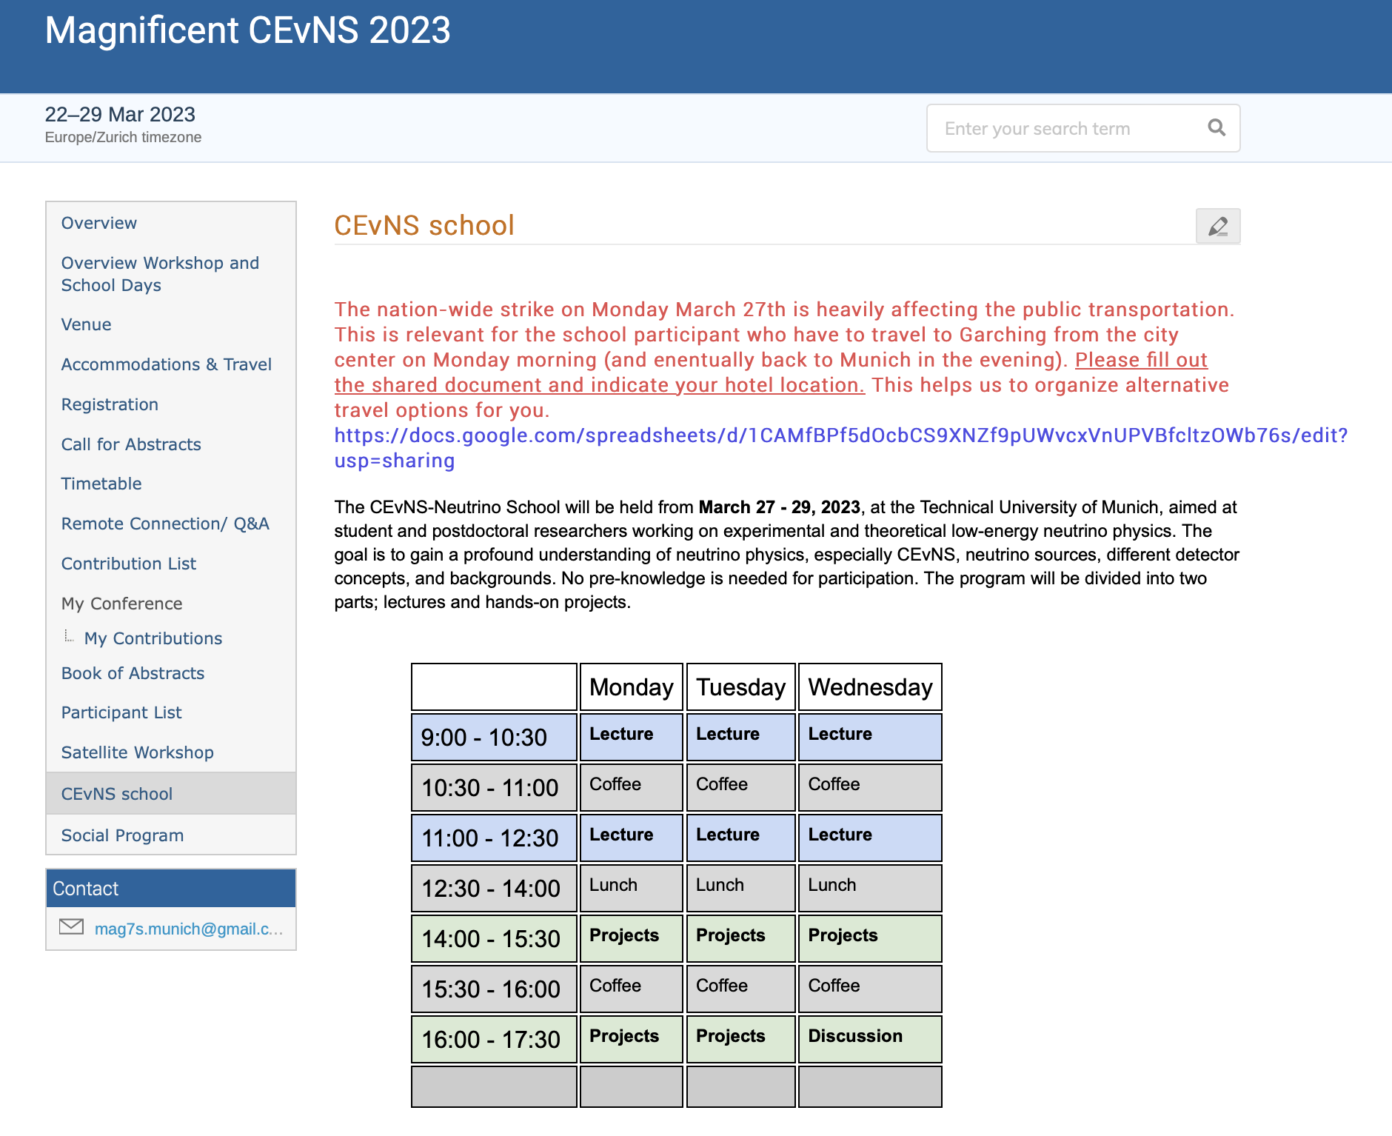

Slide 4
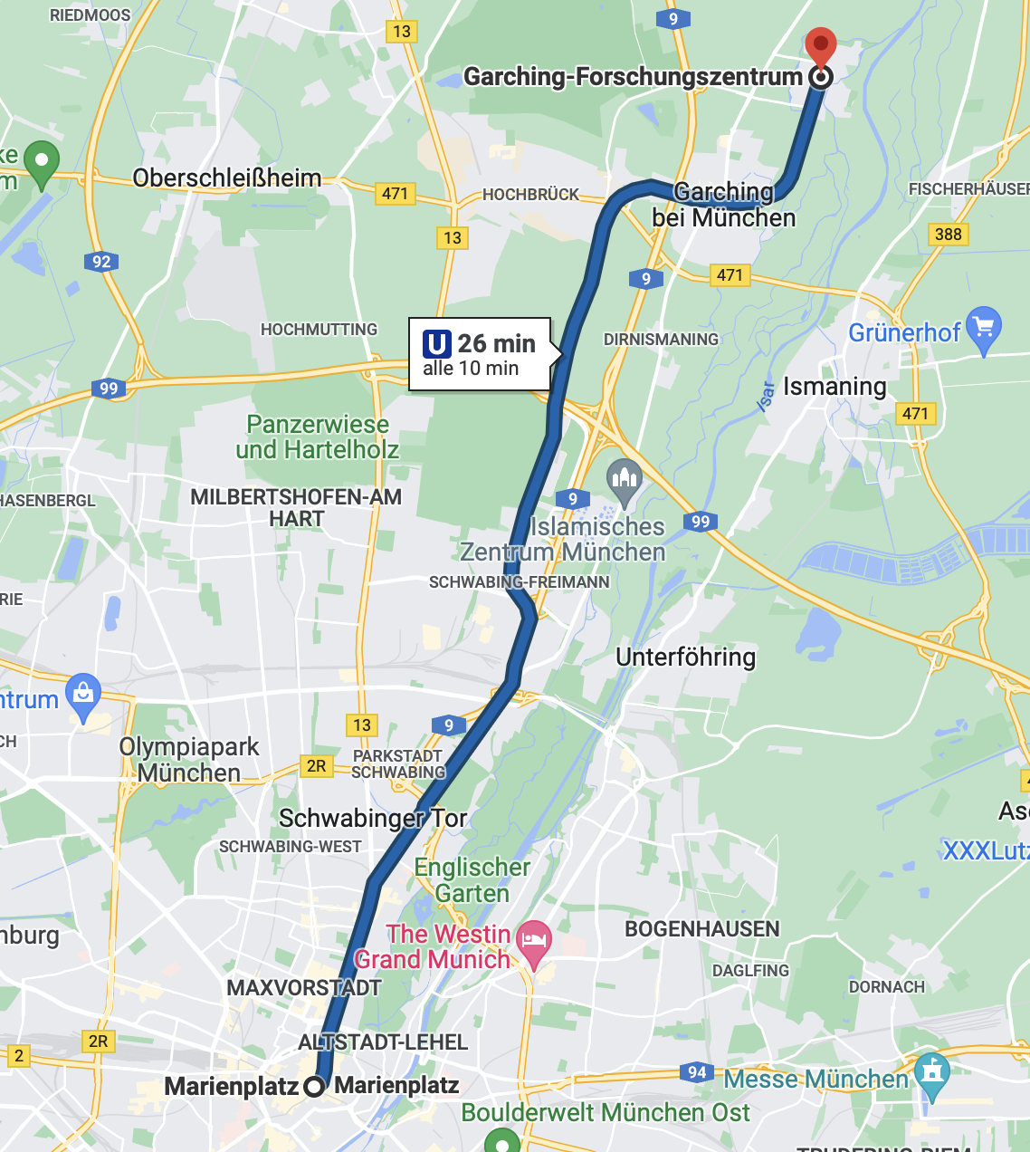
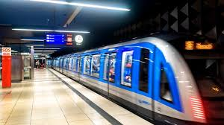


Slide 5
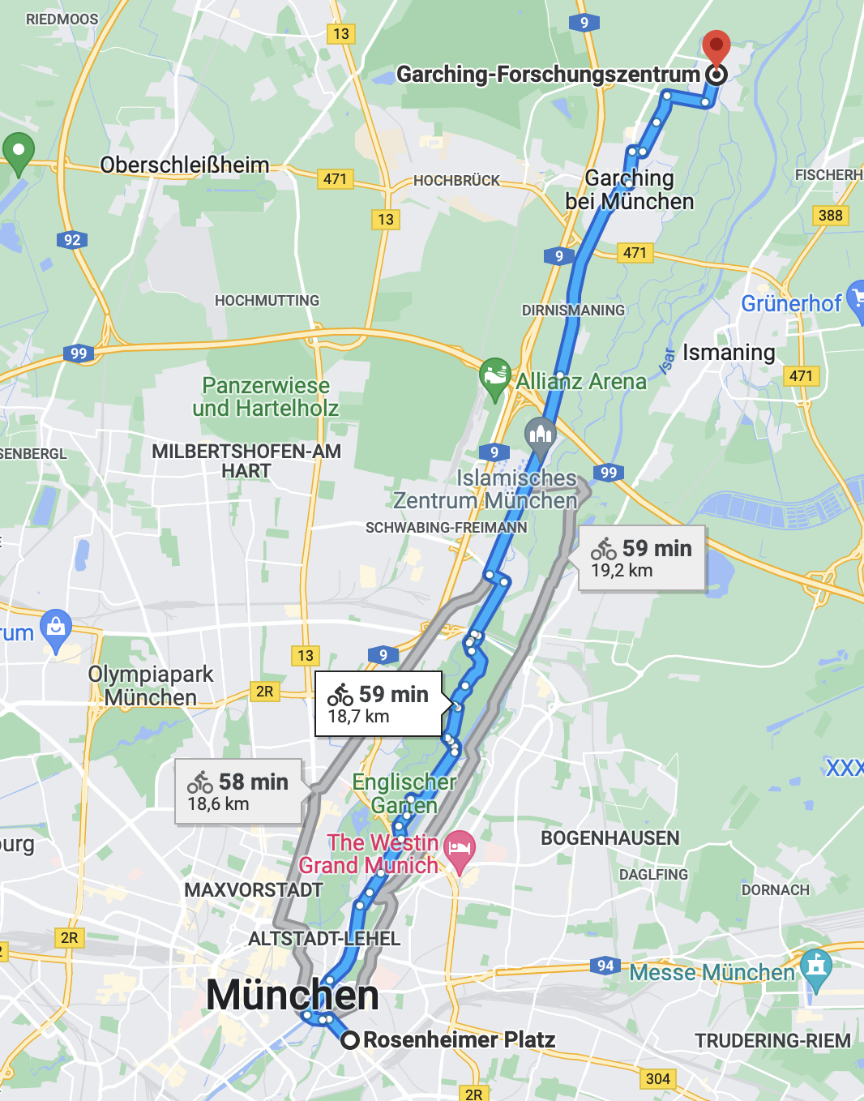


Slide 6
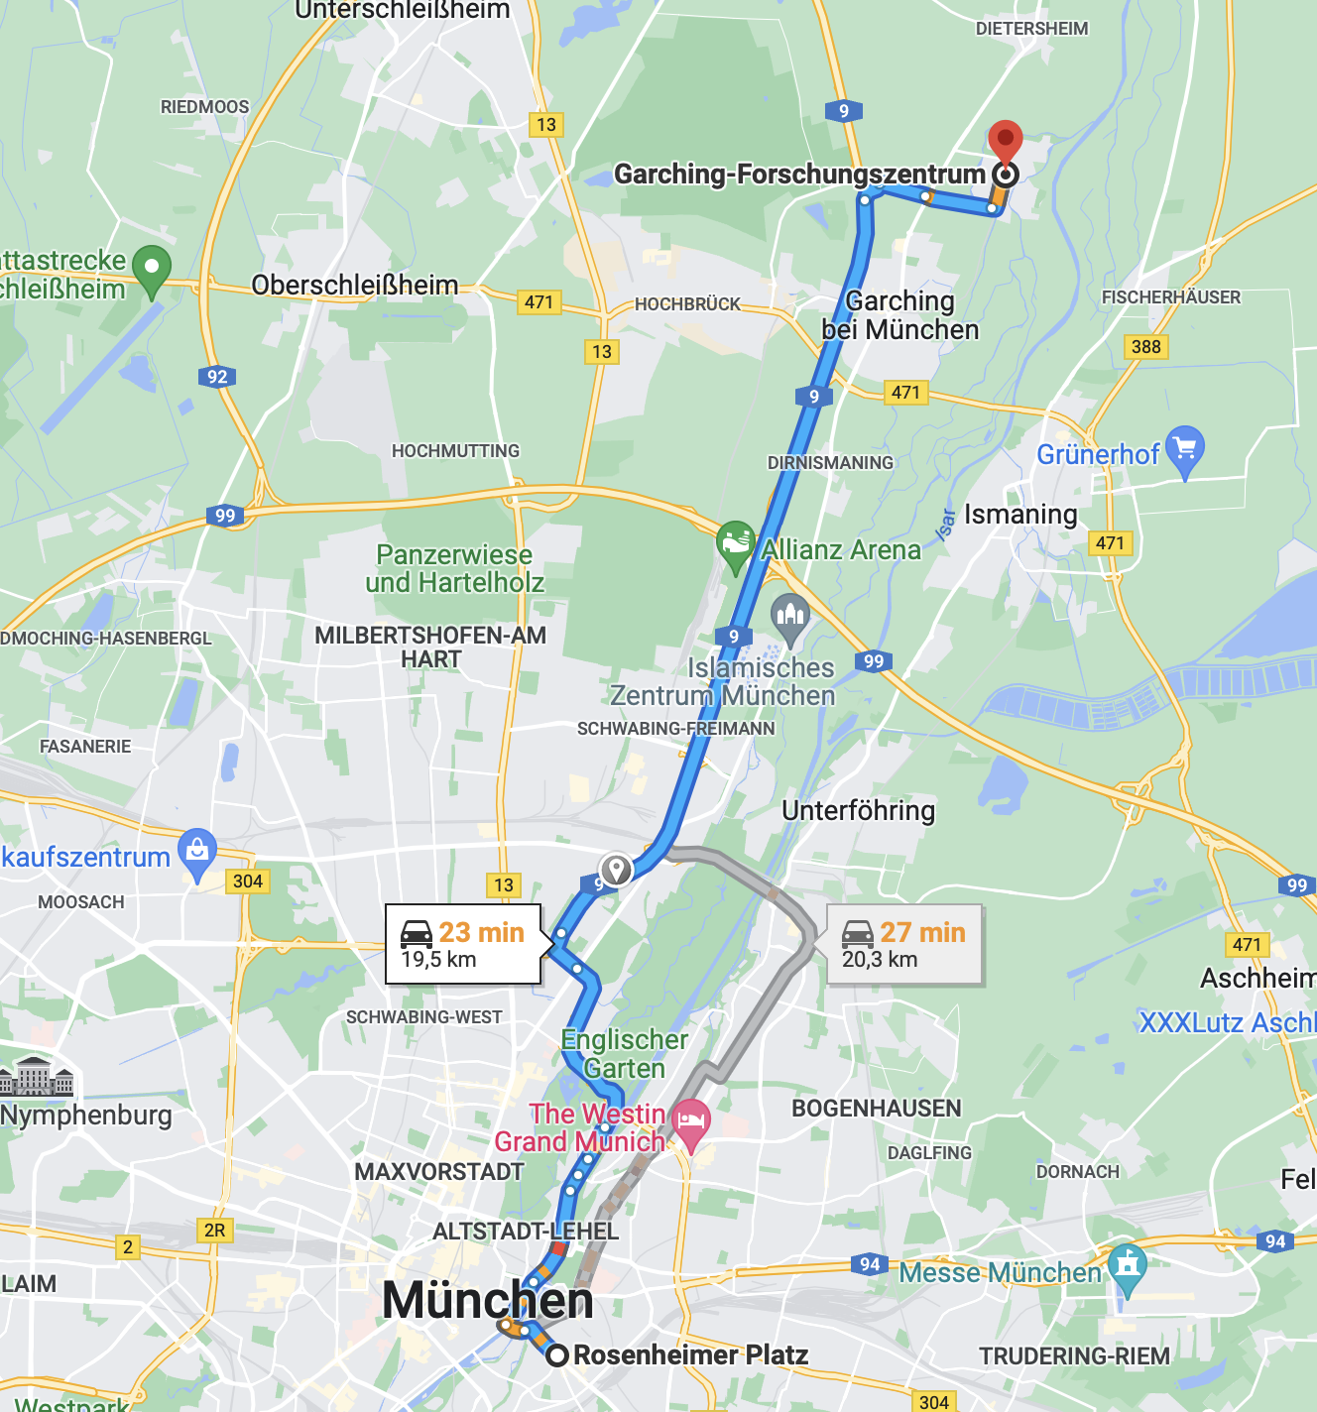


Vici
Raimund

