Slide 1



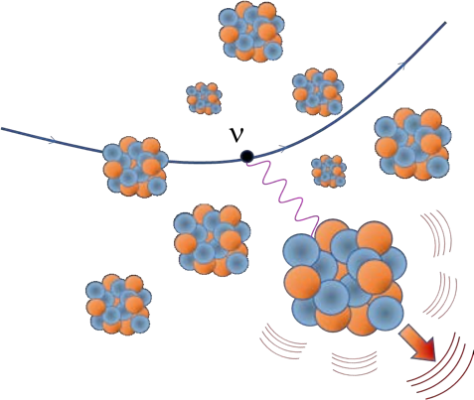




CEvNS in Munich
Victoria Wagner & Raimund Strauss
Technical University Munich
March 22nd 2023
Carl-Friedrich von Siemens Stiftung
Notes:
CEvNS belongs to Munich like Brezn and Bier – sure you will experience all three during these days.

Slide 2
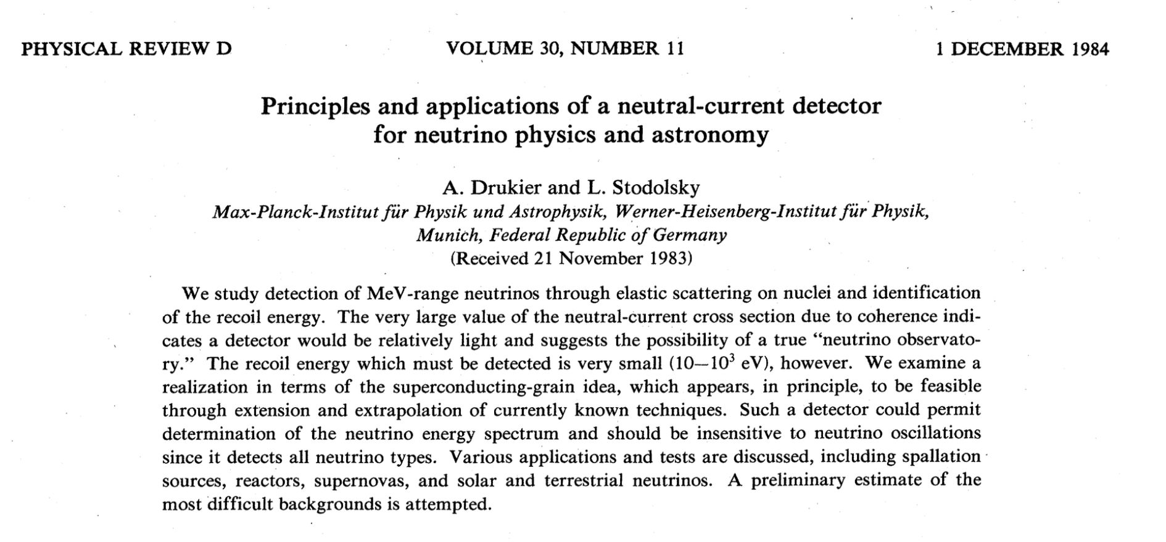
Pioneering work in Munich
Notes:
Long before CEvNS was called CEvNS. The paper invented our field(!)
The abstract has already everything ….

Slide 3
Pioneering work in Munich
CEvNS
is strong
CEvNS is tiny
CEvNS is clean
Notes:
Long before CEvNS was called CEvNS. The paper invented our field(!)
The abstract has already everything ….

Slide 4
Pioneering work in Munich
Small detectors
CEvNS
is strong
CEvNS is tiny
experimental ideas
CEvNS is clean
Backgrounds (!)
Notes:
Long before CEvNS was called CEvNS. The paper invented our field(!)
The abstract has already everything ….

Slide 5

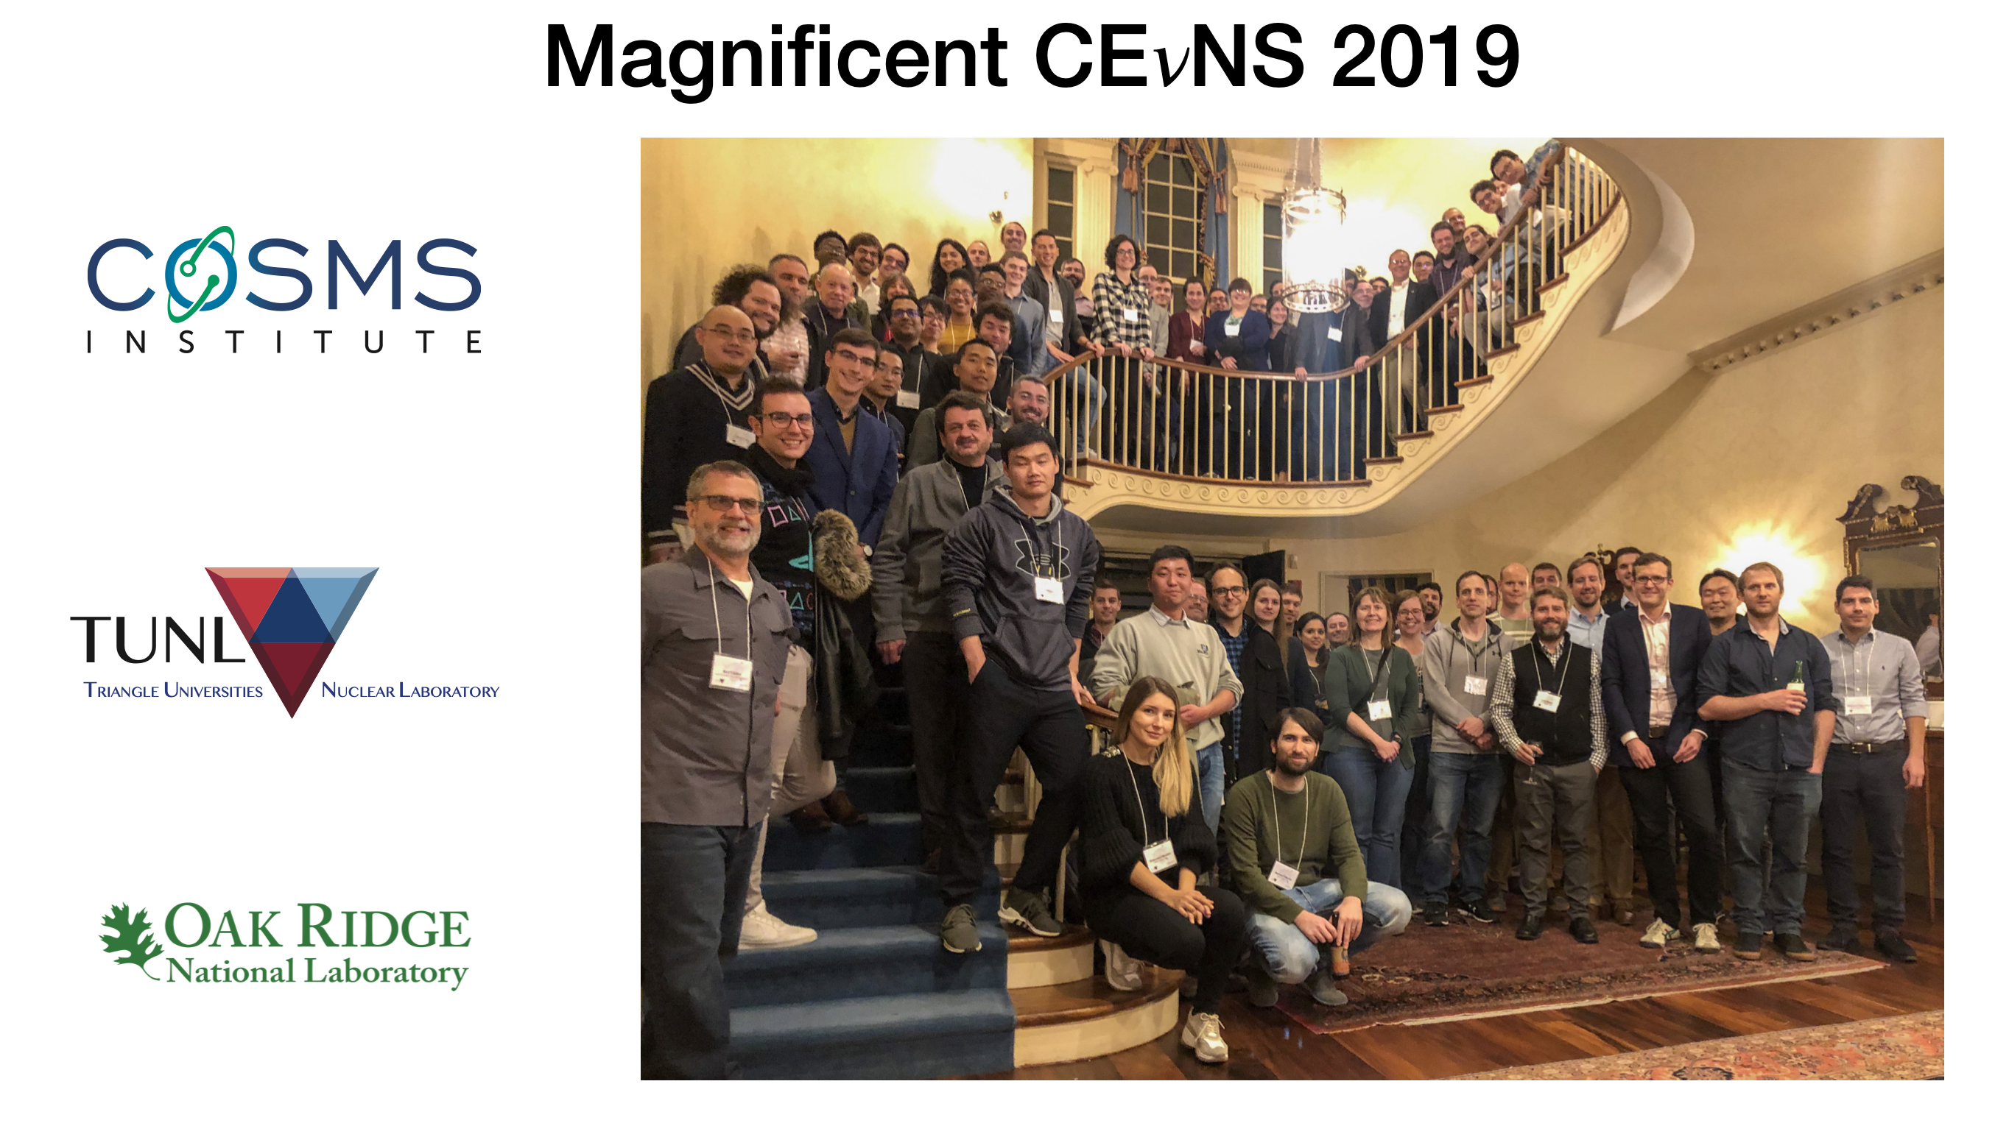

40 Years later…
2020
2021
participants
2023
time
Notes:
It took 33 years until the story became real!

Slide 6
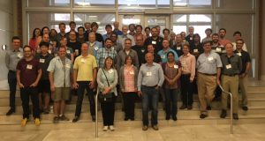


40 Years later…
2020
2021
participants
2023
time

Slide 7
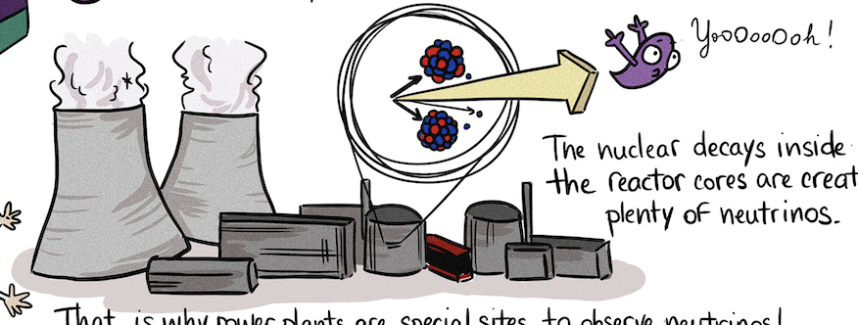
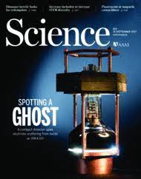
A lot to discuss…
activity
CEvNS at Spallation Source
Phenomenology
Theory
Calibration
Reactor CEvNS
Applications
©Chloe Goupy (CEA Saclay)
time

Slide 8

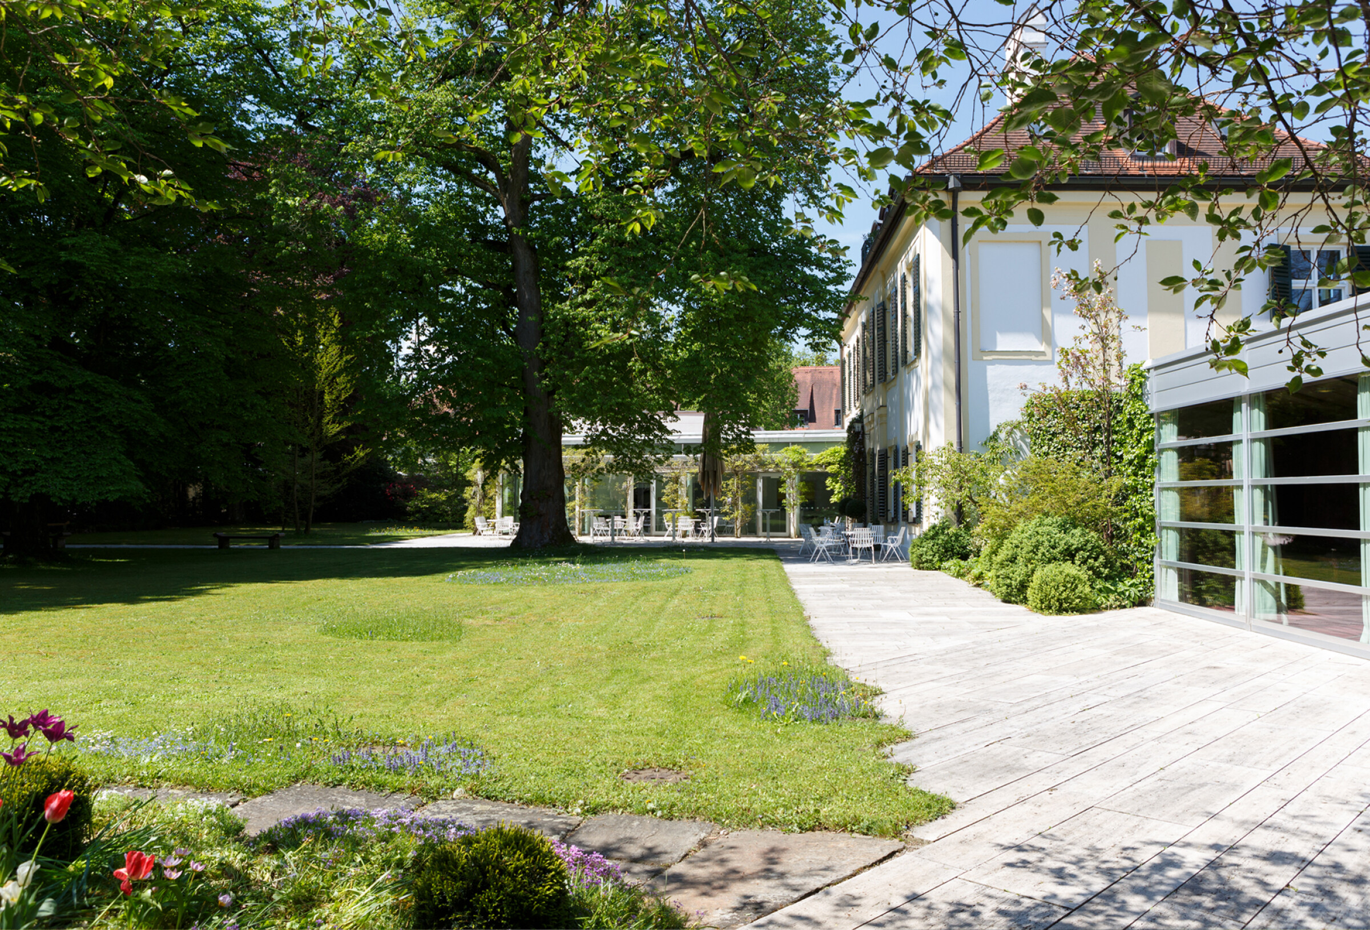

Merci [meàsse]
Notes:
Travel support, satellite workshop, school

Slide 9
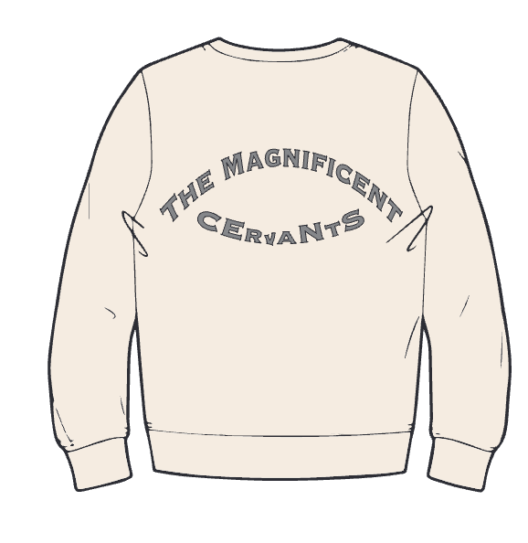
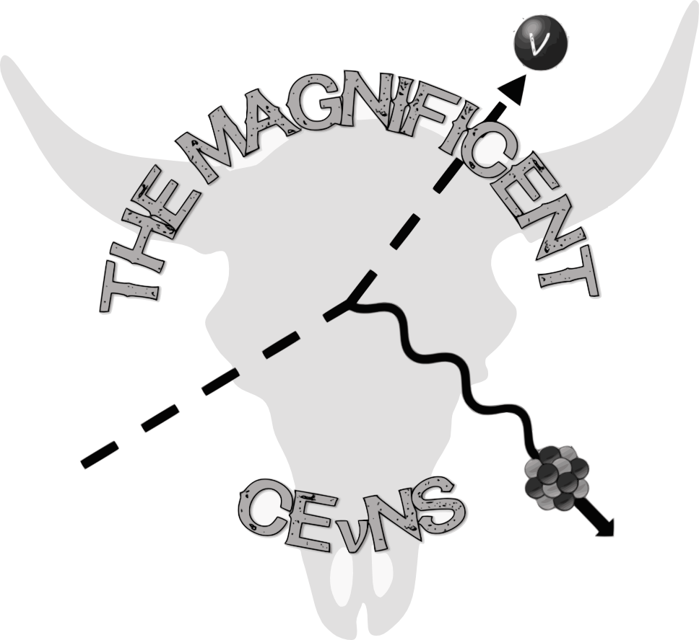

Merci [meàsse]
International Advisory Committee
Phillip Barbeau
Matthew Green
Janina Hakenmüller
Diane Markoff
Grayson Rich
Kate Scholberg
Raimund Strauss
Louis Strigari
Victoria Wagner
Local Organizing Committee
Raimund Strauss (Co-chair)
Victoria Wagner (Co-chair)
Andreas Erhart
Margarita Kaznacheeva
Angelina Kinast
Paola Mucciarelli
Tobias Ortmann
Luca Pattavina
Lilly Peters
Petra Riedel
Johannes Rothe
Nicole Schermer
Sabine Wenzel
Alexander Wex
Notes:
Bravo Vici!

Slide 10


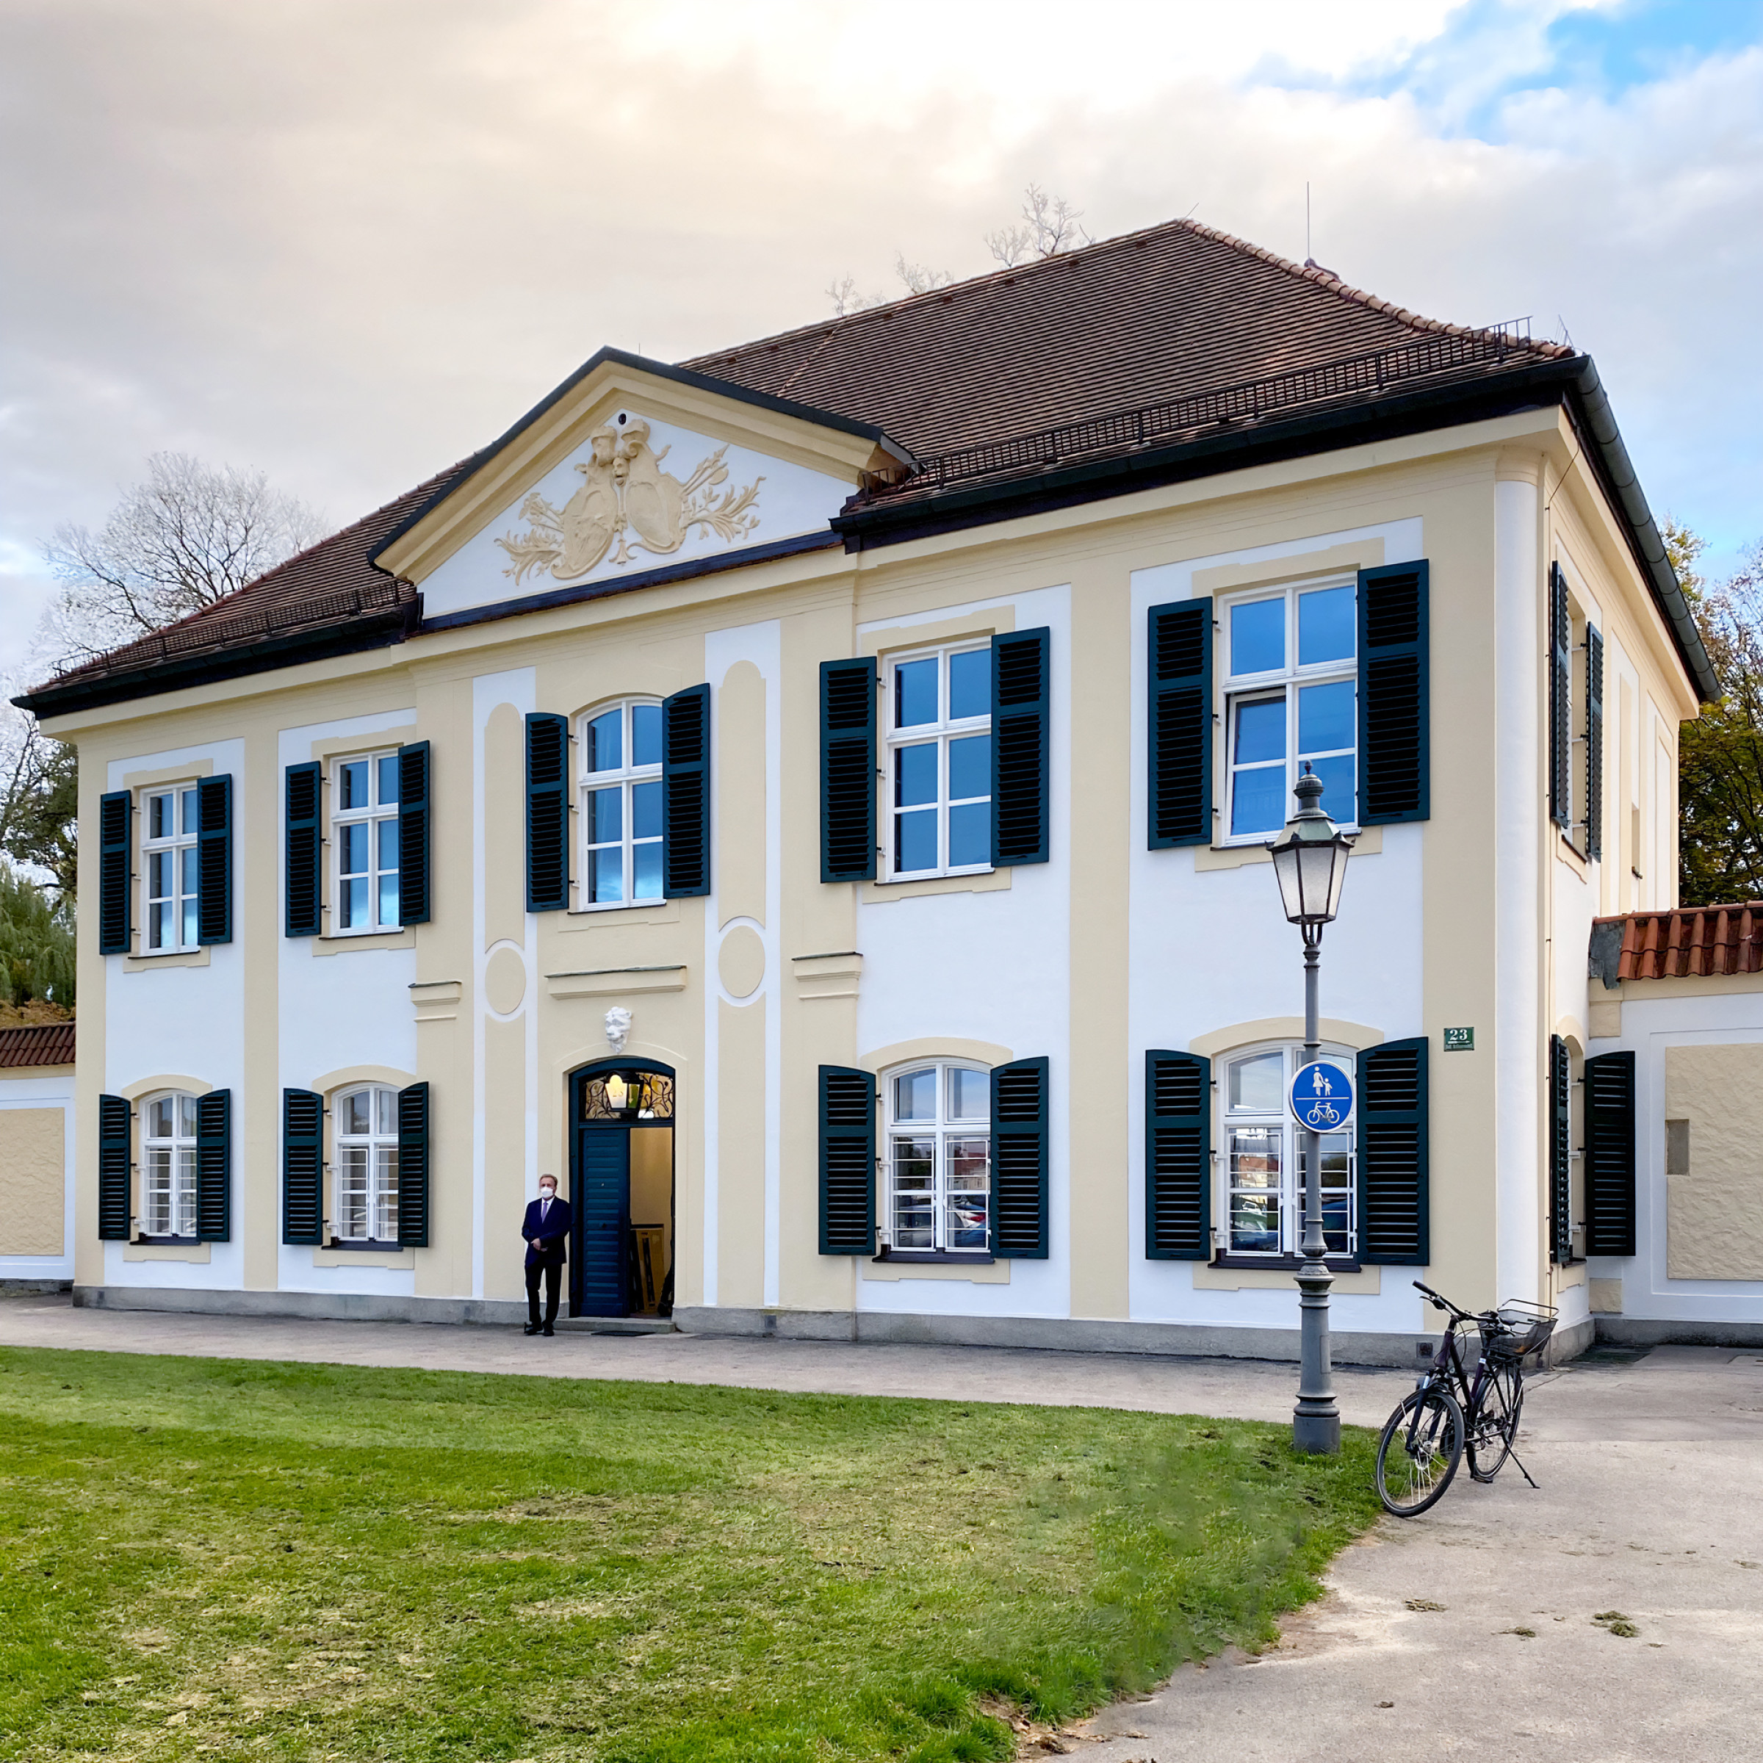

Welcome to Munich
Q
Q
CEvNS
A
A

Slide 11
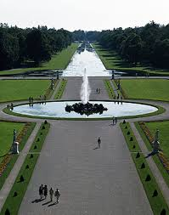
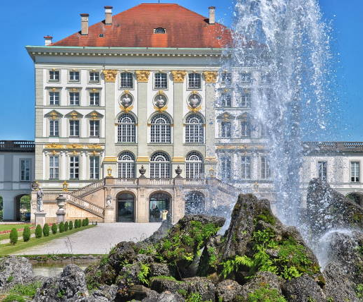
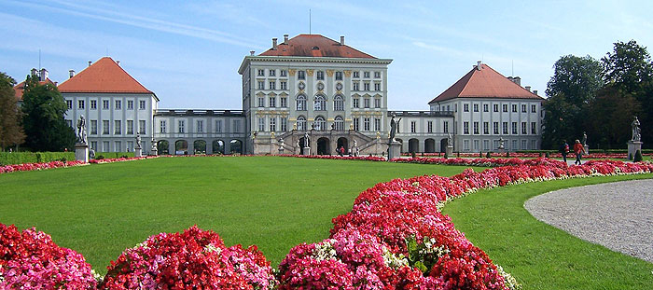
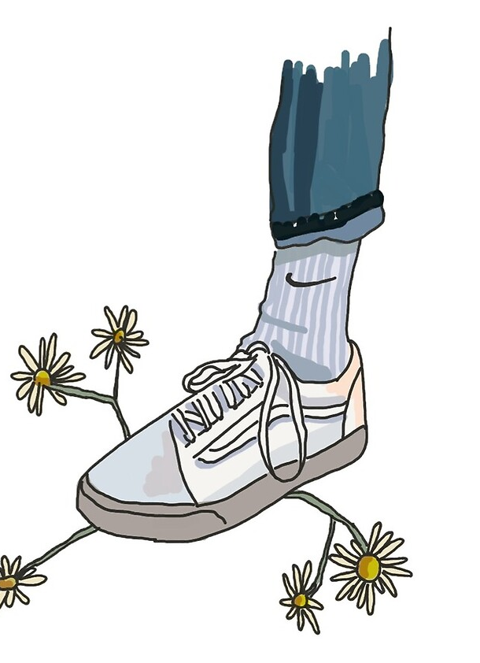


The Venue
Nymphenburg Castle & Park
Coffee breaks
Lunch breaks (all vegetarian, vegan on demand)
Please be on time in the morning & wear your badge
Ring the bell if you are late
Don’t forget to come back
In the garden
https://www.schloss-nymphenburg.de/englisch/palace/

Slide 12

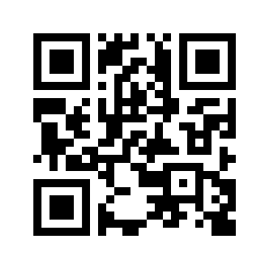

https://indi.to/J9jWv

Slide 13
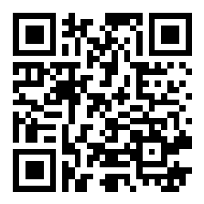
Instructions for Speaker &
Discussions
Q
Q
A
A
Please upload talks
https://indi.to/J9jWv (Indico) or by email to mag7s.munich@gmail.com
We will be strict on timing: 15 + 5 min (20 + 5 min)
Discussions on Slido (remote & anonymous questions)
https://app.sli.do/event/aJnfUYSkFPo3C2U57HhVGA

Slide 14

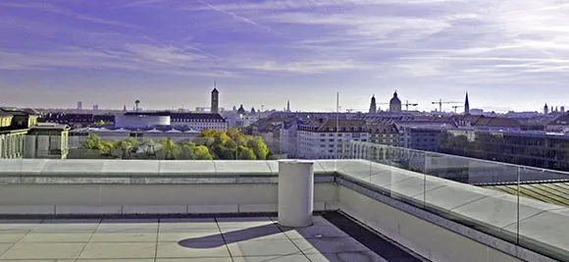
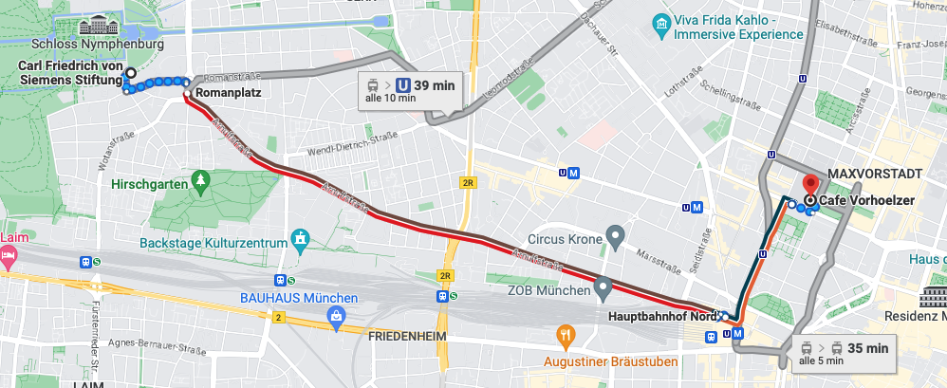
Poster Session & Social Dinner
If not you have not yet registered, please do so at the registration desk
Participation fee: 150 EUR (in cash)
Start: 6 pm (Posters & finger food)
https://goo.gl/maps/6wZoK8ub3w3ihMdV7
Location: Vorhoelzer Forum

Slide 15


… Friday is not the end …
Location: Vorhoelzer Forum
(https://goo.gl/maps/DdkDyESfyPThqRkS9 )
Location: Garching, Physics Department
(https://goo.gl/maps/vuuf7CKDhbrmCTPGA )

Slide 16

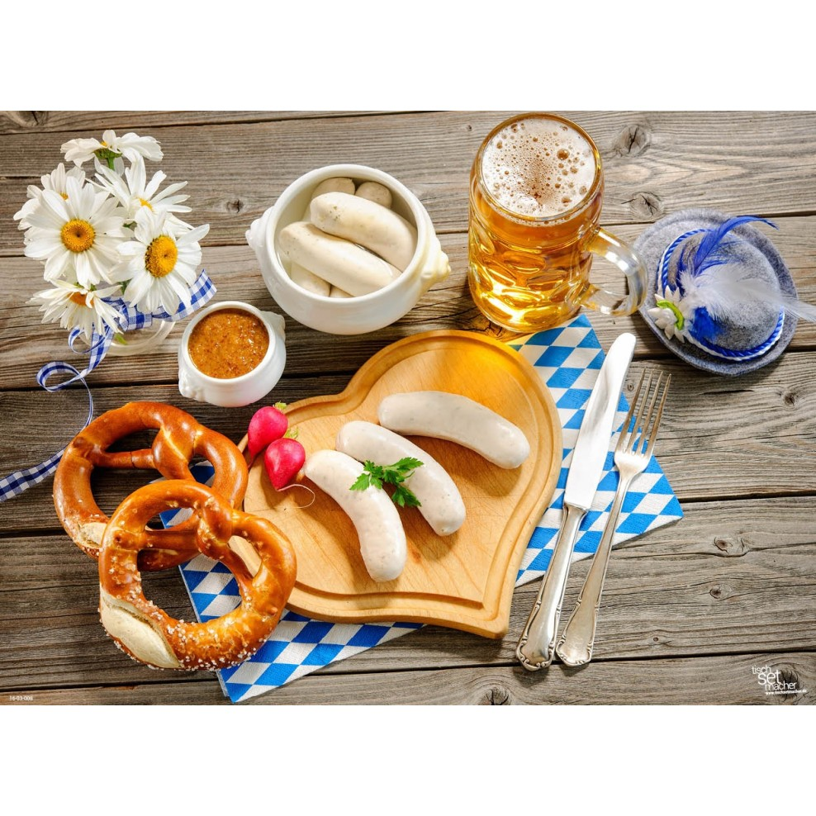
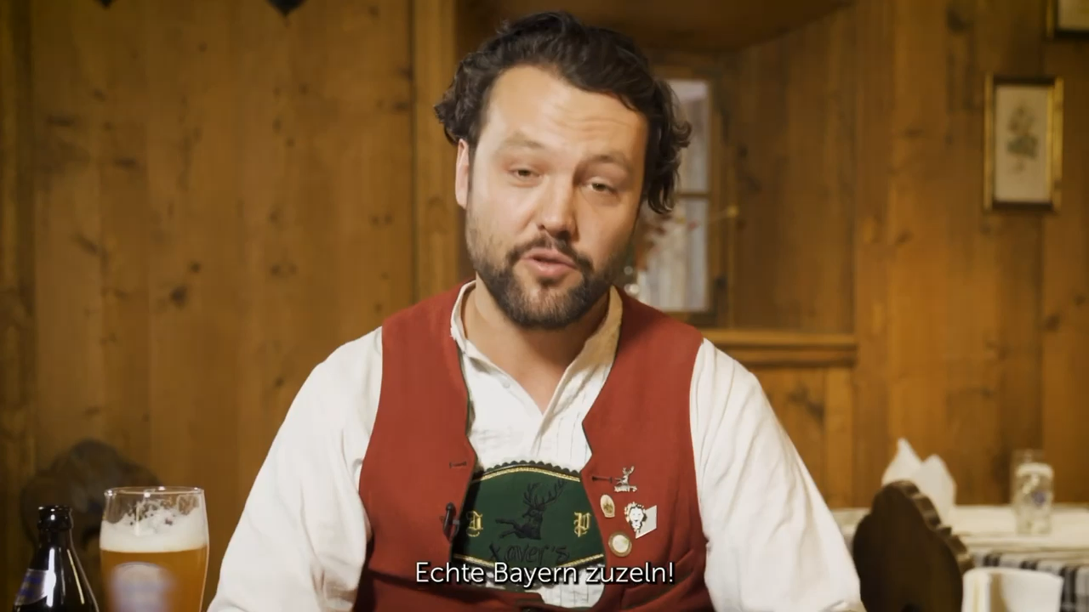
The Ultimate Munich Experience – Step 1
26
Weißwurst
beer
Start: 11:55am
hat
sweet
mustard
https://www.youtube.com/watch?v=NdjUQfY2Ejw
Brezn

Slide 17
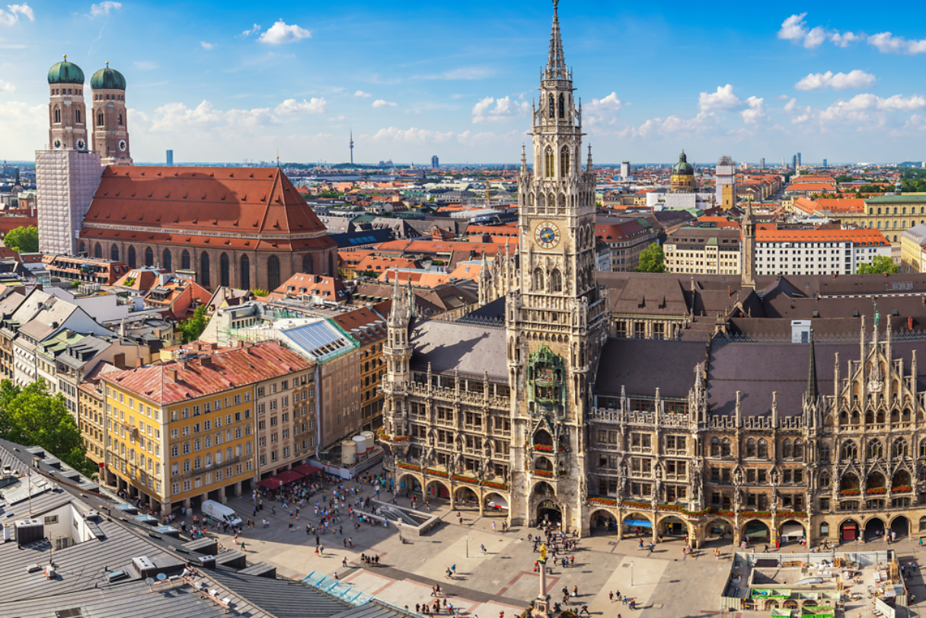
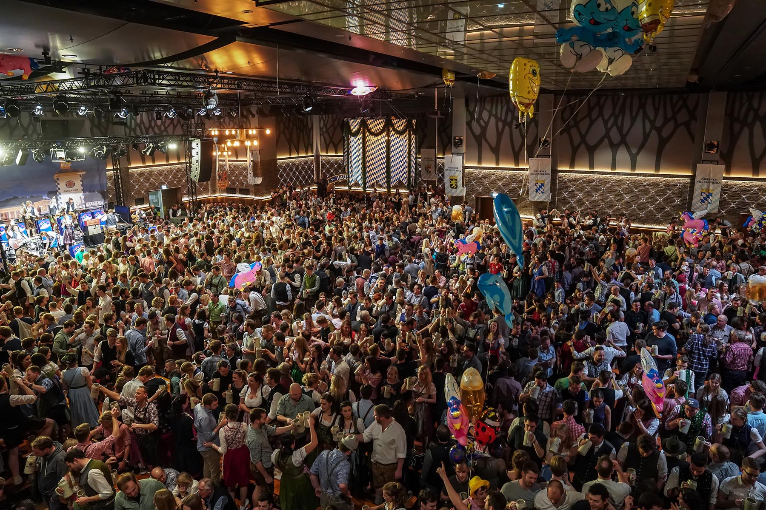

The Ultimate Munich Experience – Step 2
26
Enjoy the City Center
Guided Tour at 1:30pm
Beer Festival
Nockherberg at 4:30pm
Detailed instructions will be provided!

Slide 18

Welcome to Munich!
https://indi.to/J9jWv
Enjoy Mag7s.

