Slide 1

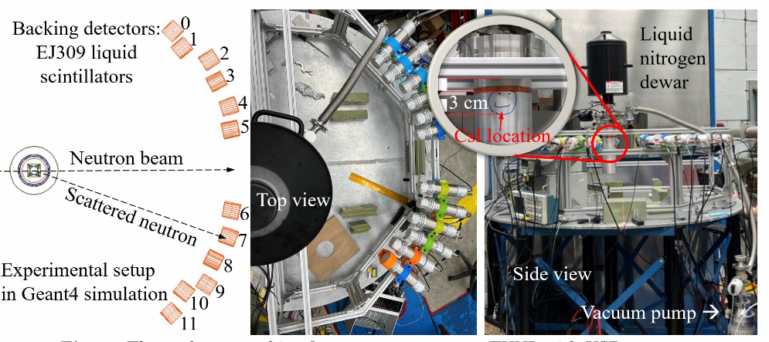
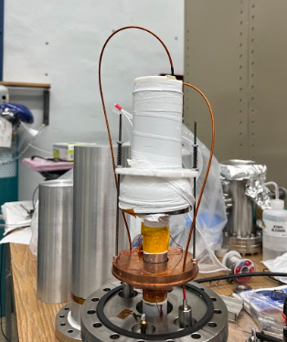
Lower threshold than HPGe? 0.4 keVnr
CryoCsI = undoped CsI + SiPM arrays @ cryogenic T
QF : ~0.17
Unlike collar’s: 0.1
Neutron beam, 1’’
Cooling finger
Sensitive to low energy events, such as low-mass dark mater searches, non-standard neutrino interactions, neutrino magnetic moment studies

