Slide 1
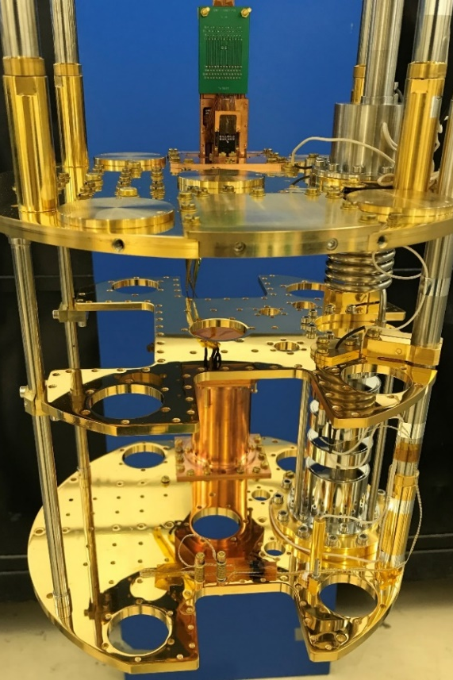
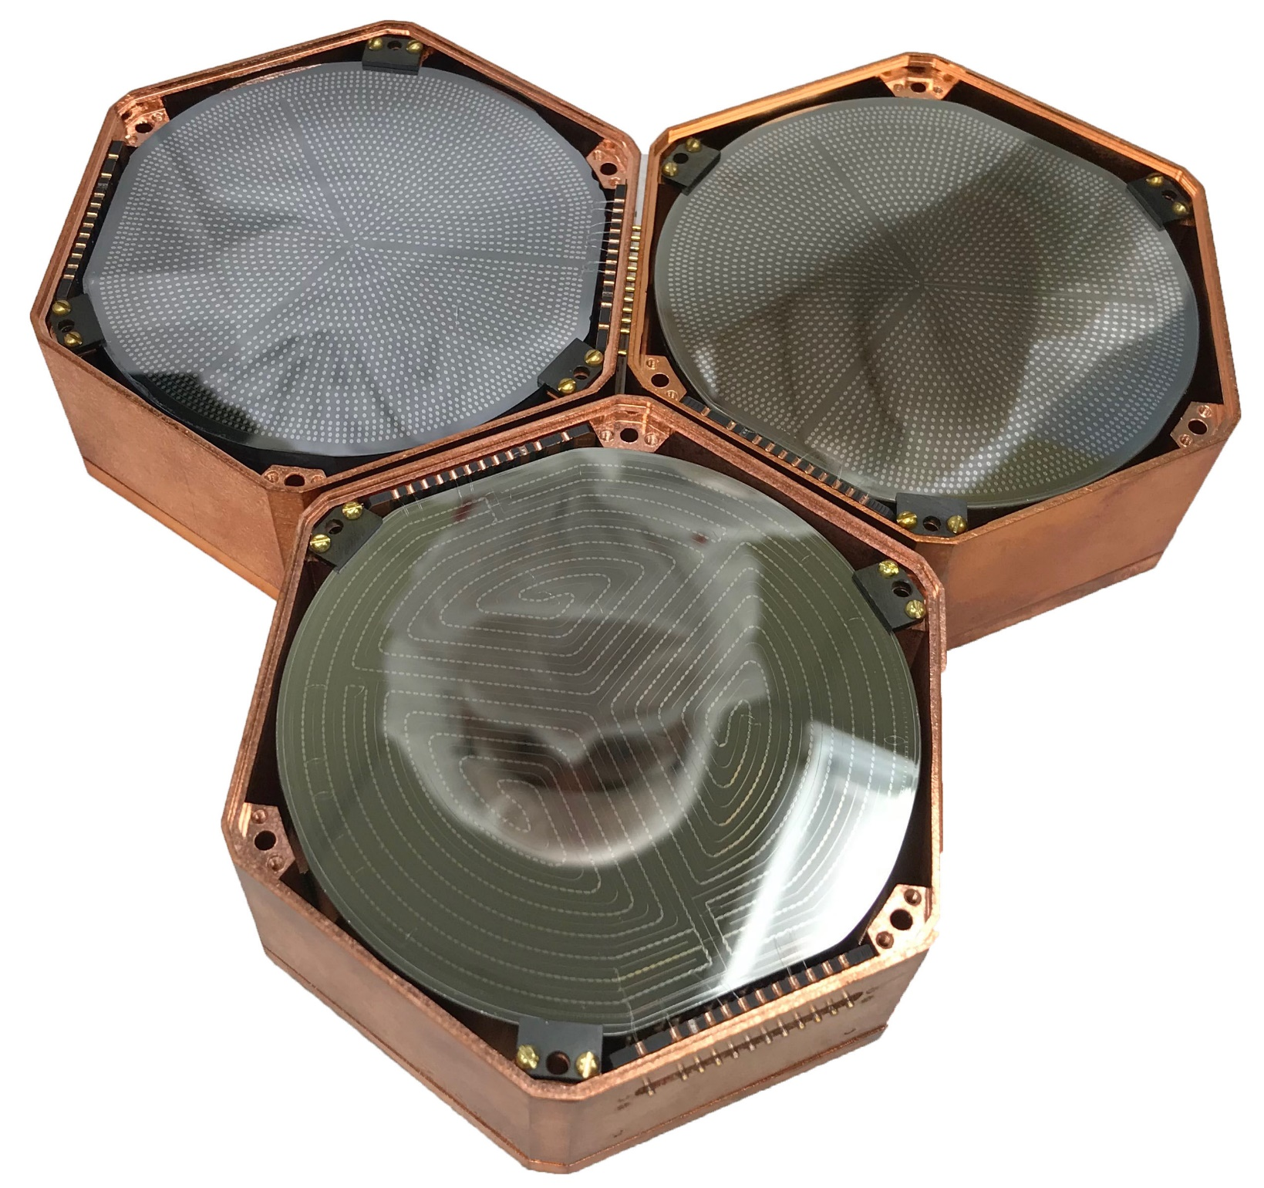
MIνER Reactor CEνNS Program
Rupak Mahapatra, Texas A&M

Slide 2
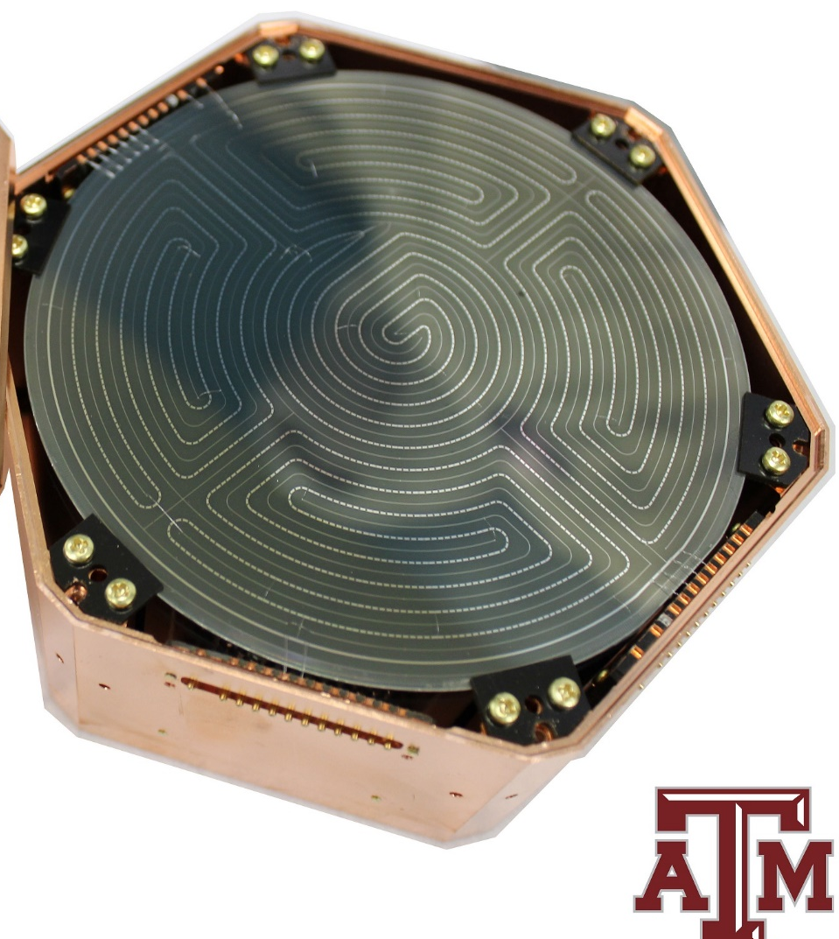
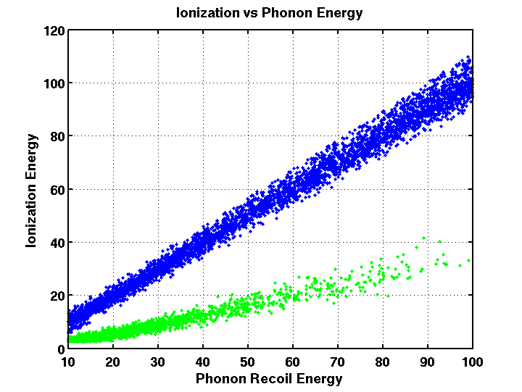
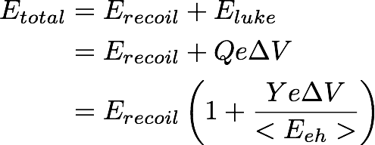
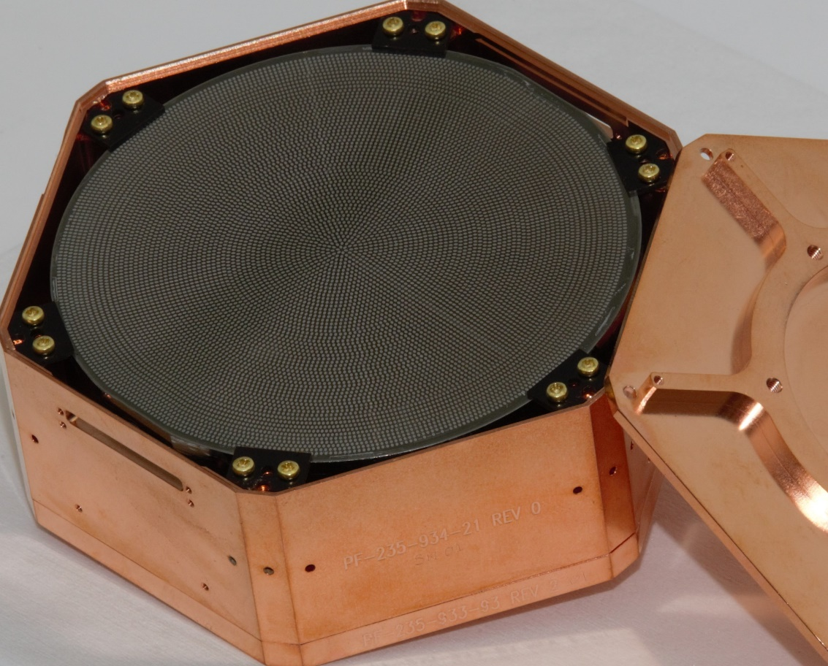
SuperCDMS Detector Technologies
iZIP Detector with ionization and phonon sensors for ER/NR discrimination down to keV-scale
Ionization
First SNOLAB Ge iZIP (fabricated at TAMU)
Phonon
High Voltage Detector with no discrimination and ~100eV threshold
Luke Phonons
ΔV
Recoil Phonons
Single-e resolution HVeV detector of ~gm-scale
PRL 121 (2018), 051301
First SNOLAB Si HV (fabricated at TAMU)
MINER uses somewhat modified versions of these detectors

Slide 3
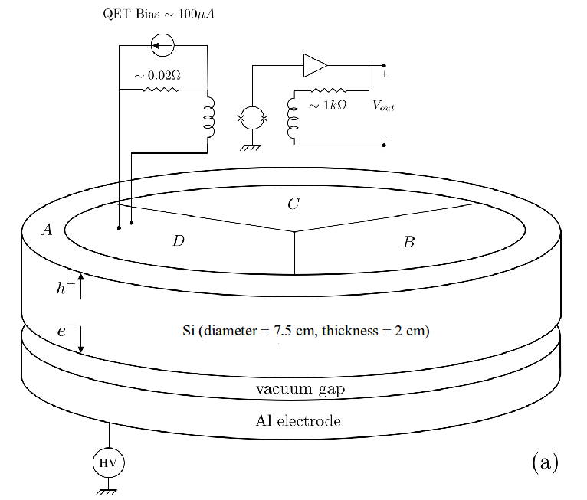
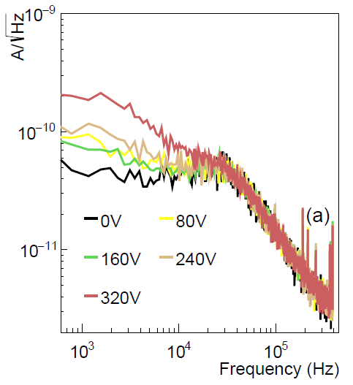
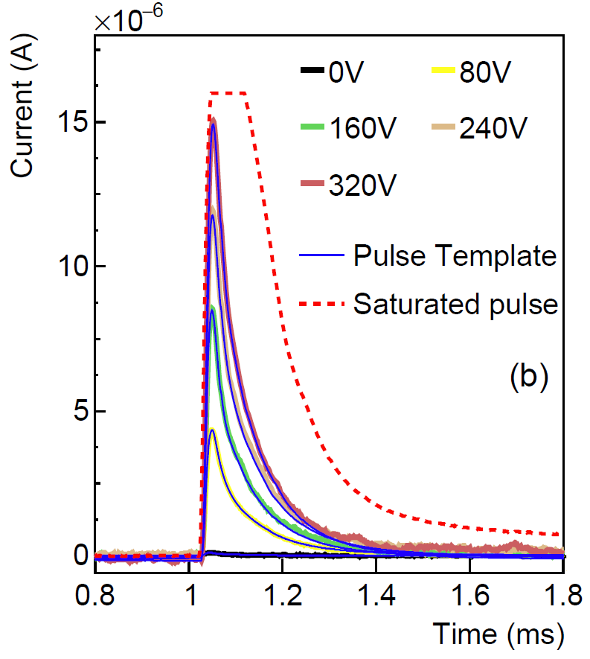
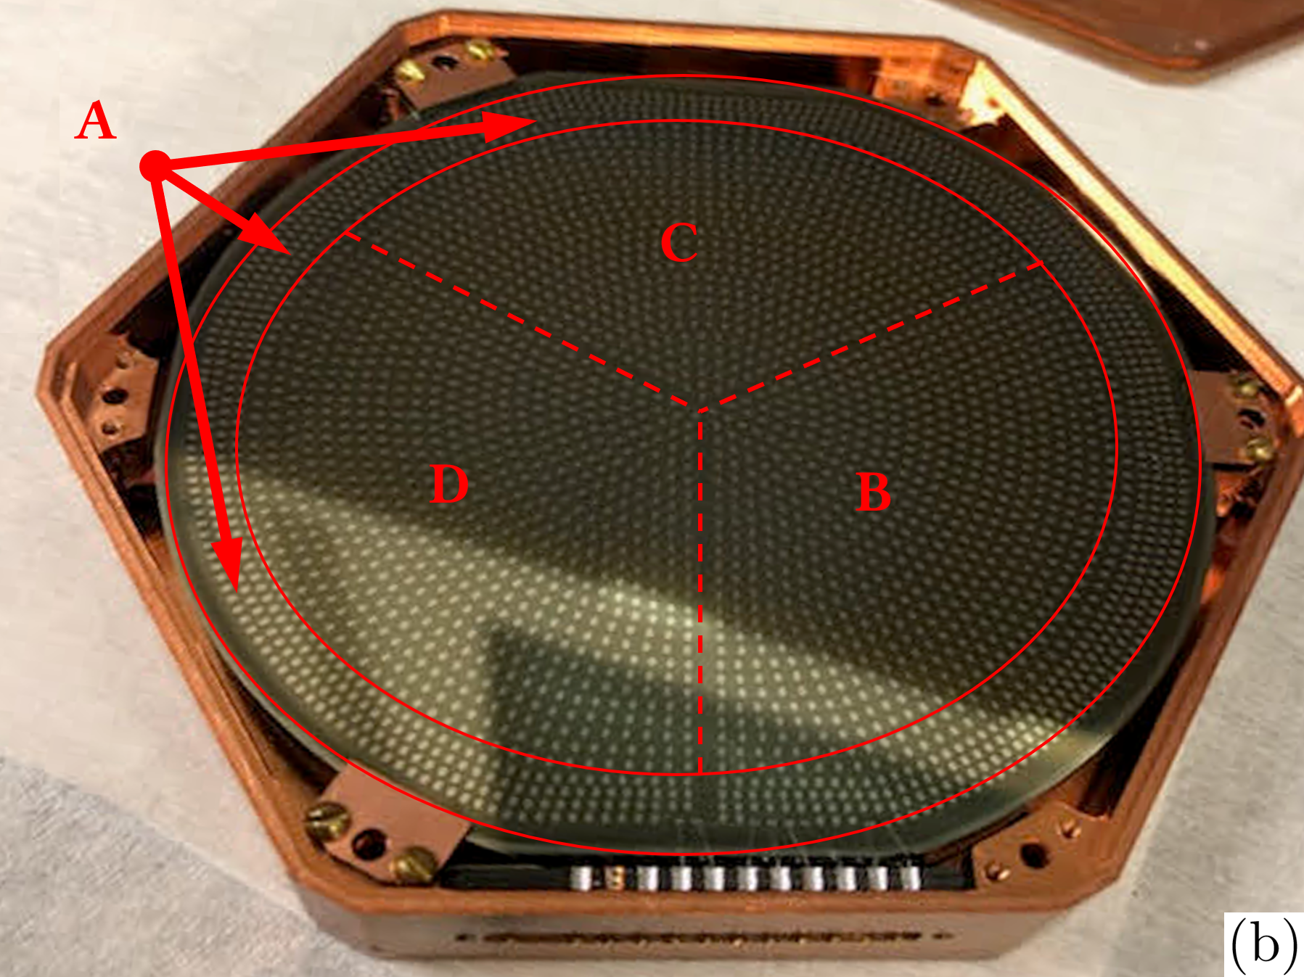
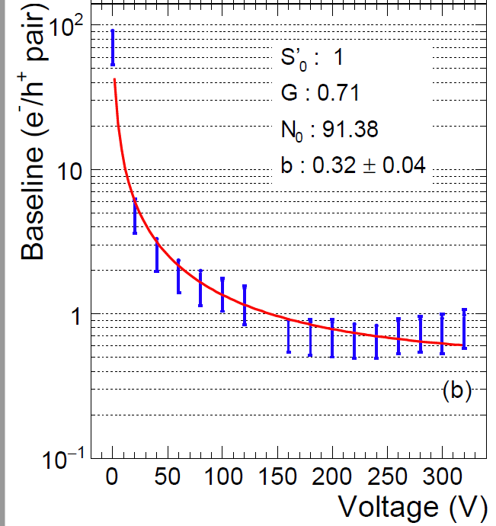
Single-e, large-mass HV detector developed for and used in MINER
Noise stays constant with V
Laser calibration at low energies
Vacuum gap between HV and crystal
100-gm 3”x1cm Si HV detector with contact free biasing shows no significant increase in leakage up to 320V.
Approaches single-e resolution at ~100V.
In use in the MINER experiment and operated at 100V.
No ER/NR discrimination like SuperCDMS HV detectors
Large-mass single-electron-resolution detector for dark matter and neutrino elastic interaction searches: arxiv.org/abs/2011.02234

Slide 4
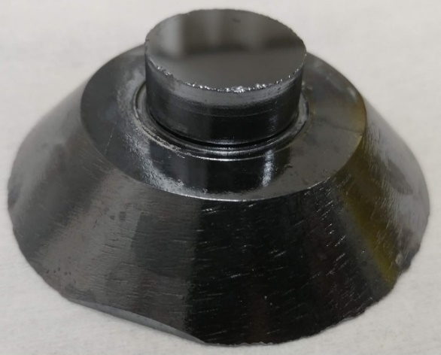
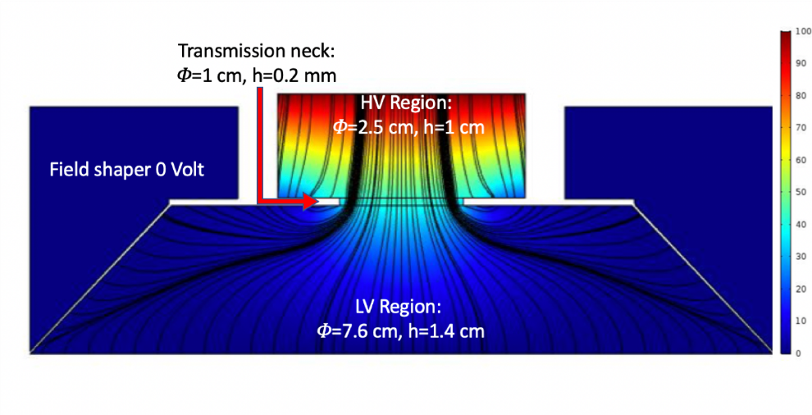
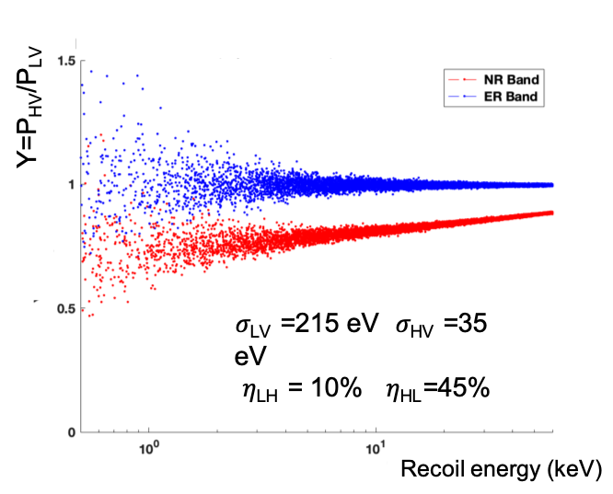
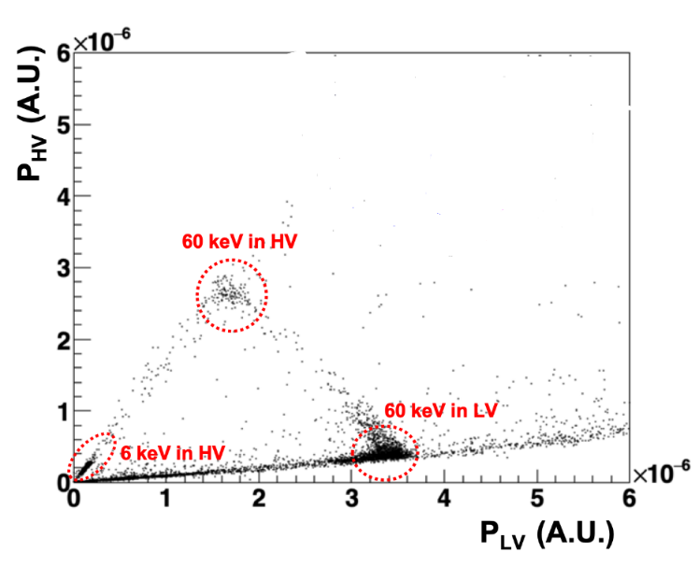
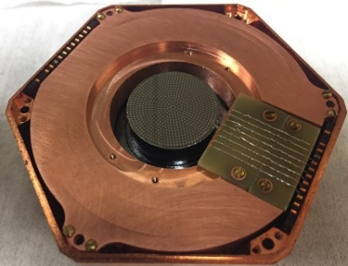
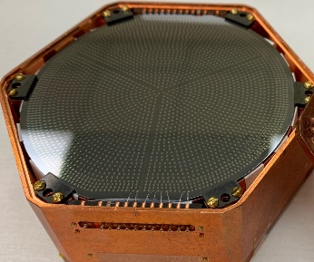
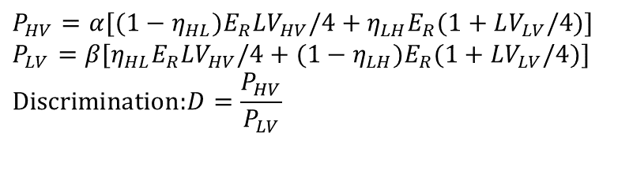
Hybrid HV Detector
Main idea: Monolithic detector with Low-Voltage (LV) and High-Voltage (HV) sides – LV measures primary phonons like iZIP and HV measures NTL phonons. Narrow neck geometrically suppresses HV to LV NTL phonon leakage
Charge transport from LV region to HV almost 100%
Simulated ER/NR bands in LV
$$P_{HV}=α[(1−η_{HL})E_{R}LV_{HV}/4+η_{LH}E_{R}(1+LV_{LV}/4)] \\ P_{LV}=β[η_{HL}E_{R}LV_{HV}/4+(1−η_{LH})E_{R}(1+LV_{LV}/4)] \\ \text{Discrimination}\text{:}D=\frac{P_{HV}}{P_{LV}}$$
Phonon geometric suppression @ 0V
Phonon-mediated High-voltage Detector with Background Rejection for Low-mass Dark Matter and Reactor Coherent Neutrino Scattering Experiments: In PRL review process https://inspirehep.net/literature/1802528

Slide 5
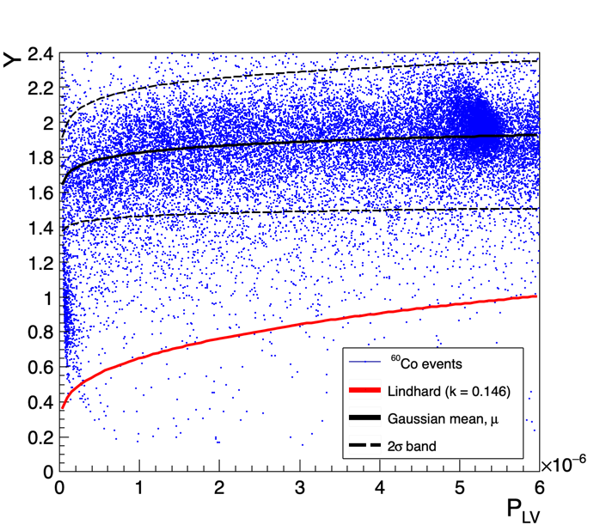
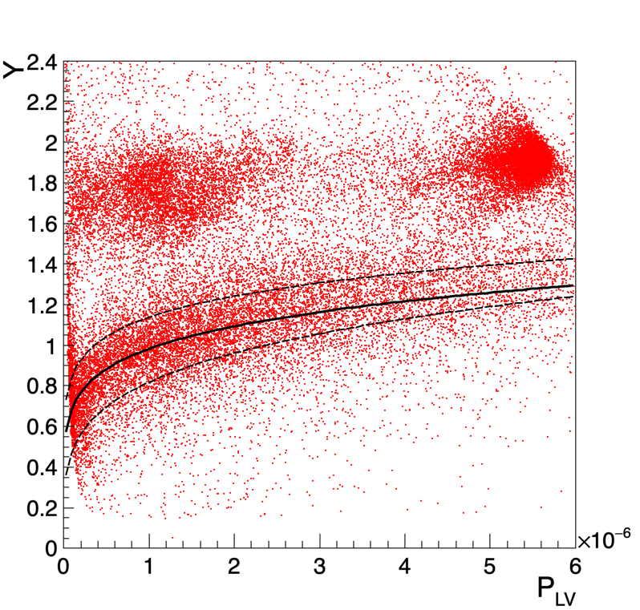
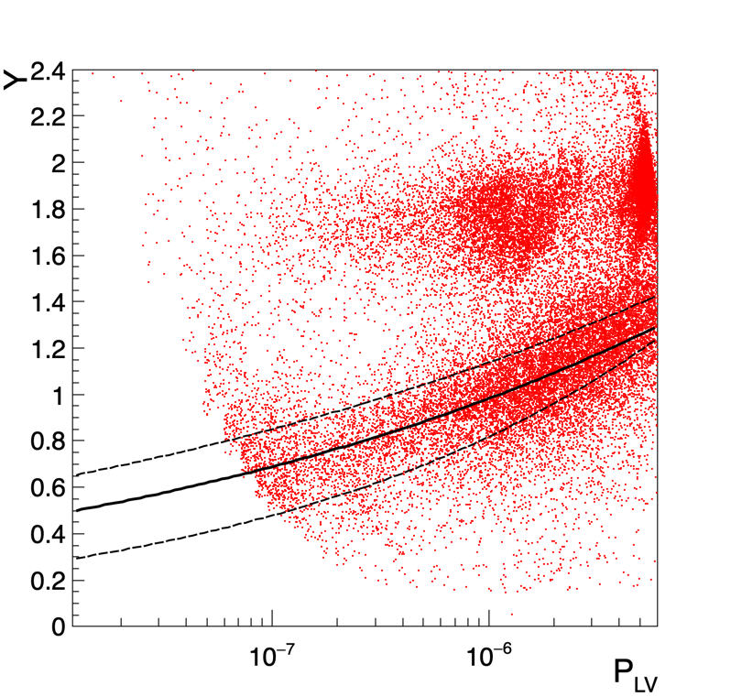
Hybrid: Improving Discrimination at Low Energies
Co60 ER Calibration
Cf252 NR Calibration
Detector calibrated with various internal (⁵⁵Fe, ²⁴¹Am) and external (⁵⁷Co, ⁶⁰Co, ²⁵²Cf) sources
Axes shown in arbitrary units
Lindhard can be directly estimated and is consistent with literature
Log-x version
Position correction will significantly tighten the bands
Discrimination improves at low energies. Funded by DOE to push the DM and CEνNS discovery potential - background is key to discovery. The ER+NR would be the total background for detectors without discrimination
Phonon-mediated High-voltage Detector with Background Rejection for Low-mass Dark Matter and Reactor Coherent Neutrino Scattering Experiments: In PRL review process https://inspirehep.net/literature/1802528

Slide 6
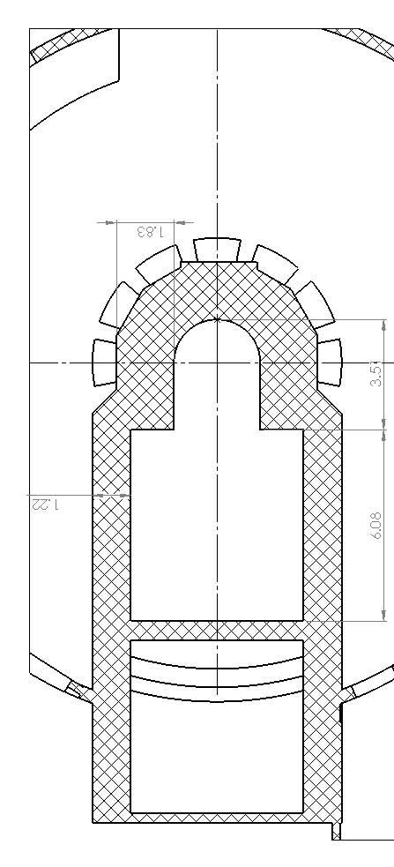
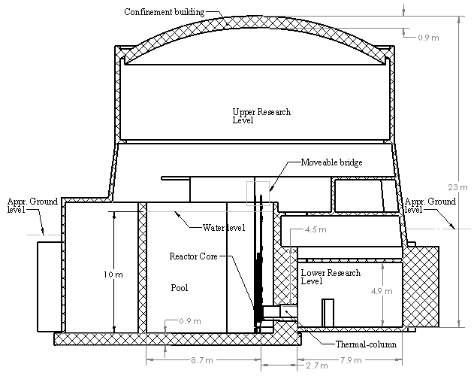
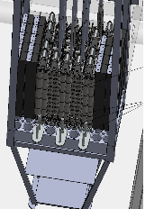

Experiment Plans
Key Features
Low-threshold (~100 eV NR) with sensitivity to CNS
2-10 m proximity to core (rate enhancement)
Moveable Core tests short baseline oscillation
1-4 kg (max) payload with Hybrid and Si HV dets.
Top View
Side View
Movable Bridge
Precisely Movable Core to Probe m-scale oscillation

Slide 7
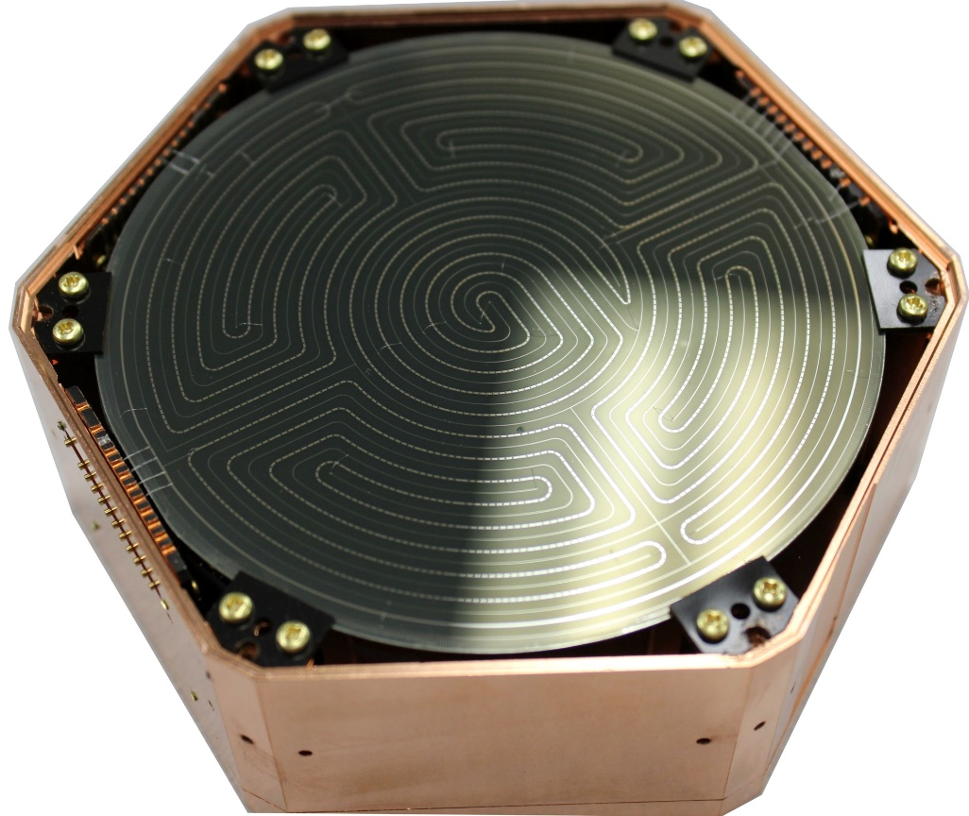
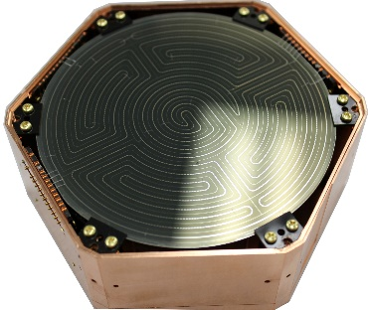
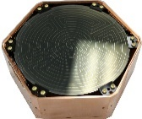
Distance from Core is the key!
Flux $ 1/r^2$
100 m Away
30 m Away
1 m Away
10 kg Detector
10 ton Detector
100 ton Detector

Slide 8
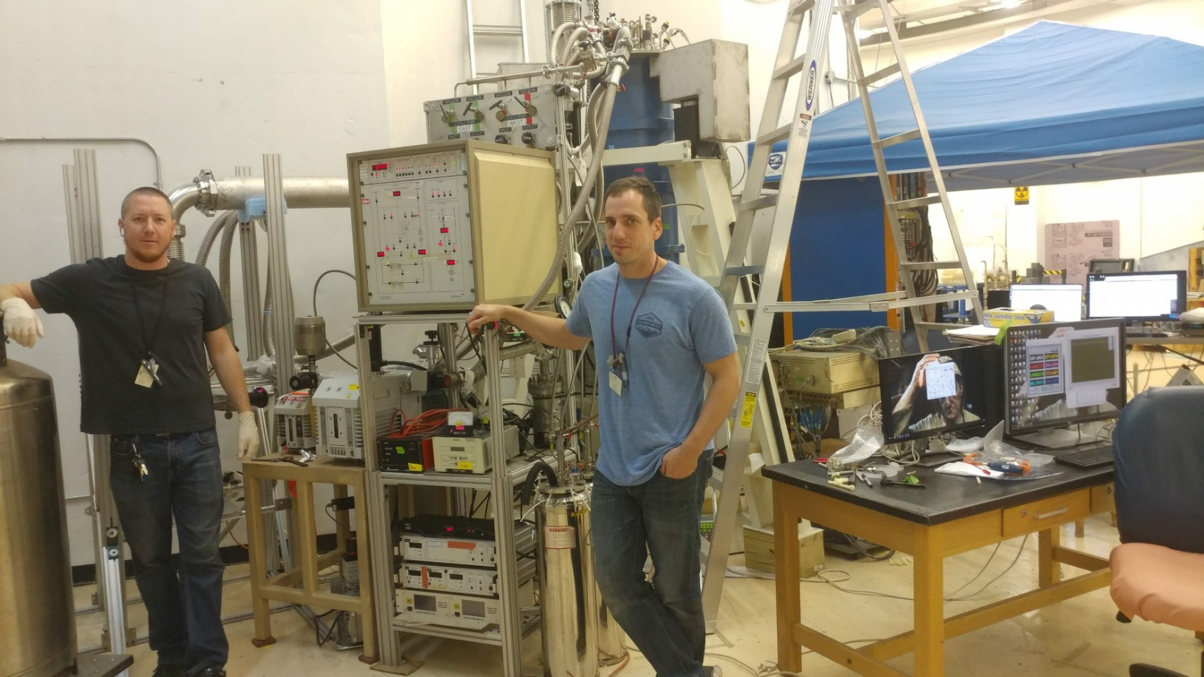
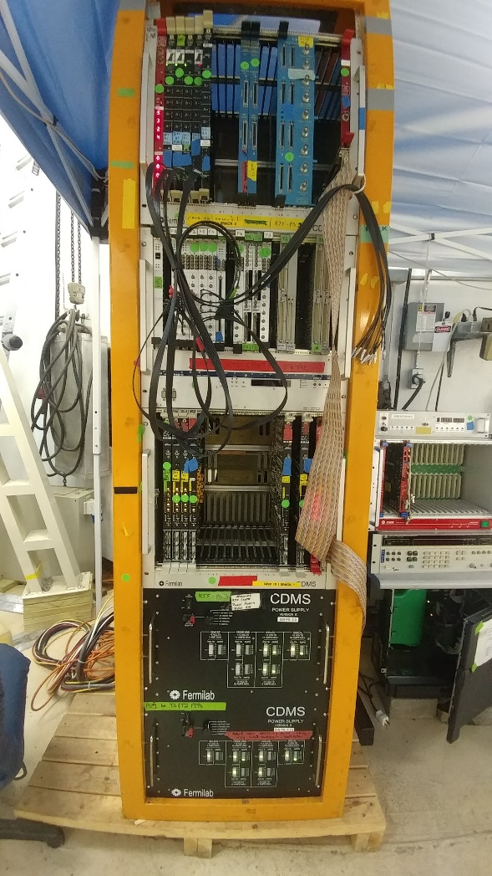
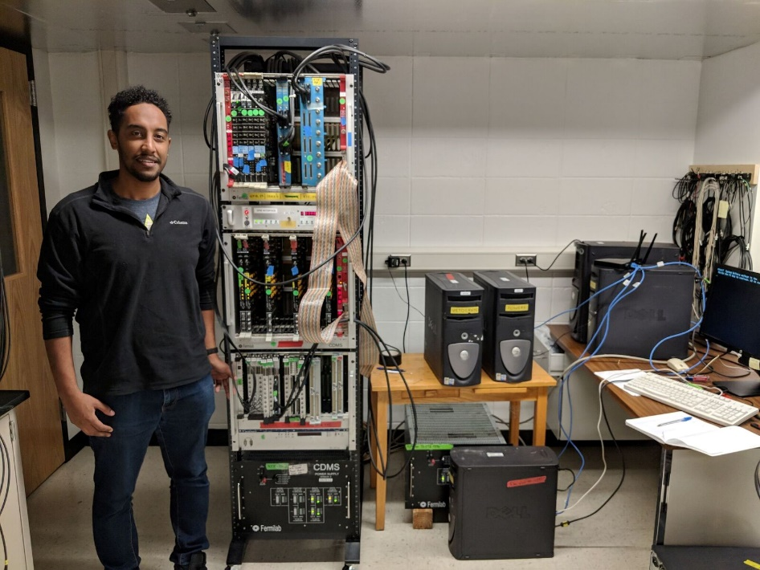
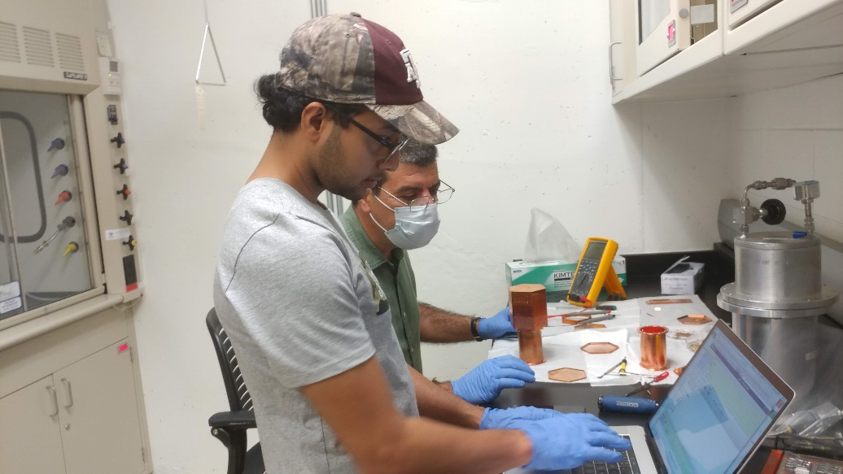
Hugely Leveraged from our SuperCDMS Work
Initial DAQ was fully set up at USD

Slide 9
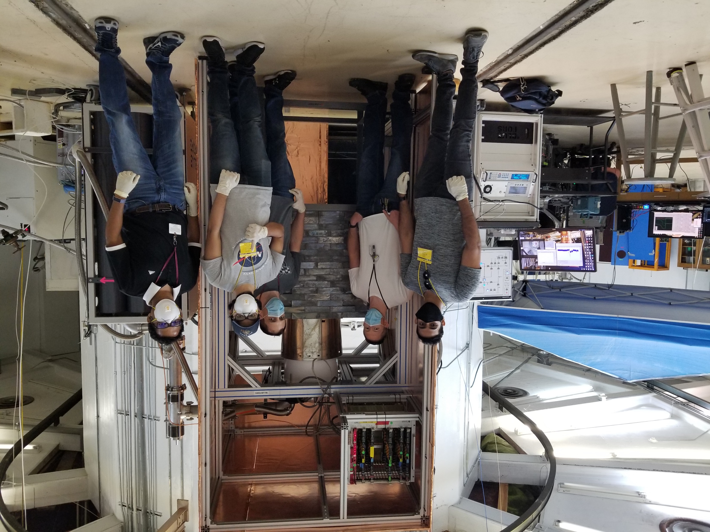
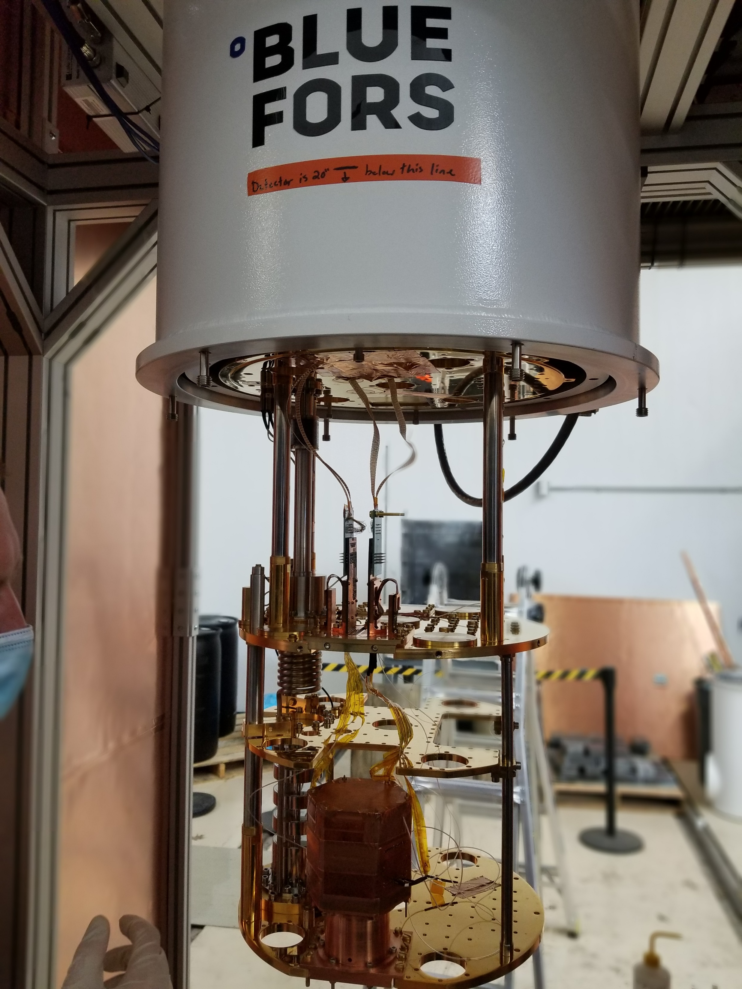
Phase-1 run doesn’t use an Icebox (extended coldfinger connected to a cold volume) that would be easier to shield hermetically. Phase-2 will use that. Hence, Phase-1 background is higher with an open top
Water bricks used for neutron shielding
Borated (55%) rubber used for thermal neutron shielding
Lead used for gamma shielding

Slide 10
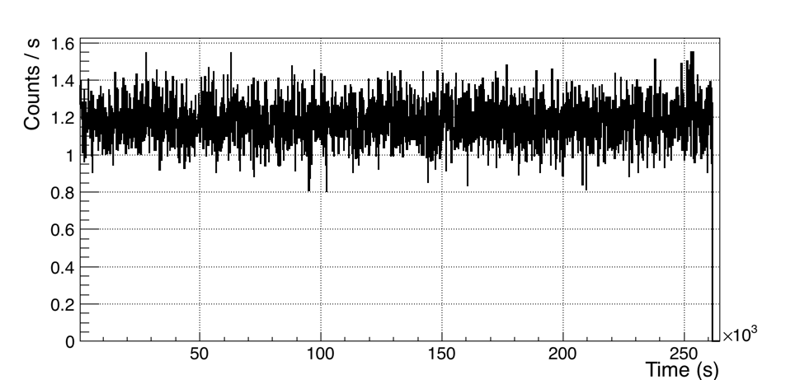
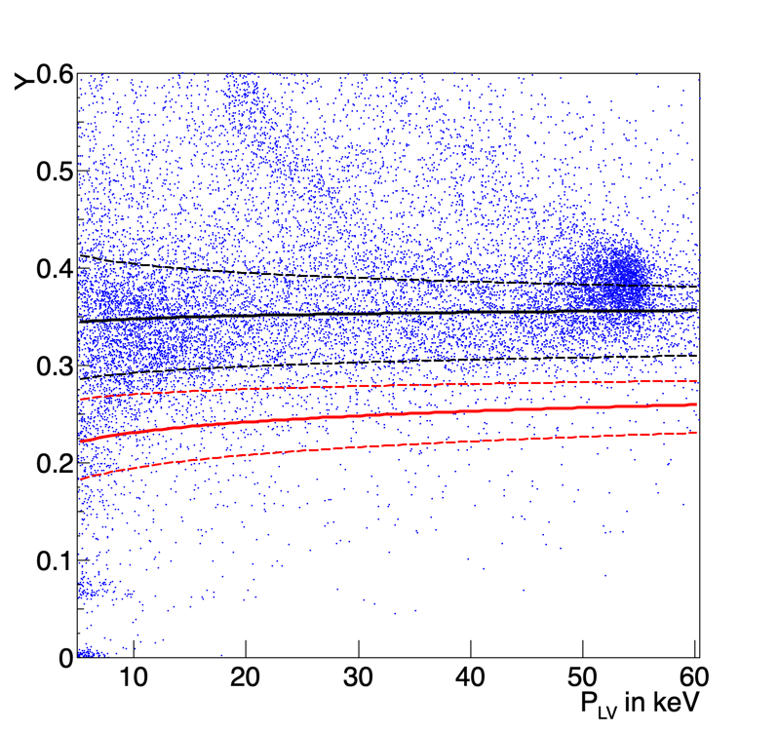
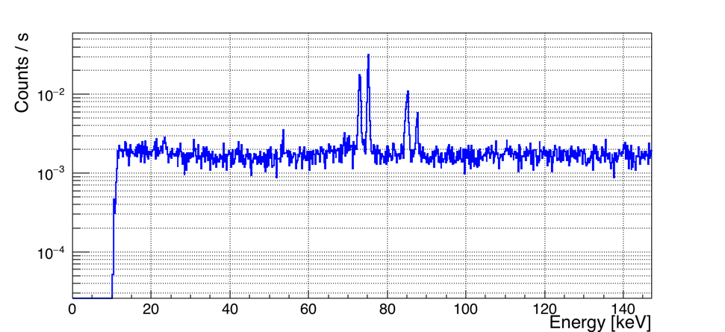
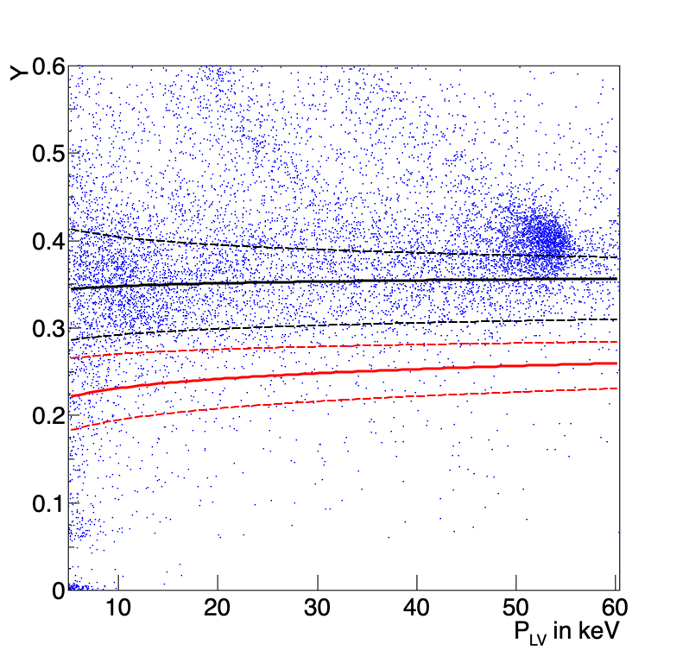
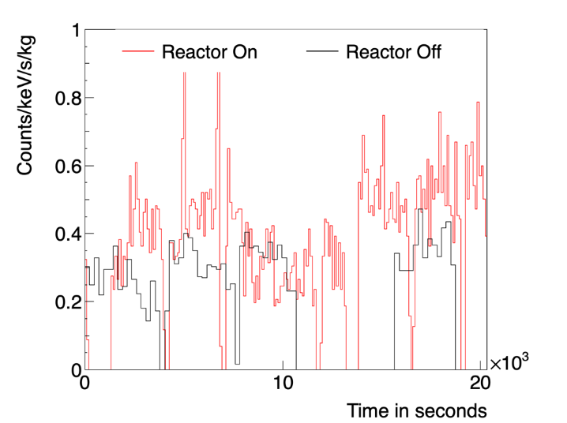
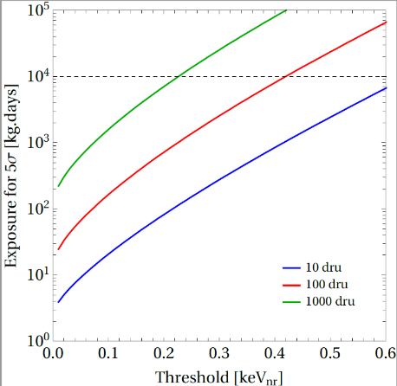
MIνER Background with 4” Pb shielding
Core On
Core On
11-hour Reactor Off
Integrated 30-2100 keV/kg NaI
Core Off
NaI (~1kg) Rate v. Time (integrated: 30 keV – 2.1 MeV)
Raw count (ER+NR) ~40 DRU inside both γ and N shielding
Core off: Raw count (20-45 keV ER+NR) ~1000 DRU. NR band ~100 DRU
Low Energy Scan using BeGe (77K) detector shows flat Compton background. Raw count (ER+NR) ~85 DRU inside both γ and N shielding
5-hour Reactor On
Core On: Raw count (ER+NR) ~1340 DRU.
NR band background ~100 DRU
MIνER has breakthroughs in both

Slide 11
MIνER: Unique Short-baseline Oscillation Test
Precisely moveable core to truly test short-baseline oscillation
Top View
Sensitivity to oscillation with a sterile fourth generation neutrino from ultra-low threshold neutrino-nucleus coherent scattering” –
Dutta et. al, PRD D94 (2016) no.9, 093002

Slide 12
Sterile Neutrino Sensitivity @ 5m – 3 towers, 3 Year
Assumed 2:1 On/Off data. Sensitivity shown for optimistic and conservative thresholds (10/100)
Can check 1 eV sterile ν in a year of data! Movable core provides great systematic checks.
Mahapatra et. al, PRD D94 (2016) no.9, 093002

Slide 13
Z’ Competitive with LHC
Z
+
Z’
LHC looks for Z’ in di-lepton inv. Mass. Sensitivity ~4-6 TeV
MINER Phase-1 (4 kg) competitive with LHC
MINER Phase-2 (30 kg) superior (10TeV) than LHC
CNS a tool to search for BSM Physics
Dutta, Mahapatra, et. al PRD 93.013015

Slide 14
Sensitivity to Neutrino magnetic moment
MINER Phase-1 will have world-best sensitivity in 1 year of data
Dutta, Mahapatra, Strigari, Walker PRD 93.013015
World-best results from GEMMA collaboration - 3.2 x 10⁻¹¹ Bohr magneton
Astrophysical bounds from energy loss in stars of 3 x 10⁻¹² Bohr magneton
Some Majorana neutrino models predict magnetic moment ~10⁻¹⁴ Bohr magneton

Slide 15
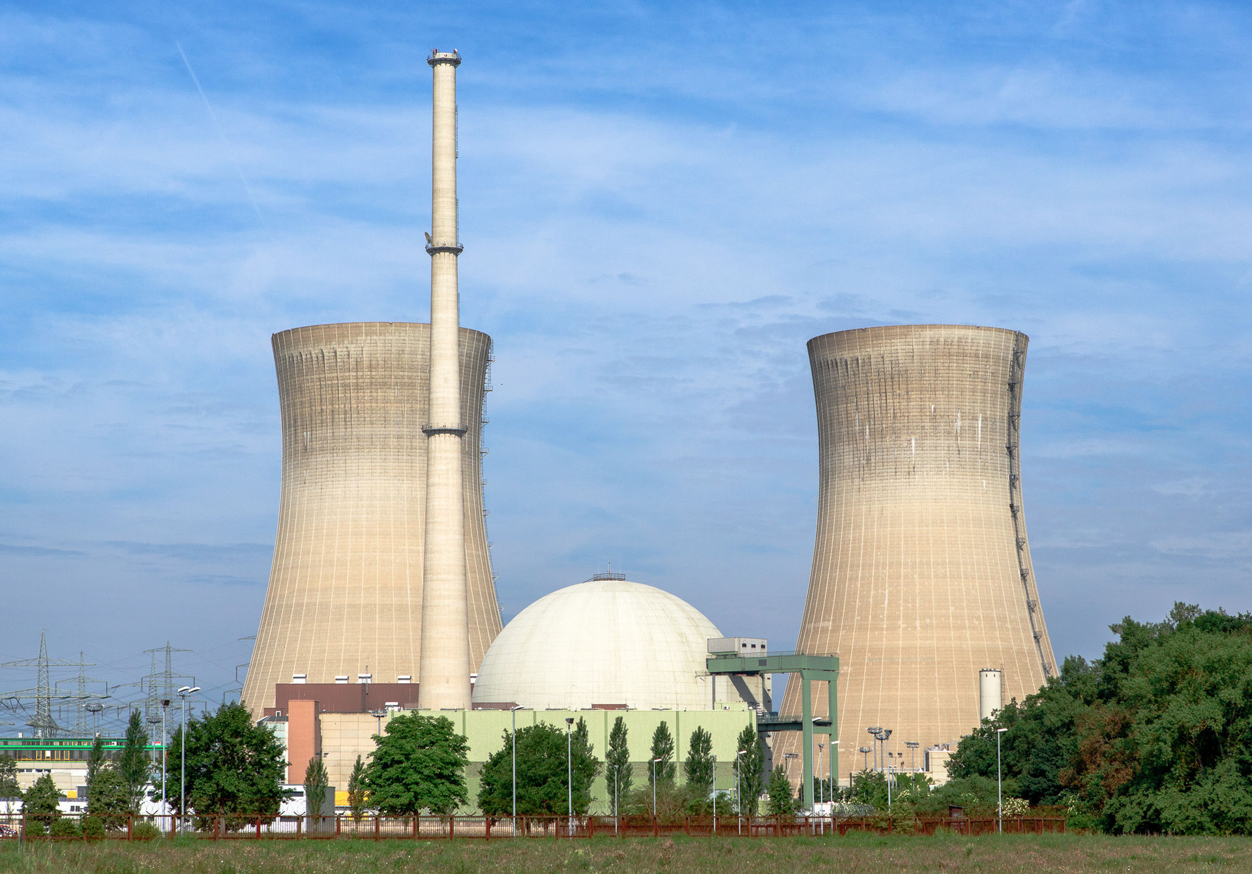
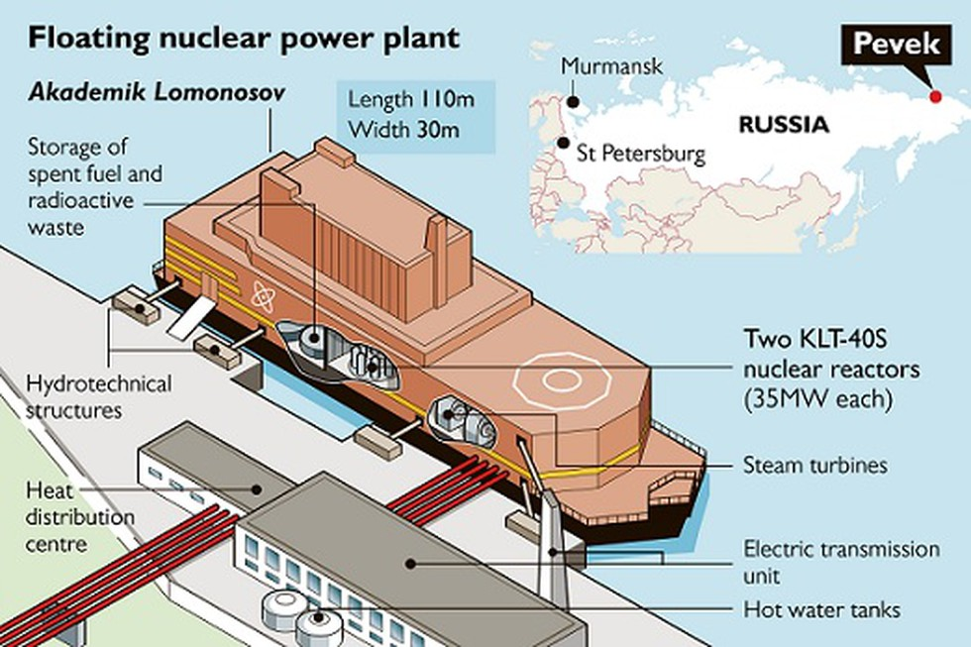
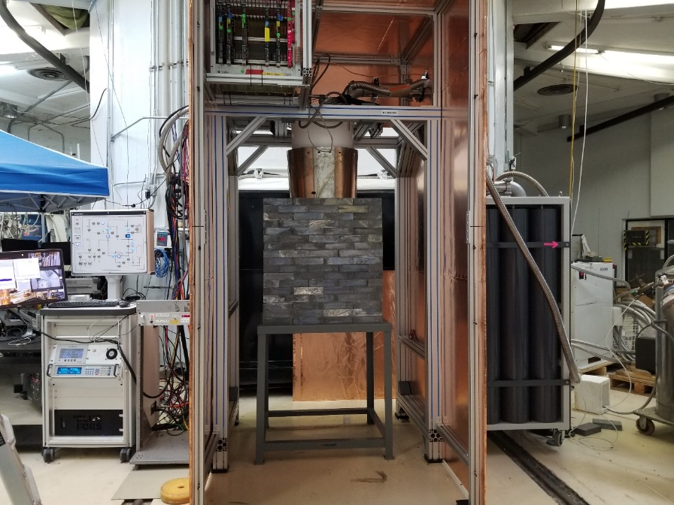
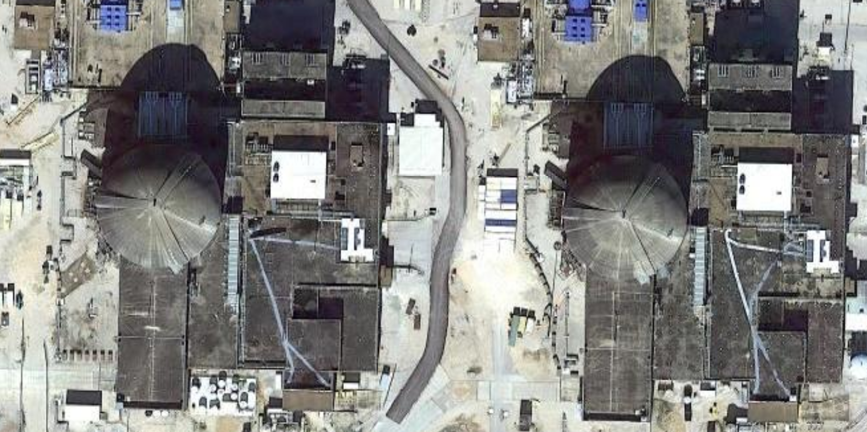
Plans for STP Power Reactor
Compact MIνER setup ideal for deployment
Excellent opportunity to take the compact MINER set up to a power reactor only 3 hours away
Expectations: provide reactor operation/history
  Reactor power and fuel cycle changes, such as fuel composition U/Pu/Th and fuel burnup
  Monitor age and cooling time at spent fuel storage
Phase-2 at South Texas Project (STP) ~3 GW next year.
MIνER Compact Installation with Bluefors closed-cycle fridge in RF cage and shielding
Proposed site 40 and 110 m

Slide 16


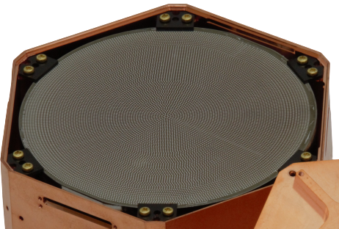

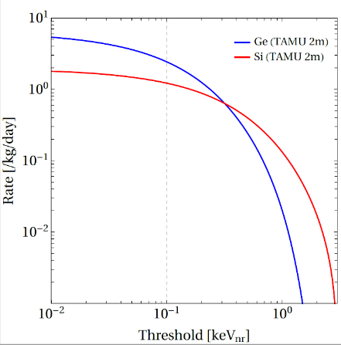
CEνNS for Monitoring – Game Changing Technologies in Hand!
Exposure in kg-days
10-kg 100-ev NR Ge Hybrid (discrimination gives 10-DRU)
1 day for 5-σ detection
10-kg 100-ev NR Si Hybrid (discrimination gives 10-DRU
10 days for 5-σ detection
10-kg 100-ev NR Si HV (without discrim. 100-DRU)
100 days for 5-σ detection
MW Reactor
Scale for Power and 1/r²
10-kg Non-Phonon (Lindhard) detector (1000-DRU without discrimination
1000-10000 days for 5-σ detection
Reactor CEνNS experiments will not only help us understand fundamental new physics, but also fundamentally change how we use the unstoppable neutrinos to detect threat! Detector technologies that push threshold and ER/NR discrimination are critically important!
Integrate on tails with background?

Slide 17
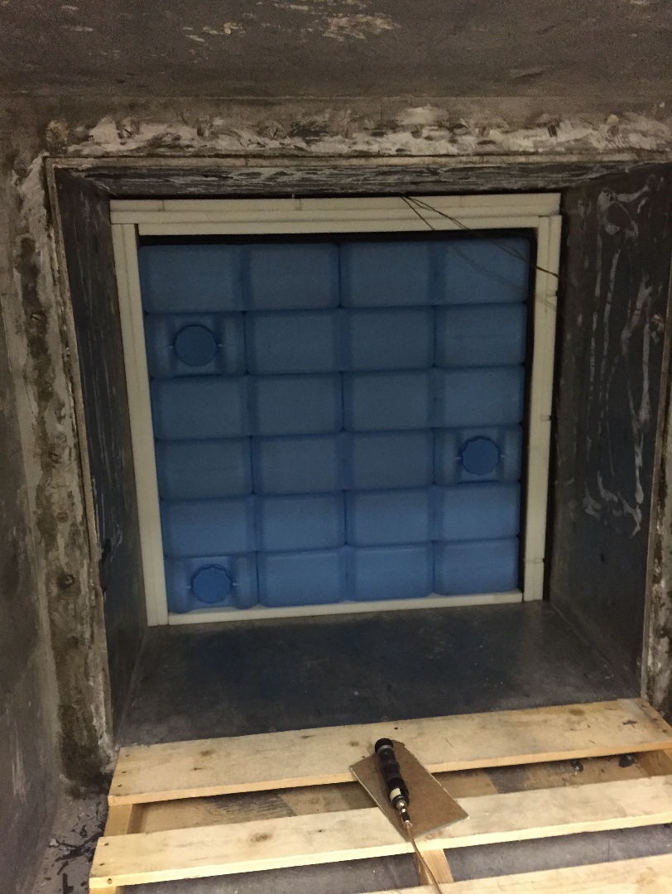
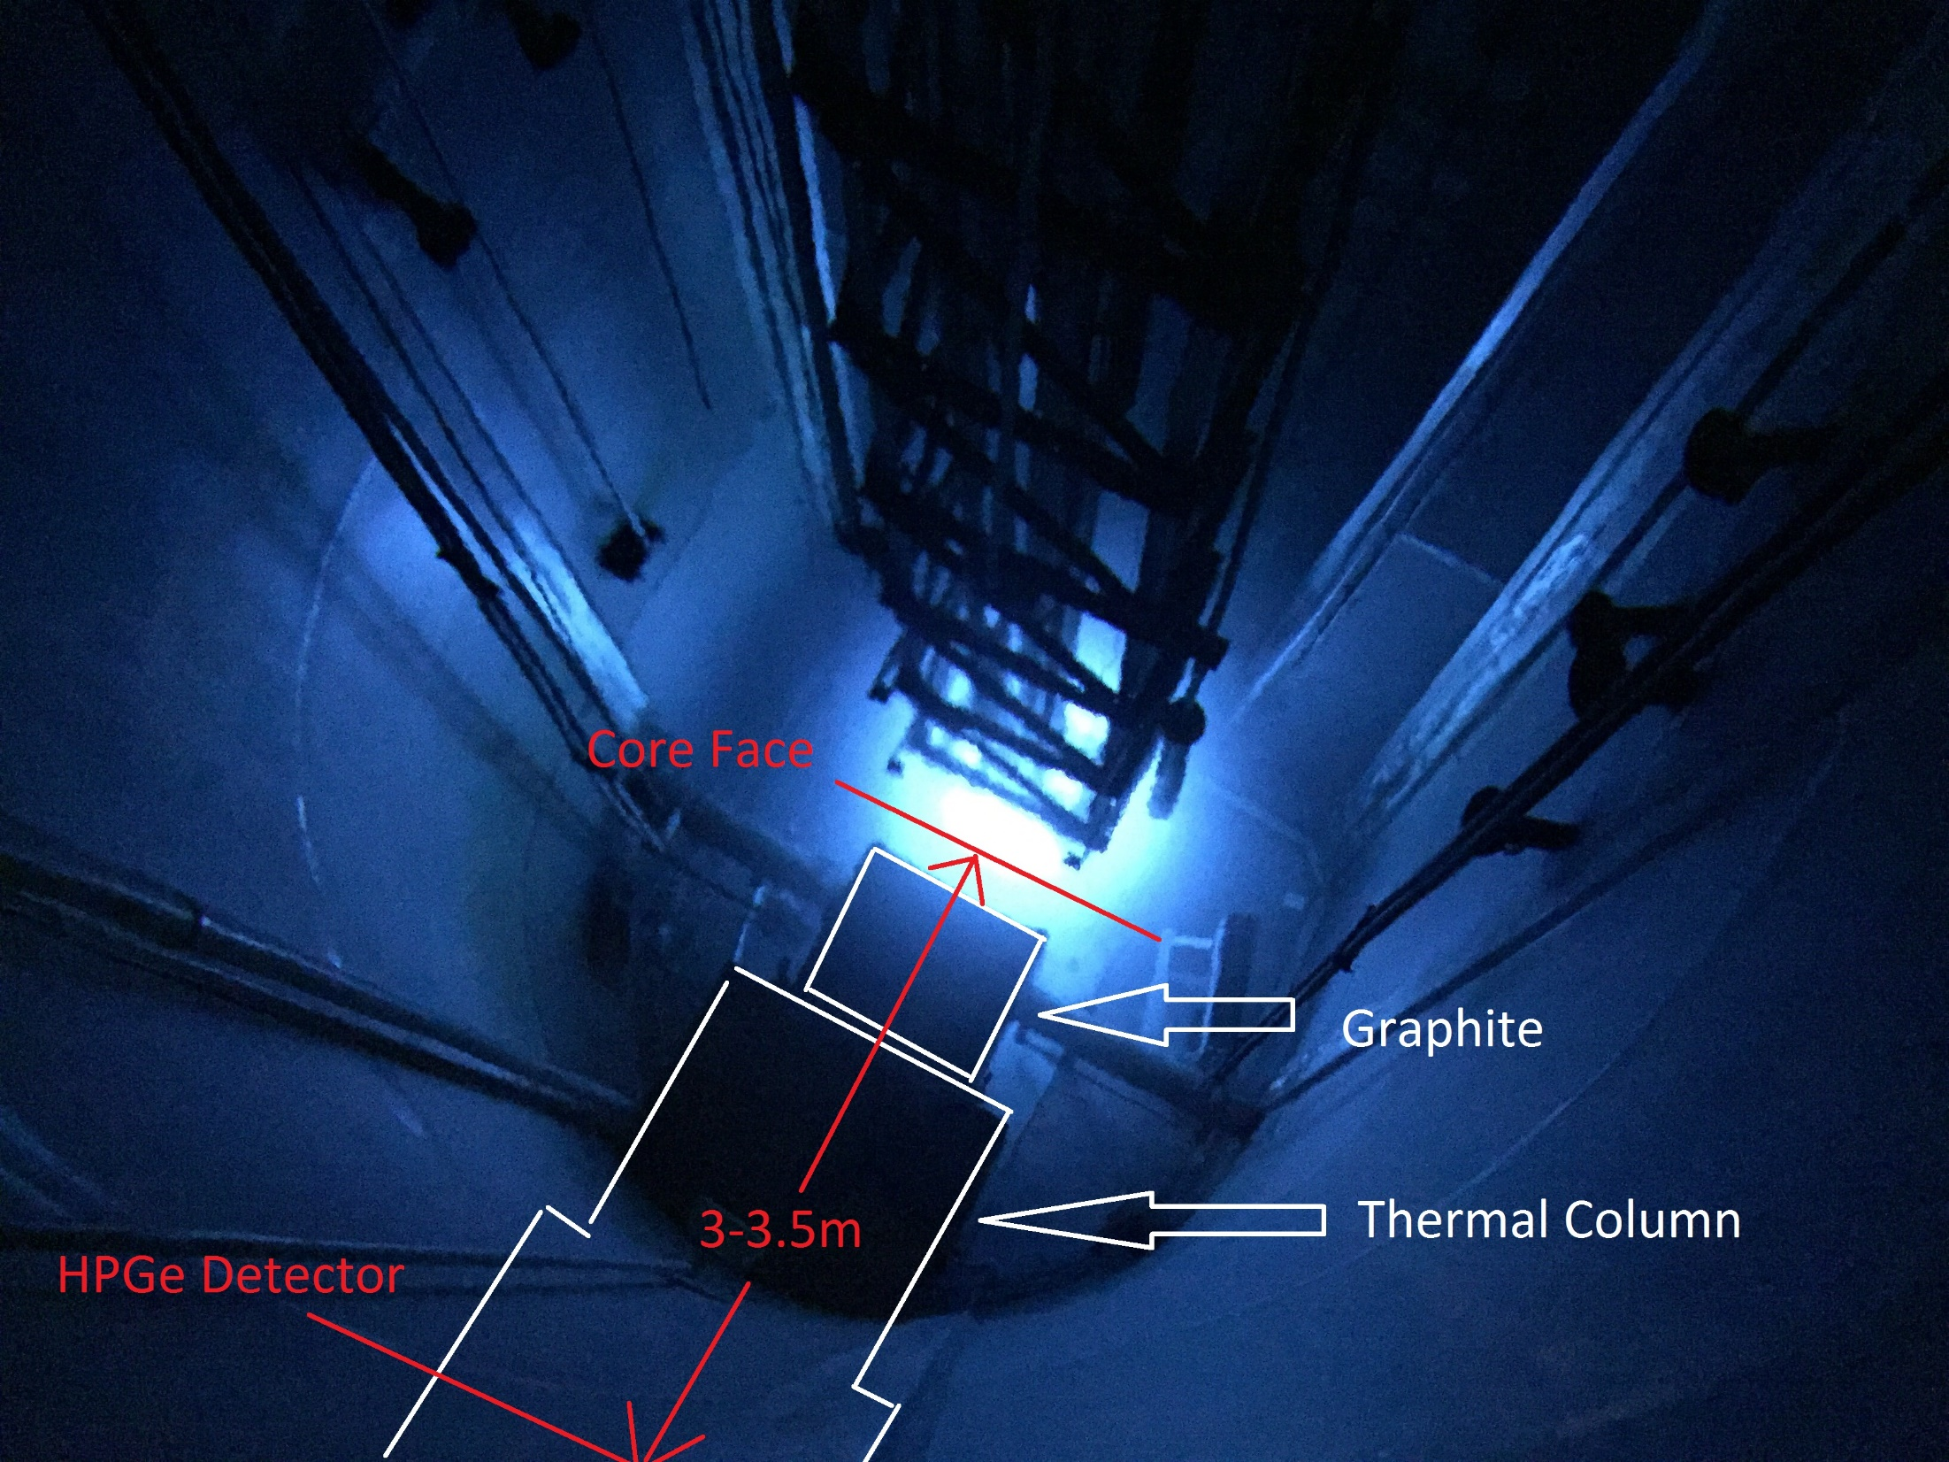
Now removed

Slide 18

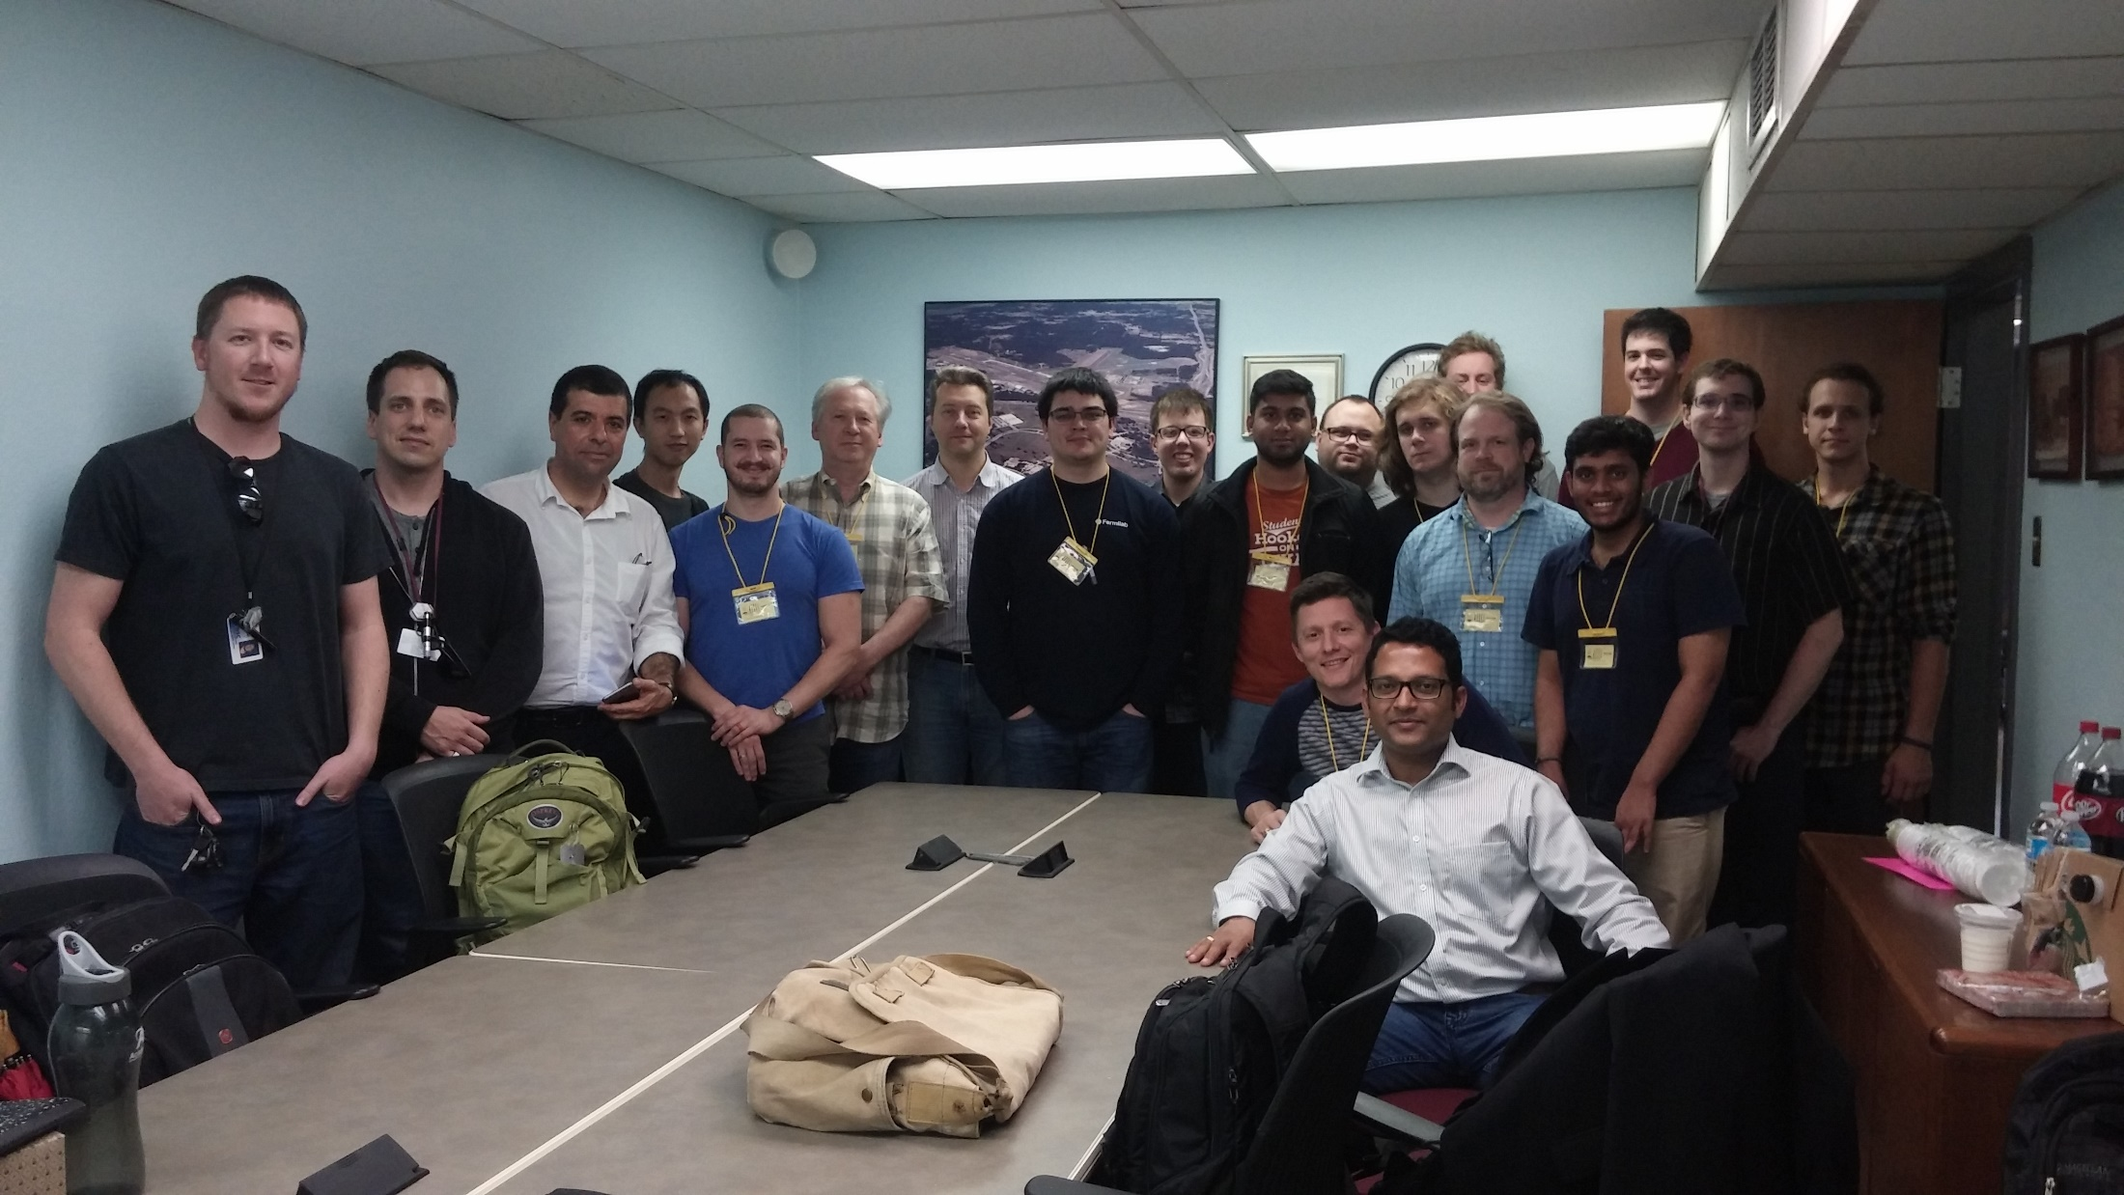










MIνER Collaboration
Texas A&M University, Physics & Astronomy
R. Mahapatra, G. Agnolet, B. Dutta, R. Harris, N. Mirabolfathi , L. Strigari, W. Teizer, B. Webb, Y. Gao, C. Hays, A. Jastram, A. Kubik, W. Baker, R. Beck, Z. Wetzel, F. Kadribasic
University Texas Austin
Karol Lang, Will Flanagan, Marek Proga, John Cesar, Dung Phan, Tom Carroll, Simon De Rijick, Ramon Salazar, Shiv Yadavalli, Kayla Leonard, Adam Rouhiainen
Cyclotron Institute - G. Rogchev, J. Hooker
Nuclear Engineering – C. Marianno, Daniel
National Institute of Science Education and Research (NISER), India
B. Mohanty, K. Senapati, V. Iyer
TEES Nuclear Science Center (NSC)
S. McDeavitt, J. Newhouse, J. Vermaak
University of Minnesota
V. Mandic, P. Cushman, M. Fritts, A. Kennedy, N. Mast, A. Villano, D. Barker
Queen’s University, Canada
R. Martin
Fukui University, Japan
Y. Tamagawa, I. Ogawa, K. Nakajima, M. Shimada
University of South Dakota
J. Sander, J. Liu, J. Mammo, T. Oli, A. Khan, B. Li
Sam Houston State Univ
J. Walker, J. Dent, J. Navarrete, C. Lanham, J. Manning, B. Sands, R. Ramos
Arizona State Univ
J. Newstead
University of Colorado at Denver
A. Vilano
University of Dallas
W. Flanagan

Slide 19
Status and Outlook: 2-Tower run Started
Phase-1 in operation has moved from wet fridge to Bluefors dry fridge with 7 mK base
  2-tower run started with 4 detectors. Detectors build on SuperCDMS detector development and fabrication efforts at Texas A&M for the SNOLAB project. Actually detector designs slightly different
  1 Si Hybrid (110 gm) to measure in-situ ER/NR background in ROI
  3 Si HV detectors (single-e/h sensitive) for CNS signal measurement
  Strong synergy in detector development and calibration efforts with SuperCDMS SNOLAB
Few months-1 year required for CNS 5-σ measurement
After CNS measurement, focus on sterile oscillation scan 4-10 meter, with optimized exposure-distance combination. Search continues during Phase-2 commissioning
Phase-2 will use an Icebox that allows the detectors to be inside a hermetic shielding, like SuperCDMS. Phase-2 operational in a year from now and run for a few years.
Unique Sterile ν sensitivity due to movable core and very short baseline (~m scale)
NSI searches will require very low background level and ~year of running
Neutrino magnetic moment sensitivity competitive with GEMMA in a year of running

