Slide 1
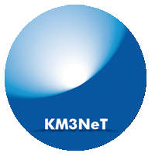
KM3NeT: studying atmospheric and astrophysical neutrinos in the Mediterranean
Clancy W. James
clancy.james@curtin.edu.au
Thanks to KM3NeT Collaboration

Slide 2
Neutrino physics

Slide 3
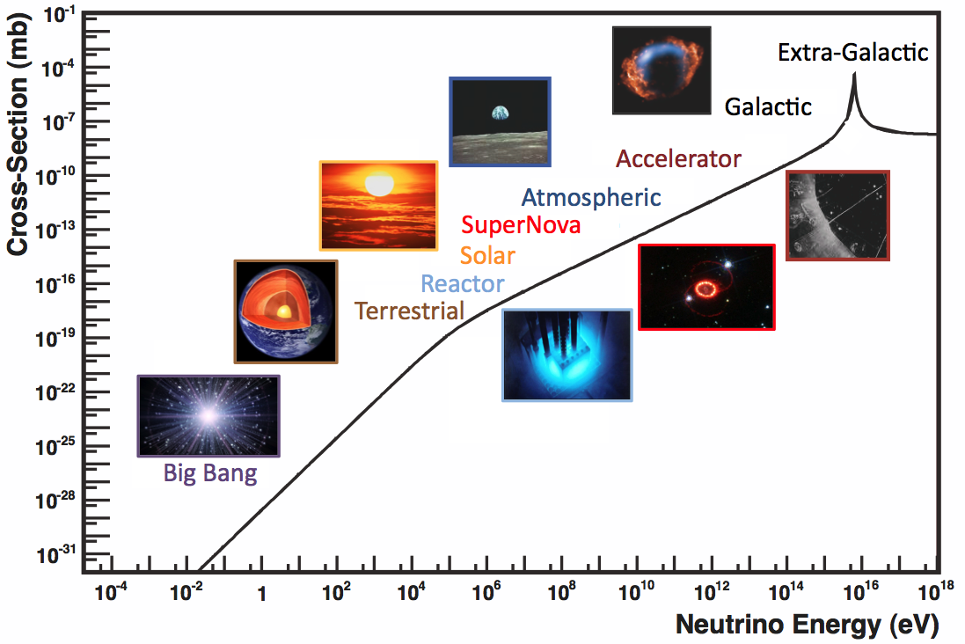
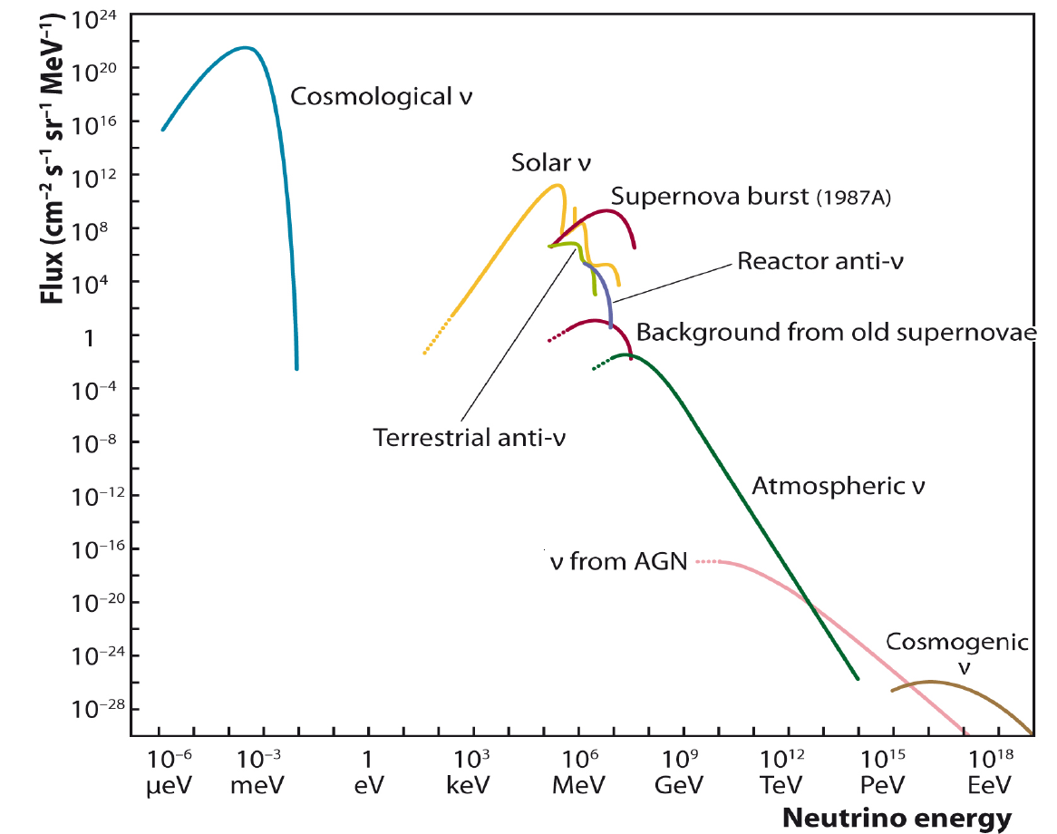
Neutrino science
1 – 100 GeV: neutrino mass hierarchy w. atmospheric flux
100 GeV - 100 TeV: various galactic (TeV gamma) sources
100 TeV – 10 PeV: extragalactic sources
Formaggio & Zeller, RevModPhys 84 (2012) 1307

Slide 4
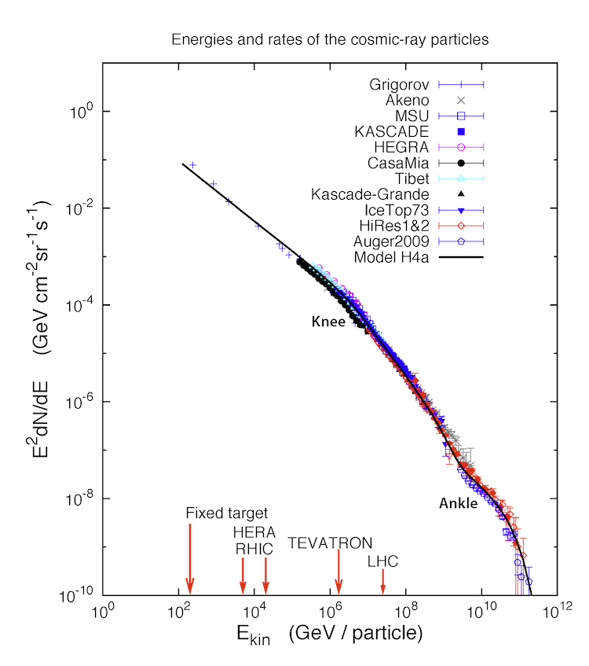

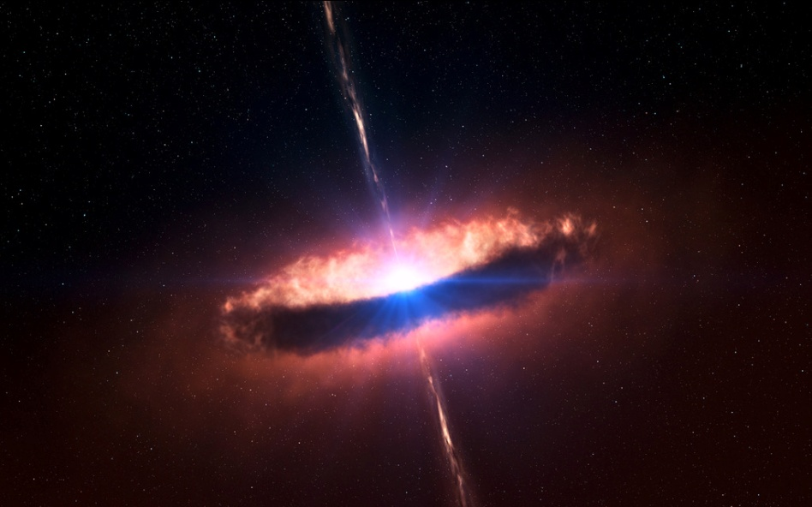
Multimessenger paradigm
Cosmic ray interactions:
Secondaries: only neutrinos provide unambiguous signal
IceCube Collaboration,
icecube.wisc.edu
cr(p, He, ..)
ν
γ

Slide 5
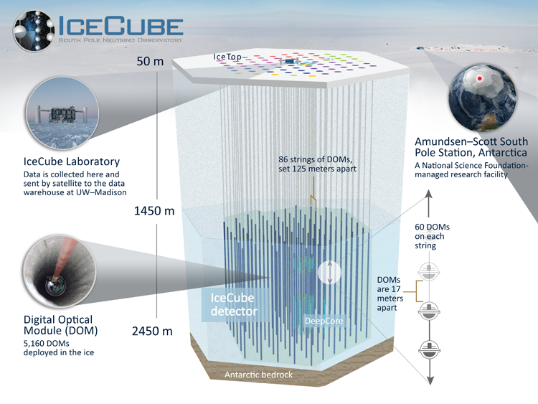
IceCube neutrino observatory
IceCube: Physical Review Letters, vol. 111, Issue 2, id. 021103
Courtesy: IceCube Collaboration

Slide 6
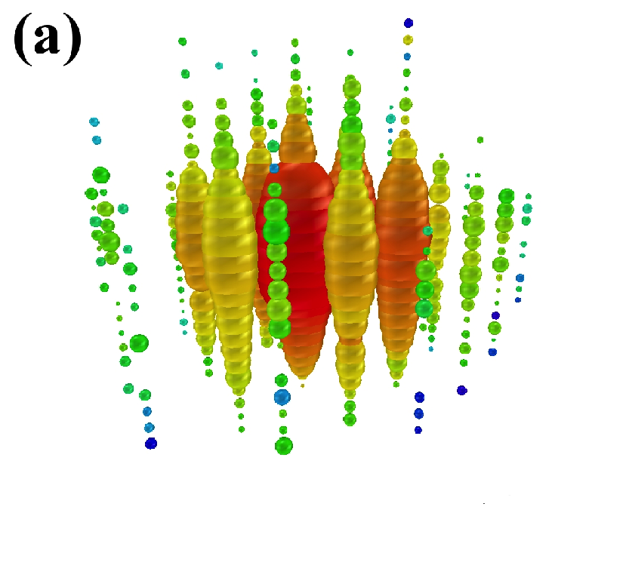
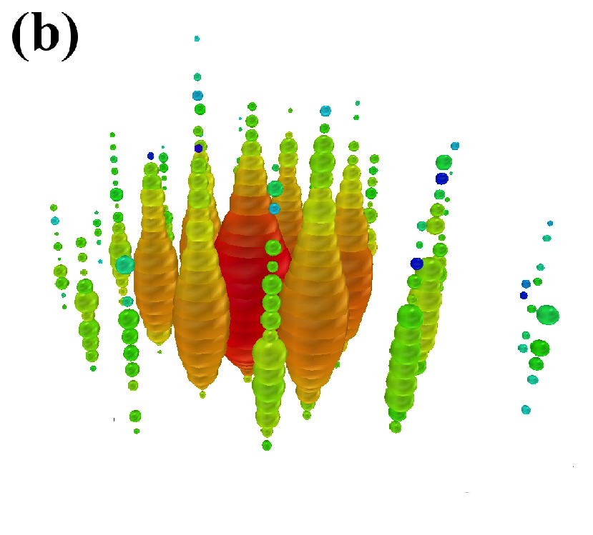
Astrophysical neutrino flux
IceCube: Physical Review Letters, vol. 111, Issue 2, id. 021103 (2013)
IceCube
  Bert (a) & Ernie (b) (2011, 2012). E~1 PeV
  Astrophysical flux: PRL 113, 101101 (2014)
  Many updates since
Current knowledge
  Inconsistent with single power-law, flavour-uniform, isotropic flux
  Source unknown

Slide 7
Sources? Time-integrated search
IceCube
  Assume constant point-like source with power-law index
  Search for excess of events in data
  None found!
  (stacked searches
  also fail)
IceCube: Physical Review Letters, vol. 124, Issue 5, id. 051103 (2020)

Slide 8
TXS 0506+056
IceCube
  IC170922A: high-energy track event
  Points back to blazar TXS 0506+056
  O~3.5 sigma significance
  BUT: at most one other HE event can be associated with a blazar…
IceCube et al: Science, Volume 361, Issue 6398, id. eaat1378 (2018).

Slide 9
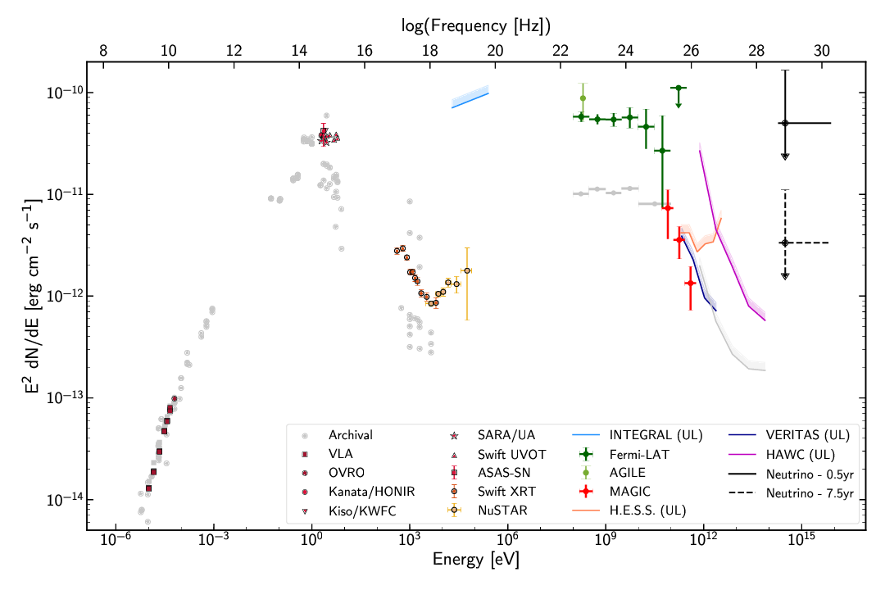
TXS 0506+056
Fermi: this blazar is flaring!
  Multiwavelength campaign
IceCube et al: Science, Volume 361, Issue 6398, id. eaat1378 (2018).

Slide 10
TXS 0506+056
Further evidence: lookback analysis
  Neutrino flare: ~6 months in 2014-2015
  Another 3.5 sigma
  Combined: strong evidence that TXS 0506+056 is first astrophysical source of high-energy neutrinos (second overall after SN 1987a)
IceCube, Science, Volume 361, Issue 6398, pp. 147-151 (2018).

Slide 11
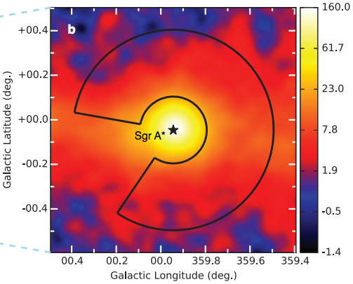
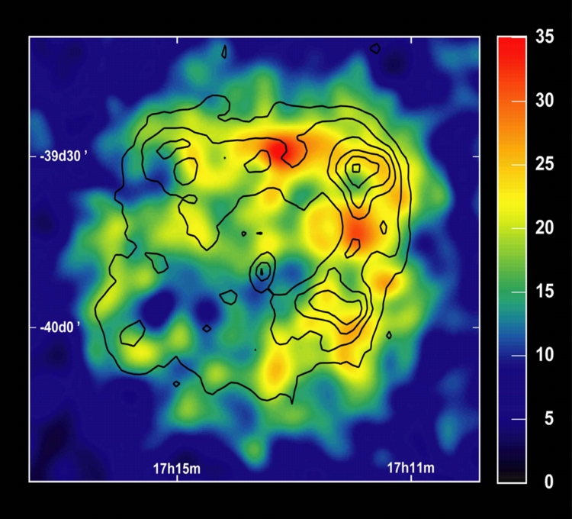
Remaining questions: 1 TeV-10 PeV
Where do IceCube’s high-energy neutrinos come from?
  One blazar source – but how did it produce its neutrinos?
  Why not other blazars?
  What other sources are there (blazar stacking: ~ <20% contribution)?
What about our Galaxy?
  Galactic cosmic rays exist to at least PeV –Pevatrons!
  HESS, Fermi, HAWK, etc: evidence for Galactic sources
  Photon signals always ambiguous (can be produced leptonically)
GC Pevatron: H.E.S.S., Abramowski et al. Nature 531, 476-479 (2016)
RX J1713: Credit: H.E.S.S. Collaboration

Slide 12
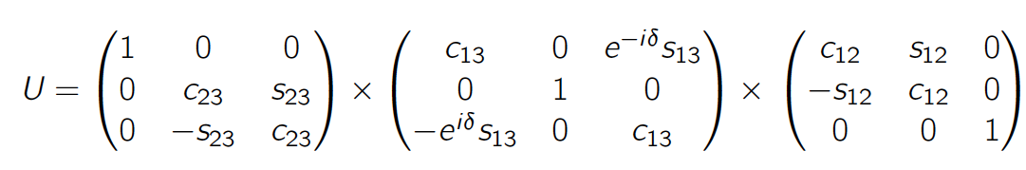
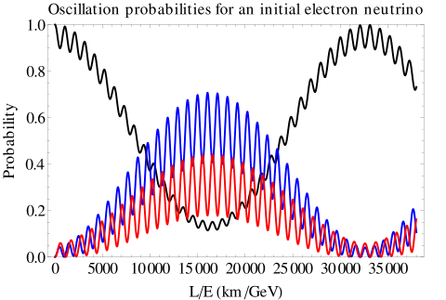


Neutrino mixing
Neutrino mixing
  Flavour states mix into mass states
  PMNS matrix U describes mixing (4 parameters)
Neutrino oscillations
  Propagator of mass eigenstate:
  Ultra-relativistic limit (low m_{i}):
  Phase difference: different ratio of mass states => changed flavour state!
From Wikipedia Commons

Slide 13
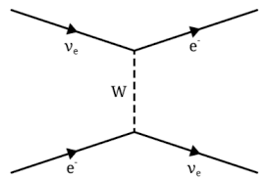
Mass hierarchy problem
Neutrino oscillations
  Vaccuum oscillations: depends on squared mass differences only
  No way to tell absolute values!
Matter effects
  In a medium…
  Effective mass changes
  Hierarchy dependent effects!
  Solar neutrino oscillations: ν₂>ν₁
  What about ν₃?
KM3NeT LoI, J.Phys G, 43, 084001, 2016

Slide 14
Solution!
KM3NeT LoI, J.Phys G, 43, 084001, 2016
Earth oscillations
  Cosmic rays: muon neutrino flux
  Daya Bay et al:
  Oscillations on Earth baselines: hierarchy-dependent effects!
  Energy
Oscillograms
  Direction (baseline) – energy rate distributions
  Measure this, compare to predictions
  Required detector size: ~megatons!
NH
IH

Slide 15

Signature
Akhmedov et al., JHEP 02 (2013) 082
A(ν_{μ})
Perfect resolution
Experimental signature
  Relative surplus/deficit of electron and muon neutrinos
  Need O~1 MT detector and good resolution at 1-20 GeV
A’(ν_{e})
A’(ν_{μ})
25% energy resolution
σ_{θ}~(E/1 GeV)^{-0.5}
KM3NeT LoI, J.Phys G, 43, 084001, 2016

Slide 16
Remaining questions: 1 GeV-100 GeV
What is the neutrino mass hierarchy?
  Normal or inverted?
  What is the CP-violating phase?
  Can we further pin down the mixing angles
Beyond the standard model physics
  Neutrino masses unexplained in SM – good place to look for new physics!
  E.g. a 4th neutrino flavour?
  Sterile neutrinos?
+???

Slide 17
KM3NeT

Slide 18
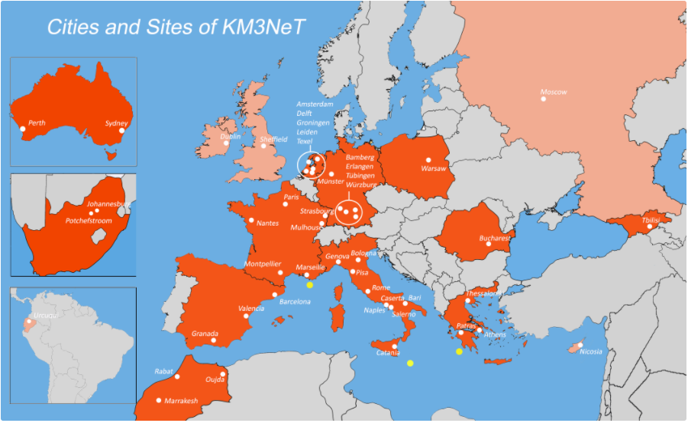
Solve these problems! KM3NeT
  Curtin University
  Western Sydney University

Slide 19
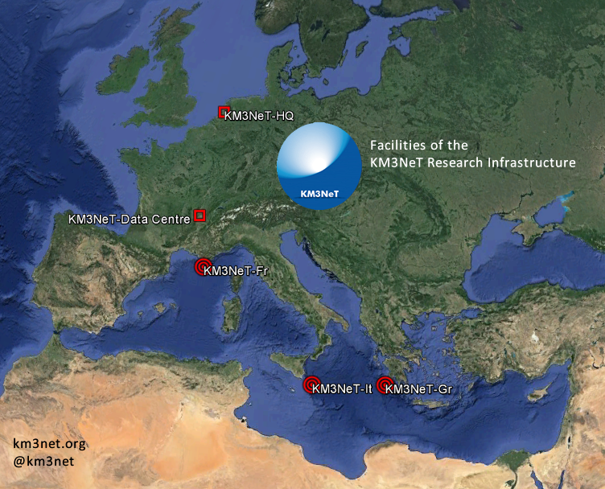
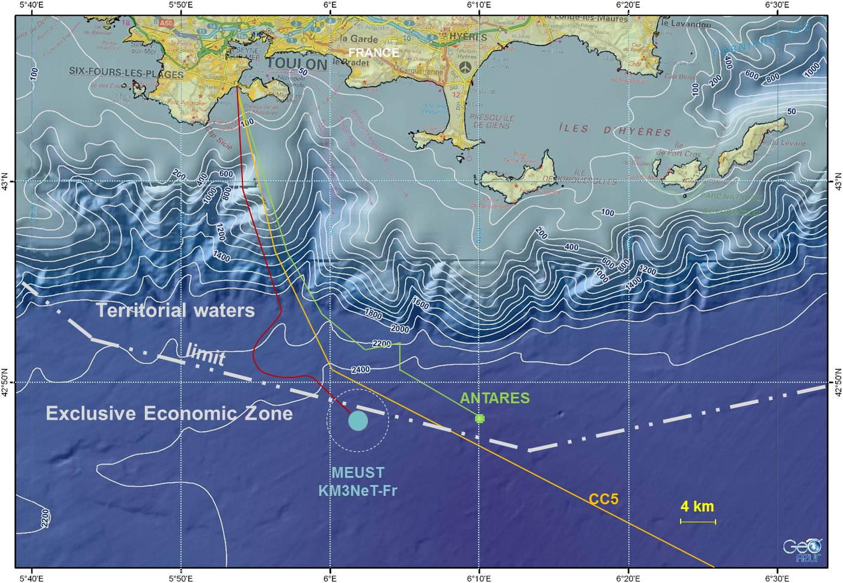
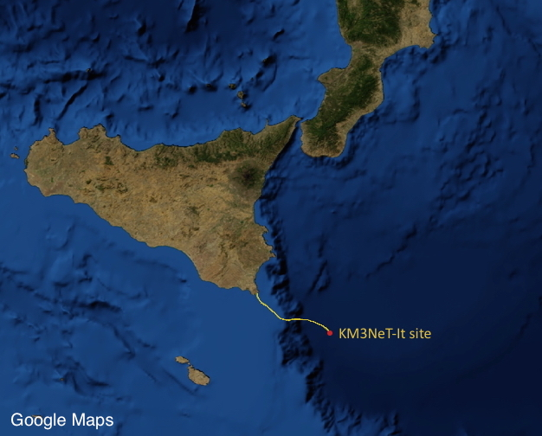
KM3NeT: ARCA + ORCA
ARCA
  Astrophysical Research with Cosmics in the Abyss
    E_{ν} 1 TeV -10 PeV
    KM3NeT-It (3.5 km depth)
    Astrophysical neutrino sources
ORCA
  Oscillation Research with Cosmics in the Abyss
    E_{ν} 1 GeV - 100 GeV
    KM3NeT-Fr (2.5 km)
    Neutrino mass hierarchy
KM3NeT Letter of Intent
    J. Phys. G, 43 (2016) 084001
    https://arxiv.org/abs/1601.07459
ORCA
ANTARES
ARCA

Slide 20
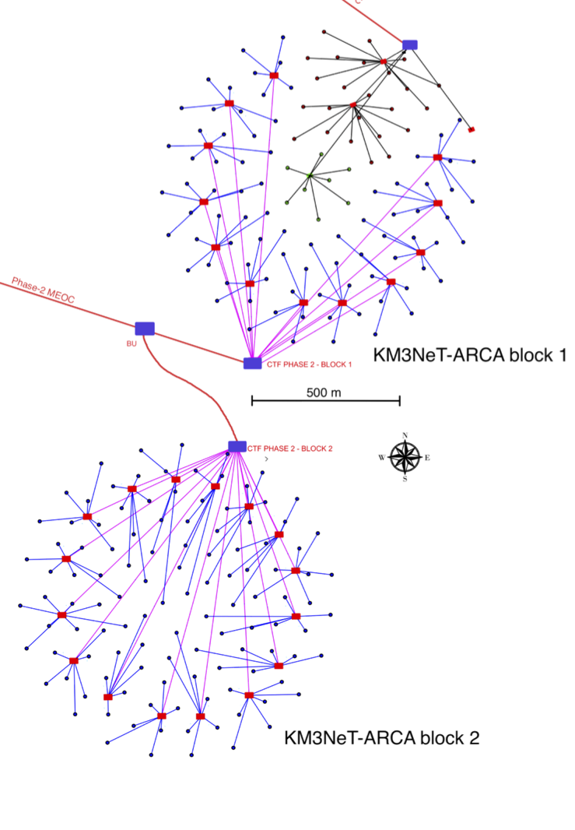
ARCA: TeV-PeV
ARCA: Astroparticle Research with Cosmics in the Abyss
ARCA: 2 blocks:
  115 ‘detection units’ per block
  90m horizontal spacing
Detection unit:
  Line anchored to the sea floor
  18 optical modules
  36m spacing
Total volume: 1.2 km³
  Site: 3.5 km depth
  Shore station:
  Capo Passero
  (Sicily)
~1 km
612 m

Slide 21
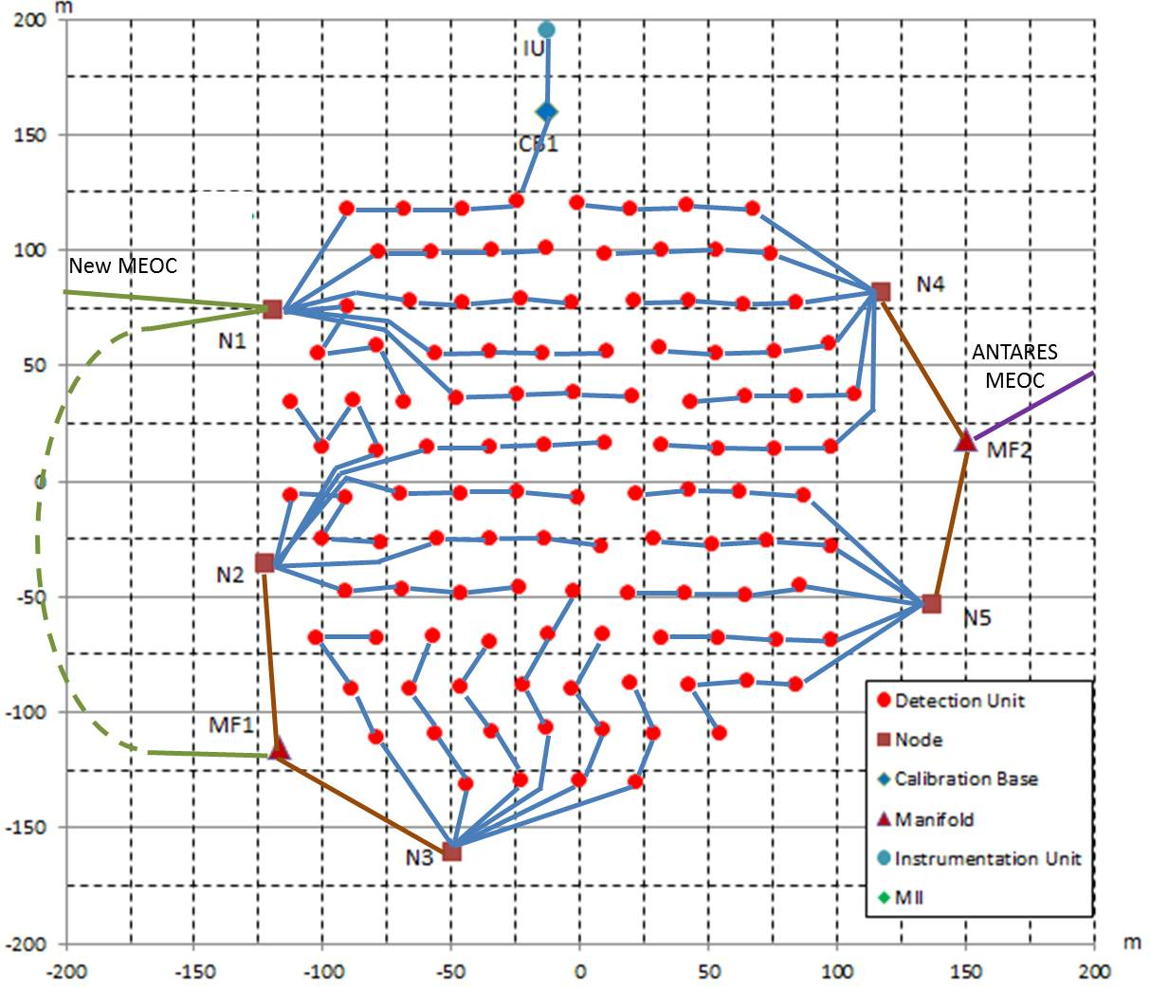
ORCA: 3-100 GeV
ORCA: Oscillation Research with Cosmics in the Abyss
1 ORCA block:
  115 lines
  20 m horizontal spacing
  9 m vertical DOM spacing
100 m
150 m

Slide 22
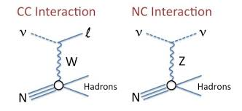
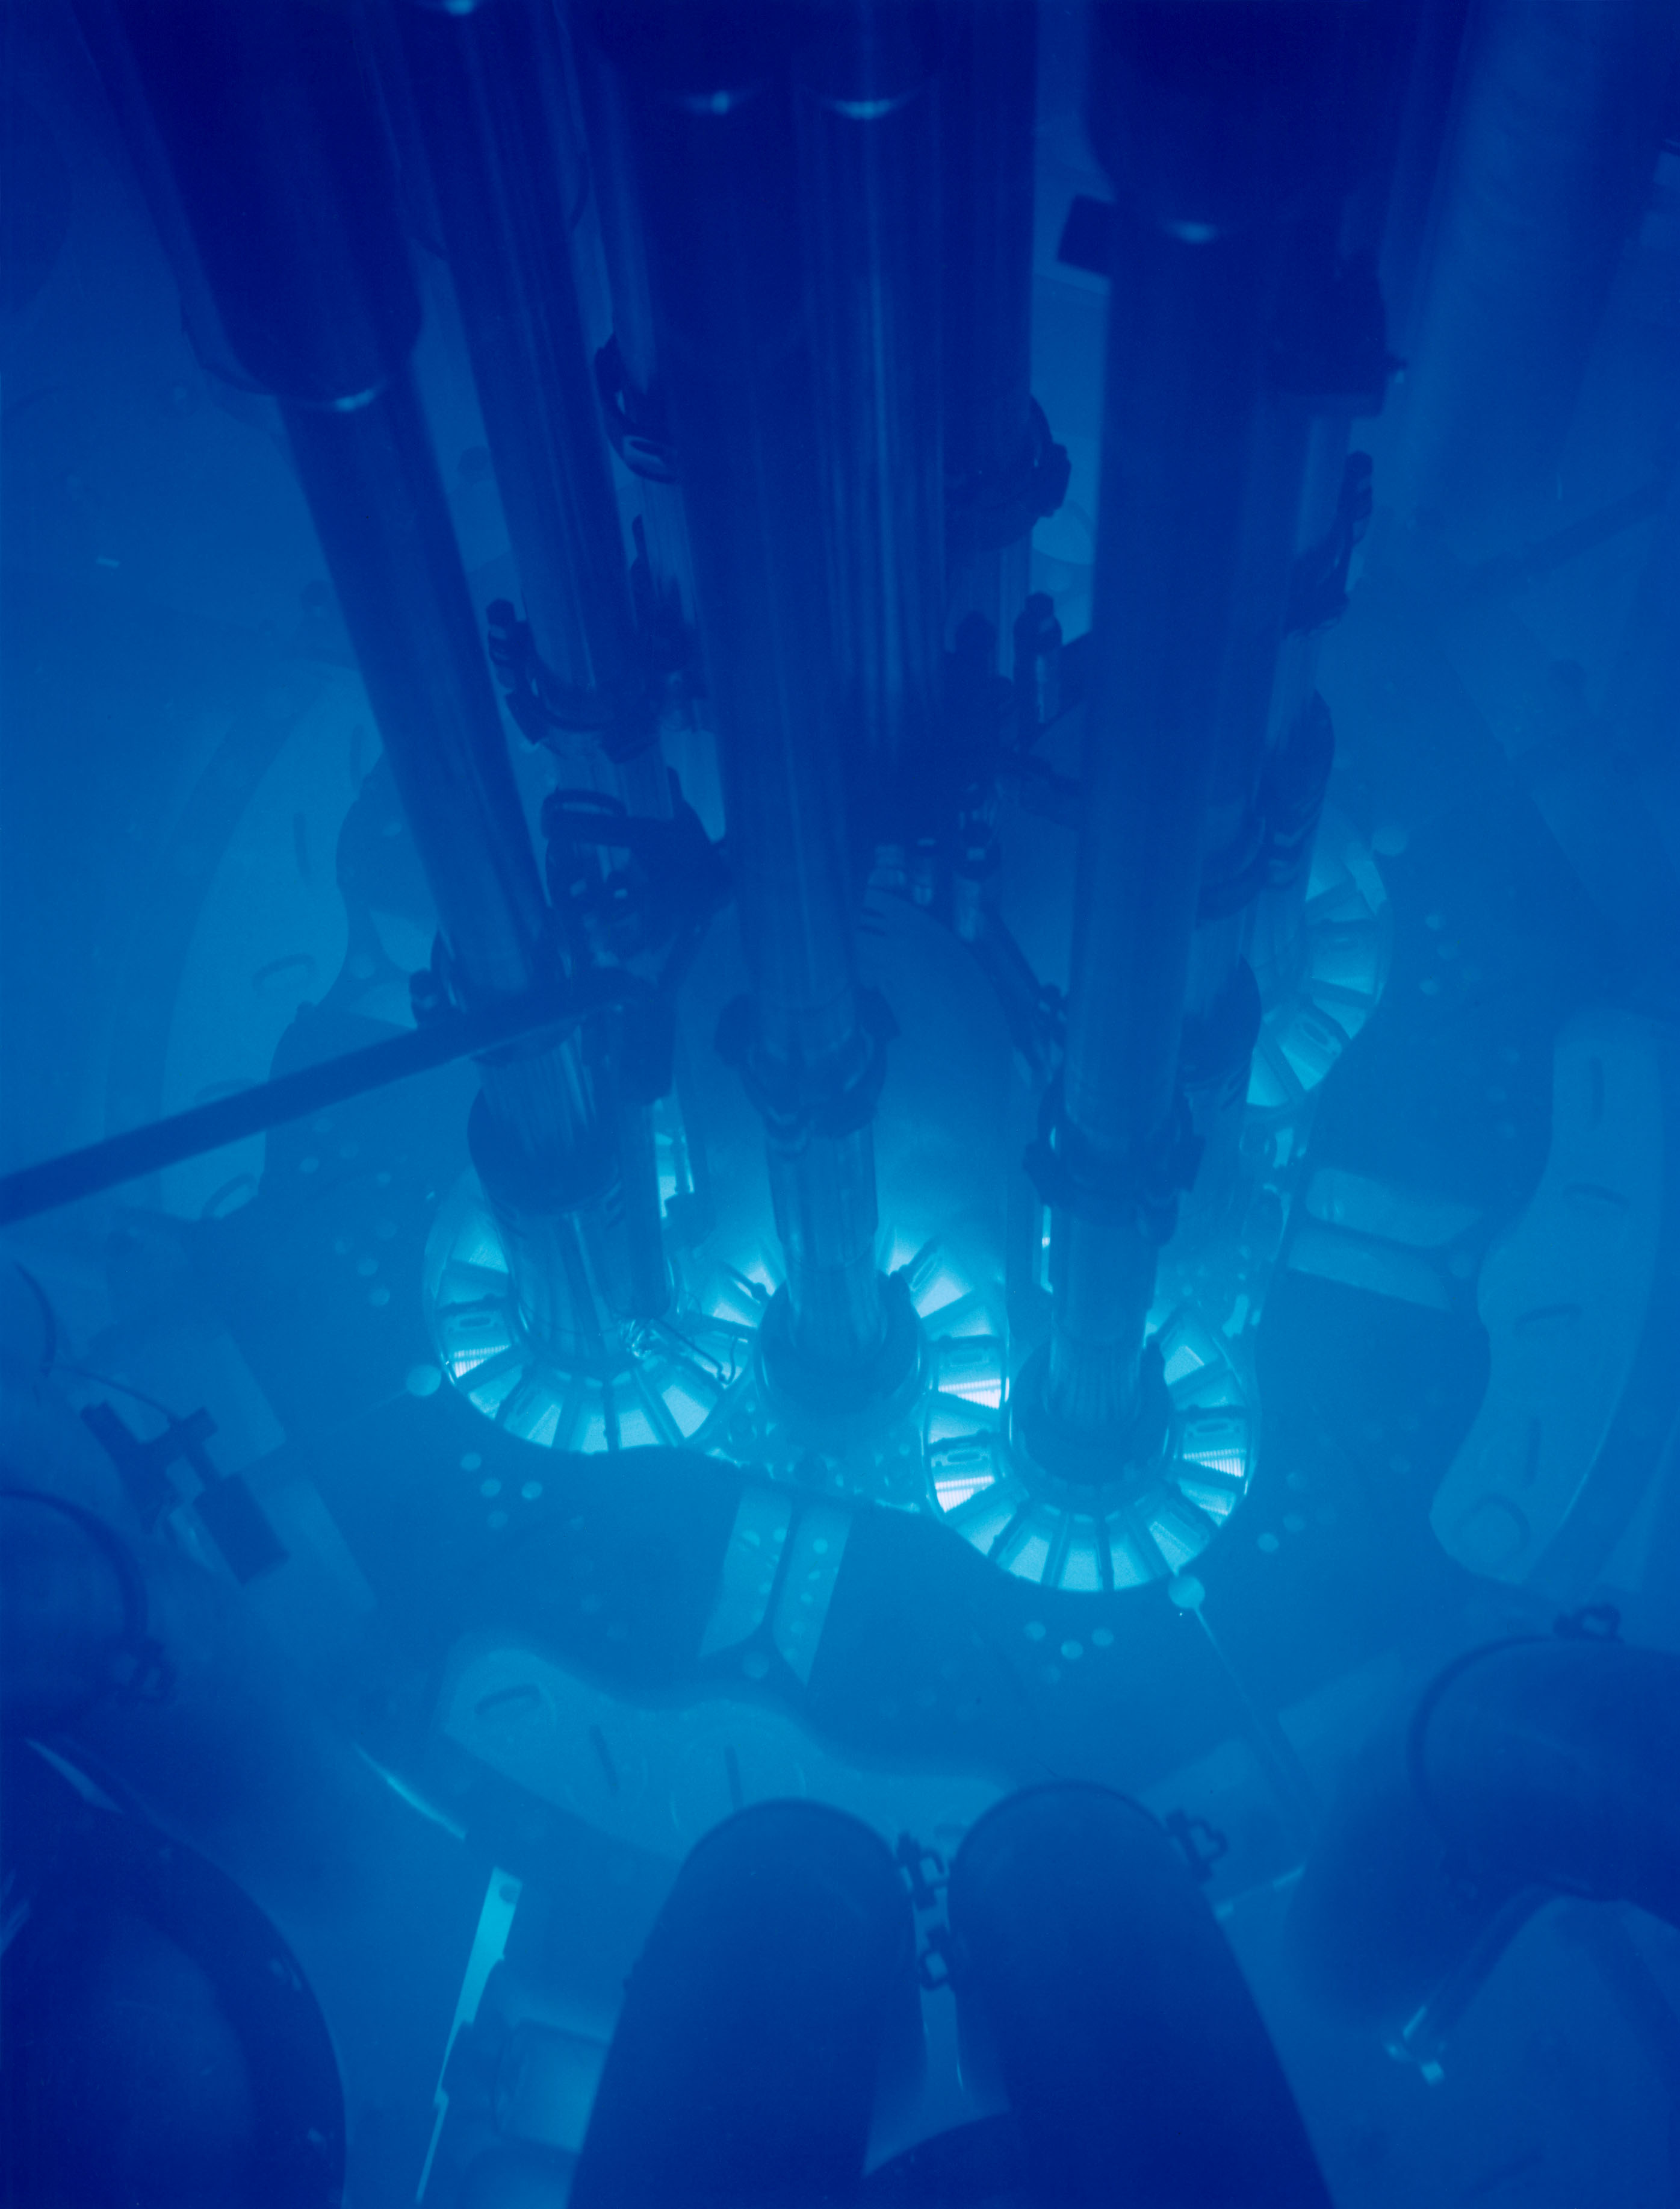
Basic detection method
Neutrino interactions
  Deep inelastic scattering
  Charged current (CC)
  Neutral current (NC)
  Relativistic secondaries produced
  Charged particles: Cherenkov radiation (~EM sonic boom)
S. Miarecki 2016
Argonne National Labs

Slide 23
Technology

Slide 24
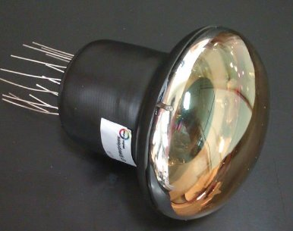
PMTs
KM3NeT Collaboration (S. Aiello et al.), JINST 13 P05035 (2018)
Optical module:
  Hammamatsu R12199-02 PMTs
  Nominal 3” diameter
  Sensitive to blue-near UV (Cherenkov) light
  KM3NeT will use nearly 200,000 of them!
Dark voltage
Single photo-electron signal
3”

Slide 25
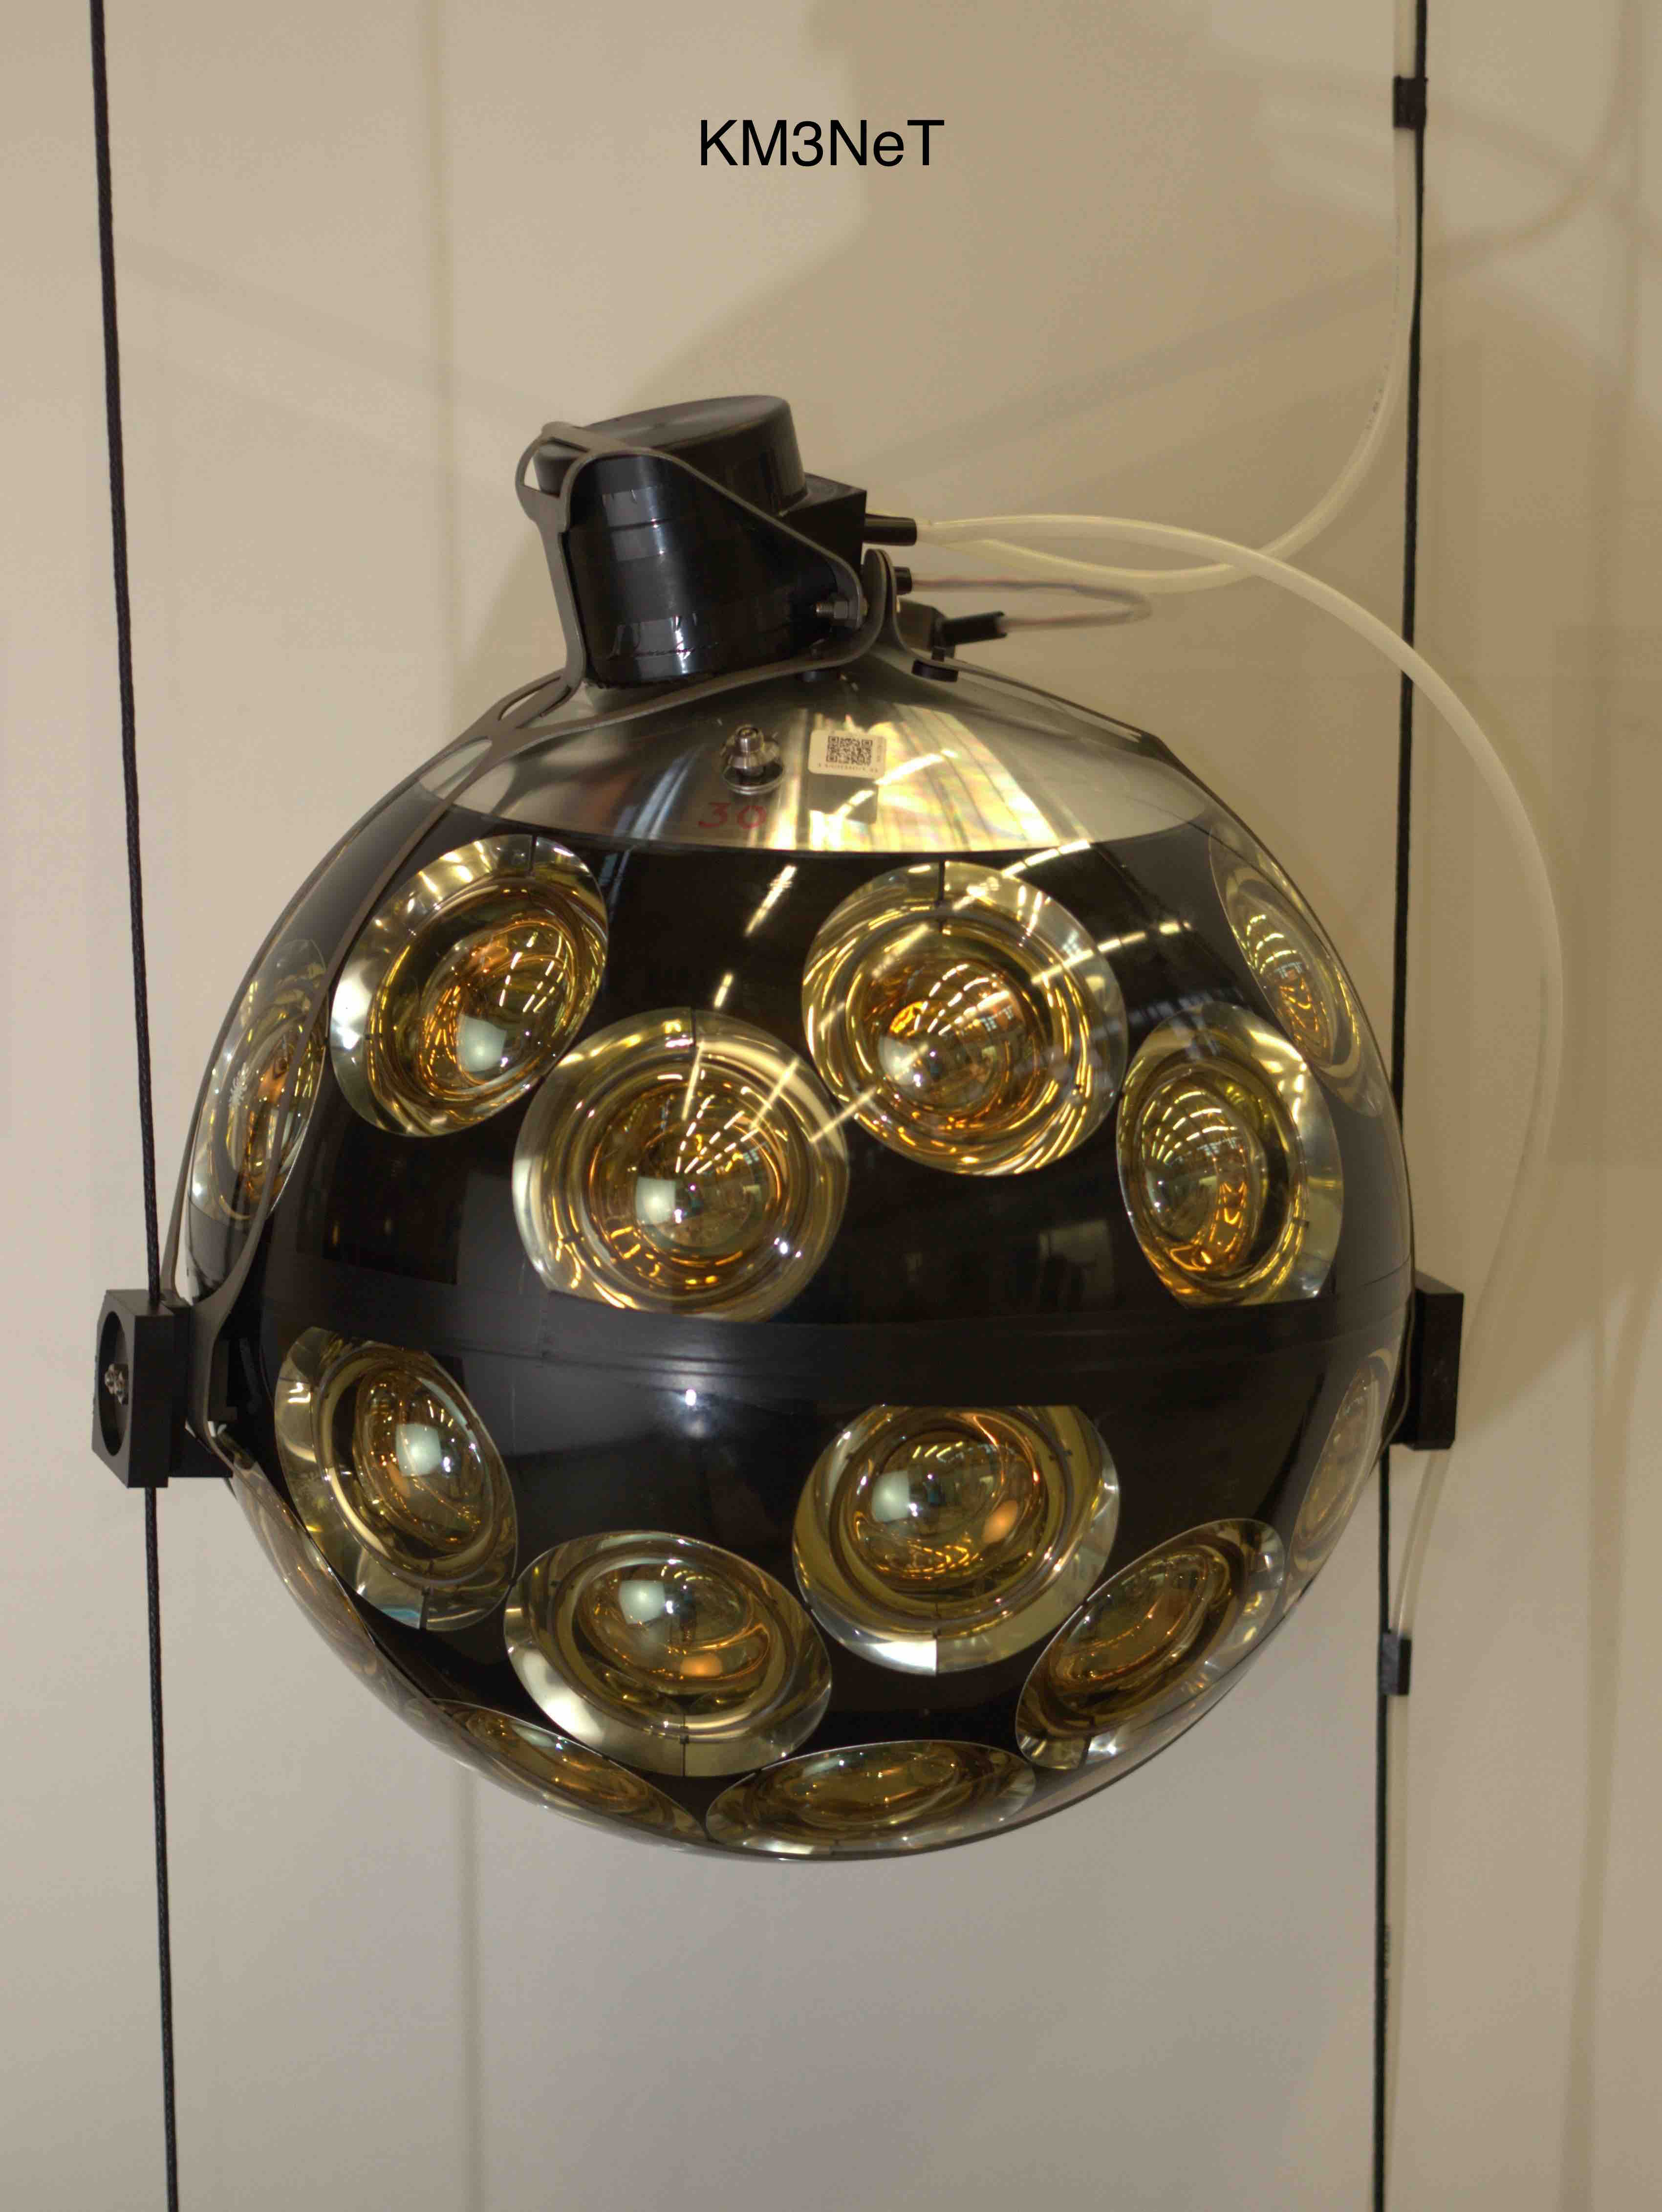
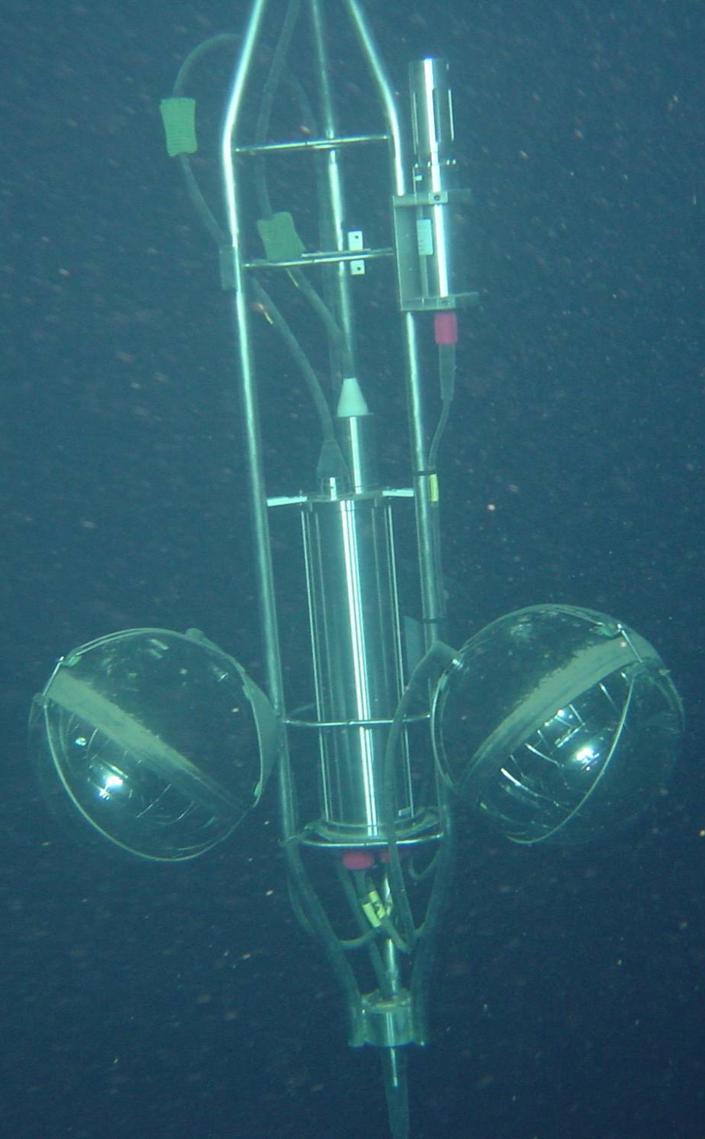
KM3NeT: digital optical module
Optical module:
  31 x 3” PMTs
  4π sr coverage
  directional resolution
  dynamic range
17”

Slide 26
Construction: pictures
DOM assembly
  Test PMTs
  Assemble in bench
  3D printed mounting
  Connect hemispheres
Current capacity
  7 sites
  3 DOMs/day
  60 DU/yr

Slide 27
DOM integration into DU
Five sites
  Initial time calibration performed
  Check all connections pre-deployment

Slide 28
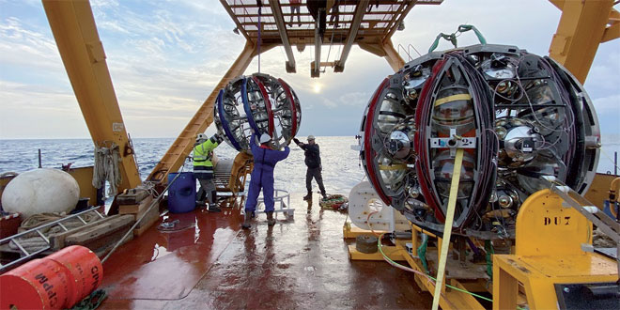
Deployment
Drop it off a ship
  Gravity-guided
  Acoustic release
  Deployment vehicle recovered
  ROV connects cables

Slide 29
Self-calibration: ⁴⁰K
⁴⁰K➔⁴⁰Ca
Natural radioactive decays from ⁴⁰K
  Cherenkov light
  ~5 kHz rate in PMTs
  Filtered by CPUs at on-shore DAQ
  Self-calibration mechanism!
Calibration tells us:
  Time offset (centre)
  Efficiency (area)
  Single-photon spread (width)
Long-term stability observed
e⁻

Slide 30
Calibration – does it work?
Compare with MC
  Good agreement!
Correct data
  Much smoother distribution!
M. Lincetto et al, for KM3NeT, Presented at Neutrino 2020

Slide 31
Long-term stability
M. Lincetto et al, for KM3NeT, Presented at Neutrino 2020
Fluctuations?
  Sediment build-up
  Washed by currents
  PMT settling in
  On/off recovery
  ~0.1%!

Slide 32
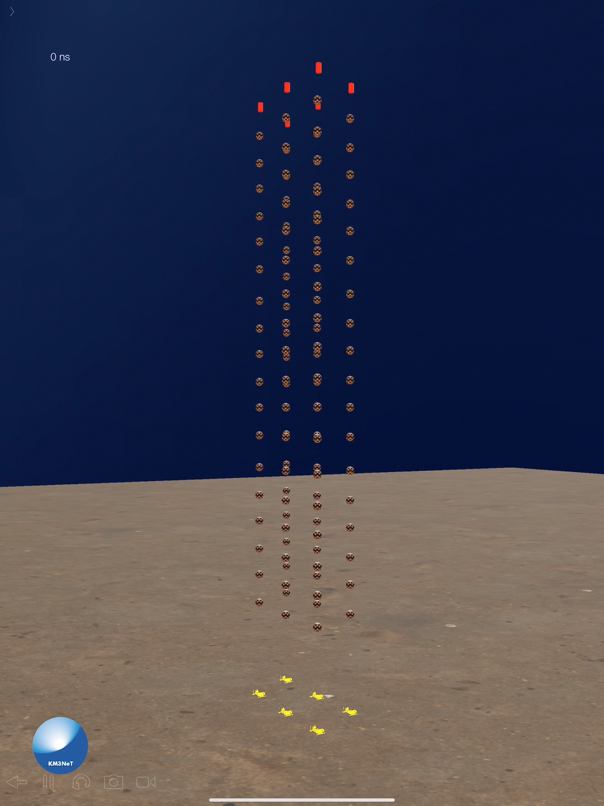
Status – operating!
ARCA
  1st string 2015
  2 strings operational to 2019
  Refurbishment of seafloor systems
  Just restarting!
  Goal: 2x115 2026
ORCA
  1st string 2017
  Now six (Jan 2020)
  Goal: 115 string 2024

Slide 33
First results
M. Lincetto et al, for KM3NeT, Presented at Neutrino 2020
Absolute muon flux measurement
  KM3NeT (systematics)
  ANTARES (systematics)
  Prediction (systematics) E. Bugaev et al., Phys. Rev. D 58 (1998), 054001)

Slide 34
ARCA: estimated performance

Slide 35
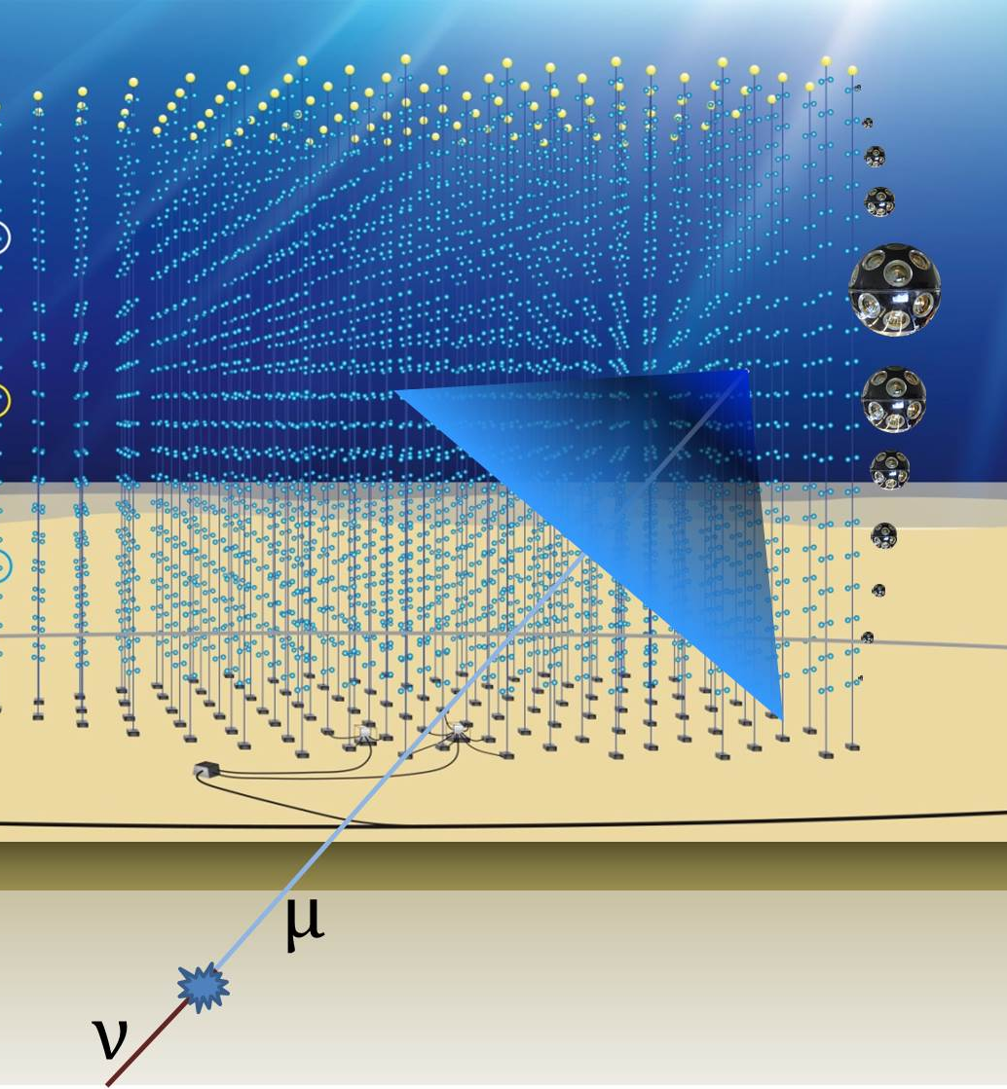
The ‘track’ channel
(from EAS)
Track channel
  Mostly sensitive to muon neutrinos
  High effective area, good angular resolution
  High atmospheric background: look at events from below only
~90%
~9%
~1%

Slide 36
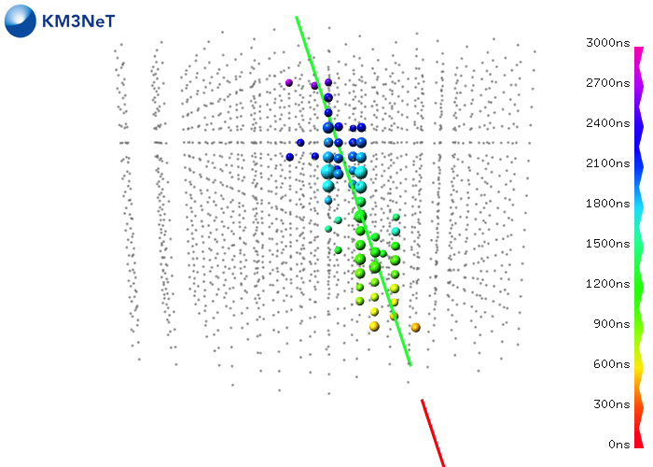
Direction resolution: tracks
Step 1: use timing for position/direction
  Limit from interaction kinematics
  Median, 68%, 90% quantiles
  < 0.1º at > 100 TeV (~astro flux)
  0.2º at 10 TeV (~Galactic)
Step 2: fit hits to determine energy
  0.27 in log₁₀ E
Simulated track event

Slide 37
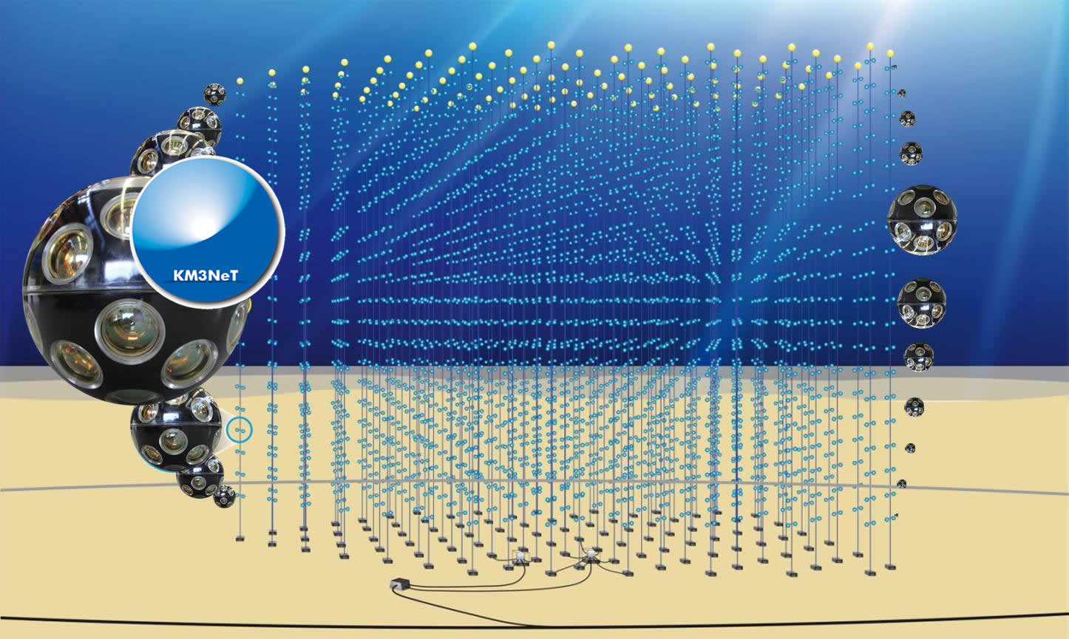
Cascade/shower events
Paths
  Mostly sensitive to electron neutrinos
  Clean neutrino signature: signals over 4 π
  ‘Good’ energy resolution, worse directional resolution: diffuse flux!

Slide 38
Resolution
P(photon)
Energy / direction
  5% energy reconstruction error (sensitive to systematics)
  1.5 degree resolution on cascade events (insensitive to systematics)
Facing towards
Backwards
Facing away
Forwards
Cherenkov cone
KM3NeT LoI, J.Phys G, 43, 084001, 2016
KM3NeT LoI, J.Phys G, 43, 084001, 2016

Slide 39
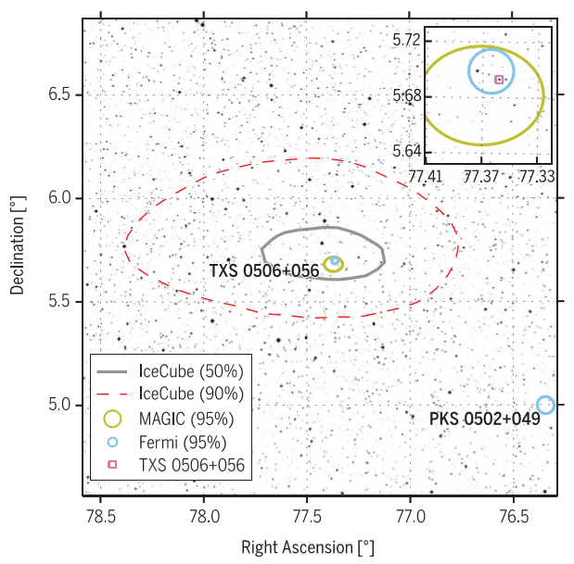
Why angular resolution?
Because there are lots of things in the sky!
e.g. TXS 0506+056
Neutrino flare:
    IceCube: 13 +- 5 events
    KM3NeT/ARCA: 13 +- 1
KM3NeT/ARCA
expected intrinsic
resolution for high
energy (>=PeV) tracks

Slide 40
Performance – generic sources
(~extragalactic)

Slide 41
Performance – Galactic sources
KM3NeT Collaboration: Astroparticle Physics 111 (2019) 100
Northern Hemisphere
  Sees Galactic sources
  Cut-offs near 10 TeV expected (Pevatrons)
Clearly model-dependent

Slide 42
Sensitivity (mean time to 3 sigma excess)
KM3NeT Collaboration: Astroparticle Physics 111 (2019) 100

Slide 43
Clancy’s unsolicited comment #1
Wtf is the deal with blazars?
  TXS 0506+056 unexpected
  (~50th brightest blazar!)
  SED inconsistent with significant neutrino production (Keivani et al)
  We do not understand this
Searches?
  Stacking: we will never get the correct weights
  Individual searches: the spectrum will NOT be a power-law!
Critical to be guided by astrophysics
The Astrophysical Journal, Volume 864, Issue 1, article id. 84, 16 pp. (2018)

Slide 44
Clancy’s unsolicited comment #2
Astrophysics is complicated!
  E.g. RX J1713
  KM3NeT analysis: assumes a uniform disc
  H.E.S.S. observations: complicated structure
H.E.S.S. Collaboration, Astronomy & Astrophysics, Volume 612, id.A6
KM3NeT
10 TeV
100
TeV
CTA + KM3NeT + multiwavelength (X-ray, radio) studies of Galactic SNR are important!

Slide 45
Not discussed
Tau identification & double-bang events
Diffuse sources: Galactic plane
Transients and MM (inc MWA) campaign: GRBs, SN, GW
Indirect dark matter searches (GC, Sun,…)
Exotic physics (nuclearites, monopoles, LIV)
Earth & sea science (whales, deep water formation)

Slide 46
ORCA: estimated performance

Slide 47
How to measure the neutrino mass hierarchy?
Reconstruction at low energies
  Energy
  Zenith angle (do not care about azimuthal angle!)
  Interaction type (with muon or without muon)
  “Raw” oscillograms useless!
Intrinsic fluctuations
  Large fluctuations in light yield
  Fluctuations in light pattern
  Even “perfect” reconstruction limited
Tracks vs cascades
  Muons: 4m/GeV
  Radiation length: 36cm
  Critical energy 80 MeV
  Hard to distinguish!

Slide 48
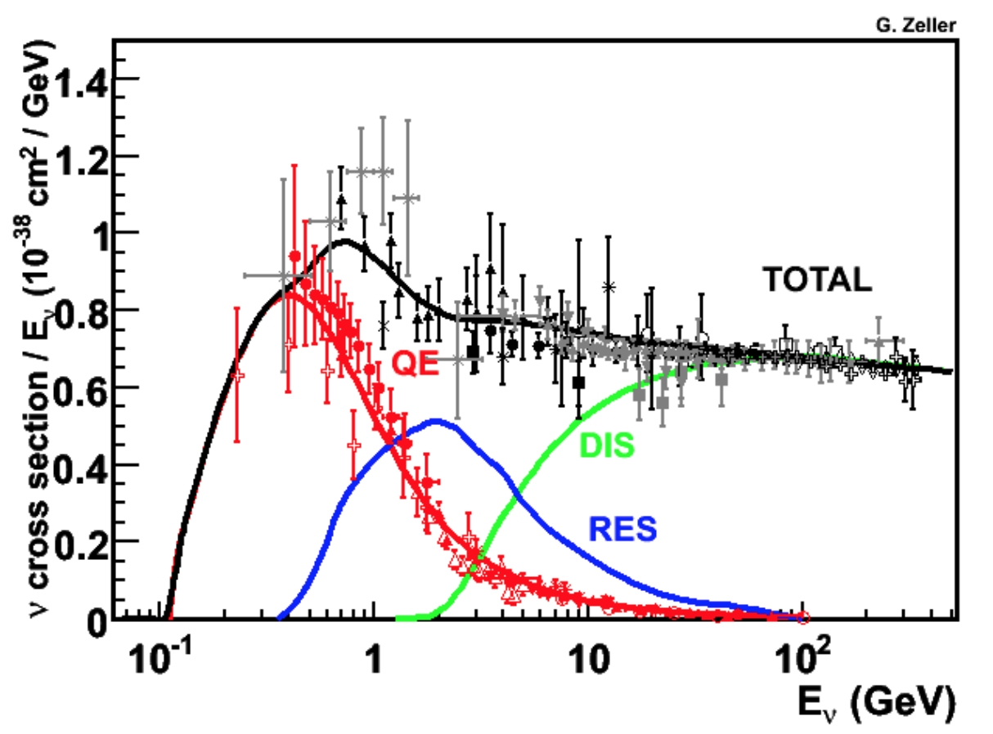
Systematics!
GeV-scale physics is *hard*!
  Quasi-eleastic and resonant interactions important
  Very difficult to model “shallow inelastic scattering” in 1-10 GeV range
    Standard code: GENIE, implemented in gSeaGen
    GIBUU
  Low-energy hadronic propagators:
    FLUKA: incorrect multiplicity
    GEISHA: energy not conserved
  Sensitive to systematics…
  Need to fit several systematics in
  sensitivity estimates
  This is why I talked so much
  about calibration!
✓

Slide 49
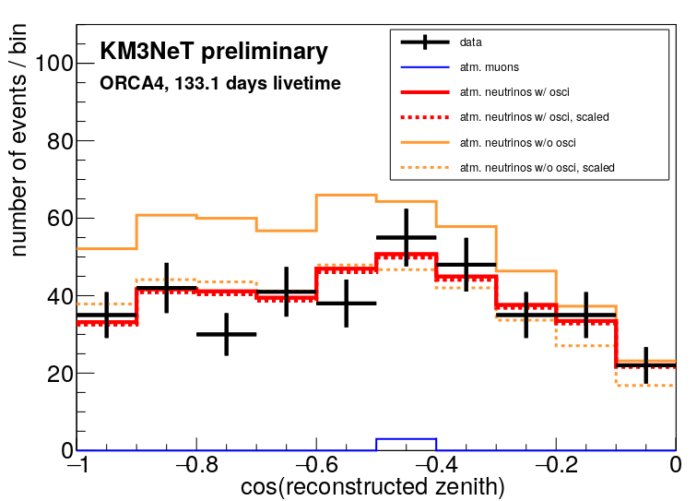
Some first results
We detect neutrino oscillations! (duh…)
  1/3rd of a year
  5% of ORCA
  Seeing something is good!
L. Fusco, J. Hofestadt et al., presented at Neutrino 2020

Slide 50
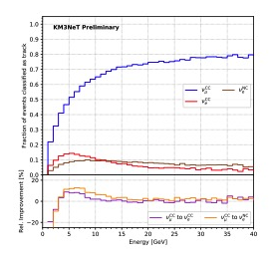
Classification – machine learning
One of several methods being tested
POS (ICRC 2019) 904

Slide 51
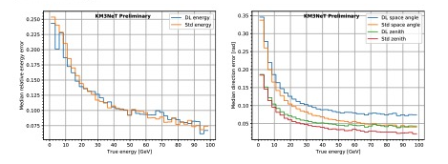
Resolution (ν_{e} CC)
Deep learning (DL) vs standard (Std)
POS (ICRC 2019) 904

Slide 52
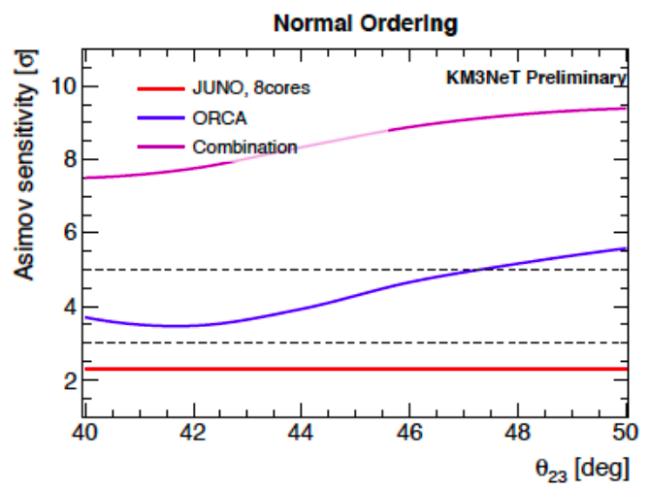
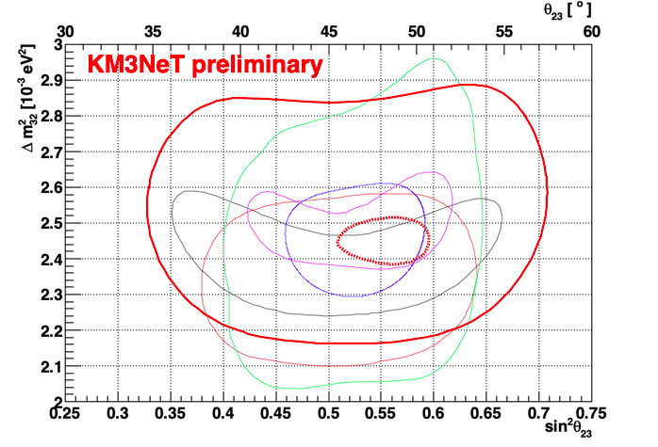
KM3NeT/ORCA Sensitivity for Neutrino Mass Ordering
Sensitivity to Neutrino Mass Ordering
- including systematics
- statistics bands shown
90% CL contours for oscillation parameters
SuperKamiokande T2K NOνA IceCube MINOS Sensitivity: ORCA-2019/20 ORCA115-3y
6 year projection
2.5-5σ determination of Neutrino Mass Ordering possible in 3 years
Combination with JUNO results can significantly enhance the sensitivity
Competitive oscillation parameter measurement possible
52

Slide 53
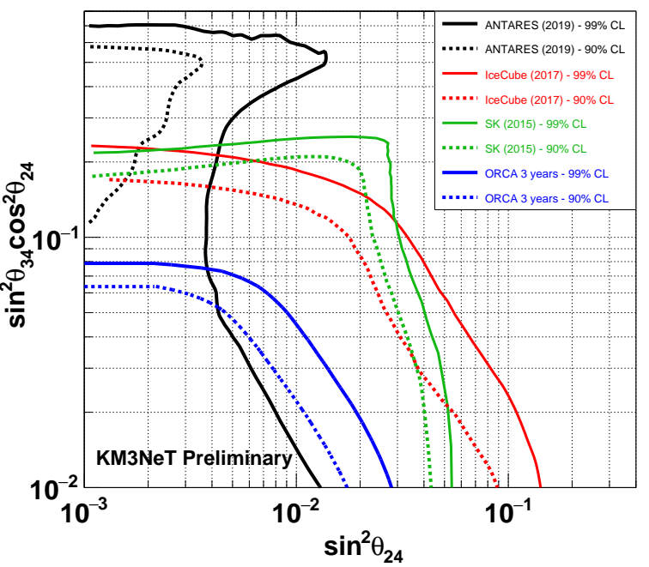
What about a 4th neutrino flavour?
Unsure of limits from beamline and reactor experiments (DUNE?)
T. Thakore et al, Chowdhury et al, Neutrino 2020

Slide 54
Australia’s role
Theoretical neutrino physics
  Specific expectations for BSM oscillations much more useful than searching for “something unusual”
  Statistical methods: currently computationally intense!
Astrophysics
  Studying Galactic accelerators (MWA, Mopra)
  Multi-messenger links (CTA, IceCube, radio, optical, x-ray.. GW?)
  Blazar VLBI: what about Southern blazars?
Diversity
  These initiatives are now becoming mandatory for EU funding
  Australia has quite a bit of experience at this (e.g. Pleiades)
  Environment?
  We have a strong incentive to encourage online meetings!

Slide 55
Conclusion
KM3NeT
  ARCA: high-energy astrophysics astrophysics
  ORCA: neutrino oscillations and mass hierarchy
  Common (beautiful!) technology
Status
  Under construction: ~2026 completion
  Some initial setbacks
  Preliminary results show that everything is under control
My motivation
  Build up participation in KM3NeT now
  Prepare for neutrino astronomy in the near future.
  Thank you!

Slide 56
IceCube: astrophysical flux
Single power-law fits
  Different event types
  Different flavour/energy/direction sensitivities
IceCube: Physical Review Letters, vol. 124, Issue 5, id. 051103 (2020)

