Slide 1
Potential of CEvNS measurements with cryogenic scintillators
Jing Liu, University of South Dakota
Magnificent CEvNS 2019, UNC

Slide 2
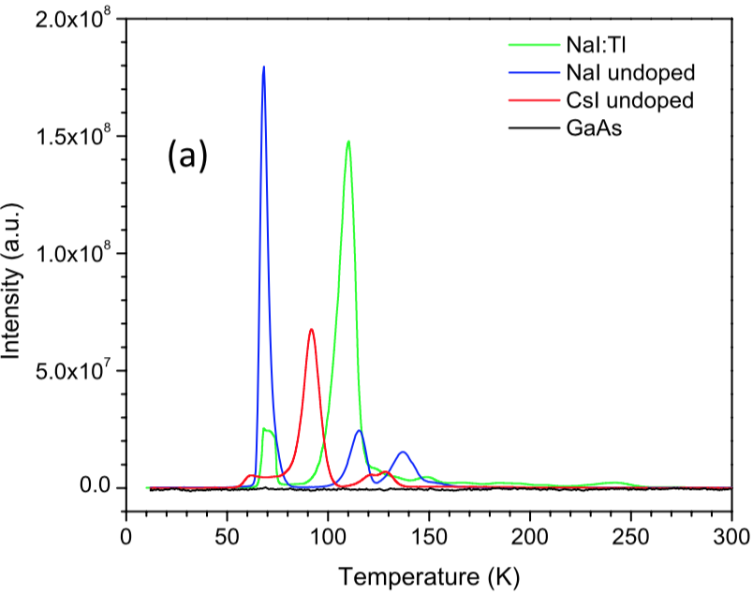
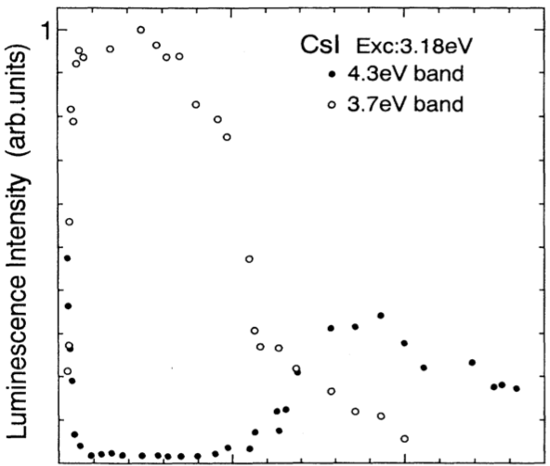
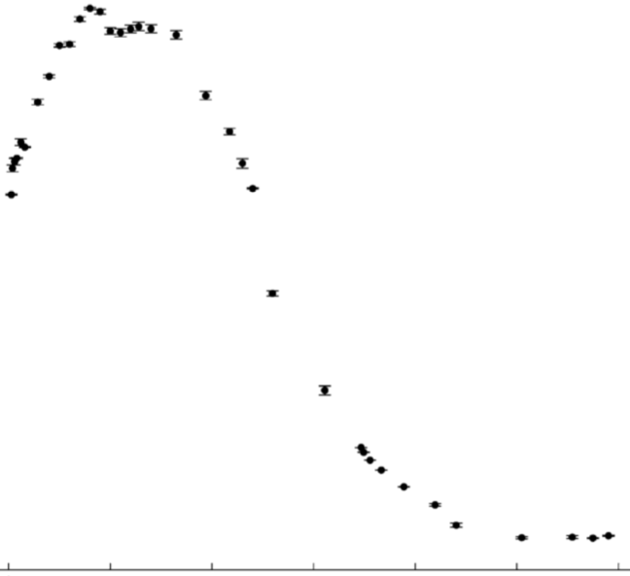
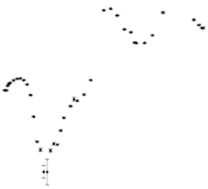
Undoped crystals
2.0
1.5
1.0
0.5
0.0
NaI(undoped) & CsI(undoped) VS NaI(Tl) and CsI(Na)
40 K
  Minimal after glow rate
  Maximal light yield
Scintillation:
CsI(undoped)
NaI(undoped)
NaI(Tl)
40 K
Afterglow:
CsI(undoped)
NaI(undoped)
NaI(Tl)
Scintillation or Afterglow Intensity [A.U.]
Eur. Phys. J. C (2012) 72:2061
Phys. Rev. B 5 (1995) 2195
J. App. Phys., 123(11):114501, 2018
Temperature [K]
Light loss in complicated readout system cancels out the gain from light yield ☹
PMT at RT
Light guide
Crystal at LNT
Light guide
PMT at RT

Slide 3
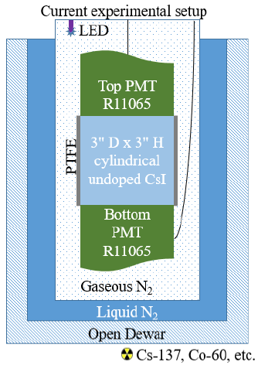
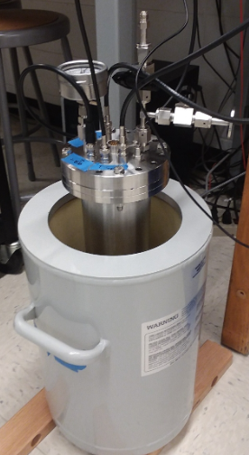
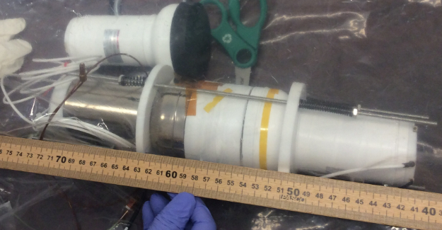
Experimental setup

Slide 4
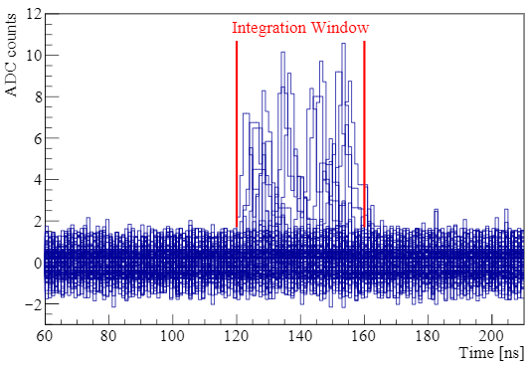
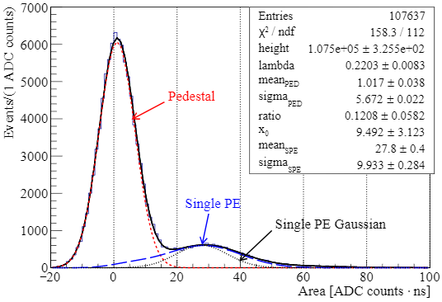
Single PE measurement

Slide 5
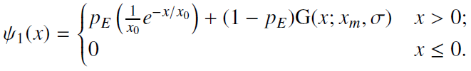


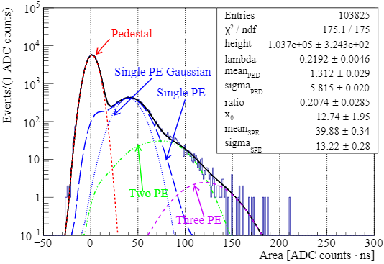
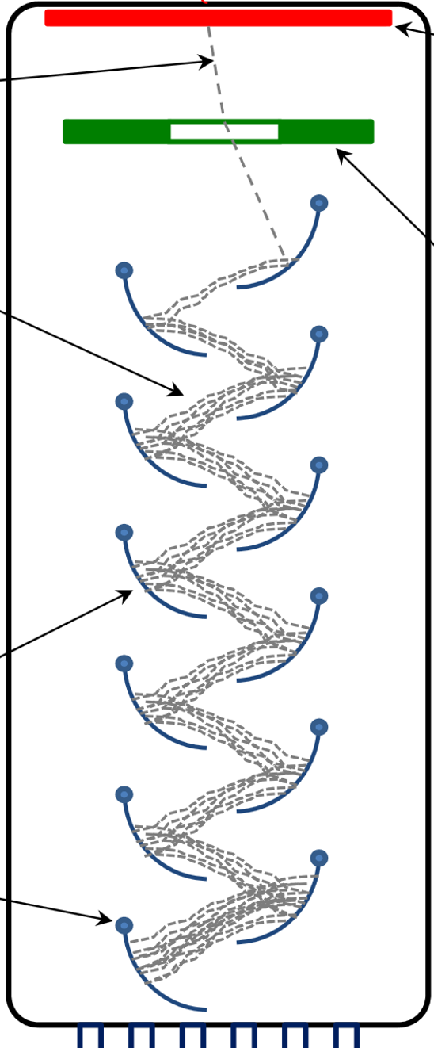
Single PE distribution
Noise
Electron loss
Gaussian
Poisson
IEEE TRAN., VOL. 58, NO. 3, JUNE 2011
Loss of electrons in PMT

Slide 6
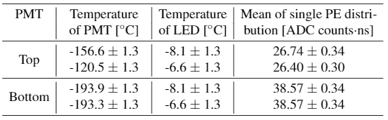
Uncertainty on gain
Amplification factor: 10

Slide 7
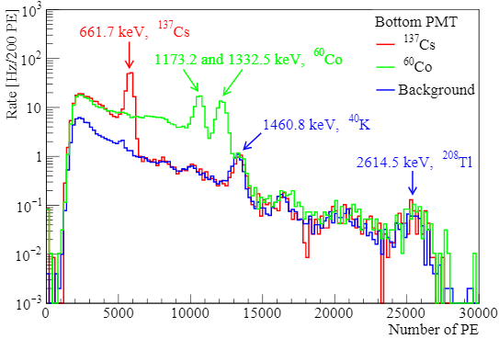
Energy calibration

Slide 8
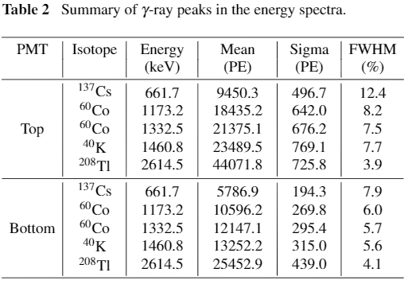
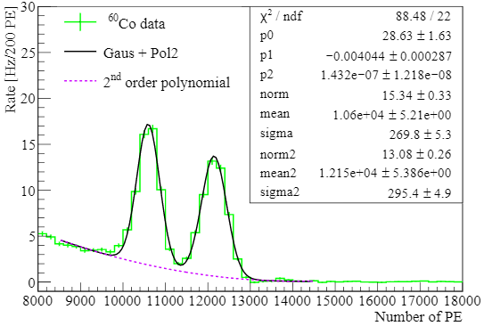
Energy calibration

Slide 9
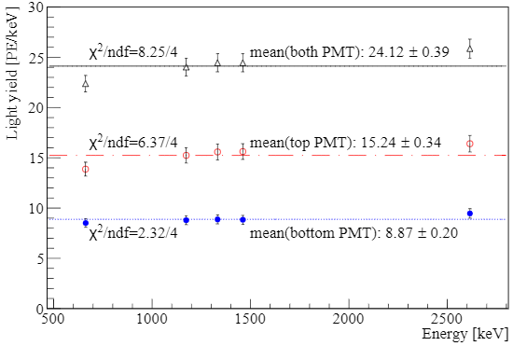
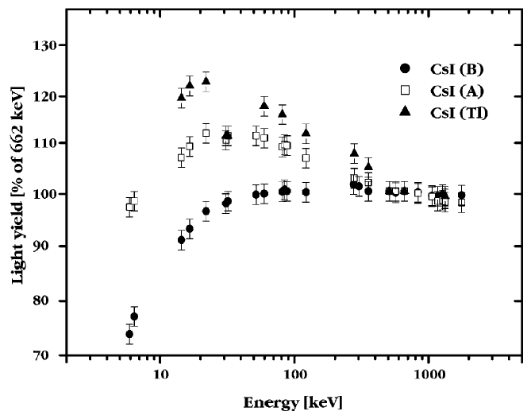
Light yield
M. Moszyński et al., NIMA, vol. 537, no. 1, pp. 357–362, Jan. 2005.

Slide 10
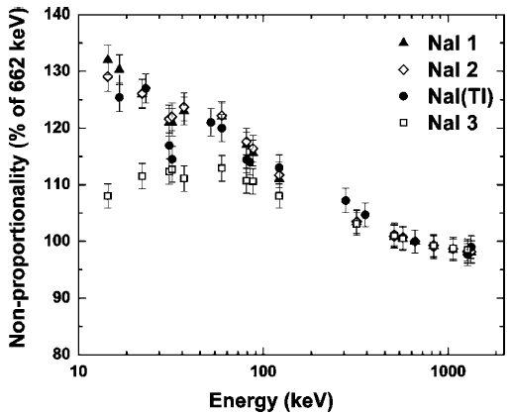
Nonlinearity of light yield
IEEE Trans., VOL. 56, NO. 3, JUNE 2009 A Comparative Study of Undoped NaI Scintillators With Different Purity
Marek Moszynski, et al.

Slide 11
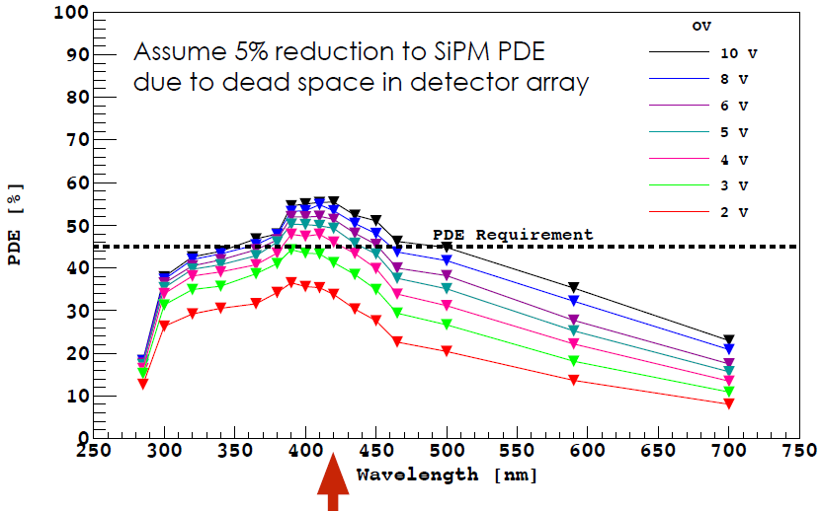
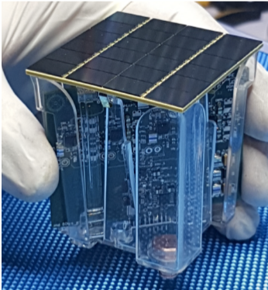
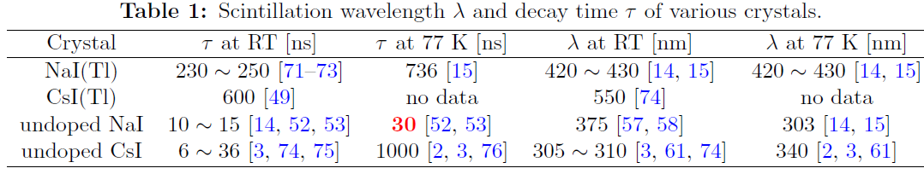
DarkSide SiPM Arrays
Progress and plans for DARKSIDE and QF measurements in LAr, Claudio Savarese
IEEE Trans. Electron Dev. 64 2, 2017

Slide 12
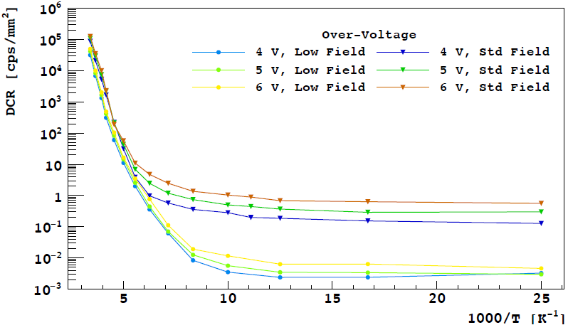
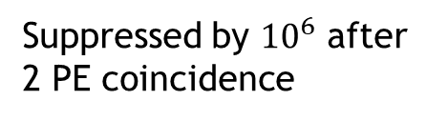
Dark counts of large SiPM arrays
Suppressed by ${10}^{6}$ after 2 PE coincidence
IEEE Trans. Electron Dev. 64 2, 2017

Slide 13
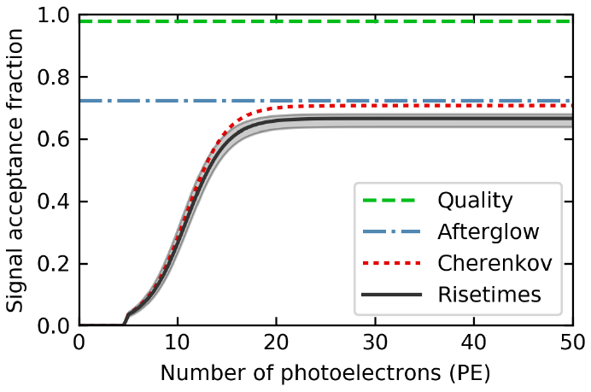
Another reason for SiPM
COHERENT Science paper
Afterglow cut removes ~25% low energy events
Replace PMTs with SiPM
  Eliminate Cherenkov light generated in PMT’s quartz window
  PDE of SiPM > QE of PMT
  Coincidence trigger to reduce SiPM dark count effect
For COHERENT CsI(Na) detector
Cherenkov cut removes most low energy events

Slide 14
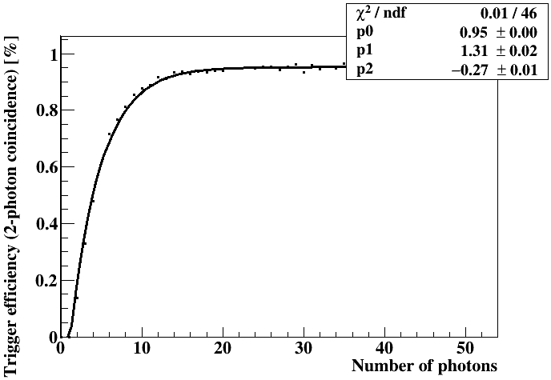

Thresholds
Simulated setup
Assuming an 80% trigger efficiency
ER threshold: 160 eVee
Na recoil threshold: 2 keVnr (QF: 0.08)
Cs recoil threshold: 3.2 keVnr (QF: 0.05)
$$p0+p1⋅e^{p2⋅N_{γ}}$$
Light sensor
Optical photons
PTFE
Crystal
Light sensor

Slide 15
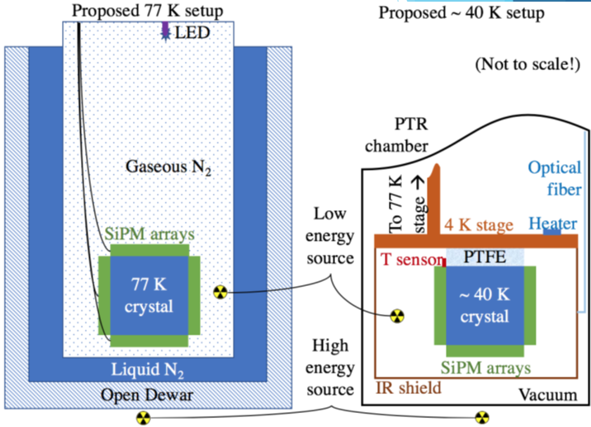
Possible setup

Slide 16
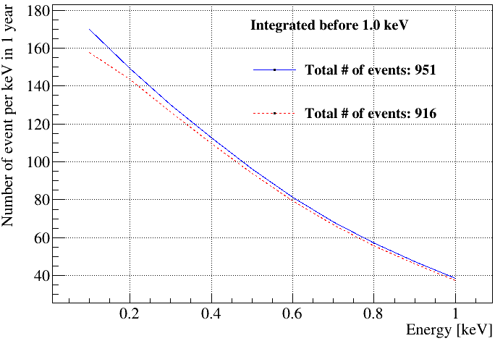
CEvNS event rate
https://github.com/schol/dukecevns
With E&M contribution:
Standard CEvNS:
Assumptions:
50 PE/keVee
10 kg of undoped NaI
2 years of data taking
NaI(Tl) quenching factor
2 PE coincident trigger

Slide 17
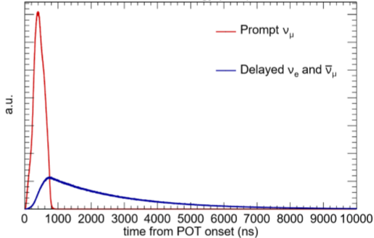
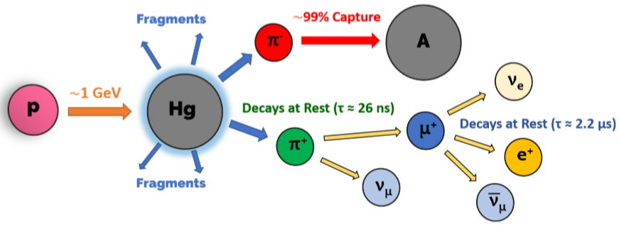
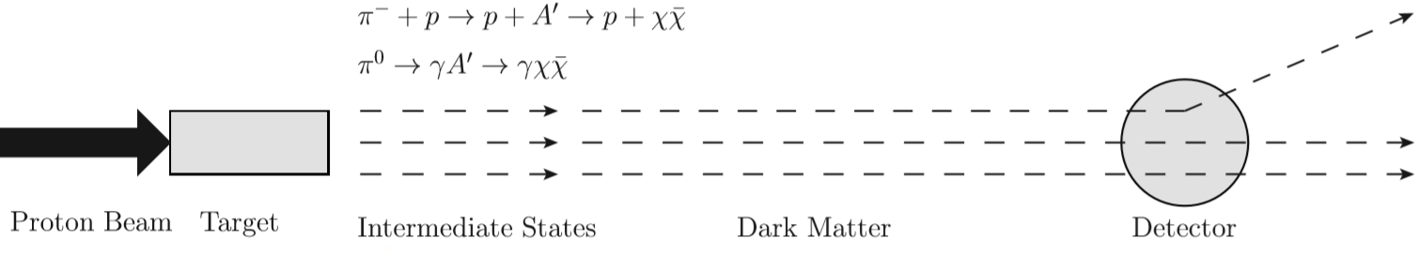
Light dark matter from SNS
M. Green on COHERENT
Searching for Light Dark Matter with Fixed Target Experiments P. deNiverville

Slide 18
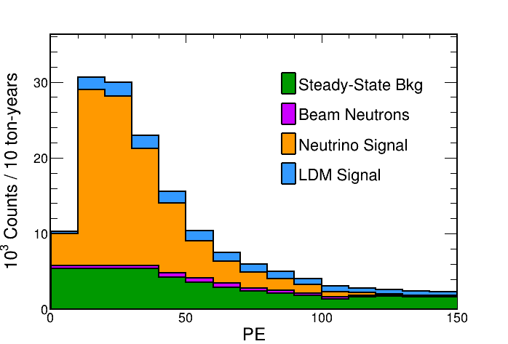
Expectation
D. Pershey
Assuming to be the same rate as in CsI(Na) detector
(very conservative)
Assumptions:
50 PE/keVee
NaI(Tl) quenching factor
2 PE coincident trigger

Slide 19
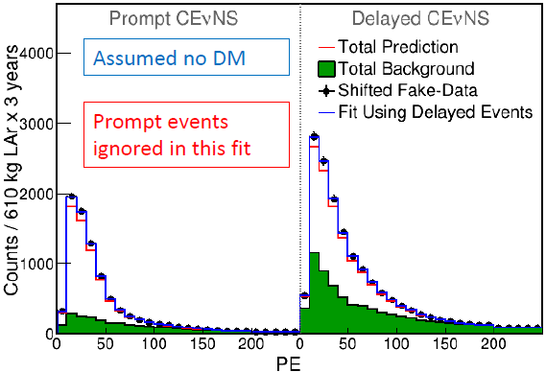
Strategies to tackle background: using delay’s neutrino signal
D. Pershey’s talk on LAr at SNS

Slide 20
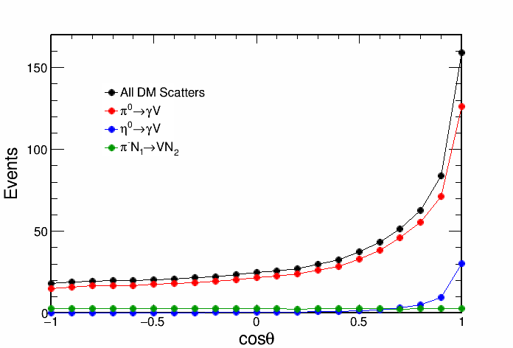
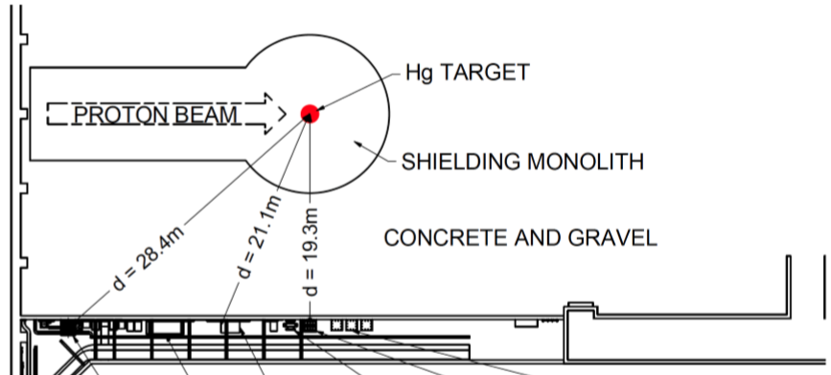
Strategies to deal with background: move the detector forward
Evaluating the curve at these angle
DM(cosθ=0.3)/DM(cosθ=-0.7) = 1.41
cosθ=0.3 also closer to the source (additional flux boost of 1.37)
D. Pershey
Current Neutrino Alley Detectors

Slide 21
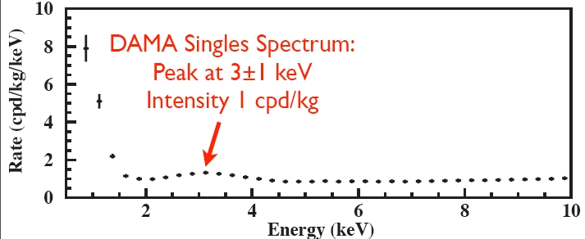
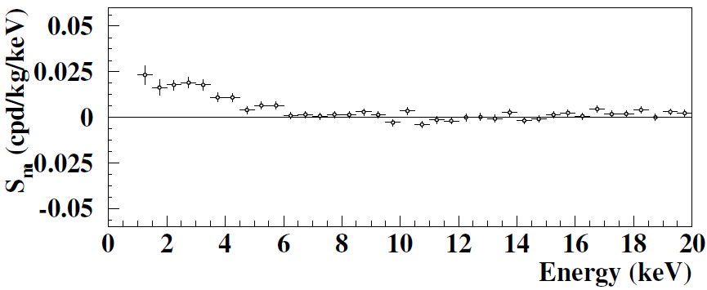
Strategies to tackle background: radiopurity of crystal
Possible sources of crystal:
Alpha Spectra
SICCAS
AMCRYS
Other experiments
Universe 2018, 4, 116

Slide 22
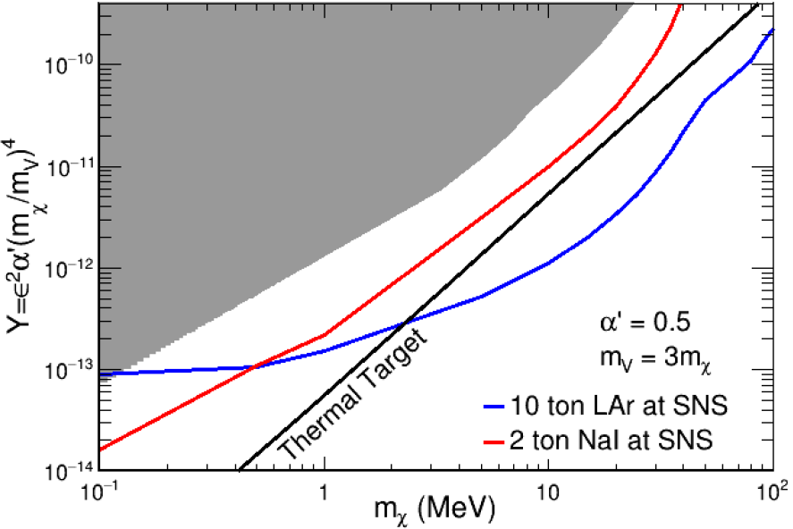
This approach + LAr
D. Pershey

Slide 23
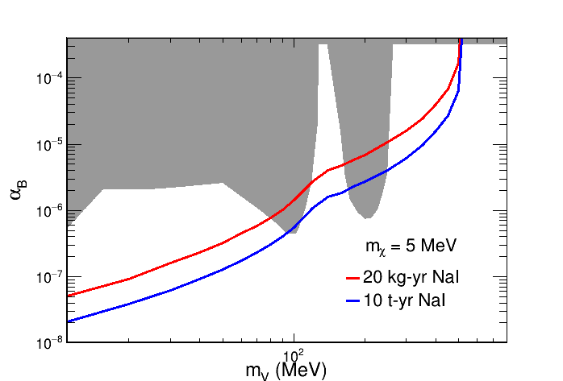
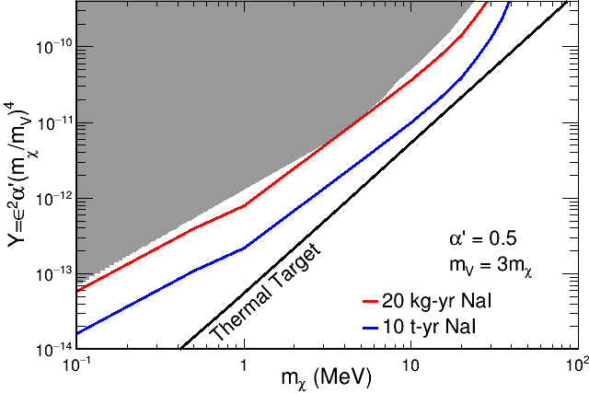
A prototype capable of delivering physics
10 kg crystal + 2 years of data taking at SNS
D. Pershey
D. Pershey

Slide 24
Scintillation mechanism
Self trapped holes:
V. B. Mikhailik, V. Kapustyanyk, V. Tsybulskyi, V. Rudyk, and H. Kraus. Luminescence and scintillation properties of CsI: A potential cryogenic scintillator. physica status solidi (b), 252(4):804-810, 2015
H. Nishimura, M. Sakata, T. Tsujimoto, and M. Nakayama. Origin of the 4.1-eV luminescence in pure CsI scintillator. Phys. Rev. B, 51(4):2167{2172, 1995.

Slide 25
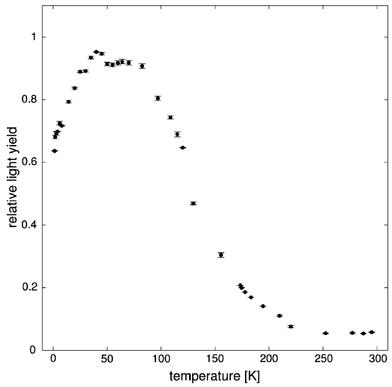
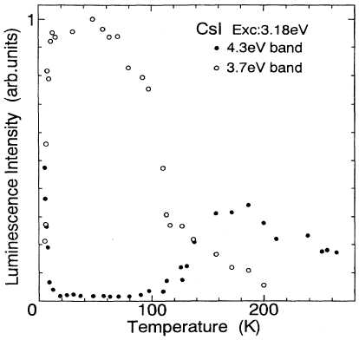
Scintillation mechanism
Eur. Phys. J. C (2012) 72:2061
Phys. Rev. B 5 (1995) 2195
Part of CRESST
LY of Pure NaI VS Temperature

Slide 26
Decay times

Slide 27
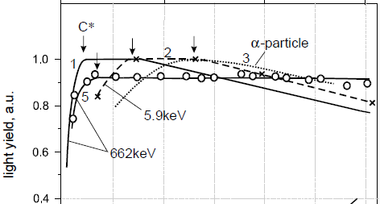
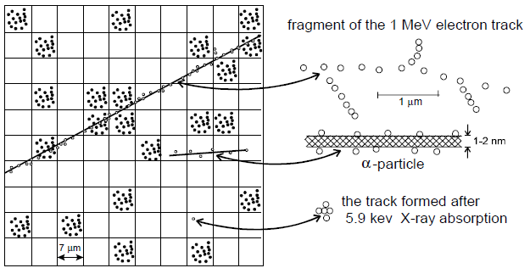
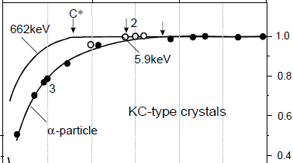

Quenching in Tl doped crystals
[1] L. N. Trefilova, et al., NIMA, vol. 486, no. 1, pp. 474–481, Jun. 2002.
[2] BRIT. J. APPL. PBYS., 1966, VOL. 17
NaI(Tl)
CsI(Tl)

Slide 28
Quiz
What kind of crystals?
Operation temperature?
Light sensors?
Threshold
  Electron recoil?
  Na recoil?
  Cs recoil?
Prototype
  Mass?
  Exposure?
# of CEvNS?

Slide 29
Answer
What kind of crystals?
Operation temperature?
Light sensors?
Threshold
  Electron recoil?
  Na recoil?
  Cs recoil?
Prototype
  Mass?
  Exposure?
# of CEvNS?
Undoped NaI and/or CsI
40 K (max LY, min after glow)
SiPM arrays to avoid Cherenkov light
~180 eVee (80% trigger efficiency)
~2 keVnr (80% trigger efficiency)
~3 keVnr (80% trigger efficiency)
10 kg
2 years
~1000

Slide 30
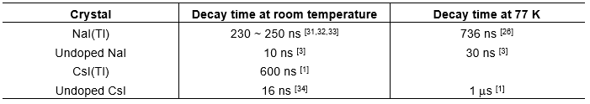
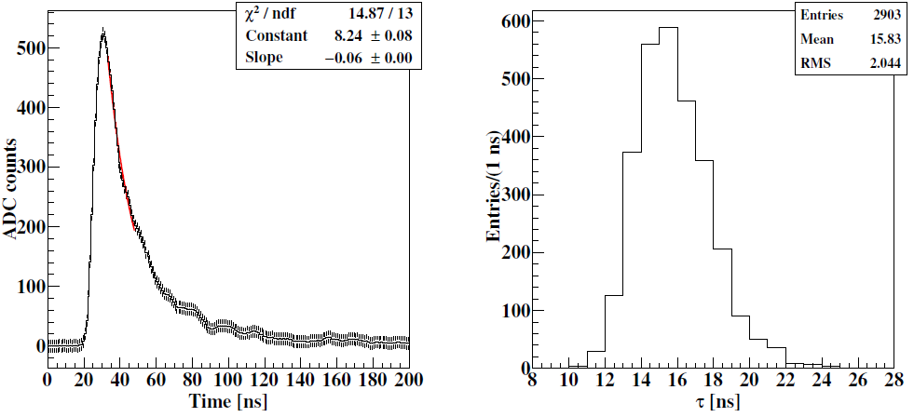

Slide 31
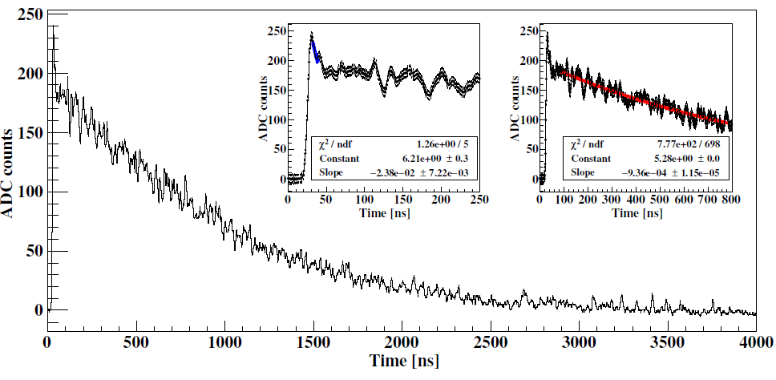
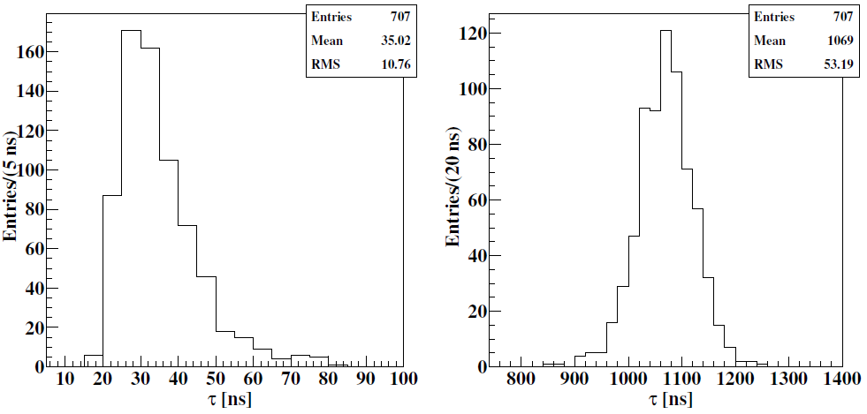

Slide 32
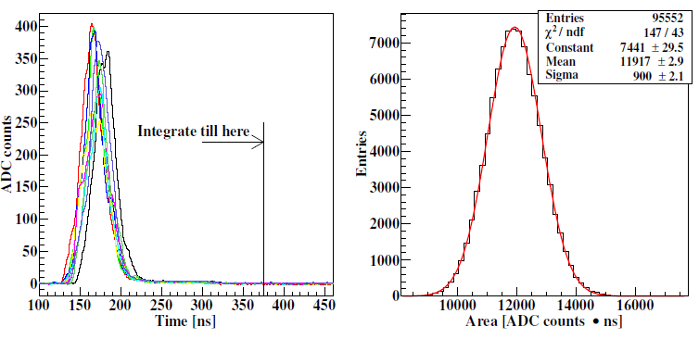

Slide 33



arXiv:1612.06071

Slide 34
Light sensors
Pure NaI or CsI crystals
cryostat

Slide 35
Sole quenching measurement
alpha (5.3 MeV) counts only 85% of gamma (662 keV)
[1] E. Hahn and J. Rossel, “Scintillations des particules dans Csl,” Helv. Phys. Acta, vol. 26, p. 271, 1953.
[2] B. Hahn and J. Rossel, “Scintillations dans Csl et spectrométrie,” Helv. Phys. Acta, vol. 26, p. 803, 1953.

