Slide 1
MINER: Low Threshold SuperCDMS Style Detectors for CNS
Andrew Kubik
Magnificent CEνNS
Nov 11, 2019

Slide 2
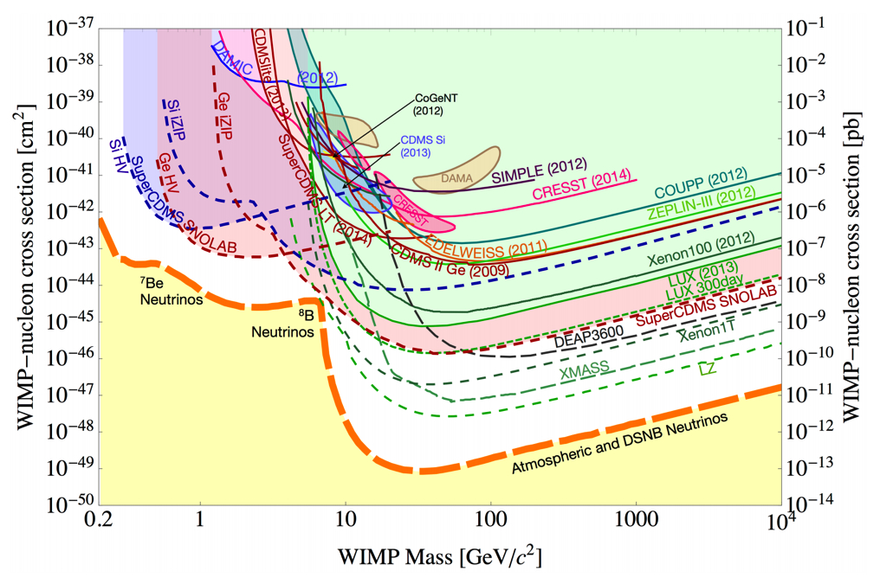
Low Mass DM models
  Not just WIMPS and not just nuclear recoils!
  Asymmetric Dark Matter
  Dark Sector
  Many more …
Previous SNOMASS projection
SuperCDMS SNOLAB focuses on low mass DM region
  Over three orders of magnitude better sensitivity
  Driven by improvements in detector design, better background control, more exposure, and lower thresholds

Slide 3
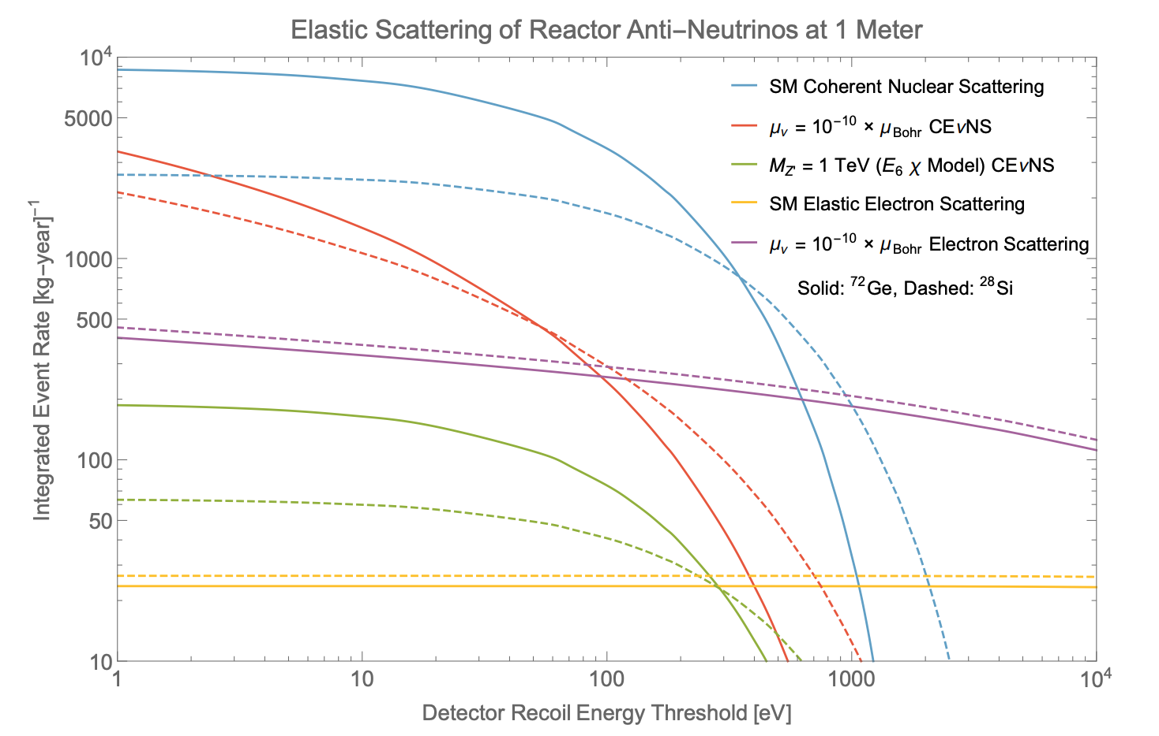

Slide 4
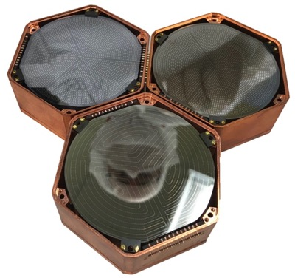
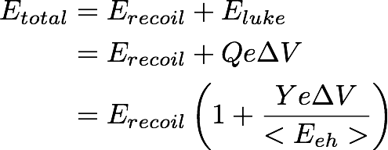
SuperCDMS Detectors in 1 Slide
Luke Phonons
ΔV
Recoil Phonons
Two types of Detector, both used by MINER
iZIP detectors
  discrimination of electron and nuclear recoils down to ~ 1 keV, limited by ionization measurement noise
  Gives solid handle on backgrounds
High Voltage detectors
  As charge carriers traverse crystal, they create secondary (Luke) phonons
  The higher the field, the more Luke phonons created
  Increase the bias, measure the phonons. Basically a charge amplifier (which doesn’t amplify the noise!)
Single-charge sensitive (σ=.27eVee) device demonstrated by SuperCDMS for ~gm-scale PRL 121 (2018), 051301

Slide 5
Coherent Neutrino Scattering: Connection to WIMPs
CDMS Style Detectors were originally envisioned to detect neutrinos!

Slide 6
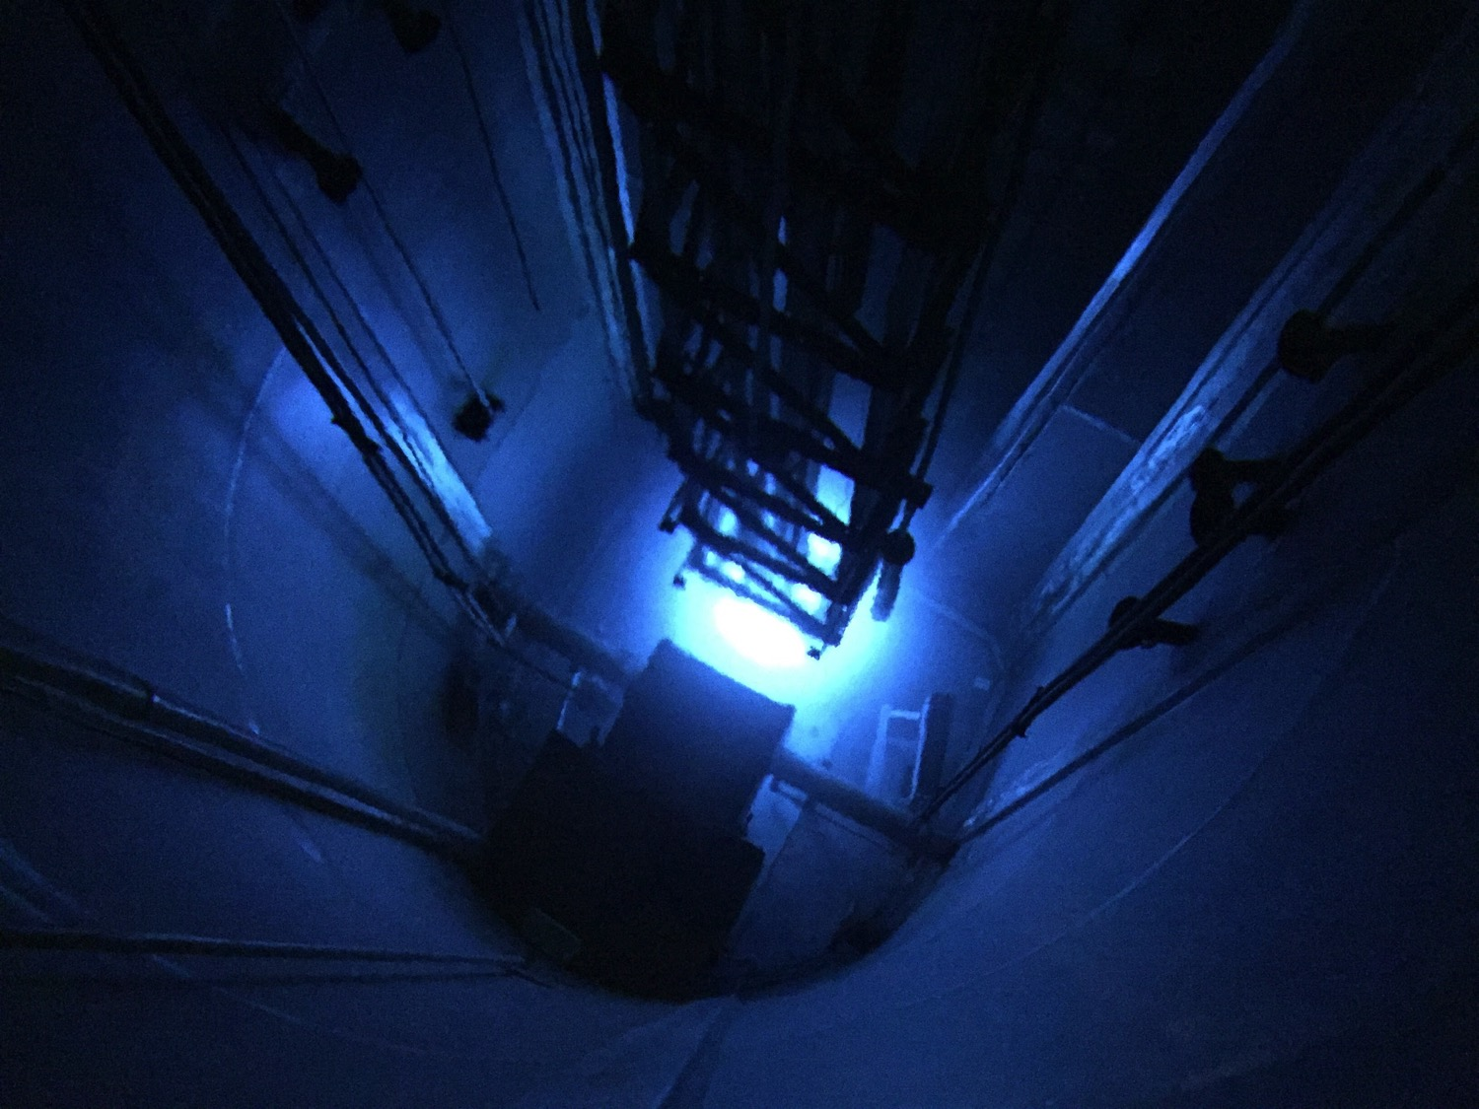


Detectors

Slide 7
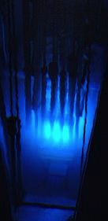
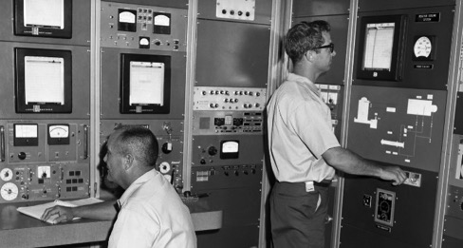
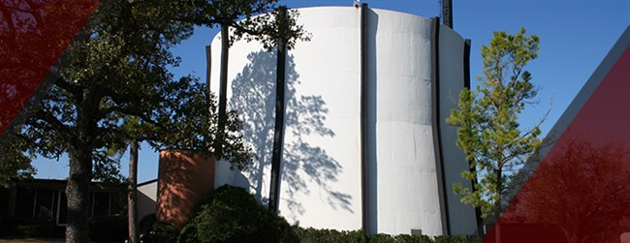
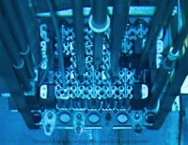
TEES Nuclear Science Center
1 MW TRIGA (Training, Research, Isotopes, General Atomics) Reactor
  Student, Professional, and Emergency Response Training.
  Renewed pursuit of research (especially materials science)
    4 or 5 Beam ports under redevelopment
    Large irradiation venues (thermal column, dry cell, & large pool)
    Two small hot cells for hot sample handling and isotope packaging.
  Neutron and high activity gamma irradiation of materials and biomaterials.
  Neutron activation analysis (rabbit tube delivery).
  Isotope Production & Shipping.
  Ability to pulse (~400 MW for a few ms) https://www.youtube.com/watch?v=xdkKxQotsro
Operating Since 1961

Slide 8
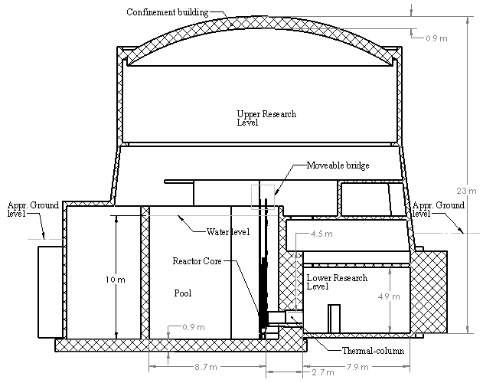
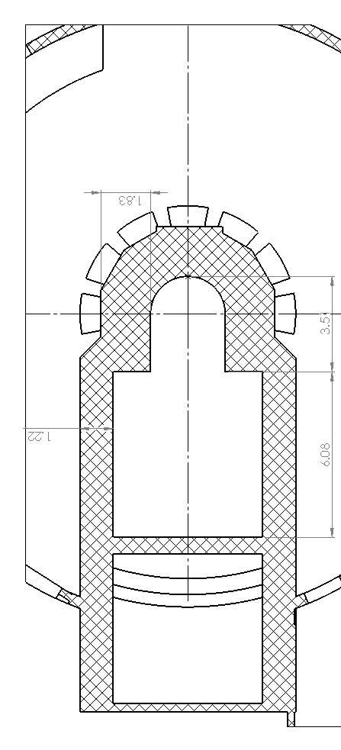
Mitchell Institute Neutrino Experiment at Reactor (MINER)
Side View
Top View
Core
Core Movable Along this Axis
Detectors
Core Movable Along this Axis

Slide 9
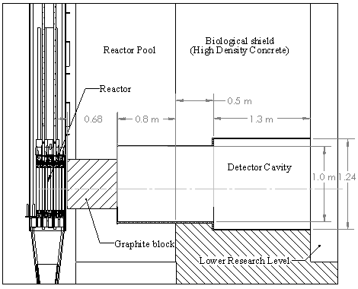
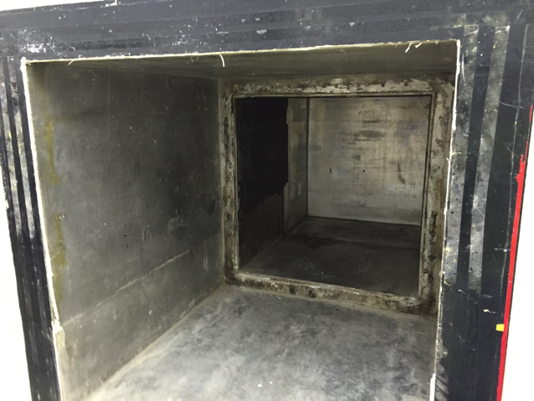
Reactor!
Detectors
“Thermal Column” Experimental Area
Specific Advantages for MINER
  Our core is movable!
  Lower power reactor leads to less fuel burnout and less variation in rate with time
  Significant period of core off time on demand
  Extremely cooperative facility staff

Slide 10
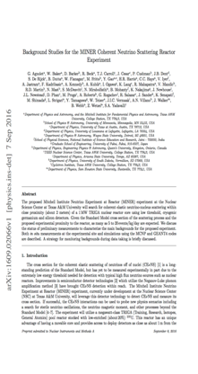
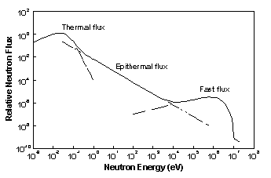
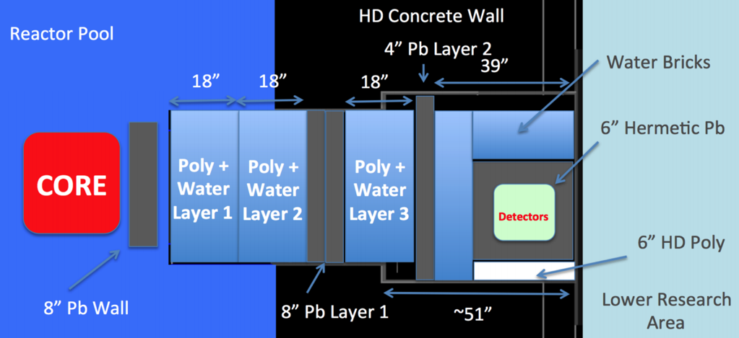
Background Control
Aggressive Shielding
Results with various measurements agree well with MCNP reactor and Geant4 transport simulations.
  Multi-pronged approach to neutron
  Gammas with commercial Ge detectors
  Iterating with shielding configurations.
NIM A 853, 5360 (2017)
LS counters
Activation Foils (⁶³Cu+n⁰→⁶⁴Cu)
⁶Li and PTP scintillator
³He counters
Bonner spheres w/ LiI(Eu) scintillator

Slide 11
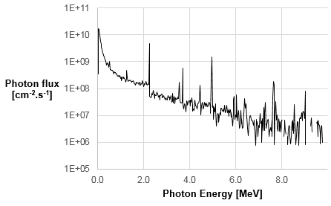
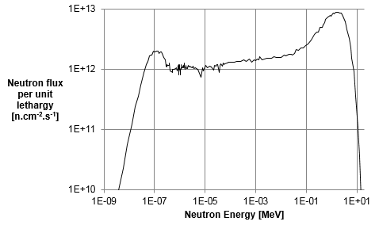
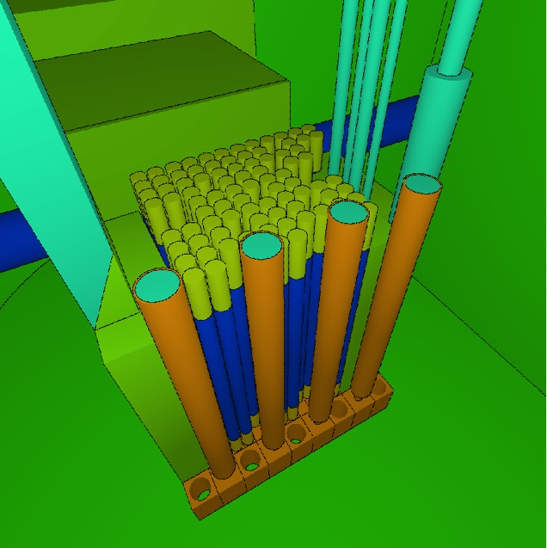
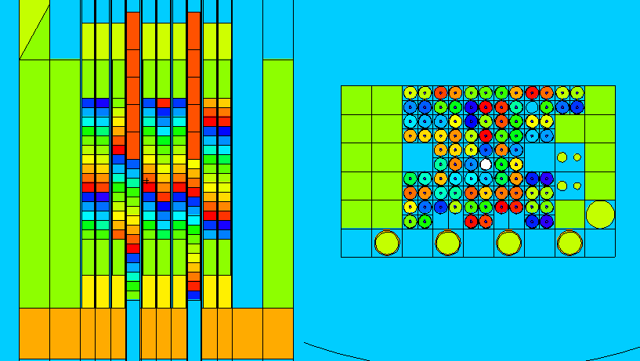
MCNP model of the reactor
We use a highly detailed model of the reactor.
Core calculations done separately from propagation through the shielding.
From Jan Vermaak, Guillermo Villanueva

Slide 12
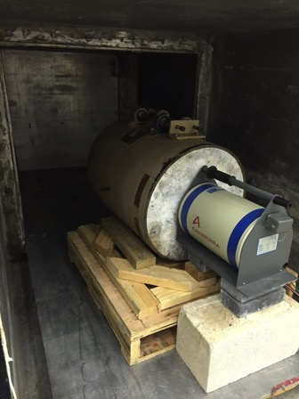
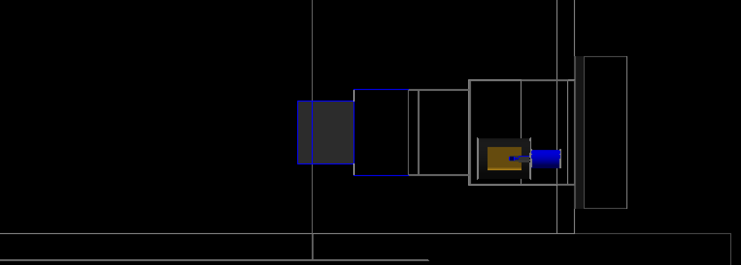
First Gamma Measurement
We measured the gamma background in-situ using a Canberra BEGe detector (~0.5 kg mass)
Minimal gamma shielding (commercial Canberra 4” lead shielding)
Core far enough away that neutrons completely moderated by water
Take data at 3 different core positions, and multiple core powers
Core Distance Measured From Here
3.83 m
2.83 m
3.33 m
Detector
Core Positions

Slide 13
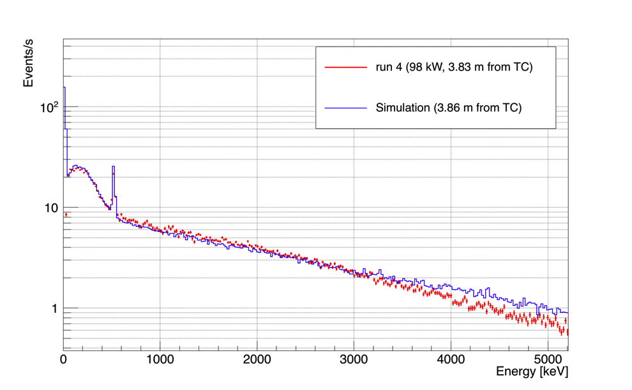
Now compare with simulation
  Plotted the spectrum for the furthest core position (3.83 m), comparing the data and MC
  Total rate scaling with core position agrees in data and MC
NIM A 853, 5360 (2017)
511 keV annihilation line
Deposited Gamma Energy [keV]

Slide 14
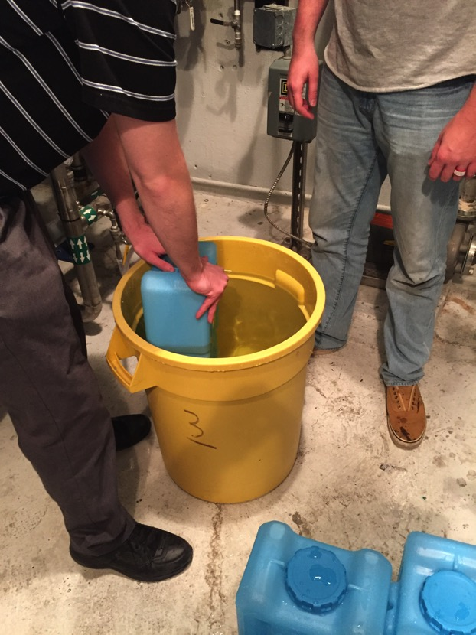
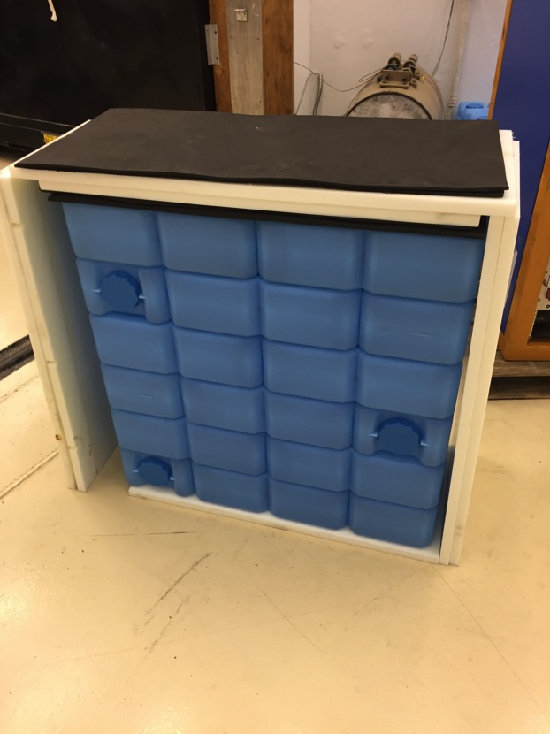

Slide 15
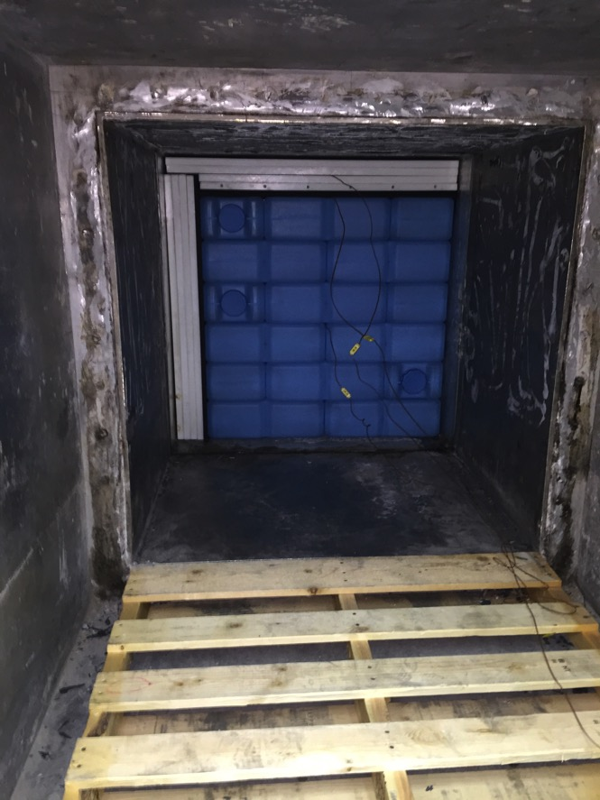
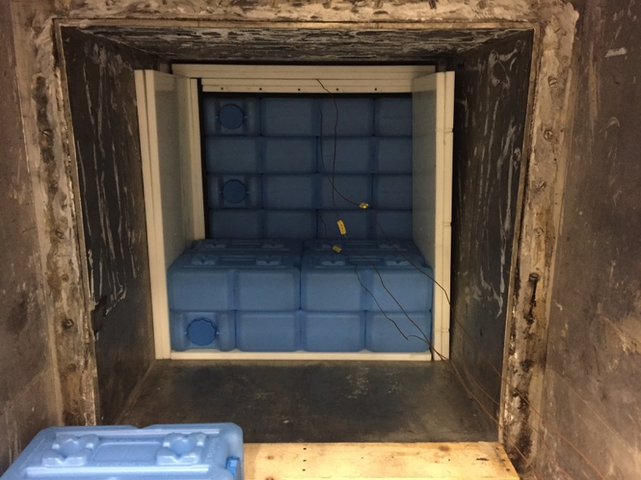

Slide 16
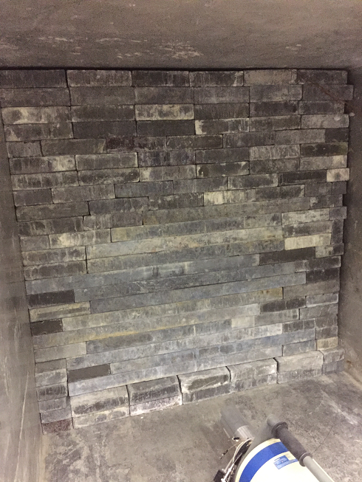

Slide 17
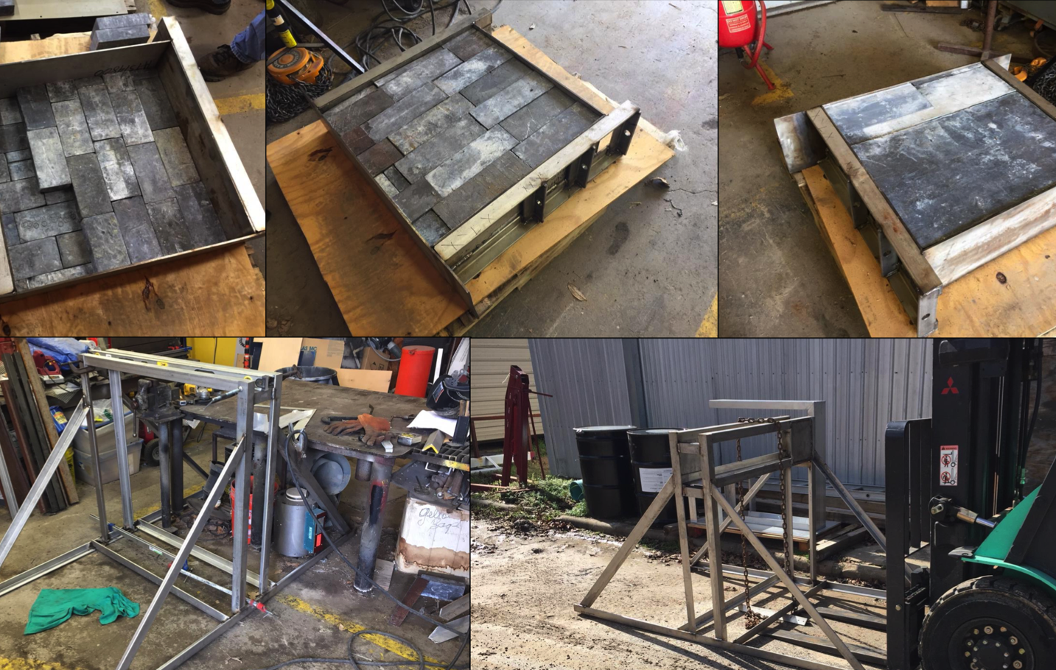
Pool Shield Construction

Slide 18
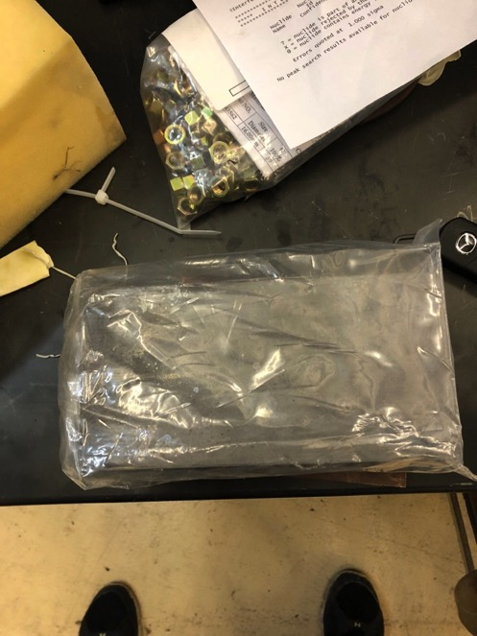
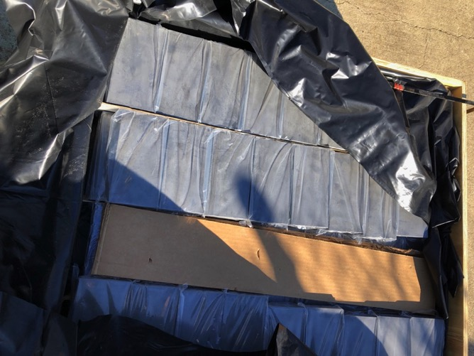
Lead from Los Alamos
We received a large amount of lead used at some point by Majorana from Los Alamos
500 good condition 2x4x8” bricks, individually wrapped.
Enough to be fairly liberal with Phase 1 shield. Will be transferred to phase 2 shield when appropriate

Slide 19
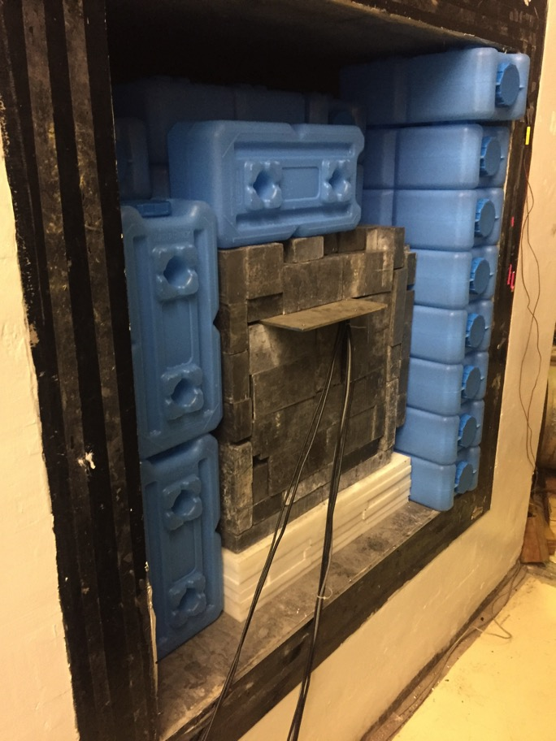
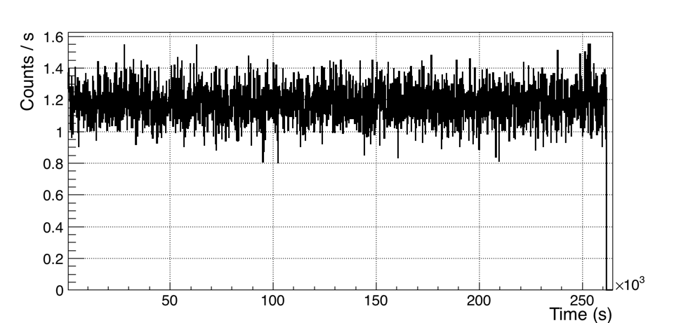
Core On @ 5 m from det
Weekend
Core On @ 5 m from det
0.5 kg NaI Detector
Rate v. Time ( integrated > 30 keV)
Well within target for sensitivity
Still room to improve (better lead close to the detector, more thermal neutron shielding, etc.)

Slide 20
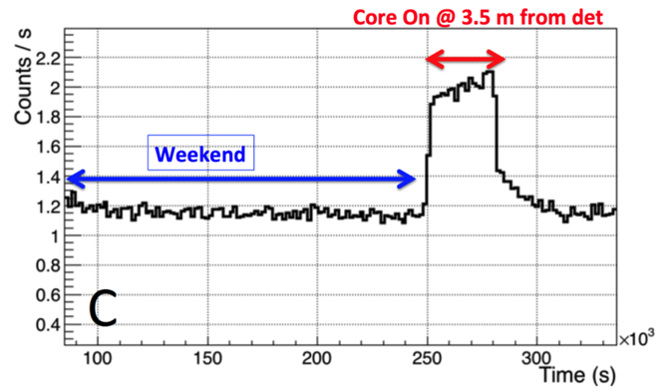
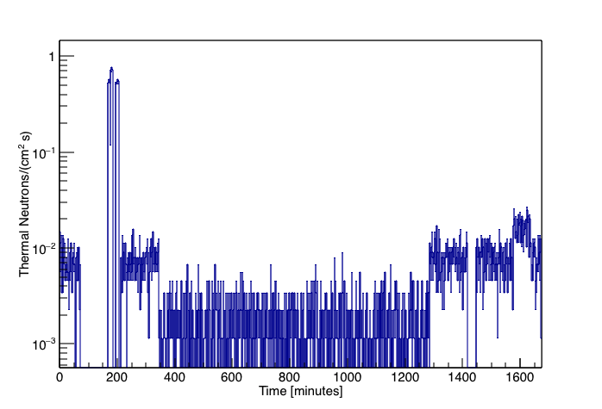
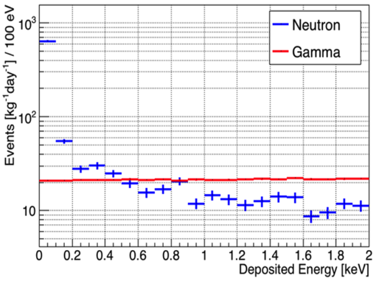
Backgrounds
GAMMAS
NEUTRONS
Core on, outside lead shielding
Core on, inside lead shielding
Core off, overnight
NaI (~1kg) Rate v. Time (integrated: 30 keV – 2.1 MeV)
Lithium Thermal Neutron
ROI: 10-1000 eV_{nr}
5-20 coherent scattering evts/kg/day expected.
Validated simulations predict that we can reduce gamma and neutron backgrounds to 100 evts/kg/day.
Have successfully measured ~ 600 evts/kg/day in prototype shielding, reactor lead wall not yet installed
GEANT4 Sim

Slide 21
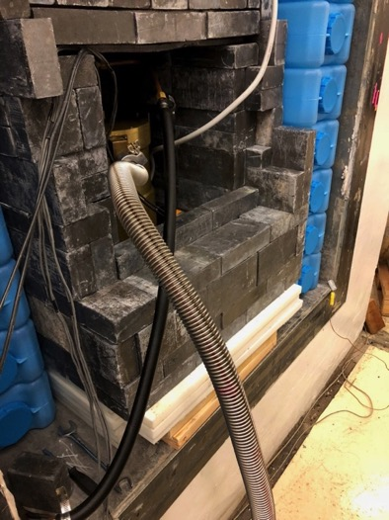
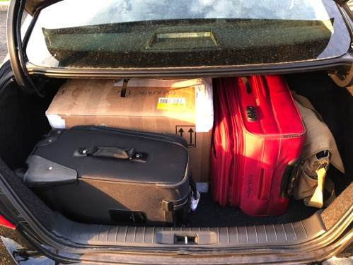
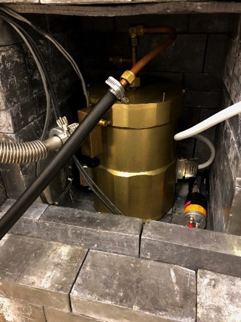
CONNIE Detector@MINER
Last year myself and our grad student Himangshu Neog took a trip to FNAL and came back to TAMU with a CCD
Many thanks to Guillermo Fernandez Maroni and the FNAL crew who patiently taught us how to run it
Gives another measure of low energy background @ the detector position with possible physics potential as well

Slide 22
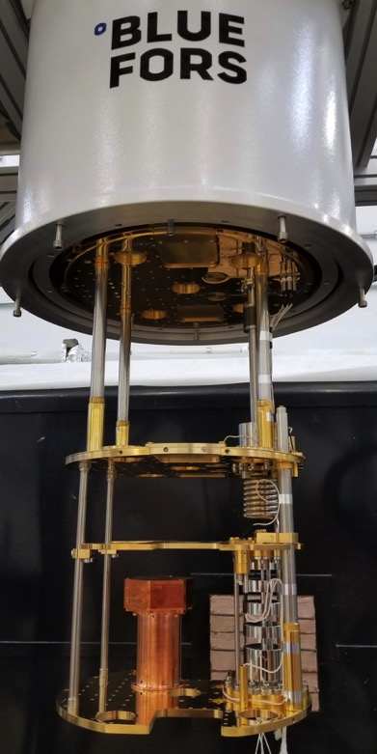
MINER 2-Phase Approach
Phase-1: fridge/electronics/DAQ from SuperCDMS, happening now!
  First 2 runs with data on tape over last 3 months
  Concentrating on reducing noise and other experimental issues
  Run with full Phase-1 payload starting in ~month (1 Ge iZip, 3 Ge HV, 1 Si HV).
Phase-2: Icebox design and rigorous shielding validation in progress. New BluFors Fridge already commissioned (joint purchase between TAMU/UTA/USD)
Phase 2 Fridge w/ Detector Installed

Slide 23
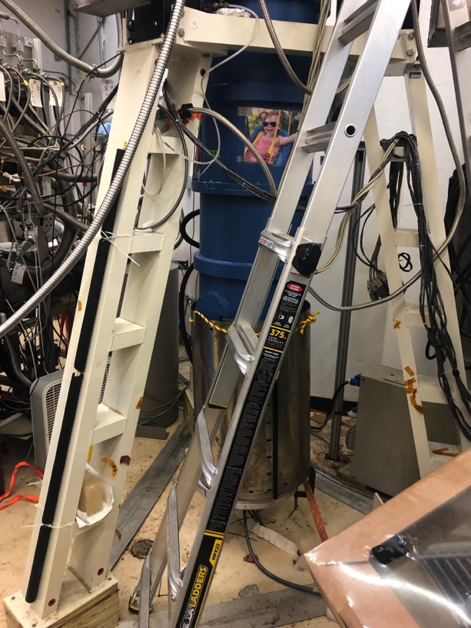
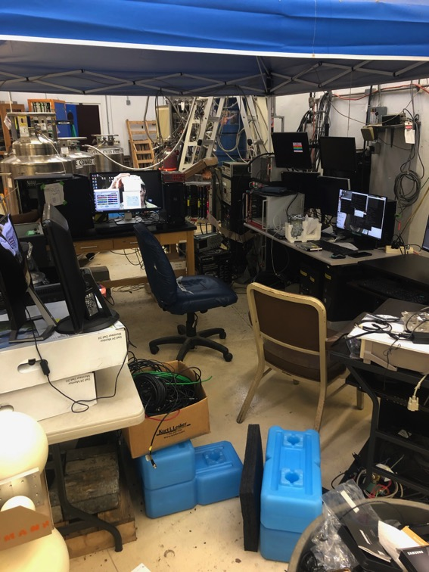
Phase I Underway

Slide 24
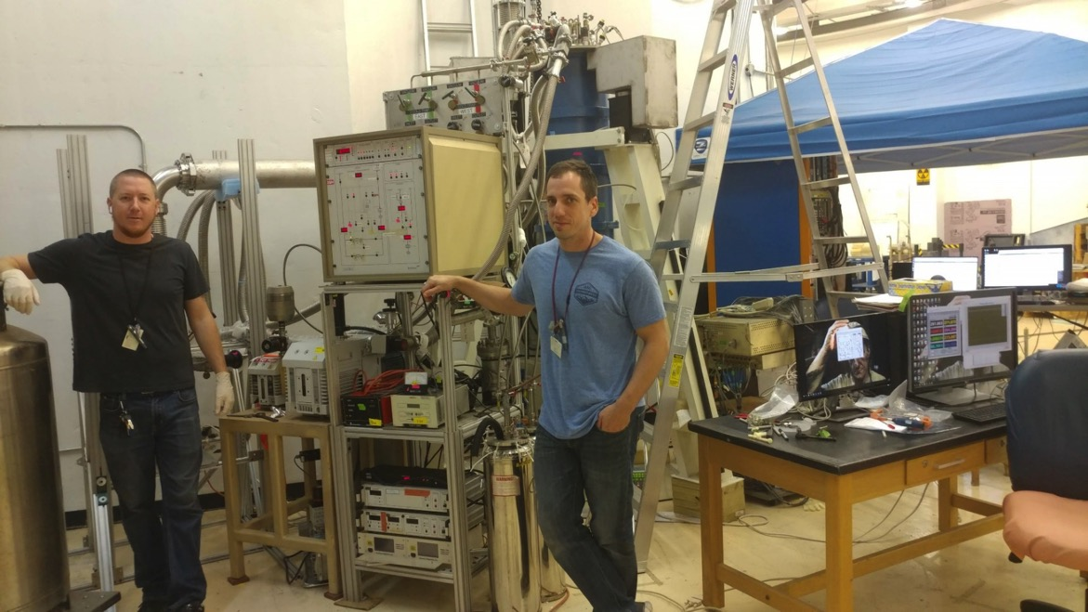
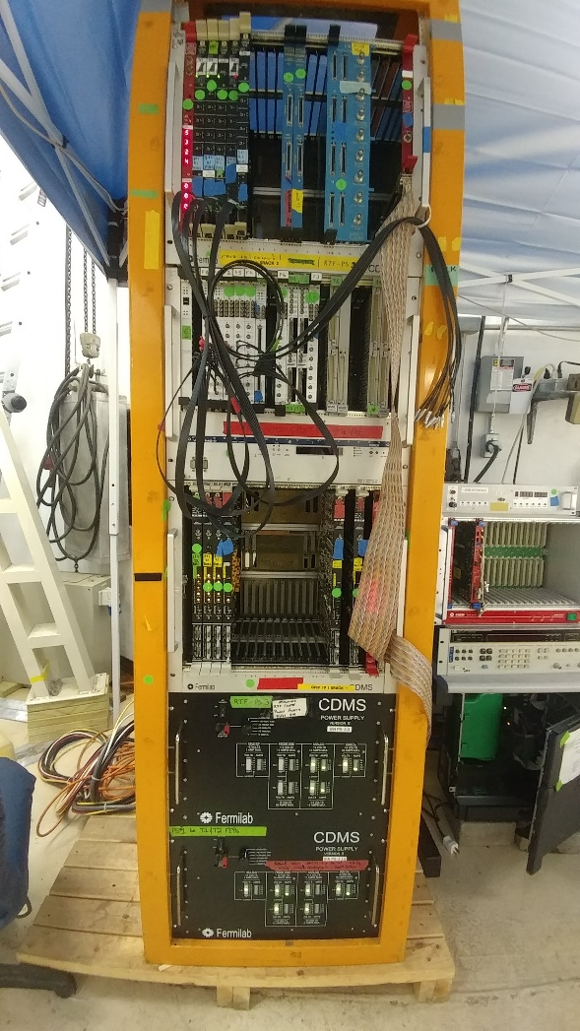
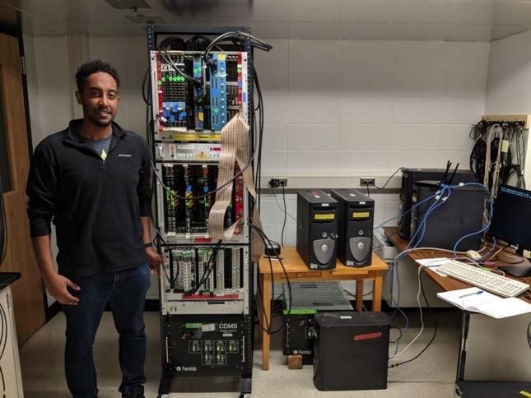
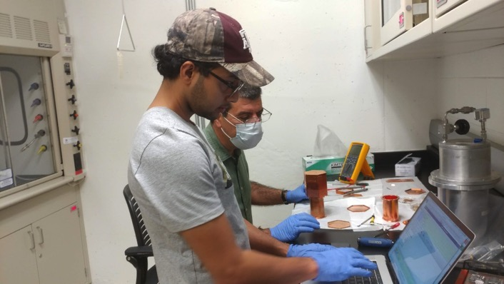
Initial DAQ was fully set up at USD

Slide 25
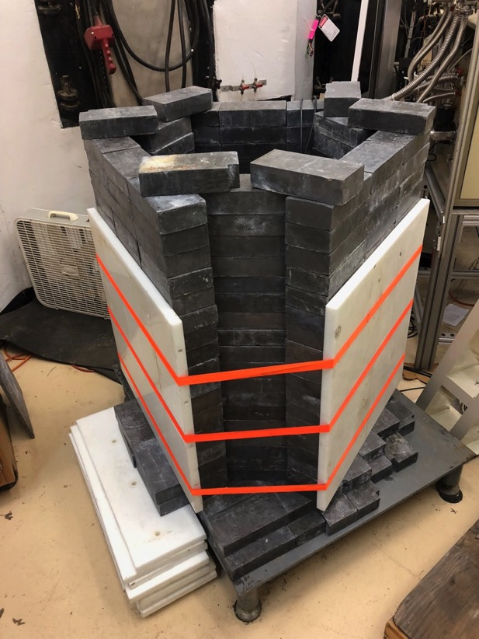
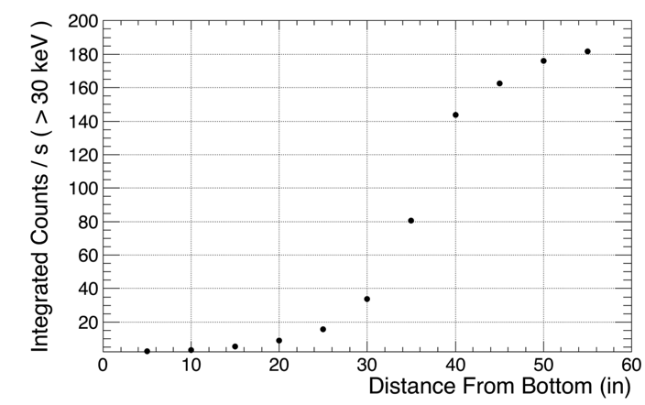
Phase 1 shielding prototype, tested early this year
Rate measured in 5” height increments with 0.5 kg Canberra Ge BEGe detector, integrating energy spectrum from 30 keV and up
Modeling in GEANT4 underway (SHSU undergrads Jaime Navarrete and Alex Clark)
Detectors
Inside Shield
Outside Shield

Slide 26
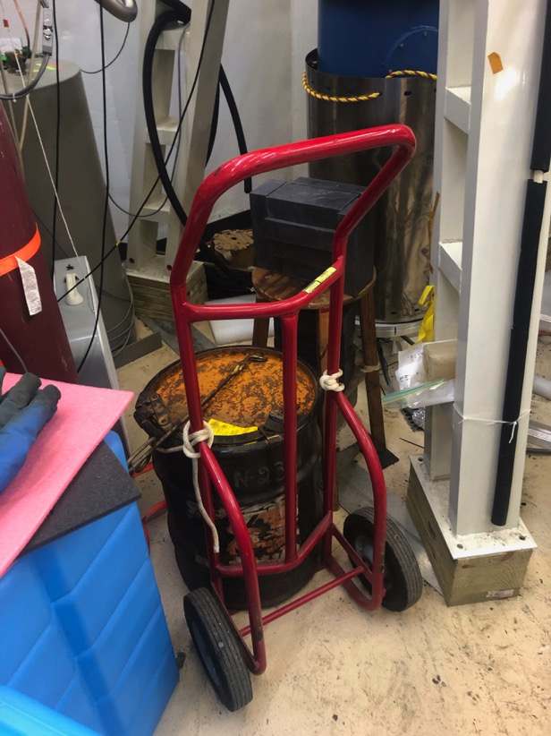
In July we took unshielded engineering run data
  1 x iZip (Ge)
  1 x HV (Ge)
Various sources for calibrations (Ba133, AmBe, + others)
Focused on engineering tasks, noise reduction and initial low energy background measurements
AmBe Neutron
Source

Slide 27
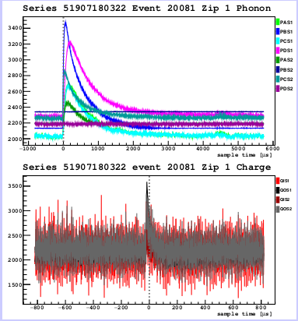
Pulses From Current Run
Phonon
Many thanks to our SuperCDMS colleges for supporting us with use of the SuperCDMS software framework (CDMSBats) and DAQ software.
Charge
Pulses from Ge iZip

Slide 28



Run 9 iZIP (Ba133 data): Partition Plot
The relative phonon amplitude and relative pulse time delay in each channel can be used to construct a quantity which relates to the lateral position of event occurrence within the detector.
Side 1
HV
Soudan partition plot
Soudan delay plot

Slide 29


Sensitivity to SM and Beyond
MINER will be able to detect neutrinos down to 1.2 MeV
Expect a total rate of about 20 events per day above 100 eV_{NR}
Standard Model process 5 sigma observation in ~100 kg*days exposure (few months)
MINER can probe multiple BSM models
  Sterile Neutrinos (see next slide)
  Z’, Nu mag. moment, other NSI
100 eV threshold
2m from core
100 d.r.u. backround
Plots from J. Newstead

Slide 30


Sterile Sensitivity
Plot from J. Newstead
MINER’s movable core makes sterile neutrino searches particularly interesting
Will be able to probe the reactor anomalies at around 1000 kg*days
Will also provide a complimentary measurement to beam based experiments (by probing electron anti-neutrinos)
Plot from J. Walker
10⁴ kg*days
100 d.r.u. backround
See Phys.Rev. D94 (2016) no.9
for more details

Slide 31

MINER Status and Outlook
Phase-1 in operation – 1-tower engineering run finished with 2 detectors
  Focus on validating backgrounds
  1 Ge iZIP to measure gamma and neutron background (and some CNS sensitivity)
  1 Ge HV detectors (target few eVee resolution) for low threshold measurement
  DAQ hardware and software from SuperCDMS Soudan.
  Full Phase-1 payload run starting by end of month. Will run over next ~3 months.
Phase-2 in development
  Bulk reactor shielding and prototype detector shielding in place
  Icebox being designed

Slide 32
BACKUP
BACKUP

Slide 33

General Idea:
  Cryogenically cooled Ge or Si crystal
  DM recoils off nucleus in target, creating athermal phonons and liberating electron hole pairs
  Phonons read out using Transition Edge Sensor array
  Electrons/holes drifted to surfaces by applied Voltage bias
Holes
→
e⁻
E
Germanium
χ⁰

Slide 34


Phonons
Athermal phonons are collected in Al fins on surface, breaking Cooper pairs to create quasi-particles
QPs travel to Tungsten TES bringing heat which quickly alters the resistance, supplying the signal

Slide 35

Electron recoils many additional electron-hole pairs
  1 eh pair per ~2.9 eV in Ge, ~3.6 eV in Si
Nuclear recoils not so easy
  Use Lindhard scaling law to predict ionization as function of recoil energy
  Ionization is LESS than that for equivalent electron recoil
Can exploit difference in ionization yield to discriminate electron and nuclear recoils

Slide 36




iZIP
Exploit ionization yield differences in Electron and Nuclear recoils to discriminate
Interweaved electrodes create trapping field near surface to discriminate surface and bulk events

Slide 37

SuperCDMS Detectors
Luke Phonons
ΔV
Recoil Phonons
Two types of Detector, both used by MINER
iZIP detectors
  discrimination of electron and nuclear recoils down to ~ 1 keV, limited by ionization measurement noise
  Gives solid handle on backgrounds
High Voltage detectors
  As charge carriers traverse crystal, they create secondary (Luke) phonons
  The higher the field, the more Luke phonons created
  Increase the bias, measure the phonons. Basically a charge amplifier (which doesn’t amplify the noise!)
  Gets us our low threshold
P.N. Luke et al. NIM A289, 405 (1990)

Slide 38

Phonon Readout
ΔR in TES -> ΔI in detector circuit
Change in current measured using Superconduction QUantum Interface Device (SQUID)
Output is phonon Pulse (after some amplification, filtering, etc.)
Slide Courtesy J. Morales

Slide 39



Improved Detectors for SNOLAB
Bigger (more fiducial volume in proportion to surface area)
Larger voltage bias
Faster phonon pulses, more position information
Lower T_{c} (better noise and resolution)
Resolution approaching level of single electron-hole pair (for HV)

Slide 40

HV Backgrounds
Si
After Analysis
Selection
³²Si and ³H limiting backgrounds
  β-decay in detector bulk
  ³H produced cosmogenically in Ge and Si, builds up over time (τ = 12.3 years)
  ³²Si produced cosmogenically from argon in atmosphere, seeps into natural Si and ends up in crystals
  Some control by limiting surface exposure of components and detectors
3He + 32Si
Ge Activation
Surface Betas
Surface 206Pb
Neutrons
CNS
Ge

Slide 41

Improved Environmental Backgrounds
Other backgrounds controlled to be < ³H and ³²Si levels by:
  6000 M.W.E.
  Better screening of materials
  Shielding design improvements
  Better radon mitigation (both in lab and during fabrication) and surface radon removal
After Analysis
Selection
Si
3He + 32Si
Ge Activation
Surface Betas
Surface 206Pb
Neutrons
CNS
After Analysis
Selection
Ge
iZIP Backgrounds

Slide 42


BSM with CNS at Reactors
Using CNS from Reactor neutrinos has many advantages
  Huge flux, somewhere around 10¹² /cm²/s @ 1 meter distance from a 1 MW reactor
  Cross section is large
    7.4x10⁻⁴² cm² for Si
    6.0x10⁻⁴¹ cm² for Ge
  CNS is flavor independent, blind to SM
  oscillations (but not sterile!)
But there are difficulties as well
  End-point (2 E_{ν}²/M) with ~MeV scale reactor neutrinos is ~1 keV. Need a extremely low threshold detector
  Most detectors must deal with Quenching Factors at these low energies
  The neutrinos come with other stuff you wish wasn’t there (neutrons, gammas). The closer you get the more aggressive your shielding must be.
New low-threshold (σ ~ few eVee) detectors, many designed for dark matter searches, enable this sensitivity
Most reactor ν
below IBD Thresh.

Slide 43


MCNP Core Model Input
a

Slide 44

Variance Reduction
Due to the large amount of shielding necessary in our setup, we need to implement a variance reduction scheme in our GEANT4 model
Chosen Importance Sampling: straightforward and proven success in similar situations
  Setup parallel geometry in model, split into regions with different “importance values: I₁, I₂, etc.”
  As track transitions between regions (R₁ & R₂):
    Take ratio R = I_{R1}/I_{R2}
    If R = 1: do nothing, continue as normal
    If R > 1: split track into R tracks
    If R < 1: flip a coin with probability R to win. If winner, do nothing, otherwise kill the track

Slide 45

The MC scales with distance in close to the same way as the data
Calculate the scale factor needed to match the normalization of the detector energy distribution in the MC to the data
Assume the scaling in the MC will match the data, and move the core to the closest position and add full ideal shielding
Scale results with close core and full shielding by the above factor to get the rate (Red)
Do the same with the neutrons, and scale accordingly (Blue)
~ Few hundred DRU estimate
Target < 1000 (from sensitivity studies)
Region of Interest
NIM A 853, 5360 (2017)

Slide 46


Low Energy Background
Canberra UltraLEGe
spectrum down to ~0.3 keV
Validates low energy background with MC

Slide 47

Core Off
2.2 days live time
Mostly Noise
10.37 keV
1.3 keV Ge

Slide 48

Fast and Thermal Neutron measurements
P-Terphenyl with PSD for fast N measurements
Core on, outside lead shielding
Core on, inside lead shielding
Core off, overnight
Li-6 Glass

Slide 49



Run 9 Data Analysis in progress: iZIP Charge Noise
Example plot from Soudan R18
Side 1
Side 2
Side 1
Noise performance comparable to SuperCDMS Soudan noise.

