Slide 1
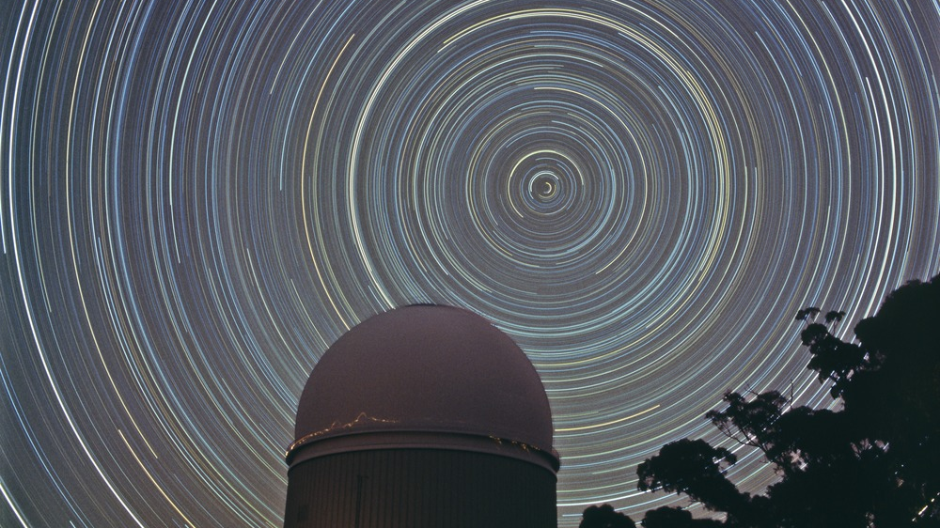
AAT Town Hall
Christian Wolf (ANU)
SSO Director
David Malin (AAO & DC)

Slide 2
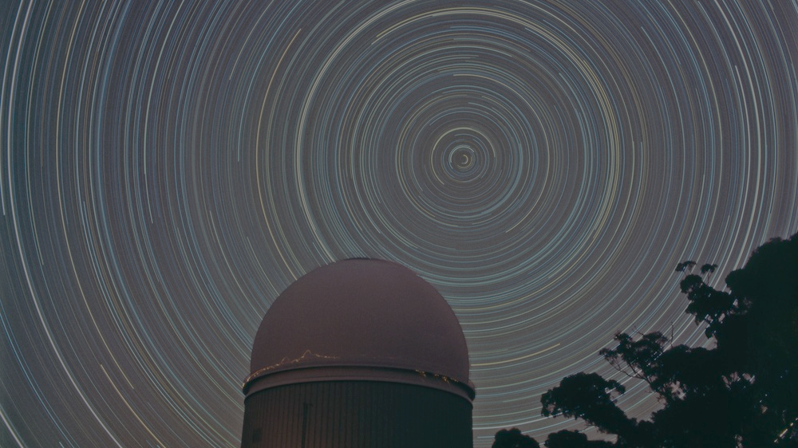
Executive Summary
Commonwealth funding July 2025 to June 2027
(formal announcement by Minister soon)
Long-term future under discussion
65% time for key projects
High performance
David Malin (AAO & DC)

Slide 3
Budget
Commonwealth: $1.5 million/year over two years
AAT Consortium: $2.4 million/year (from nine universities)
Paid time: $0.4 million/year
Total budget: $4.3 million/year
Observing time model:
  65% key projects
  25% open time (via ATAC)
  Rest paid time and Director’s time
David Malin (AAO & DC)

Slide 4
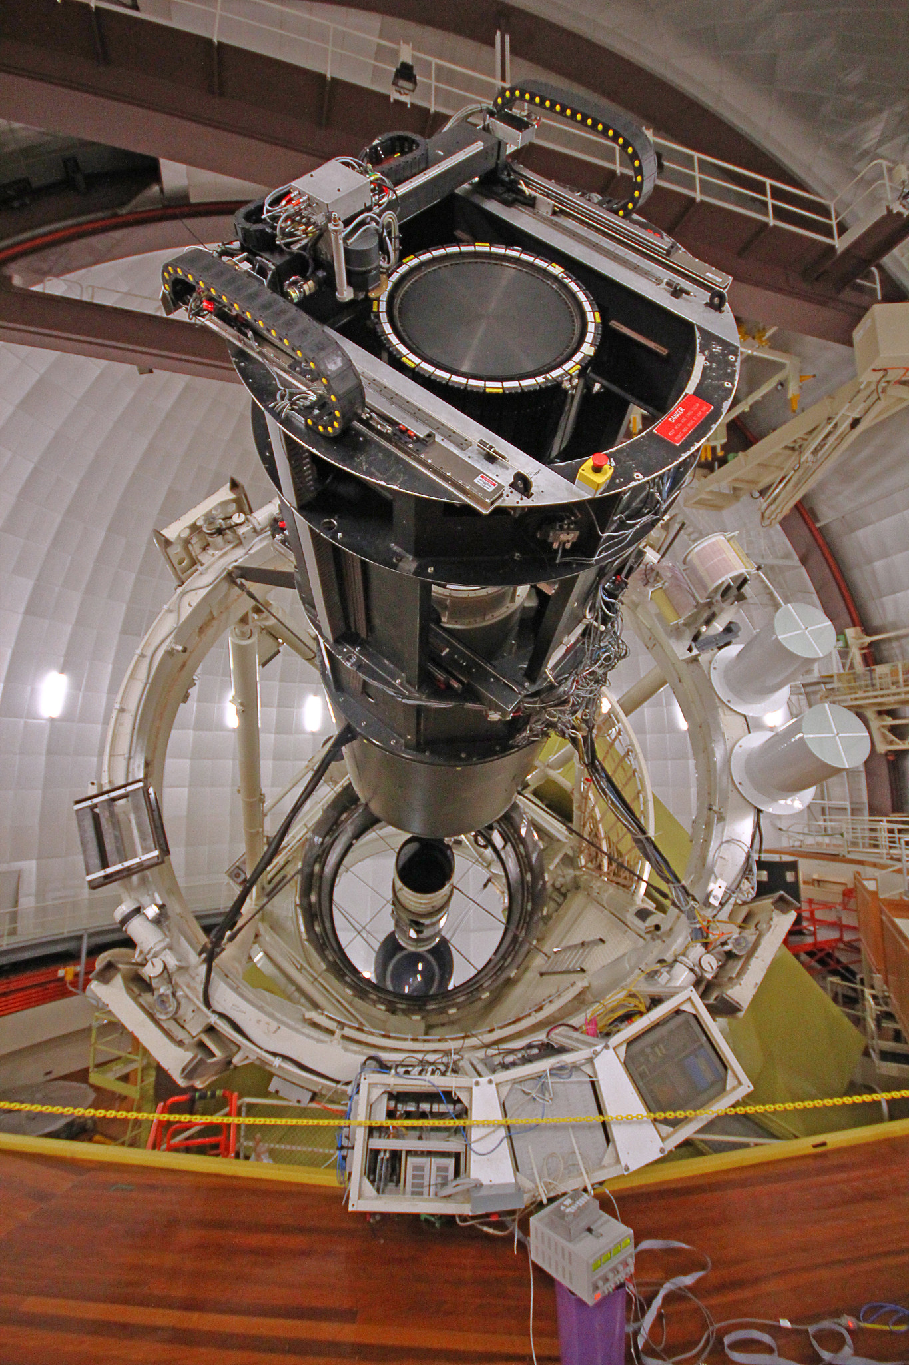
Instrumentation
Large instruments with four key projects
  AAOmega+Koala, Hector, Veloce
Visitor instruments occasionally
  E.g., HIPPI-2 at Cassegrain focus ∼20 nights/year
2dF undergoing refurbishment
  Plenty of surprises; on sky in November(?)
  Most important instrument for paid time
AAT testbed for new applications/instruments
David Malin (AAO & DC)
Weather 2025 1st half: worst in living memory?

Slide 5
Key Projects
Waiting to use the refurbished 2dF
Exoplanets with Veloce
  Follow-up of TESS exoplanets
  Add mass measurements to sizes
  Orbital periods: 1 day to 4 years
Hector Galaxy Survey
  15,000 galaxies at z<0.1, IFU
  Range of masses, environments
  Gas + stellar kinematics, outflows, star formation and morphology
OzARCH Survey
  Streams & shells in MW halo
  Kinematics & chemistry to 60 kpc
  Reconstructing dynamical history
GALAHAD – the Milky Way Disc
  “Next-generation GALAH”
  Highly accurate kinematics, ages, abundances for 30+ elements
  Every metal-poor star in Gaia
  Assembly history of MW disc
David Malin (AAO & DC)

Slide 6
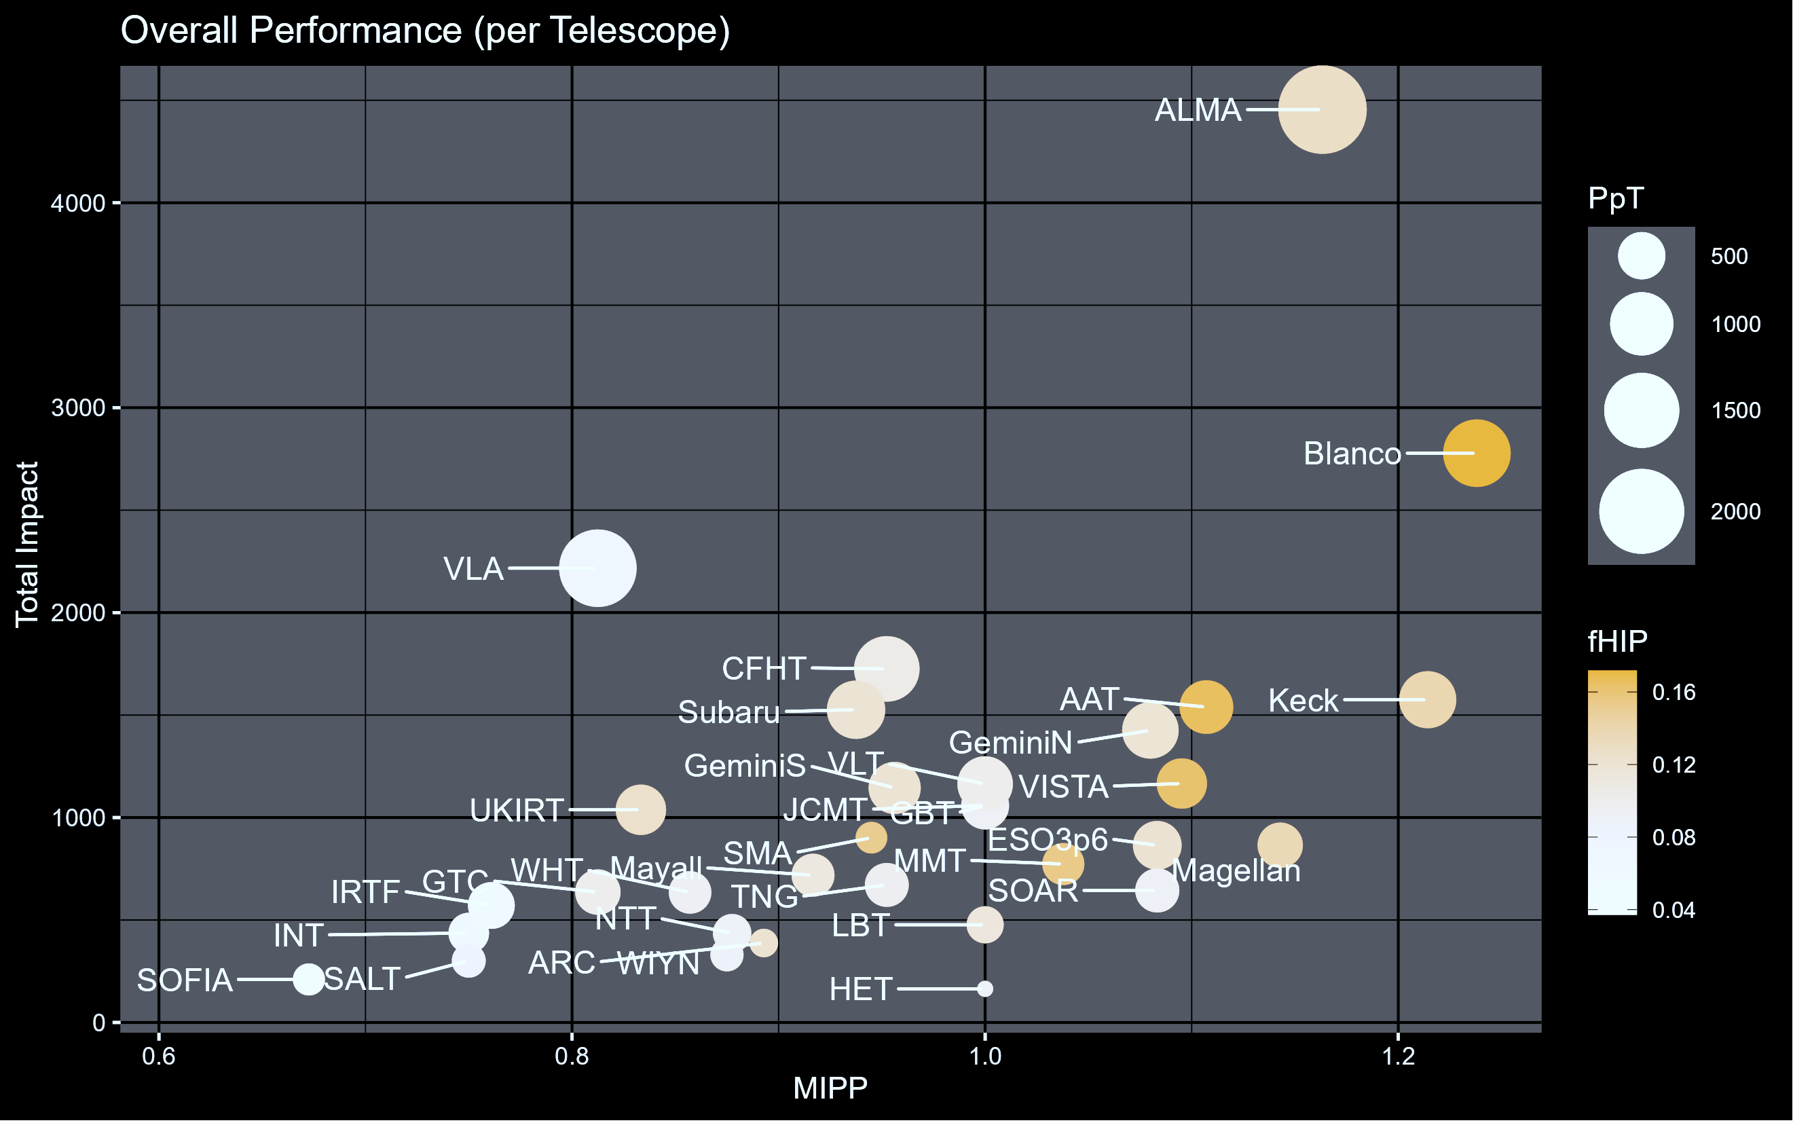
Downtime <5%
User satisfaction 4.5+/5
Weather usually 60-70% useful
Dennis Crabtree (NRC Herzberg)
Citations up to Feb 2025

Slide 7
Outlook
Current Activity
  Two key surveys progressing but two have not even started
Beyond July 2027
  AAT Consortium funding in place for +1.5 years, until Dec 2028
  DISR funding extension not ruled out, other options limited
  Key surveys may only be completed around 2030
Long-term future
  Unclear; decommissioning may be required
David Malin (AAO & DC)

