Slide 3
1. Apologies

Slide 4

2. Minutes of the 58th AGM
Available on the ASA webpage
For noting only
Minutes of the 58th Annual General Meeting
held at 14.00 pm (AEST) / 13.30 pm (ACST) / 12.00 pm (AWST) on Tuesday 25 June 2024
Entirely online meeting via Zoom, Spatial and YouTube
AGM Slack channel supporting live comment and discussion.
The Meeting was opened at 1:57 pm (AEST) with the President in the Chair and over 100 members online – approximately 62 on Zoom, 19 on Spatial and 26 on YouTube.

Slide 5
3. Business Arising from the Minutes
See following reports

Slide 6

4. President’s Report on Behalf of the Council
Council 2024-2025
Stas Shabala President
Richard McDermid (in 2024-25) Vice President
Ashley Ruiter (in 2024) Vice President
John Lattanzio Immediate Past President
John O’Byrne Secretary
Marc Duldig Secretary
Yeshe Fenner Treasurer
Christoph Federrath Councillor
Bernhard Mueller Councillor
Sarah Pearce Councillor
Ivy Wong Councillor
Richard McDermid (in 2024-25) Councillor
Claudia Lagos (in 2025) Councillor
Pradosh Barun Das Student Representative
Ivo Seitenzahl (in 2024) Chair, PASA Editorial Board
Minh Huynh (in 2025) Chair, PASA Editorial Board
Tanya Hill (Co-opted) Prizes and Awards Co-ordinator
Vanessa Moss Media and Outreach Co-ordinator
Available on the ASA webpage

Slide 7
1. Council 2024-2025
4. President’s Report
Council 2024-2025
Stas Shabala President
Richard McDermid (in 2024-25) Vice President
Ashley Ruiter (in 2024) Vice President
John Lattanzio Immediate Past President
John O’Byrne Secretary
Marc Duldig Secretary
Yeshe Fenner Treasurer
Christoph Federrath Councillor
Bernhard Mueller Councillor
Sarah Pearce Councillor
Ivy Wong Councillor
Richard McDermid (in 2024-25) Councillor
Claudia Lagos (in 2025) Councillor
Pradosh Barun Das Student Representative
Ivo Seitenzahl (in 2024) Chair, PASA Editorial Board
Minh Huynh (in 2025) Chair, PASA Editorial Board
Tanya Hill (Co-opted) Prizes and Awards Co-ordinator
Vanessa Moss Media and Outreach Co-ordinator
Sincere thanks to all for their time and effort.
Special thanks to those who are finishing their terms today.
Gary Da Costa continues to act as our
Public Officer in the ACT
Thanks to Chairs of Chapters and Groups:
ANITA: Fiona Panther
ECR: Amit Seta
EPOC: Jackie Bondell (and Fred Watson)
GAP: Mark Krumholz
IDEA: Devika Kamath
TDA: Ben Montet
SWG: Themiya Nanayakkara and Clancy James
CWG: Vanessa Moss
EWG: John Lattanzio and Terry Cuttle

Slide 8
2. The year in review
4. President’s Report
Details in my report - read it please !
Community contributions to the new Decadal Plan.
ASA’s continued advocacy for the importance of fundamental research.
Outstanding work by all our Chapters. Both continuing and new initiatives, including:
  Pleiades Awards (IDEA)
  ECR Software Prize, upcoming “History and Mystery” series (ECR)
  Theory workshop and summer school (ANITA)
  Synergies between astrophysical and particle physics probes of Dark Matter (GAP)
  Unconference (TDA)
  Careers brochure (EPOC, with ASTRO3D and OzGrav)
Establishment of:
  a new Joint Group (with Geological Society of Australia) in Stellar and Planetary Astronomy;
  a new History of Astronomy Chapter
  the Eclipse Working Group
Recognition of many ASA members by various bodies.
First ever online-first ASM in 2024
PASA continues to perform strongly, supported by membership.
Survey of ASA membership.

Slide 9
4. Awards and Honours
4. President’s Report
Professor Tamara Davis
(University of Queensland)
Elected as a Fellow of the Academy of Science
“Professor Tamara Davis is Australia's pre-eminent theoretical cosmologist, specialising in bridging the gap between cosmology theory and observations with a focus on dark energy. Throughout her career she has fortified the foundations on which modern cosmology is built. She has led efforts to make robust measurements of the homogeneity-scale of the Universe, invent a new way of measuring galactic distances, put upper-limits on the mass of the neutrino, and measure time-dilation in distant supernovae. Professor Davis has also led the cosmological analyses of several major astronomical surveys, resulting in deeper understanding of the properties of dark energy and constraining potential advanced theories of gravity.”

Slide 10
4. Awards and Honours
4. President’s Report
Professor Matthew Bailes (Swinburne)
Awarded the 2024 Prime Minister’s Prize for Science
“Along with his collaborators, he discovered the first fast radio burst (FRB) in 2007. His discovery has significantly advanced scientific understanding of the universe, including how much normal matter exists there. Scientists now use his techniques to study some of the most powerful explosions in the Universe.”

Slide 11
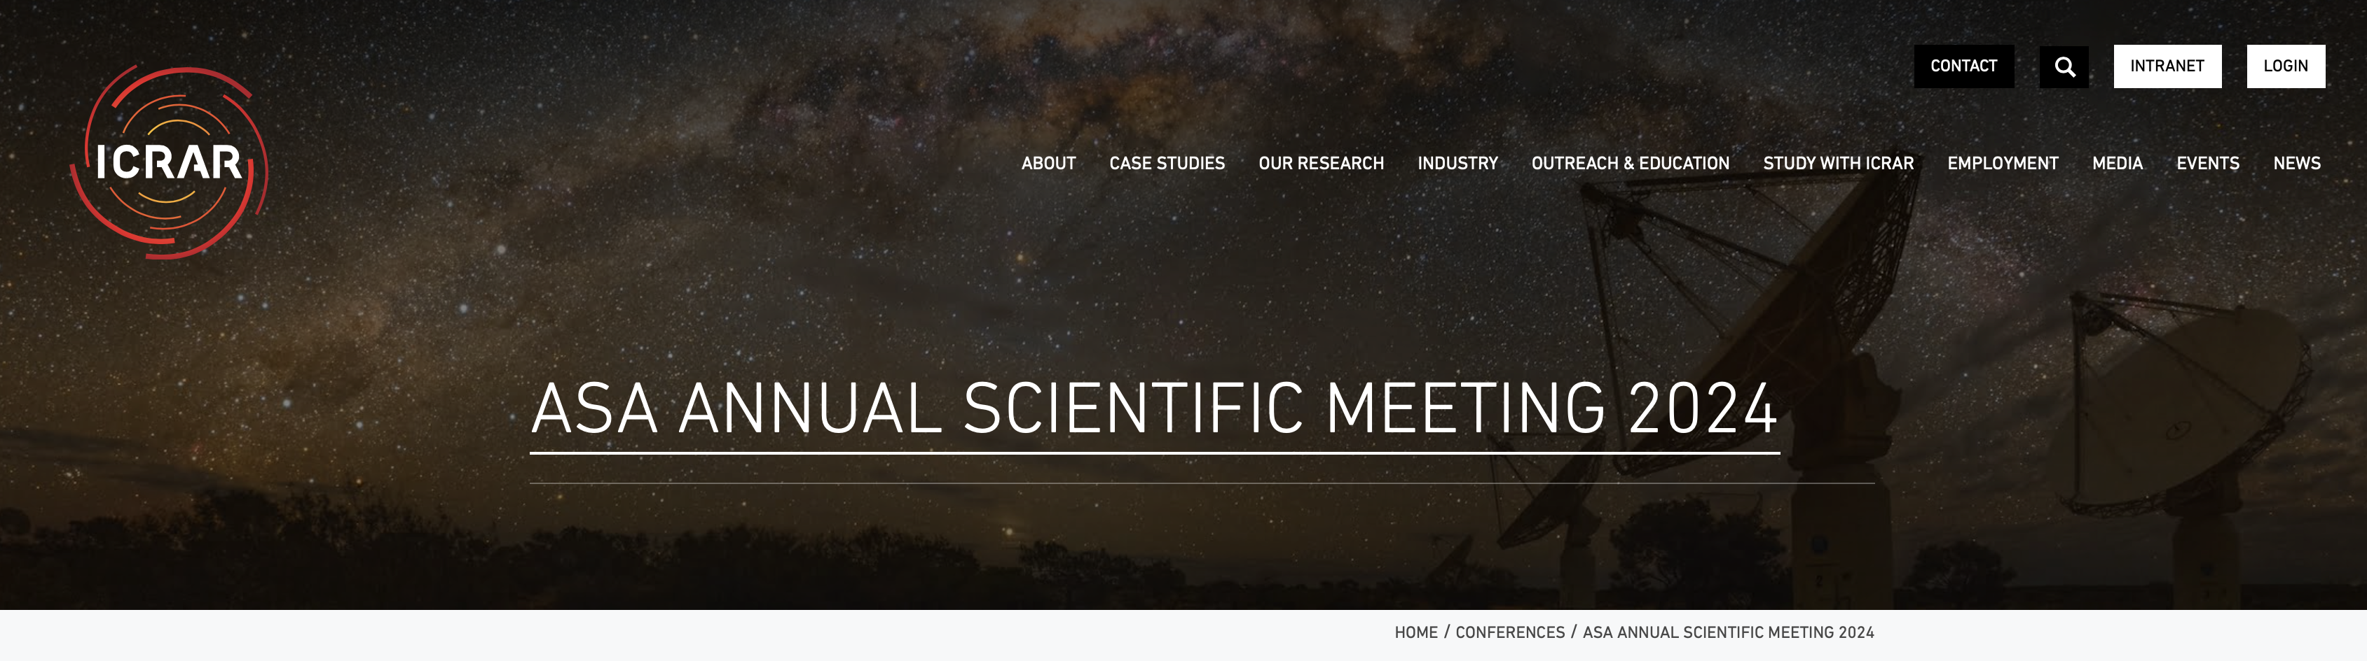
5. ASA Meetings
4. President’s Report
2024 ASM was held in online-first mode – for the first time ever.
Zoom, Slack, YouTube, Spatial. Technology access grants.
Hub Day on Wednesday.
NOC: Co-chaired by Clancy James and Vanessa Moss.
Student prizes for best talk and poster are in my report.
Harley Wood School of Astronomy on “Bigger than Big: Across all Scales in Science and Technology”, held at Long Point Conference Centre (NSW) with remote attendance option; 38 participants (35 in-person, 3 online).
273 registered
10 review talks, 44 contributed talks, 6 prize talks
87 posters
Plenary Sessions, Town Halls, training sessions

Slide 12
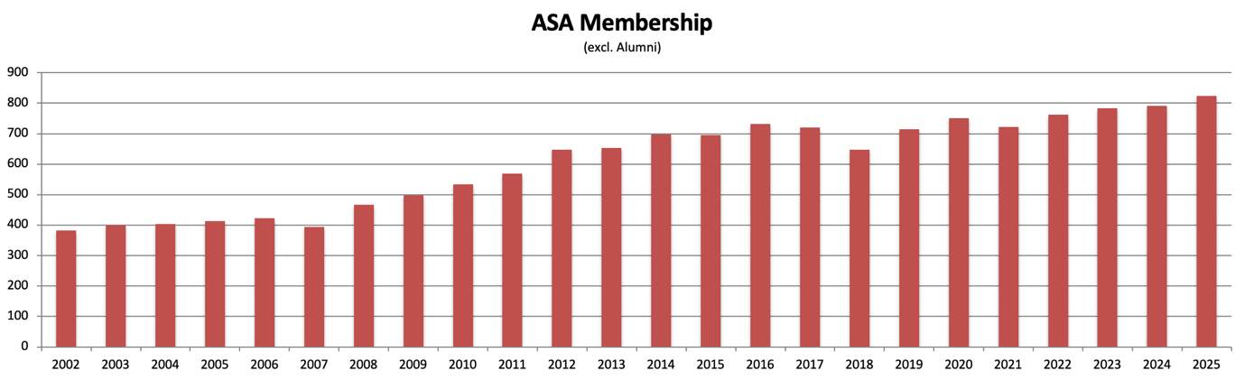
6. ASA Membership
4. President’s Report
Now 824 members (compared to 791 last year).
Stabilised with some mild growth in recent years.
Passing of three long-standing members: David Crawford, Denis Coates, Don Mathewson.

Slide 13
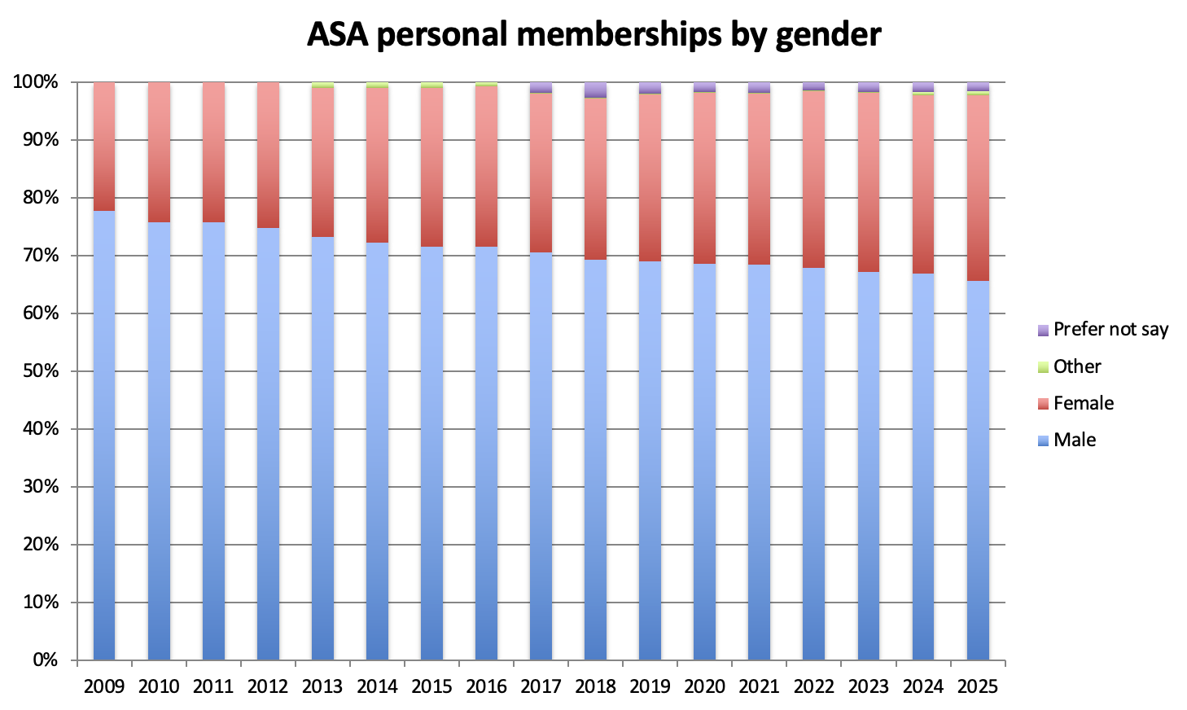
6. ASA Membership
4. President’s Report
259 Female
530 Male
4 Other
14 Prefer Not To Say
(includes Corporates)
32% female (was 31% last year)
Notes:
Other = indeterderminate/intersex/unspecified

Slide 14
7. Finances
4. President’s Report
A $30k surplus.
Significant income from PASA, plus income from a past ASM.
Membership fees frozen for the next year ( as for the last few years).
See Treasurer’s Report (Item 5 on Agenda).

Slide 15
8. Publications of the ASA (PASA)
4. President’s Report
Maintained a high number of submissions this year
IF similar to last year, on par with MNRAS, ApJ, AJ, A&A
New things: Overleaf Template, PASA Letters
Success driven by high-quality submissions from Australian astronomers
Send your big survey release paper to PASA !
See Editorial Board Report (Item 7 on Agenda).

Slide 16
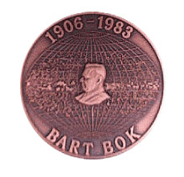
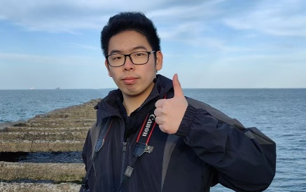
9. ASA Prizes and Awards
4. President’s Report
Bok Prize
“outstanding research in astronomy or a closely related field, by an Honours student or eligible Masters student at an Australian university.”
Li Yusen – ANU
Honours thesis title:
Orbital dynamics in barred Milky Way: the dynamical and chemical origin of the Hercules stream
Prize talk on Thursday

Slide 17

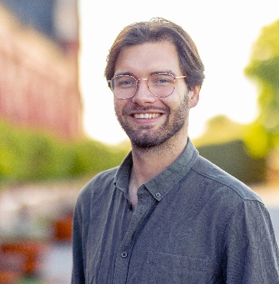
9. ASA Prizes and Awards
4. President’s Report
Charlene Heisler Prize
“most outstanding PhD thesis in astronomy or a closely related field, accepted by an Australian university ”
Matthew Miles – Swinburne
Doctoral thesis title:
Millisecond pulsar timing and gravitational wave searches with the MeerKAT radio telescope
Prize talk on Friday

Slide 18
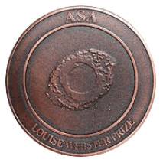
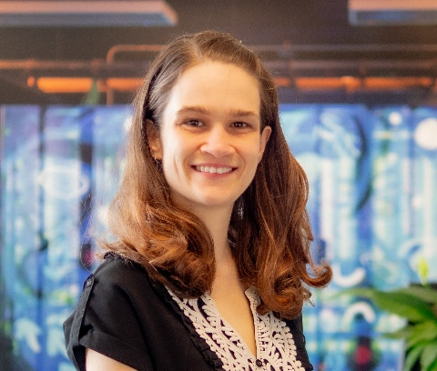
9. ASA Prizes and Awards
4. President’s Report
Louise Webster Prize
“outstanding research by a scientist early
in their postdoctoral career”
Rebecca Davies – Swinburne
“JWST reveals widespread AGN-driven neutral gas outflows in massive z~2 galaxies”
MNRAS (2024), 528, 4976
also a Superstar of STEM !

Slide 19

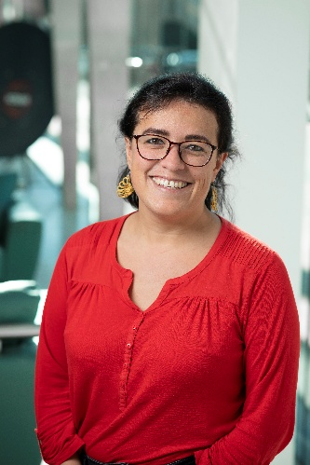
9. ASA Prizes and Awards
4. President’s Report
Anne Green Prize
“significant advance or accomplishment by a mid-career scientist”
Claudia Lagos – ICRAR-UWA
For her work on modelling the formation of galaxies, specifically the open source SHARK semi-analytic model which has led to breakthroughs in our understanding of the complex physics that governs galaxy formation and evolution.
Prize talk on Friday

Slide 20
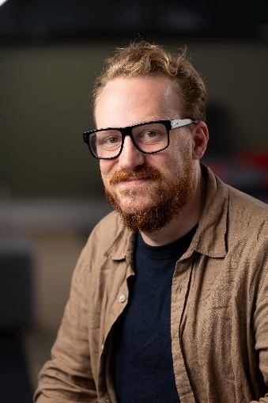
9. ASA Prizes and Awards
4. President’s Report
Emerging Leaders in Astronomy Software Development Prize
“outstanding contribution to the development of open-source astronomical software that is vital to the Australian astronomical community.”
Joshua Preston Pritchard – CSIRO
For DStools, a processing pipeline package specifically designed for radio interferometric data.
Prize will be presented tomorrow

Slide 21
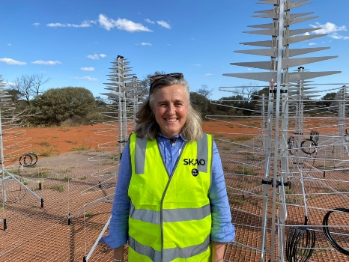
9. ASA Prizes and Awards
4. President’s Report
“Outstanding contributions in astronomy or a related field. The Lectureship is normally awarded every two years.”
Robert Ellery Lectureship
Naomi McClure-Griffiths – ANU
For seminal work based on high-fidelity observational surveys undertaken with Australia’s radio telescope facilities, including the discovery of a new spiral arm within the Milky Way, the first detection of neutral gas outflowing from the nucleus of the galaxy, and the pioneering demonstration of the importance of magnetic fields in the flow of matter into the Galactic disc.
Lecture will be delivered at the 2026 ASM

Slide 22

9. ASA Prizes and Awards
4. President’s Report
2025 breakdown by gender: note 32% of members are Female
 | Bok Prize | Heisler Prize | Webster Prize | Green Prize | Software
Total nominations | 13 | 9 | 6 | 6 | 4
% female nominations | 38% | 56% | 50% | 83% | 0%
% female short-list | 40% | 60% | 50% | 100% | 0%
Gender of winner | M | M | F | F | M
Thanks to Tanya Hill and all our judges
Once again we have engaged Science in Public to promote the Prizes

Slide 23
27. Student travel grants
4. President’s Report
There will be changes for the next student travel grant round.
Funding for up to one conference or workshop.
  This reverts back to pre-COVID rules
  Current scheme: can apply for one of each, up to $1500 per scheme and $2500 total. Only two students have done this in the history of the scheme.
The scheme will be competitive
  Or not, depending on the number of applications. But we have a fixed budget.
  Prioritise students with work to present, who have not previously had opportunity.
Value increased to up to $2,000 (from $1,500).
Sustainable funding: $25,000 / $2,000 = 12.5
Changes start after current round closes on Sep 30.

Slide 24
4. President’s Report
22. Science and Technology Australia
Peak body for Science and Technology in Australia. ASA is a member.
Strong lobby for science with government. Often amplifies ASA messages.
Organise Science meets Parliament each year. ASA delegates attended in 2025:
  Richard McDermid (Macquarie)
  Simon Ellingsen (ICRAR)
  Jane Kaczmarek (CSIRO)
  Amit Seta (ANU)
  Benjamin Pope (Macquarie)
23. National Committee for Astronomy
24. European Southern Observatory
25. Astronomy Australia Limited
ASA President is ex-Officio member of all these.
Details are in my report.

Slide 25
26. Priorities and Planned Activities for 2025-26
4. President’s Report
The Council has identified the following priorities for 2025-26:
Use the survey results of the ASA membership survey to inform ASA activities and priorities.
Manage PASA so that it remains an excellent option for ASA members in a rapidly changing publishing landscape.
Enable web submissions for ASA prizes and student grants.
Establish a working group to monitor and encourage diversity in ASA prize applications.

Slide 26
29. ASM/AGM and HWSA for 2026
4. President’s Report
2026 ASM/AGM
Australian National University
Chair: Melanie Kaasinen
In-person first, hybrid format
First two weeks of July

Slide 27
30. Membership survey – Preliminary results
4. President’s Report
Thanks to John Lattanzio for driving this !
Details in appendix to President’s report
264 responses
25% fixed term positions
55% continuing positions
Caveats
This is the first pass at results
No demographic analysis has been done – yet!

Slide 28
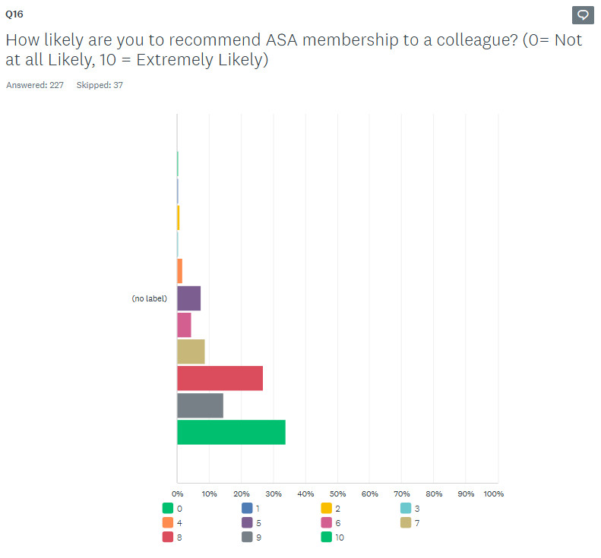
Is the ASA rubbish ?
You seem mostly happy
5
6
7
8
9
10

Slide 29
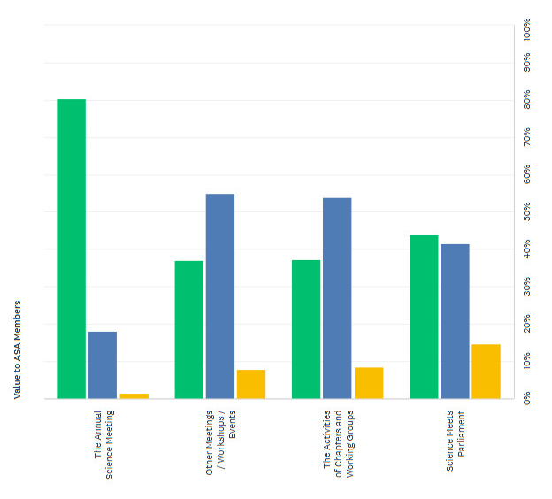

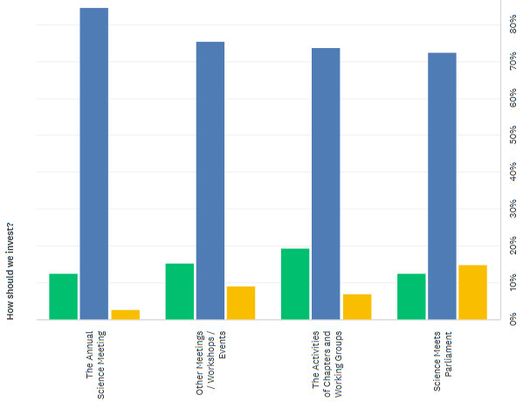

What is of value ?
ASM is the most valued thing we do
Spending “about right” for all these activities

Slide 30
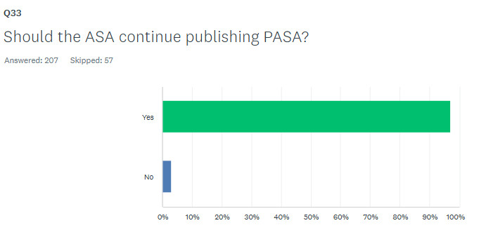
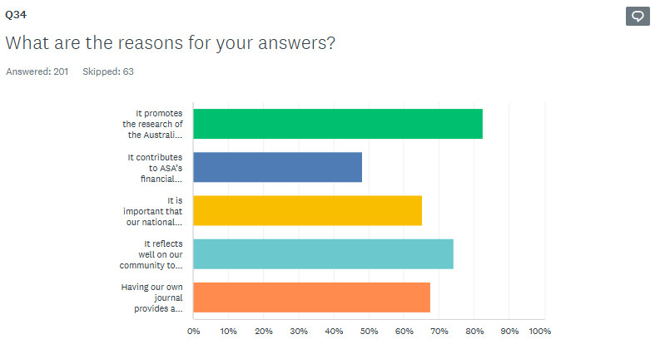
PASA
Fact: PASA brings $ to the ASA
Survey result: communication about transition to Open Access was done well

Slide 31
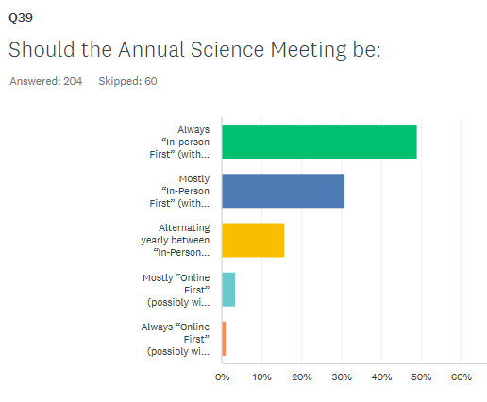
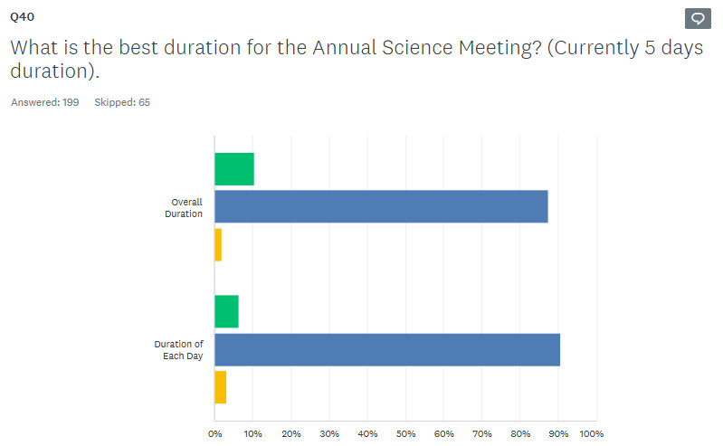

Annual Scientific Meeting
Strong preference for in-person first
Duration / format approximately right
Preference for June/July

Slide 32
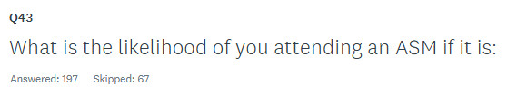
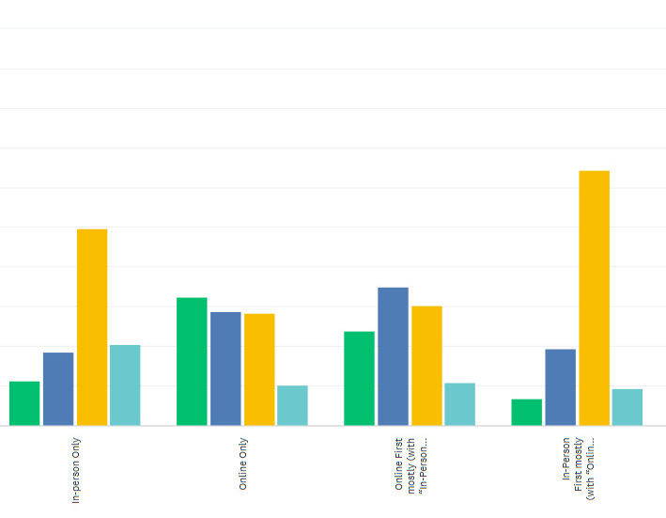

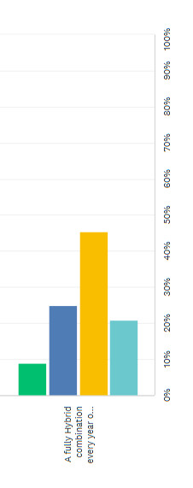
Annual Scientific Meeting
In-person is much more popular

Slide 33
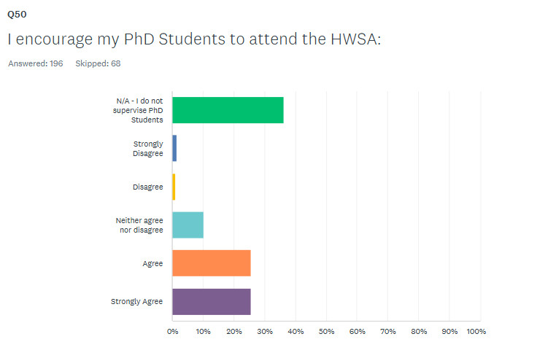
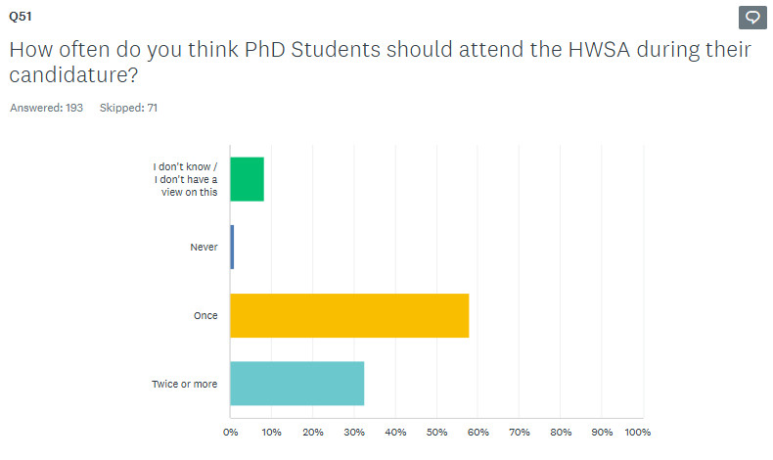
HWSA
Survey analysis is ongoing. Next step is to compare responses between demographic groups:
Gender
Career stage
Most encourage students and expect them to go once

Slide 34

32. Closing Remarks
4. President’s Report
Your Society is in a strong position.
  Financial
  Membership
  Engagement
Chapters, Groups and PASA are doing fabulous work
Special thanks to the hard-working Exec, and Council
Membership survey will inform ASA activities
Questions ?
Motion to accept my report please…

Slide 36
Treasurer’s Report
2025 ASA AGM
Yeshe Fenner
Reports: https://asa.astronomy.org.au/about-2/council-reports/
Slack channel: #agm

Slide 37
Overview
824 active members with 138 overdue renewals
Our business/operating accounts grew by ~$30K
Our Foundation accounts had a deficit of ~$13K
Our healthy financial position was used to fund initiatives incl: publicity for ASA prizes, travel support for students, Chapters and PASA editorial board & to support the implementation of the strategic plan
Financial reports have been finalised and accepted by the auditor and ASA.

Slide 38
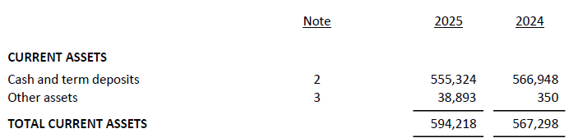
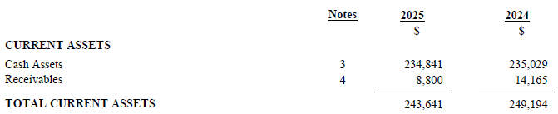
ASA & Foundation Equity
ASA accounts (for operational costs)
ASA equity equivalent to 4+ years of operating expenses
Foundation accounts (for donations and prizes)
Notes:
Our financial years end on the 31 March each year.
Our equity corresponds to about 4 years of operating costs
Payables for ASA = Invoices to be paid, amounts to be transferred to FAA, GST payable, auditor costs

Slide 39
ASA & Foundation Equity
Notes:
Our financial years end on the 31 March each year.
Our equity corresponds to about 4 years of operating costs
Payables for ASA = Invoices to be paid, amounts to be transferred to FAA, GST payable, auditor costs

Slide 40
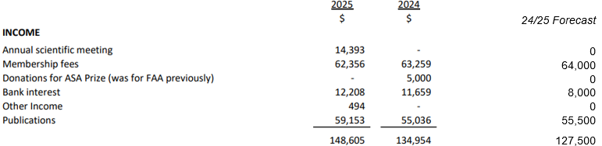
ASA Income
Interest earnings higher than in recent years due to higher interest rates on Term Deposits
Revenue from PASA a little higher than forecast
Income included recouped surplus from a past ASA ASM

Slide 41
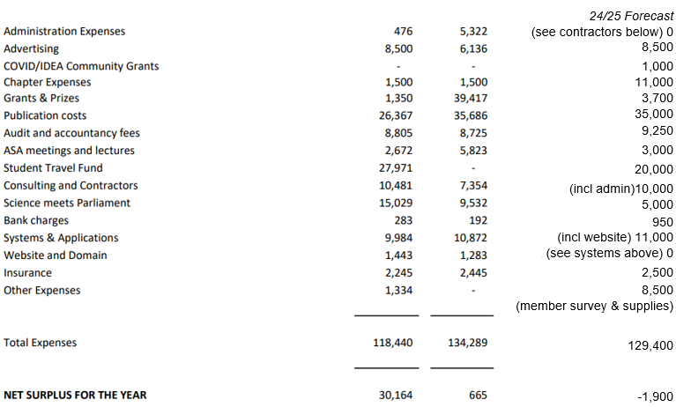
ASA Expenditure
Student travel awards dropped from ~$39K in 2024 to $28K, but still >budget ($20K).
Publication costs = PASA Editorial fees. Not everyone invoiced us. ~$9000 in fees are owing.
Advertising = promotion of ASA Prizes through Science in Public.
Science meets Parliament higher than budget (costs are for six delegates).
Chapter costs lower than budget
Notes:
P4 – what are “trade debtors” for ~$30k?
o Mostly it is a Cambridge Uni Press invoice that wasn't paid until after 31/3/25 for $30,203.91, plus some other smaller invoices that were also dated before 31/3/2025 but paid after that date.
· P5 – I’ll ask before others do?
o Advertising is largely SiP?
§ Yes
o Grants and prizes – why so large in 2024 and not now?
§ In 2024, the auditors included the student travel awards in that item, whereas this year we have that listed as a separate item.
o Student travel fund – why nothing in 2024 and large now?
§ As above
o What does Systems and Application mean?
§ Includes STA annual membership, survey monkey subscription, wild apricot subscription, HR analytics survey drafting costs
· P6 – What are the Current Liabilities – payables? - Since accompanying notes explaining the Note numbers are not attached.
o Sorry - the pages are out of order, I will fix that too in the version that goes to our members. Here's the details. Trade creditors is an invoice that we received before 31/3/25 but we paid it after 31/3/25. Accrued expenses is anticipated auditor fees that doesn't get charged until after the audit work is done. And then there's GST.


Slide 42
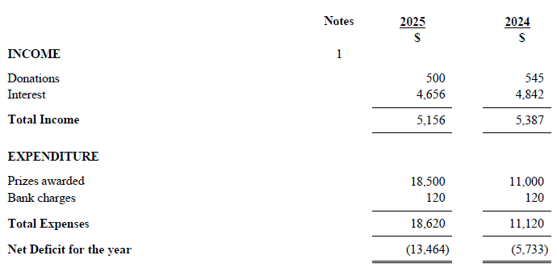
Foundation Financials
Prizes: Heisler $1000; Green $2500 x 2; Webster $2500; Bok $1000; ECR software $1500, David Allen $5000; Ellery Lecture $2500
FAA perpetuity model assumed interest rate of 3% and annual donations of $3500
If you would like to donate, to help recognise our members’ achievements and make the Foundation more sustainable, please visit https://asa.wildapricot.org/Donate
Notes:
FAA perpetuity model assumed interest rate of 3% and annual donations of $3500
FAA is required to distribute each year at least 4% of the market value of its net assets (as at the end of the previous financial year) or $8800 (whichever is greater)

Slide 43
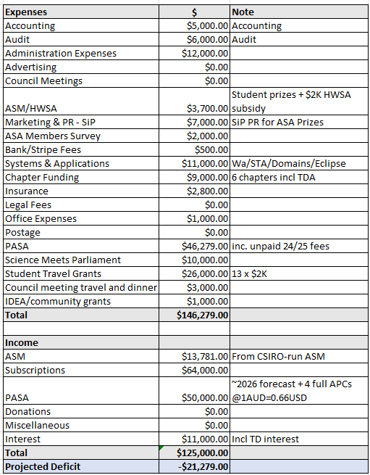
2025/2026 budget forecast
This conservative budget predicts a deficit next year of ~$21K.
PASA estimated costs include the editor fees unpaid from 2024/25.
Increased the forecast costs for SmP and student travel grants.
PASA revenue is a little uncertain since moving to the new model.
Notes:
Conservative estimates, as some of these cost items are at the upper end of the range

Slide 44
ASA Membership Rates 2026
 | Current Rate | 2026 Rate | Discount | Rate if paid by 28/2/2026
Fellow | 213 | 213 | 33 | 180
Member | 178 | 178 | 33 | 145
Student, Retired, Overseas | 85 | 85 | 22 | 63
Associate | 85 | 85 | 22 | 63
Associate Society | 119 | 119 |  | 119
Corporate Member | 0 | 0
We would usually raise fees by CPI (which was 2.4% for the year ending March 2025). However, we propose to once again freeze the fees (the 5th year in a row), in recognition of our healthy financial position, and financial pressures some of our members may be facing.

Slide 45
Election of auditor
We propose to re-engage the services of Jeff Ryan C.A. B Bus from Thomas Davis & Co, who handled this year’s audit, to undertake next year’s audit.

Slide 46
Questions
Reports: https://asa.astronomy.org.au/about-2/council-reports/
Slack channel: #agm

Slide 48
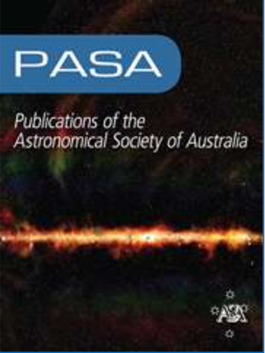
7. PASA Editorial Board Report
Minh Huynh (CSIRO), PASA Editor in Chief
Written report:
Written report will be circulated via email and be available for download.

Slide 49
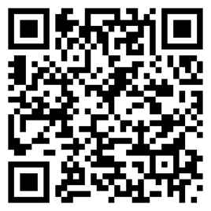
7. PASA Editorial Board Report: Editorial Board Update
Minh Huynh (CSIRO), Editor in Chief (from 1 Jan 2025)
Andrew Hopkins (Macq Uni), Deputy Editor in Chief (from 1 Jan 2025)
Nithya Thyagarajan (CSIRO), Associate Editor (from 1 Jan 2025)
Luca Casagrande (ANU), Associate Editor (from 1 Jan 2025)
Evanthia Hatziminaoglou (ESO, Germany), Associate Editor
Pablo Saz-Parkinson (Uni. of Santa Cruz, USA) ), Associate Editor (until 31 Oct)
Anna Kapinska (NRAO, USA) ), Associate Editor (until 31 Aug)
Searching for two new Associate Editors
Please consider applying! Deadline 15th July
https://aas.org/jobregister/ad/8d736527

Slide 50

Successfully transitioned to Open Access on 1 Jan 2025
- author flip Nov 2024
- publishing in PASA currently free for majority of Aus community (transf. agreement)
- APCs discounted by 20% for ASA members
- APC waivers offered by CUP
PASA Letters now open for submission!
- For rapid publication of high impact and novel research that merit a quick turnaround
7. PASA Editorial Board Report: Main PASA News

Slide 51
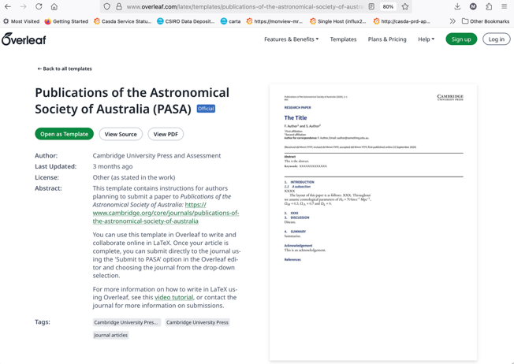
Overleaf Template:
- New overleaf template (since May)
- Findable from Overleaf directory
PASA Datastore
- now at Data Central
- deposit datasets up to 1TB in size
- we can archive your data with your paper!
7. PASA Editorial Board Report: Other PASA News

Slide 52
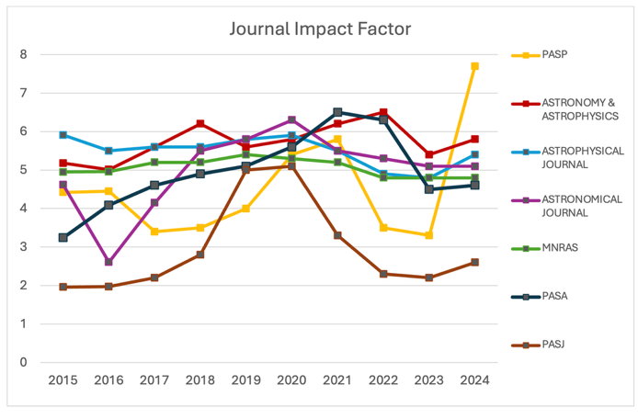
7. PASA Editorial Board Report: Impact Factor
The 2024 journal IF is 4.6, and increase of 0.1 from 2023.
Steady increase since 2015 (and earlier), small drop in last two years.
Now slightly below our peer journals (ApJ, AJ, A&A, MNRAS), but we are a small journal with year on year variation.
We remain a Q1 journal.

Slide 53
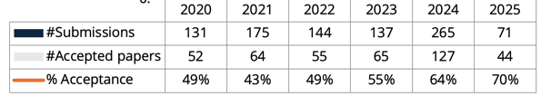
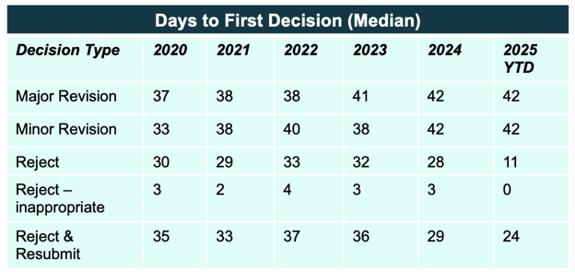
7. PASA Editorial Board Report: PASA Performance
Submissions:
Large increase (~x2) in original submissions in 2024, sustained into 2025
No page volume budget, so increase is not an issue
Top countries for submissions YTD in 2025: Australia (67, 52%), India (9), Turkey (9), China (8), USA (7)
  USA is new in top 5 since 2023
Turnaround times:
Median times have remained steady in last few years, creep up from 2020?
Thank you to diligent work from associate editors
Stats in May 2025

Slide 54
PASA is healthy, receiving high-quality submissions.
We need your support: publish in PASA, review for PASA, advocate for PASA.
7. PASA Editorial Board Report
“PASA is a society journal and the editorial board is working hard to create a product that satisfies the needs of the community. Thanks to the outstanding work of all the EiCs before me, PASA is now one of the leading journals in astronomy.
We need your active support to remain so. PASA is your (our) journal! Thank you!”
minh.huynh@csiro.au

Slide 57
The BIGGEST thank you #1
21 years of service
Councillor 1997-99
PASA Editor-in-Chief 2002-08
Councillor 2009-11, 2017-19
Vice-President 2019-21
President 2021-23
Imm. Past President 2023-25
? What do John’s colleagues really think of him ?
“Versatile leader”
“Wonderful human being”
“A wise and good-natured colleague”
“Fairness, fairness, fairness”
“Generous and honest, with a great sense of humour”

Slide 58
The BIGGEST thank you #2
40 years of service
2 years as Councillor 1997-99
38 years as Secretary
also AIP President (2011-13) and Treasurer
? What do Marc’s 20 ASA presidents really think of him ?
“A trusted friend and an outstanding contributor to our community”
“Dedicated, supportive. His knowledge of ASA happenings over a period of decades is second to none.”
“Mr Precedent”
“Without doubt an ASA legend”
“Great sense of bureaucratic humour, doing what was needed super efficiently and making onerous tasks almost seem pleasant”
“Wise counsel for managing difficult situations”
Notes:
Roy Allen medal for exceptional service to society

Slide 60
9. ASA Council for 2025-27
Richard McDermid President
Claudia Lagos Vice President
Stas Shabala Immediate Past President
John O’Byrne Secretary
Katrina Sealey Secretary
Yeshe Fenner Treasurer
Nichole Barry Councillor
Manisha Caleb Councillor
Nick Seymour Councillor
Ivy Wong Councillor
Daniel Zucker Councillor
Pradosh Barun Das Student Representative
Minh Huynh Chair, PASA Editorial Board
Tanya Hill Prizes and Awards Co-ordinator
Vanessa Moss Media and Outreach Co-ordinator
New President and Vice-President.
New Secretary.
Four new Councillors.
Thank you to outgoing Councillors:
Christoph Federrath
Sarah Pearce
Bernhard Muller
Welcome to our new President

Slide 61

Meeting Closed

