Slide 1

Neutron Star Structure in QMC with Hyperons and High-Density Repulsion
Jesper Leong, University of Adelaide
Supervisor: Professor Anthony Thomas

Slide 2
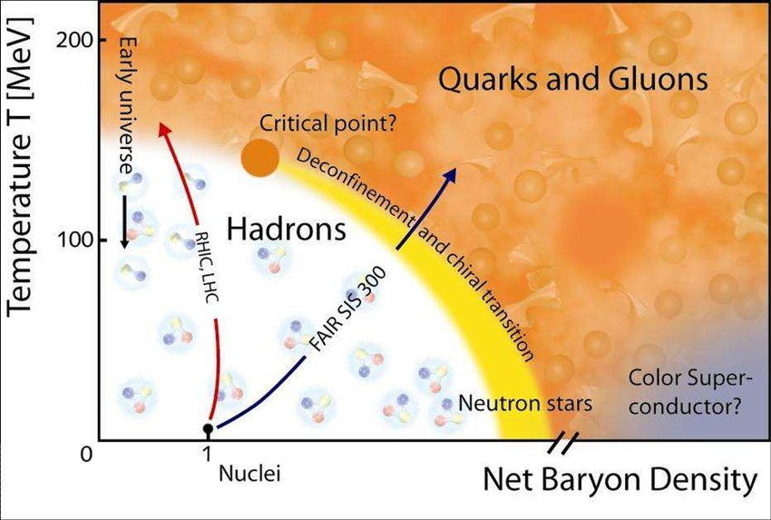
Why Neutron Stars?
Liquid Drop Model, shell models, potential models , QMC, …
Neutron Stars are crucial at constraining the Equation of State
Are NS made of nucleons, hyperons or deconfined quark matter?
Neutron Stars constrain the EoS
“Known physical ideas which are ignored when studying finite nuclei need to be incorporated when describing neutron stars because of the extreme conditions nuclear matter is now in”

Slide 3
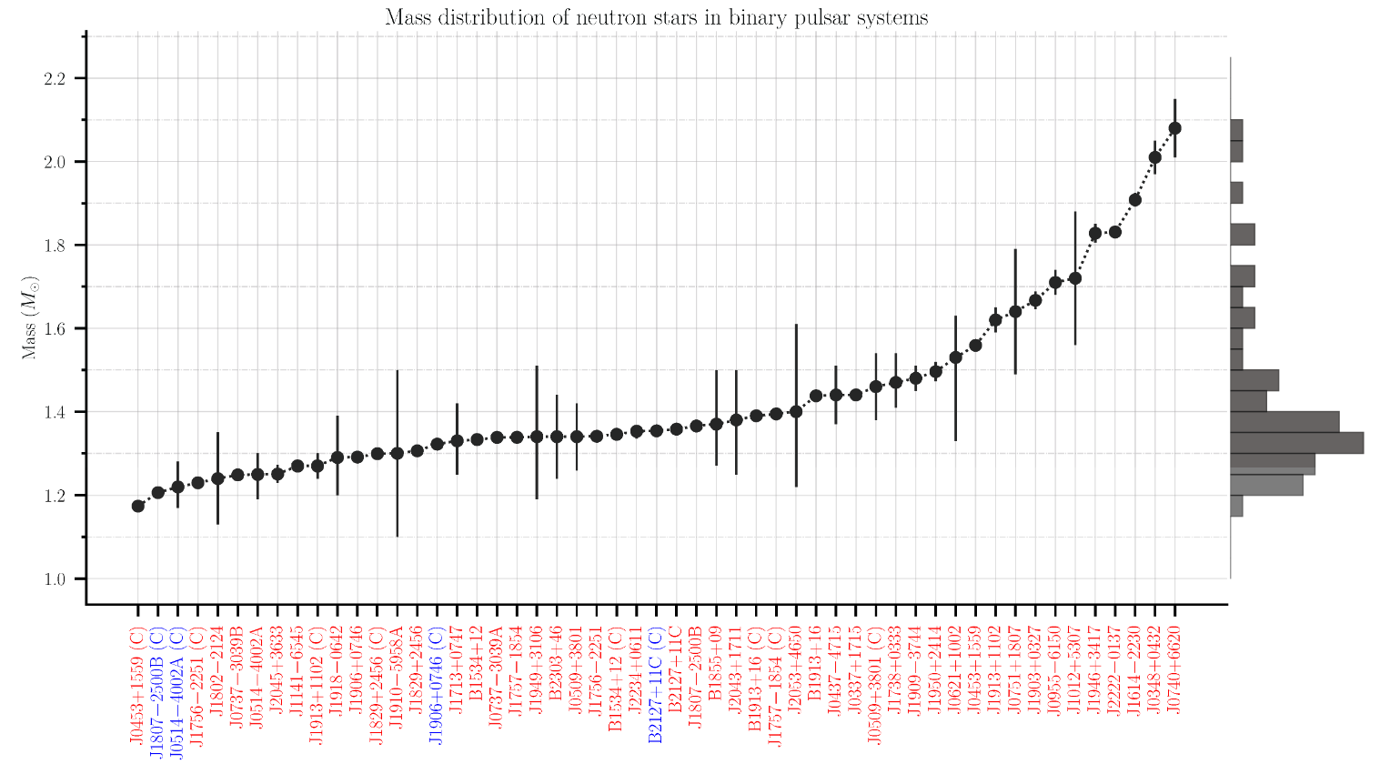
https://www3.mpifr-bonn.mpg.de/staff/pfreire/NS_masses.html

Slide 4
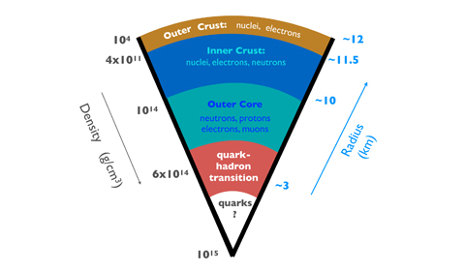
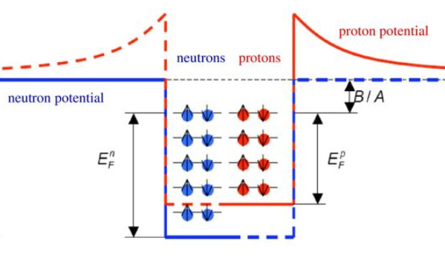

Heavy NS and the Hyperon Crisis
PSR J0348+0432: $M={2.01}_{−0.04}^{+0.04}$ $M_{⊙}$
PSR J0740+6620: $M={2.072}_{−0.066}^{+0.067}$ $M_{⊙}$
PSR J0952-0607$: M={2.35}_{−0.17}^{+0.17}$ $M_{⊙}$
NS have core densities of 4-10 $n_{0}$
β-equilibrium: Hyperons appear $>3{ n}_{0}$ (QMC)
Hyperons: Low momentum
Little Pressure
Soften EoS
Low Mass Stars

Slide 5
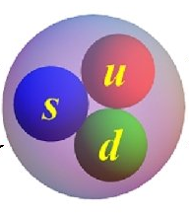
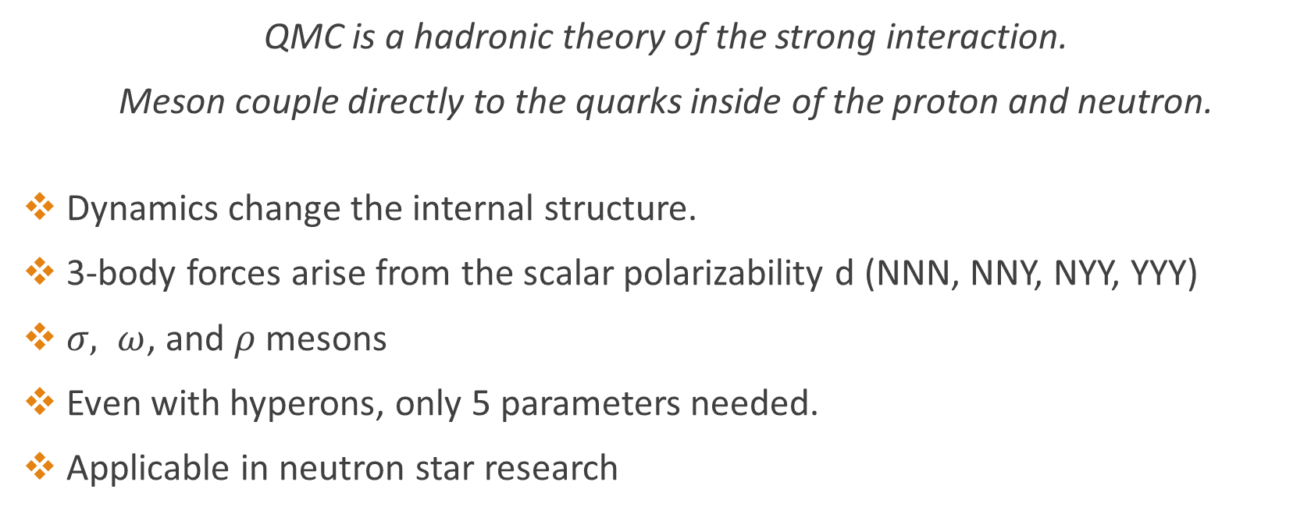


Quark-Meson-Coupling
$$M_{f}^{∗}=M_{f}−w_{σ}^{f}g_{σ}σ− {\tilde{w}}_{σ}^{f}\frac{d}{2}(g_{σ}σ)^2$$
$$E_{f}=\sqrt{{M_{f}^{∗}}^{2}+{\vec{k}}^{2}}+g_{ω}^{f}ω+g_{ρ}^{f}I_{m}^{f}ρ$$
QMC is a hadronic theory of the strong interaction.
Meson couple directly to the quarks inside of the proton and neutron.
Dynamics change the internal structure.
3-body forces arise from the scalar polarizability d (NNN, NNY, NYY, YYY)
$σ, ω$, and $ρ$ mesons
Even with hyperons, only 5 parameters needed.
Applicable in neutron star research
P. A. M. Guichon, J. R. Stone, and A. W. Thomas, Quark-Meson-Coupling model for finite nuclei, nuclear matter, and beyond,Prog. Part. Nucl. Phys. 100, 262 (2018)
Note: The isoscalar-scalar $δ$-interaction has recently been explored by Motta et al., 2019

Slide 6
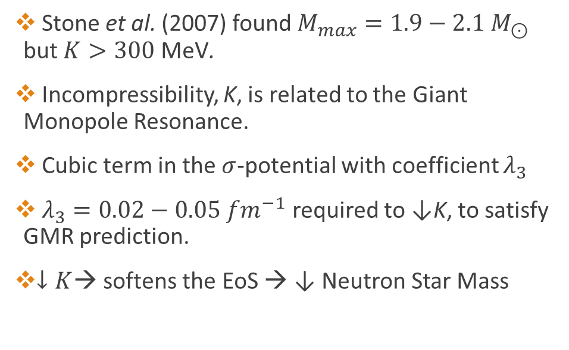
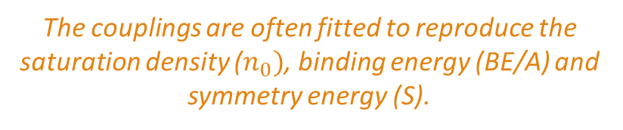
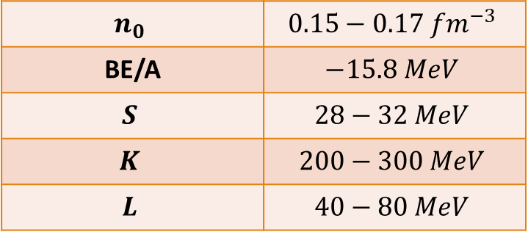
Review: QMC and Neutron Stars
$$n_{0}$$ | $$0.15−0.17 {fm}^{−3}$$
BE/A | $$−15.8 MeV$$
$$S$$ | $$28−32 MeV$$
$$K$$ | $$200−300 MeV$$
$$L$$ | $$40−80 MeV$$
Stone et al. (2007) found $M_{max}=1.9−2.1 M_{⊙}$
but $K>300$ MeV.
Incompressibility, K, is related to the Giant Monopole Resonance.
Cubic term in the $σ$-potential with coefficient $λ_{3}$
$λ_{3}=0.02−0.05 {fm}^{−1}$ required to ↓K, to satisfy GMR prediction.
$↓K$→ softens the EoS → ↓ Neutron Star Mass
The couplings are often fitted to reproduce the saturation density ($n_{0})$, binding energy (BE/A) and symmetry energy (S).

Slide 7
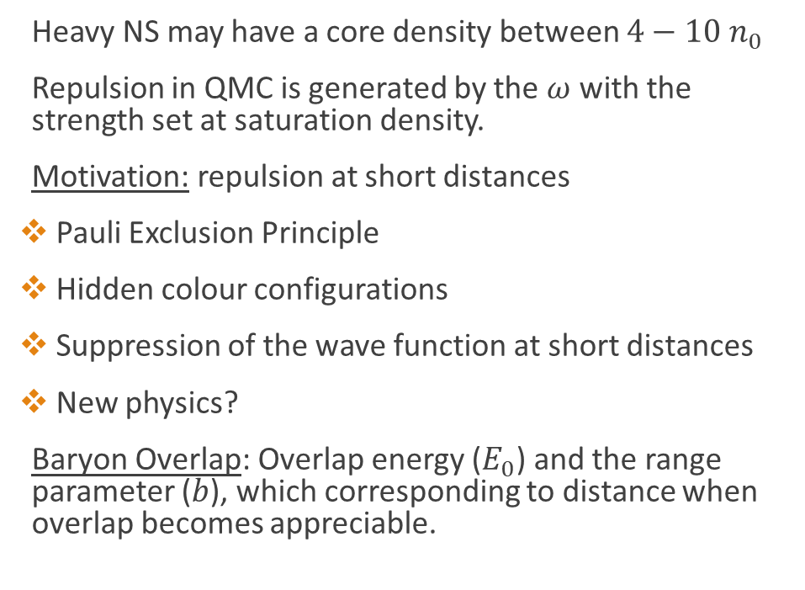
High Density Repulsion
Baryon Overlap
Heavy NS may have a core density between $4−10 n_{0}$
Repulsion in QMC is generated by the $ω$ with the strength set at saturation density.
Motivation: repulsion at short distances
Pauli Exclusion Principle
Hidden colour configurations
Suppression of the wave function at short distances
New physics?
Baryon Overlap: Overlap energy ($E_{0}$) and the range parameter ($b$), which corresponding to distance when overlap becomes appreciable.

Slide 8
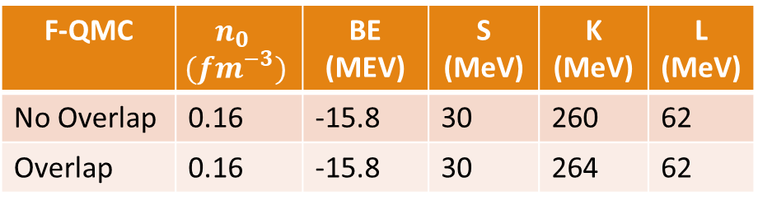
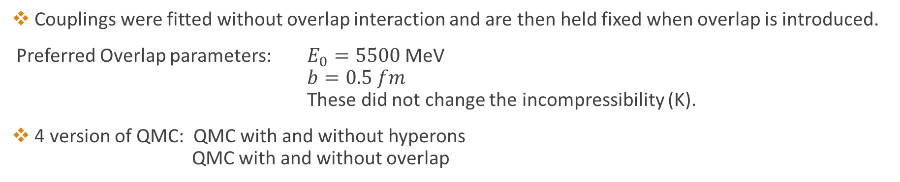
Parameters and Infinite Symmetric Nuclear Matter Properties at Saturation
The hypothesis is that the overlap interaction is only detectable at high densities
Therefore should not change the nuclear properties at ordinary densities (see table)
F-QMC | $$n_{0} \\ ({fm}^{−3})$$ | BE (MEV) | S (MeV) | K (MeV) | L (MeV)
No Overlap | 0.16 | -15.8 | 30 | 260 | 62
Overlap | 0.16 | -15.8 | 30 | 264 | 62
Couplings were fitted without overlap interaction and are then held fixed when overlap is introduced.
Preferred Overlap parameters: $E_{0}=5500$MeV
$b=0.5 fm$
These did not change the incompressibility (K).
4 version of QMC: QMC with and without hyperons
QMC with and without overlap

Slide 9
QMC Equation of State
Hyperons only appear in stars which have a core density greater than 3 times saturation density (above).
Hyperons (solid lines) soften the EoS
QMC without overlap is indicated in red
Overlap is repulsive and stiffer (blue) the EoS

Slide 10
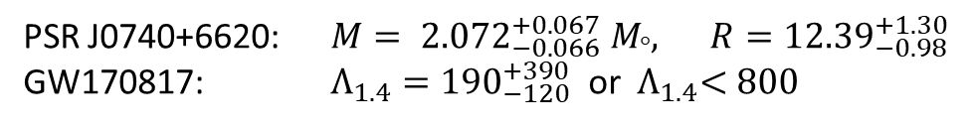
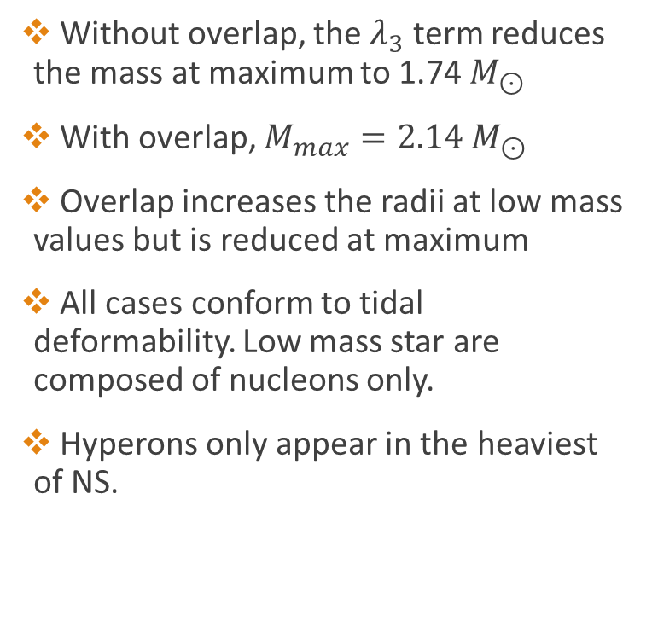
Bulk Properties of NS
Without overlap, the $λ_{3}$ term reduces the mass at maximum to 1.74 $M_{⊙}$
With overlap, $M_{max}=2.14 M_{⊙}$
Overlap increases the radii at low mass values but is reduced at maximum
All cases conform to tidal deformability. Low mass star are composed of nucleons only.
Hyperons only appear in the heaviest of NS.
PSR J0740+6620: $M= {2.072}_{−0.066}^{+0.067} M_{°}, R={12.39}_{−0.98}^{+1.30}$
GW170817: $Λ_{1.4}={190}_{−120}^{+390}$ or ${ Λ}_{1.4}<800$

Slide 11
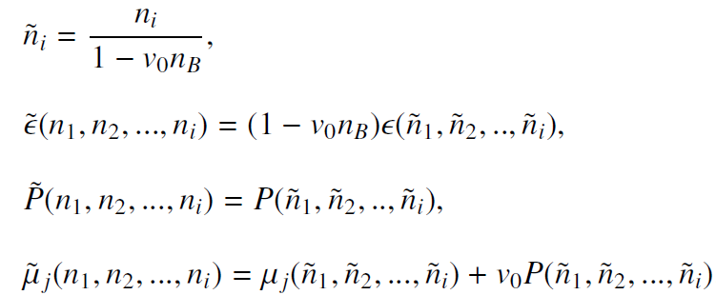
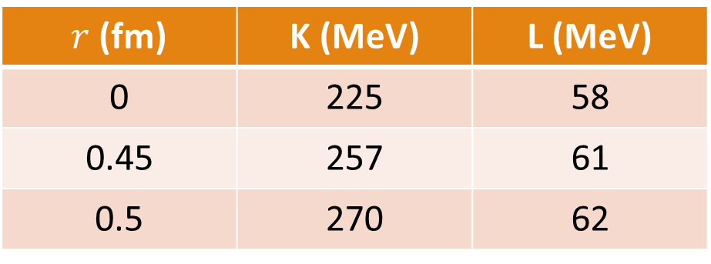
Excluded Volume Effect (EVE)
All baryons adopt a finite size, $v_{0}=\frac{4}{3}πr^{3}$, regardless of flavour. No baryon is permitted to enter the space occupied by other baryons.
$r$ (fm) | K (MeV) | L (MeV)
0 | 225 | 58
0.45 | 257 | 61
0.5 | 270 | 62
Rischke, Gorenstein, Soecker, Greiner, Excluded volume effect for the nuclear matter equation of state, Phys. C 51 (1991)

Slide 12

$β$-equilibrium
Hyperons: $Λ Ξ^{−} Ξ^{0}$
EVE lowers the threshold of hyperon appearance

Slide 13

Causality
EVE is known to violate Special Relativity
Causality requires $c_{s}^{2}<1$
Markers indicate central density at maximum
The core density of the physical star does not violate causal for r<0.5 fm

Slide 14
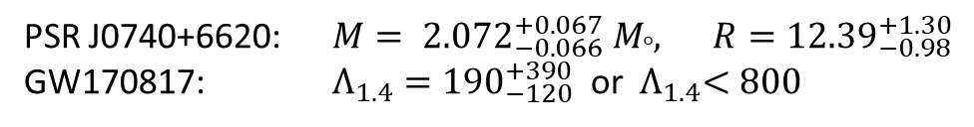

MR curve and Tidal Deformation
Hardcore radius, r, increases the maximum mass and the radii at all mass values.
- $r=0.45 fm→2.06 M_{⊙}$
- $r=0.5 fm →2.22 M_{⊙}$
Tidal deformation but for $r = 0.5 fm$ only if $Λ_{1.4}<800$
PSR J0740+6620: $M= {2.072}_{−0.066}^{+0.067} M_{°}, R={12.39}_{−0.98}^{+1.30}$
GW170817: $Λ_{1.4}={190}_{−120}^{+390}$ or ${ Λ}_{1.4}<800$

Slide 15
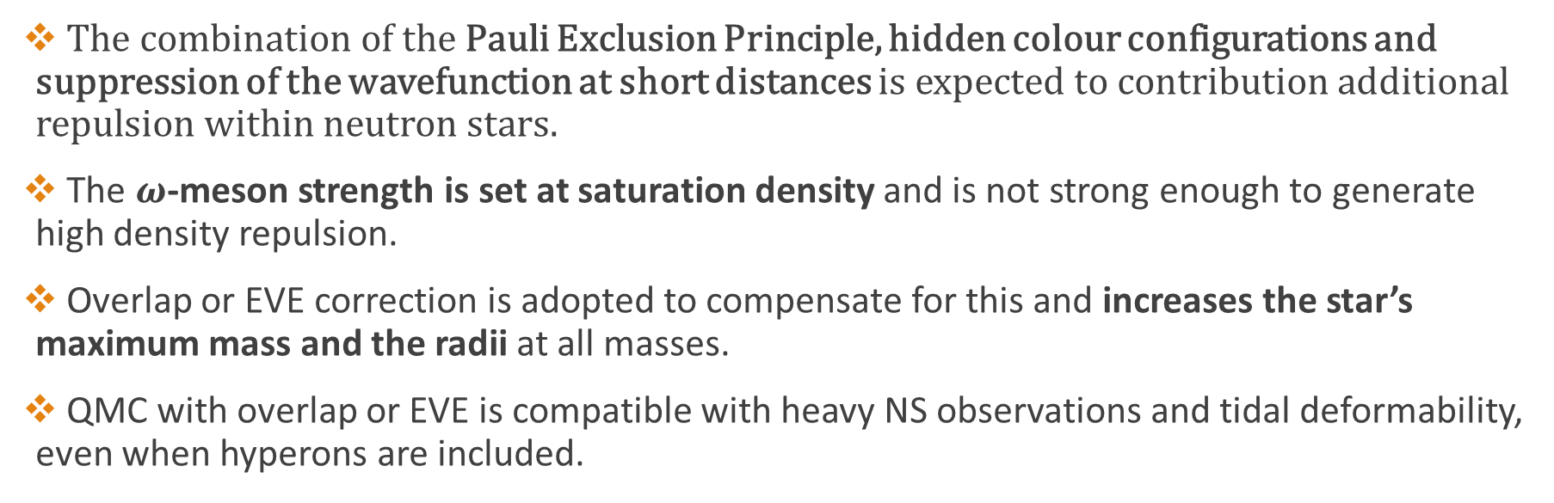
Summary: Overlap and EVE
The combination of the Pauli Exclusion Principle, hidden colour configurations and suppression of the wavefunction at short distances is expected to contribution additional repulsion within neutron stars.
The $ω$-meson strength is set at saturation density and is not strong enough to generate high density repulsion.
Overlap or EVE correction is adopted to compensate for this and increases the star’s maximum mass and the radii at all masses.
QMC with overlap or EVE is compatible with heavy NS observations and tidal deformability, even when hyperons are included.

Slide 16

References
J. Leong, T. F. Motta, A. W. Thomas, P. A. M. Guichon, Dense nuclear matter with phenomenological short distance repulsion, Phys. Rev. C., 108 (2022).
arXiv: 2208.09331
J. Leong, A. W. Thomas, and P. A. Guichon, Excluded Volume Effects on Cold Neutron Star Phenomenology Nuclear Physics A 1050, 122928 (2024).4
arXiv: 2308.08987
Special thanks to Professor Anthony Thomas and Pierre Guichon for entrusting me in continuation of their work and Dr. Theo Motta for his mentorship.

