Slide 1


Lattice QCD calculation of EW box diagrams
Xu Feng (Peking U.)
2024.08.19

Slide 2
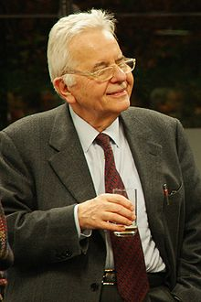
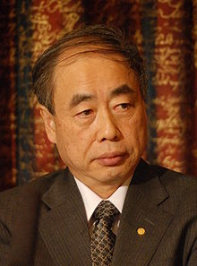
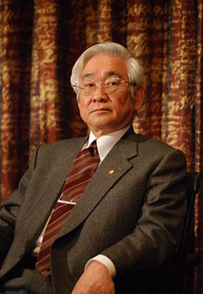
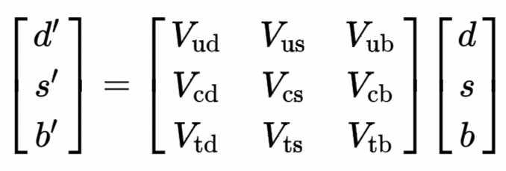

Test of CKM unitarity
In SM, CKM matrix is unitary, describing the strength of flavor-changing weak interaction
Cabibbo Kobayashi Maskawa
Most stringent test of CKM unitarity is given by the first row condition
|V_{ub}|=3.82(24)✖️10⁻³，tiny contribution
[PDG 2022]
|V_{ud}|=0.97373(31), most precise determination from superallowed nuclear beta decays
(also from neutron & π beta decays, but uncertainties are 3 and 10 times larger）
|V_{us}|， most precise determination from kaon decays (K_{l3} + K_{μ2}/π_{μ2})
requires LQCD inputs
(also from hyperon & tau decays, errors are about 3 and 2 times)

Slide 3
|V_{us}|

Slide 4
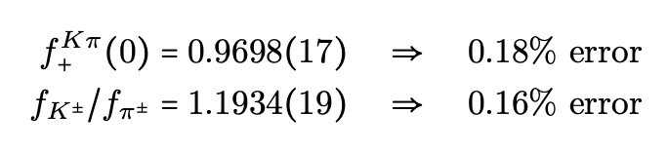
Leptonic and semileptonic decays
Flavor Lattice Averaging Group (FLAG) average, updated on 2023

Slide 5
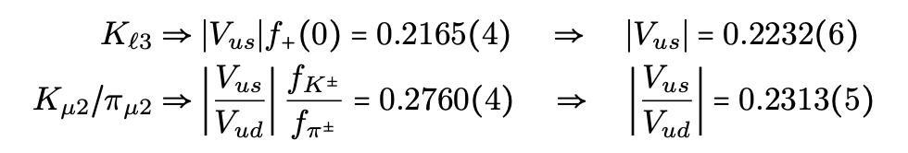



Extraction of V_{ud} and V_{us}
Experimental information from kaon decays [arXiv:1411.5252, 1509.02220]
Use |V_{us}| from K_{l3} + |V_{us}/V_{ud}| from K_{μ2}/π_{μ2}
V_{ud} from nuclear β decay
(more accurate results from N_{f}=2+1+1)
V_{us}/V_{ud} from K_{μ2}/π_{μ2}
Use |V_{us}| from K_{l3} + |V_{ud}| from β decays
V_{us} from Kl3
|V_{us}/V_{ud}| from K_{μ2}/π_{μ2} + |V_{ud}| from β decay
CKM unitarity
Question: Deviation due to |V_{ud}| from β decays, |V_{us}| from K_{l3} or new physics?

Slide 6
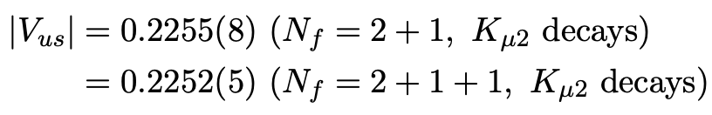
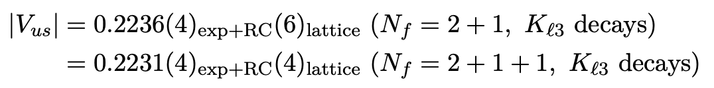
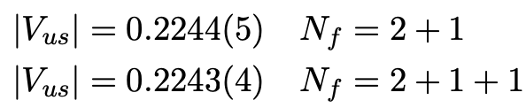


CKM matrix elements quoted by PDG 2022
Use |V_{us}/V_{ud}| from K_{μ2}/π_{μ2} + |V_{ud}| from β decay to determine |V_{us}|
Use |V_{us}| from K_{l3}
2.7 σ
Average yields
Enlarge the error by a scale factor of 2.7 and average N_{f}=2+1 and N_{f}=2+1+1 values
Conservative estimate of |V_{us}| due to the deviation between K_{l3} and K_{μ2} 2.1 σ deviation

Slide 7
|V_{ud}|

Slide 8
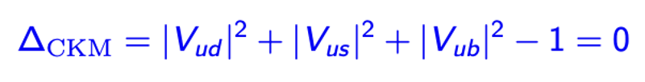
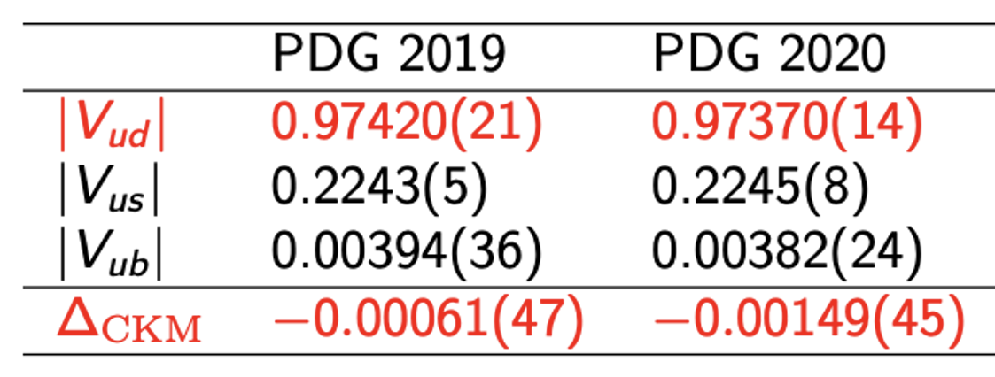
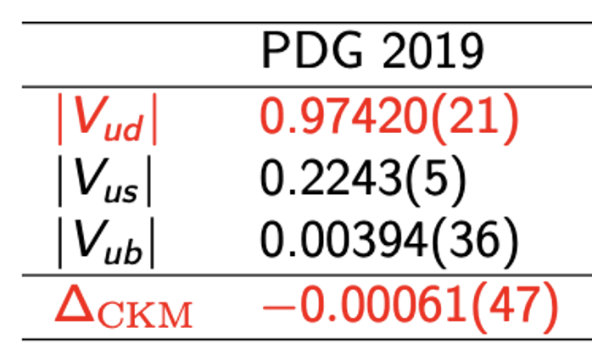
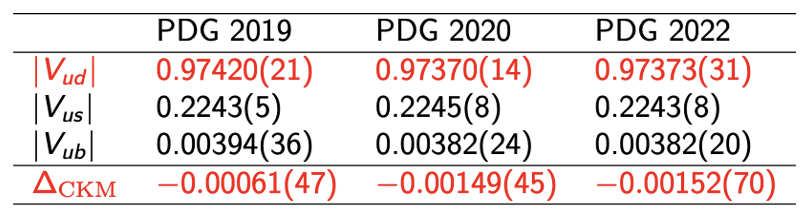
Role played by V_{ud}
Interesting to examine the update of the violation of CKM unitarity within recent years
PDG 2019 → PDG 2020 → PDG 2022
PDG 2019 → PDG 2020
PDG 2019
2020 update: 3.3 σ deviation from CKM unitarity due to the update of EWR corrections
2022 update: 2.1 σ deviation only
For V_{ud}, central value nearly unchanged, but uncertainty becomes twice larger
A more conservative estimate of nuclear structure uncertainties
[M. Gorchtein, PRL123 (2019) 042503]

Slide 9
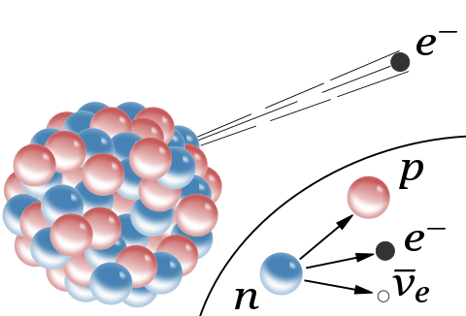
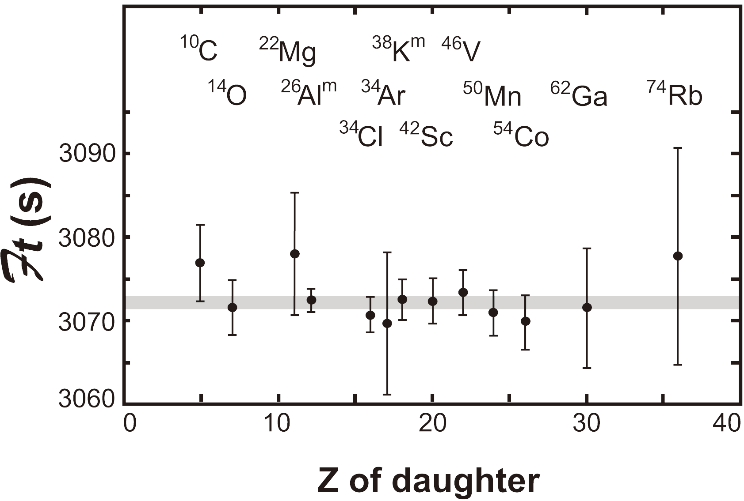
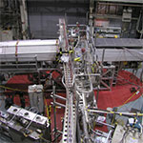
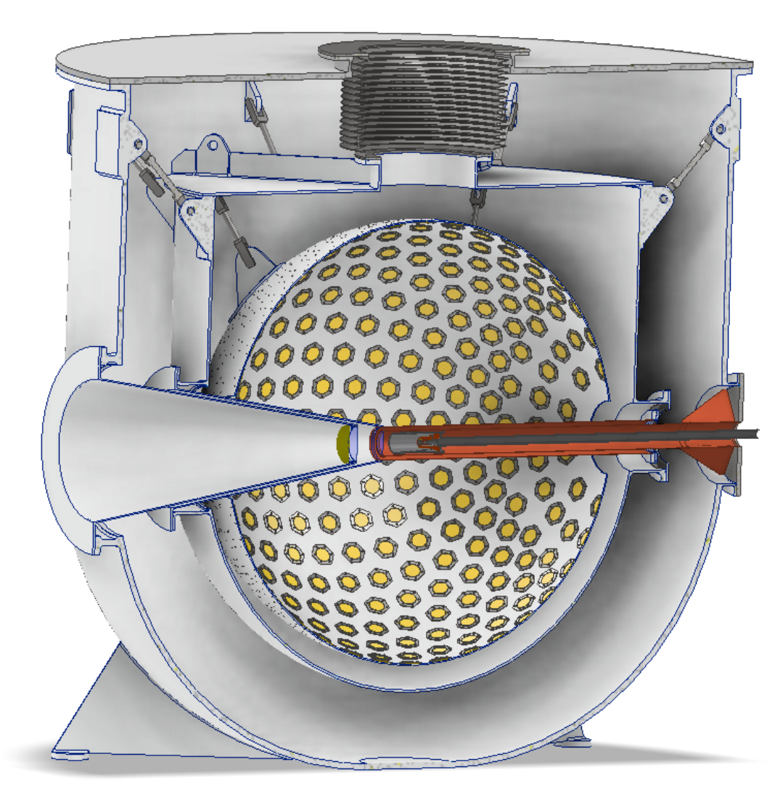
V_{ud} from different measurements
Superallowed nuclear β decays
PIBETA
PIONEER
Super-allowed
Ultra-Cold Neutron
Neutron β decays
Pion β decays

Slide 10
Status for V_{ud}
Superallowed β decays
|V_{ud}|=0.9737(3)
0⁺→0⁺ nuclear β decays： J=0→0, transition must be V₀ or A₀; Parity unchanged, must be V₀
Vector current transition (Fermi transition) at leading order
Estimate of nuclear structure uncertainties is important
Neutron β decays
|V_{ud}|=0.9737(9)
Free from nuclear structure uncertainties
Nuclear-structure independent radiative correction (RC) is same as superallowed nuclear β decay
Pion β decays
|V_{ud}|=0.9739(29)
More difficult to measure pion decays
Theoretically simpler, especially for lattice QCD
Summary
To extract V_{ud} from superallowed decay or neutron β decay
Need a well determined EW radiative corrections

Slide 11
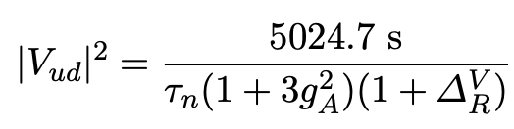

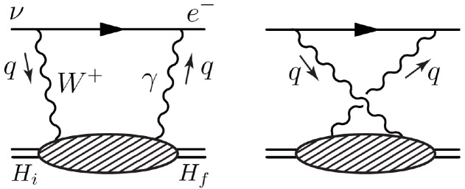
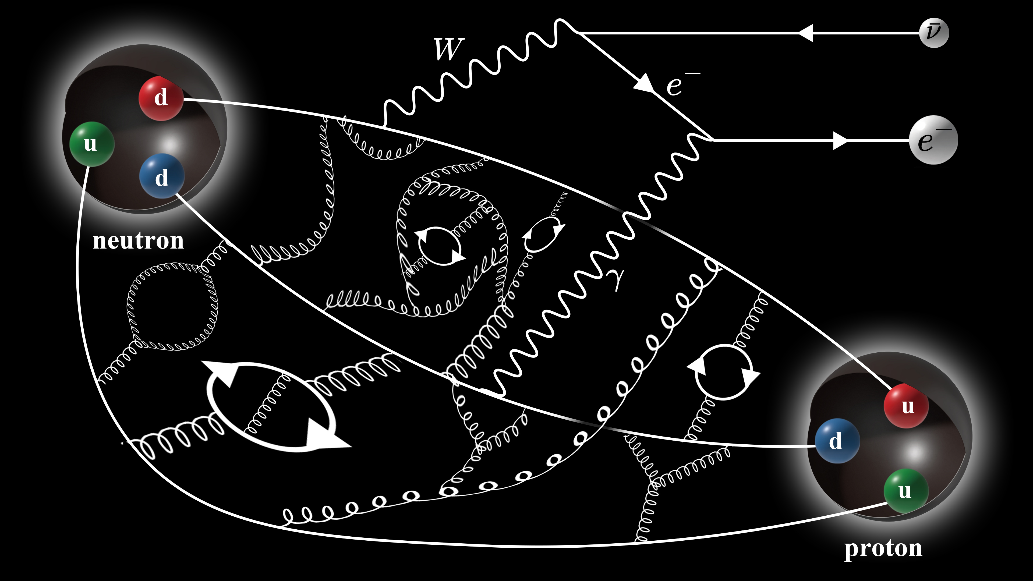
Important uncertainty from γW box diagram
Superallowed nuclear β decays
Neutron β decays
Universal electroweak radiative corrections (EWR)
Nuclear structure uncertainties
Axial vector current transition absorbed in g_{A}
Measured by experiment, different from lattice
Based current algebra, only axial γW box diagram is sensitive to hadronic scale
[A. Sirlin, Rev. Mod. Phys. 07 (1978) 573]
It dominates the uncertainties in EWR

Slide 12
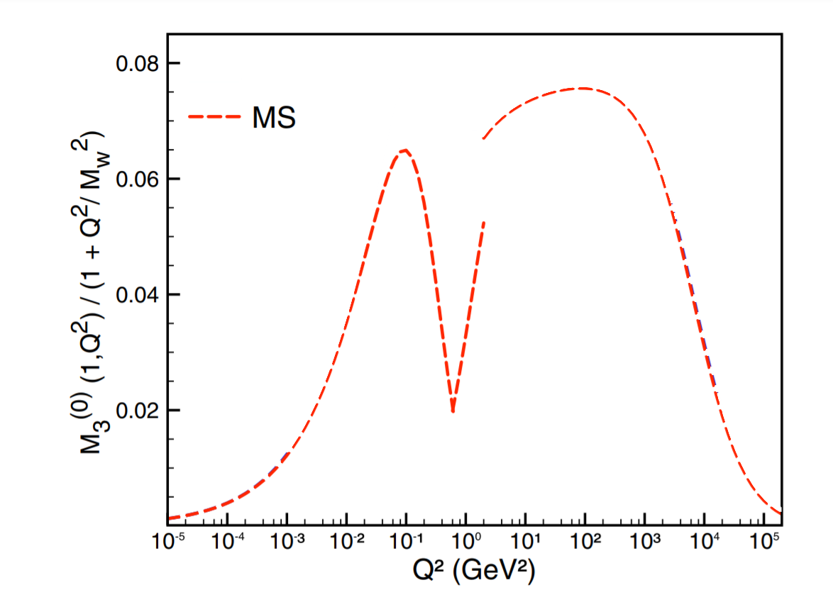
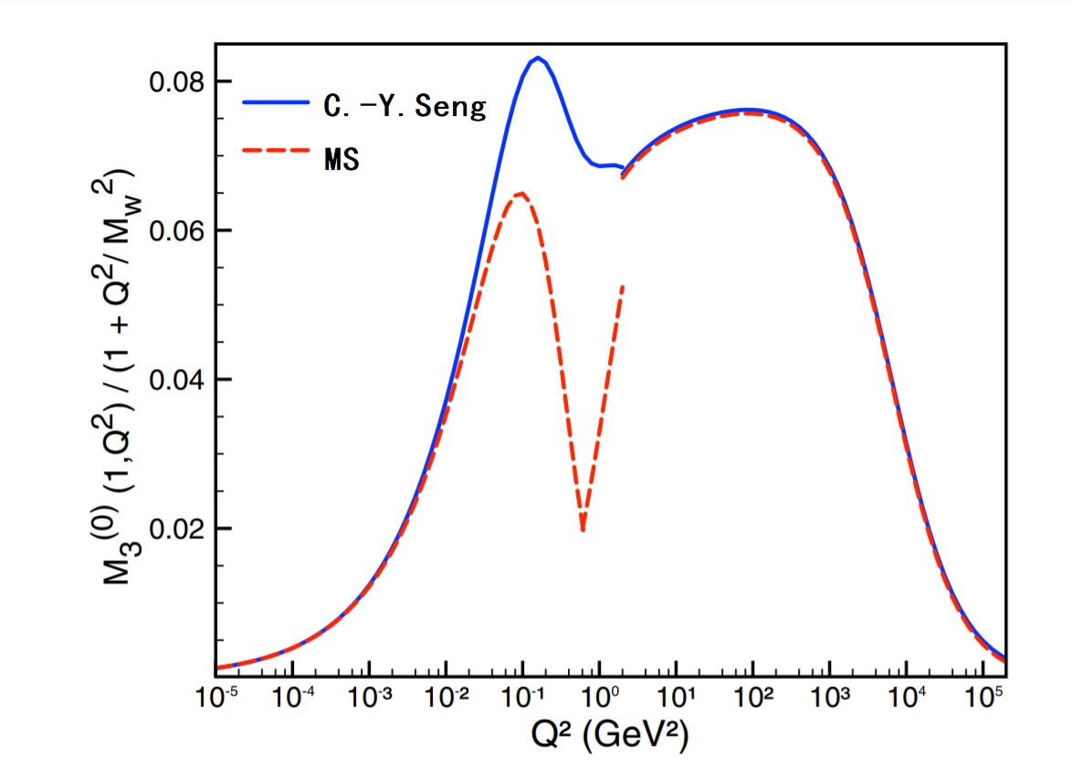
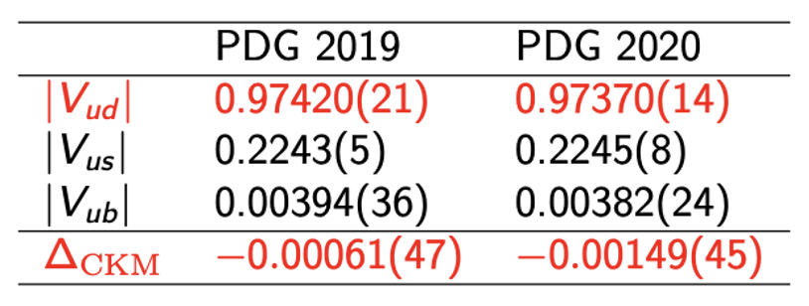
Important uncertainty from γW box diagram
PDG 2019 → PDG 2020
It is responsible for the update of PDG and 3.3 σ deviation in CKM unitarity
[1] Marciano & Sirlin, PRL96, 032002 (2006)
[2] Seng et.al. PRL 121, 241804 (2018)

Slide 13
Starting from pion sector

Slide 14
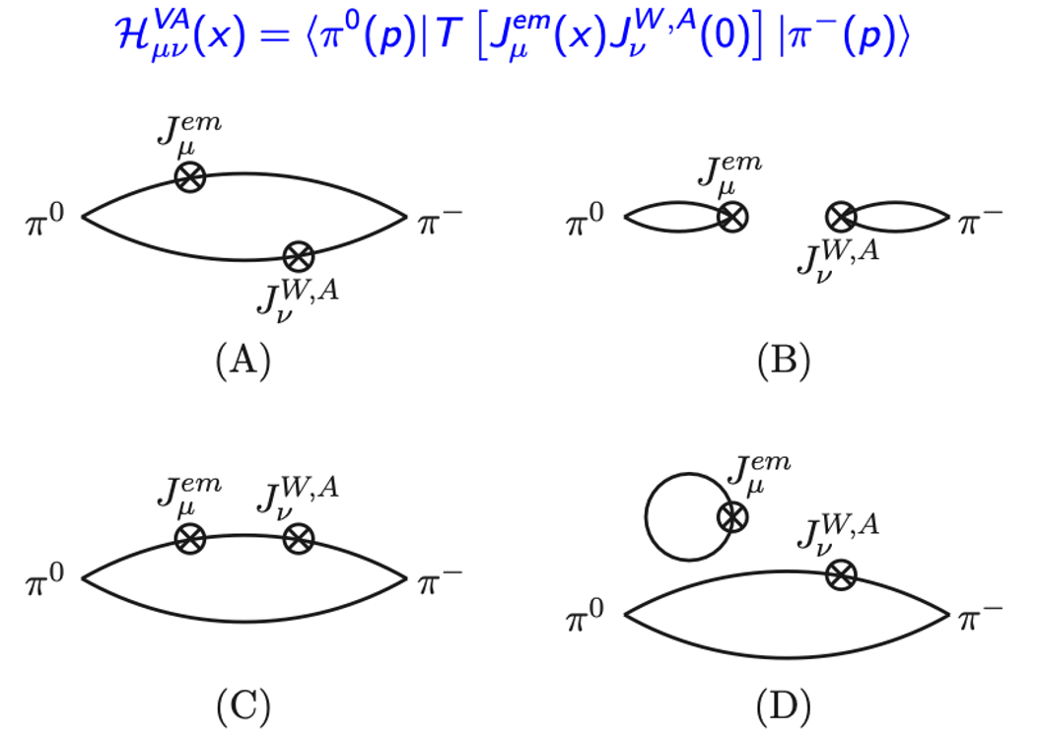
Quark contractions for the γW-box diagram
Coulomb gauge fixed wall source used for pion
Type (C) is most important contribution, with one current as source and the other as sink using 1024-2048 point-source prop per conf.
For type (A) & (B), double FFT to achieve spacetime translation average over L³✖️T measurements
Type (D) vanishes in the flavor SU(3) limit

Slide 15
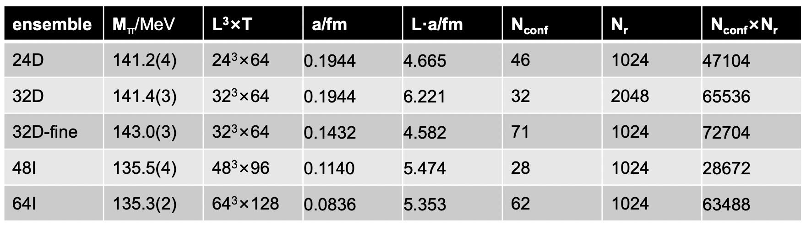
Five gauge ensembles at physical pion mass
Gauge ensembles generated by RBC-UKQCD Collaborations using 2+1 flavor domain wall fermion
24D, 32D, 32D-fine use Iwasaki+DSDR action; while 48I, 64I use Iwasaki gauge action

Slide 16
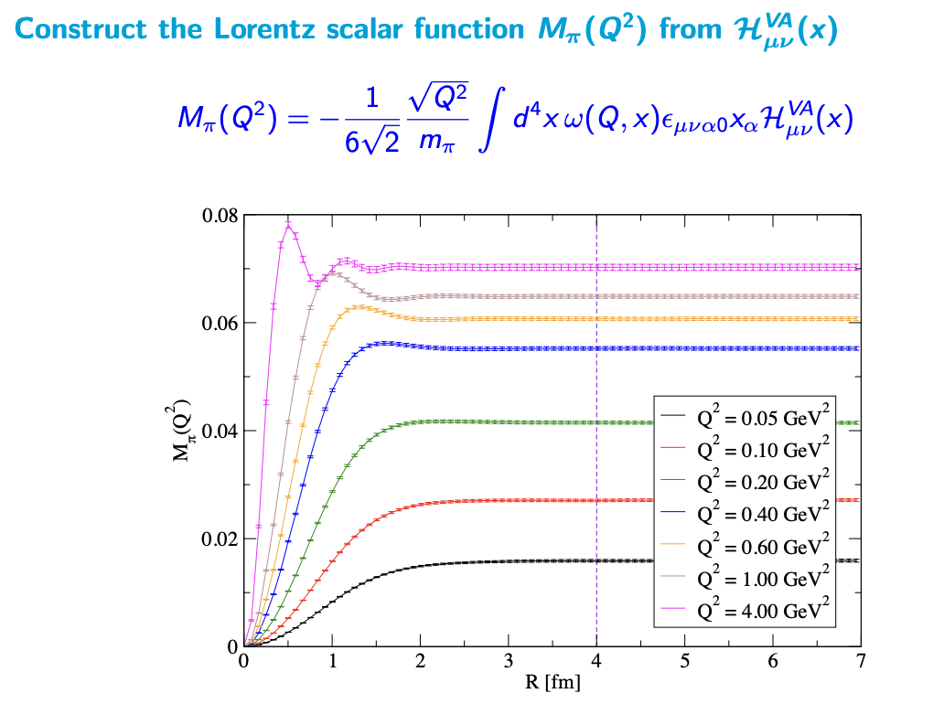


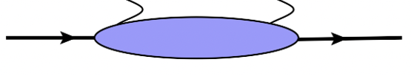
Lattice results for the hadronic functions
At large spacetime separation, integral converges very quickly!

Slide 17
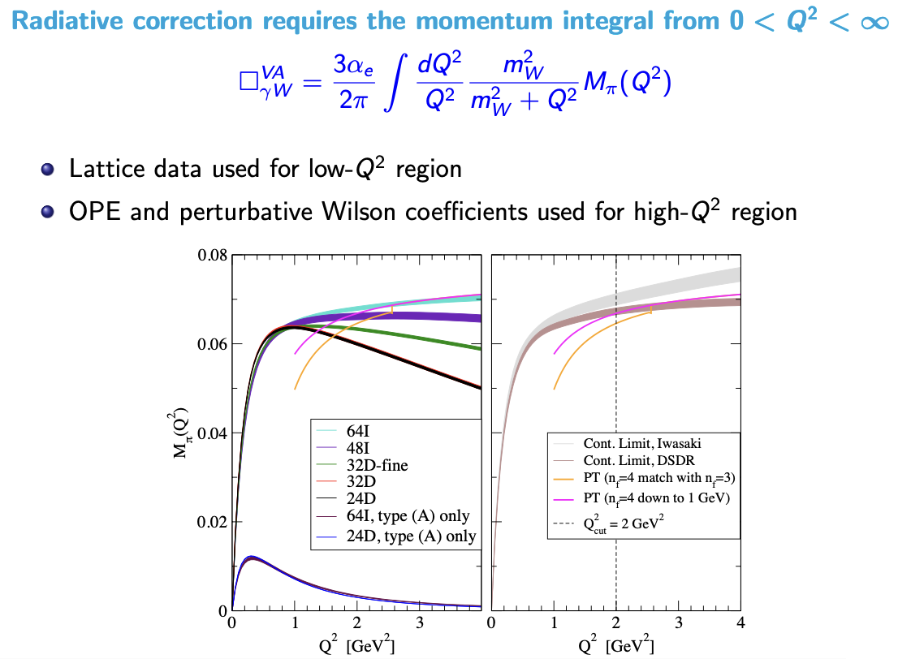
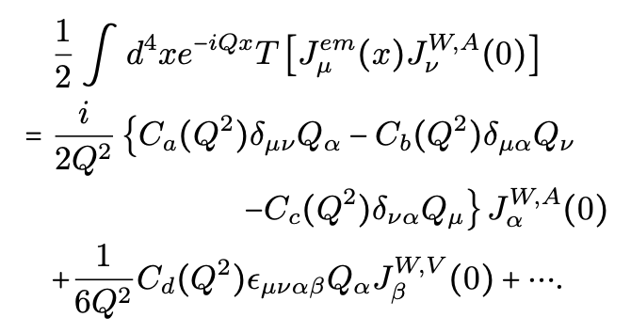
Combine lattice results with pQCD
OPE with Wilson coefficients at 4-loop accuracy
24D & 32D with diff. volume on top of each other
Only last term contributes to pion & superallowed β decays

Slide 18
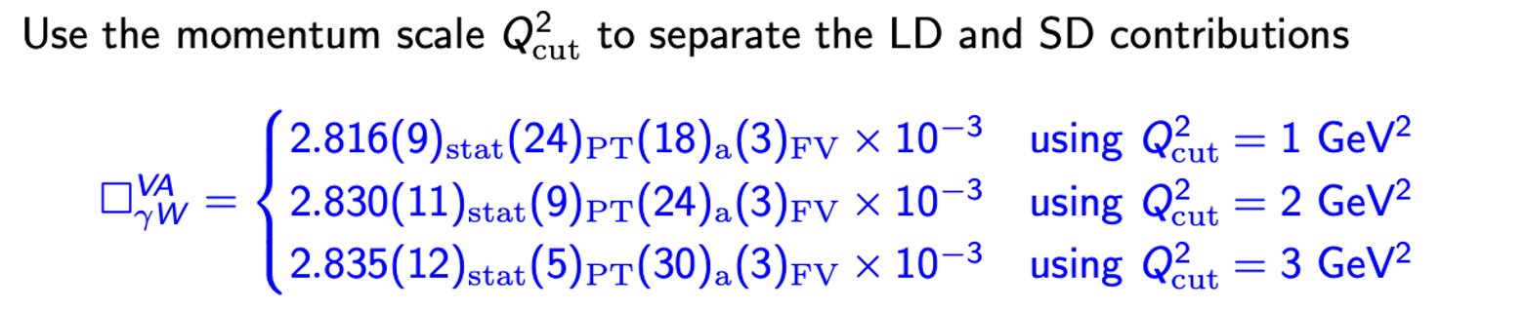

Error analysis
Independent calculation by Los Alamos group using Wilson-clover fermion
[J. Yoo, T. Bhattacharya, R. Gupta et.al. PRD 108 (2023) 034508 ]

Slide 19
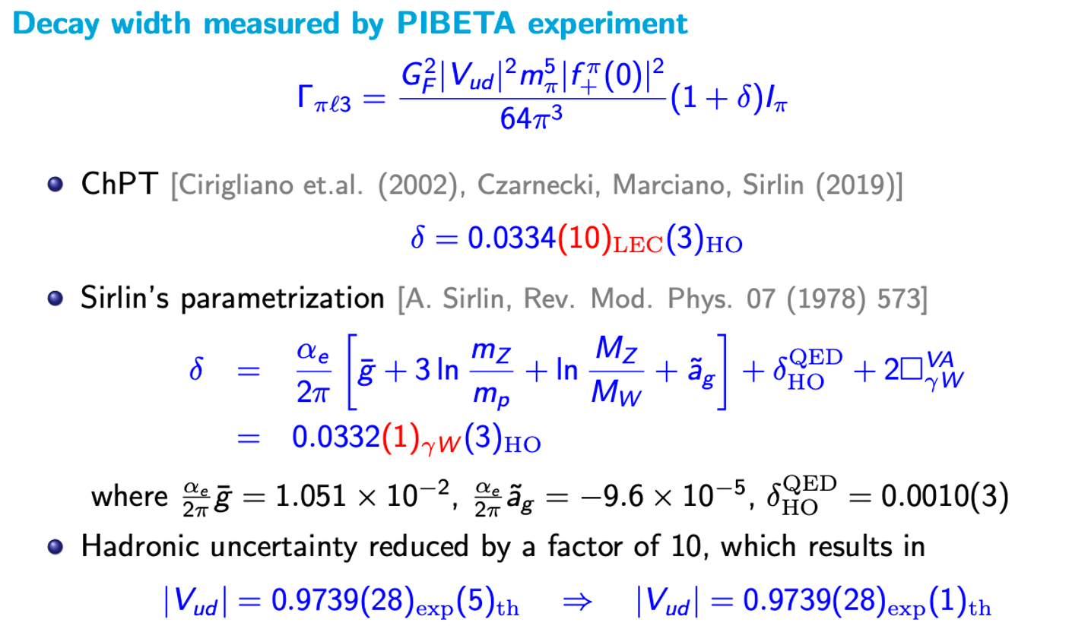
Pion semileptonic β decay

Slide 20

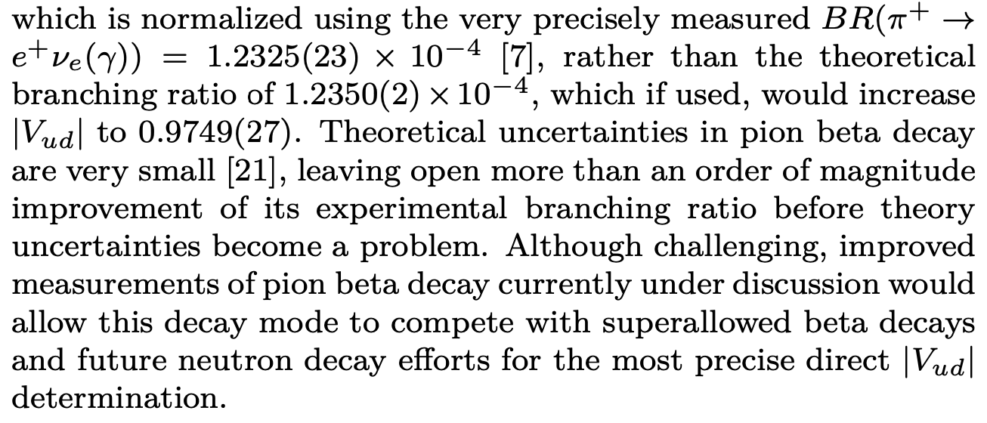
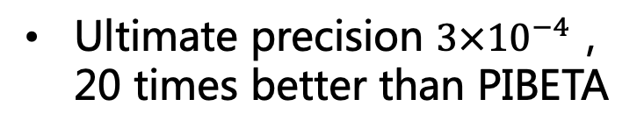
Interplay between theory and experiment
V_{ud} from π β decay
Past Experiment - PIBETA
D. Pocanic et.al. PRL 93 (2004) 181803
Precision 0.6%
XF, M. Gorchtein, L. Jin, et.al. PRL124 (2020) 19, 192002
New Experiment - PIONEER
Main uncertainty arises from exp. measurements
M. Hoferichter, arXiv:2403.18889
Phase I ：π leptonic decays
Phase II+III：π β decays
Ultimate precision $3×{10}^{−4}$，20 times better than PIBETA
Future exp. uncertainty comparable to theoretical one！
PDG 2022, reviewed by E. Blucher & W. J. Marciano

Slide 21
Move to nucleon sector

Slide 22
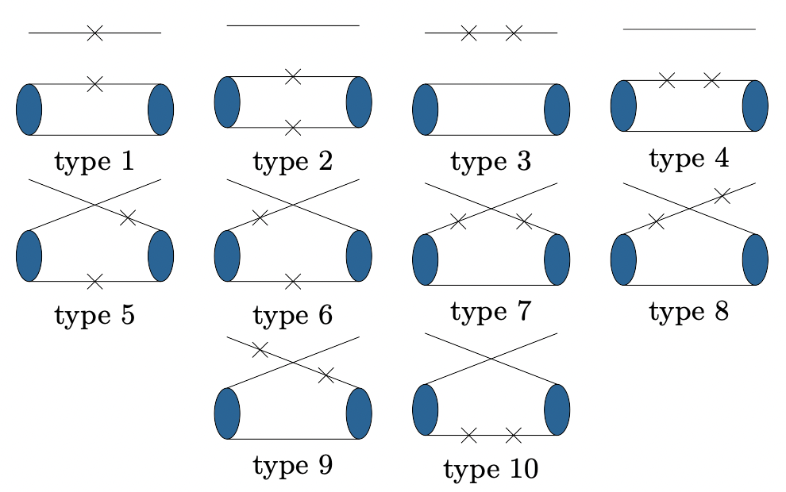
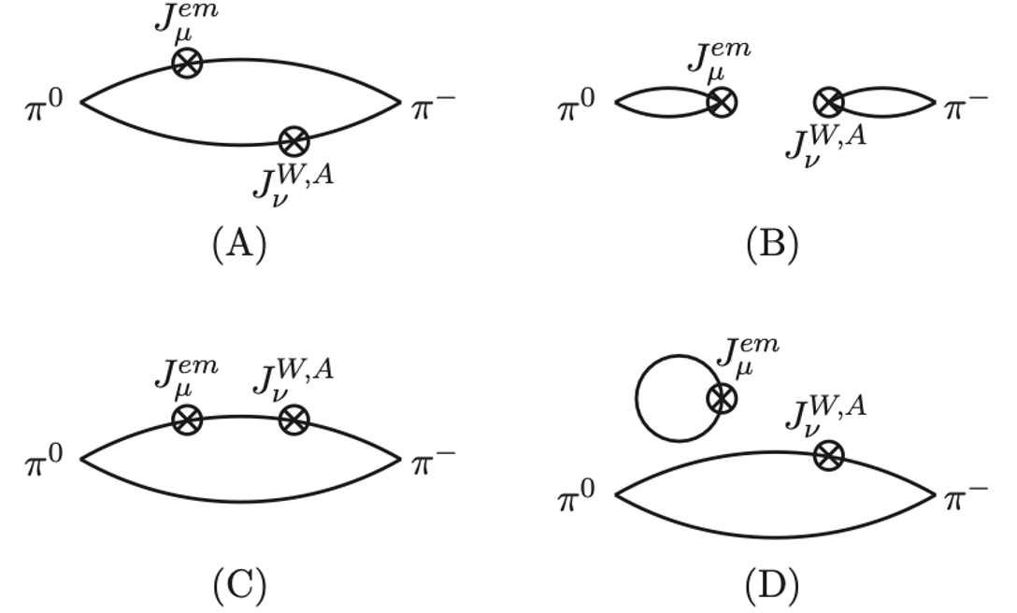
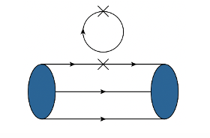
Challenges for moving to nucleon sector (I)
π γW box diagram
Nucleon γW box diagram
Connected diagram (8 of 10)
Disconnected diagram
Vanish in flavor SU(3) limit, so far neglected

Slide 23
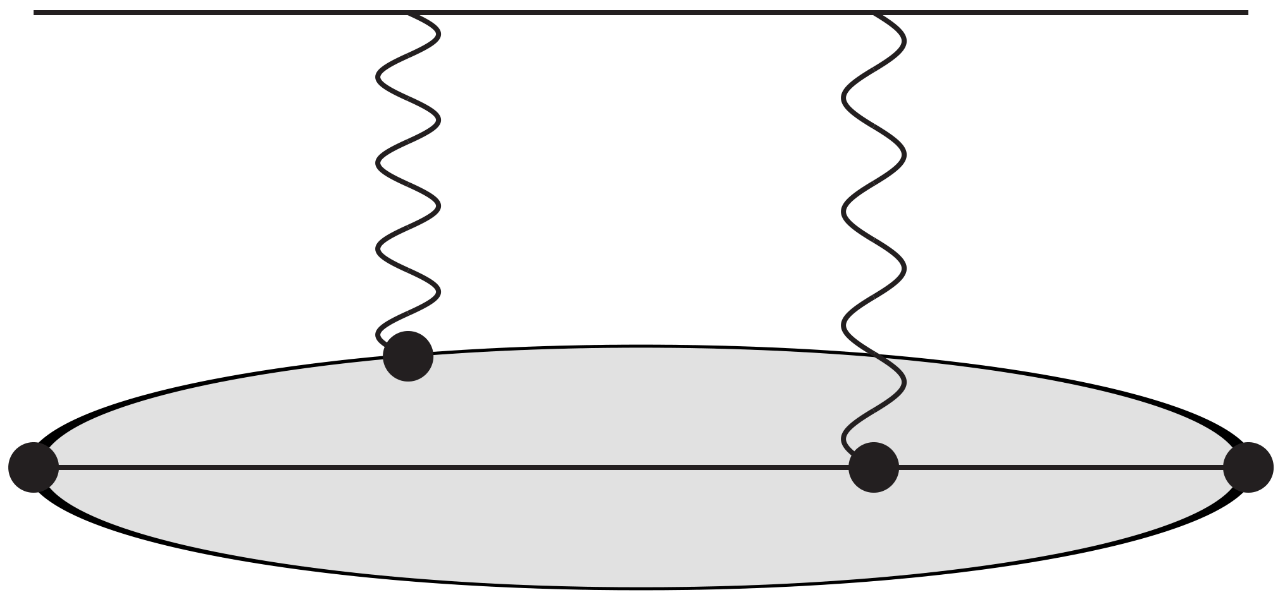
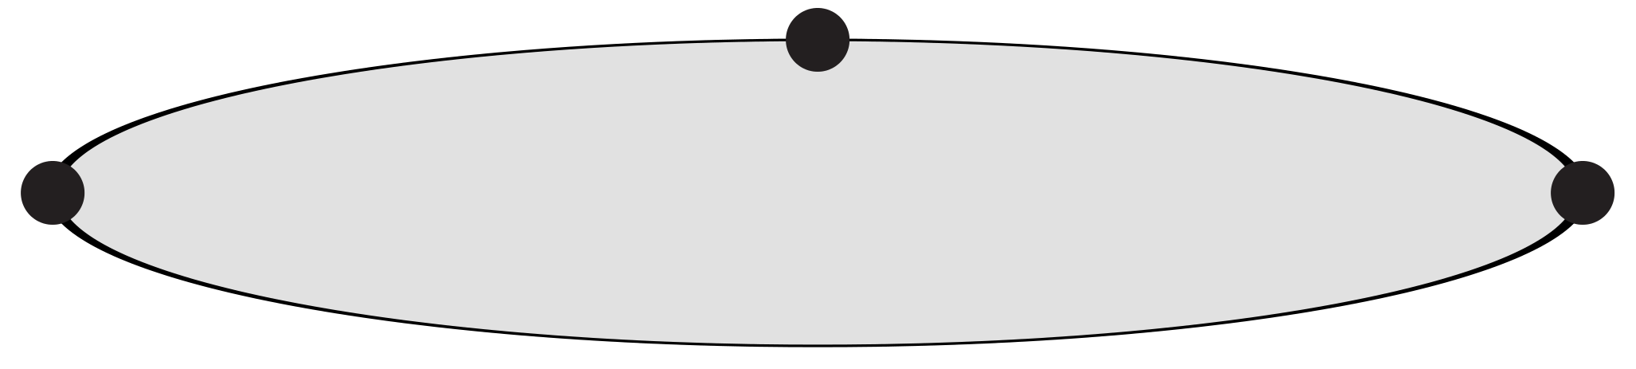
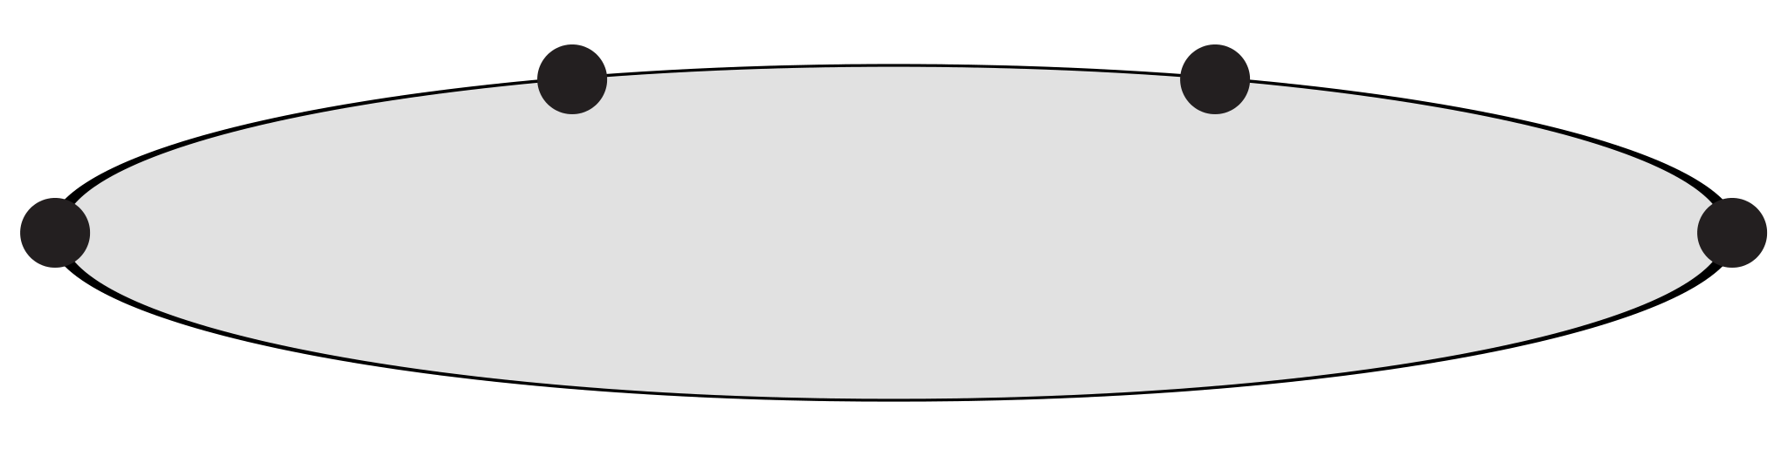


Challenges for moving to nucleon sector (II)
Hadronic part from a typical 4-point function
Solution：Field sparsening method
【Y. Li, S. Xia, XF, L. Jin, C. Liu, PRD 103 (2021) 014514】
【W. Detmold, D. Murphy, et. al. PRD 104 (2021) 034502】
2
1
3
4
Perform the volume summation for each point
$$\sum_{x∈L^{3}}{}$$
Less summation points may lead to lower precision
It is not the case because of high correlation in lattice data
Used for pion, proton, g_{A} to verify its application
From 3-point to 4-point function
$$x_{1}$$
$$x_{3}$$
$$x_{2}$$
$$x_{1}$$
$$x_{3}$$
$$x_{4}$$
$$x_{2}$$
10²-10³ times less points yields similar precision
3-point: $L^{6}$ summation
4-point: $L^{9}$ summation
Utilize field sparsening method
Increasing each point, computational cost increases by 10⁴-10⁵ times!
Reduce the computational cost by a factor of 10²-10³ with almost no loss of precision!

Slide 24
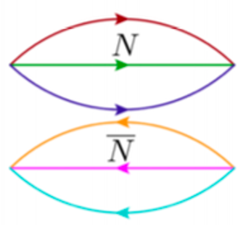
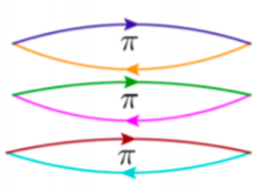

Challenges for moving to nucleon sector (III)
Nucleon system – severe signal/noise (S/N) problem
Statistics tells us that variance is given by <O²> – <O>²
Square of signal
Variance is dominated by <O²>
<O>² =
<O²>=
4-pt function requires operators at 4 diff. time slices and thus needs large t separation
S/N is
Solution: optimized operators, variational analysis, reconstruction of low-lying intermediate states
24

Slide 25

Challenges for moving to nucleon sector (IV)
pion×
proton√
Temporal integral converge very slowly!

Slide 26
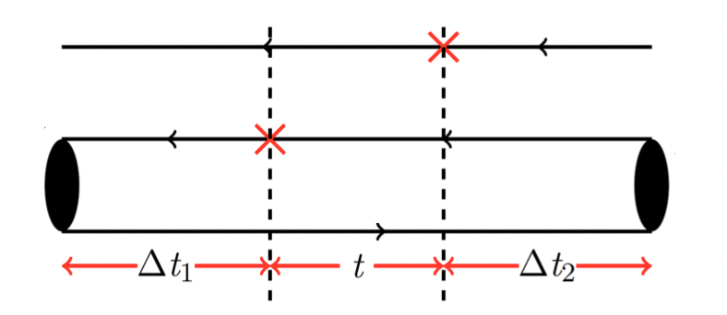




Numerical results
Ensemble information
Is time separation sufficiently large?

Slide 27

Examine the ground-state dominance
Infinite-volume reconstruction method:
Construct a ratio to examine the ground-state dominance
Within statistical uncertainty, reconstruction works well
Confirm t_{g}=0.6 fm is a safe choice for reconstruction

Slide 28
Results from IVR
Long distance part using IVD
Short distance part using lattice data

Slide 29
Examine excited-state contamination
Nucleon excited-state contamination is very strong for axial-vector current, A_{μ}→π
Axial γW is essentially a V₀ transition. Excited-state contamination is not that significant

Slide 30
Examine finite-volume effects
Good convergence in the spatial integral when using substitution method
Better to estimate FV effects using more ensembles and multiple volumes

Slide 31
Continuum extrapolation
Currently only use 2 lattice spacings, more ensembles with finer lattice spacing shall be beneficial!

Slide 32
Comparison with dispersive analysis
P. Ma, XF, M. Gorchtein, L. Jin, C. Seng, Z. Zhang, PRL132 (2024) 191901
Using lattice input, deviation from CKM unitarity: 2.1 σ → 1.8 σ

Slide 33
Conclusion
Test of first-row CKM unitarity
|V_{ud}| Theory: EWR, Nuclear structure
f₊(0): More lattice calculations for average
Inclusion of electromagnetic effects in the precision era
An interesting frontier
Beta decay or other processes → More studies + new method
γW box diagrams
More studies with different discretization and more ensembles to control systematic effects

Slide 34
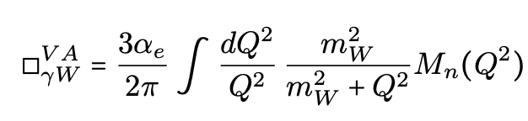
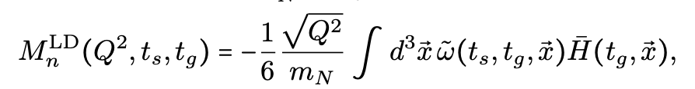

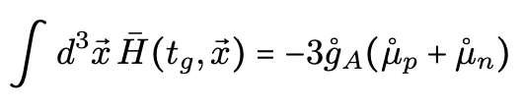


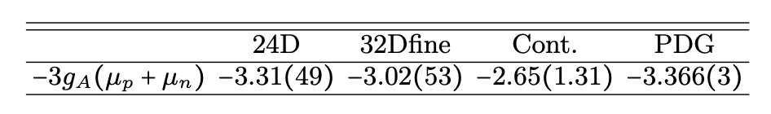
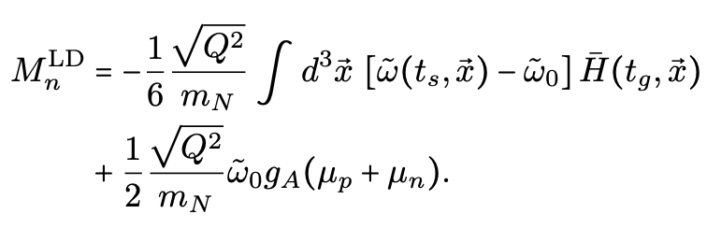
Low-Q² behavior of the hadronic function
with
Due to 1/Q² factor, encounters a notably increased noise at small Q²
For ground-state dominance at large t_{g}, we have
with
Make substitution
Help to reduce uncertainties
But introduce additional experimental inputs

