Slide 1


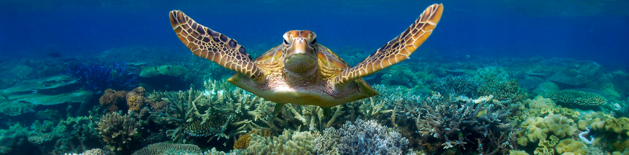

IPPOG and spin-offs
from particle and nuclear physics
Yiota Foka (GSI/CERN)
on behalf of
IPPOG*
*IPPOG International Particle Physics Outreach Group

Slide 2
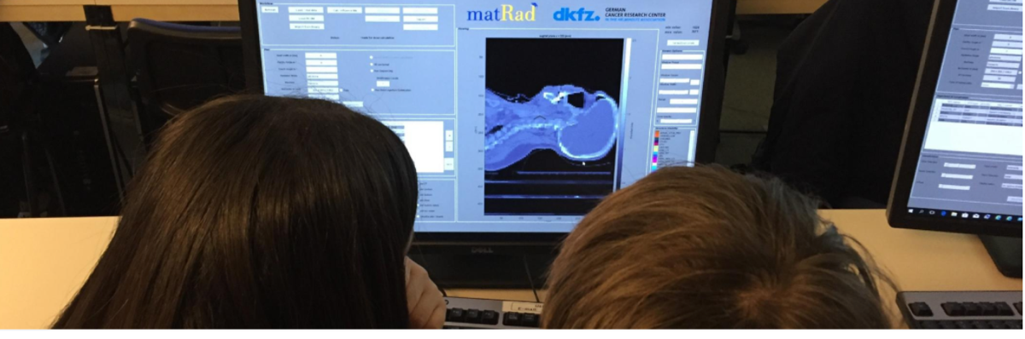

IPPOG activities on benefits for society
Particle Therapy MasterClass
Contacts:
yiota.foka@cern.ch
https://indico.cern.ch/e/PTMC
Tangible examples of connecting fundamental research and everyday life
Contacts:
yiota.foka@cern.ch
barbora.gulejova@cern.ch
https://ippog.org/for-ippogers/outreach-application-society

Slide 3
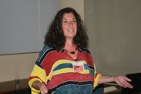
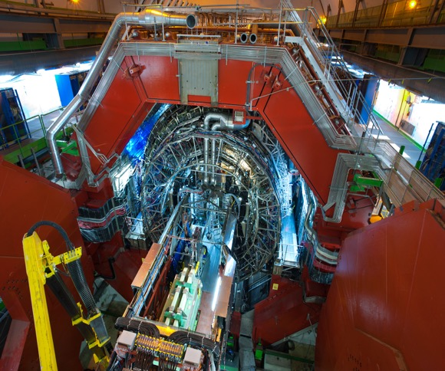
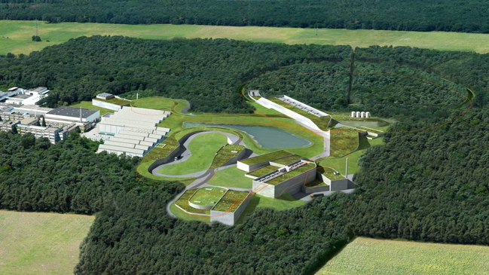
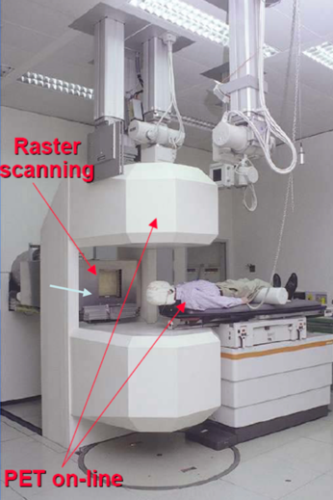
Heavy-ion research and heavy-ion therapy
Heavy-ion Physicist, involved with medical applications of heavy-ions for cancer therapy
ALICE heavy-ion experiment at CERN
GSI, pioneering heavy-ion cancer therapy in the 90s
GSI therapy room
ALICE at the CERN LHC
GSI and future FAIR
Mission and mandate of research institutes: fundamental research
Developed technologies and acquired knowledge find applications for society

Slide 4
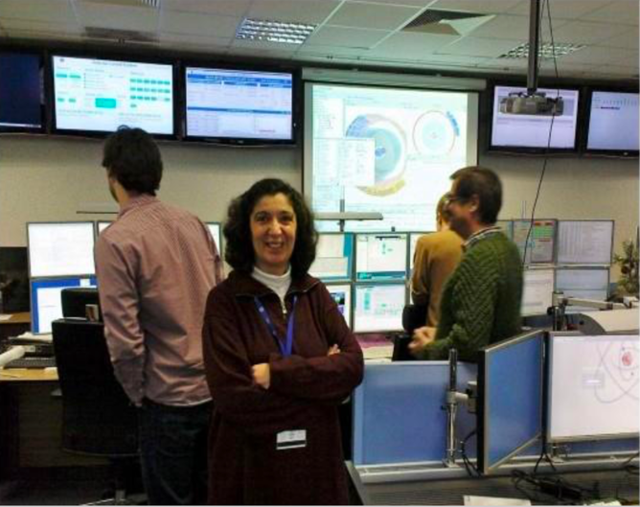
Heavy-ion research and heavy-ion therapy
Heavy-ion Physicist, involved with medical applications of heavy-ions for cancer therapy
ALICE heavy-ion experiment at CERN
GSI, pioneering heavy-ion cancer therapy in the 90s
GSI therapy room
ALICE Control Room
ALICE at the CERN LHC
GSI and future FAIR
ALICE at the CERN LHC
Mission and mandate of research institutes: fundamental research
Developed technologies and acquired knowledge find applications for society

Slide 5
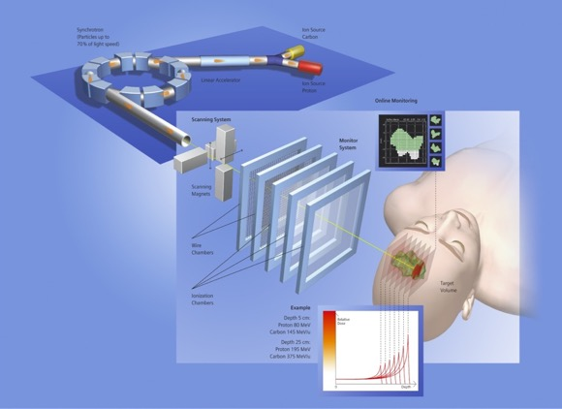
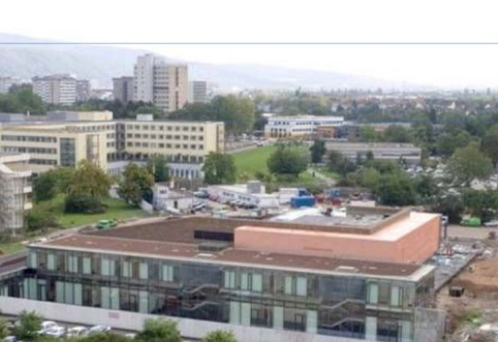
Heavy-ion research and heavy-ion therapy
Heavy-ion Physicist, involved with medical applications of heavy-ions for cancer therapy
ALICE heavy-ion experiment at CERN
GSI, pioneering heavy-ion cancer therapy in the 90s
Heidelberg Ion Therapy HIT centre
ALICE Control Room
ALICE at the CERN LHC
Implemented at HIT, Heidelberg Ion Therapy centre
GSI and future FAIR
ALICE at the CERN LHC
Mission and mandate of research institutes: fundamental research
Developed technologies and acquired knowledge find applications for society

Slide 6
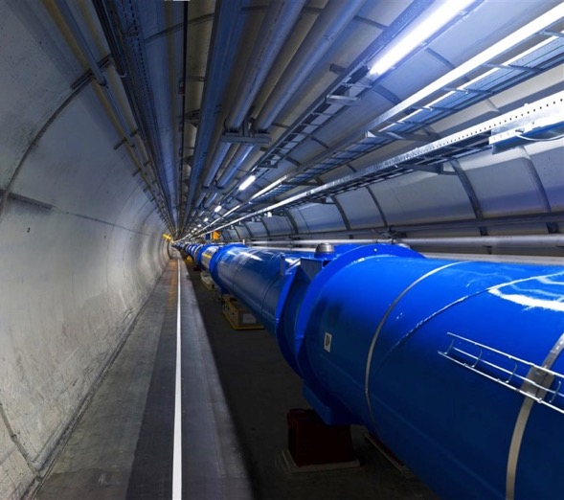
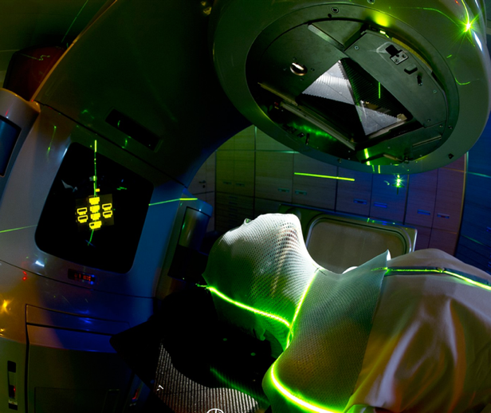
Heavy-ion research and heavy-ion therapy
Next Steps: Next Ion Medical Machine Study, NIMMS, CERN group
ALICE heavy-ion experiment at CERN
Innovative technologies for next generation ion facilities
From LHC Technologies
to medical applications
GSI therapy room
ALICE Control Room
ALICE at the CERN LHC
CERN LHC
Cancer Therapy Facility
GSI and future FAIR
ALICE at the CERN LHC
Mission and mandate of research institutes: fundamental research
Developed technologies and acquired knowledge find applications for society

Slide 7
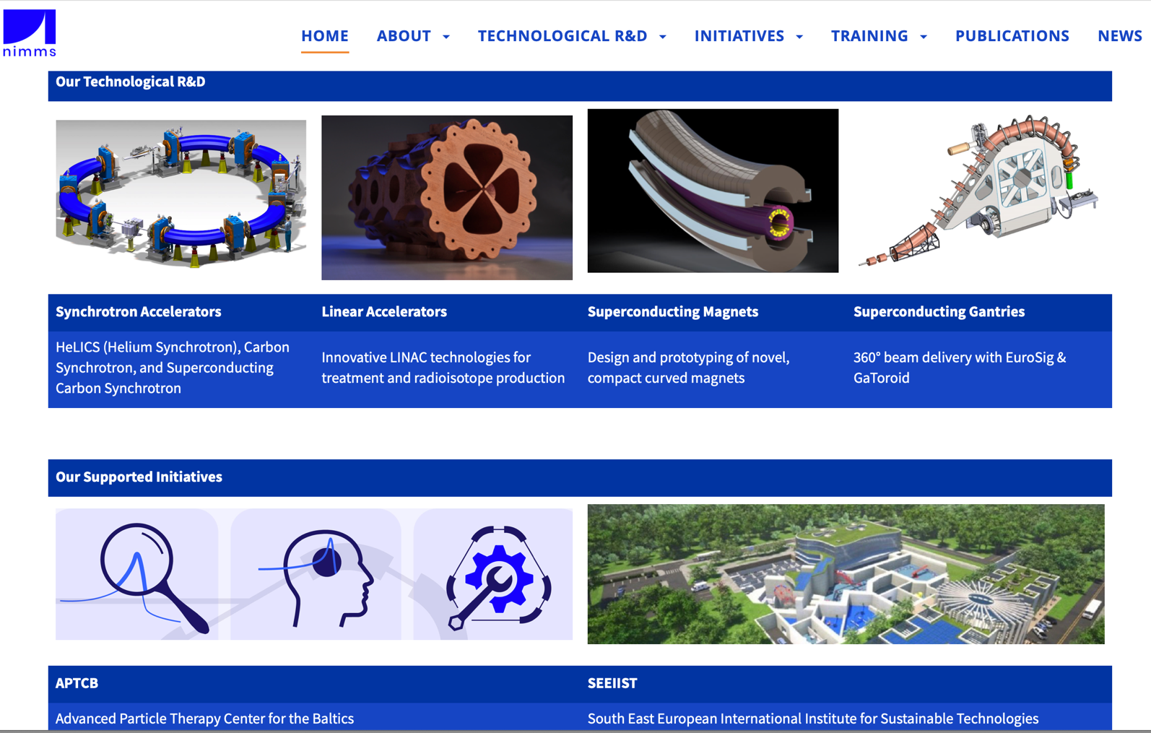
Next Ion Medical Machine Study Group Developments

Slide 8
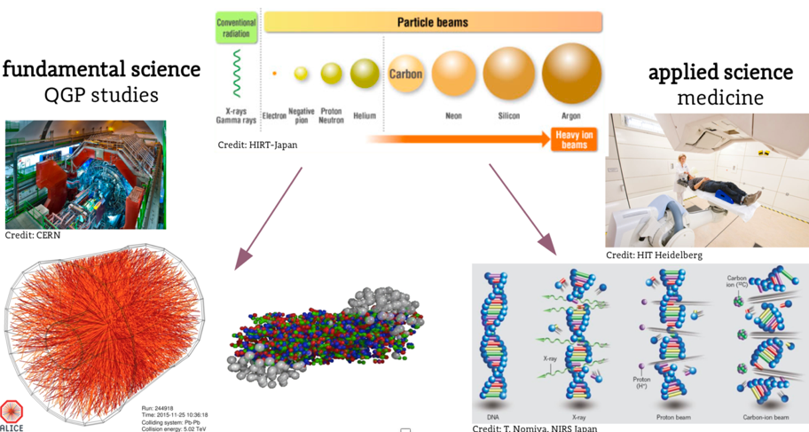

Heavy-ion research and heavy-ion therapy
Pb-Pb at 5.5 TeV
pp at 14 TeV
88-430 MeV/u carbon
50-221 MeV/u protons
An example of applications of fundamental research for the benefit of society

Slide 9
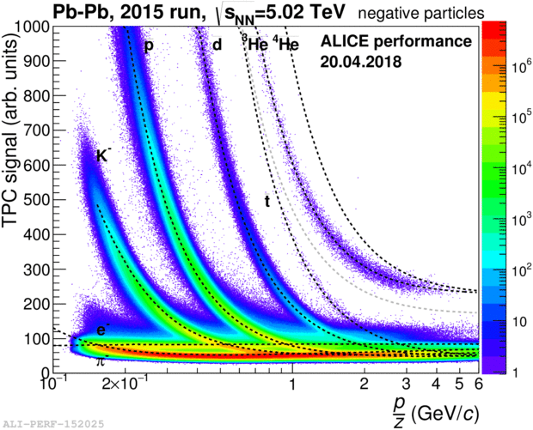
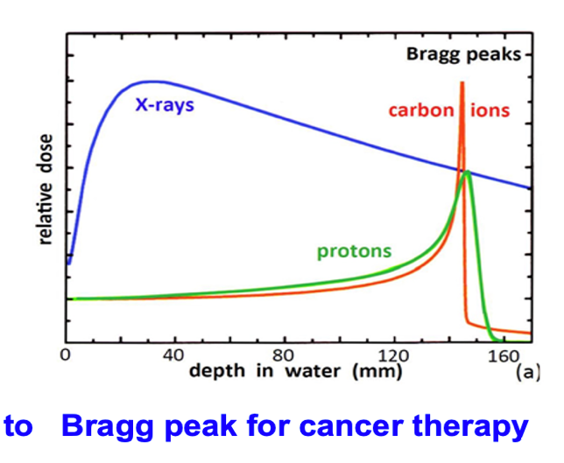
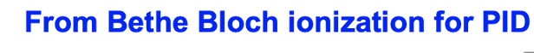
Heavy-ion research and heavy-ion therapy
Pb-Pb at 5.5 TeV
pp at 14 TeV
88-430 MeV/u carbon
50-221 MeV/u protons
fundamental properties
of particles
and their interaction with matter
in the service of society

Slide 10
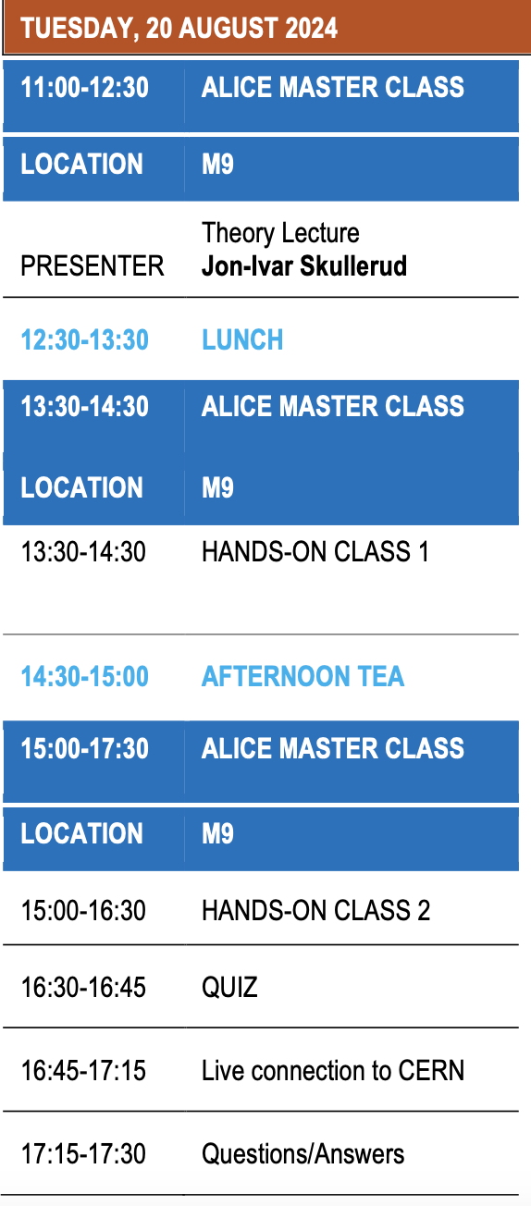
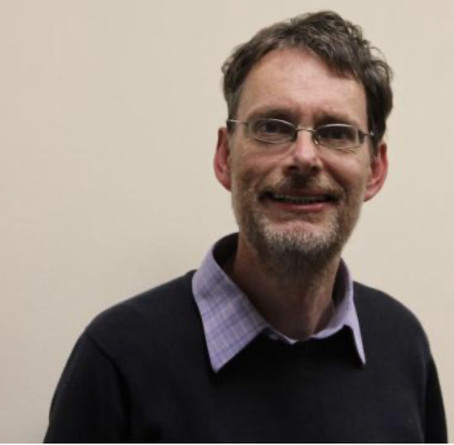
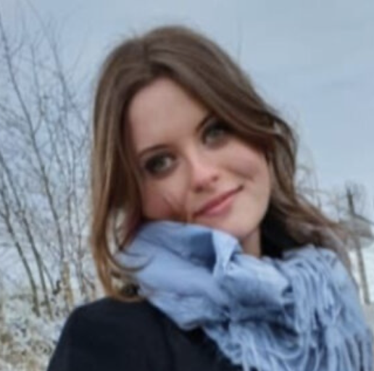
ALICE MasterClass on Strangeness
Pb-Pb at 5.5 TeV
pp at 14 TeV
Jon-Ivar Skullerud
Wioleta Rzesa

Slide 11
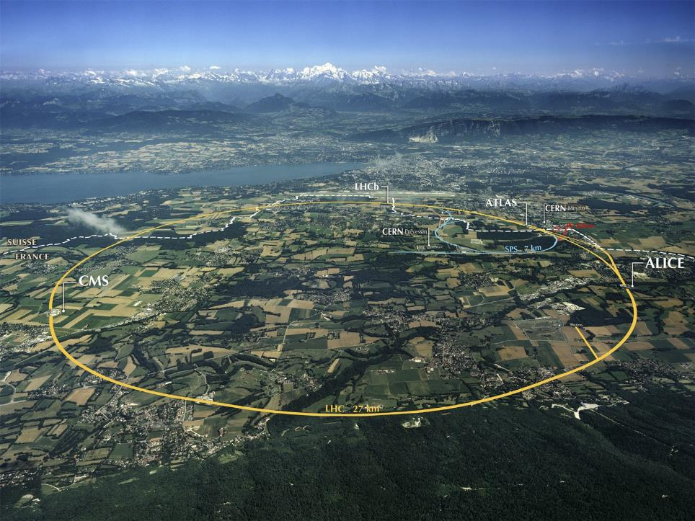
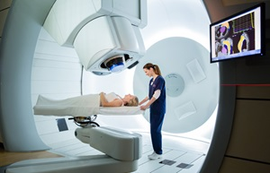
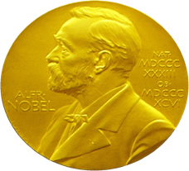
From Fundamental Research….
What are
the benefits
for society?
…..to Medical Applications
The developed accelerator technology is used for cancer research and therapy
Innovative technologies developed for future CERN projects find already applications in medicine
Accelerators for Health

Slide 12
What are the
International MasterClasses IMC
and
Particle Therapy MasterClasses PTMC

Slide 13
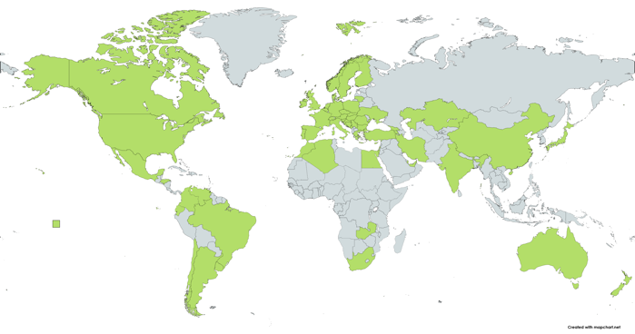
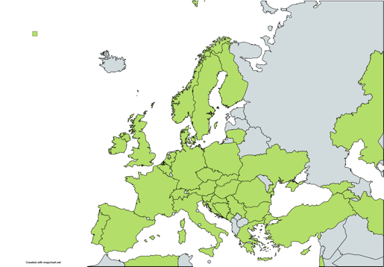
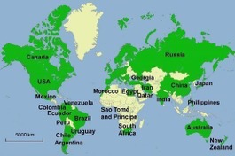
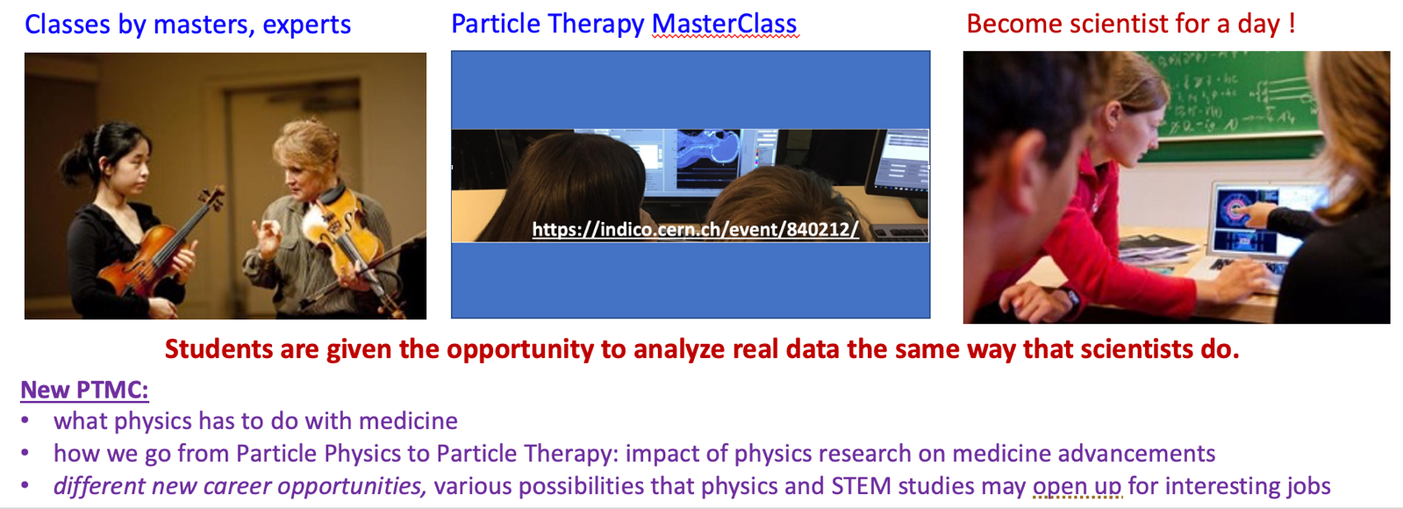
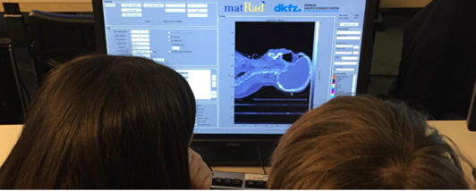
International MasterClasses
Flagship project of IPPOG
Brings scientific methods to schools!
IMC2024: 6.5 weeks
64 countries
311 institutes
15 000 students
Coordination QuarkNet / TU Dresden
188 institutes (177)
266 LHC Masterclasses (257)
  30 ATLAS W (35)
  101 ATLAS Z (104)
  64 CMS (58)
  41 LHCb (39)
  27 ALICE SP (18)
  3 ALICE R_AA (3)
51 institutes (48)
54 LHC Masterclasses (50)
  22 ATLAS (19)
  32 CMS (31)
12 MINERvA Masterclasses
https://indico.cern.ch/e/PTMC

Slide 14
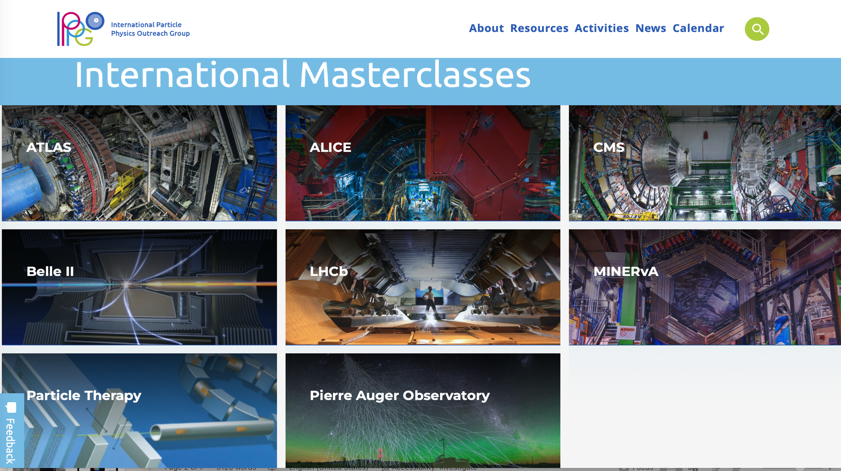


Coordinated and moderated by GSI

Slide 15
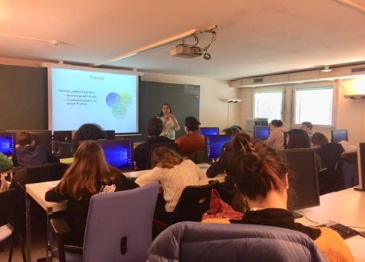
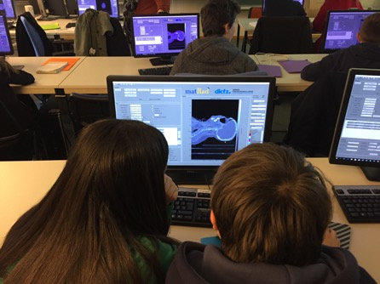
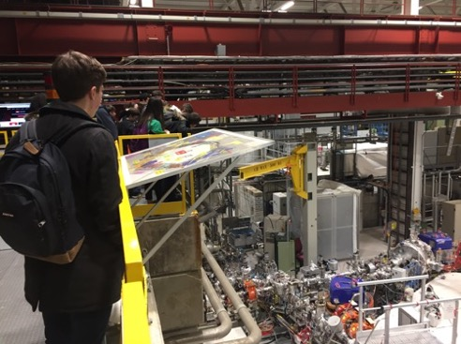
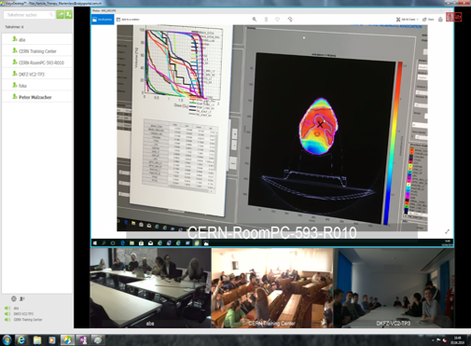
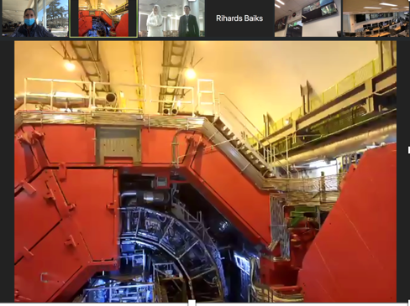
PTMC: Typical MasterClass Day Agenda
Adapted: online/hybrid modes
Local: Morning Presentations
Local: Afternoon Hands-on
Every day 3-5 institutes participate,
during the months of February-April.
School-children (15-19 year old)
are invited at/by an institute of their area.
LOCAL TIME: ACTIVITY
8:30 - 9:00 Registration and Welcome
9:00 - 10:00 Introductory lectures
10:30 - 11:30 Visit of a lab or experiment
12:00 - 13:00 Lunch
13:00 - 15:00 Hands-on session
15:00 - 16:00 Discuss results locally
16:00 - 17:00 Common Video Conference
Local: Morning Visits
real-time online ALICE visit
Common: Afternoon at 16:00
Video-Conference
Importance of collaboration for common projects

Slide 16
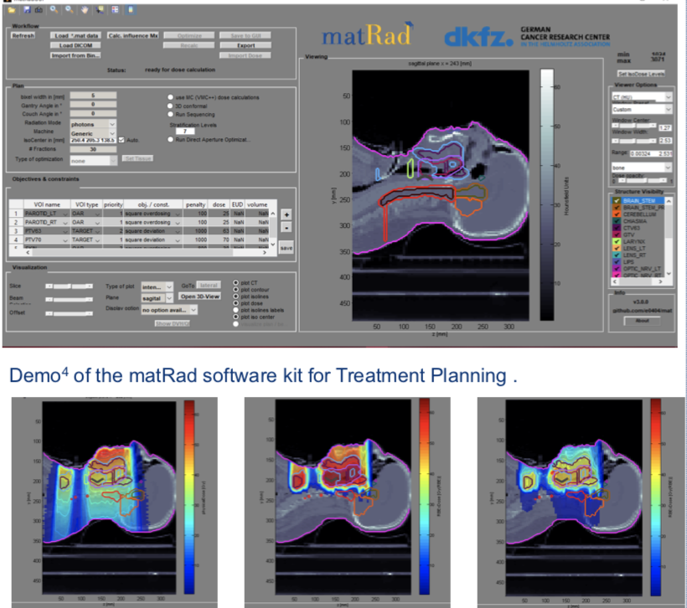
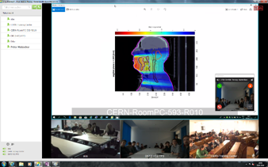
PTMC hands-on Treatment Planning
Based on professional open source treatment planning: matRad
developed by DKFZ, Heidelberg www.matrad.org
Simplified version for PTMC
Dose prescription
using photons, protons and carbon ions
Easily visible the difference of photons and hadrons

Slide 17
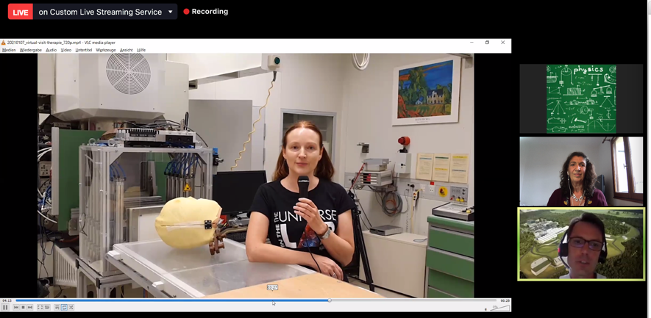
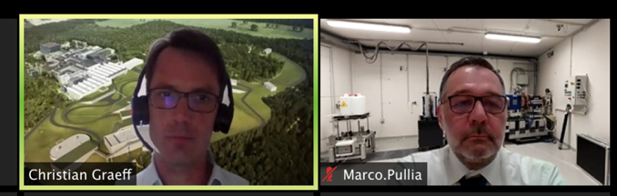
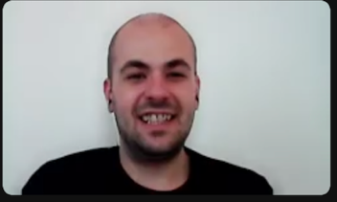
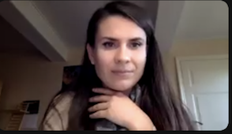
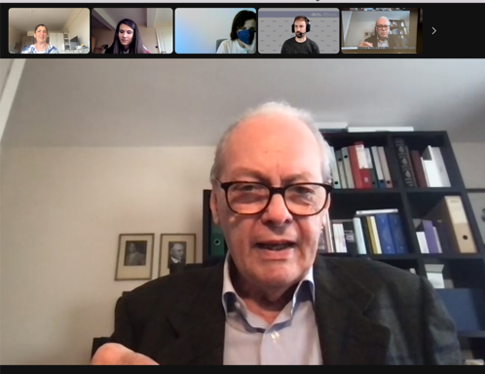
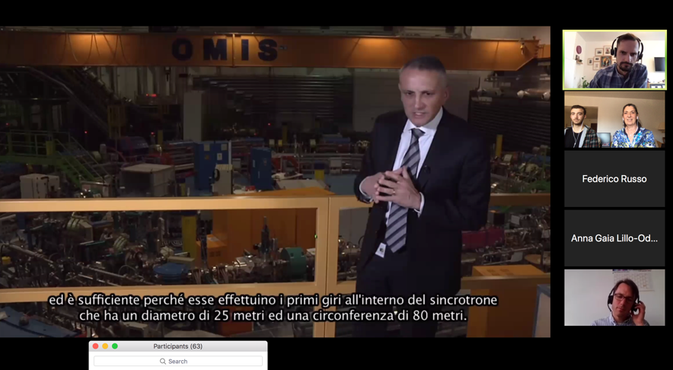
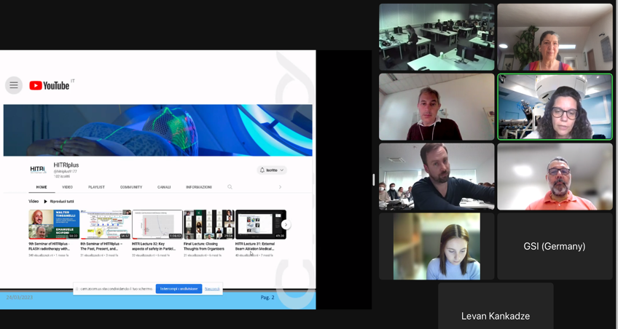
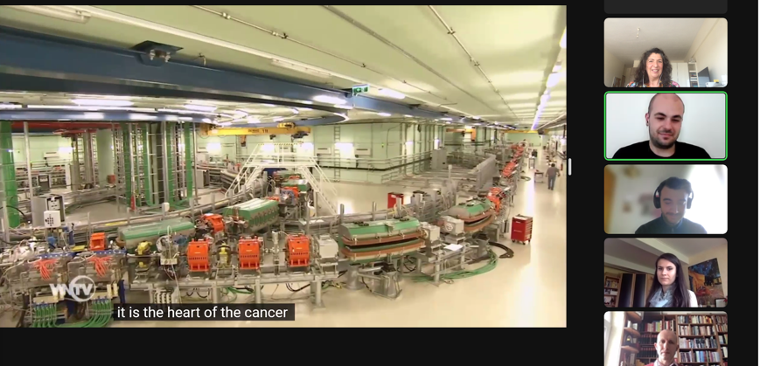
Virtual visits and video-conferences
Virtual visits during video-conference: GSI research institute, CNAO, MedAustron therapy centers
GSI moderators
CNAO moderator
medAustron moder.
U. Amaldi: HI therapy pioneer
HITRIplus EU-funded project

Slide 18
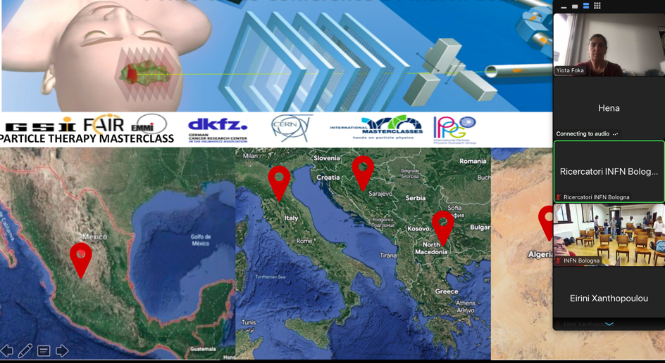
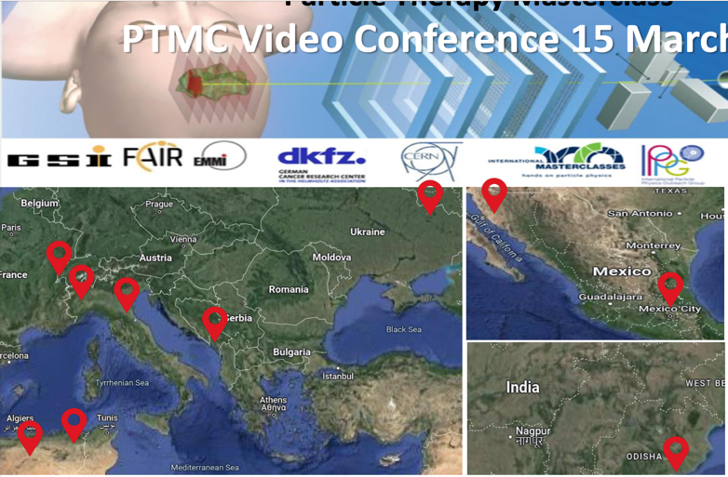


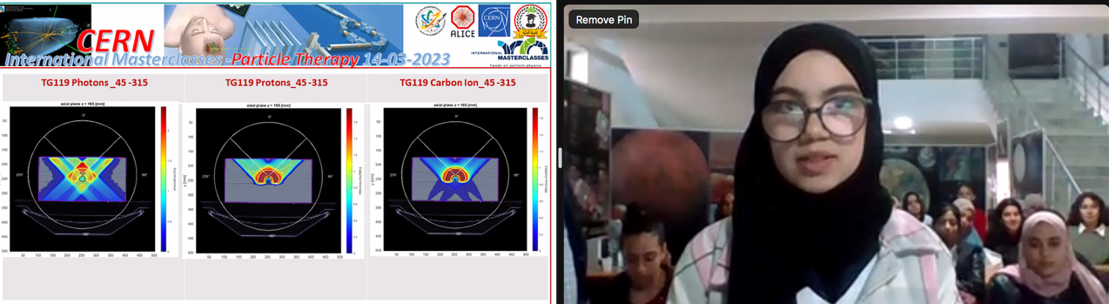


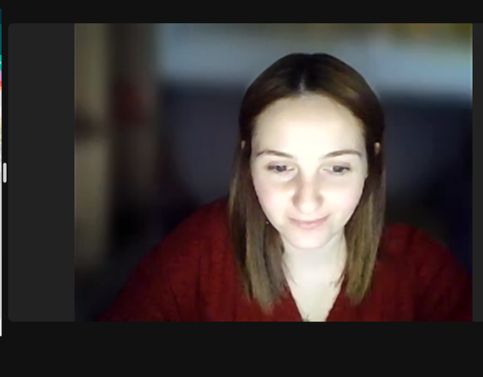
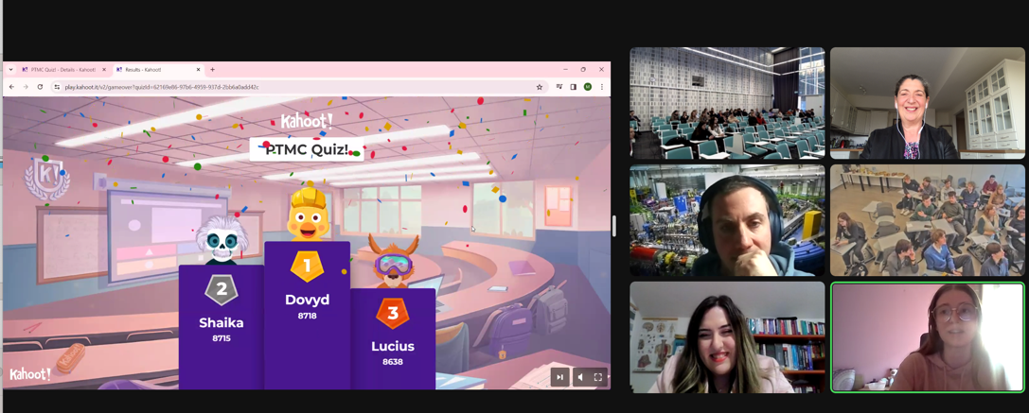
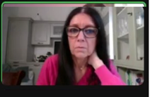
PTMC supporting females in STEM
11 Feb and 8 March sessions
encouraging female participation
and providing role models
PTMC quiz: a fun way to finish
What have we learnt?

Slide 19
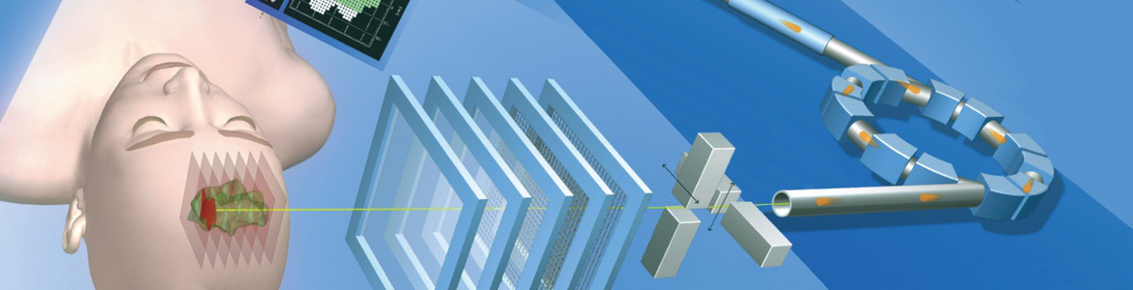

Particle Therapy MasterClass
Particle Therapy MasterClass
https://indico.cern.ch/e/PTMC
Material in different languages
including animations and demos
“PTMC in a kit”
in different languages
with introduction by DKFZ
including recordings
https://drive.google.com/drive/folders/1L94yhos6L7k3FQlMzD9Ql7kpk_c_ABD7
Training sessions: 4-5 per year
Importance of training teachers:
Sofia, Madrid, and Sarajevo
Example of UNSA/Sarajevo:
in-person at university
in-person at schools
common lectures online

Slide 20



PTMC and matRad Treatment Planning
First Local Test: GSI Feb 2019
International Pilot: CERN, GSI, DKFZ April 2019
Web page: UNSA students
CERN Open Days, Aug 2019
IMC Steering Group Approval: GSI May 2019
We could not imagine
what physics has to do with medicine,
that research institutes such as CERN
can contribute to medical applications

Slide 21







First PTMC in IMC2020
Mexico 2nd March 2020, then online due to covid

Slide 22


Participants of online PTMC in IMC2021
https://indico.cern.ch/e/PTMC
PTMC2021 online:
6 sessions, 1500 students
from 20 countries and 37 institutes

Slide 23

Participants of online PTMC in IMC2022
https://indico.cern.ch/e/PTMC
PTMC2022 online/hybrid:
6 sessions, 1500 students
from 22 countries and 37 institutes
web pages with agendas of every institute with material
in different languages, publicly available for future events
Interest of students, motivation of tutors (voluntary work), potential impact

Slide 24

Participants of hybrid PTMC in IMC2023
https://indico.cern.ch/e/PTMC
PTMC2023 in person/online/hybrid:
9 sessions
from 22 countries and 38 institutes
From Japan to Latinoamerica
web pages with agendas of every institute with material
in different languages, publicly available for future events
Interest of students, motivation of tutors (voluntary work), potential impact

Slide 25



Participants of hybrid PTMC in IMC2024
https://indico.cern.ch/e/PTMC
Statistics of 22 out of 47 institutes:
Total: 1567
428 female, 430 male
17 in person, 5 hybrid
PTMC2023 in person/online/hybrid:
8 sessions, more than 1500 students
from 22 countries and 47 institutes
Some institutes had 2 sessions
in-person and online
web pages with agendas of every institute with material
in different languages, publicly available for future events
Interest of students, motivation of tutors (voluntary work), potential impact

Slide 26
Took it a step further !
A full week MasterClass school
inspired by the PTMC format
within the HITRIplus EU funded project
Advanced material
for uni students and up to professionals
https://indico.cern.ch/e/HeavyIonTherapyMasterClass

Slide 27


https://indico.cern.ch/e/HeavyIonTherapyMasterClass
https://indico.cern.ch/e/PTMC
Full week course
One day activity
The HITM school is aimed at university students,
and up to early stage researchers.
The Particle Therapy MasterClass,
is aimed at high-school students (16-18)
Future tutors
Different options studying physics, for example accelerator physics, medical physics, bio-physics…
that can provide interesting career paths in upcoming fields where there is lack of specialised personnel
Future Tutors
Information about upcoming modern techniques for cancer tumour therapy and new research avenues,
where clearly the development of technology and the expertise of research laboratories is crucial

Slide 28




HITRIplus full week heavy-ion therapy masterclass school
World-wide reach motivating next generation of scientists
International MasterClasses one day activity
1050 registrants,
600 connections
at any given time
Power of Networks !

Slide 29










PTMC and HITRIplus school assistants
PTMC surveys cumulative
Changed your perspective regarding the job of scientists/physicists
At CERN
At MedAustron
Encouraged you to look for more information on related subjects

Slide 30

PTMC and HITRIplus school assistants
Next one in Thessaloniki
21 October, full day, hybrid
https://indico.cern.ch/event/1431035/
At CERN
At MedAustron

Slide 31

Main Message: need for fundamental research
To get the fruit you need the tree with its roots, trunk, branches….
Attract high-school students to STEM
Cultivate confidence through the hands-on
Support female participation
Create groups of Uni assistants that learn better in order to teach
Enhance public awareness on benefits from fundamental research
Prepare future generations aware of importance of fundamental research
a science educated future generation is crucial for shaping the future of any country,
based on rational scientific thinking and decision-making processes
Demonstrate a return to society from investment in fundamental research
Our reward: the enthusiasm and appreciation of the students

Slide 32


Proposal for a facility in South East Europe: SEEIIST
50% research and 50% therapy
with multiple ions
Optimisation of linac injector
for radio-isotope production
CERN Yellow Report
in publication process
Architectural design, Kaprinis Architects

Slide 33
IPPOG Working Group
Outreach of Applications for Society
contribute to making known to general public
the benefits for society from fundamental research

Slide 34

IPPOG witness stories
https://ippog.org/for-ippogers/outreach-application-society
Resently compiled,
outcome of Hackathons

Slide 35


IPPOG witness stories
IPPOG WG Applications for Society Guidelines for Contributions

Slide 36

IPPOG witness stories
become ambassador, use them to stimulate interest for STEM studies

Slide 37
We are paid to produce Knowledge !
and
Knowledge is Power
We share it empowering Students
and
the Broader Society
Thank you for your attention !

Slide 38
BACKUP

Slide 39

IPPOG WG Applications Guidelines for Contributions - Dokumenty Google
Thank you
for your attention!
Contributions Welcome!
Contacts:
yiota.foka@cern.ch
barbora.gulejova@cern.ch

Slide 40

IPPOG witness stories
https://ippog.org/ippog_witness_stories

Slide 41

IPPOG witness stories
cross-references: general principles and witness cases

Slide 42

IPPOG witness stories
become ambassador, use them to stimulate interest for STEM studies

Slide 43
PTMC Important Links
https://indico.cern.ch/e/PTMC
Information about the PTMC, in a different languages, can be found through the PTMC web page and the “PTMC in a kit” Google Drive links:
  PTMC web page: https://indico.cern.ch/event/840212/overview
  Google Drive: https://drive.google.com/drive/folders/1jRnLf49N_yRoOGg8V8vwq3DIpnetWdF0?usp=sharing
Material for the matRad installation can be found through the word document in the link below, together with a video describing the procedure:
  Installation: https://drive.google.com/file/d/1vT9tQ9ft1C7AwUSbU18pftC9H-ep4BPC/view
  Video: https://drive.google.com/file/d/1BdkjN63StX-1kFEqR_FgTgj_pgZ2-PhL/view?usp=sharing
Additional instructions for the use of matRad are provided through the workflow, which is available in many languages through the PTMC web page A video describing the workflow of different cases is provided via the google drive:
  Workflow: https://indico.cern.ch/event/840212/page/17991-workflow
  Video: https://drive.google.com/file/d/1jyCzJFfS7I_-0e45ZEcyb4fnXTaRJmpK/view?usp=sharing
Units and terminology of matRad can be found here:
  Link: https://indico.cern.ch/event/840212/page/18006-definitions

Slide 44






Acknowledgements PTMC
matRad Developers
Wahl, Niklas
Bangert, Mark
Hans-Peter Wieser
DKFZ Heidelberg
LoC: Wahl, Niklas
Katrin Platzer, Malte Ellerbrock
Noa Homolka Amit Ben Antony Bennan
GSI
LoC: Yiota Foka
GSI Biophysics:
Christian Graeff, Radek Pleskac
GSI ALICE, EMMI :
Ralf Averbeck, Malzacher, Peter
GSI IT :
Thorsten Kollegger, Behnert, Katharina
Osdoba, Sascha
CERN (staff and users)
CERN: tutors
Loc Org: Nikolaos Charitonidis
Alexander Gerbershagen
Evangelia Dimovasili
Elena Benedetto
CERN/ARIES: Maurizio Vretenar, Valerie Brunner
CERN/ENLIGHT: Manjit Dosanjh Petya Georgieva
CERN/KT: Manuela Cirilli Anais Rassat Rita Ferreira Giovanni Porcellana
CERN: Visits Service Erwan Harrouch Francois Butin
CERN: Training Centre: Eric Bonnefoy M-L LECOQ
Uni Sarajevo: web pages
Amila Avdic
Amra Ibrahimovic
Mirsad Tunja
Damir Skrijelj
Online mode, web pages, training
Sponsors : Edmond Offermann
Aris Mamaras (AUTH), Damir Skrijelj (UNSA), Elpida Theodoridou et al (AUTH)
Nermine Muradi (Uni of Tetovo)
General Coordination :
p.foka@gsi.de yiota.foka@cern.ch

Slide 45
More than 1500 students participated from 22 countries and 47 institutes during 8 sessions
Participants of hybrid PTMC in IMC2024
Including 11 Feb and 8 March women days
CERN
Slovenia
Lithuania Vilnious, Uni AND Cancer institute
Lithuania Kaunas Health uni AND Uni of Technology
Germany DKFZ
Georgia
France
Slovenia Uni Ljubljana
N. Macedonia Uni Tetovo
Morocco
Bulgaria Varna Astronomical observatory AND Uni
Bulgaria Sofia Uni
Spain Uni AND Hospital
Portugal Uni Lisbon
BiH Sarajevo AND Tuzla
Czech republic, Prague, Proton Therapy centre AND Charles UNI
Mexico Puebla
Mexico Hermosillo Uni of Sonora
Mexico, Mexico city, UNAM
Algeria
Poland
Greece
India
Montenegro
Ukraine
Italy Uni Piemonte Orientale
Italy Bologna
Italy Pavia Uni AND INFN
Italy Torino
Italy Cosenza. Uni AND INFN
Italy Milano UNIMI AND INFN

Slide 46


Attendees of IMC were attracted by Science, Technology, Engineering and Math careers.
It was definitely our case
From participants to collaborators
It is inspiring to young students.
This could mean more professionals in STEM topics
Noteworthy fact:
now we collaborate in UNAM with our IMC tutors
.

Slide 47






PTMC: Typical MasterClass Day Agenda
Real-time virtual visits at the end of the morning lectures to ALICE heavy-ion experiment
Thanks to the ALICE Outreach coordinator:
Despina Chatziphotiadou
Alternatively, use of provided videos
in the PTMC web pages

Slide 48



PTMC: Typical MasterClass Day Agenda
Start with videos on hadron therapy procedures in a virtual hadron therapy center
while participants arrive (or join the zoom session)
https://indico.cern.ch/event/840212/
Lectures adapted to the expertise of institutes

Slide 49


