Slide 1


Non-Nucleonic Components in Short Nuclear Distances
Misak Sargsian
Florida International University, Miami
XVIth Quark Confinement and the Hadron Spectrum
August 18-24, 2024, Cairns, Queensland, Australia

Slide 2
Why are nuclei not collapsing?
- Because of Nuclear Repulsive Core
What is Nuclear Repulsive Core?
- Repulsion in the NN System
- Repulsion in NNN+ system
How to probe the Repulsion
- Probe nuclei at larger and larger densities

Slide 3
Probing NN Repulsive Core
- NN force is attractive: But Nuclei are Stable
“If the two-body forces are everywhere attractive and if many-body forces are neglected then the nucleon pairs are sufficiently close to take advantage of attractive interactions and a collapsed state of nuclear matter results “
With binding energy 1600MeV/N for A=200 (compare 8 MeV/N)
G. Breit and E.P. Wigner, Phys. Rev. 53, 998 (1938).
Many body forces keeping nucleus stable
Jastrow 1950/51 assumed the existence of the infinite hard core to explain the
angular distribution of pp cross section at 340 MeV (r₀=0.6fm)
Non-monotonic NN central potential with the repulsive core was introduced:
Brueckner & Watson 1953 to obtain nuclear density saturation.

Slide 4
Modern NN Potentials
60’s

Slide 5
- understanding of the dynamics of transition between
hadronic to quark-gluon phases above saturation densities
- relevant for stability of atomic nuclei as well as structure disappearance
at very high densities.
Vc, MeV
pn
pn
Hidden Color
r

Slide 6
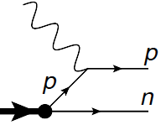
Considering mainly high Q² d(e,e’N)N reaction
Theory of high energy semi-inclusive electro-nuclear processes:
d
Deuteron consist of proton and neutron
Exclusiveness of the reaction as an advantage in probing unintegrated density matrix
of the deuteron at given missing momentum
not entirely true: final state hadronic interactions are never dynamically small
In High Energy and Momentum Transfer limit: Q² > 1GeV²: MEC is dynamically
suppressed, Delta is possible to suppress both kinematically and dynamically
For FSI eikonal regime is established: allowed to develop self-consistent theoretical
framework that allows to account for the short distance nuclear dynamics

Slide 7
Probing Deuteron at Small Distances at large Q²
MS PRC 2010
JLab, Q² = 3.5 GeV²
Boeglin et al PRL 2011, deuteron probed at up to 550MeV/c

Slide 8
Probing NN interaction at very short distances
d
M.Sargsian & F. Vera, PRL 2023

Slide 10
Some Paradigm Shift
Our current mindset about deuteron is fully non-relativistic, the observation that it has
total spin, J=1 and parity, P=+, together with the relation that
for non-relativistic wave function, P= (-1)^{l}, one concludes that the deuteron consists of S- and D- partial waves for proton-neutron system.
Paradigm Shift: The above reaction at high Q², measures the probability of observing proton and neutron in the deuteron at very large relative momenta.
In such a formulation the deuteron is not a composite system consisting of proton and neutron but it is a composite pseudo - vector (J=1, P=+) ``particle" from which one extracts proton and neutron.
How such a proton and neutron produced at such extremal conditions is related
to the dynamical structure of Light-Front deuteron wave function, which may include internal elastic as well as inelastic , or
transitions.

Slide 11
New Structure in the Deuteron and possible non-nucleonic components
M.S & Frank Vera PRL 2023
Paradigm shift:
- consider a deuteron not a nucleus that consist of proton and neutron
- but pseudovector composite particle from which we extract proton and neutron
- Light-Front Deuteron wave function
- Absorbing the energy denominator into the vertex function and using crossing symmetry

Slide 12
-
is a four-vector, which can be constructed in a most general form satisfying
time reversal, parity and charge conjugate symmetries
Because the deuteron is a bound system, in addition to on-shell p₁ and p₂ four momenta
one introduces
Constructed vertex:

Slide 13
High Momentum Transfer Kinematics
For large Q² limit, Light-Front momenta for the reaction are chosen as follows:
- One observes that for fixed x,

Slide 14
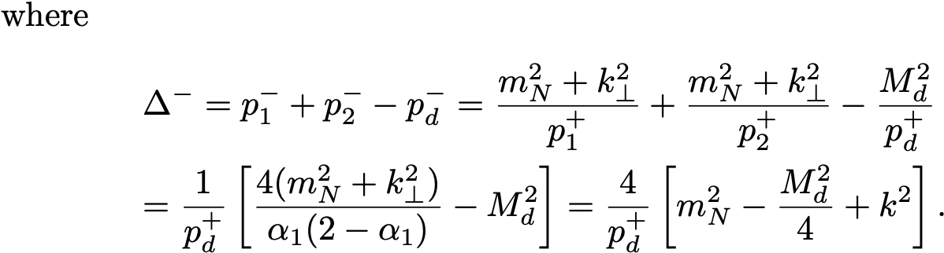
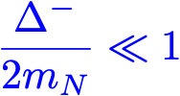
In high Q² limit

Slide 15
Consider:
Since:
and
then
Leading Oder!
where

Slide 16
Where:
fully relativistic: in addition to
term
has additional
term

Slide 17
Light Front Density Matrix and Momentum Distribution
Baryonic and Momentum Sum Rules

Slide 18
Non-Nucleonic Components and the New Structure
- Momentum distribution depends on
separately
- This is impossible for non-relativistic quantum mechanics of the deuteron since
in this case the potential of the interaction is real (no inelasticities) and the solution
of Lippmann-Schwinger (or Schroedinger) equation for partial S- and D-waves
satisfies ``angular condition", according to which the momentum distribution
in unpolarized deuteron depends on the magnitude of relative momentum only.
- On the other hand, in the relativistic domain the definition of the interaction potential is not straightforward to allow to use quantum-mechanical arguments in claiming that momentum distribution should satisfy the angular condition (i.e. depends on magnitude of k only).

Slide 19
- However, for the Light-Front, there is a remarkable theorem by Frankfurt and Strikman
which states that if one considers only pn component in the deuteron, then for most
acceptable forms of NN potential – constructed from elastic pn pn scattering, the angular
condition should be satisfied also for LF momentum distribution.
-The realization of the angular condition for relativistic case will require that light-front
potential to satisfy a condition
- Lorentz invariance for on-shell NN amplitude requires

Slide 20
- Existence of the Born term indicates that
- Iterating the equation around the on-shell kinematic point.
- will result in:
for the general case
V_{NN} – analytic function of angular momentum and it does not diverge exponentially in the
complex-angular momentum space it was shown that also for the off-shell case

Slide 21
- For Non-nucleonic components no such iteration can be done

Slide 22
Estimate of the effect
Frank Vera, PhD Thesis 2021

Slide 23
Estimate of the effect

Slide 24
Estimate of the effect

Slide 25
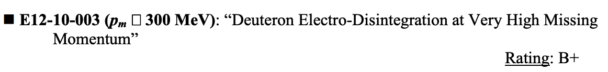
Possibility of Experimental Verification
PAC-36, 2010

Slide 26
Possibility of Experimental Verification
3-days of commissioning measurement,
JLab experiment Q² = 4 GeV²
C. Yero, et al Phys.Rev.Lett. 125 (2020) 26, 262501

Slide 27
Frank Vera, PhD Thesis 2021

Slide 28

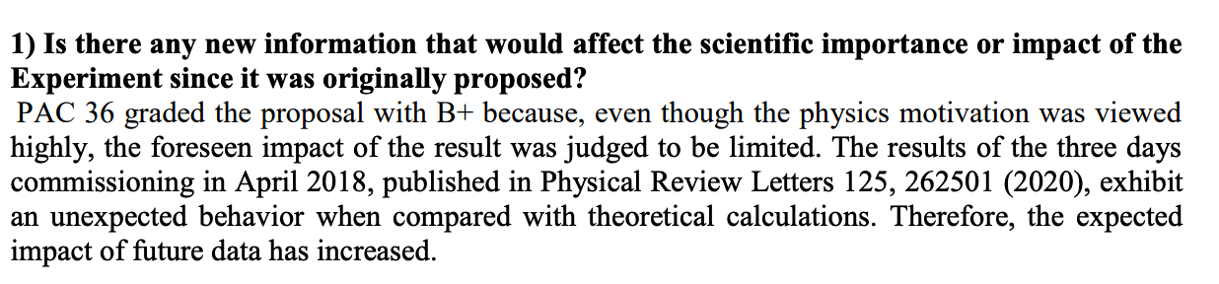
Possibility of Experimental Verification
PAC-49, 2021

Slide 29
Outlook on Experimental Verification of the Effect
analysis of the experiment will require careful account for competing nuclear effects
most importantly final state interactions
If angular dependence is found it will motivate new area of research
a: modeling non-nucleonic components in the deuteron,
b: understanding their origin and nature
c: evaluating parameters that can be used for Equation of State of high density
Nuclear Matter
If no angular dependence is found,
a: nucleonic degrees persist at very high density fluctuations
b: non-nucleonic components conspire to preserve angular condition
c: theory was wrong
This work is supported by U.S. DOE grant under contract DE-FG02-01ER41172.

Slide 30
Probing Deuteron at Small Distances at large Q²
JLab, Q² = 3.5 GeV²
Boeglin et al PRL 2011, deuteron probed at up to 550MeV/c

