Slide 1



End-to-end Optimization of the Layout of the SWGO Experiment
Quark Confinement and the Hadron Spectrum, Cairns Aug 19 2024
Tommaso Dorigo, Michele Doro, Federico Nardi, Luis Recabarren
(INFN, Padova & University of Padova)
Rafael Izbicki, Ann Lee, Luca Masserano, Alexander Shen
(Carnegie-Mellon University)
Max Aehle, Nicolas R. Gauger
(University of Kaiserslautern-Landau, RPTU)

Slide 2
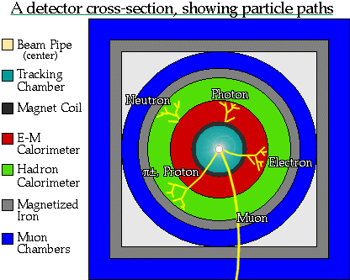
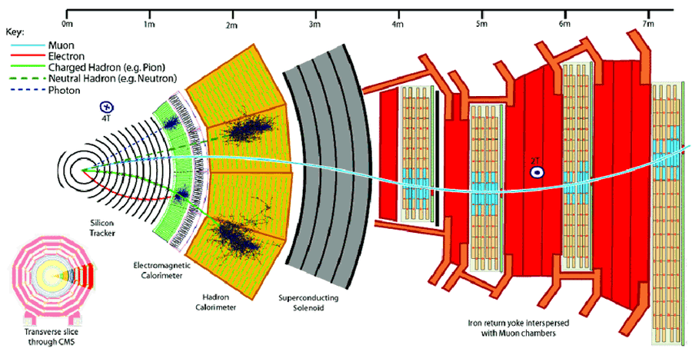
We Are Successful Detector Builders…
1989
In the past 60+ years our community established robust design paradigms, while pushing technologies to their bleeding edge
Some of those deeply ingrained paradigms are not necessarily as motivated today as they once were
- track first, destroy later (dichotomic!)
- redundancy (the opposite of optimality!)
- symmetric layouts (but the relevant physics is not!)
The design space of the biggest projects has grown to transcend our understanding – we cannot think in 10⁵ dimensions
Our demands (luminosity, resolution) are also on the rise, as is the size of the viable technological solutions space (e.g. 3D printing)
2010
2050?
?

Slide 3
We Are Successful Detector Builders…
1989
In the past 60+ years our community established robust design paradigms, while pushing technologies to their bleeding edge
Some of those deeply ingrained paradigms are not necessarily as motivated today as they once were
- track first, destroy later
- redundancy
- symmetric layouts
The design space of the biggest projects has grown to transcend our understanding – we cannot think in 10⁴ dimensions
Our demands (luminosity, resolution) are also on the rise, as is the size of the viable technological solutions space (e.g. 3D printing)
2010
2050?
DO’H!
Who’re you gonna call?

Slide 4
Research Directions in Fundamental Science
Explore higher energy / higher intensity frontier, ensuring we do not miss new physics
Explore the universe with multiple messengers, seeking answers to cosmology riddles
Study matter at extreme densities
Understand neutrinos
Formulate new theories of Nature
Improve calculational tools and prediction power of our theories
Extract sufficient statistics from high-D data
Ensure complete control of uncertainties and type-1 error rates
The above are mostly data analysis tasks. The next customer in line is detector design!
Nowadays we are doing all of this and more with deep learning!

Slide 5
Scale of Optimization Problems in Physics and Elsewhere
Task | Number of parameters | Year | Status
Typical LHC new physics search | 20-50 | 2012- | OK
MUonE detector station geometry | 20 | 2019-2020 | OK
SWGO Cherenkov tanks layout | O(100) | 2023-2024 | In progress
FDFLC (a future detector for a future large collider) | O(10,000) | ? | Not presently contemplated
AlexNet (for ImageNet challenge) | 62,300,000 | 2012 | OK
kNN for muon energy regression in granular calo | 66,000,000 | 2022 | OK
ChatGPT 3.5 | 150,000,000,000 | 2023 | OK
ChatGPT 4.0 | 1,700,000,000,000 | 2023 | OK

Slide 6
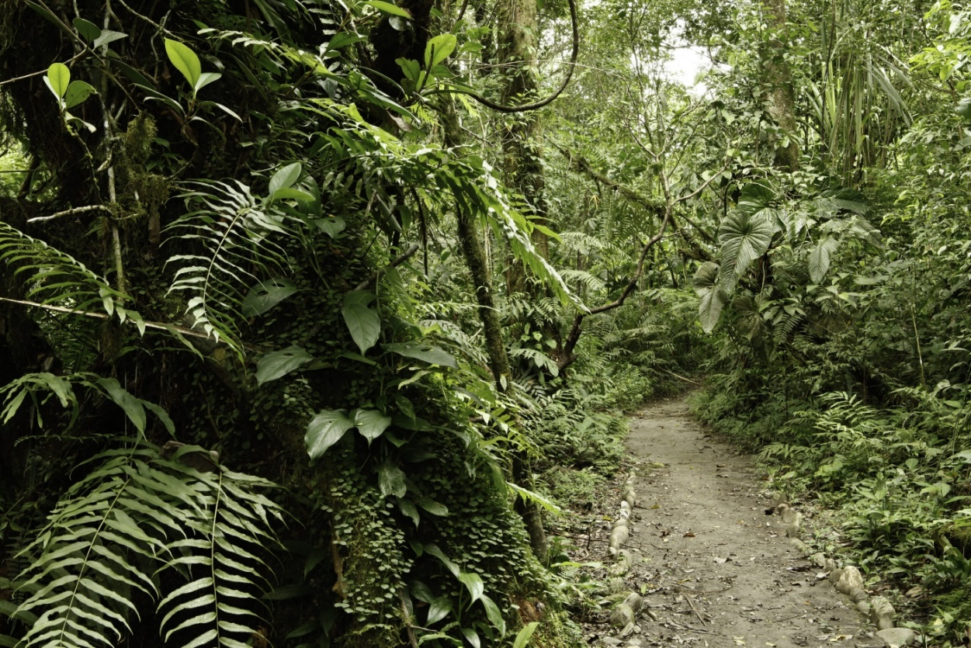
A Walk in the Jungle…
- We need new competences
The detector experts community is largely not enthused by AI
Some parts of the design decisions cannot, and will never, be automated
→ Engage computer scientists in our problems
→ Start easy, prove new technology by targeting low-hanging fruits
→ Pursue “human in the middle” approach

Slide 7














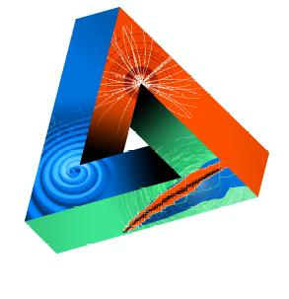

















Machine-Learning Optimized Design of Experiments
MODE Collaboration
https://mode-collaboration.github.io
M. Aehle¹⁷, A. G. Baydin⁵, A. Belias¹⁰, A. Boldyrev⁴, K. Cranmer⁸, P. de Castro Manzano¹, Z. Daher², C. Delaere², D. Derkach⁴, J. Donini^{3,26}, T. Dorigo^{1,14,21,26}, P. Elmer¹⁸, F. Fanzago¹, S. Gami²⁷, N.R. Gauger¹⁷, A. Giammanco^{2,26}, C. Glaser¹¹, L. Heinrich¹², R. Keidel¹⁷, J. Kieseler²², C. Krause²⁸, L. Kusch¹⁷, M. Lagrange², M. Lamparth¹², A. Lee²⁵, M. Liwicki²¹, G. Louppe⁶, L. Layer¹, L. Masserano²⁵, F. Nardi^{3,14}, P. Martinez Ruiz del Arbol⁹, F. Ratnikov⁴, R. Roussel²⁰, T. Samui²⁴, F. Sandin²¹, P. Stowell¹⁵, G. Strong¹, M. Tosi^{1,14}, A. Ustyuzhanin⁴, S. Vallecorsa⁷, X.C. Vidal²³, P. Vischia^{13,26}, G. Watts¹⁹, H. Zaraket¹⁶
Sponsored by
1 INFN, Italy
2 Université Catholique de Louvain, Belgium
3 Université Clermont Auvergne, France
4 Laboratory for big data analysis of the HSE, Russia
5 University of Oxford, UK
6 Université de Liege, Belgium
7 CERN, Switzerland
8 New York University, USA
9 IFCA, Spain
10 GSI, Germany
11 Uppsala Universitet, Sweden
12 TU Munchen, Germany
13 Universidad de Oviedo and ICTEA, Spain
14 Università di Padova, Italy
15 Durham University, UK
16 Lebanese University, Lebanon
17 Kaiserslautern-Landau University, Germany
18 Princeton University, USA
19 University of Washington, USA
20 SLAC, USA
21 Lulea University of Technology, Sweden
22 Karlsruhe Institute of Technology, Germany
23 Universidad de Santiago de Compostela, Spain
24 IISER Kolkata, India
25 Carnegie-Mellon University, USA
26 Universal Scientific Education and Research Network
27 NISER, India
28 HEPHY OeAW, Austria
JENAS

Slide 8
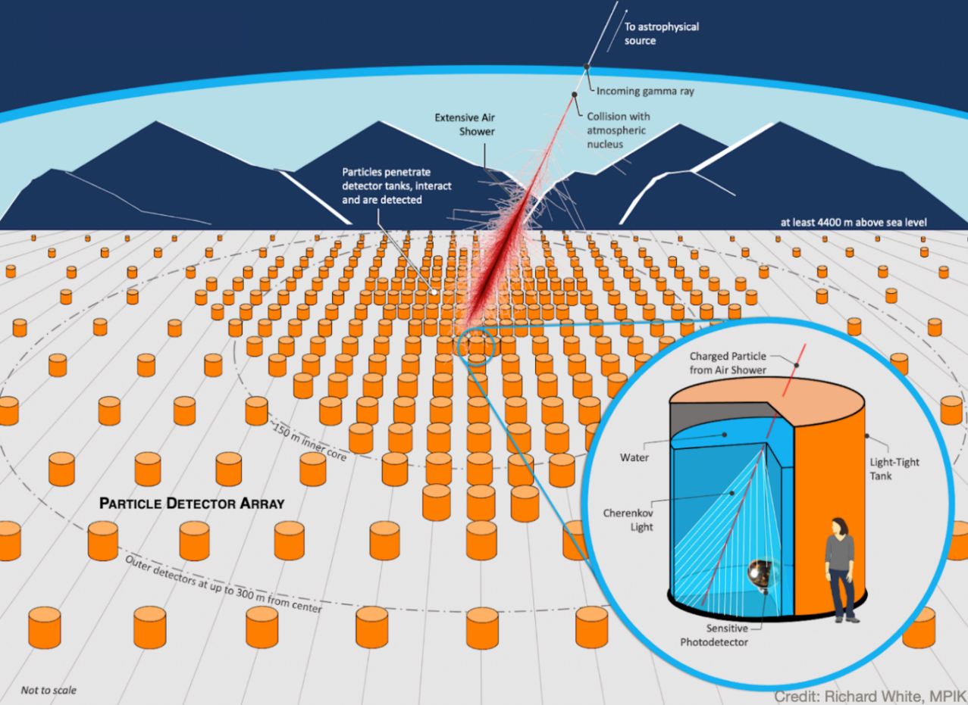
One Medium-Scale Astrophysics Use Case:
SWGO Layout Optimization
Below: the Southern Wide-field Gamma Observatory will
observe high-energy gamma rays with an array of water
Cherenkov tanks at high altitude in South America
The SWGO experiment will deploy O(6000) Cherenkov detectors over a O(km²) area, to reconstruct ultra-high energy gamma rays
The optimization of the single tank characteristics is fairly decoupled from the optimization of the array layout on the ground
→ Excellent use case of differential optimization!

Slide 9
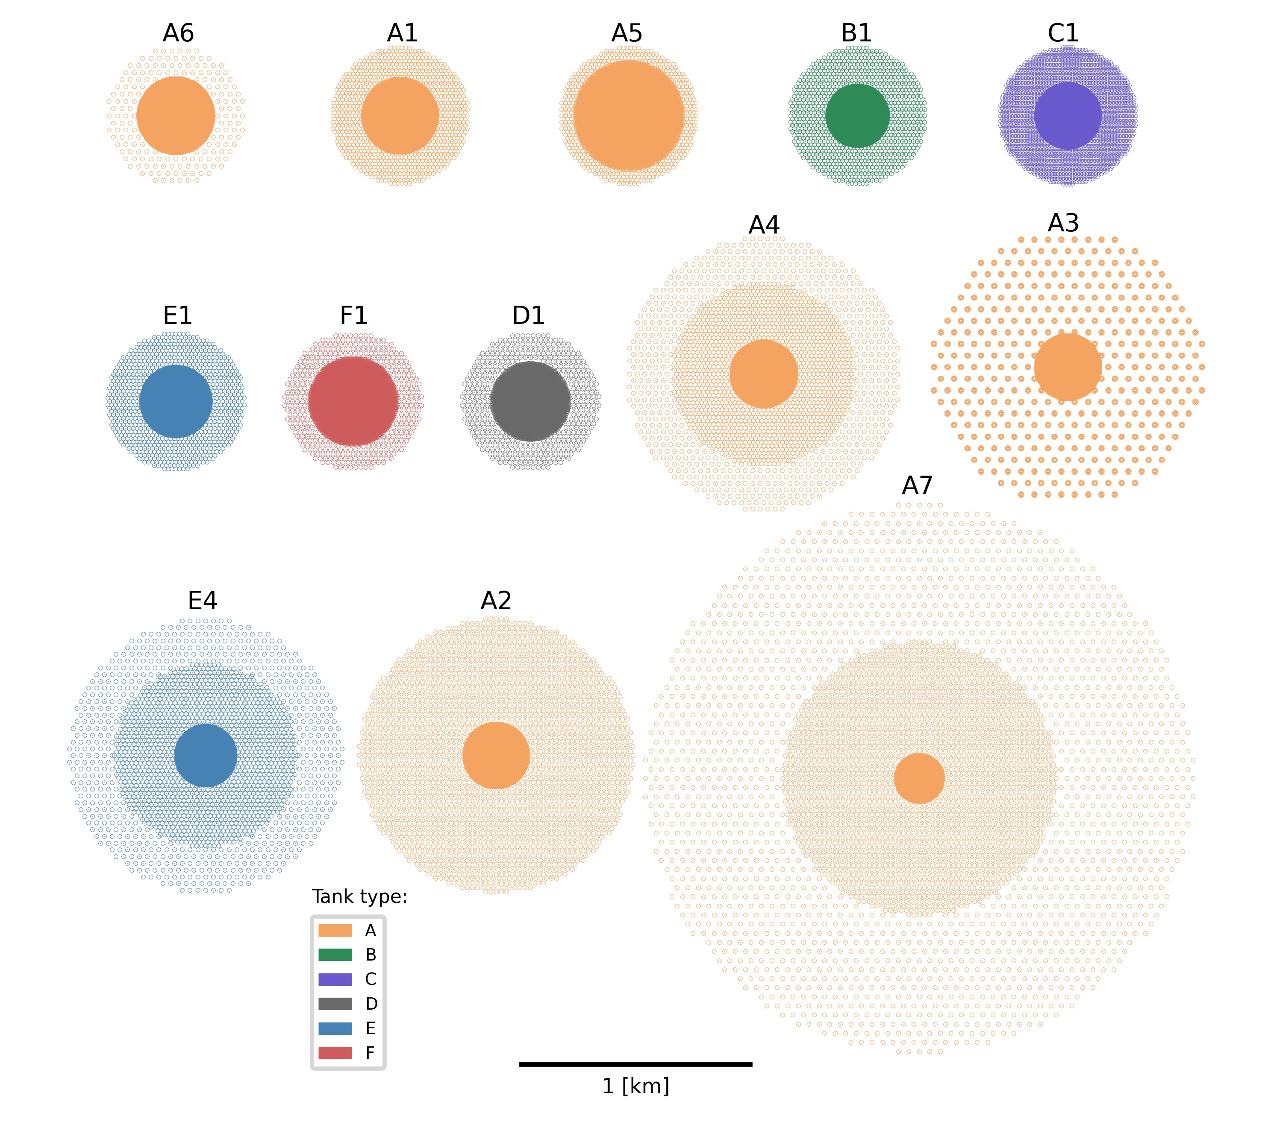
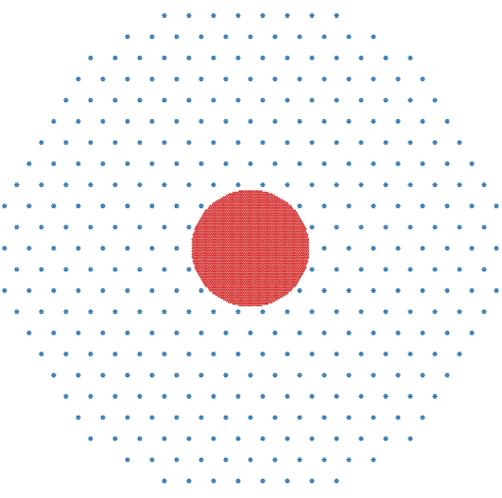
The Question
Several layouts have been proposed for SWGO.
→ Reasonable choices, sharing the idea of a dense core and sparse periphery
Which one is the best layout (in terms of science output per invested $) ?

Slide 10

The Question and a Possible Answer
Recipe:
Simulate showers in 13 given configurations
Endow ourselves with accurate model of best achievable inference extraction
Agree on a Utility function - e.g., weights w_{E} of
$U=\sum_{E=E_{1}}^{E_{n}}{w_{E_{i}}}\frac{Φ_{i}}{σ_{Φ_{i}}}$
Get 13 estimates of energy-integrated precision on $Φ_{γ}$, modulated by scientific value

Slide 11
The Principled Question
The most principled question is,
«WHAT is the best possible layout given X detectors?»
This is on another league – it demands the sorting out of R^{2X-3} choices, not 13!
It can NOT be answered by the above discrete-sampling technique.
→ We need something better!

Slide 12
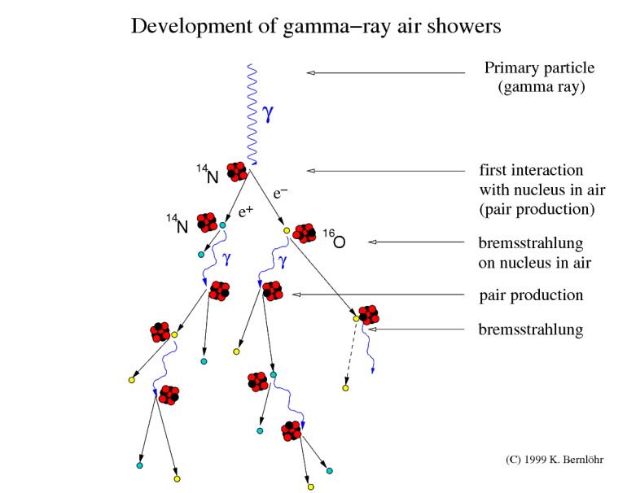
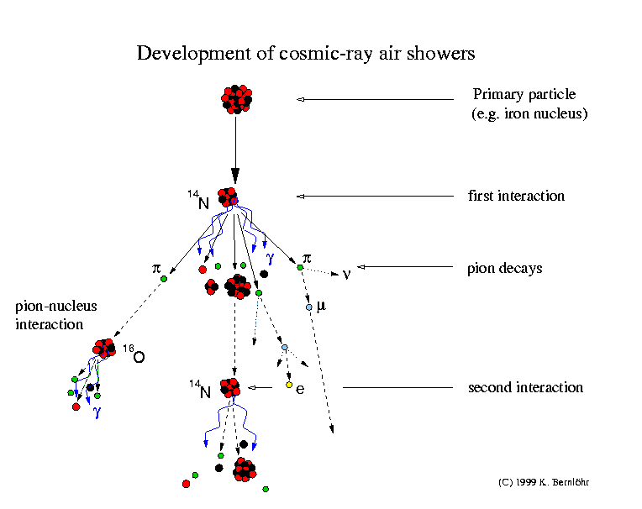
A Tentative Solution to the Principled Question
Atmospheric showers are a stochastic phenomenon: the model is implicit
Yet observable quantities are simple:
N_{μ}(t,x,y) - X,Y of shower center
N_{γ}(t,x,y) → These depend on shower pars. ω: - Primary particle ID
N_{e}(t,x,y) - Primary E, θ
→ Can devise a parametric model :
p [ N_{μ}(t), N_{γ}(t), N_{e}(t) | ω ]
Given F, we can compute in closed form the utility function for any detector configuration.
This enables gradient descent to the minimum of -U of –U!

Slide 13
A Tentative Solution to the Principled Question
Atmospheric showers are a stochastic phenomenon: the model is implicit
Yet observable quantities are simple:
N_{μ}(t,x,y) - X,Y of shower center
N_{γ}(t,x,y) → These depend on shower pars. ω: - Primary particle ID
N_{e}(t,x,y) - Primary E, θ, φ
→ Can devise a parametric model :
p [ N_{μ}(t), N_{γ}(t), N_{e}(t) | ω ]
Given F, we can compute in closed form the utility function for any detector configuration.
This enables gradient descent to the minimum of -U of –U!

Slide 14
A Tentative Solution to the Principled Question
Atmospheric showers are a stochastic phenomenon: the model is implicit
Yet observable quantities are simple:
N_{μ}(t,x,y) - X,Y of shower center
N_{γ}(t,x,y) → These depend on shower pars. ω: - Primary particle ID
N_{e}(t,x,y) - Primary E, θ
→ Can devise a surrogate: a parametric model
p [ N_{μ}(t), N_{γ}(t), N_{e}(t) | ω ]
Given F, we can compute in closed form the utility function for any detector configuration.
This enables gradient descent to the minimum of -U of –U!

Slide 15
A Tentative Solution to the Principled Question
Atmospheric showers are a stochastic phenomenon: the model is implicit
Yet observable quantities are simple:
N_{μ}(t,x,y) - X,Y of shower center
N_{γ}(t,x,y) → These depend on shower pars. ω: - Primary particle ID
N_{e}(t,x,y) - Primary E, θ
→ Can devise a surrogate: a parametric model
p [ N_{μ}(t), N_{γ}(t), N_{e}(t) | ω ]
Given p[ ], we can compute in closed form the utility function for any detector configuration.
This enables gradient descent to the minimum of –U!

Slide 16
Building a Shower Model
Primary cosmic ray | Angle θ (degrees) | Energy (PeV) | Energy power law | Number
Proton | 0° - 65° | 0.1 – 1. | -1.0 | 100,000
Proton | 0° - 65° | 1. – 10. | -1.0 | 200,000
Proton | 20° | 1. – 10. | -1.0 | 200,000
Proton | 40° | 1. – 10. | -1.0 | 200,000
Gamma | 20° | 0.1, 0.3, 1., 3. | - | 100,000 * 4
Gamma | 40° | 0.1, 0.3, 1., 3. | - | 100,000 * 4
Gamma | 0° - 65° | 0.1 – 10. | -2.0 | 100,000
We use CORSIKA to generate gamma and proton showers
Highly CPU intensive, large outputs

Slide 17
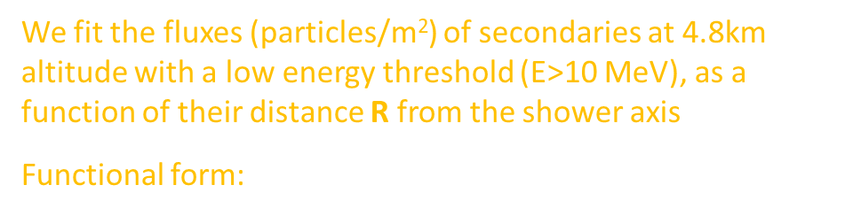
Fits of dN/dR Fluxes
We fit the fluxes (particles/m²) of secondaries at 4.8km altitude with a low energy threshold (E>10 MeV), as a function of their distance R from the shower axis
Functional form: $\frac{dN}{dR}= e^{(p_{0}+p_{1}R^{p_{2}})}$
R

Slide 18
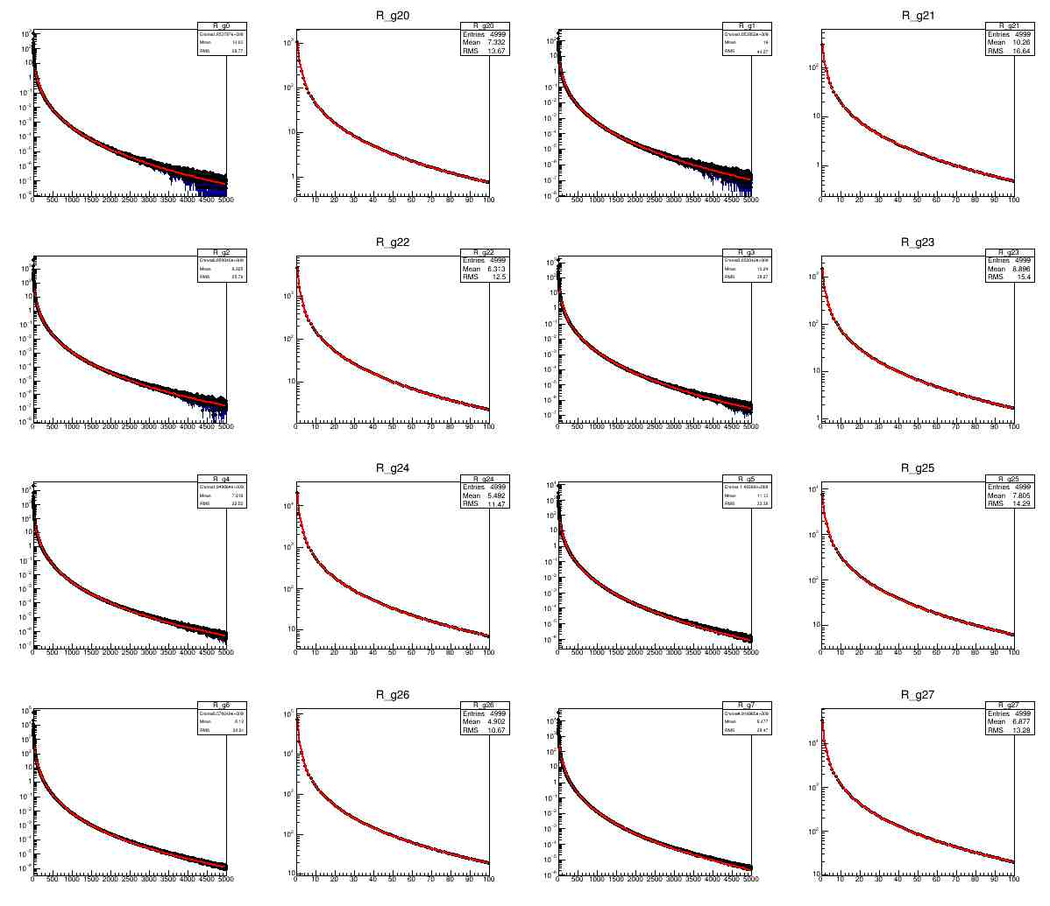
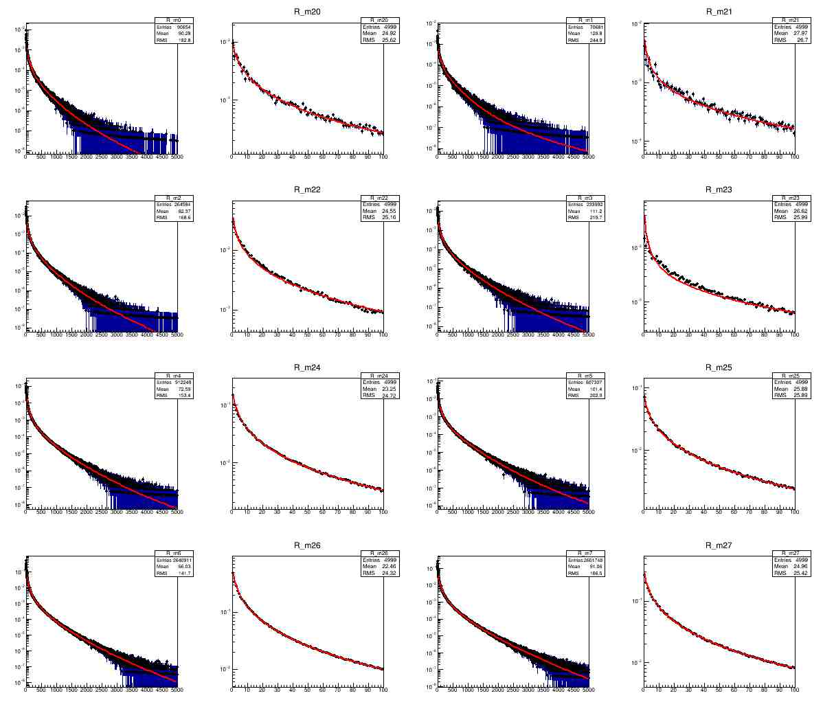
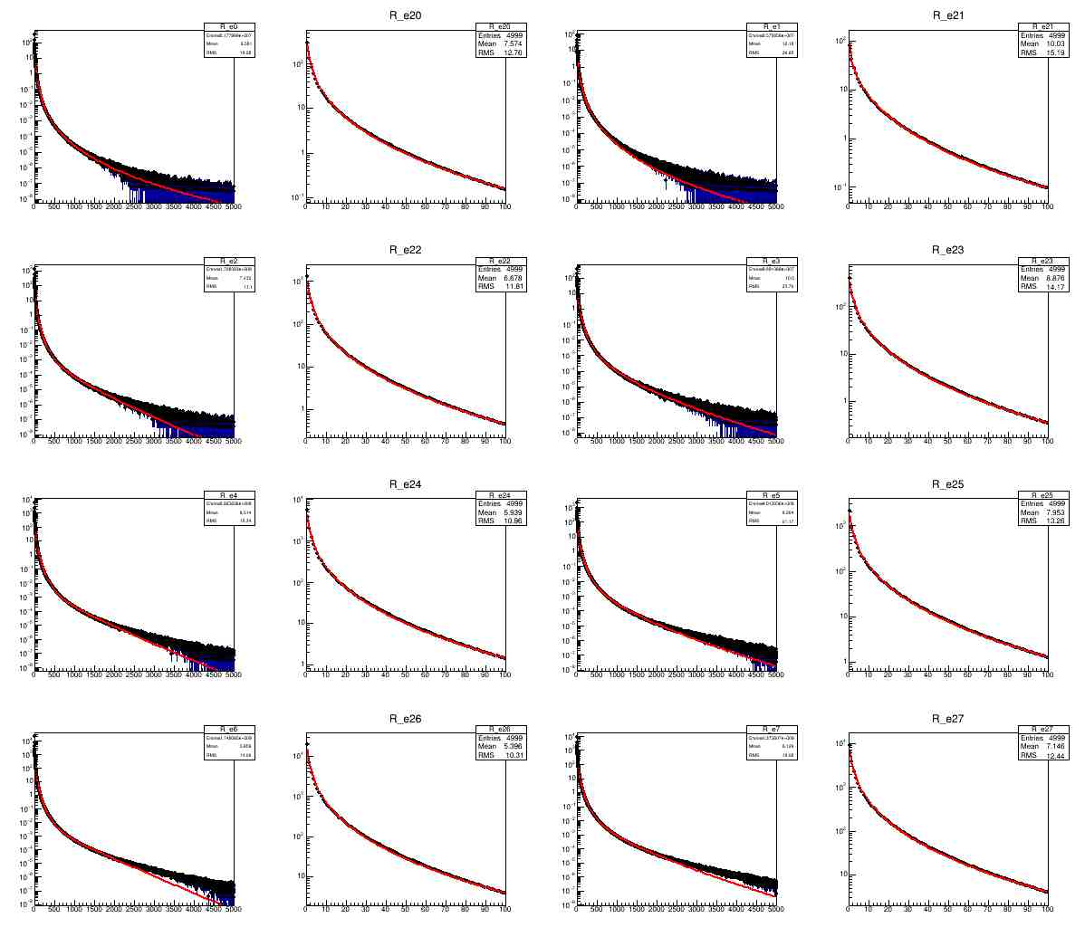
Fits of dN/dR Fluxes
Secondary gamma fluxes are shown for four shower angles ([0°-16.25°], [16.25°-32.5°], [32.5°-48.75°], [48.75°-65°] and energies [0.1, 0.3, 1, 3 PeV]

Slide 19
Fits of dN/dR Fluxes
Secondary muon fluxes are shown for four shower angles ([0°-16.25°], [16.25°-32.5°], [32.5°-48.75°], [48.75°-65°] and energies [0.1, 0.3, 1, 3 PeV]

Slide 20
Fits of dN/dR Fluxes
Secondary electron fluxes are shown for four shower angles ([0°-16.25°], [16.25°-32.5°], [32.5°-48.75°], [48.75°-65°] and energies [0.1, 0.3, 1, 3 PeV]

Slide 21




Fits to dN/dR Fit Parameters
Once we have reasonable fits to the dN/dR distributions, we proceed to obtain a continuous model of the three function parameters p₀, p₁, p₂:
E.g. p₀ (top), and p₁ and p₂ (resp. center and bottom) parameters of fits to dN/dR distributions for e+γ are fit to exponential (resp. parabolic) functions of energy in four angular ranges
Finally we interpolate the parameters with a cubic fit to the four theta values
$${\left.\frac{dN}{dR}\right]}_{e(p)}=exp\left\{p_{0}{\left[E_{p},θ_{p}\right]}_{e}+p_{1}{\left[E_{p},θ_{p}\right]}_{e}R^{p_{2}{\left[E_{p},θ_{p}\right]}_{e}}\right\}$$
$${\left.\frac{dN}{dR}\right]}_{e(γ)}=exp\left\{p_{0}{\left[E_{γ},θ_{γ}\right]}_{e}+p_{1}{\left[E_{γ},θ_{γ}\right]}_{e}R^{p_{2}{\left[E_{γ},θ_{γ}\right]}_{e}}\right\}$$
$${\left.\frac{dN}{dR}\right]}_{μ(p)}=exp\left\{p_{0}{\left[E_{p},θ_{p}\right]}_{μ}+p_{1}{\left[E_{p},θ_{p}\right]}_{μ}R^{p_{2}{\left[E_{p},θ_{p}\right]}_{μ}}\right\}$$
$${\left.\frac{dN}{dR}\right]}_{μ(γ)}=exp\left\{p_{0}{\left[E_{γ},θ_{γ}\right]}_{μ}+p_{1}{\left[E_{γ},θ_{γ}\right]}_{μ}R^{p_{2}{\left[E_{γ},θ_{γ}\right]}_{μ}}\right\}$$

Slide 22
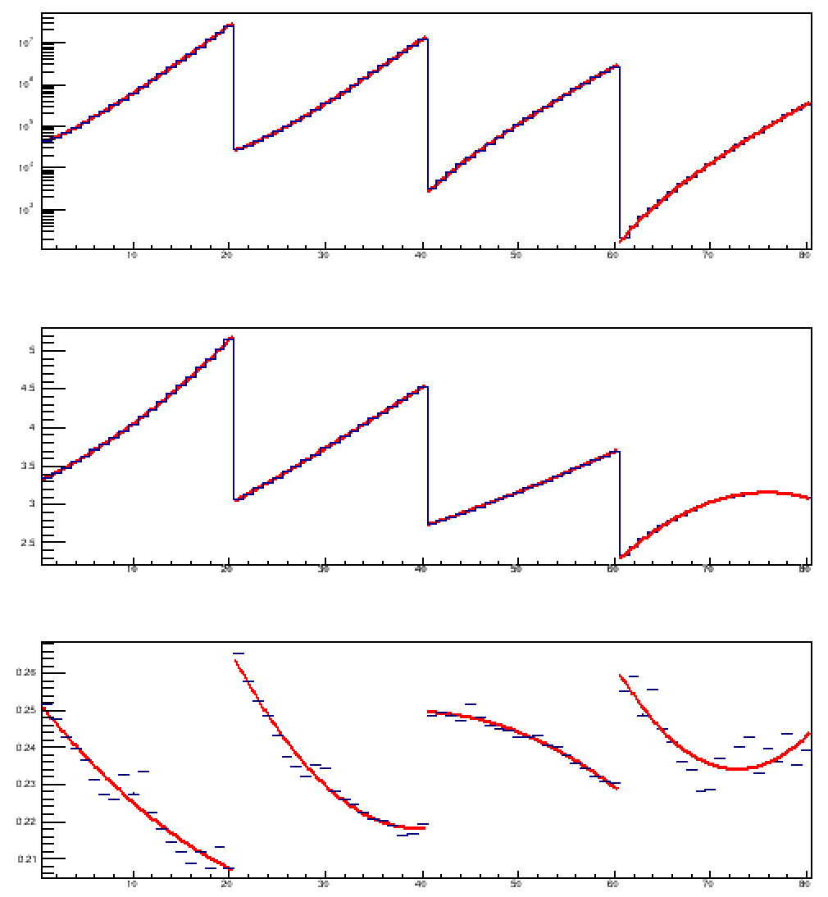
Fits to dN/dR Fit Parameters
Once we have reasonable fits to the dN/dR distributions, we proceed to obtain a continuous model of the three function parameters p₀, p₁, p₂:
E.g. p₀ (top), and p₁ and p₂ (resp. center and bottom) parameters of fits to dN/dR distributions for e+γ from photon primaries are fit to exponential (resp. parabolic) functions of energy in four angular ranges
Finally we interpolate the parameters with a cubic fit to the four theta values

Slide 23
Fits to dN/dR Fit Parameters
Once we have reasonable fits to the dN/dR distributions, we proceed to obtain a continuous model of the three function parameters p₀, p₁, p₂:
E.g. p₀ (top), and p₁ and p₂ (resp. center and bottom) parameters of fits to dN/dR distributions for e+γ from photon primaries are fit to exponential (resp. parabolic) functions of energy in four angular ranges
We may then interpolate the parameters at any energy with a cubic fit to the four θ values
θ
θ*
0° 16.25° 32.5° 48.75° 65°

Slide 24
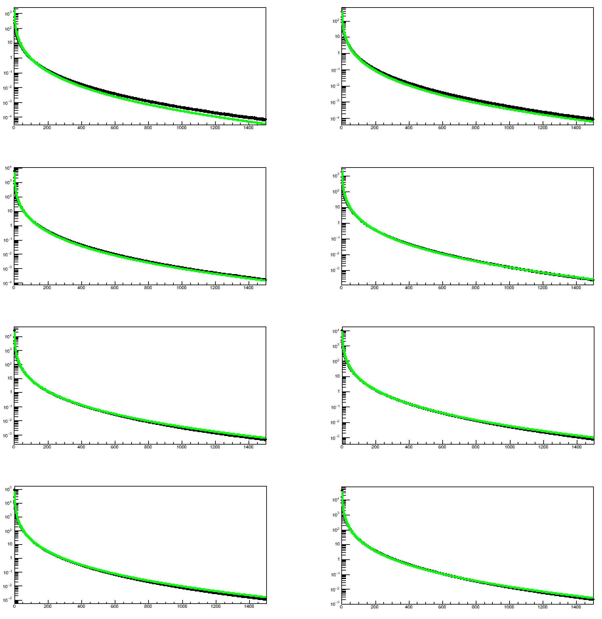
Fits to dN/dR Fit Parameters
Once we have reasonable fits to the dN/dR distributions, we proceed to obtain a continuous model of the three function parameters p₀, p₁, p₂:
E.g. p₀ (top), and p₁ and p₂ (resp. center and bottom) parameters of fits to dN/dR distributions for e+γ from photon primaries are fit to exponential (resp. parabolic) functions of energy in four angular ranges
We may then interpolate the parameters at any energy with a cubic fit to the four θ values
Finally we validate the model → OK for our task (deviations of 5-10% over 6-7 orders of magnitude).
Shown are e+ γ flux comparisons at four fixed values of E (0.1, 0.3, 1, 3 PeV) and angle (20°, 40°)

Slide 25
Building an End-to-End Model of SWGO
Next, we need to address the problem of producing a state-of-the-art inference extraction procedure.
This requires:
Effective discrimination of proton from gamma showers
Precise reconstruction of shower parameters
And of course the full thing must be differentiable…

Slide 26
Building an End-to-End Model of SWGO
Next, we need to address the problem of producing a state-of-the-art inference extraction procedure.
This requires:
Effective discrimination of gamma from proton showers
Precise reconstruction of shower parameters
And of course the full thing must be differentiable…
P
γ

Slide 27
Building an End-to-End Model of SWGO
E, θ, φ,
X, Y
E, θ, φ,
X, Y
Next, we need to address the problem of producing a state-of-the-art inference extraction procedure.
This requires:
Effective discrimination of gamma from proton showers
Precise reconstruction of shower parameters
And of course the full thing must be differentiable…

Slide 28

Building an End-to-End Model of SWGO
Next, we need to address the problem of producing a state-of-the-art inference extraction procedure.
This requires:
Effective discrimination of gamma from proton showers
Precise reconstruction of shower parameters
And the full thing must be differentiable…
$$\frac{∂}{∂x}$$

Slide 29

Shower Reconstruction
To model reconstruction performances of a future instrument, safe to err on the high-precision side
→ For now we assume that tanks count with full efficiency and perfect discrimination the e+gamma and muons crossing them
We also assume we have a perfect model of dN/dR fluxes
→ We may use a likelihood to extract E, θ under each primary particle hypotheses:
$L_{p}\left({\left\{N_{e},N_{μ}\right\}}_{i}|E,θ\right)=\prod_{i}^{N_{det}}{Pois\left[N_{e}^{i}|λ_{e}^{i}{\left(E,θ,φ,X,Y\right)}_{p}\right]}$ $\prod_{i}^{N_{det}}{Pois\left[N_{μ}^{i}|λ_{μ}^{i}{\left(E,θ,φ,X,Y\right)}_{p}\right]}$
$L_{γ}\left({\left\{N_{e},N_{μ}\right\}}_{i}|E,θ\right)=\prod_{i}^{N_{det}}{Pois\left[N_{e}^{i}|λ_{e}^{i}{\left(E,θ,φ,X,Y\right)}_{γ}\right]}$ $\prod_{i}^{N_{det}}{Pois\left[N_{μ}^{i}|λ_{μ}^{i}{\left(E,θ,φ,X,Y\right)}_{γ}\right]}$
To it we must add Gaussian terms modeling the time of signals recorded by each detector (WIP)

Slide 30
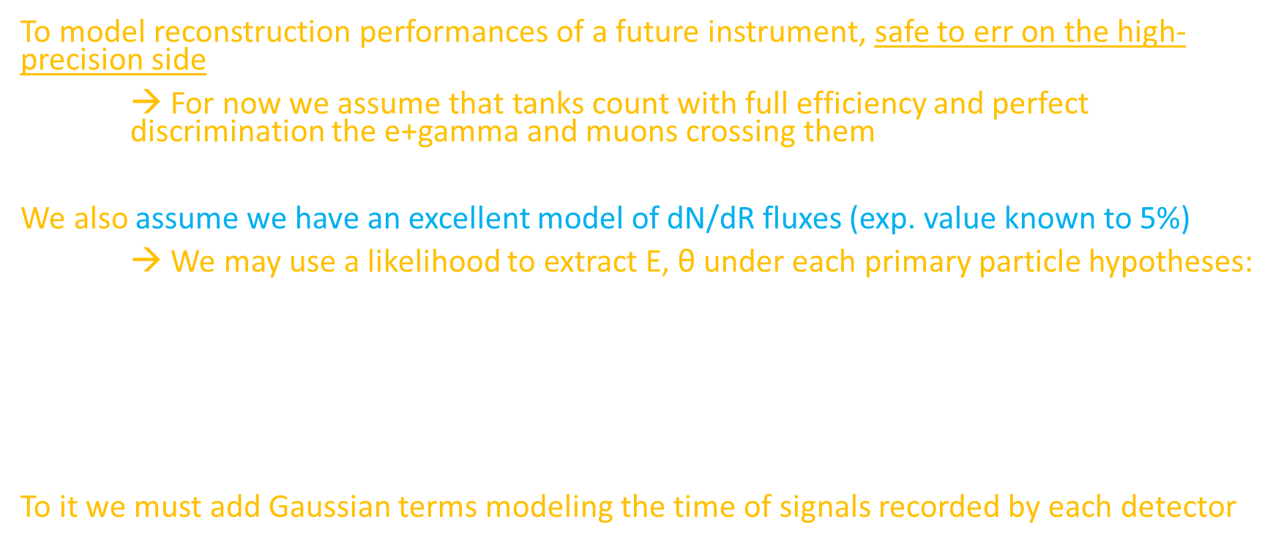
Shower Reconstruction
To model reconstruction performances of a future instrument, safe to err on the high-precision side
→ For now we assume that tanks count with full efficiency and perfect discrimination the e+gamma and muons crossing them
We also assume we have an excellent model of dN/dR fluxes (exp. value known to 5%)
→ We may use a likelihood to extract E, θ under each primary particle hypotheses:
$L_{p}\left({\left\{N_{e},N_{μ}\right\}}_{i}|E,θ\right)=\prod_{i}^{N_{det}}{Pois\left[N_{e}^{i}|λ_{e}^{i}{\left(E,θ,φ,X,Y\right)}_{p}\right]}$ $\prod_{i}^{N_{det}}{Pois\left[N_{μ}^{i}|λ_{μ}^{i}{\left(E,θ,φ,X,Y\right)}_{p}\right]}$
$L_{γ}\left({\left\{N_{e},N_{μ}\right\}}_{i}|E,θ\right)=\prod_{i}^{N_{det}}{Pois\left[N_{e}^{i}|λ_{e}^{i}{\left(E,θ,φ,X,Y\right)}_{γ}\right]}$ $\prod_{i}^{N_{det}}{Pois\left[N_{μ}^{i}|λ_{μ}^{i}{\left(E,θ,φ,X,Y\right)}_{γ}\right]}$
To it we must add Gaussian terms modeling the time of signals recorded by each detector

Slide 31
Scheme of Optimization Pipeline
Simulate an initial layout for detector array

Slide 32
Simulate an initial layout for detector array
Scheme of Optimization Pipeline
p
p
γ
Simulate a set of gamma and proton showers hitting array

Slide 33
Simulate an initial layout for detector array
Scheme of Optimization Pipeline
p
p
γ
Simulate a set of gamma and proton showers hitting array
Reconstruct shower parameters ω in each hypothesis by likelihood maximization

Slide 34
Simulate an initial layout for detector array
Scheme of Optimization Pipeline
Simulate a set of gamma and proton showers hitting array
T_{i} = log L_{γ}^{max,i} – log L_{p}^{max,i}
Reconstruct shower parameters ω in each hypothesis by likelihood maximization
Derive log-likelihood ratio of the two hypotheses

Slide 35
Simulate an initial layout for detector array
Scheme of Optimization Pipeline
pdf
p γ
Simulate a set of gamma and proton showers hitting array
T = log L_{γ} - log L_{p}
Reconstruct shower parameters ω in each hypothesis by likelihood maximization
Derive log-likelihood ratio of the two hypotheses
Obtain PDFs of LLR for the gamma and proton hypotheses given current layout

Slide 36
Simulate an initial layout for detector array
Scheme of Optimization Pipeline
pdf
p γ
Simulate a set of gamma and proton showers hitting array
T = log L_{γ} - log L_{p}
Reconstruct shower parameters ω in each hypothesis by likelihood maximization
Derive log-likelihood ratio of the two hypotheses
Obtain PDFs of LLR for the gamma and proton hypotheses given current layout

Slide 37


Simulate an initial layout for detector array
Scheme of Optimization Pipeline
$$L\left(f_{γ}\right)=\prod_{1}^{N_{events}}{\left[f_{γ}p_{γ}+\left(1−f_{γ}\right)p_{p}\right]}$$
Compute the likelihood of the observed batch as a function of the fraction of gammas in the batch; compute the second derivative of the likelihood
Simulate a set of gamma and proton showers hitting array
$$σ_{f_{γ}}^{2}=−{\left(\frac{d^{2}L}{d{f_{γ}}^{2}}\right)}^{−1}$$
Reconstruct shower parameters ω in each hypothesis by likelihood maximization
Derive log-likelihood ratio of the two hypotheses
Obtain PDFs of LLR for the gamma and proton hypotheses given current layout
Simulate a batch of gammas and protons and reconstruct them; obtain the TS of each shower

Slide 38
Simulate an initial layout for detector array
Scheme of Optimization Pipeline
Use RCF bound to estimate the expected variance of the signal flux measurement
Compute the likelihood of the observed batch as a function of the fraction of gammas in the batch; compute the second derivative of the likelihood
Simulate a set of gamma and proton showers hitting array
$$σ_{f_{γ}}^{2}=−{\left(\frac{d^{2}L}{d{f_{γ}}^{2}}\right)}^{−1}$$
Reconstruct shower parameters ω in each hypothesis by likelihood maximization
Derive log-likelihood ratio of the two hypotheses
Obtain PDFs of LLR for the gamma and proton hypotheses given current layout
Simulate a batch of gammas and protons and reconstruct them; obtain the TS of each shower

Slide 39
Simulate an initial layout for detector array
Scheme of Optimization Pipeline
Update layout (x,y of each tank) following gradient of U
Obtain the utility and its gradient with respect to each detector x,y position
Use RCF bound to estimate the expected variance of the signal flux measurement
Compute the likelihood of the observed batch as a function of the fraction of gammas in the batch; compute the second derivative of the likelihood
Simulate a set of gamma and proton showers hitting array
Reconstruct shower parameters ω in each hypothesis by likelihood maximization
Derive log-likelihood ratio of the two hypotheses
Obtain PDFs of LLR for the gamma and proton hypotheses given current layout
Simulate a batch of gammas and protons and reconstruct them; obtain the TS of each shower

Slide 40
Simulate an initial layout for detector array
Stop when satisfied
Scheme of Optimization Pipeline
Update layout (x,y of each tank) following gradient of U
Obtain the utility and its gradient with respect to each detector x,y position
Use RCF bound to estimate the expected variance of the signal flux measurement
Compute the likelihood of the observed batch as a function of the fraction of gammas in the batch; compute the second derivative of the likelihood
Simulate a set of gamma and proton showers hitting array
Reconstruct shower parameters ω in each hypothesis by likelihood maximization
Derive log-likelihood ratio of the two hypotheses
Obtain PDFs of LLR for the gamma and proton hypotheses given current layout
Simulate a batch of gammas and protons and reconstruct them; obtain the TS of each shower

Slide 41


The utility
The choice of the utility to maximize is crucial. We started with a simple ratio that tracks the precision on the gamma flux:
( the ρ factor corrects for the density of simulated showers)
We also added to this a term U₂ that tracks the energy resolution of showers:

Slide 42

The utility
We then add to this a term U₂ that tracks the energy resolution on gamma showers:
$U_{2}=\frac{\sum_{i}{w(E_{i})}}{\sum_{i}{\frac{E_{i}}{σ_{E_{i}}}w(E_{i})}}$
Above, the sums run on gamma events in a batch of showers, and w(E) accounts to the relative desirability of getting a small uncertainty on showers based on their energy

Slide 43

The utility
$U_{2}=\frac{\sum_{i}{w(E_{i})}}{\sum_{i}{\frac{E_{i}}{σ_{E_{i}}}w(E_{i})}}$
Finally, we added a term sensitive to the pointing resolution on gamma showers in the sky:
$U_{3}=\frac{\sum_{i}{\frac{w(E_{i})}{\sqrt{σ_{θ}^{2}+σ_{φ}^{2}}}}}{\sum_{i}{w(E_{i})}}$
The total utility is thus non-convex and results from assigning a relative value to each term:
U = λ₁U₁ + λ₂U₂ + λ₃U₃

Slide 44
A different utility definition
Although the utility definition discussed above “works” – it provides a well specified objective for our optimization task –, it connects in an arbitrary way the different capabilities of the array (in terms of flux measurement and p/gamma discrimination, energy resolution, pointing resolution)
→ Better to try and use the ingredients to provide more “physics motivated” utility definitions, that exploit the resolution and acceptance of the instrument in a coherent way.
Proposal: minimum exposure time to obtain 3-sigma evidence for a point source at high energy, from an on-off counting experiment
This integrates background discrimination (expected background flux in signal region), pointing resolution (width of signal region in the sky), and energy resolution (spread of energy from source) and ideally connects with performance of the instrument

Slide 45
Point Source Utility
We define an “on” region of extension [-1.4σ_{θ},1.4σ_{θ}] x [-1.4σ_{φ}, 1.4σ_{φ}]
and a surrounding “off” region 10 times wider.
Similarly, we only look at photons in a [-1.4σ_{Ε},1.4σ_{Ε}] region around the point source energy E
We estimate backgrounds in the off region by a fit to the gamma fraction there; then we combine Poisson uncertainty and fit fraction uncertainty to get an estimate of the background in the on region,
B_{exp} = 0.01 (B_{off} +- [B_{off} + (B_{off} σ(f_{γ})/f_{γ})²]^{0.5})

Slide 46
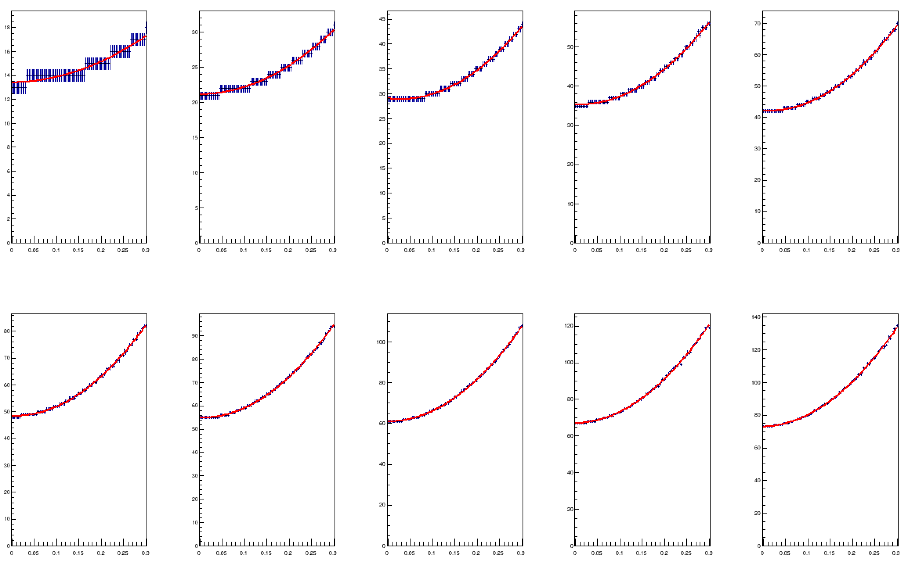
Approximation of N(3s)
We needed a differentiable model of the number of signal events producing a 3-sigma excess, given Poisson background B+-σ_{Β}
Modeling method:
compute tail probabilities of B fluctuations, with the uncertainty modeled as a log-normal distribution, for a range of B, σ_{Β} combinations
Fit these with power laws
Model parameters of the power law functions with polynomials
Above: N(3s) versus σ_{Β} for 10 different B values (from5 to 50 evts)

Slide 47
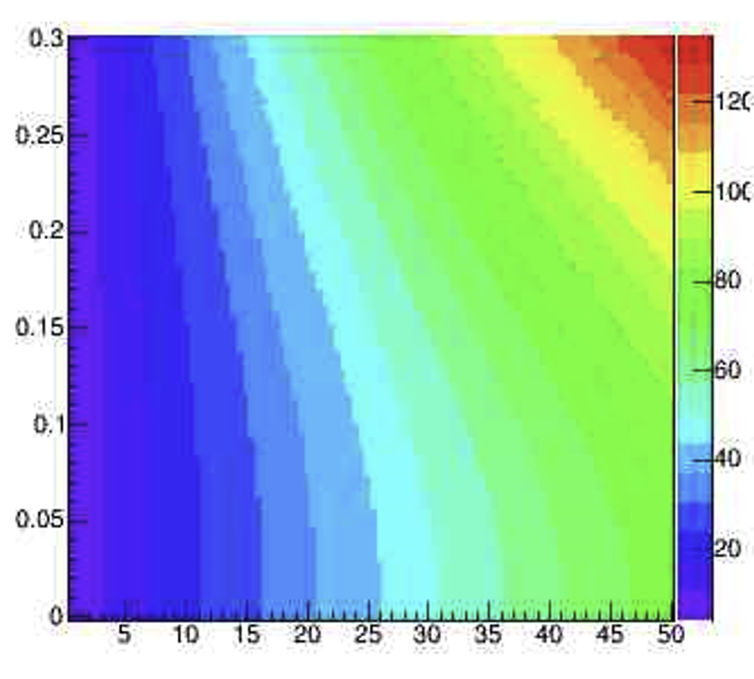
Approximation of N(3s)
We needed a differentiable model of the number of signal events producing a 3-sigma excess, given Poisson background B+-σ_{Β}
Modeling method:
compute tail probabilities of B fluctuations, with the uncertainty modeled as a log-normal distribution, for a range of B, σ_{Β} combinations
Fit these with power laws
Model parameters of the power law functions with polynomials
Above: for background B (x axis) and relative
uncertainty on B(y axis), the computed value of N(3s)
is shown as a temperature map

Slide 48
Finally, we obtain the number of signal events in the ON region that would constitute a 3-sigma excess over B_{exp}, using the tail Poisson probability with the B_{off} uncertainty modeled as a Log-normal distribution and integrated out.
The point source utility is then proportional to
U_{PS} = Exposure / N(3σ)
For example, and using a Gaussian approximation to simplify:
Exposure = 1 → N_{expected} = 25 evts → N(3s) = 3*sqrt(25) = 15 evts
→ U₁ = 1/15
Exposure = 4 → N_{expected} = 100 evts → N(3s) = 3*sqrt(10) = 30 evts
→ U₂= 4/30 = 2 U₁

Slide 49
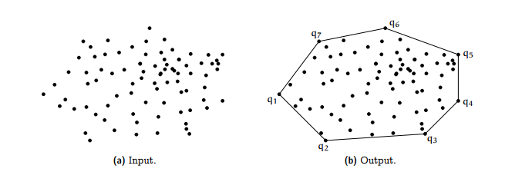
Area cost
We include in the utility, as a penalization term, a cost proportional to the area of ground used by the array (proportional to $$ needed to level ground, etcetera).
This is computed as the area of the convex hull surrounding the tanks.

Slide 50
Area cost
We include in the utility, as a penalization term, a cost proportional to the area of ground used by the array (proportional to $$).
This is computed as the convex hull surrounding the tanks.
We add an optional term proportional to the total distance of tanks to the center of the array (cost of cabling, servicing roads, etc.)
The two factors can be added to the utility to “constrain” the spatial extension of the array (otherwise both the flux and the point source utility want to extend to several km away from the center, as the considered photons have very high energy in this model).

Slide 51
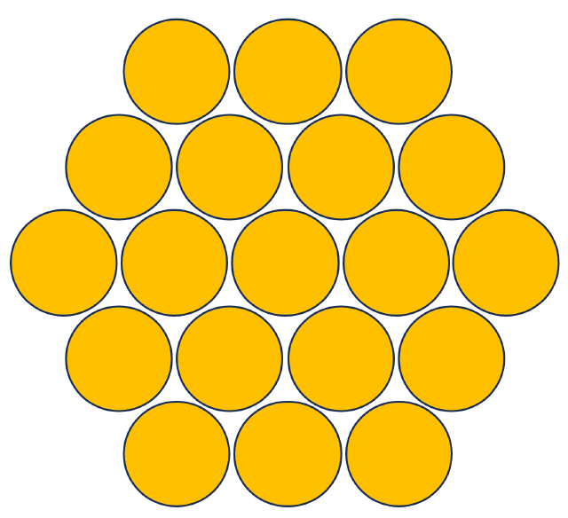
Macro-tank aggregates
The 11,997-dimensional problem of finding optimal (x,y) of 6000 tanks needs to be simplified to avoid CPU divergence
We solve it by aggregating tanks in small packed groups of 19 or 37 1.9-meter radius tanks
We only compute position updates for these macro-
aggregates during gradient descent, but we consider
individual tanks when we enforce triggering conditions
(e.g., N>50 tanks –not macro-tanks- should record
particles for an event to be classified as reconstructable).
Once aggregate positions are optimized, one may consider
the refining of tanks positions by leaving them free to move
independently
Above: a 19-tank aggregate

Slide 52
Resolving physical overlaps
Every gradient update of a tank aggregate’s position changes its coordinates:
x → x’ = x + k * dU/dx
y → y’ = y + k * dU/dy
This can only be done sequentially on all tank aggregates. At the end of an update of the geometry, some tank aggregates may be physically overlapping if
R² = (x₁-x₂)² + (y₁-y₂)² < 4R²_{aggregate}
An algorithm resolves these overlaps at the end of each gradient descent epoch, by iterating on the aggregates:
- Find pair of aggregates with minimum R
If R<2R_{aggregate}, then separate the pair:
  Find vector connecting centers
  Move each aggregate center away
  from the midpoint by R_{aggregate}-R
- Iterate until no pair overlaps

Slide 53
Gradient descent
We check the pipeline for gradient descent with our complex utility function runing with 300 “macro-tanks”, each corresponding to 19 r=1.91m tanks, reducing the dimensionality of the problem
Further, we assume triangular symmetry – within a 120 degree sector the system can arrange a third of the units freely, but the pattern repeats thrice in azimuth
→ “only” 197 parameters to optimize !
→ the gradient is averaged out and is less noisy!
Results in the following slide

Slide 54
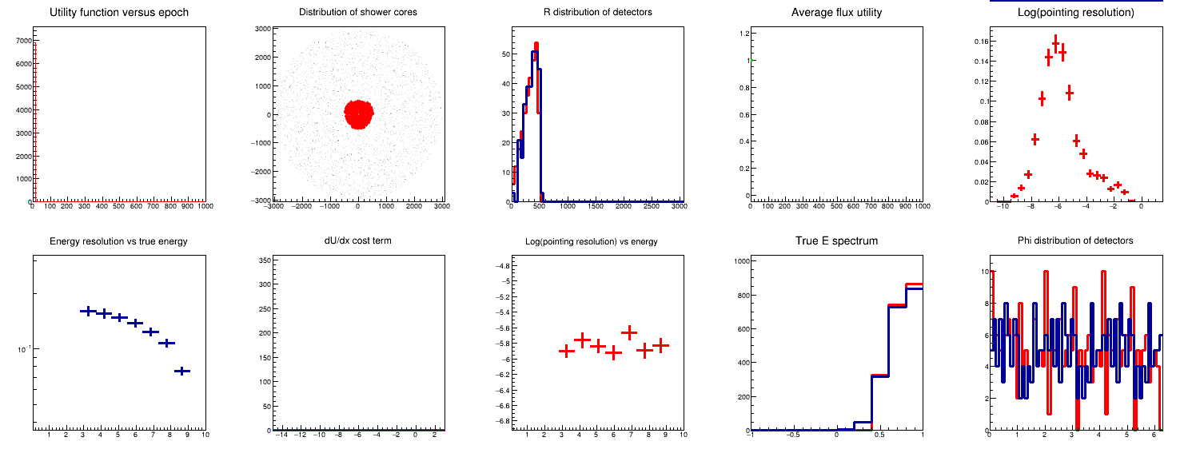
Animation of optimization run
Total utility vs epoch XY positions of tanks Radial distr of tanks Utility components Log(pointing resolution)
red: initial, blue:current black: E res., red: pointing Red: initial, blue: current
Relative energy res. Log(pointing res.) Energy spectrum Angular distr of tanks

Slide 55
Results compared to the 13 SWGO layouts
Layout | N units | R_{max} (m) | U_{point source} | U_{energy res.} | U_{pointing res.} | U_{flux}
Optim | 5700 | 4000 | 17489+-511 | 2286.6 +- 46.6 | 1237.2+- 7.0 | 3614.6+-21.7
A1 | 6589 | 300 | 3526+-101 | 1155.5 +- 15.5 | 880.2 +- 4.7 | 2035.8 +- 16.2
B1 | 4849 | 300 | 3260+-93 | 1153.5+-15.1 | 856.3+-6.2 | 2009.8+-16.4
C1 | 8371 | 300 | 3255+-82 | 1185.3+-15.8 | 877.4+-5.4 | 2062.7+-16.7
D1 | 3805 | 300 | 3540+-139 | 1116.2+22.9 | 886.4+-5.8 | 2002.6+-23.6
E1 | 5461 | 300 | 3527+-108 | 1162.4+-18.2 | 886.0+-5.6 | 2048.4+-19.0
F1 | 4681 | 300 | 3654+-131 | 1181.9+-14.9 | 913.5+5.9 | 2095.5+-18.7
A2 | 6631 | 600 | 6923+-163 | 1220.5+-25.2 | 1203.0+-5.2 | 2423.5+-25.7
A3 | 6823 | 600 | 7061+-132 | 1215.5+-21.1 | 1208.4+-4.1 | 2423.9+-21.5
A4 | 6625 | 600 | 6018+-122 | 1231.5+-15.5 | 1135.4+-7.0 | 2366.9+-17.0
A5 | 6541 | 300 | 4381+-95 | 1164.4+-15.4 | 993.8+-5.1 | 2158.2+-11.1
A6 | 6637 | 300 | 2956+-37 | 1150.6+-14.8 | 821.9+-4.9 | 1972.6+-15.6
A7 | 6571 | 1200 | 11641+-281 | 1532.9+-36.5 | 1430.6+-5.8 | 2963.5+-37.0
E4 | 5455 | 600 | 6105+-198 | 1216.1+-17.7 | 1142.7+-5.8 | 2358.8+-18.6
The table shows utility values computed for the 13 layouts AND for the 300-macro-tanks optimized solution
No constraint on area was used here, so the layout expands to “conquer” more effective area, maximizing the utility for 3-sigma point source detection

Slide 56
A comparison
We may compare the utility reached by this run with that of the best performer among the SWGO layouts (A7):
U = 17489 +- 511
U(A7) = 11641 +- 281
The improvement is of 50%, and the optimized solution uses 13% fewer tanks.

Slide 57
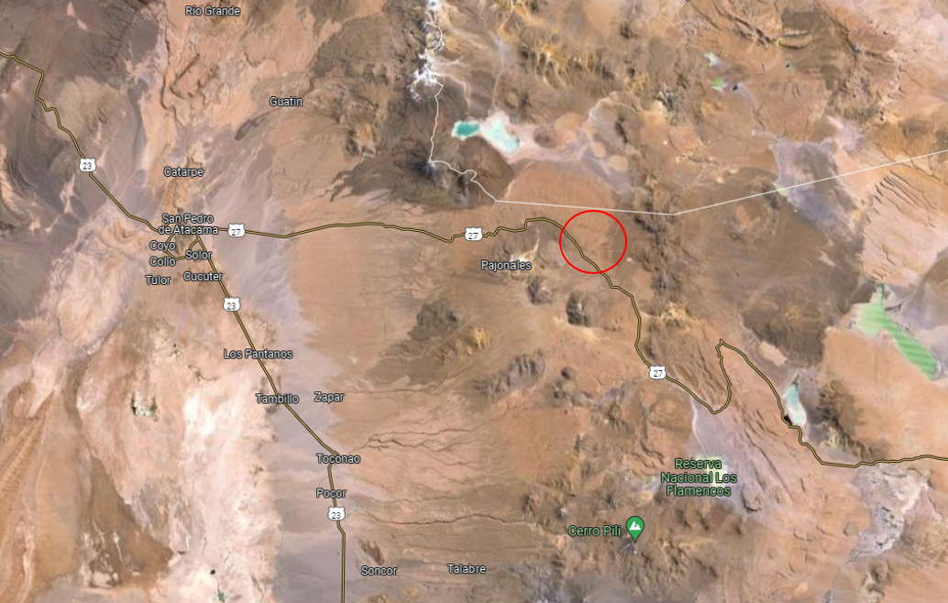
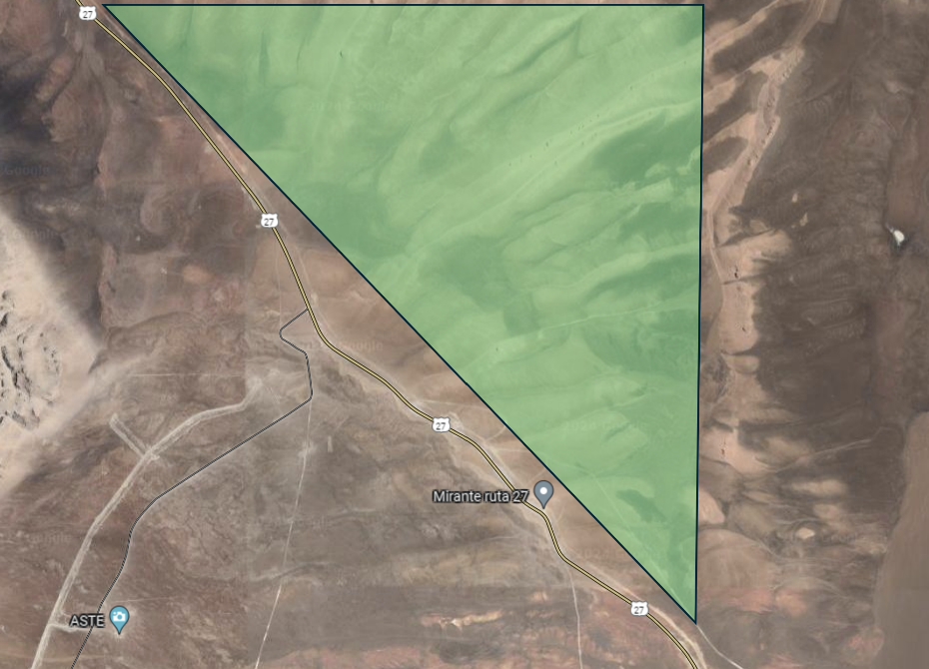
Physical Constraints
SWGO recently decided that the construction site is Pampa la Bola, in northern Chile
The area allowed by physical constraints and roads (and contained in the Parque Astronomico) is a triangle
We model this with a repulsive potential at the boundaries

Slide 58
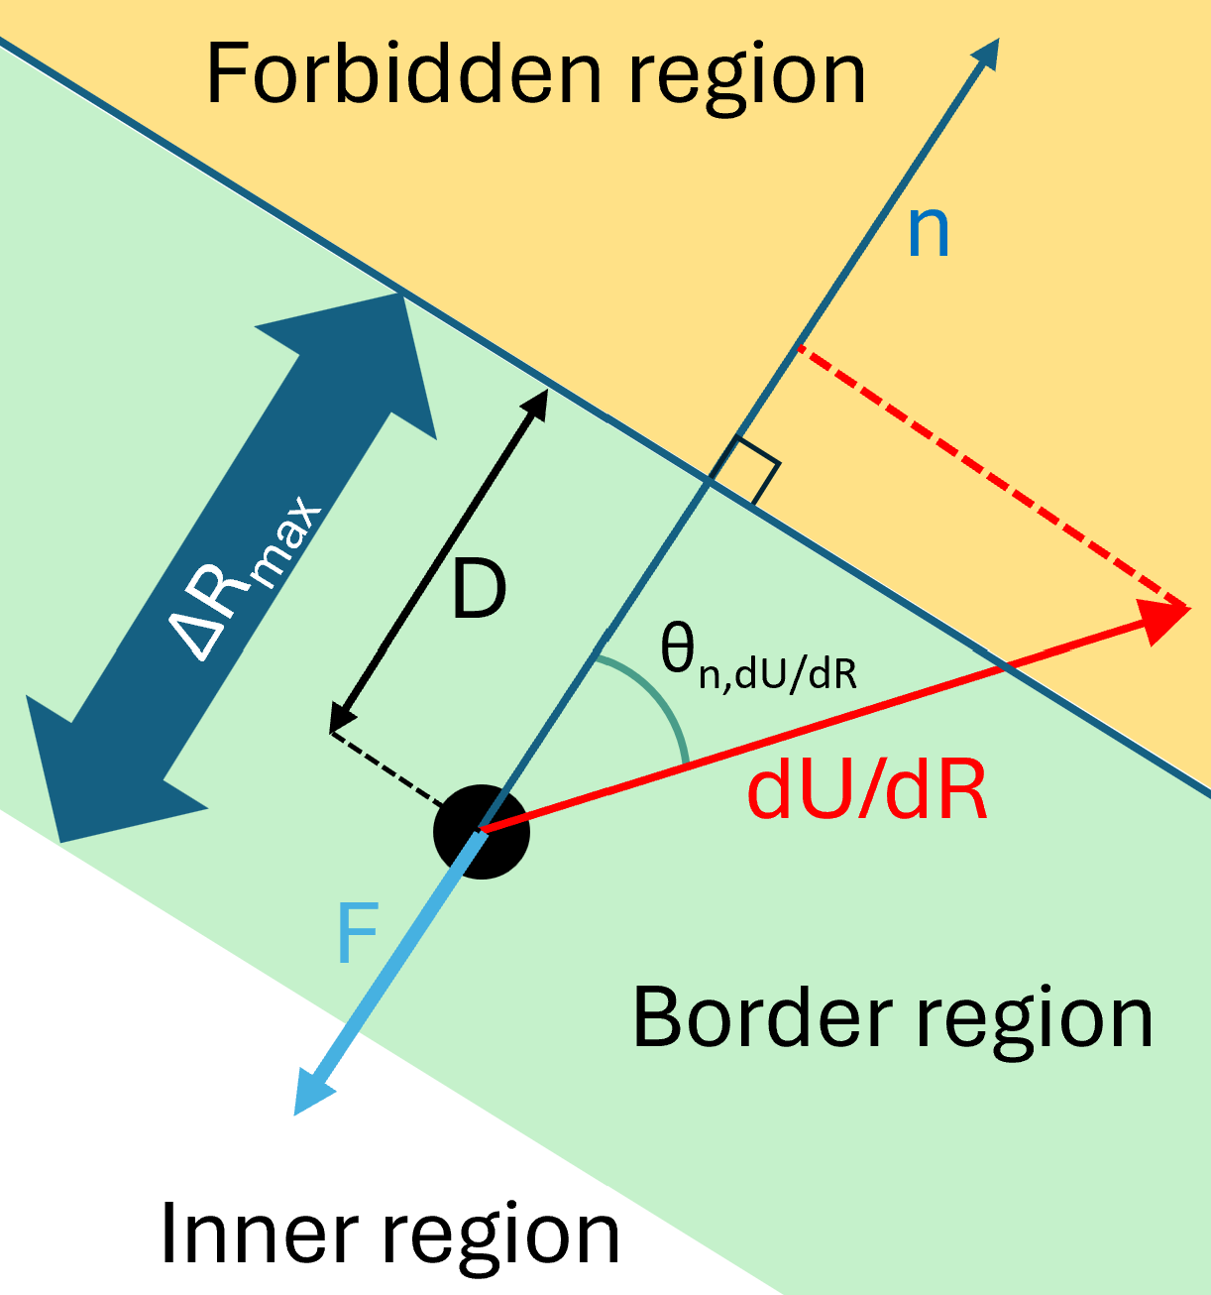
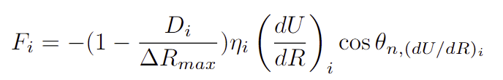
Physical Constraints
SWGO recently decided that the construction site is Pampa la Bola, in northern Chile
The area allowed by physical constraints and roads (and contained in the Parque Astronomico) is a triangle
We model this with a repulsive potential at the boundaries

Slide 59
Discussion
The pipeline produces optimal layouts (and converges to them from different initial conditions!)
Next step: Check with full simulation that optimization, despite all shortcomings, produces improvements according to same metric
→ if check fails:
- improve model of showers, extend to lower energy
→ if check succeeds:
- improve model of showers, extend to lower energy
Then we can start to:
implement utilities closely matching those of the benchmark physics cases of SWGO
Improve reconstruction model

Slide 60
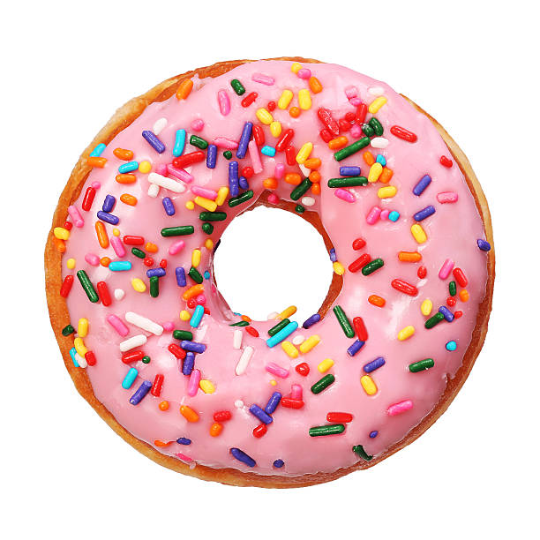
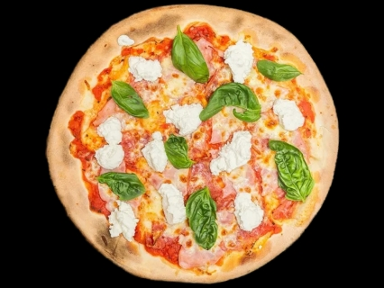
Take away bit - what we consistently observe:
The center of the array is a point of measure zero – we will catch no showers hitting there.
A donut shaped array will catch more showers at no loss of reconstruction power
“but we lose precision on low-energy showers”
FALSE – you can still get dense areas of tanks in a donut-shape array, while also having exposure to larger radii

Slide 61
Summary
We produced a continuous model of particle showers, constructed a principled solver and an end-to-end pipeline for optimization
Gradient-based optimization works in high-D spaces
Many improvements in our wish list:
  Add energy deposition model, clumpiness model
  Enable checkpointing with full simulation and approved reconstruction
  Implement DNN reconstruction
  Add model of tank reconstruction efficiency and precision
  Extend model to lower energies

Slide 62
Thank you for your time !

Slide 63
Abstract
We describe a software pipeline that models atmospheric gamma and hadron showers and their detection and reconstruction by an array of Cherenkov detectors on the ground, as well as the calculation of a utility function aligned with the scientific goals of the SWGO experiment. The variation of the utility with the position of each detector on the ground allows to perform stochastic gradient descent to an optimal layout. This epitomizes the concept of co-design for future experiments in fundamental science.

Slide 64
Selection of showers
We assume we only consider showers that produced particle signals (N>0) in at least N_{trigger} units. For now we set that threshold to 10.
Making this selection differentiable is tricky, but we managed it with an approximated expression – see the note.

Slide 65
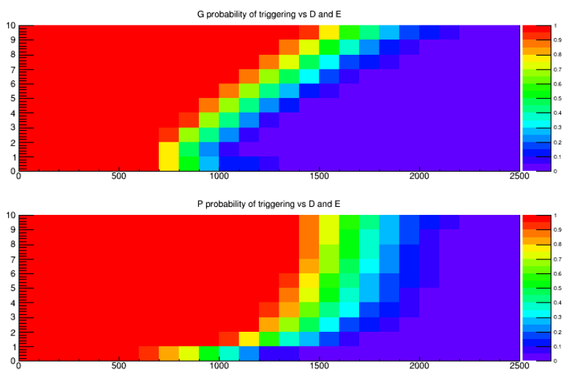
Selection of showers
The graphs show the probability that showers of given energy (y axis) and distance from the array (x axis) pass the trigger criterion
Making the trigger selection differentiable is tricky, but we managed it with an approximated expression – see the note.

Slide 66
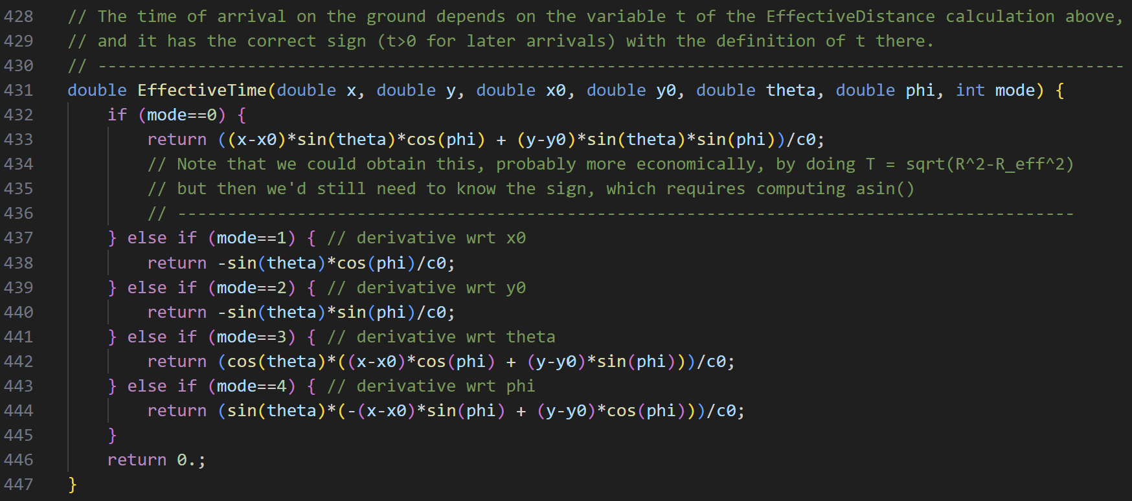
Implementation
The program is written in c++, and derivatives are computed by hand and implemented in the code as different “modes” of operation of routines
Getting all partial derivatives correctly is doable for a task of this complexity, but still tricky!
I learned a lot while solving the problem the hard way…

Slide 67
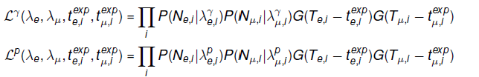
Reconstruction of showers
Showers are reconstructed with an analytic likelihood from the number of observed e.m. particles and muons in each unit, and the time of arrival of the signals, given a layout of the N_{det} units.
The likelihood depends on the core position X₀,Y₀, and on energy E and angular parameters θ, φ of the shower.

Slide 68

Classification
Once we have a maximum likelihood solution for the two hypotheses, we take a likelihood ratio
as the quantity to use to figure out the fraction of gammas in a batch of showers.

Slide 69


Signal fraction from the mixture model
From a generated batch of Ng + Np events, and their reconstructed values of T, we proceed to extract the fraction of gammas f_{g} by likelihood maximization, using the PDFs of the two components:
The second derivative of the above versus f_{g} provides the variance of the measurement:

Slide 70
Signal fraction from the mixture model
From a generated batch of Ng + Np events, and their reconstructed values of T, we proceed to extract the fraction of gammas f_{g} by likelihood maximization, using the PDFs of the two components:
The second derivative of the above versus f_{g} provides the variance of the measurement:

Slide 71
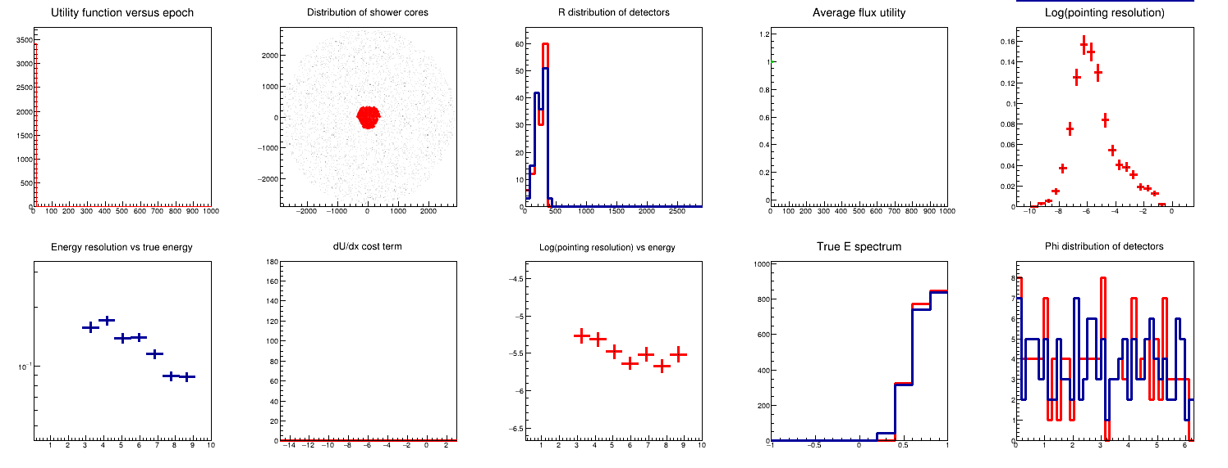
Run with 150 macro-tanks, 1000 epochs

