Slide 1
Dark photon in parity-violating electron scatterings
Xuan-Gong Wang
CDMPP/CSSM, The University of Adelaide
16th Conference on Quark Confinement and the Hadron Spectrum
Cairns, Aug. 18-24, 2024

Slide 2
Outline
Dark photon hypothesis
New proposal: parity-violating electron scattering
Constraints from parity-violation data and W-mass
Summary

Slide 3
Dark photon hypothesis

Slide 4
BSM new physics
The gauge sector of the SM could be extended by introducing extra U(1)’ fields
SU(2)_{L} X U(1)_{Y} X U(1)’
Kinetic mixing (dark photon model)
P. Fayet, Phys. Lett. B 95 (1980) 285;
B. Holdom, Phys. Lett. B 166 (1980) 196;
L. B. Okun, Sov. Phys. JETP 56 (1982) 502
Anomaly free U(1)’ charges (Z’ model)
P. Fayet, Nucl. Phys. B 347 (1990) 743;
A. Leike, Phys. Rept. 317 (1999) 143;

Slide 5
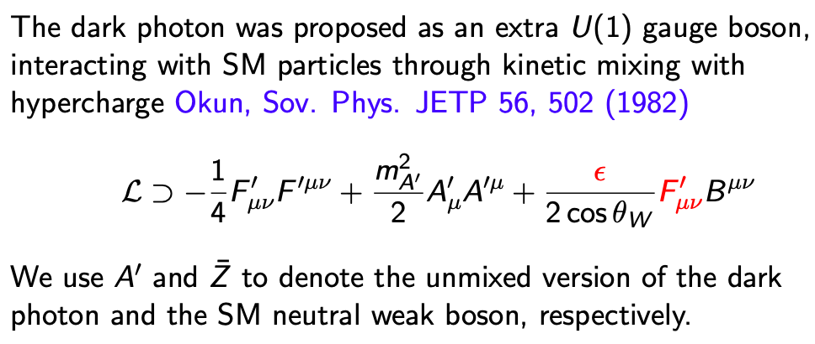
Dark Photon

Slide 6

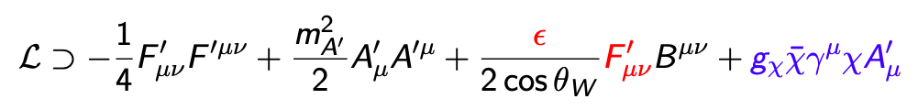
Dark matter portal
A. Filippi, M. De Napoli, Rev. Phys. 5, 100042 (2020)

Slide 7
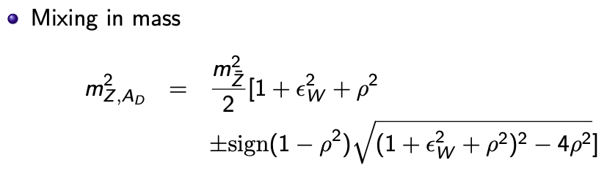
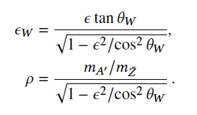
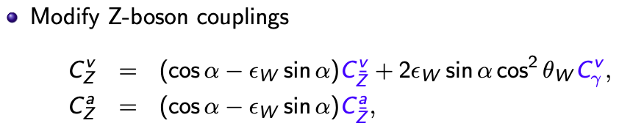
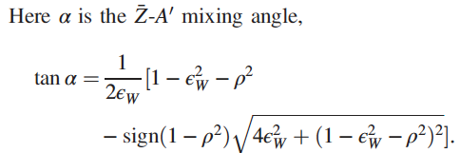
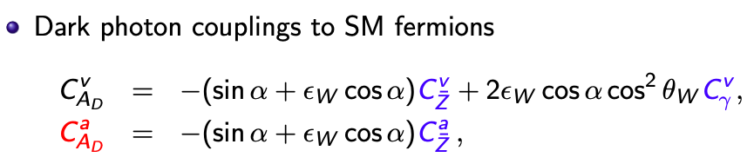
G.D. Kribs et al., Phys. Rev. Lett. 126 (2021) 011801
more like a Z’

Slide 8

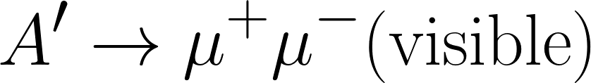
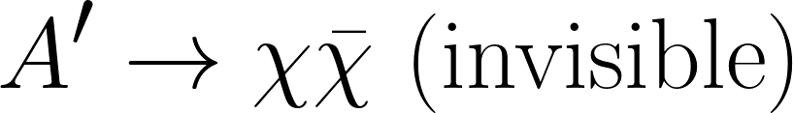
Direct experimental searches
Production
electron or proton fixed target experimetns
and hadron colliders
BaBar, Phys. Rev. Lett. 119, 131804 (2017)
NA64, Phys. Rev. Lett. 123 121801 (2019)
LHCb, Phys. Rev. Lett. 124, 041801 (2020)
CMS, Phys. Rev. Lett. 124, 131802 (2020)
- Decay
energy missing events

Slide 9
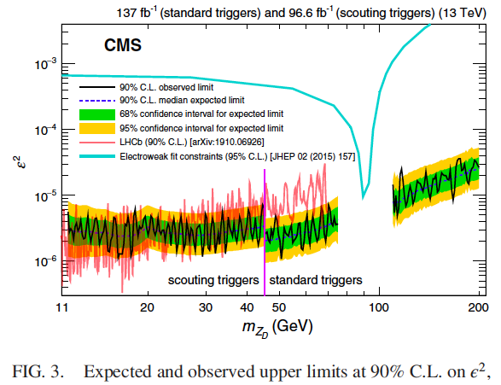
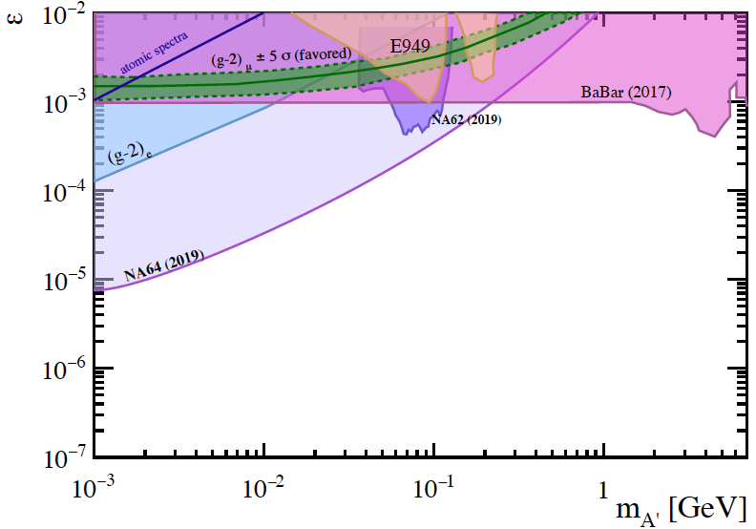
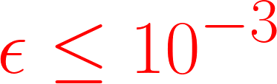
Exclusion limits
Some gaps
NA64, Phys. Rev. Lett. 123 (2019) 121801
BABAR, Phys. Rev. Lett. 119 (2017) 131804
CMS Collaboration, Phys. Rev. Lett. 124, 131802 (2020)
Could be relaxed depending on the detailed structure of the dark matter sector
A.M. Abdullahi et al., Phys. Rev. D 108 (2023) 015032

Slide 10
Decay-agnostic limits
Shifit of Z boson mass and decay width
Electroweak precision observables (EWPO)
Hook, E. Izaguirre, J.G. Wacker, Adv. High Energy Phys. 2011 (2011) 859762 D. Curtin et al., JHEP 02 (2015) 157
- Muon g-2:
M. Pospelov, Phys. Rev. D 80 (2009) 095002;
H. Davoudiasl et al.,Phys. Rev. Lett. 109 (2012) 031802
Rare kaon and B meson decay
H. Davoudiasl, H.S. Lee, W.J. Marciano, Phys. Rev. D 85 (2012) 115019
A. Datta et al., JHEP 03 (2023) 108
X.G. Wang, A.W. Thomas, J. Phys. G 50 (2023) 085001

Slide 11
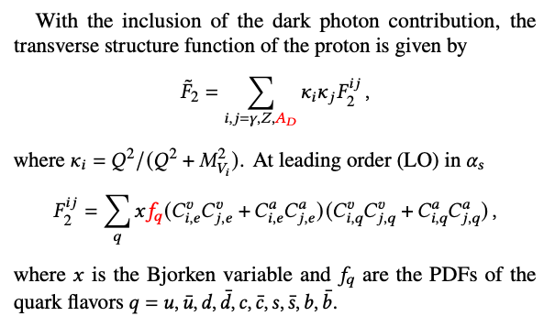
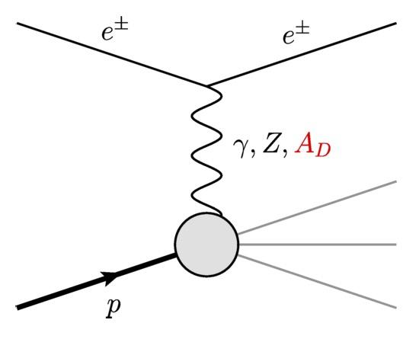
e-p DIS
Large dataset and wide kinematic coverage

Slide 12
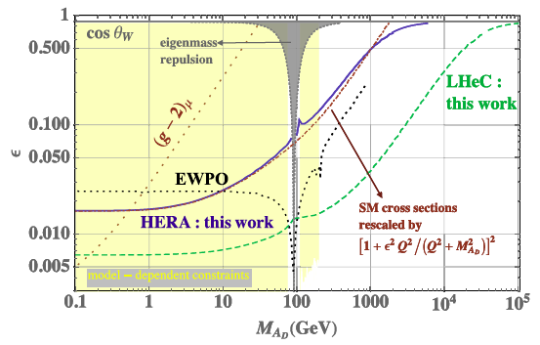
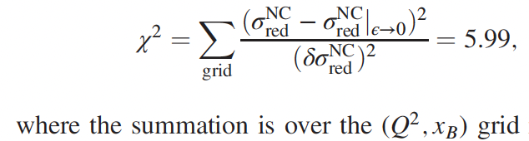

G.D. Kribs, D. McKeen, N. Raj, Phys. Rev. Lett. 126 (2021) 011801
HERA data of reduced cross section
95% CL exclusion limits on ($ε, M_{AD}$)
PDFs are fixed at HERAPDF2.0 LO results

Slide 13
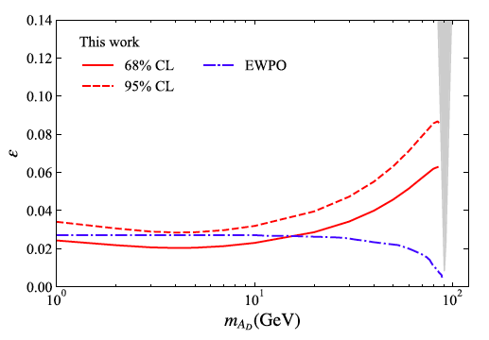
Improved DIS limits
A.W. Thomas, X.G. Wang, A.G. Williams, Phys. Rev. D 105 (2022) L031901
- two-component model
- vector meson dominance + correct photoproduction limit
- simultaneous fit of PDFs and dark photon effects

Slide 14
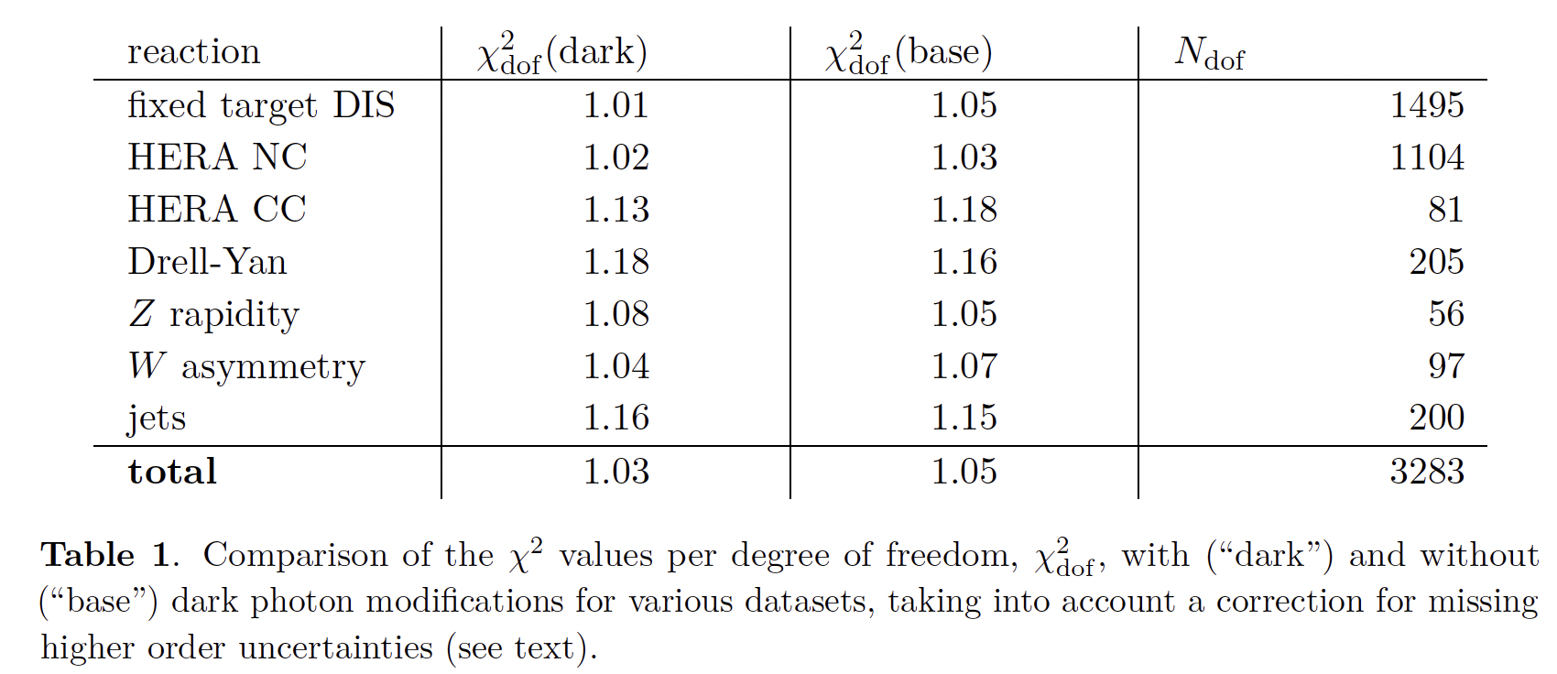
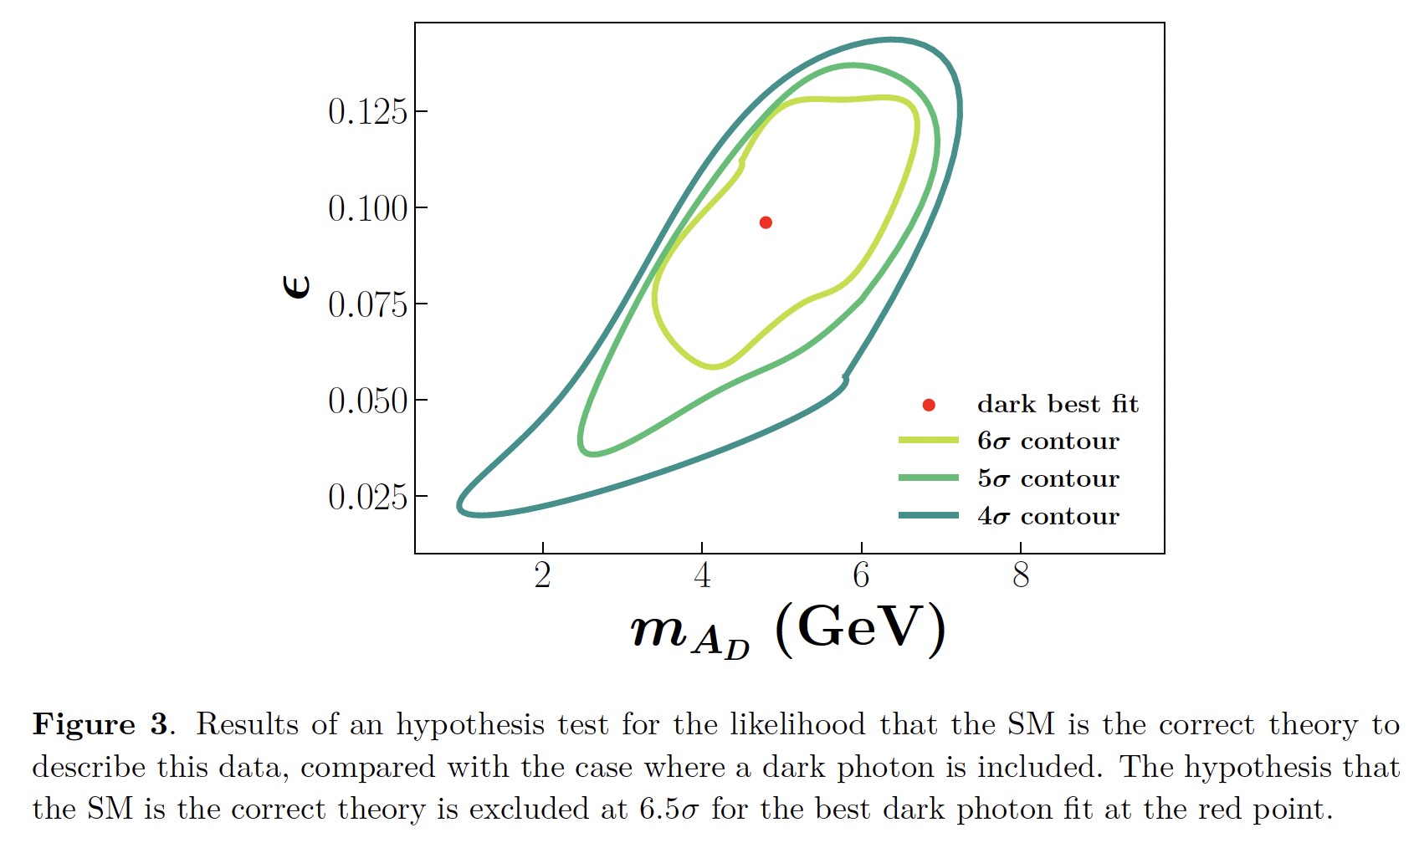
Global QCD analysis
Nicholas Hunt-Smith, et al., JHEP 09 (2023) 096

Slide 15
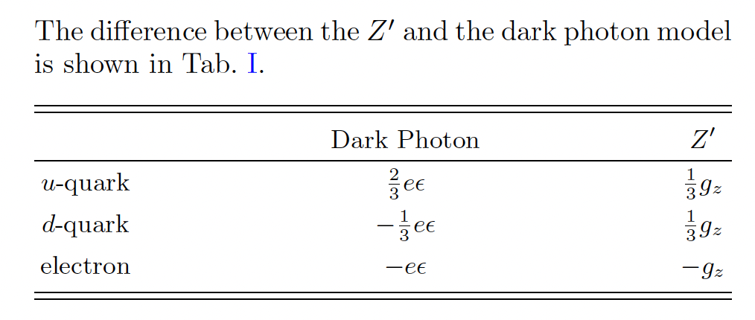
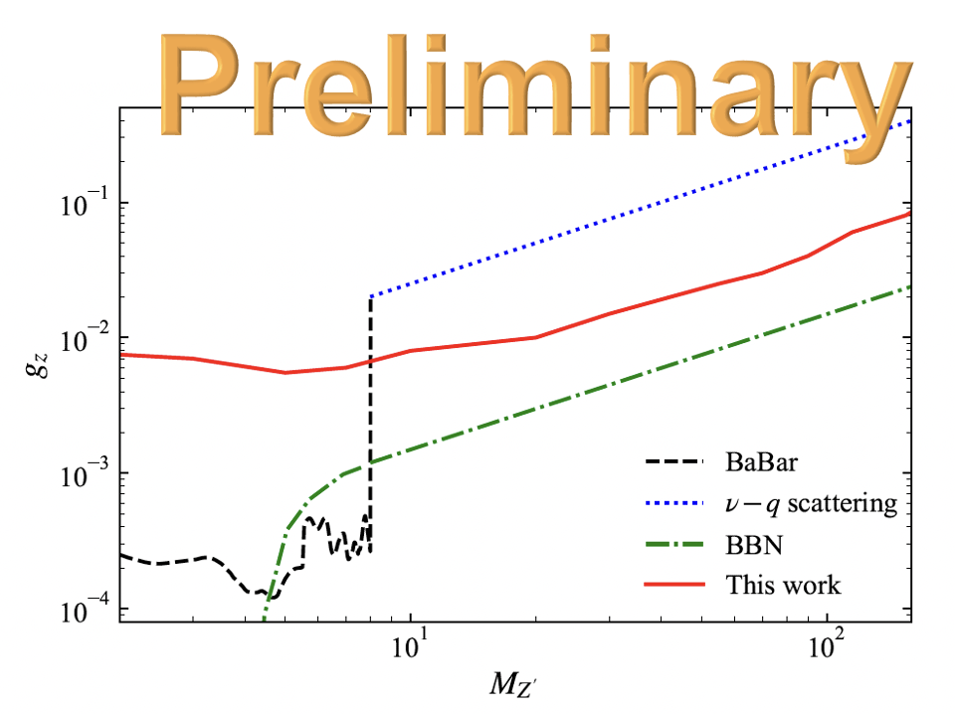
B-L Z’ model
Nicholas Hunt-Smith et al., paper in preparation
No improvement in $χ^{2}$ when Z’ is included

Slide 16
New tool
(PVES)
A.W. Thomas, X.G. Wang, A.G. Williams, Phys. Rev. Lett. 129 (2022) 011807
- The dark photon contribution to A_{PV}
How large is it

Slide 17
II. New proposal: PVES

Slide 18
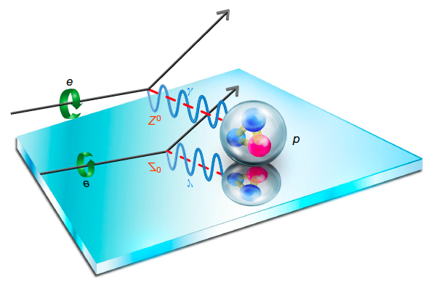
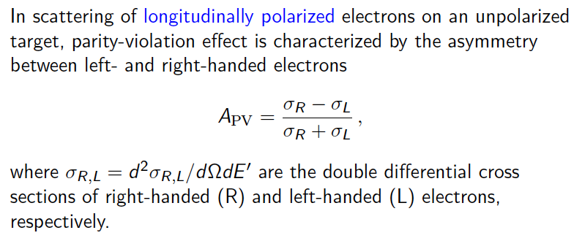
Parity-violating electron scattering (PVES)
The effect is small, typically less than 1 part per million
Can be measured very precisely, e.g., 0.6% accuracy at SoLID experiment
J. Arrington et al. [SoLID], J. Phys. G 50 (2023) 110501
Figure taken from Qweak Collaboration,
Nature 557 (2018) 207

Slide 19
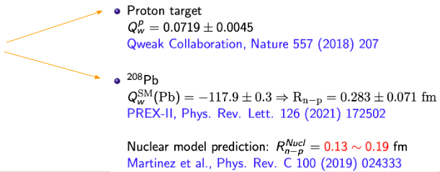

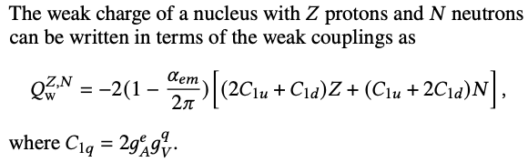
Elastic PVES
Elastic PEVS probe the structure of atomic nuclei and $C_{1q}$

Slide 20
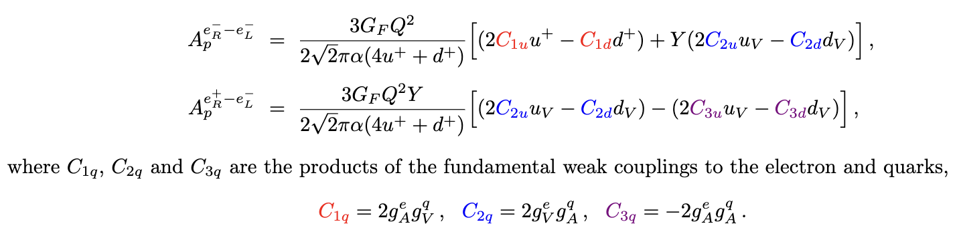
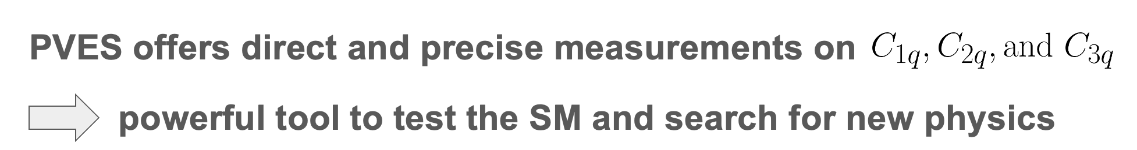
PVDIS
X. Zheng et al., Eur. Phys. J. A 57 (2021) 173

Slide 21
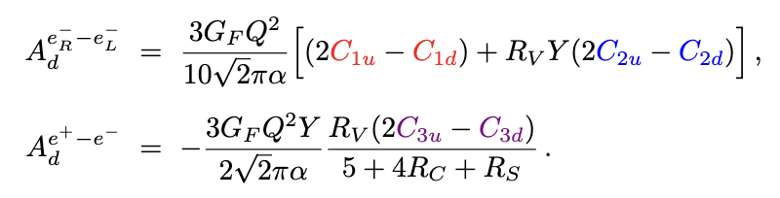
PVES Experiments
PVDIS Collaboration:
SoLID Collaboration:
D. Wang et al. (PVDIS), Nature 506 (2014) 67
J. Arrington et al. (SoLID), J. Phys. G 50 (2023) 110501
Possible corrections from charge symmetry violation, strange and charm quark distributions:
X.G. Wang, A.W. Thomas, arXiv: 2403.07327 [hep-ph]

Slide 22
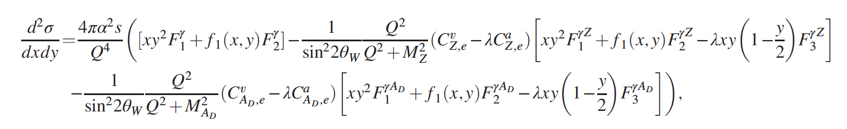
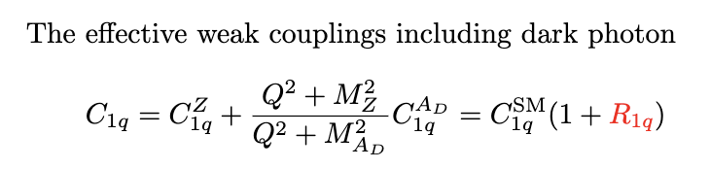
Including dark photon
A.W. Thomas, X.G. Wang, A.G. Williams, Phys. Rev. Lett. 129 (2022) 011807
where $λ=+1\left(−1\right)$ represents right-handed (left-handed) electron helicity

Slide 23
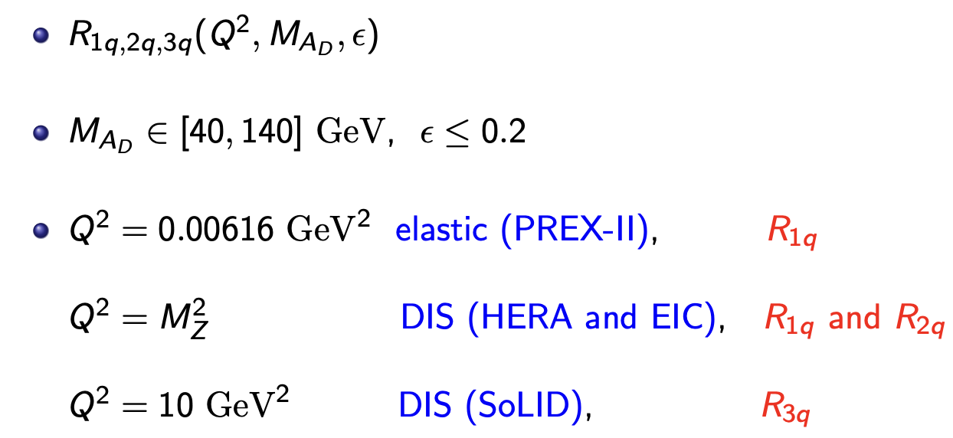
Sensitivity to the dark photon parameters

Slide 24
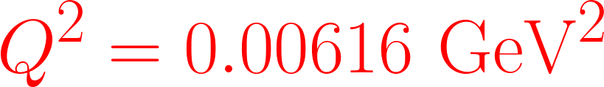
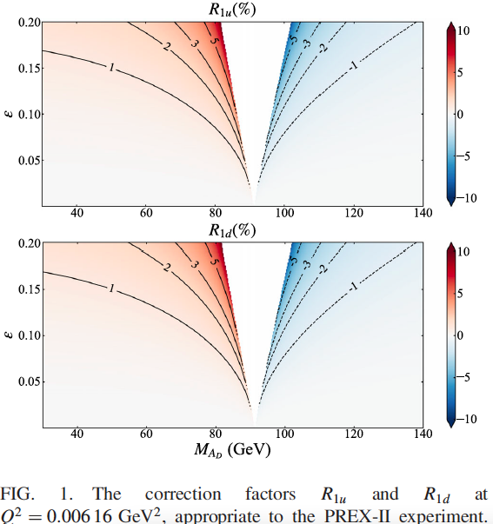
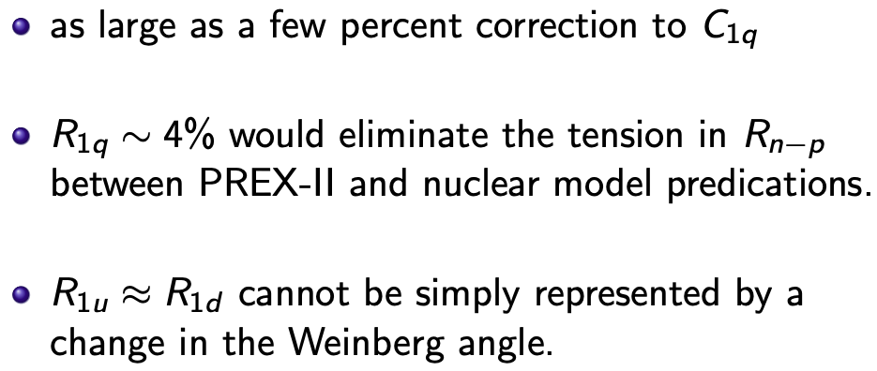

Slide 25
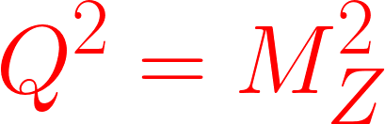
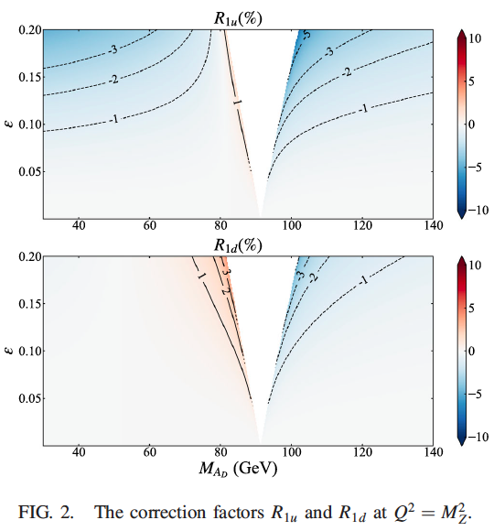
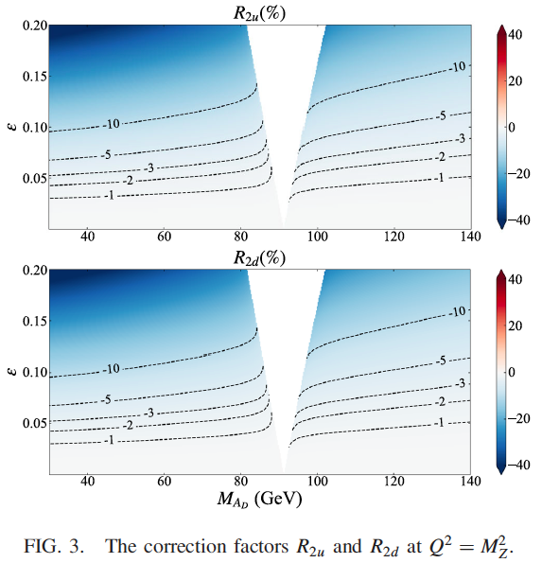
Large effect (10%) on valence PDFs from HERA

Slide 26
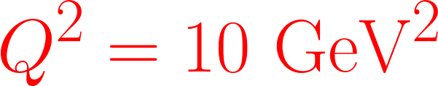
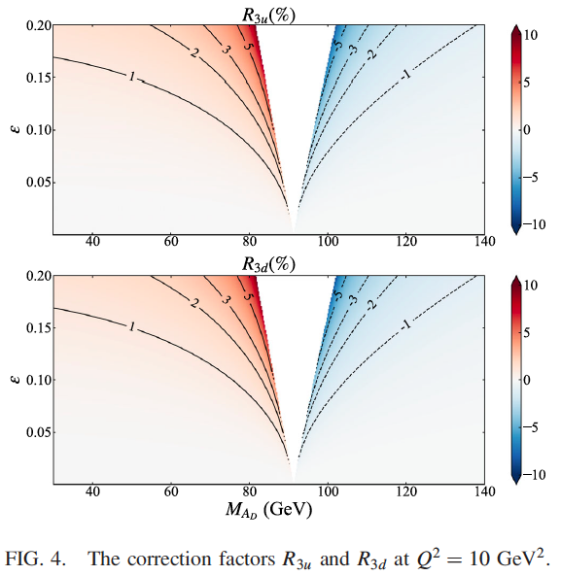
as large as 5% deviations from the SM expectations, were a dark photon to exist

Slide 27
III. Fitting parity-violation data and W-mass

Slide 28

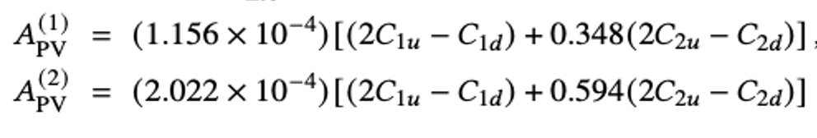
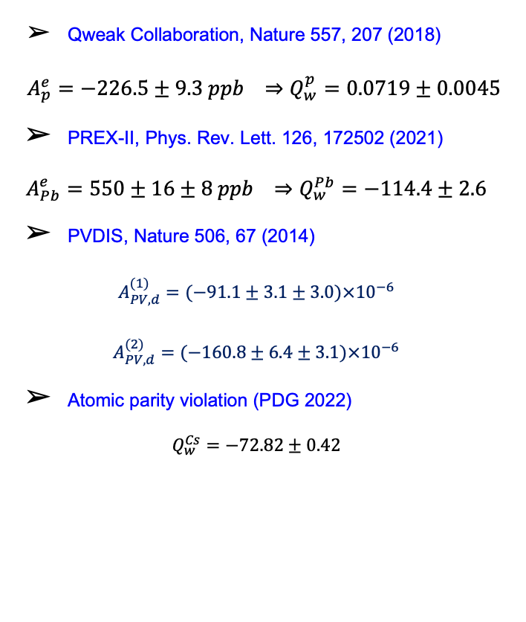
Key observables
Qweak Collaboration, Nature 557, 207 (2018)
$${A_{p}^{e}=−226.5±9.3 ppb ⇒Q}_{w}^{p}=0.0719±0.0045$$
PREX-II, Phys. Rev. Lett. 126, 172502 (2021)
$${A_{Pb}^{e}=550±16±8 ppb ⇒Q}_{w}^{Pb}=−114.4±2.6$$
PVDIS, Nature 506, 67 (2014)
$$A_{PV,d}^{(1)}=(−91.1±3.1±3.0)×{10}^{−6}$$
$$A_{PV,d}^{(2)}=(−160.8±6.4±3.1)×{10}^{−6}$$
Atomic parity violation (PDG 2022)
$$Q_{w}^{Cs}=−72.82±0.42$$

Slide 29

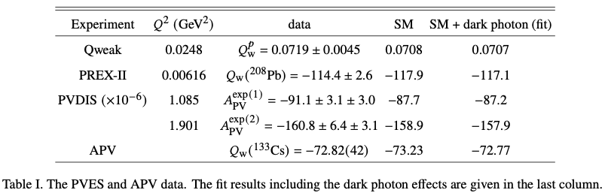
Dark photon fit
A.W. Thomas, X.G. Wang, Phys. Rev. D 106, 056017 (2022)

Slide 30
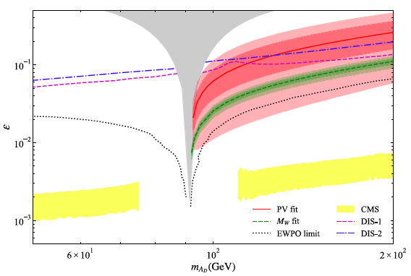
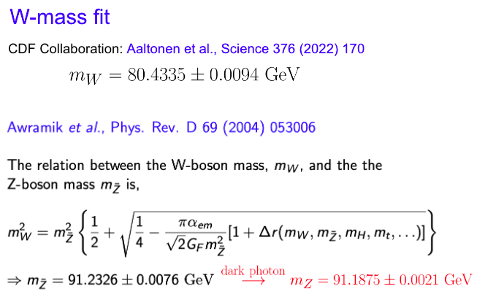

Slide 31
The dark photon improves the agreement between theory and a numbe of parity violation experiments
It would improve the agreement between result for Cs and the SM, while also explaining the latest W-mass anomaly
Both PV data and the W-mass favour a heavy dark photon with mass above the Z-boson mass

Slide 32
IV. Summary and outlook

Slide 33
Summary
We proposed a new tool for dark photon searches through parity-violating electron scattering
We explore the sensitity of PVES asymmetry to the dark photon parameters
The dark photon effect is characterised by corrections to the SM couplings, which could be as large as 10% for C_{2q} in DIS region, and 5% for C_{1q} and C_{3q} at low scales
We also derived the required dark photon parameters by fitting the parity-violation data and the W-boson mass anomaly, favoring a heavy dark photon with mass above M_{Z}

Slide 34
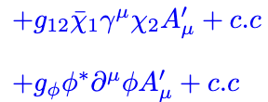
Outlook
PVES experiments at SoLID, EIC, P2, and MOLLER
Dark matter portal
+ ……
(Bill Loizos’s poster on Wednesday)

Slide 35
Thanks!

