Slide 1


NNLO QCD Corrections to Mesons EM Form Factors
QCHSC 2024
arXiv:2312.17228
arXiv:2407.21120
Long-Bin Chen
In collaboration with：Wen Chen, Feng Feng and Yu Jia
2024/8/20

Slide 2
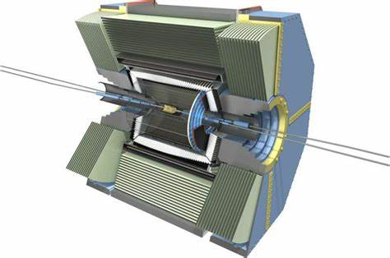

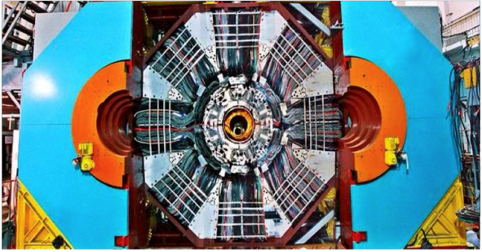
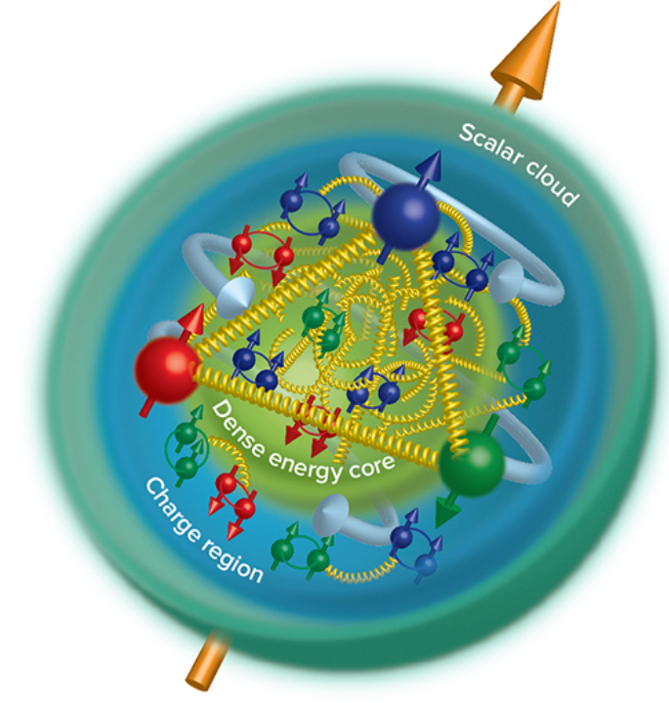
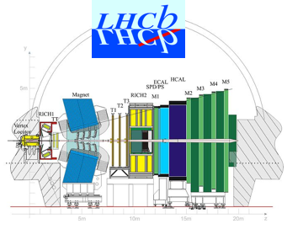
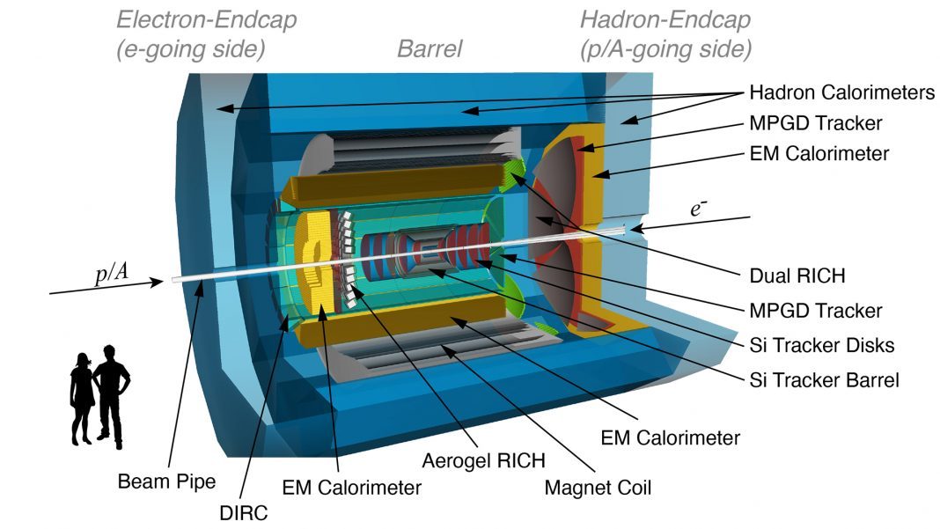


Unveiling the inner structure of hadron
Motivation
$$u$$
$$\overline{d}$$
QCD

Slide 3

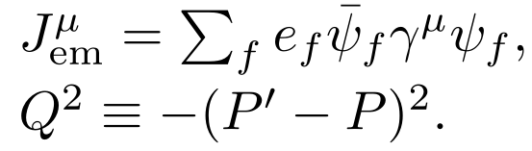
EM FFs: Probing the internal structure of hadrons
Charge Pion Form Factors:
At small Q^2：Chiral Perturbative Theory, Lattice QCD.
Relate to pion charge radius

Slide 4
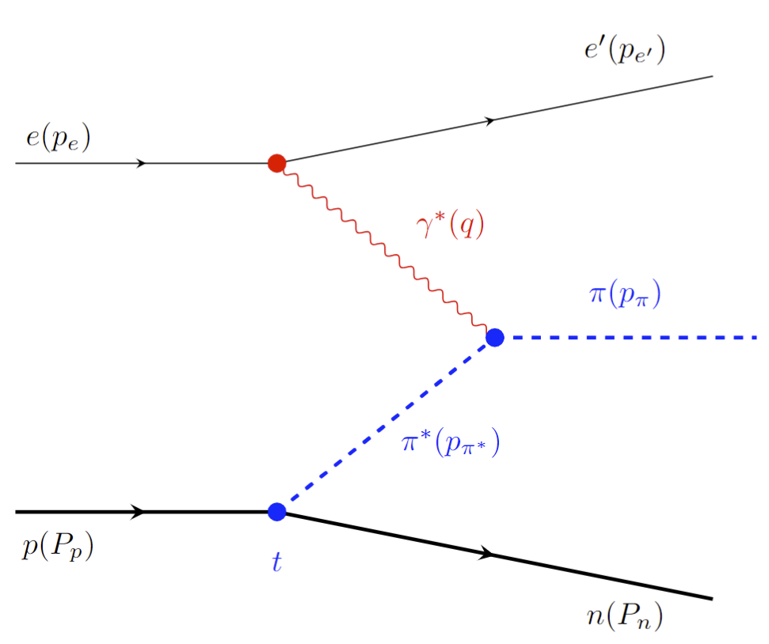
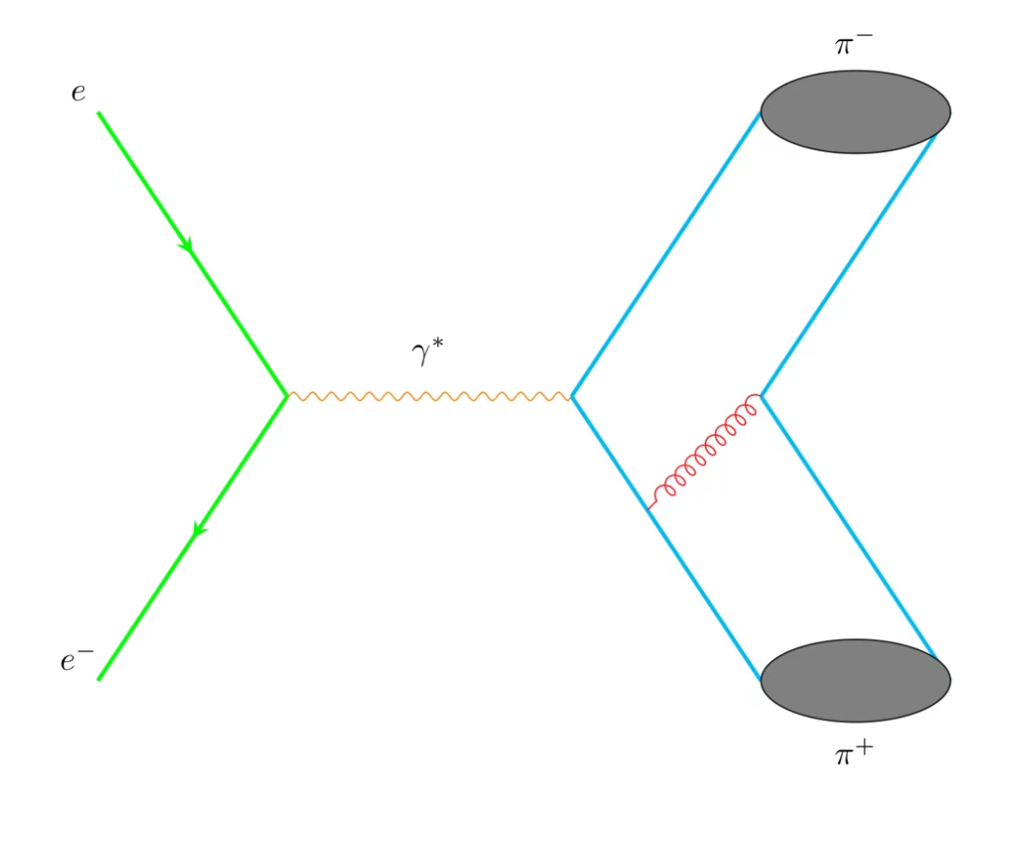
Space Like
Sullivan Process
At small t is sensitive to pion form factor
EIC：Q^2 up to 30 GeV^2
arXiv:2208.14575
Time Like
BESIII
BarBar
Belle II
STCF
Probing pion Form Factors

Slide 5
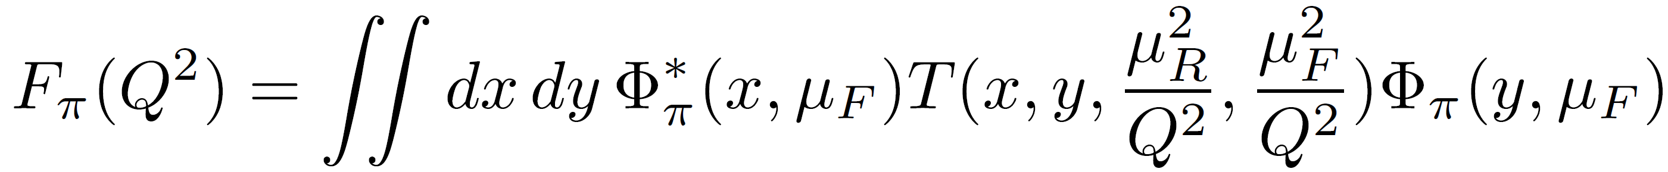
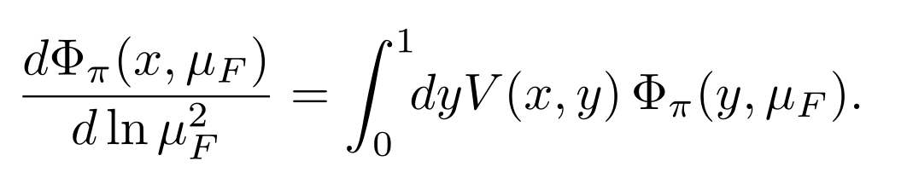
In framework of Collinear Factorization, Large Q^2
(Lepage, Brodsky, Efremov, Radyushkin, Duncan, Mueller)
Leading-Twist Pion LCDA:
ERBL evolution equations

Slide 6
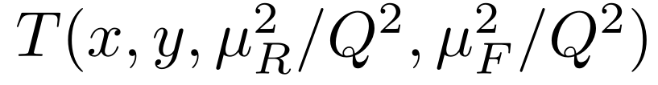
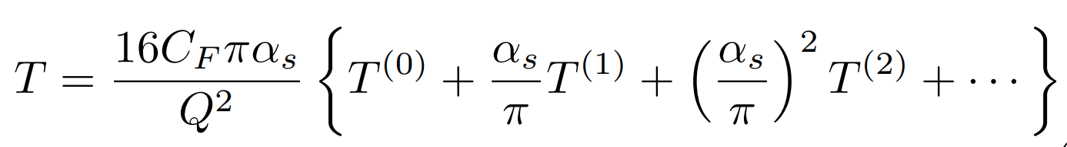
Hard Kernel
Pertubative Expansion
LO: 1977-1980 Lepage, Brodsky, Efremov, Radyushkin, Duncun, Muller…
NLO: Field, Gupta, Otta, Chang(1981), Dittes, Radyushkin(1981), Sarmadi (1984),
Braaten,Tse(1987), Melic, Nizic and Passek (1998).
The goal of this work is to achieve NNLO calculations.

Slide 7
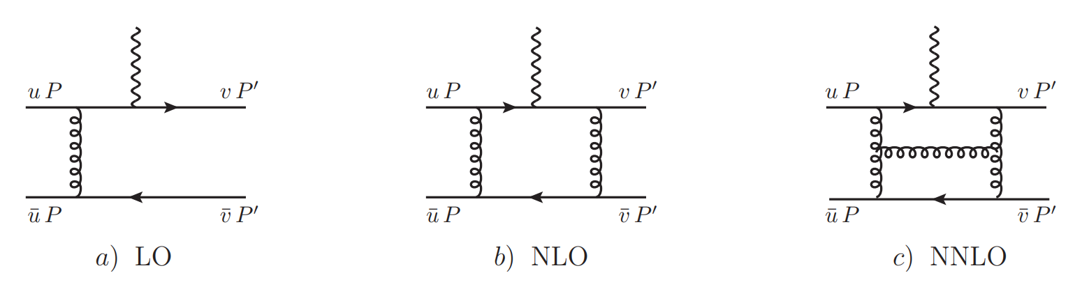
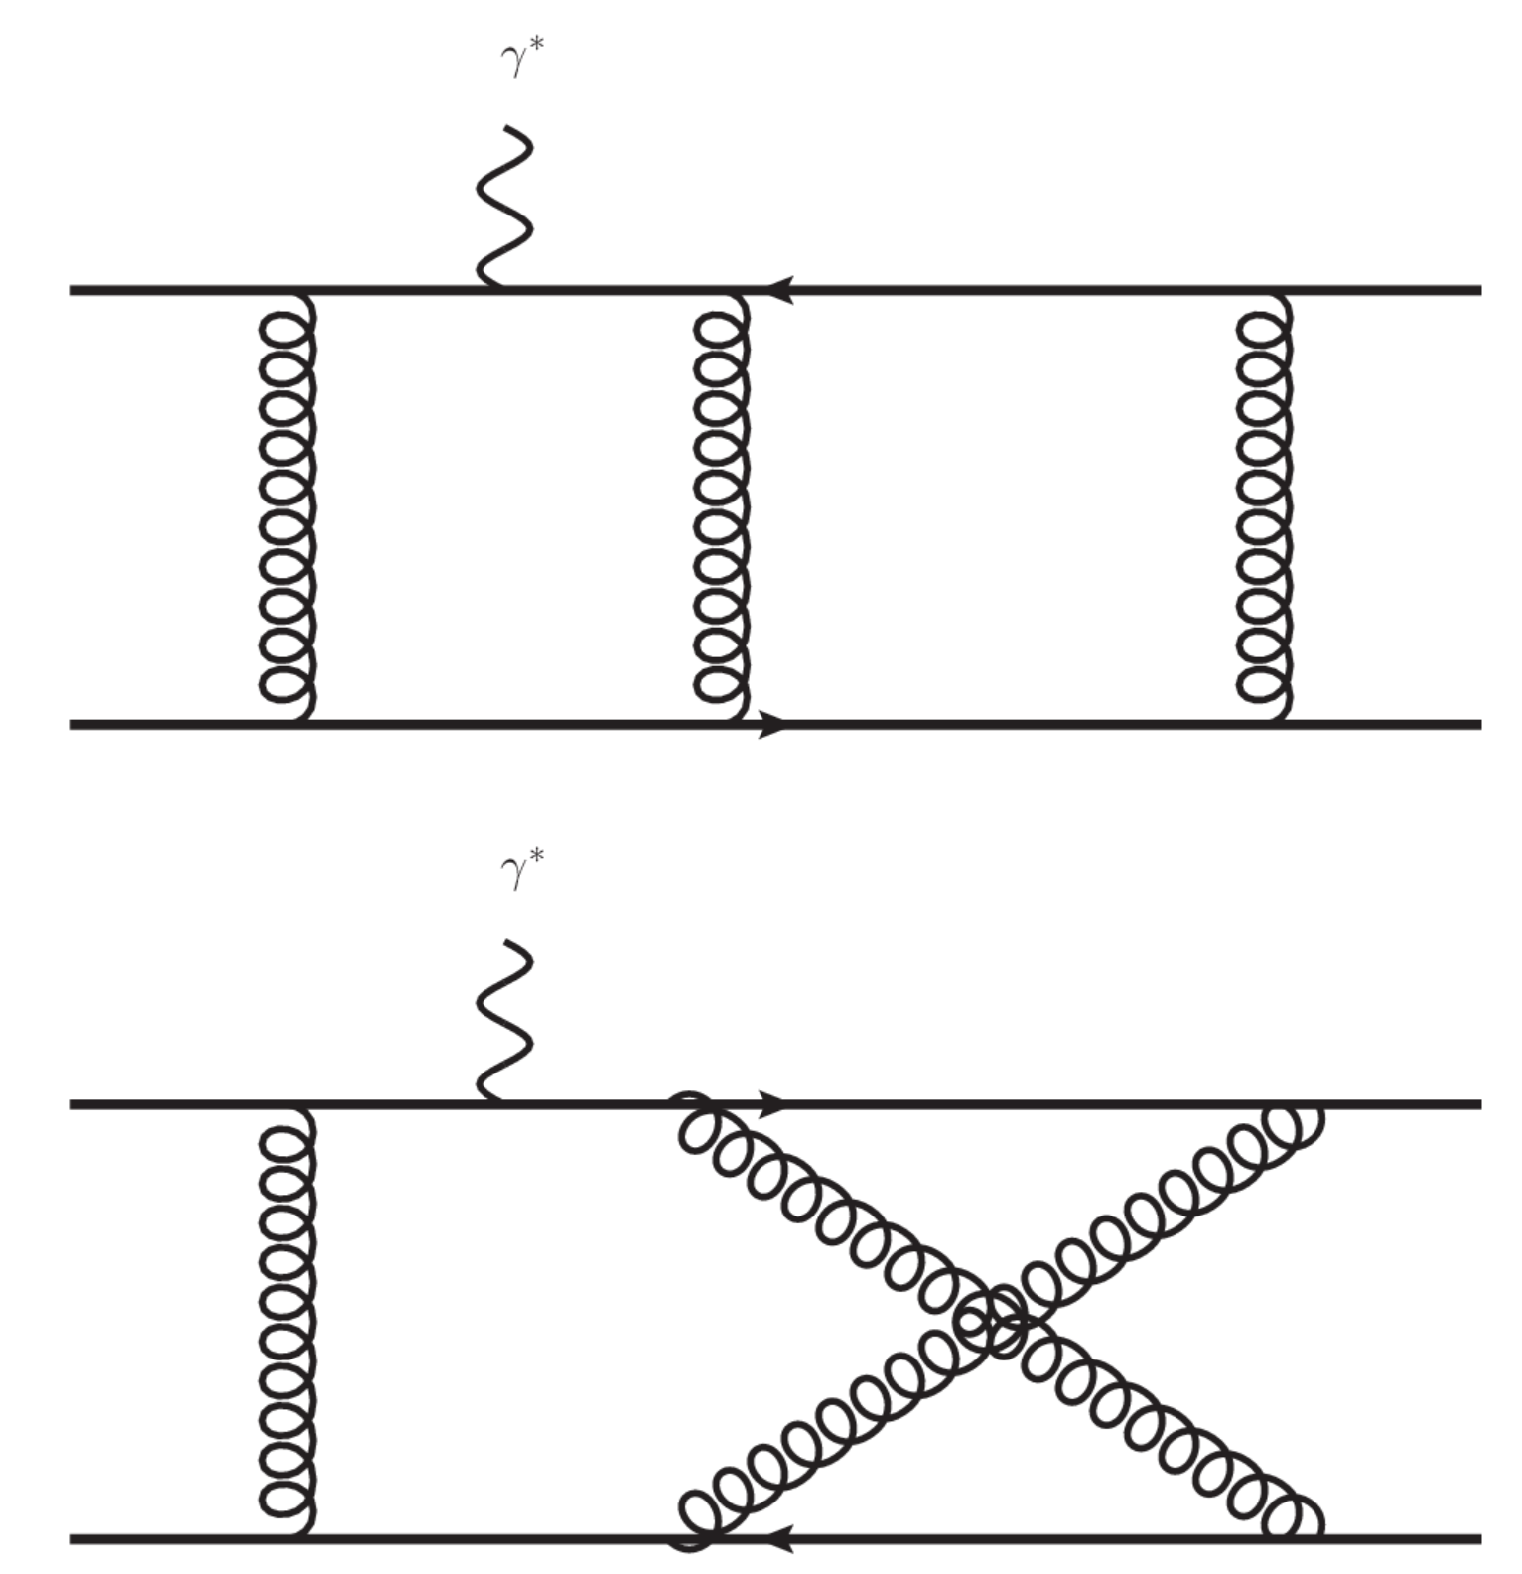
Feynman Diagrams(about 1600)
Partonic Process

Slide 8
Calculation Methods
Diagrams and amplitudes : HepLib, FeynArts
Partial Fraction: Apart
Integrals Reduction: FIRE (Integration-By-Parts)
Master Integrals Calculation: Differential Equations
Validations of analytic results for MIs: AMFLOW, AmpRed

Slide 9
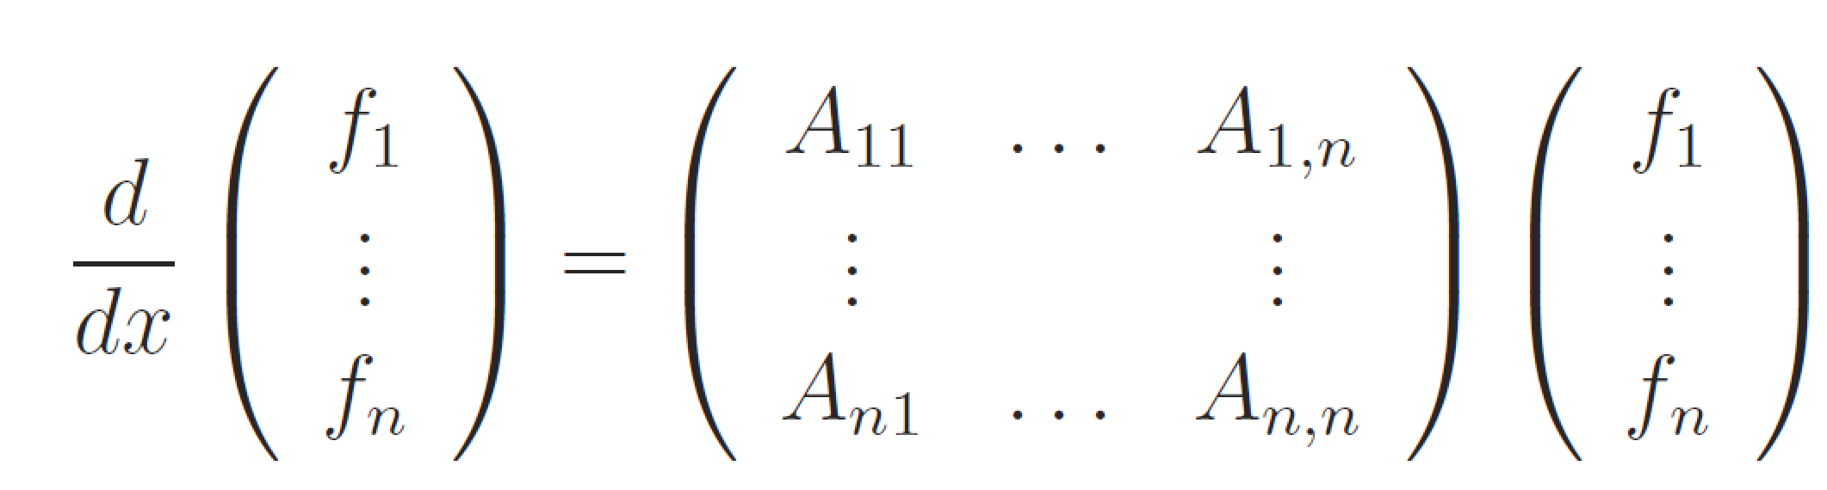
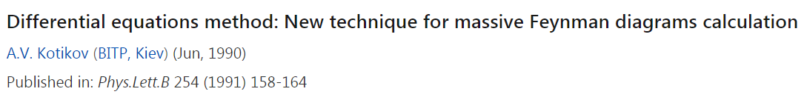
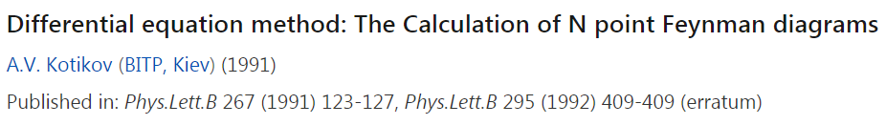
Differential Equations (DE)
Feynman Integrals

Slide 10
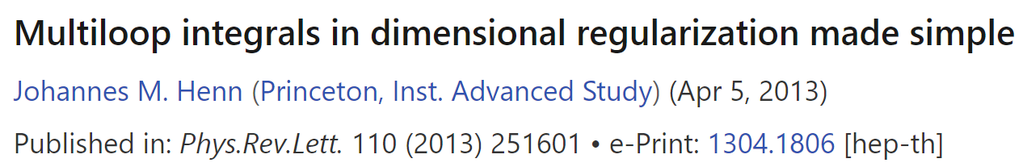
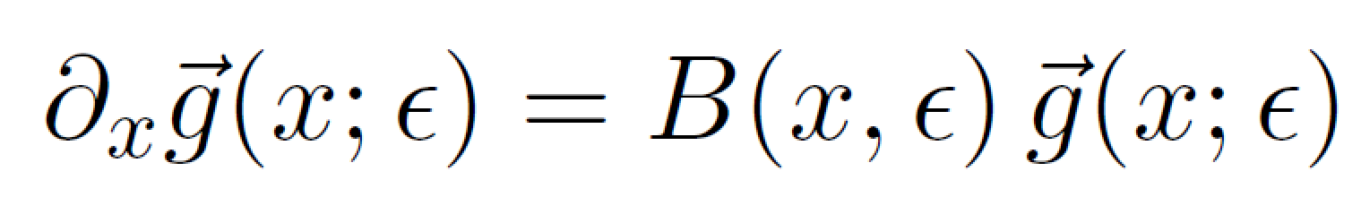
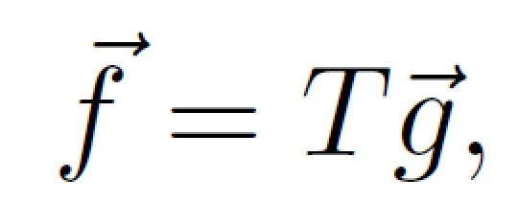
Choosing canonical basis (Basis with uniform transcendentality)
For random integral basis g, we have:
We can choose new basis f:

Slide 11
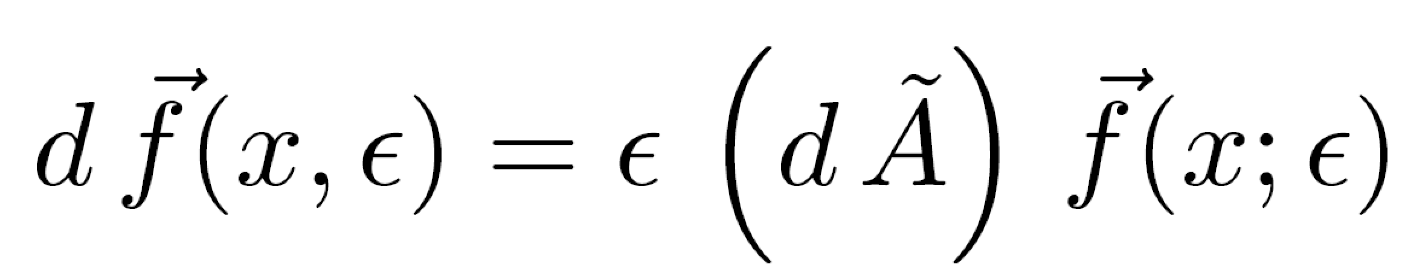
The new DEs is simple and elegant

Slide 12
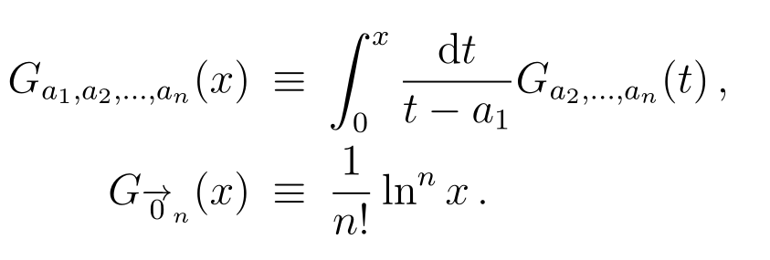
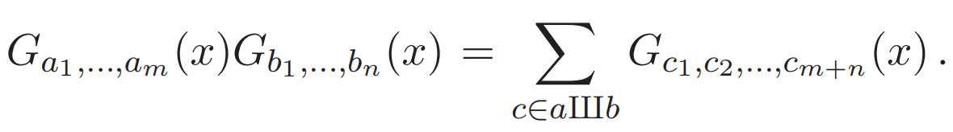
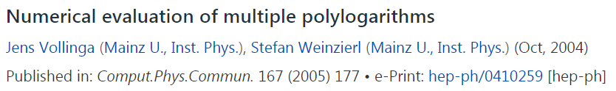
Goncharov Polylogarithms
GINAC

Slide 13
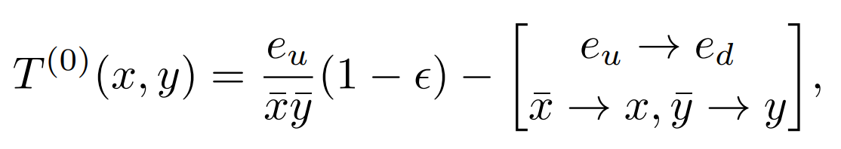
LO kernel

Slide 14
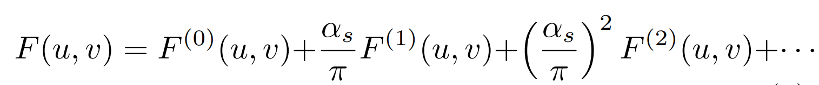
Perturbative expansion
Renormalized “pion” LCDA can be expressed as :

Slide 15
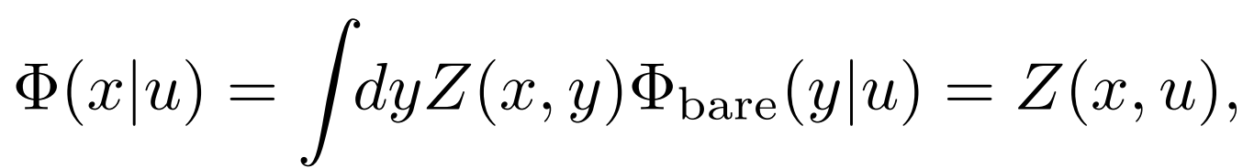
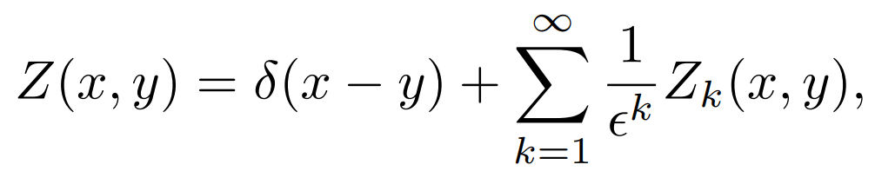
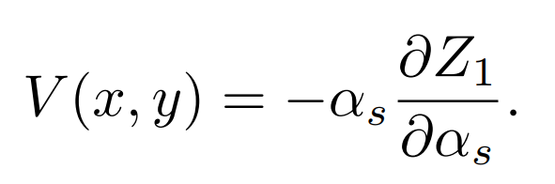
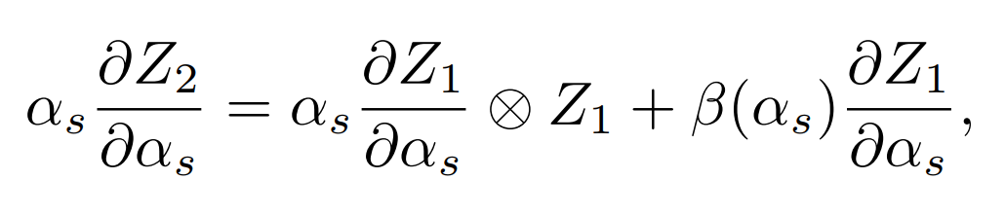
Renormalized LCDA
Related with EBRL kernel
arXiv:hep-ph/0512208

Slide 16
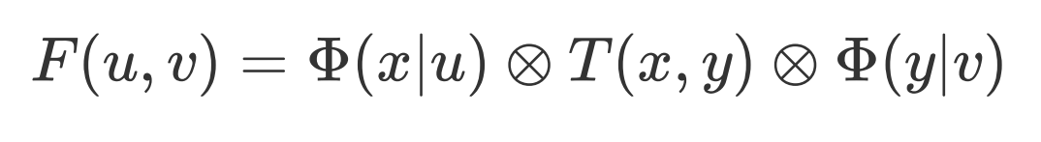
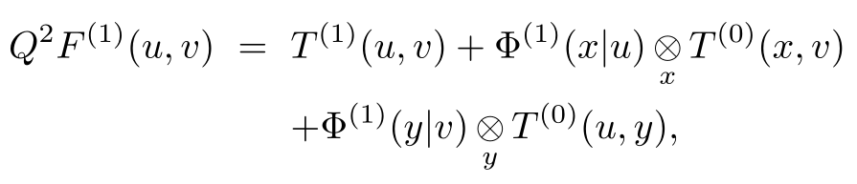
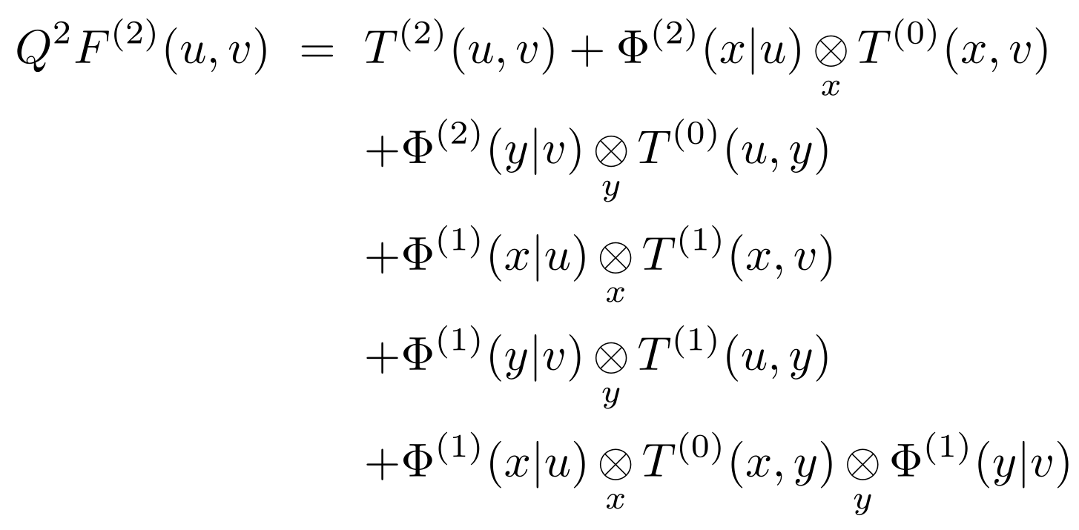
Matching
NLO
NNLO

Slide 17
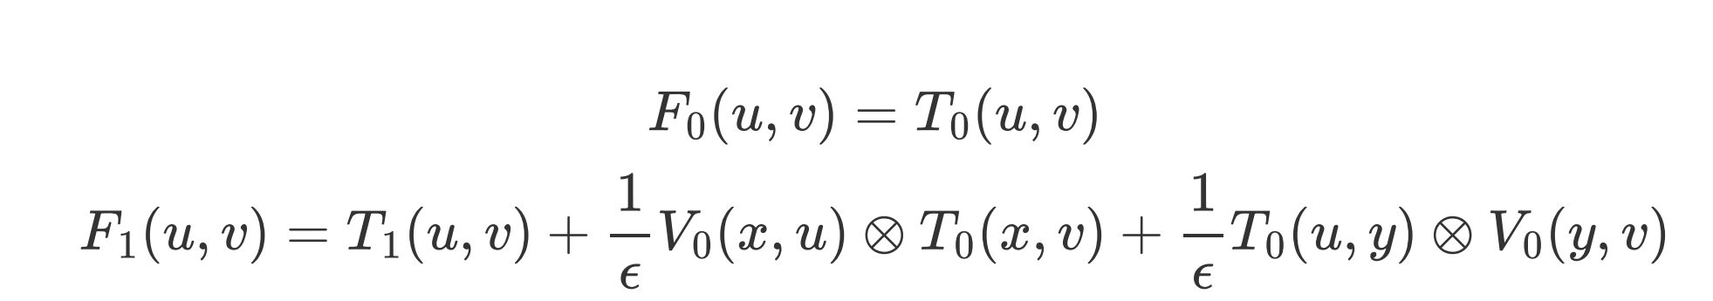
LO and NLO Matching

Slide 18
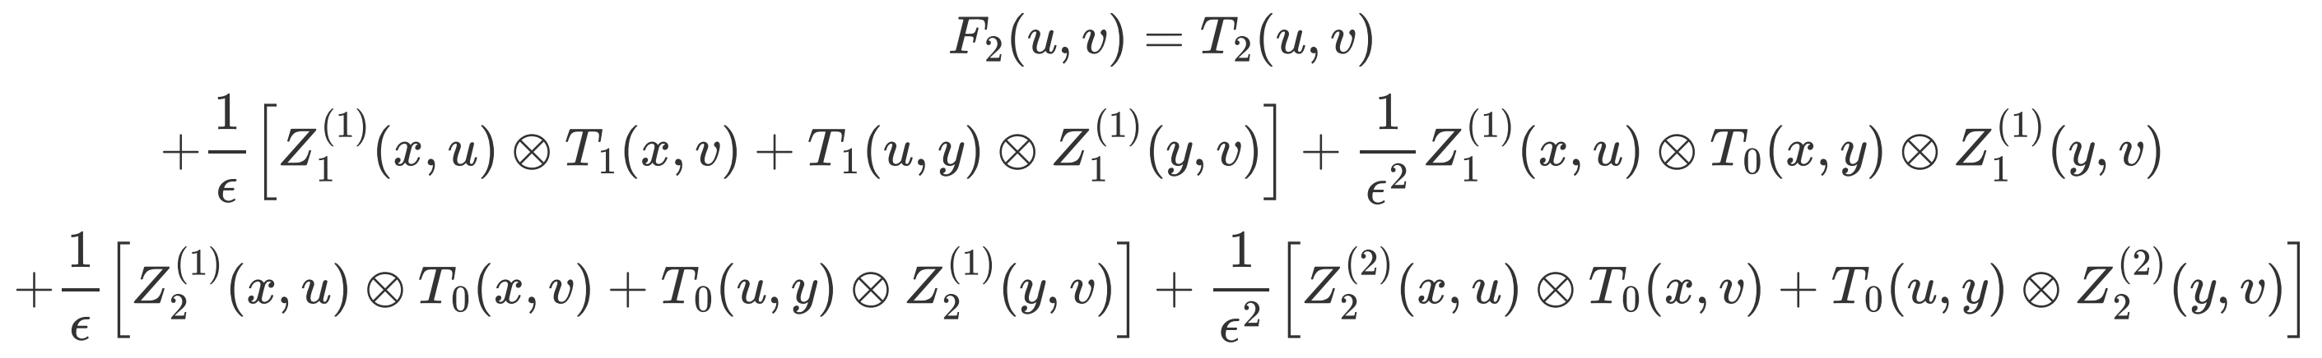
NNLO Matching
The convolutions above are calculated analytically.
All Infra-divergences are cancel.
We obtain analytic results for finite T2

Slide 19
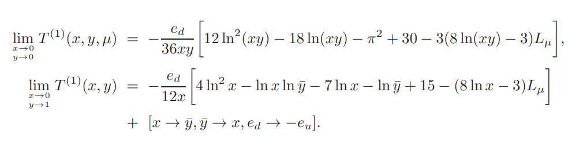
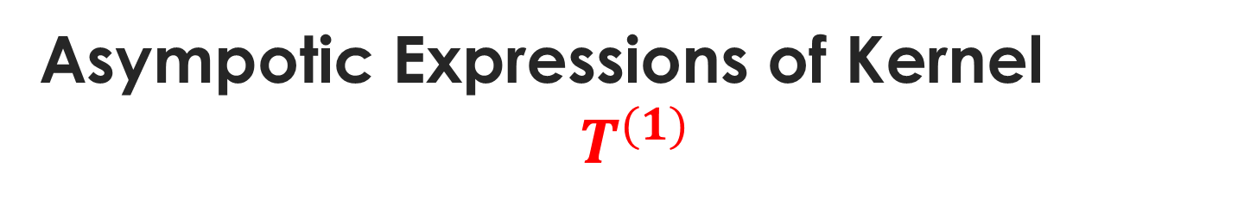
Asympotic Expressions of Kernel
$$T^{(1)}$$
NLO results agree with previous calculations

Slide 20
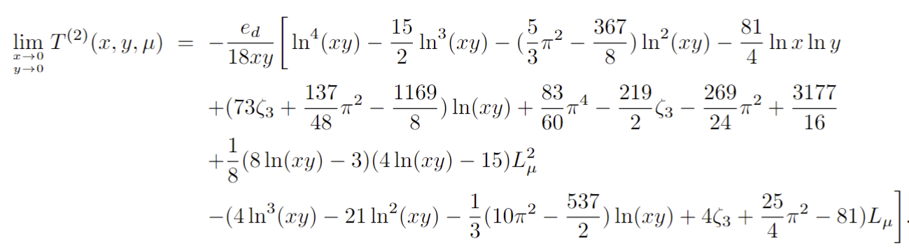
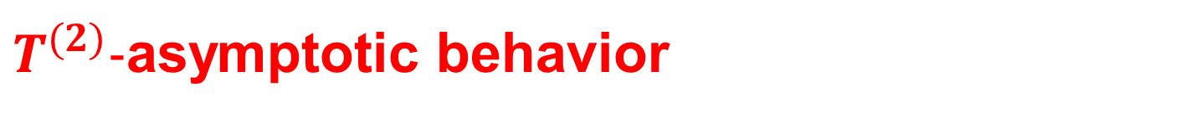
$T^{(2)}−$asymptotic behavior

Slide 21
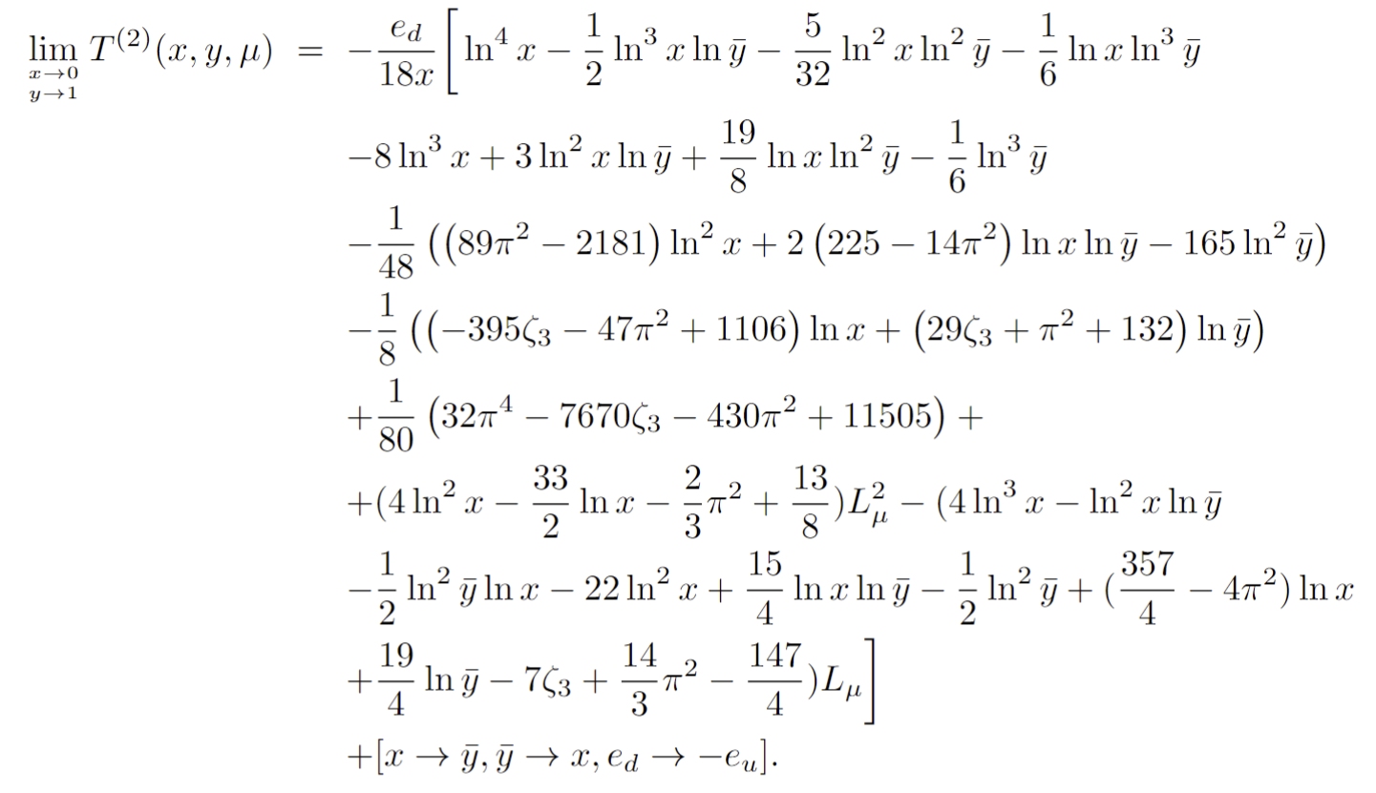
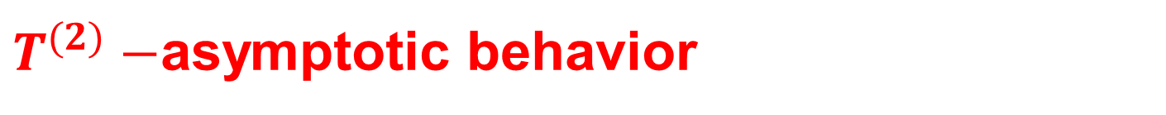
$T^{(2)}−$asymptotic behavior
Can the endpoint logarithms be resummation?

Slide 22
Phenomenological Exploration

Slide 23
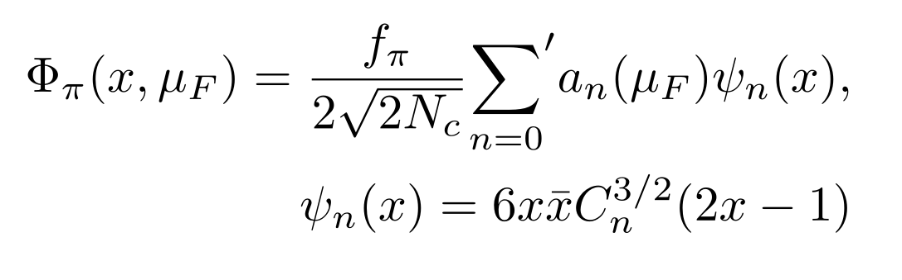
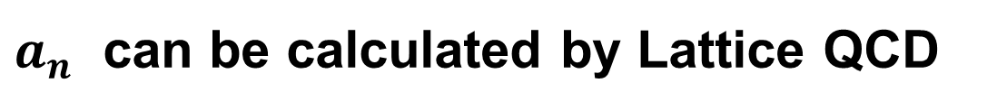
Leading-twist pion LCDA
$a_{n}$ can be calculated by Lattice QCD

Slide 24
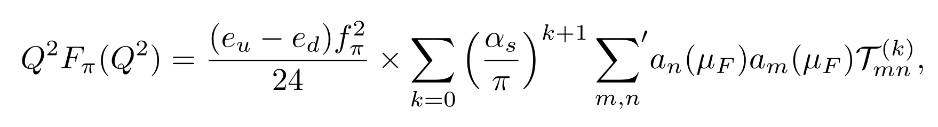
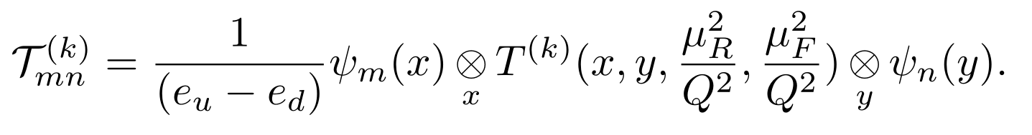
The pion EM form factor
Two-fold Convolution

Slide 25
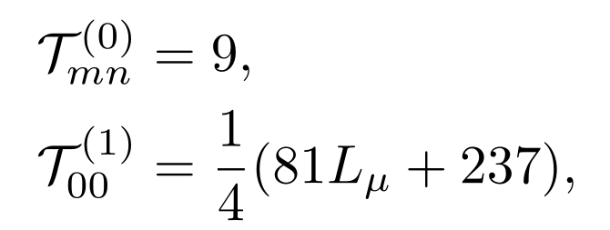
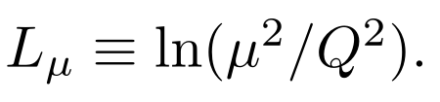
The convolutions can be evaluated analytically
About ${10}^{5}$ terms appear in the calculation of convolutions

Slide 26
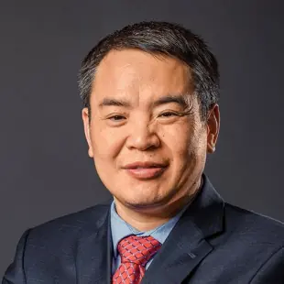
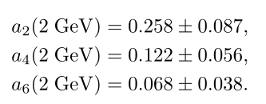

Phenomenological exploration
Inputs: Gegenbauer Moments
LPC
LaMET-Ji
arXiv: 1305.1539
RQCD
1909.08038
2201.09173

Slide 27
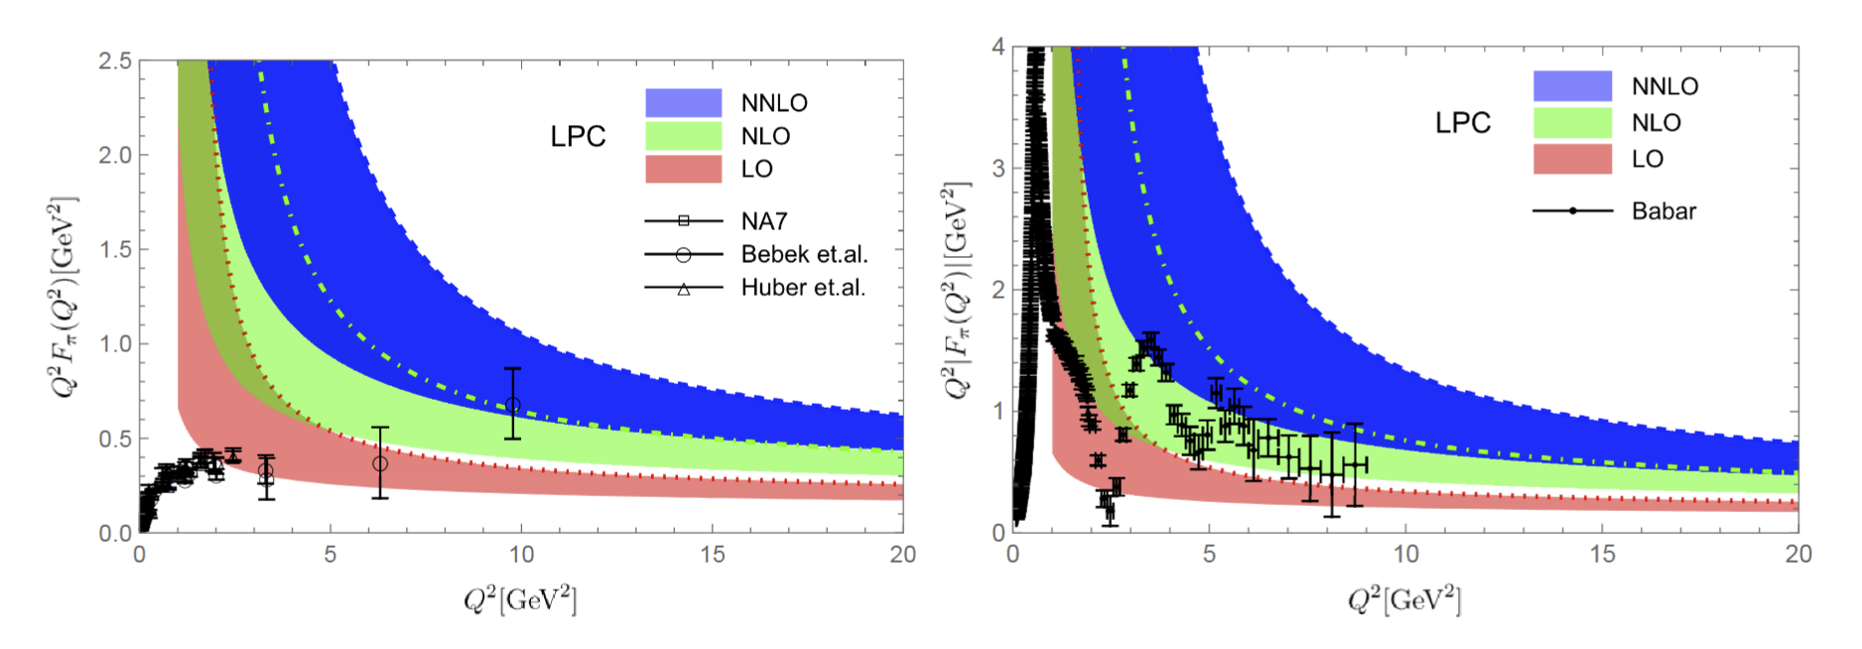
Phenomenological exploration
Results with LPC inputs
Space Like FF
Time Like FF

Slide 28

Results with RQCD inputs
Space Like FF
Time Like FF

Slide 29

Extend to Kaon(charge and neutral) Form Factors
arXiv:2407.21120

Slide 30

Charge Kaon FFs
Space like FFs, data taken form Ding et.al. arXiv:2404.04412
Time like FFs, data take from BESIII and BarBar

Slide 31

Neutral Kaon FFs
Time like FFs, data take from BESIII

Slide 32


SU(3) Flavor Breaking Effects
Data take from BESIII

Slide 33
Conclusion
The EM form factors for pion/kaon have been calculated up to NNLO QCD corrections.
We verify the validity of the collinear factorization up to NNLO for this observable.
The matching kernel have been obtained analytically.
The NNLO corrections turn out to be positive and significant.
The NNLO results can provides strong constraint on the Gegenbauer moments.

Slide 34
Thanks！

