Slide 1

Exploring Nucleon Resonances with DVCS:
HOW TO MAKE MATHEMATICA DO TENSOR ALGEBRA
Matthew Rumley (Supervisor: Anthony Thomas)
The University of Adelaide

Slide 2
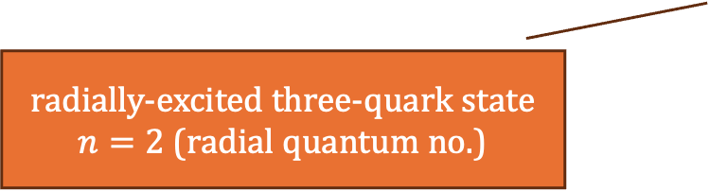
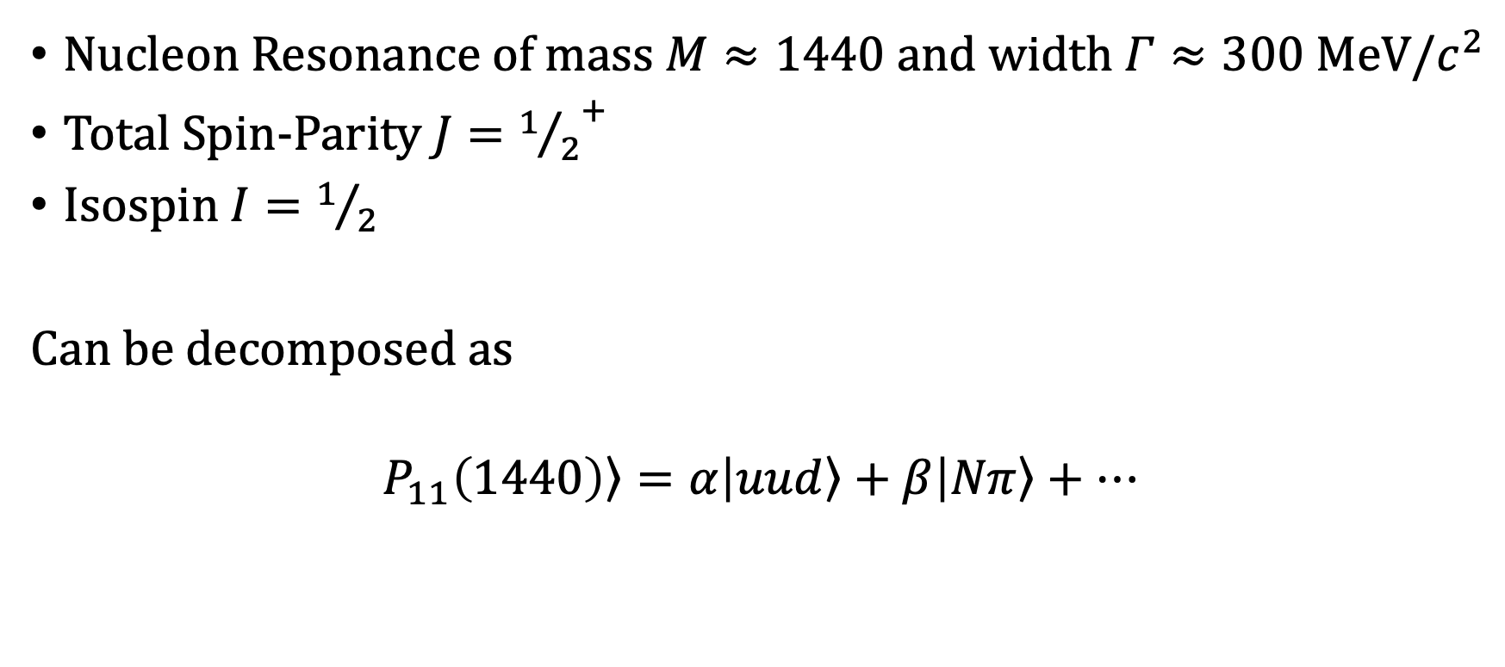
The Roper Resonance
Nucleon Resonance of mass $M≈1440$ and width $Γ≈300 MeV/c^{2}$
Total Spin-Parity $J={1/2}^{+}$
Isospin$I=1/2$
Can be decomposed as
$$\left.P_{11}\left(1440\right)\right\rangle =α\left|\left.uud\right\rangle +β\right|\left.Nπ\right\rangle +…$$
radially-excited three-quark state
$n=2$ (radial quantum no.)
molecule-like bound state of a nucleon and a pion
Notes:
Explain how the Nucleon resonance is likely some linear combination of a three-quark state with some radial excitation and molecule-like bound states.
Likely similar makeup for other resonances. Presents future research opportunities.
When looking at the makeup of hadrons, the internal structure provides detail about the hadron.

Slide 3
Notes:
GPDs are the 3D analogue of PDFs. Coordinate interpretation.
Clarify difference from TMDs.
Quickly run through how TMDs, GPDs, PDFs, and Form Factors are related distributions obtained by integrating different dimensions of the Wigner Distribution.

Slide 4
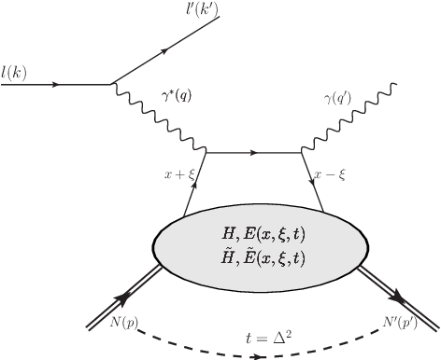
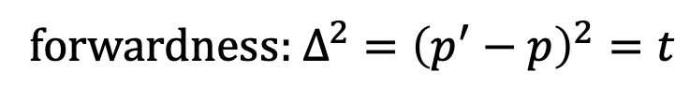
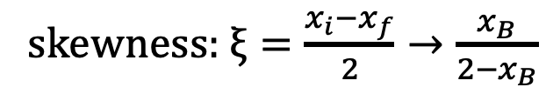
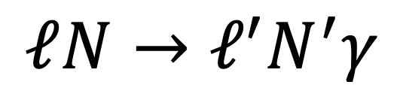
DVCS
$$ℓN→ℓ^{′}N^{′}γ$$
skewness: $ξ=\frac{x_{i}−x_{f}}{2}→\frac{x_{B}}{2−x_{B}}$
forwardness: $Δ^{2}={\left(p^{′}−p\right)}^{2}=t$
Notes:
Common process to explore 3D structure. GPDs factorise the quark-photon interaction.
Note off-forwardness and skewness.

Slide 5
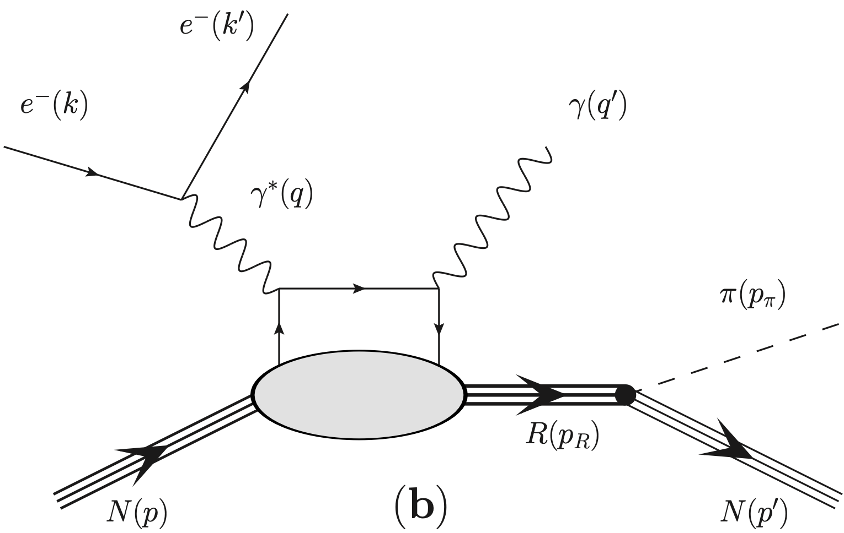
Notes:
We extend this process by allowing the Roper to decay into N + pi.
Obtain final process, N + e → N + e’ + pi + gamma

Slide 6




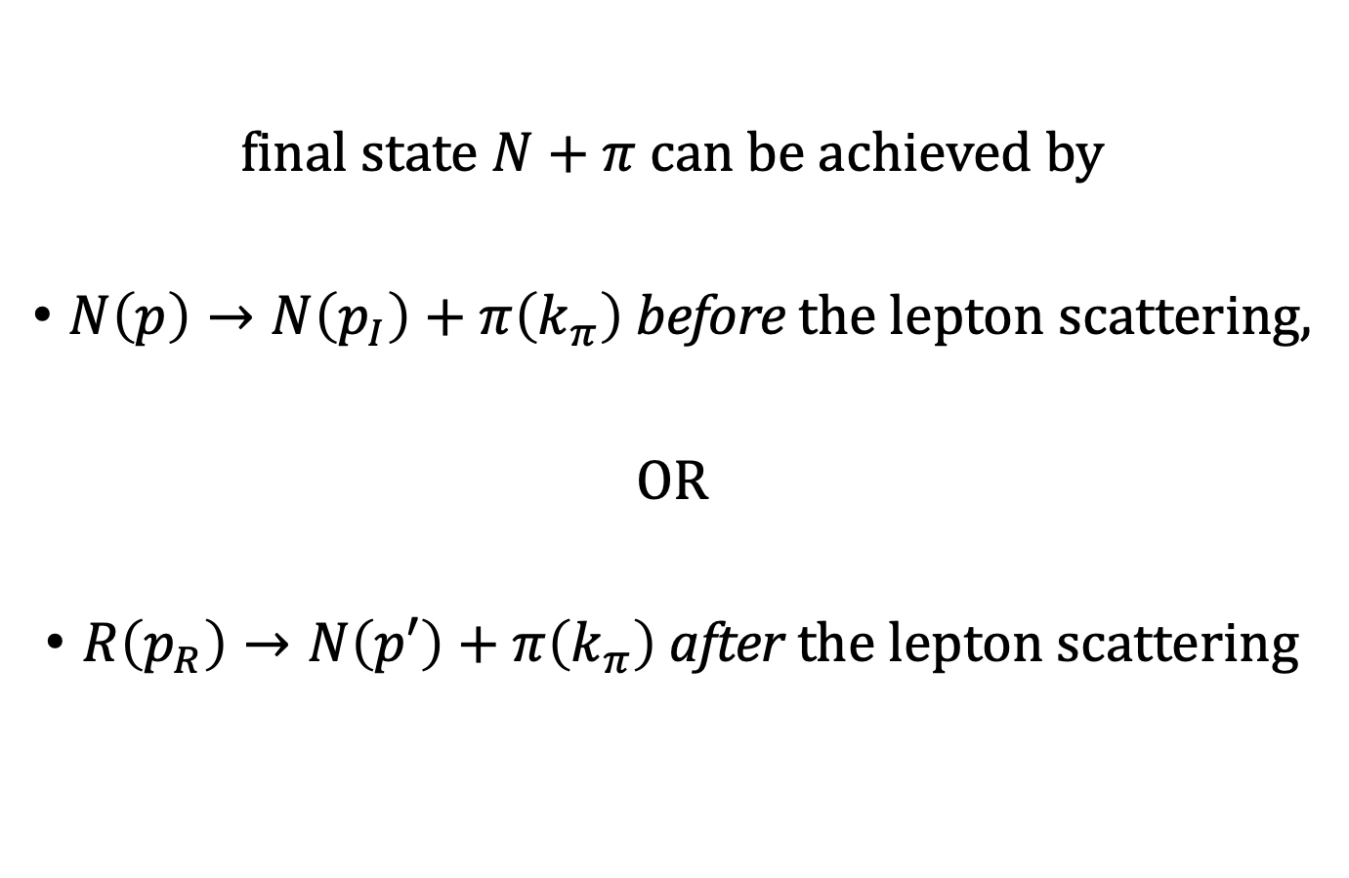

final state $N+π$ can be achieved by
$N\left(p\right)→N\left(p_{I}\right)+π\left(k_{π}\right)$ before the lepton scattering,
OR
$R\left(p_{R}\right)→N\left(p′\right)+π\left(k_{π}\right)$ after the lepton scattering
$$N\left(p−p_{π}\right)$$
where $p^{′}+p_{π}=p_{R}$
$$N\left(p^{′}\right)$$
$$N\left(p\right)$$
$$π\left(p_{π}\right)$$
Notes:
Both processes are necessary to consider for obtaining cross-section of process

Slide 7
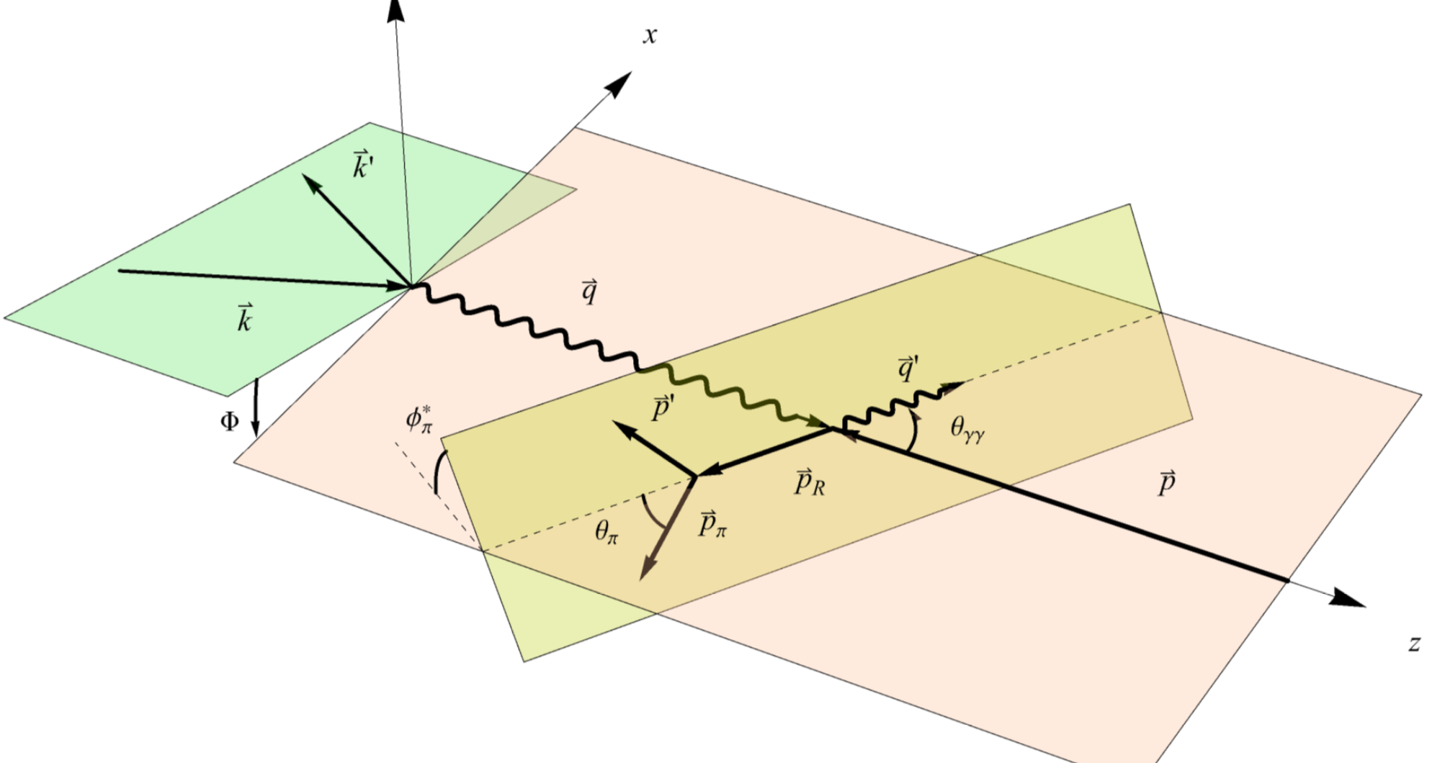

7-fold differential cross section
$$\frac{dσ}{dQ^{2} dx_{B} dt dM_{πN}^{2} dΩ_{π}^{∗}}$$
Notes:
Kinematic Diagram

Slide 8
Tensor Algebra using xAct
Written for the Wolfram Language in 2004 primarily by José M. Martín-García.
Often used for General Relativity.
Handles really complex Tensor Algebra reasonably intuitively.
SYMBOLIC!!!

Slide 9
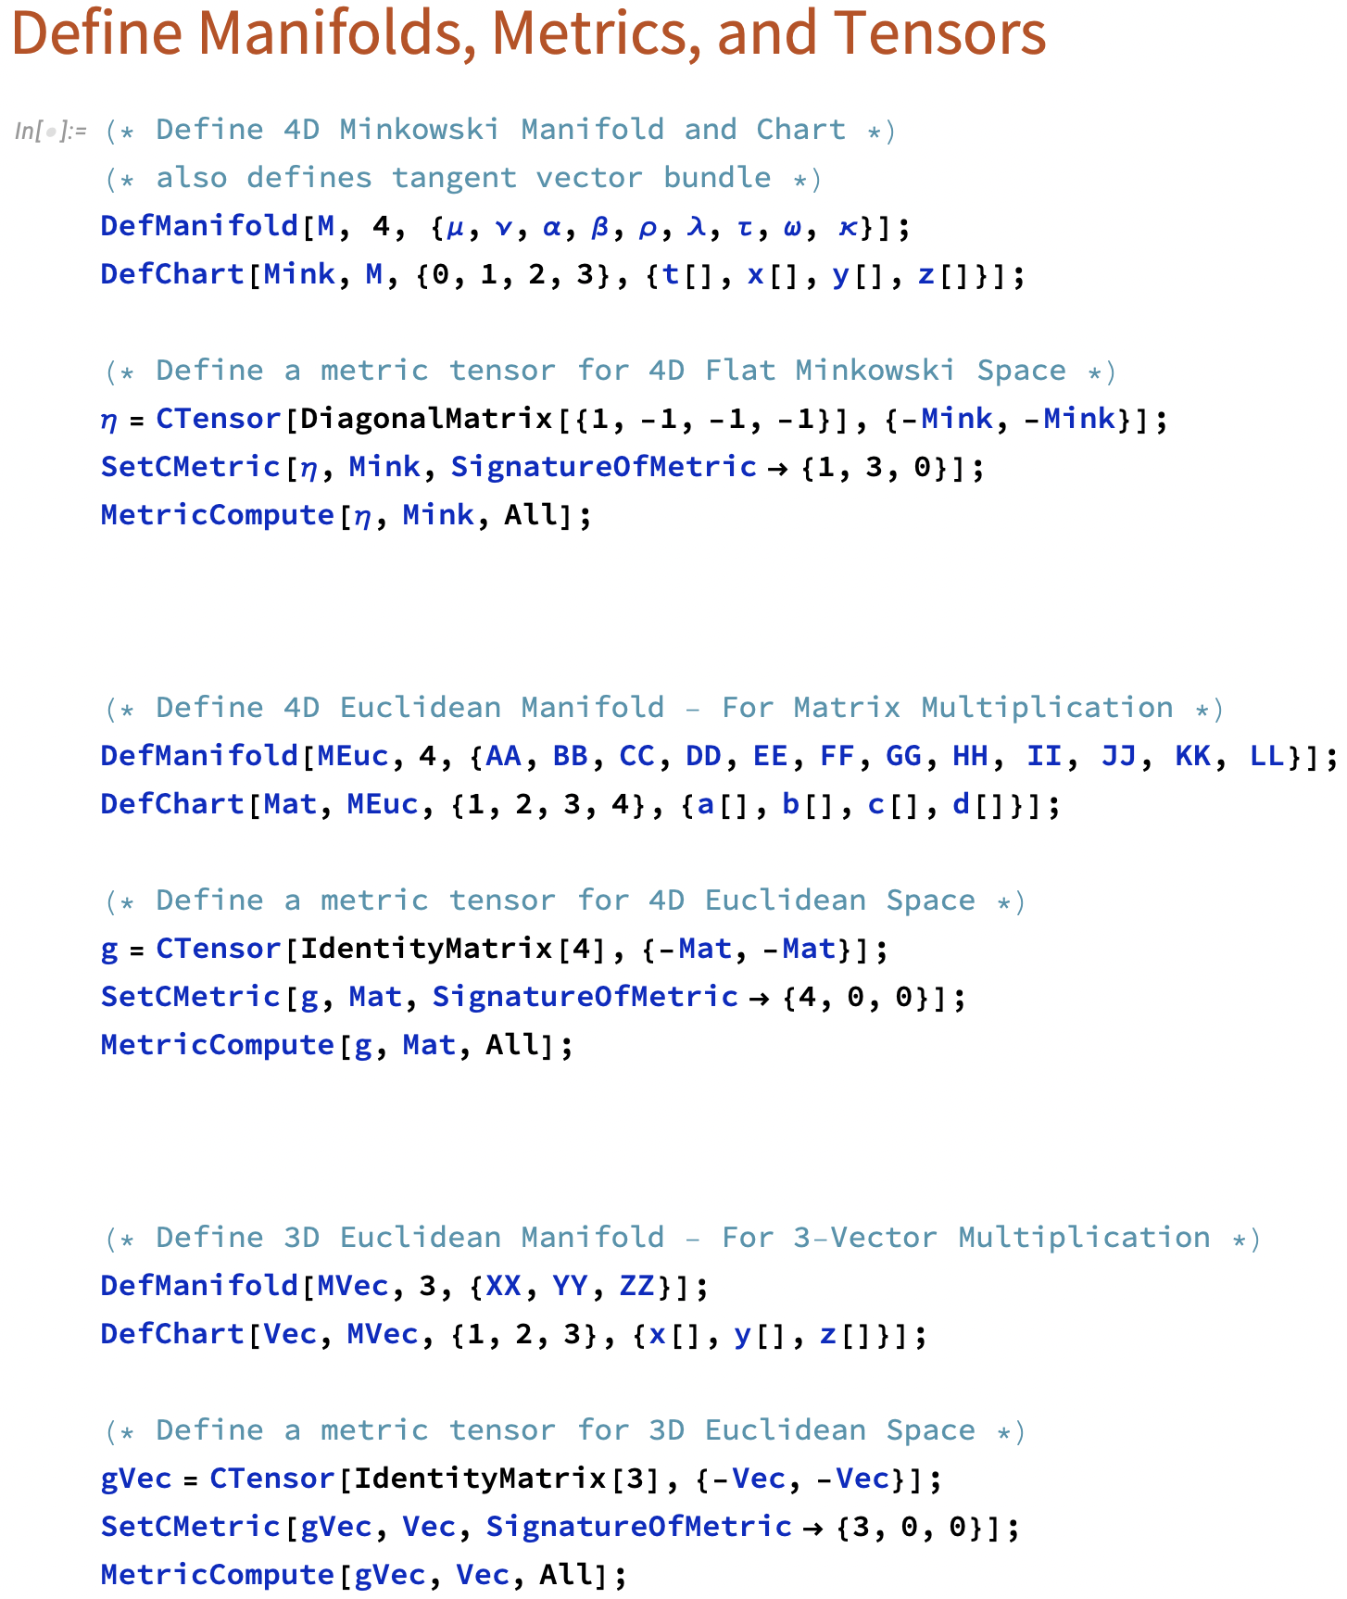
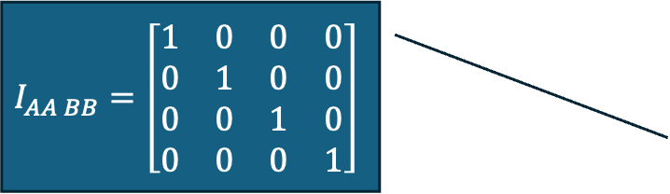
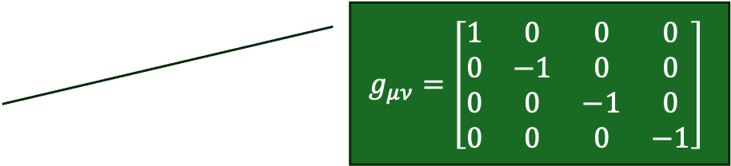
no. of dimensions
indices linked to manifold
chart labels for manifold
$$g_{μν}=\left[\begin{matrix}1 & 0 & 0 & 0 \\ 0 & −1 & 0 & 0 \\ 0 & 0 & −1 & 0 \\ 0 & 0 & 0 & −1\end{matrix}\right]$$
$$I_{AA BB}=\left[\begin{matrix}1 & 0 & 0 & 0 \\ 0 & 1 & 0 & 0 \\ 0 & 0 & 1 & 0 \\ 0 & 0 & 0 & 1\end{matrix}\right]$$
Notes:
Can do any Tensor Algebra by carefully defining the spaces we want to work in.
Explain how indices are set up

Slide 10
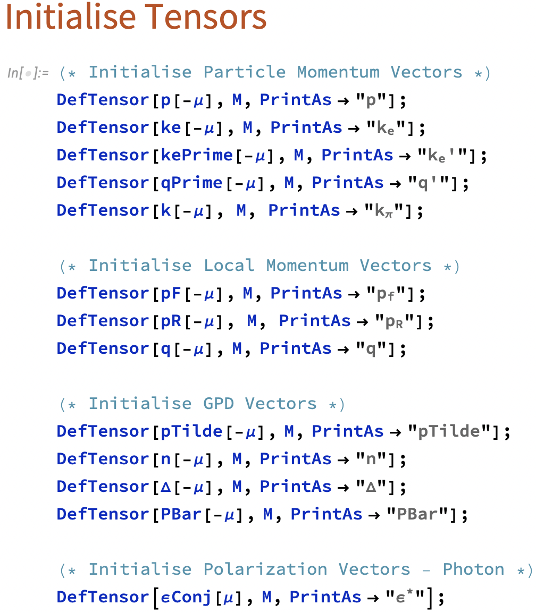
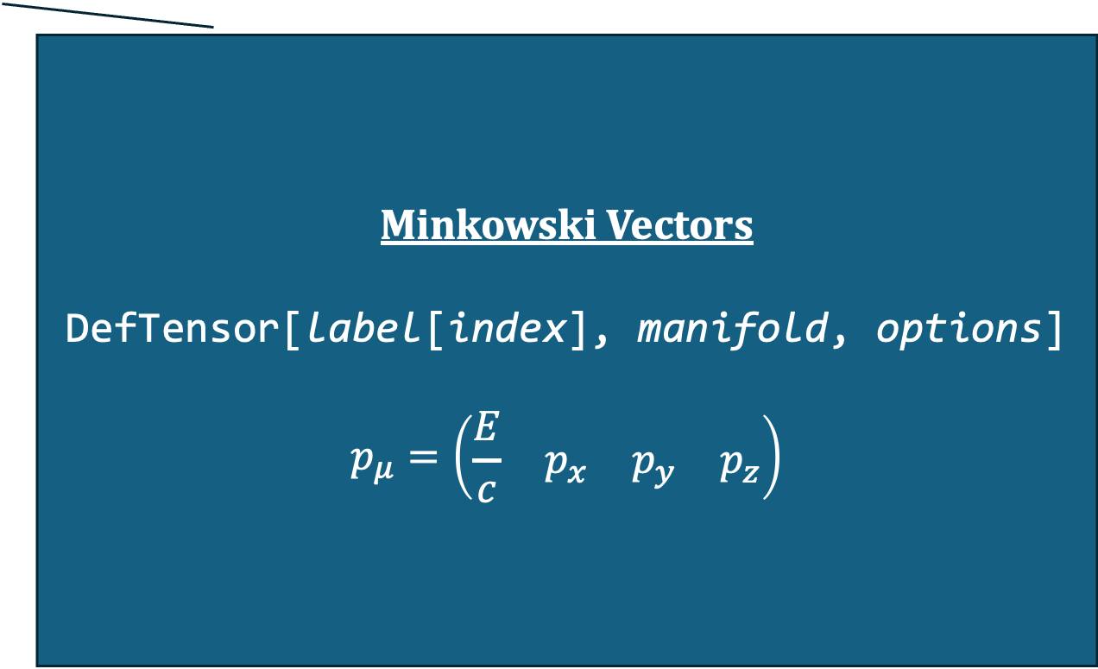
Minkowski Vectors
DefTensor[label[index], manifold, options]
$$p_{μ}=\left(\begin{matrix}\frac{E}{c} & p_{x} & p_{y} & p_{z}\end{matrix}\right)$$
Notes:
QUICKLY show how to create vectors with a particular manifold

Slide 11
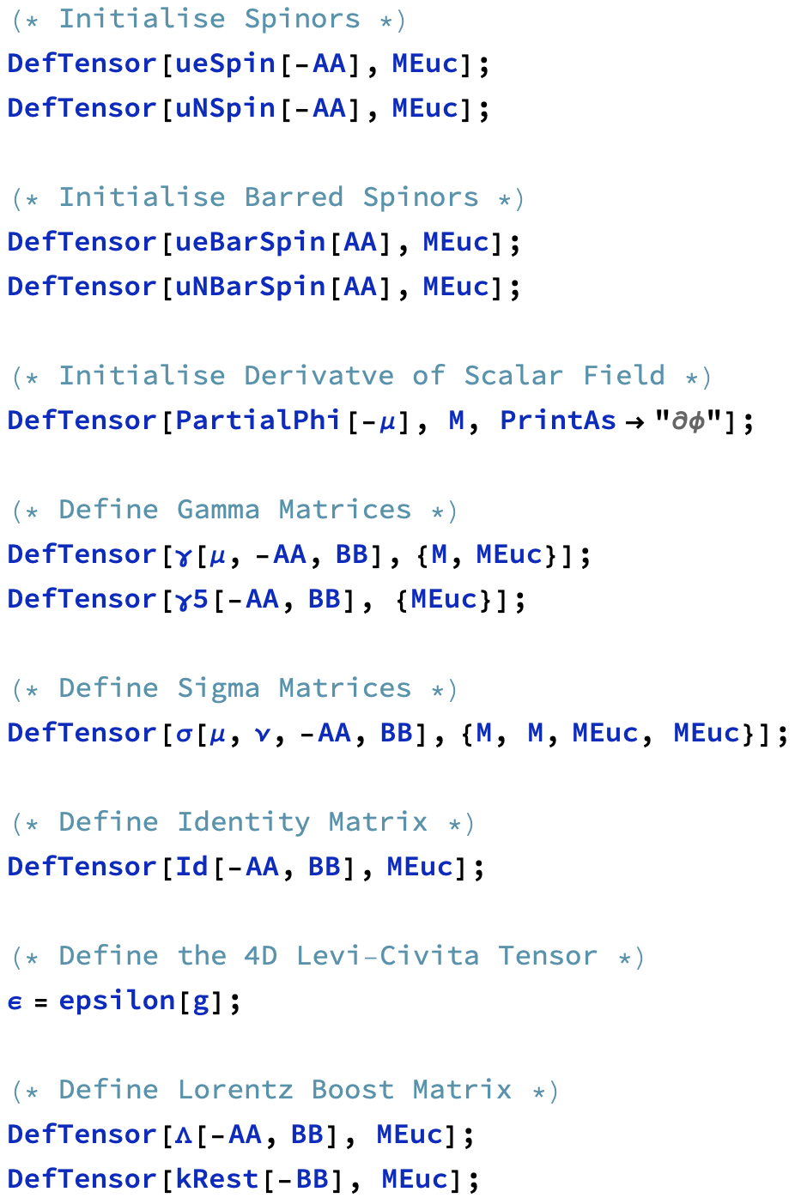
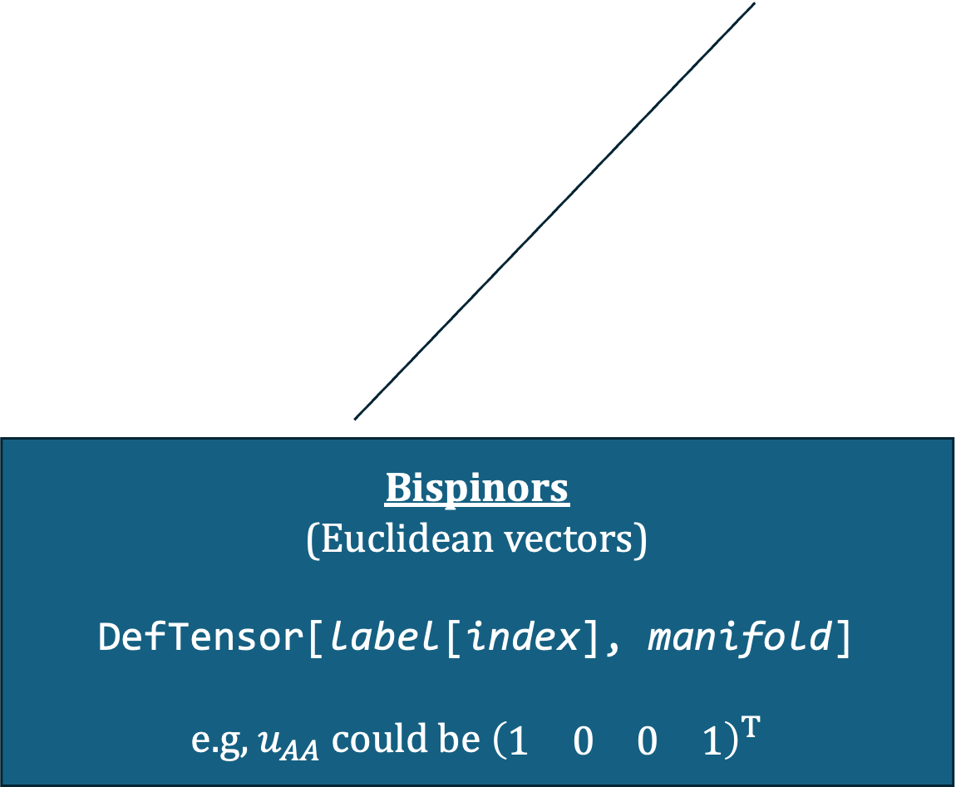
Bispinors
(Euclidean vectors)
DefTensor[label[index], manifold]
e.g, $u_{AA}$ could be ${\left(\begin{matrix}1 & 0 & 0 & 1\end{matrix}\right)}^{T}$
Notes:
Can also make standard Euclidean vectors like bispinors

Slide 12
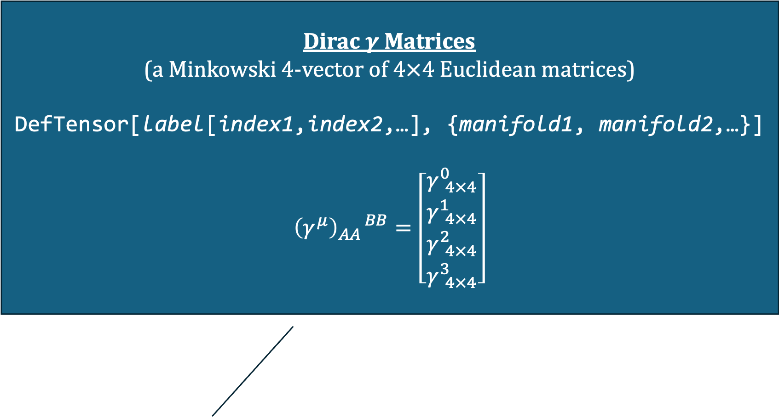
Dirac $γ$ Matrices
(a Minkowski 4-vector of $4×4$ Euclidean matrices)
DefTensor[label[index1,index2,…], {manifold1, manifold2,…}]
$${\left(γ^{μ}\right)}_{AA}^{ BB}=\left[\begin{matrix}γ_{ 4×4}^{0} \\ γ_{ 4×4}^{1} \\ γ_{ 4×4}^{2} \\ γ_{ 4×4}^{3}\end{matrix}\right]$$
Notes:
Can make objects using multiple manifolds.
Good because it allows us to use Minkowski indices on Euclidean matrices

Slide 13
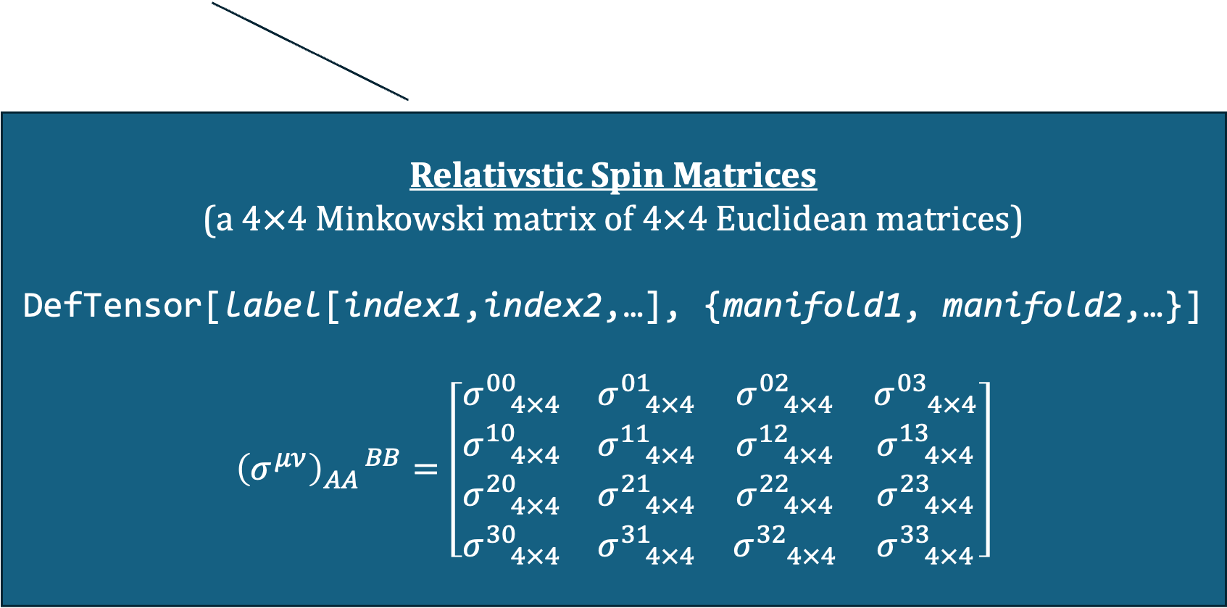
Relativstic Spin Matrices
(a $4×4$Minkowski matrix of $4×4$ Euclidean matrices)
DefTensor[label[index1,index2,…], {manifold1, manifold2,…}]
$${\left(σ^{μν}\right)}_{AA}^{ BB}=\left[\begin{matrix}σ_{ 4×4}^{00} & σ_{ 4×4}^{01} & σ_{ 4×4}^{02} & σ_{ 4×4}^{03} \\ σ_{ 4×4}^{10} & σ_{ 4×4}^{11} & σ_{ 4×4}^{12} & σ_{ 4×4}^{13} \\ σ_{ 4×4}^{20} & σ_{ 4×4}^{21} & σ_{ 4×4}^{22} & σ_{ 4×4}^{23} \\ σ_{ 4×4}^{30} & σ_{ 4×4}^{31} & σ_{ 4×4}^{32} & σ_{ 4×4}^{33}\end{matrix}\right]$$
Notes:
Can even extend this to a Minkowski matrix of Euclidean indices

Slide 14

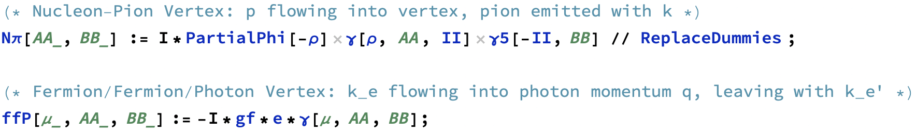



$$=−ig_{f}e γ^{μ}$$
$$=i ∂_{ρ}φ γ^{ρ} γ^{5}$$
Notes:
Can create a rule for each type of vertex we will encounter.
Functional form

Slide 15
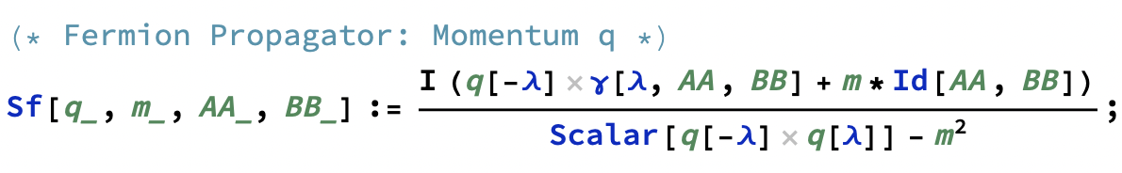
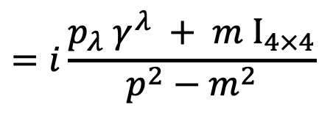
$$=i\frac{p_{λ} γ^{λ} + m I_{4×4}}{p^{2}−m^{2}}$$
Notes:
Including propagators

Slide 16
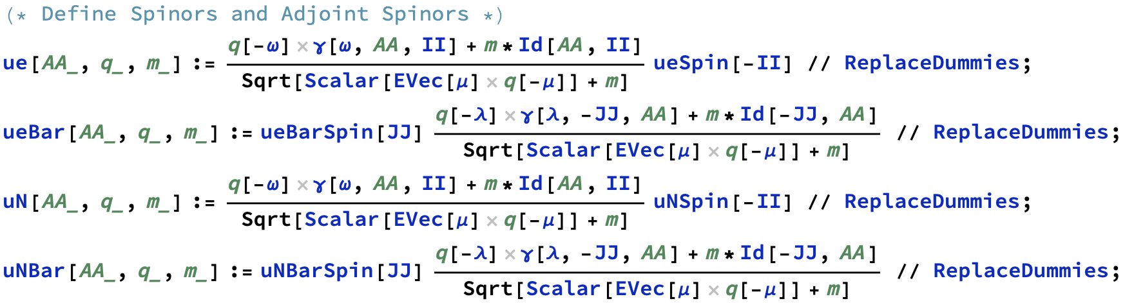
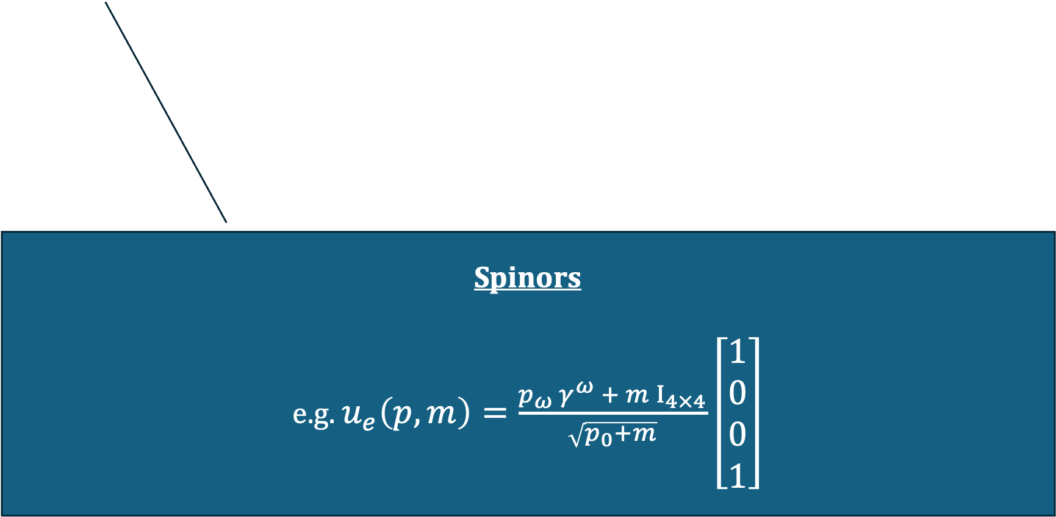
Spinors
e.g. $u_{e}\left(p,m\right)=\frac{p_{ω} γ^{ω} + m I_{4×4}}{\sqrt{p_{0}+m}}\left[\begin{matrix}1 \\ 0 \\ 0 \\ 1\end{matrix}\right]$

Slide 17
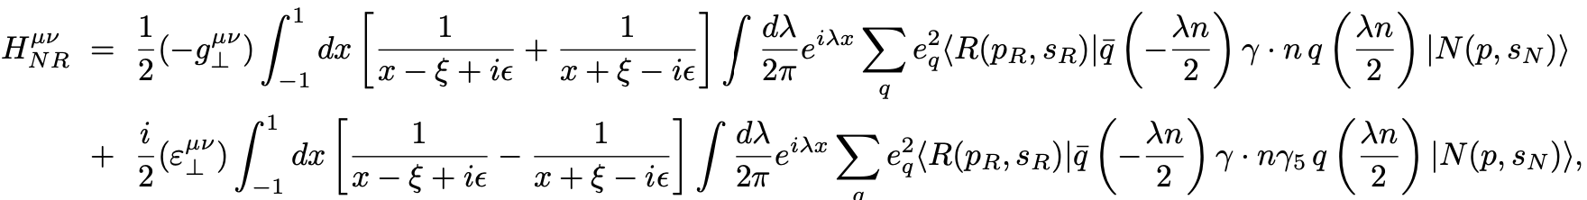
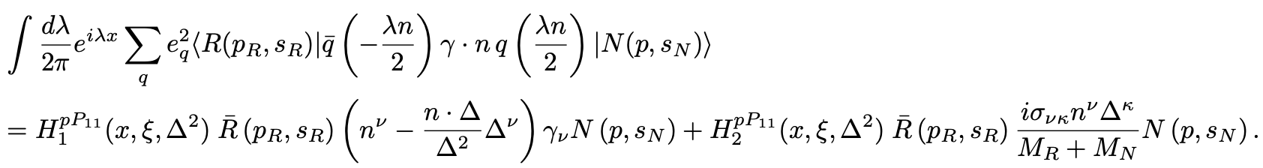
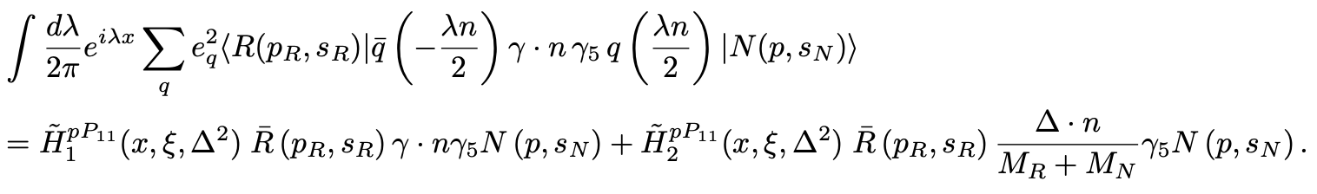

DVCS Tensor $H_{NR}^{μν}$
Notes:
This is the DVCS tenosr.
Has a vector and axial vector portion of the transition matrix element.
Written in terms of GPDs.

Slide 18
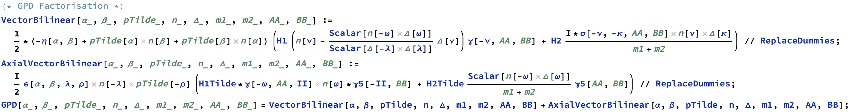
DVCS Tensor $H_{NR}^{μν}$
Notes:
Can encode this into a vertex too!

Slide 19
Notes:
Then, it’s as simple as writing out a string of vertices in order.
Mathematica will correctly replace them with the rules we’ve identified.

Slide 20
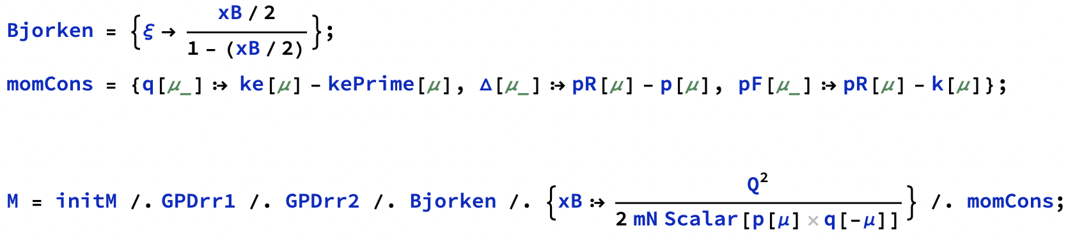
Notes:
VERY QUICK
Easy to apply simple rules like momentum conservation or the Bjorken or forward limits

Slide 21
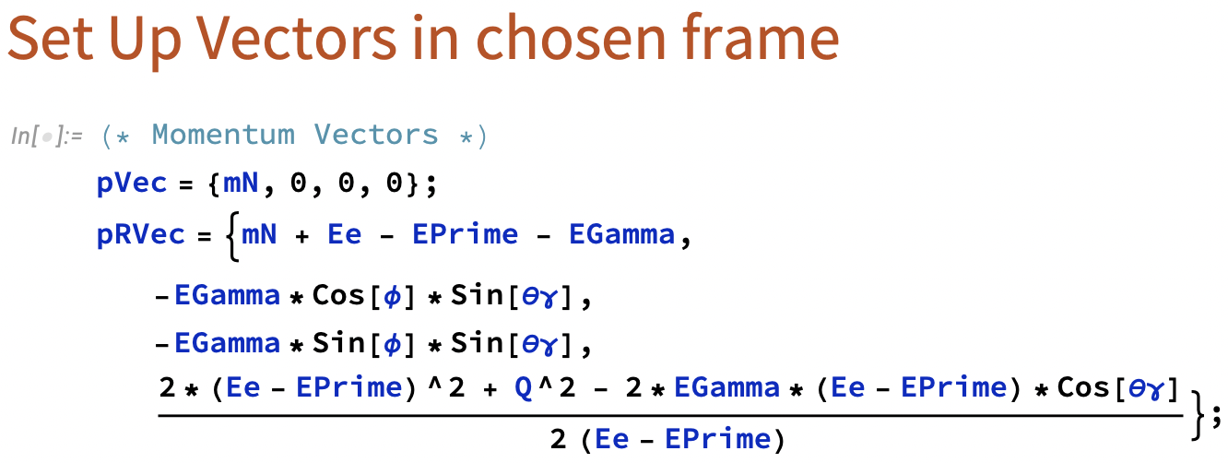
Everything up until now has been entirely general: no frame dependence
Notes:
VERY QUICK
Input kinematics in a frame of choice

Slide 22
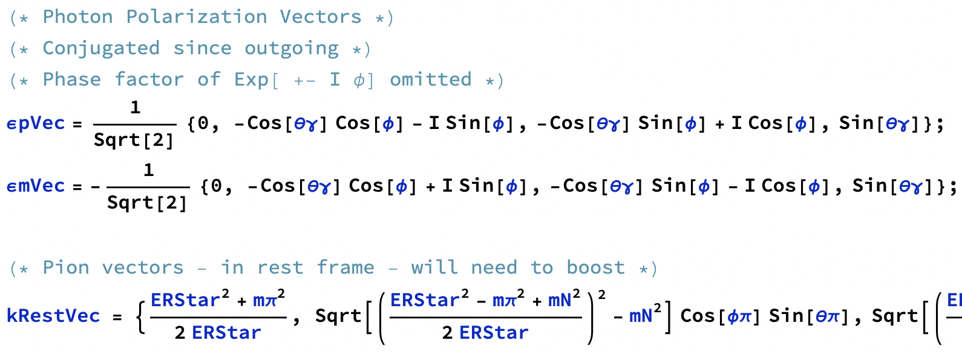
Notes:
VERY QUICK
Can put in photon polarisation options

Slide 23
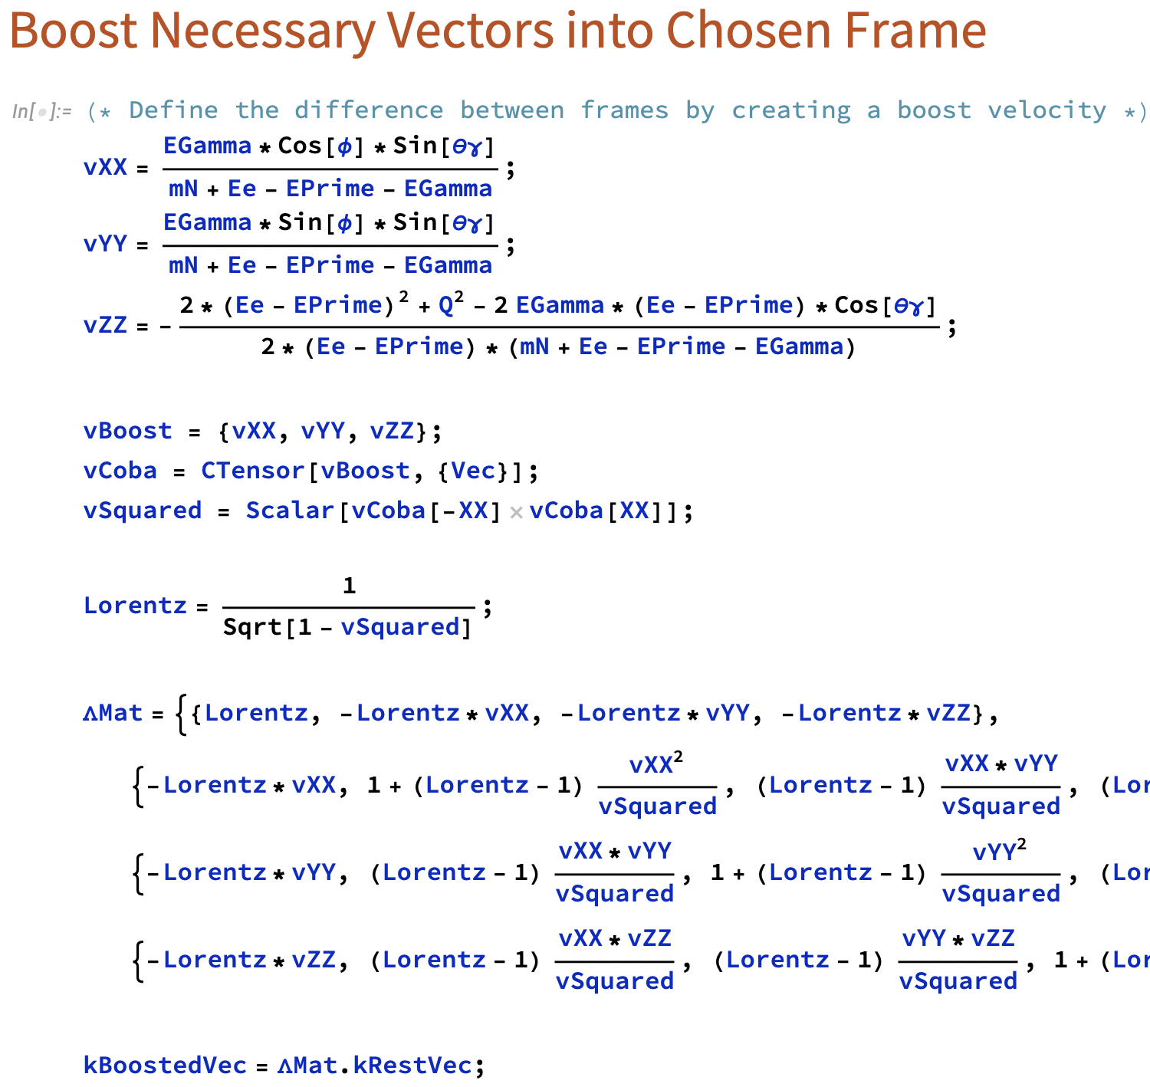
Notes:
VERY QUICK
Highlight how we can use a second frame for some vectors and boost them as necessary

Slide 24
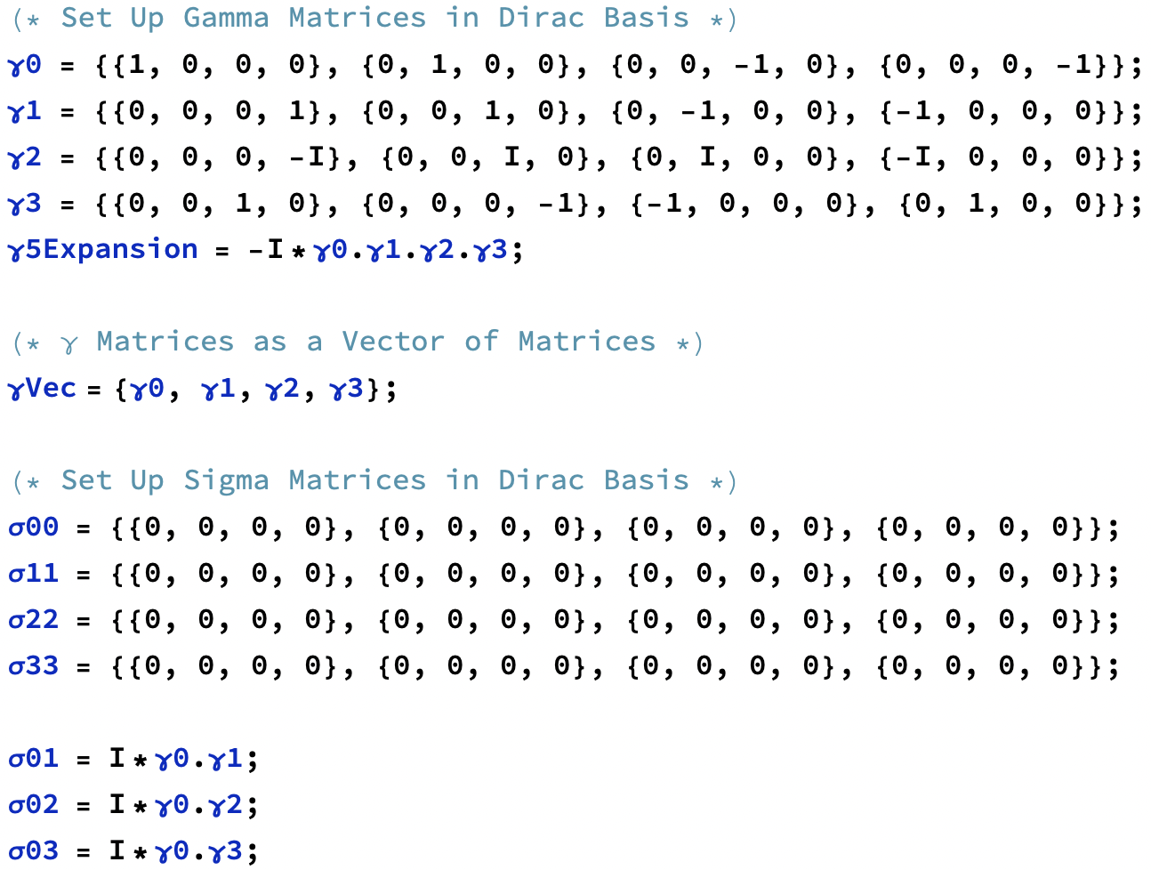
Notes:
VERY QUICK
Input gamma and sigma matrices

Slide 25
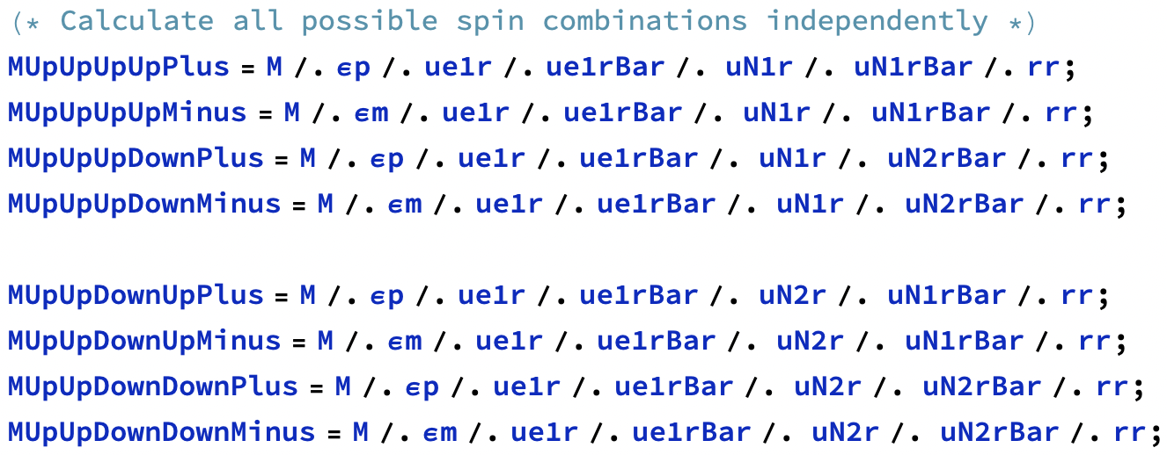
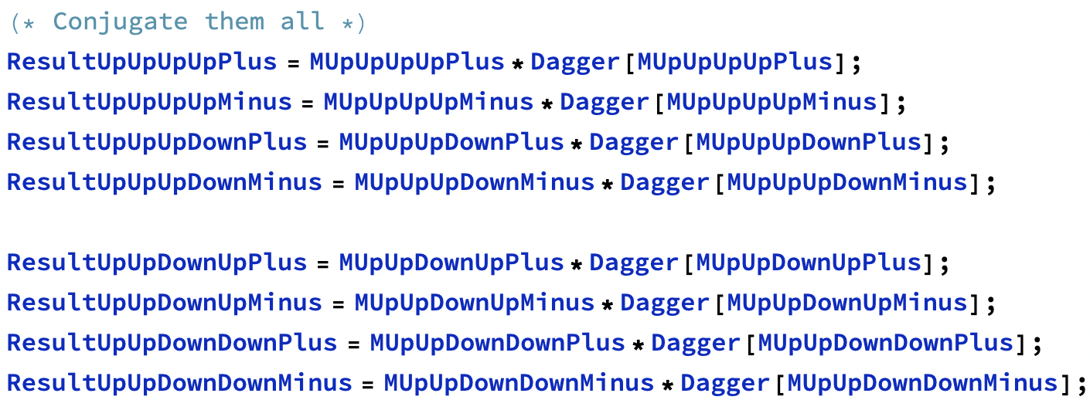
Notes:
Pick a choice of spin for each spinor and polarisation for each photon, and replace the symbolic form with the component form.
Conjugate and then sum for a spin summed result

Slide 26
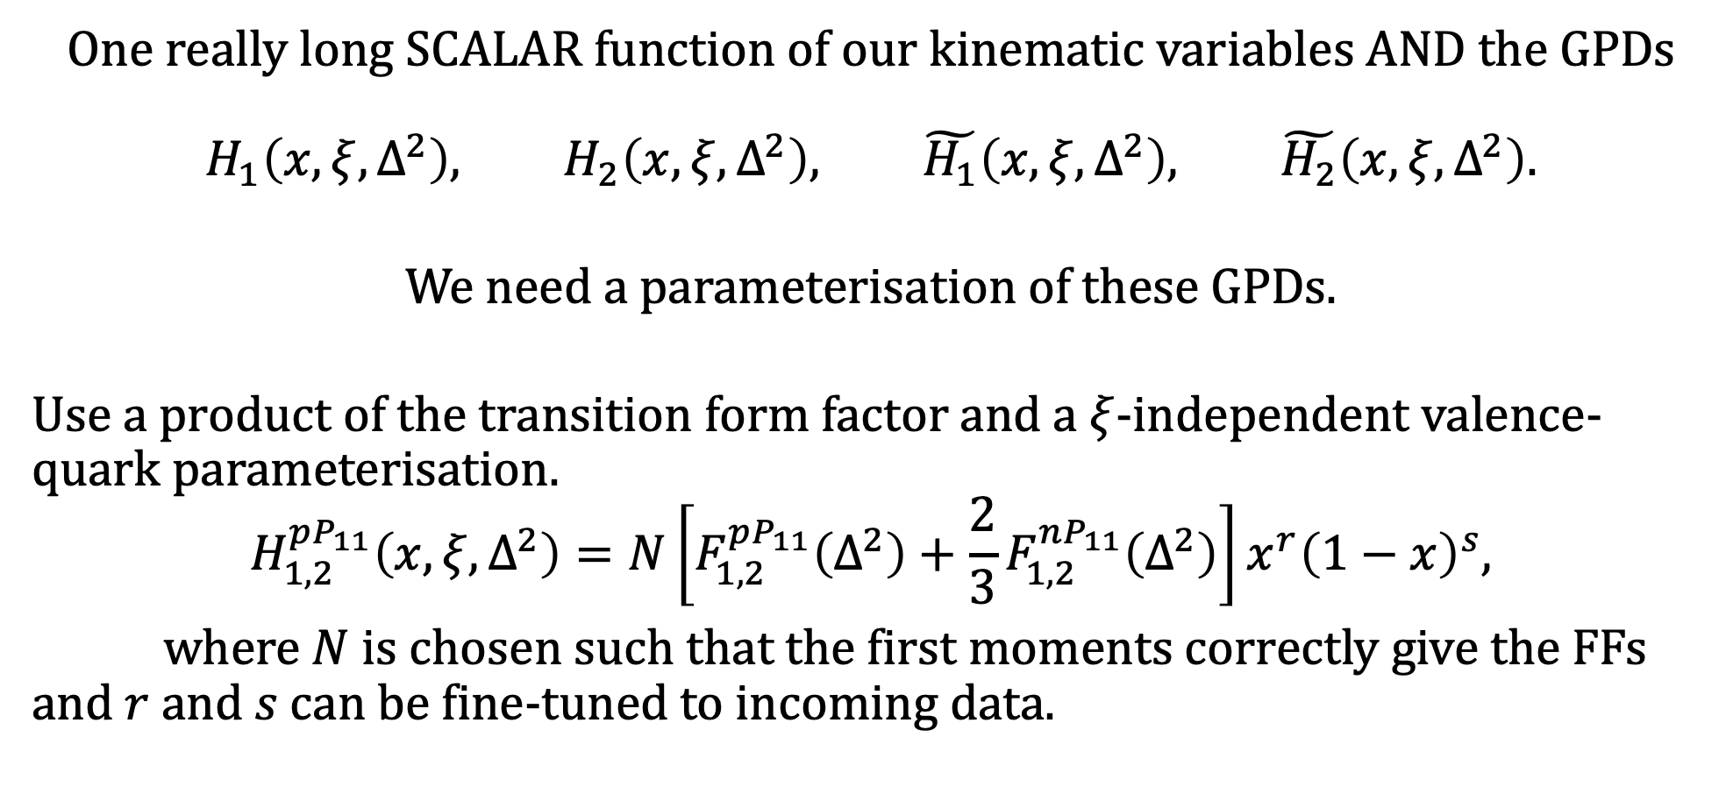
What’s remaining?
One really long SCALAR function of our kinematic variables AND the GPDs
$$H_{1}\left(x,ξ,Δ^{2}\right), H_{2}\left(x,ξ,Δ^{2}\right), \tilde{H_{1}}\left(x,ξ,Δ^{2}\right), \tilde{H_{2}}\left(x,ξ,Δ^{2}\right).$$
We need a parameterisation of these GPDs.
Use a product of the transition form factor and a $ξ$-independent valence-quark parameterisation.
$$H_{1,2}^{pP_{11}}\left(x,ξ,Δ^{2}\right)=N\left[F_{1,2}^{pP_{11}}\left(Δ^{2}\right)+\frac{2}{3}F_{1,2}^{nP_{11}}\left(Δ^{2}\right)\right]x^{r}{\left(1−x\right)}^{s},$$
where $N$ is chosen such that the first moments correctly give the FFs and $r$ and $s$ can be fine-tuned to incoming data.

Slide 27
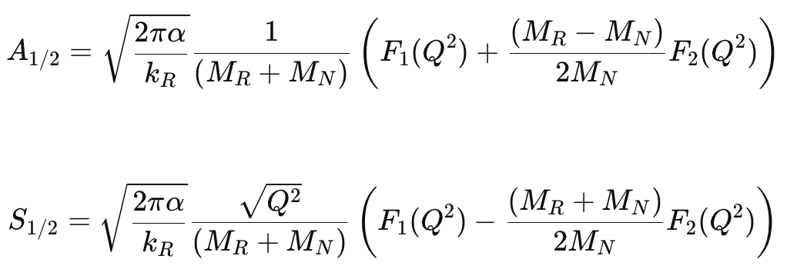
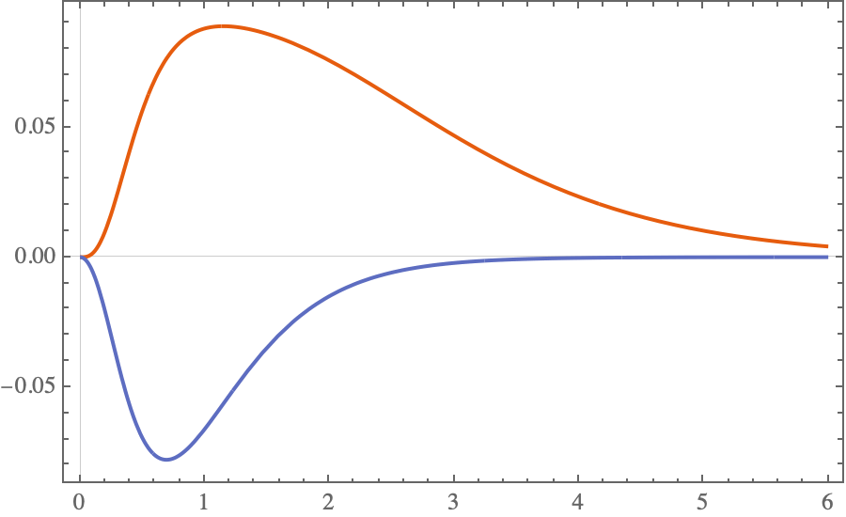
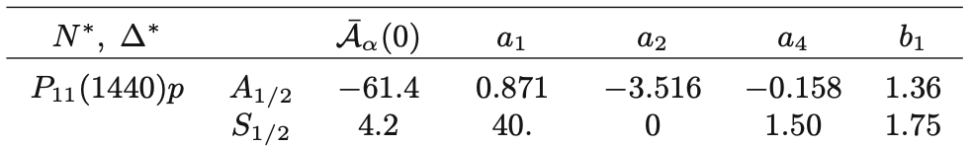
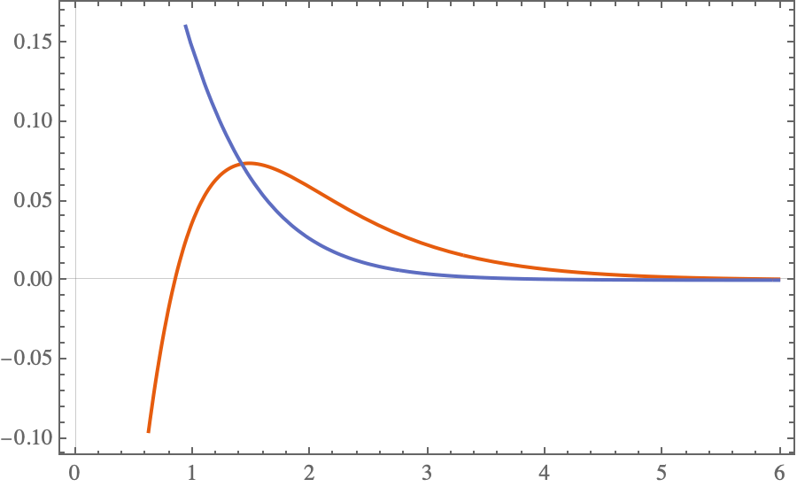
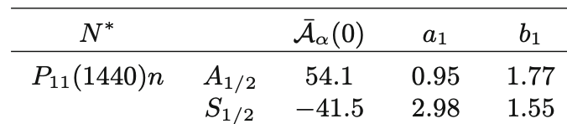



Need some Transition FFs: use MAID data!
THE CURRENT STAGE
$$F_{1}\left(Q^{2}\right)$$
proton
neutron
$$F_{2}\left(Q^{2}\right)$$
$$Q [GeV]$$

Slide 28

Then what???
Integrate over the solid angle to get a total cross-section.
Repeat the process for the pion-emitted first and Bethe-Heitler interference terms.
Compare the cross-sections.
Repeat everything for other resonances or extend to other meson-baryon molecules
Program can be converted into a script that takes as input the kinematics, resonance, and meson and returns a total cross-section.
compute time $≈$ 6 minutes
Notes:
Approx. 15s per spin configuration atm

Slide 29
Exploring Nucleon Resonances with DVCS:
HOW TO MAKE MATHEMATICA DO TENSOR ALGEBRA
Matthew Rumley (Supervisor: Anthony Thomas)
The University of Adelaide

Slide 30
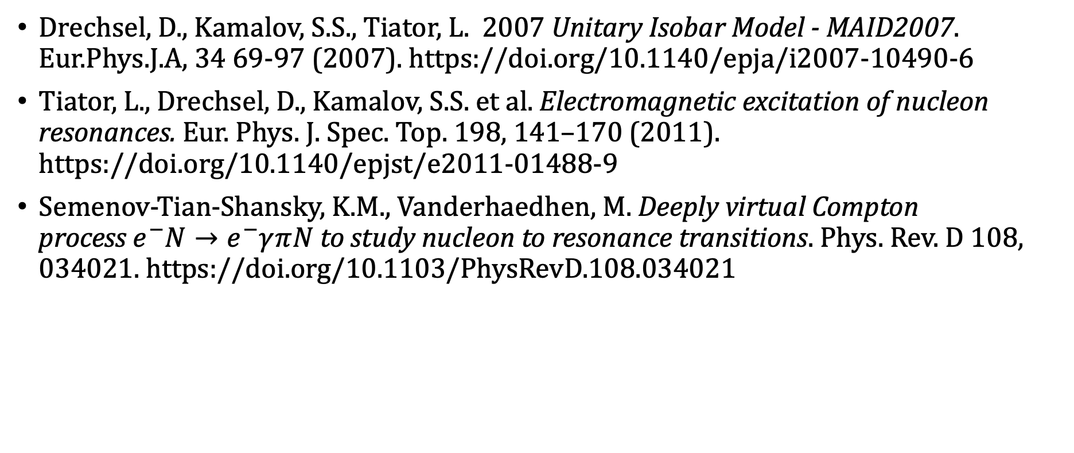
Further Reading
Drechsel, D., Kamalov, S.S., Tiator, L. 2007 Unitary Isobar Model - MAID2007. Eur.Phys.J.A, 34 69-97 (2007). https://doi.org/10.1140/epja/i2007-10490-6
Tiator, L., Drechsel, D., Kamalov, S.S. et al. Electromagnetic excitation of nucleon resonances. Eur. Phys. J. Spec. Top. 198, 141–170 (2011). https://doi.org/10.1140/epjst/e2011-01488-9
Semenov-Tian-Shansky, K.M., Vanderhaedhen, M. Deeply virtual Compton process $e^{−}⁢N→e^{−}⁢γ⁢π⁢N$to study nucleon to resonance transitions. Phys. Rev. D 108, 034021. https://doi.org/10.1103/PhysRevD.108.034021

