Slide 1
Open Questions in Statistical Practice for Particle Physics
Francisco Matorras
Instituto de Física de Cantabria
Santander, Spain

Slide 2
Introduction
Statistics in HEP a rich (and often non-trivial) topic
  Lot of new techniques being explored
  Better understanding of old techniques
Will concentrate on few highlights
  What’s behind discovery statements
    5σ
    Local p-values, look elsewhere effect
  Data (re)interpretation
    How to use published data for your interpretation
  Machine learning vs statistics
More on parallel session H, have a look to many interesting results and applications

Slide 3
Why?

Slide 4
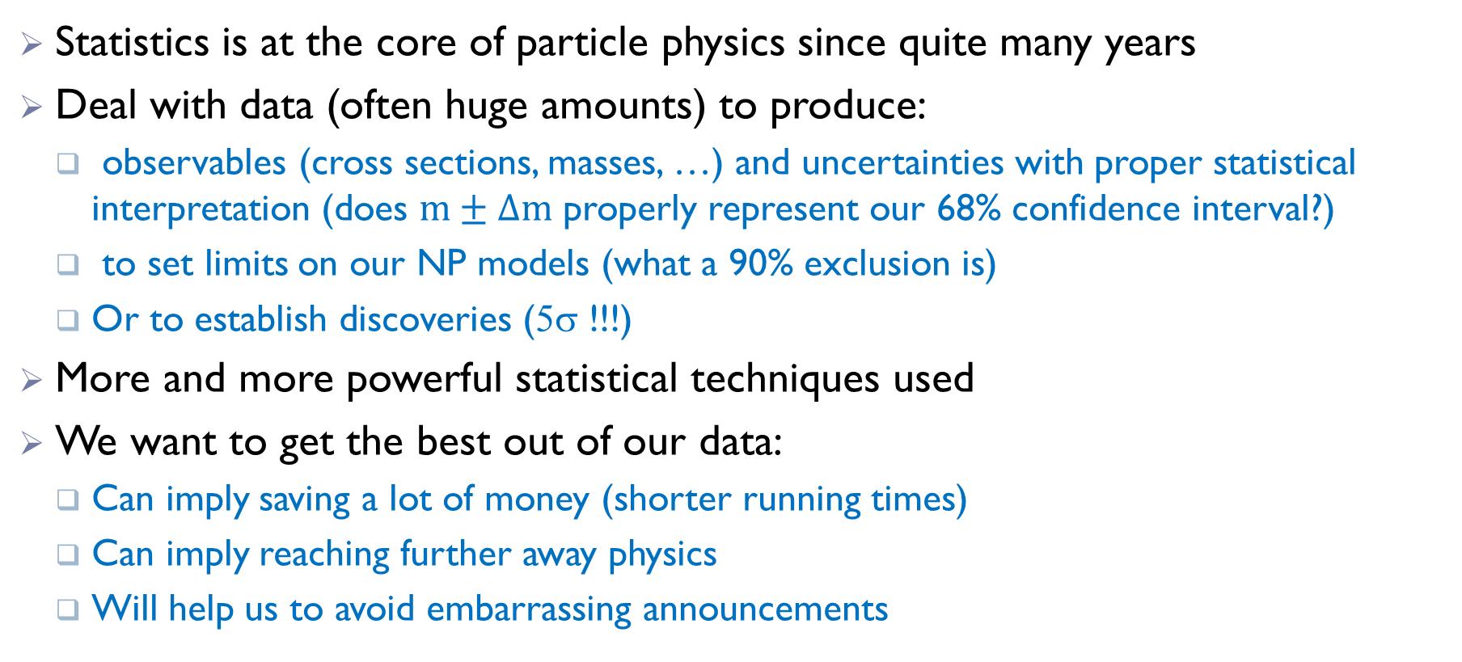
Why statistics at a particle physics conference?
Statistics is at the core of particle physics since quite many years
Deal with data (often huge amounts) to produce:
  observables (cross sections, masses, …) and uncertainties with proper statistical interpretation (does $m±Δm$ properly represent our 68% confidence interval?)
  to set limits on our NP models (what a 90% exclusion is)
  Or to establish discoveries (5σ !!!)
More and more powerful statistical techniques used
We want to get the best out of our data:
  Can imply saving a lot of money (shorter running times)
  Can imply reaching further away physics
  Will help us to avoid embarrassing announcements

Slide 5
Statisticians & physicists

Slide 6

Trying to speak a common language
Often physicists tend to reinvent existing methods
And are not aware of recent (or not so recent) useful ones
An effort ongoing of joining physicists and statisticians
PHYSTAT founded in 2000 by L. Lyons
many seminars, conferences and workshops to debate on relevant issues
You are invited to attend and explore here or here (legacy page)

Slide 7
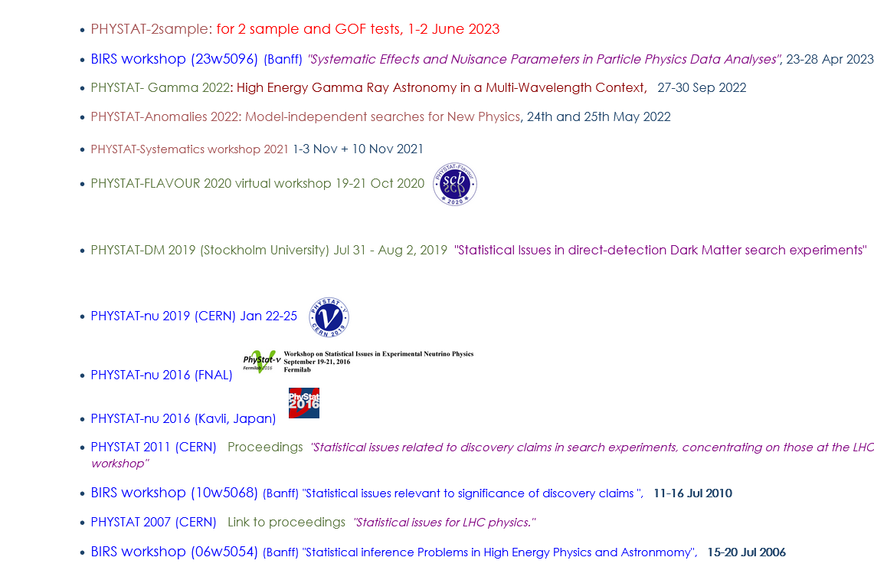
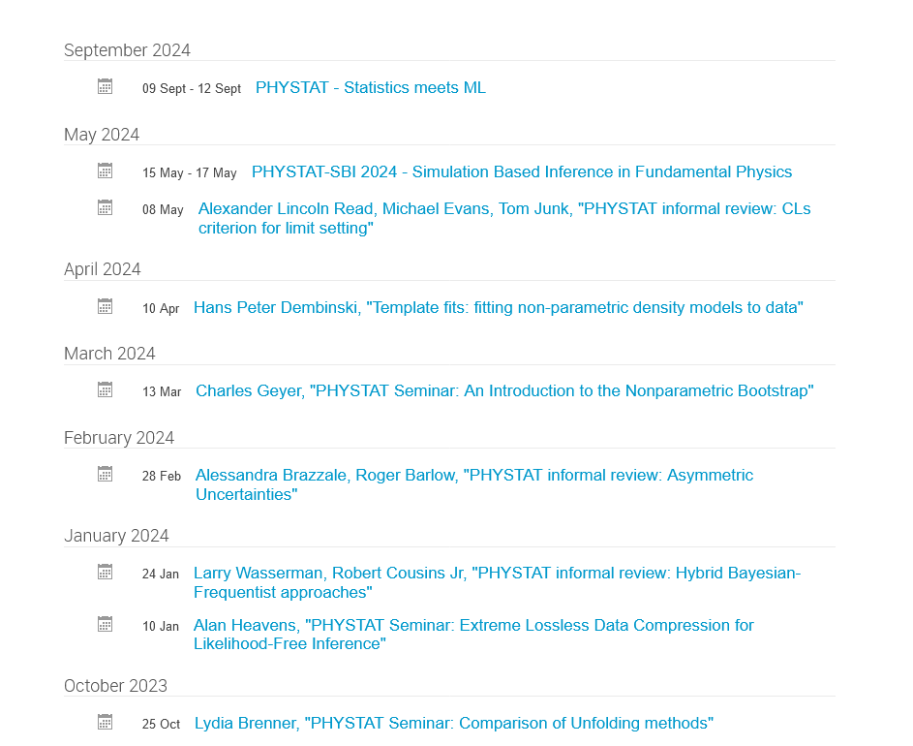
Many topics

Slide 8
Discovery
A discovery from the point of view of statistics

Slide 9

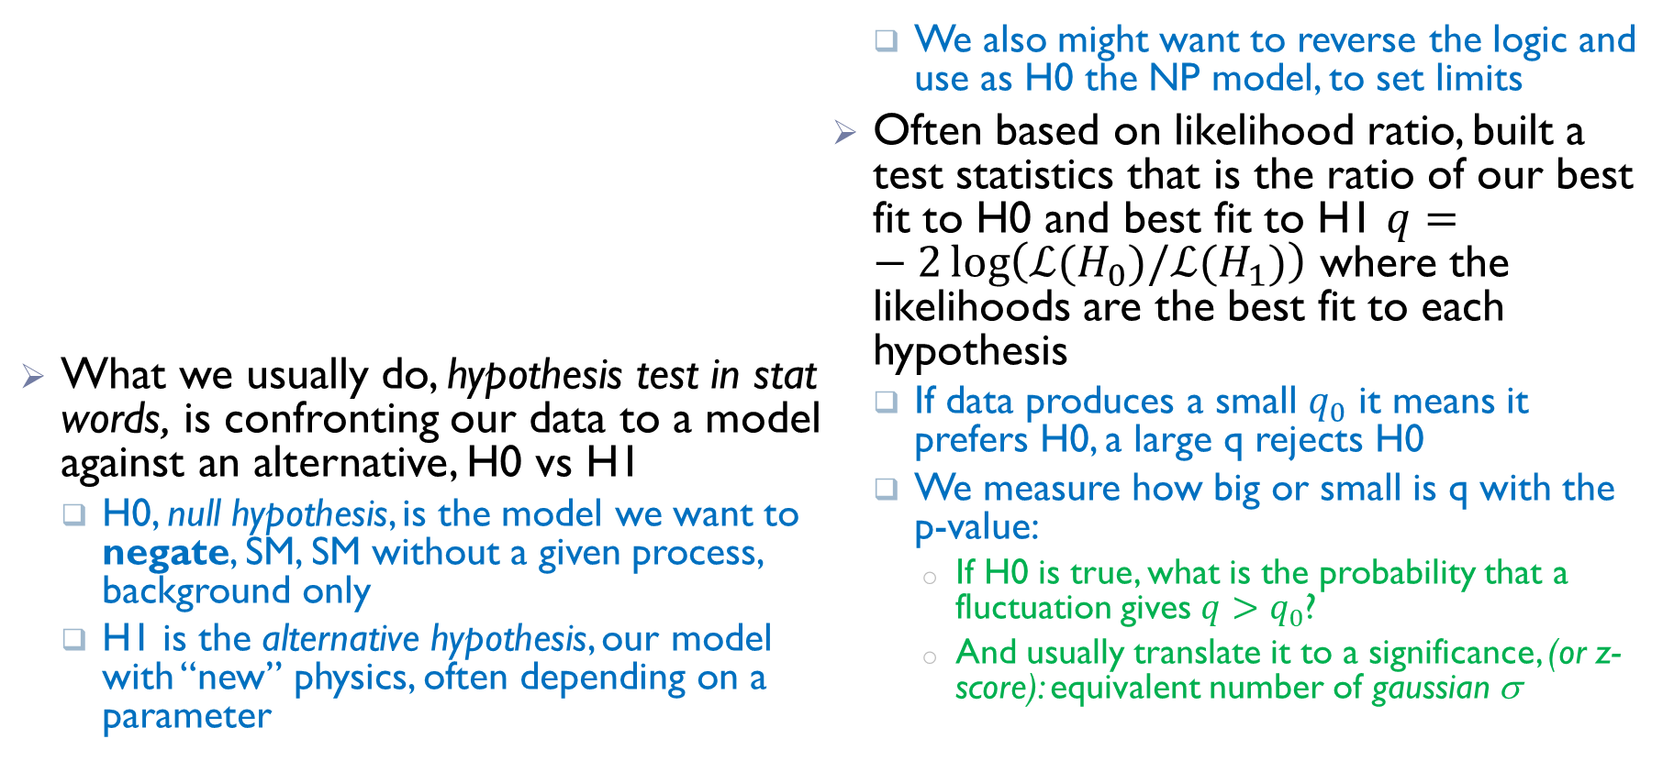
Hypothesis testing in a nutshell
What we usually do, hypothesis test in stat words, is confronting our data to a model against an alternative, H0 vs H1
  H0, null hypothesis, is the model we want to negate, SM, SM without a given process, background only
  H1 is the alternative hypothesis, our model with “new” physics, often depending on a parameter
  We also might want to reverse the logic and use as H0 the NP model, to set limits
Often based on likelihood ratio, built a test statistics that is the ratio of our best fit to H0 and best fit to H1 $q=−2\log\left(ℒ(H_{0})/ℒ(H_{1})\right)$ where the likelihoods are the best fit to each hypothesis
  If data produces a small $q_{0}$ it means it prefers H0, a large q rejects H0
  We measure how big or small is q with the p-value:
    If H0 is true, what is the probability that a fluctuation gives $q>q_{0}$?
    And usually translate it to a significance, (or z-score): equivalent number of gaussian σ

Slide 10
5σ

Slide 11
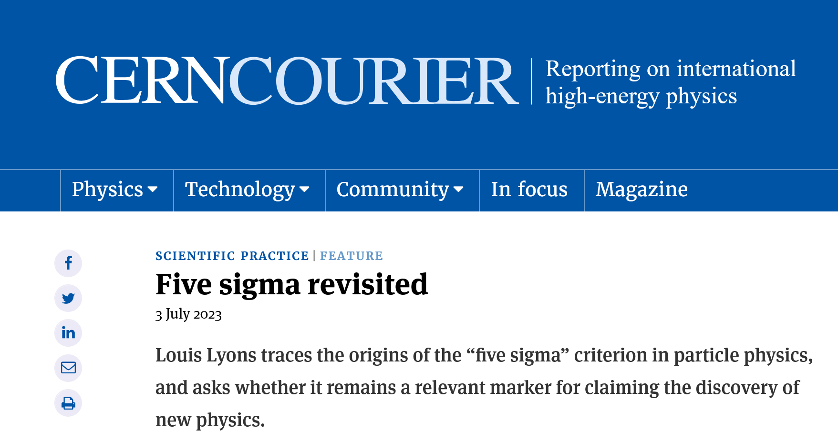
When to claim a discovery? Aka 5σ
It is well known that in HEP we have a (historical) convention that we cannot claim a discovery unless we have an excess of at least 5σ
But are we aware what it means? Does it make sense?
Some comments here, largely based on different pubs by Louis Lyons, nicely summarized in a recent CERN Courier article

Slide 12
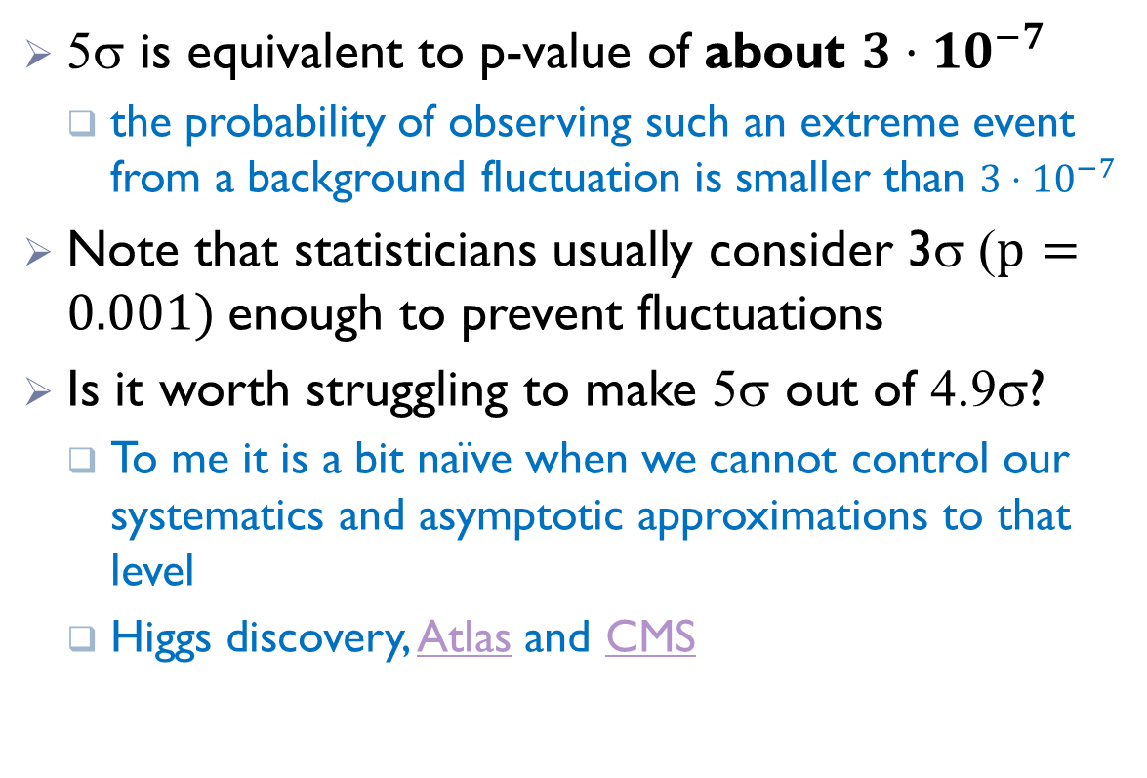
Are 5σ enough? too much?
5σ is equivalent to p-value of about $3⋅{10}^{−7}$
  the probability of observing such an extreme event from a background fluctuation is smaller than $3⋅{10}^{−7}$
Note that statisticians usually consider 3σ ($p=0.001)$enough to prevent fluctuations
Is it worth struggling to make 5σ out of 4.9σ?
  To me it is a bit naïve when we cannot control our systematics and asymptotic approximations to that level
  Higgs discovery, Atlas and CMS

Slide 13
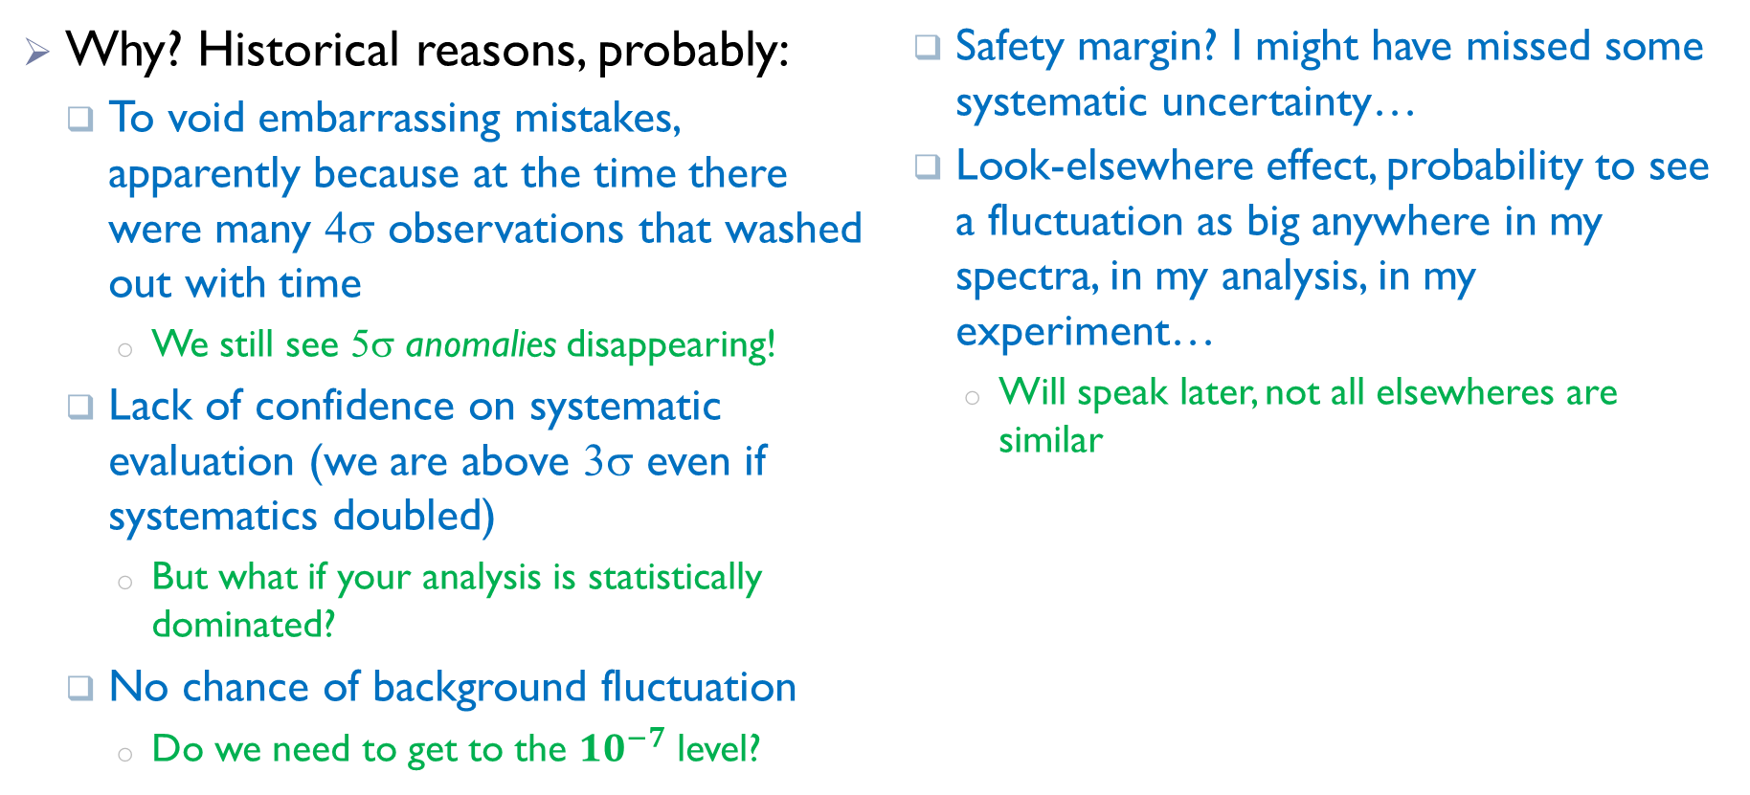
Why 5σ?
Why? Historical reasons, probably:
  To void embarrassing mistakes, apparently because at the time there were many 4σ observations that washed out with time
    We still see 5σ anomalies disappearing!
  Lack of confidence on systematic evaluation (we are above 3σ even if systematics doubled)
    But what if your analysis is statistically dominated?
  No chance of background fluctuation
    Do we need to get to the ${10}^{−7}$ level?
  Safety margin? I might have missed some systematic uncertainty…
  Look-elsewhere effect, probability to see a fluctuation as big anywhere in my spectra, in my analysis, in my experiment…
    Will speak later, not all elsewheres are similar

Slide 14
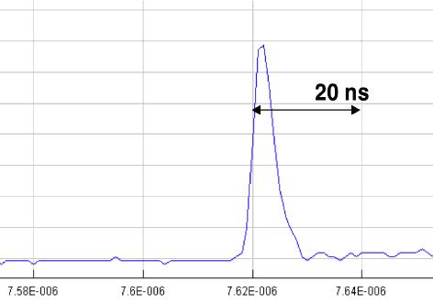
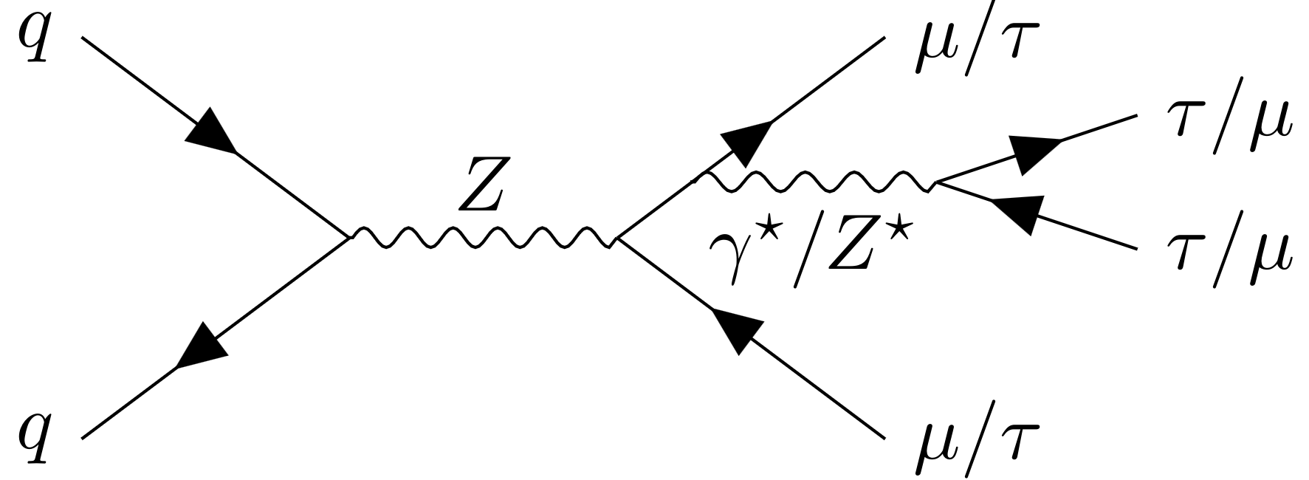
Plausibility
L. Lyons introduced the concept of “plausibility”
  Should not use the same significance for Higgs discovery, leptoquarks, faster-than-light neutrinos, HH in pp, a given decay channel expected by SM, violation of lepton universality, or an anomaly not covered by any expected model
  For some cases 3σ is enough, for others even 5σ not sufficient, suspicion beyond statistics…
Should define a case-dependent threshold but not an easy task

Slide 15
Look elsewhere effect (LEE)

Slide 16


Look elsewhere
What is the probability to get hit by a coconut falling in your hotel?
Apparently not that small if you account for many guests and many days

Slide 17
Look elsewhere effect
A simple example: in one bin we see a big excess over background
  We calculate the p-value, and it is very small.
But one wonders:
  I would have been equally surprised if the excess was in any other bin, what is the prob to see such a fluctuation in any bin? p increases..
Maybe we have no information on the width, we would have been surprised by smaller fluctuations in two nearby bins, p grows more
Why not smaller fluctuations in three consecutive bins? Or 4? Or…
Even could accept cases where the excess oscillates, and look for excesses separated by one, two, three bins…
We should account for all possibilities when calculating the p-value

Slide 18
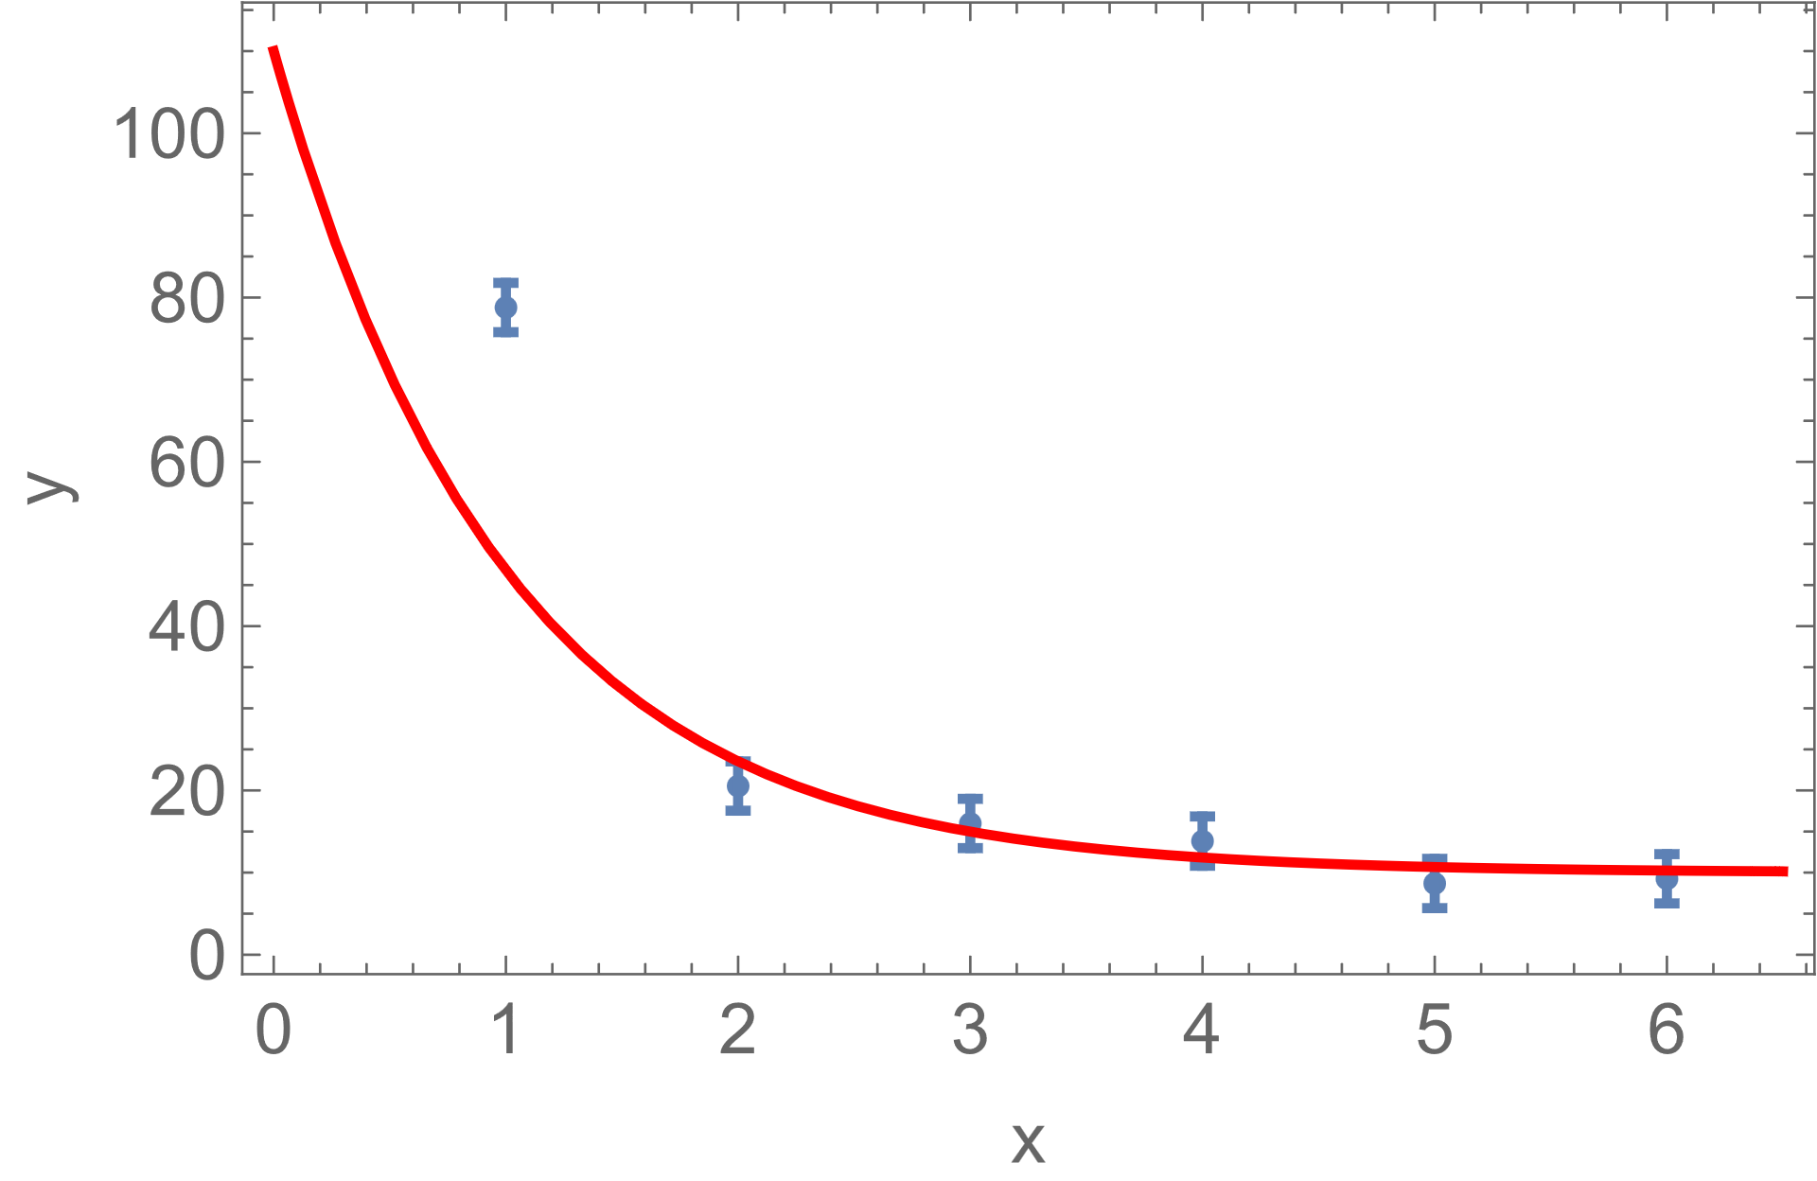
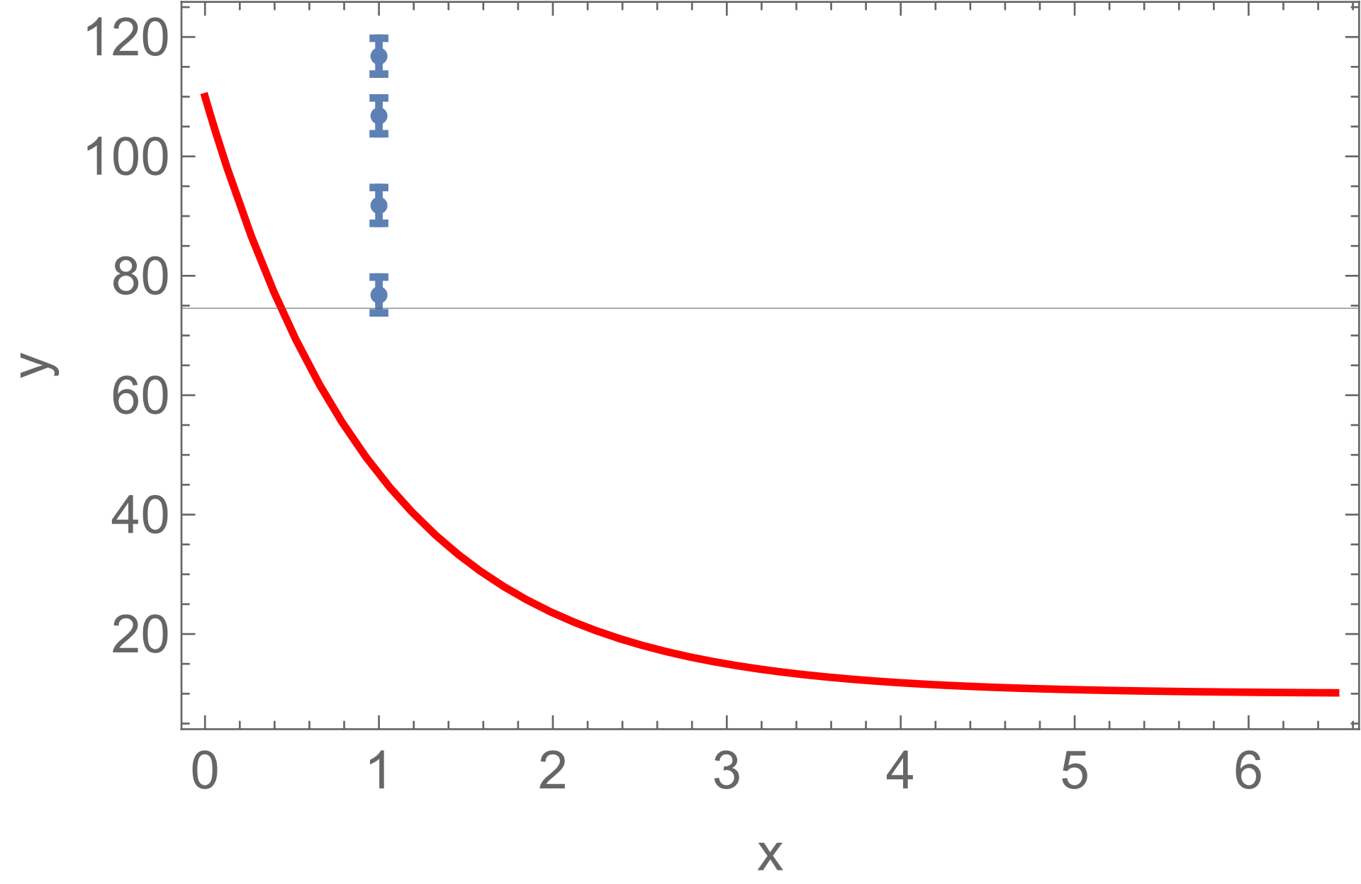
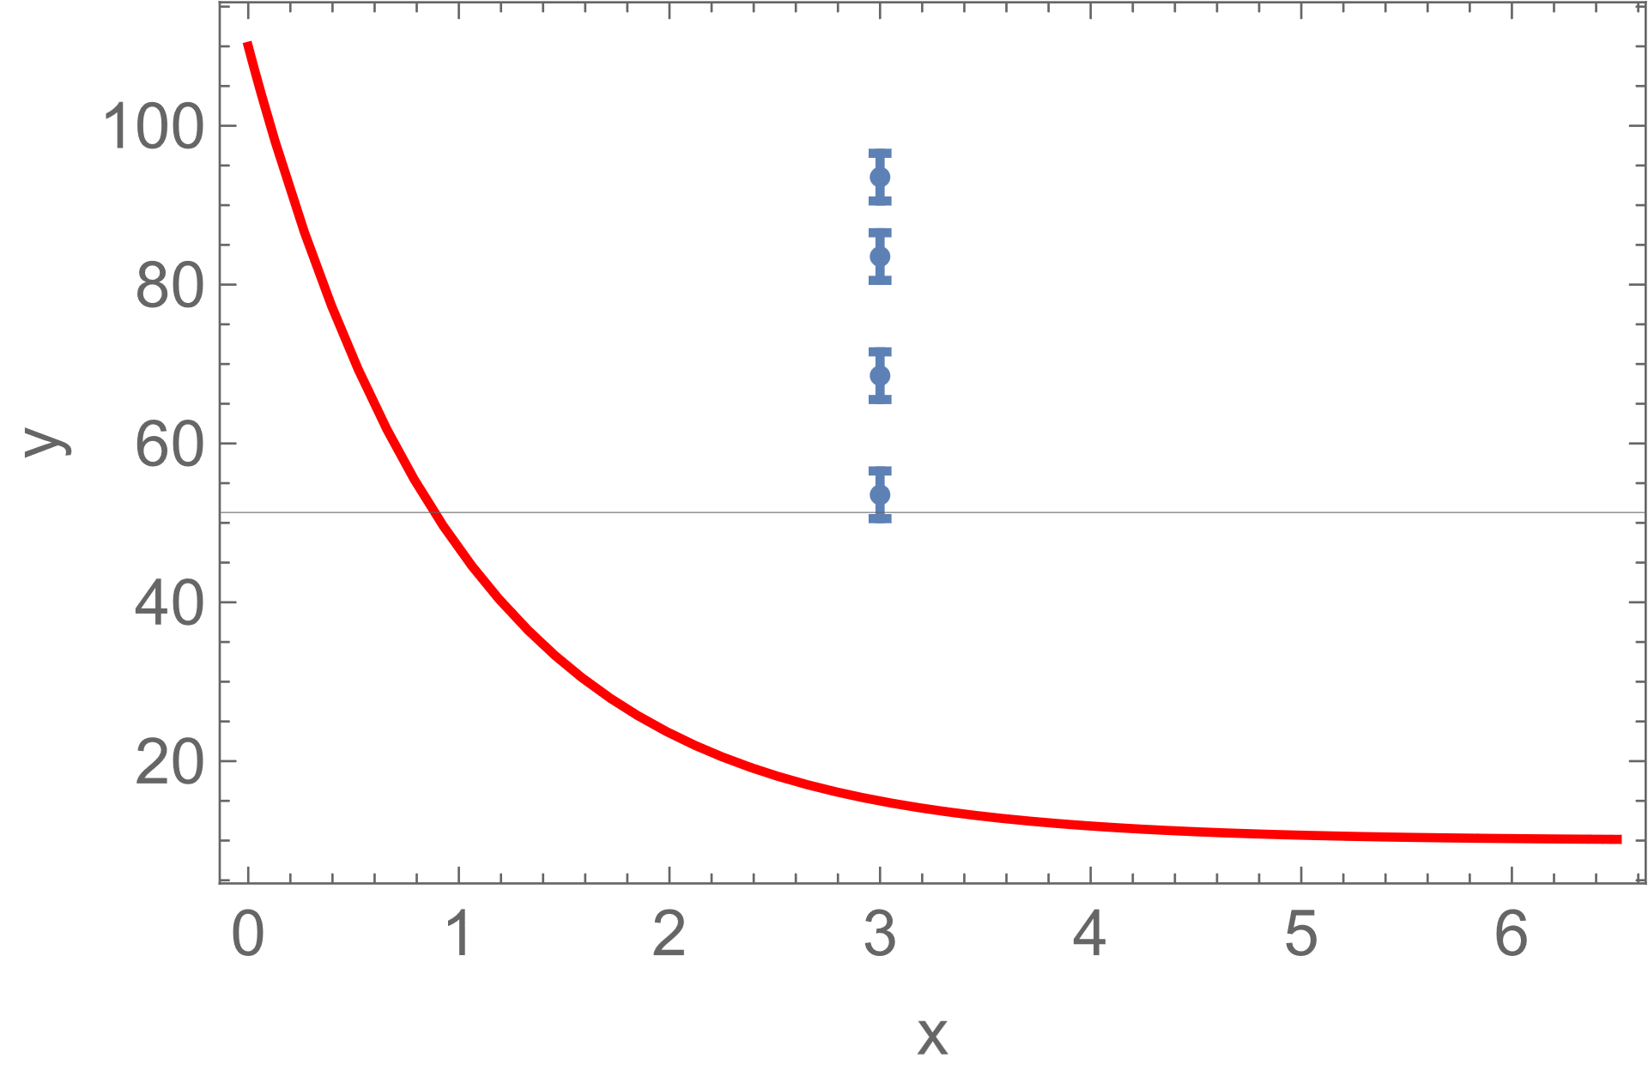
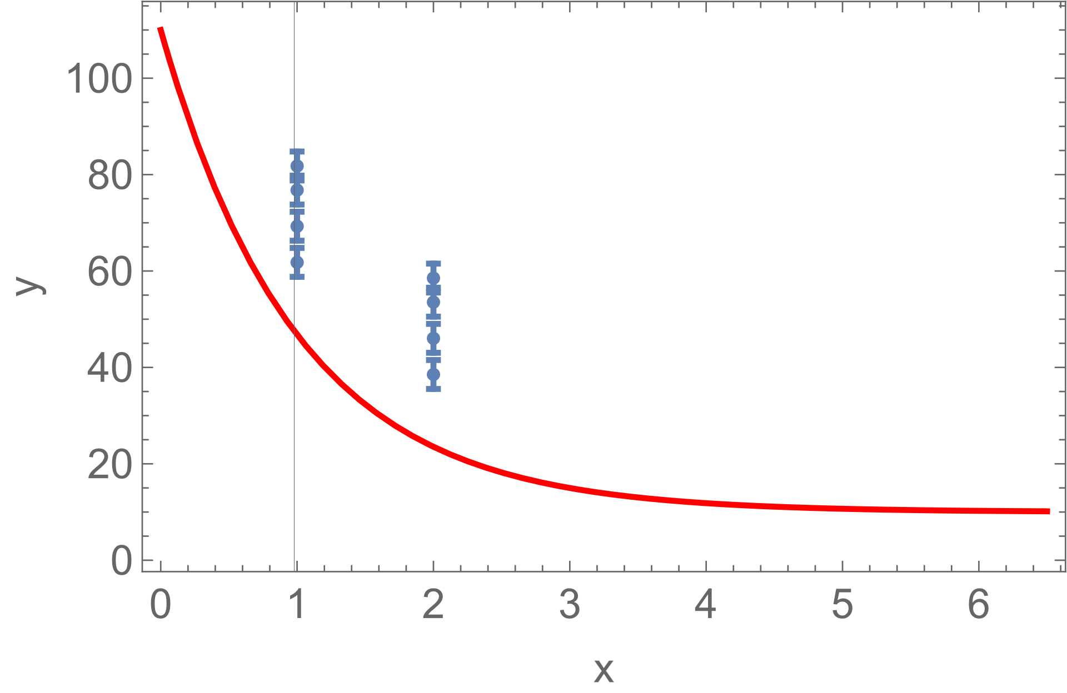
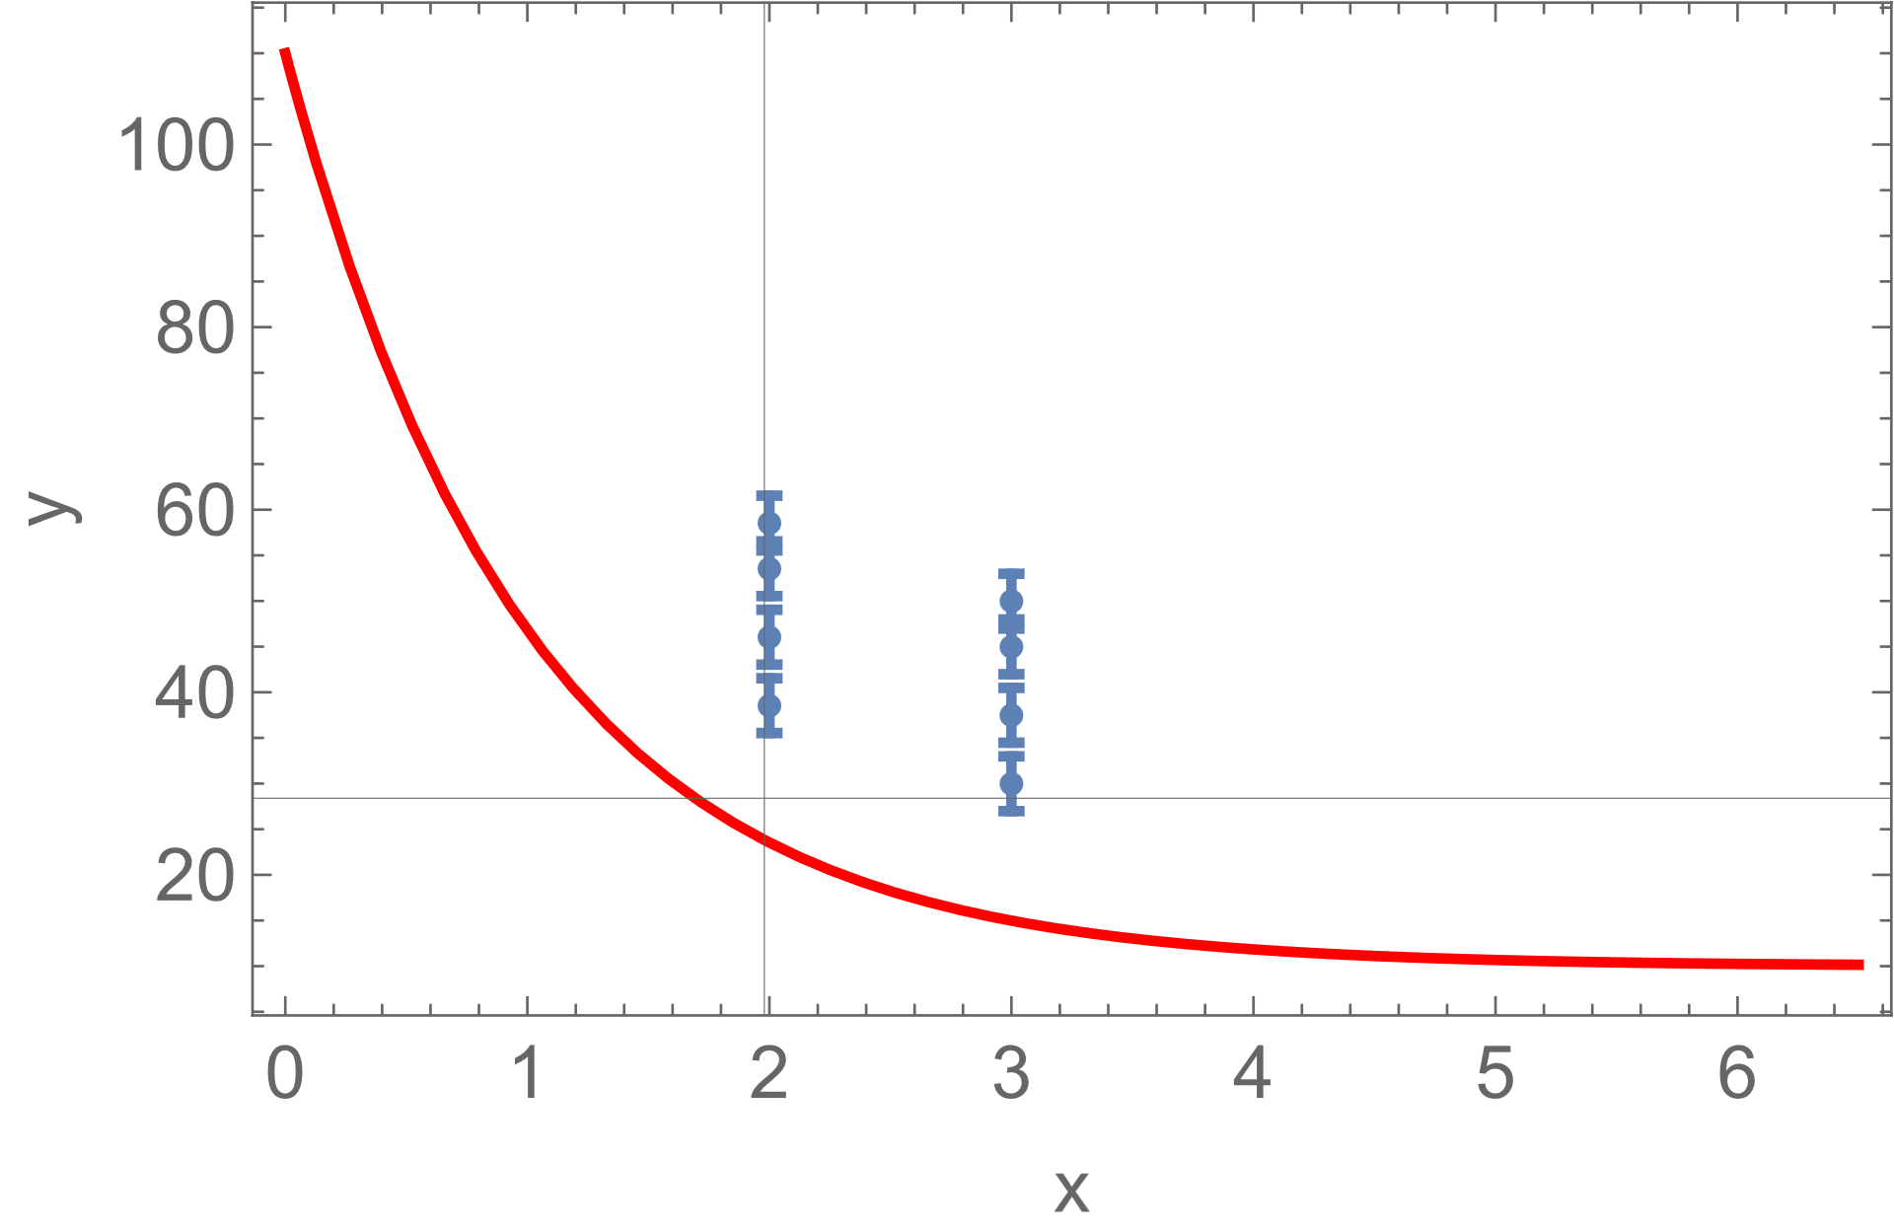

Elsewhere?
Depending on your model parameters, many elsewheres…
Any bin
…
Any width
Anywhere…
…

Slide 19
Going beyond local p-values

Slide 20
(ab)use of local p-values
Usual procedure at LHC:
  p-value calculated for a single free parameter (usually signal strength) as a function of other(fixed) parameters (ie mass and possibly width)
  Quote as local p-value the smallest one in the scan
    Note it is calculated assuming only one free parameter
    i.e., Wilks with 1 dof (even if 2 or 3 free parameters)
Decide if the excess is a discovery based on the local p-value
Eventually quote a global p-value, based on estimation of LEE
This is unfair, not all cases have the same LEE
  Going to an extreme case, one can make a 5σ local excess from just a 1σ if one chooses a loose model, ie 20 parameters

Slide 21
Beyond local p-values
Should move to global p-values to more properly quantify the significance
Should be coupled with relaxing the 5σ requirement
  Obviously experiments reluctant to degrade their discovery!
Unfair to consider a discovery with 5σ local and 4σ global and reject a 4.5σ global
All this is about the elsewhere in the studied spectrum, still there are unpredictable elsewheres, some safety margin is good 😉
My personal opinion:
  Global p-values have to be used and 4σ should be enough
  More emphasis on scrutinizing the systematic errors than having 4.9 or 5.0 σ

Slide 22
Discoveries from measurements

Slide 23

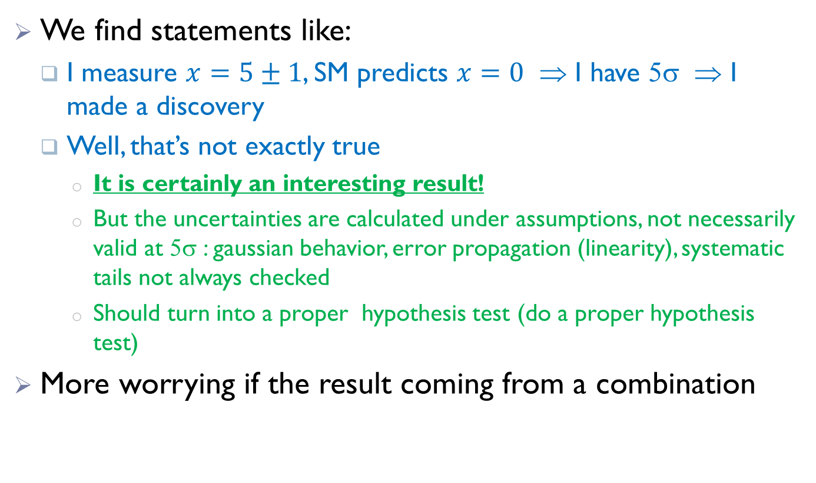
Discoveries based on measurements: caution
We find statements like:
  I measure $x=5±1$, SM predicts $x=0$ ⇒ I have 5σ ⇒ I made a discovery
  Well, that’s not exactly true
    It is certainly an interesting result!
    But the uncertainties are calculated under assumptions, not necessarily valid at 5σ : gaussian behavior, error propagation (linearity), systematic tails not always checked
    Should turn into a proper hypothesis test (do a proper hypothesis test)
More worrying if the result coming from a combination

Slide 24
Combining for discovery
Please do not confront your theory with ad-hoc combination of existing measurement
  Experimental results are often correlated
  Inside experiments, but also between experiments
  Naïve combination will almost always give underestimated errors
Be careful with PDG combinations
  Much better but still incomplete for this pourpose
BLUE combinations (Best Linear uncertainty estimator) way better
  Account for correlations to some level
  Still gaussian assumptions
  Still linear

Slide 25
Comparing with theory
Data reinterpretation

Slide 26
Steps forward
LHC experiments (and others) are aware of these limitations
Experiments now tend to combine data and not results,
  Build a global likelihood with all sets, include the systematics (nuisances) and their correlations to your best knowledge, more than multiplying the likelihoods
  Do a single fit, you’ll get the most precise measurement
To combine experiments a bit harder…
Even harder for theoreticians if they want to interpret their data
  How can I test my physics model with that cross-section measurement (properly with all systematics and correlations)?

Slide 27

More steps
HEPDATA
  Most relevant information published in HEPDATA
  14000 data tables published!
Simplified likelihoods
  An attempt was made to make public a simplified version of the likelihood function
  So that everyone could plug-in their data or theoretical model
Publish the whole model
  Publish full set of data, nuisances, statistical model…
  And tools
  Some results already available

Slide 28
Forum on the Interpretation of the LHC Results for BSM studies
Please have a look to the twiki of this working group or to some of their publications
  Les Houches guide to reusable ML models in LHC analyses
Snowmass white paper on Data and Analysis Preservation, Recasting, and Reinterpretation
White paper on Publishing statistical models: Getting the most out of particle physics experiments
Reinterpretation of LHC Results for New Physics: Status and recommendations after Run 2

Slide 29
A few things you will be able to do
Update existing analyses using
  more precise theoretical calculations
  improved experimental calibrations
  different probability model…
Kinematic reinterpretation considering a different physical process with a different phase space distribution, which might have different efficiencies
Combinations of analyses or datasets in model surveys, global averages…
Reuse of datasets for other studies such that the determination of parton distribution functions

Slide 30
unfolding
Correct your results for detector effects so it can directly be compared with theory

Slide 31
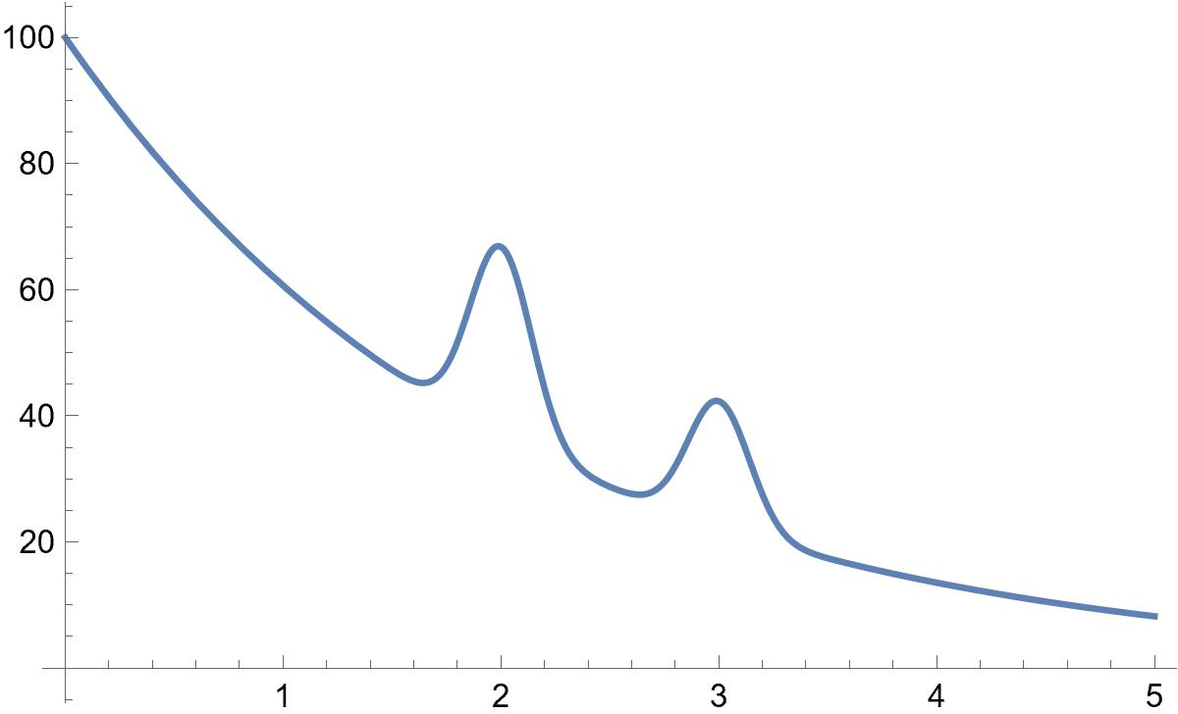
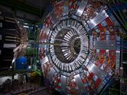
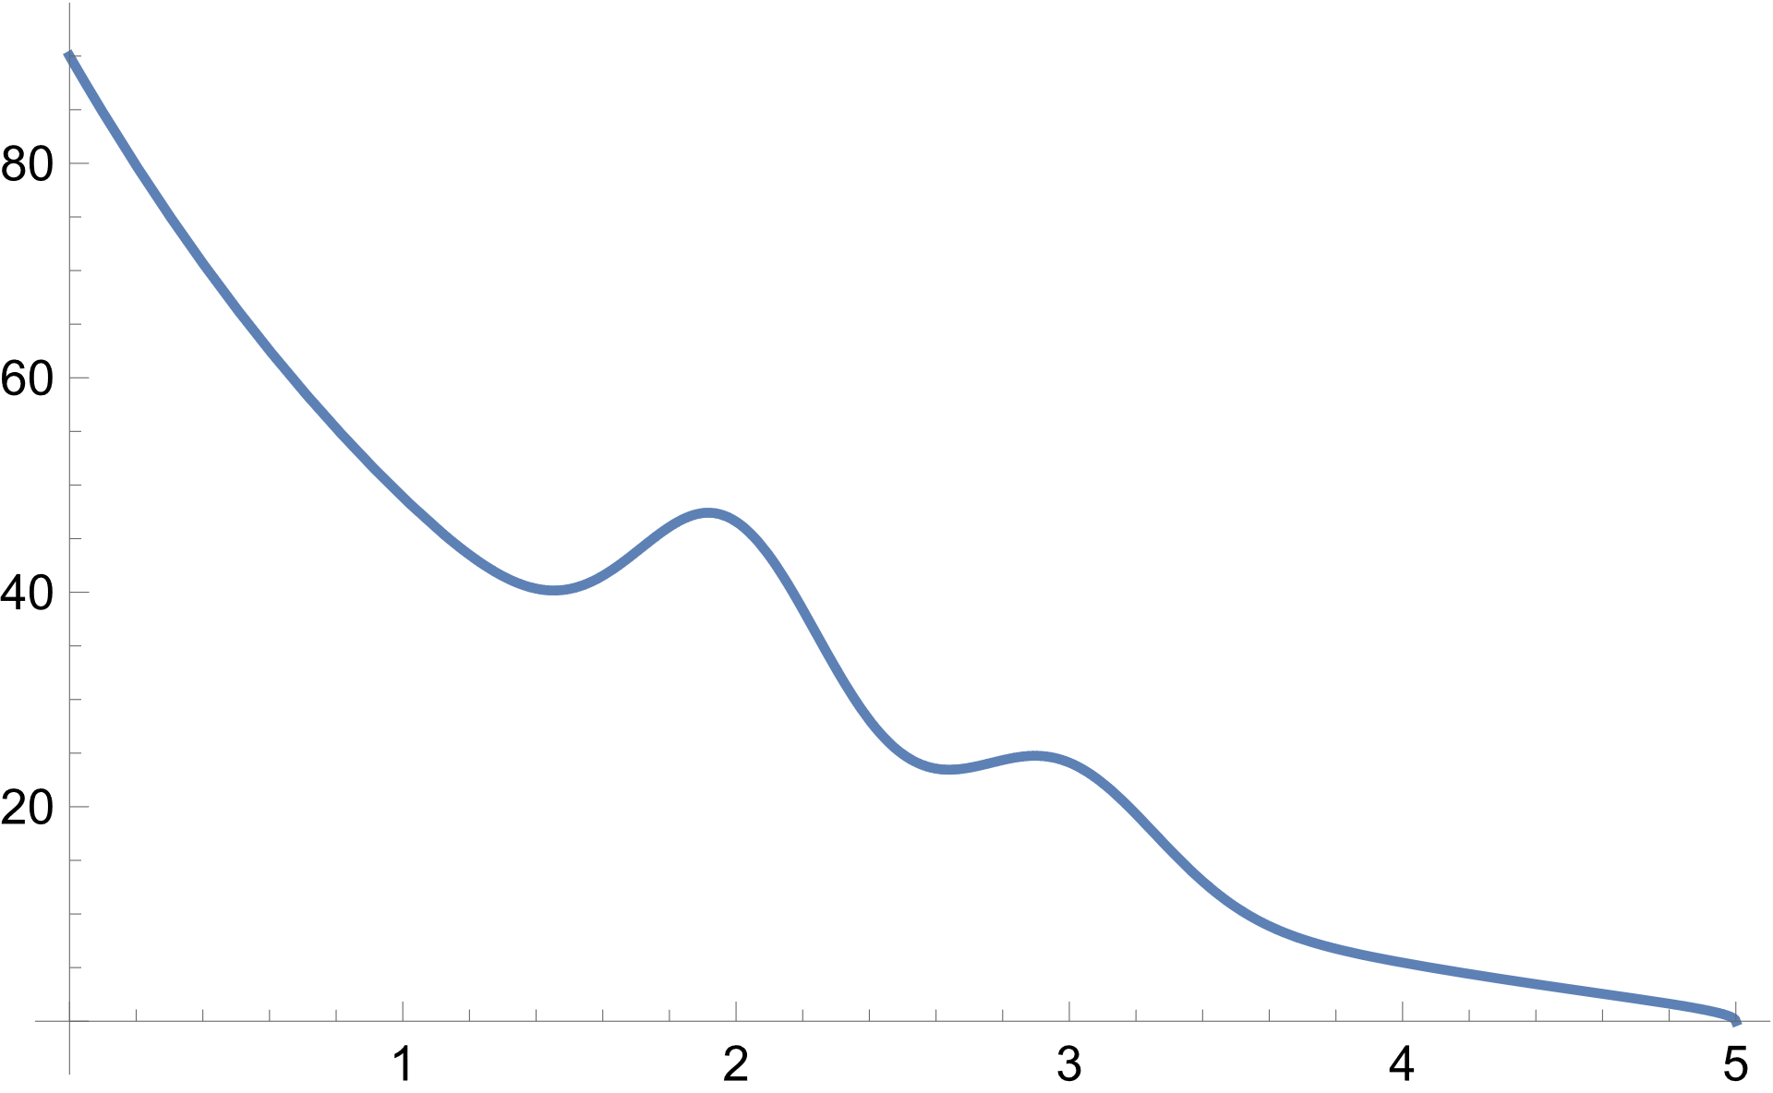
The problem
Truth, original physics
Detector level physics
An inverse problem: basically, recover original quantities before suffering resolution and efficiency effects when going through a detector
?

Slide 32
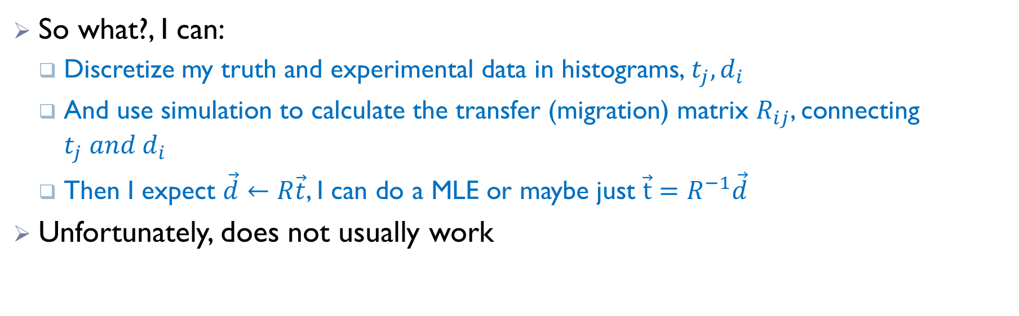
A simple problem?
So what?, I can:
  Discretize my truth and experimental data in histograms, $t_{j}, d_{i}$
  And use simulation to calculate the transfer (migration) matrix $R_{ij}$, connecting $t_{j} and d_{i}$
  Then I expect $\vec{d}←R\vec{t}$, I can do a MLE or maybe just $\vec{t}=R^{−1}\vec{d}$
Unfortunately, does not usually work

Slide 33
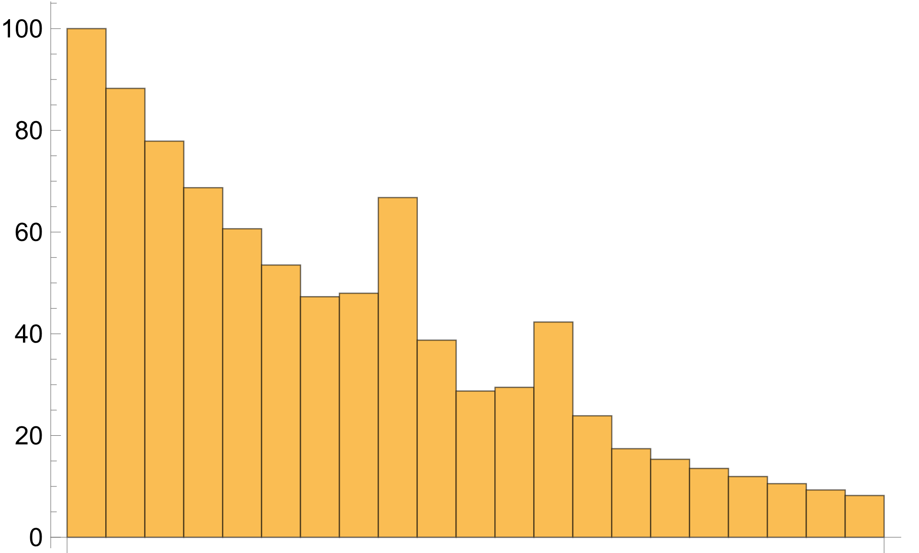
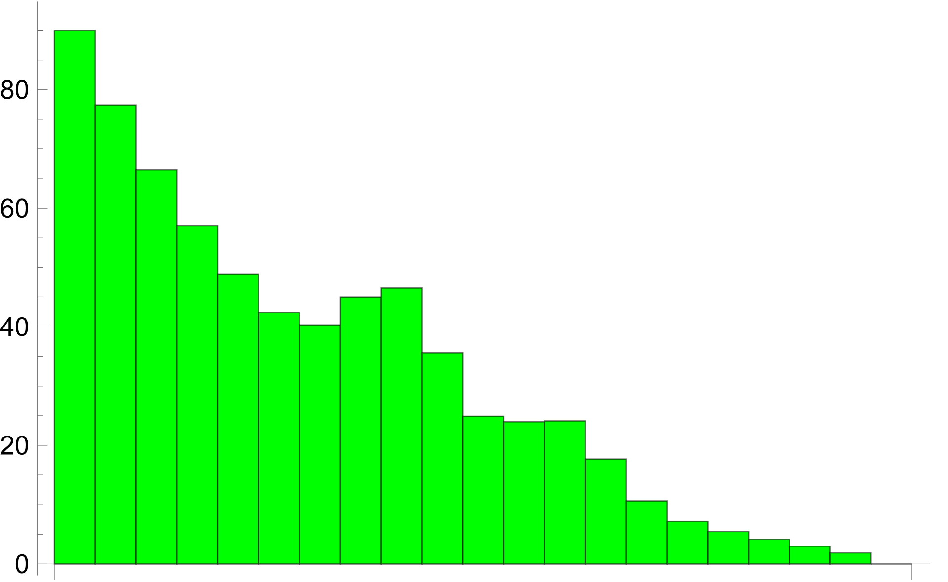
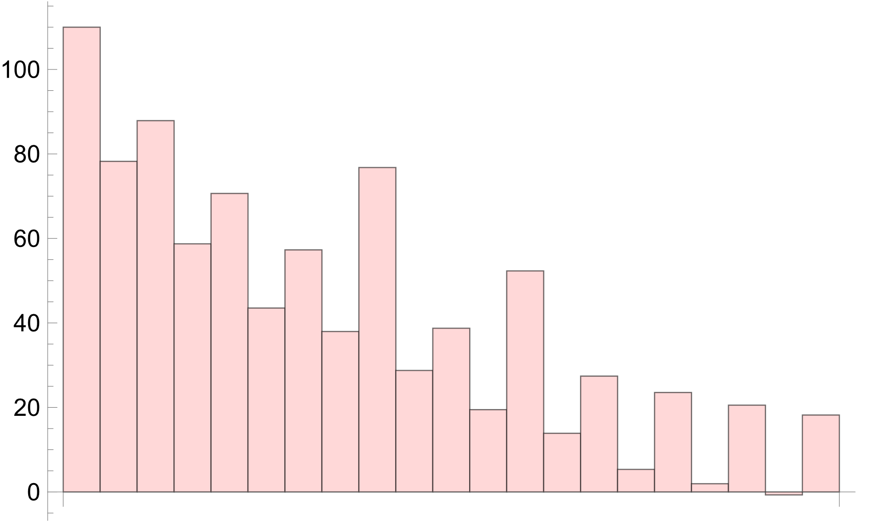
Not so easy
Truth, original physics
Detector level physics
🤔
Naïve maximum likelihood

Slide 34
unfolding
The problem is known to be ill-posed, with instabilities introducing high frequency terms
Several techniques used to overcome the problem (See Mikael Kuusela talk for details): iterative, Tikhonov, NN, wide/narrow binning
Include regularization, additional information to soften the fluctuations
The challenge:
  If you are doing the measurement, optimize the bias-uncertainty trade-off. Publish the whole information
  If you are using the unfolded results, be aware that a bias exists, be aware that there are (potentially big) correlations
  If you are doing combinations, consider possible correlations with older measurements

Slide 35
Machine learning

Slide 36

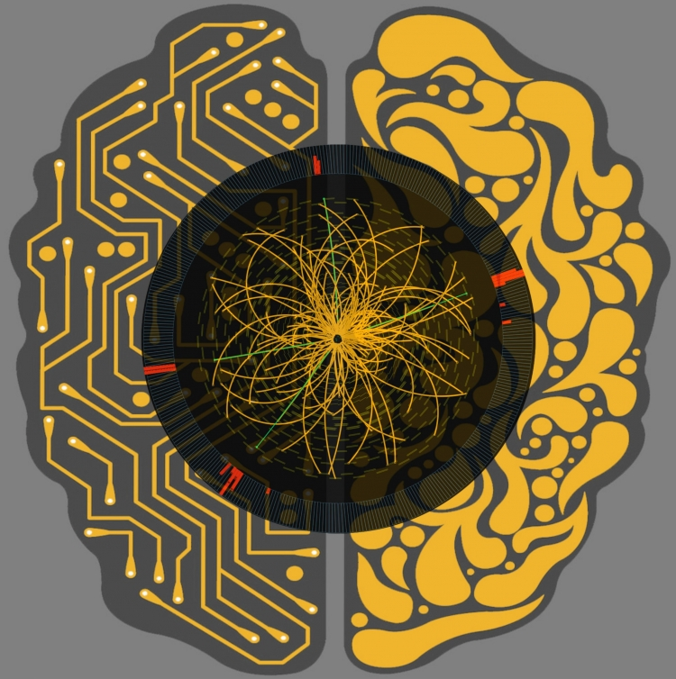
A whole new field of research
Used in HEP since at least 20 years, but as in many other applications going through a big bang lately
Initially only used for classification and (timidly) for regression (fits)
  Particle id and calibration
  Anomaly detection
  Unfolding and other inverse problems
  Simulation
  Density estimation
  Detector optimization
  Reweighting MC
  Theory: param tuning, lattice, nuclear…
And many techniques: DNN, GAN, CNN, GNN…

Slide 37
Some challenges (from a statistics point of view)
Overfitting and Generalization
  Does it introduce a systematic?
NN modeling uncertainty Quantification
Bias and Systematic Errors
  Systematics usually calculated one at a time, but ML power from combined separation
Interpretability and Explainability
  Where the power comes from, useful to understand systematics
Handling Imbalanced Datasets
  What if we look for a tiny signal?
…

Slide 38
Summary and conclusion
Statistics plays an important role in particle physics and is currently an active field
It is probably time to revise de 5σ convention
I suggest to move to global p-values and drop the concept of local p-value
An important effort ongoing in LHC community to publish the whole data and statistical model to permit optimal and correct public (re)interpretation
Machine learning is boiling (also here), lot of new techniques and challenges to accommodate them in our analyses
Thank you for your attention

