Slide 1
Welcome to TeVPA 2019!
Venue – Sydney Nanoscience Hub (SNH), teaching wing
Plenary sessions: Mon-Fri, 9:00-13:00 – Messel Lecture Theatre (Rm 4002)
Parallel sessions: Mon, Tue, Thu, start 14:30 – SNH Rms 4002, 4001, 3001, 3003 and Physics LT 1
Poster sessions – Tue, Wed 10:30 – 11:00

Slide 2
Welcome to TeVPA 2019!
Coffee breaks: SNH Messel foyer, 10:30-11:00 (morning); 16:10-16:30 (afternoon, except Wed, Fri)
Lunch breaks: 13:00-14:30

Slide 3
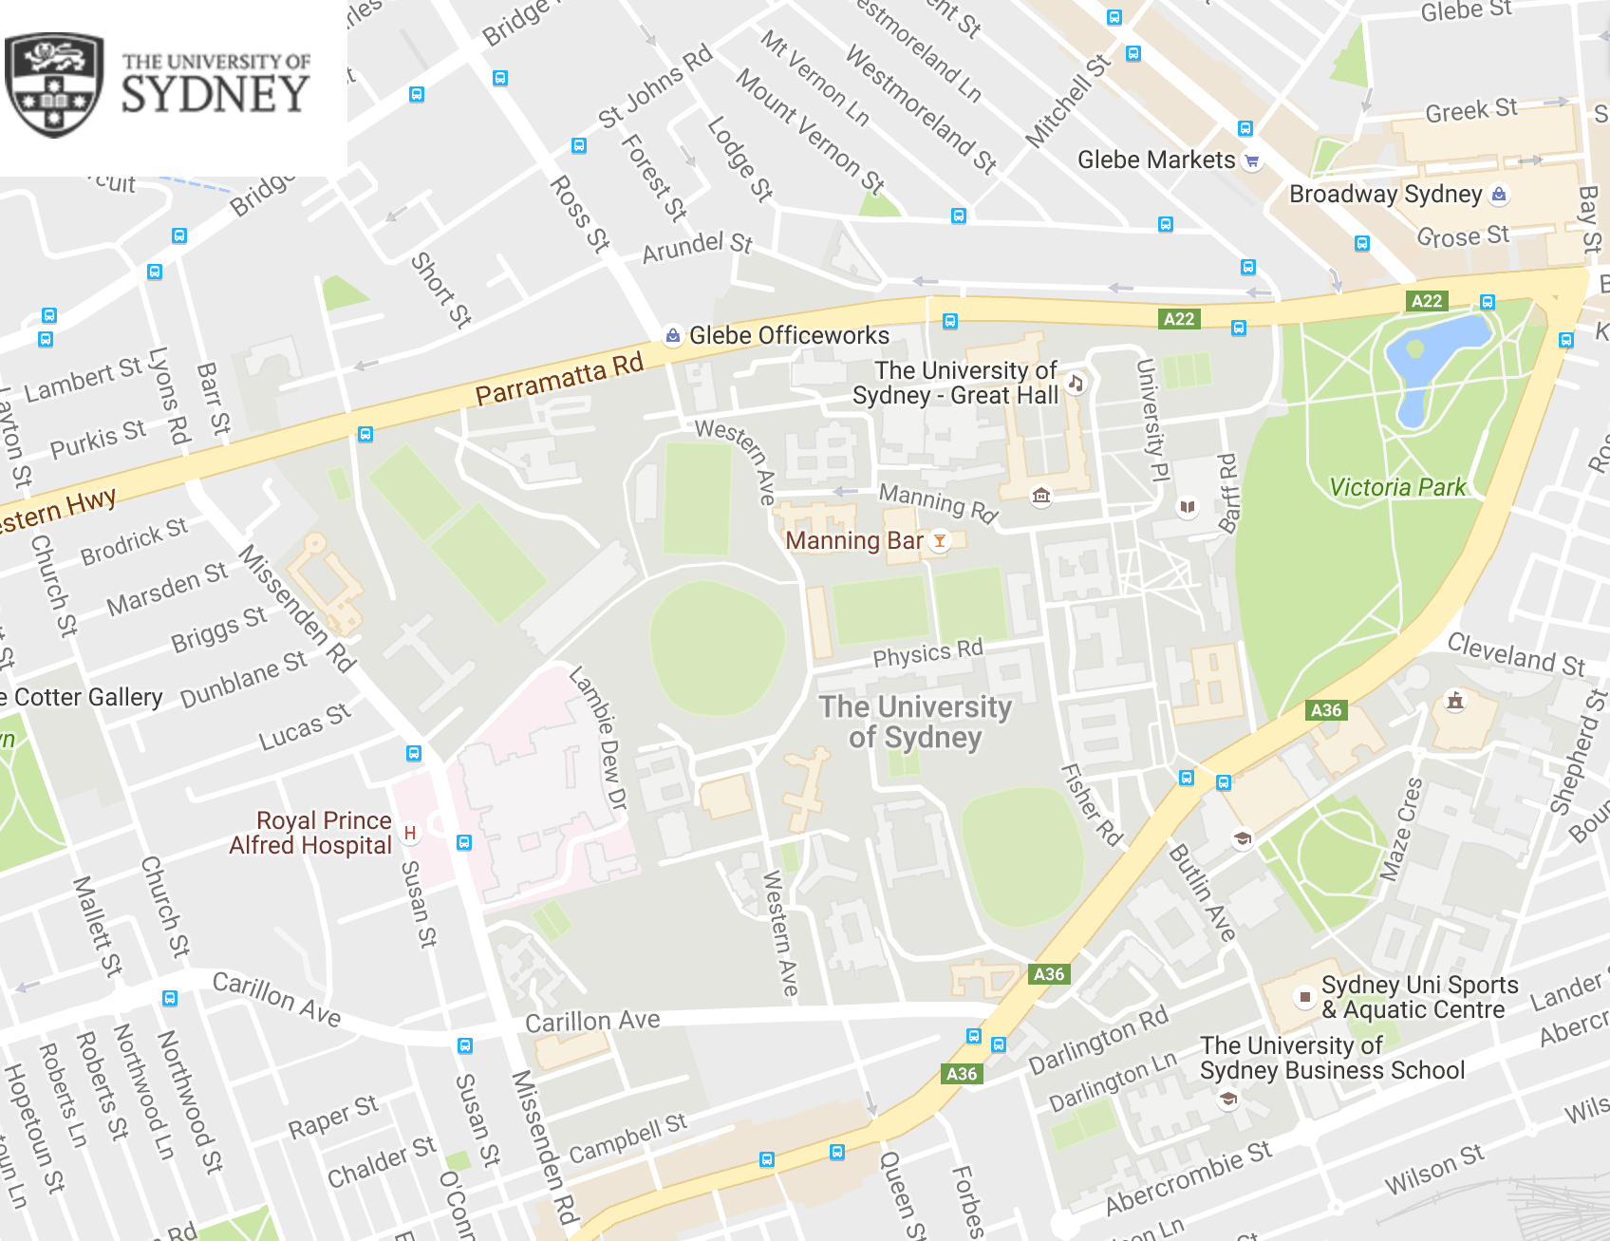
Glebe Point Rd eateries
Food Court
Manning House
Ralph’s Cafe
SNH
Wentworth Bld.
King Str eateries

Slide 4
Welcome to TeVPA 2019!
Welcome reception: SNH Courtyard, Mon 18:30-20:30pm
Conference photo: Messel Lecture Theatre, Tue 13:00pm
Public Lecture: Prof Paolo Gondolo “The Mystery of Cosmic Darkness” – Messel Lecture Theatre, Tue 18:30
https://www.eventbrite.com.au/e/professor-paolo-gondolo-the-mystery-of-cosmic-darkness-tickets-81261582581

Slide 5
Welcome to TeVPA 2019!
Self-organised excursion: Wed from 13:00
Conference dinner: Dockside at Cockle Bay Wharf, Thu 19:00.
Bus transportation to the dinner venue – 18:30 (more details will follow)

Slide 6
Welcome to TeVPA 2019!
Internet: Eduroam (within the campus), UniSydney-Guest (SNH, Physics)
Username: tevpa2019
Password: tevpa2019p

Slide 7
Welcome to TeVPA 2019!
Speakers: Please upload your talk to the indico webpage as soon as it ready, at least 1 hour before the designated session!
  Having trouble – bring your talk to the session chair on the memory stick well in advance of the session.

Slide 8



Welcome to TeVPA 2019!

Slide 9
Welcome to TeVPA 2019!
Further Info
Conference webpage:
https://indico.cern.ch/event/828038/overview
E-mail: tevpa.conference@sydney.edu.au
Ask us
Enjoy the conference and your stay in Sydney!

