Slide 1
TeVPA 2019
The 21cm probe of Cosmology
Xuelei Chen
National Astronomical Observatories
Chinese Academy of Sciences
University of Sydney, 2019.12.03

Slide 2
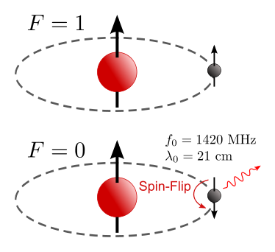
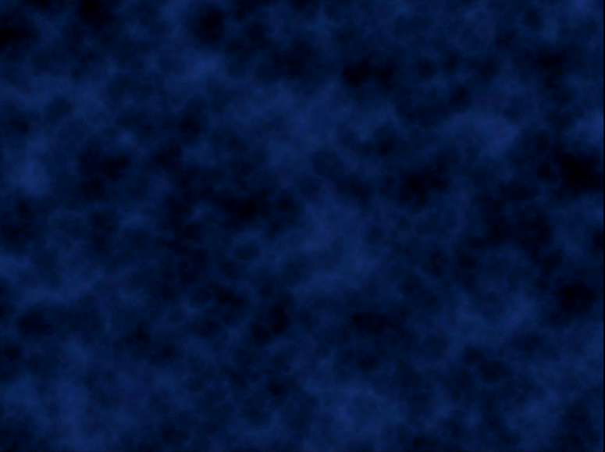
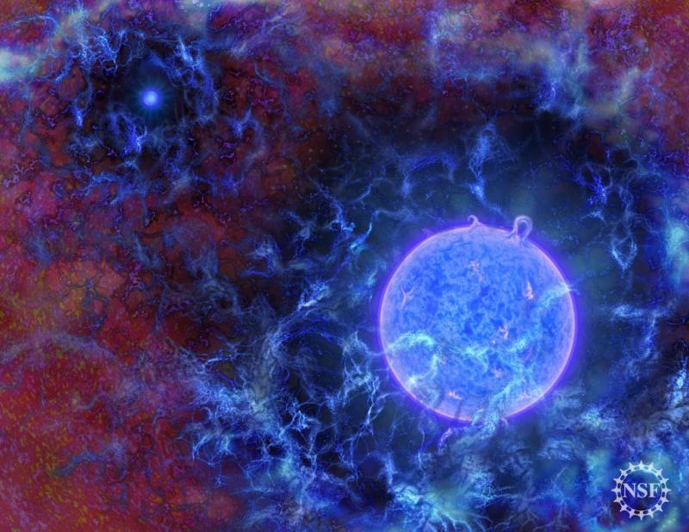
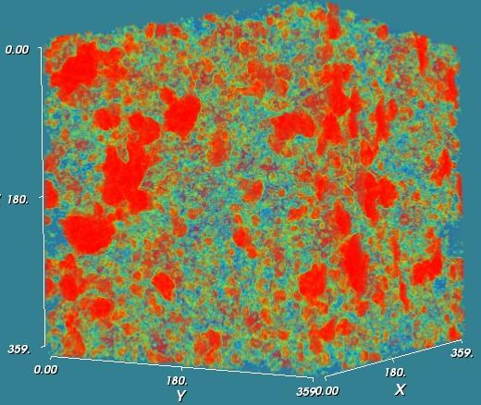
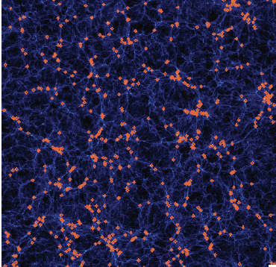


What is the 21cm line
ground state hydrogen atom
dark ages
cosmic dawn
Redshifted to 21(1+z) cm
observe w.r.t. radio background:
spin temperature
reionization
post-reionization

Slide 3
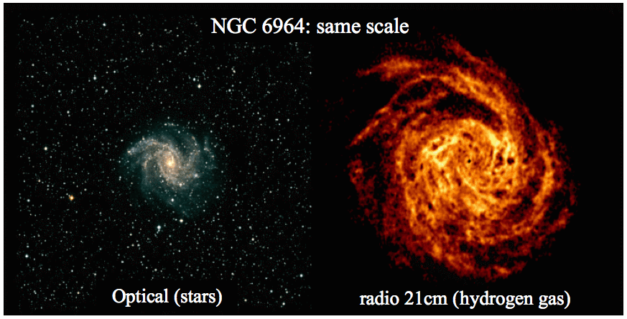
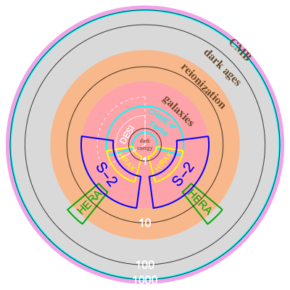
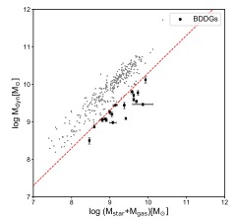
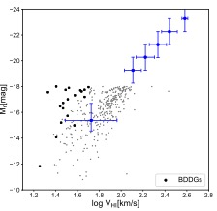
Why 21cm observation
Ubiquitous: 76% of baryons
A different perspective
area ∝ volume
mass relation
Tully-Fisher
The observable Universe in comoving scale
Q. Guo et al.(2019), Nature Astronomy

Slide 4
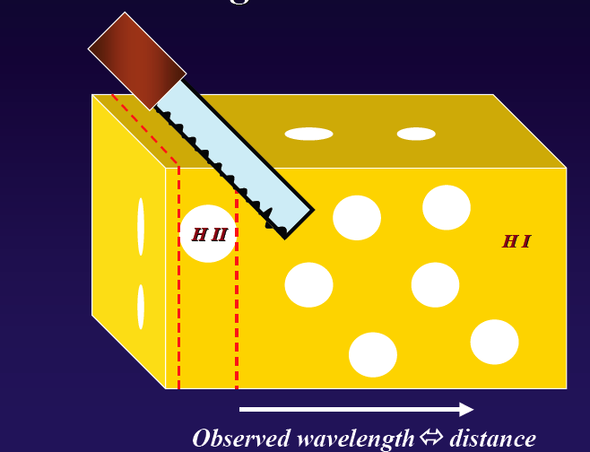
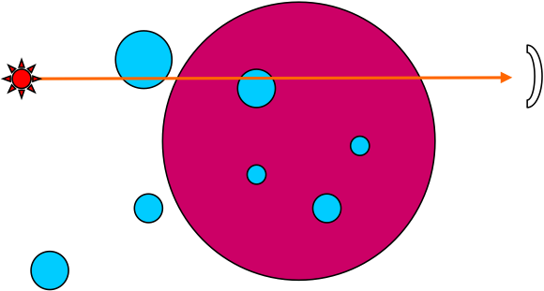
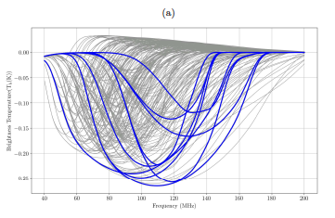
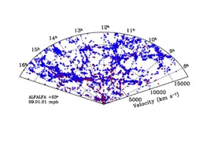
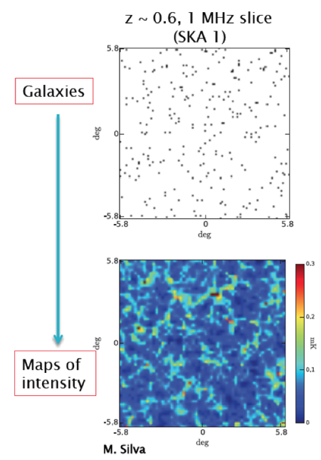
Modes of 21cm Observation
21cm tomography
21cm forest
21cm global spectrum
HI galaxies
Intensity Mapping

Slide 5
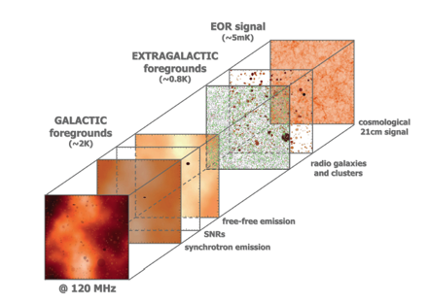
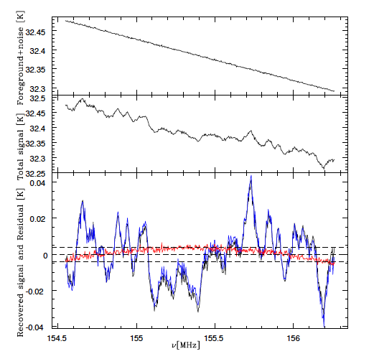
Foreground
raw signal to noise ration (SNR) ～ 10⁻⁵
In principle, smooth foreground can be subtracted
smooth foreground
foreground+21cm
V. Jelic et al. (2010)
X. Wang et al. (2006)

Slide 6
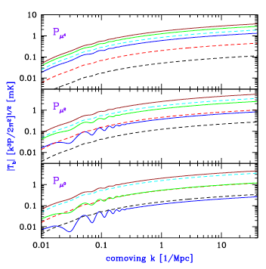
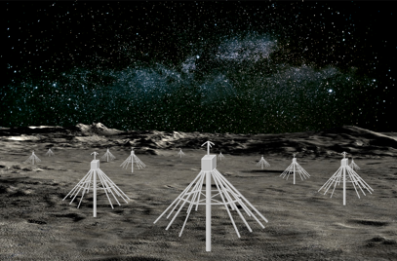
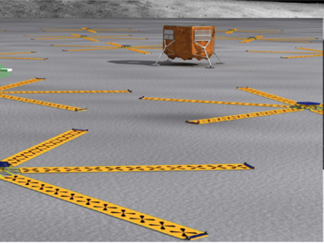
Cosmic Dark Ages
Loeb & Zaldarriaga 2004
But:
The signal is redshifted to very low frequencies, ionosphere absorption—may need to observe from the farside of the moon
Very strong galactic foreground, need extremely large array to achieve enough sensitivity
First Step: global signal (DSL, DAPPER)
Barkana & Loeb 2005

Slide 7
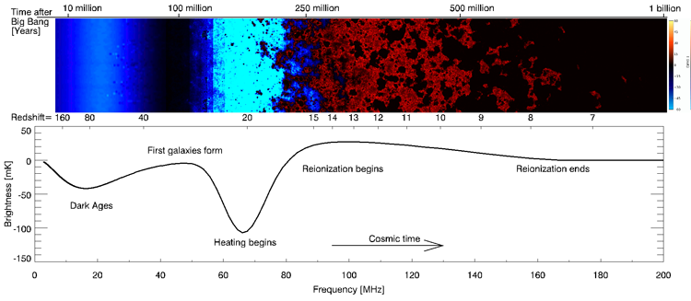
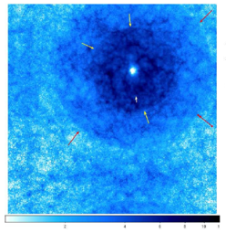
Cosmic Dawn
Reionization signal--Emission
Cosmic Dawn signal—Absorption
(XC& J. Miralda-Escude 2003, 2008)
halo around first star
Figure by K. Ahn et al.
Cohen et al. 2017

Slide 8
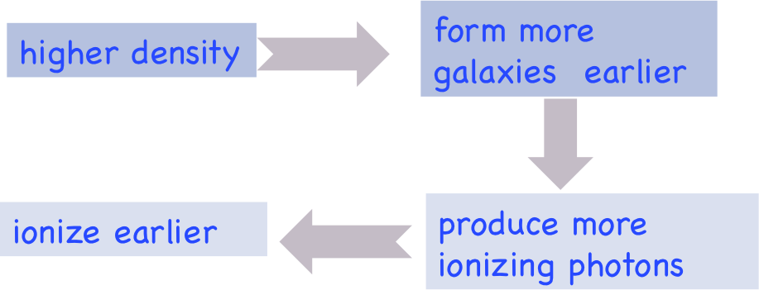
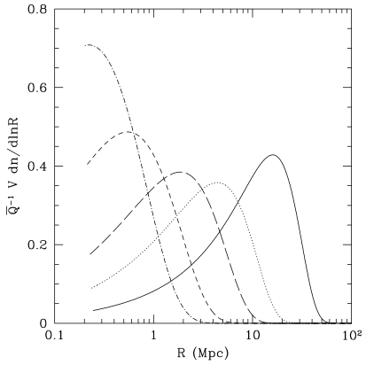
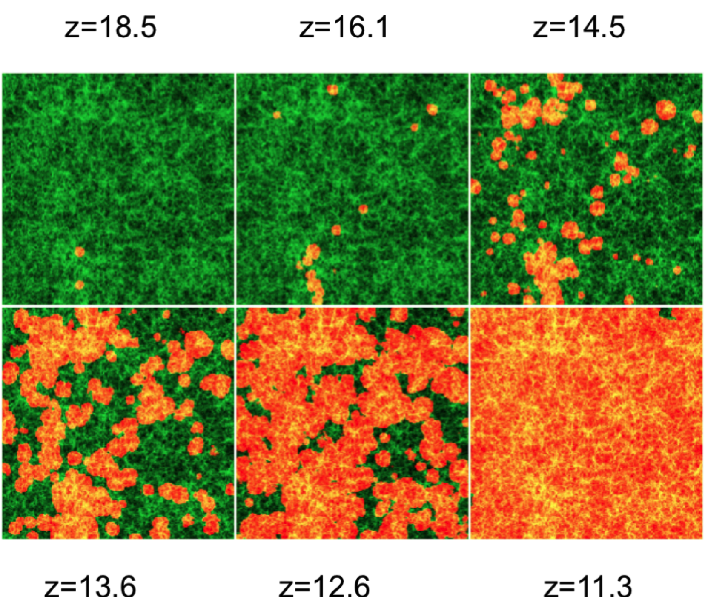
Model of Reionization
Iliev et al （2006）
Bubble Model (Furlanetto, Hernquist, Zaldarriaga 2004):
#photon needed = #photon produced
#photon needed = n_{B} V (1+n_{rec})
#photon produced = ξ n_{B} V f_{coll}
bubble size

Slide 9
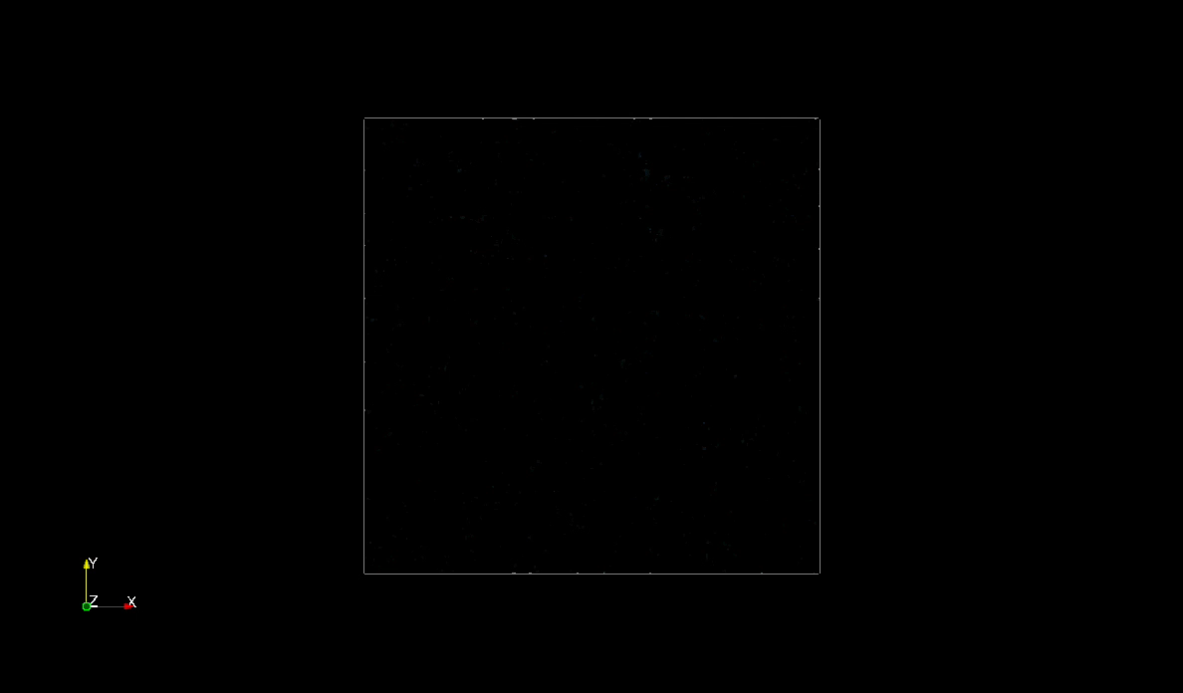

Late Stage of EoR
Semi-Numerical Model IslandFAST
Overlapping bubbles—no longer isolated!
neutral islands: large low density regions (voids) （Y. Xu et al. 2014, 2017)
ionization equation:
#photons= local produced + backgroud

Slide 10
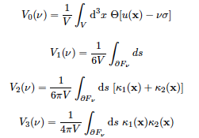
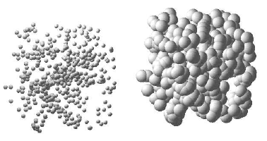
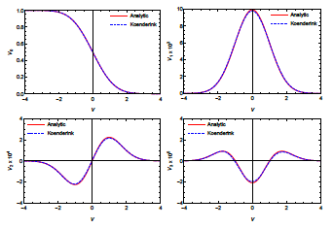
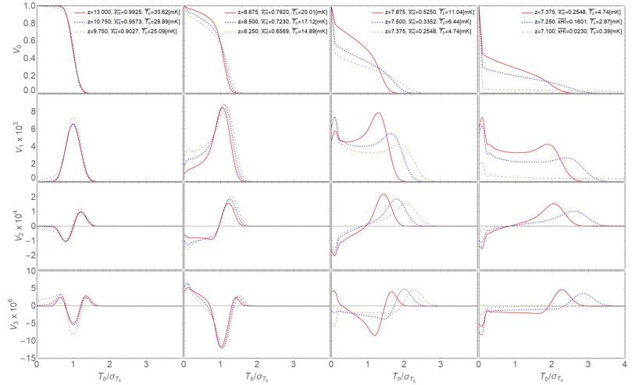
Stages of Reionization
Based on Minkowski functionals (Chen et al. 2018)
Ionized Bubble Stage (x_{HI} > 0.9)
Ionized Fiber Stage (0.9 >x_{HI} > 0.7)
Sponge Stage (0.7 >x_{HI} > 0.3)
Neutral Fiber (0.3>x_{HI} > 0.16)
Neutral Island Stage (x_{HI} < 0.16)
volume
area
mean curvature
Eular characteristic
Broadly Consistent with Furlanetto & Oh (2016), Yoshiura et al. (2016), Bag et al. (2018)

Slide 11
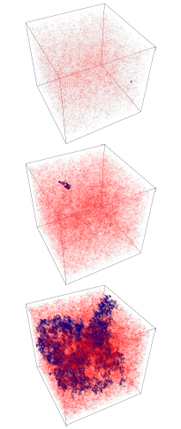
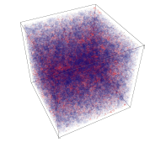
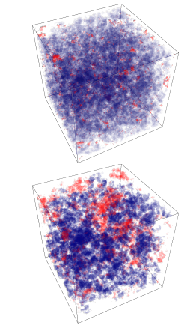
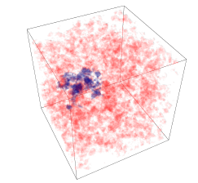
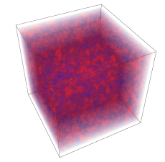
Reionization
blue: largest ionized region
red: other ionized region
transparent: neutral
blue: largest neutral region
red: other neutral regions
transparent: ionized
neutral island
from ionized fiber to sponge
neutral fiber
from bubble to fiber

Slide 12
Power spectrum and Bias
neutral fraction cross power
21cm cross power
The density and neutral fraction anti-correlated on large scales
W. Xu et al. (2019)

Slide 13
The Reality:
Mode Mixing foregrounds
Data = Instrument Response ✪ Sky + Noise
The Instrument Response is frequency dependent (chromatic beam)
The Instrument Response is not smooth (sidelobe, standing wave, ...)
Instrument Response only known up to the precision of calibration
(polarization leakage and cross-coupling between array elements, Faraday rotation of the polarization, ...)
Nevertheless, people hope to detect the cosmological 21cm signal!

Slide 14

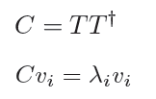
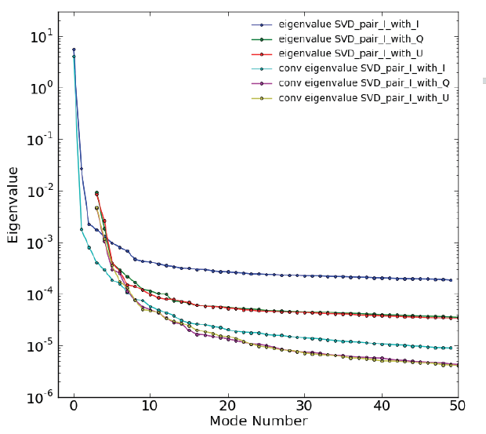
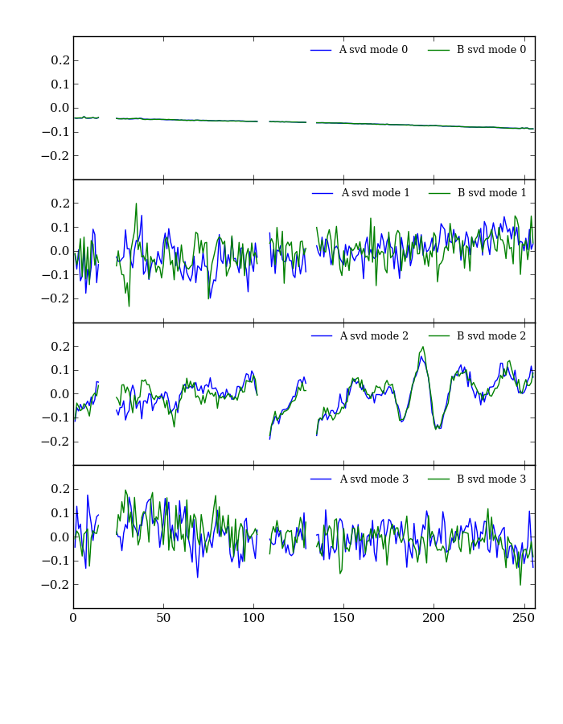
Foreground Subtraction
Data covariance matrix:
Example: GBT (Masui et al. 2013)
PCA analysis:
eigenvectors
eigenvalues
Other foreground subtraction methods developed,
e.g. ICA (L. Wolz), RPCA (Zuo et al.)

Slide 15


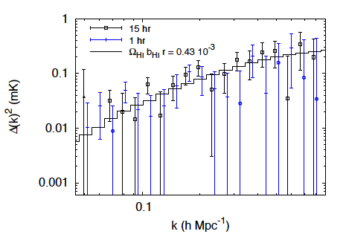
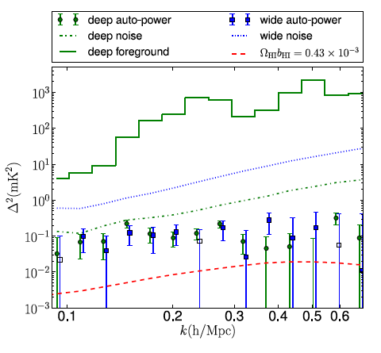
Power Spectra compensation
cross correlation with WiggleZ (Masui et al 2013)
auto correlation (Switzer et al. 2013)

Slide 16
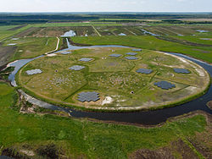
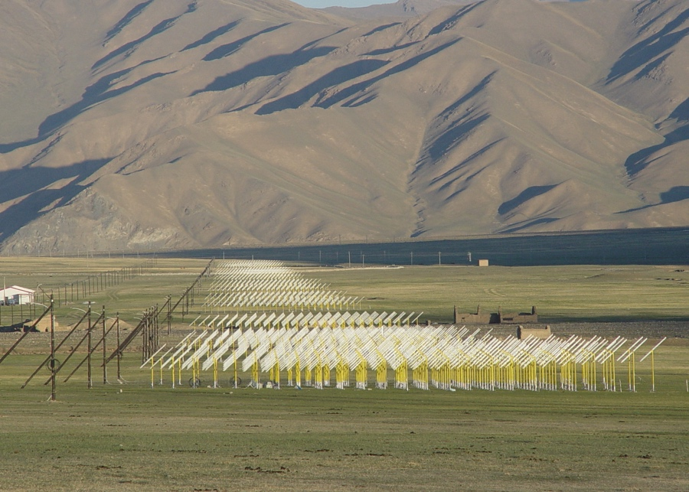
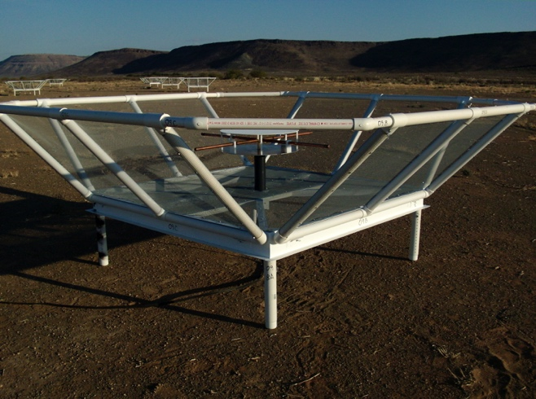
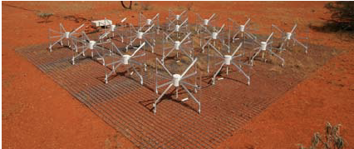
EoR tomography Experiments
21CMA
LOFAR
PAPER
MWA

Slide 17
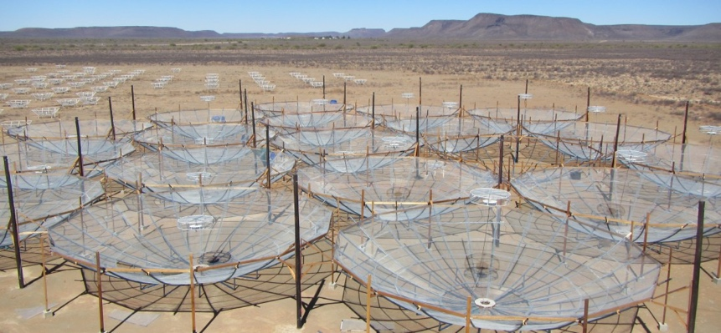
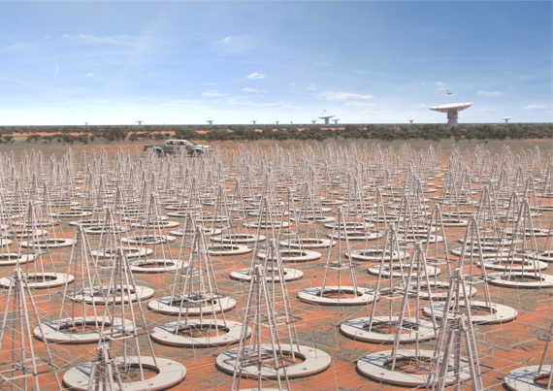
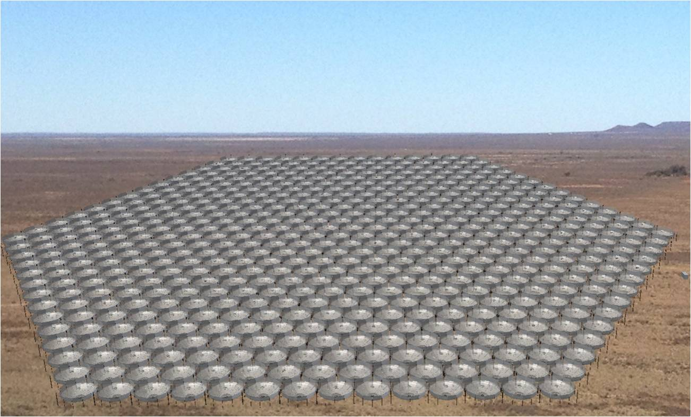
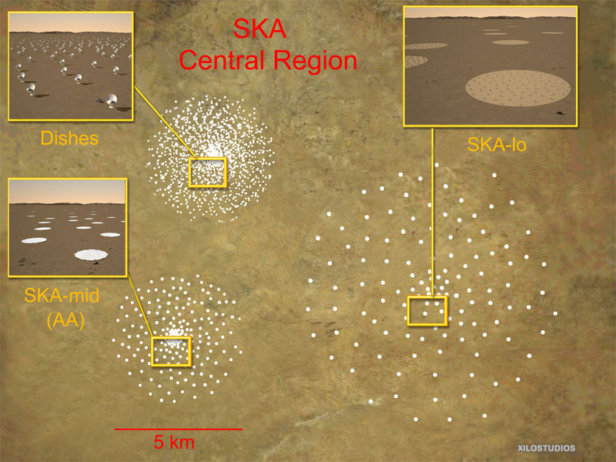
EoR 21cm experiments
HERA: 350 x 14m dish, measure the 3D 21cm power spectrum. Regular grid, redundant baseline calibration
SKA-low: 512 x 256 dipole,
randomized uv coverage,
imaging EoR region

Slide 18
EoR power spectrum
N. Barry et al. arxiv:1909.00561
Beardsley et al. arxiv:1910.02895

Slide 19
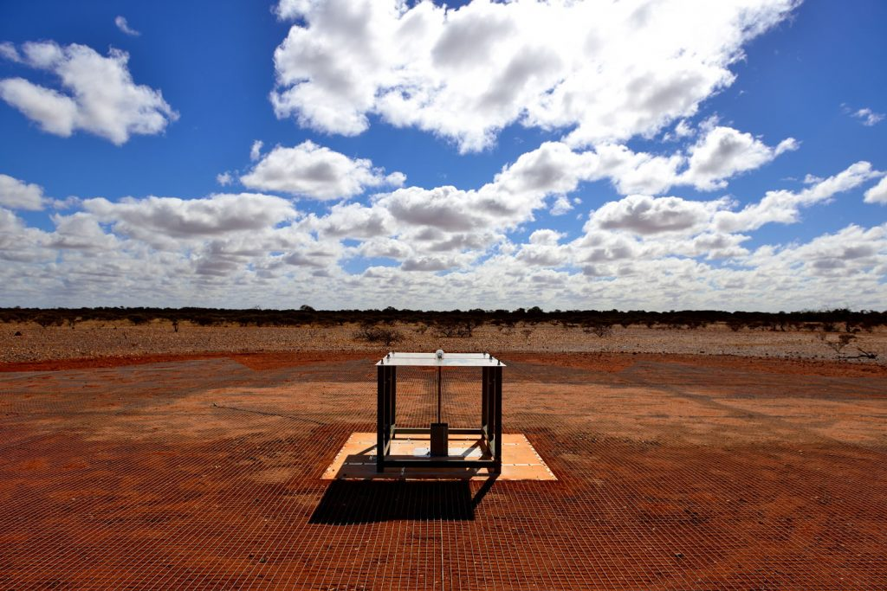
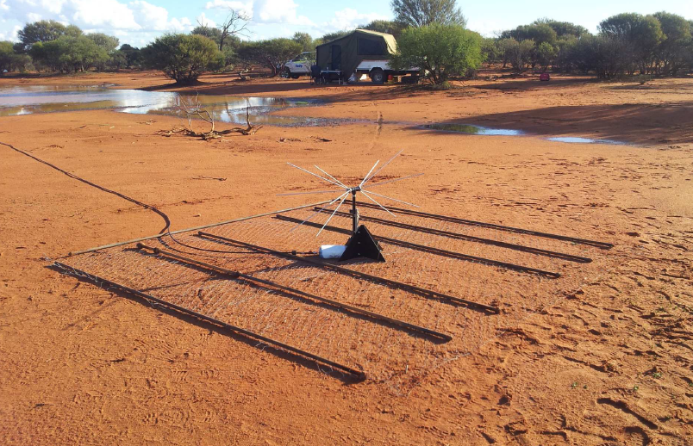
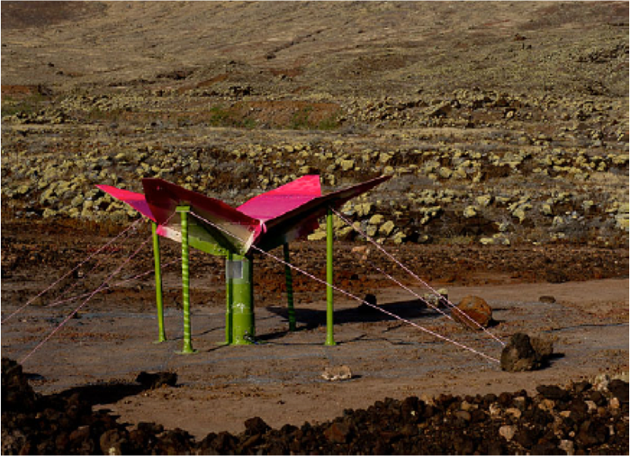




Global Spectrum Experiments
EDGES
SCI-HI/PRIZM
BIGHORN
SARAS-2
LEDA
DSL

Slide 20

How to achieve Precision Calibration
Internal Calibration
sky calibration: galaxy up down

Slide 21


EDGES-low result

Slide 22
Interpretation of the Result
The absorption observed by EDGES is much stronger than typical model, even stronger than maximum case!
foreground contamination (Hills et al. 2018)
unknown systematics: e.g. underground water reflection, ionosphere
colder baryons (cooled by interacting dark matter, (T_{S} < 3.2 K))
extra-radio background (T_{R} > 104 K)

Slide 23

Excess Radio Background
Maybe in the cosmic dawn, in addition to CMB,
there is a radio background generated by early sources AGN, pop star, ... (Ewall-Wice et al. 2018)
Must be very radio loud (Mirocha & Furlanetto 2018) but at high-z, inverse-Compton stronger, the main radio mechanism-synchrotron likely to be comparatively weaker (Sharma 2018)
Constrained by reionization redshift, radio and X-ray source count, ...
If global signal enhanced, fluctuation signal is also strong
Roger 22MHz
Maeda 45MHz
Haslam 408MHz
Reich 1.42GHz
ARCADE-2

Slide 24


Dark Matter Cooling
Barkana 2018
DM is cooler than baryon as it decoupled earlier, but need baryon-DM interaction, temperature (energy) dependent, e.g. Coloumb interaction
Severely constrained by various experiments
Berlin et al. 2018

Slide 25
Other Ideas
Baryonic Universe + MOND (S. McGaugh)
Early baryon decoupling (so it is colder) by an early dark energy (Hill & Haxter)
Modify early Hubble parameter by Interacting dark energy (A. Costa et al.)
Dark photon mixing (M. Pospelov et al.)
axion Bose-Einstein condensation cooling (Houston et al. 2018)
Dark matter decay to radio (Fraser et al.)
Dark matter annihilation to radio (Yang)
Dark force (Li & Cai)
。。。。。。

Slide 26


Space Experiment
DARE
ionosphere refraction and absorption also affects global spectrum
DSL HFS

Slide 27



Space-based low frequency radio observation
Below 10MHz, due to ionosphere absorption, ground observation is nearly impossible.
Planck map
RAE-2 sky map (1979)

Slide 28





Experiments during CE-4 mission
CE-4 Lander
Netherland-China Low frequency Experiment (Relay Satellite)
Longjiang orbiting satellites (piggy-back on relay satellite launch)--unfortunately, Longjiang-1 malfunctioned
EMI limited sensitivity, and also work time is very short due to limited power, but still can see moon shield radiation from Earth
EMI

Slide 29


Discovering Sky at Longest (DSL) wavelength
A linear array (5-8) of satellites moving around the moon, take observation at the backside of the moon, then transmit data back at the front side of the moon.
A mother satellite measure the position of the daughter satellites
Low frequency aims for imaging of foregrounds, high frequency aims to detect cosmic dawn signal by precise global spectrum measurement

Slide 30








Current mid-redshift Radio Telescopes
Parkes (64m)
JVLA
GMRT
27 dish
27 dish
GBT (105m)
ASKAP
FAST (500m)
36 dish
Arecibo (150m)
MeerKAT
64 dish

Slide 31
FAST survey
Wenkai Hu et al., Forecast for FAST: from Galaxies Survey to Intensity Mapping", arxiv:1909.10946
L-band beams
number density of detected galaxies
DETF Figure of merit

Slide 32





Dedicated Experiments
Stable, large field of view（also good FRB searcher)
Array Size: ~ 100 m for BAO (T. Chang et al. 2008, Seo et al. 2009, Ansari et al. 2012)

Slide 33




The Tianlai (heavenly sound) Experiment
Cylinder pathfinder : 3x15m x 40m, 96 feeds
Dish Pathfinder: 16 x 6m
frequency: 700-800MHz, can be tuned in 600~1420MHz

Slide 34






probe of Large Scale Structure
(BAO,PNG, inflation features)
Xu, Wang & Chen (2015)
D_{A} δθ
cδz/H
Xu, Hamann, Chen(2016)

Slide 35




21cm Intensity Mapping Experiments
Tianlai (96 units)
CHIME (1024 units)
HIRAX (1024 units)
BINGO

Slide 36

Near Future: SKA-mid
SKA-1: 197 dish (15m) + 64 MeerKAT dish
SKA-2: ～ 3000 dish

Slide 37


Intensity Mapping
BAO measurements
SKA Cosmology Workgroup （http://skacosmology.pbworks.com)

Slide 38
Future Ideas: PUMA
200～1100MHz，6m dish,
10⁴ elements
Slosar et al., arxiv:1907.12559

Slide 39
Outlook
21cm experiments are easy (to start) and hard (to detect!)—lots of experiment efforts going on
Varies approaches: global spectrum, single dish, regular and irregular interferometer arrays
New and more powerful data analysis method: AI?
The 21cm auto-correlation is still to be detected, but progresses are being made
The 21cm cosmology is coming!

Slide 40

Thanks and Enjoy!

Slide 41
Backup slides

Slide 42



Problems with Lunar Array
Traditional imaging algorithm can not work!
short dipole (l<<λ) antenna have very wide field of view (almost whole sky), traditional synthesis algorithm only for small field of view (flat sky, small w-term)
A mirrow symmetry w.r.t. orbital plane, can be broken by 3D baselines (produced by orbital plane precession)
Different baselines have different part of sky blocked by Moon
mirrow symmetry
3D baselines
simulated reconstruction map
map-making by invertion
Huang et al., arXiv:1805.08259

Slide 43
galaxy detection vs intensity mapping
Cheng et al (2018): criterion
L_{SN} : luminosity scale for voxel shot noise
σ_{L} : rms noise per voxel
l∗ : galaxy characteristic luminosity.

