Slide 1


An Overview of Galactic TeV Sources
Jamie Holder (U. Delaware/ Bartol)
TeVPA, Sydney 2019

Slide 2
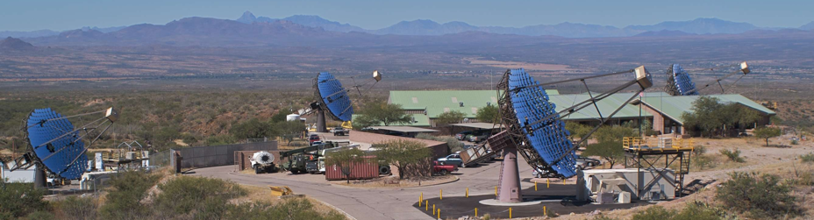
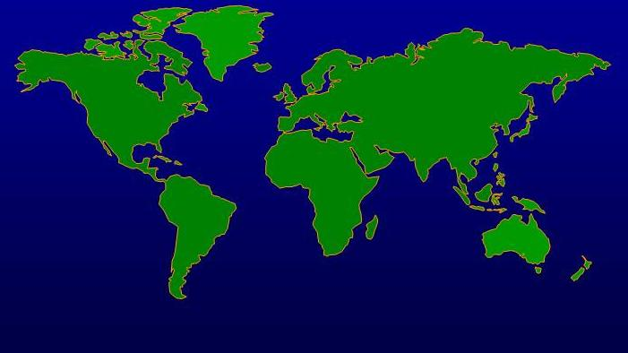
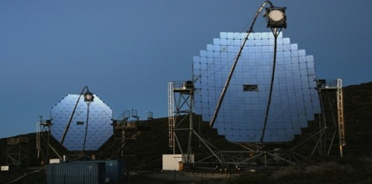
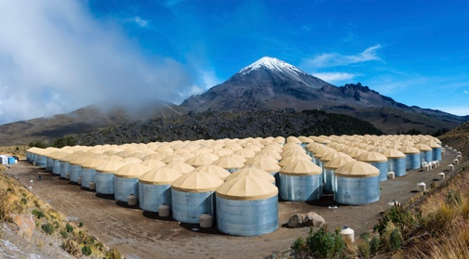
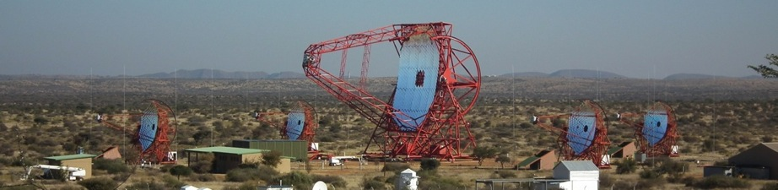
VERITAS
MAGIC II
HAWC
H.E.S.S.
Galactic discovery instruments of the last decade
Notes:
Stress upgrades
HESS 2004 (2012)
MAGIC 2003 (2009)
VERITAS 2007

Slide 3
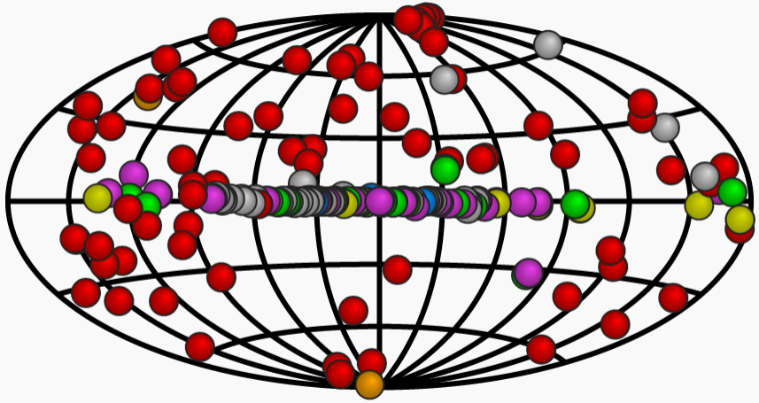
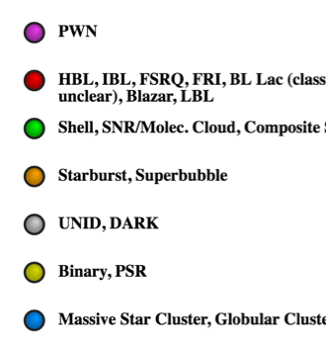
The TeV Gamma-ray Source Catalog
225 sources from many different source classes and sub-categories.
One third are Galactic.
Pulsar and/or
Pulsar wind Nebula
Active Galactic Nucleus
Supernova Remnant
Starburst Galaxy
Unidentified
Binary system
Stellar Cluster
http://tevcat2.uchicago.edu/
Notes:
3EG had 271 >100MeV sources
Revised EGRET catalog had 188
4th Uhuru Catalog had 339 X-ray sources (4UXXXX+XX) (1978)

Slide 4

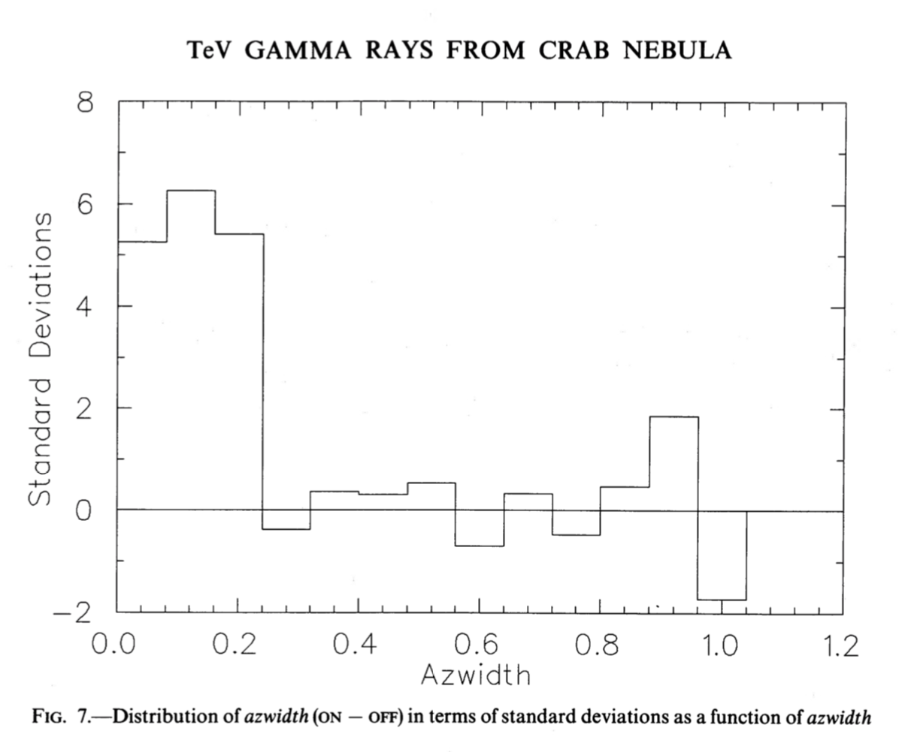
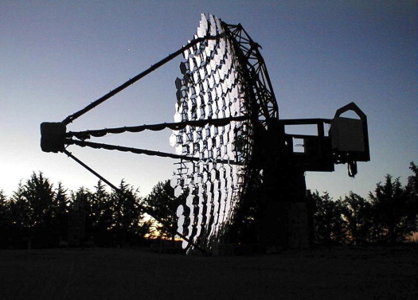
The Crab Nebula
First astrophysical TeV gamma-ray source detected (Whipple Collaboration, in 1989).
Emission is SSC of leptons accelerated near the termination shock of the pulsar wind.
Notes:
30-year anniversary
9 sigma. 37-element camera.
80 hours.

Slide 5
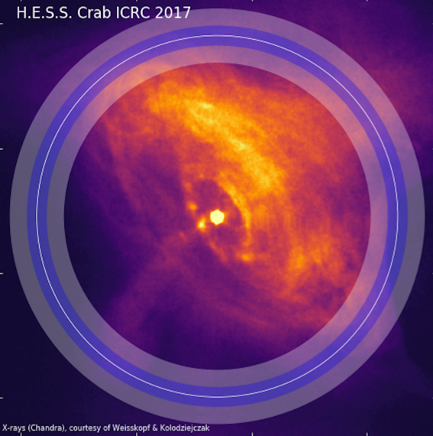
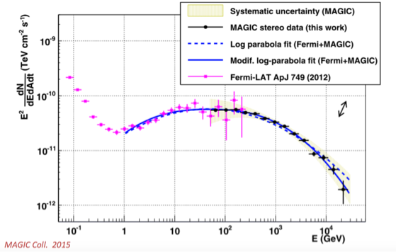
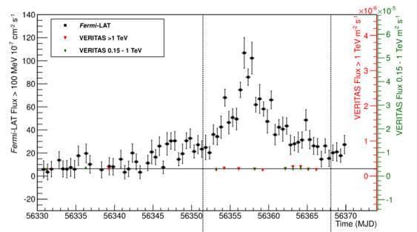
The Crab Nebula
Current generation of IACTs have provided measurements of exceptional precision:
  The Crab emission is spatially resolved at TeV energies.
  The inverse Compton spectral peak is flattened.
  Emission is steady to <12%. GeV Crab flares have no counterpart at TeV energies.
Notes:
These relativistic particles are thought to be ac
celerated to a power-law distribution either via a Fermi-like a
cceleration process taking place at the termination shock (T
S) (Arons & Tavani 1994, and references therein) or via shock-
driven reconnection in a striped wind (P ́etri & Lyubarsky 20
07; Sironi & Spitkovsky 2011). The downstream flow interacts with
the surrounding magnetic and photon fields creating the PWN.
The nebula emits synchrotron radiation which is observed from
radio frequencies up to soft γ rays. This emission is well de-
scribed by the magnetohydrodynamic (MHD) model of Kennel & C
Oroniti (1984). At higher energies (above 1 GeV), the overall emission
is instead dominated by the Inverse Compton (IC) up-scattering
of synchrotron photons by the relativistic electrons in the neb-
ula (de Jager & Harding 1992; Atoyan & Aharonian 1996)
According to magnetohydrodynamic (MHD) models, the rotational energy of a rapidly spinning neutron star is carried away by a relativistic wind and deposited at a large distance, in the nebula, downstream of the wind termination shock. The energy transport in the outflow is mediated by Poynting flux, but it is not clear how the energy stored in the fields is transferred into the energized population of emitting particles. The most plausible dissipation mechanisms are thought to be related to the "striped" structure of the wind, in particular, to the existence of a current sheet, prone to reconnection events. In this model the current sheet is a natural place for internal dissipation and acceleration of particles responsible for pulsed, high-energy emission. Moreover, reconnection is a promising scenario for explaining annihilation of fields at the shock and conversion of their energy into the kinetic energy of particles. The shock structure, however, is likely to differ in the low-density plasmas, in which non-MHD effects intervene. In this regime, the striped wind can dissipate its energy via an electromagnetic precursor of the shock.
Crab is at 2kpc
we find that the nebula measured with H.E.S.S. is significantly larger than when measured with
Chandra. This result is naturally explained by the radiation cooling of electrons. The Crab nebula size therefore decreases
with increasing electron energy, and the energies of electrons producing the TeV gamma rays are
well below those of electrons emitting the hard X-rays measured by
Chandra. The measured size of the TeV gamma-ray nebula can be reproduced within the standard magnetohydrodynamic model
of Kennel and Coroniti assuming a magnetisation parameter σ≈0.01.
Flat IC peak implies that the assumption of the homogeneity of the B-field inside the nebula is incorrect

Slide 6
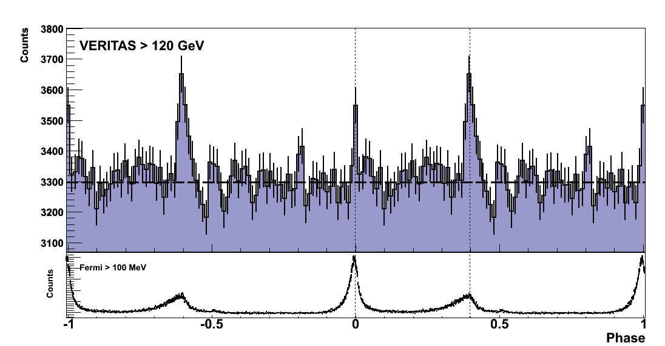
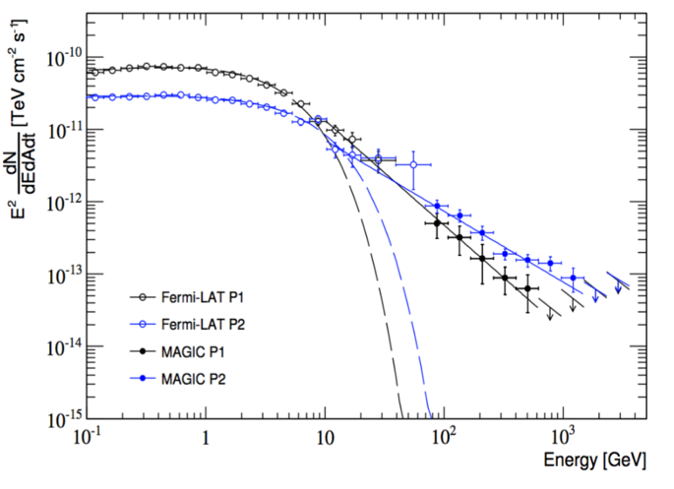
The Crab Pulsar
Fermi-LAT measures a spectral break at 6 GeV
VERITAS measured power-law emission above 100 GeV
Implies emission region > 10 stellar radii, curvature radiation unlikely.
Latest MAGIC results extend to 1 TeV, and H.E.S.S. has now detected Vela pulsar up to 7 TeV.
  New component.
  The Crab is not the only TeV pulsar.
What is the pulsar emission mechanism at the highest energies? What is the population?
The Crab pulsar lightcurve >120 GeV
The Crab pulsar spectrum
VERITAS Collaboration, Science, 334, 69, 2011.
MAGIC Collaboration, A&A, 585, 133, 2016.
Notes:
(Spin-down E= 4.6 x 10³⁸ erg s⁻¹.)
1706, Geminga and Vela also detected from the ground (as Fermi extension)

Slide 7
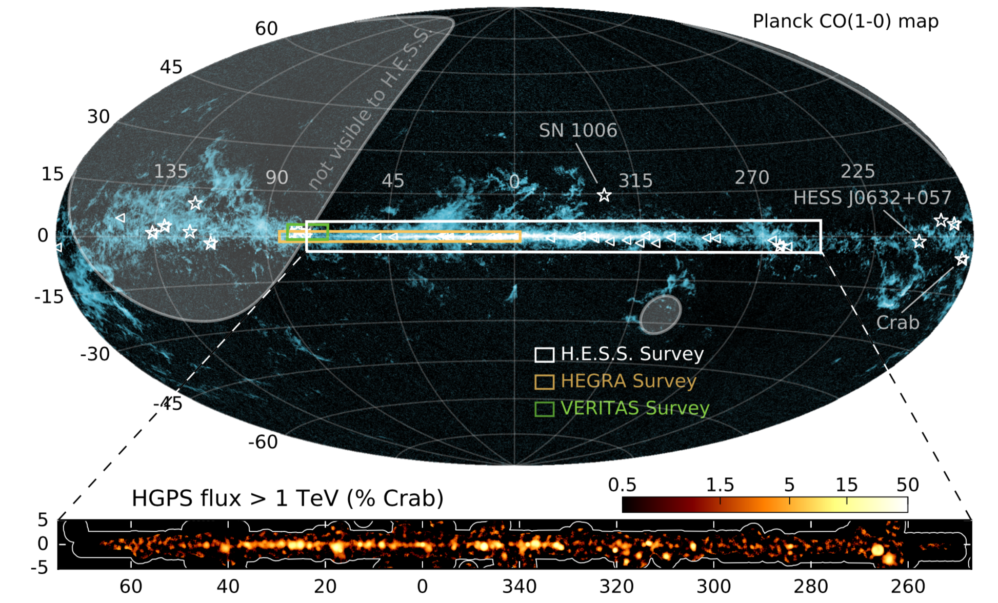
https://www.mpi-hd.mpg.de/hfm/HESS/pages/home/som/2016/01/
Notes:
An overview image showing the H.E.S.S. Galactic Plane Survey (HGPS) region (top), the measured TeV gamma-ray flux (middle), and the observation time (bottom). For reference, the all-sky image shows the distribution of gas in the sky, as revealed by recent carbon monoxide (CO) measurements by the Planck satellite (Adam et al. 2015). Overplotted (triangles) are Galactic gamma-ray sources measured at lower but complementary energies, recently detected by the Fermi-LAT satellite (Ackermann et al. 2015). The 15 Galactic TeV sources known to be outside the HGPS region are also indicated (stars). The regions covered by earlier, more limited surveys are also illustrated. The middle panel show the HGPS gamma-ray flux above 1 TeV (correlation radius of 0.4°), and the bottom panel shows the respective observation livetime. The white contours mark the edge of the survey region.
77 sources in the plane survey. 16 unidentified.
Reveals new population. Allows source population studies. Data are now public.
The deepest and most comprehensive, high resolution (∼ 0.1o) and sensitive (<2% Crab Nebula) survey of the Milky Way in very-high-energy g-rays.

Slide 8
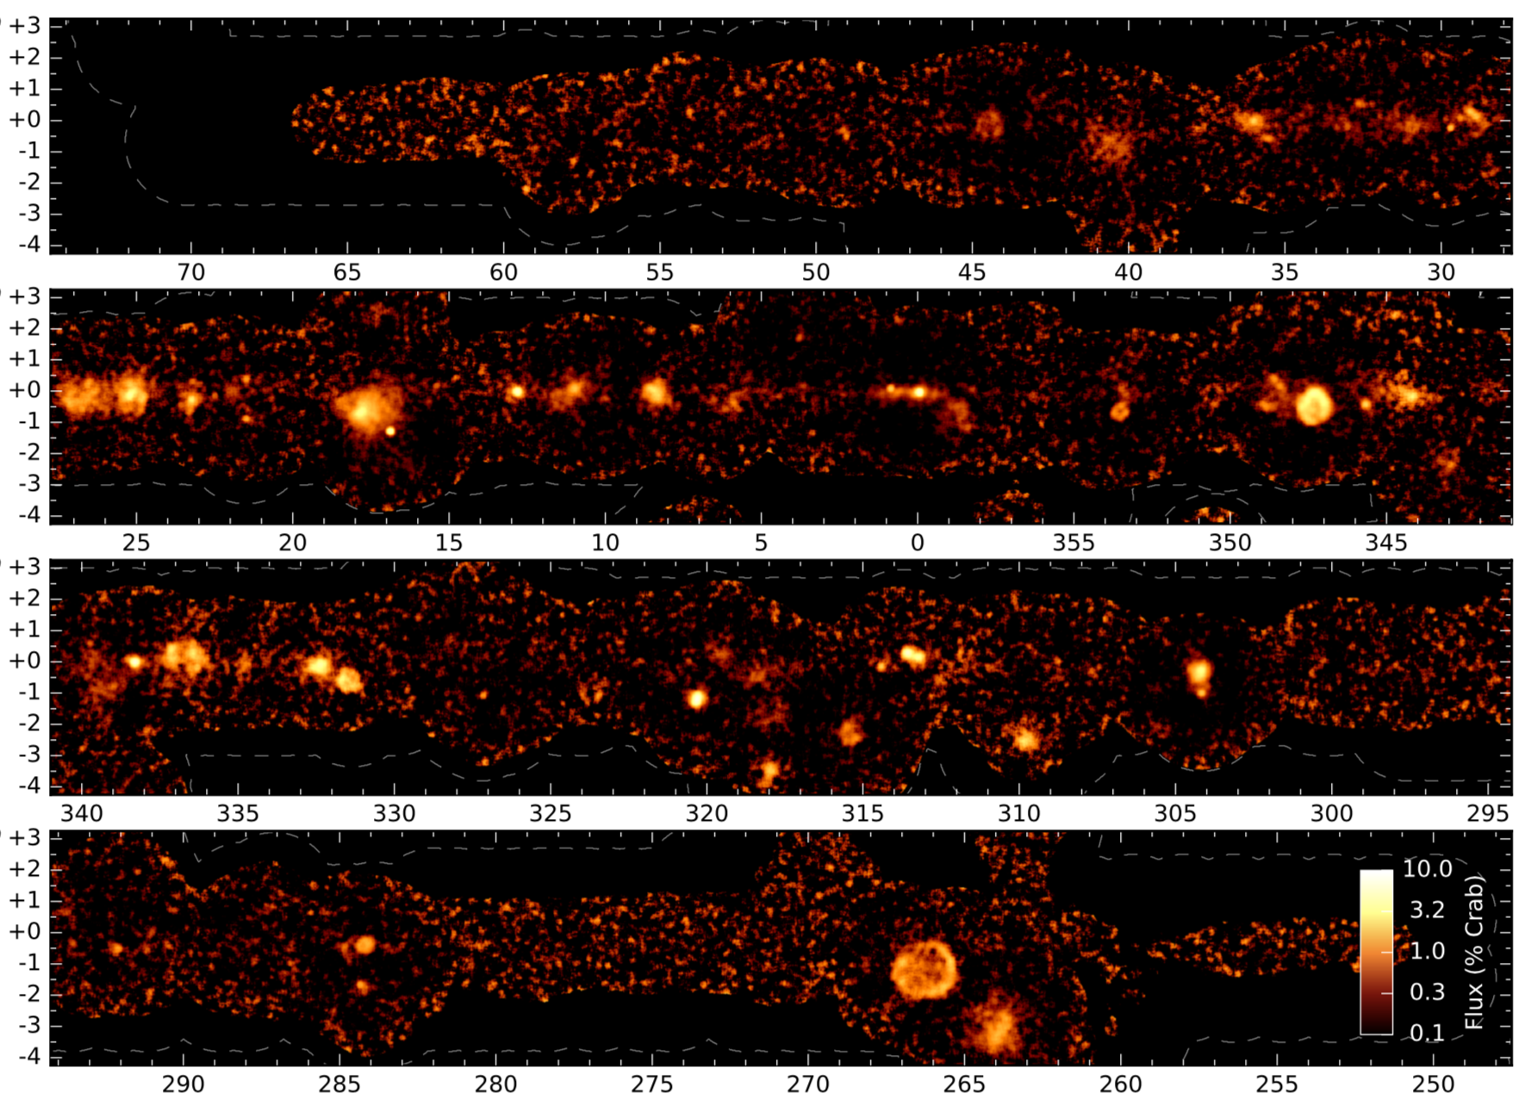
https://www.mpi-hd.mpg.de/hfm/HESS/pages/home/som/2016/01/
Notes:
An overview image showing the H.E.S.S. Galactic Plane Survey (HGPS) region (top), the measured TeV gamma-ray flux (middle), and the observation time (bottom). For reference, the all-sky image shows the distribution of gas in the sky, as revealed by recent carbon monoxide (CO) measurements by the Planck satellite (Adam et al. 2015). Overplotted (triangles) are Galactic gamma-ray sources measured at lower but complementary energies, recently detected by the Fermi-LAT satellite (Ackermann et al. 2015). The 15 Galactic TeV sources known to be outside the HGPS region are also indicated (stars). The regions covered by earlier, more limited surveys are also illustrated. The middle panel show the HGPS gamma-ray flux above 1 TeV (correlation radius of 0.4°), and the bottom panel shows the respective observation livetime. The white contours mark the edge of the survey region.
77 sources in the plane survey. 16 unidentified.
Reveals new population. Allows source population studies. Data are now public.
The deepest and most comprehensive, high resolution (∼ 0.1o) and sensitive (<2% Crab Nebula) survey of the Milky Way in very-high-energy g-rays.

Slide 9
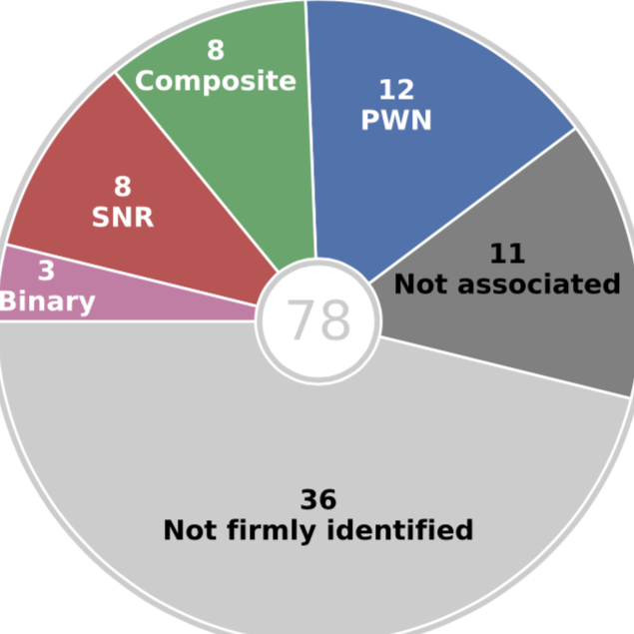
https://www.mpi-hd.mpg.de/hfm/HESS/pages/home/som/2016/01/
Notes:
An overview image showing the H.E.S.S. Galactic Plane Survey (HGPS) region (top), the measured TeV gamma-ray flux (middle), and the observation time (bottom). For reference, the all-sky image shows the distribution of gas in the sky, as revealed by recent carbon monoxide (CO) measurements by the Planck satellite (Adam et al. 2015). Overplotted (triangles) are Galactic gamma-ray sources measured at lower but complementary energies, recently detected by the Fermi-LAT satellite (Ackermann et al. 2015). The 15 Galactic TeV sources known to be outside the HGPS region are also indicated (stars). The regions covered by earlier, more limited surveys are also illustrated. The middle panel show the HGPS gamma-ray flux above 1 TeV (correlation radius of 0.4°), and the bottom panel shows the respective observation livetime. The white contours mark the edge of the survey region.
77 sources in the plane survey. 16 unidentified.
Reveals new population. Allows source population studies. Data are now public.
The deepest and most comprehensive, high resolution (∼ 0.1o) and sensitive (<2% Crab Nebula) survey of the Milky Way in very-high-energy g-rays.

Slide 10
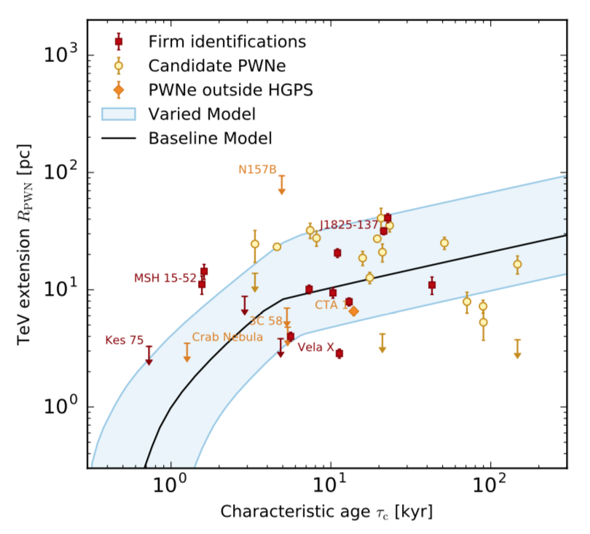
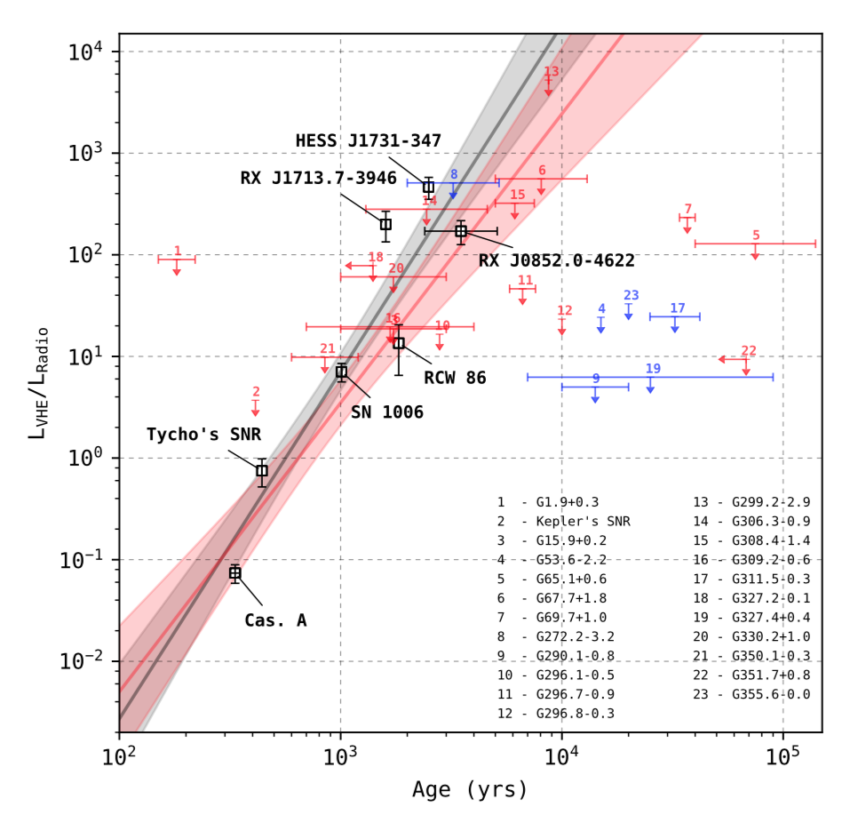
Galactic Population Studies
The growing catalogue of Galactic TeV sources allows the first population studies of the properties and evolution of very high energy emission from pulsar wind nebulae and supernova remnants.
H.E.S.S. collaboration, A&A 612 (2018)
Notes:
Note – only 8 shell-type SNR firmly identified. The rest (50) are upper limits.

Slide 11
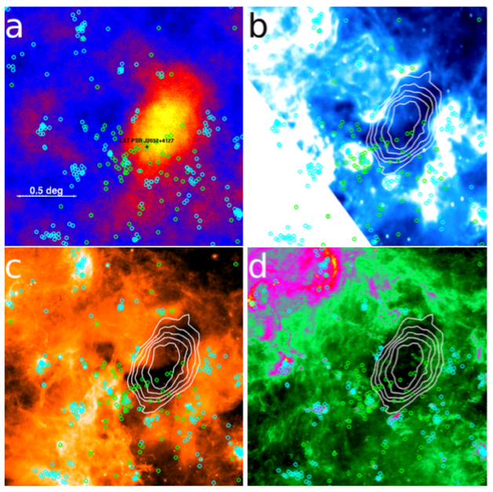
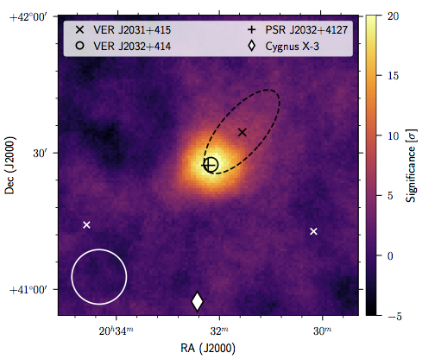
Two-for-one: a gamma-ray binary PWN
TeV J2032+4127 was the first TeV source discovered (HEGRA) with no clear counterpart.
VERITAS showed it to be an asymmetric, extended source, coincident with a radio/IR void.
In 2009, Fermi discovered the likely power source: PSR J2032+4127 driving a PWN.
In 2015, Lyne et al. showed that the pulsar is in 50-year period Be-star binary system.
MAGIC and VERITAS monitored from 2016-2018, detecting bright flaring from the binary.
VERITAS and MAGIC Collaborations, ApJL, 867, 19, 2018.
Notes:
Detected in 2002.
How the emission produced and modulated?
Complex temporal and spectral properties.
Great laboratories: allow to study particle acceleration under changing environmental conditions.
Distance is 1.5 kpc

Slide 19
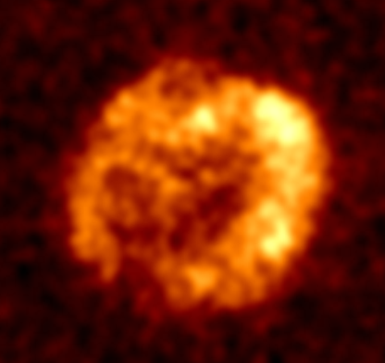
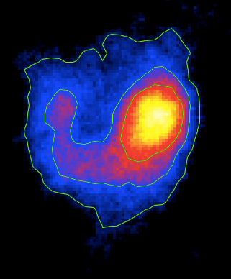
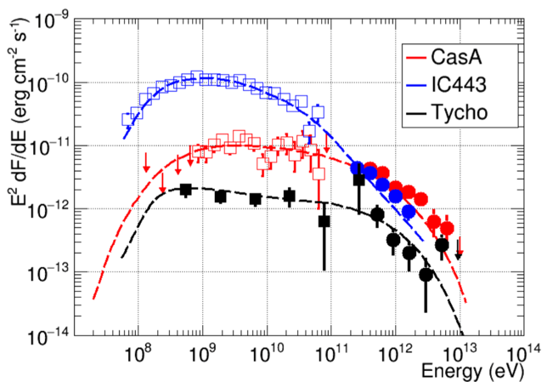
Shell-type Supernova Remnants
Promising candidates to supply the majority of Galactic cosmic rays.
A population which now includes a TeV-only detection (HESS J1912+101).
Discrimination between leptonic and hadronic particle populations is often difficult.
Even where hadrons are favored, the spectra do not extend to tens of TeV.
RX J 1713.7-3946
H.E.S.S.
IC 443
VERITAS
Fermi-LAT/ VERITAS
Notes:
HESS J1534-571: No X-ray emission is found from the source region, excluding non-thermal X-ray emission at the level detected from the other known TeV SNR. Excellent candidate for proton-dominated processes.
§ HESS J1912+101: New data shows shell-like morphology, first TeV-only shell candidate.

Slide 20
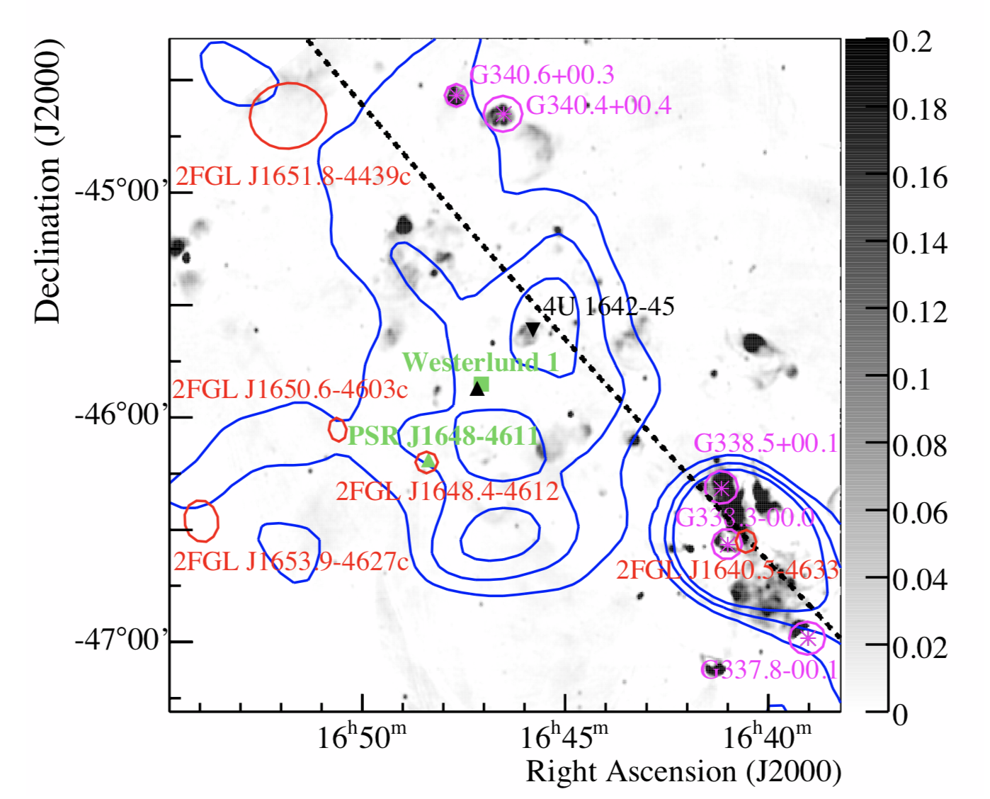
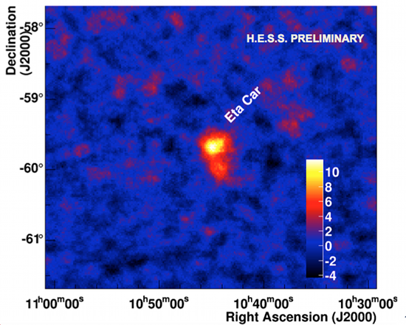
Star forming regions and wind interactions
Westerlund 1: most massive stellar cluster in the Galaxy
Challenging observations and interpretation, due to source extent and confusion.
Eta Carina provides first clear evidence of TeV emission from colliding winds.
Westerlund1
Eta Carina
H.E.S.S. II
Notes:
We are happy to state that we have detected Eta Carinae in very-high energies with a significance of 13.6 sigma. Our data set covers the time when the companion star is approaching the primary star, and a few months around the periastron passage when the stars are as close to each other as depicted in Figure 3. Eta Carinae is detected significantly at each of the two phases. With this detection, the new source class of colliding wind binaries is entering the field of very-high-energy gamma-ray astronomy.
H.E.S.S. smoothed VHE γ-ray excess contours in blue overlaid on the Molonglo 843 MHz map (grey scale, in Jy/beam; Green et al. 1999). Also shown are SNRs (purple, Green 2009), the pulsar PSR J1648–4611 (Manchester et al. 2005), the LMXB 4U 1642–45 (Forman et al. 1978), Fermi-LAT sources (Abdo et al. 2011), the magnetar CXOU J164710.2–455216 (Muno et al. 2006a) as a black upright triangle and the stellar cluster Wd 1.

Slide 21
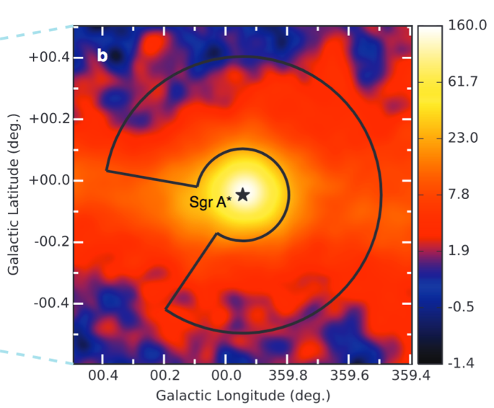
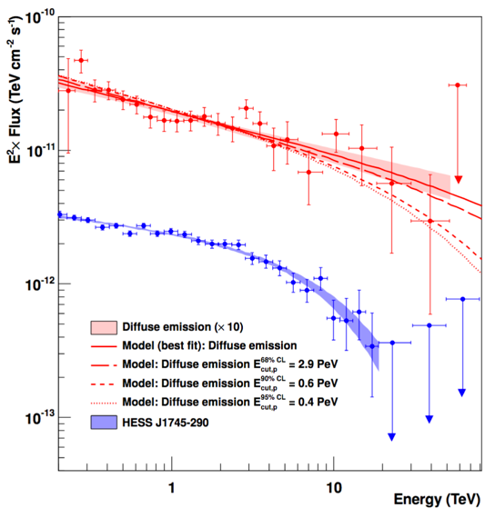
The Galactic Center Region.
H.E.S.S. detected a bright, steady TeV source, spatially coincident with SgrA*
Diffuse emission is observed along the plane, within a few degrees of the Galactic Center.
The diffuse spectrum extends to 40 TeV with no cutoff.
Indicates presence of PeV particles – but not sufficient to explain Galactic CR flux..
Large zenith observations by northern instruments help to study highest energies.
H.E.S.S. Collaboration, Nature 531 (2016) 476
Notes:
Galactic cosmic rays reach energies of at least a few Peta-electronvolts (1 PeV =1015 electron volts). This implies our Galaxy contains PeV accelerators (PeVatrons), but all proposed models of Galactic cosmic-ray accelerators encounter non-trivial difficulties at exactly these energies. Tens of Galactic accelerators capable of accelerating particle to tens of TeV (1 TeV =1012 electron volts) energies were inferred from recent gamma-ray observations. None of the currently known accelerators, however, not even the handful of shell-type supernova remnants commonly believed to supply most Galactic cosmic rays, have shown the characteristic tracers of PeV particles: power-law spectra of gamma rays extending without a cutoff or a spectral break to tens of TeV. Here we report deep gamma-ray observations with arcminute angular resolution of the Galactic Centre regions, which show the expected tracer of the presence of PeV particles within the central 10~parsec of the Galaxy. We argue that the supermassive black hole Sagittarius A* is linked to this PeVatron. Sagittarius A* went through active phases in the past, as demonstrated by X-ray outbursts and an outflow from the Galactic Centre. Although its current rate of particle acceleration is not sufficient to provide a substantial contribution to Galactic cosmic rays, Sagittarius A* could have plausibly been more active over the last ≳106−7 years, and therefore should be considered as a viable alternative to supernova remnants as a source of PeV Galactic cosmic rays.
Inner 300pc around the Galactic Center. Cuspy profiles most promising (e.g. Einasto). GC is at 8.5kpc – proximity alone makes it a good DM target.

Slide 22
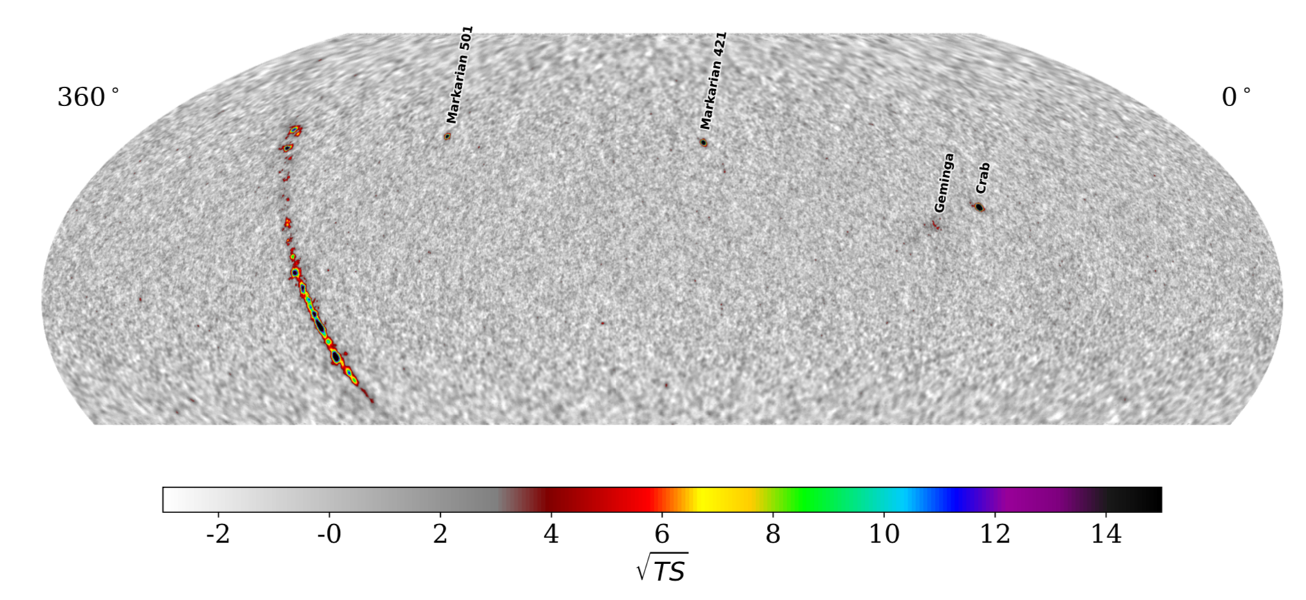
HAWC Survey
HAWC Collaboration, ApJ 843 (2017), 40.
Notes:
We present the first catalog of TeV gamma-ray sources realized with the recently completed High Altitude Water Cherenkov Observatory (HAWC). It is the most sensitive wide field-of-view TeV telescope currently in operation, with a 1-year survey sensitivity of ∼5–10% of the flux of the Crab Nebula. With an instantaneous field of view >1.5 sr and >90% duty cycle, it continuously surveys and monitors the sky for gamma ray energies between hundreds GeV and tens of TeV.
HAWC is located in Mexico at a latitude of 19◦ North and was completed in March 2015. Here, we present the 2HWC catalog, which is the result of the first source search realized with the complete HAWC detector. Realized with 507 days of data and represents the most sensitive TeV survey to date for such a large fraction of the sky. A total of 39 sources were detected, with an expected contamination of 0.5 due to background fluctuation. Out of these sources, 16 are more than one degree away from any previously reported TeV source. The source list, including the position measurement, spectrum measurement, and uncertainties, is reported. Seven of the detected sources may be associated with pulsar wind nebulae, two with supernova remnants, two with blazars, and the remaining 23 have no firm identification yet.

Slide 23
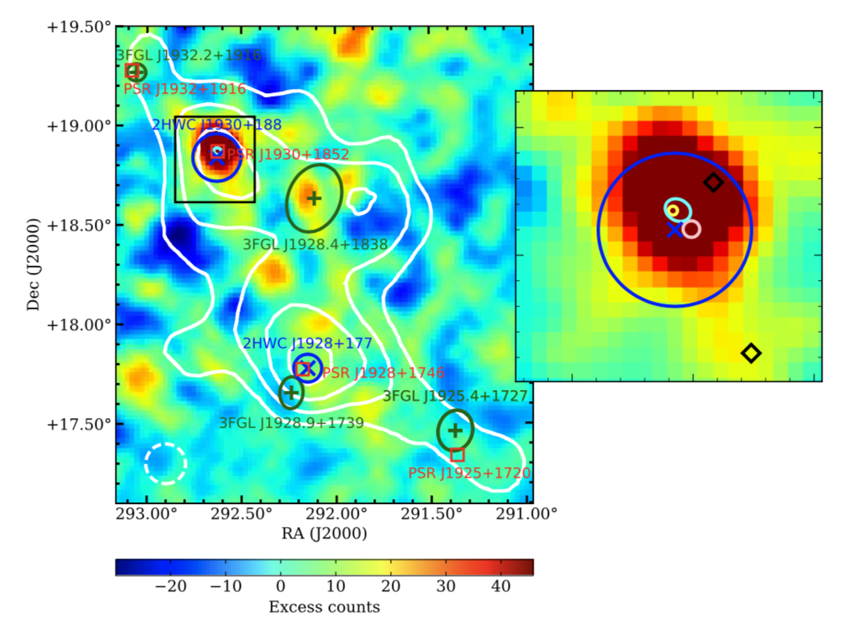
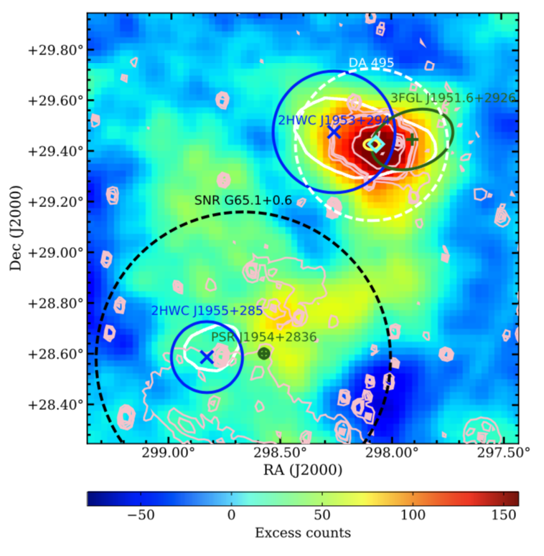
Complementarity
VERITAS, Fermi-LAT and HAWC. ApJ 866 (2018), 24.
Notes:
Figure 3. VERITAS gamma-ray counts map of the SNRG54.1+0.3 region with point source search cuts. The θ cut used for the study, θ <0.1◦, is shown as a white dashed circle. The extension of the radio emission from SNR G54.1+0.3 (Lang et al. 2010) is shown with a cyan ellipse. A zoomed 0.36◦ by 0.36◦ view around SNRG54.1+0.3 is shown on the right inset within the black box. The centroid of a known TeV source, VER J1930+188, measured by VERITAS, is shown with a yellow circle in the right inset. The centroid of the source measured by H.E.S.S. is shown with a pink circle in the inset. In the region around VERJ1930+188, Fermi-LAT data are best described with a model with two point sources whose locations are indicated with black diamond markers. The point source coinciding with the VERITAS source has a TS value of 23, while the other source has a TS value of 17. The four dark green crosses are the locations of 3FGL sources with dark green ellipses showing the 1σ uncertainty of the location. The two blue x marks indicate the centroids of two HAWC sources in the region with 1σ uncertainty of the position marked with blue circles. Four pulsars with a spin-down luminosity higher than 1035 erg s−1 are marked with red boxes. White contours are HAWC’s significance contours of 5, 6, 7, and 8σ.
VERITAS gamma-ray counts map of the PWN DA 495 and the surrounding region with extended source search cuts, θ <0.3◦. The re- gion used for the spectral analysis with VERITAS data is shown with a white dashed circle. The yel- low circle is the centroid measured by VERITAS. Two dark green crosses and ellipses are the loca- tion and 1σ uncertainty of the location of 3FGL sources. Blue x marks indicate the centroids of two HAWC sources in the region with blue cir- cles showing 1σ uncertainty. White contours are HAWC’s significance contours of 5σ. The cyan di- amond is the location of an X-ray compact source, 1WGA J1952.2+2925 (Arzoumanian et al. 2004). Light pink contours show the radio contours around PWNDA495 measured by the Canadian Galactic Plane Survey in the 1.42 GHz band (Taylor et al. 2003). The extension of radio emission from SNR G65.1+0.6 is marked with a dashed black line

Slide 24
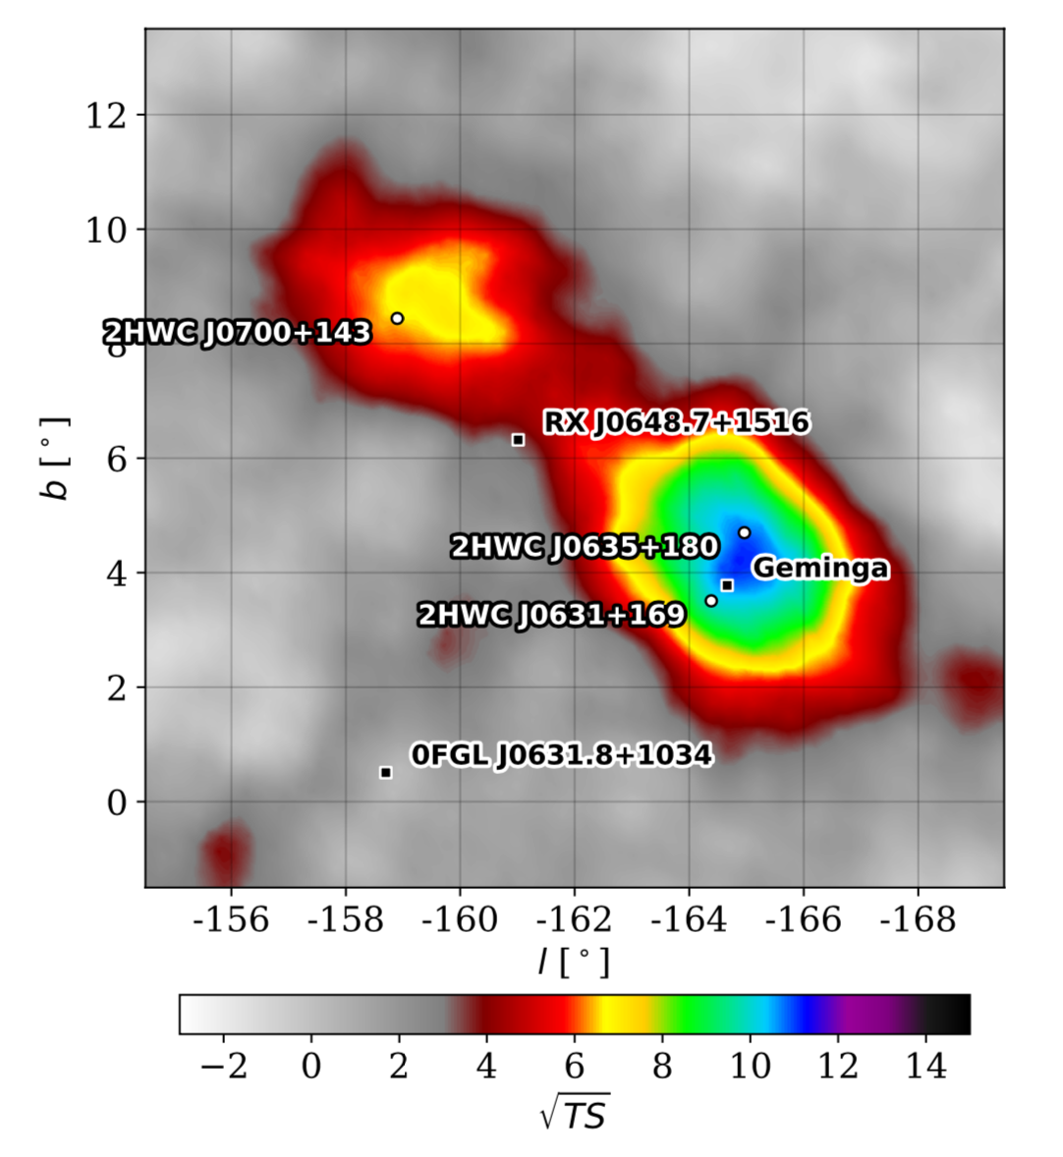
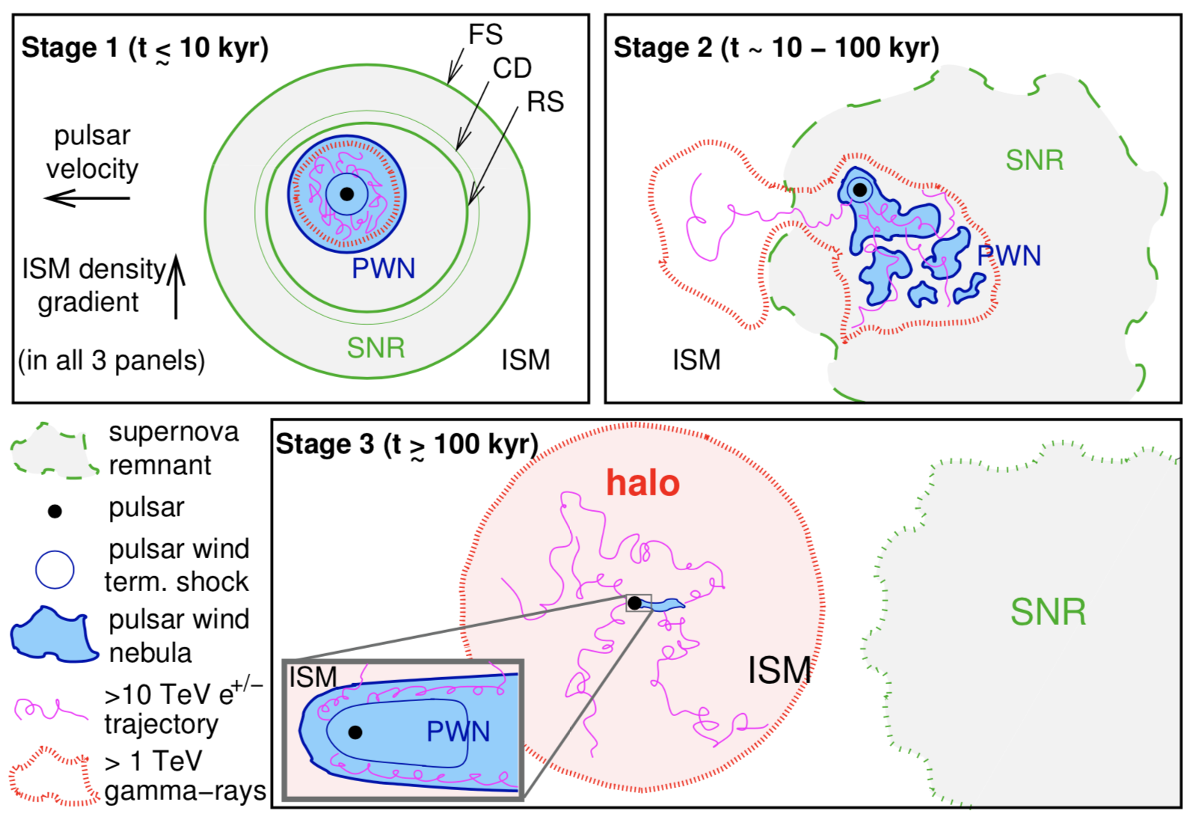
TeV Halos
HAWC Collaboration, ApJ 843 (2017), 40.
Giacinti et al. arXiv:1907.12121
Notes:
Geminga and Monogem. Also HAWC J0635+070 may be the TeV halo of the pulsar PSR J0633+0632

Slide 25
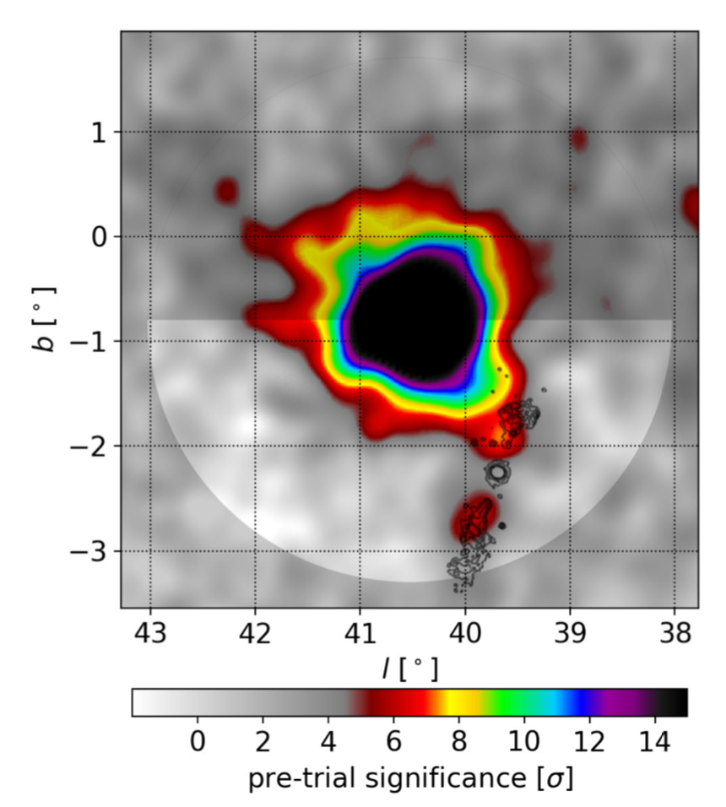
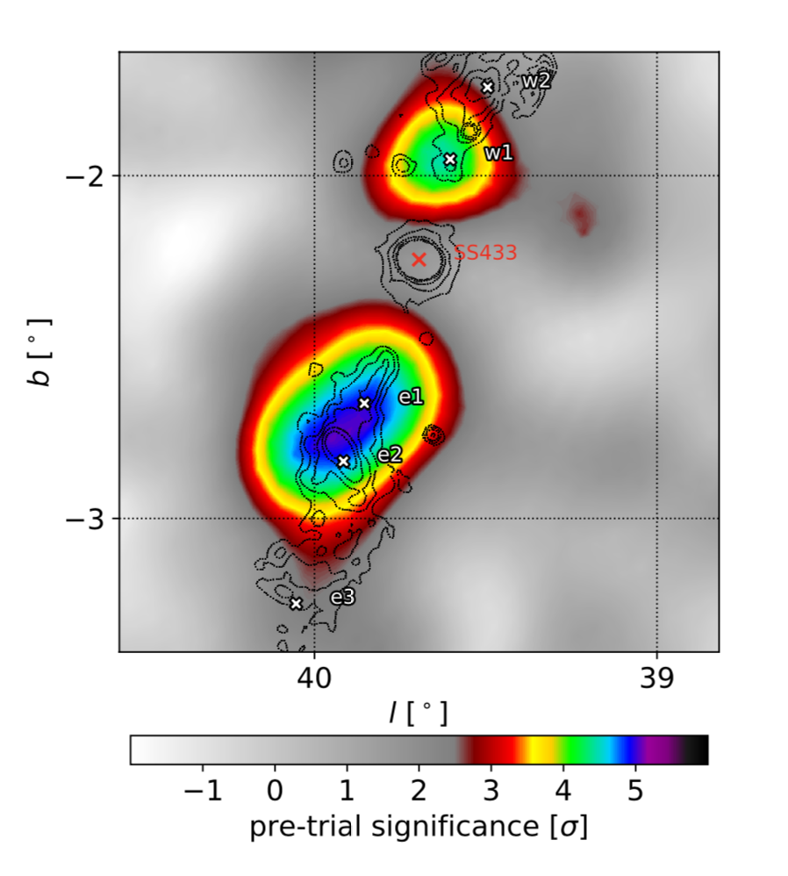
SS 433
HAWC Collaboration, Nature 562, 82 (2018)
Notes:
SS 433 is a binary system containing a supergiant star that is overflowing its Roche lobe with matter accreting onto a compact object (either a black hole or neutron star)^{1,2,3}. Two jets of ionized matter with a bulk velocity of approximately 0.26c (where c is the speed of light in vacuum) extend from the binary, perpendicular to the line of sight, and terminate inside W50, a supernova remnant that is being distorted by the jets^{2,4,5,6,7,8}. SS 433 differs from other microquasars (small-scale versions of quasars that are present within our own Galaxy) in that the accretion is believed to be super-Eddington^{9,10,11}, and the luminosity of the system is about 10⁴⁰ ergs per second^{2,9,12,13}. The lobes of W50 in which the jets terminate, about 40 parsecs from the central source, are expected to accelerate charged particles, and indeed radio and X-ray emission consistent with electron synchrotron emission in a magnetic field have been observed^{14,15,16}. At higher energies (greater than 100 gigaelectronvolts), the particle fluxes of γ-rays from X-ray hotspots around SS 433 have been reported as flux upper limits^{6,17,18,19,20}. In this energy regime, it has been unclear whether the emission is dominated by electrons that are interacting with photons from the cosmic microwave background through inverse-Compton scattering or by protons that are interacting with the ambient gas. Here we report teraelectronvolt γ-ray observations of the SS 433/W50 system that spatially resolve the lobes. The teraelectronvolt emission is localized to structures in the lobes, far from the centre of the system where the jets are formed. We have measured photon energies of at least 25 teraelectronvolts, and these are certainly not Doppler-boosted, because of the viewing geometry. We conclude that the emission—from radio to teraelectronvolt energies—is consistent with a single population of electrons with energies extending to at least hundreds of teraelectronvolts in a magnetic field of about 16 microgauss.

Slide 26
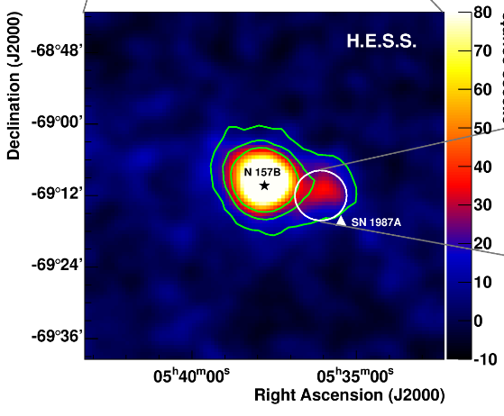
“Galactic” sources in the Local Group
The LMC hosts some exceptionally powerful TeV emitters:
  N157B: PWN of the most energetic pulsar known.
  N132 D: a radio-loud SNR.
  30 Dor C: a wind-blown “superbubble”.
  LMC P3: a 10-day gamma-ray binary.
  But SN1987a is still not detected.
H.E.S.S. Collaboration. Science 347 (2015) 406-412
Notes:
The Large Magellanic Cloud, a satellite galaxy of the Milky Way, has been observed with the High Energy Stereoscopic System (H.E.S.S.) above an energy of 100 billion electron volts for a deep exposure of 210 hours. Three sources of different types were detected: the pulsar wind nebula of the most energetic pulsar known N 157B, the radio-loud supernova remnant N 132D and the largest non-thermal X-ray shell - the superbubble 30 Dor C. The unique object SN 1987A is, surprisingly, not detected, which constrains the theoretical framework of particle acceleration in very young supernova remnants. These detections reveal the most energetic tip of a gamma-ray source population in an external galaxy, and provide via 30 Dor C the unambiguous detection of gamma-ray emission from a superbubble. The 30 Dor C shell also emits non-thermal X-rays and radio and optical radiation and appears to have been produced by the stellar winds and supernovae in the OB association LH 90
LMC is at 50 kpc
10s of Dsphs within 100 kpc

Slide 27
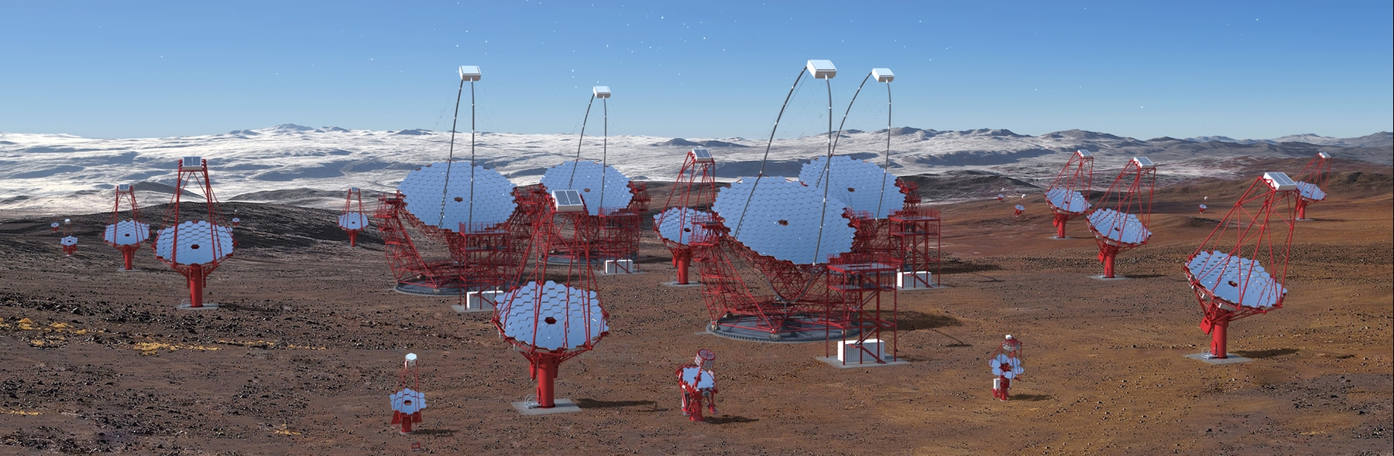
Conclusions
Galactic TeV gamma-ray astronomy is still a young, and rapidly evolving field.
As always, progress and new discoveries have opened more questions and opportunities.
To address these requires better sensitivity and better spectral, spatial and temporal resolution.
CTA is the tool to provide this.

