Slide 1


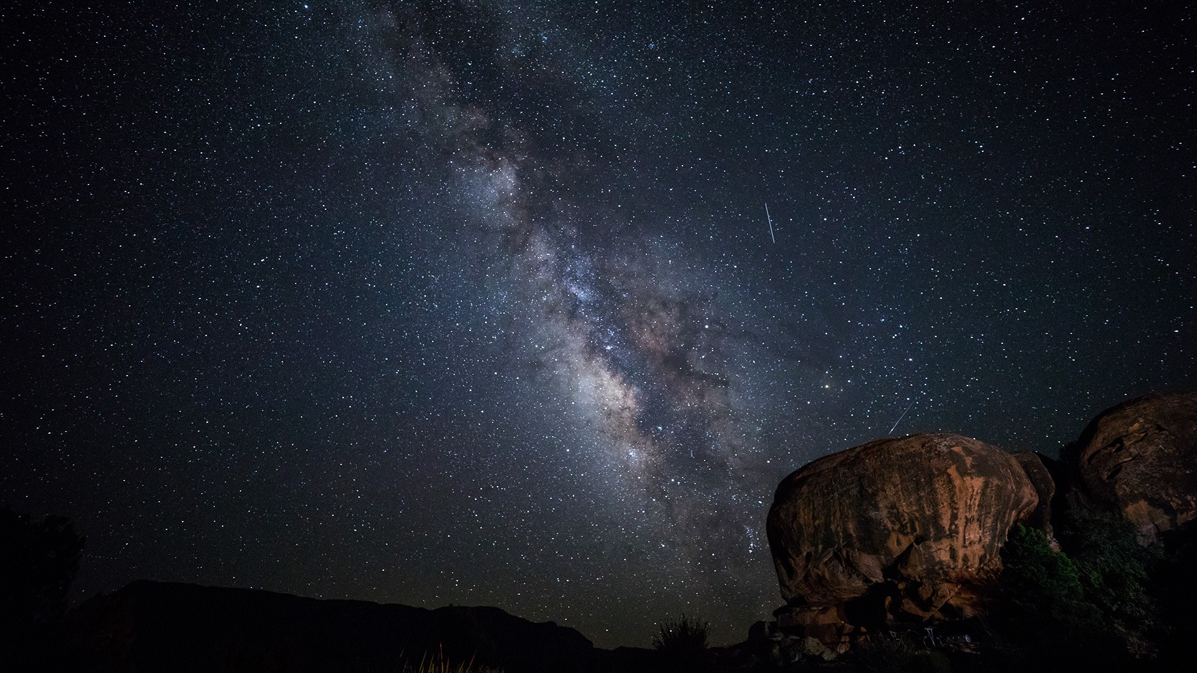
Searching for Axions and Axionic Dark Matter with Interference and
Axion-induced Nuclear Moments
V. V. Flambaum, I. B. Samsonov and H. B. Tran Tan
School of Physics
University of New South Wales, Sydney, Australia
Phys. Dark Universe 24, 100272, Flambaum, Samsonov, Tran Tan, Stadnik & Budker
Int. J. Mod. Phys. A, 33, 31, 1844030, Flambaum, Samsonov, Tran Tan, Stadnik & Budker
Phys. Rev. D 98, 095028, Flambaum, Samsonov, Tran Tan & Budker
Phys. Rev. D 99, 115019, Flambaum, Samsonov & Tran Tan
Phys. Rev. A 99, 013430, Tran Tan, Flambaum & Samsonov
ArXiv:1808.01856, Tran Tan, Flambaum & Berengut
ArXiv:1904.07609, Flambaum & Tran Tan
ArXiv:1910.07705, Flambaum, Tran Tan, Budker & Wickenbrock
TeVPA – Sydney, Australia – December 2019

Slide 2
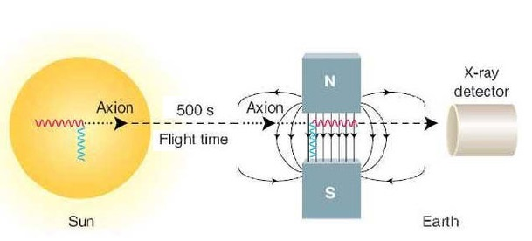
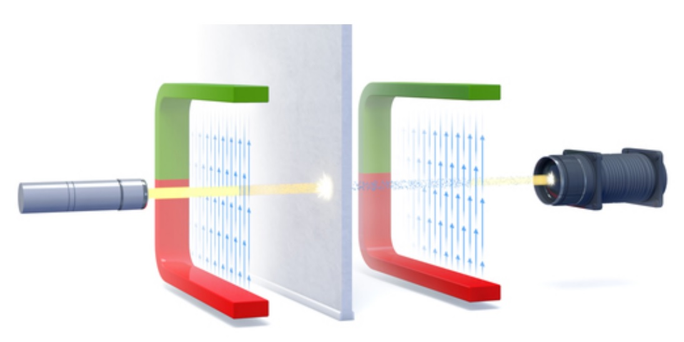
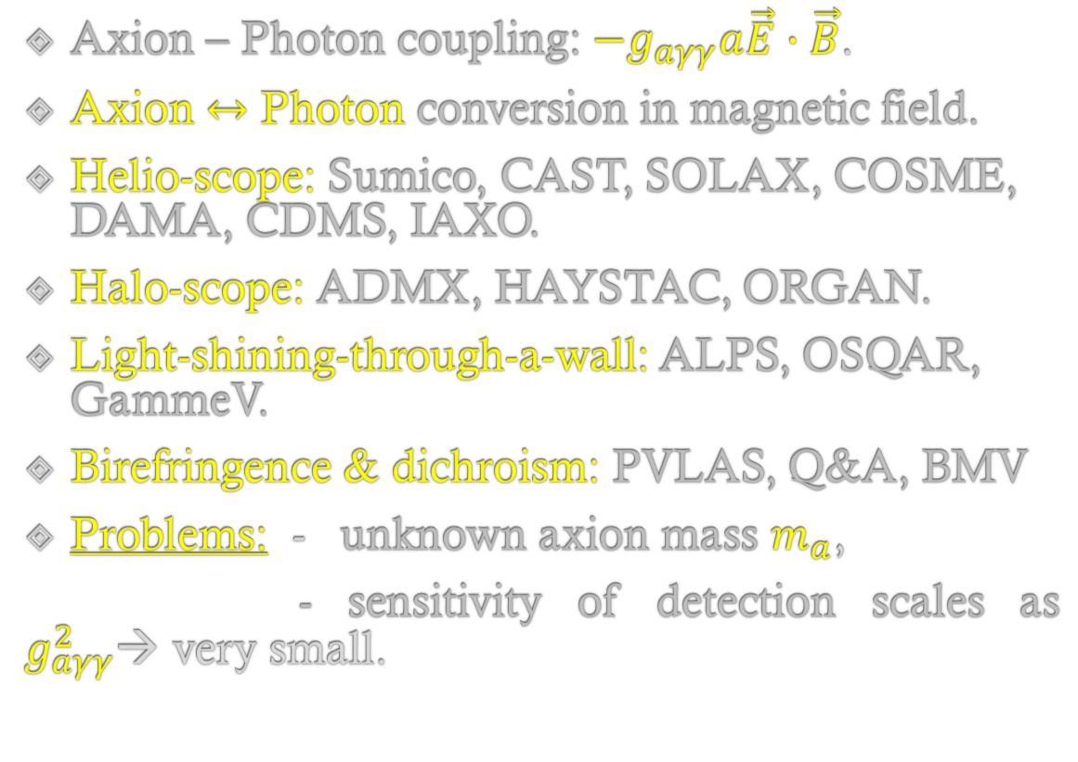
Traditional searches for Axion
Axion – Photon coupling: $−g_{aγγ}a\vec{E}∙\vec{B}$.
Axion $↔$ Photon conversion in magnetic field.
Helio-scope: Sumico, CAST, SOLAX, COSME, DAMA, CDMS, IAXO.
Halo-scope: ADMX, HAYSTAC, ORGAN.
Light-shining-through-a-wall: ALPS, OSQAR, GammeV.
Birefringence & dichroism: PVLAS, Q&A, BMV
Problems: - unknown axion mass $m_{a}$,
- sensitivity of detection scales as $g_{aγγ}^{2}$→ very small.
Converting solar axions into photons
Light-shining-through-a-wall (ALPS)
TeVPA – Sydney, Australia – December 2019

Slide 3
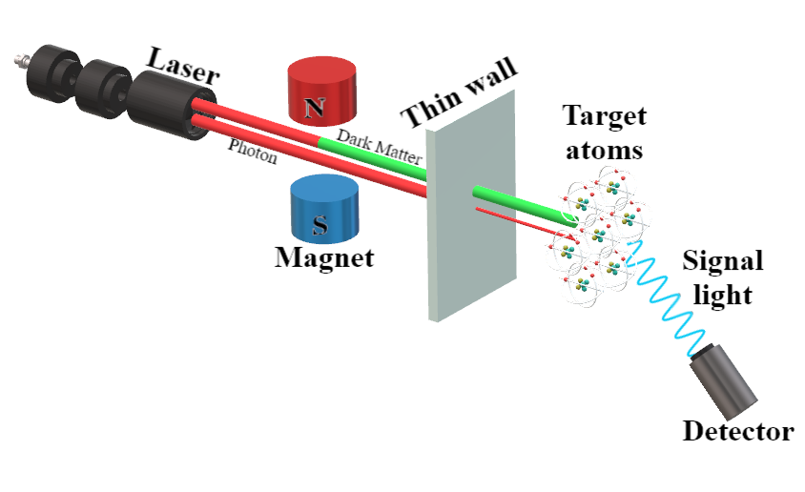
Our work: Axion – Photon interference – Set-up
Don’t block all photons with the wall.
Use Atomic/Molecular transitions for detection.
M_{total} = M_{axion} + M_{photon} → P = M²_{total} = M²_{axion} + 2 M_{axion}M_{photon} + M²_{photon}
Interference of absorption amplitudes → signal linear in coupling constant → enhancement.
Axion-photon Interference set-up
TeVPA – Sydney, Australia – December 2019

Slide 4
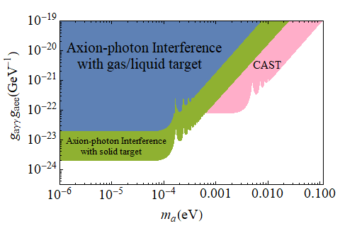
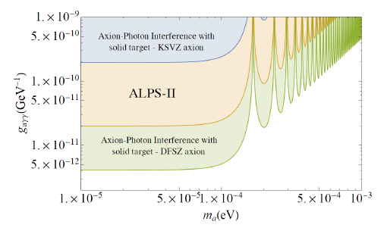
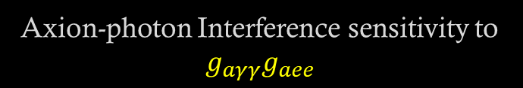
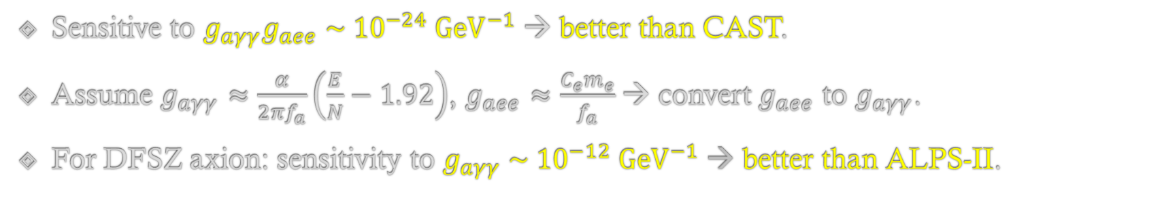

Our work: Axion – Photon interference – Sensitivity
Sensitive to $g_{aγγ}g_{aee} \sim {10}^{−24} {GeV}^{−1}$ → better than CAST.
Assume $g_{aγγ}≈\frac{α}{2πf_{a}}\left(\frac{E}{N}−1.92\right)$, $g_{aee}≈\frac{C_{e}m_{e}}{f_{a}}$→ convert $g_{aee}$ to $g_{aγγ}$.
For DFSZ axion: sensitivity to $g_{aγγ} \sim {10}^{−12} {GeV}^{−1}$ → better than ALPS-II.
Axion-photon Interference sensitivity to $g_{aγγ}g_{aee}$
Axion-photon Interference sensitivity to $g_{aγγ}$
TeVPA – Sydney, Australia – December 2019

Slide 5
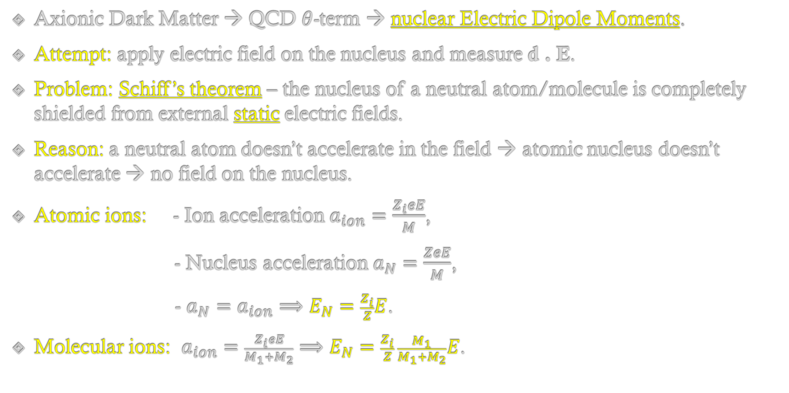
Nuclear EDMs & Schiff’s theorem
Axionic Dark Matter → QCD $θ$-term → nuclear Electric Dipole Moments.
Attempt: apply electric field on the nucleus and measure d . E.
Problem: Schiff’s theorem – the nucleus of a neutral atom/molecule is completely shielded from external static electric fields.
Reason: a neutral atom doesn’t accelerate in the field → atomic nucleus doesn’t accelerate → no field on the nucleus.
Atomic ions: - Ion acceleration $a_{ion}=\frac{Z_{i}eE}{M}$,
- Nucleus acceleration $a_{N}=\frac{ZeE}{M}$,
- $a_{N}=a_{ion}⟹E_{N}=\frac{Z_{i}}{Z}E$.
Molecular ions: $a_{ion}=\frac{Z_{i}eE}{M_{1}+M_{2}}⟹E_{N}=\frac{Z_{i}}{Z} \frac{M_{1}}{M_{1}+M_{2}}E$.
TeVPA – Sydney, Australia – December 2019

Slide 6
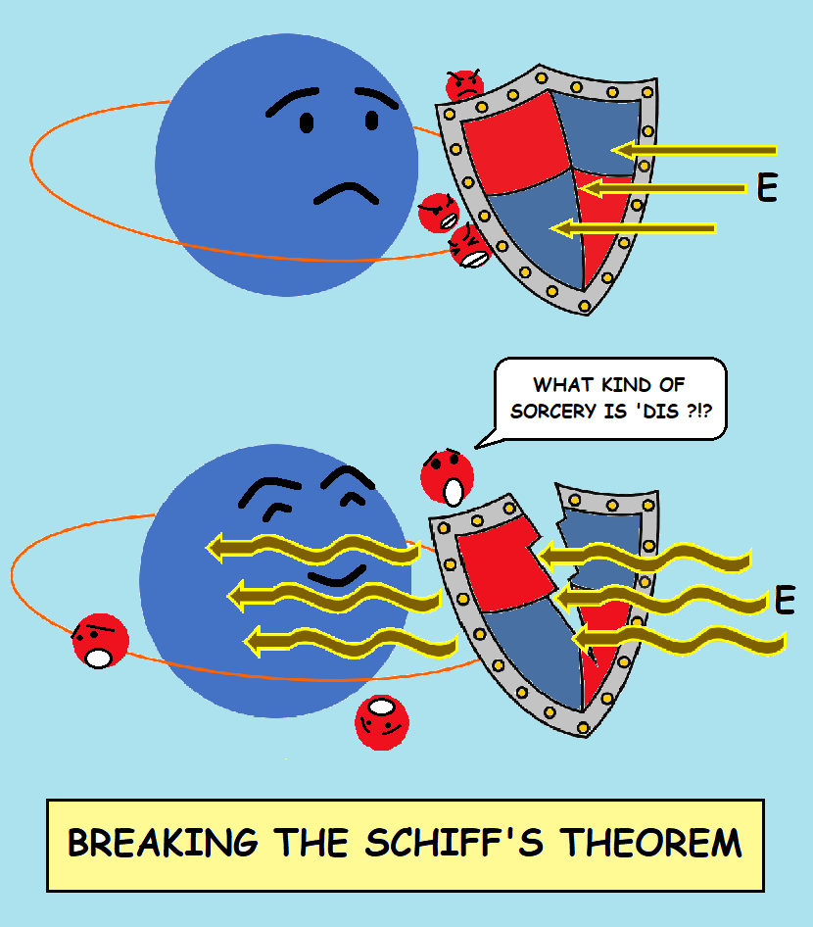
Our solution: Breaking Schiff’s theorem
Schiff’s theorem: Constant electric fields are screened.
Our solution: Oscillating electric fields are NOT screened!
TeVPA – Sydney, Australia – December 2019

Slide 7
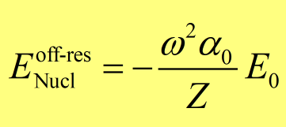
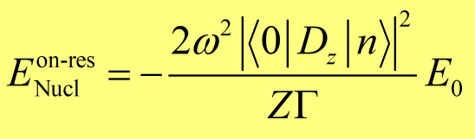
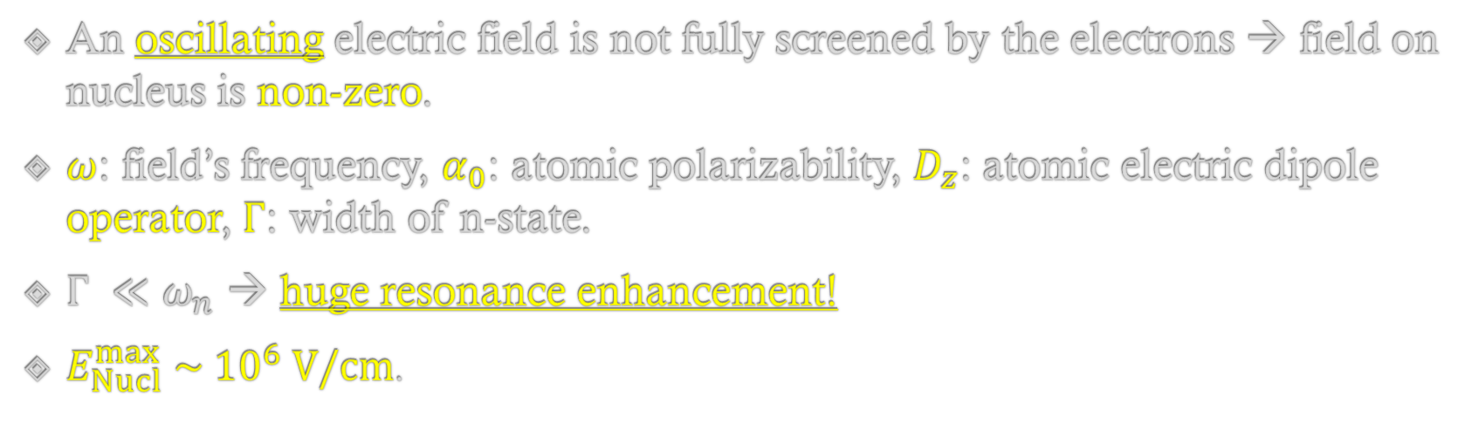
Our solution: Breaking Schiff’s theorem - Atoms
An oscillating electric field is not fully screened by the electrons → field on nucleus is non-zero.
$ω$: field’s frequency, $α_{0}$: atomic polarizability, $D_{z}$: atomic electric dipole operator, $Γ$: width of n-state.
$Γ ≪ω_{n}$ → huge resonance enhancement!
$E_{Nucl}^{max} \sim {10}^{6} V/cm$.
Off-resonance screening
On-resonance enhancement
TeVPA – Sydney, Australia – December 2019

Slide 8
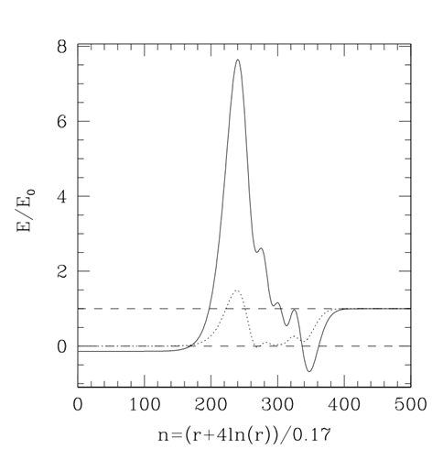
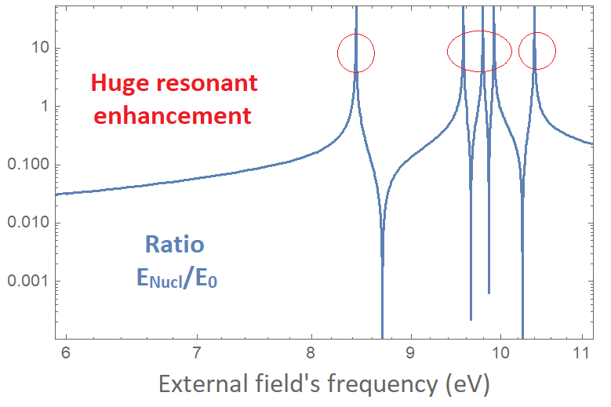

Our solution: Breaking Schiff’s theorem - Atoms
$E\left(r\right)/E_{0}$, Xe, $ω=0.3$ a.u)
$E_{nucl}/E_{0}$ – Dependence on $ω$
TeVPA – Sydney, Australia – December 2019

Slide 9
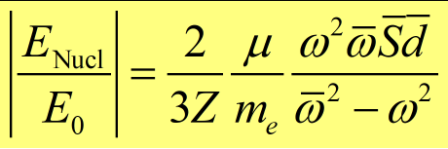
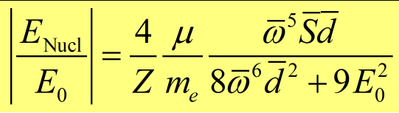
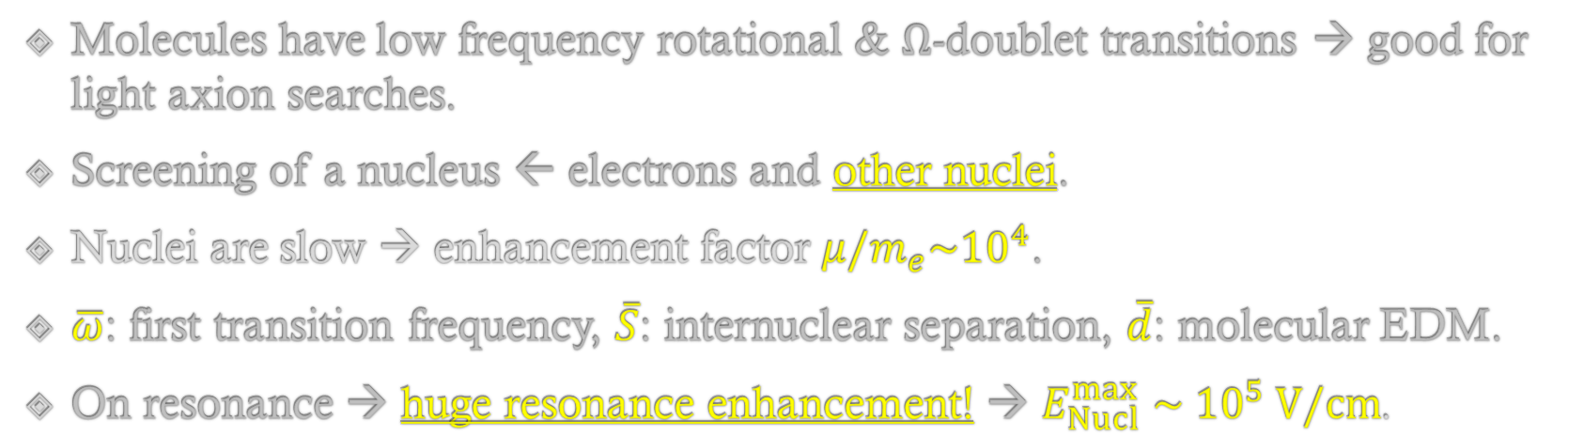
Our solution: Breaking Schiff’s theorem - Molecules
Molecules have low frequency rotational & $Ω$-doublet transitions → good for light axion searches.
Screening of a nucleus ← electrons and other nuclei.
Nuclei are slow → enhancement factor $μ/m_{e}\sim {10}^{4}$.
$\overline{ω}$: first transition frequency, $\overline{S}$: internuclear separation, $\overline{d}$: molecular EDM.
On resonance → huge resonance enhancement! → $E_{Nucl}^{max} \sim {10}^{5} V/cm$.
Off-resonance screening
On-resonance enhancement (first rotational frequency)
TeVPA – Sydney, Australia – December 2019

Slide 10
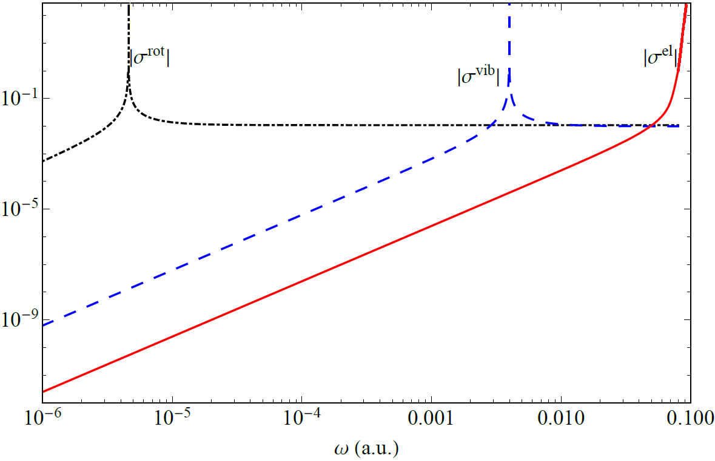
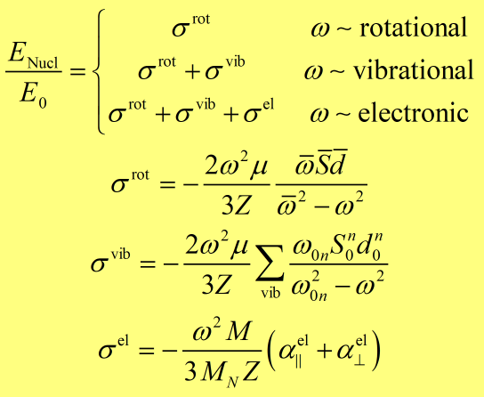

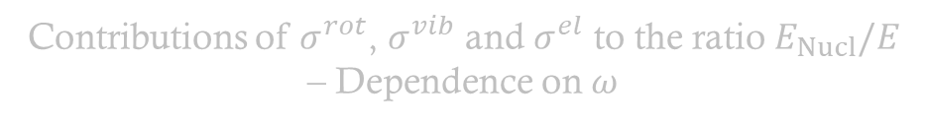
Our solution: Breaking Schiff’s theorem - Molecules
Contributions of $σ^{rot}$, $σ^{vib}$ and $σ^{el}$ to the ratio $E_{Nucl}/E$ – Dependence on $ω$
Definitions of $σ^{rot}$, $σ^{vib}$ and $σ^{el}$
TeVPA – Sydney, Australia – December 2019

Slide 11
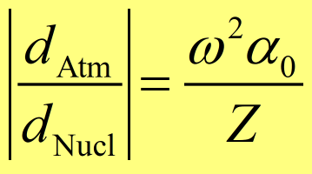
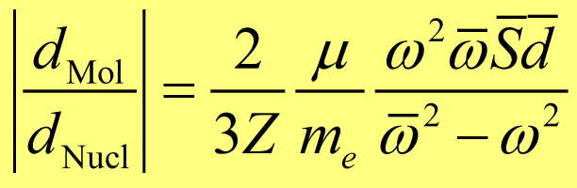
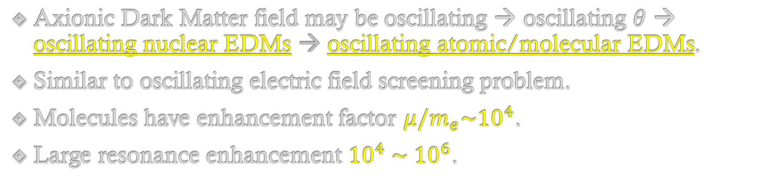
Our work: Effects of oscillating nuclear EDMs
Axionic Dark Matter field may be oscillating → oscillating $θ$ → oscillating nuclear EDMs → oscillating atomic/molecular EDMs.
Similar to oscillating electric field screening problem.
Molecules have enhancement factor $μ/m_{e}\sim {10}^{4}$.
Large resonance enhancement ${10}^{4} \sim {10}^{6}$.
Atomic EDM induced by oscillating nuclear EDM
Molecular EDM induced by oscillating nuclear EDM
TeVPA – Sydney, Australia – December 2019

Slide 12
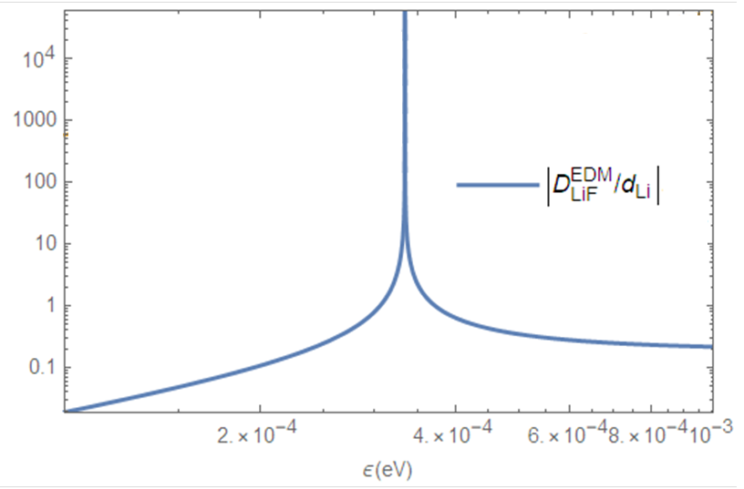
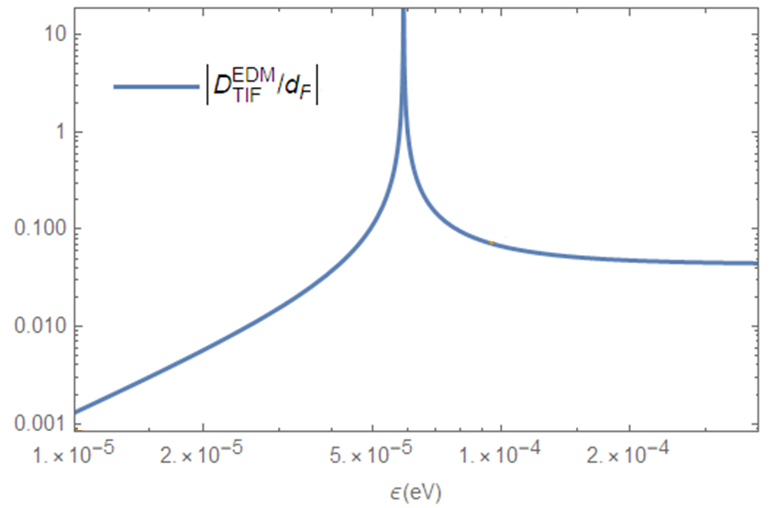
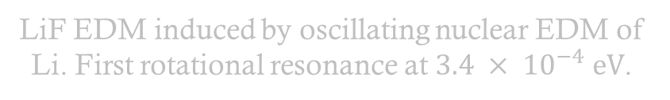
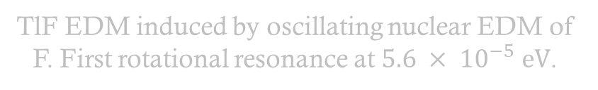
Our work: Effects of oscillating nuclear EDMs
LiF EDM induced by oscillating nuclear EDM of Li. First rotational resonance at ${3.4 × 10}^{−4} eV$.
TlF EDM induced by oscillating nuclear EDM of F. First rotational resonance at ${5.6 × 10}^{−5} eV$.
TeVPA – Sydney, Australia – December 2019

Slide 13
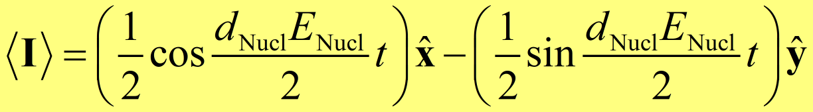
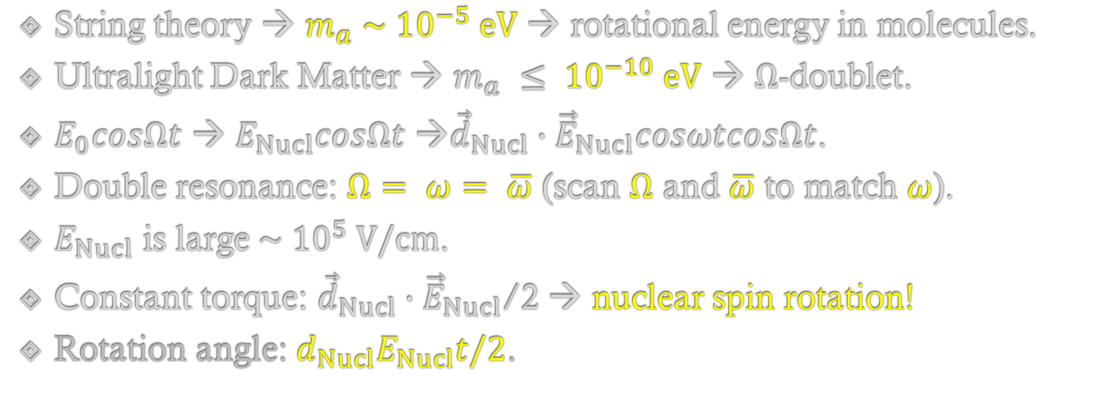
Why molecules? – Nuclear spin rotation
String theory → $m_{a} \sim {10}^{−5} eV$ → rotational energy in molecules.
Ultralight Dark Matter → $m_{a} ≤ {10}^{−10} eV$ → $Ω$-doublet.
$E_{0}cosΩt$ → $E_{Nucl}cosΩt$ →${\vec{d}}_{Nucl}∙{\vec{E}}_{Nucl}cosωtcosΩt$.
Double resonance: $Ω= ω= \overline{ω}$ (scan $Ω$ and $\overline{ω}$ to match $ω$).
$E_{Nucl}$ is large $\sim {10}^{5} V/cm$.
Constant torque: ${\vec{d}}_{Nucl}∙{\vec{E}}_{Nucl}$/2 → nuclear spin rotation!
Rotation angle: $d_{Nucl}E_{Nucl}t/2$.
Precession of nuclear spin ½ due to interaction of an oscillating nuclear EDM and an oscillating electric field
TeVPA – Sydney, Australia – December 2019

Slide 14
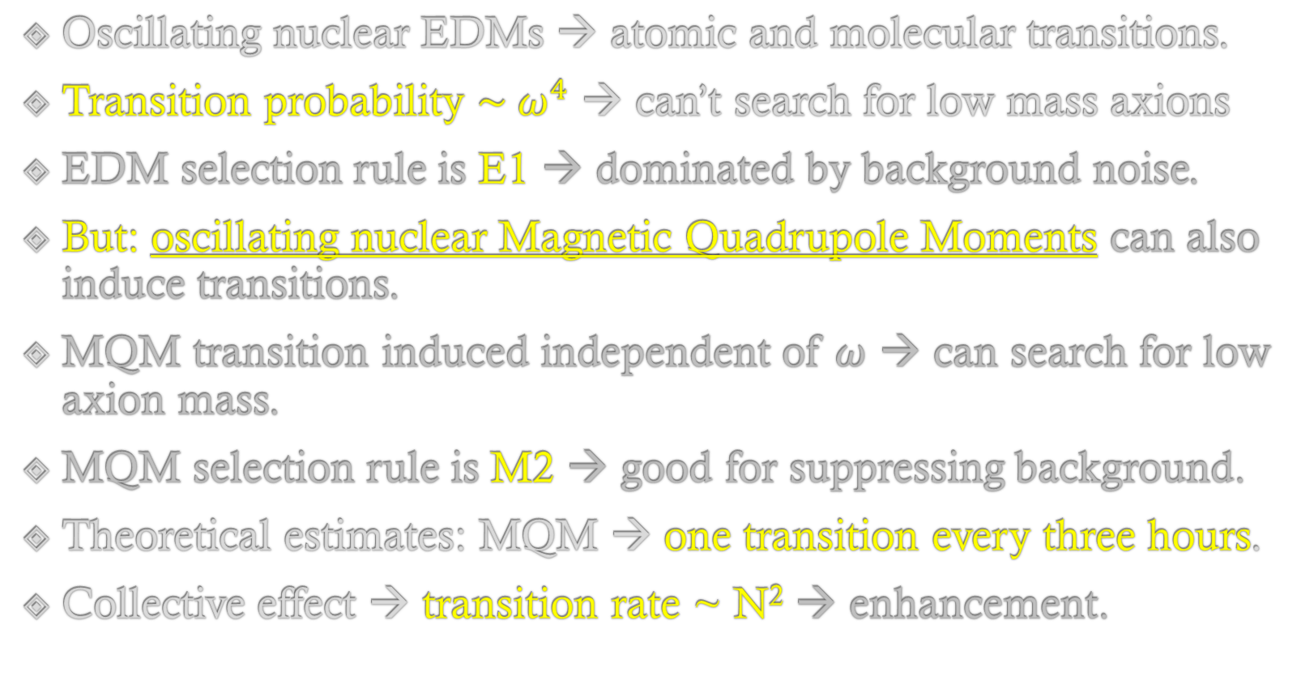
Oscillating nuclear moments cause transitions
Oscillating nuclear EDMs → atomic and molecular transitions.
Transition probability ${\sim ω}^{4}$ → can’t search for low mass axions
EDM selection rule is E1 → dominated by background noise.
But: oscillating nuclear Magnetic Quadrupole Moments can also induce transitions.
MQM transition induced independent of $ω$ → can search for low axion mass.
MQM selection rule is M2 → good for suppressing background.
Theoretical estimates: MQM → one transition every three hours.
Collective effect → transition rate ~ N² → enhancement.
TeVPA – Sydney, Australia – December 2019

Slide 15
Summary
Our proposal: using Axion-photon interference → linear in coupling constant → better sensitivity.
Schiff’s theorem stops us detecting axions with nuclear EDMs.
Our solution: use Oscillating electric fields → circumvent Schiff’s theorem.
Oscillating nuclear EDMs → oscillating Atomic & Molecular EDMs or nuclear spin rotation.
Oscillating nuclear MQMs → Atomic & Molecular transitions.
Thank you!
TeVPA – Sydney, Australia – December 2019

Slide 16
Axion as a Dark Matter Candidate
AXION was proposed to resolve the CP problem in QCD.
AXION is electrically neutral and interacts very weakly with normal matter.
AXION field may be created non-thermally in the early Universe.
AXION field may form a coherent condensate of zero momentum → cold Dark Matter.
AXION mass and coupling constants are unknown → need to probe these parameters.
TeVPA – Sydney, Australia – December 2019

