Slide 1
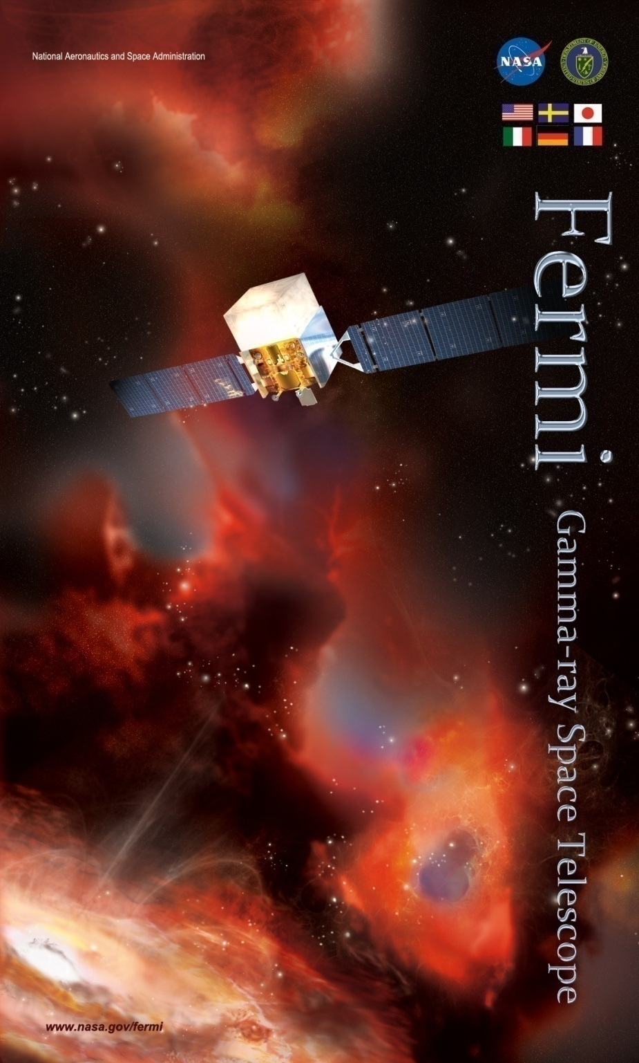
Study of the Cosmic Rays and Interstellar Medium in Local HI Clouds using Fermi-LAT Gamma-Ray Observations
2019-12_TeVPA_localHI.ppt
Dec. 5, 2019 @ TeVPA 2019 in Sydney, Australia
Tsunefumi Mizuno (Hiroshima Univ.)
S. Abdollahi, Y. Fukui, K. Hayashi, T. Koyama, A. Okumura, H. Tajima, and H. Yamamoto
On behalf of the Fermi-LAT collaboration
Notes:
Local CR spectrum is the objective
Accurate estimate of the ISM gas is important for studying CRs

Slide 2
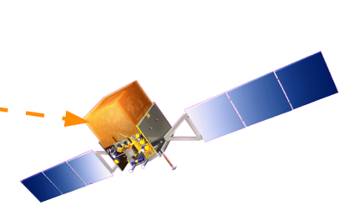
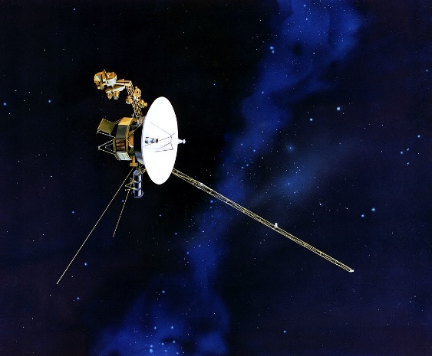
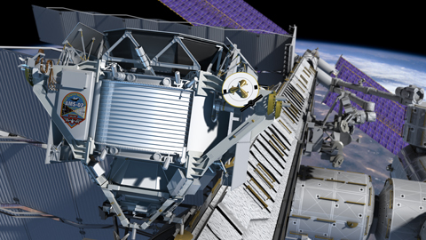
Motivation: Local Interstellar Spectra (LIS)
LIS of galactic cosmic-rays (CRs) provide vital information about their origin and propagation
  Special variation? Spectral break? (e.g., Ptsukin +06)
In addition to direct measurements, γ-ray observation is unique and crucial to constrain the LIS
Grenier, Black &
Strong 2015
Fermi-LAT
AMS-02
Voyager 1&2
Notes:
Let me remind you the motivation
1: origin and propagation of CRs (injection, source distribution, and propagation)
2: gamma-ray observation is unique (illustrated by the figure) (gap in 1 – a few 10s GeV)

Slide 3


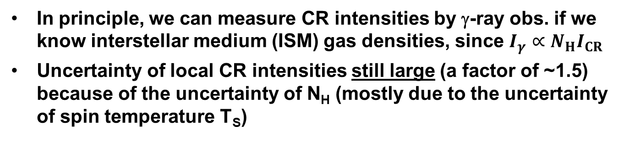
Caveat: Uncertainty of ISM & CR
In principle, we can measure CR intensities by γ-ray obs. if we know interstellar medium (ISM) gas densities, since $I_{γ}∝N_{H}I_{CR}$
Uncertainty of local CR intensities still large (a factor of ~1.5) because of the uncertainty of N_{H} (mostly due to the uncertainty of spin temperature T_{S})
Grenier, Black &
Strong 2015
γ-ray emissivity of local clouds ($∝I_{CR}$)
($E_{γ}\sim \frac{1}{10}E_{p}$)
Average of
high lat.
Individual clouds
Arms in
Galactic plane
0.1 1 10 GeV
0.1 1 10 GeV
Notes:
3
However, there is one caveat in g-ray observation; ISM density and CR intensity are uncertain to some extend.
1: In principle, we can measure CR intensity through gamma-ray obs.
2: Uncertainty by a factor of ~1.5 due to uncertainty of NH (illustrated by the figures; agreement is good but not perfect)

Slide 4
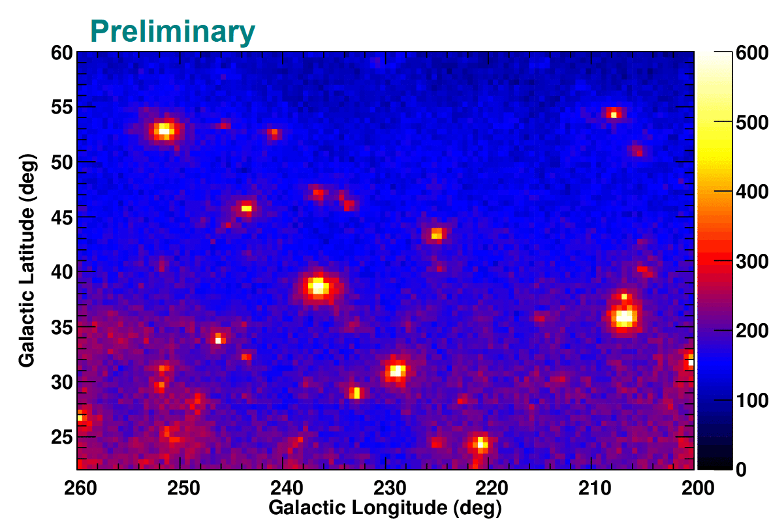
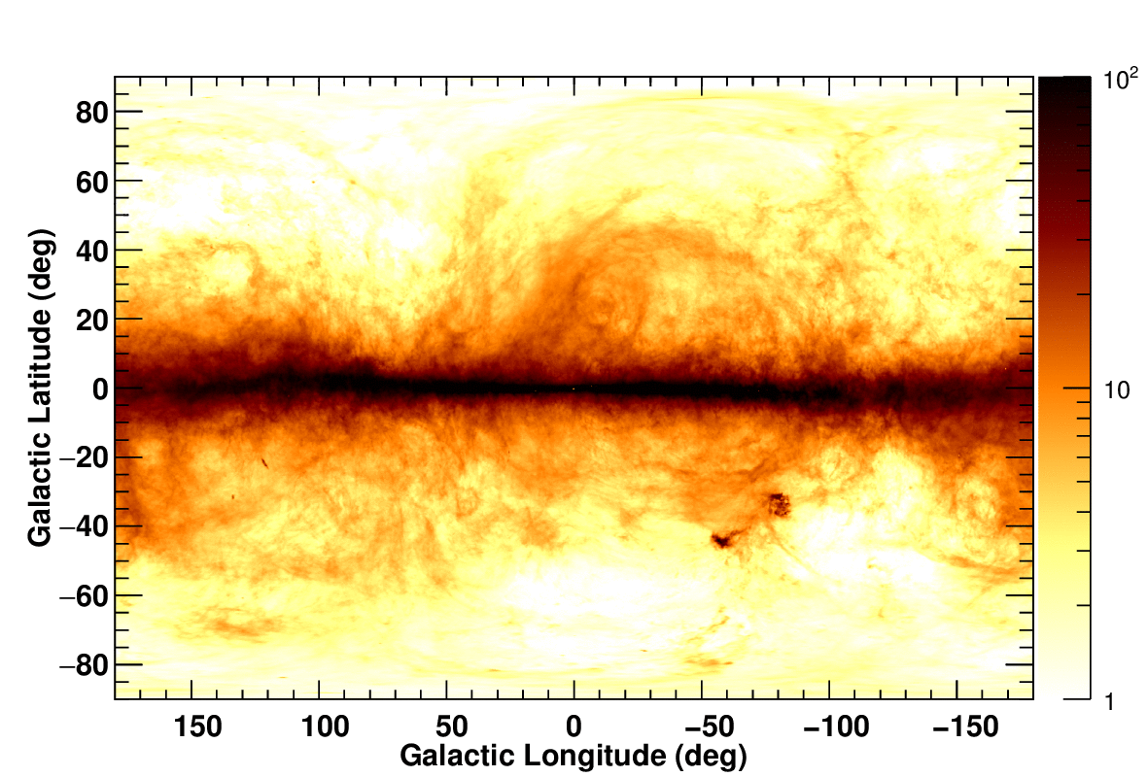
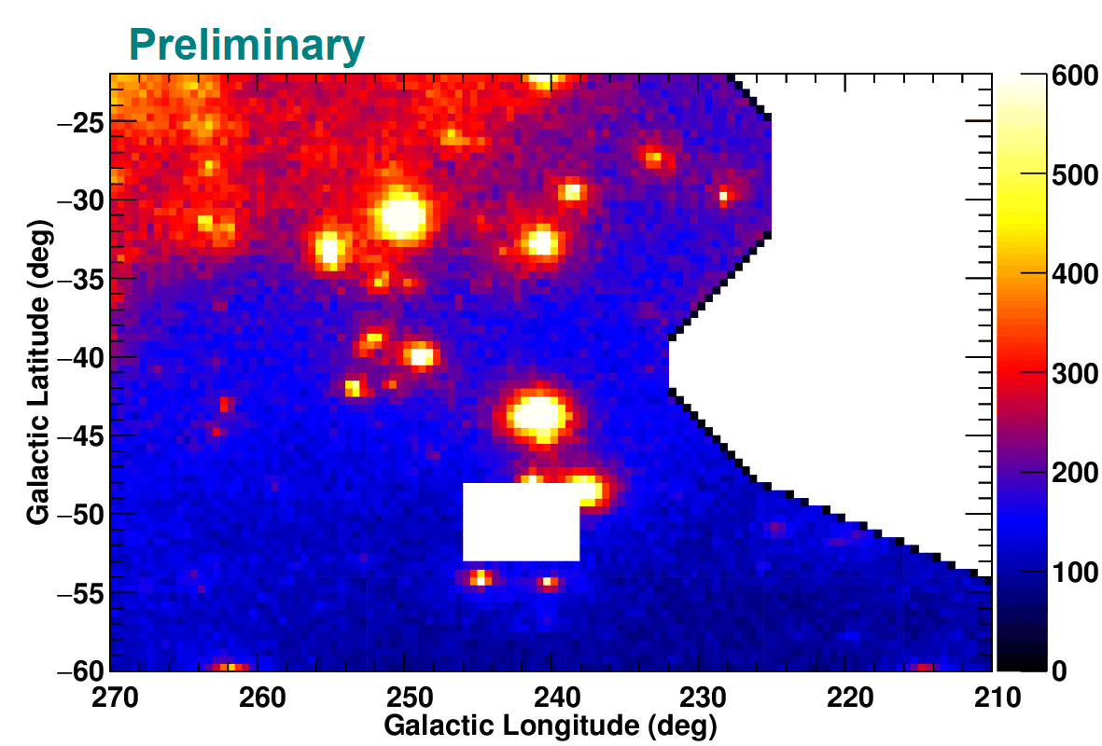

Objectives of the Study
Accurate estimate of ISM gas densities is crucial to constrain Galactic CR intensities
Procedure to trace “dark gas” (gas not properly traced by HI and CO line surveys (Grenier+05)) not established yet => detailed study of nearby clouds
$N_{HI}^{thin}$ in 10²⁰ cm⁻² and
Regions of interest (ROI)
Fermi Data (>100 MeV)
Notes:
Here I show the objectives of this study
ROIs: suitable to study the property of local HI clouds and CRs (no strong CO, high-lat)

Slide 5
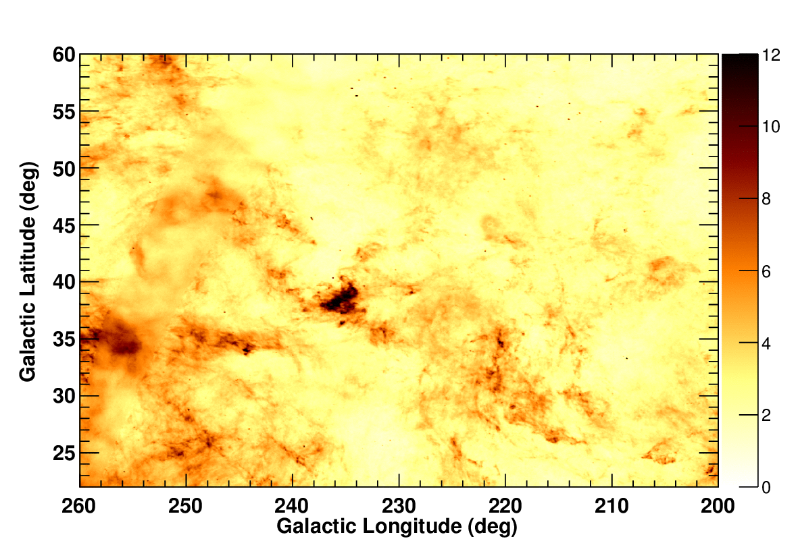
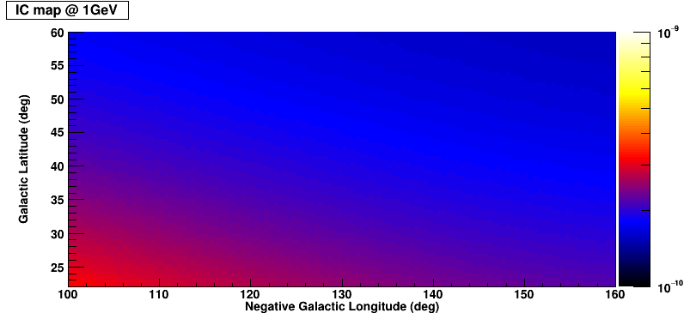

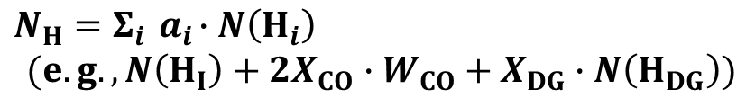

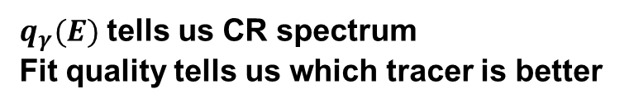




Procedure of the Analysis
Uniform CR intensity (assumption testable by energy dependence) -> we can model γ-ray intensity as a linear combination of templates
Fermi Data (8 yrs, 0.1-25.6 GeV)
Planck dust, LAB H_{I}, W_{CO}, etc.
$$I_{γ}\left(l, b, E\right)= q_{γ}\left(E\right)∙N_{H}\left(l,b\right)$$
$$+I_{IC}\left(l, b, E\right)$$
$$+I_{iso}\left(E\right)$$
$$+Σ I_{source}\left(l,b,E\right)$$
$$+…$$
$q_{γ}(E)$ tells us CR spectrum
Fit quality tells us which tracer is better
IC model (e.g., galprop)
$$N_{H}=Σ_{i}{ a}_{i}∙N\left(H_{i}\right)$$
$$(e.g., N\left(H_{I}\right)+{2X}_{CO}∙W_{CO}+X_{DG}∙N\left(H_{DG}\right))$$
Coefficients ($a_{i}$) tell us gas properties
Notes:
Here I show the procedure of the analysis:
We assume uniform CR intensity within each ROI (simple and plausible, and testable); model gamma-ray as a linear combination of templates
Q_gamma tells us CR spectrum. If we prepare several NH templates, fit quality tells us which tracer is better
If we decompose NH template into subcomponents, coefficients tell us gas properties

Slide 6
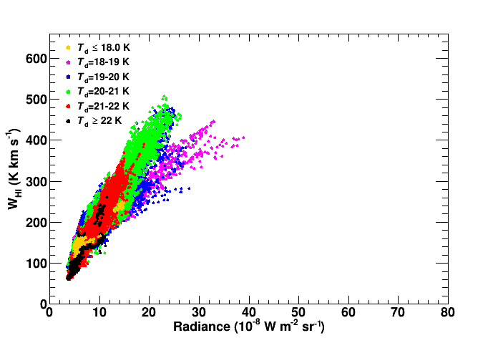
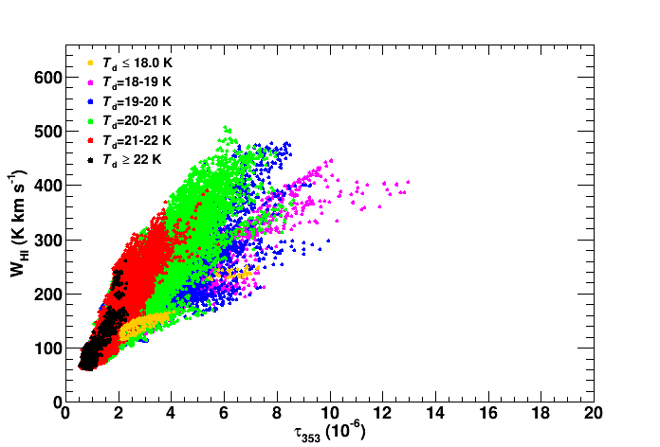
W_{HI}-Dust Relation (North)
Correlation btw. W_{HI} and dust emission D_{em} (R or τ₃₅₃)
  Dust temperature (T_{d}) dependence seen in the W_{HI}-τ₃₅₃ correlation
Linear curves that follow trends in high T_{d} areas are used to construct initial N_{H} templates assuming N_{H} ∝ D_{em}
We will use γ-rays (robust tracer of ISM gas) to constrain N_{H}
  R vs. τ₃₅₃, possible T_{d}-dependence/non-linearity
$$N_{H}\left({cm}^{2}\right)=1.82×{10}^{18}×\left(21.1×{10}^{8} R or 87.2×{10}^{6}{ τ}_{353}\right)$$
Notes:
In the following, let me focus on the analysis of the north region (similar conclusion for the south)
Here we show the correlation between the WHI and dust emission.
1) Td dependence in WHI-tau (predict different NH distribution)
2) Linear curves to construct “initial” NH template (tau=6e-6=>WHI=500=>NH=10^21)
3) We use gamma-rays to constrain the true NH

Slide 7
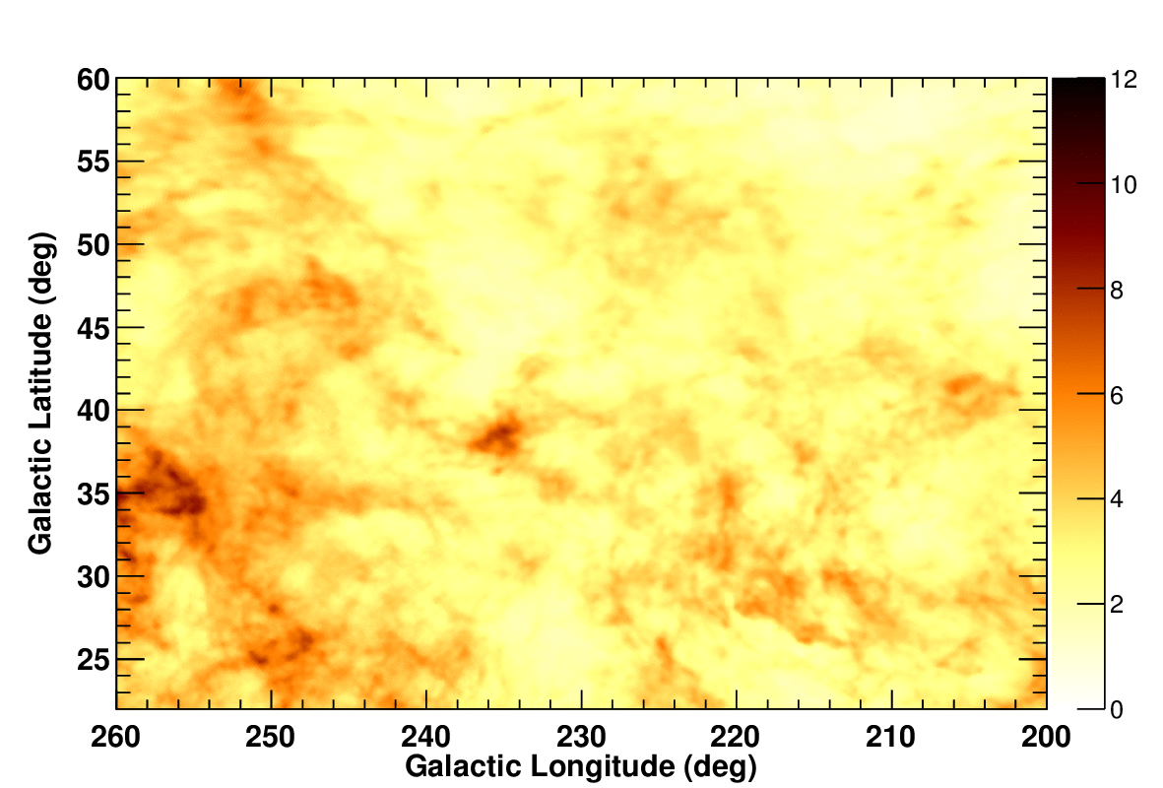
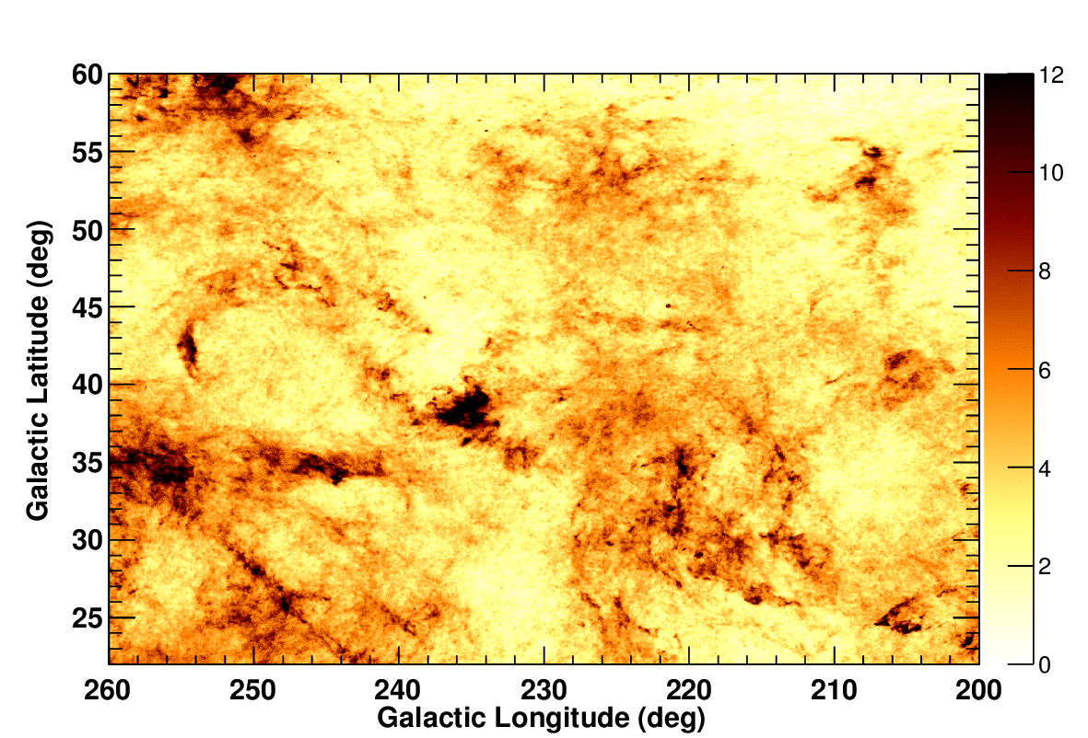
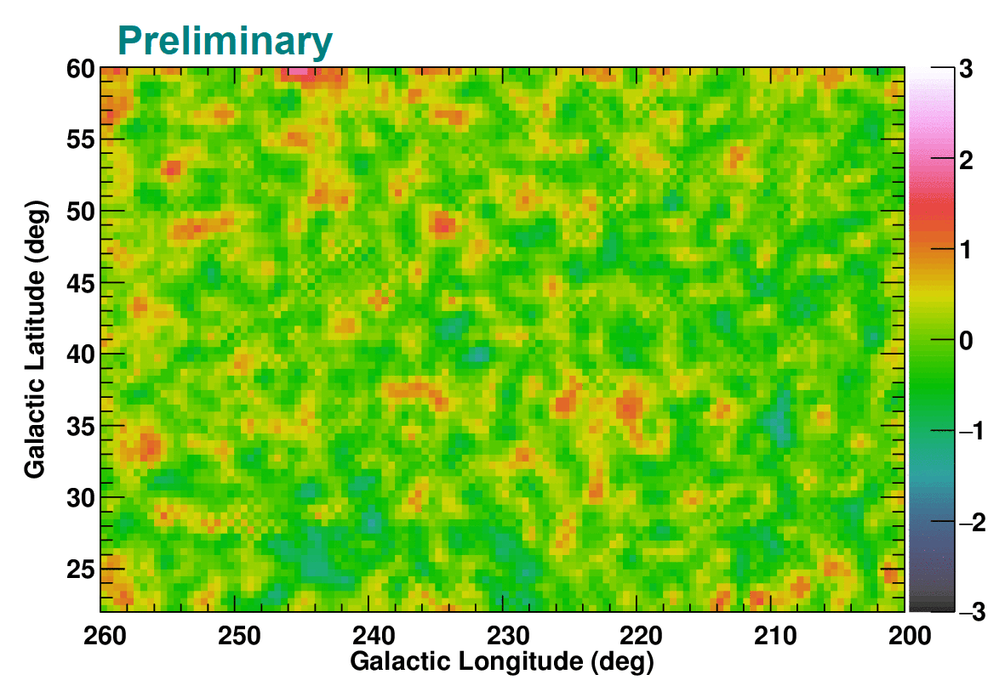
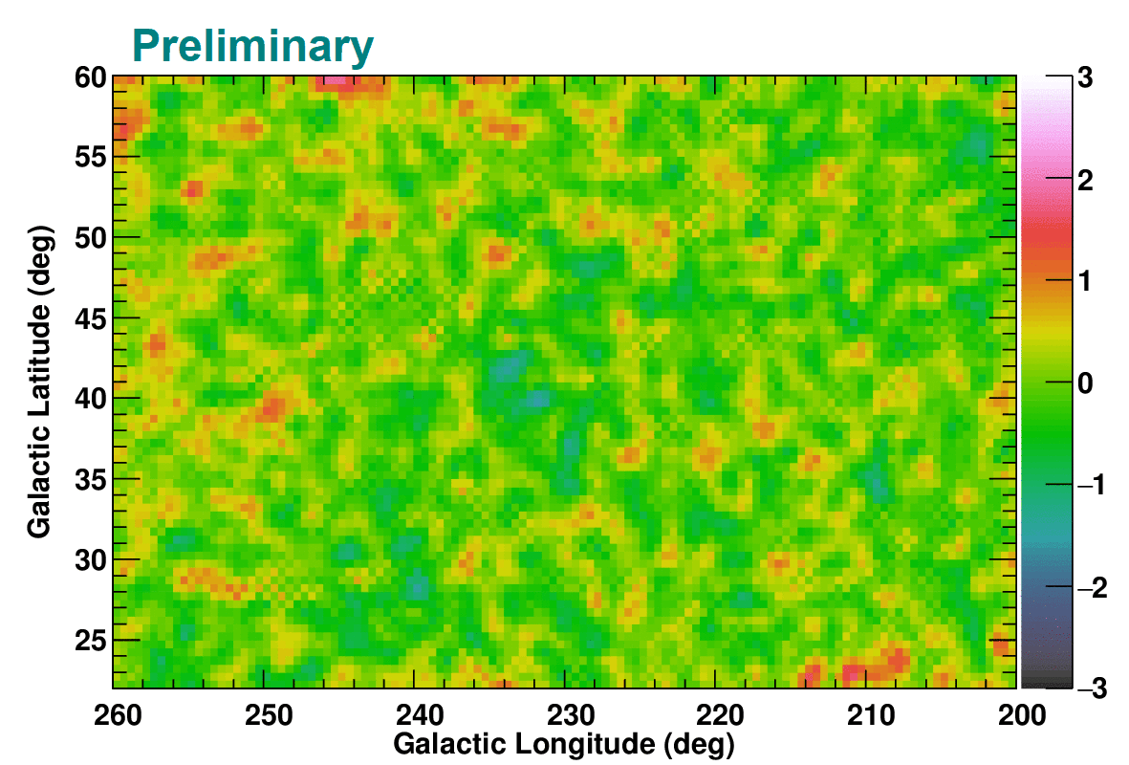
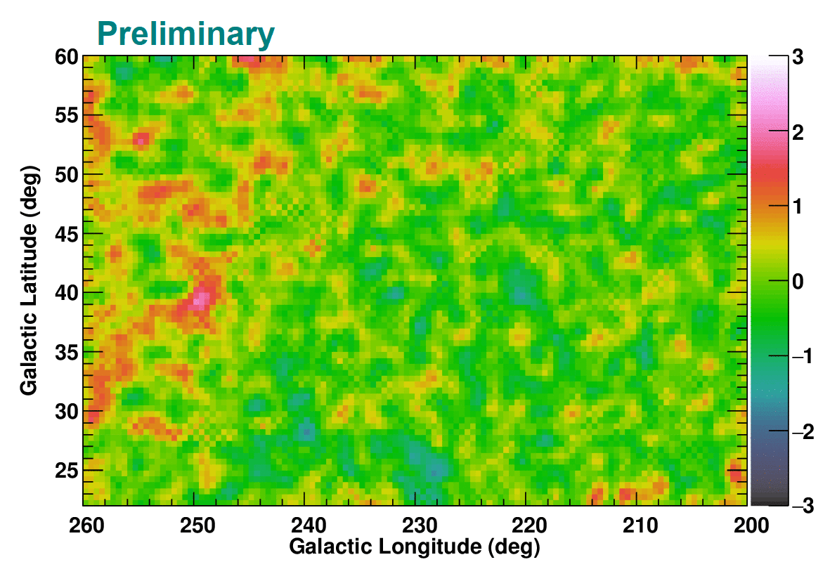
N_{H} Model Maps and Residuals (North)
We prepared N_{H} model maps (∝ W_{HI} or D_{em}) and used them in the fit of γ-ray data -> R gives the best fit (same conclusion for the south region)
North
HI4PI survey
radiance (R)
τ₃₅₃
N_{H} in 10²⁰ cm⁻²
ΔlogL
=0 (ref)
ΔlogL=
62.2
ΔlogL
=-455.5
Notes:
Here I show the summary of model maps and residuals in gamma-rays
Upper: model maps (they show different contrast, can be distinguished by gamma-ray analysis)
Lower: residuals and lnL (t353 underpredicts NH in low density areas, overpredicts NH in high density areas)

Slide 8
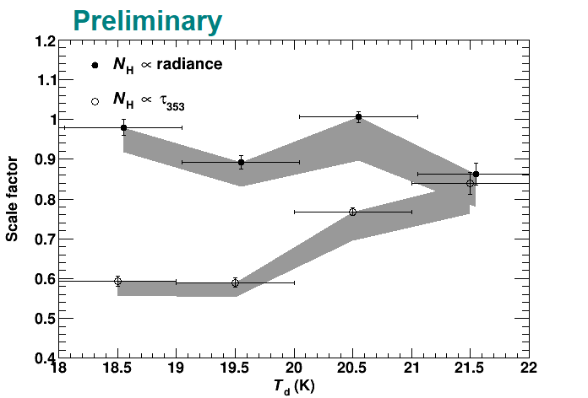
T_{d} Dependence (North)
If N_{H} ∝ D_{em}, fit coefficient is constant for a uniform CR intensity
Fit with T_{d}-sorted N_{H} templates shows a significant T_{d} dependence for τ₃₅₃, implying an overestimate of N_{H}/τ₃₅₃ in low T_{d} areas
Fit improvement not significant for R; we adopt a single R-based template as our best estimate of N_{H} (same conclusion for the south region)
Emissivity scale factor
(∝(N_{H}/D_{em})⁻¹), averaged over 0.2-12.8 GeV
Notes:
We then examine the WHI-Dem relation in more detail (in particular we study Td dependence)
1) See if NH is proportional to Dem throughout the ROI
2) Td dependence for t353 (lower scale factor, or overestimate of NH, in low Td areas)
3) Scale factor rather constant and fit improvement moderate for R => NH is proportional to R (single, R-based template)

Slide 9
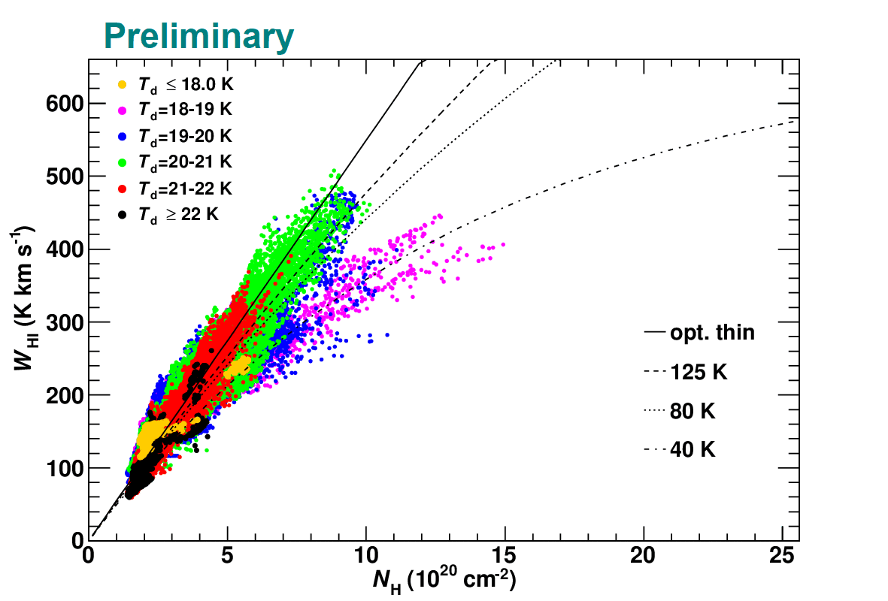
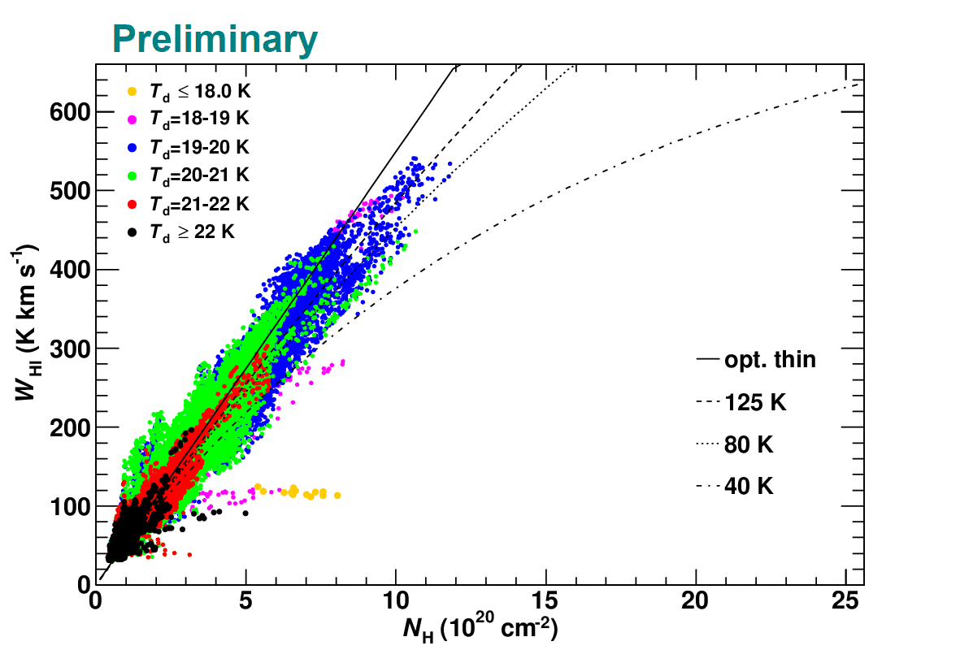
Properties of ISM Gas
W_{HI} vs. N_{H} (∝ R) with models for several values of T_{S}
  In general, data agrees with T_{S}=125 K or higher
(North) Large N_{H}/W_{HI} ratio in T_{d}=18-19 K corresponds to residuals at around (l, b)~(236º, 37.5º) for the W_{HI}-based model; likely optically-thick HI
(South) Flat profile with W_{HI}～100 K km/s corresponds to residuals at (l, b)~(230º, -28.5º); likely CO-dark H₂
opt-thin 125 K
80 K
North
South
40 K
Notes:
Based on the conclusion that NH is proportional to R, we will examine the ISM and CR properties
Firstly, lets go through the ISM
North: large NH/WHI <-> coherent residuals; opt-thick HI
South: flat profile <-> spot in residual; CO-dark H2

Slide 10
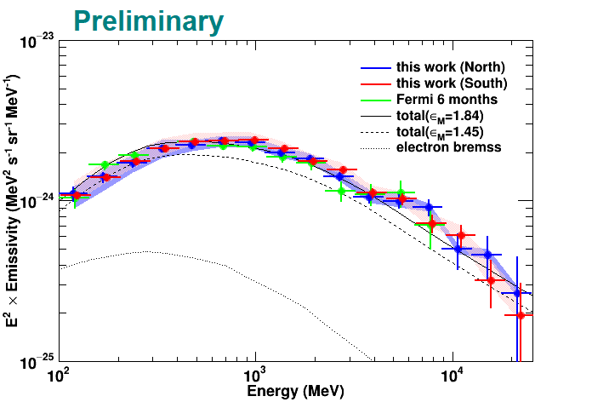
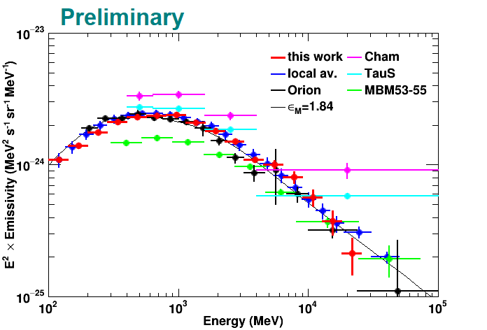
Properties of CRs
(left) HI emissivity spectra of two regions and model curves (right) average compared with results of other areas
(left) Two regions agree within uncertainty, supporting uniform CR intensity. Small deviation from a model implies a possible spectral break and should be investigated
(right) Comparison with other studies shows pk-pk variation by a factor of ~2 due to the uncertainty of N_{H} models (this study does not assume the value/uniformity of T_{S})
Notes:
Finally let’s discuss the CR properties based on gamma-ray emissivity spectrum
Left: HI emissivity of north and south with model curves (uniform CR intensity, possible break)
Right: average of N&S compared with other regions (pk-pk variation, this study does not assume Ts and would be a solid basis for studying local CRs)

Slide 11
Summary
We studied local HI clouds in detail to constrain LIS
  Use γ-ray data as a robust tracer of the ISM gas with an aid by HI4PI survey data and Planck dust emission model
Outcomes/Findings
  We developed/showed the analysis procedure without the assumption of uniform T_{S}
  While most of the gas can be interpreted as being HI of T_{S}=125 K or higher, possible optically-thick HI and CO-dark H₂ identified
  Uniform CR intensity confirmed. The emissivity roughly consistent with a model for the LIS based on direct measurements. Possible spectral break should be investigated
Thank you for your Attention
Notes:
OK, here is the summary

Slide 12
Reference
Abdo +09, ApJ 703, 1249
Brown +95, A&A 300, 903
Grenier +05, Science 307, 1292
Grenier +15, ARAA 53, 199
Hayashi, TM +19, ApJ 884, 130
HI4PI Collaboration 2016, A&A 594, 116
Karberla +05, A&A 440, 775
Ochsendorf +15, ApJ 808, 111
Planck Collaboration 2014, A&A 571, 13 (Planck 2013 Results XIII)
Ptsukin +06, ApJ 642, 902
Mizuno +16, ApJ 833, 278
Mori 09, Astropart. Phys. 31, 341

Slide 13
Backup Slides

Slide 14
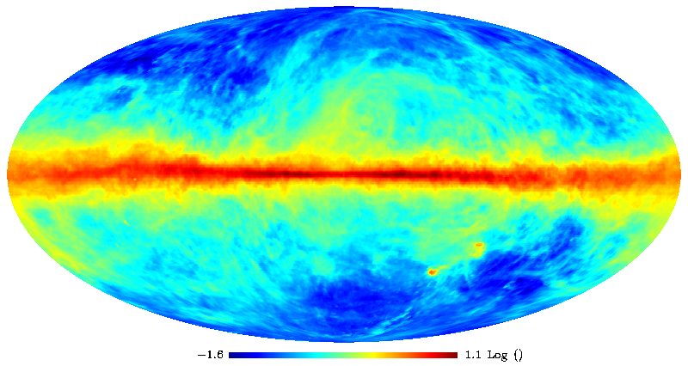
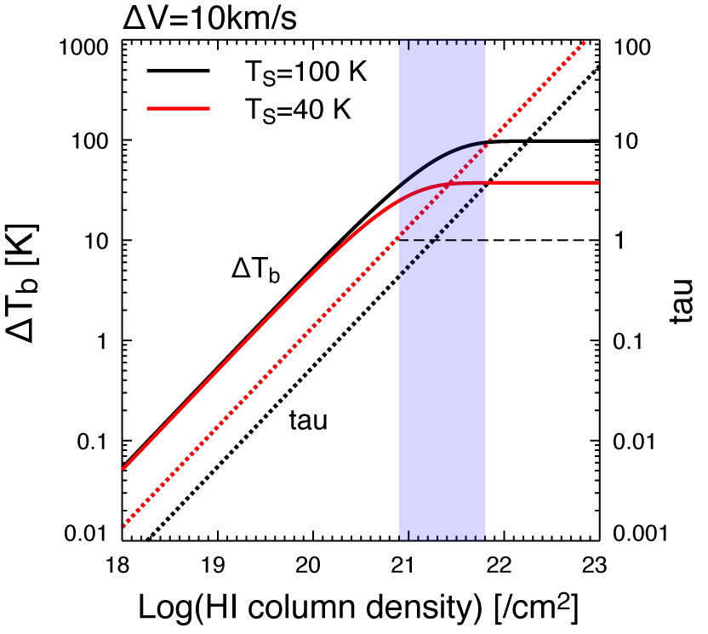
Atomic Gas
Main component of ISM, scale height ~ 200 pc
Traced by 21 cm line (W_{HI})
  True N_{HI} is uncertain due to the uncertainty of the spin temperature T_{S}
opt. thin
HI 21 cm, (LAB survey;
Kalberla +05)
Notes:
ガスの分布はどのくらい分かっているのか？
主成分；原子ガス(21cmマップ)。Scale height
ライン強度->ガス密度の変換の不定性
ガスが濃い or 温度が低いと不定性が無視できない

Slide 15
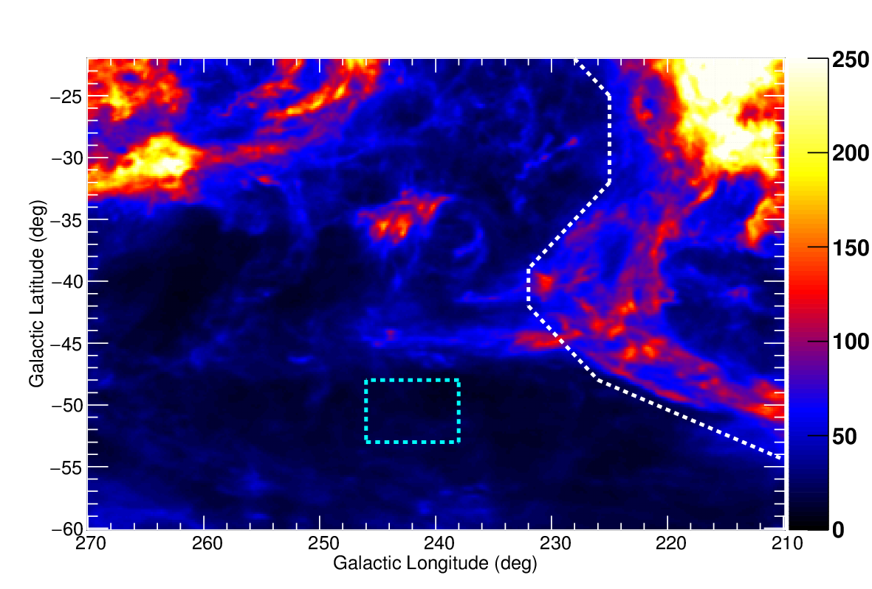
Region Mask: Velocity-Sorted HI Map
A white polygon is defined to exclude Orion-Eridanus superbubble traced by outer Hα filaments and the expanding HI shell
W_{HI} (K km/s) in
-1 to 8 km/s
(Brown +95)
box to eliminate an area contaminated by an intermediate velocity cloud

Slide 16
Hα Filaments (in Ref.)
(upper right) Several Hα filaments in the Orion-Eridanus superbubble
(lower right) Outer parts of Hα filaments on the south and west are traced by a solid blue line to guide the eye. Toward the southwest, they are surrounded by a shell of neutral gas (traced by a red line).
Ochsendorf +15

Slide 17
Neutral Gas (in Ref.)
Velocity-sorted HI maps reveal an expanding HI shell -> Use HI maps (and also Hα) to define the bubble area
V_{lsr} = -40 to -30 km/s
-28 to -3 km/s
Brown +95
-1 to 8 km/s
9 to 14 km/s
15 to 40 km/s

Slide 18

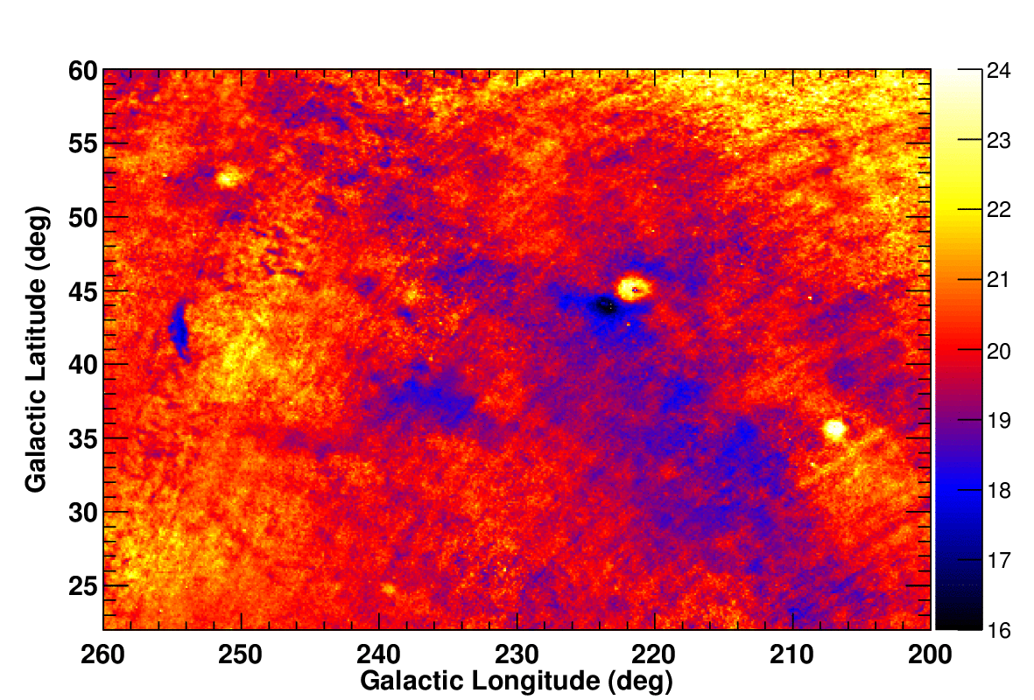
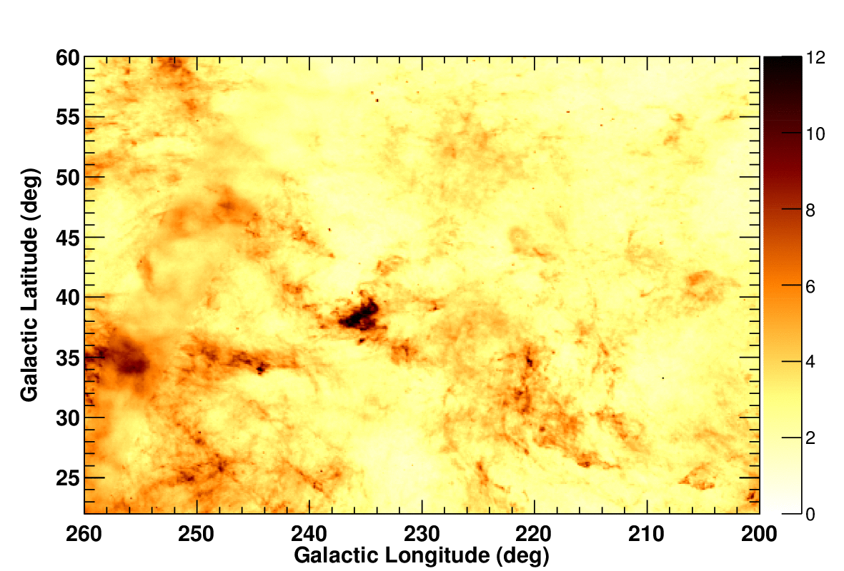

Initial N_{H} Template Maps (North)
We prepared N_{H} template maps (∝ W_{HI}, R, or τ₃₅₃) and used them in a fit of γ-ray data (different contrast in 3 models)
N_{H} in 10²⁰ cm⁻²
HI4PI W_{HI}
T_{d}
radiance (R)
τ₃₅₃

Slide 19
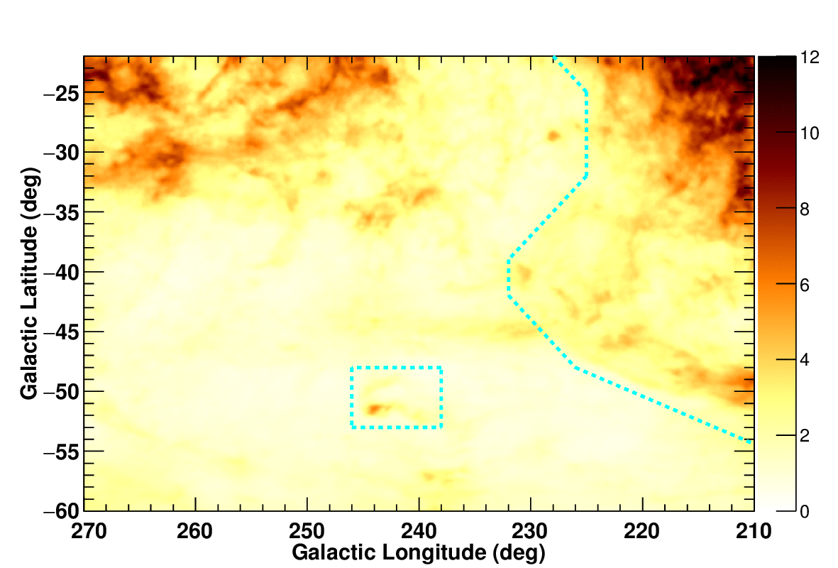
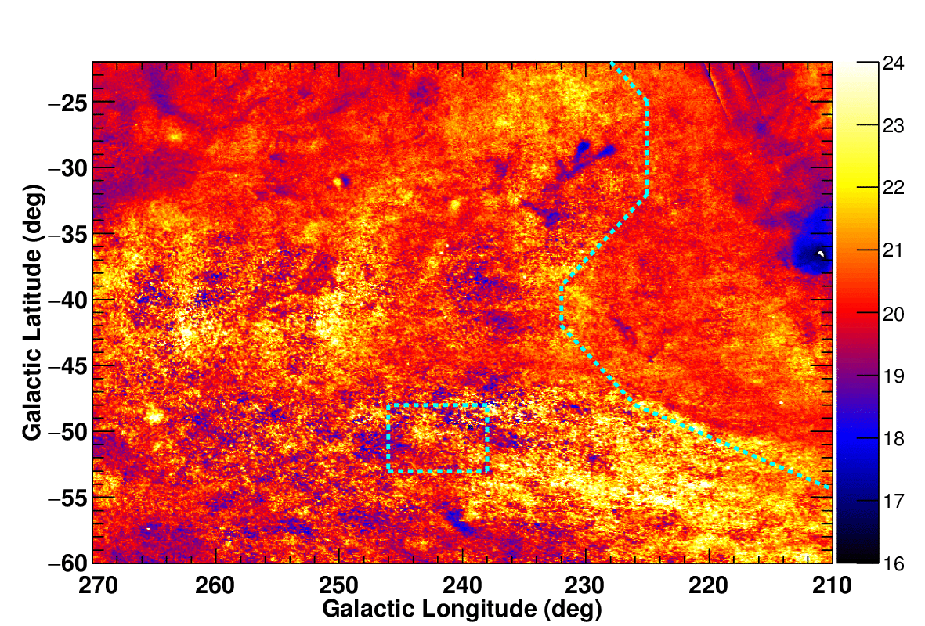
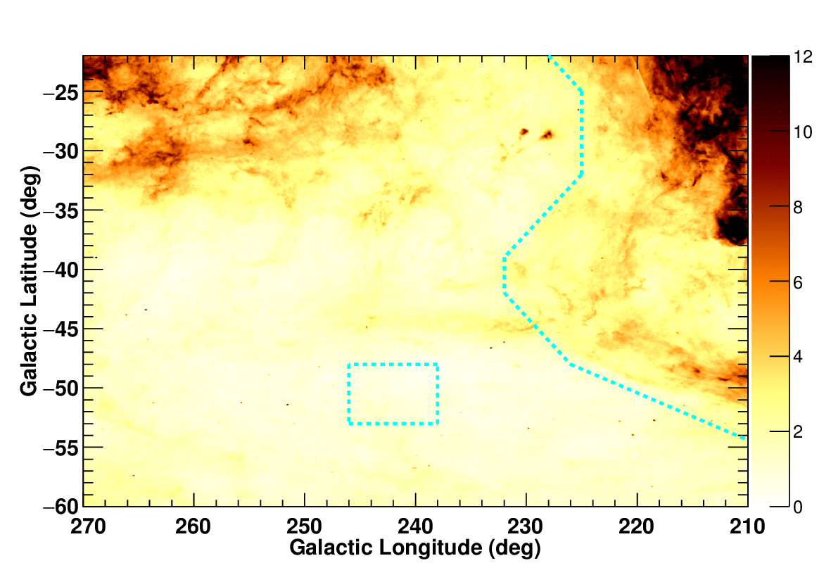
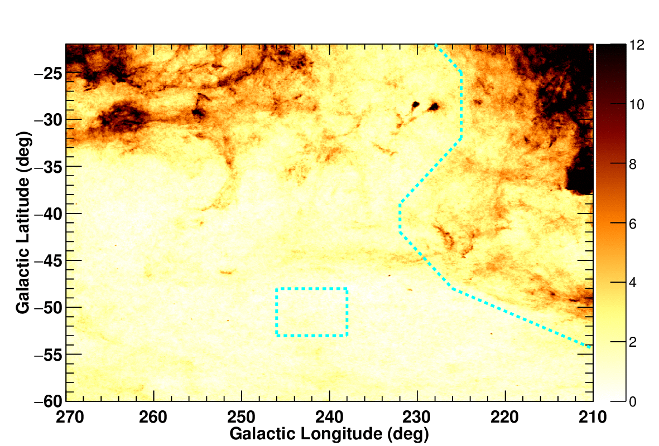
Initial N_{H} Template Maps (South)
We prepared N_{H} template maps (∝ W_{HI}, R, or τ₃₅₃) and used them in a fit of γ-ray data (different contrast in 3 models)
N_{H} in 10²⁰ cm⁻²
HI4PI W_{HI}
T_{d}
radiance (R)
τ₃₅₃

Slide 20
W_{HI}-Dust Relation (North)
Correlation btw. W_{HI} and dust emission D_{em} (R or τ₃₅₃)
  Dust temperature (T_{d}) dependence seen in the W_{HI}-τ₃₅₃ correlation
Linear curves that follow trends in high T_{d} areas are used to construct initial N_{H} templates assuming N_{H} ∝ D_{em}
We will use γ-rays (robust tracer of ISM gas) to constrain N_{H}
  R vs. τ₃₅₃, possible T_{d}-dependence/non-linearity
$$N_{H}\left({cm}^{2}\right)=1.82×{10}^{18}×\left(21.1×{10}^{8} R or 87.2×{10}^{6}{ τ}_{353}\right)$$
Notes:
以下、北側の領域の結果
ガスのトレーサーとしては21cm線 or ダスト(周波数積分輝度 or 光学厚み)->ガンマ線で優劣判定
まずはガスの性質：WHI vs. dust emission (Radiance, tau353)
温度依存性がtau353で顕著。（異なるガス分布を予言）ガンマ線で検証
dust emission =>NHはまず比例を仮定。係数は水色(high Td areaでopt-thin)。Tsの値を仮定しない，Tsが一様という仮定をしない

Slide 21
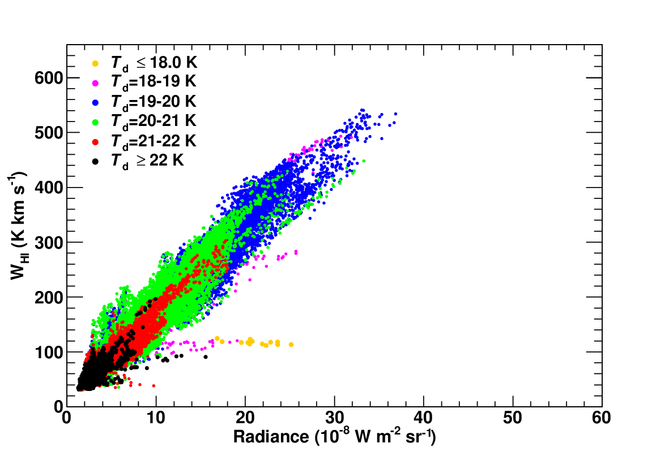
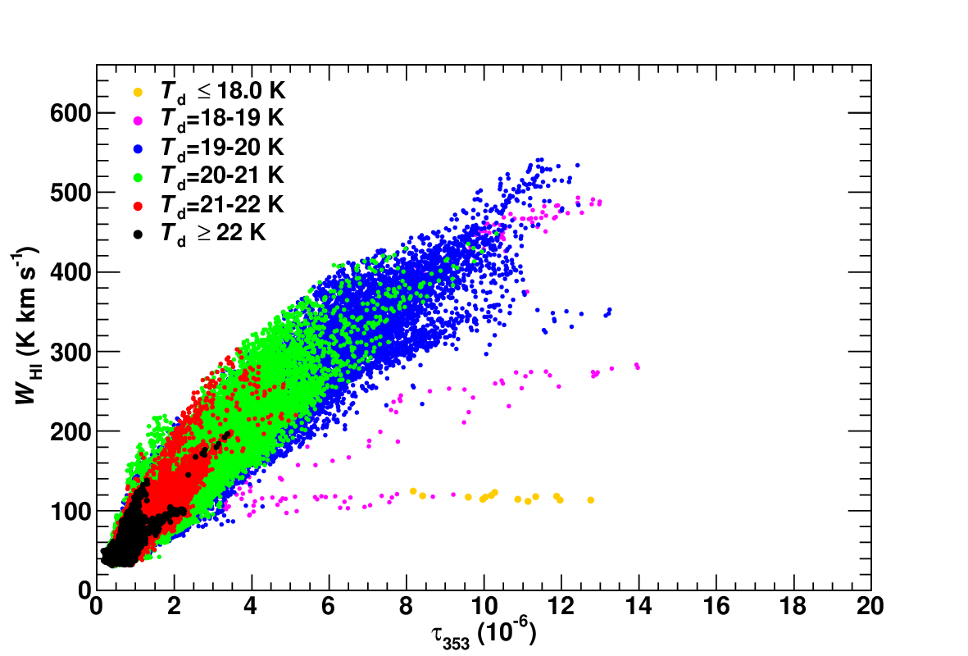
W_{HI}-Dust Relation (South)
Correlation between W_{HI} and D_{em}
  Weak T_{d} dependence, non-linear W_{HI}-D_{em} relations
Linear curves that follow trends in high T_{d} areas are used to construct initial N_{H} templates assuming N_{H} ∝ D_{em}
We will use γ-rays (robust tracer of ISM gas) to constrain N_{H}
  R vs. τ₃₅₃, possible T_{d}-dependence/non-linearity
$$N_{H}\left({cm}^{2}\right)=1.82×{10}^{18}×\left(17.6×{10}^{8} R or 66.9×{10}^{6}{ τ}_{353}\right)$$

Slide 22
N_{H} Model Maps and Residuals (North)
We prepared N_{H} model maps (∝ W_{HI} or D_{em}) and used them in the fit of γ-ray data -> R gives the best fit (same conclusion for the south region)
North
HI4PI survey
radiance (R)
τ₃₅₃
N_{H} in 10²⁰ cm⁻²
ΔlogL
=0 (ref)
ΔlogL=
62.2
ΔlogL
=-455.5
Notes:
上段：モデルマップ
コントラスト異なる(場所で示す)，10-30%くらいガス密度異なる。ガンマ線で検定。
下段：残差マップ & logL
t353の残差：過少評価(濃いところが過大評価)
logLはRが一番よい，t353は一番悪い
南側の領域も同じ結論(R gives best fit)

Slide 23
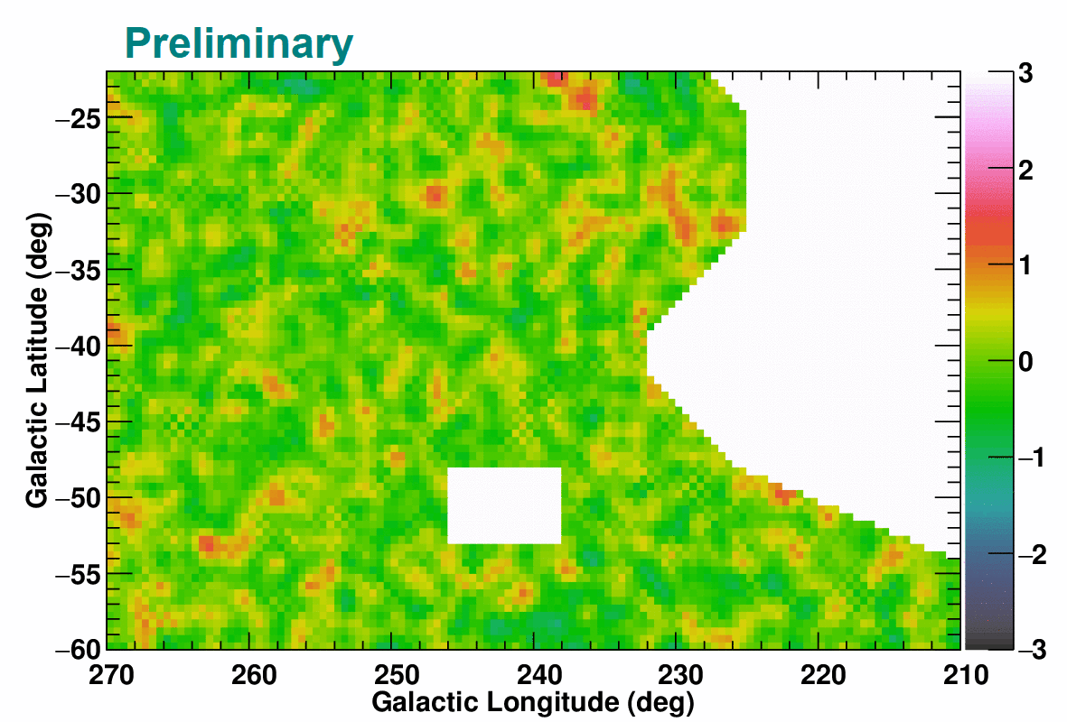
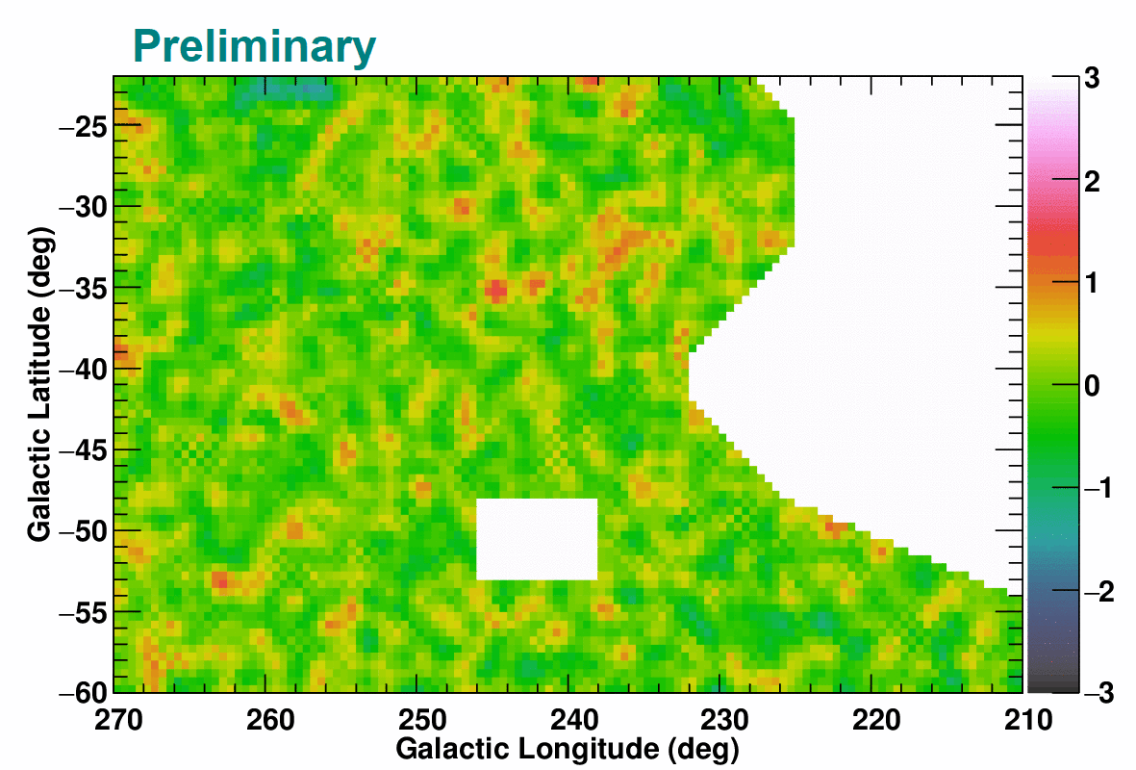
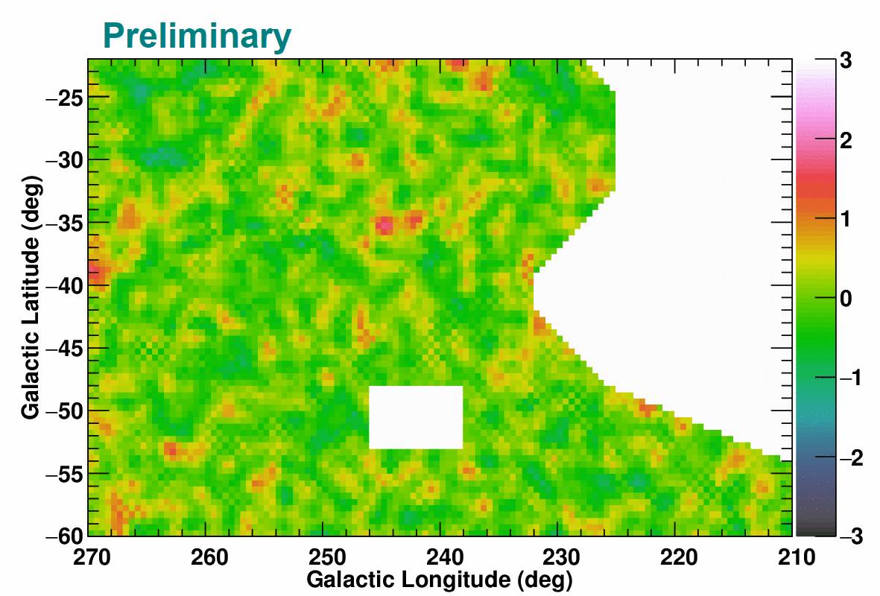
N_{H} Model Maps and Residuals (South)
We prepared N_{H} model maps (∝ W_{HI} or D_{em}) and used them in the fit of γ-ray data -> R gives the best fit.
South
HI4PI survey
radiance (R)
τ₃₅₃
N_{H} in 10²⁰ cm⁻²
ΔlogL
=0 (ref)
ΔlogL=
19.4
ΔlogL
=-74.6
Notes:
上段：モデルマップ
コントラスト異なる(場所で示す)，10-30%くらいガス密度(->CR密度)異なる
下段：残差マップ & logL
Rが一番よい，t353は一番悪い
t353の残差：過少評価(濃いところが過大評価)
WHIに特有な残差(ガスが足りていない)

Slide 24
T_{d} Dependence (North)
If N_{H} ∝ D_{em}, fit coefficient is constant for a uniform CR intensity
Fit with T_{d}-sorted N_{H} templates shows a significant T_{d} dependence for τ₃₅₃, implying an overestimate of N_{H}/τ₃₅₃ in low T_{d} areas
Fit improvement not significant for R; we adopt a single R-based template as our best estimate of N_{H} (same conclusion for the south region)
Emissivity scale factor
(∝(N_{H}/D_{em})⁻¹), averaged over 0.2-12.8 GeV
Notes:
Whi-Dem関係のダスト温度依存性を詳しく見る
Demがガス密度を正しく表してれば，係数はダストの性質によらず一定のはず
Td依存性のまとめ：ダスト温度でソートしたテンプレートの係数(Nh/Demに比例)=>
t353で顕著なTd依存性(Td:低でNh/tau353を過大評価していることが確実に)
Rでは依存性はsignificantでない=>Nh∝Rなテンプレートがガス分布のbest estimate
南側も同様の結論

Slide 25
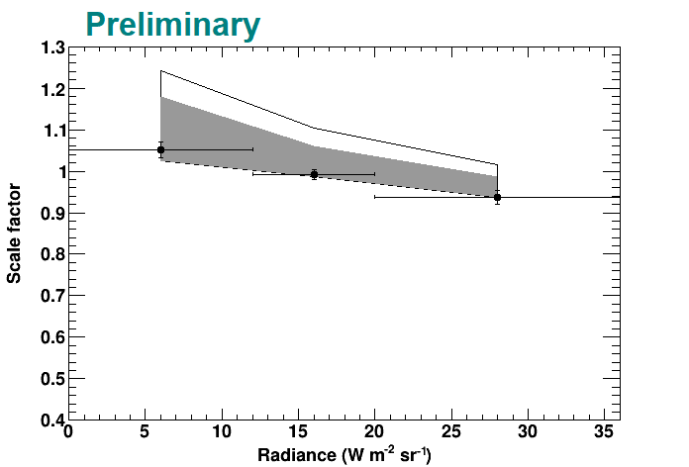
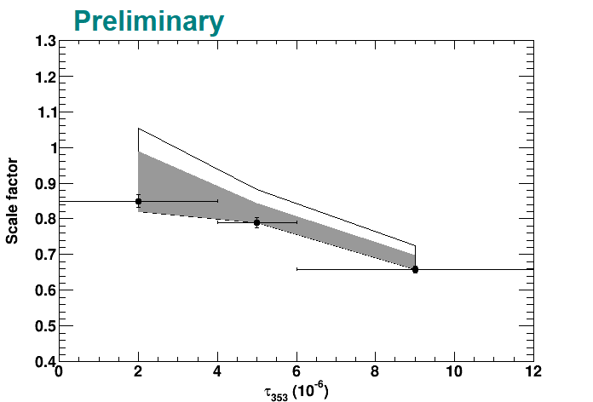
D_{em} Dependence (South)
Examine a possible non-linear N_{H}-D_{em} relation through a fit with R(or τ₃₅₃)-sorted N_{H} templates (cf. Hayashi +19)
Large (~25%) negative τ₃₅₃ dependence, implying an overestimate of N_{H}/τ₃₅₃ in high density areas
R dependence not significant (1.2σ) and small (~10%); we adopt a single R-based N_{H} template as our best estimate of N_{H}
Emissivity scale factor (∝(N_{H}/D_{em})⁻¹), averaged over 0.2-12.8 GeV

Slide 26
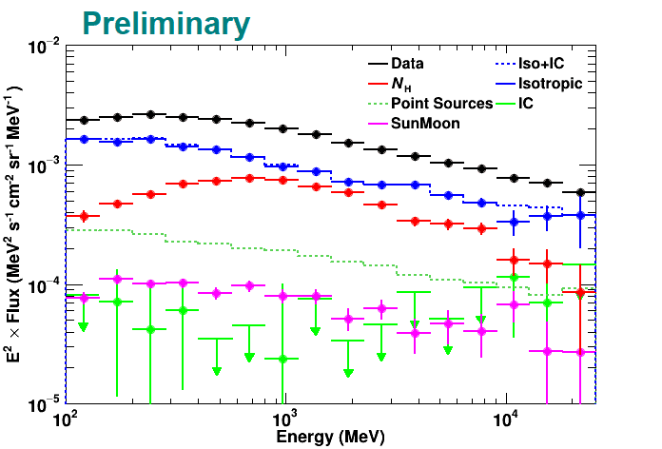
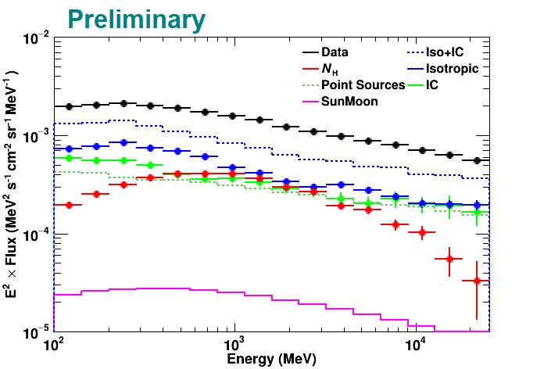
Spectrum of Each Component
In both North and South regions we conclude that single N_{H} template based on R reproduces the data well and fit the data with finer energy bins
Spectrum of each component summarized below
North
South
North
South

Slide 27
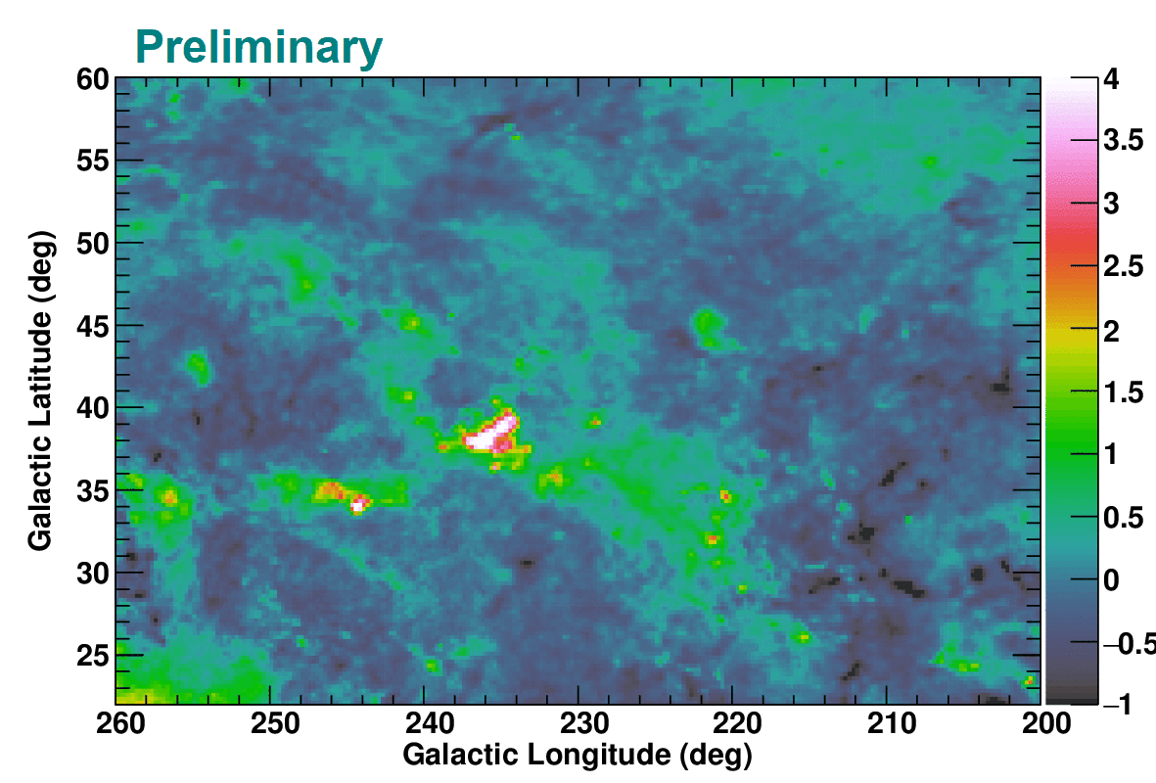
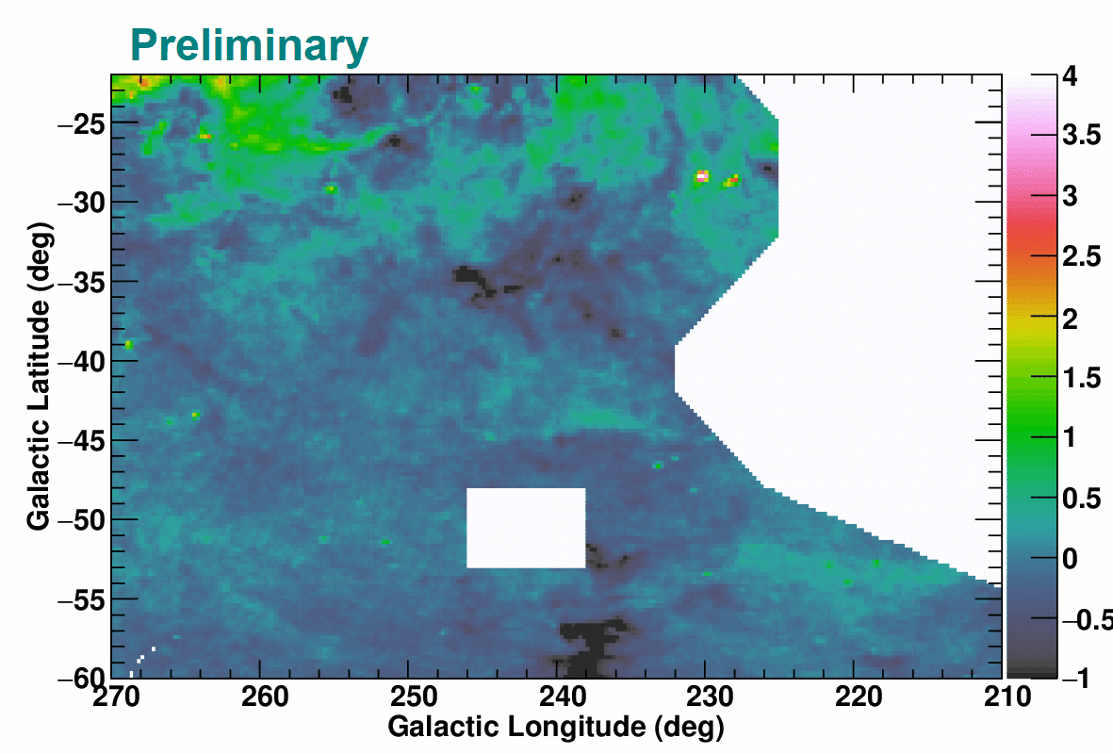
Properties of ISM gas
Excess gas densities (N_{H}-N_{HI}^{thin}) in 10²⁰ cm⁻²
(North) Large N_{H}/W_{HI} ratio in T_{d}=18-19 K corresponds to residuals at around (l, b)~(236º, 37.5º) for the W_{HI}-based model; likely optically-thick HI
(South) Flat profile with W_{HI}～100 K km/s corresponds to residuals at (l, b)~(230º, -28.5º); likely CO-dark H₂
North
South

Slide 28
Assumed LIS Model
Assumed proton LIS model (solid blue) has marginal break in momentum (cf. LIS model by Shikaze +07; dotted blue)
Both models can reproduce CR spectrum directly measured (with different φ); γ-ray data is crucial to constrain the LIS
Abdo +09

