Slide 1
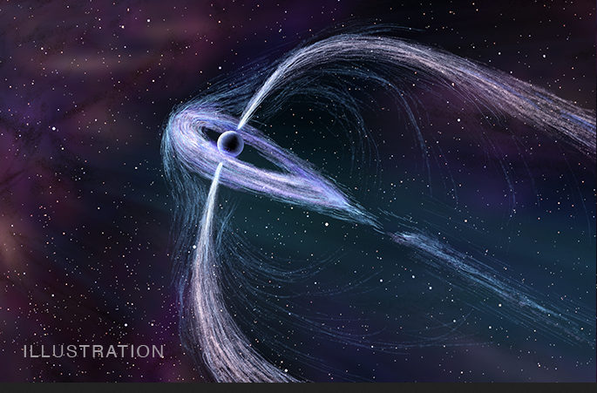

Understanding the Multi-wavelength Observation on the TeV halo of Geminga
Ruoyu Liu
Nanjing University
Deutsches Electronen-Synchrotron
Collaborators: Huirong Yan, Heshou Zhang, Shao-Qiang Xi, Chong Ge, Xiao-Na Sun, Xiang-Yu Wang
03.12.2019, 2019 TeVPA, Sydney

Slide 2
Outline
A Brief Introduction
HAWC’s Observation
Previous Studies
X-ray Observation and its Implication
Anisotropic Diffusion Model
Summary

Slide 3
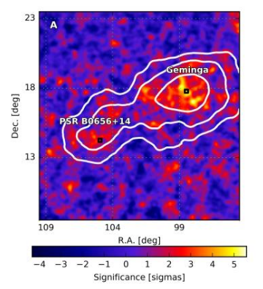
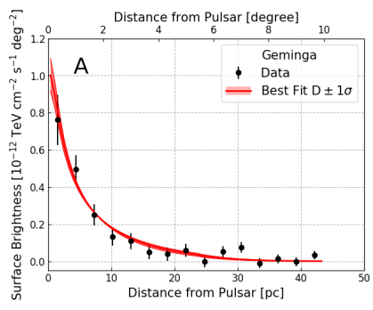

HAWC’s observation on Geminga
30pc
Intensity profile consistent with diffusion-dominated particle transport
IC Scattering of 100TeV electron/positron off CMB
HAWC Collaboration 2017, Science, 2017, 358, 911
Two orders of magnitude smaller than the typical ISM diffusion coefficient

Slide 4
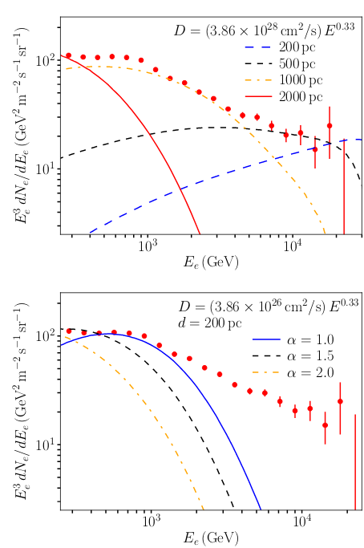
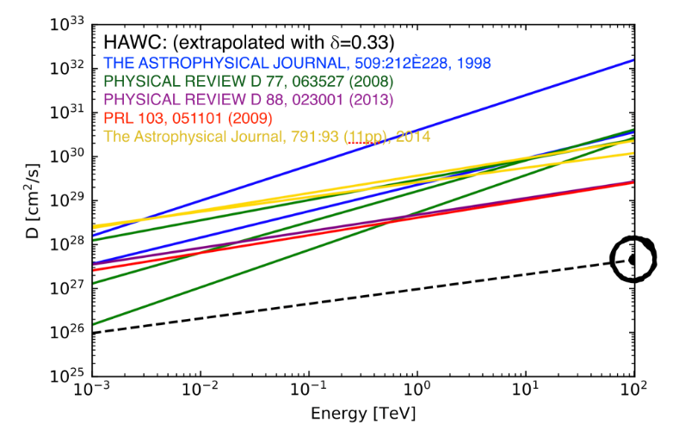
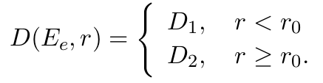
Zhou@TeVPA2018
an inefficient diffusion zone embedded in normal diffusion zone in the ISM
Hooper & Linden 2018, PRD
Electron spectrum measurement disfavor a small diffusion coefficient
e.g., Fang et al. 2018 ApJ, Profumo et al. 2018, PRD

Slide 5
The generation of a very inefficient diffusion region
Small diffusion coefficient-> saturation of turbulence at small scale
(r_{g}=0.04pc (E_{e}/100TeV)(B/3μG)⁻¹)
- CR self-generated waves:
CR density is not sufficiently high for an efficient self-regulation
the mechanism of self-generated Alfv́en waves due to the streaming instability cannot work to produce such a low diffusion coefficient even in the most optimistic scenario where the energy loss of electrons and the dissipation of the Alfv ́en waves are neglected. The reason is simple as Geminga is too weak to generate enough high energy electrons at the late age. (Fang et al., 2019, MNRAS)
- From background turbulence?
Need a strong ΔB Or small injection scale (~1pc & 3μG, Lopez-Coto & Giacinti 2018)?
Very chaotic topology:
X-ray emission

Slide 6
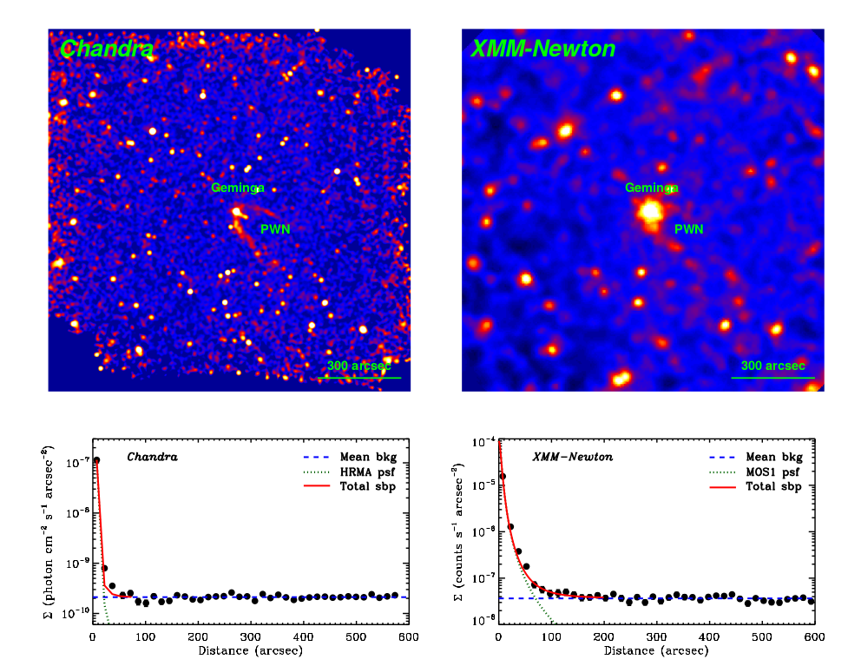
X-ray observation on the TeV halo
f_{0.7−2.0 keV} =
6.1 × 10⁻¹⁵ erg cm⁻²s⁻¹
f_{xmm,0.7−1.3 keV} =
5.0 × 10⁻¹⁵ erg cm ⁻²s⁻¹
RYL et al. 2019, ApJ

Slide 7

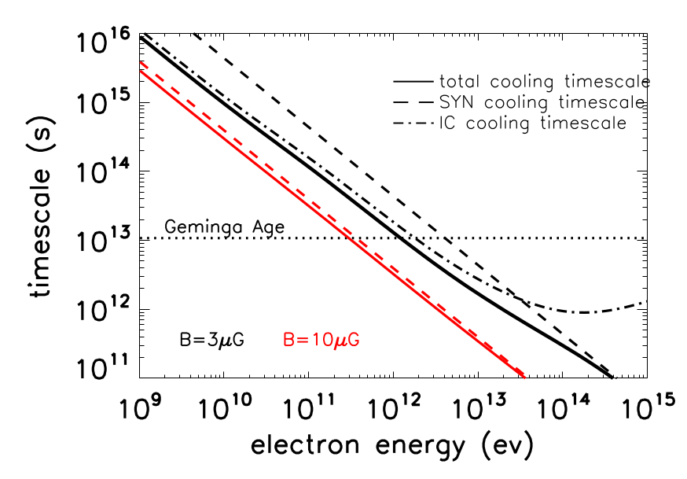

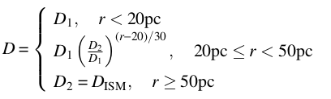
Calculation of Intensity Profile
Line of sight integration
pulsar
HAWC
XMM
observer

Slide 8
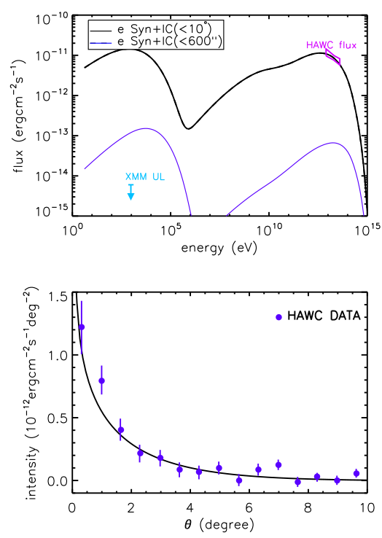
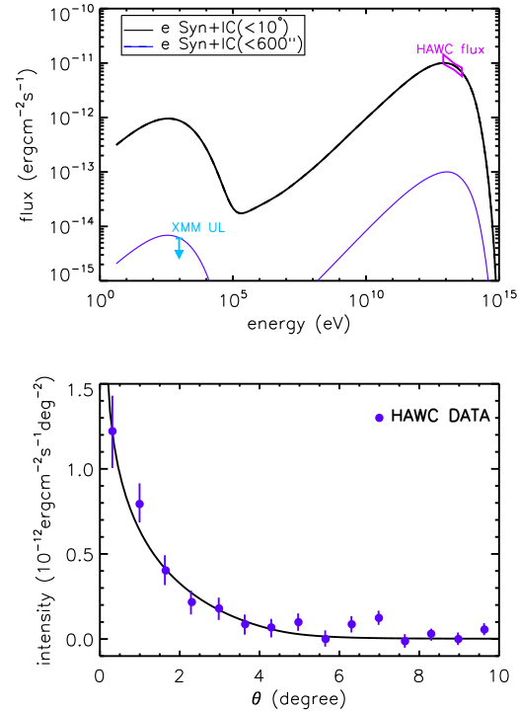
B=3μG
B=0.8μG
TeV Observation
→ small diffusion coefficient → strong & chaotic B field
X-ray Observation
→ weak B field

Slide 9
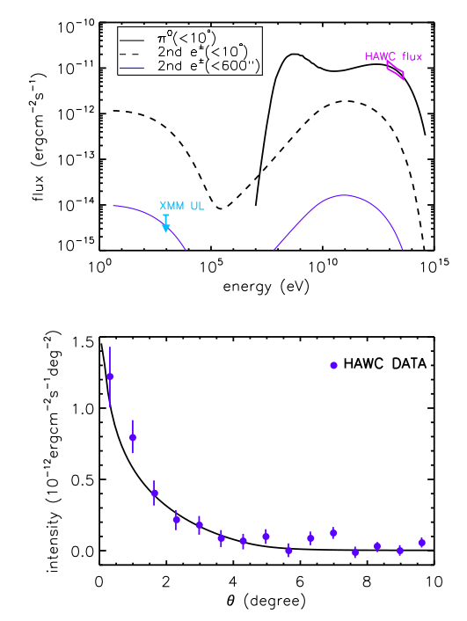


Hadronic origin?
n_{g}~0.1cm⁻³
Inefficient hadronic radiation
W_{p} = 1.6 × 10⁵² ergs

Slide 10
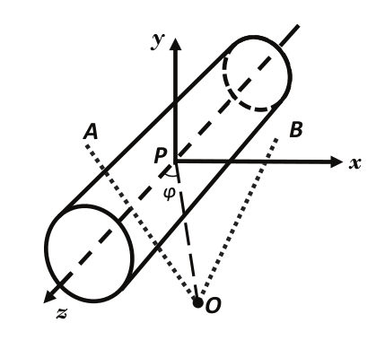
A more realistic scenario
ISM turbulence: coherent length 50-100pc, mean B field 3-6μG
sub-Alfvenic (M_{A}~ΔB/B<1) turbulence, anisotropic
Diffusion coefficient -> Diffusion coefficient tensor

Slide 11
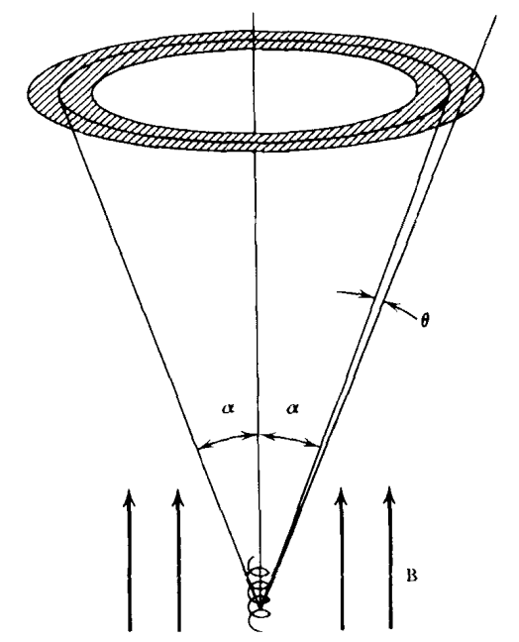


Synchrotron radiation also becomes anisotropic
X-ray emission can be reduced significantly if the mean B field is roughly aligned with our line of sight
Rybicki & Lightman 1979

Slide 12
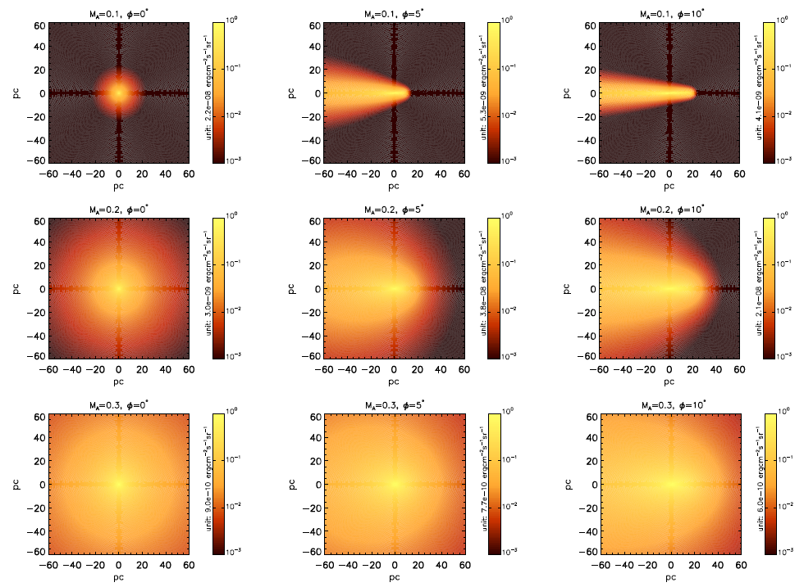
Horizontal: different viewing angle
Vertical: different Alfvenic Mach Number
D//=4x10²⁸ (E/1GeV)^{1/3}cm²/s
B=3μG
M_{A}=0.1, φ=0, too concentrated
M_{A}=0.1, φ>0, anisotropic morphology
M_{A}=0.3 insufficient gradient

Slide 13
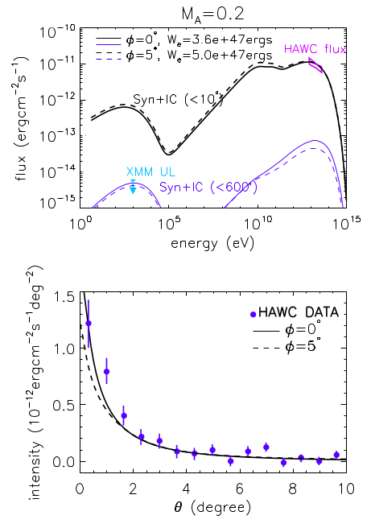
M_{A}~0.2, φ<5°
Sub-alfvenic turbulence
Mean B field well aligned with LOS
Mean B field in other TeV halos cannot be always aligned with LOS
RYL et al. 2019, PRL

Slide 14
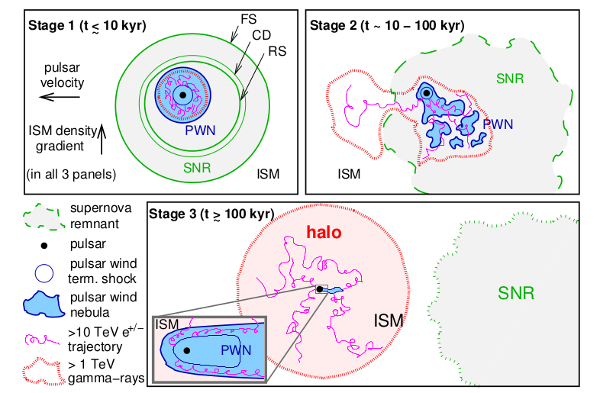
A general picture for TeV halo
Giacinti et al. 2019

Slide 15
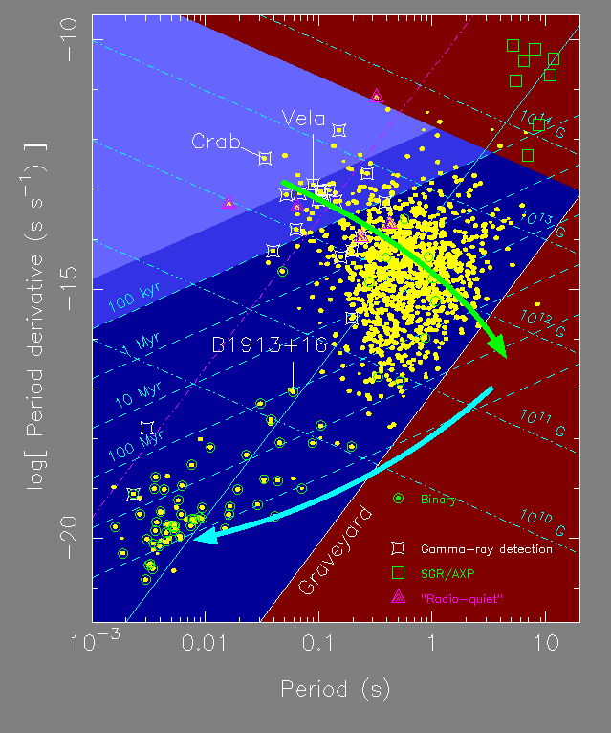
How many potential TeV halos in our Galaxy？
Selection Criteria:
T_{age}>100kyr
F=η_{γ}L_{s}/4πd²>F_{lim}
η_{γ：} Ratio of 100TeV luminosity
to spindown luminosity
η_{γ}~0.07% (for Geminga)
300 pulsars with estimate flux above 5yr sensitivity of LHAASO
Credit: Duncan Lorimer

Slide 16
Summary
No significant diffuse X-ray emission around Geminga PWN has been detected by Chandra and XMM-Newton
In the framework of isotropic diffusion, a highly turbulent region with very weak magnetic field is required.
- hard to find physical interpretation
- difficult to explain positron flux (unless with energy-independent diffusion coefficient)
In the framework of anisotropic diffusion (more natural)
both diffuse X-ray and TeV emission can be explained with the typical ISM parameters
requirement: mean B field aligned with LOS
Test the model with future observation of LHAASO and HAWC

Slide 17
Backup slides

Slide 18
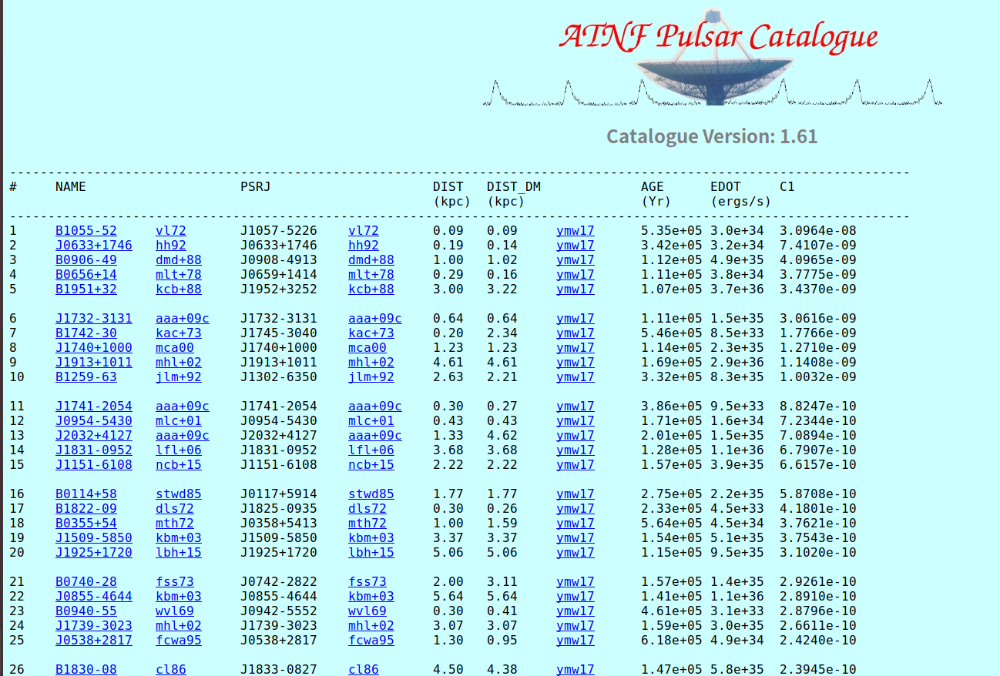
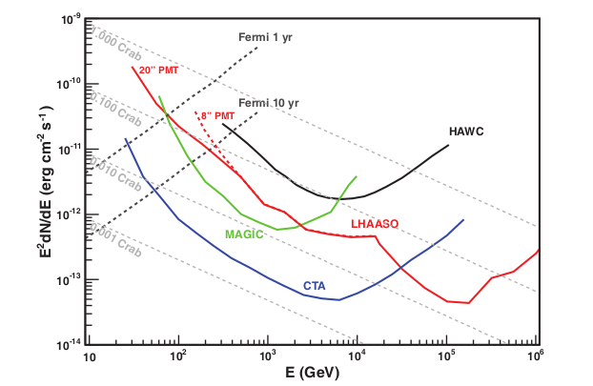
LHAASO 1-yr diff. flux sensitivity of point source @ 100TeV = 4e-14ergcm⁻²s⁻¹
137 pulsars with “spindown flux > 5.7e-11 erg/cm^2/s (1yr sensitivity)
300 pulsars with “spindown flux” > 1.1e-11 erg/cm^2/s (5yr sensitivity)

Slide 19
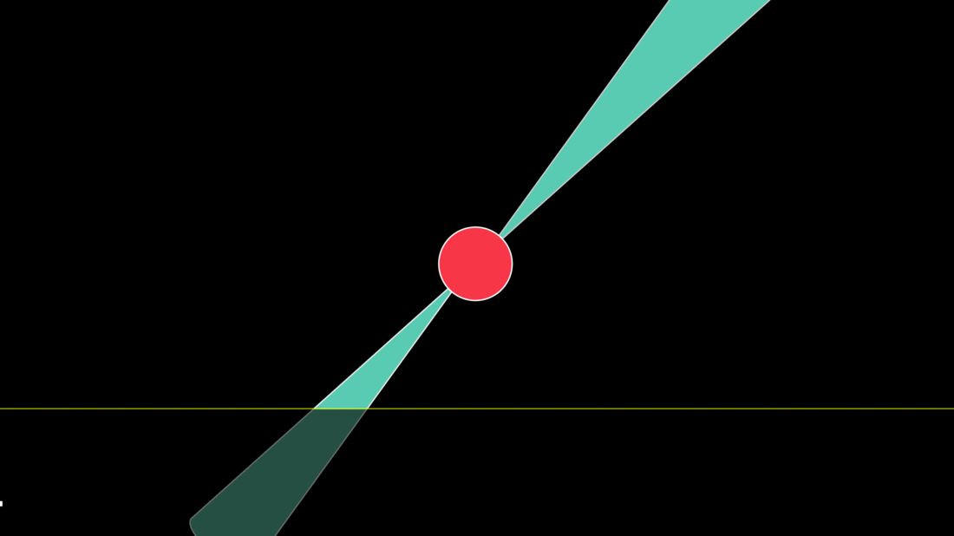
There are actually many more invisible pulsars in our Galaxy
Gamma-ray pulsar : 230+
Radio pulsar : 2600+
outer gap solid angle : 1 sr (gamma-ray)
Polar cap solid angle : 0.1 sr （radio）
But emission of the TeV halo is not beamed!
Credit: Jen Christiansen, Scientific American.
total pulsar with detectable TeV halo:
10- 100 x observed number ~ 3000 - 30000
Gamma-ray flux + morphology + X-ray/radio flux
=> study mean B field direction and M_{A}

Slide 20
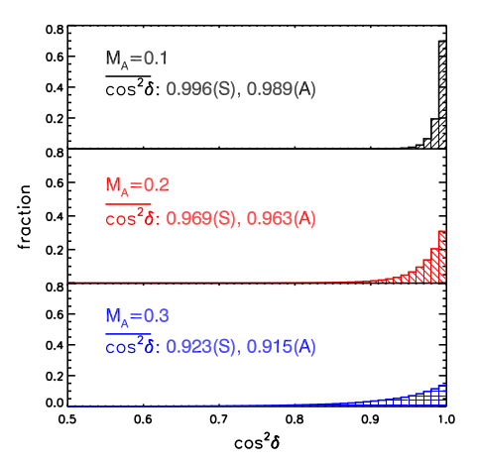

Slide 21
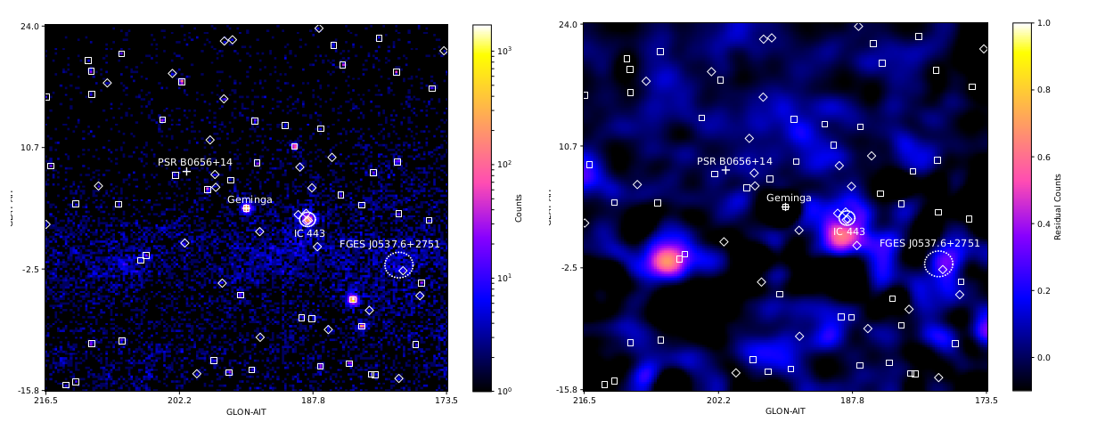
Fermi-LAT observation on the TeV halo
D(100GeV)~2x10²⁶cm²/s, (Dt_{gem})^{1/2}~30pc ~ 7°
40°x40° ROI, 10-500GeV
Count map
Residual map

Slide 22
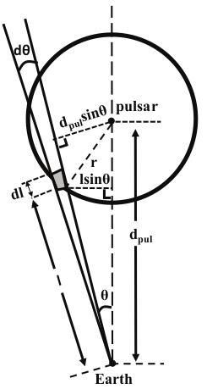
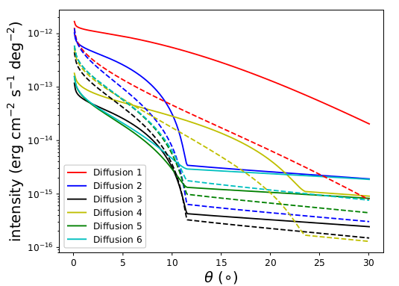
Line of sight integration
Produce spatial templates (on the premise of fitting HAWC’s observation
Soild:10GeV
Dashed: 500GeV

Slide 23
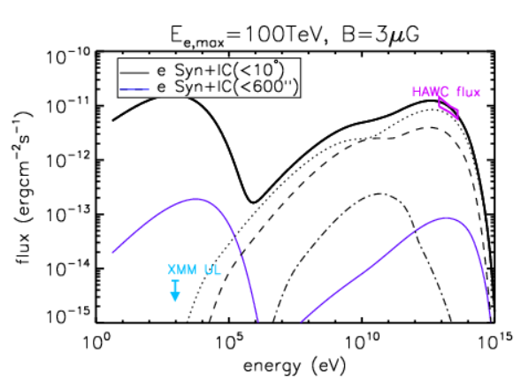
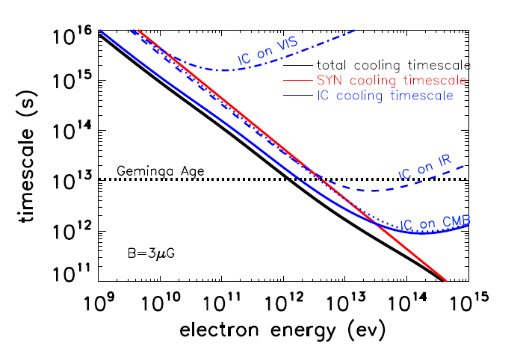

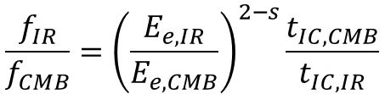





IC on IR
IC on IR
IC on Opt
$$f_{IC}∝N_{e}P_{IC}=CE_{e}^{2−s}t_{IC}^{−1}$$
$$\frac{f_{IR}}{f_{CMB}}={\left(\frac{E_{e,IR}}{E_{e,CMB}}\right)}^{2−s}\frac{t_{IC,CMB}}{t_{IC,IR}}$$
$$P_{IC}=\frac{E_{e}}{t_{IC}}$$
Considering KN effect (recoil)
$$N_{e}≈E_{e}\frac{{dN}_{e}}{dγ_{e}}=CE_{e}^{1−s}$$
$$E_{e,IR}\left(20TeV\right)=50TeV$$
$$E_{e,CMB}\left(20TeV\right)=100TeV$$

Slide 24
Distribution of 100GeV positron density in anisotropic diffusion scenario, assuming the global mean B field between Geminga and Earth is aligned with LOS (most optimistic case)

Slide 25
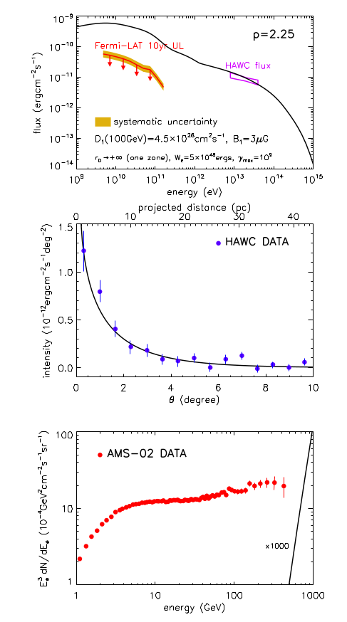
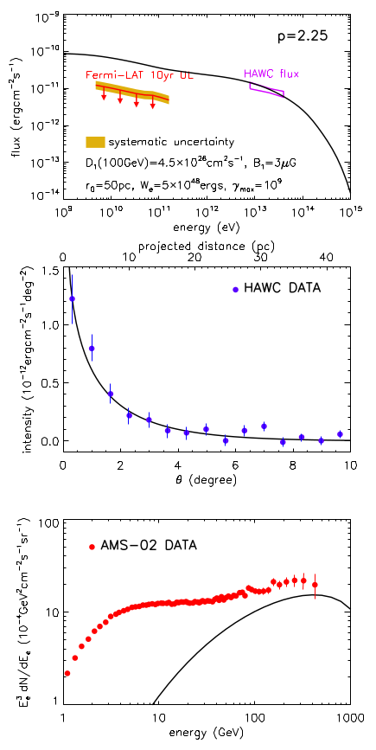
HAWC’s best-fit parameters
Two diffusion zone

Slide 26
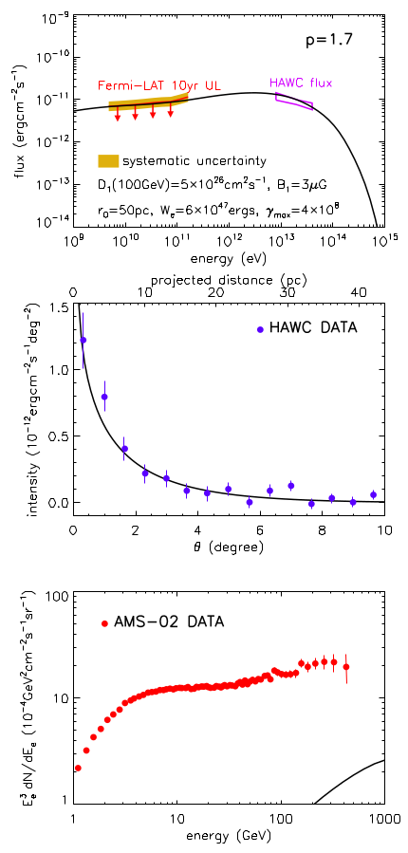
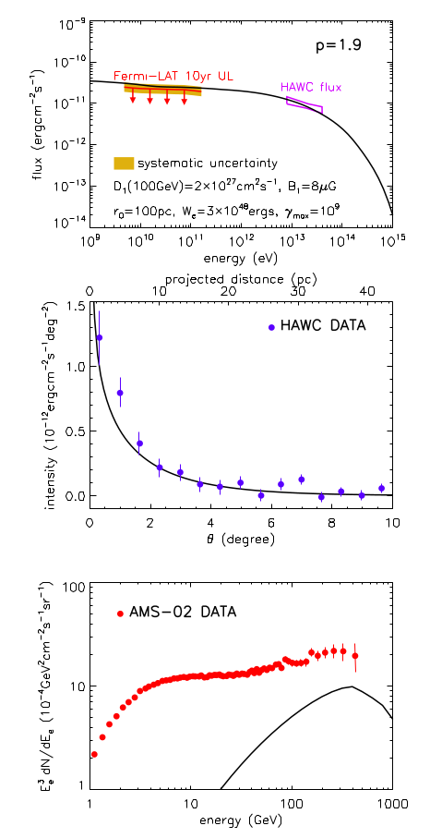
A harder injection spectrum
Energy-independent diffusion

Slide 27
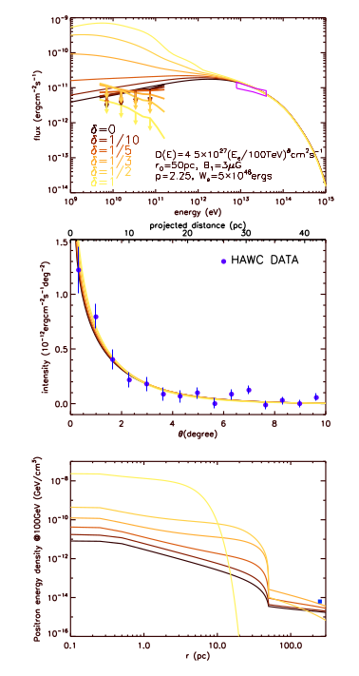
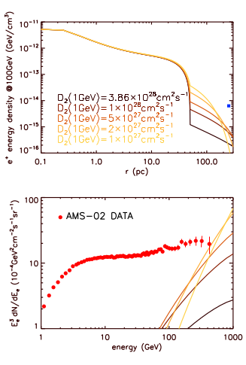
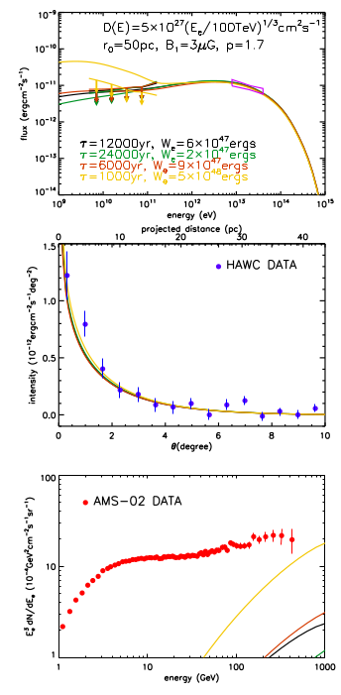
Notes:
27

Slide 28
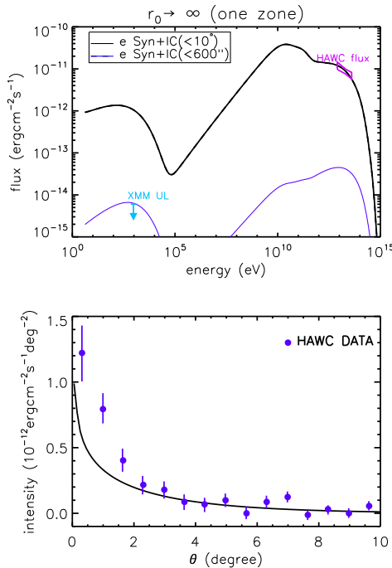
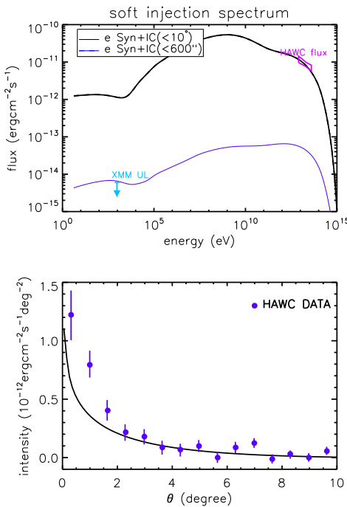
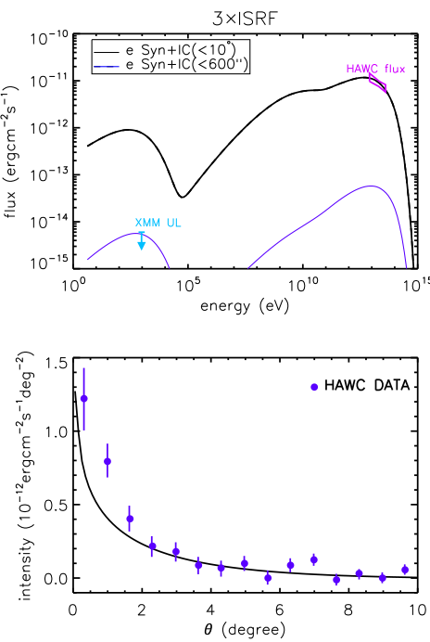
B=0.9μG

