Slide 1
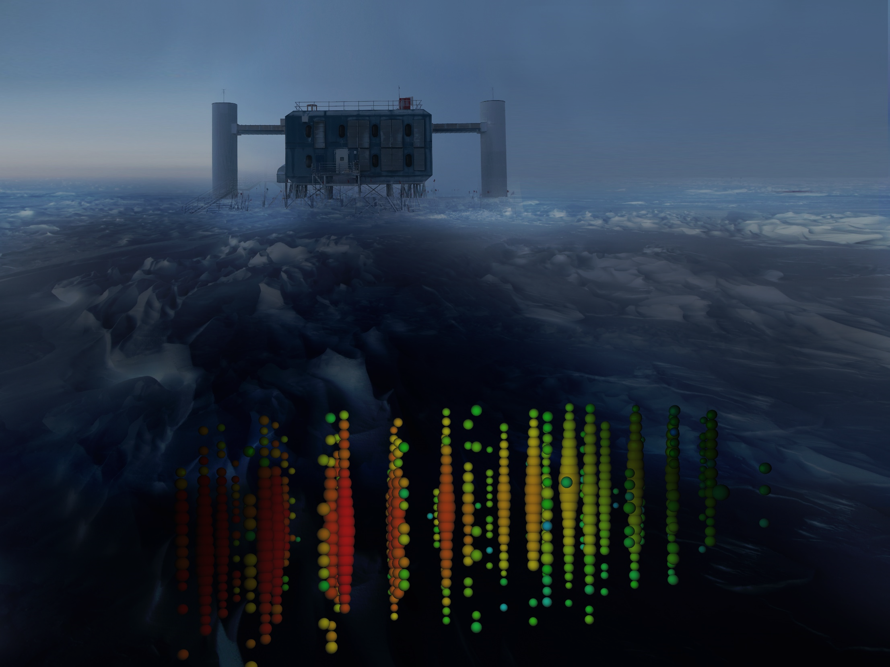



Photo-Hadronic Neutrino
Production in Blazars
Markus Böttcher
North-West University
Potchefstroom, South Africa
Anita Reimer
University of Innsbruck, Austria
Sara Buson
University of Würzburg
Hassan Abdalla
North-West University, Potchefstroom
Supported by the South African Research Chairs Initiative (SARChI) of the Department of Science and Innovation and the National Research Foundation of South Africa.

Slide 2
Neutrino Production in Blazars
IceCube-170922A
TXS 0506+056
(IceCube et al. 2018)

Slide 3
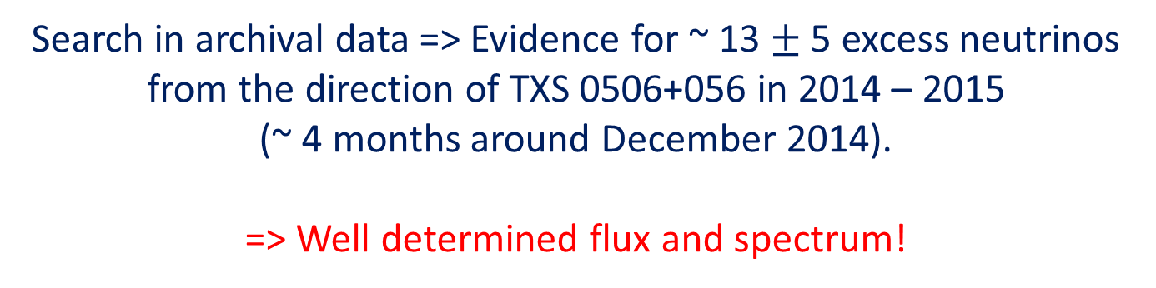
The Neutrino Flare from TXS 0506+056
(IceCube et al. 2018b)
Search in archival data => Evidence for ~ 13 $±$ 5 excess neutrinos from the direction of TXS 0506+056 in 2014 – 2015
(~ 4 months around December 2014).
=> Well determined flux and spectrum!

Slide 4
The Neutrino Flare from TXS 0506+056
No evidence of γ-ray flaring during the neutrino flare!

Slide 5
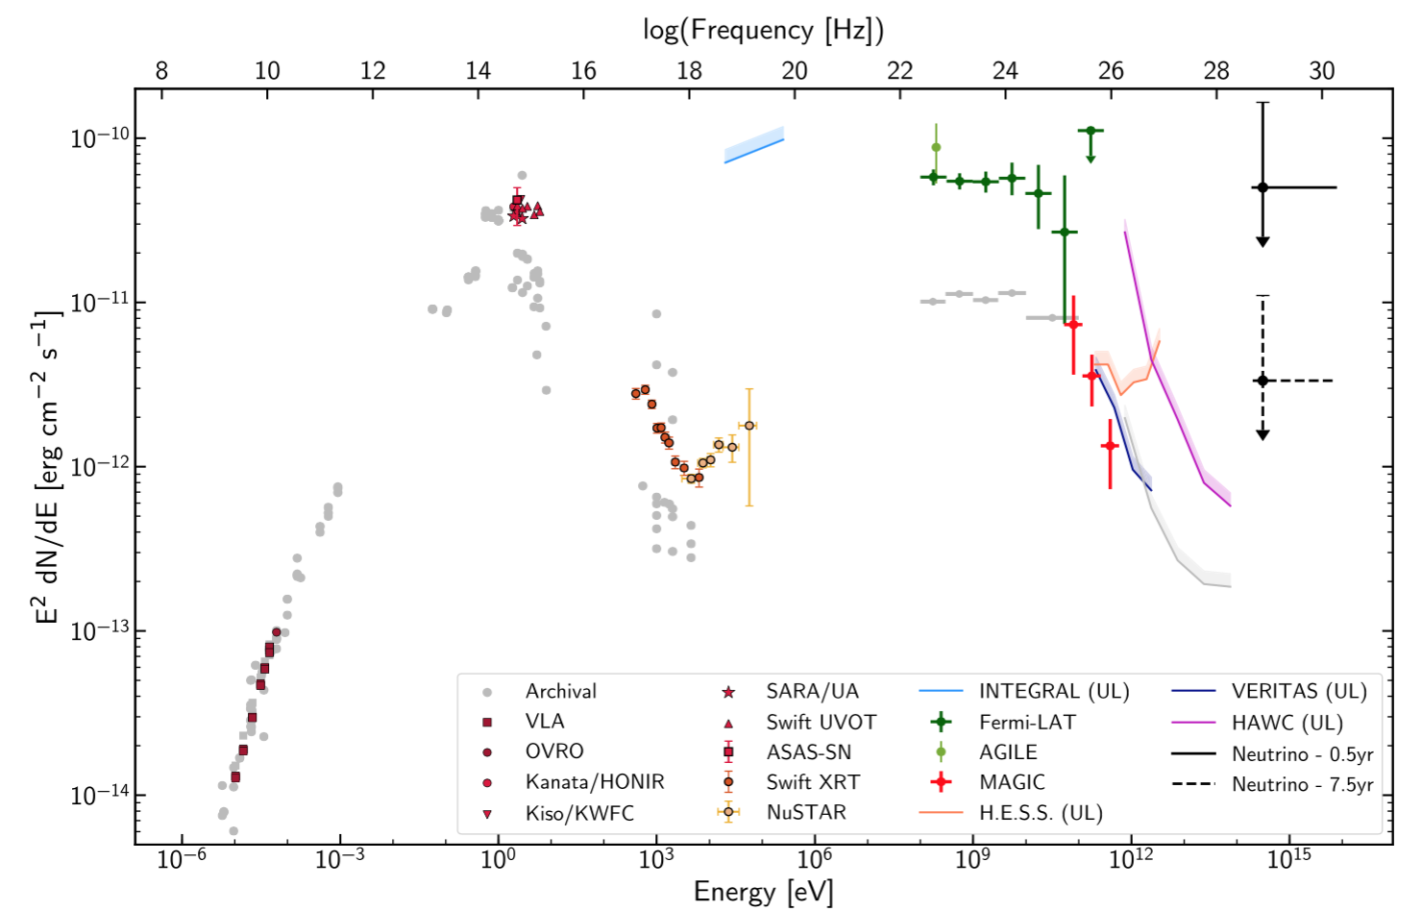
Spectral Energy Distribution of TXS 0506+056
2014-15 ν flare
IC 170922A
limits
F_{X} ~ 10⁻¹² erg/(cm² s)
(IceCube et al. 2018a)
(Photon SED from the time of IC 170922A)

Slide 6
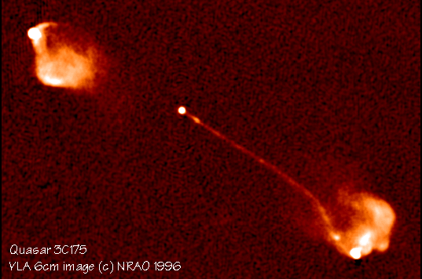

General Scenario
2γ
pγ → p π⁰
n π⁺
e⁺
μ⁺
ν_{μ}
ν_{μ}
ν_{ε}
θ
Earth
$$δ= \frac{1}{Γ (1 − β cosθ)}$$
Γ
E_{obs} = δ E’

Slide 7
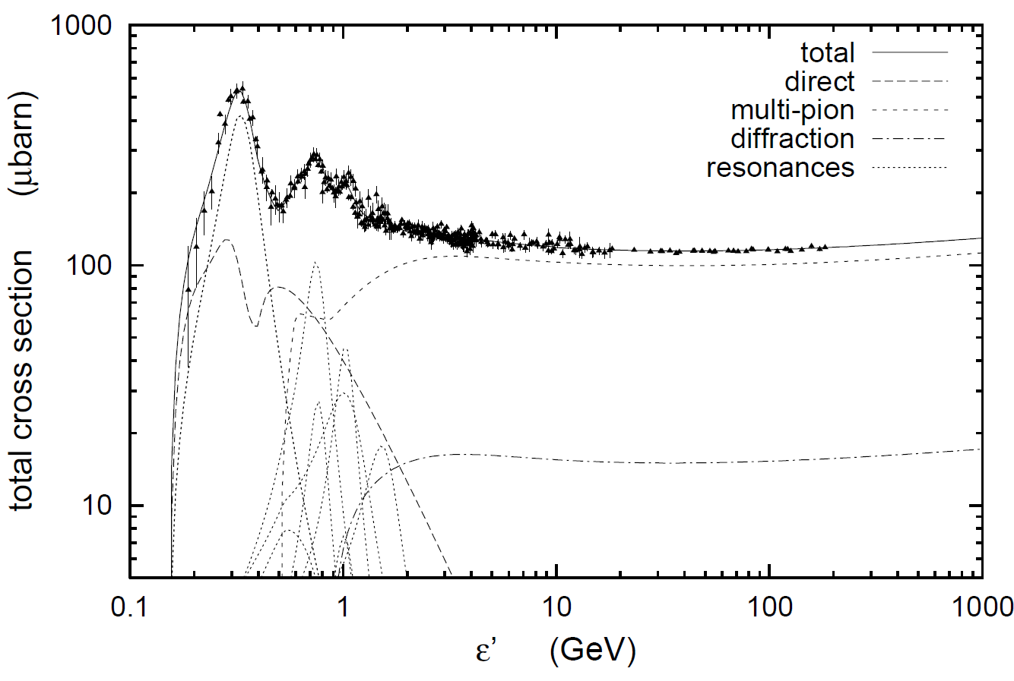
Photo-Pion Production
Δ⁺ resonance
1232 MeV
= m_{p}c² + 294 MeV
σ(pγ→pπ⁰) : σ(pγ→nπ⁺) = 2:1
(Baldini et al. 1998; Mücke et al. 2000)

Slide 8
Photo-Pion Production
Spectral index (n[ε] ~ ε^{−α}) of target photon field
Interaction Probability
(Mücke et al. 1999)
Center-of-Momentum energy
For realistic target photon fields,
most interactions occur near Δ⁺ resonance.

Slide 9
Photo-pion production - Energetics
At Δ⁺ resonance:
s = E’_{p} E’_{t} (1 – β_{p}’ μ) ~ E’_{p} E’_{t} ~ E_{Δ+}² = (1232 MeV)²
and E’_{ν} ~ 0.05 E’_{p}
To produce IceCube neutrinos (~ 100 TeV → E_{ν} = 10¹⁴ E₁₄ eV):
(i.e., E’_{ν} = 10 E₁₄ δ₁⁻¹ TeV)
Need protons with E’_{p} ~ 200 E₁₄ δ₁⁻¹ TeV
and target photons with E’_{t} ~ 1.6 E₁₄⁻¹ δ₁ keV
=> PeV CRs
=> X-rays

Slide 10

Cosmic-Ray Acceleration in Blazars
No conclusive correlation between AGN and UHECR arrival directions observed.
To produce > 100 TeV neutrinos → Need PeV protons
Simplest constraint: Confinement (Hillas Criterion):
E’_{n} < Z e B R = 3 × 10¹⁸ B₂ R₁₆ eV
(Z = 1 for protons)
for hadronic blazar models with B = 100 B₂ G
R = 10¹⁶ R₁₆ cm
  PeV Protons for IceCube neutrino production:
  UHECRs (E = δ E’ > 10¹⁹ eV): Plausible for heavy elements
  (Z >> 1)
(e.g., Rodrigues et al., 2018: ApJ, 854, 54)

Slide 11
Photo-Pion Models for TXS 0506+056
neutrinos
pion-induced cascades
(Cerruti et al. 2019: MNRAS, 483, L12)
Proton-synchrotron
Bethe-Heitler-induced
cascades
Models producing neutrinos and gamma-rays through the same proton population, predict too high neutrino energies!

Slide 12
Photo-Pion Models for TXS 0506+056
(Gao et al. 2018, Nature Astron., 3, 88)
Models with p-γ induced γ-ray emission over-produce X-rays due to cascades!

Slide 13
Photo-Pion Models for TXS 0506+056
(Gao et al. 2018, Nature Astron., 3, 88)
(Keivani et al. 2018, ApJ, 864, 84)
Models producing neutrinos and gamma-rays require leptonically dominated gamma-ray production!

Slide 14
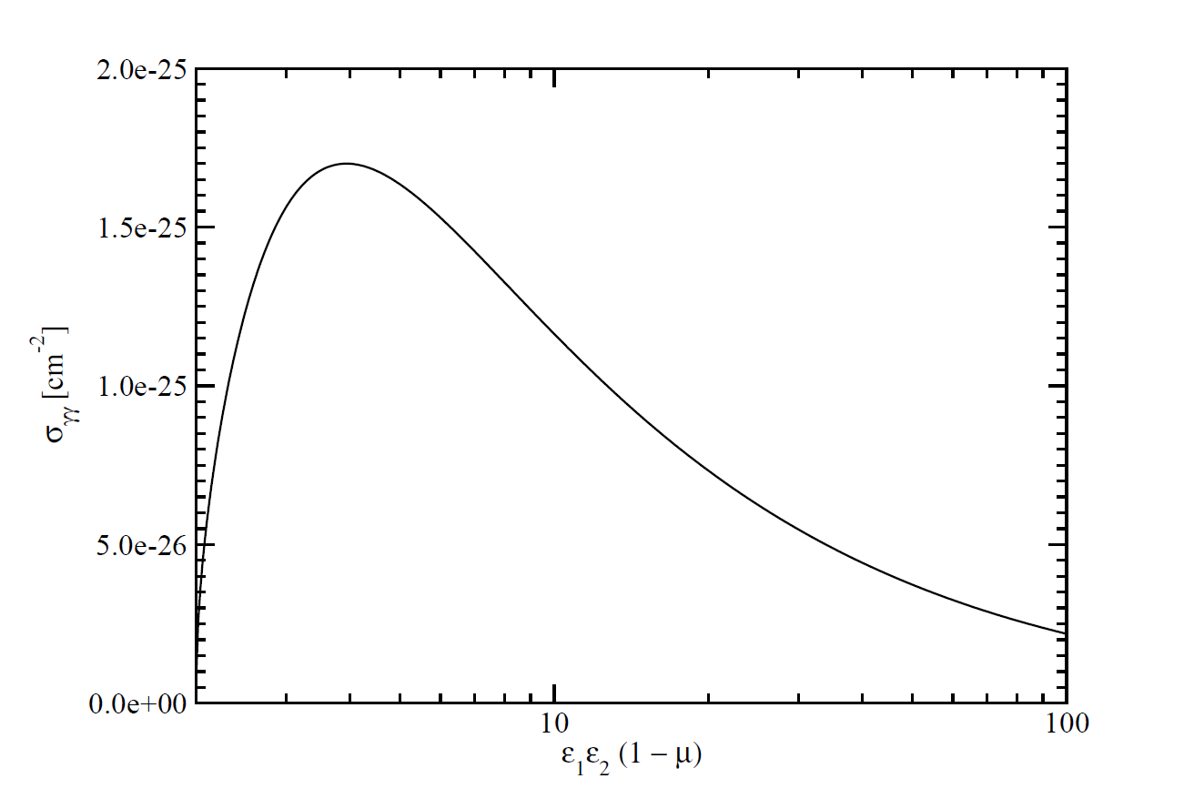
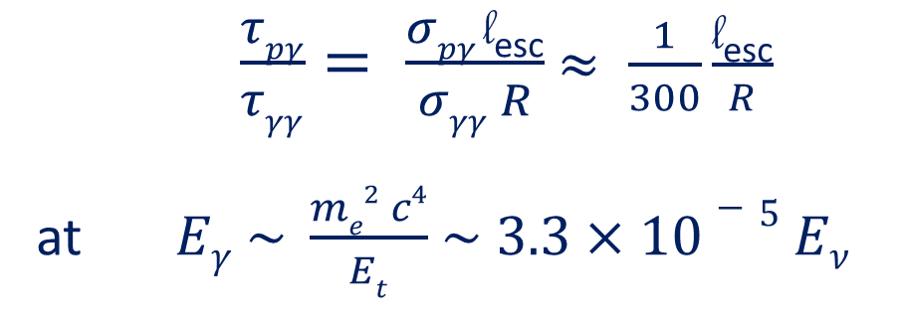
The pγ Efficiency Problem
Efficiency for protons to undergo pγ interaction ~ τ_{pγ} = l_{esc} σ_{pγ} n_{ph}
Likelihood of γ-ray photons to be absorbed ~ τ_{γγ} = R σ_{γγ} n_{ph}
σ_{pγ}
σ_{γγ}
$\frac{τpγ}{τγγ}= \frac{σpγ \text{l}\text{esc}}{σγγ R}$ $≈ \frac{1}{300}\frac{\text{l}\text{esc}}{R}$
at $Eγ \sim \frac{me2 c4}{Et}$ $\sim 3.3×10−5 Eν$
l_{esc} = average length travelled by protons until escape
~ GeV – TeV γ-rays

Slide 15

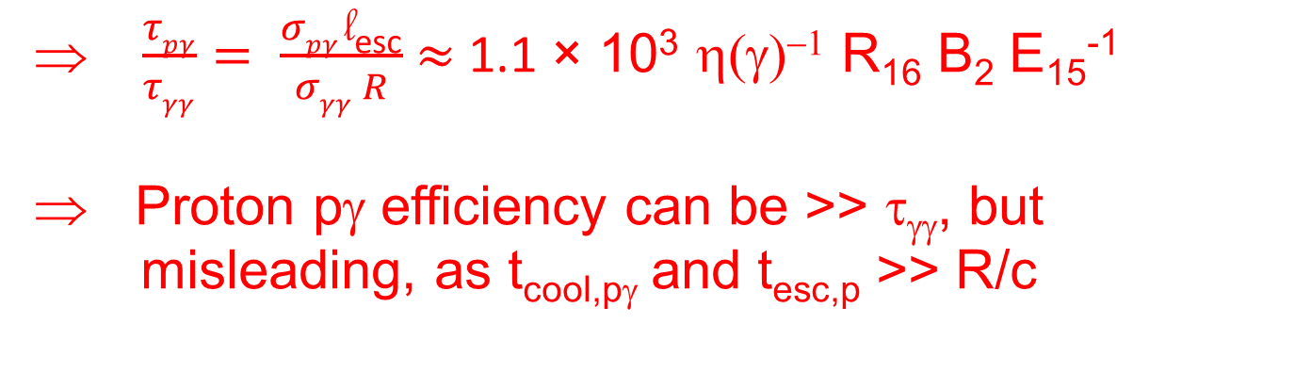
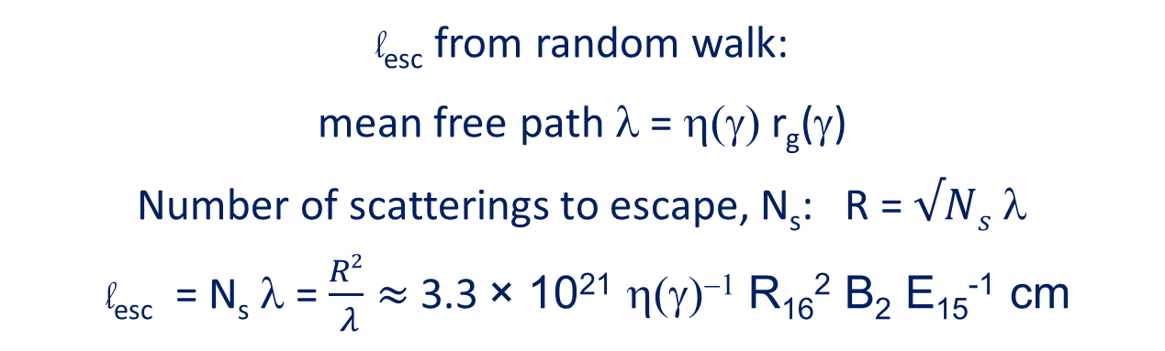
The pγ Efficiency Problem
$\frac{τpγ}{τγγ}= \frac{σpγ \text{l}\text{esc}}{σγγ R}$ $≈ \frac{1}{300}\frac{\text{l}\text{esc}}{R}$
l_{esc} = average length travelled by protons until escape
l_{esc} from random walk:
mean free path λ = η(γ) r_{g}(γ)
Number of scatterings to escape, N_{s}: R = $√Ns$ λ
l_{esc} = N_{s} λ = $\frac{R2}{ λ}≈$3.3 × 10²¹ η(γ)⁻¹ R₁₆² B₂ E₁₅⁻¹ cm
$\frac{τpγ}{τγγ}= \frac{σpγ \text{l}\text{esc}}{σγγ R}$ $≈$ 1.1 × 10³ η(γ)⁻¹ R₁₆ B₂ E₁₅⁻¹
Proton pγ efficiency can be >> τ_{γγ}, but
misleading, as t_{cool,pγ} and t_{esc,p} >> R/c

Slide 16
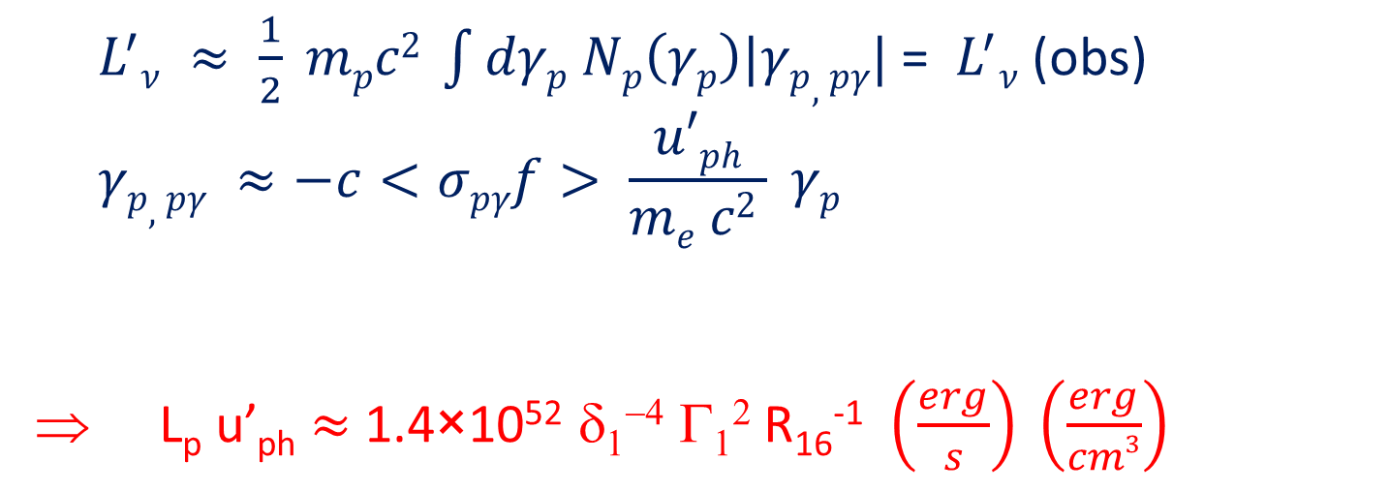
The pγ Efficiency Problem
Relevant constraint for proton bulk kinetic luminosity:
.
${ L}^{′}ν ≈ \frac{1}{2} mpc2 \int{dγp Np\left(γp\right)|γp,pγ|}$ = ${ L}^{′}ν$(obs)
$$γp,pγ ≈−c<σpγf> \frac{u′ph}{me c2 } γp$$
L_{p} u’_{ph} $≈$ 1.4×10⁵² δ₁⁻⁴ Γ₁² R₁₆⁻¹ $\left(\frac{erg}{s}\right) \left(\frac{erg}{cm3}\right)$
.
2014-15 neutrino flare of TXS 0506+056
Constrained from observed X-ray flux
(Reimer et al. 2019: ApJ, 881, 46)

Slide 17
Cascading Constraints for TXS 0506+056
pγ neutrino production in TXS 0506+056 possible with strong external UV/X-ray radiation field, but under-predicts Fermi γ-rays.
=> No neutrino – γ-ray correlation expected!
Need u_{t}’ >> u_{B}’
= 4 B₁² erg / cm³
Requires L_{p,kin} ~
1.5×10⁴⁹ δ₁⁻⁴ R_{t,17}² R₁₆⁻¹ erg/s
(Reimer et al. 2019: ApJ, 881, 46;
See also last year’s TeVPA talk)
=> External Radiation field Doppler boosted and strongly anisotropic in co-moving frame

Slide 18
Effects of the Anisotropic Radiation Field
Γ
Primary effect: (1 – μ) → 2
~ Factor 2 reduction of interaction threshold
ν_{μ}
μ⁺
γ
π⁺
n
μ ≈ -1
p

Slide 19
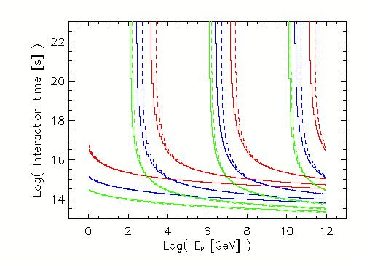
Effects of the Anisotropic Radiation Field
Reduction of interaction time scales primarily for pion production near threshold;
Negligible effect at Δ⁺ resonance and above.
Pion Production
Γ = 2
Γ = 10
Γ = 30
Isotropic with energy + density boost
Full anisotropy
Bethe-Heitler

Slide 20
Summary
Production of IceCube neutrinos requires
  Protons of ~ PeV energies (not UHECRs!)
  Target photons of co-moving UV / X-ray energies
No correlation between γ-ray and neutrino activity necessarily expected
TXS 0506+056 neutrino flare of 2014-15 strongly favours UV / soft X-ray target photon field external to the jet
Effects of the anisotropic radiation field properly captured by simply accounting for Doppler boosting.
Supported by the South African Research Chairs Initiative (SARChI) of the Department of Science and Innovation and the National Research Foundation of South Africa.

Slide 21
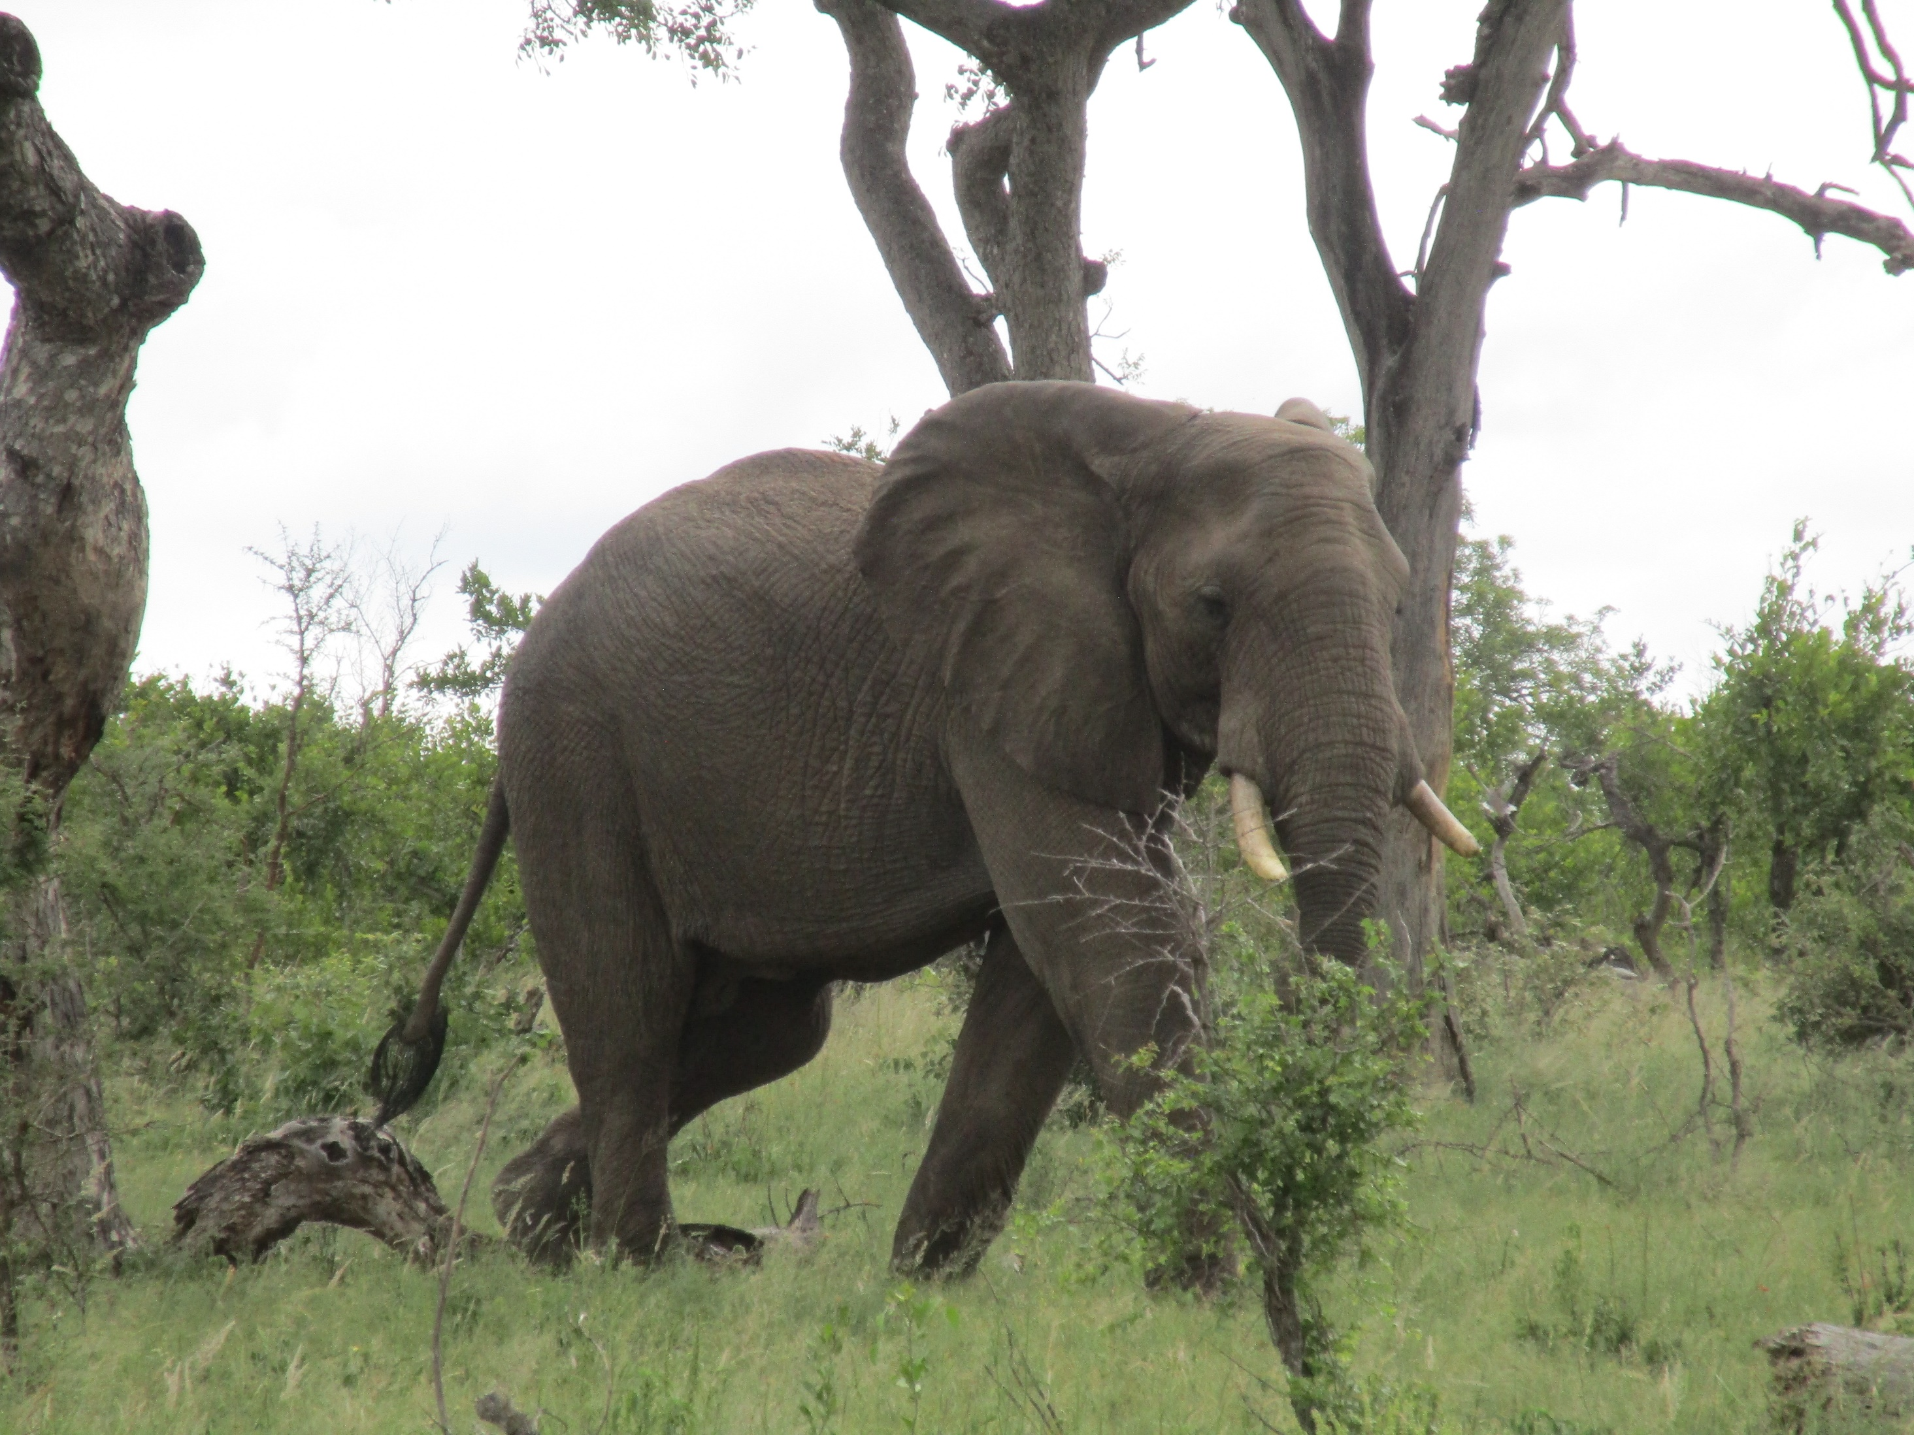
Thank you!
Any opinion, finding and conclusion or recommendation expressed in this material is that of the authors and the NRF does not accept any liability in this regard.

