Slide 1
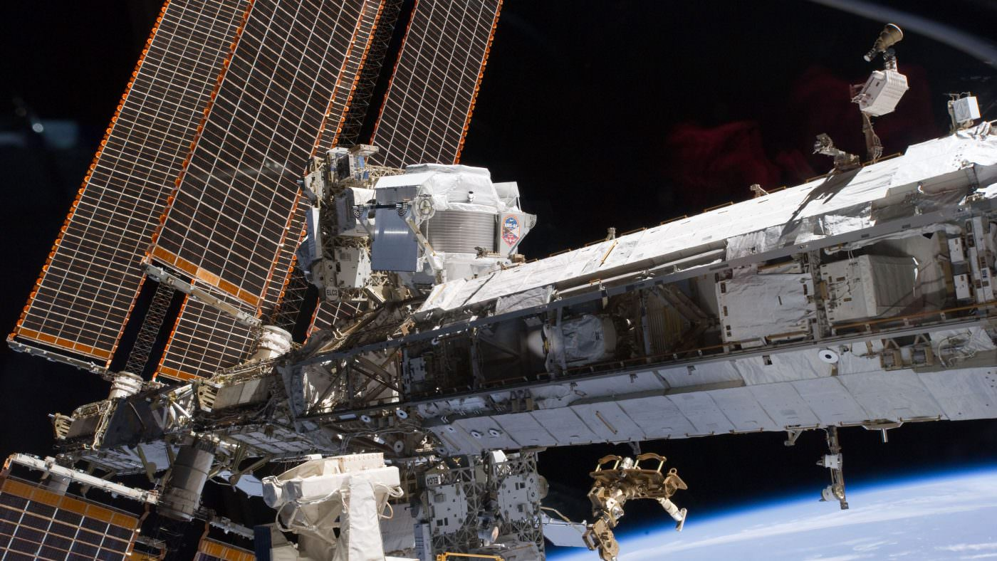
Precision Measurement of Primary Cosmic Rays with the
Alpha Magnetic Spectrometer on the International Space Station
Huy Phan, MIT
On behalf of the AMS Collaboration
TeVPA2019 Sydney, December 5th 2019
1

Slide 2
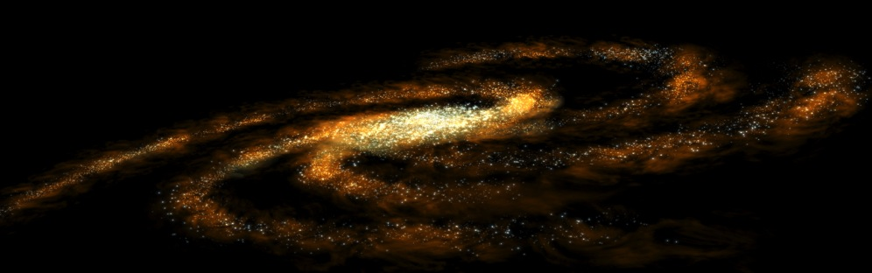
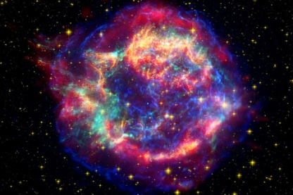
Primary Cosmic Rays
Traditionally, cosmic rays are classified into primary and secondary.
Primary cosmic rays are produced and accelerated at the source (such as Supernovae Remnants)
They propagate across the galactic magnetic field to arrive at AMS, carrying information about their sources and history of travel
p, He, C, O, Ne, Mg, Si, S…
AMS
2

Slide 3
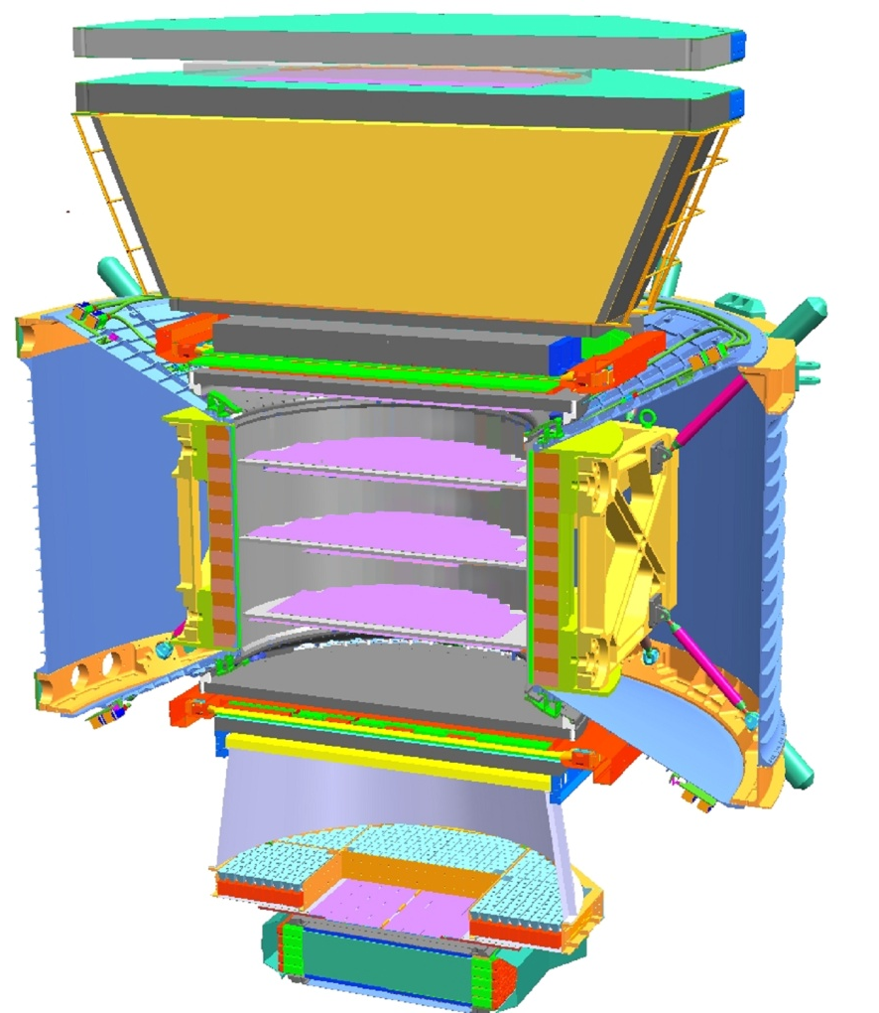
Nuclei Measurement from Proton to Sulphur by AMS
L1
9 Layers of Silicon Trackers (L1, Inner Tracker L2-L8, L9) and Magnet measure Rigidity (Momentum/Charge)
Charge | Coordinate Resolution | Maximum Detectable Rigidity
Z = 1 | ~10 μm | 2 TV
2 ≤ Z ≤ 8 | 5 - 7 μm | 3.2 - 3.7 TV
9 ≤ Z ≤ 16 | 6 - 8 μm | 3 - 3.5 TV
TRD
TOF
L2
L3-4
L5-6
L7-8
L1, Upper TOF, Inner Tracker, Lower TOF, L9 provide consistent Charge measurements along the particles’ trajectory.
TOF
Charge | Inner Tracker Charge Resolution (charge unit)
1 ≤ Z ≤ 8 | 0.05 – 0.12
9 ≤ Z ≤ 16 | 0.13 – 0.19
RICH
L9
ECAL
3

Slide 4

Cosmic Ray Composition
H
AMS has an excellent capability to distinguish the different nuclei within cosmic rays
He
Primary Cosmic Ray Analysis
C
O
Li
B
Be
N
Ne
Mg
Si
F
Na
Al
S
P
Cl
Ar
Ca
K
Ti
Fe
Sc
Cr
V
Mn
Ni
Co
4

Slide 5
Proton + Carbon Inelastic Cross Section
AMS detector components are made up of mostly Carbon and Aluminum.
Simulated p+C inelastic cross section compared with past experiments’ measurement data
5

Slide 6
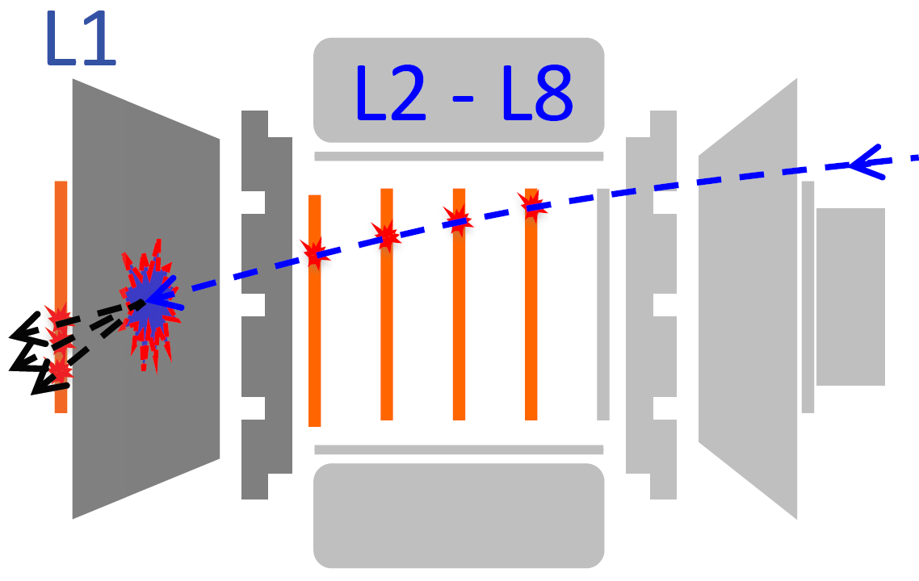
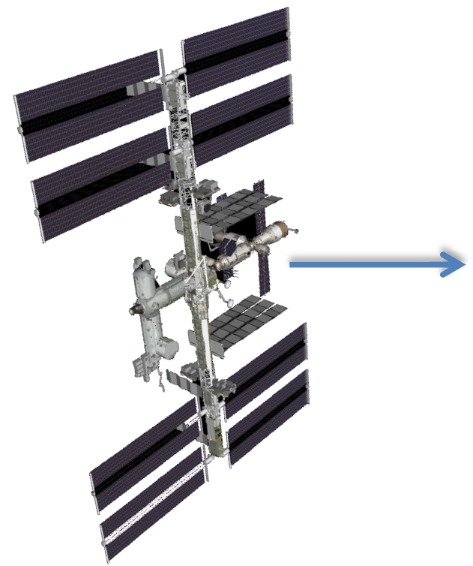
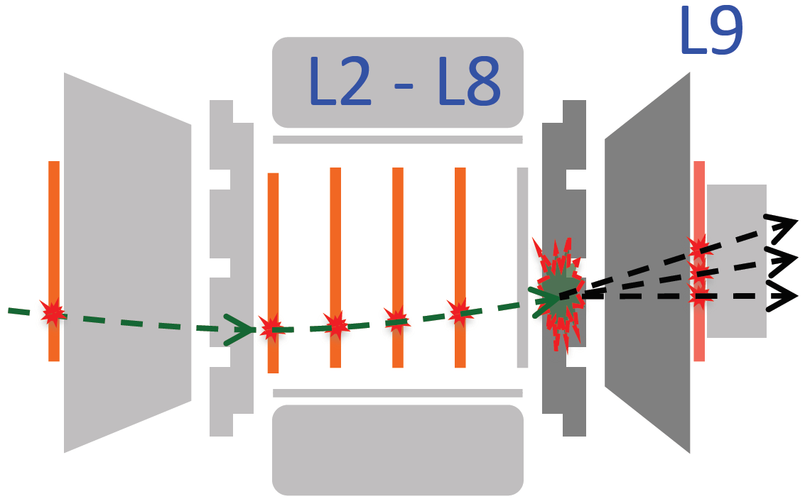
Nuclei Inelastic Cross Section Measurement with Light Cosmic Rays (2 ≤ Z ≤ 8)
The inelastic cross-section of X+C and X+Al interaction have only been measured for He and C at low energy below few GeVs.
AMS has performed such measurements for nuclei from He to S at high energy.
1/ Nuclei inelastic cross section can be determined by measuring the survival probability, which is the proportion of survival nuclei events without inelastic interaction
2/ Survival probability is measured when AMS is flying horizontally, such that particles can enter the detector both from right to left and left to right.
3/ Both the survival probabilities in the upper part (L1-L2) and the lower part (L8-L9) of AMS are used to measure the nuclei inelastic cross-section.
Particle entering the detector from right to left
Particle entering the detector from left to right
6

Slide 7
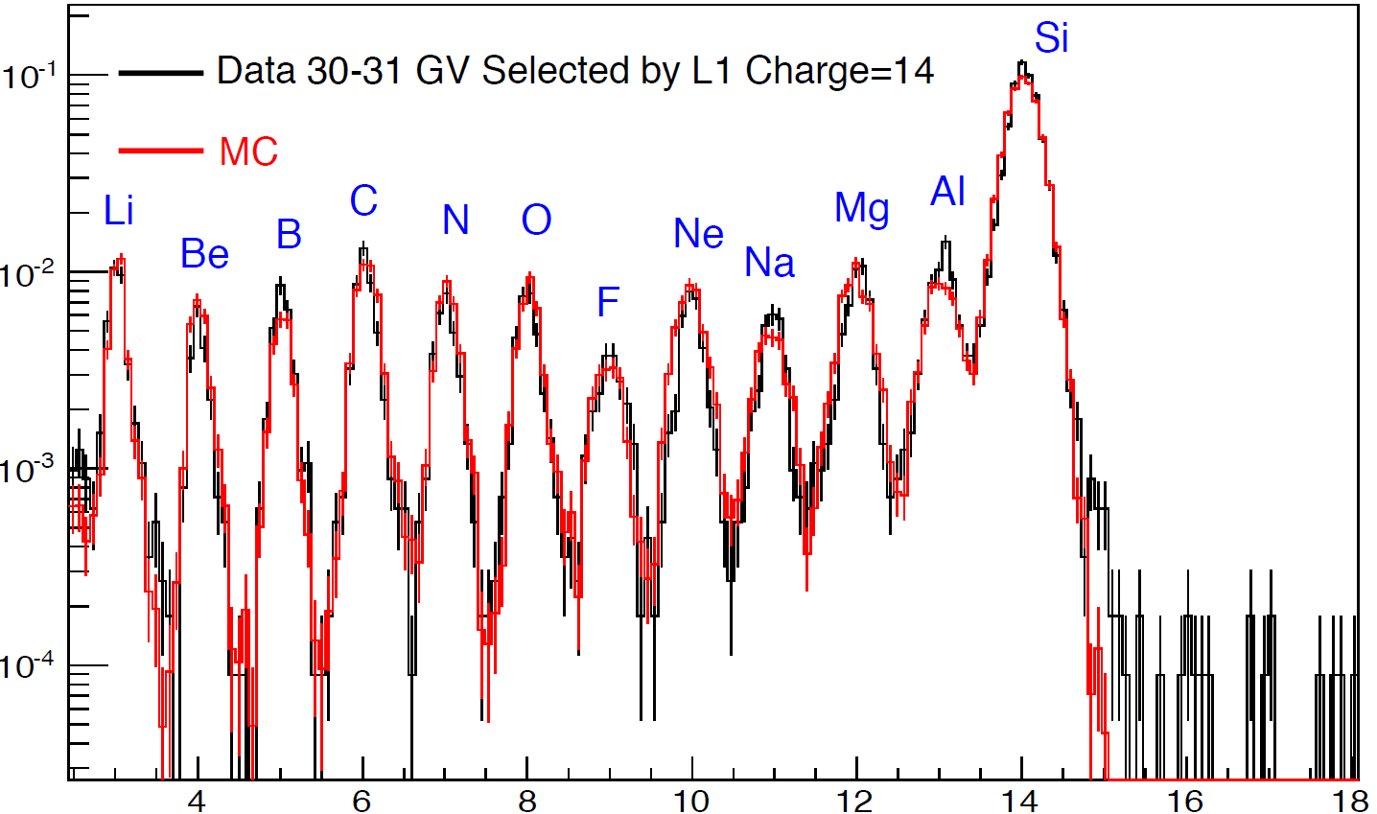
Nuclei Inelastic Cross Section Measurement with Heavy Cosmic Rays (9 ≤ Z ≤ 16)
Statistics in “horizontal” runs are not sufficient (0.13% of total exposure time) for heavy nuclei survival probability evaluation.
For evaluation of nuclei survival probability between L1-L2:
Select primary nuclei by L1 charge.
Obtain survival probability by comparing charge measured with inner tracker.
Si
L1
Normalized Events
Silicon breakup channels
TRD
L2
TOF
L3-4
L5-6
L7-8
TOF
RICH
L9
ECAL
Inner Tracker Charge
7

Slide 8
Nuclei Inelastic Cross Section Measurement with Heavy Cosmic Rays (9 ≤ Z ≤ 16)
For evaluation of nuclei survival probability between L8-L9, we compare the L8 tracker charge with charge measured by L9
Neon
Si
MC/Data Survival Probability
L1
TRD
Magnesium
L2
TOF
L3-4
L5-6
L7-8
Silicon
TOF
RICH
L9
ECAL
Rigidity [GV]
8

Slide 9

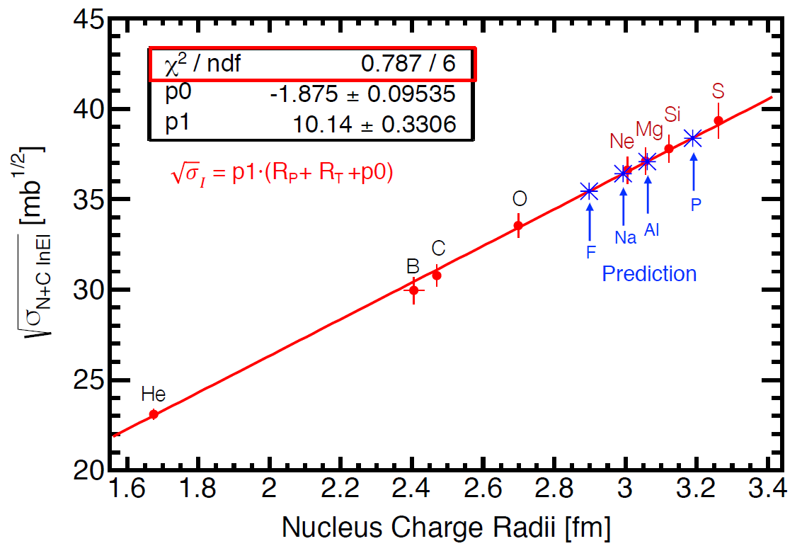
AMS Nucleus + C Inelastic Cross Section (5-100 GV)
Interestingly, shows a linear dependence on charge radius
I. Angeli and K. P. Marinova. “Table of experimental nuclear ground state charge radii: An update.” Atomic Data and Nuclear Data Tables 99.1 (2013): 69-95
9

Slide 10
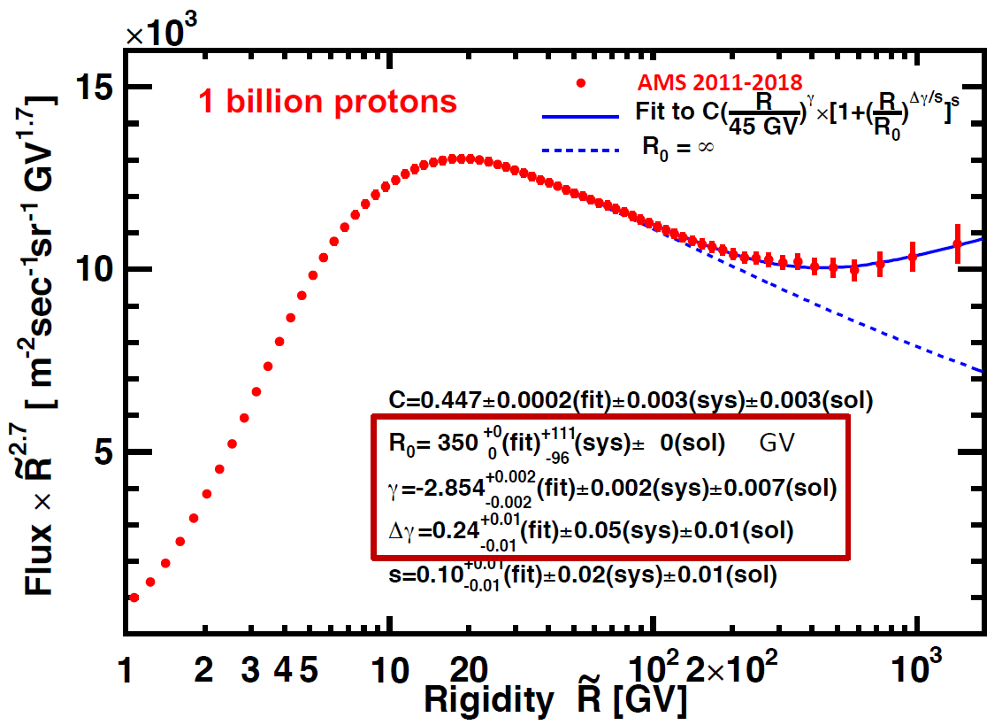

Latest AMS Measurement of Proton Spectrum
Fit from 45 GV to 1.8 TV
The new AMS result (2011-2018) is consistent with earlier AMS PRL result (2011-2013)
“M. Aguilar et al., Phys. Rev. Lett., 114, 171103 (2015)” but with improved accuracy.
10

Slide 11
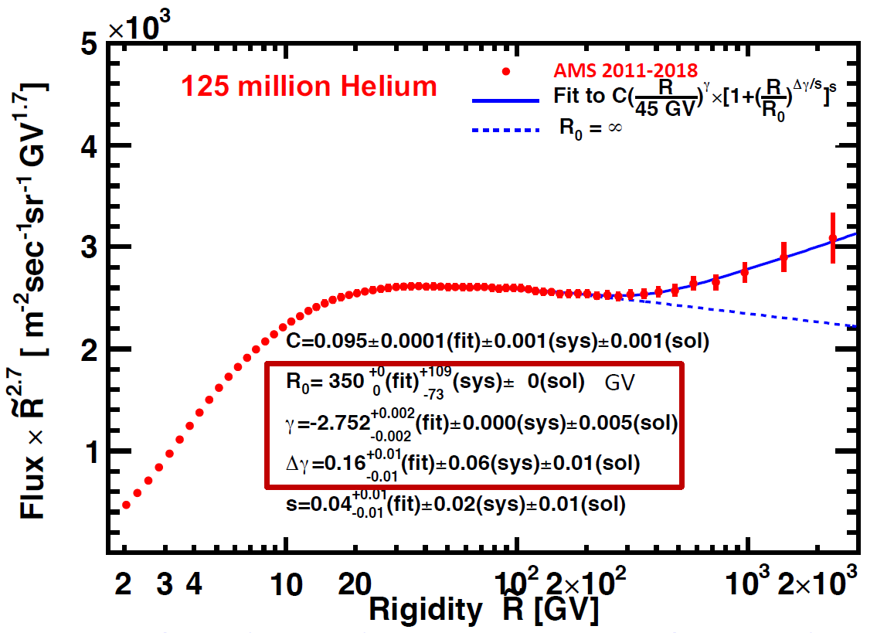
Latest AMS measurement of Helium Spectrum
Fit from 45 GV – 3 TV
The new AMS result (2011-2018) is consistent with earlier AMS PRL result (2011-2016)
“M. Aguilar et al., Phys. Rev. Lett., 119, 251101 (2017)” but with improved accuracy.
11

Slide 12
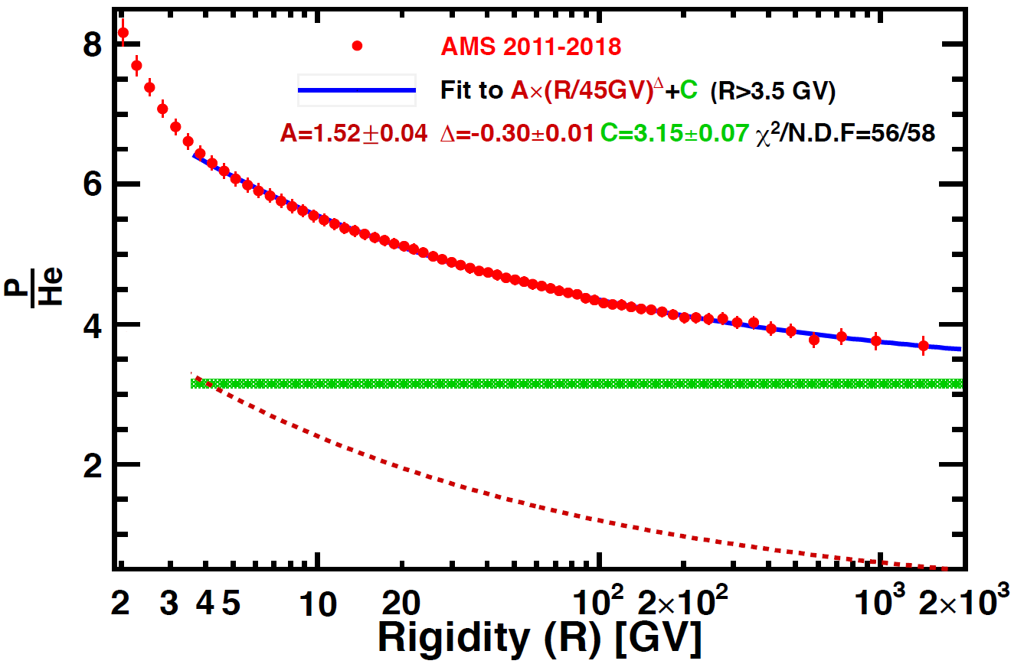
p/He Flux Ratio
1/ p/He ratio can be parametrized as the sum of a power law and a constant value above 3.5 GV
2/ The ratio seems to approach a constant value at high energy
12

Slide 13
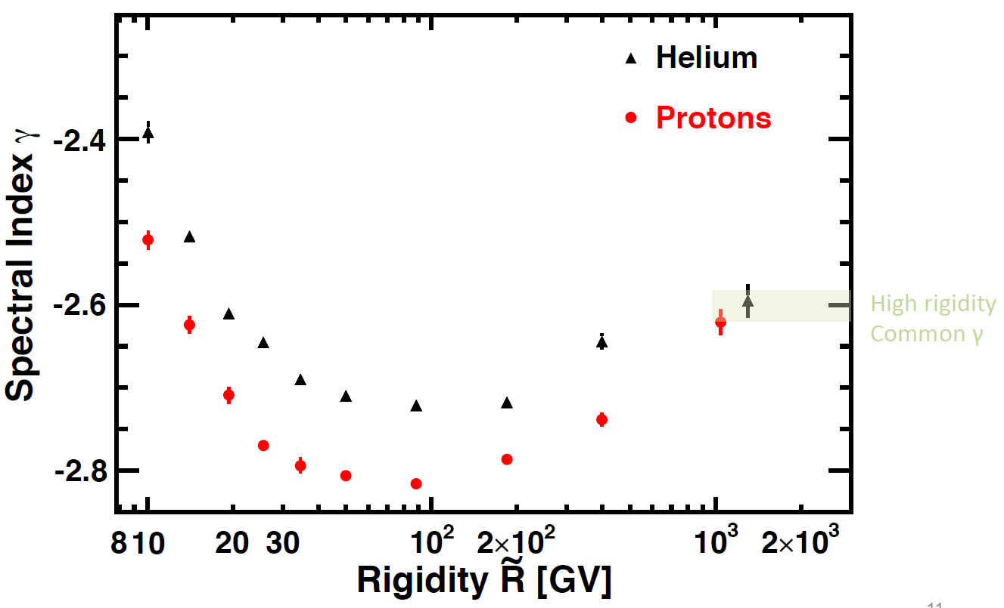
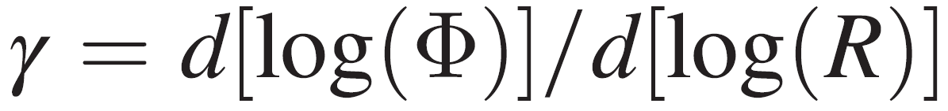
Proton and Helium Spectral Indices $γ$
Proton and Helium seem to share the same spectral index at high rigidity (~1 TV).
13

Slide 14
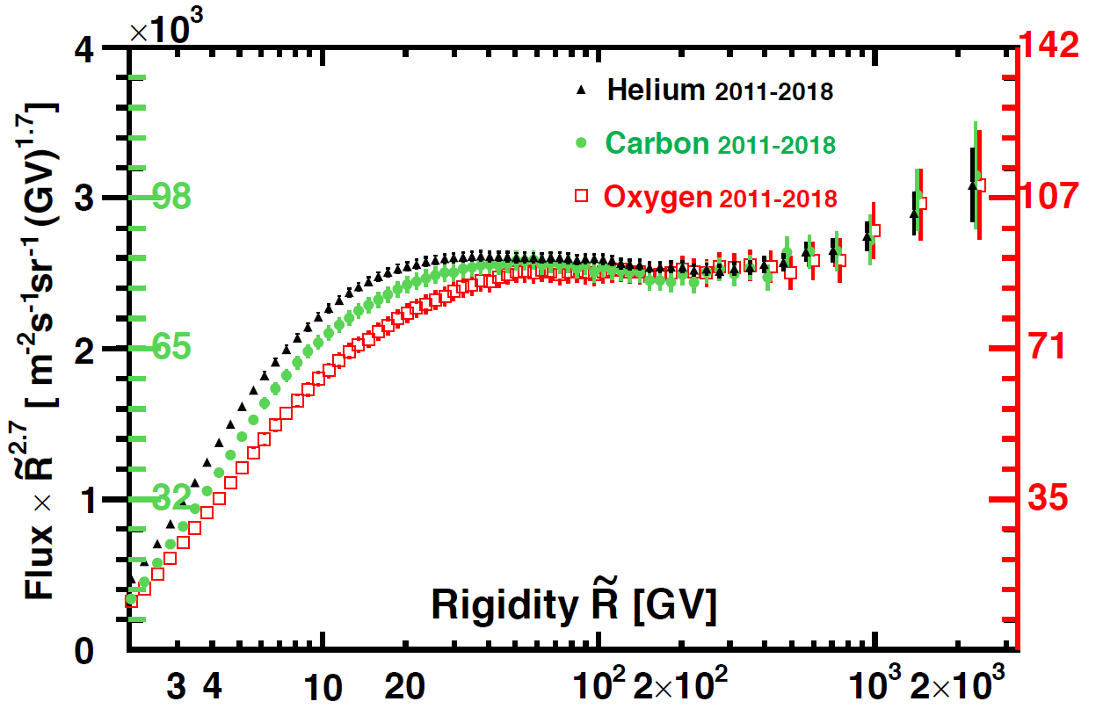
Latest AMS Measurement of He, C and O fluxes
He, C and O fluxes all deviate from a single power law above hundred GV.
Furthermore, they seem have identical rigidity dependence above 60 GV.
125 Million
14 Million
12 Million
60 GV
The new AMS result (2011-2018) is consistent with earlier AMS PRL result (2011-2016)
“M. Aguilar et al., Phys. Rev. Lett., 119, 251101 (2017)” but with improved accuracy.
14

Slide 15
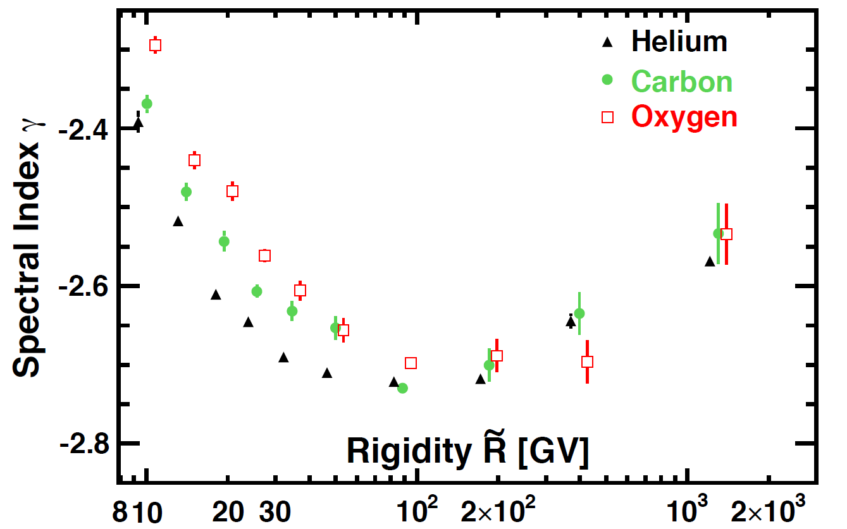
He, C and O Spectral Indices $γ$
Above 200 GV, Helium, Carbon and Oxygen fluxes harden in an identical manner.
15

Slide 16
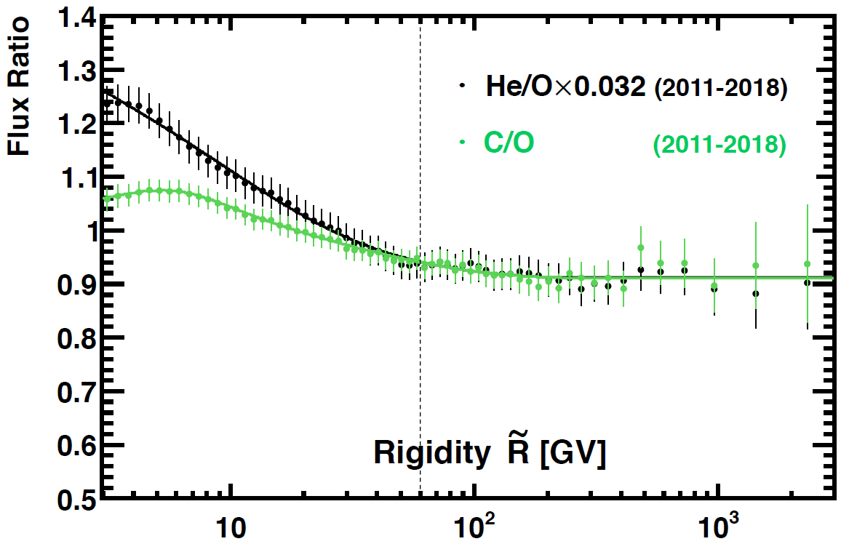
He/O and C/O Fluxes Ratio
He, C and O have identical rigidity dependence above 60 GV.
60 GV
16

Slide 17
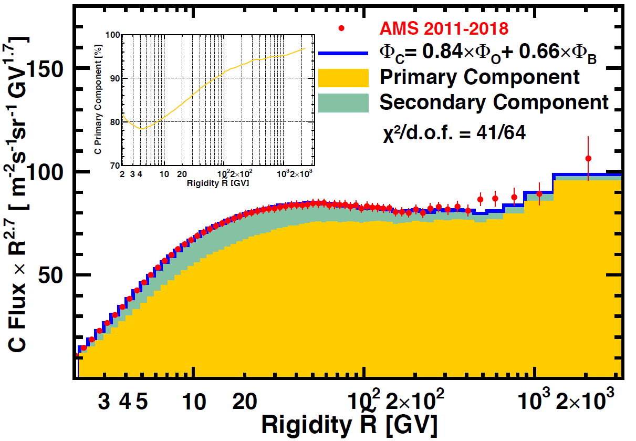
Carbon Spectrum Primary and Secondary Component
The Carbon flux Φ_{C} can be described as a linear combination of primary flux $∝$ Φ_{O} and a secondary flux $∝$ Φ_{B} over the entire rigidity range
17

Slide 18
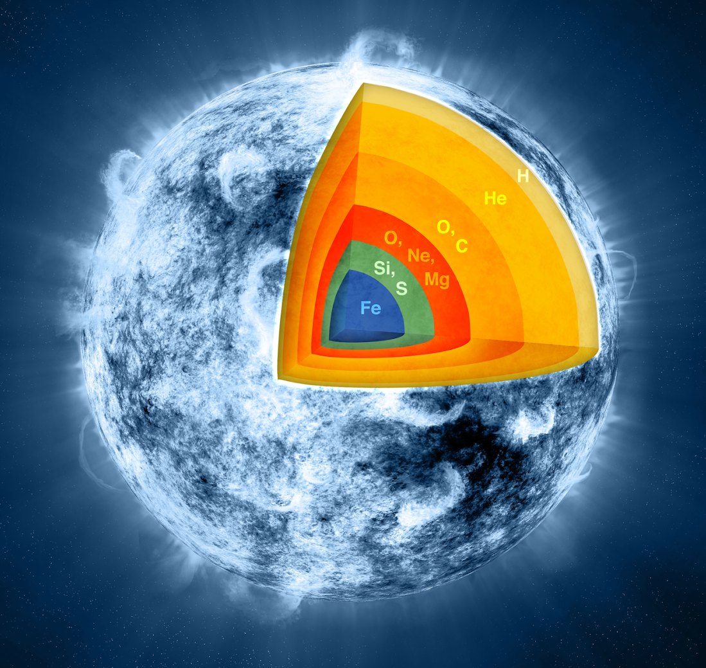
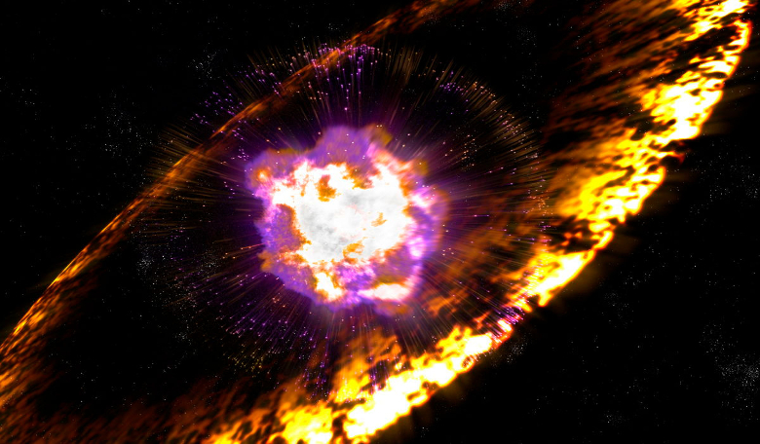
Heavy Primary Cosmic Rays
Heavy elements (Ne, Mg, Si, S...) are
produced during the lifetime of stars, though at later stage than light nuclei, and accelerated by supernovae explosion.
Do they behave the same way as light primaries (He, C, O)?
Nuclei fusion
in stars
supernovae
S
Si
Ne
Mg
18

Slide 19
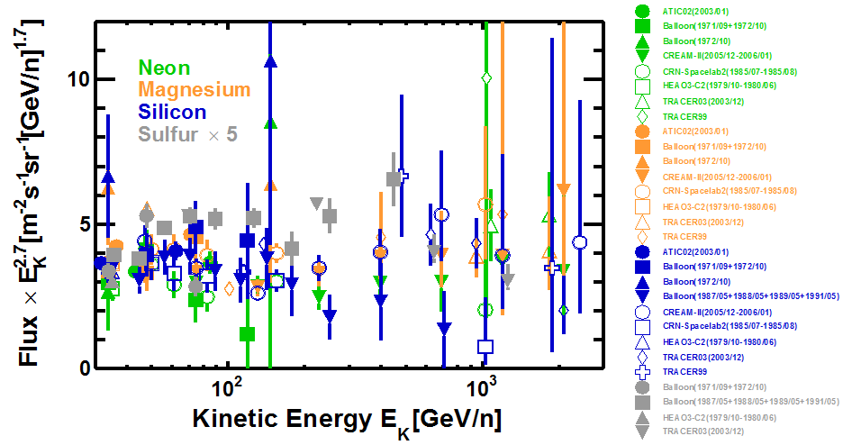
Heavy Nuclei Flux Measurements before AMS
19

Slide 20
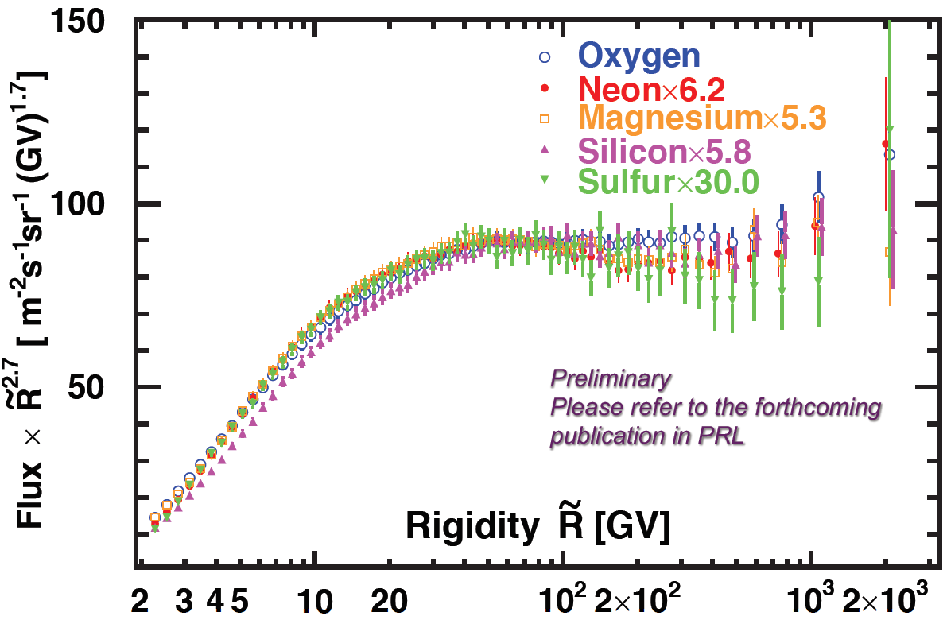
AMS Measurements of Neon, Magnesium, Silicon and Sulphur Spectrum
Ne, Mg, Si and S fluxes all deviate from a single power law above hundred GV.
12 Million
1.8 Million
2.2 Million
1.6 Million
0.3 Million
20

Slide 21
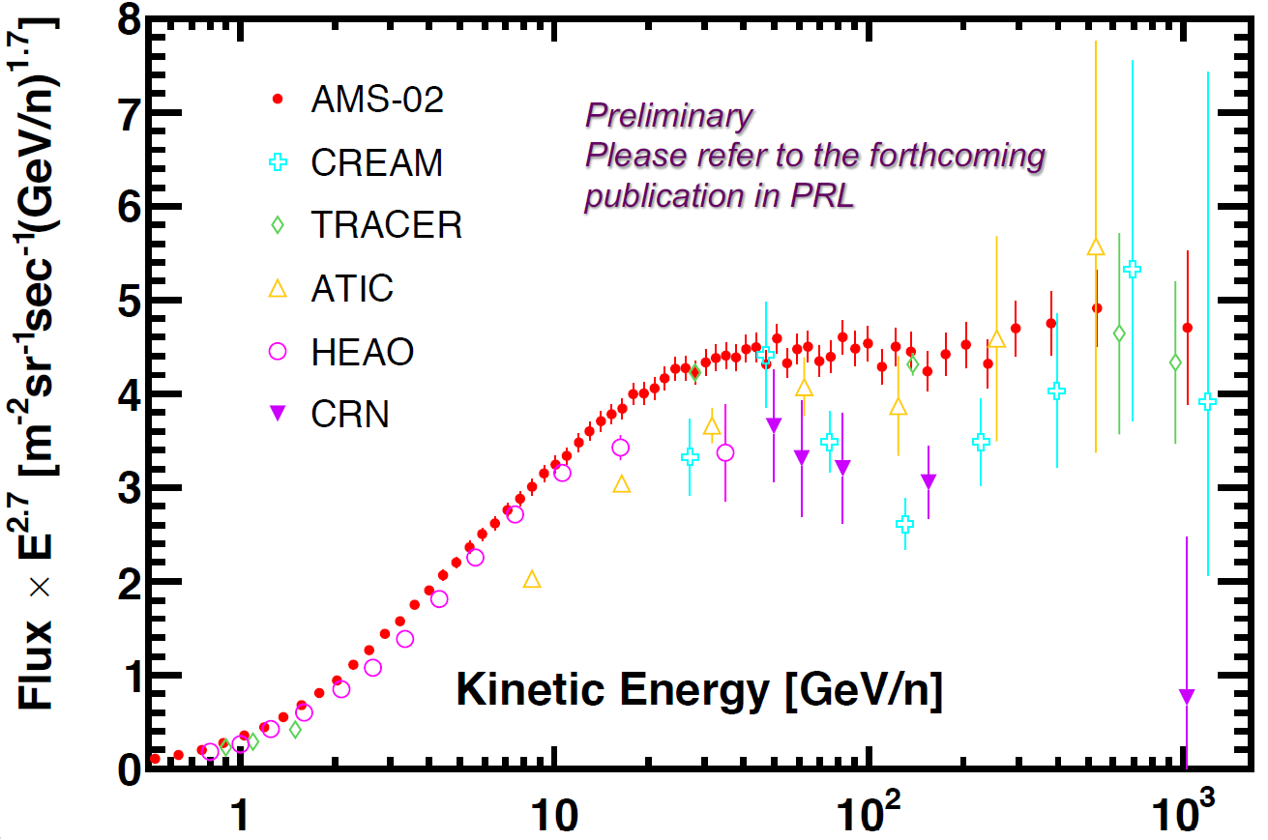
Comparison with previous experiments for Silicon
21

Slide 22
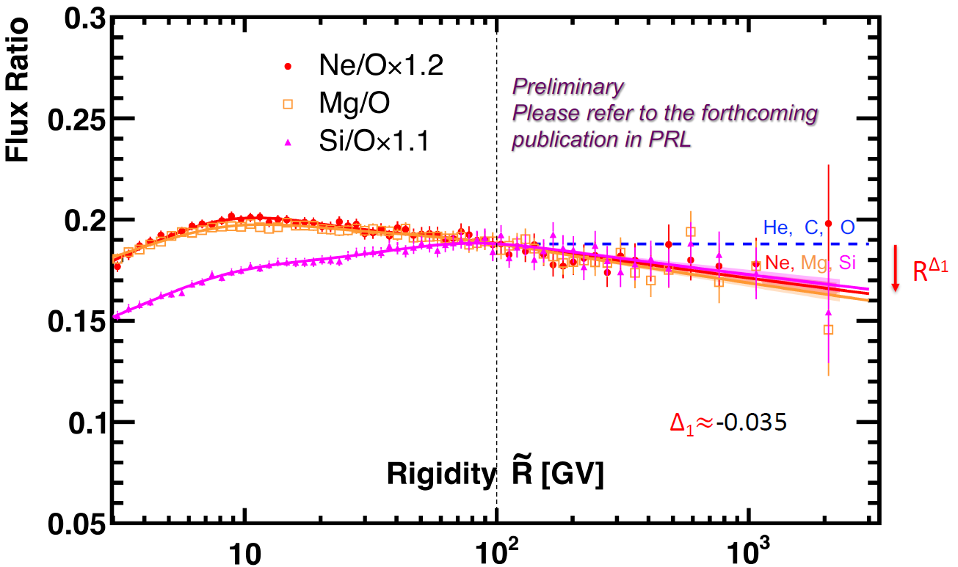
Ratio of Neon, Magnesium, and Silicon Flux over Oxygen
Ne, Mg, and Si have identical rigidity dependence above 100 GV, however, they deviate from O by a power law $R^{∆_{1}}$.
22

Slide 23
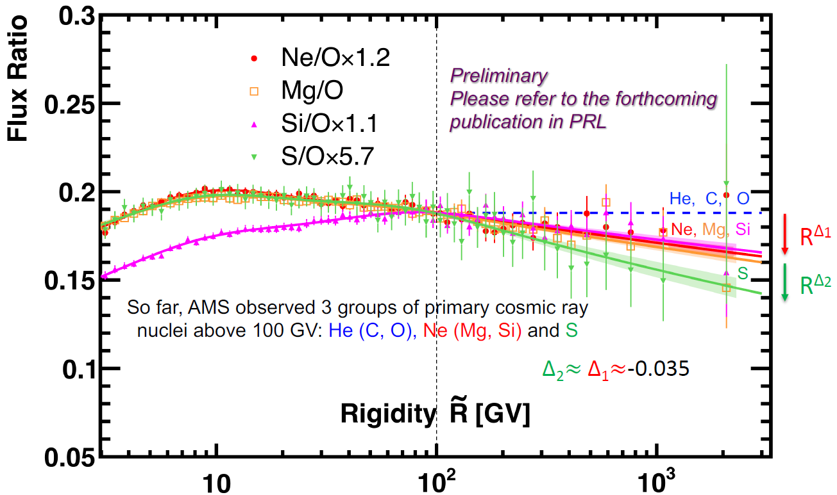
Ratio of Neon, Magnesium, Silicon and Sulphur Flux over Oxygen
S is soften by a power law $R^{∆_{2}}$ compared to Ne, Mg, Si group.
23

Slide 24
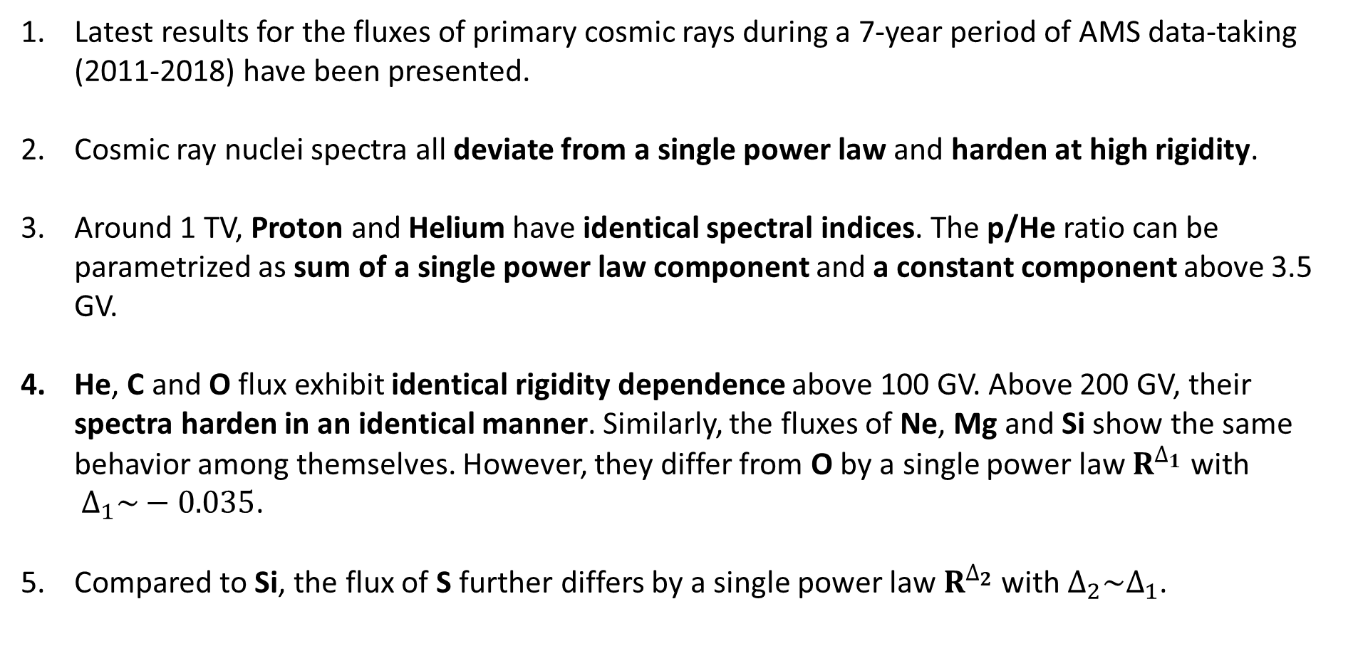
Summary
Latest results for the fluxes of primary cosmic rays during a 7-year period of AMS data-taking (2011-2018) have been presented.
Cosmic ray nuclei spectra all deviate from a single power law and harden at high rigidity.
Around 1 TV, Proton and Helium have identical spectral indices. The p/He ratio can be parametrized as sum of a single power law component and a constant component above 3.5 GV.
He, C and O flux exhibit identical rigidity dependence above 100 GV. Above 200 GV, their spectra harden in an identical manner. Similarly, the fluxes of Ne, Mg and Si show the same behavior among themselves. However, they differ from O by a single power law $R^{∆_{1}}$ with ${ ∆}_{1}\sim −0.035$.
Compared to Si, the flux of S further differs by a single power law $R^{∆_{2}}$with $∆_{2}\sim ∆_{1}$.
24

Slide 25
Back Up

Slide 26
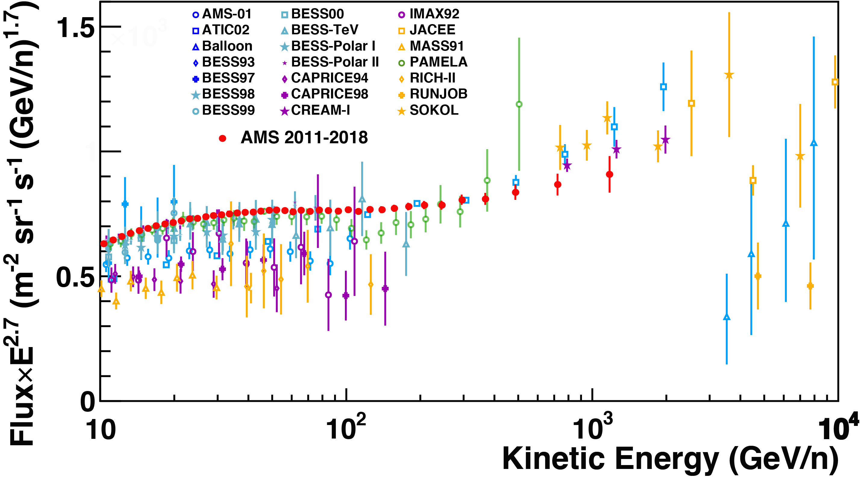
Latest AMS measurement of Helium Spectrum
The new AMS result (2011-2018) is consistent with earlier AMS PRL result (2011-2013)
“M. Aguilar et al., Phys. Rev. Lett., 114, 171103 (2015)” but with improved accuracy.

Slide 27
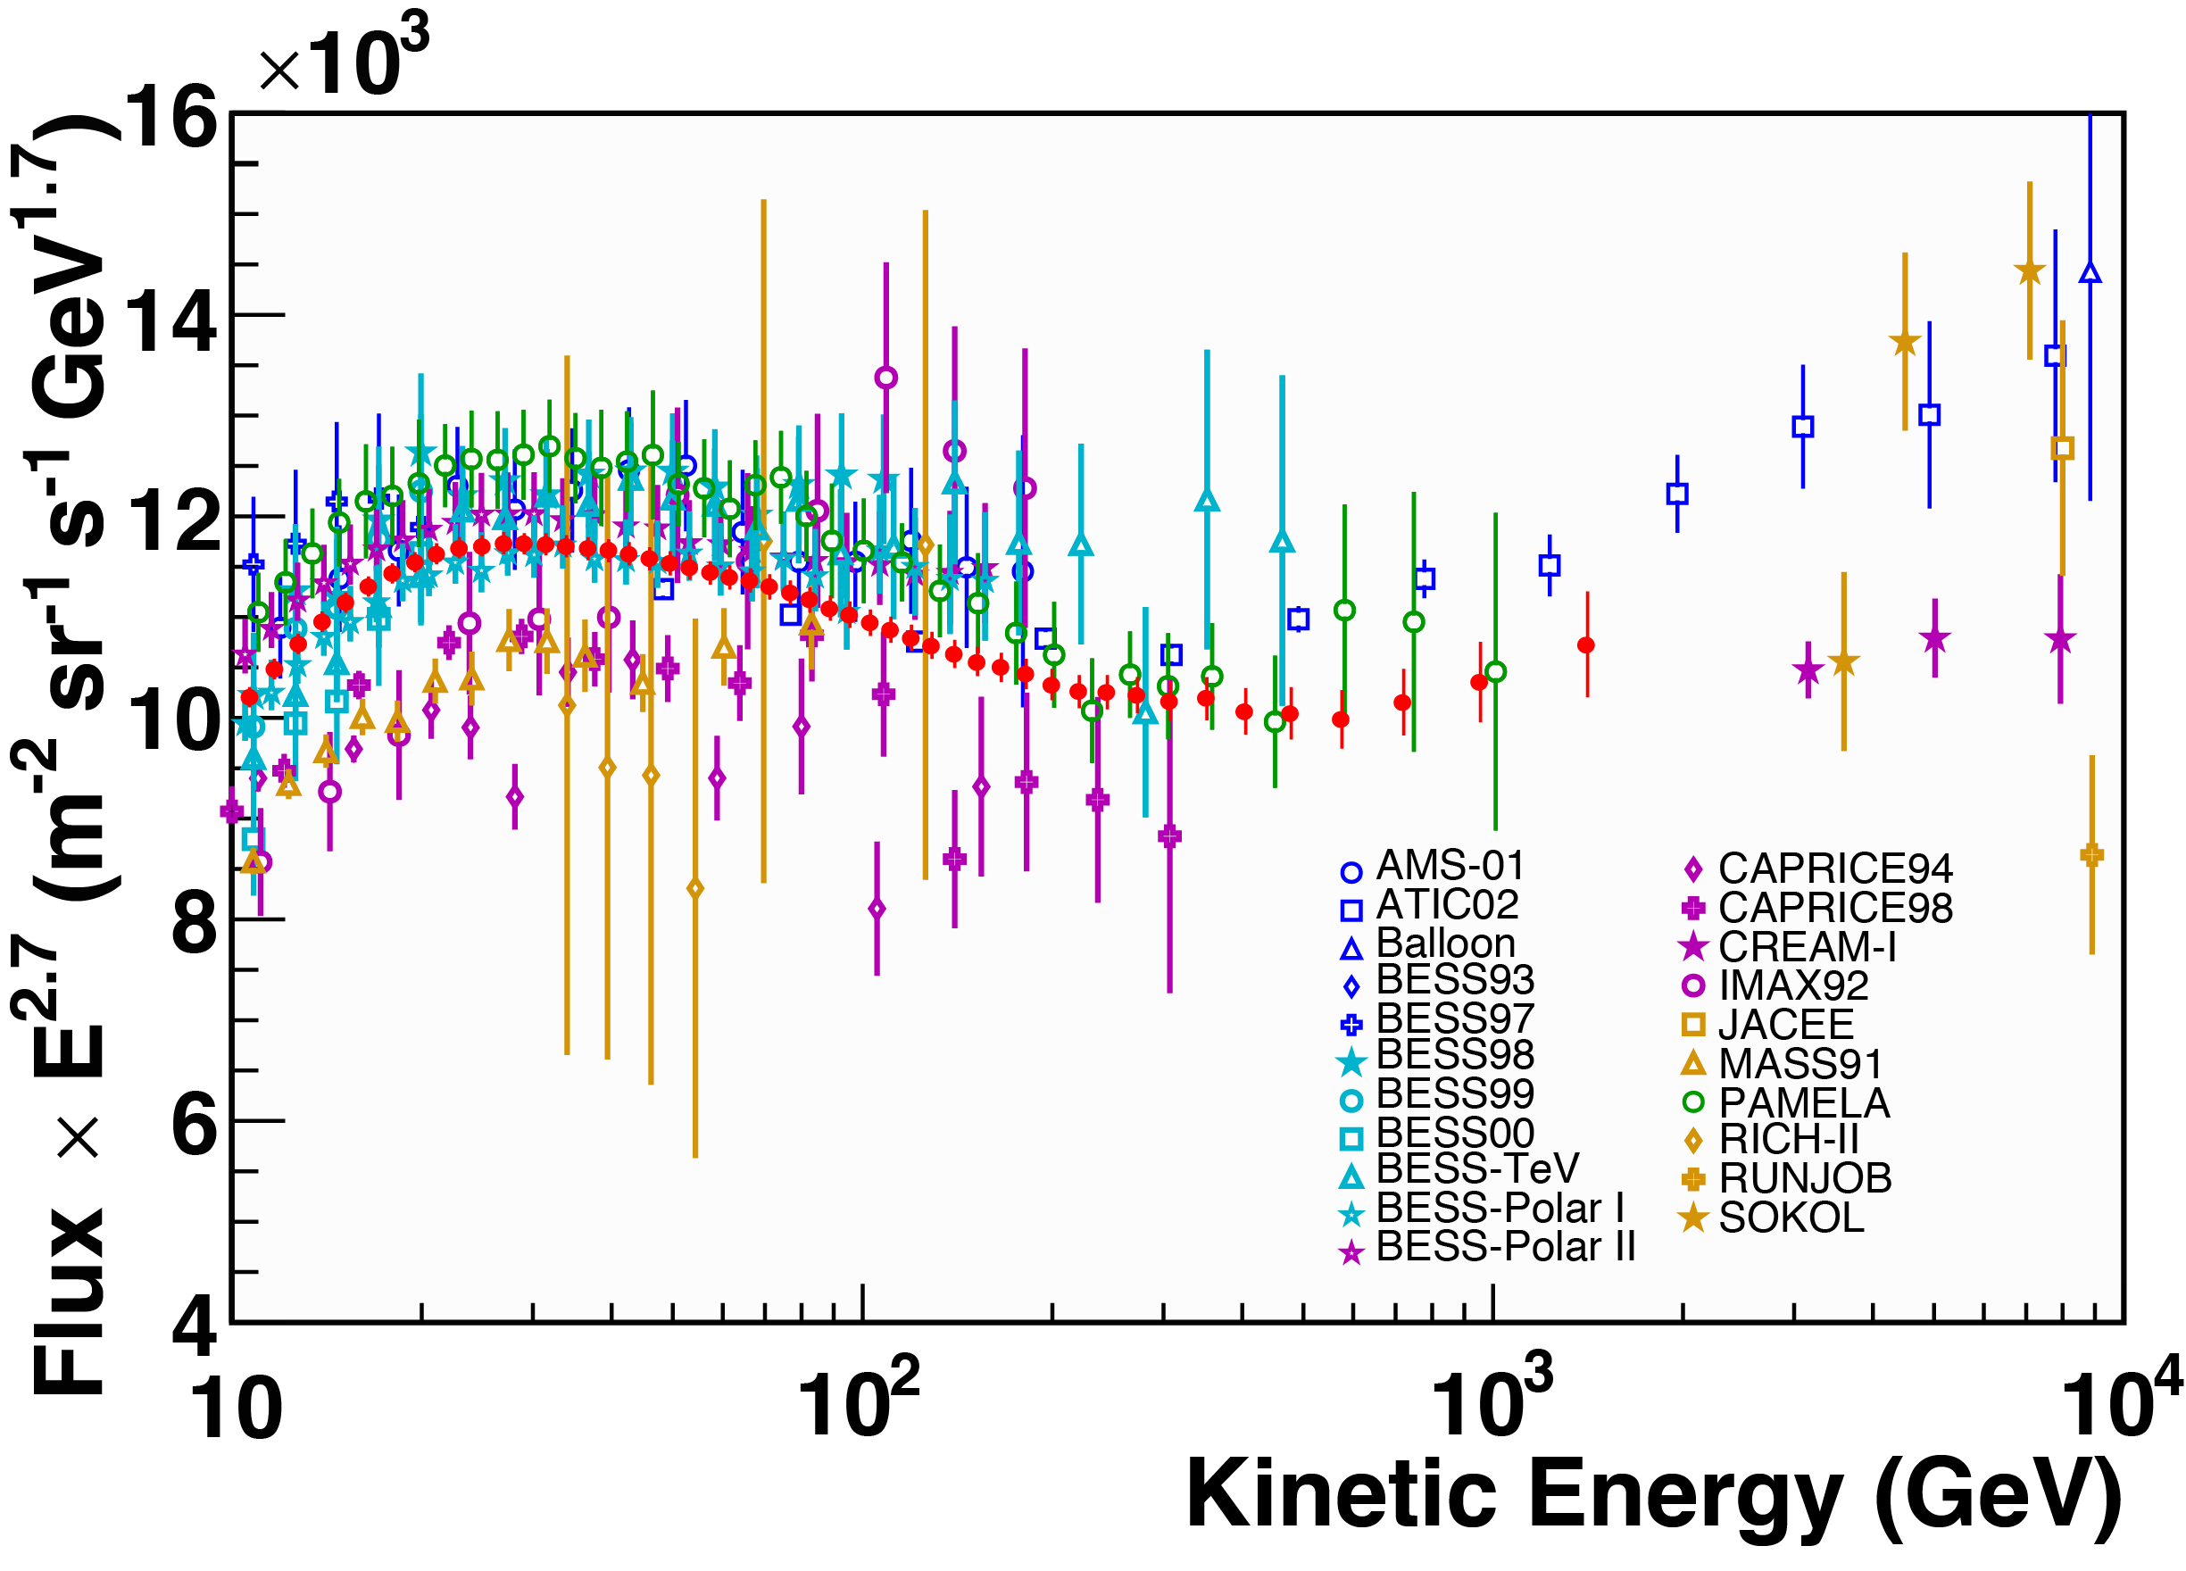
Latest AMS measurement of Proton Spectrum
The new AMS result (2011-2018) is consistent with earlier AMS PRL result (2011-2016)
“M. Aguilar et al., Phys. Rev. Lett., 119, 251101 (2017)” but with improved accuracy.

Slide 28
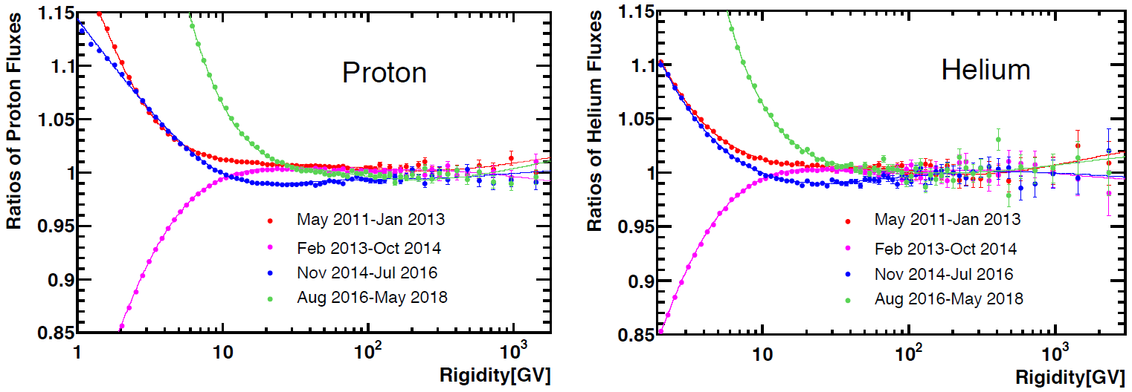
Stability of Proton and Helium Fluxes
1/ Proton and Helium fluxes are expected to show time dependence below 100 GV due to solar modulation.
2/ At higher rigidities, the effect of solar modulation is negligible and the fluxes should be constant within measurement error.
3/ Fluxes from different period are compared to the average to check their stability.

Slide 29
AMS Nuclei + C Inelastic Cross Section Measurements (5-100 GV)
The inelastic cross-section of X+C and X+Al interaction have only been measured for p, He and C at low energy below few GeV
29

