Slide 1
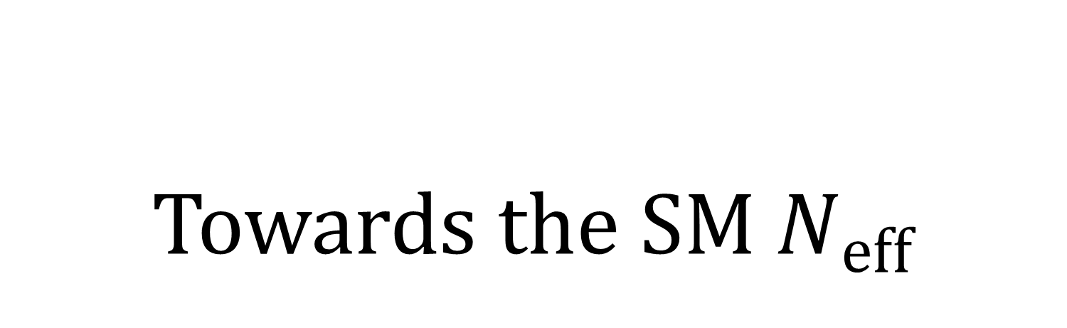
Towards the SM $N_{eff}$
Jack Bennett. UNSW, Australia.
with: Y. Wong, G. Buldgen, M. Drewes.
Arxiv:1911.04504

Slide 2
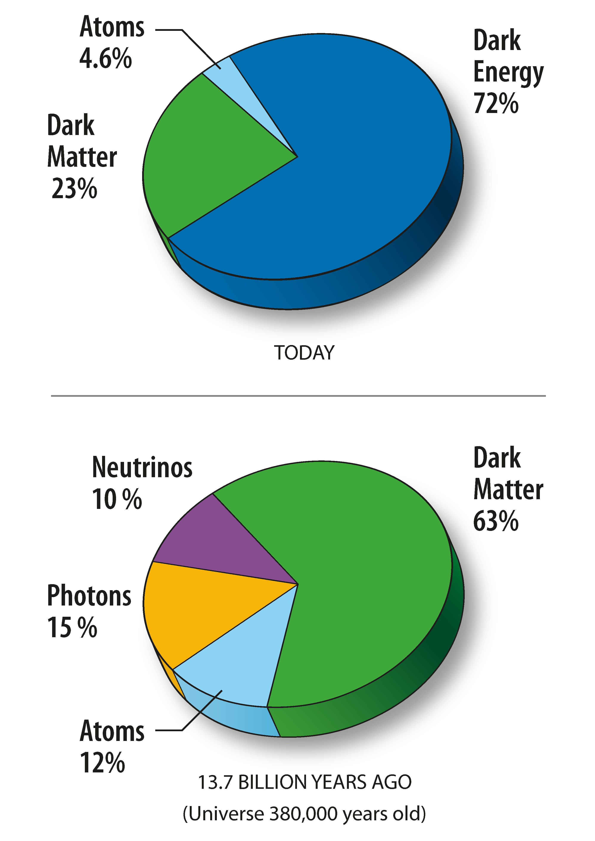
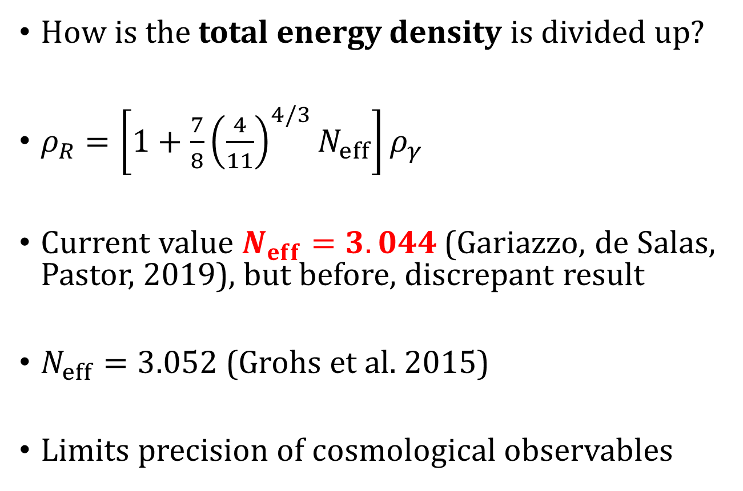
Effective number of neutrinos
map.gsfc.nasa.gov/media/080998/index
How is the total energy density is divided up?
$ρ_{R}=\left[1+\frac{7}{8}{\left(\frac{4}{11}\right)}^{4/3}N_{eff}\right]ρ_{γ}$
Current value $N_{eff}=3.044$ (Gariazzo, de Salas, Pastor, 2019), but before, discrepant result
$N_{eff}=3.052$ (Grohs et al. 2015)
Limits precision of cosmological observables

Slide 3
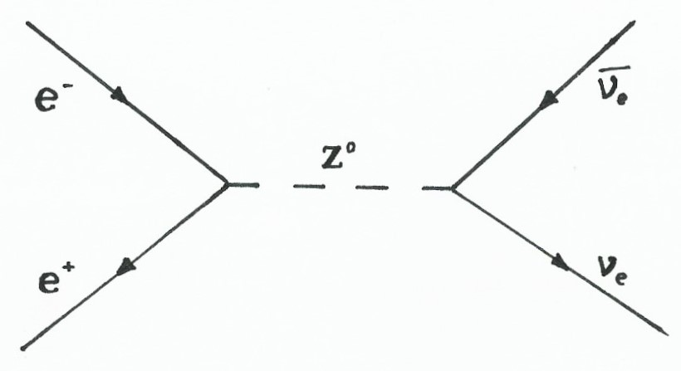
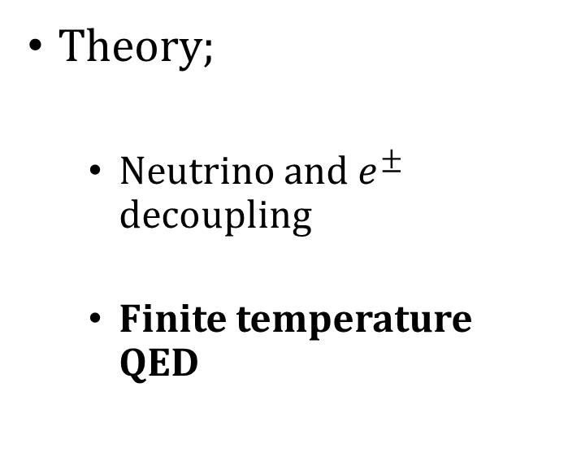
Outline
Theory;
  Neutrino and $e^{±}$ decoupling
  Finite temperature QED
Our work:
  Partition function
  Solve ODE, add next order
  Optical Theorem → decoupling temperature

Slide 4
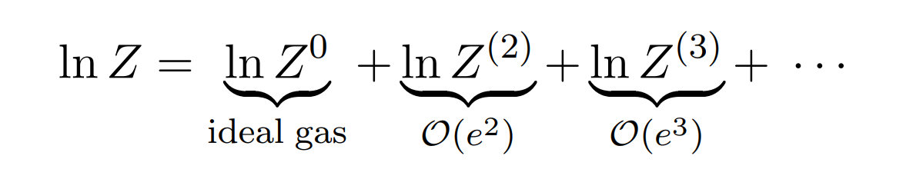
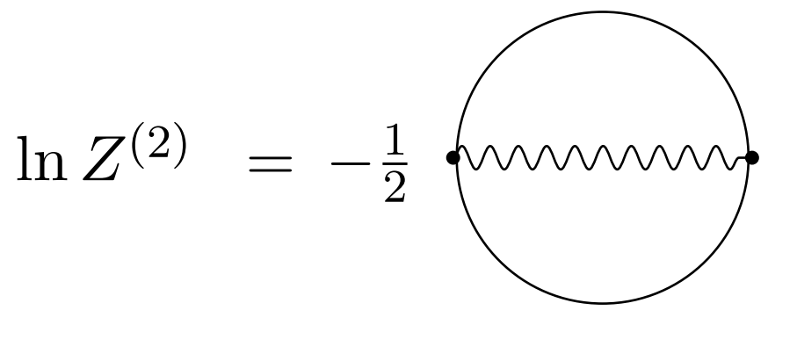
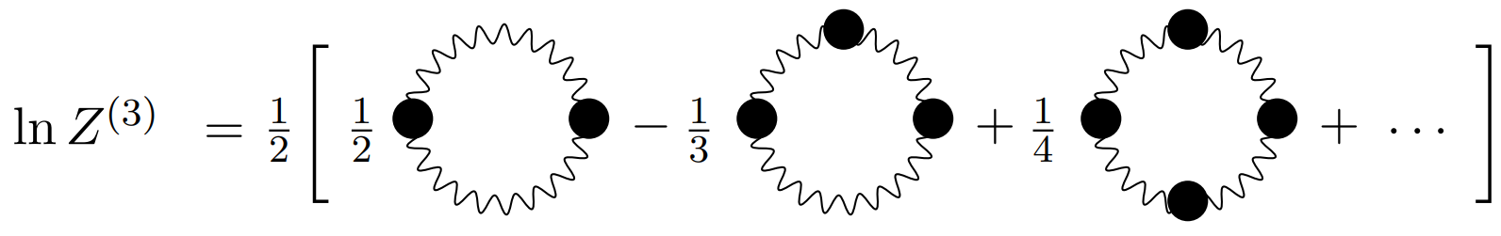
Finite T QED
Calculate partition function using FT statistical field theory
Use these guys

Slide 5
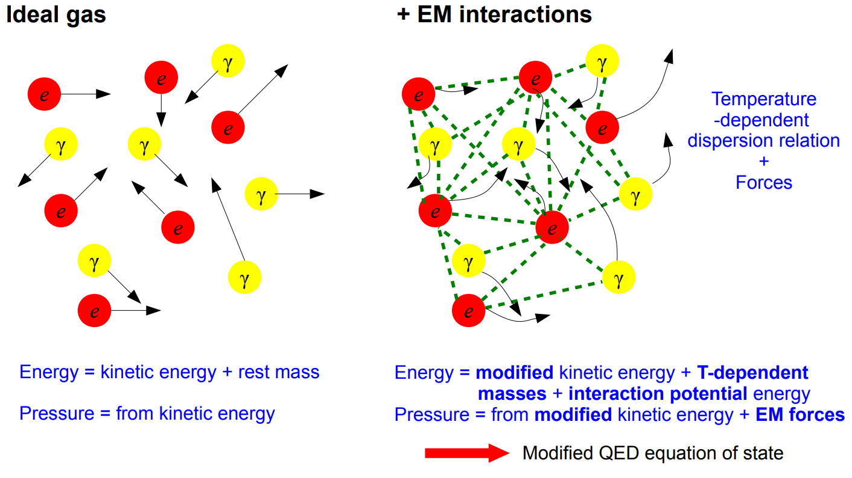
Ideal gas vs interactions Image
Y. Wong

Slide 6

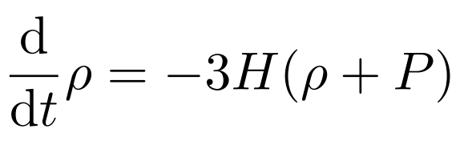
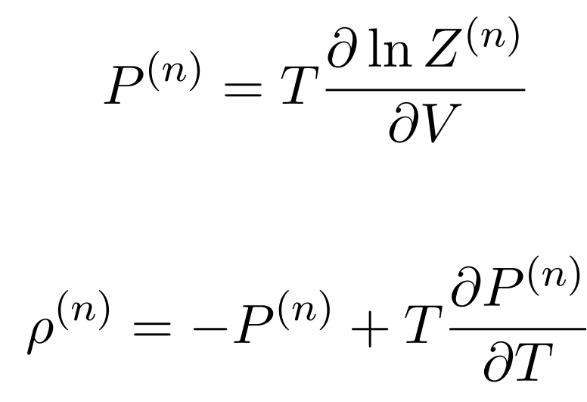
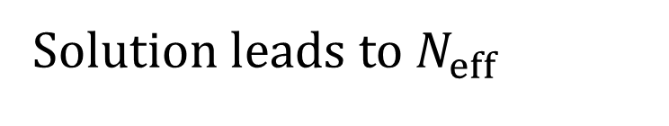
Continuity equation
Need three equations:
Continuity
Pressure
Energy density
Solution leads to $N_{eff}$

Slide 7
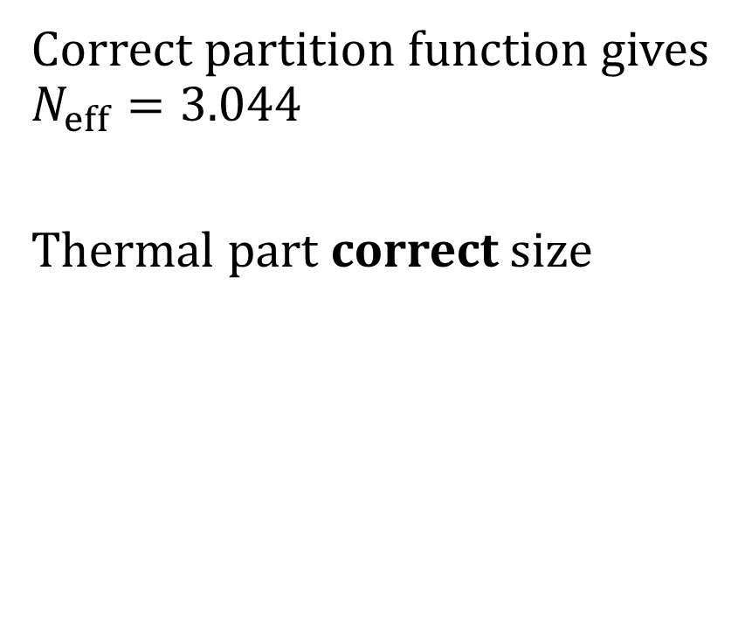
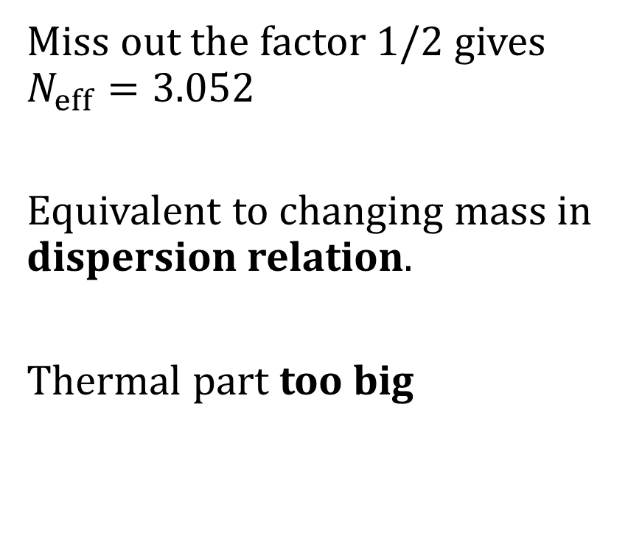
Results part one: which method is correct?
Correct partition function gives $N_{eff}=3.044$
Thermal part correct size
Miss out the factor 1/2 gives $N_{eff}=3.052$
Equivalent to changing mass in dispersion relation.
Thermal part too big

Slide 8
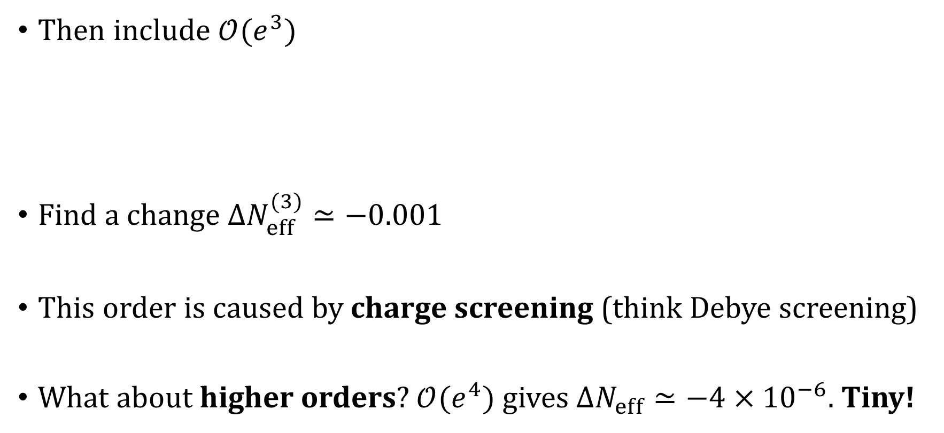
Higher Orders
Then include $𝒪(e^{3})$
Find a change ${ΔN}_{eff}^{(3)}≃−0.001$
This order is caused by charge screening (think Debye screening)
What about higher orders? $𝒪(e^{4})$ gives ${ΔN}_{eff}≃−4×{10}^{−6}$. Tiny!

Slide 9
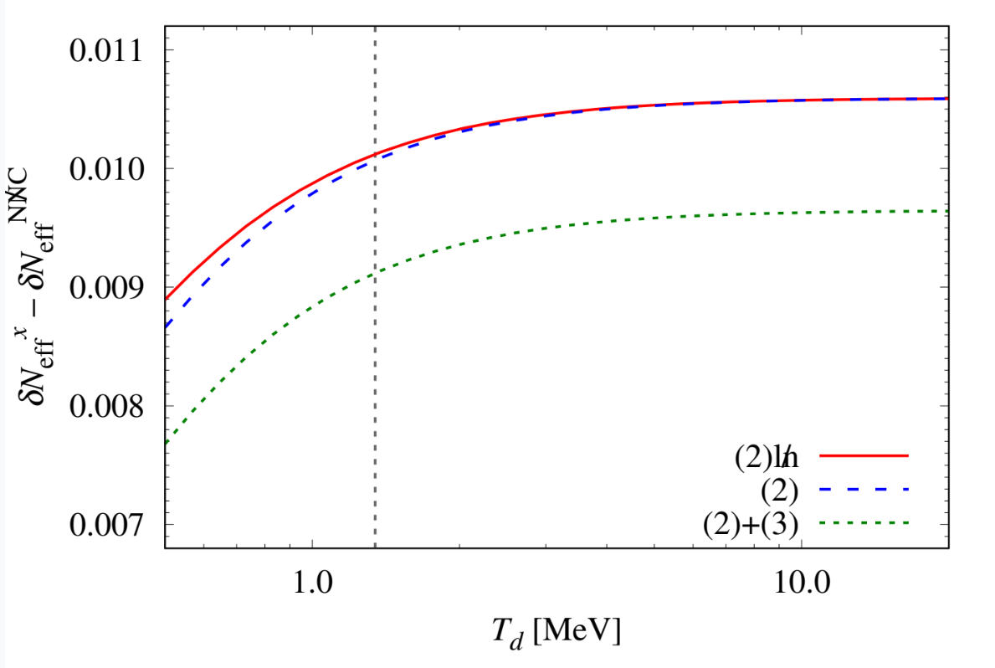
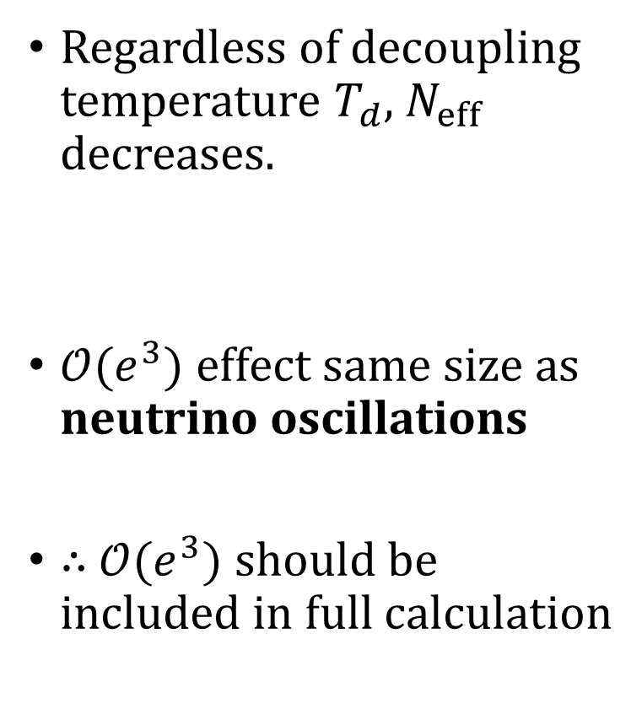


Results Part One: including $𝒪(e^{3})$
Regardless of decoupling temperature $T_{d}$, $N_{eff}$ decreases.
$𝒪(e^{3})$effect same size as neutrino oscillations
$∴$ $𝒪(e^{3})$ should be included in full calculation
Thermal part of $N_{eff}$
Decoupling temperature MeV

Slide 10
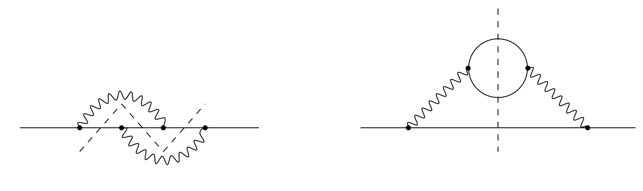




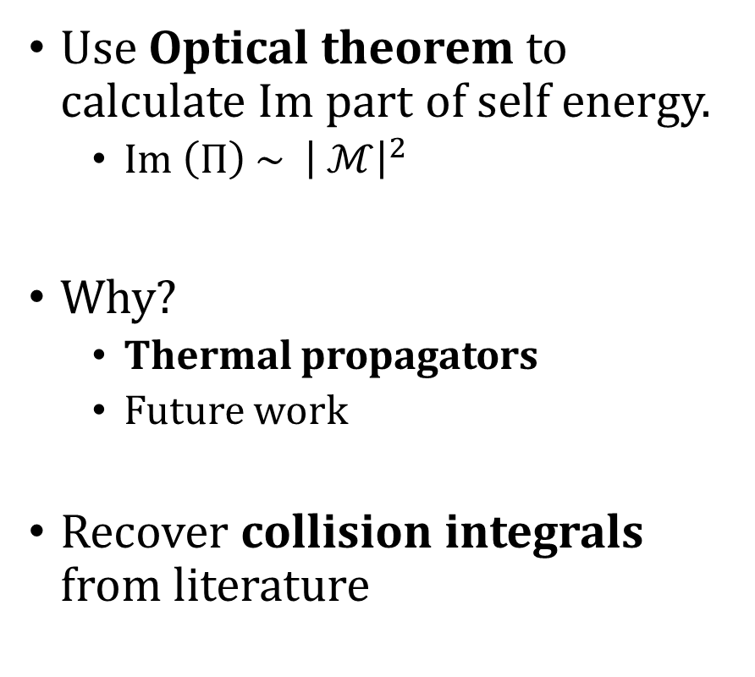

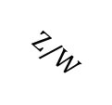
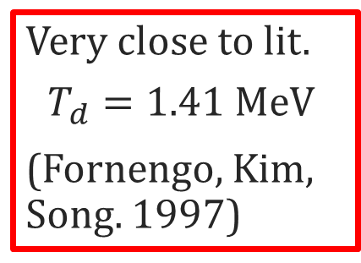
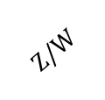
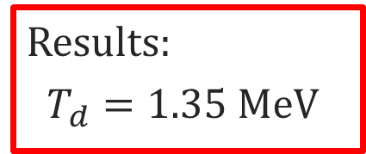

Decoupling Temperature
Use Optical theorem to calculate Im part of self energy.
  $Im \left(Π\right) \sim {\left| ℳ\right|}^{2}$
Why?
  Thermal propagators
  Future work
Recover collision integrals from literature
$$Z/W$$
$$Z/W$$
$$ν$$
$$ν$$
Results:
$$T_{d}=1.35 MeV$$
$$Z/W$$
Very close to lit.
$$T_{d}=1.41 MeV$$
(Fornengo, Kim, Song. 1997)
$$ν$$
$$ν$$
$$Z/W$$

Slide 11
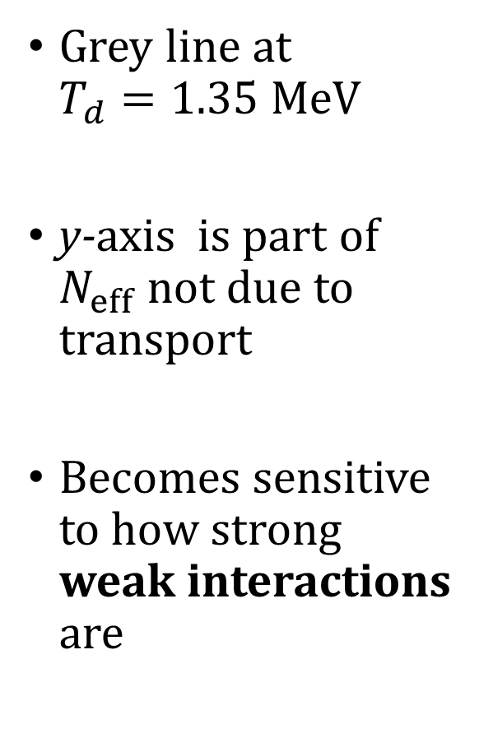

Results Part two
Grey line at $T_{d}=1.35 MeV$
y-axis is part of $N_{eff}$ not due to transport
Becomes sensitive to how strong weak interactions are
Thermal part of $N_{eff}$
Decoupling temperature MeV

Slide 12
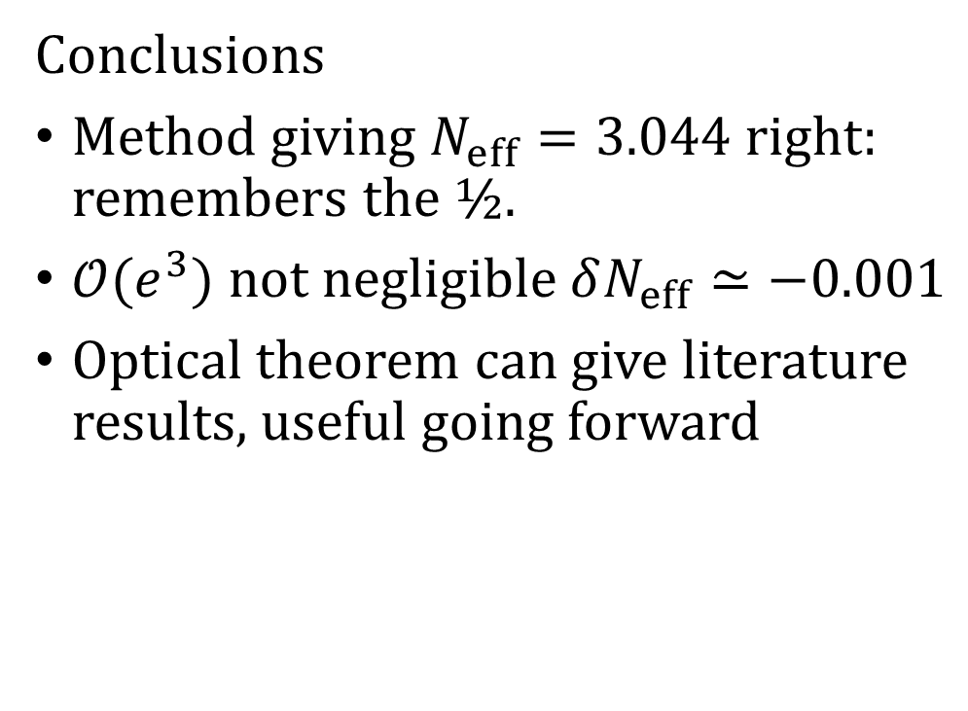
Future and Conclusions
Future (in progress)
Need to include neutrino decoupling effects.
  Preliminary results
Add higher order effects to neutrino decoupling via optical theory
Conclusions
Method giving $N_{eff}=3.044$ right: remembers the ½.
$𝒪(e^{3})$ not negligible $δN_{eff}≃−0.001$
Optical theorem can give literature results, useful going forward
Thank you for listening!

