Slide 1
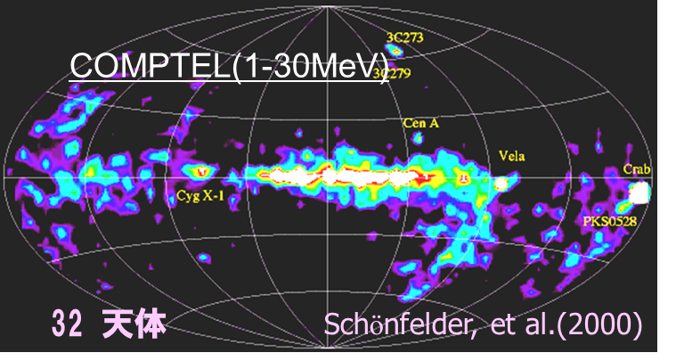
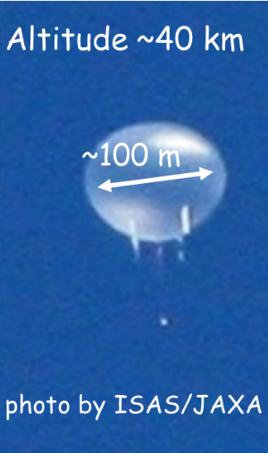
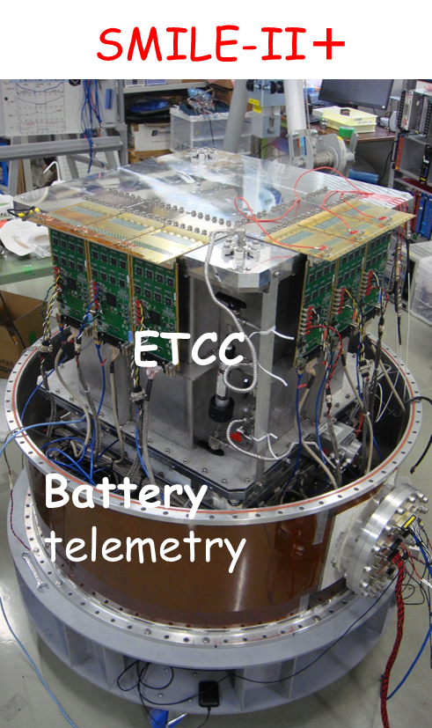
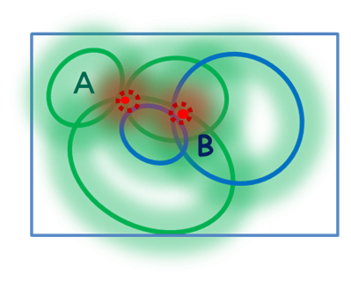
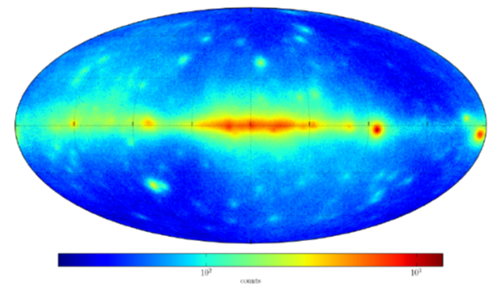
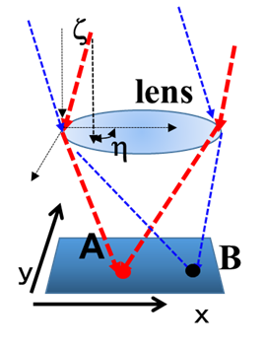
Imaging Observation for Cosmic MeV γ Background and Galactic Diffuse MeV γ by SMILE2+ balloon-bore experiment
SMILE Project : Electron Tracking Compton Camera(ETCC)
SM2+ 2018
30cm ETCC
COMPTEL 1d-auglar resolution(RMS)
~1.5º 32sources (9yrs)
Deconvolution image !!
G. Principe et al. (2018)
Fermi low energy Map (30-100MeV)
198sources 2D-PSF (3º-12º) 9yrs.
2nd/Dec. TeVPA2019 @Sydney
T. Tanimori on behalf of SMILE-Project,
Cosmic-ray group, Physics Division, Kyoto University, Japan

Slide 2
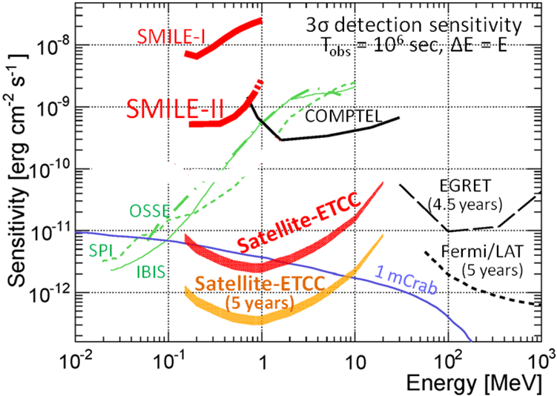



How to fill up MeV gap
Final Goal; sub-mCrab sensitivity
Present Statuts of MeV astronomy
MeV γ astronomy suffers from two major problems
Incomplete imaging method (Conventional Compton; CC) Imaging spectroscopy is impossible
Huge background by collision of cosmic-ray and instruments
No instruments of CC detected source flux as estimated on ground
S: signal EA: Effective Area
θ:; Half Power Radius (HPR) as PSF
$$BG dominated$$
2. Significance ∝ $\frac{\text{EA}\text{•}\text{S}}{\text{θ}\text{√(}\text{EA}\text{ }•\text{BG}\text{)}}$
Effective Area ~200 cm² @1MeV: gas (3atm CF₄) and Si in <1m³ cube is possible.
Minimum Back Ground =>
Same as Cosmic MeV background
=> We achieved !
PSF θ(HPR)＝ 1～2º is needed !!
=> Fine electron tracking (mm sampling in gas
sub-μm sampling in Si ) Key technology
=>Now 15~10o in SM2+ <5o in next SM3

Slide 3
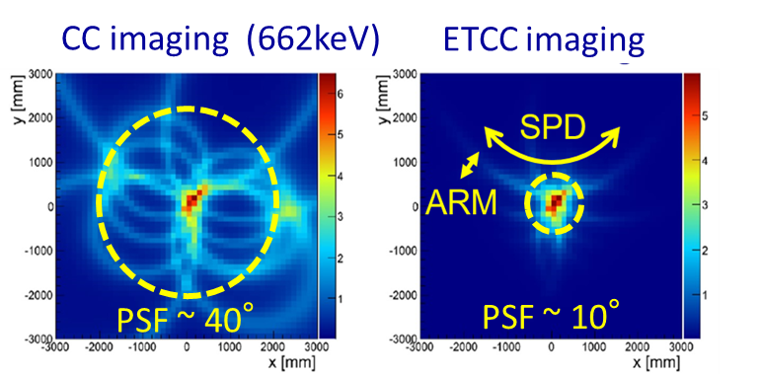
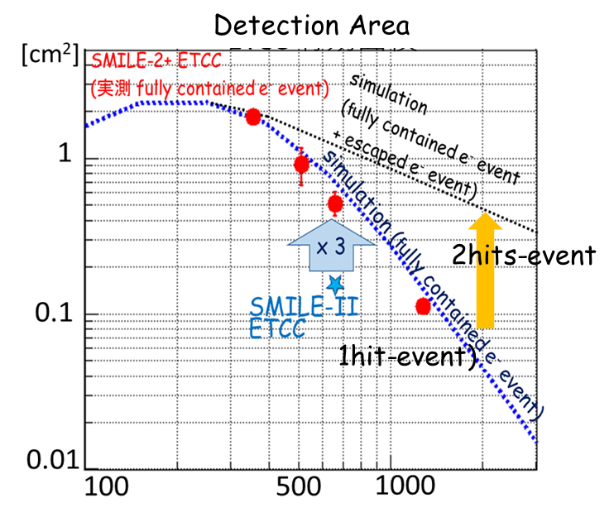
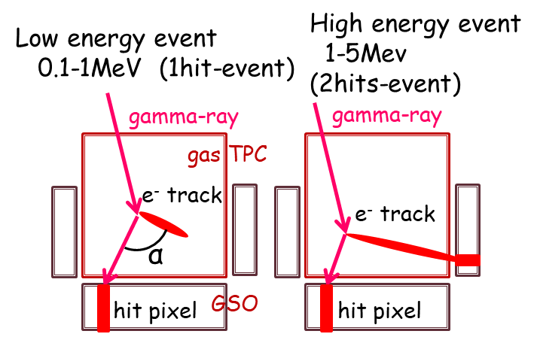
Electron Tracking Compton Camera (SMILE-Project)
--- tracking of recoil electron ---
Measuring all parameters of Compton process
1. ture PSF (８~15º @Half Power Radius)
=> Realization of proper imaging spectroscopy
2. dE/dx + kinematical test using α =>(particle –Identification)
3. large Field of View (>4str)
electron
Micro Pixel Chamber
30cm-cubic Gas Time Projection Chamber(TPC)
+ Scintillator Array for scattered γ
. Ar 2atm in TPC
dE/E ~20%@30keV
GSO
dE/E ~11%@662keV

Slide 4
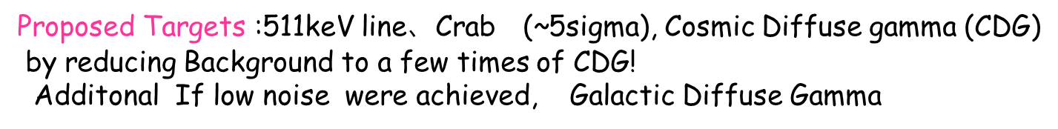
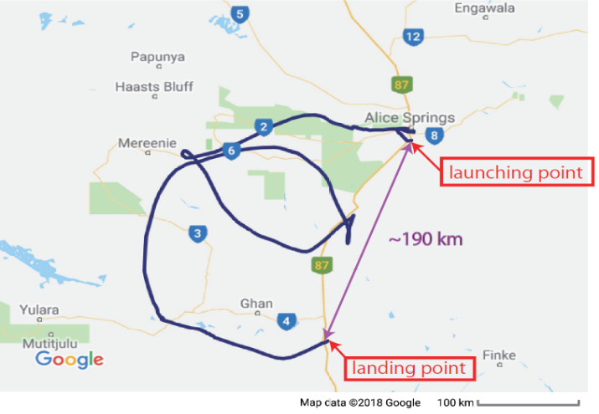
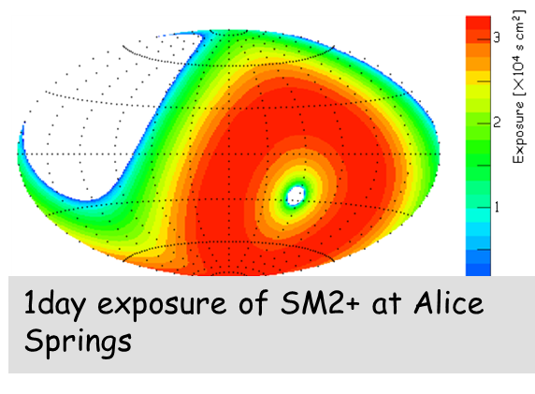
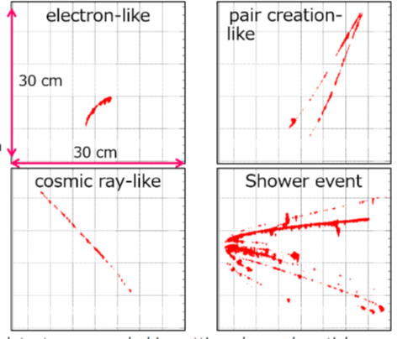
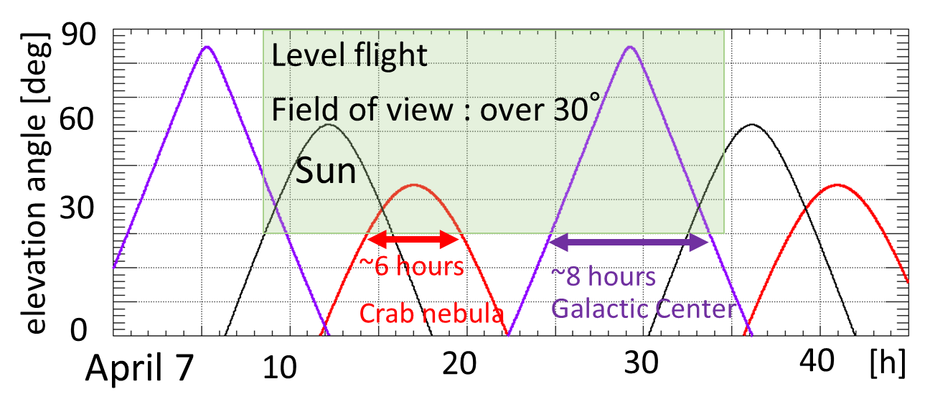
SMILE-2+ Balloon flight at Alice Springs (JAXA)
Observed Tracks in space
2arm Ar 30cm ~ 200μm thick SSD x3
©google
SMILE-2+ 30cm-cubic ETCC
Tracks in TPC
Alice Springs
～60㎝
Flight duration ~29 hours
level flight ~26 hours
Altitude ~39 km

Slide 5
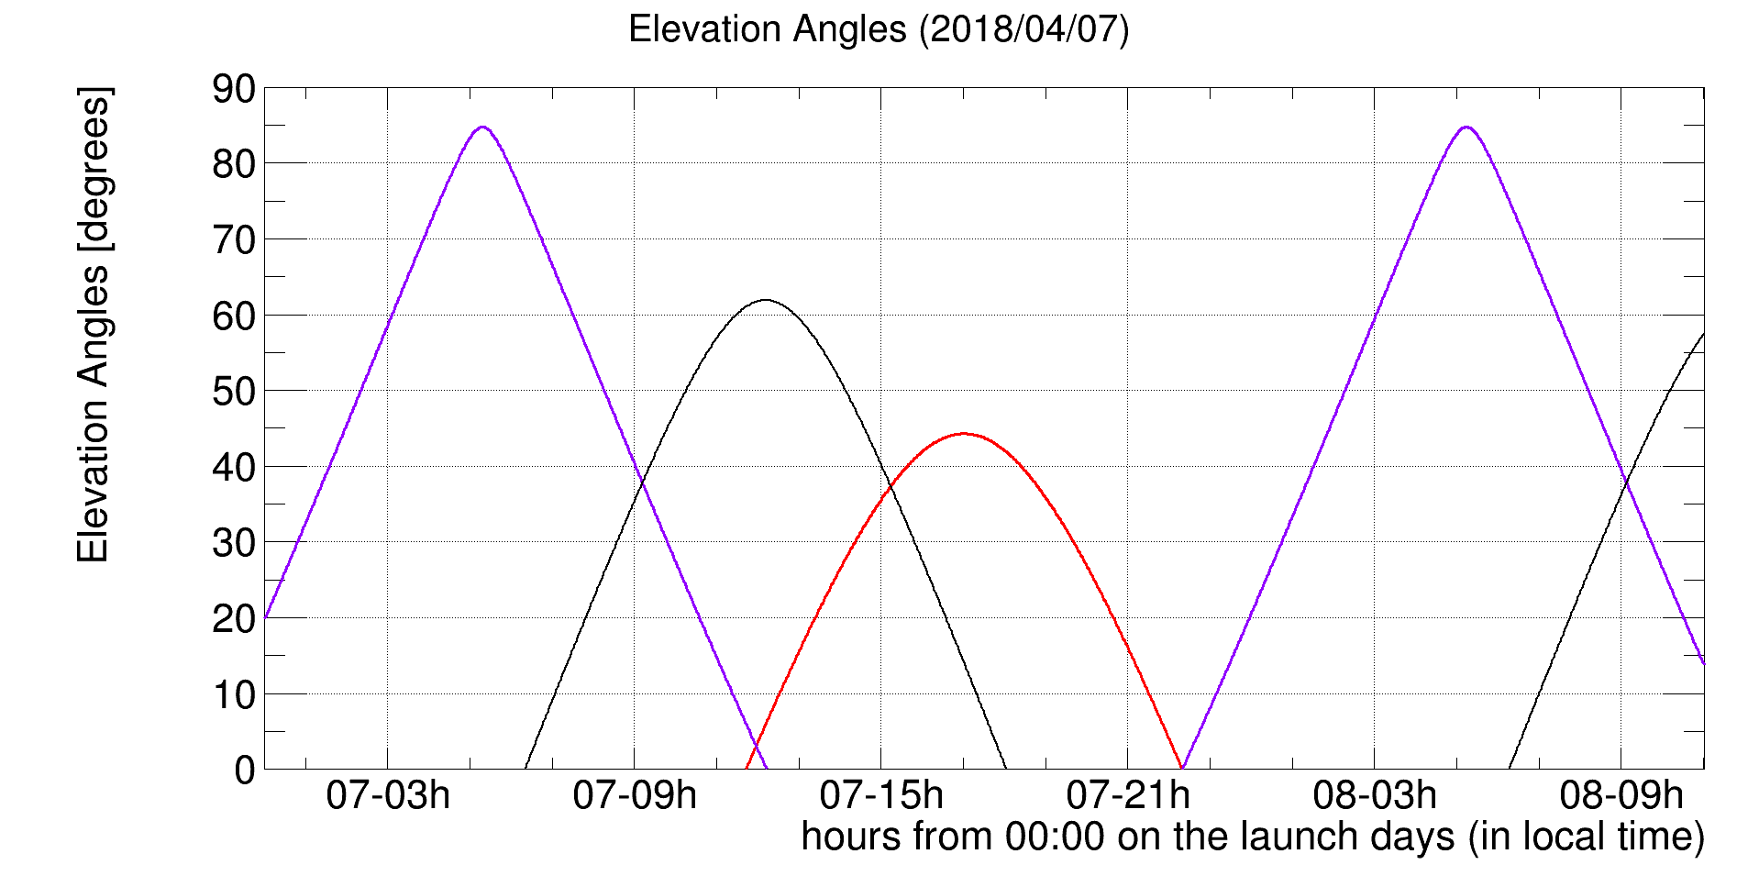
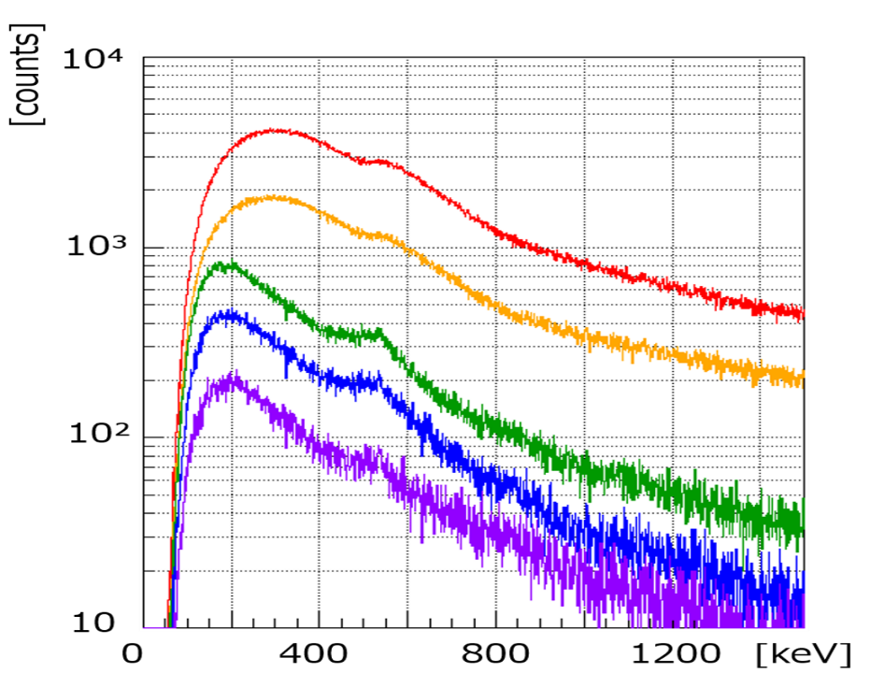
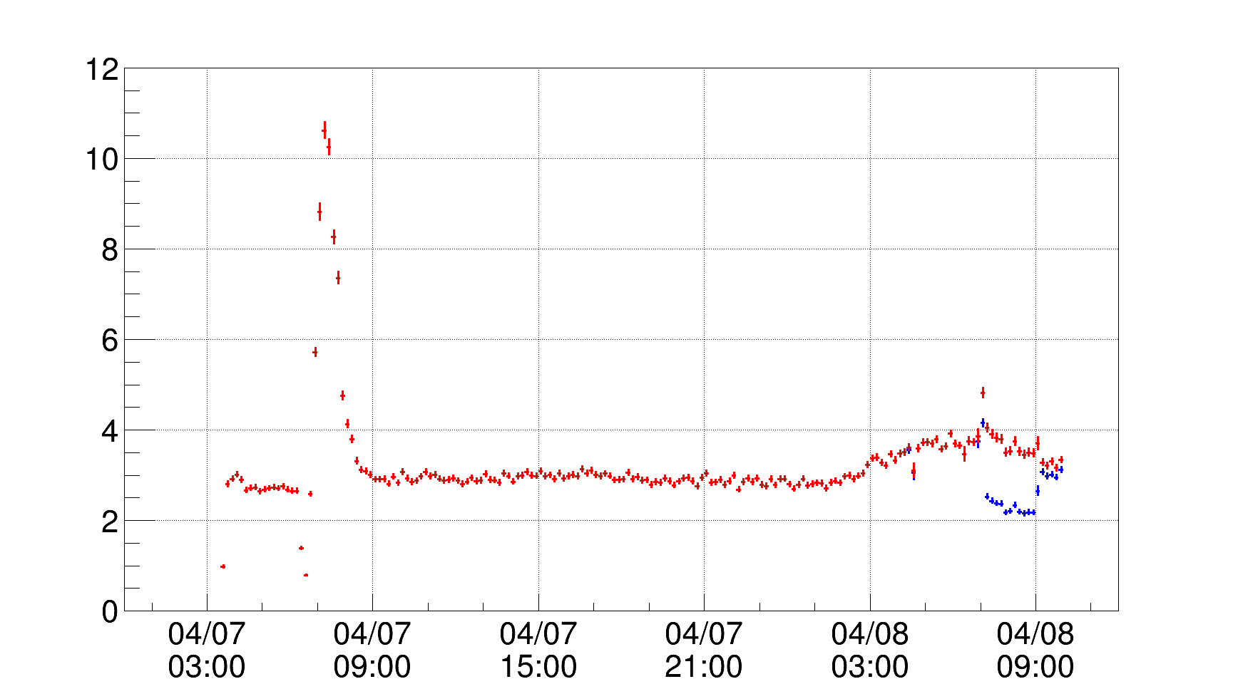
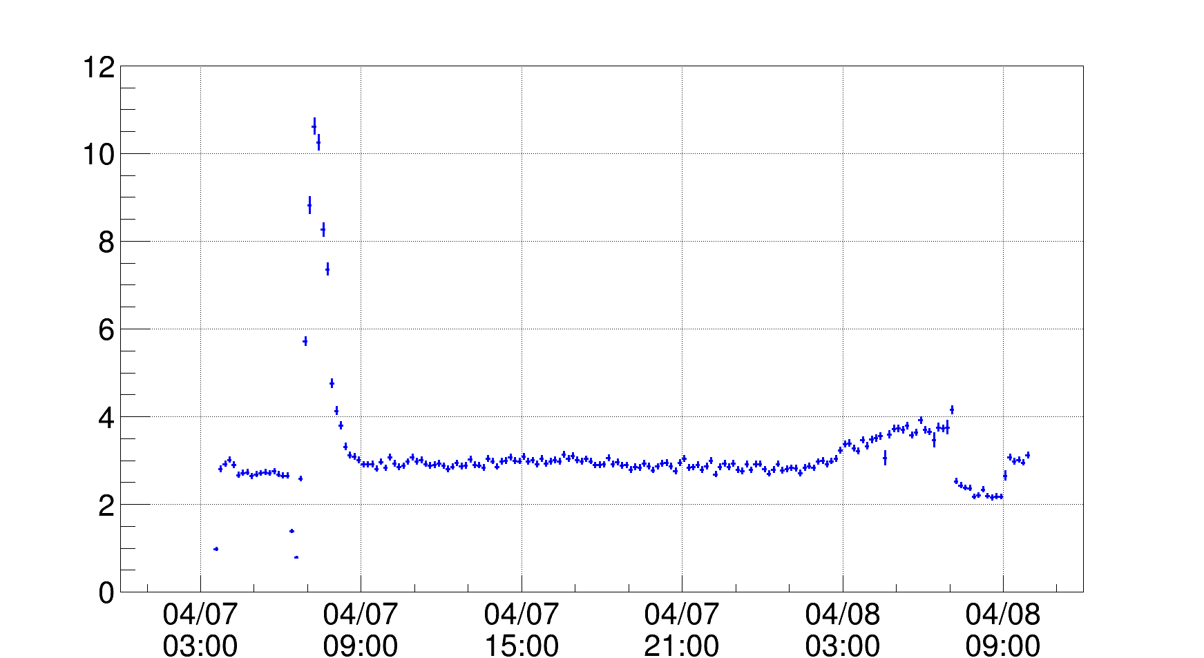
Time Variation of detection rate of gamma-ray events
Simple Event selection
Fiducial cut in TPC
dE/dx cut
90
60
GC
Sun
Zenith [deg]
Crab
GC
30
Event reduction of 1 hit events
Used only in this time window
10
Single hit in PSA
8
1 hit events
Preliminary
6
Preliminary
Fiducial volume
4
Mainly Cosmic Background γ
Limit of CC
2
dE/dx cut
0
Level flight
Final Event rate [events/sec]
4/7
15:00
4/7
03:00
4/7
09:00
4/7
21:00
4/8
03:00
4/8
09:00
Kinematical test
2 hit events
Zenith<60°
After 7 o’clock 4/8
heavy nose in TPC
Now we used data before 7
Both enhancements are consistent
with the observation ratio of the cosmic diffusion and galactic diffusion of about 3:1

Slide 6
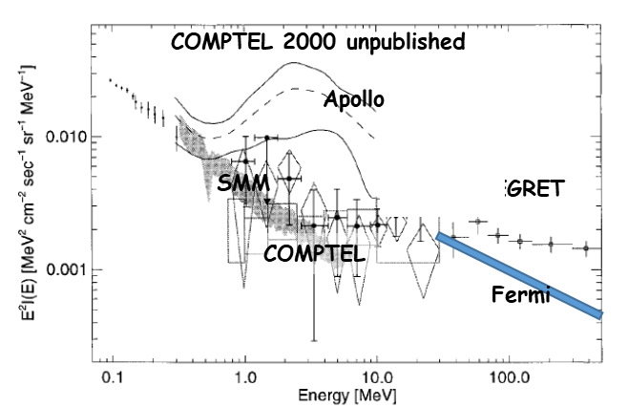
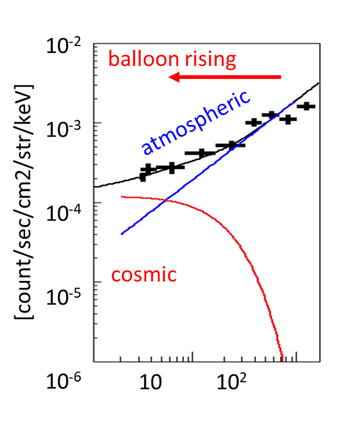
Estimation of BG & Cosmic Diffuse Gamma (CDG)
CDG spectra
CDG
zenith
Atmospheric gamma
~1/3 <zenith 30º
2/3 of events are
Cosmic Diffuse γ
EGRET
Growth curve
CDG +BG Zenith distribution
Events (>560keV)
Intensity of gamma
Direct CDG
Events <560keV
normalized to Eve >560keV
(mostly scattered CDG)
Atmospheric depth (g/cm²)
0
140
80
Minimum Back Ground was acheuved !!
We have clean several 10⁴ DDG => soon provide precise intensity of CDG
Zenith(degree)

Slide 7
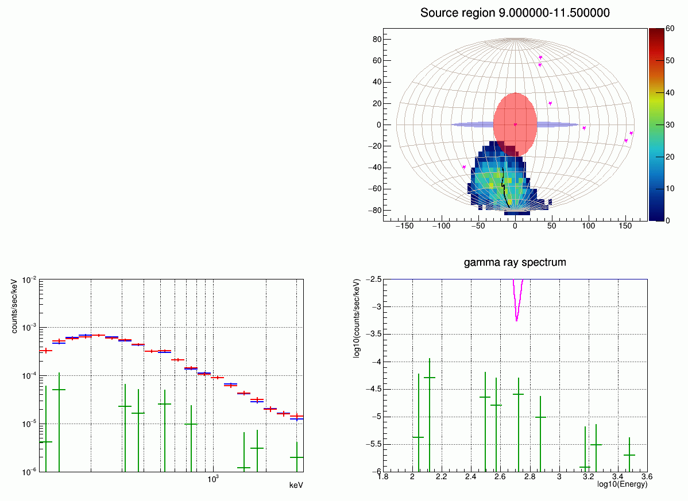
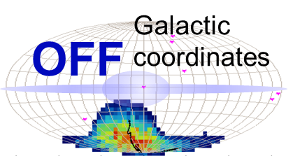

Slide 8
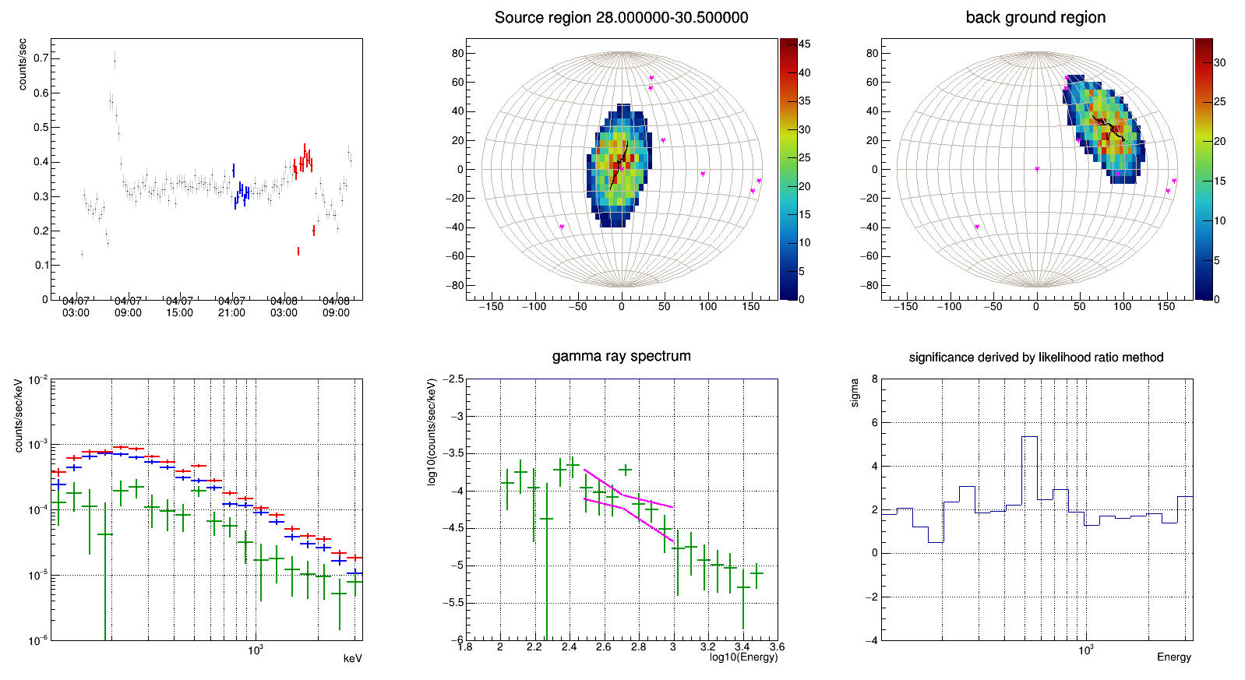
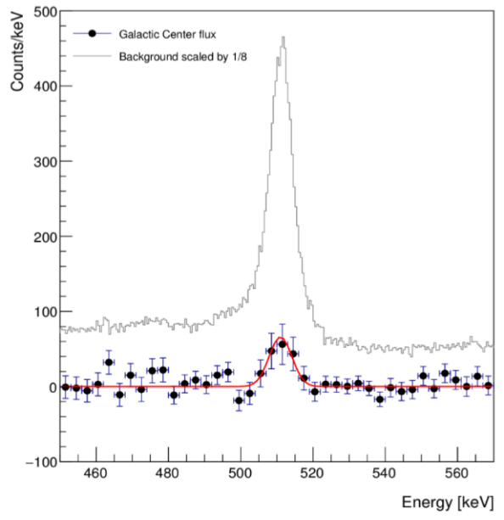
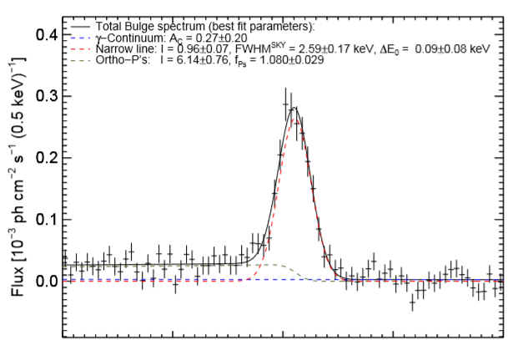


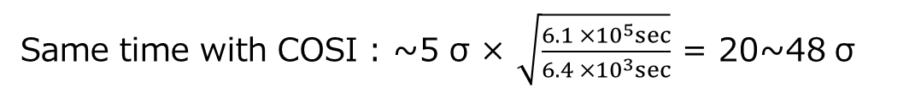



Comparison of significance with other observations
SMILE-2+
COSI 2016
${10}^{−3}$
Balloon
46 Days
~34 km
BG 1/8
${10}^{−4}$
S/N ~ 5/1
INTEGRAL/SPI
events/sec/keV
5.36 σ
S/N ~ 1/80
${10}^{−5}$
Excess: 10.3 σ
Siegert et al. 2016
500
510
520
keV
${10}^{−6}$
Chiu et al. 2017
100
500
1000
keV
・511 keV line 58 σ
・3-gammas 29 σ
SMILE-2+ 511 keV bin ~5 σ
511 keV bin over duffuse ~2 σ
・combined 65 σ
Same time with COSI : ~5 σ × $\sqrt{\frac{6.1 ×{10}^{5}sec}{6.4 ×{10}^{3}sec}}$ = 20~48 σ
INTEGRAL/SPI same time: ~5σ × $\sqrt{\frac{1.6 ×{ 10}^{9} {cm}^{2} sec /75cm²}{6.4 ×{10}^{3}sec}}$ = 140~295 σ
Instum. | Eff. Area | ΔE/E | Normalized Sensitivity to SPI
SPI | 75cm² | <1% | １ Coded Mask with Veto
COSI | ~10cm² | <1% | 5 x Conventional CC with Veto
SM2+ | 1cm² | 13% | 100ー200 x ETCC with no-veto

Slide 9
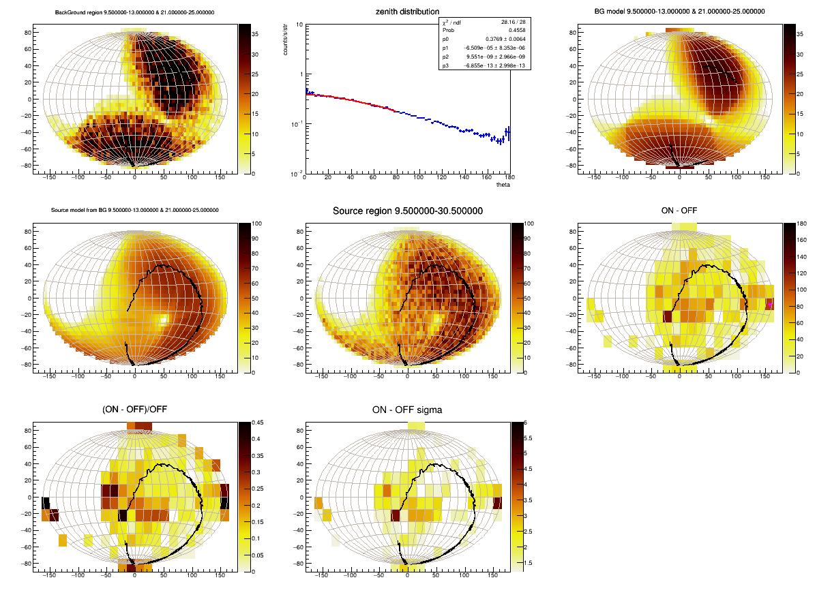
First true MeV gamma sky map
redisual count map(=GDG)
ON data
simple count map <1MeV
significance map
Preliminary
Preliminary
Crab!
~5σ
Crab!
GC
GC
sample region
OFF sky map model
(=CGB + atmospheric
+instrumental)
Simple Detection of Crab on the Map
5sigma as expected by proposal
Halo-like emission around GC over 30º radius
zenith profile

Slide 10
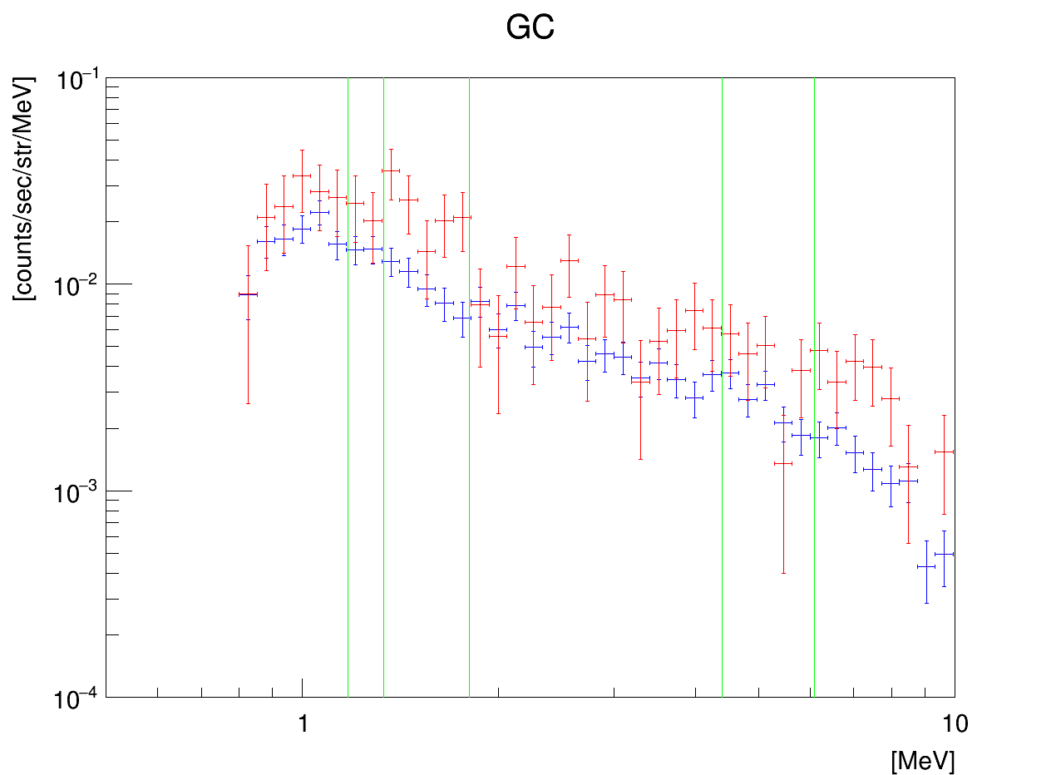
High energ event count spectrum
GC region：4/8 4:30-6:30
level flight w/o GC：4/7 11:00-4/8 1:30
(zenith < 30 deg)
Very Preliminary
¹⁶O* 6.1 MeV
²⁶Al 1.809 MeV
¹²C* 4.4 MeV
⁶⁰Fe 1.332 MeV
⁶⁰Fe 1.173 MeV
In the next experiment, we get a reliable spectrum of the Galaxy with X10 statics and reveal the nuclear synthesis in the Galaxy.

Slide 11
Spectrum of Galactic diffuse γ in 0.2-1MeV
uncertainty
Obtained spectra may still include the effects of scattering ( of several 10 %) => uncertainty of ~50% for Photon fluxes
Anyway GC is very bright from the enhancement in Light-curve

Slide 12
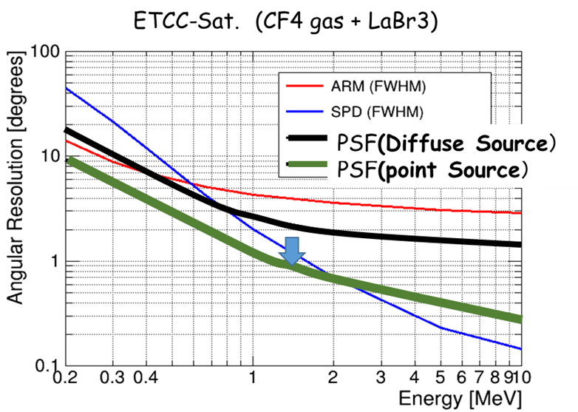
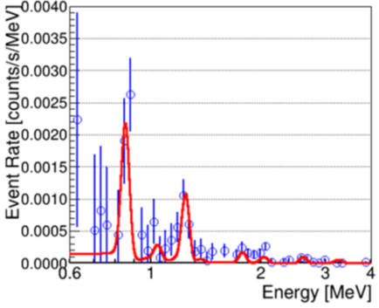
Expected Sensitivity based on well-defined PSF
SMILE3: long duration balloon (more one month) within 4~5years
30cm or 50cm cubic ETCC, CF4 2~3atm,
Effective Area 10~30cm² PSF (3~10º)
Expected data 1000times of SM2+
PSF by HPR
ETCC-Satellite 50cm-cubic ETCC (CF₄ 3atm) with >5RL Scinti. x 4 modules
Effective Area ~200cm²@1MeV and PSF:HPR-2º
Next & Future Plans
For Continuum γ (10⁶ sec)
６０Ｍｐｃ SN
~20SNe/year
New MeV gamma Astronomy beynond 1mCrab

Slide 13
Summary
ETCC provides true Imaging Spectroscopic Observation based on proper Optics same as general astronomical telescopes, and reveals the reliable way to reach to sub mCrab
Background is successfully reduced less than Cosmic Diffuse MeV gammas
Crab and 511keV were detected with ~5σ as proposed
Galactic Center region (>10σ ) is tremendously bright !!
Analysis is still in tne middle
All above results are achieved for the first time i
Next Balloon SMILE-3 project ＝＞10times better sensitivity than COMPTEL : ~1000 times data (10⁸ γ)
MeV γ sky will be most clean and rich ( 1000 times of GeV gamma sky.) in near future !!

Slide 14
Members of SMILE Projects
Toru Tanimori, Atushi Takada, Yoshitaka Mizumura, Taito Takemura, Kei Yoshikawa, Yuta Nakamura, Mitsuru Abe, Tetsuya Mizumoto, Shinya Sonoda, Hidetoshi Kubo,Shotaro komura, Tetsuro Kishimoto, Tomoyuki Taniguchi, Ken Onozaka, Kaname Saito, Shunsuke Kurosawa^{A}, Kentaro Miuchi^{B}, Kenji Hamaguchi^{C}, Tatsuya Sawano^{D}, Masayoshi Kozai^{E}, Yasuhiro Syoji^{F}
Kyoto Univ., A; Tohoku Univ, B; Kobe Univ. C; Maryland Univ. ,D; Kanazawa Univ. E ISAS/JAXA, F; Osaka Univ.
Thank you for your attention!

Slide 15
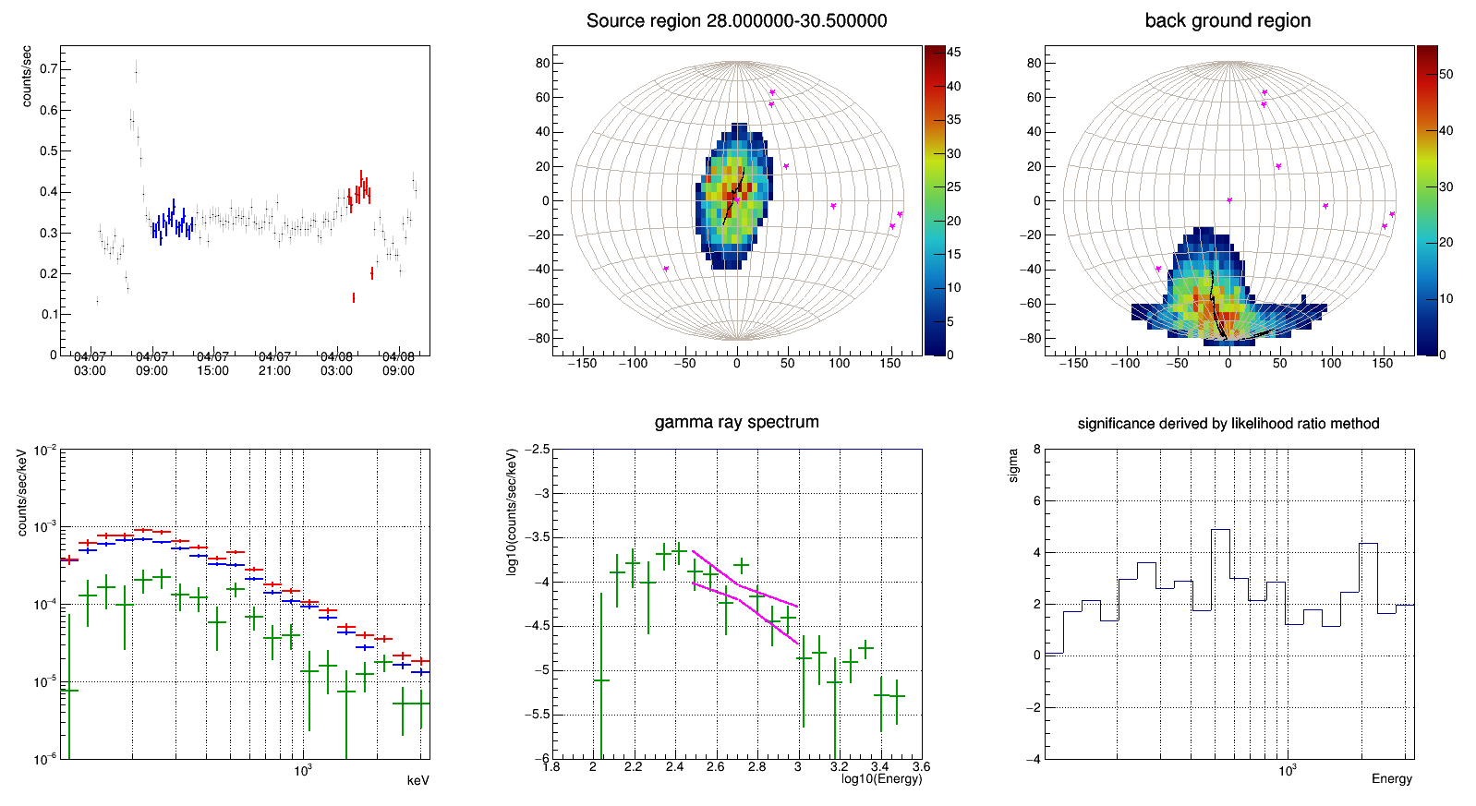
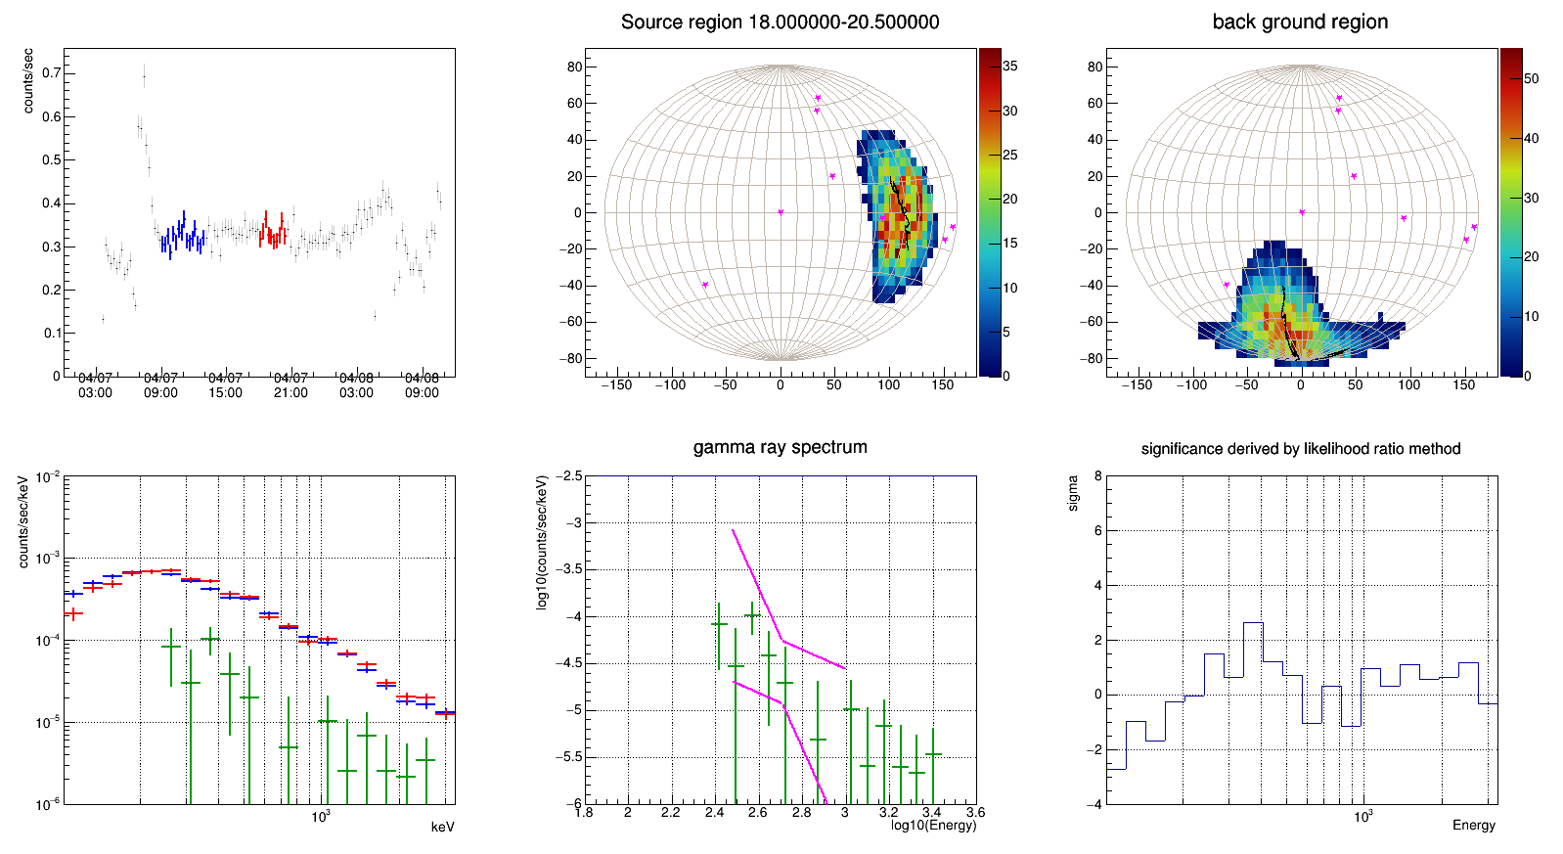
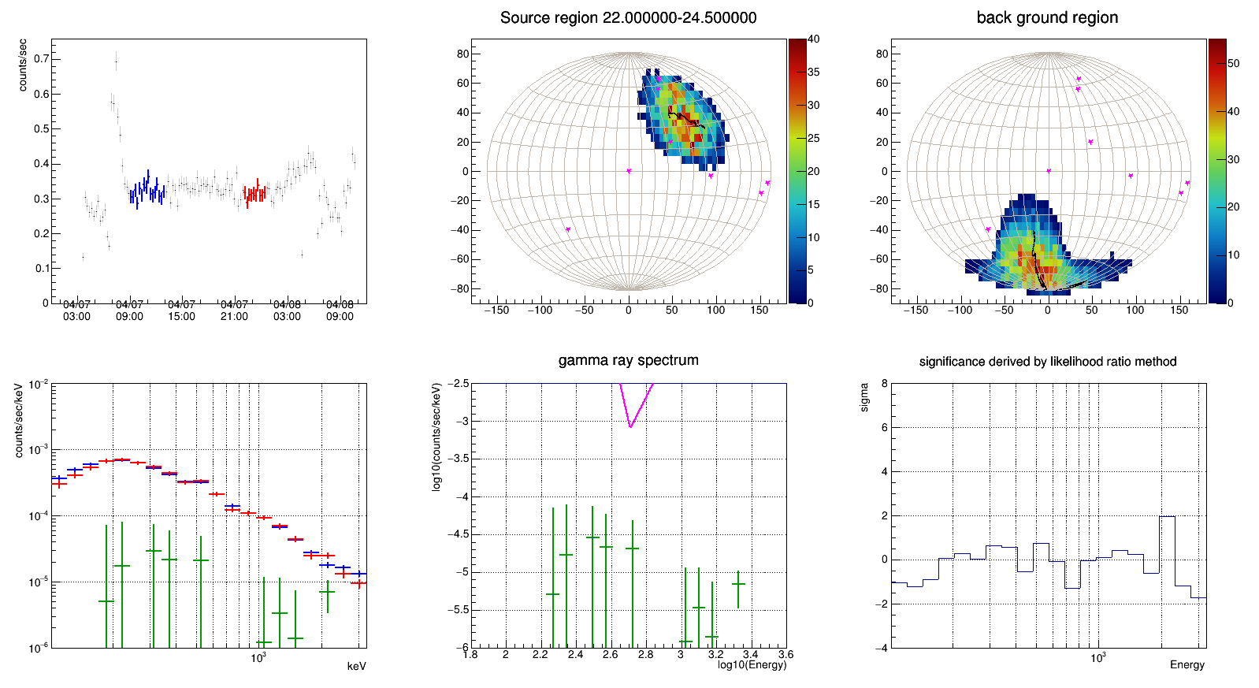
Diffuse & 511keV γs rays from Galactic Center
Analysis of the event rate in the ON and OFF
using only 1 hit events (0.2-1MeV)
For several FoV regions,
select the high Declination area of the field of view as the OFF region
4/7 9:00-13:00 (ACST)
Galactic
coordinates
OFF
In case of FoV ( radius of 30º)
ON A
ON B
ON C
4/7 18:00-20:30 (ACST)
4/7 22:00-24:30 (ACST)
4/8 4:00-6:30 (ACST)
events/sec/keV
events/sec/keV
events/sec/keV
spectrum
spectrum
spectrum
ON-B
OFF
Residual
ON-C
OFF
Residual
10⁻³
ON-A
OFF
Residual
10⁻³
10⁻³
10⁻⁴
10⁻⁴
10⁻⁴
10⁻⁵
10⁻⁵
10⁻⁵
511keV 4.90 σ
Preliminary
Preliminary
Preliminary
10⁻⁶
10⁻⁶
10⁻⁶
Excess : 11.5 σ
100
300
500
1000
keV
100
300
500
1000
keV
100
300
500
1000
keV
An excess of ~ 511 keV & diffuse components in G.C. is observed.

Slide 16
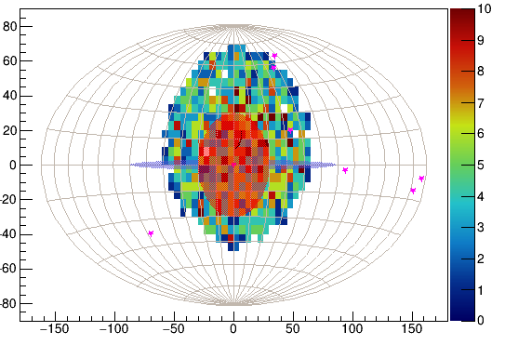
Simple map for extended source
Very Preliminary
COSI Texas Sympo. 2017
511keV

