Slide 1

Using Minkowski Functionals to Analyze CMB Lensing
Yuqi Kang
Jan Hamann

Slide 2
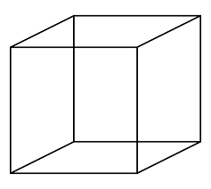
What is Minkowski Functionals?
Euler’s formula for convex polyhedra
V + F - E = 2
vertices
faces
edges

Slide 3
What is Minkowski Functionals?
Euler’s formula for convex polyhedra
V + F - E = 2
vertices
faces
edges
8 + 6 – 12 = 2

Slide 4
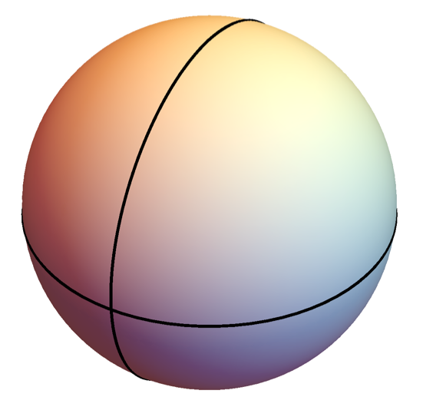
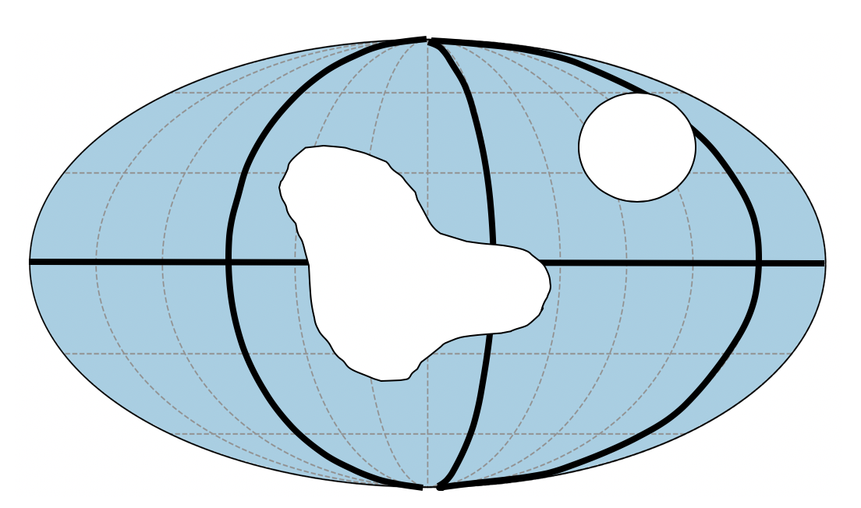
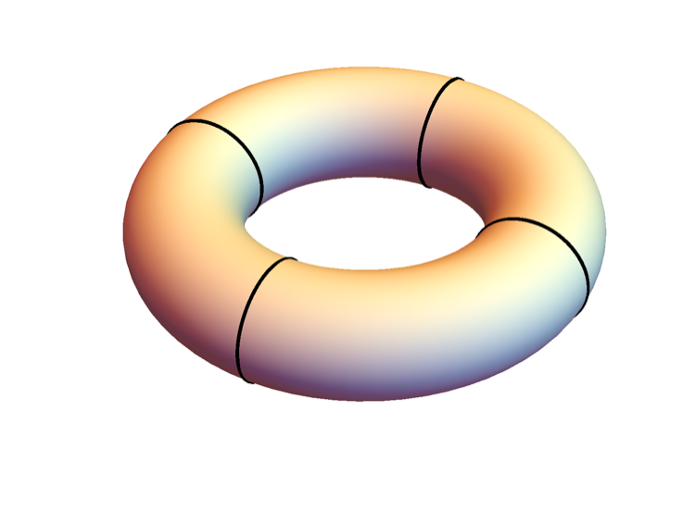
Euler’s formula for general surface

Slide 5
Euler’s formula for general surface
2 + 4 - 4 = 2
vertices
faces
edges
10 + 6 - 16 = 0
vertices
faces
edges
0 + 4 – 4 = 0
vertices
faces
edges

Slide 6
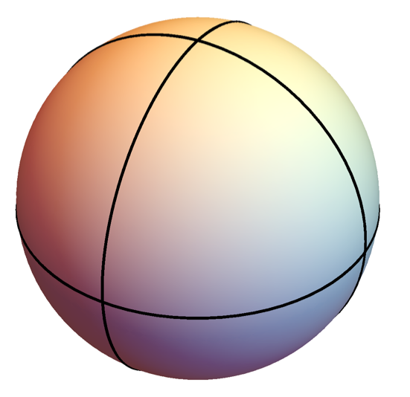
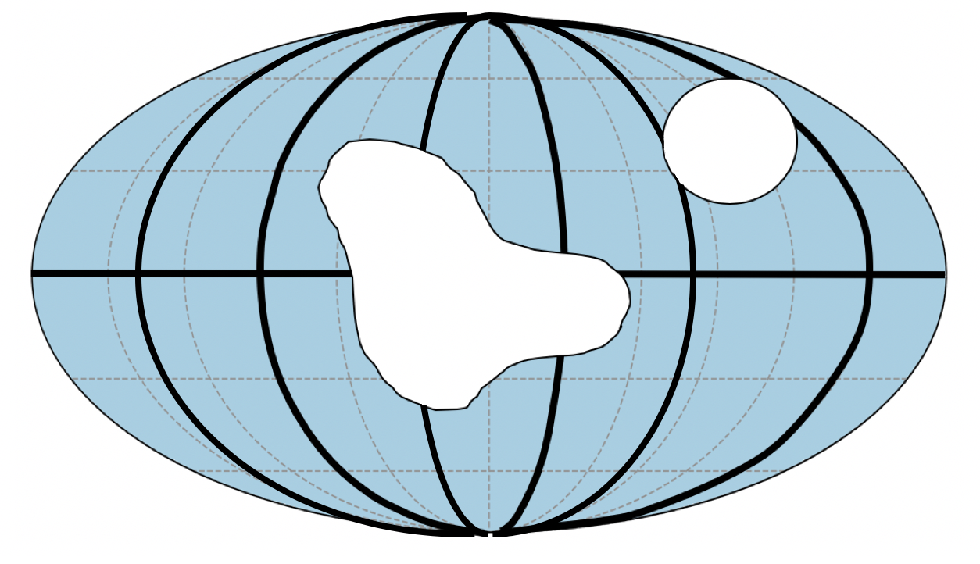
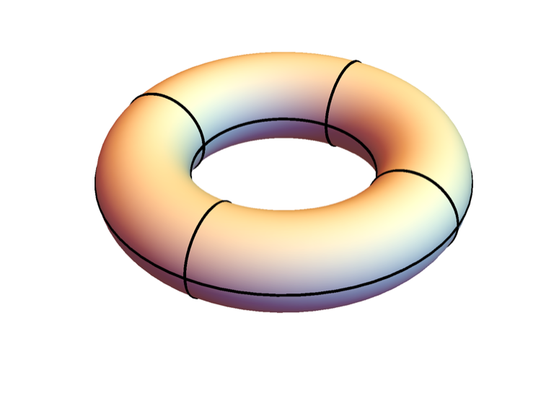
Euler’s formula for general surface
6 + 8 - 12 = 2
vertices
faces
edges
16 + 13 - 29 = 0
vertices
faces
edges
8 + 8 - 16 = 0
vertices
faces
edges

Slide 7
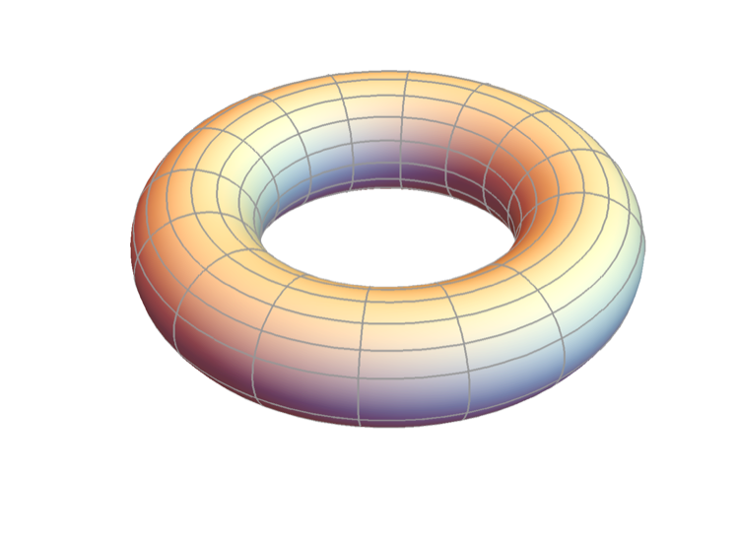
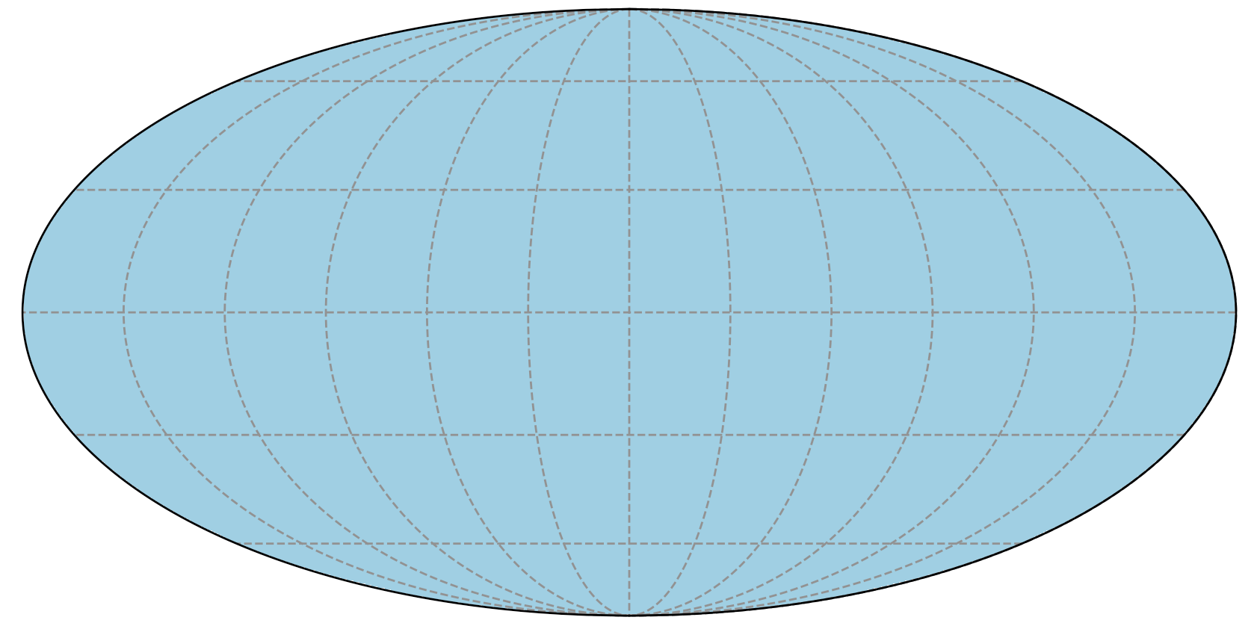

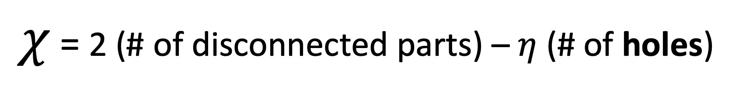
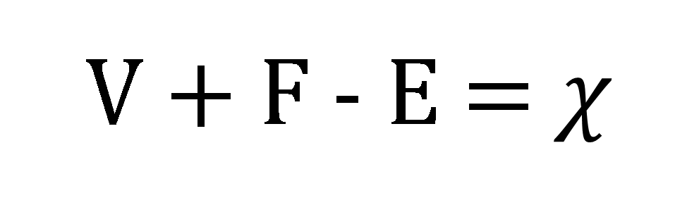
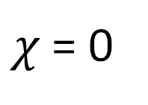

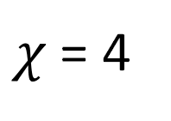
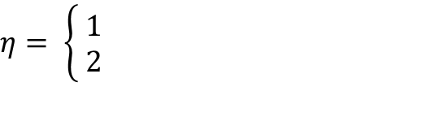
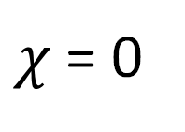
V + F - E =$χ$
vertices
faces
edges
Euler characteristic
$χ$ = 2 (# of disconnected parts) – $η$ (# of holes)
$$\text{non} \text{−} \text{orientable}$$
$$\text{orientable}$$
$$η= \left\{\begin{aligned} 1 \\ 2 \end{aligned}\right.$$
$χ$ = 0
$χ$ = 4
$χ$ = 0

Slide 8
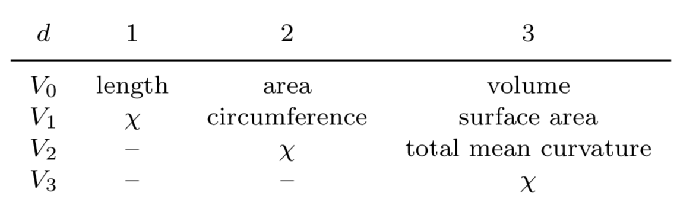
Minkowski Functionals (MFs)
morphological descriptors

Slide 9
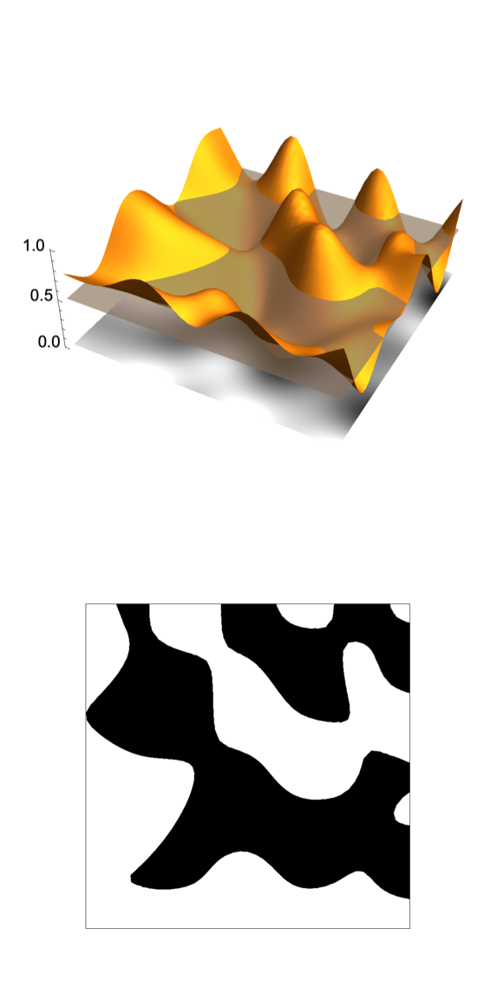
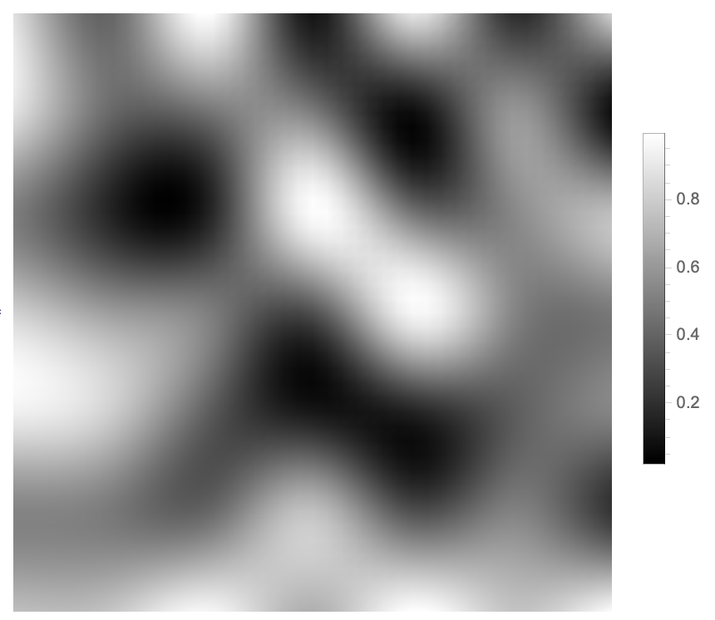
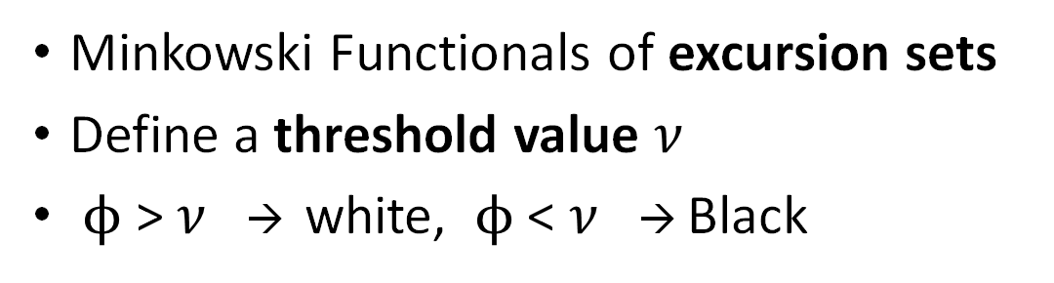


Analysis of 2D scalar field $ϕ$
Minkowski Functionals of excursion sets
Define a threshold value $ν$
$ϕ$ > $ν$ → white, $ϕ$ < $ν$ → Black
$$φ$$
excursion sets

Slide 10
Analysis of 2D scalar field $ϕ$
Minkowski Functionals of excursion sets
Define a threshold value $ν$
$ϕ$ > $ν$ → white, $ϕ$ < $ν$ → Black
excursion sets
$χ$ = # of isolated white parts – # of isolated black parts

Slide 11
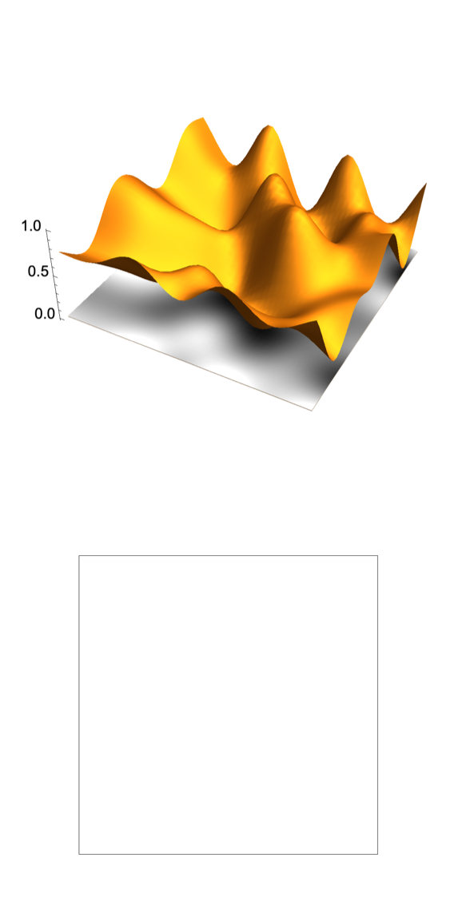
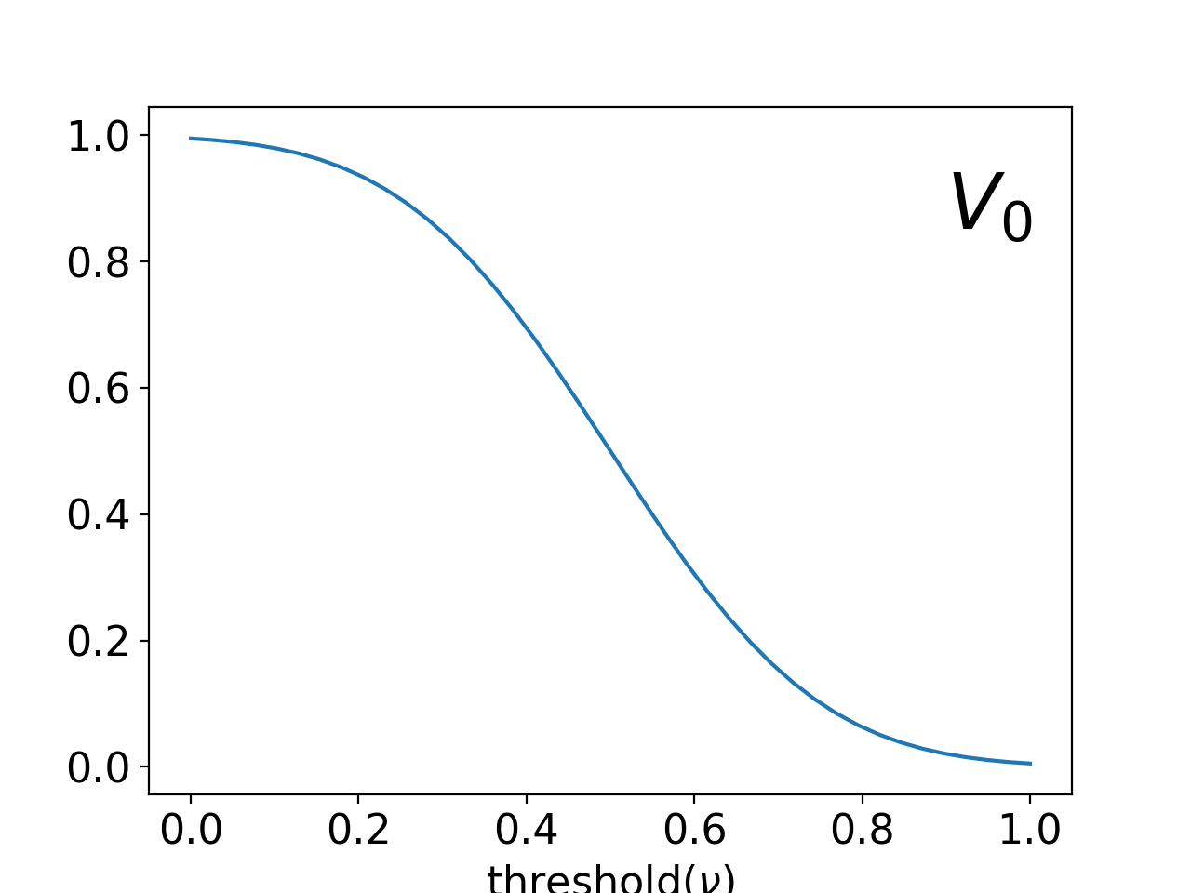
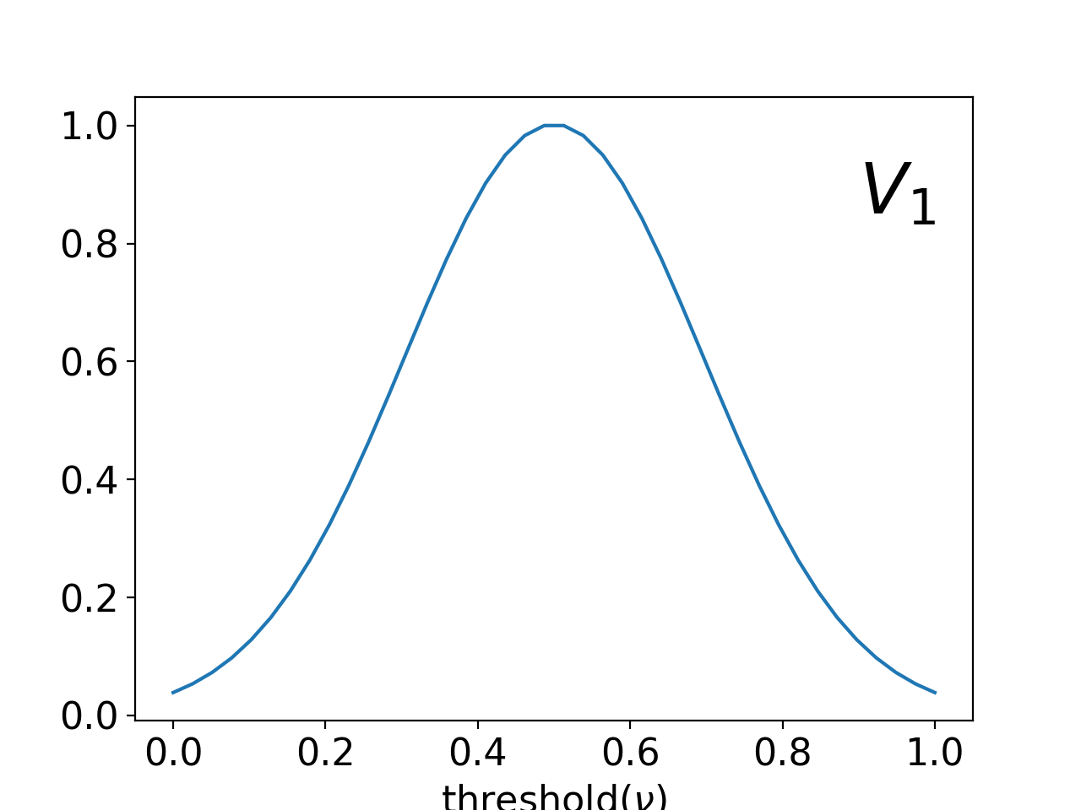
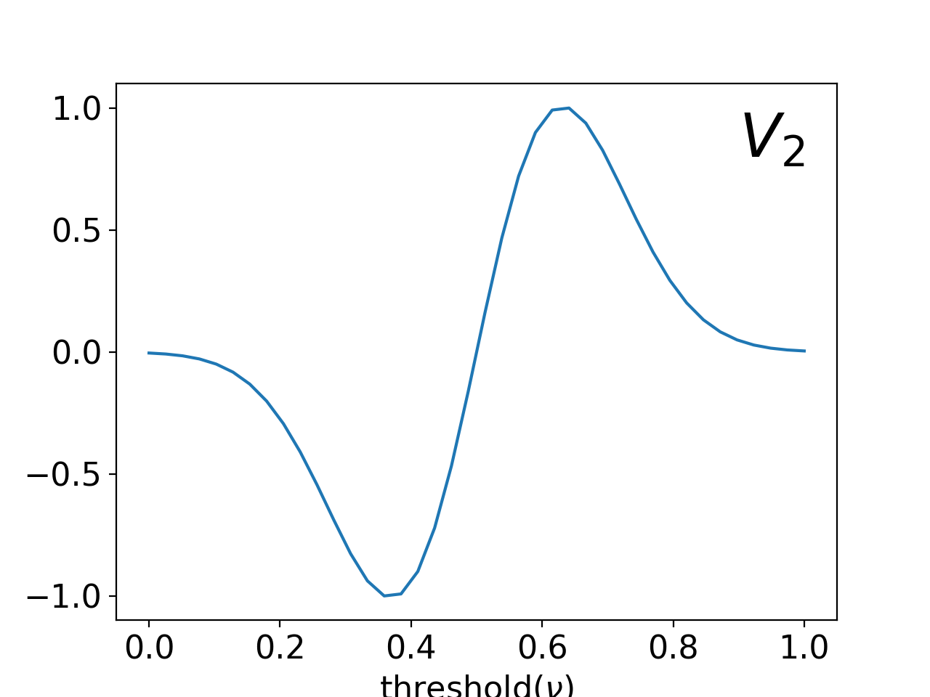








Analysis of 2D scalar field $ϕ$
Minkowski Functionals of excursion sets
Define a threshold value $ν$
$ϕ$ > $ν$ → white, $ϕ$ < $ν$ → Black
area
circumference
$$χ$$
$χ$ = # of isolated white parts – # of isolated black parts
Note: This is not a one to one plot, just for demonstration

Slide 12
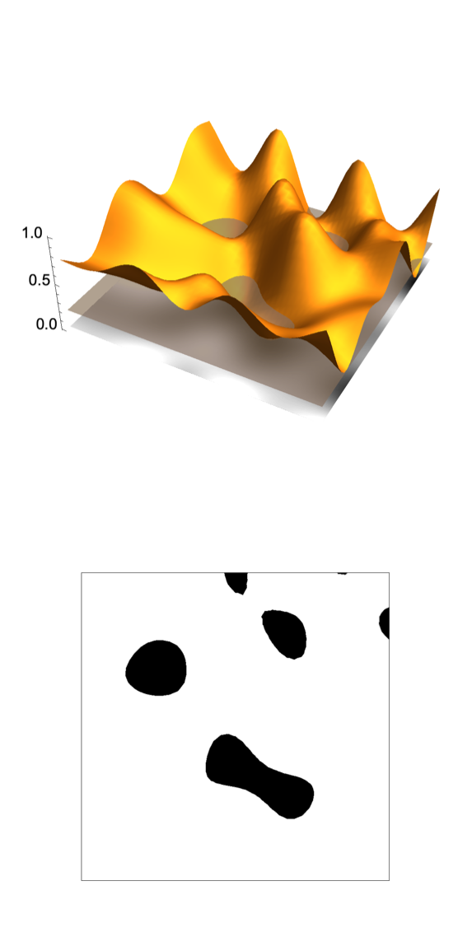







Analysis of 2D scalar field $ϕ$
Minkowski Functionals of excursion sets
Define a threshold value $ν$
$ϕ$ > $ν$ → white, $ϕ$ < $ν$ → Black
area
circumference
$$χ$$
$χ$ = # of isolated white parts – # of isolated black parts
Note: This is not a one to one plot, just for demonstration

Slide 13
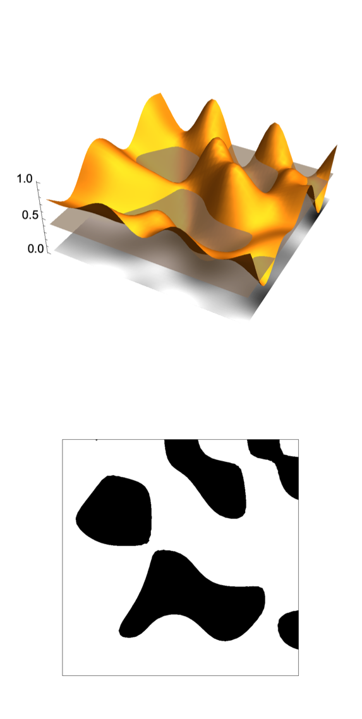





Analysis of 2D scalar field $ϕ$
Minkowski Functionals of excursion sets
Define a threshold value $ν$
$ϕ$ > $ν$ → white, $ϕ$ < $ν$ → Black
area
circumference
$$χ$$
$χ$ = # of isolated white parts – # of isolated black parts
Note: This is not a one to one plot, just for demonstration

Slide 14
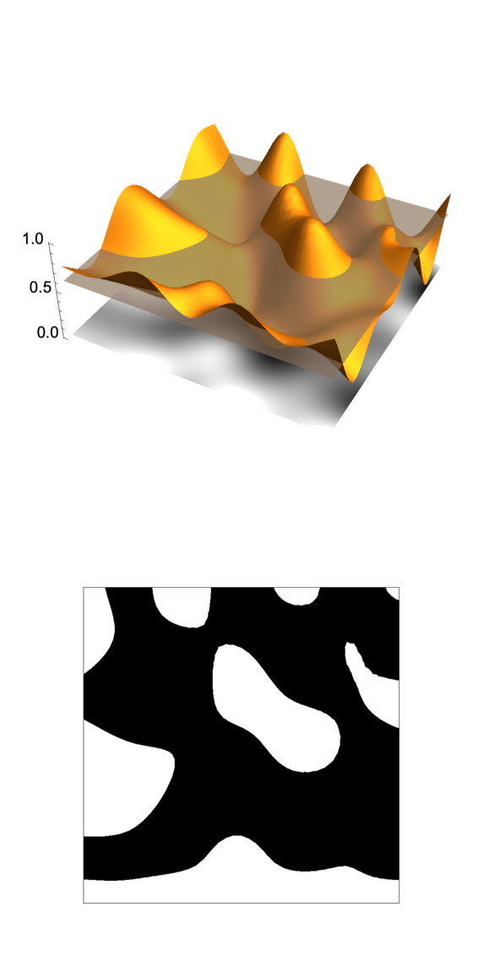



Analysis of 2D scalar field $ϕ$
Minkowski Functionals of excursion sets
Define a threshold value $ν$
$ϕ$ > $ν$ → white, $ϕ$ < $ν$ → Black
area
circumference
$$χ$$
$χ$ = # of isolated white parts – # of isolated black parts
Note: This is not a one to one plot, just for demonstration

Slide 15
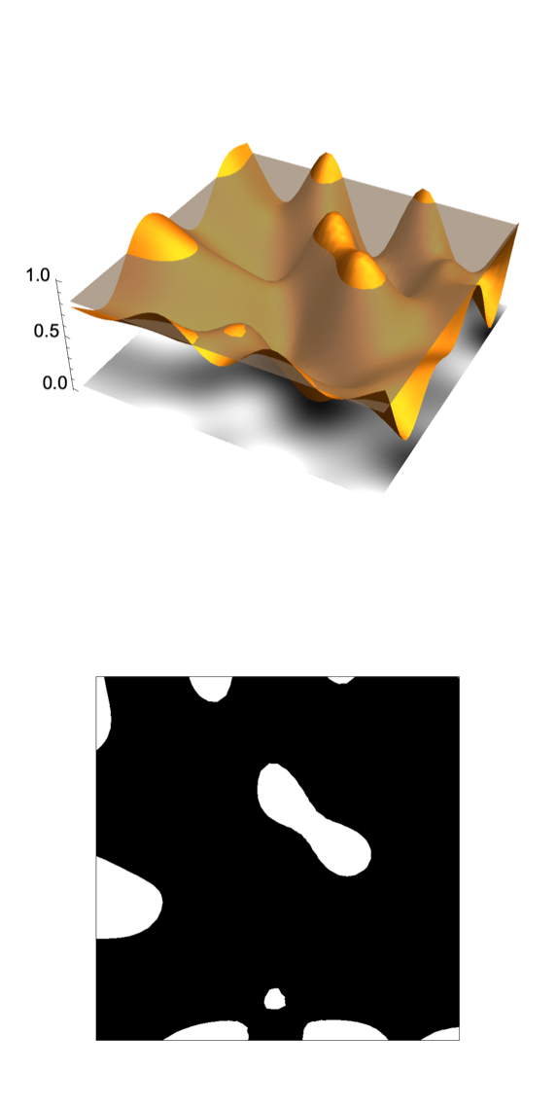

Analysis of 2D scalar field $ϕ$
Minkowski Functionals of excursion sets
Define a threshold value $ν$
$ϕ$ > $ν$ → white, $ϕ$ < $ν$ → Black
area
circumference
$$χ$$
$χ$ = # of isolated white parts – # of isolated black parts
Note: This is not a one to one plot, just for demonstration

Slide 16
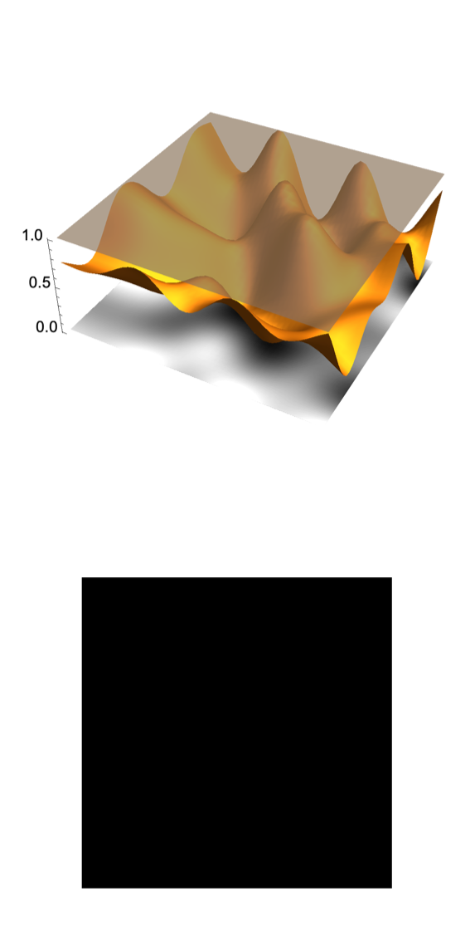
Analysis of 2D scalar field $ϕ$
Minkowski Functionals of excursion sets
Define a threshold value $ν$
$ϕ$ > $ν$ → white, $ϕ$ < $ν$ → Black
area
circumference
$$χ$$
$χ$ = # of isolated white parts – # of isolated black parts
Note: This is not a one to one plot, just for demonstration

Slide 17
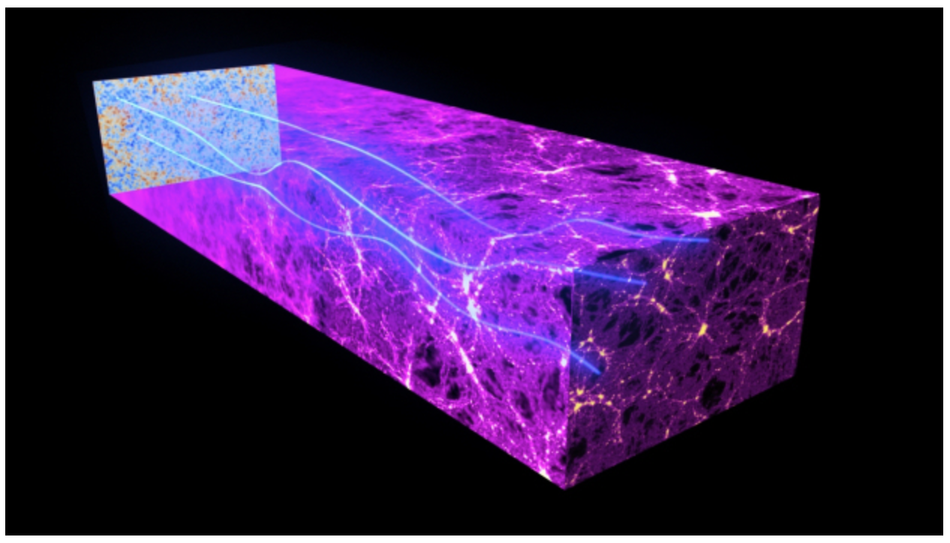
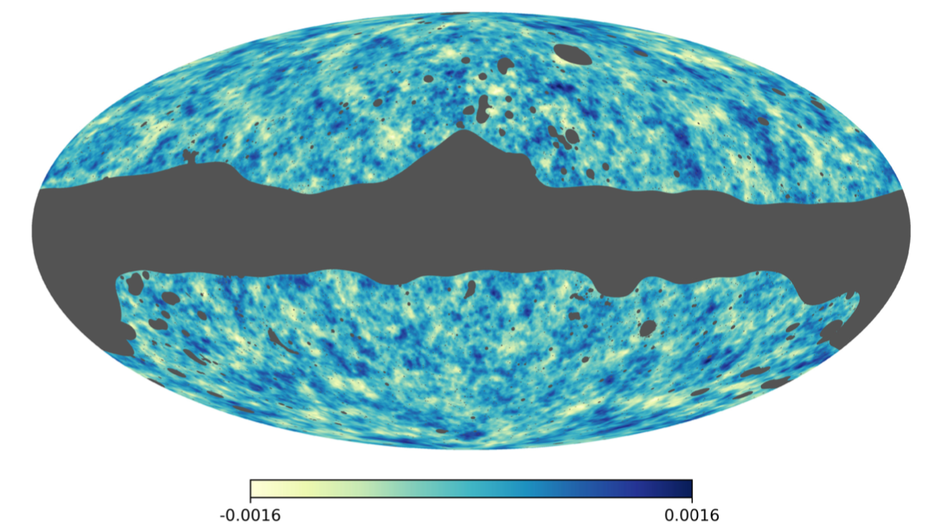
MFs are idea descriptors of CMB Lensing
Relatively straightforward to evaluate
Sensitive to all higher order correlations (great for non-Gaussian field)

Slide 18
MFs are idea descriptors of CMB Lensing
Relatively straightforward to evaluate
Sensitive to all higher order correlations (great for non-Gaussian field)
Very robust with respect to systematics

Slide 19
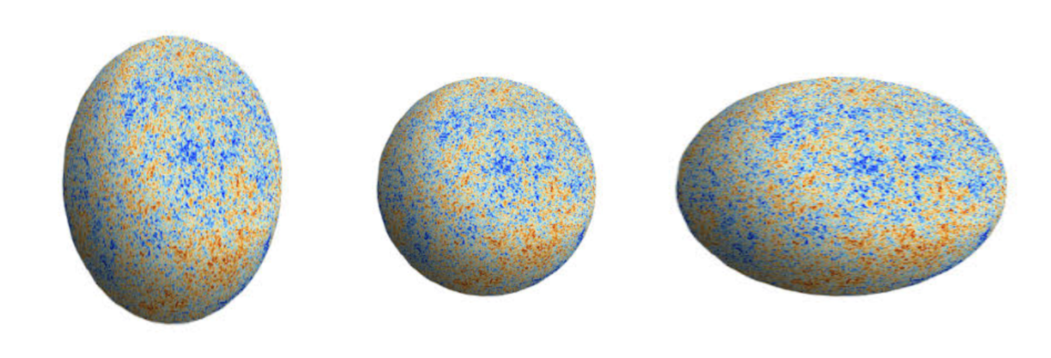
MFs are idea descriptors of CMB Lensing
Relatively straightforward to evaluate
Sensitive to all higher order correlations (great for non-Gaussian field)
Very robust with respect to systematics

Slide 20
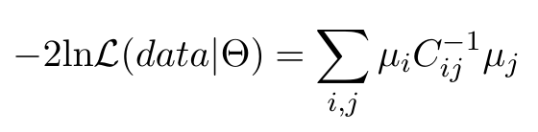

Constrain cosmological parameters
Likelihood
covariance matrix
Planck observation
theory prediction

Slide 21

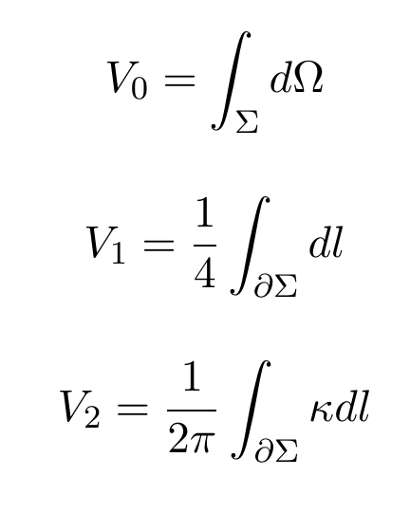







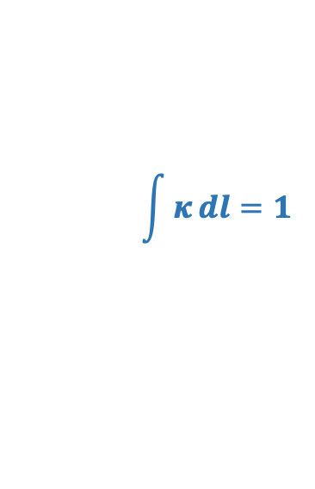






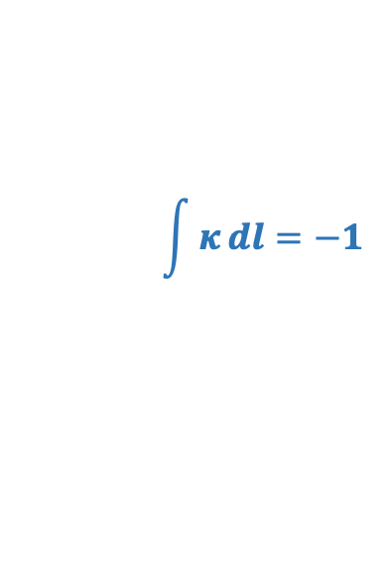



Constrain cosmological parameters
$$\int{κ}dl=−1$$
MFs from maps
Numerically
Likelihood
covariance matrix
$$\int{κ}dl=1$$
area
circumference
Planck observation
theory prediction
$$χ$$
$χ$ = # of isolated white parts – # of isolated black parts

Slide 22
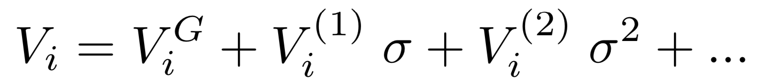
Constrain cosmological parameters
Prediction of MFs
N-body simulations + ray-tracing
Perturbative approach
Likelihood
covariance matrix
Planck observation
theory prediction

Slide 23
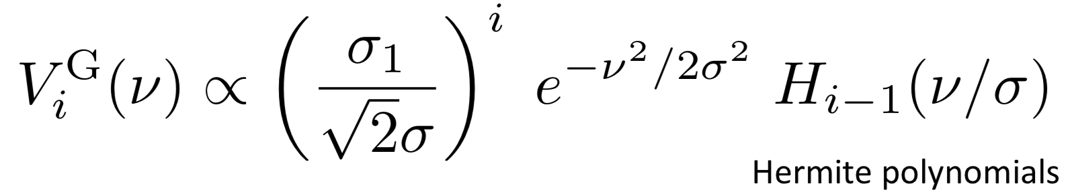
Constrain cosmological parameters
Prediction of MFs
N-body simulations + ray-tracing
Perturbative approach
Likelihood
covariance matrix
Planck observation
theory prediction

Slide 24
Constrain cosmological parameters
Prediction of MFs
N-body simulations + ray-tracing
Perturbative approach
Likelihood
covariance matrix
Planck observation
theory prediction
2nd moment (variance)

Slide 25
Constrain cosmological parameters
Prediction of MFs
N-body simulations + ray-tracing
Perturbative approach
Likelihood
covariance matrix
Planck observation
theory prediction
2nd moment (variance)
2nd moment of field gradient

Slide 26
Constrain cosmological parameters
Prediction of MFs
N-body simulations + ray-tracing
Perturbative approach
Likelihood
covariance matrix
2nd moment
Planck observation
theory prediction

Slide 27
Constrain cosmological parameters
Prediction of MFs
N-body simulations + ray-tracing
Perturbative approach
Likelihood
covariance matrix
2nd moment
Planck observation
theory prediction
Power spectrum

Slide 28
Constrain cosmological parameters
Prediction of MFs
N-body simulations + ray-tracing
Perturbative approach
Likelihood
covariance matrix
2nd moment
3rd moment
4th moment
Planck observation
theory prediction
Power spectrum

Slide 29
Constrain cosmological parameters
Prediction of MFs
N-body simulations + ray-tracing
Perturbative approach
Likelihood
covariance matrix
2nd moment
3rd moment
4th moment
Planck observation
theory prediction
Power spectrum
Bispectrum
Trispectrum

Slide 30
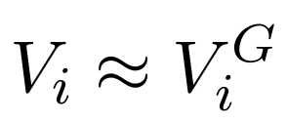
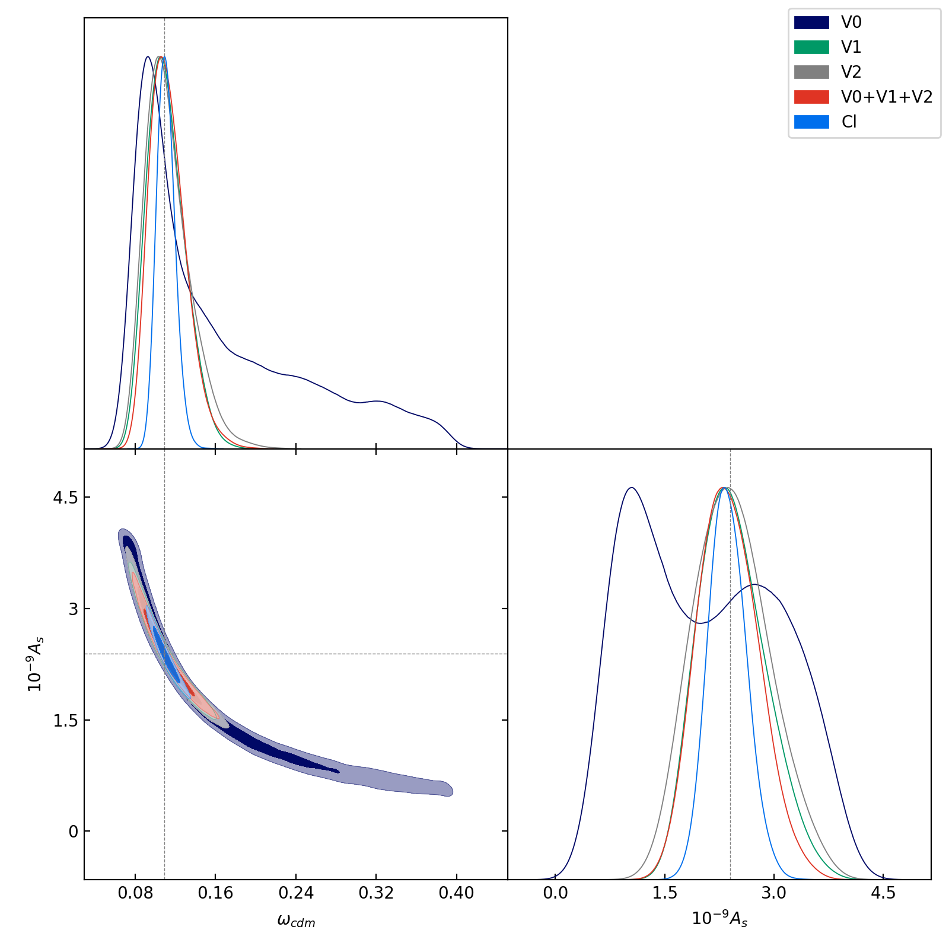
Current Result
Gaussian approximation
Forecast constrain with Planck-like fiducial data (best-fit, noise, mask)
Planck lensing likelihood (power spectrum)

Slide 31
Current Result
Gaussian approximation
Forecast constrain with Planck-like fiducial data (best-fit, noise, mask)
Treat low multipoles and high multipoles separately
Planck lensing likelihood (power spectrum)

Slide 32
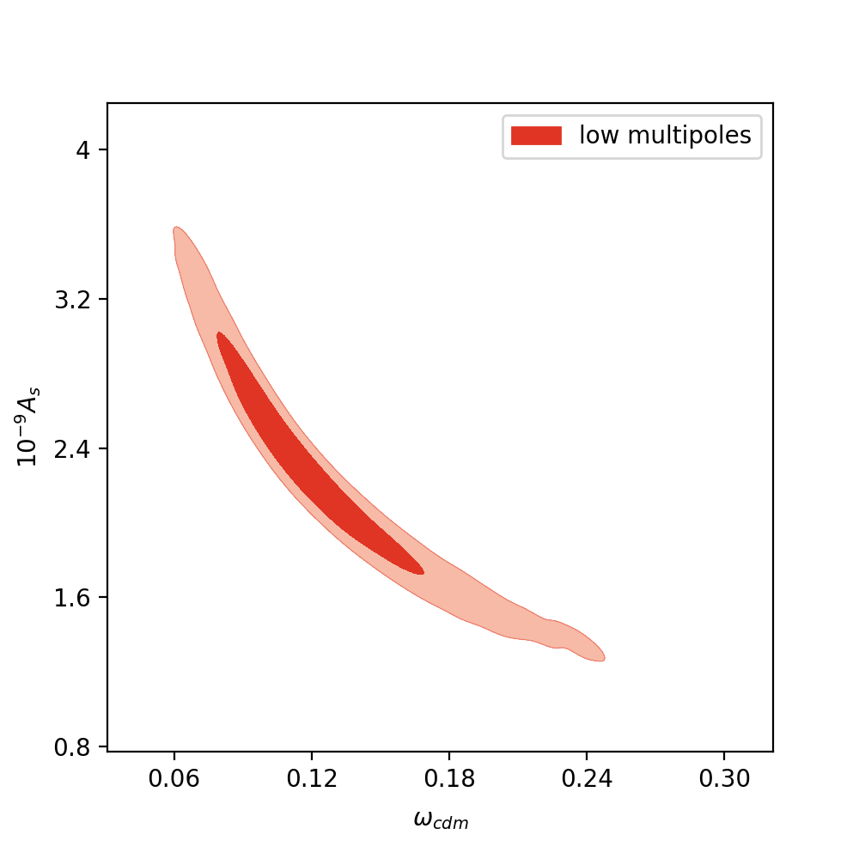
Current Result
Gaussian approximation
Forecast constrain with Planck-like fiducial data (best-fit, noise, mask)
Treat low multipoles and high multipoles separately

Slide 33
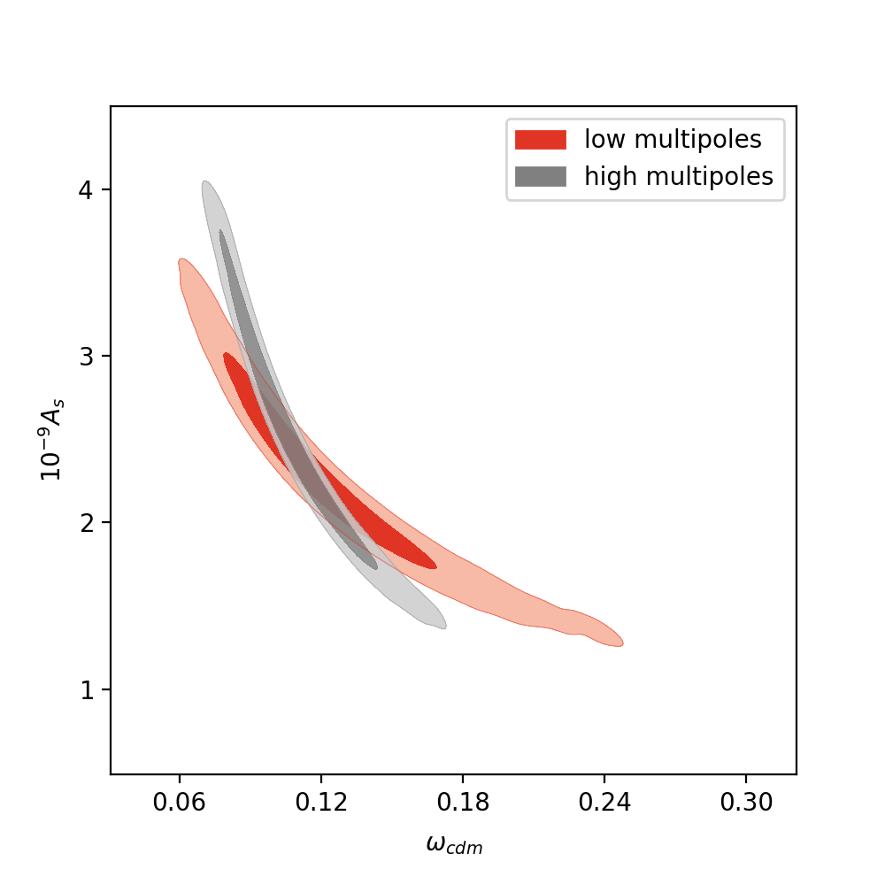
Current Result
Gaussian approximation
Forecast constrain with Planck-like fiducial data (best-fit, noise, mask)
Treat low multipoles and high multipoles separately

Slide 34
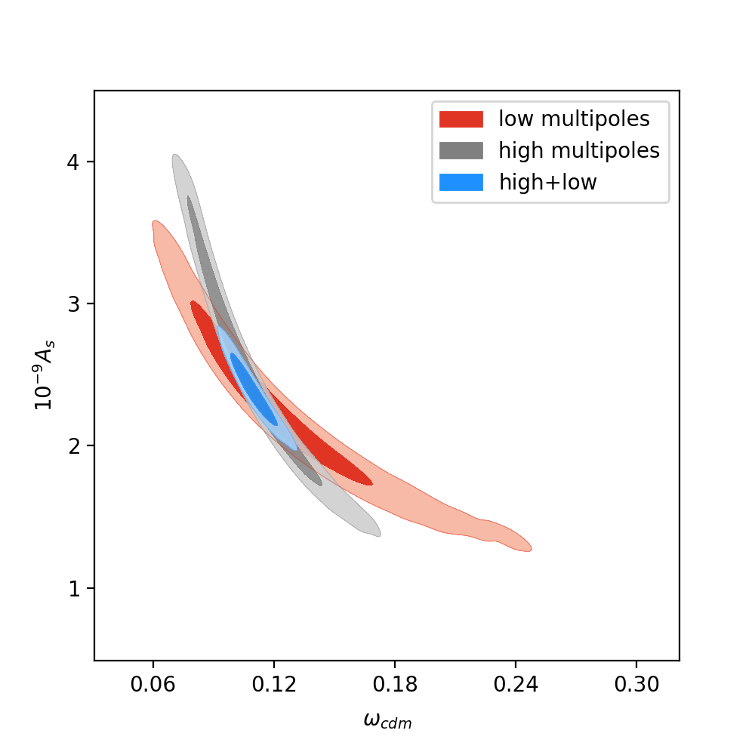
Current Result
Gaussian approximation
Forecast constrain with Planck-like fiducial data (best-fit, noise, mask)
Treat low multipoles and high multipoles separately

Slide 35
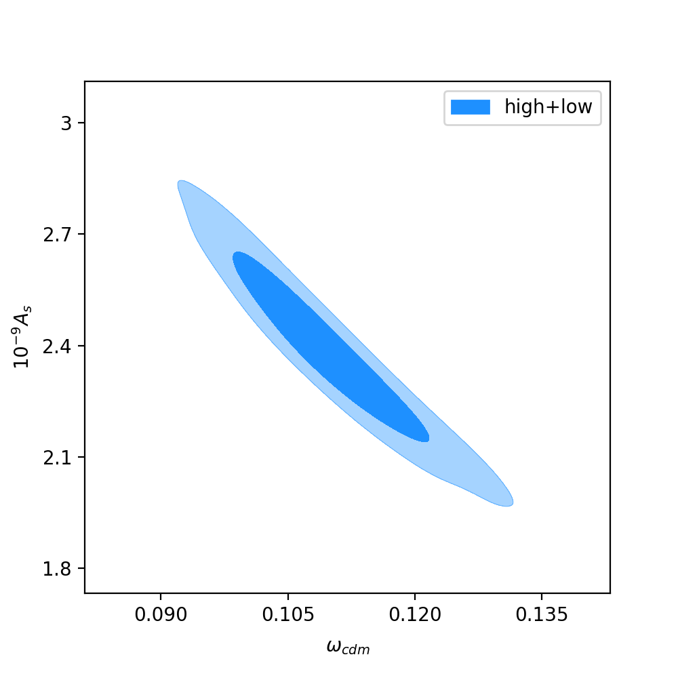
Current Result
Gaussian approximation
Forecast constrain with Planck-like fiducial data (best-fit, noise, mask)
Treat low multipoles and high multipoles separately

Slide 36
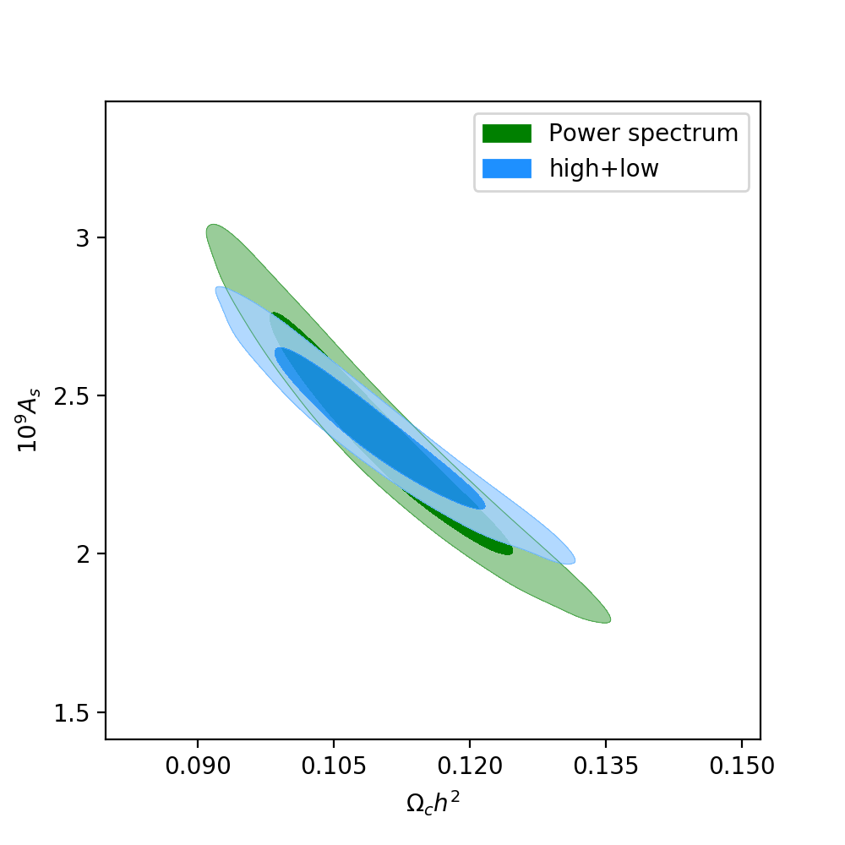
Current Result
Gaussian approximation
Forecast constrain with Planck-like fiducial data (best-fit, noise, mask)
Treat low multipoles and high multipoles separately

Slide 37
Summary
Minkowski functionals describe topological and morphological properties of maps
For non-Gaussian maps, MFs can add information that is missed by the power spectrum
MFs are promising tools for current and future CMB lensing observations

Slide 38
Back up Slides

Slide 39
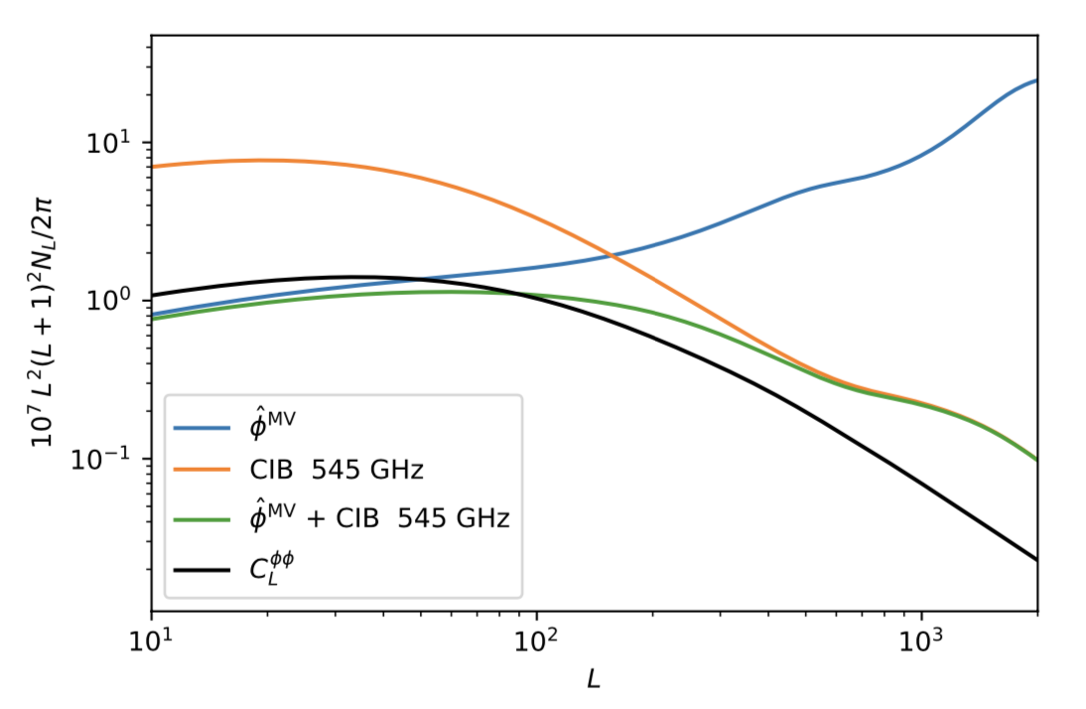
Current Result
Gaussian approximation
Forecast constrain with Planck-like fiducial data (best-fit, noise, mask)
Treat low multipoles and high multipoles separately
L = 106
[Planck,2018]

Slide 40
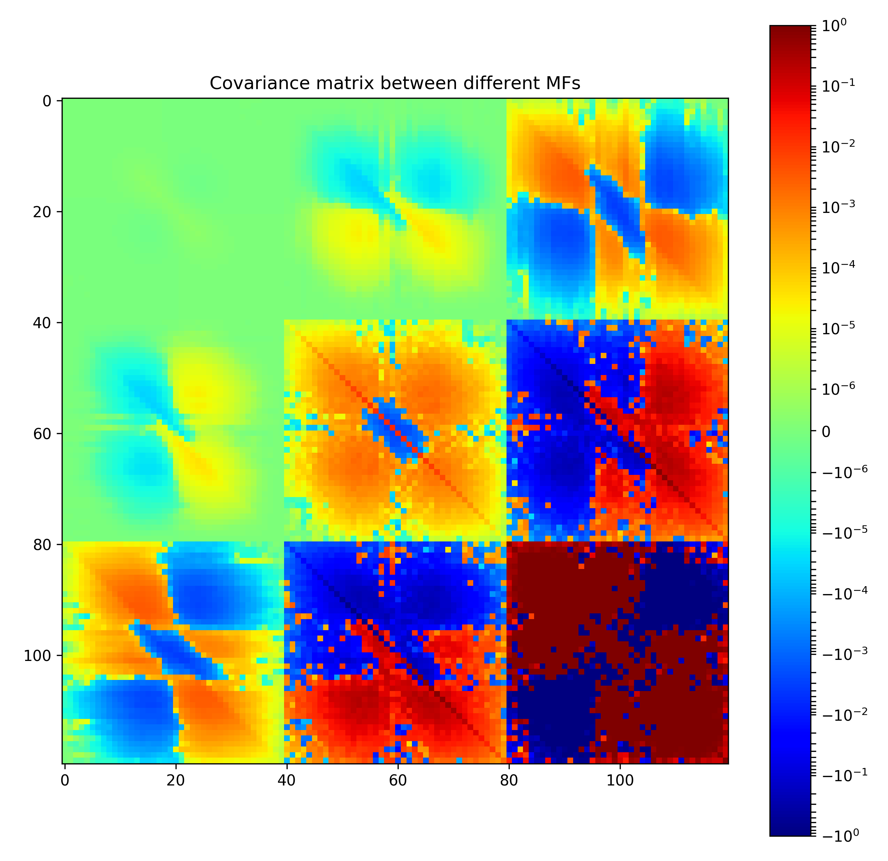
Covariance Matrix

