Slide 1
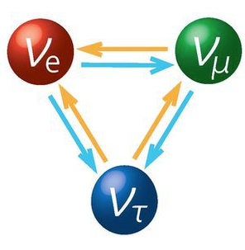
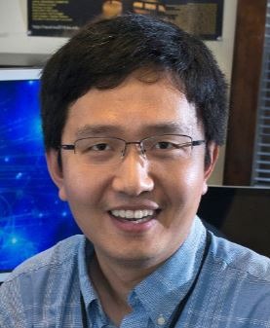
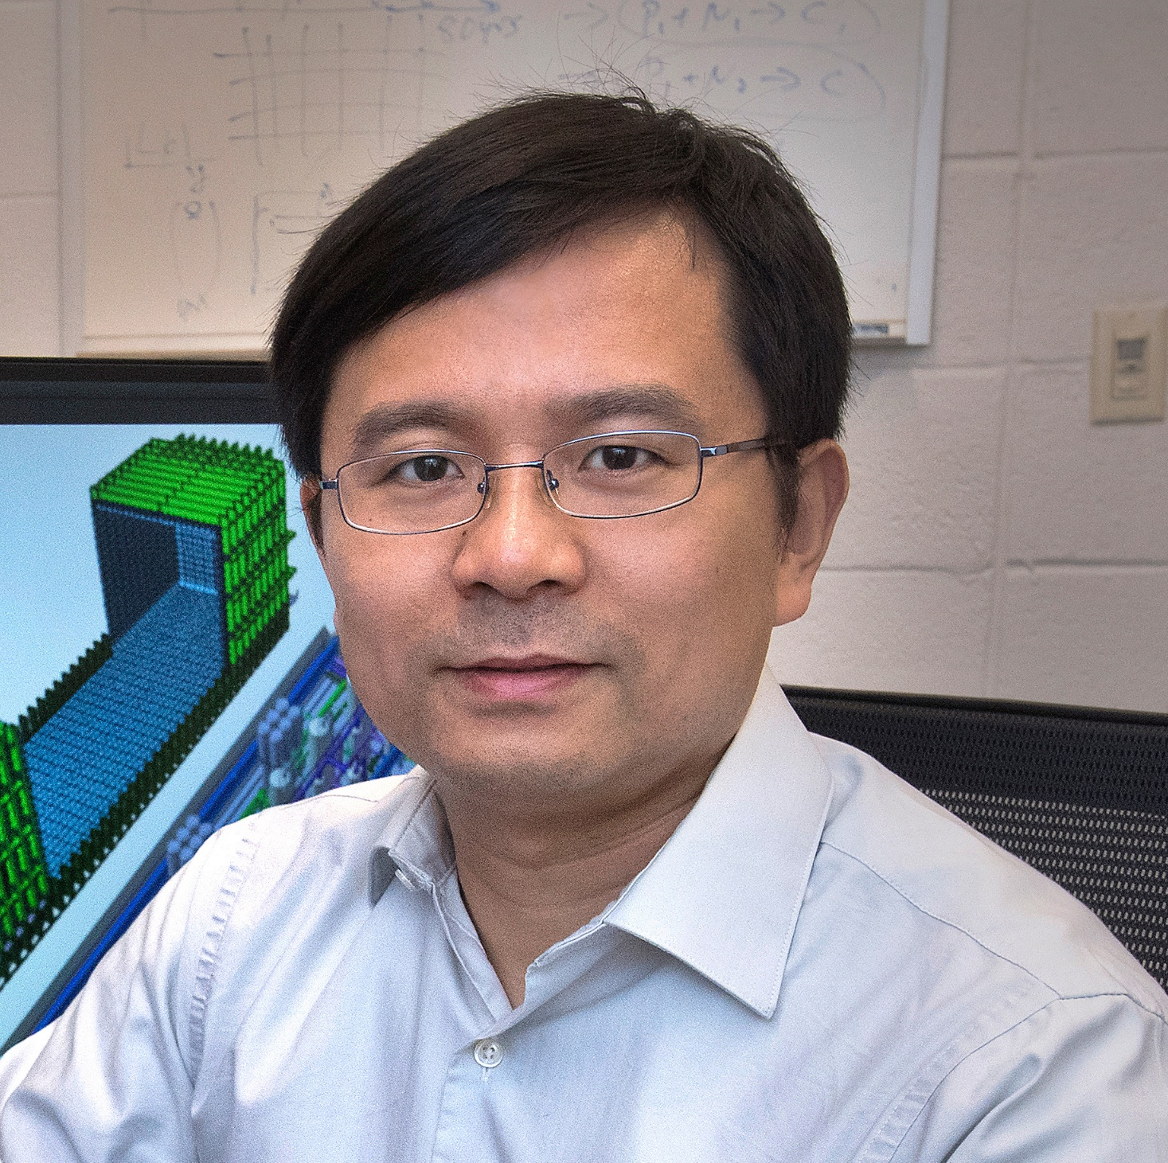

Reactor Neutrinos
Xin Qian
xqian@bnl.gov
Borrowed many materials from my colleague Dr. Chao Zhang (czhang@bnl.gov), who is traveling right now

Slide 2
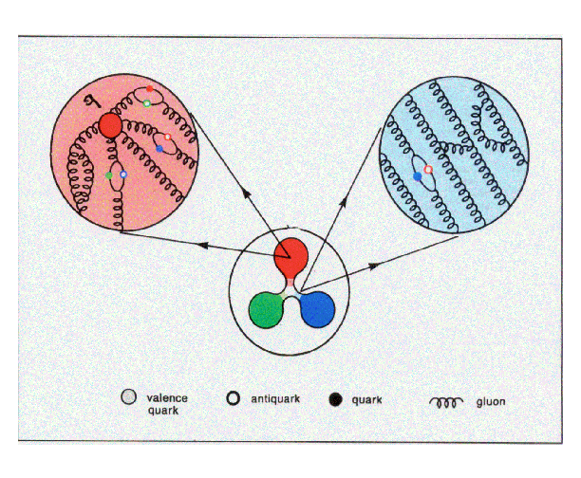
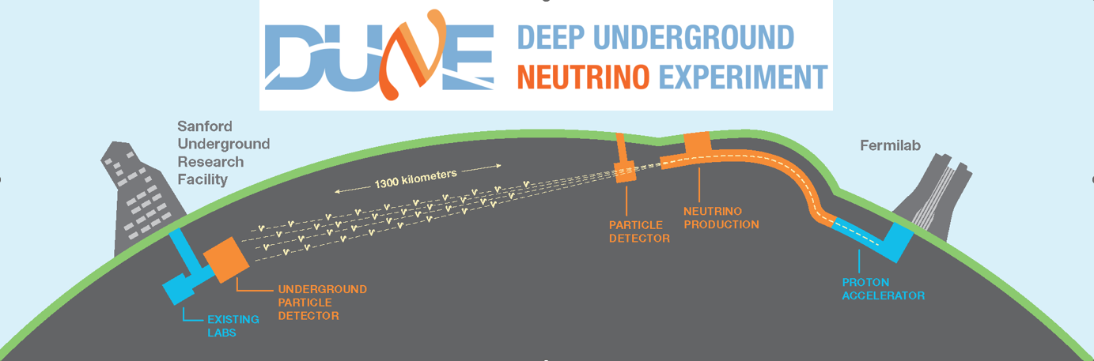
Me and Reactor Neutrinos
Physicist in the Electronic Detector Group (EDG), Physics Department, BNL
  PhD @ Duke University (2010)
    Nucleon spin structure with electron scattering
  Post-doc @ Caltech (2010-2013)
    Daya Bay experiment (China)
    LBNE → DUNE experiment
  Staff Scientist @ BNL (2013-Now):
  BNL | Staff | Xin Qian, Physics Department
    PROSPECT experiment (US)
    LArTPC technology development for DUNE
    PIONEER: rare decay experiment

Slide 3

Worlds’ First Nuclear Reactor
Chicago Pile-1 (CP-1) ~ 0.5 W power
Part of the Manhattan Project
  Did you watch “Oppenheimer” last weekend?
Designed and tested by a team of 49 scientists led by Enrico Fermi at
U. Chicago
Dec 2, 1942: first human-made self-sustaining nuclear chain reaction:
  Fuel: 40-ton Uranium Oxide and 6-ton Uranium Metal
  Neutron moderator: 380-ton Graphite blocks
  Control rods: Cadmium sheets
CP-1 in a squash court under the stands of Staff Field @ U. Chicago

Slide 4

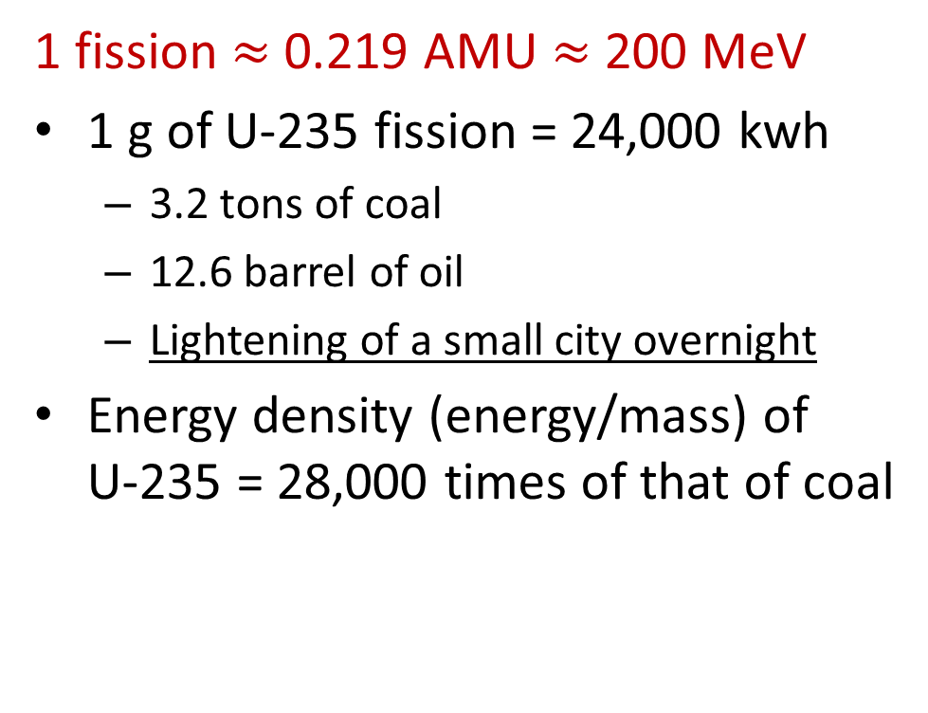
Fission and Energy Release $E=mc^{2}$
91.926 AMU
1 fission $≈$ 0.219 AMU $≈$ 200 MeV
1 g of U-235 fission = 24,000 kwh
  3.2 tons of coal
  12.6 barrel of oil
  Lightening of a small city overnight
Energy density (energy/mass) of
U-235 = 28,000 times of that of coal
1.008 atomic mass unit (AMU)
235.044 AMU
140.883 AMU
Key properties of fission:
Release substantial energy (mostly as kinetic energy of the fission fragments)
Release excess neutrons: possibility of chain reaction
Reactor Design Requirement
Thermal neutrons: needs “moderator” to slow down neutrinos (water, graphite etc.)
Controllable fission: engineering to make output neutron = 1

Slide 5
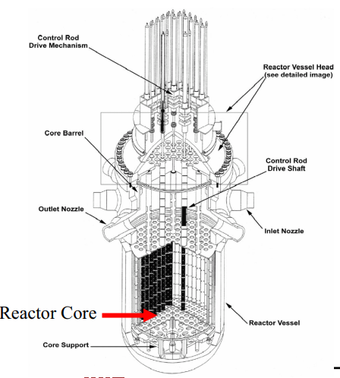
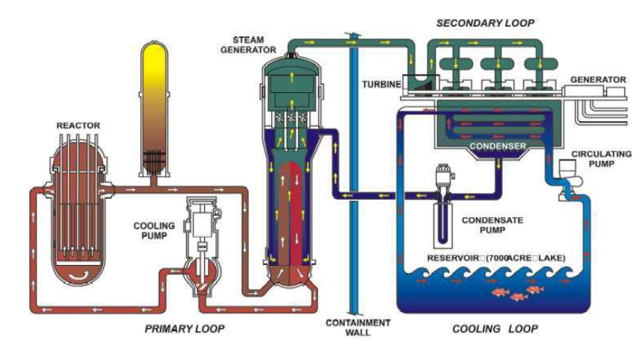
Core Heat Removal
Coolant: Heat Transfer
Safety Systems
Confinement of Radioactivity
Electricity Production
Spent fuel processing
Schematic of a Pressurized Water Reactor (PWR)
Reactor Core Design:
Core Power Distribution
Ability to shutdown plant
No fuel failure or melting

Slide 6
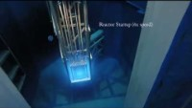
Full video with annotations:
Breazeale Nuclear Reactor Start up, 500kW, 1MW, and Shut Down (ANNOTATED) - YouTube

Slide 7
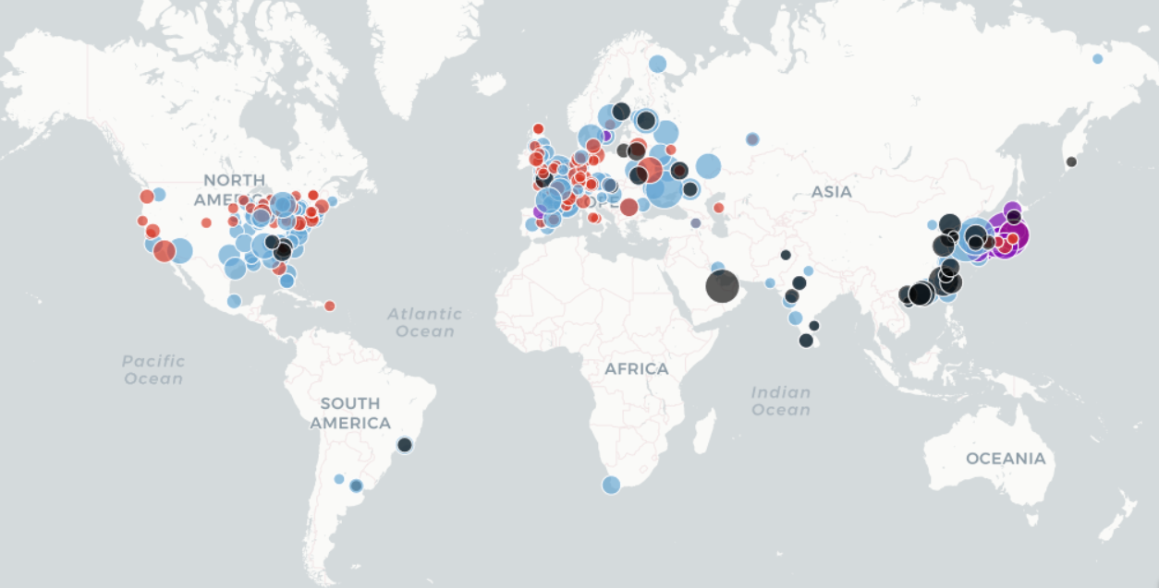
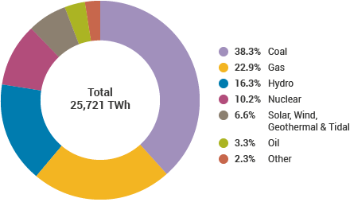
https://www.carbonbrief.org/mapped-the-worlds-nuclear-power-plants
IEA Electricity Information 2019
2015 Ranking
>450 operating nuclear reactors with
>50 under construction in >30 countries,
contributing to ~10% of global electricity

Slide 8
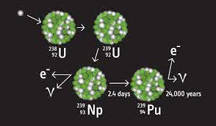
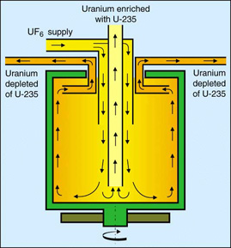
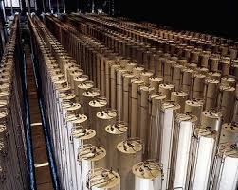
Production of Weapon-graded Plutonium
U-235: 52 kg critical mass
Pu-239: 10 kg critical mass
Natural abundance of 0.72% (mostly U-238)
90% and above is needed for weapon graded → electromagnetic separation, diffusions, centrifuges, highly technically challenging
93% and above for weapon graded
Produced in nuclear reactors → given enough time, all U-238 → Pu
Safeguards efforts (e.g. WATCHMAN: arXiv:1502.01132)

Slide 9
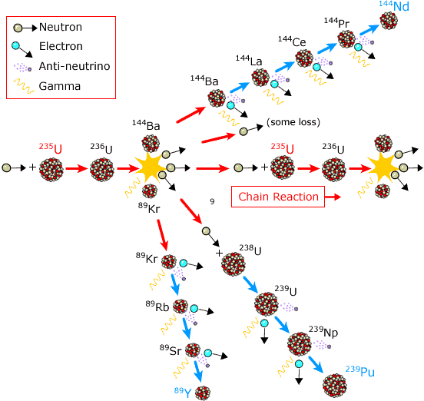
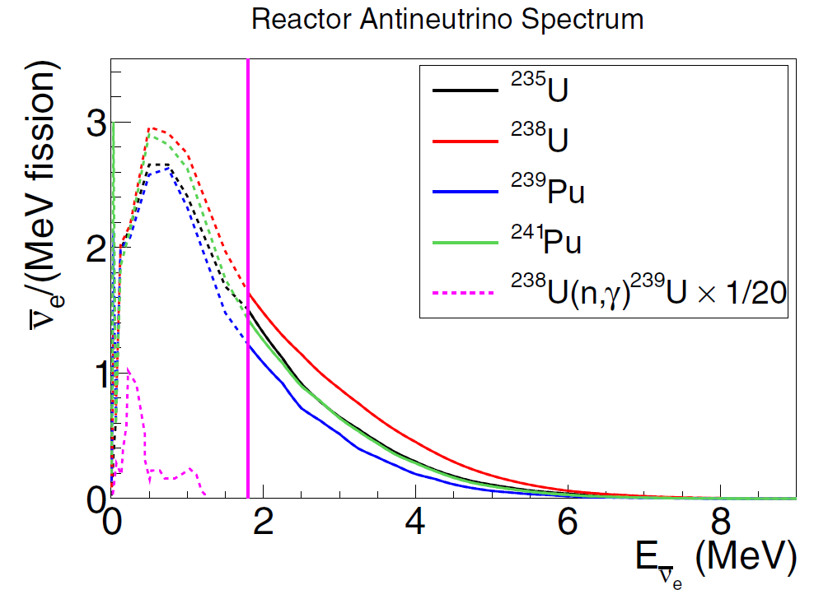
Nuclear Reactor as Antineutrino Source
Fission process in a nuclear reactor
Low-enriched uranium (LEU) cores in Commercial reactors in Nuclear Power Plants
  Mixture of fissions: ²³⁵U (~55%), ²³⁹Pu (~30%), ²³⁸U (~10%), ²⁴¹Pu (~5%)
  Large power: ~3 GW_{th}
Highly-enriched uranium (HEU) cores with compact size in
Research reactors
  ²³⁵U fission fraction ~99%
  Lower power, few tens of MW_{th}
nobelprize.org
Pure anti-ν_{e} source with
~6 anti-ν_{e} per fission
~2 x 10²⁰ anti-ν_{e}/sec per GigaWatt thermal power (GW_{th})
Rep. Prog. Phys. 82, 036201
Notes:
Explicitly state that anue are produced in beta decay of fission daughters. This is hard to see in the image. Write out GWth = GigaWatt of thermal power.

Slide 10
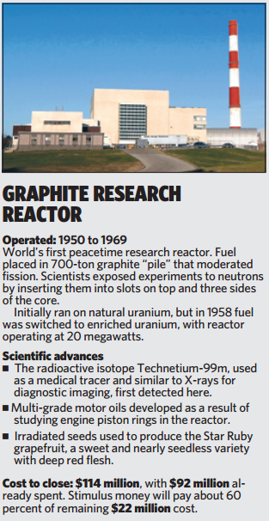
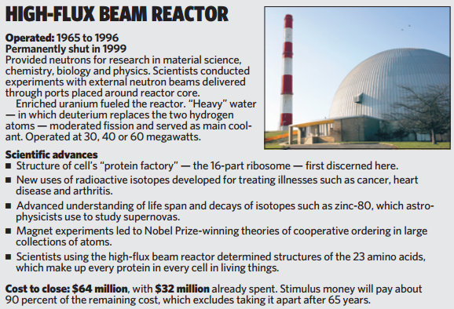
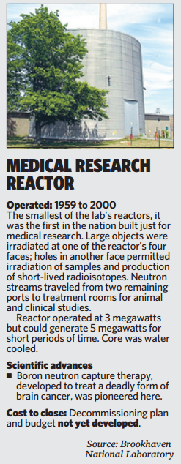
Research Reactors typically ~10 MW
BNL’s past 3 reactors
  BGRR, HFBR, BMRR
https://www.bnl.gov/about/history/reactors.php

Slide 11
Homework Problem 1
How many antineutrinos are produced per second for a typical 3-gigawatt (thermal) commercial reactor?
  Each fission releases ~200 MeV energy. How many fissions are produced per second?
  Each fission produce ~6 antineutrinos on average from the beta-decay chains. How many antineutrinos are produced per second?

Slide 12
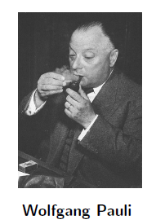
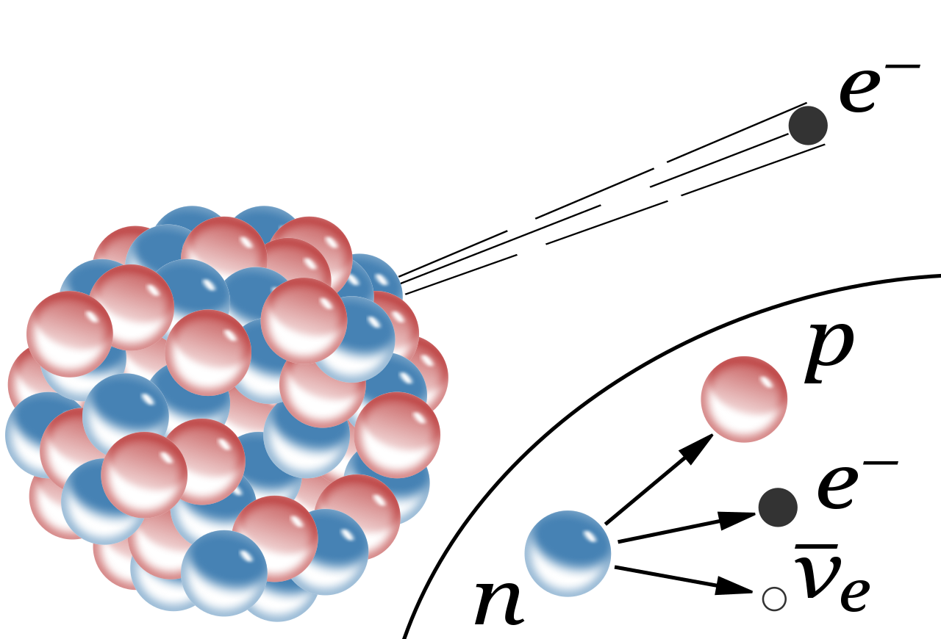

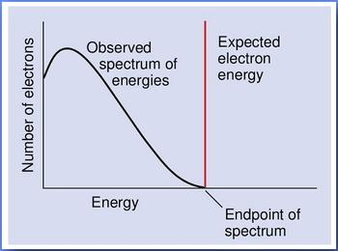
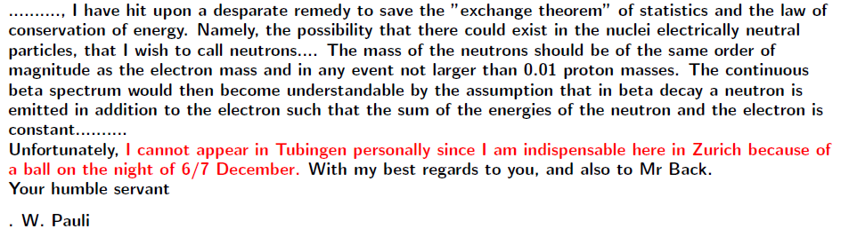
Neutrino and Beta Decay
1930: Pauli’s letter to physicists at a workshop in Tubingen
Dear Radioactive Ladies and Gentlemen,
“I have done a terrible thing. I have postulated a particle that cannot be detected.”

Slide 13

The Elusive Neutrinos
ν
Weak nuclear force
ν
100 million Earths
Neutrino detection requires:
An intensive neutrino source: a billion trillion (~10²¹) ν per second
A huge neutrino detector: tons to kilotons of target material
A distinctive method to tell “neutrino interactions” from other backgrounds

Slide 14
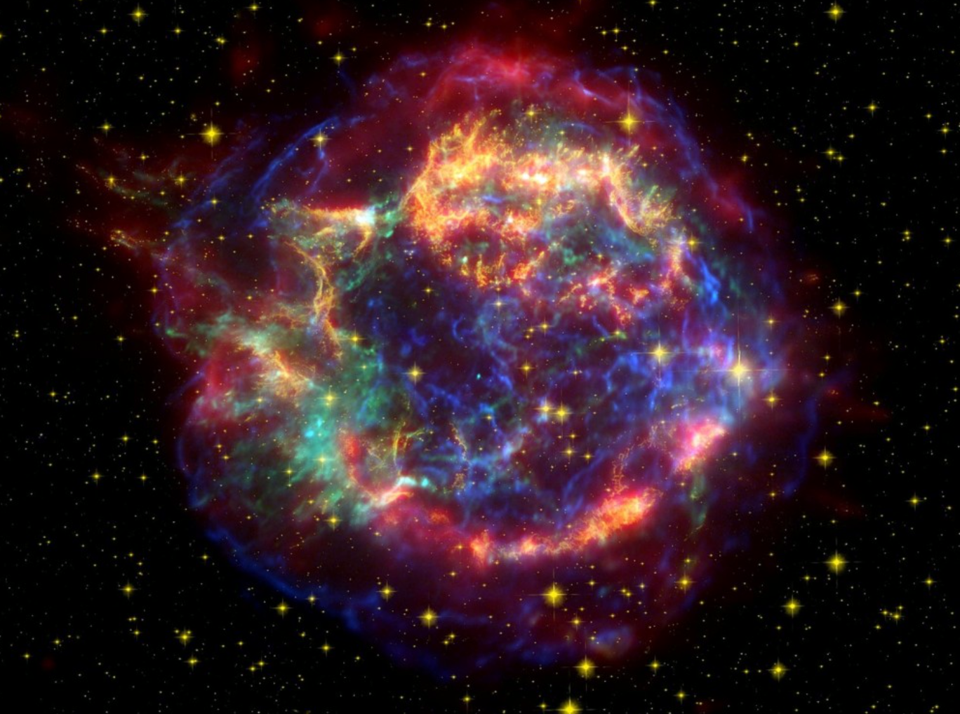
Neutrinos from the Universe
99% of the energy in a core collapse supernova explosion is carried away by neutrinos
10³⁸ ν_{e}/s are produced by the sun
Notes:
A mole of neutrino passing through your body through your lifetime

Slide 15
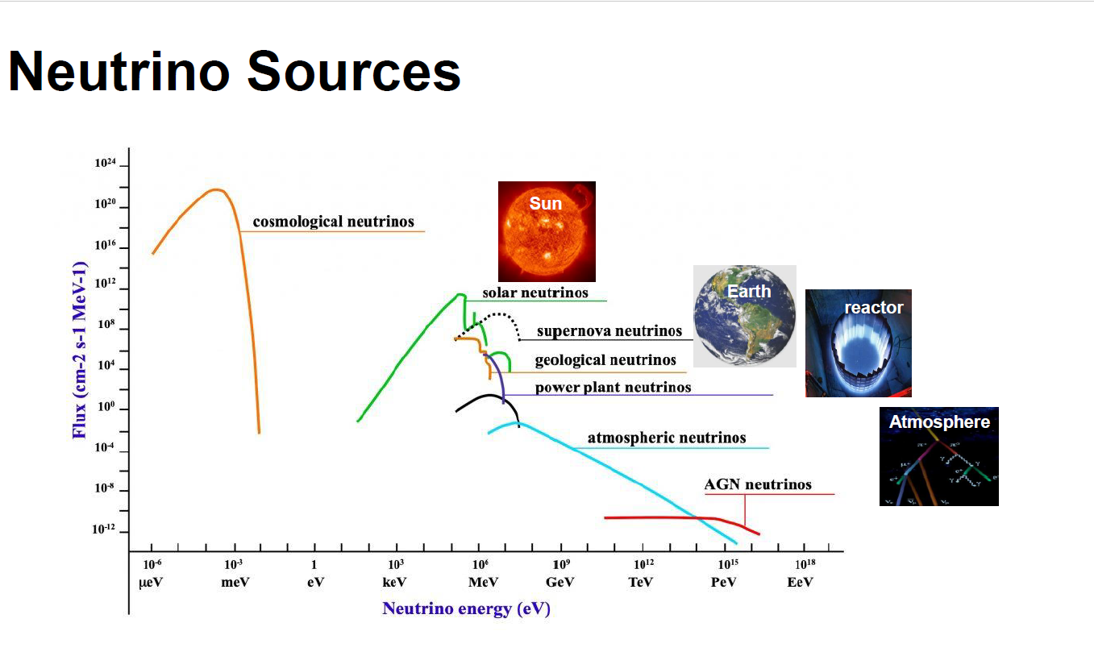

Slide 16
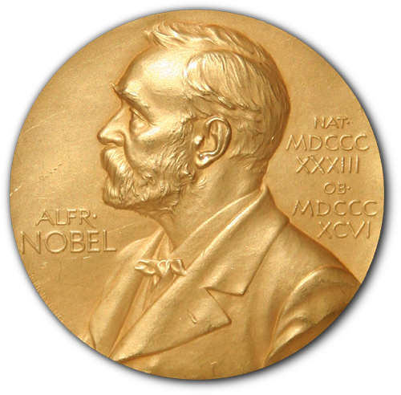
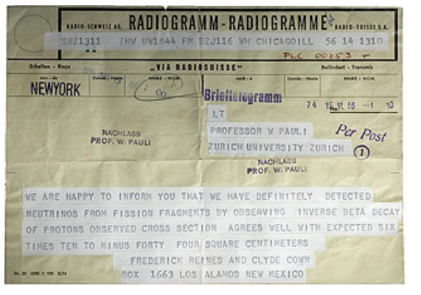
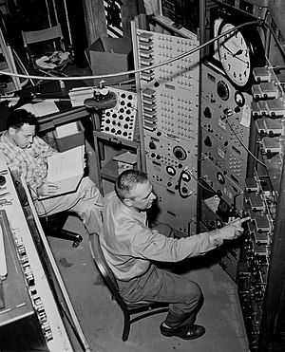
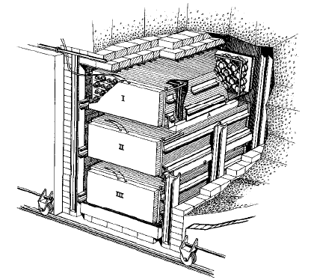
Neutrinos: First Detection
Reines and Cowan’s telegram to W. Pauli (1956)
Frederick Reines and Clyde Cowan first detected (anti)neutrinos using the Savanah River nuclear reactor in South Carolina in 1956. (26 years after Pauli’s proposal)
“We are happy to inform you that we have definitely detected neutrinos from fission fragments by observing inverse beta decay of protons”
Target: Water + CdCl₂
Detector: Liquid Scintillator + PMTs

Slide 17
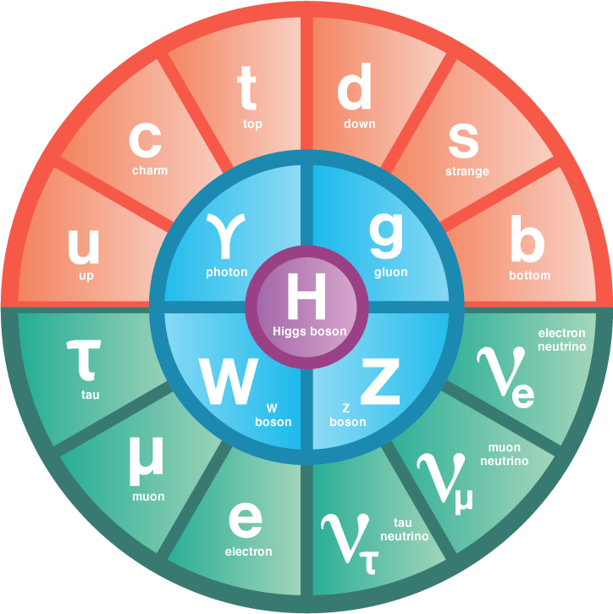
26 free parameters
As fundamental particles in the standard model of particle physics, neutrinos are the second most abundant (known) particles in our universe
Notes:
For every proton/neutron/electron the Universe contains a billion of neutrinos from the Big Bang

Slide 18
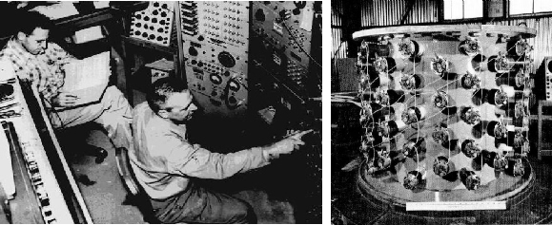
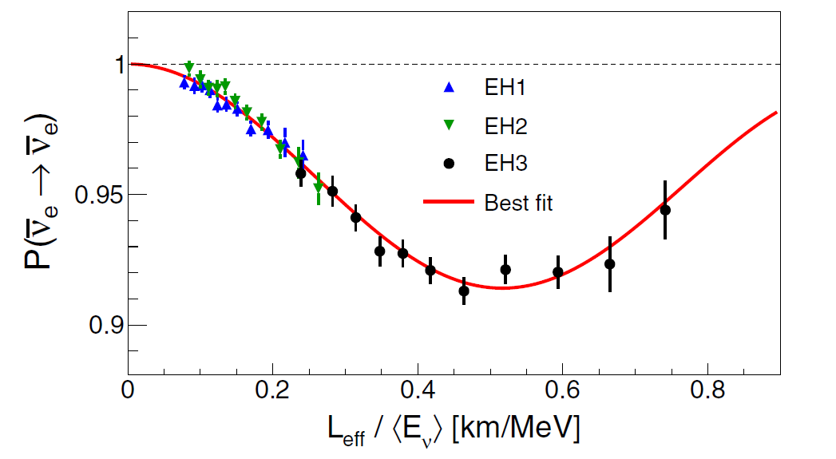
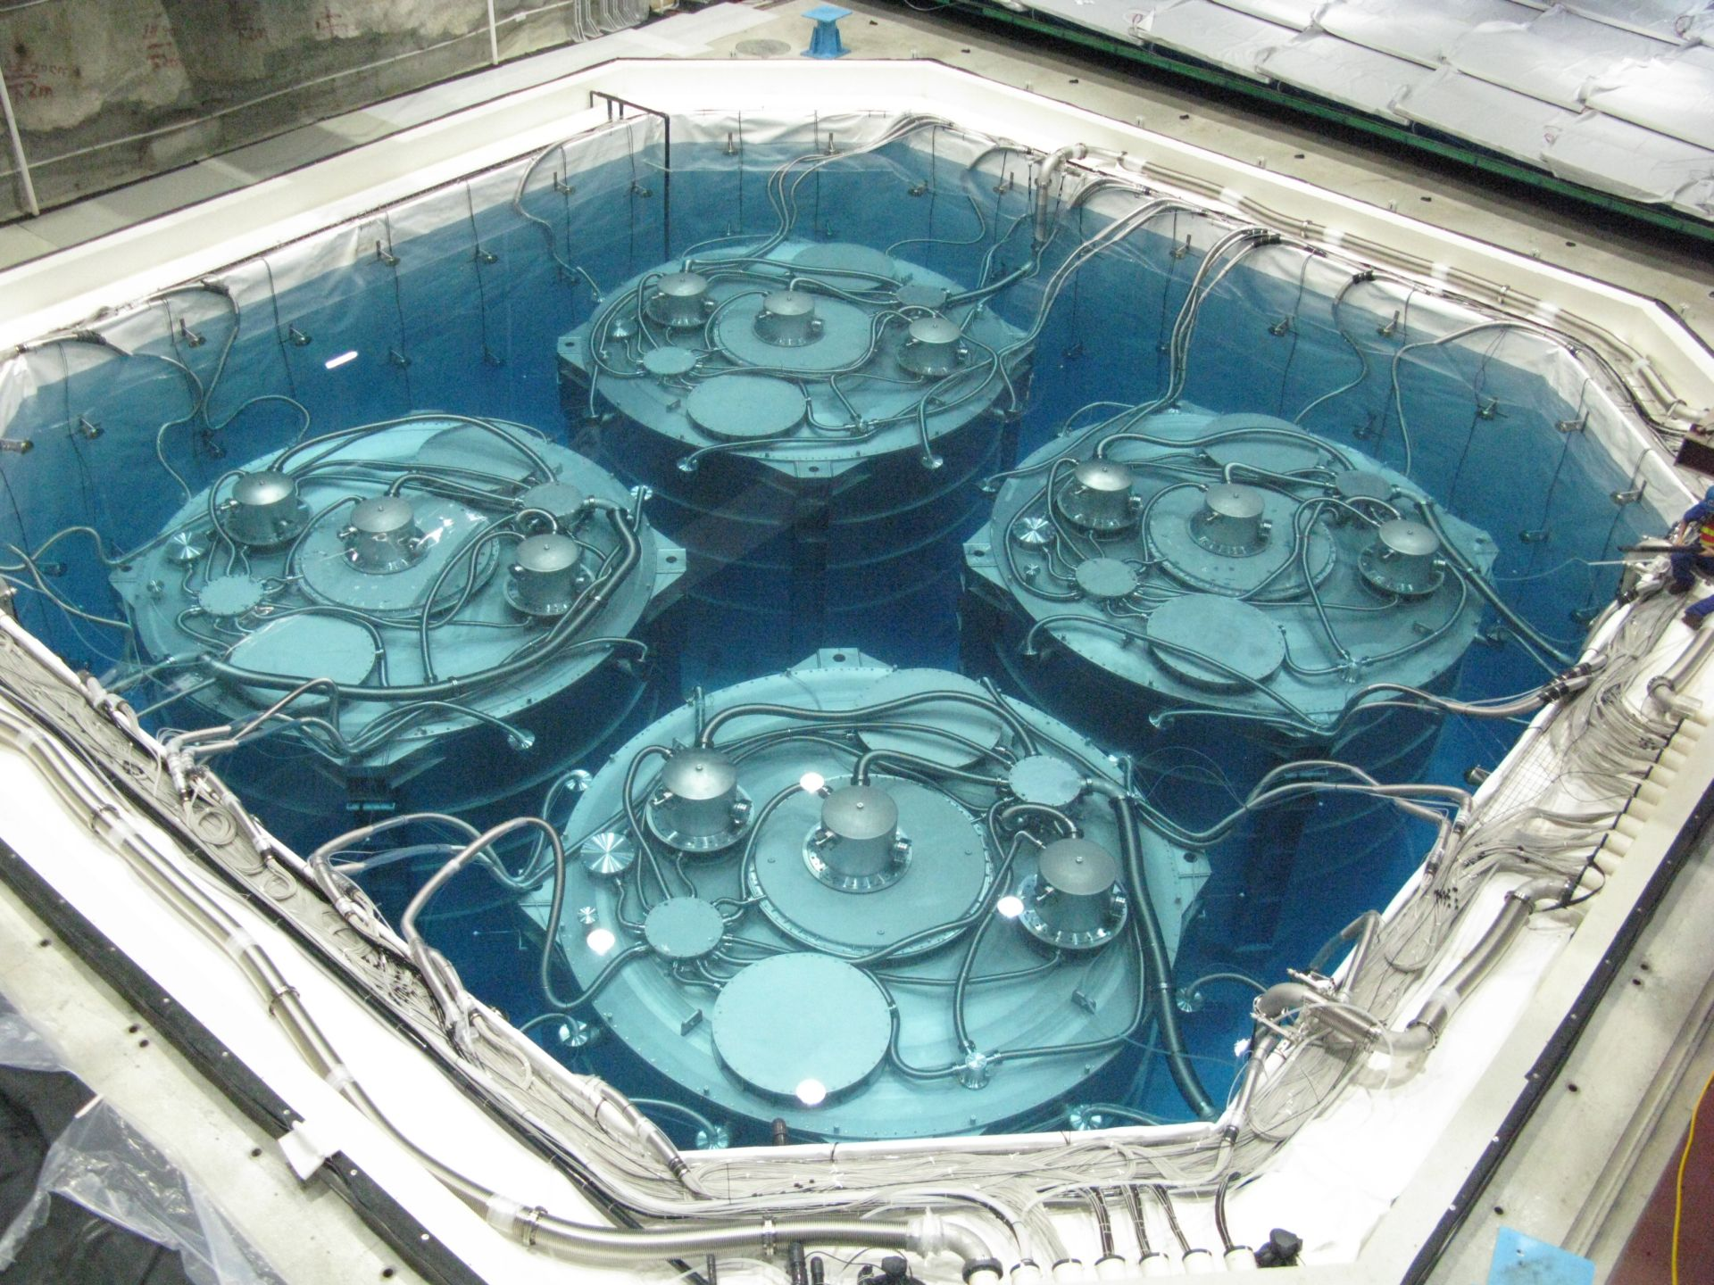
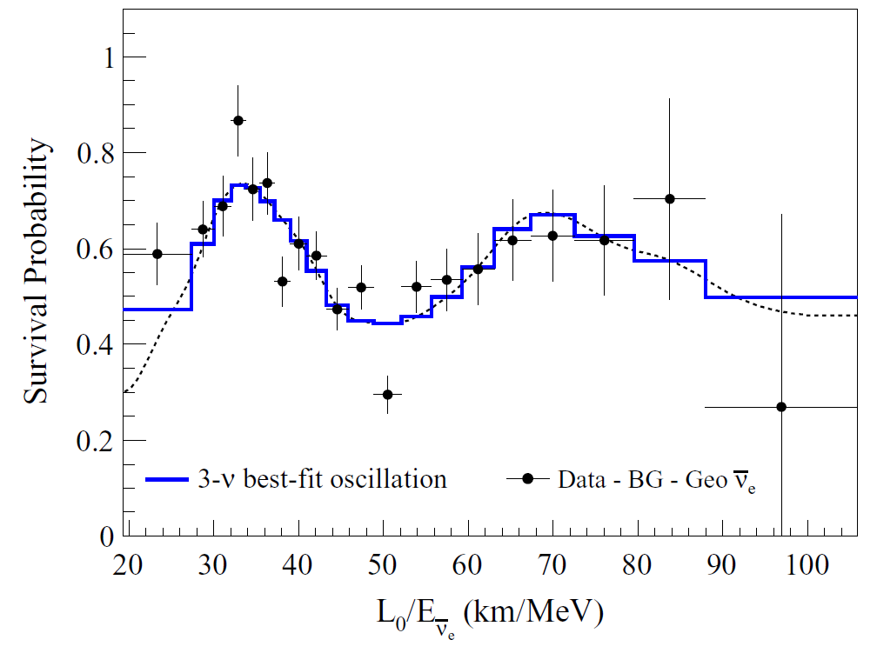
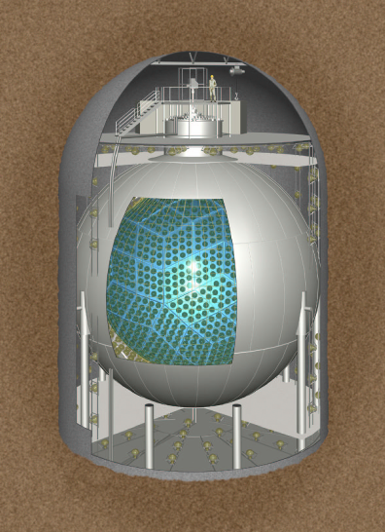

Discoveries with Reactor Anti-ν
1950s: Reines and Cowan
Detection of anti-v
Solving solar v problem on Earth
Measurement of non-zero oscillation angle θ₁₃
Currently hold the best precision of
  Δm²₂₁ (KamLAND)
  θ₁₃ (Daya Bay)
Comparable precision to accelerator-based experiments
  | Δm²₃₂ | (Daya Bay)
2010s: Daya Bay
2000s: KamLAND
Courtesy of Karsten Heeger

Slide 19
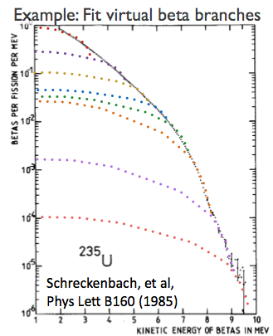
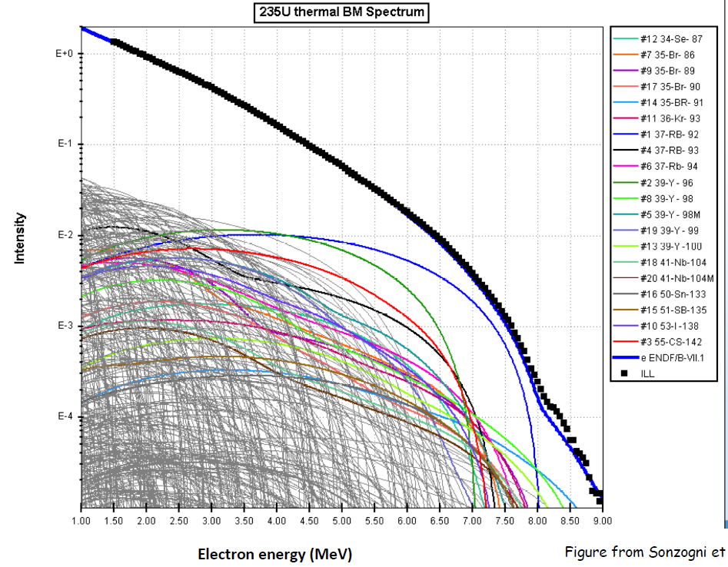
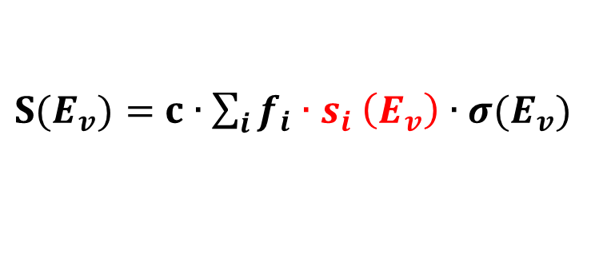
Reactor Models
$S(E_{v})=$ $c∙\sum_{i}{f_{i}{∙s}_{i}\left(E_{v}\right)}∙σ(E_{v})$
reactor thermal power, energy released per fission, baseline, target protons, detection efficiency, oscillation, etc.
isotope fission fraction
isotope neutrino spectra
IBD cross section
Conversion Method
  Measure total outgoing
  beta-decay electron energy spectra
  Predict corresponding anti-neutrino spectra with >30 virtual branches
  Considered to be more precise: ~2.5% uncertainty
Summation (ab initio) method
  Calculate the spectrum of each beta-decay branch using nuclear databases: fission yields, decay schemes
  ~10% uncertainty
Sonzogni et al
PRC 91, 011301
~6000 decay branches
Latest update @
PRL 123, 022502

Slide 20
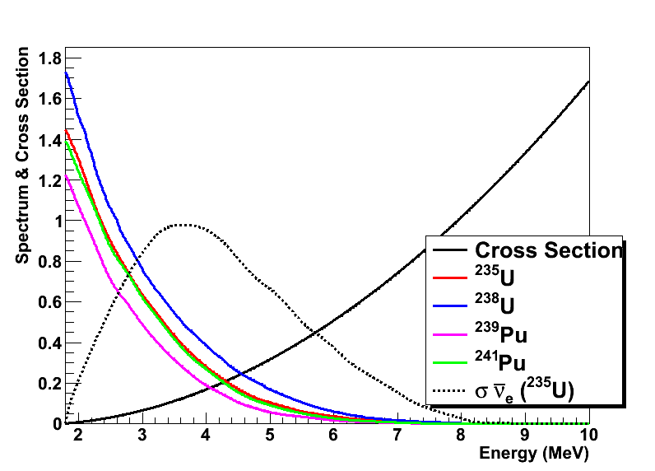
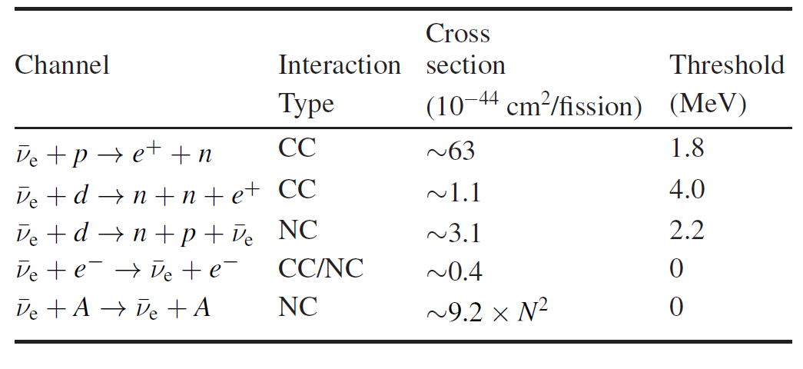
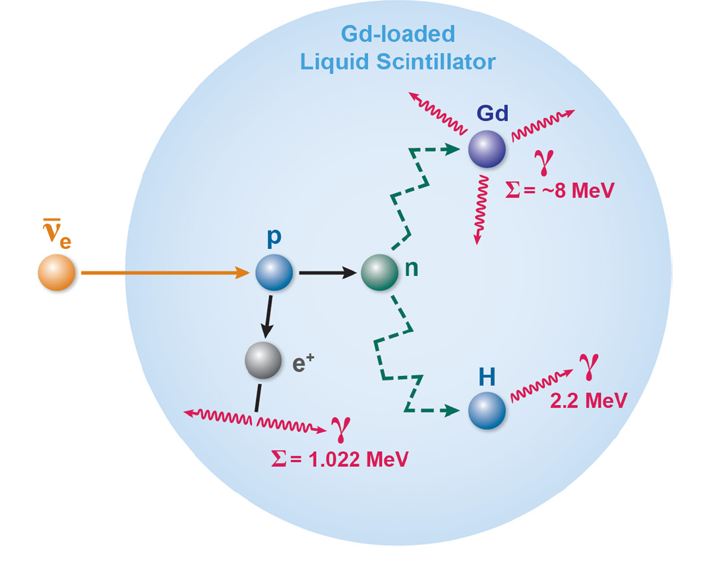
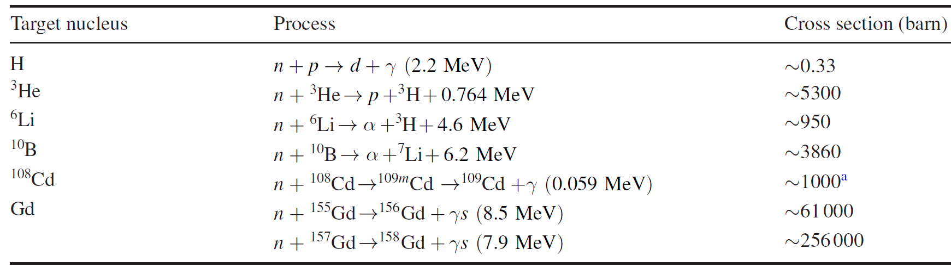
Reactor Anti-ν_{e} Detection
Inverse Beta Decay (IBD)
Coincidence signal of IBD:
Thermal neutron
Rep. Prog. Phys. 82, 036201

Slide 21


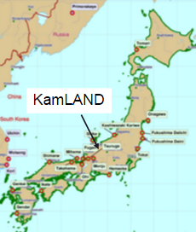
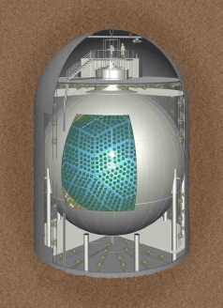
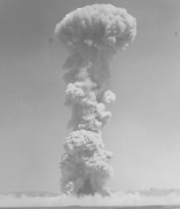
Event Rate
Depending on the power of the reactors, size of the detectors, and the distance between them
17 GW
800 /day
80 /day
500 m
Daya Bay
20 ton
1.6 km
55 GW
0.5 /day
KamLAND
180 km
1000 ton
< 0.001 event
10 kt TNT-equivalent
Nuclear Bomb Test
1000 km
1000 ton

Slide 22
Homework Problem 2
Daya Bay’s antineutrino detector (AD) is a 20-ton liquid scintillator detector. The far ADs are placed at ~1.6 km away from reactors with a total power of ~17 GW. How many inverse beta decay(IBD) reactions are expected per day in each far AD?
  The hydrogen mass fraction in the AD is ~12%. How many free protons (from hydrogen) are there in each AD?
  How many reactor antineutrinos per cm² per second is expected at the AD? (this is referred as the “flux”)
  The average IBD cross section is ~3x10⁻⁴³ cm² , calculate event rate = flux * cross section * number of protons, assuming 100% detection efficiency. (remember that IBD can only detect 1/3 of all reactor antineutrinos)

Slide 23
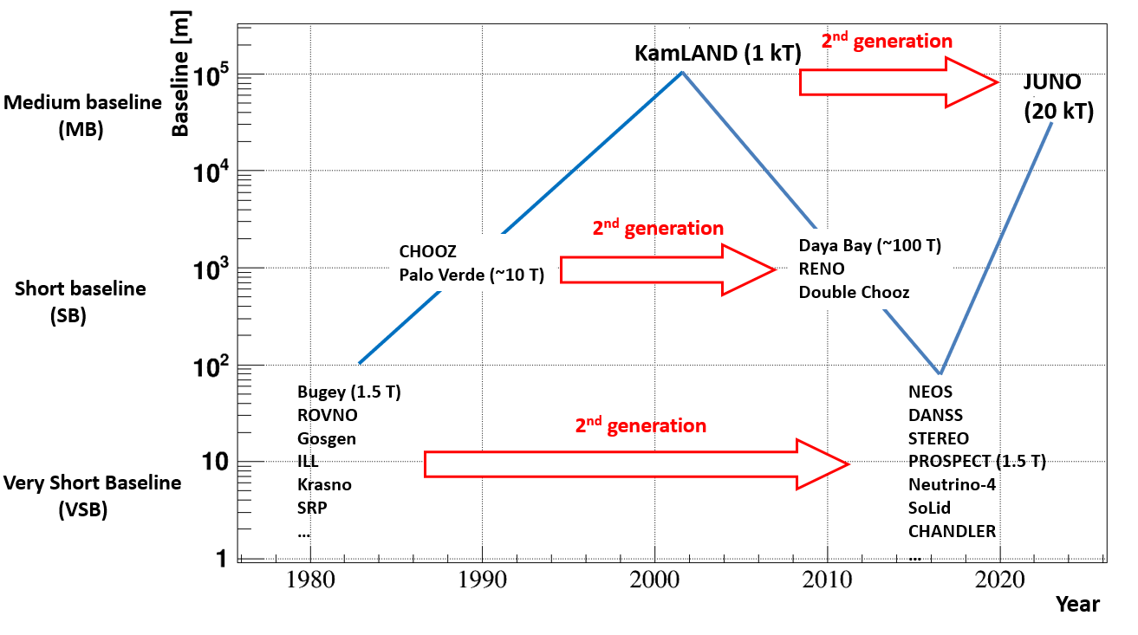
Reactor Neutrino Experiments
Four major motivations:
  Measurement of fundamental parameters (MB, SB)
  Search for new physics
  (VSB, SB, MB)
  Measurement of neutrino flux, spectrum, evolution (SB, VSB)
  Technology development (MB, VSB, SB)
Courtesy of Chao Zhang

Slide 24
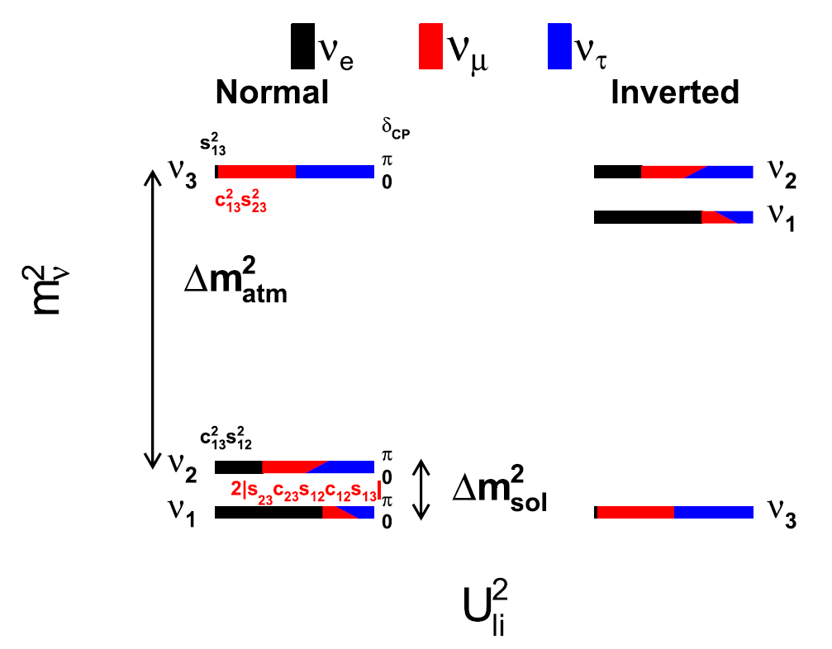
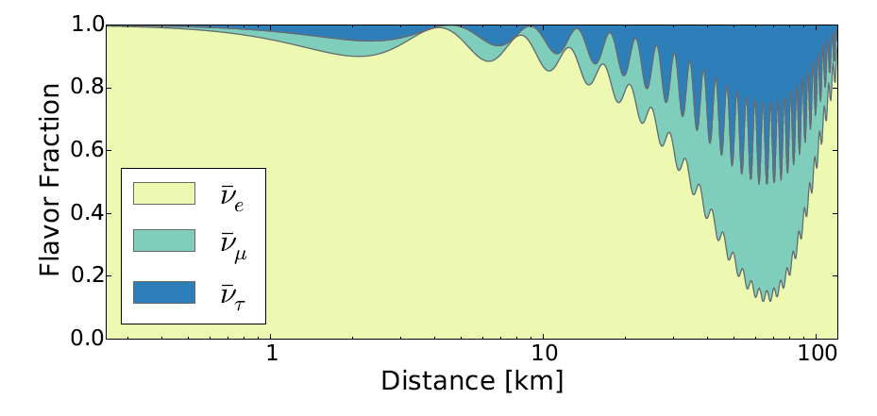
Measurement of Fundamental Parameters
4 MeV
Nat. commun. 6, 6935
Prog. Part. Nucl. Phys. 83, 1
Notes:
neutrino oscillation enables access to fundamental parameters.
Neutrino mass hierarchy, explain,
Explain atm, or sol

Slide 25
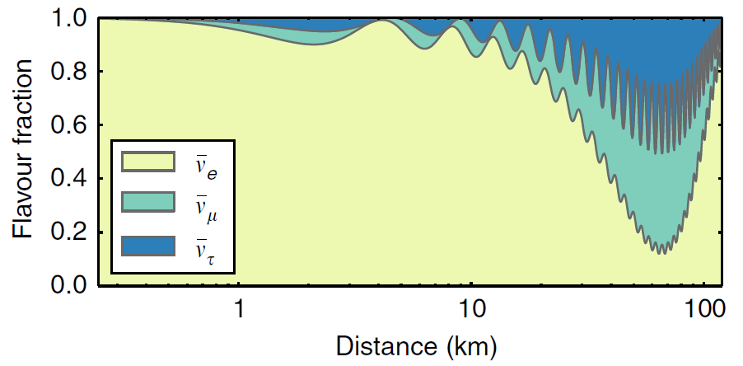


Near AD
(500 m)
Far AD
(1.6 km)
$$P=1−\sin^{2}{2θ13}⋅\sin^{2}{(1.27|Δm_{ee}^{2}(eV^{2})|⋅\frac{L (m)}{E(MeV)})}$$
Far/Near
Neutrino Ratio
Detector
Target Mass
Distance
from
Reactor
Detector
Efficiency
Survival Probability
(θ13)

Slide 26
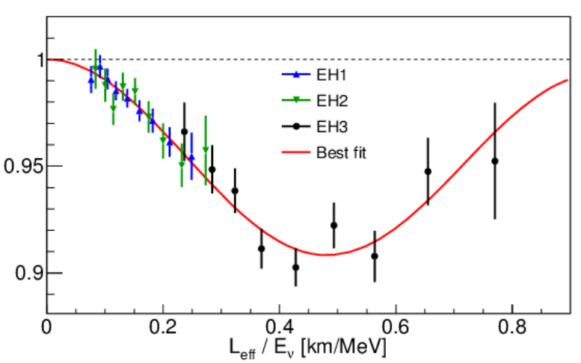



Δm² ~ 2.5 x 10⁻³ eV²
Daya Bay data
My post-doc work @ Caltech
survival probability
Δm² ~ 7.5 x 10⁻⁵ eV²
Chao Zhang’s Ph. D thesis
Image credit: H. Murayama

Slide 27

Designed to discover sin²(2θ₁₃) < 0.01 @90% C.L.
Statistics
  powerful reactors (17.4 GW_{th}) + large detectors (80 ton at Far site)
Systematics
Reactor
  Far/Near relative measurement
Detector
  multiple functionally identical detectors (4 Near + 4 Far)
Background
  deep underground (860 m.w.e at far site)

Slide 28





Detection of Reactor Neutrino in Daya Bay

Slide 29


Discovery of non-zero θ₁₃ at 5.2 σ
  2011/12/24 – 2012/2/17 (55 days)
  6 detectors in operation first
End of operation ceremony (Dec 24, 2011 - Dec 12, 2020)
Phys. Rev. Lett. 108, 171803 (2012)
In fact, in the first 5 days we already knew that θ₁₃ is large from the data. In the homework I’ll give you all the inputs to do a simplified analysis.
BNL virtual mini-symposium: The Daya Bay Reactor Neutrino Experiment and the Discovery of Non-zero Theta13
https://indico.bnl.gov/event/9947/

Slide 30
Homework Problem 3
How to discover the smallest neutrino oscillation with 5 days of Daya Bay reactor neutrino data?

Slide 31

Reactor and Detector Location
Reactor | D1 | D2 | L1 | L2 | L3 | L4
x (m) | 43.0 | -44.6 | 856.0 | 792.3 | 1143.6 | 1076.5
y (m) | -7.0 | 6.9 | 830.9 | 767.9 | 1206.1 | 1138.5
z (m) | -12.0 | -12.0 | -12.0 | -12.0 | -12.0 | -12.0
All reactor cores operated at approximately equal power for the 5 days
  L2 was powered off during the 5 days
AD | 1 | 2 | 3 | 4 | 5 | 6
x (m) | 94.5 | 97.8 | 584.1 | -254.3 | -259.5 | 257.3
y (m) | 350.2 | 345.2 | 1216.2 | 1892.6 | 1889.6 | 897.8
z (m) | -20.0 | -20.0 | -16.6 | -15.4 | -15.4 | -15.4

Slide 32

Summary of event selection for the first 5 days
Signal + Backgrounds
Backgrounds
Calculate the signal rate per day after efficiency correction
  EH1-AD1: (3278 - 60.9 – 43 - 6) / 0.8144 / 5.39 = 721.7 events/day
Calculate the statistical error on the signal rate
  EH1-AD1: sqrt(3278)/0.8144/5.39 = 13.0 events/day

Slide 33






Background to IBD
Accidentals: statistically calculate from uncorrelated singles
Li9 / He8: measure time distribution of after-muon events
Fast neutron: measure energy spectrum from AD/water/RPC tagged muon events
Background | Near | Far | Uncertainty
Accidentals | 1.4% | 2.3% | negligible
Li-9 / He-8 | 0.4% | 0.4% | ~30%
Fast neutron | 0.1% | 0.1% | ~30%

Slide 34

How to discover the smallest neutrino oscillation with 5 days of Daya Bay reactor neutrino data?
  Plot the measured antineutrino signal rate of each AD vs. the expected flux, assuming each AD has the same size, and each reactor has the same power.
  Fit the data (what function to use?) with the near ADs and extrapolate to the far ADs. What do you see?
  What is the “survival probability” in the far ADs relative to the near ADs? What is the statistical significance of this observation?
  What is the size of θ₁₃ using the oscillation formula?
Δm² | 2.4 x 10⁻³ (eV²)
L | 1.66 x 10³ (m)
E | 3.5 (MeV)
$$P=1−\sin^{2}{2θ13}⋅\sin^{2}{(1.27|Δm_{ee}^{2}(eV^{2})|⋅\frac{L (m)}{E(MeV)})}$$

Slide 35




Data taking (12/24/2011 – 12/12/2020)
  3275 days, 5.5M ${\overline{ν}}_{e}$ events
  largest reactor neutrino data sample in the world
Daya Bay
Near Hall
Ling Ao
Near Hall
Far Hall

Slide 36


Precision Oscillation (1/26 free parameters in the SM)
Final results with the full data set
Phys. Rev. Lett. 130, 161802 (2023)
(2.8% precision)
Daya Bay Near Hall
Ling Ao Near Hall
Far Hall
Likely to be the best measurement in the foreseeable future
Critical input to the current and future long-baseline experiments (DUNE)

Slide 37



Resolution of the Neutrino Mass Hierarchy (MH or NMO) with Reactors
20 kt JUNO detector with better than 3% energy resolution
@ 1 MeV and better than 1% energy scale determination
~100k neutrino events with ~27 GW_{th} → 3σ MH sensitivity*
* See PRD 86, 113011 for the statistical interpretation of MH sensitivity
JUNO
PRD 87, 033005
Ann. Rev. Nucl. Part. Sci. 67, 183
Notes:
6 -7 years …

Slide 38



Micro-Channel Plate PMT and
High-Light-Yield Liquid Scintillator (LS)
20 kT liquid scintillator
3% energy resolution @ 1 MeV
PMTs:
17,600 20’’ PMT
25,000 3’’ PMT
Coverage 77.5%
LS:
10⁴ PE/MeV
L_{att} > 20 m @ 430 nm
Low background
~40 m
http://juno.ihep.cas.cn/
PDE: Photon Detection Efficiency

Slide 39

Construction Process of JUNO

Slide 40

Questions?

