Slide 1

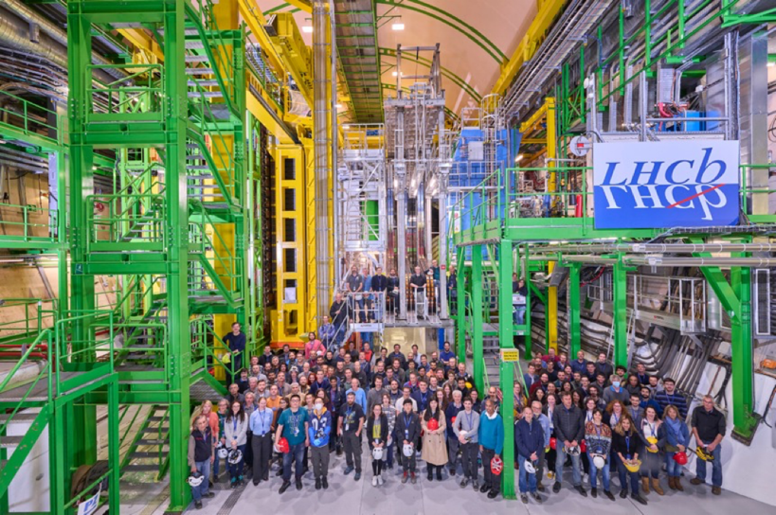

Original
Upgrade I
Upgrade II
2009-2018
2022-2032
2033-
LHCb Upgrade II
CMOS Tracker
Upgrade II Overview
Opportunities in CMOS Trackers
7th March 2024
Chris Parkes

Slide 2
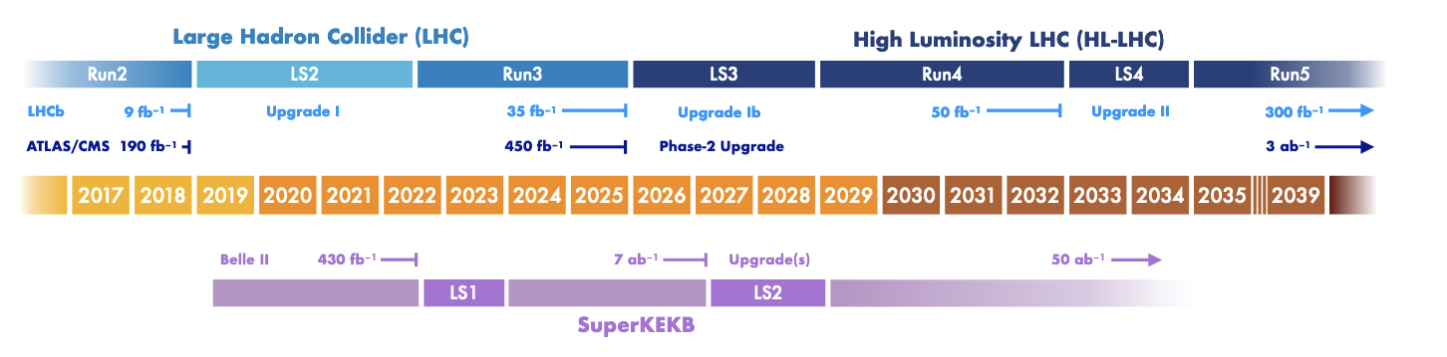
Collaboration Scale & Timescales
Collaboration & Financial Scale
1100 authors, 99 institutes, 22 countries
Upgrade II ~$150M core-capital
~ half an ATLAS
U2 Silicon projects much larger than in original /Upgrade I – new collaborators
Upgrade II
2033-
Timescale
Upgrade II installation in LS4 (2033/2034)
Beyond Belle II
Beyond ATLAS Phase II

Slide 3
Upgrade II: steps so far
Upgrade II
2033-
Expression of Interest
Physics case
Accelerator study
LHCC-2017-003
LHCC-2018-027
CERN-ACC-2018-038
LHCC-2021-012
CERN Research Board September 2019
"The recommendation to prepare a framework TDR for the LHCb Upgrade-II was endorsed, noting that LHCb is expected to run throughout the HL-LHC era.”
Approved March 2022
Scoping document 2024
R&D programme followed
by sub-system TDRs ~2026
European Strategy Update 2020 "The full potential of the LHC and the HL-LHC, including the study of flavour physics, should be exploited”
US P5 2023 “LHCb upgrade II will be a major project that opens a new era of precision”

Slide 4
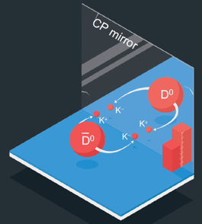
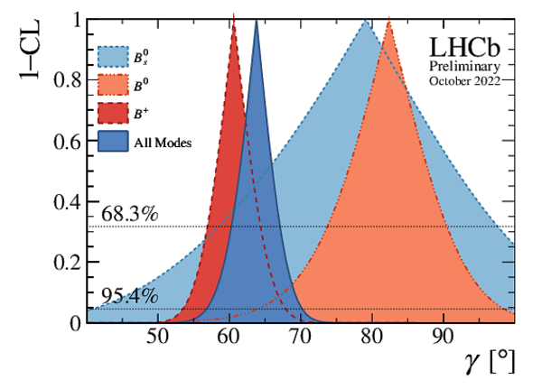
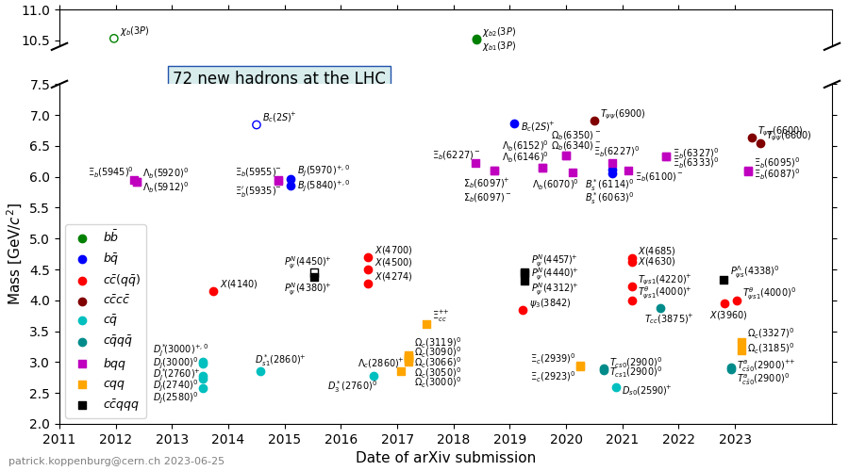


LHCb Highlights
Original
2009-2018
Future plans build on the success of the experiment so far e.g.
$$B_{s}^{0}→μμ$$
$$Δm_{s}$$
arXiv:2108.09284
arXiv:2104.04421
CPV in Charm
CKM angle 𝛾
arXiv:1903.08726
LHCb-CONF- 2022-003
64 at LHCb
… but it achieved much more than flavour: exotic spectroscopy, heavy ions, fixed target programme, EW precision physics, dark sector searches…

Slide 5
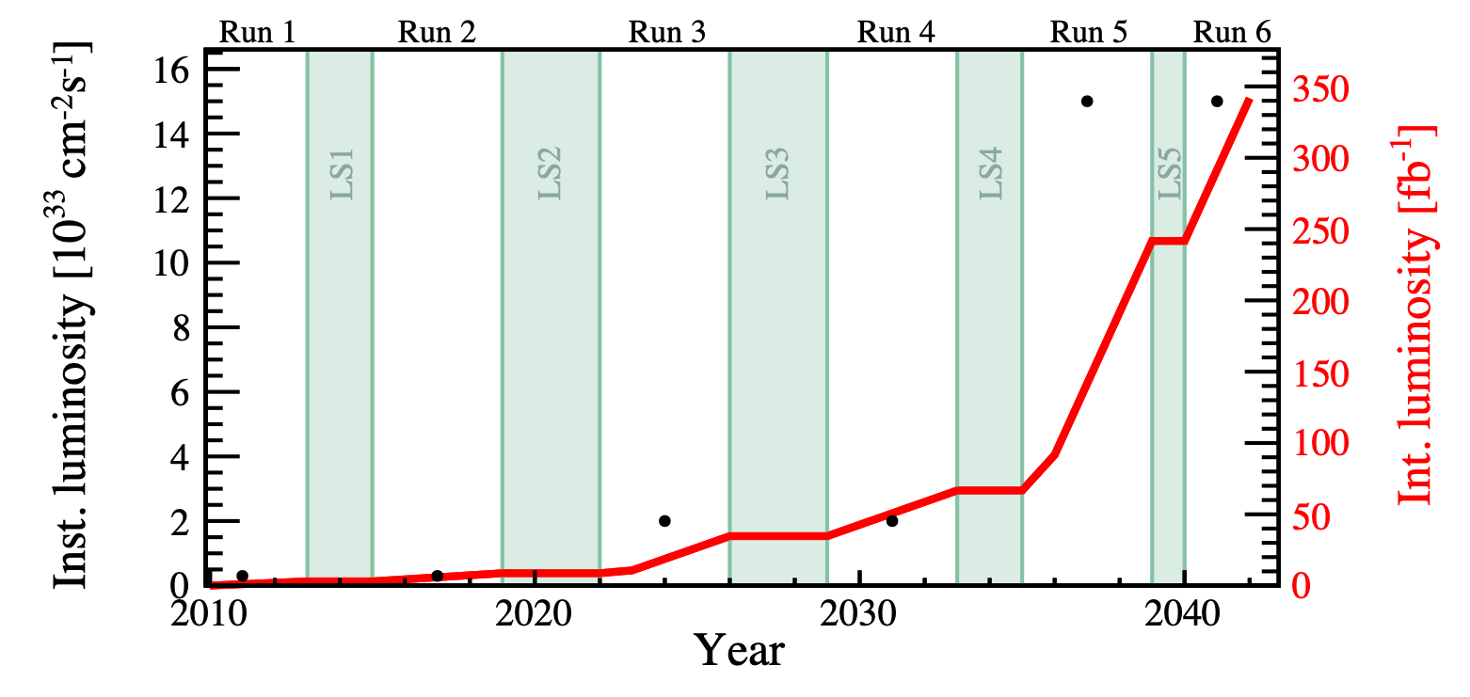
LHCb Upgrades
Physics programme limited by detector, NOT by LHC
Hence, clear case for an ambitious plan of upgrades
Upgrade I
Upgrade II
Upgrade I running now!
schedule updated beginning of 2022
Lpeak = 2x10³³ cm⁻² s⁻¹
Lint = 50 fb⁻¹ during Run 3 & 4
Healthy competition with Belle II at 50 ab⁻¹
Upgrade II
Lpeak = 1-1.5x10³⁴ cm⁻² s⁻¹
Lint = ~300 fb⁻¹ during Run 5 & 6, Install in LS4 (2033)
Potentially the only general purpose flavour physics facility in world on this timescale

Slide 6
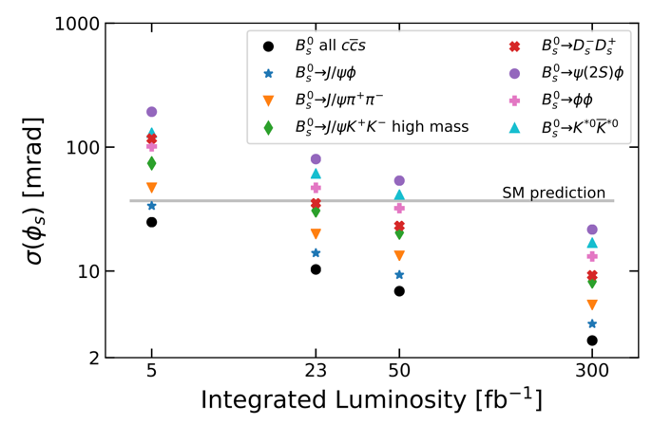
Constraining the Unitarity Triangle
LHCb Upgrade II will test the CKM paradigm with unprecedented accuracy
LHCb only, end of 2018
LHCb Upgrade II + LQCD improvement
CP violating phase φ_{s}
CP violation in charm
Upgrade II sensitivity below SM prediction in multiple channels
realistic possibility to observe CPV in charm mixing
Broad programme – Ions, Fixed Target, EW, Dark Sector….

Slide 7
The detector challenge
Targeting same performance as in Run 3, but with pile-up 30-40
Same spectrometer footprint, innovative technology for detector and data processing
Key ingredients:
granularity
fast timing
(few tens of ps)
radiation hardness
Use CMOS for silicon tracker
before/after magnet
~2000 tracks

Slide 8
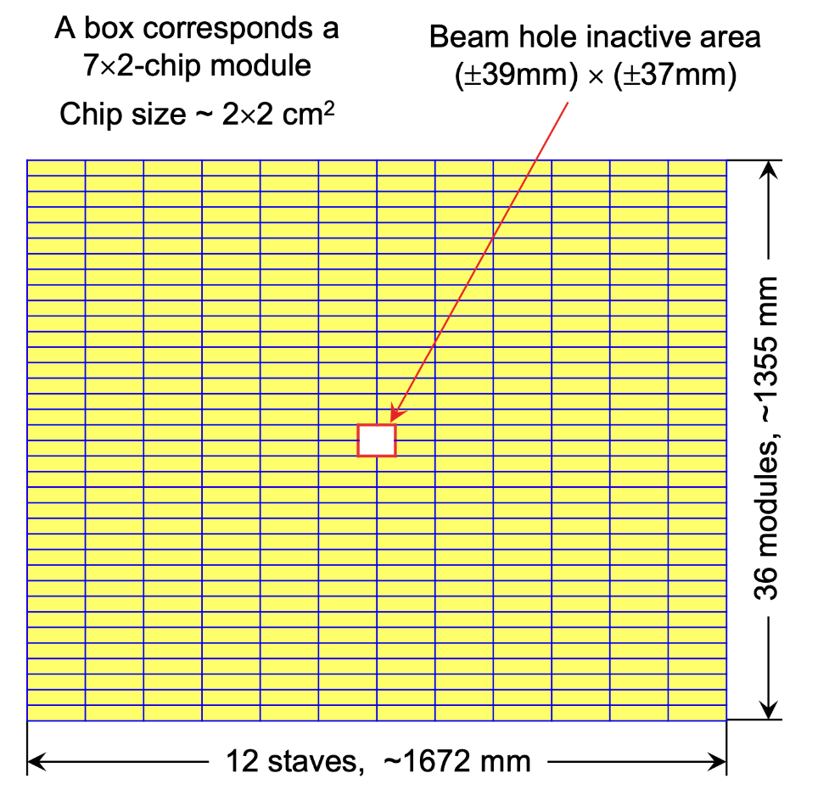
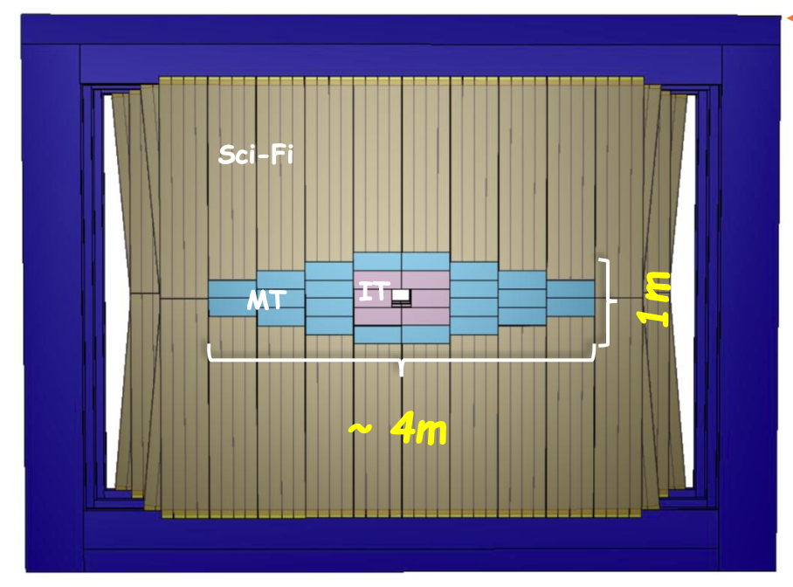
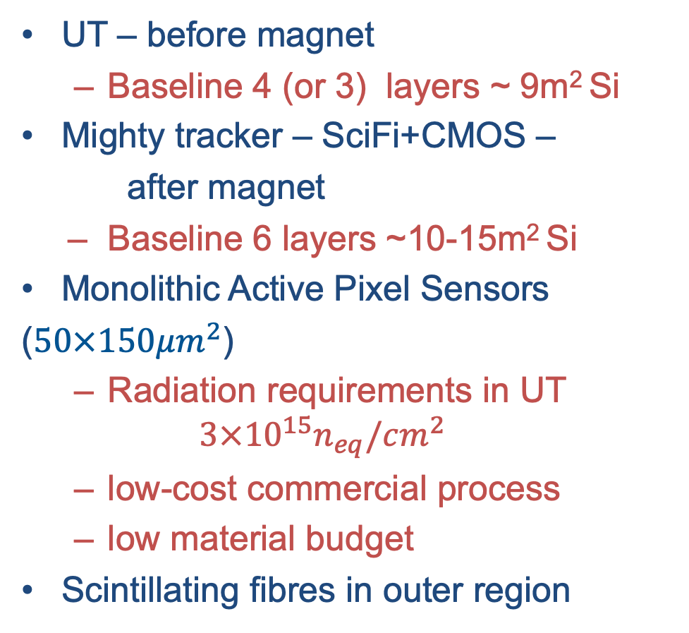
Tracker: Rad Hard MAPs, first of kind at LHC
UT – before magnet
  Baseline 4 (or 3) layers ~ 9m² Si
Mighty tracker – SciFi+CMOS –
after magnet
  Baseline 6 layers ~10-15m² Si
Monolithic Active Pixel Sensors
($50×150μm^{2}$)
  Radiation requirements in UT
  $$3×{10}^{15}n_{eq}/cm^{2}$$
  low-cost commercial process
  low material budget
Scintillating fibres in outer region

Slide 9
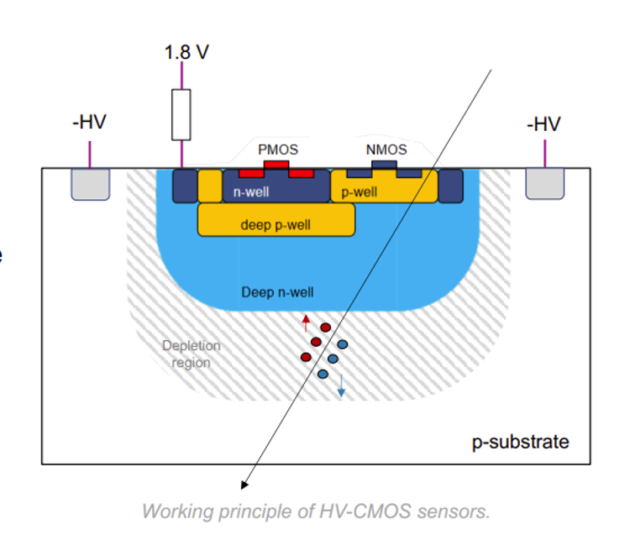
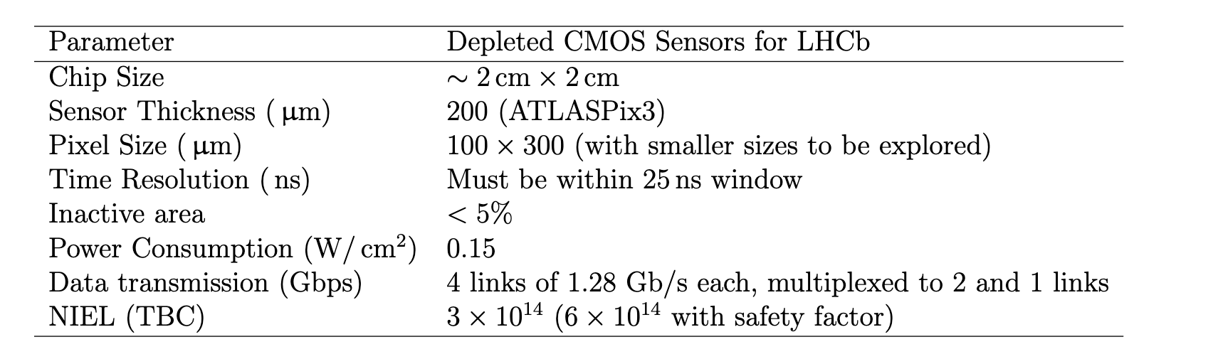
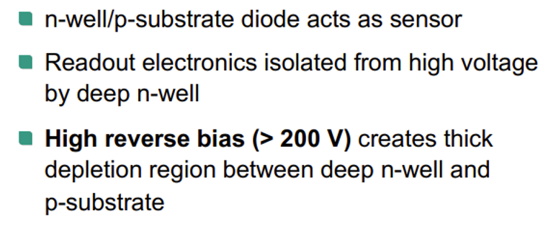
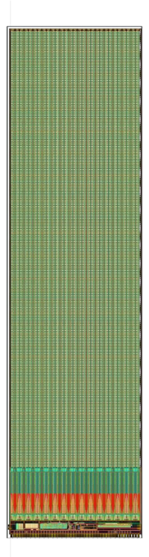
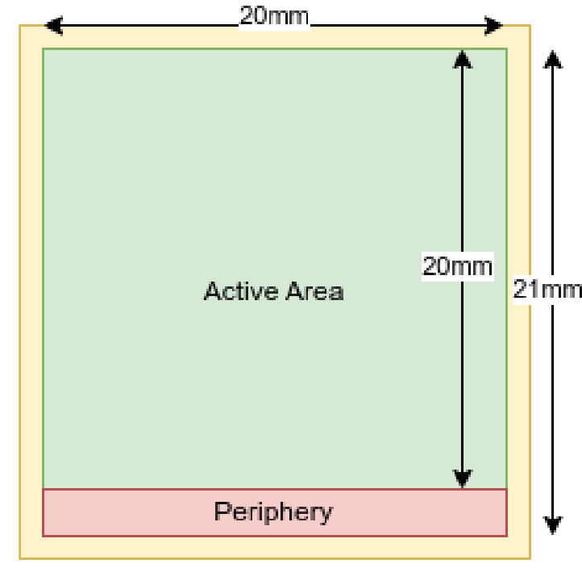
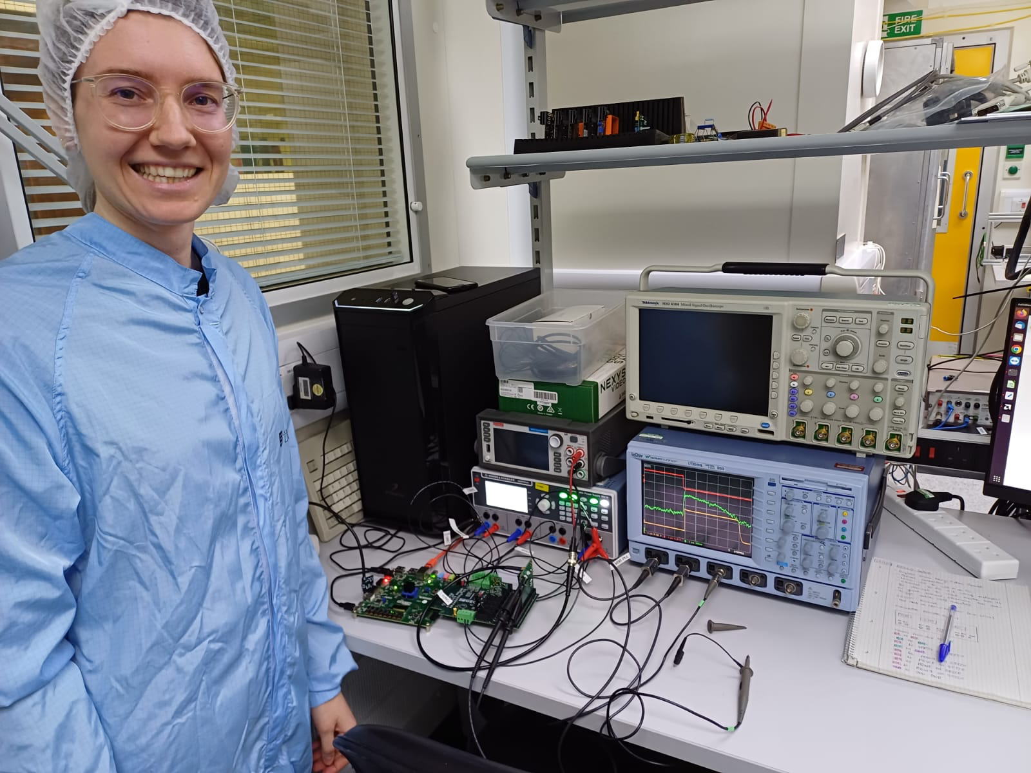
ASIC
Most advanced developments are based on ATLASPix HVCMOS
  Developed for ATLAS Phase II pixels but not used
180nm TSI /AMS/ LFoundry processes
Though other possibilities also being explored (e.g. based on MALTA)
Specification MT from 2020
50 x 150μm
UT: 3 x 10¹⁵ n_{eq}/cm²
MightyPix1 1/4 scale chip fabricated
but foundry change and significant further design work needed
and characterization (timing, radiation hardness vs temp.)

Slide 10
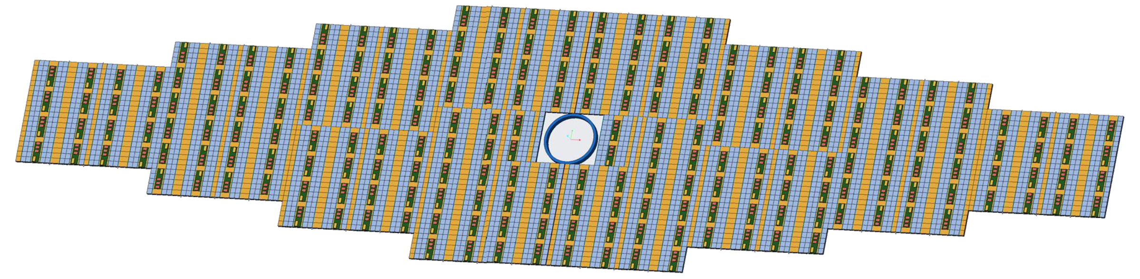
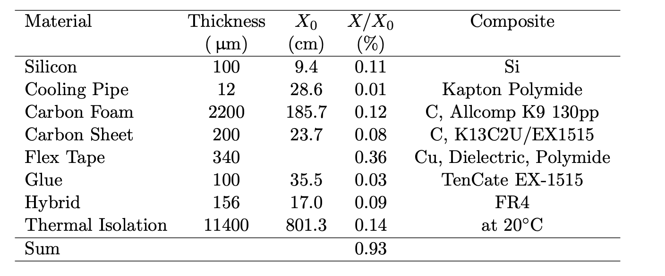
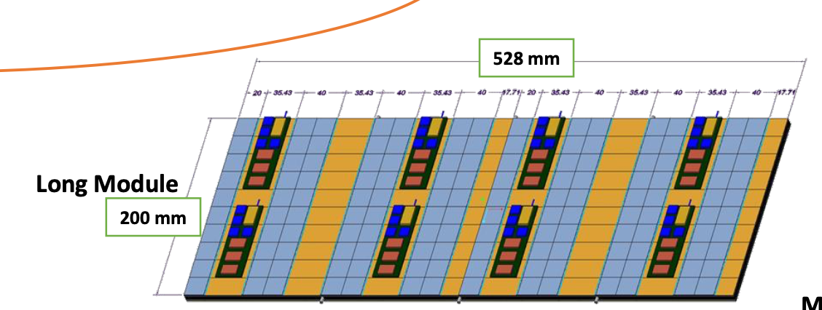
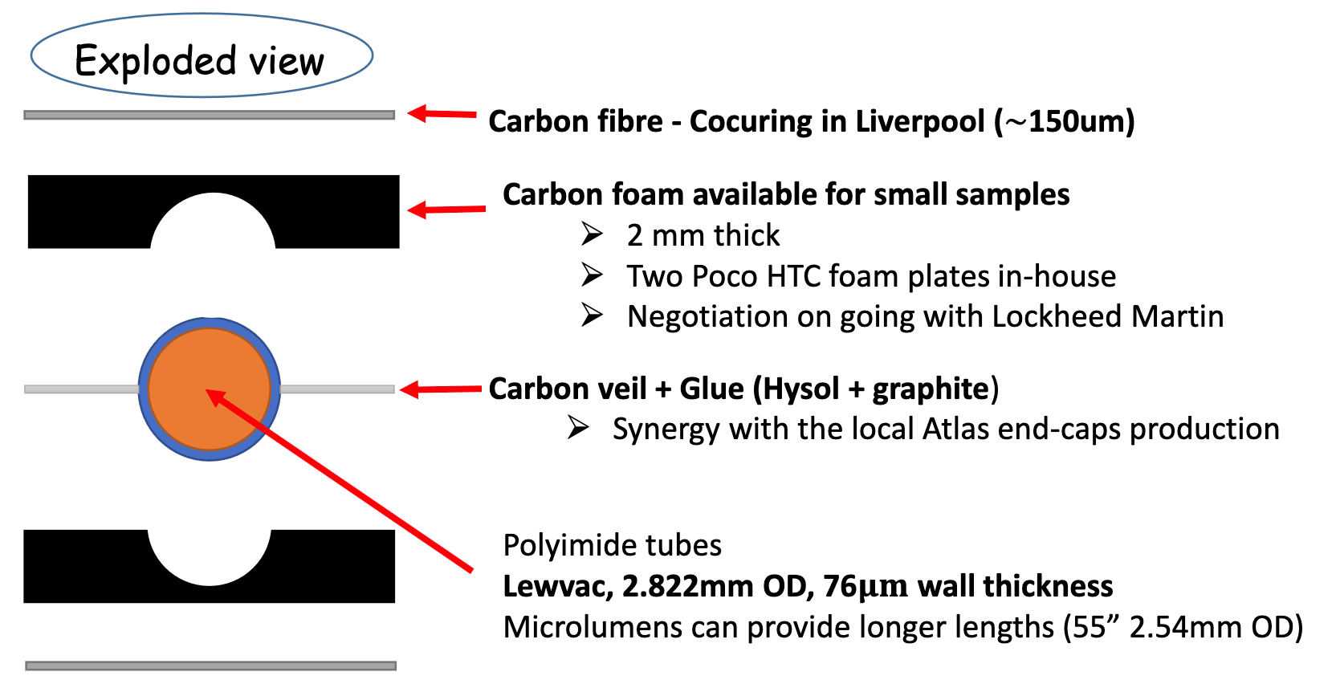
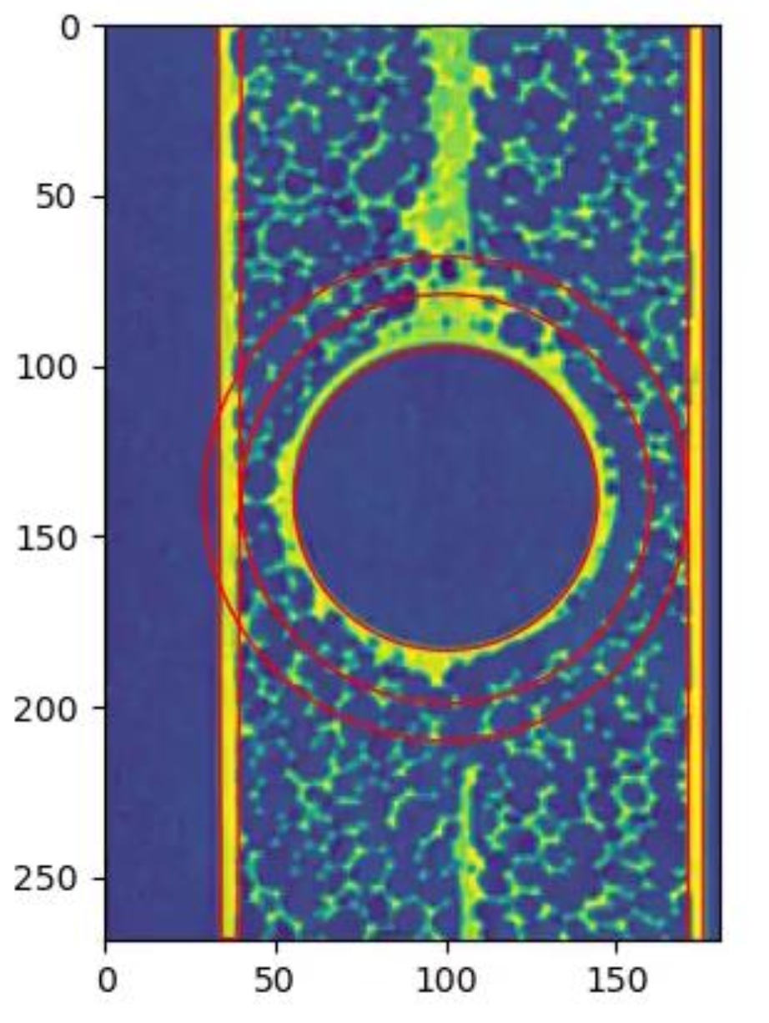
“Baseline” Module Design (MT)
Material budget aim ~ 1% X₀ per layer
Design inspired by
ATLAS Pixels (& ALICE ITS)
x-ray
But other significantly different ideas: Honeycomb, 3D printing pipes, ceramics…..

Slide 11
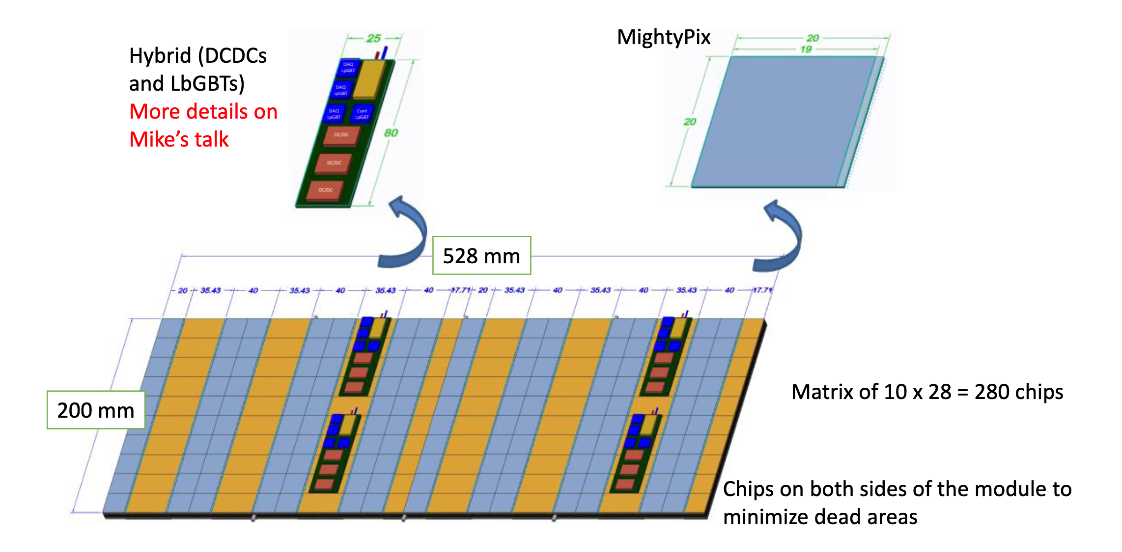
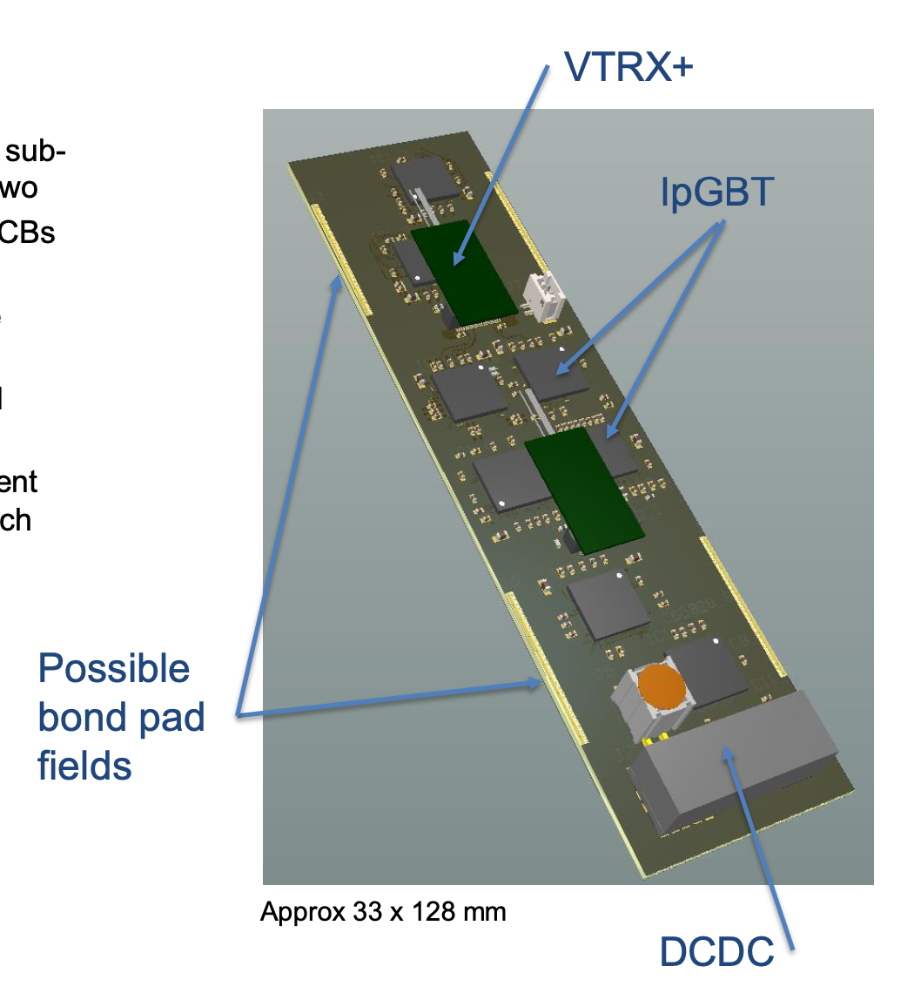
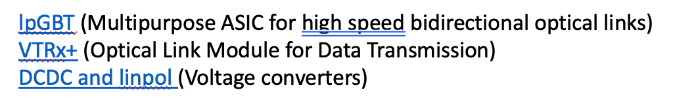
“Baseline” Module Design (MT) - Electronics
Serial powering being actively looked at

Slide 12
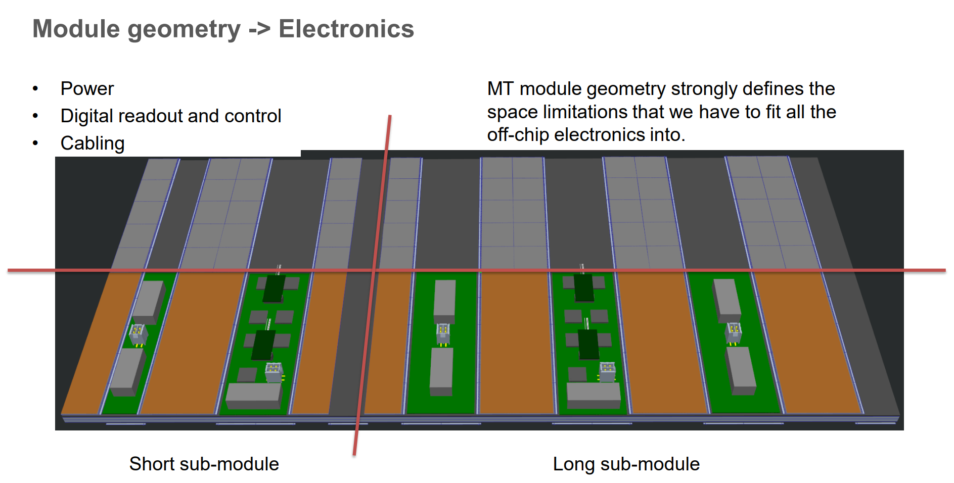
“Baseline” Module Design (MT) – Off-chip Electronics

Slide 13
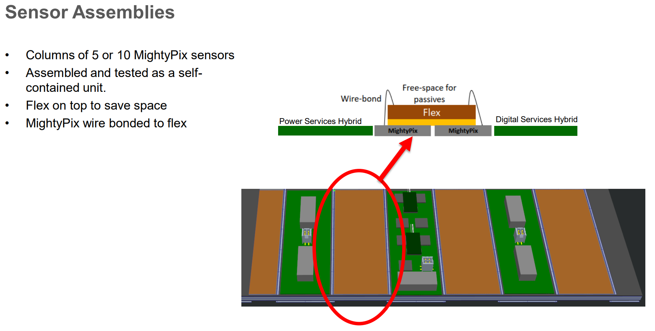
Module Production
ASIC to flex hybrid attachment & bonding
Module thermo-mechanical support structure construction
Attachment of ASIC+flex, hybrid to module support

Slide 14
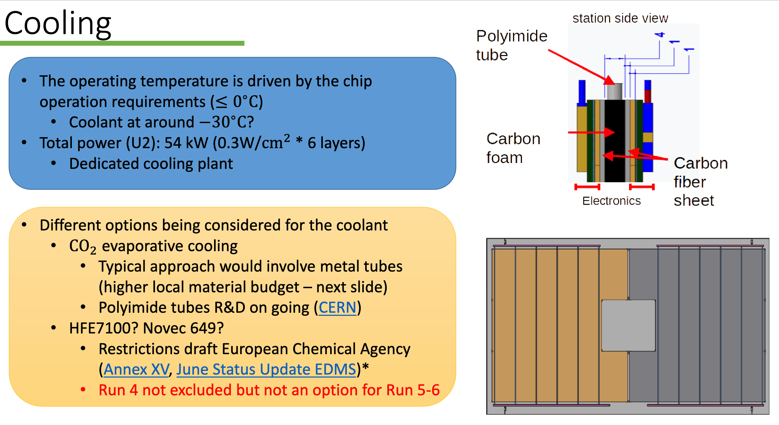
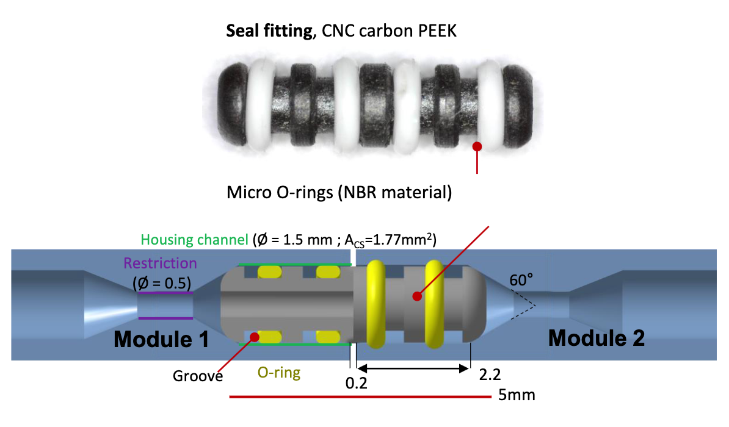
Cooling (MT)
Interconnections

Slide 15
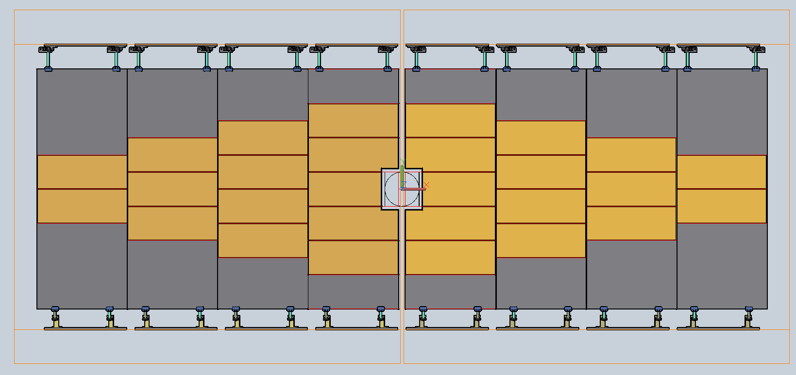
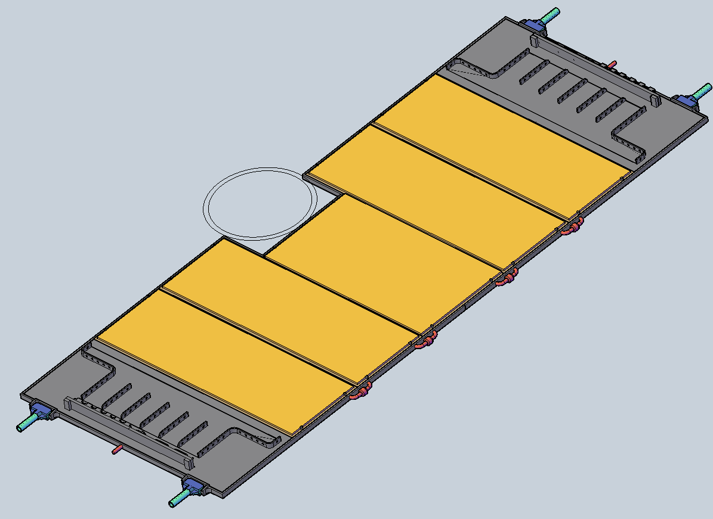
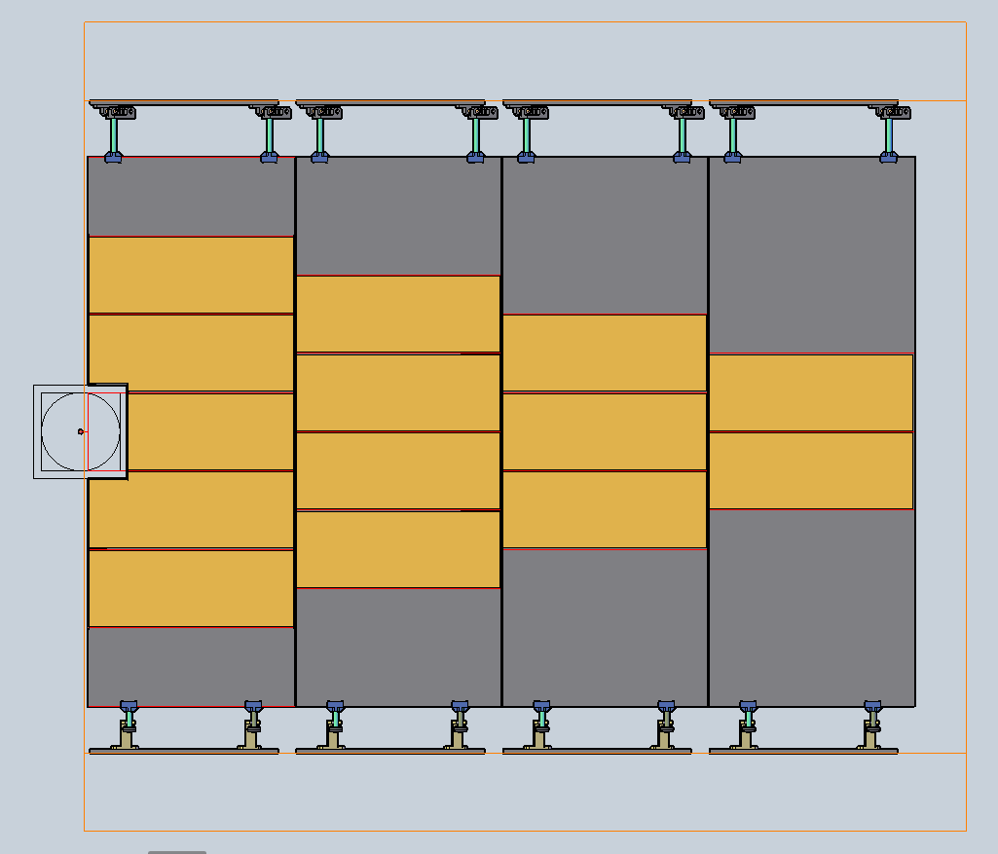
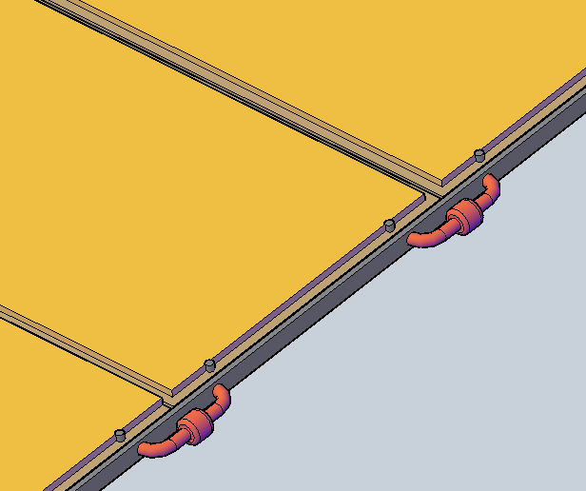
Mechanics – Module support
Services
Fully populated modules plug into support panel
  Allows modules to be installed and repaired as a unit in a clean room
Panel supported mostly from the top
  Bottom pieces provide stability, little mechanical support
Services

Slide 16
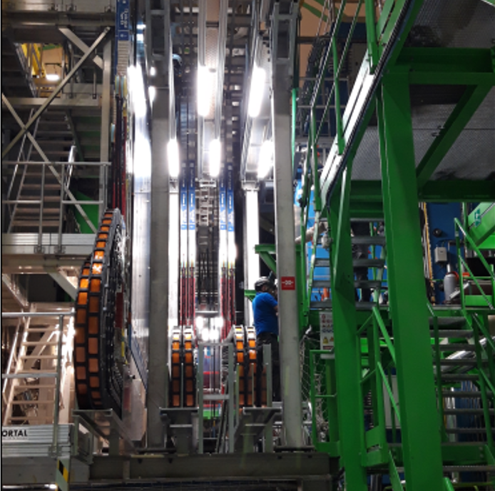
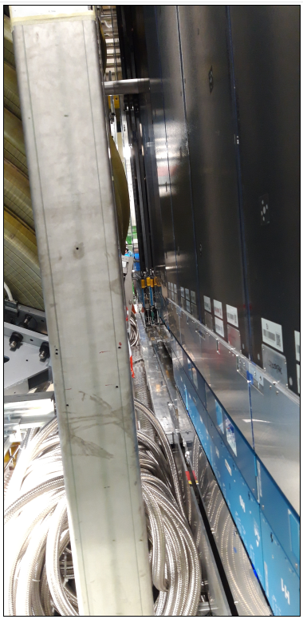
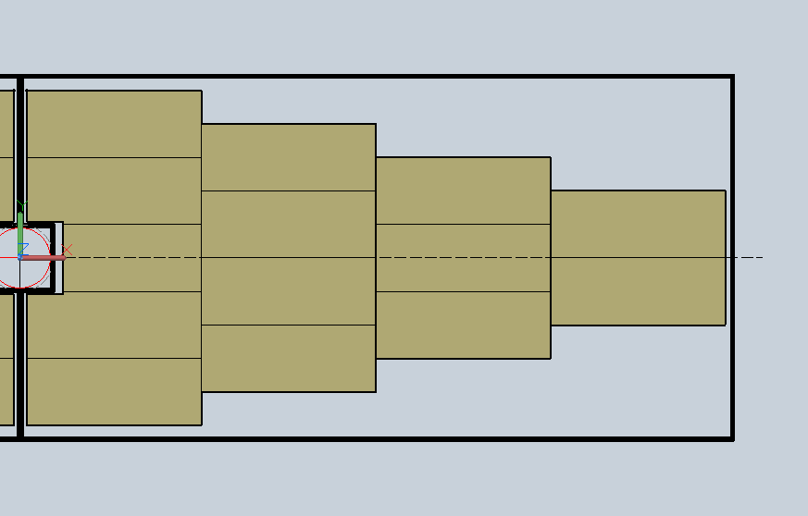
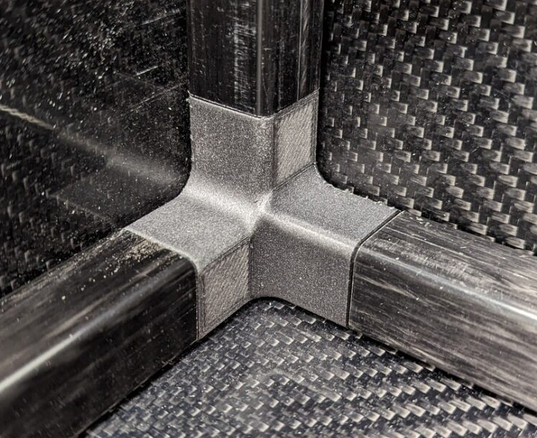
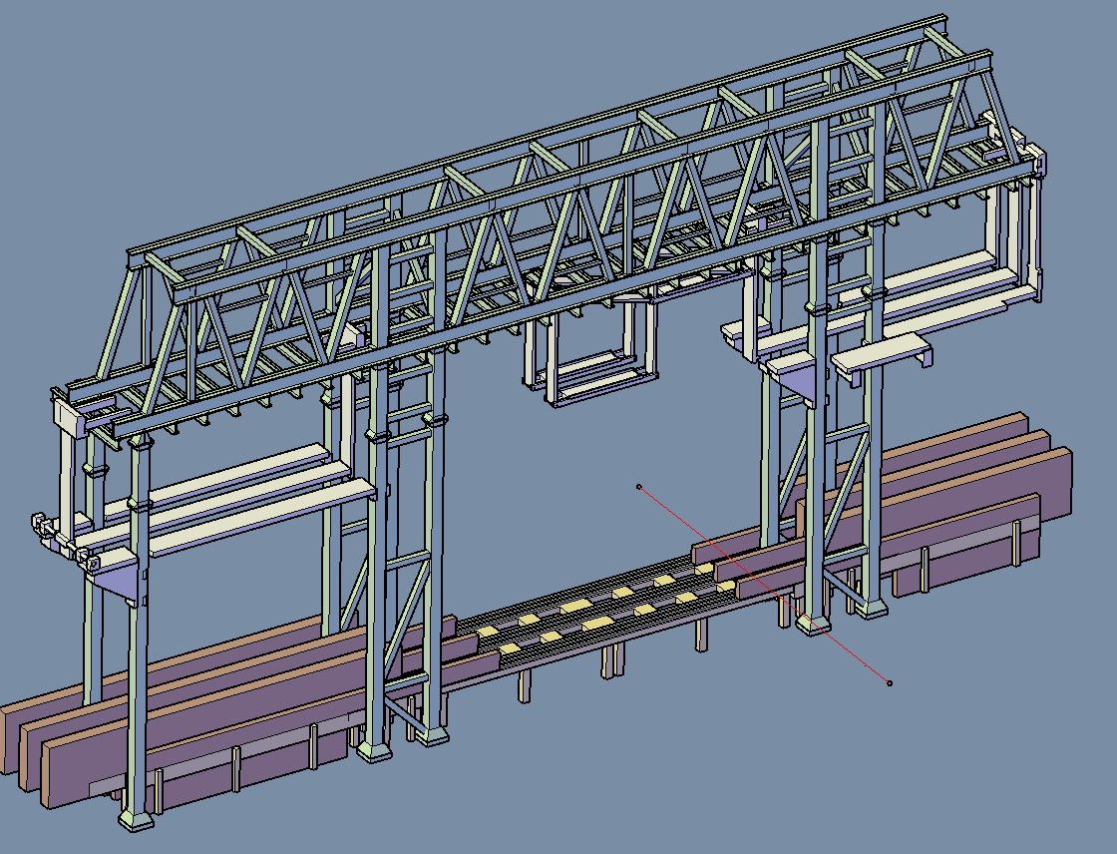
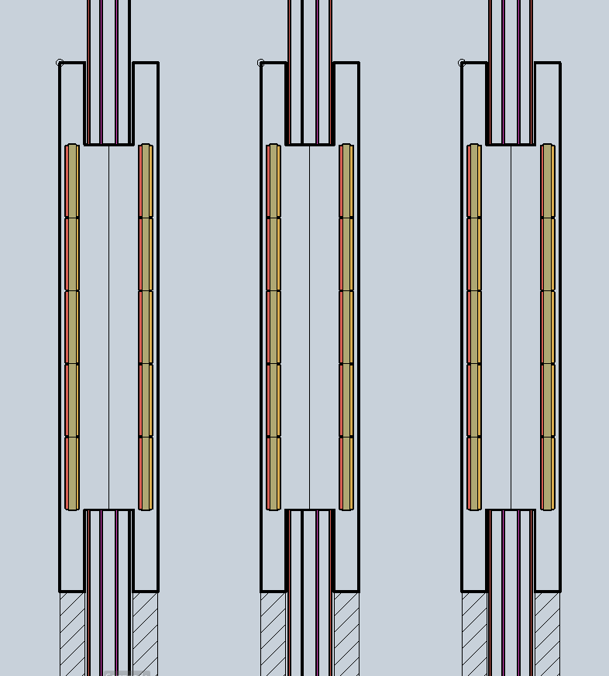
Large Scale Mechanics
Modules will operate below dew point
Need dry enclosure
Carbon fibre enclosure e.g. around pairs of layers
Space available is challenging
Integration SciFi & CMOS

Slide 17
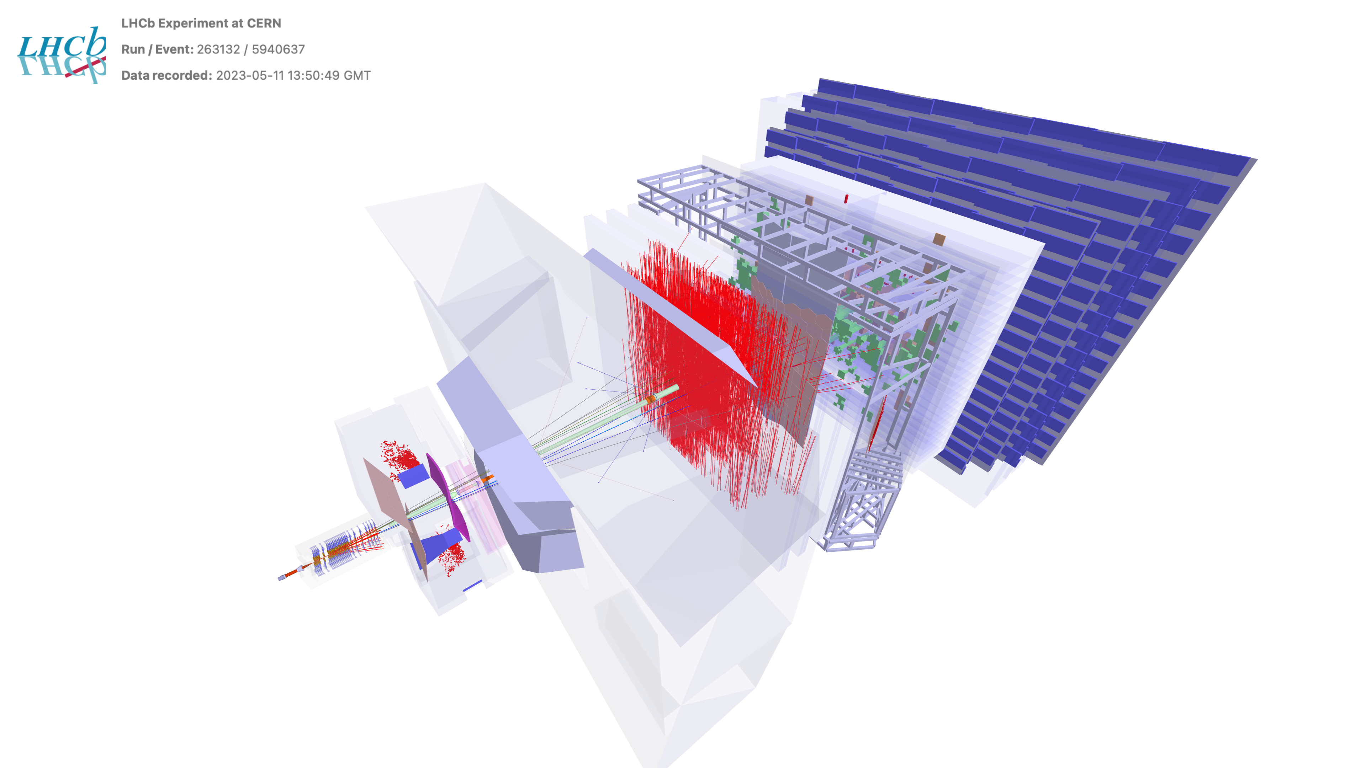
Summary
Original
Upgrade I
Upgrade II
2009-2018
2022-2032
2033-
LHCb Upgrade II
  project taking shape: Framework TDR approved, R&D setting path to future
  Scoping document this year
CMOS based tracker
  First of kind
  Before & After magnet
  Larger Si project than undertaken
  before at LHCb
  New collaborators on most
  R&D areas welcomed, including
  ASIC,
  Off-chip electronics module designs
  thermo-mechanical module design
  Mechanical structure
And then later for production
and quality assurance
17

Slide 18
Backup

Slide 19
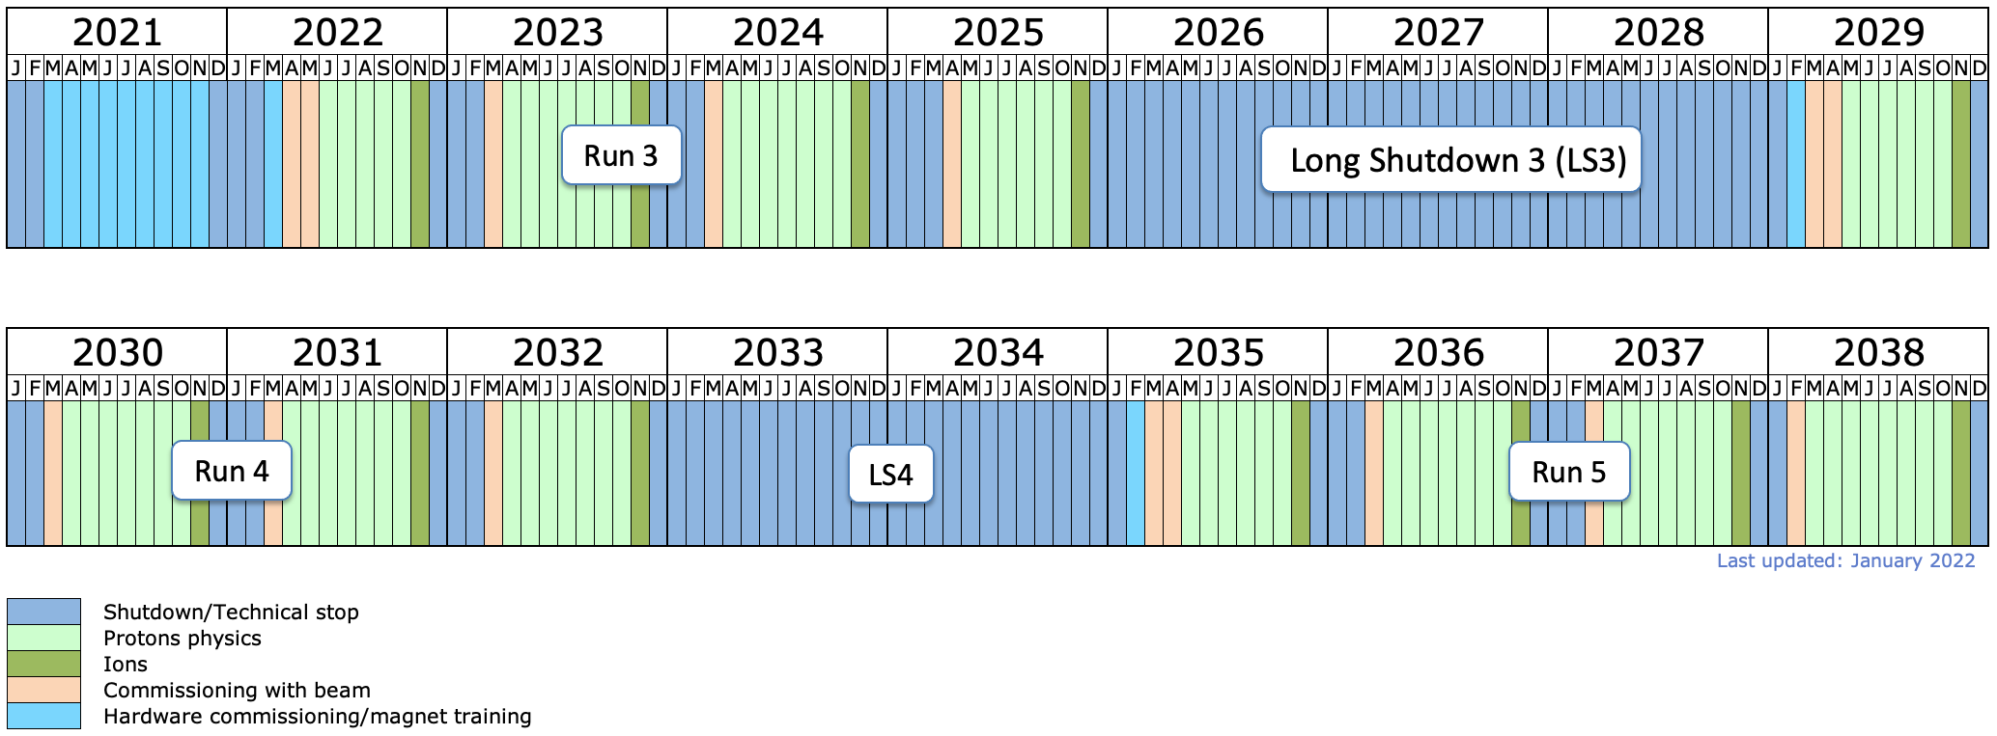
LHC Schedule
LS4 extended to
allow LHCb Upgrade II
installation

