Slide 1
AAF & Big Science Workflows and Orchestration
Andrew Bowness – Australian Access Federation
a.bowness@aaf.edu.au

Slide 2





AUSTRALIAN ACCESS FEDERATION
WHAT IS THE AAF?
WHY THE AAF?
The Australian Access Federation (AAF) provides the authentication framework for Australia’s research and education community. The AAF is a not-for-profit that is owned and governed by the Australian research and education sector.
Enables researchers to securely access national and international research and collaboration infrastructure. The AAF is part of the Australian Government’s National Collaboration Research Infrastructure Strategy (NCRIS) and roadmap.
Allows Australian researchers to use their existing login details to seamlessly access shared resources and services across national and international organisation boundaries without additional usernames and passwords.
Operates a highly secure and reliable technical environment that delivers federated authentication to members. An AAF connection provides a trusted and secure solution.
Members include all Australian universities and:

Slide 3
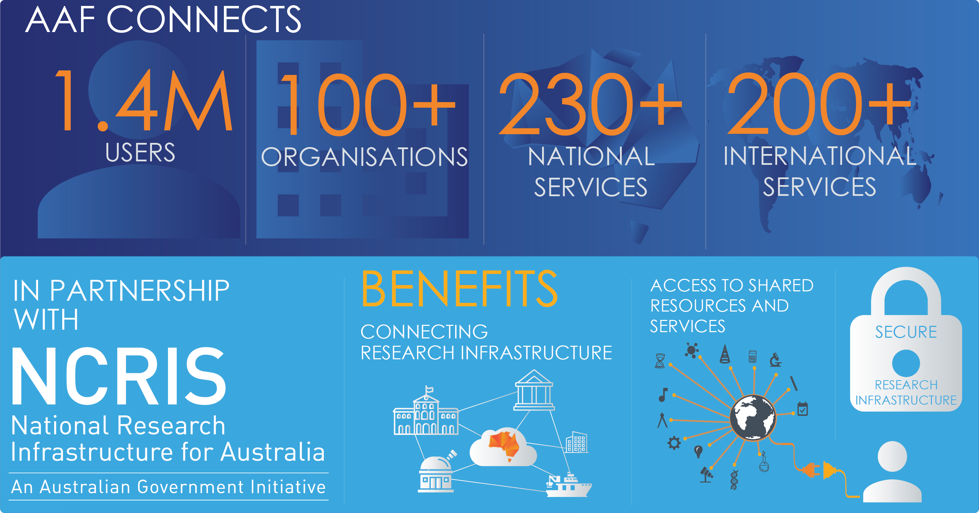
AAF 2020 SNAPSHOT

Slide 4


Empowering Australian Researchers
INTERNATIONAL RESEARCHERS CAN NOW MAP THE UNIVERSE WITH MURCHISON
The Murchison Widefield Array (MWA) is one of Australia’s leading radio telescopes enabling astronomers from around the world to explore the universe. Global collaboration is integral to the success of the MWA and researcher outputs. To ensure seamless and secure collaboration the MWA has connected to eduGAIN, a connection which is made possible by the AAF.
The MWA Director, Professor Melanie Johnston-Hollitt, said, “the eduGAIN connection is a vital service for an international collaboration like the MWA making it simple for our team of global researchers to access data from the telescope”. Connecting the MWA to eduGAIN not only enhances and accelerates innovation in astrophysics, it enables borderless research.

Slide 5
THE CHALLENGE
Horizontal authorisation across different research and e-infrastructures is difficult, particularly within the same project. An individual researcher may need to access resources provided by different infrastructures. Moreover, having different authentication and authorisation infrastructure (AAI) can create compatibility issues, let alone the time spent in creating new capabilities.
We need to find a way to integrate identity services across different infrastructures and provide research communities with the support they need to securely share data and resources. How to do it?
THE SOLUTION
The European Commission provided funding several years ago to document a standard architecture for collaborative research activities. Research and education federations like the AAF and major research organisations from around the world contributed to create the AARC Blueprint Architecture.
This architectural pattern is used by major research initiatives including: Elixir (EU), National Institute of Health (US), Murchison Widefield Array (AU), LIGO (US) and many others.

Slide 6
AARC BLUEPRINTS HIGHLIGHTS
Objectives
  Brings federation to large-scale scientific collaborations
  Supports more nuanced role information not currently available via eduGAIN
  Provides a persistent identifier to track users across different services that make up the collaboration
  Reduces complexity for services/applications (a single point of integration)
Integrate users from different identity sources
  SAML-based federations (AAF, eduGAIN)
  X.509 certificates
  OIDC providers (eg. Google, Facebook, GitHub)
  LDAP
Enrolment flows
  User-initiated request
  Automated provisioning using attribute values and/or manual approval steps
Group and entitlement management
  Consistent access to collections of systems based on groups and roles
  Centralised or delegated

Slide 7
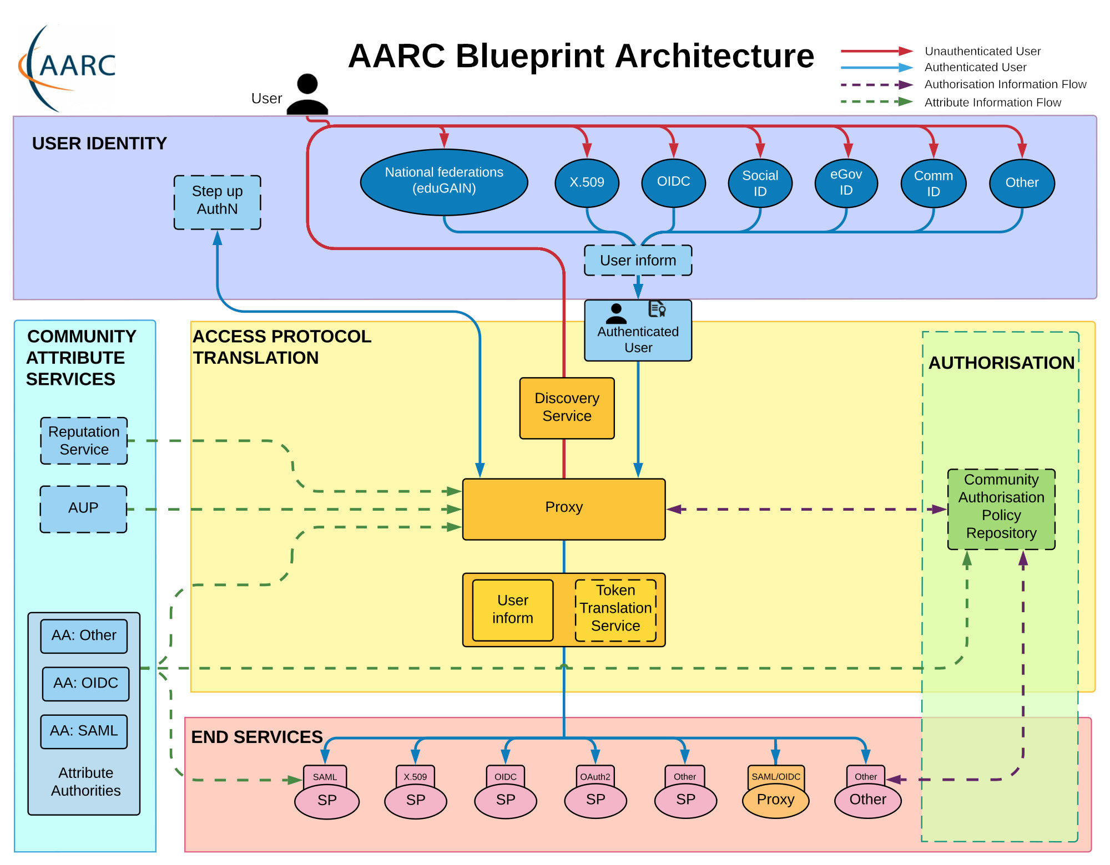

Slide 8


AARC blueprints in the wild
AARC Blueprint deployments
Murchison Widefield Array telescope proxy
LIGO
XSEDE
EGI
ELIXIR
NIH / NIAID
EUDAT
DARIAH
Globus
Deployment Options
  DIY with open source projects
  As a Service
    CILogon (https://www.cilogon.org)
    eduTEAMS (https://eduteams.org)
AAF and AARC Blueprint Architecture
The AAF is partnering with Australian BioCommons to pilot an AARC Blueprint deployment for life science research in Australia
Pilot using CILogon (https://www.cilogon.org)
The AAF is investigating options to operate an Authentication & Authorisation Infrastructure in support of Australian research activities

Slide 9
Implementation considerations
BUSINESS PROCESS
A solid understanding of the business process around authorisation steps and requirements is necessary prior to implementation.
Data Classification may impact on the authorisation steps. Be aware of use cases where data or access to systems may need additional restrictions. Consider things like MFA assertion and other possible requirements.
Understand the type of logging and reporting that will be required post go-live. Retrofitting this type of capability can be problematic in horizontally scaled infrastructure.
OPERATIONAL SUPPORT PLAN – CONSIDER EARLY
Who is providing operational support for the accounts and attributes once the project phase is finished?
Who is authorised to approve accounts and access once the project phase is finished?
Who is the subject matter expert? This role is required on an ongoing basis to answer discipline specific questions that may arise during the daily operations of the service.

Slide 10
Questions and links
Australian Access Federation
https://aaf.edu.au/
NCRIS and AAF roadmap activities
https://ncris.aaf.edu.au
AARC Blueprint
https://aarc-project.eu/architecture/
International Access through the AAF (eduGAIN)
https://aaf.edu.au/edugain/
Full list of Australian eduGAIN connected institutions
https://aaf.edu.au/edugain/connect.html

