Slide 1
Big Science Workflows and Orchestration:
Opportunities in medical physics
A/Prof Susanna Guatelli and Dist. Prof. Anatoly Rosenfeld,
University of Wollongong

Slide 2
Opportunities in computing for medical physics: general considerations
All the proposed deliverables will support research in medical physics in Australia
    Deliverable 1: Data orchestration (movement, workflow, popularity, access).
    Deliverable 2: Software access
    Deliverable 3: Computing access to data
    Deliverable 4: Large-scale data access
    Deliverable 5: Training and Community
Depending on the specific application, some deliverables may be more important than others

Slide 3
Some use cases scenarios
Within research of the Centre For Medical Radiation Physics, University of Wollongong

Slide 4
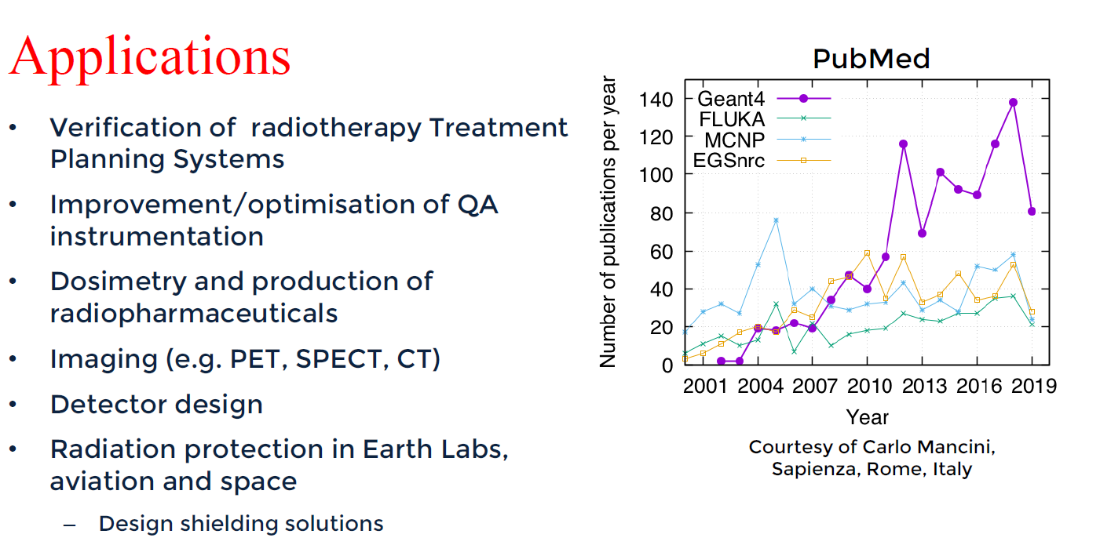
Monte Carlo simulations for medical physics
Modelling of Medical Accelerators for hadron therapy

Slide 5
Monte Carlo for Treatment Planning System (TPS)
MC used for verification of TPS
  Too slow in terms of execution for many applications (conventional X-ray radiotherapy, Microbeam Radiation Therapy, hadron therapy)
However, access to extensive computing resources could change the paradigm
Key point: computing power and resources
Note: confidentiality is crucial when dealing with TPS and images
Data Orchestration | Software access | Computing access to data | Large-scale data access
Useful, important

Slide 6
Study of the effect of radiation at sub-cellular level
Applications: radiotherapy and radiation protection (especially in space missions)
Very computing demanding as particle interactions are modelled one by one (no condensed history approach)
Data Orchestration | Software access | Computing access to data | Large-scale data access
Useful, important

Slide 7
Research for space exploration
Space Medicine
  Radiation effects in humans and electronics
  Australian Space Agency Program : Moon to Mars, $50M grants allocated today
  New direction at CMRP
Monte Carlo based radiation protection studies in the Moon and Mars environments
  Including shielding
Including industrial partners: confidentiality is important
Data Orchestration | Software access | Computing access to data | Large-scale data access
Useful, important

Slide 8
Radiomics
Extraction of a large number of features from medical images
  using data-characterisation algorithms, I
  machine learning algorithms
Large datasets
Often confidential information within inter-institutional agreements
  Security is crucial
Data Orchestration | Software access | Computing access to data | Large-scale data access
Useful, important

Slide 9
Summary
The proposed project will definitively support computing based research in medical physics, at national level
  Common platform and methodologies
  Enhancement of national and international collaborations
  Easier use of software tools
  More efficient use of computing resources
Security is very important for specific applications, especially if hospitals may be users of this platform or if industrial partners are involved
Good user documentation should be provided for the wider community (also for non experts)
Maybe something to look into: use the platform for education purposes, e.g. in Depth studies of High School students, tertiary education

