Slide 1
Research Activities
Overview of current Accelerator Physics research involvement.
Rohan Dowd
Senior Accelerator Physicist

Slide 2
Overview
Emittance minimization and the Quantum Limit
Beam based alignment
Studies into IVU generated instabilities
The CompactLight Collaboration

Slide 3
Vertical Emittance at the Quantum Limit
Achieving the world’s flattest beams

Slide 4
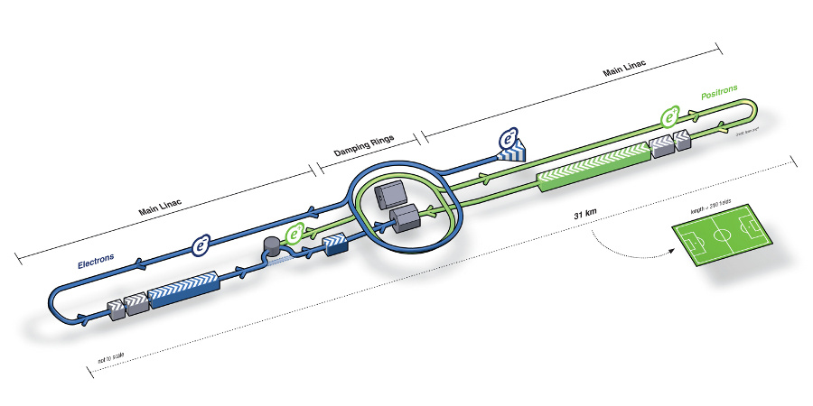
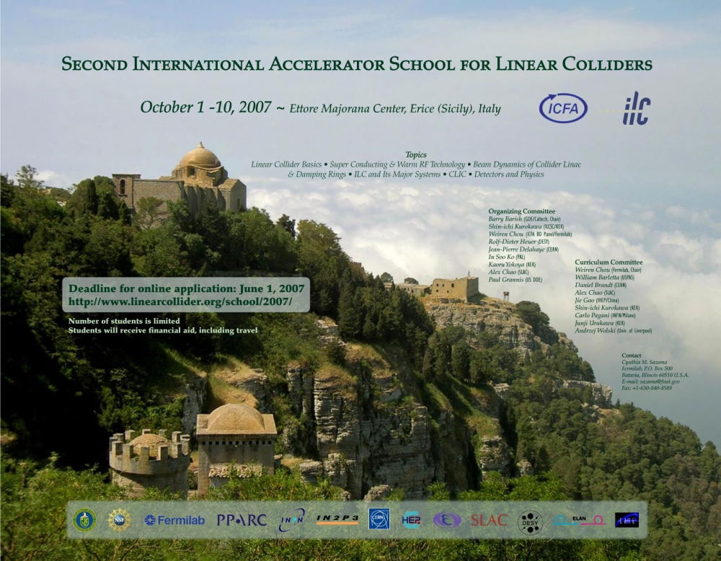
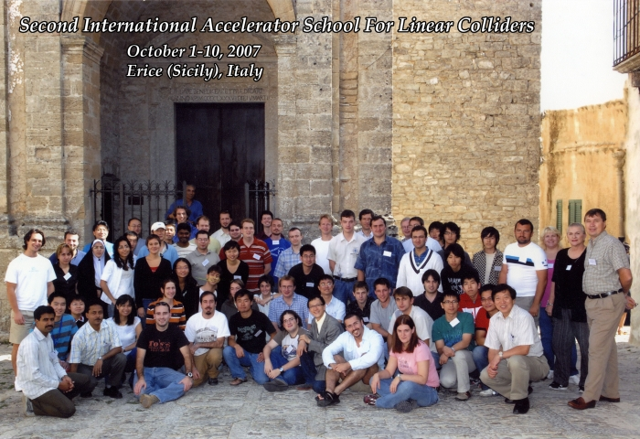
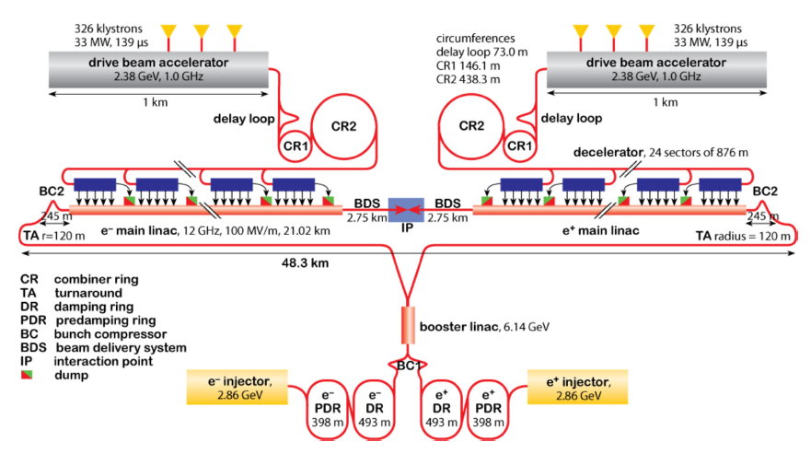
ILC School 2007
Linear Collider Basics
Super Conducting & Warm RF Technology
Beam Dynamics of Collider Linac & Damping Rings
ILC and its Major Systems
CLIC
Detectors and Physics

Slide 5
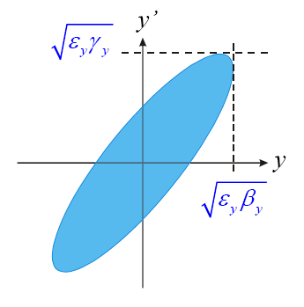
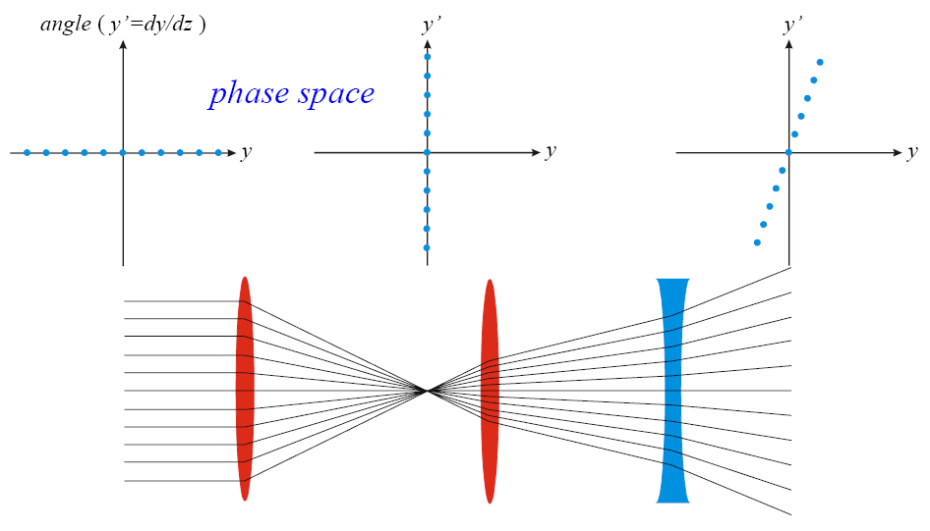
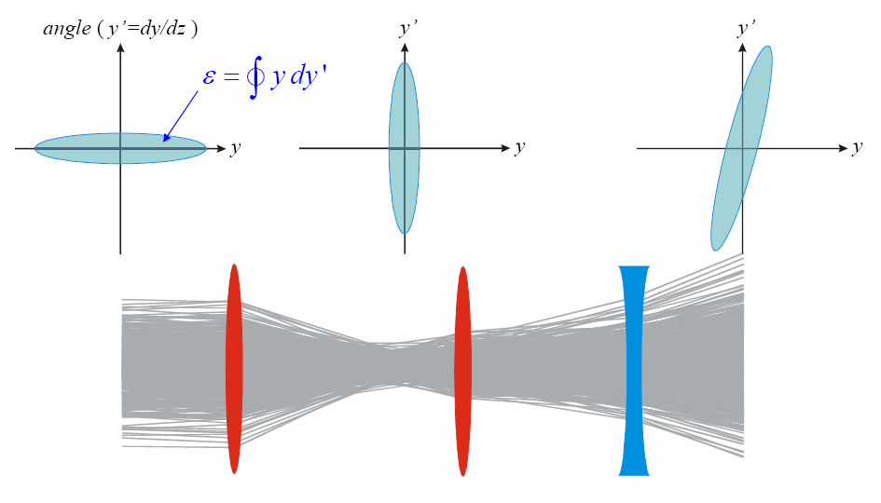
Emittance
Emittance is the area of phase space the particles in the beam occupy.
Emission of synchrotron radiation will ‘Damp’ the emittance
Dispersion, Magnet misalignments and Quantum effects can increase the emittance
Colliders want a very small vertical beam size, which means a very small vertical emittance.
New colliders will employ ‘Damping Rings’
γ
y
p
P’
s
RF cavity

Slide 6
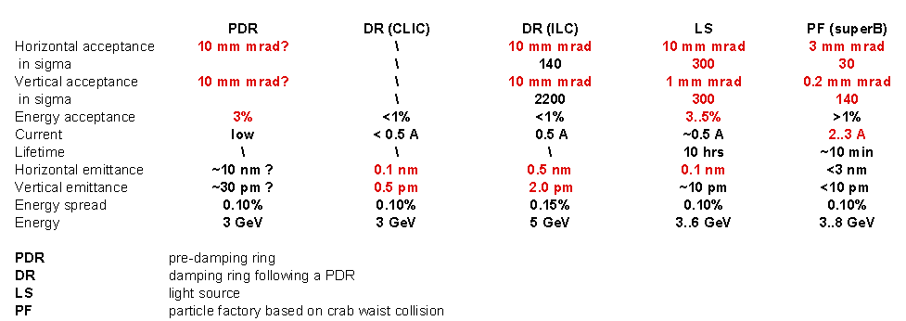
Low Emittance rings workshop series
HEP community is starting to appreciate input from light sources.
Low Emittance Rings 2010 Workshop. CERN, 12-15 January:
“The workshop will profit from the experience of colleagues who have designed, commissioned and operated lepton ring colliders and synchrotron light sources.”

Slide 7
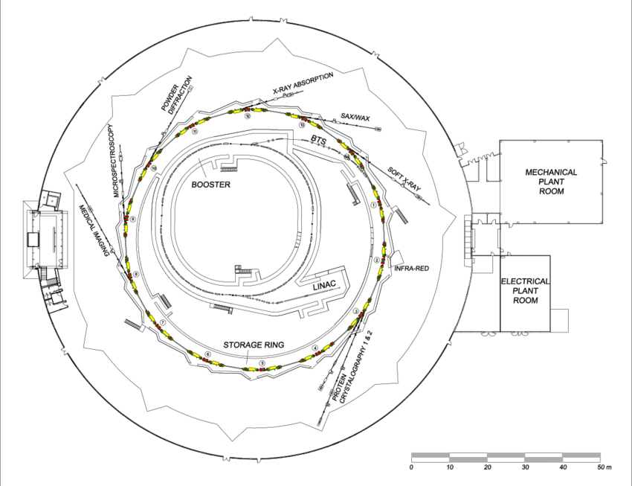
Light Sources as a testing ground
Light sources excel at beam stability and precision. The collider community has now recognized there are many lessons to learn from them.
Physicists at light sources often have the time and ability to test beam dynamics theories and hardware
Light Sources are very similar to damping rings. Can demonstrate techniques needed for future accelerators.

Slide 8
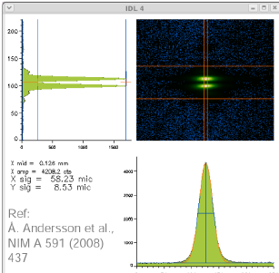
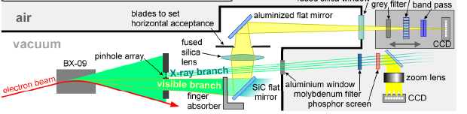
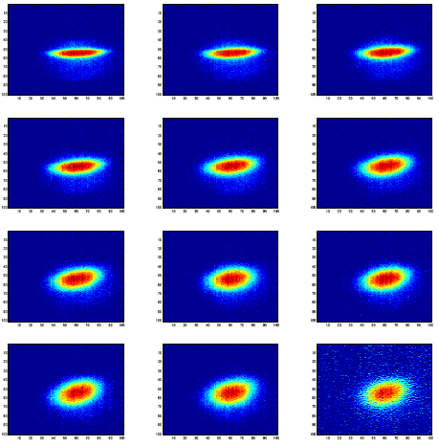
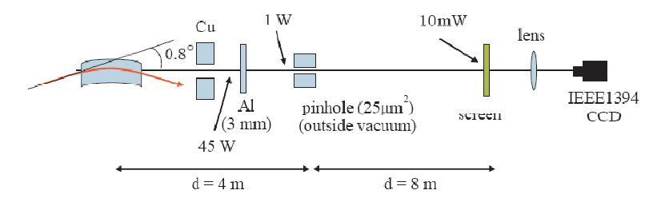
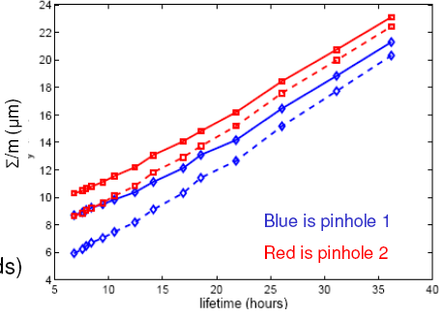
Direct emittance measurement
SLS: ε_{y} = 2.8 pm ± 0.4 (0.05% coupling)
Diamond: ε_{y} = 2.2 pm ± 2? (0.08% coupling)

Slide 9
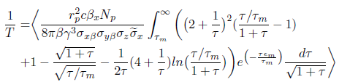
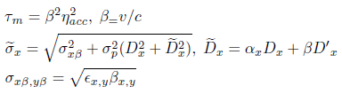
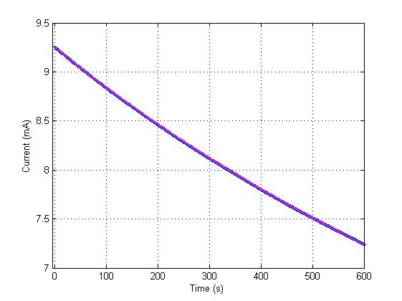
Indirect emittance measurement
Without the resources for a dedicated high quality diagnostic beamline, we must try indirect inference of the beam size.
Tousheck effect is the scattering of particles within the beam from each other.

Slide 10
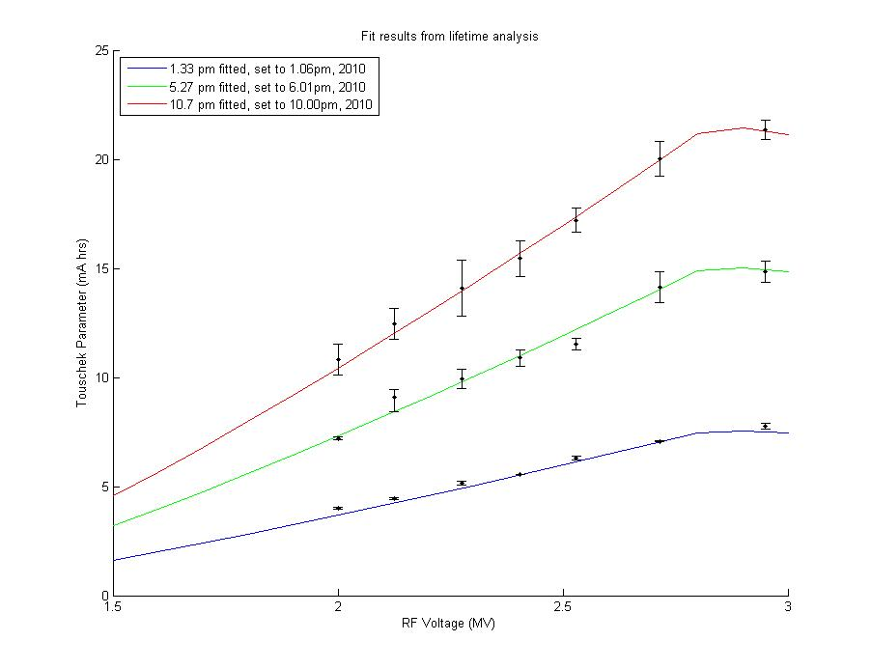
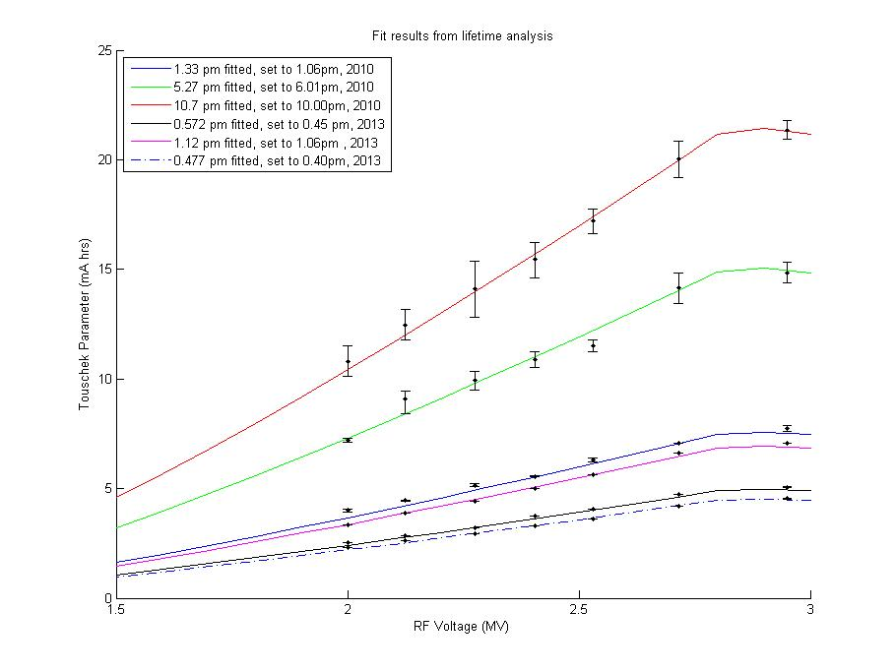
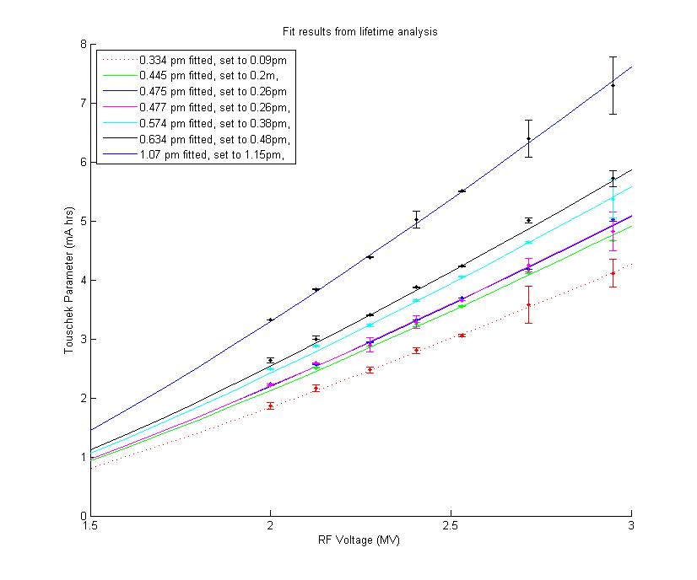
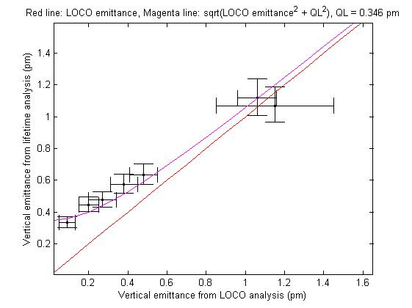
Towards the Quantum Limit
Employed a model based minimization technique and indirect measurements to achieve 1.3 pm Vertical emittance – Phys. Rev. ST Accel. Beams 14, 012804 (2011)
Since then, we have refined the technique and come within spitting distance of the Quantum limit
Some further-analysis to do.
Lessons learned in beam control have translated to better stability of AS beam

Slide 11
Beam Based Alignment
Or how to start fights with mechanical engineers…

Slide 12
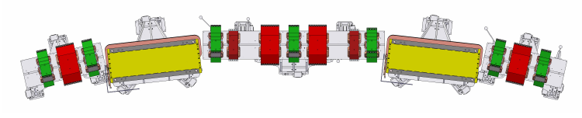
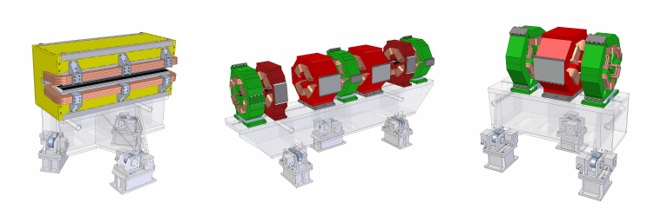
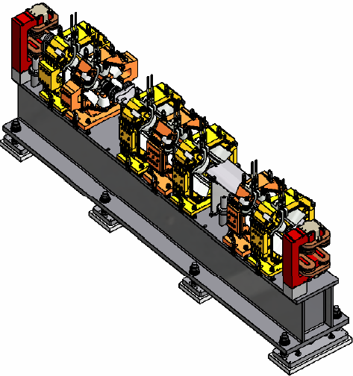
Alignment Methods Comparison
AS uses laser tracker and magnet fiducials. Magnet to magnet resolution ~ 25-50 micron (but magnetic centre somewhat uncertain).
NSLS II employs a vibrating wire measurement. Resolution of finding magnetic centre is 5-10 micron. Locked onto girder then installed. Overall magnet to magnet positioning claimed < 30 micron (15-20?)
What about Beam based Alignment?

Slide 13
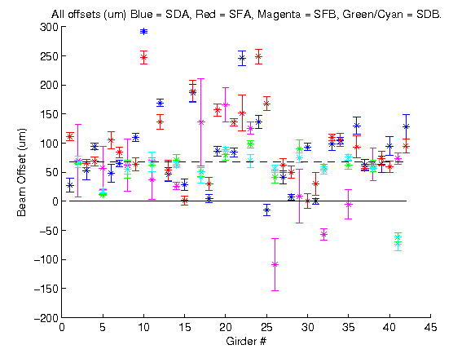
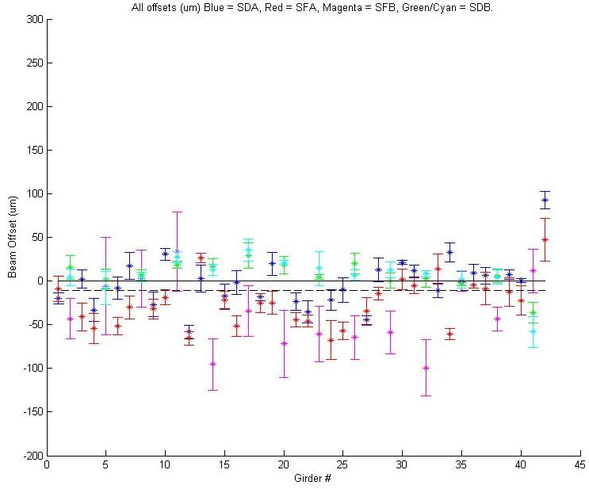
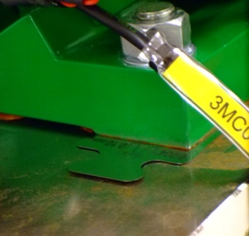
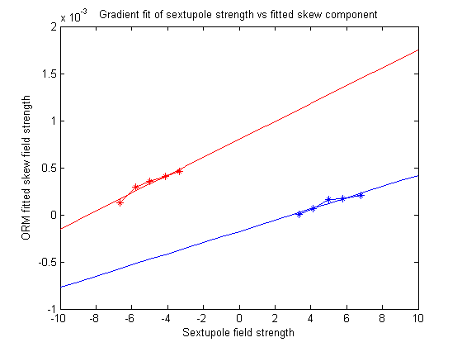
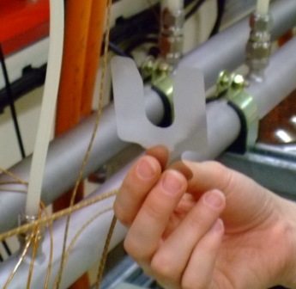
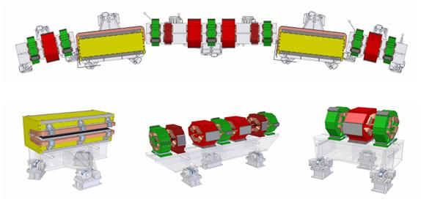
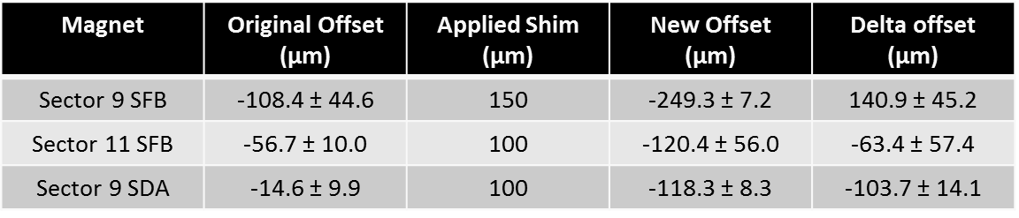
Sextupole Vertical offsets
Shunt each sextupole magnet family to different strengths and and fit skew quadrupole terms to each sextupole.
Gradient of skew field vs sextupole field gives vertical offset.

Slide 14
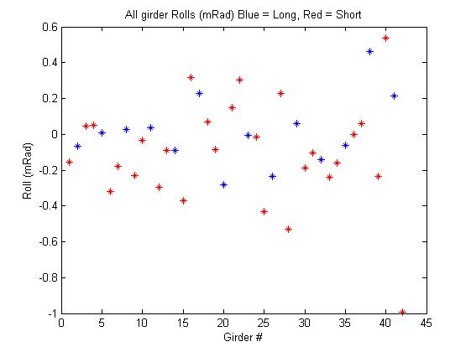
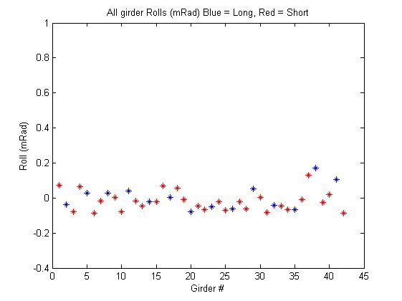
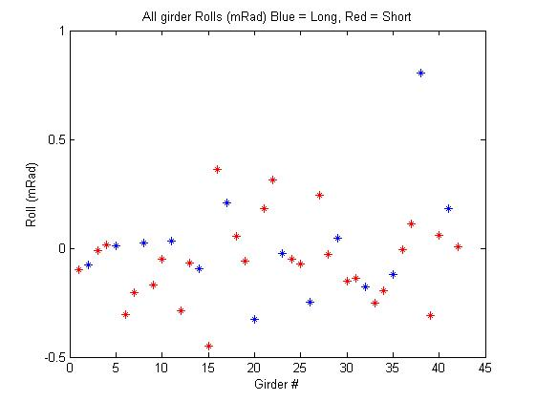
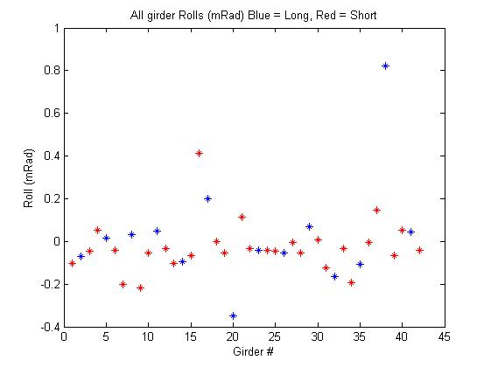

Quadrupole Rolls
Turn off Sextupoles and perform skew analysis of quadrupoles.
Method was found to be accurate to ±0.05 mRad. Mechanical precision of setting the girders ±0.1 mRad.
Rolls now reduced to < 0.2 mRad.
Alignment through BBA methods now on par with mechanical bench top measurements
Further Refinement of alignment technique ongoing

Slide 15
IVU Induced Instabilties
Solving a long standing issue

Slide 16
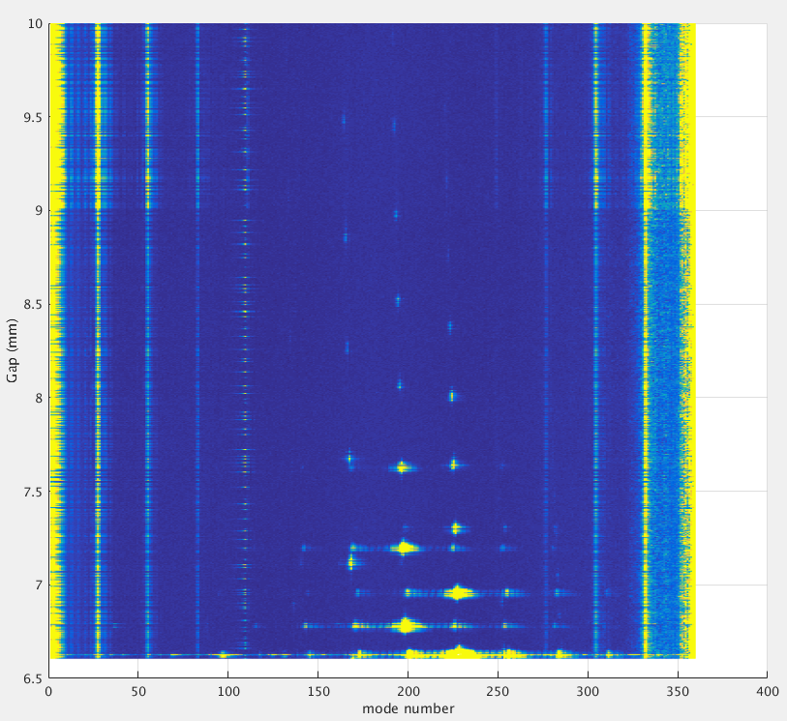
Background
We have observed vertical beam instabilities generated when the IVUs are at small gap since they were installed in 2006.
Have been able to control them, but mechanism was not identified.
Risk that future IVUs will produce stronger instabilities
This problem also reported in other facilities – of interest to global community.

Slide 17
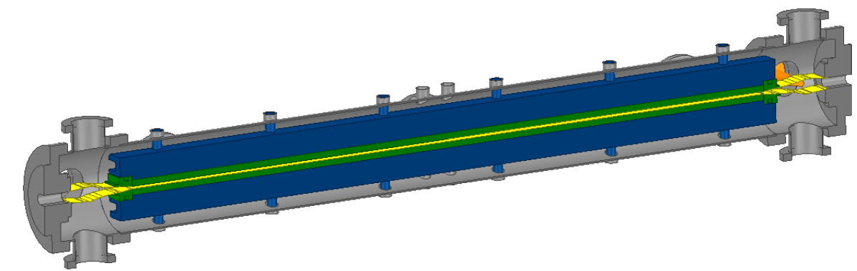
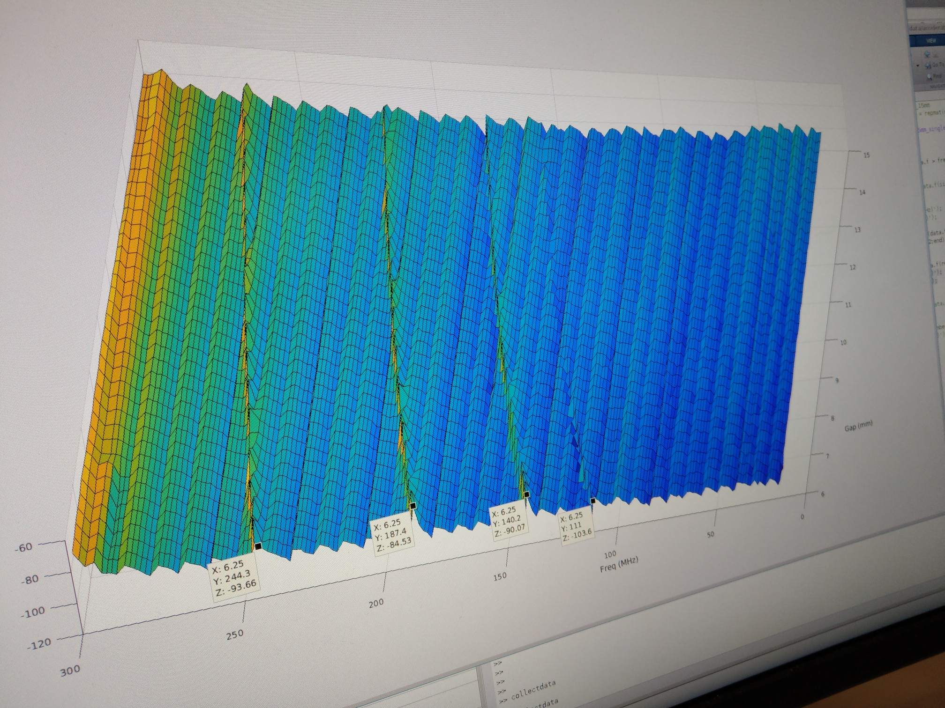
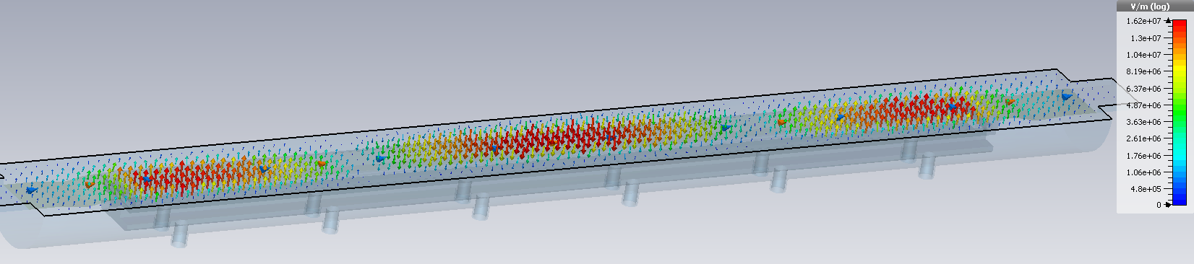
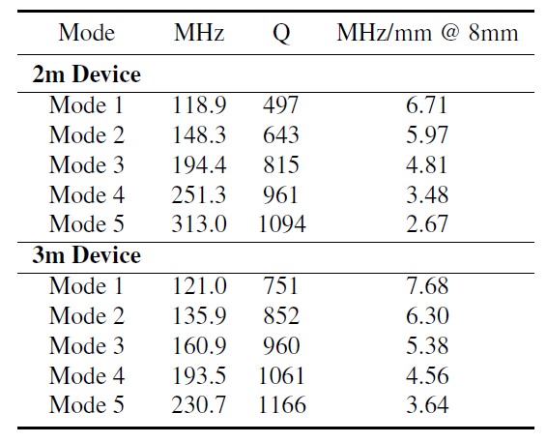
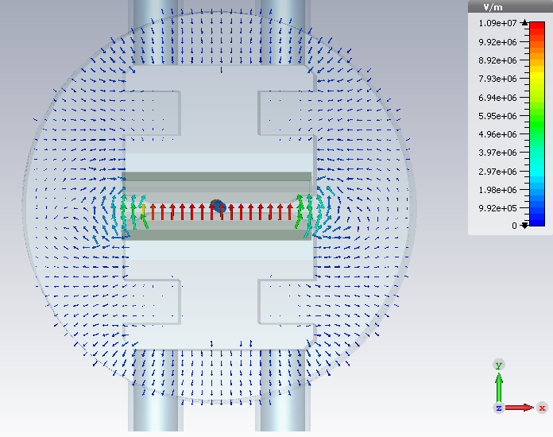
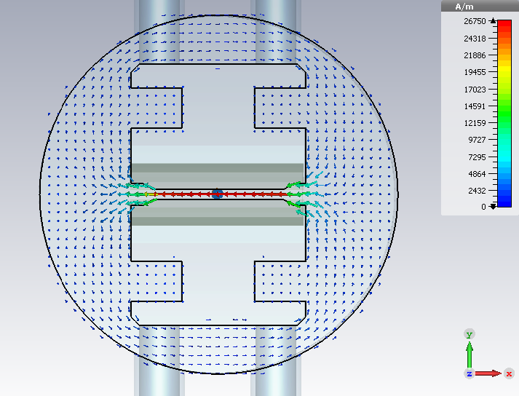
Modelling the IVUs
A full 3D model of the IVU was created from the engineering drawings
RFS conducted modelling and analysis of the structures and identified several resonance modes.
Antenna installed in IVU to confirm modelling

Slide 18
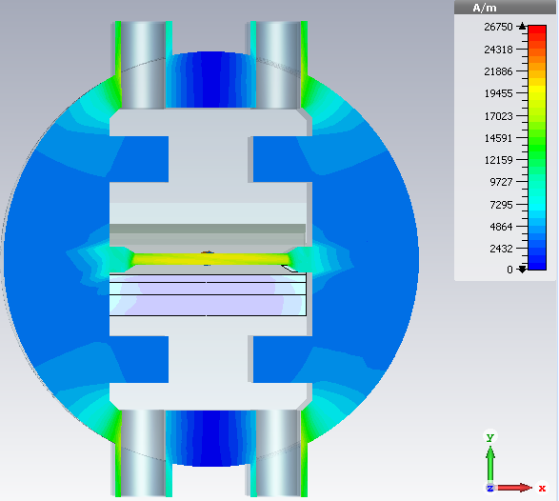
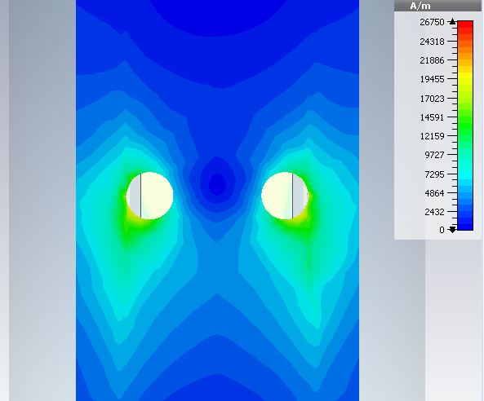
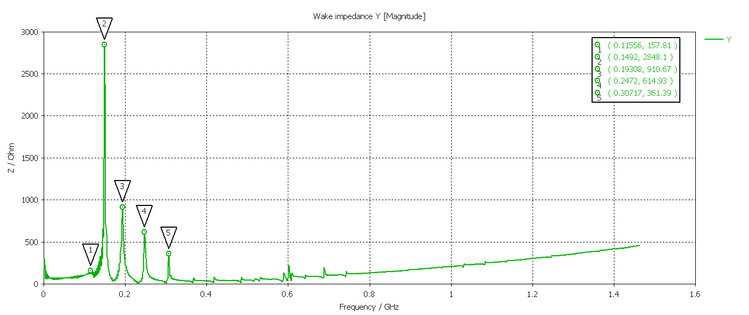
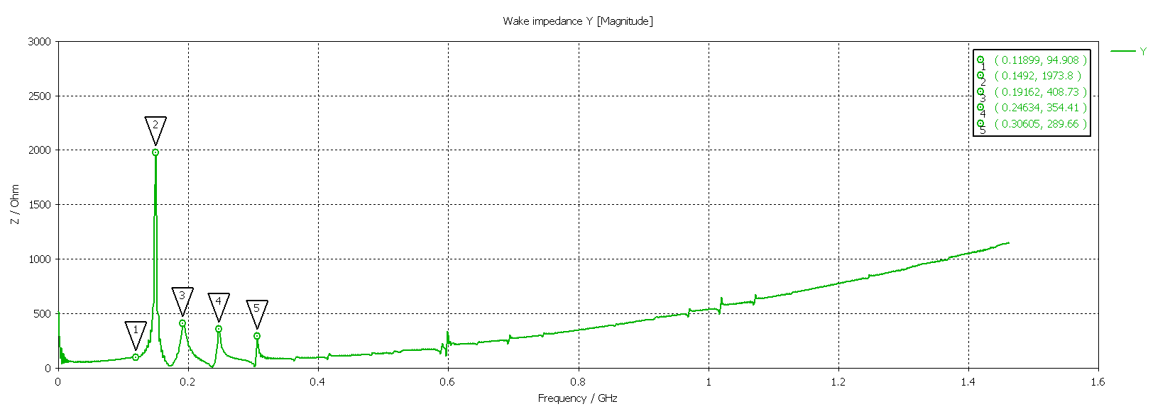
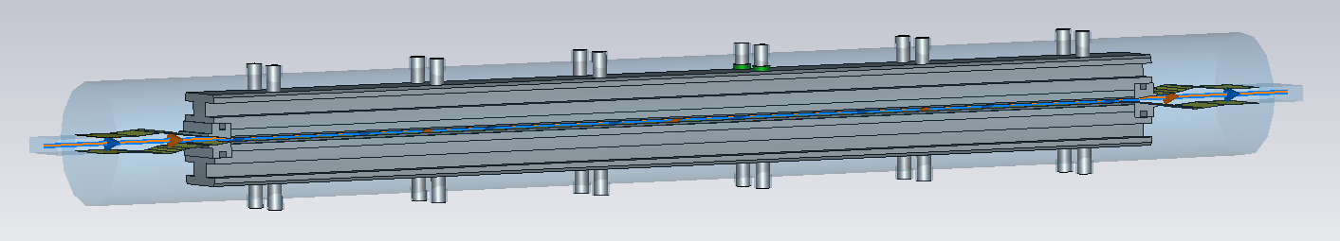
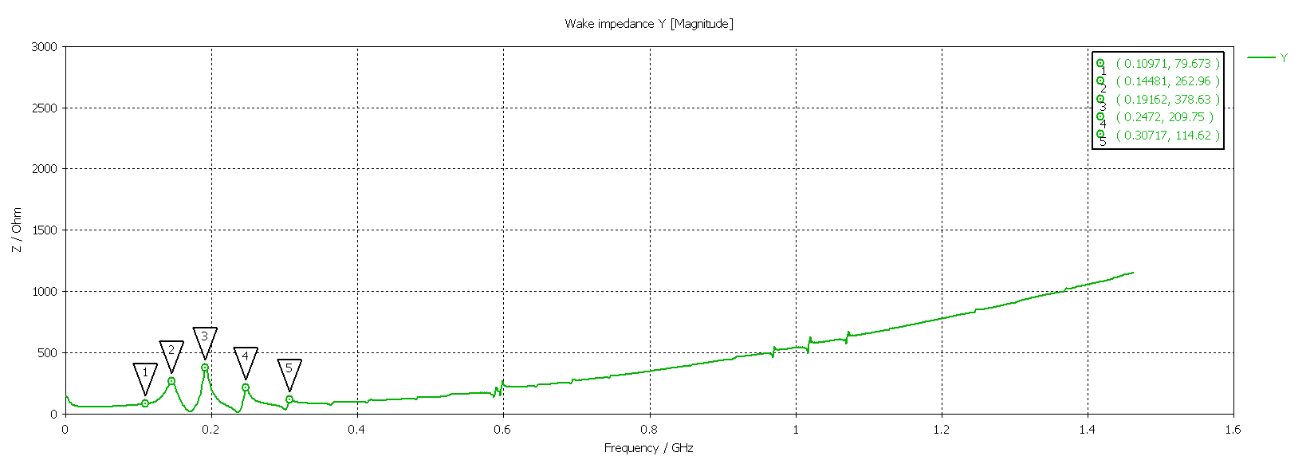
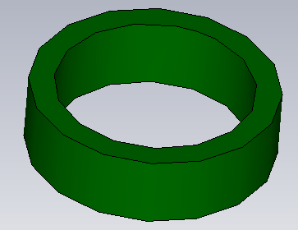
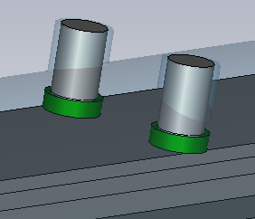

Possible solution – ferrite rings
4
8
12

Slide 19
The CompactLight Collaboration
Conceptual design for a compact X-band FEL

Slide 20

CompactLight
“The key objective of the CompactLight Design Study is to demonstrate, through a conceptual design, the feasibility of an innovative, compact and cost effective FEL facility suited for user demands identified in the science case.”
X–Band acceleration will be a compact, cost effective solution for a future FEL in Australia.

Slide 21

The Collaboration Members

Slide 22

RF Undulator Work
David is working with Strathclyde University for RF undulator research, including simulations of electromagnetic wave fields setup in the cavity, electron beam dynamics simulations by ASTRA code, photon radiation simulations by SPECTRA code and SIMPLEX code.
A 36 GHz microwave undulator has been chosen for producing a conceptual design report for this work package .

Slide 23
Thank you.

