Slide 1
Introduction of the EuPRAXIA
Project
Imre Ferenc Barna
Hungarian Research Network, Wigner
Research Centre for Physics

Slide 2
Structure of the talk
Introduction, personal info
The basic physics of plasma accelerators
The EuPRAXIA project itself
Future plans
Summary and Outlook

Slide 3
Personal Introduction
My name is Imre Ferenc Barna
I am a research associate at the Hun-Ren Wigner Research Centre, the Hungarian contact person of EuPRAXIA
My PhD background was theoretical atomic physics
Ionization of He atoms in relativistic heavy ion collisions, 2002
Giessen Germany (I am from the “Greiner school Frankfurt” )
2002 - 2005 Made post docs at Max Planck Institute for Complex Systems in Dresden and later Technical University Vienna
photoionization of He atoms
2005 - 2013 Later was active in the Energy Research Centre in Budapest, calculating hydrodynamical transients (already permanent)
2012 -2019 was active in ELI ALPS at Szeged, (half position)
2013- till today work in Wigner Research Centre
Active fields: Laser-Matter Interaction, (ionization, scattering) and independently mathematical physics (solutions of physically relevant PDEs with the self-similar Ansatz, investigate flow and diffusion problems)
Giving biophysics lecture at the university for veterinary but in German language
I have no real high energy or accelerator activity background :(

Slide 4
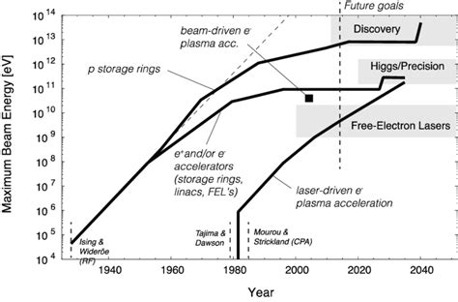
The main motivation of plasma accelerators
1) Big question how to go further?
2) Why to go further?
Answer 1A): use the same technology
and plan/build even larger Very Large Hadron Collider (VLHC) near Chicago 235 km long
OR Future Circular Collider near CERN
90 -100 km 100 TeV for pp
Answer 1B): use some other technology
a) accelerating particles in plasma
(main part of the present talk)
b) dielectric wall accelerators
Answer 2): one aim is High Energy Physics but that is not the main goal, today we have 30’000 accelerators world-wide and to make them cheaper smaller for applications
I
The Livingstone plot shows
that in 2024 the conventional linacs and colliders achieved their physical limits in the magnitude of 100 MeV/meter

Slide 5
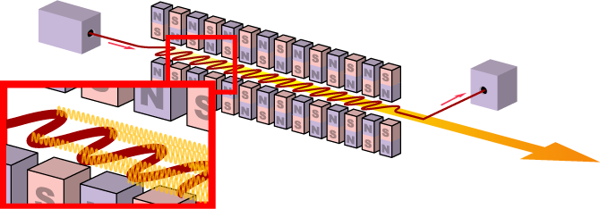
The main motivation of plasma accelerators
The main motivation of plasma accelerators
The main motivation of plasma accelerators
The main motivation of plasma accelerators
Answer 2A): for Why to go further
if we have cheap, compact
accelerator for electrons then with free
electron lasers we can produce tunable
short duration UV, XUV even soft X-ray
radiation which are heavily used in material
science
How a free electron laser looks like?
What is the main idea behind?

Slide 6
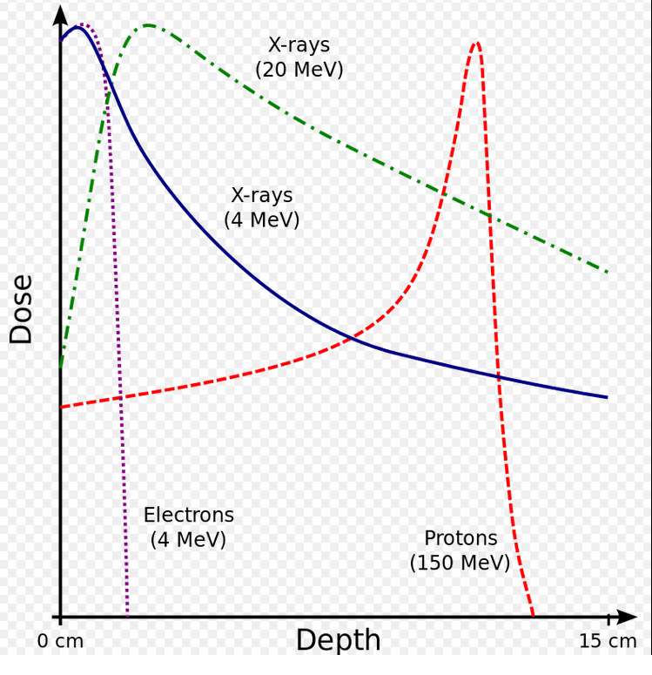
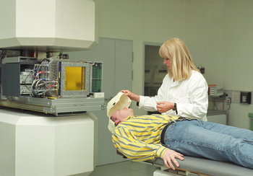
The main motivation of plasma accelerators
The main motivation of plasma accelerators
The main motivation of plasma accelerators
The main motivation of plasma accelerators
Answer 2B): why to go further?
To have compact heavy ion accelerators
for the hadron therapy as application
against cancer
Physics: the Bragg curve, energy deposition of
charged particles
2013-ra közel 100 ezer embert kezeltek már
Such centres already exist:
GSI Darmstadt, (Germany),
Heidelberg, (Germany), Pavia (Italy)
Statistics say: till 2013 almost 100’000 patients
were treated with proton therapy

Slide 7
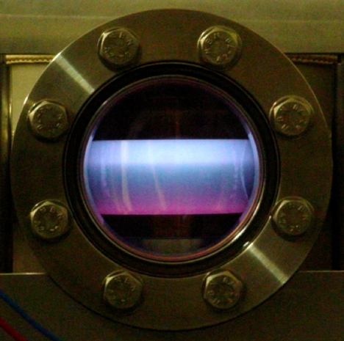
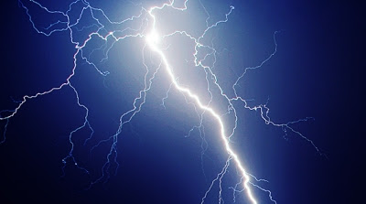
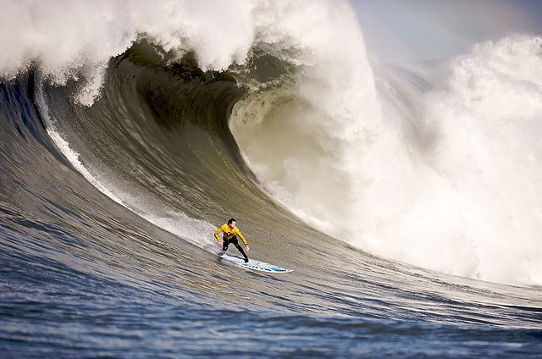
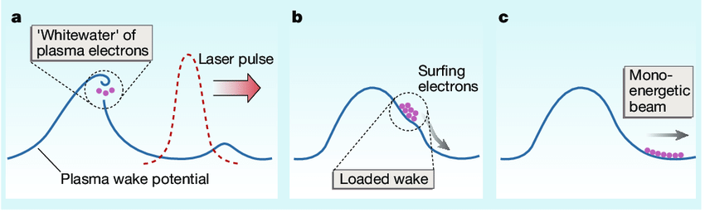
The main motivation of plasma accelerators
The main motivation of plasma accelerators
The main motivation of plasma accelerators
The main motivation of plasma accelerators
Answer 1A): How to go further?
My explanation: now we accelerate with vacuum with RF it has limits so change the conditions
plasma with laser
(no upper limit for E field gradient) (has higher frequency)
(Per definition: plasma is an ionised gas, (when T is large enough everything will be a plasma)
That is what exactly happens: examples for plasmas:
- need to fill a volume with some gas (eg. H2, Rb )
- it should be ionized (with charged particles, of with strong electromagnetic
field eg. laser,
producing a strong charge separation,
producing a propagating charge wave, wake field
(there are many ways to do it)
- inject the electrons which we want to accelerate at the right phase
(there are many way to do that, the two steps can happen in one step)
I explain only two ways
)

Slide 8
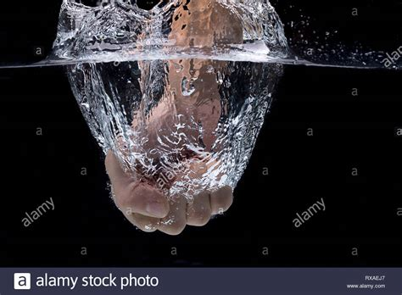
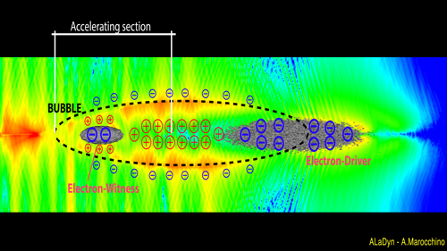
Particle driven plasma wake field acceleration
First a plasma is produced, does not matter how (the big volume is neutral from seeing from outside )
than like a “ fist strike into water” we shoot an energetic charged particle bunch (can be electron, positron or even proton)
that makes a strong charge separation, eg. when an electron bunches is used (driver), it pushes out the
electrons creating a void with a positive charge
then electrons are injected into the void which
will be accelerated (whitness bunch)
If it is at the proper space at the proper time then it will accelerated, there is a focusing effect
Such a proof of principle experiment is AWAKE CERN
E
Assmann, R.; et al. (2014).
"Proton-driven plasma wakefield acceleration: a path to the future of high-energy particle physics"
Plasma Physics and Controlled Fusion. 56 (8): 084013

Slide 9
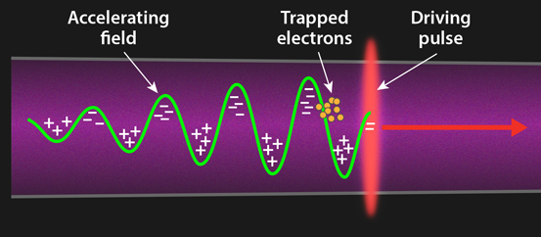
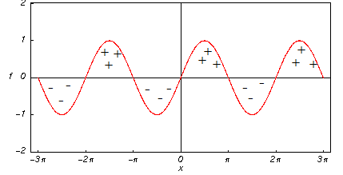
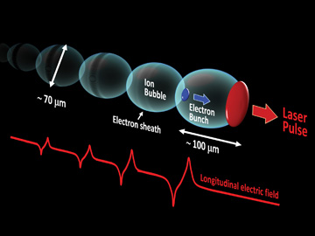
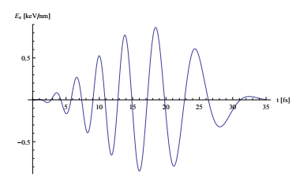
Laser driven plasma wake field acceleration
In plasma we can make spatial charge separation,
can have horizontal electric field gradient
whic is used for electron acceleration
Remarks: 1) with a plain wave
there is no way to accelerate
an electron,
E(x,t)
Propagation direction
which is diagonal to el.field E(x,t)
we want to accelerate electron
paralel to x also a problem
Tajima, T.; Dawson, J. M. (1979).
"Laser Electron Accelerator
PRL 43(4) 267-270
The solution: is to break the symmetry:
-so apply finite duration pulses
- apply chirp which is time dependent
frequency
It is possible to accelerate electrons in vacuum
with lasers as well but not so effective
In such a way 3.4 GeV/cm electron
acceleration was achieved in Berkley

Slide 10
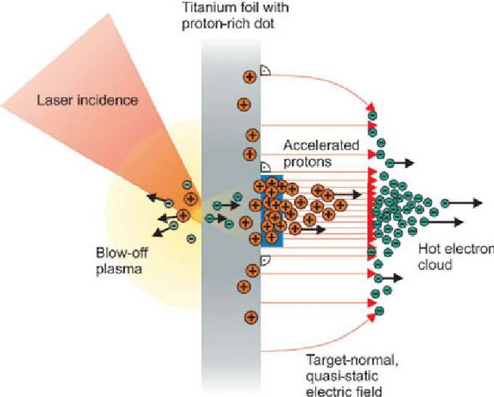
Some general remarks on plasma wake field acceleration
Till now only electrons are considered, and accelerated:
What to do with protons or heavy ions?
It is not effective to use this method, other schemes are
used
Target -Normal Sheath Acceleration (TNSA)
Ions are much more heavier than electrons so
E < 10 MeV for protons
water wapor,
contaminated
surface
Snavely, et all.
"Intense High-Energy Proton Beams from Petawatt-Laser Irradiation of Solids".
Physical Review Letters. (2020) 85 (14): 2945–2948.

Slide 11
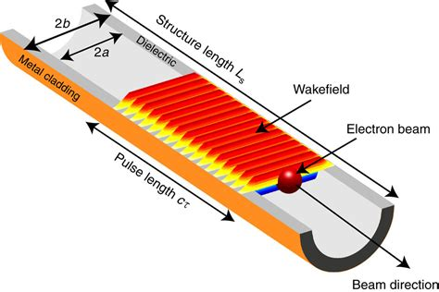
Dielectric wall accelerator
The other very promising and innovative approach
- works for electrons and ions as well
- E >200 MeV/m is possible
- a wave guide from a dielectric is positioned into a traveling wave of a high gradient electric field
This would be ideal, for protons and for hadron therapy
Ultra‐High‐Current Electron Induction Accelerators
Physics today [0031-9228] Kapetanakos, year:1985 vol:38 iss:2 pg:58

Slide 12
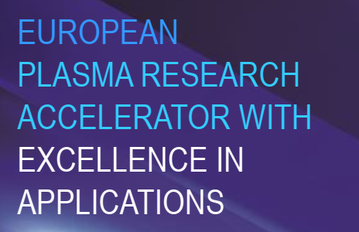

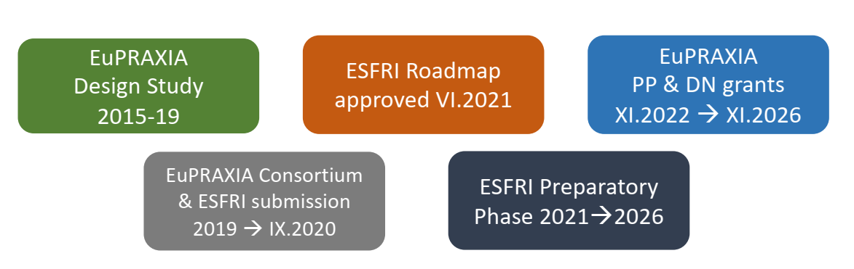
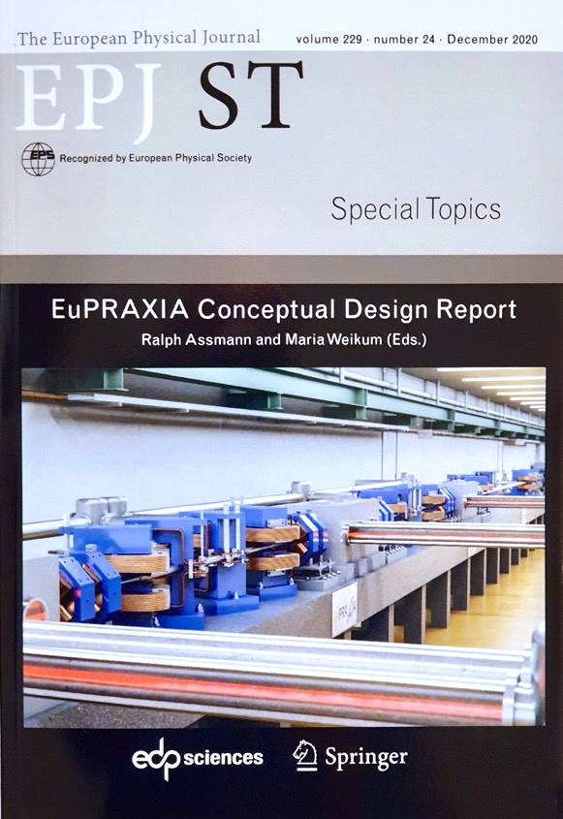
An now finally what is EuPRAXIA Project??
An international consortium to plan, build up and operate all the set-ups I mentioned before on two sites
Now 18 countries are included, EuPRAXIA =
The number of joined institutes are always increasing now > 50
Story board – it started in 2015
The CDR Conceptual Design Study was published in
Eur. Phys. J. Special Topics 229, 3675–4284 (2020) ©
https://doi.org/10.1140/epjst/e2020-000127-8
600+ page CDR, 240 scientists contributed

Slide 13
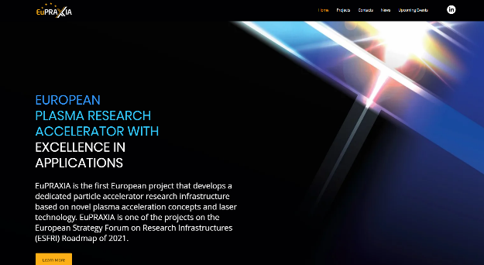

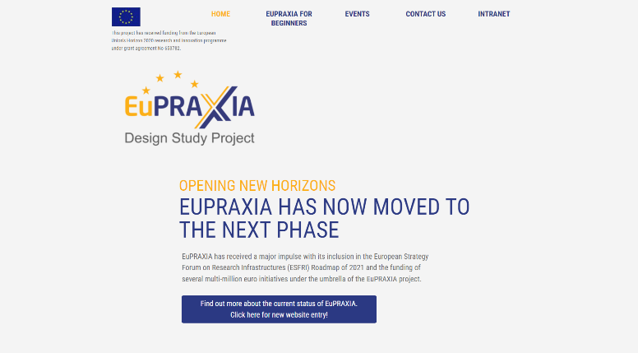
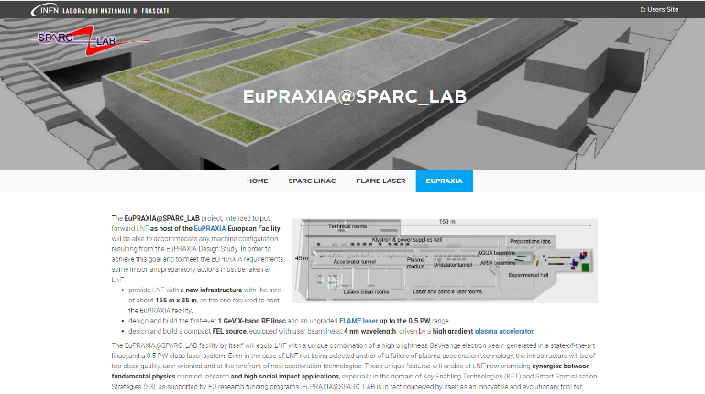
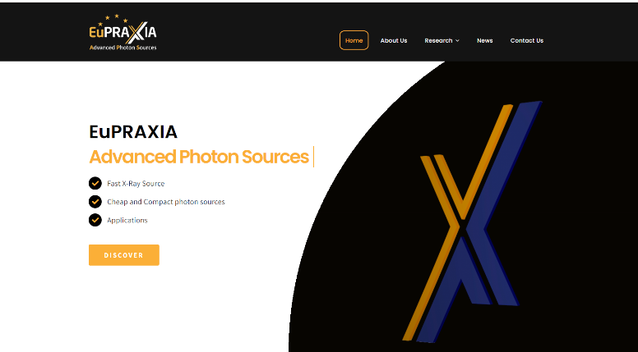
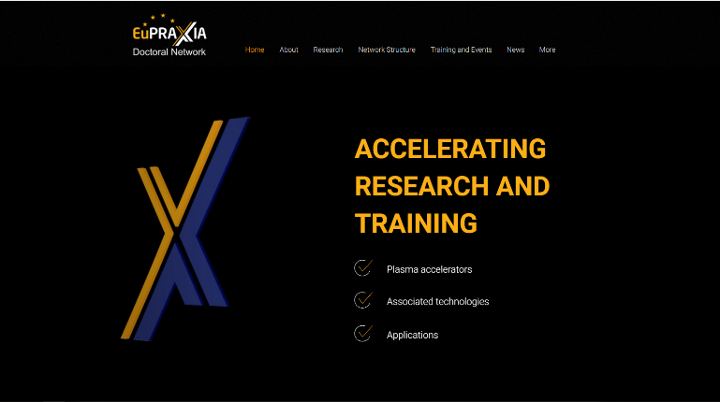
EuPRAXIA Web Structure
Preparatory Phase
www.eupraxia-facility.org
Design Study (2015 – 2019)
Advanced Photon Sources
SPARC_LAB
Doctoral Network
www.eupraxia-pp.org
www.eupraxia-project.eu
sparclab.lnf.infn.it
euaps.infn.it
www.eupraxia-dn.org

Slide 14
The EuPRAXIA CDR
First ever design of a plasma accelerator facility.
Conceptual Design Report for a distributed research infrastructure funded by EU Horizon2020 program. Completed by 16+25 institutes.
Challenges addressed by EuPRAXIA since 2015:
  Can plasma accelerators produce usable electron beams?
  For what can we use those beams while we increase the beam energy towards HEP and collider usages?
Next phase consortium: > 50 institutes
Preparatory Phase project: 2022 – 2026 (approved)
Start of 1st operation: 2029
http://www.eupraxia-project.eu
600+ page CDR, 240 scientists contributed

Slide 15


















































EuPRAXIA-PP Consortium (what I got official in 2024 september)
Coordinator

Slide 16
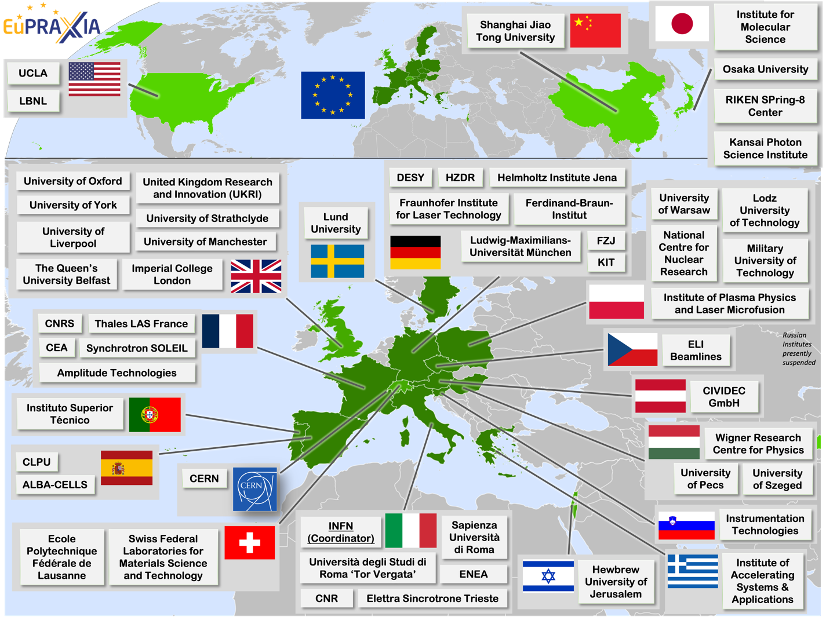
Wide International Collaboration
The EuPRAXIA Consortium today: 54 institutes from 18 countries plus CERN
Included in the ESFRI Road Map
Efficient fund raising:
  Preparatory Phase consortium (funding EU, UK, Switzerland, in-kind)
  Doctoral Network (funding EU, UK, in-kind)
  EuPRAXIA@SPARC_LAB (Italy, in-kind)
  EuAPS Project (Next Generation EU)
  What Next? => PACRI !

Slide 17
EuPRAXIA Doctoral Network
- In the framework of Marie Skłodowska-Curie Actions a doctoral
network started in sept 2023
- all together 12 PhD students were recruted and applied all around the world
- Dr. Carsten Welsh (University of Liverpool is the main organiser in this project)
- beyond studing physics they develop their other soft skills,
having numerous extra courses eg. how to give a good talk etv.
- eg. Andres Leiva Genre from Argentina works at University of Pécs,
THz accelerator in dielectric media
EuPRAXIA-DN: Global Minds,
Accelerating Tomorrowhttps://www.youtube.com/watch?v=6NPgxCdffrE

Slide 18
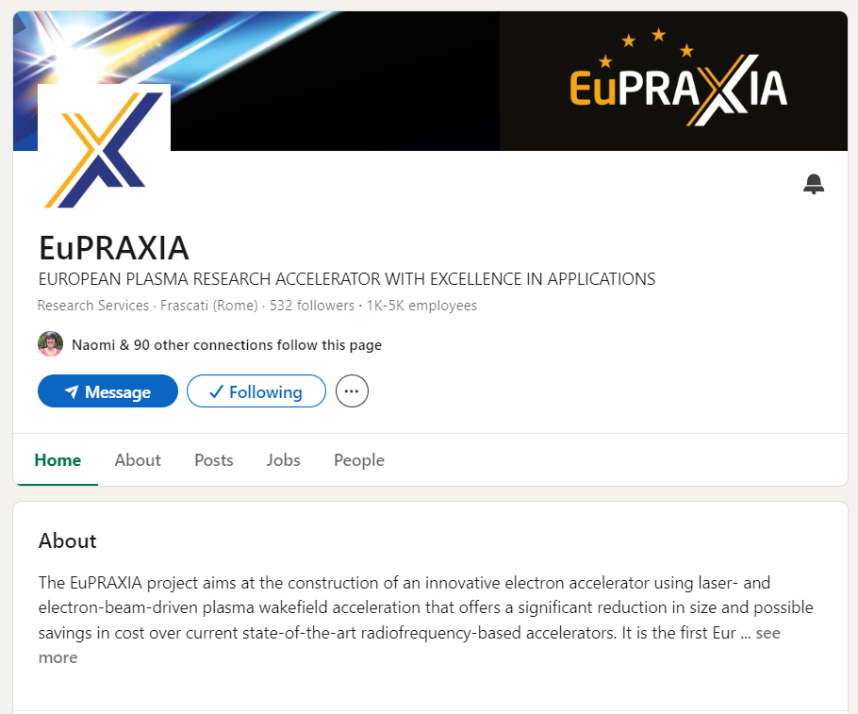
Social Media (it is done very professional)
All activities are supported by ULIV’s and INFN’s established social media channels:
  X/Twitter: @livuniphysics, @QUASAR_6group, @INFN_, @INFN_LNS
  Facebook: @theQuasarGroup, @IstitutoFisicaNucleare, @infn.lns
  Instagram: @livuniphysics, quasar_6roup, @infn_insights, @lnf_infn
  LinkedIn: EuPRAXIA, QUASAR Group Project T.E.A.M.
Social media campaigns to boost visibility

Slide 19
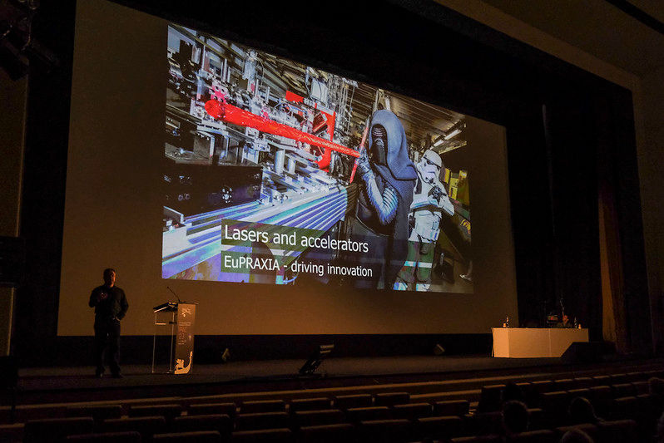
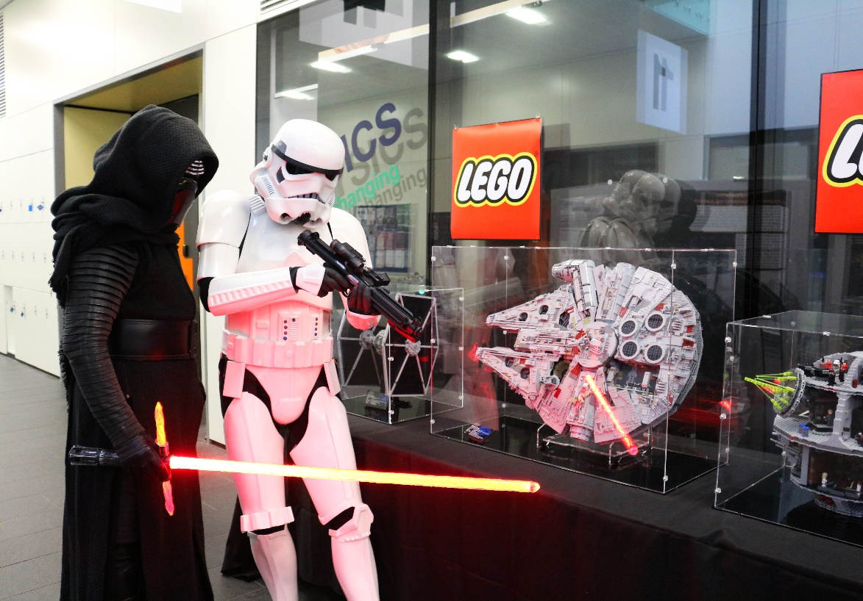

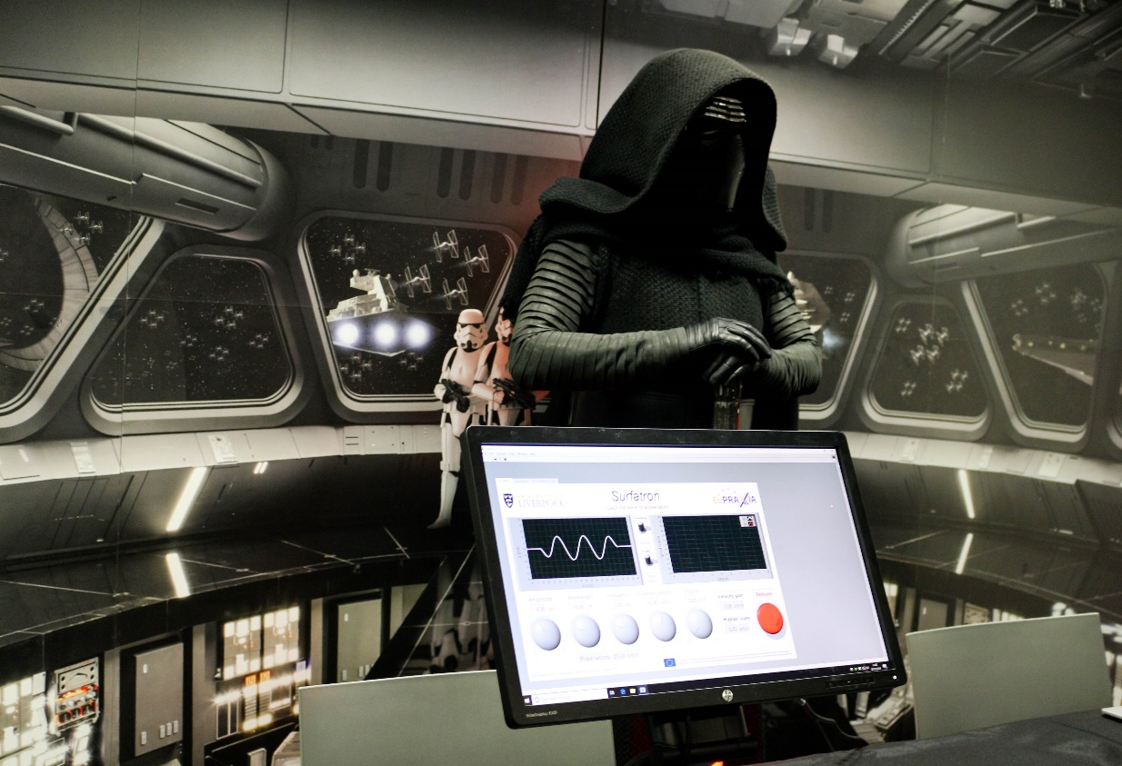
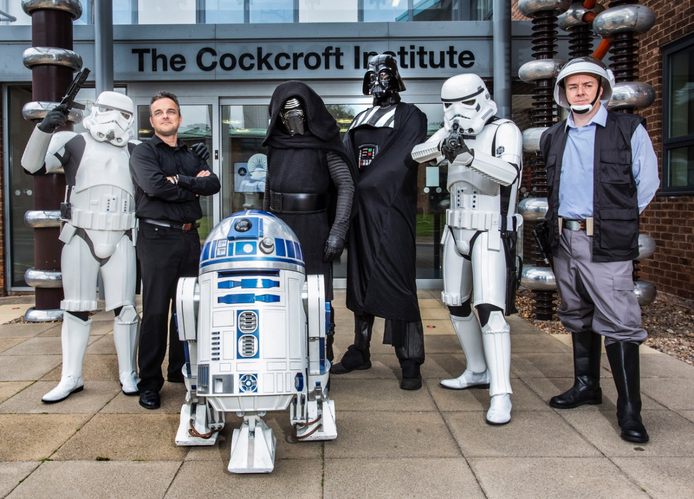
EuPRAXIA Outreach – Physics of Star Wars (making enormous hype… but a successful doctoral network)

Slide 20
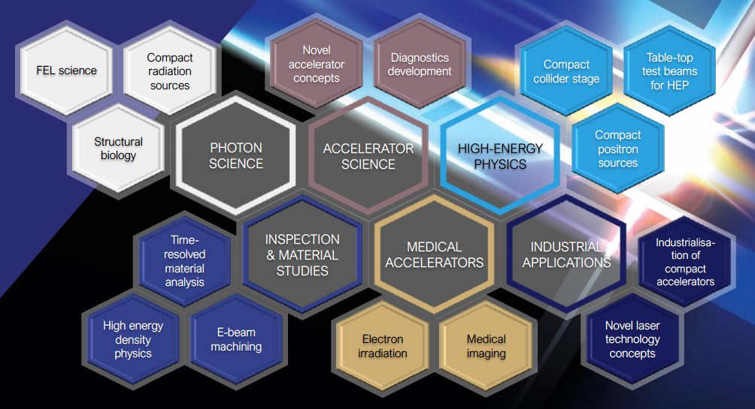
Intense R&D Program on critical components
Electrons
(0.1-5 GeV, 30 pC)
Positrons
(0.5-10 MeV, 10⁶)
Positrons (GeV source)
Lasers
(100 J, 50 fs, 10-100 Hz)
X-band RF Linac
(60 MV/m , up to 400 Hz)
Plasma Targets
Betatron X rays
(1-10 keV, 10¹⁰)
FEL light
(0.2-36 nm, 10⁹-10¹³)
Main info for us, now, will apply Ti:Sapphire lasers

Slide 21
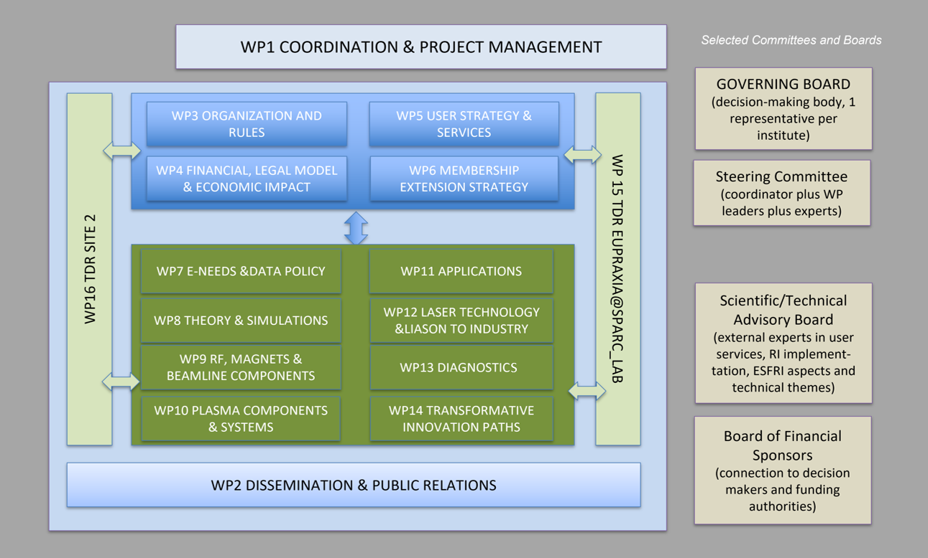
EuPRAXIA-PP Structure

Slide 22
EuPRAXIA_PP Project Coordinator: Pierluigi Campana (INFN)
(in september 2024)
Coll. Board
M. Ferrario
WP1 - Coordination & Project Management
P. Campana, INFN
M. Ferrario, INFN
WP2 - Dissemination and Public Relations
C. Welsch, U Liverpool
S. Bertellii, INFN
WP3 - Organization and Rules
A. Specka, CNRS
A. Ghigo, INFN
WP4 - Financial & Legal Model. Economic Impact
A. Falone, INFN
WP5 - User Strategy and Services
F. Stellato, U Tor Vergata
E. Principi, ELETTRA
WP6 - Membership Extension Strategy
B. Cros, CNRS
A. Mostacci, U Sapienza
WP7 - E-Needs and Data Policy
R. Fonseca, IST
S. Pioli, INFN
WP8 - Theory & Simulation
J. Vieria, IST
H. Vincenti, CEA
WP9 - RF, Magnets & Beamline
Components
S. Antipov, DESY
F. Nguyen, ENEA
WP10 - Plasma Components & Systems
K. Cassou, CNRS
R. Shalloo, DESY
WP11 - Applications
G. Sarri, U Belfast
E. Chiadroni,U Sapienza
WP12 - Laser Technology, Liaison to Industry
L. Gizzi, CNR
P. Crump, FBH
WP13 - Diagnostics
A. Cianchi, U Tor Vergata
R. Ischebeck, EPFL
WP14 - Transformative Innovation Paths
B. Hidding, U Dusseldorf
S. Karsch, LMU
WP15 - TDR EuPRAXIA @SPARC-lab
C. Vaccarezza, INFN
R. Pompili, INFN
WP16 - TDR EuPRAXIA Site 2
A. Molodozhentsev, ELI-Beamlines
R. Pattahil, STFC
Steering
Committee
Scientific and Technical Advisory Board
Board of Financial Sponsors
There are 16 Workpackages

Slide 23
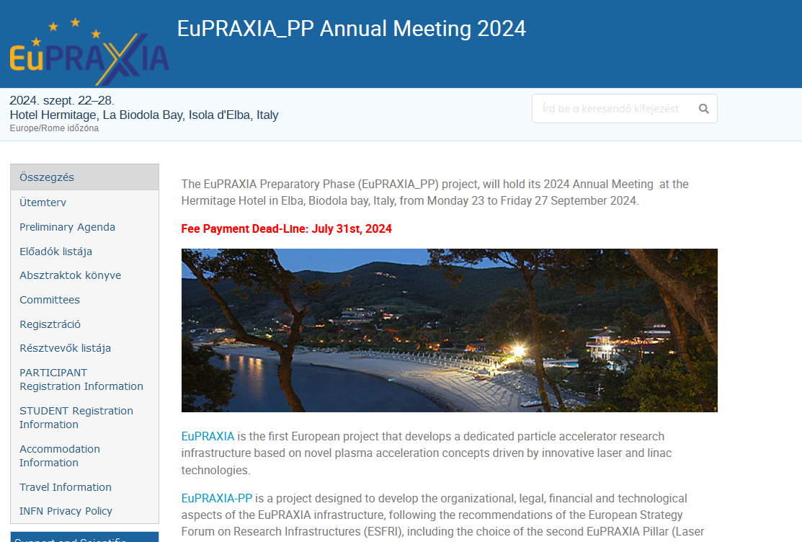
Up to date informations
(in september 2024)
The deliverables, deadlines status reports are always mentioned by the work package leaders
the present status of the Workpackages can be found: EuPRAXIA PP Annual Meeting 2024 2024 Sept 22 -28 Isola d’Elba Italy
https://agenda.infn.it/event/41613/

Slide 24
Phased Implementation of Construction Sites
 | Laser-driven | Beam-driven
Phase 1 | FEL beamline to 1 GeV + user area 1 Ultracompact positron source beamline + positron user area | FEL beamline to 1 GeV + user area 1 GeV-class positrons beamline + positron user area
Phase 2 | X-ray imaging beamline + user area Table-top test beams user area FEL user area 2 FEL to 5 GeV | ICS source beamline + user area HEP detector tests user area FEL user area 2 FEL to 5 GeV
Phase 3 | High-field physics beamline / user area Other future developments | Medical imaging beamline / user area Other future developments
INFN (Italy):
Facility for beam-driven plasma accelerators
Beamline BB-A: Radiation sources
FEL user area 1
Undulator
Undulator
Plasma Accelerator
FEL user area 2
RF Injector
RF Accelerator
ICS X-ray source user area (BU3)
HEP detector test user area
laser
Plasma Accelerator
Conversion & conditioning
electrons
GeV-class positron user area
positrons
Beamline BB-B: GeV-class positrons & HEP detector test stand
Beamline LB-C: X-ray imaging – life sciences & materials
Facility for laser-driven plasma accelerators
Plasma Injector
Life-science & materials X-ray imaging user area
Beamline LB-B: Positron beam source & table-top test beam
Table-top test beam user area
Plasma Injector
Plasma Accelerator
Conversion & conditioning
Ultracompact positron source user area
ELI Beamlines/ELI-ERIC (Prag) Frascati Itali FIXED
EPAC (Oxford)
Centro de Léseres
Pulsados (Salamanca)
CNR (Pisa)
Laser
FEL user area 1
Plasma Accelerator
Undulator
Undulator
RF Injector
Beamline LB-A: FEL
FEL user area 2

Slide 25
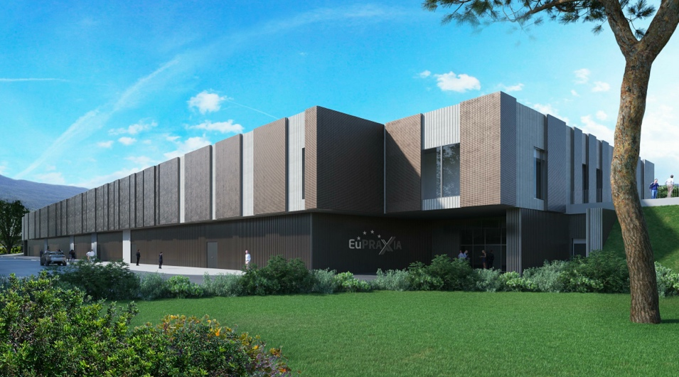
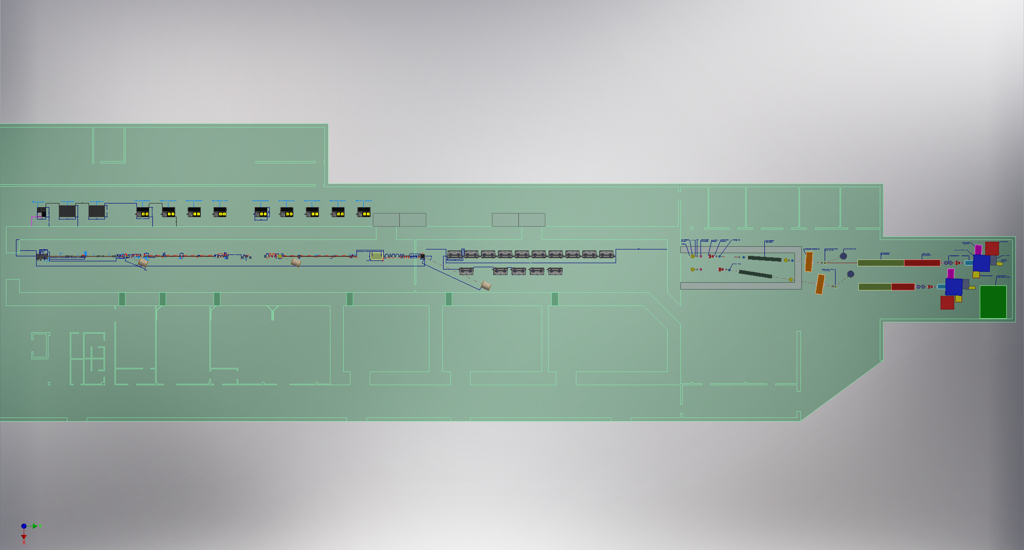
Headquarter and Site 1: EuPRAXIA@SPARC_LAB
Frascati`s future facility
> 130 M€ invest funding
Beam-driven plasma accelerator
Europe`s most compact and most southern FEL
The world`s most compact RF accelerator (X band with CERN)

Slide 26
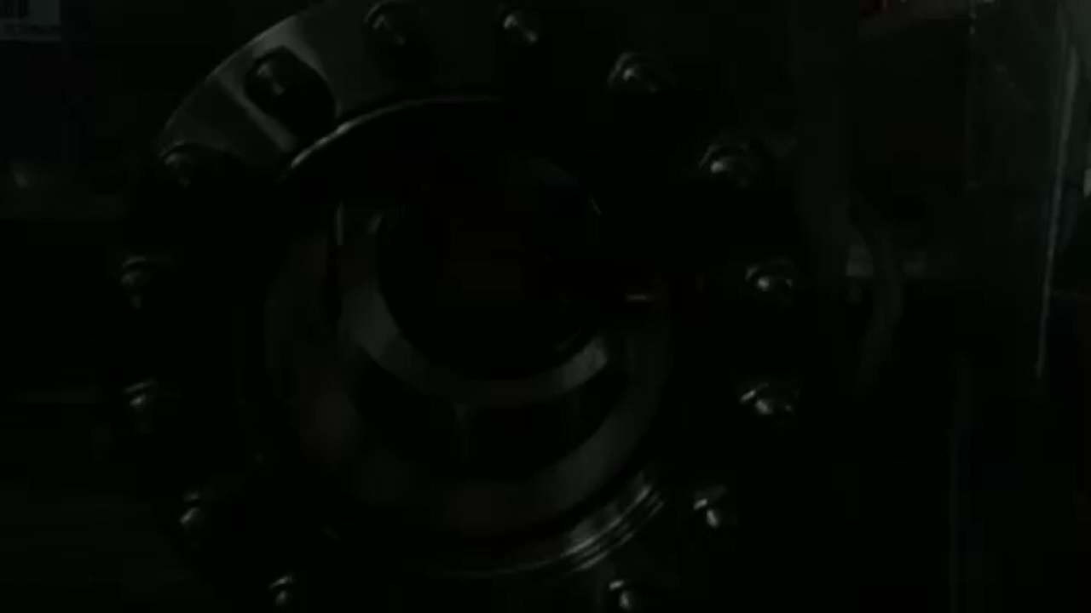
EuPRAXIA@SPARC_LAB
I skipp additional technical details…
Undulators
1 GeV LINAC
Plasma module
RF power modules
FEL user area @4nm
Secondary
Sources
Beam user areas
0.5 PW Laser

Slide 27
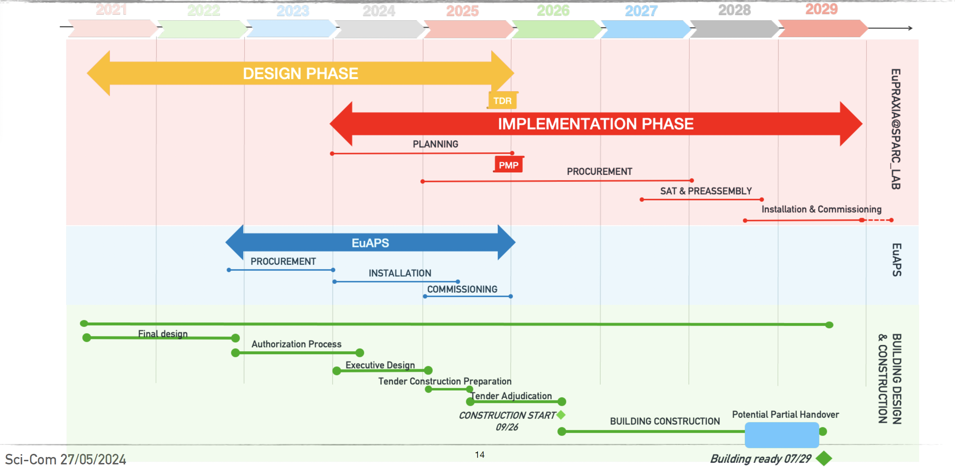
EuPRAXIA@SPARC_LAB baseline updating
in operation:
after 2029

Slide 28
Usage of EuPRAXIA@SPARC_LAB
ARIA will be complementary to the other EuPRAXIA@SPARC_LAB FEL beamline, AQUA
AQUA is a soft-X-ray SASE FEL beamline that will deliver photons in the region between 4 and 10 nm
Parameter | Value
Wavelength | 4-10 nm
Photons/pulse | 10 ¹⁰ - 10 ¹¹
Pulse duration | < 50 fs
Repetition rate | 100 Hz

Slide 29
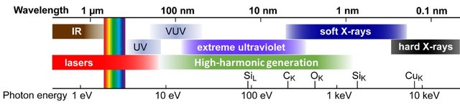
What is ARIA?
ARIA AQUA

Slide 30
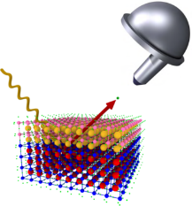
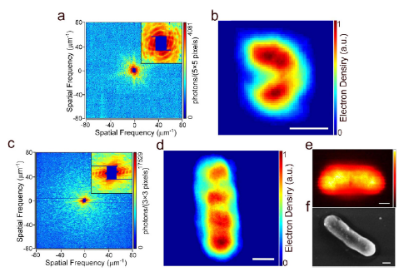
Science @ AQUA in a nutshell
What is is good for?
X-ray & Photoemission pump-probe spectroscopy
Ultrafast studies on hydrocarbons, aminoacids, alloys, warm-dense matter, cuprates, catalysts, batteries
Coherent imaging in the water window, including stereoimaging schemes
Hydrated environment measurements on bacteria, viruses, nanoparticles, ashes…
Ultrafast
Raman spectroscopy
on metalloproteins
and organometallic molecules

Slide 31
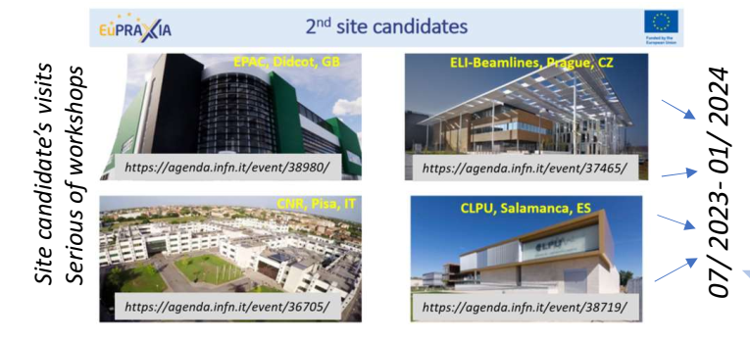
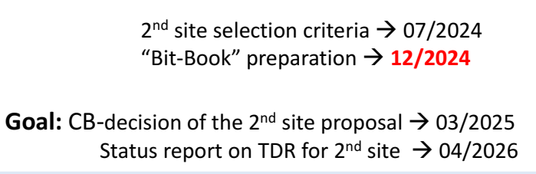
EuPRAXIA second site
The first two sites have
larger chances…
For us in Middle Europe
Prague is favourable...
EPAC has also a neutron
center which is an advantage

Slide 32
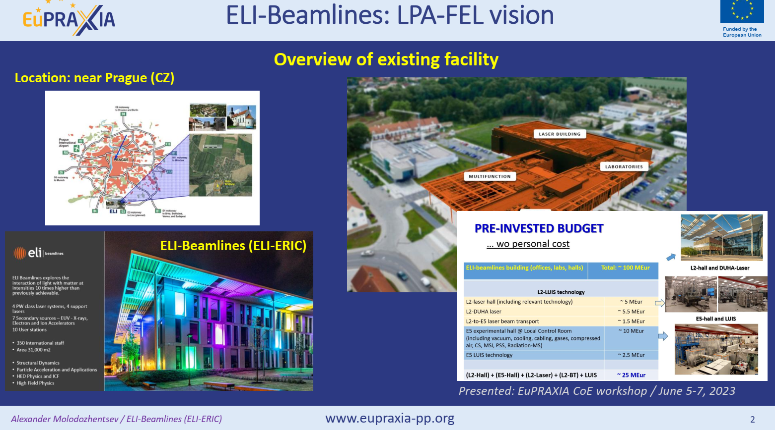
EuPRAXIA second site
The first two sites have
larger chances…
For us in Middle Europe
Prague is favourable...
EPAC has also a neutron
center which is an advantage

Slide 33
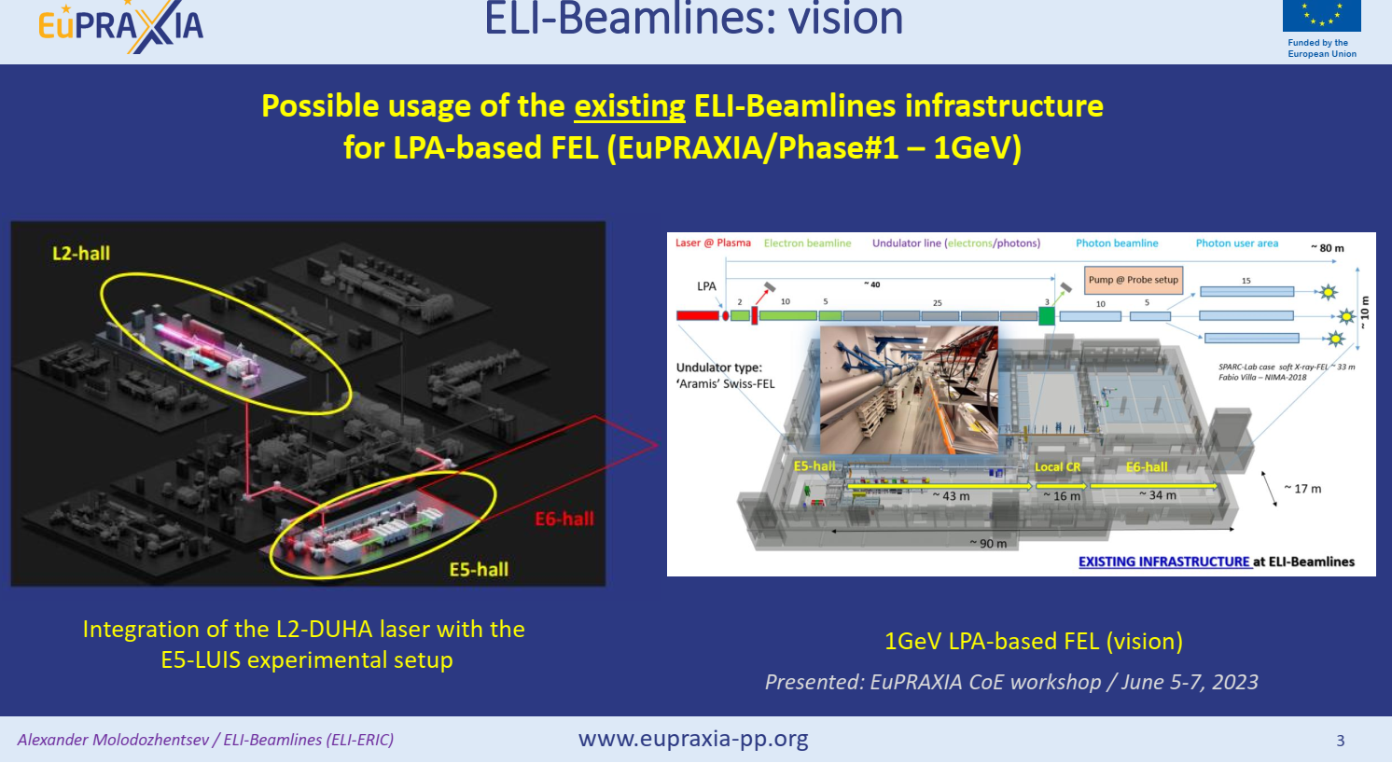


Slide 34
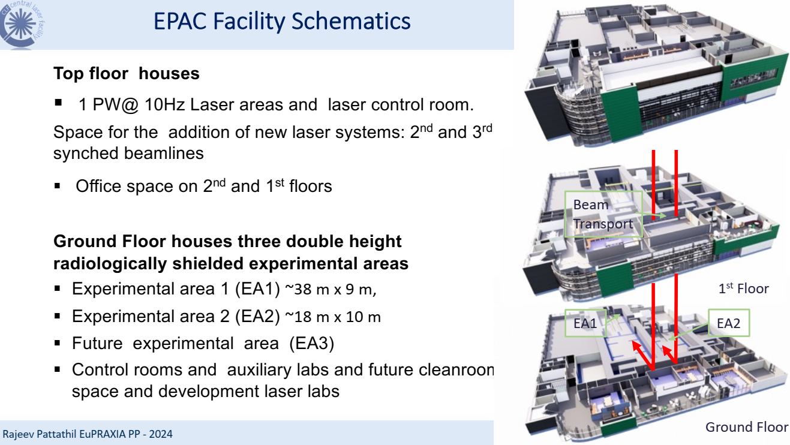
EuPRAXIA second site

Slide 35
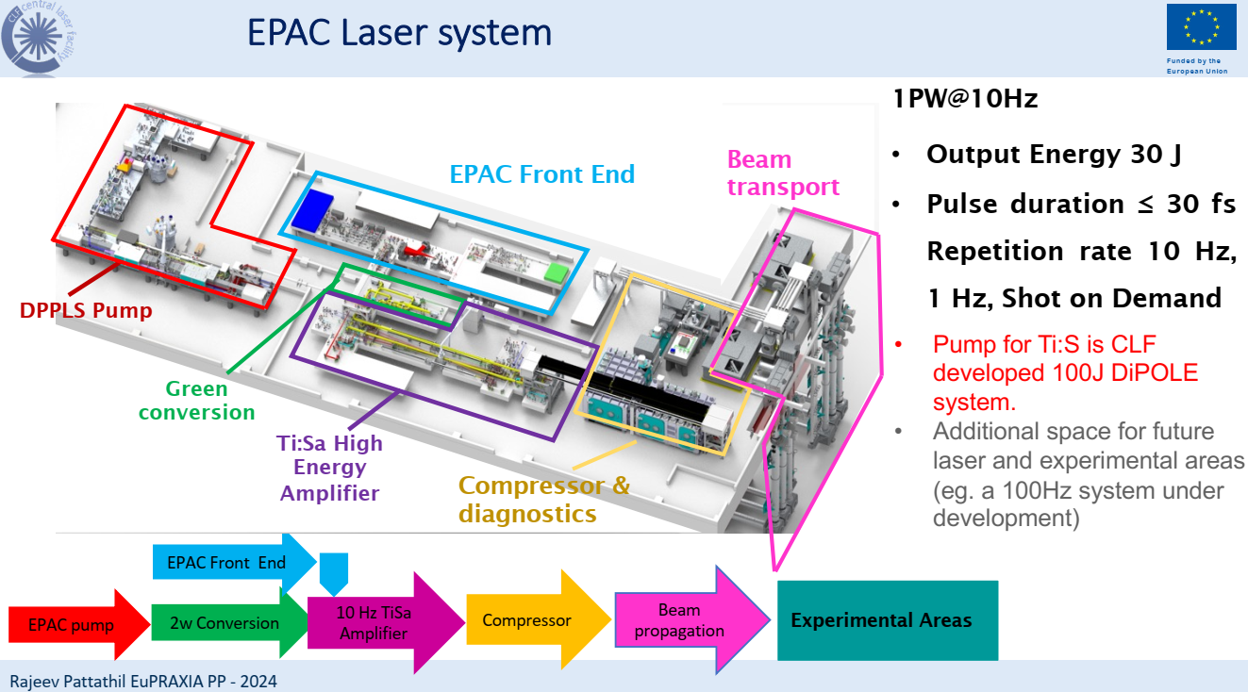
EuPRAXIA second site

Slide 36
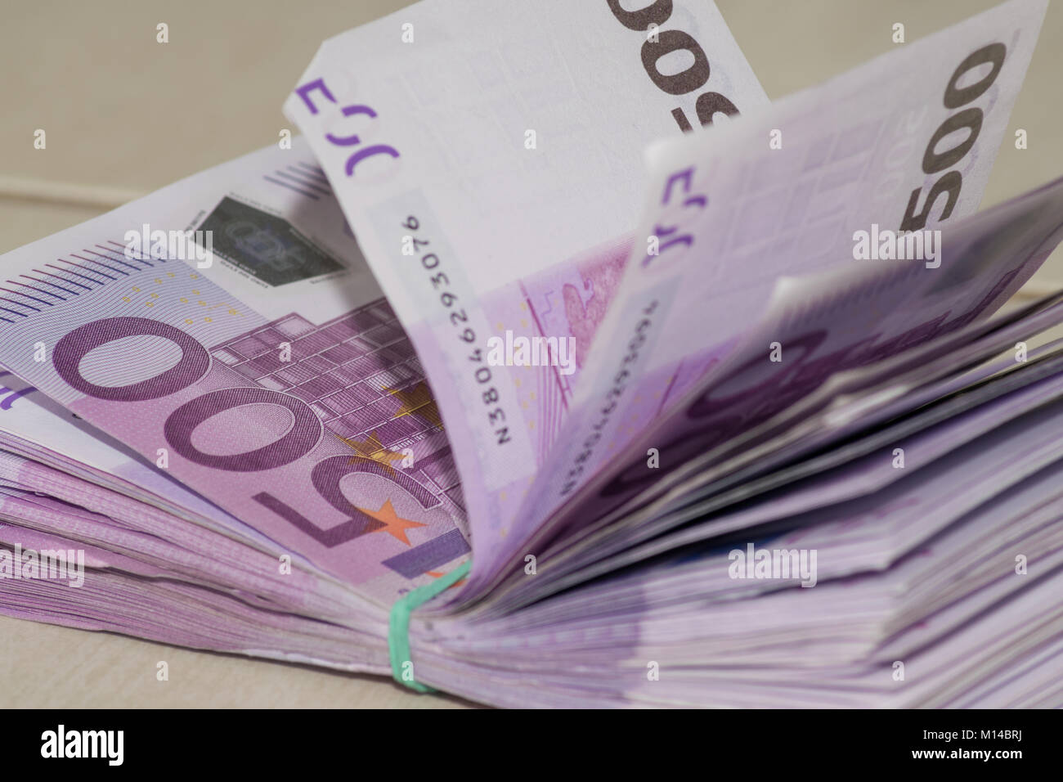
Last but not least the planned prices
- The LHC in CERN was > 7*10⁹ (billion) euro 2010
- The European Spallation Sources was < 2*10⁹ (billion) euro -
green field investment with a 1km long LINAC 1GeV proton 2022
- ELI-ALPS Hungary was about 300 million Euro –
green field investment 2020
- EuPRAXIA Beam Driven site in Italy – “development on a site” > 130 million Euro
- EuPRAXIA laser driven ELI Beamlines/ELI-ERIC (Prag) - 20 million Euro
EPAC (Oxford) - 60 – 80 millio Euro

Slide 37
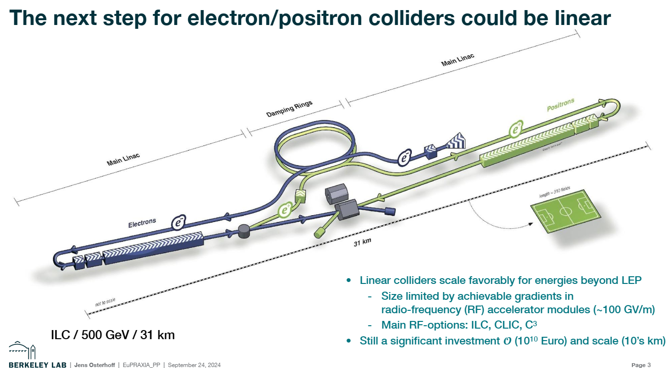
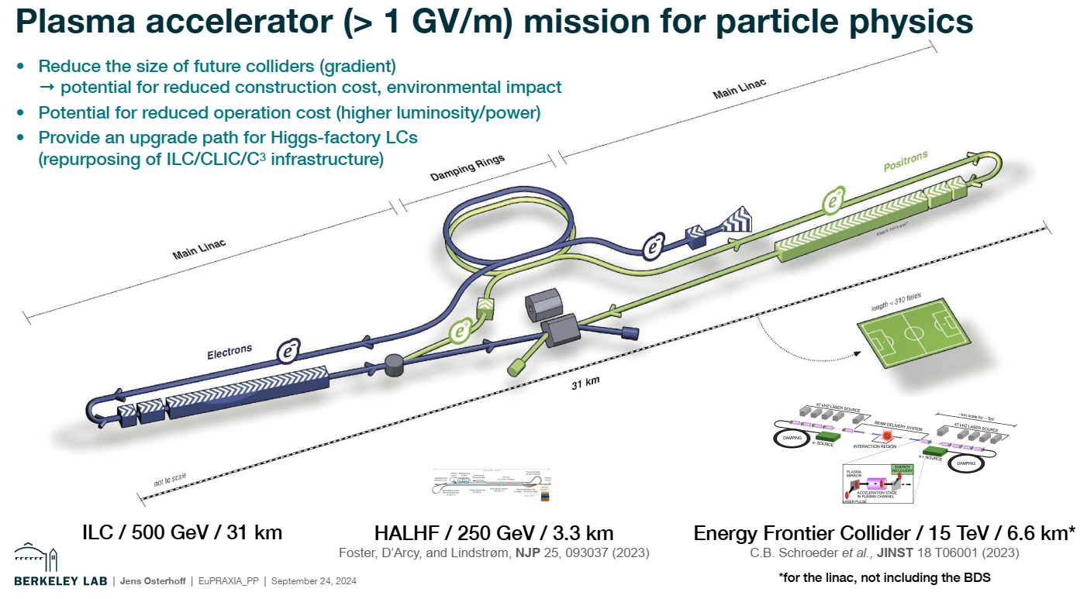
Future plans after EuPRAXIAs in operation
- Overview of plasma based linear collider efforts
Jens Osterhoff – Lawrence Berkley National Lab speculation if it could be done with plasma accelerator, it is known that for electron it is fine
but for pozitron the gradiane is much smaller it could be asymmetric

Slide 38

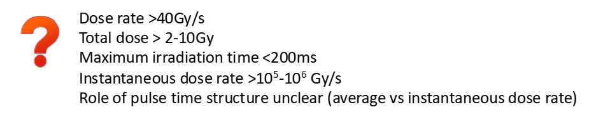


Possible usage of EuPRAXIAs in operation
Towards radiotherapy with ultha high dose rate the FALSH effect
Luca Labate, CNR Pisa,

Slide 39

Possible usage of EuPRAXIAs in operation
The romanian ELI is working in this field so EuPRAXIa might try it too

Slide 40

Possible usage of EuPRAXIAs in operation
The romanian ELI is working in this field so EuPRAXIa might try it too

Slide 41

Acknowledgements
EuPRAXIA Preparatory Phase
This project has received funding from the European Union’s Horizon Europe research and innovation programme under Grant Agreement No. 101079773. It is supported by in-kind contributions by its partners and by additional funding from UK and Switzerland.
EuPRAXIA Doctoral Network
This project has received funding from the European Union´s Horizon Europe research and innovation programme under grant agreement no. 101073480 and the UKRI guarantee funds.
EuAPS
This publication has been made with the co-funding of European Union Next Generation EU.

Slide 42
Thank you for your
attention!

