Slide 1



Theory & Experiment in High Energy Physics
Rare Kaon Decays and
Searches for
Beyond Standard Model Physics
Tomáš Blažek (Comenius University Bratislava)
13/03/2024 V4HEP, KFKI Budapest
Tomas.Blazek@fmph.uniba.sk

Slide 2
Outline
1) Intro to Standard Model (SM)
Why going beyond the SM
How can rare decays help
NA62 Experiment results on rare Kaon decays

Slide 3

Standard Model
Based on work of many bright physicists 1955 ~ 1967
pushing to extend the successful Quantum Electrodynamics
gauge field theory to include also weak (& strong) interactions
1964 – marvellous idea: the „Higgs Mechanism“ Higgs,
Brout & Englert
Guralnik, Hagen, Kibble
1967 – unified theory of EM & Weak force Abdus Salam, Steven Weinberg
1971 – 1973 the theory is renormalisable: ‘t Hooft & Veltman
1973 - … and QCD is asymptotically free: Politzer
Gross & Wilczek
1973 – neutral currents observed: the first successful prediction
Gargamelle bubble chamber at CERN
1983 – W & Z boson discovery, UA1 & UA2 Experiments at CERN
...
2013
1979
1999
2004
1984

Slide 4
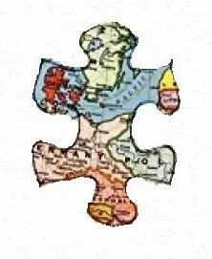
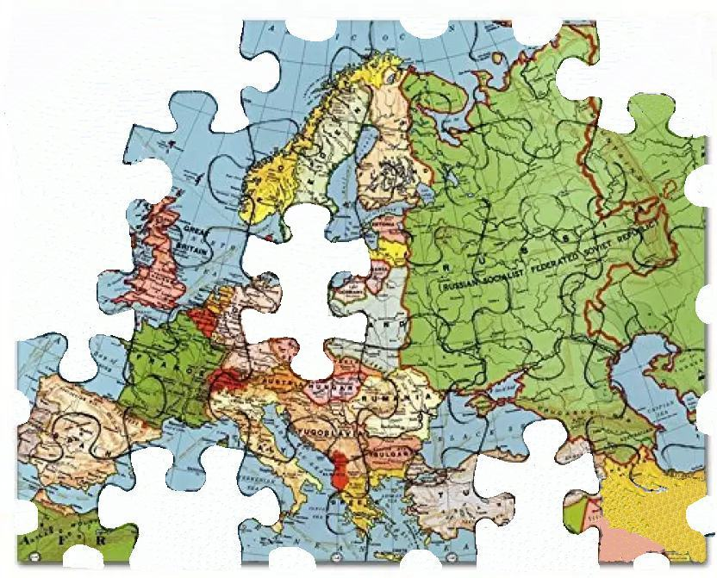
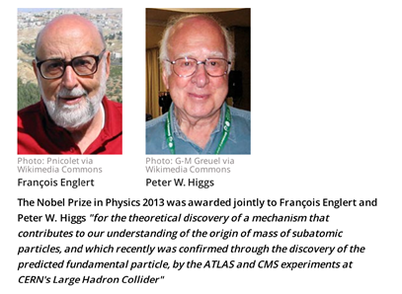

Standard Model
2012 – Higgs Boson discovery
ATLAS & CMS Experiments at CERN
The missing
piece
2013

Slide 5
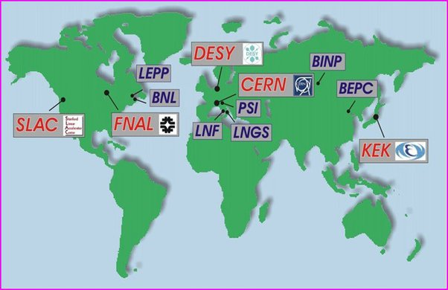
The SM agrees with all CERN experiments,
furthermore, it agrees with all accelerator experiments
across the world.

Slide 6
Is there anything more to be done at the LHC?
Why Future Circular Collider (FCC) ?

Slide 7
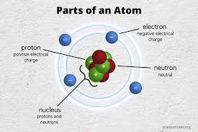
What is the Standard Model?
Elementary (point-like) particles:
u quark
d quark
electron
electron neutrino
} QUARKS
} LEPTONS
} This is where they are
(except neutrinos)

Slide 8
What is the Standard Model?
In fact, we observe THREE generations of Quarks and Leptons:
u c t
d s b
e⁻ μ⁻ τ⁻
ν_{e} ν_{μ} ν_{τ}
} QUARKS
} LEPTONS
The second part of the talk will be on the s-quark decays
inside K mesons
} s,c,b,t quarks and 4 more leptons
are not here: they are massive and decay away

Slide 9
The Standard Model is a quantum theory
Gauge (& Yukawa) Interactions among Quarks & Leptons
Even the Vacuum State contains interactions among virtual particles
Gauge Symmetry: need to add
Interactions: elektromagnetic PHOTONS
strong GLUONS
weak W & Z BOSONS
gravity GRAVITONS ?

Slide 10
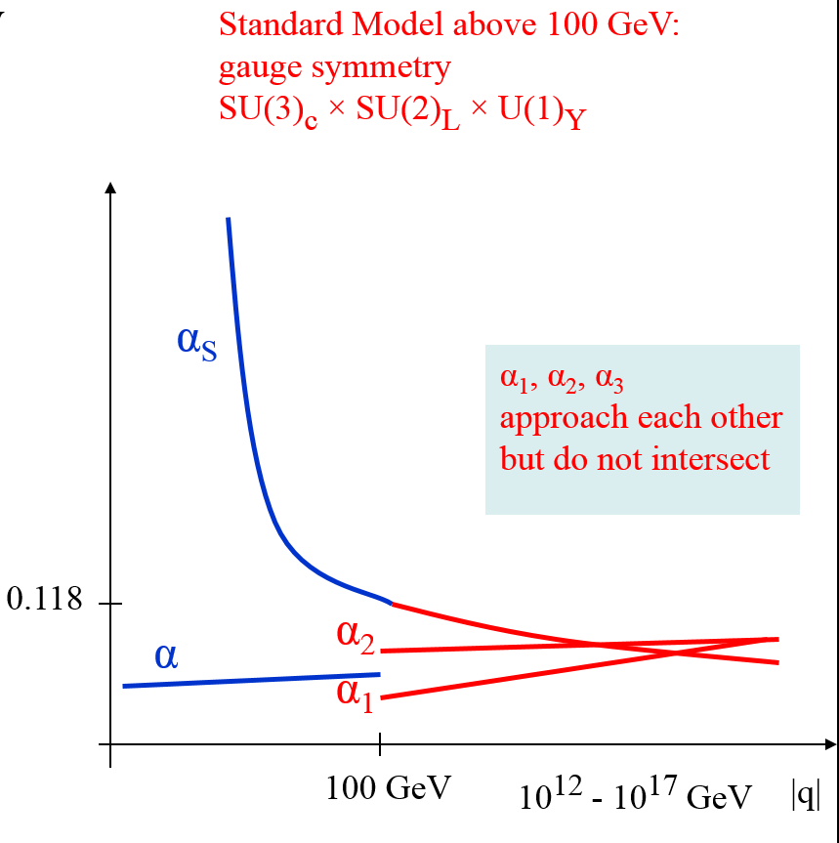
Interactions and the corresponding couplings (=charges) in the Standard Model
at energies E « 100 GeV , E ≈ 100 GeV a E » 100 GeV
Running Couplings in the Standard Model
Quarks become
confined within
baryons and mesons
strong force:
from
GLUON
exchange
Note:
The hierarchy between the electroweak scale 100 GeV
and indicated unification scale
is disturbingly unnatural
if the Standard Model higgs boson, a scalar, is present
electric force:
PHOTON exchange
q = momentum transfer
The Weak Force is non-renormalisable at E « 100 GeV
and in this regime it cannot be described the same way

Slide 11
Interactions and the corresponding couplings (=charges) in the Standard Model
at energies E « 100 GeV , E ≈ 100 GeV a E » 100 GeV
Running Couplings in the Standard Model
Quarks become
confined within
baryons and mesons
strong force:
from
GLUON
exchange
Note:
The hierarchy between the electroweak scale 100 GeV
and indicated unification scale
is disturbingly unnatural
if the Standard Model higgs boson, a scalar, is present
electric force:
PHOTON exchange
q = momentum transfer
The Weak Force is non-renormalisable at E « 100 GeV
and in this regime it cannot be described the same way

Slide 12
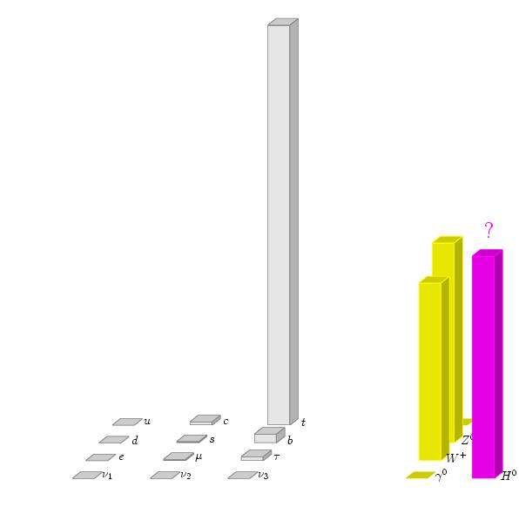
Standard Model particle content & masses
M_{top quark} = 173 ± 1 GeV/c²
M_{Z boson} = 91 ± 0.002 GeV/c²
M_{W boson} = 80 ± 0.02 GeV/c²
M_{Higgs} = 125.09 ± 0.24 GeV/c²
quarks and leptons
bosons
1st generation
2nd generation
3rd generation

Slide 13
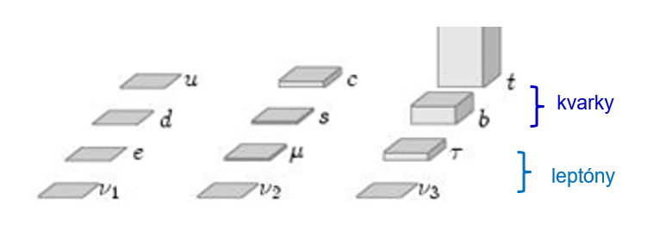
Standard Model particle content & masses - fermion mass details

Slide 14
If the accelerator observations fit the SM with the discovered
Higgs Boson why do we wish to advance the experiment
? ? ? ? ?

Slide 15
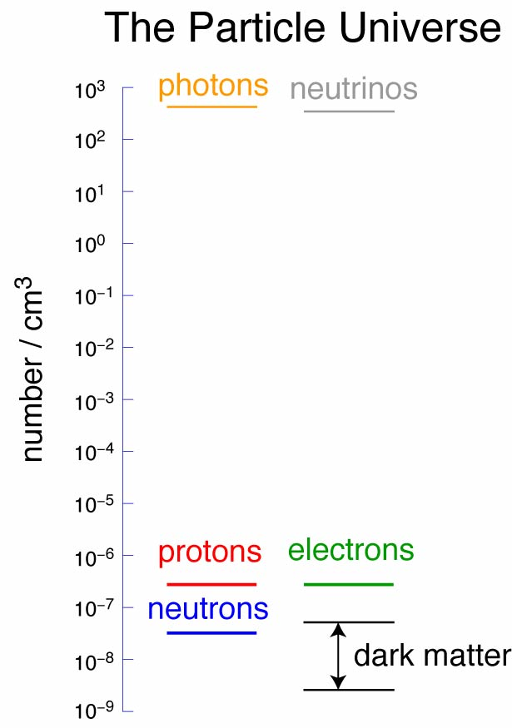
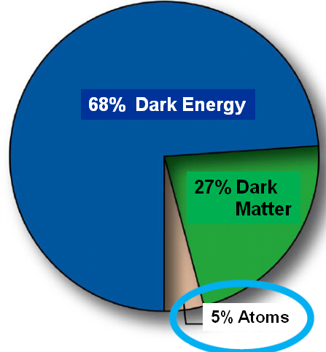
Our Universe
observed stable particle densities
energy density contributions
?

Slide 16
Why need to go Beyond the Standard Model
Experimental Motivation
What is Dark Matter?
Why does the Universe’s Expansion accelerate? What is Dark Energy?
Why is there more matter than antimatter?
Theoretical Motivovation
Origin of Gauge Symmetry SU(3)_{c} x spontaneously broken SU(2)_{L} x U(1)_{Y} ?
Origin of the observed particle multiplets as low-dim irreps of the gauge symmetry
... in principle, many other irreps might be observed by quarks/leptons
Origin ... of 3 fermionic generations
Origin ... electric charge quantization
Origin … observed fermionic masses & mixings
Origin ... ~ 100 GeV scale of EWSB
Origin ... Planck scale » 100 GeV?
... Dark Energy scale « 100 GeV?
answers would be very welcome
Motivation for more complete
“Beyond Standard Model” theory

Slide 17
Large number of Theoretical Ideas investigated
e.g., Beautiful idea of Supersymmetry - with its surprises
Gauge Coupling Unification at energies two orders below the Planck Scale
α_{S}
α
α₂
α₁
100 GeV
10¹⁶ GeV
|q|
q = momentum transfer
Other example of a SUSY surprise:
Higgs mass to be below 140 GeV

Slide 18
The Large Hadron Collider:
13 years Searches for signals of Beyond Standard Model Physics
No clear cut signal found
New idea:
Keep looking for Direct production of new particles at the LHC
but at the same time
Pay attention also to rare or forbidden processes
(especially decays) at much lower energies

Slide 19
Indirect NEW PHYSICS Searches
Examples of rare or forbidden decays at low energies
BR(B_{s}⁰ → μ ⁺ μ ⁻ )
BR(K⁺ → π ⁺ ν νbar)
R_{K} = Γ(K ⁺ → e⁺ ν_{e}) / Γ(K ⁺ → μ⁺ ν_{μ})
BR(τ→eγ)
BR(H→ τ μ)
with P.Maták, Intl. J. Phys. 2014, PhD Thesis 2015
with P.Maták, Z.Kučerová
and Z.Šinská, M.S. Thesis 2016
with S.Beznák, M.S. Thesis 2017
constraining non-Minimal SUSY parameter space
A VERY BROAD topic

Slide 20
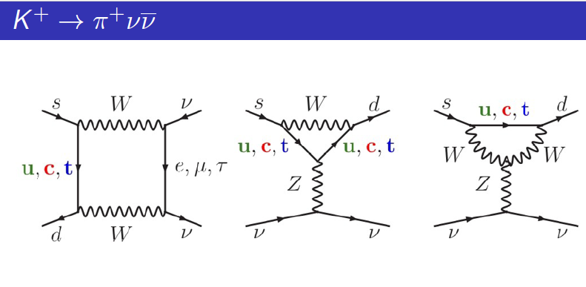
Kaon Decays: (weak decay of the s-quark)
easily accessible (mK ~ 0.5 GeV)
Flavor-changing neutral currents (FCNC) responsible for many decay channels
(no tree-level amplitudes)
Studied by the NA62 Collaboration with the goal to observe
K+ → π+ ν ν
Dominated by top exchange
(suppression by top propagators,
and by V_{td}*V_{ts})
Potentially competing with new
heavy particles in the loop
Long range hadronic corrections
more under control than elsewhere
- theoretically very clean

Slide 21
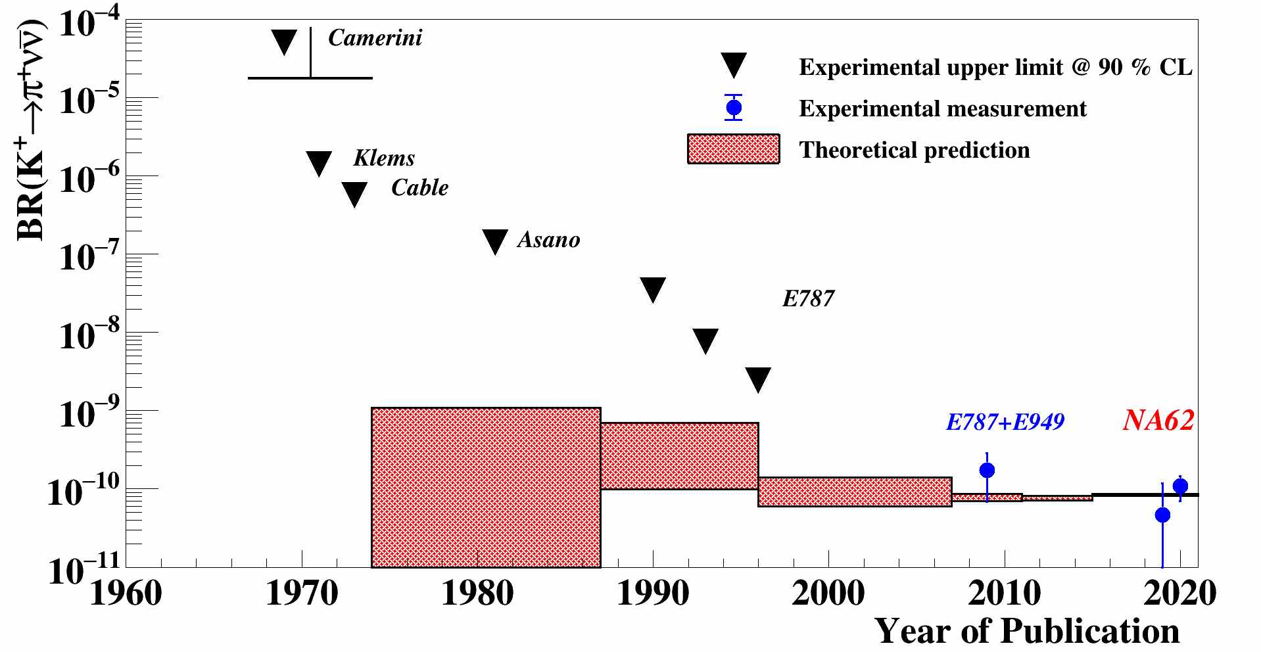
K+ → π+ ν ν - the main goal of NA62 Experiment

Slide 22

K+ → π+ ν ν - the main goal of NA62 Experiment
Experiment: BR( K+ → π+ ν ν ) = ( 10.6 _{stat} ± 0.9_{syst} ) x 10⁻¹¹ NA62, 2020
First experimental evidence
Theoretical SM prediction: BR( K+ → π+ ν ν ) = ( 8.4 ± 0.4 ) x 10⁻¹¹ Buras et al, 2022
Very demanding to measure, must understand the backgrounds to more than 10 orders!
However, NA62 measures many more other kaon decay channels due to large data samples (high intensity initial proton beam from SPS at CERN)

Slide 23
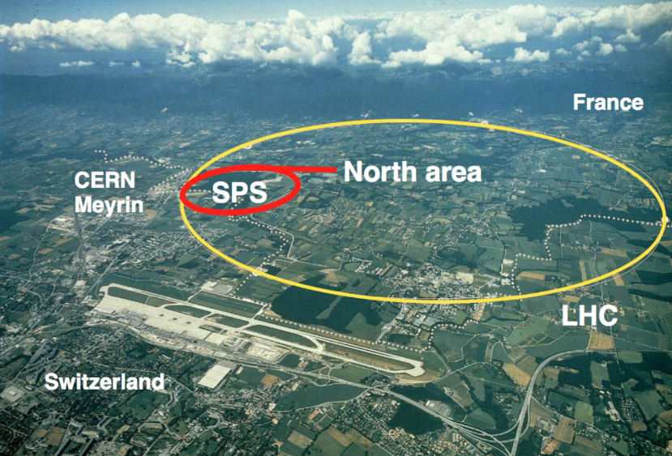
NA62 Experiment

Slide 24
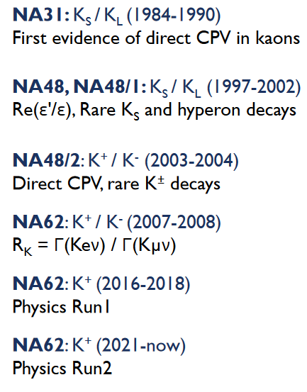
Kaon Physics at CERN: history

Slide 25
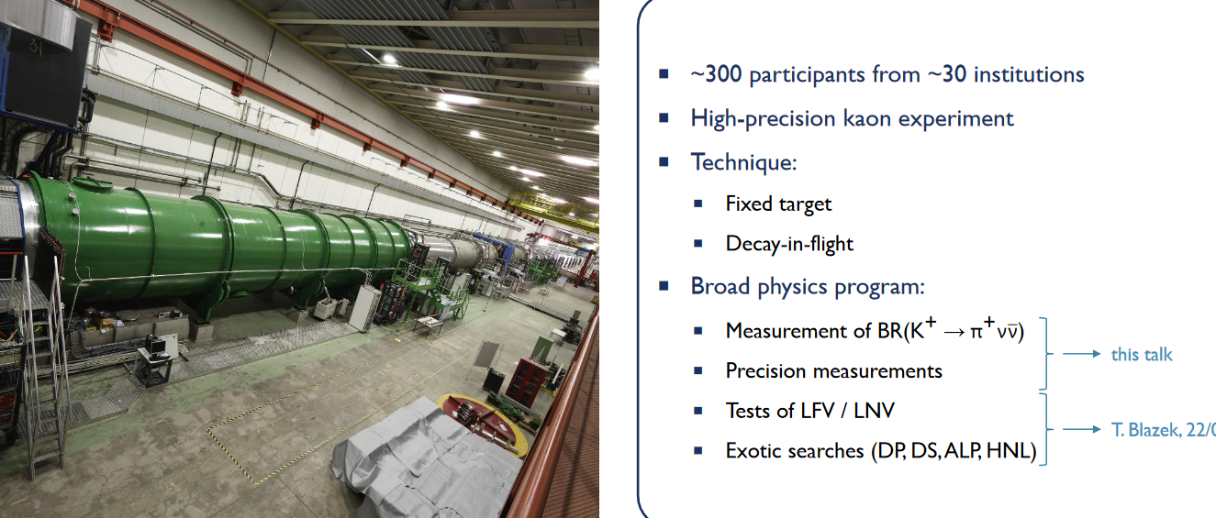
NA62 Experiment

Slide 26
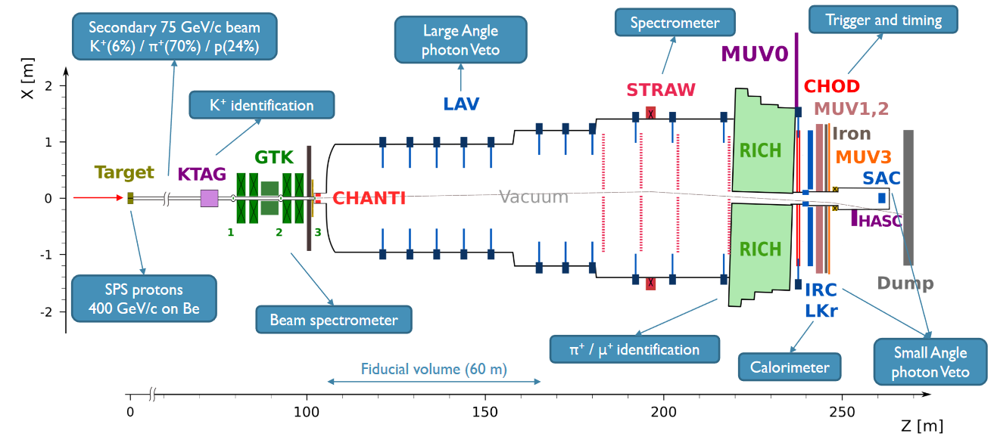
The NA62 Detector

Slide 27
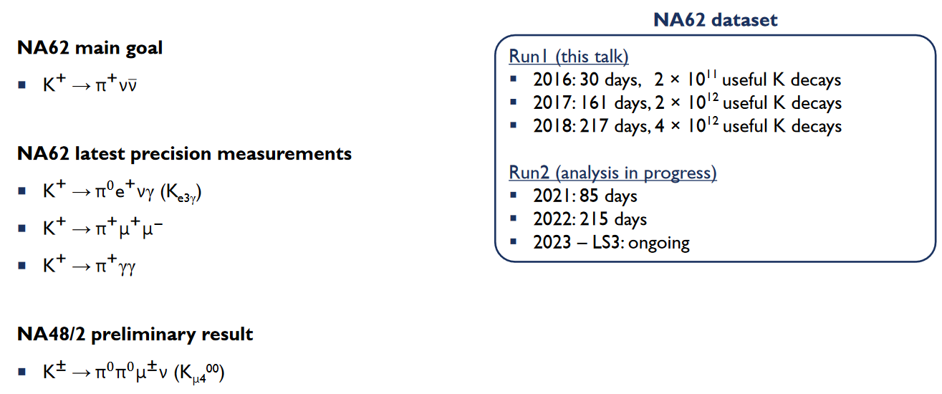
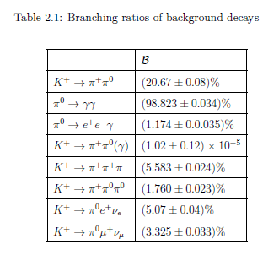
Outline of the Kaon Decay results in this talk

Slide 28

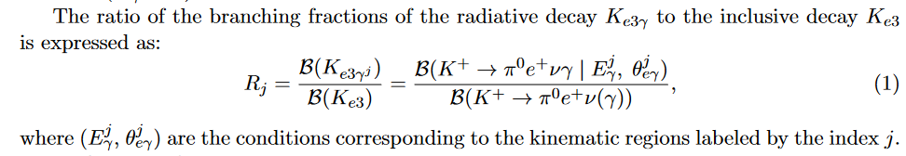
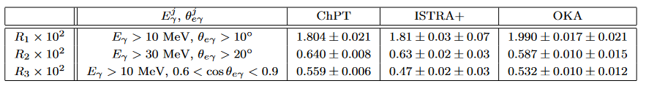
NA62 latest precision measurements

Slide 29
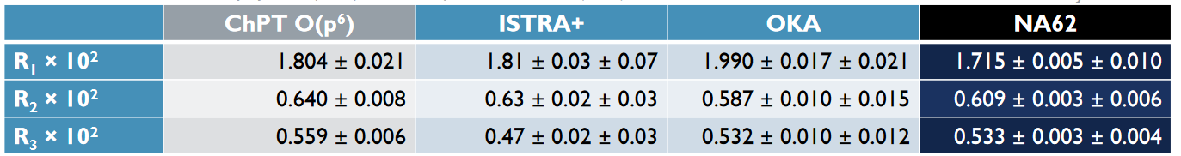
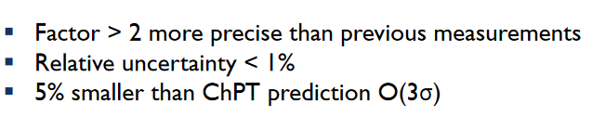
NA62 latest precision measurements
results JHEP 09 (2023) 040

Slide 30

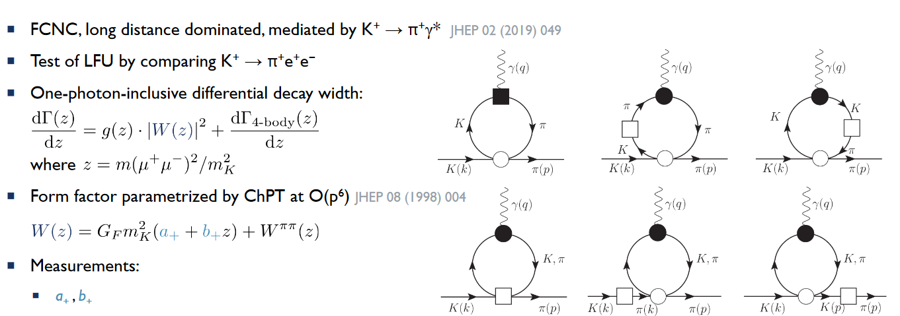
NA62 latest precision measurements

Slide 31
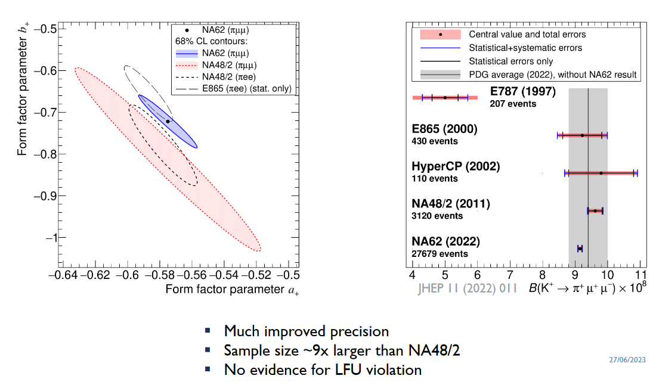
NA62 latest precision measurements
results JHEP 11 (2022) 011

Slide 32
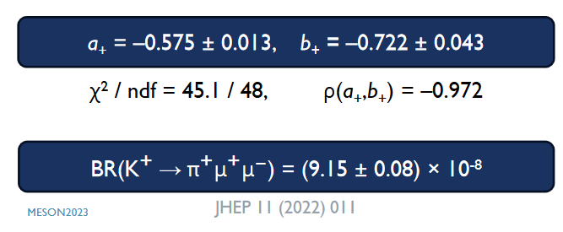
NA62 latest precision measurements
results JHEP 11 (2022) 011
Factor 3 improvement

Slide 33

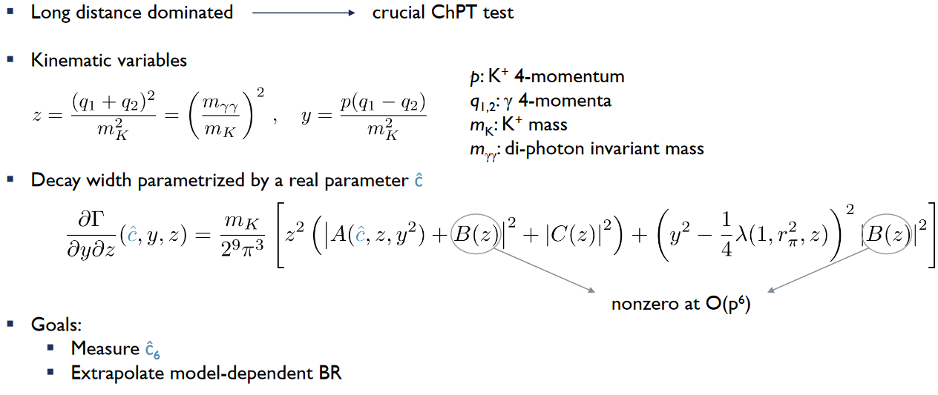
NA62 latest precision measurements
Theory: Phys.Lett. B386 (1996) 403

Slide 34
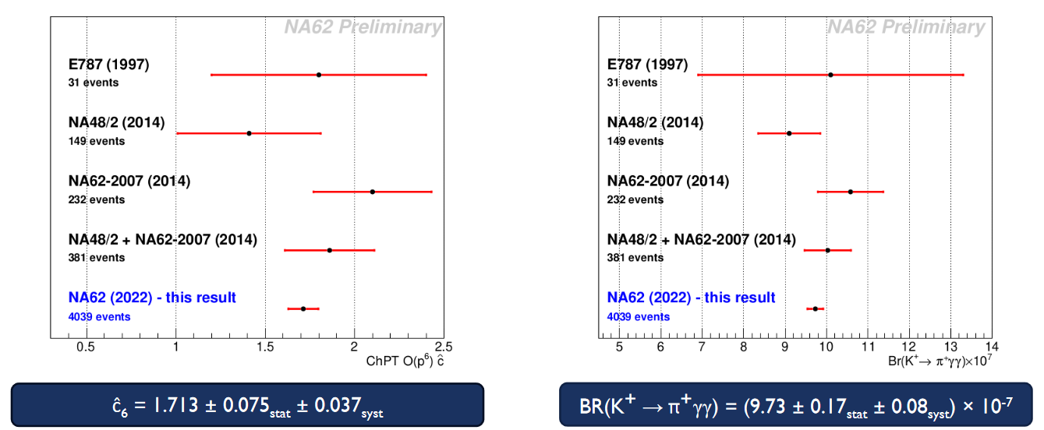
NA62 latest precision measurements
results Preliminary from MESON2023

Slide 35
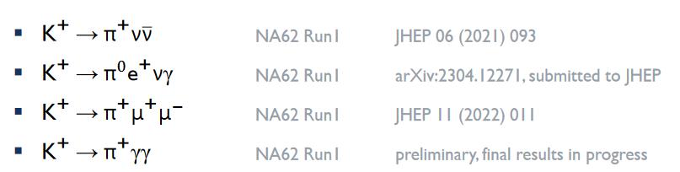
Summary
1) Low-energy indirect searches for new physics beyond Standard Model are in place and have the potential to find signals before the LHC experiments
NA62 Kaon Physics program is an example of such a search
NA62 search is ongoing by the start of Long Shutdown at end of 2025 ?
Examples of the latest precision measurement results from the NA62 Experiment were given:
No clear-cut signals of new physics have been found so far.

