Slide 1
Axion-Like-Particle Search Using Machine Learning for the Signal Sensitivity Optimization with Run-2 LHC Data Recorded by the ATLAS Experiment
Ondřej Matoušek
Czech Technical University in Prague
                Supervisor
                Doc. Dr. André Sopczak

Slide 2
Content
CERN
Theoretical indroduction
Original search results
The task
The solution
Results of the project

Slide 3
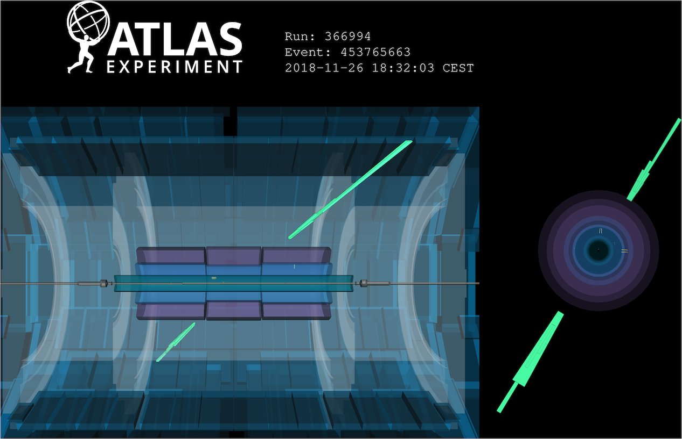
CERN, LHC, ATLAS
SM $γγ→γγ$ observed in lead ion collisions
Phys. Rev. Lett. 123 (2019) 052001

Slide 4
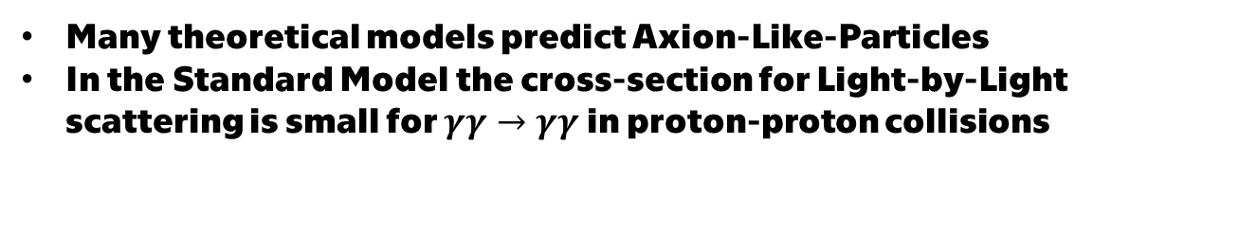
Theoretical introduction
Many theoretical models predict Axion-Like-Particles
In the Standard Model the cross-section for Light-by-Light scattering is small for $γγ→γγ$ in proton-proton collisions
BSM the ALP enhances this cross-section

Slide 5
Single
dissociative
Double
dissociative
Exclusive

Slide 6
Single
dissociative
Exclusive and Double dissociative events already have the maximal possible efficiency, which is limited by the physical constrains ofthe meassuring process.

Slide 7
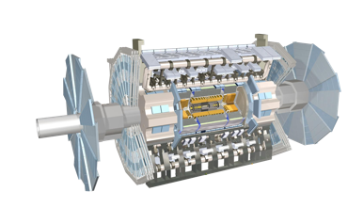
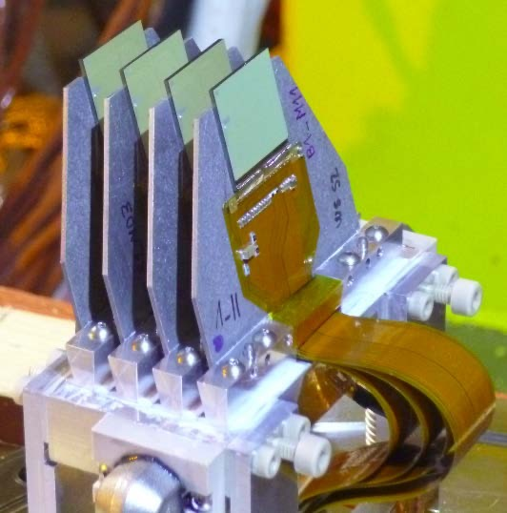

ATLAS forward proton (AFP) detectors
Light-by-Light scattering
AFP
ATLAS detector
proton
A-side
~+200 m
AFP
proton
C-side
~$−$200 m

Slide 8
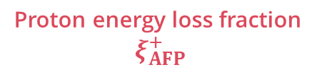
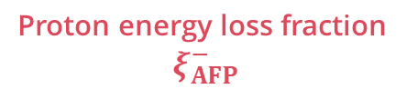
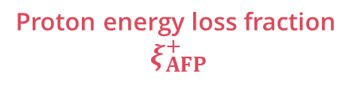




AFP pixel detector
$$x$$
Proton energy loss fraction
$$ξ_{AFP}^{+}$$
AFP
$$z$$
High acceptance range
proton
ATLAS detector
~+200 m
A-side
AFP
Dipole magnet
proton
~+70 m
C-side
Proton energy loss fraction
$$ξ_{AFP}^{+}$$
~$−$70 m
~$−$200 m
Exclusive event
Proton energy loss fraction
$$ξ_{AFP}^{−}$$

Slide 9
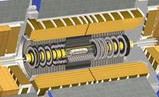



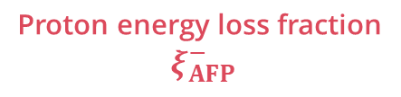

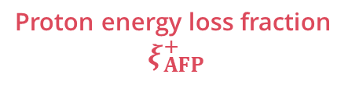
Main strategy
Match $ξ_{AFP}$ to $ξ_{γγ}$:
AFP
ATLAS detector
A-side
~+200 m
AFP
Proton energy loss fraction
$$ξ_{AFP}^{+}$$
C-side
~$−$200 m
Diphoton $ξ_{γγ}^{±}$
Proton energy loss fraction
$$ξ_{AFP}^{−}$$
6.5 TeV
$$γ$$
$$γ$$
EM calorimeter
6.5 TeV

Slide 10
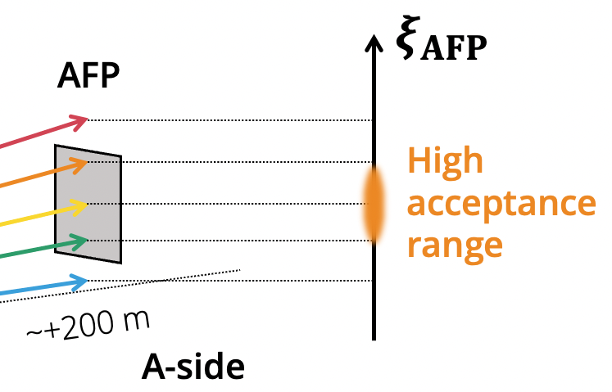
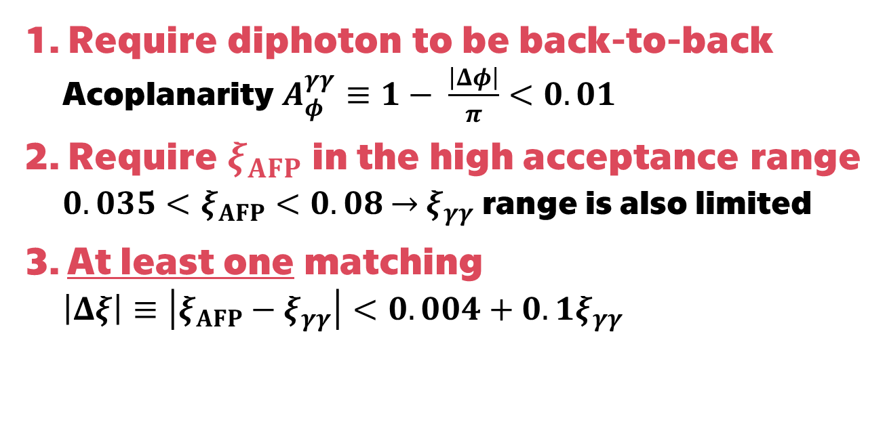
Event selection
Require diphoton to be back-to-back
  Acoplanarity $A_{φ}^{γγ}≡1− \frac{\left|Δφ\right|}{π}<0.01$
Require $ξ_{AFP}$ in the high acceptance range
  $0.035<ξ_{AFP}<0.08$ $→$ $ξ_{γγ}$ range is also limited
At least one matching
  $\left|Δξ\right|≡\left|ξ_{AFP}−ξ_{γγ}\right|<0.004+0.1ξ_{γγ}$

Slide 11
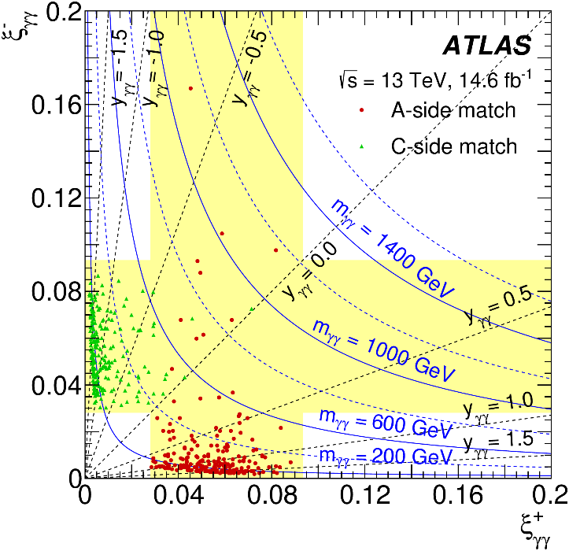
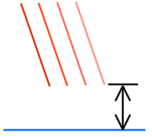


Original search results
arXiv:2304.10953
441 events observed
Dominant systematic uncertainity:
AFP global alignment
AFP
$$d≈2−3 mm$$
Beam
$$σ_{d}≈300 μm$$
No double matching

Slide 12
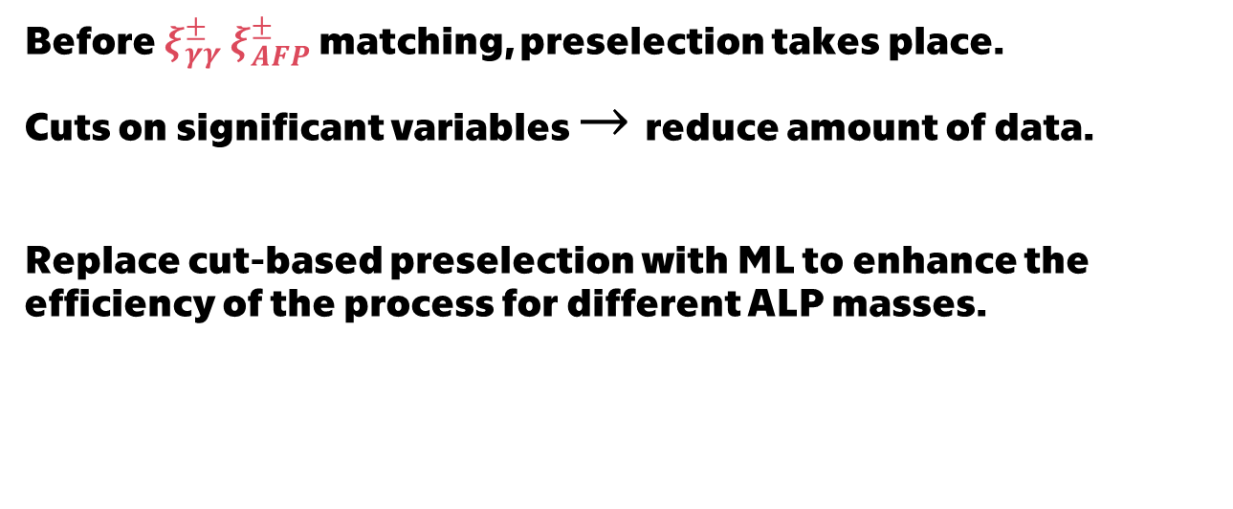
The task
Before $ξ_{γγ}^{±}$ $ξ_{AFP}^{±}$ matching, preselection takes place.
Cuts on significant variables $→$reduce amount of data.
Replace cut-based preselection with ML to enhance the efficiency of the process for different ALP masses.

Slide 13
The solution
Binary classifier to distinguish signal/background.
Input features are the same variables as the ones used in preselection.
In total cca 600 000 signal and 70 000 background data were used.
Division 70% / 30% for training / validation.
Signal was generated artificially and for background data, real measured Run-2 data were used.

Slide 14
Classifier model
Training with weighted binary cross-entropy loss function + optimizer Adam.
Linear
Linear
Linear
5 input features
BN
BN
ReLU
ReLU
Softmax
Acoplanarity
Pseudorapidities of both protons
Transverse momenta of both protons

Slide 15
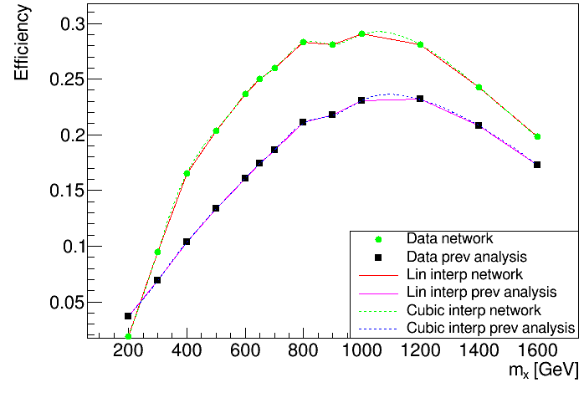

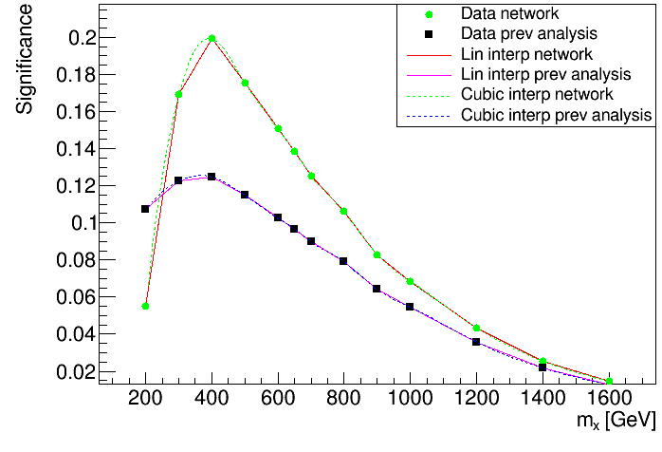
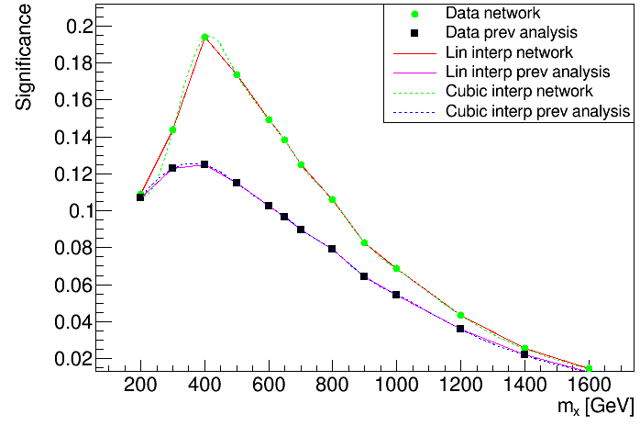

Results of the project
optimization
$$significance= \frac{s}{\sqrt{b}}$$

Slide 16










Different background data generation
arXiv:2304.10953
Another approach for future studies
Photons and protons are recorded for each event
Event 1
$$ξ_{γγ}^{(1)}$$
$$ξ_{AFP}^{(1)}$$
Event 2
$$ξ_{γγ}^{(2)}$$
$$ξ_{AFP}^{(2)}$$
Event 3
$$ξ_{γγ}^{(3)}$$
$$ξ_{AFP}^{(3)}$$
…
…
…
Event N-1
$$ξ_{γγ}^{(N−1)}$$
$$ξ_{AFP}^{(N−1)}$$
Event N
$$ξ_{γγ}^{(N)}$$
$$ξ_{AFP}^{(N)}$$
16

Slide 17

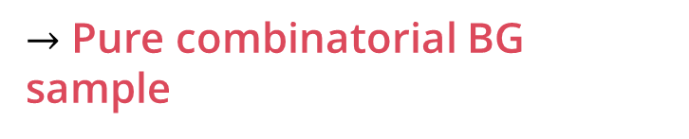
Different background data generation
arXiv:2304.10953
Another approach for future studies
Photons and protons are recorded for each event
Reassignment of
protons to diphotons
Event 1
$$ξ_{γγ}^{(1)}$$
$$ξ_{AFP}^{(1)}$$
Event 2
$$ξ_{γγ}^{(2)}$$
$$ξ_{AFP}^{(2)}$$
$→$ Pure combinatorial BG sample
Event 3
$$ξ_{γγ}^{(3)}$$
$$ξ_{AFP}^{(3)}$$
…
…
…
Event N-1
$$ξ_{γγ}^{(N−1)}$$
$$ξ_{AFP}^{(N−1)}$$
Event N
$$ξ_{γγ}^{(N)}$$
$$ξ_{AFP}^{(N)}$$

Slide 18
Different background data generation
arXiv:2304.10953
Another approach for future studies
Photons and protons are recorded for each event
Reassignment of
protons to diphotons
Event 1
$$ξ_{γγ}^{(1)}$$
$$ξ_{AFP}^{(1)}$$
Event 2
$$ξ_{γγ}^{(2)}$$
$$ξ_{AFP}^{(2)}$$
$→$ Pure combinatorial BG sample
Event 3
$$ξ_{γγ}^{(3)}$$
$$ξ_{AFP}^{(3)}$$
…
…
…
Event N-1
$$ξ_{γγ}^{(N−1)}$$
$$ξ_{AFP}^{(N−1)}$$
Event N
$$ξ_{γγ}^{(N)}$$
$$ξ_{AFP}^{(N)}$$

Slide 19
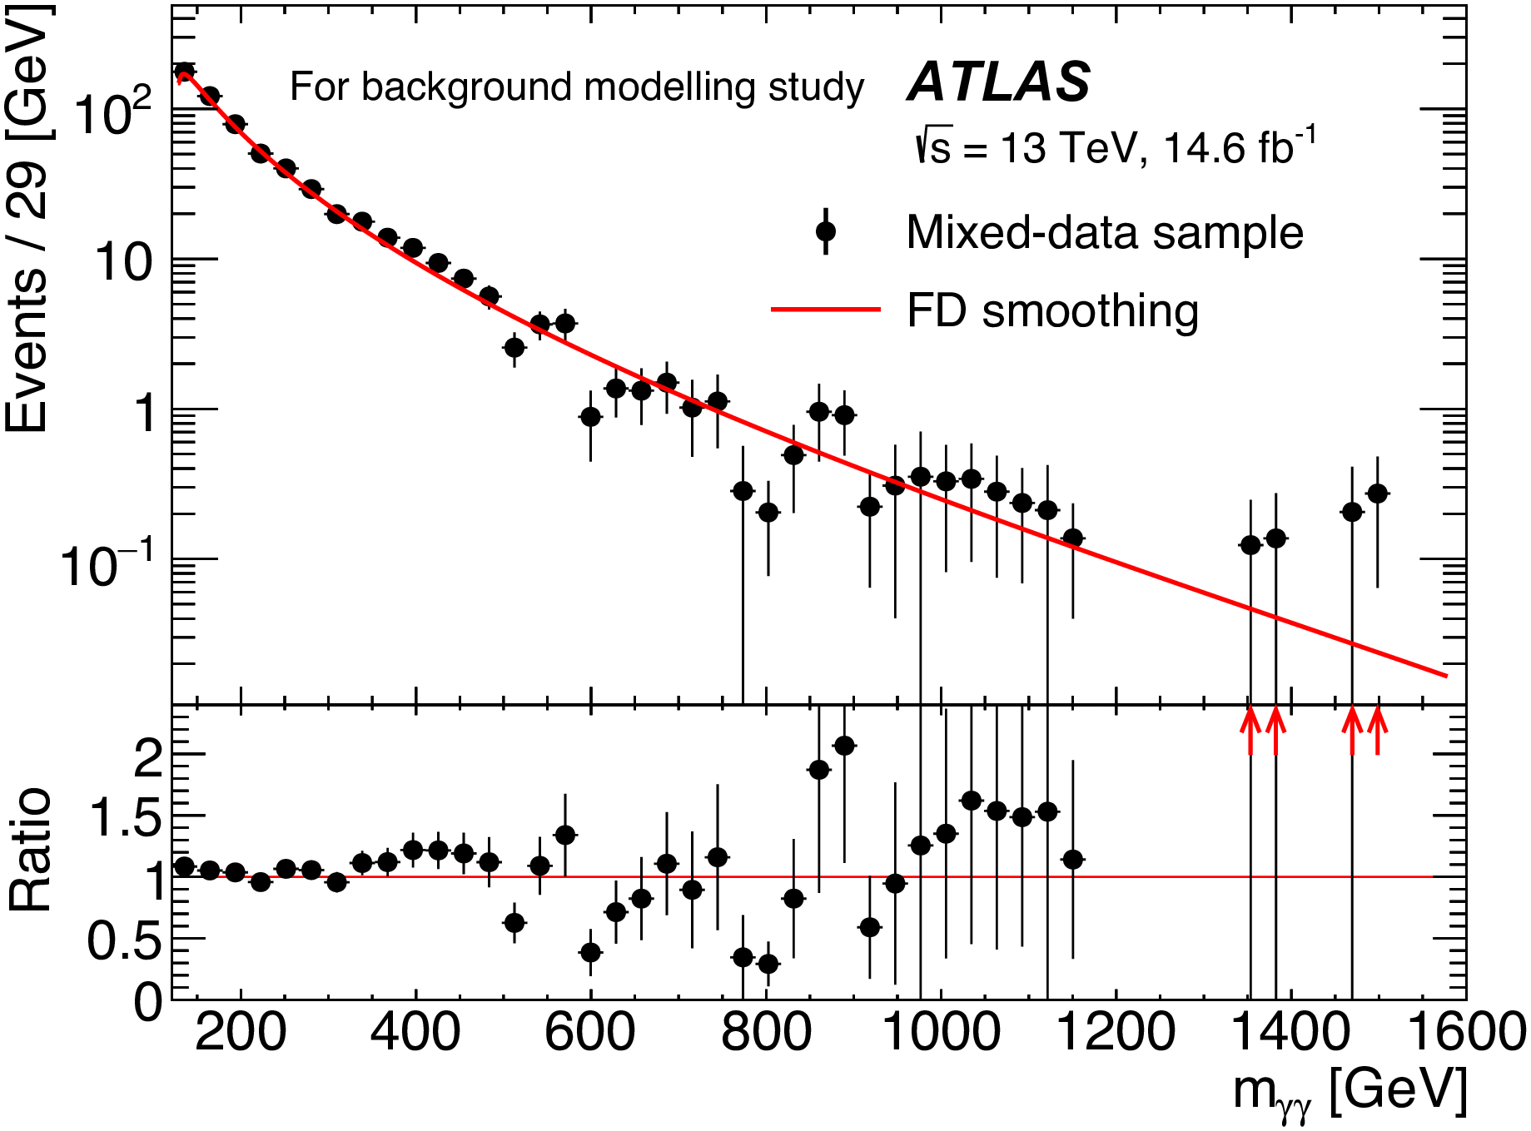
Backround approximation
Functional Decomposition
arXiv:2304.10953

Slide 20
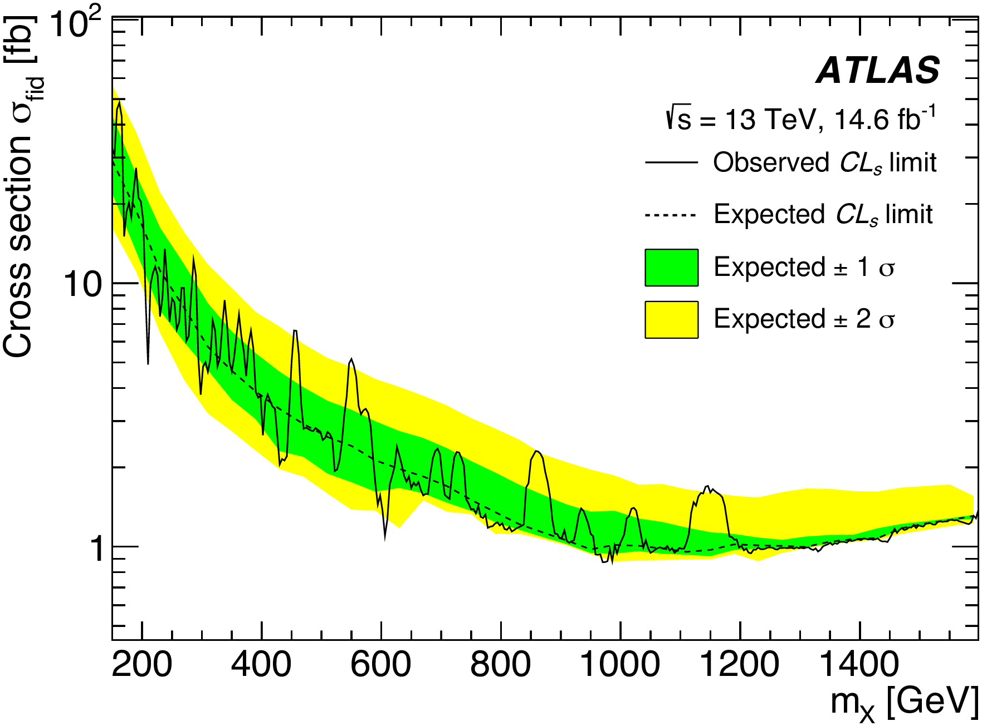
Original ALP cross section limit at 95% CL
arXiv:2304.10953

Slide 21
Conclusions
Study of Axion-Like-Particle optimization completed
Significant increase of single-dissociative efficiency obtained
Optimization of contributions of different signal masses
Machine Learning for the signal efficiency will improve the sensitivity for Axion-Like-Particles further
CERN-THESIS-2023-075

Slide 22
Thank you for attention!

