Slide 1
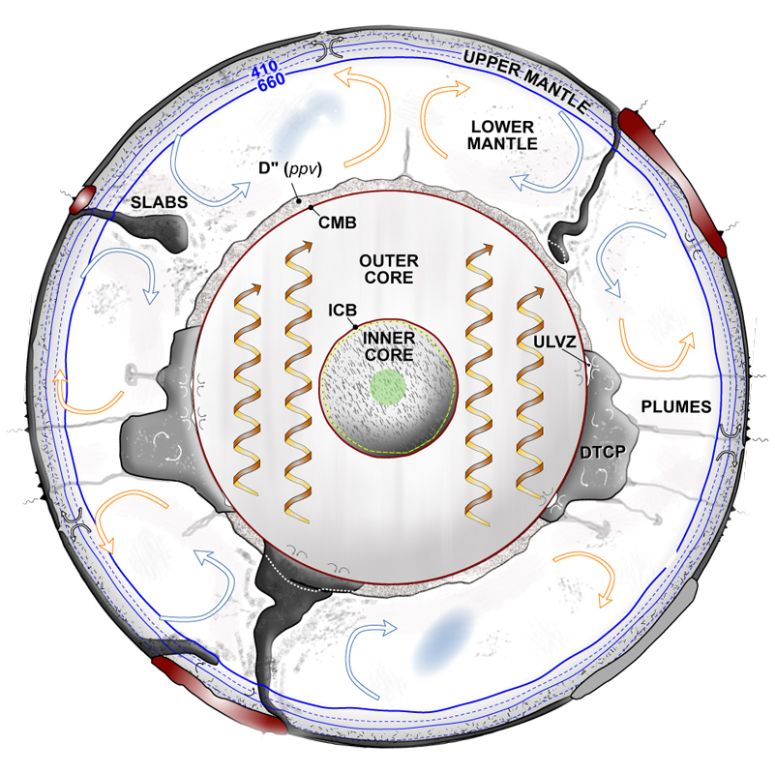


Core Constraints on Deep Earth Evolution
Monica Pozzo
David Gubbins
Dario Alfe
Sam Greenwood
Chris
Davies
Img. Cred. Ed Garnero
Notes:
This talk will focus on how Earth’s core responds to the flow of heat across the core-mantle boundary.
Now it turns out that the amount of heat flowing across the CMB is very important for the core.
It dictates the amount of power available to generate the geomagnetic field, the nature of core stratification and the history of the inner core.
But of course the CMB heat flow is ultimately regulated by the mantle; what the core wants to do and what is can do are not the same!

Slide 2
Fluctuations of Earth’s Magnetic Field
What are the power sources for the dynamo over the last 3.5 Gyrs?
A.Biggin (Pers. Comms, 2016)

Slide 3
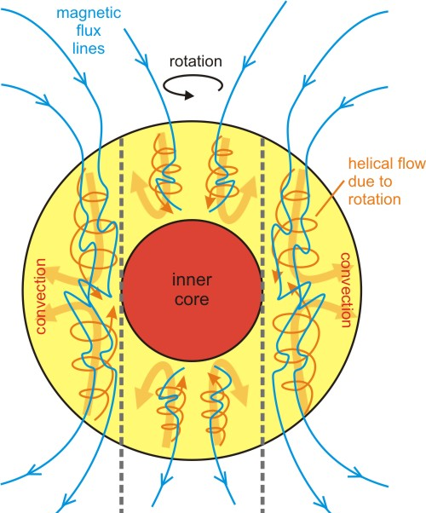
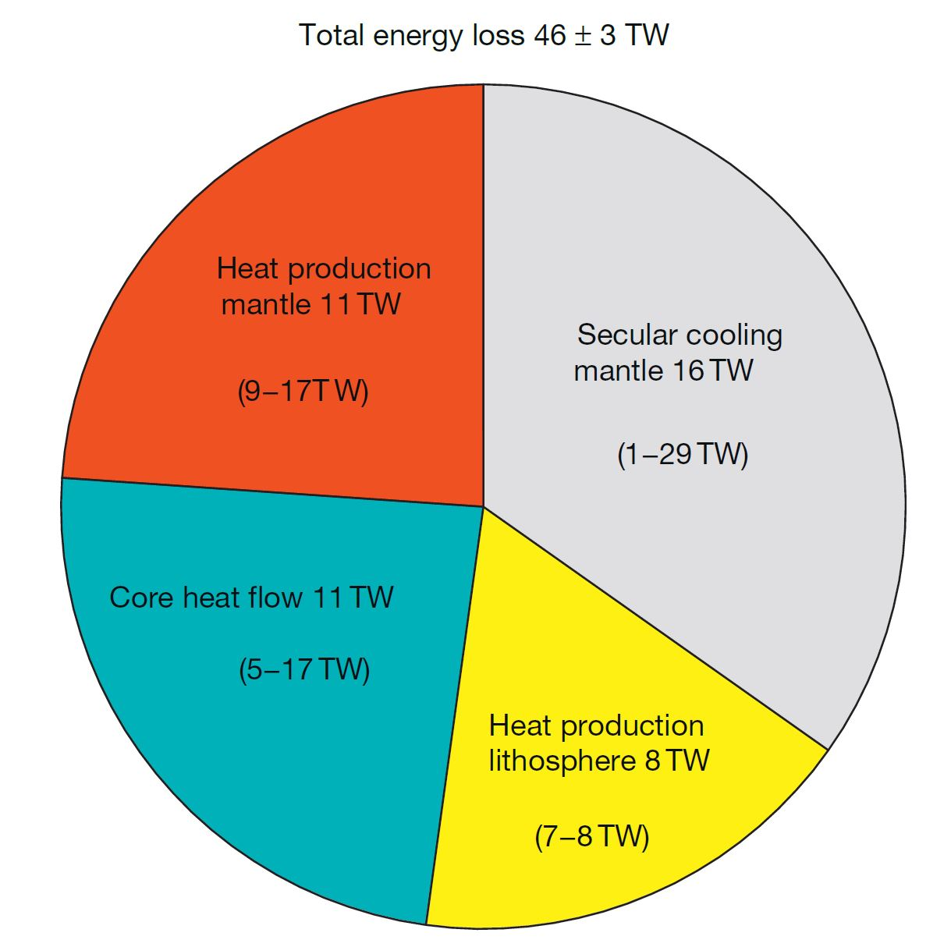

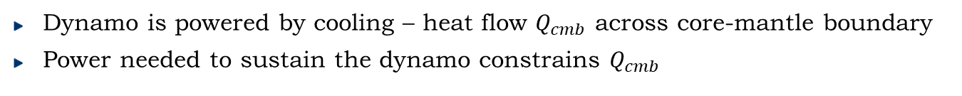
Generating the Geomagnetic Field
$$Q_{cmb}$$
Fe+Si+O+Mg…
Glatzmaier & Roberts (1997)
Jaupart et al (2015)
Dynamo is powered by cooling – heat flow $Q_{cmb}$ across core-mantle boundary
Power needed to sustain the dynamo constrains $Q_{cmb}$
Notes:
John and Andy go before me so their IC estimates already mentioned?

Slide 4
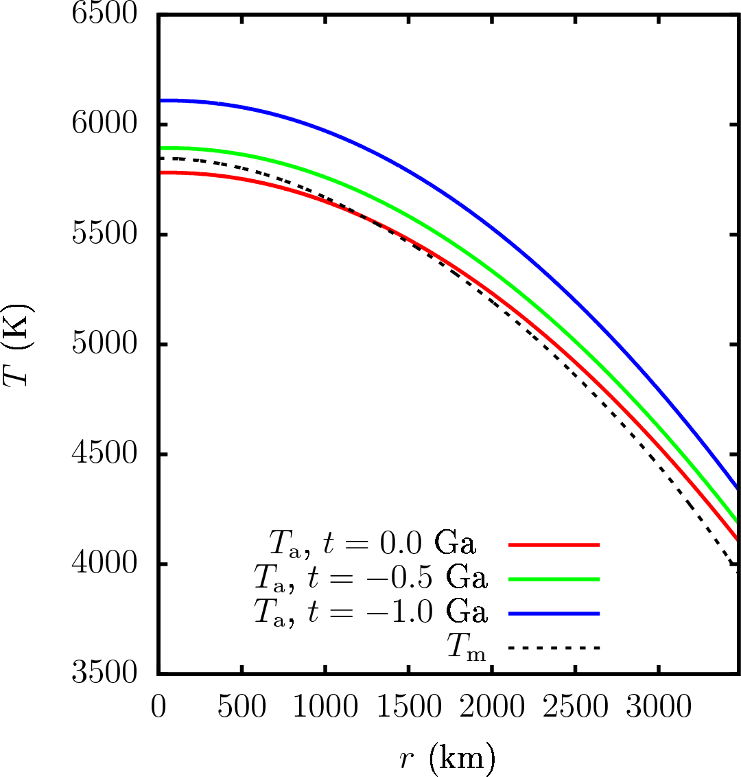
Cooling – Inner Core Growth
$$Q_{cmb}$$
Jaupart et al (2015)
Power to sustain the dynamo constrains rate of core cooling and inner core growth
Notes:
Korenaga: Crustal heat production= 5-10
Present-day conv HF: 36.5 =/- 4.5
See [41]

Slide 5
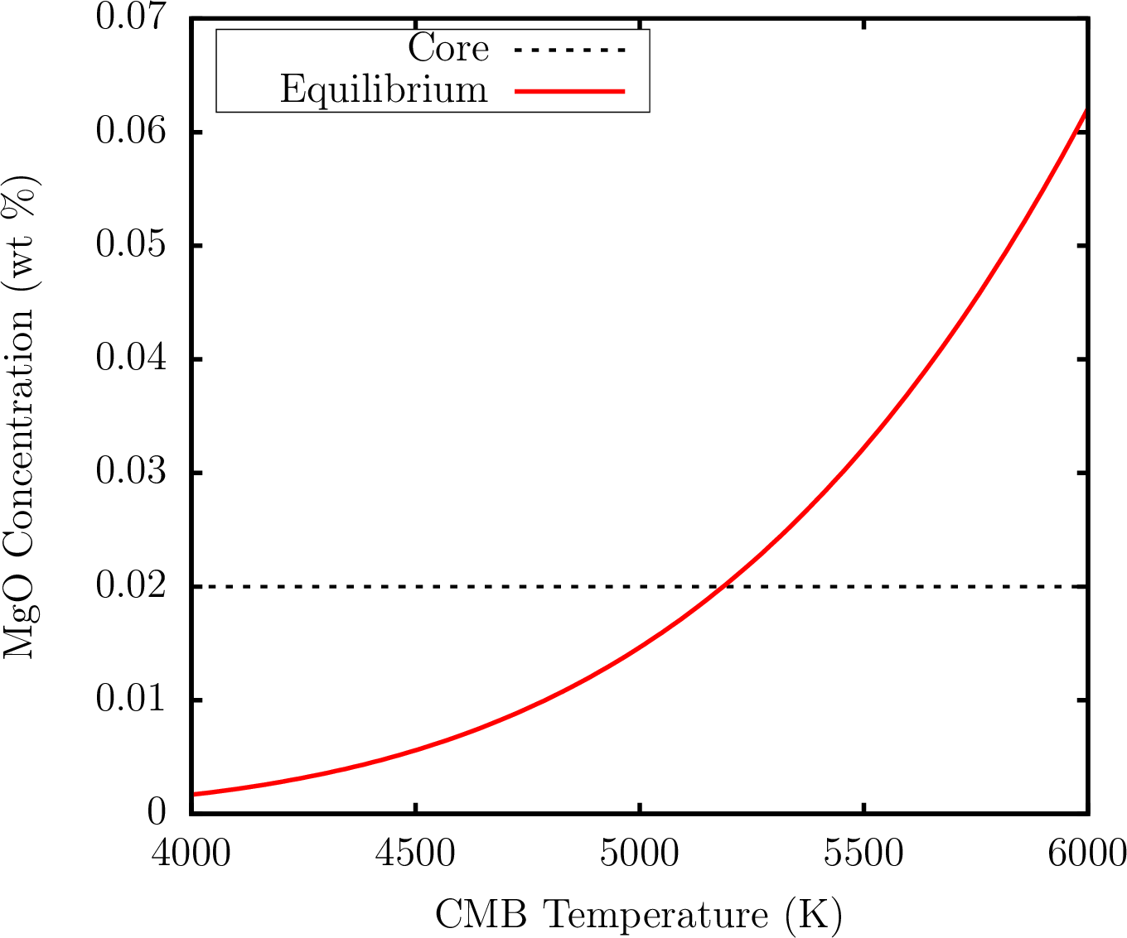
Cooling - Precipitation of MgO?
Based on Badro et al (2016)
Dense residual fluid sinks
Precipitation may occur from core formation and could significantly lower core cooling rate (O’Rourke & Stevenson (2016); Badro et al (2016, 2018); Du et al (2017, 2019))
[NB – SiO₂ and FeO could also precipitate (e.g. Hirose et al, 2017)]
Notes:
Considering only the present day omits a key piece of information: we have had a field for the last 3.5Gyr.
Another constraint is that, prior to formation of the inner core, the total cmb flux must exceed the conducted flux.
This calculation is constrained to just give enough power to generate a field for the last 3.5Gyr.
Key implications:
present-day heat-flux must be high, >6-9TW.
The core is very hot at early times => lower mantle melting
The inner core is younger than previous estimates.

Slide 6
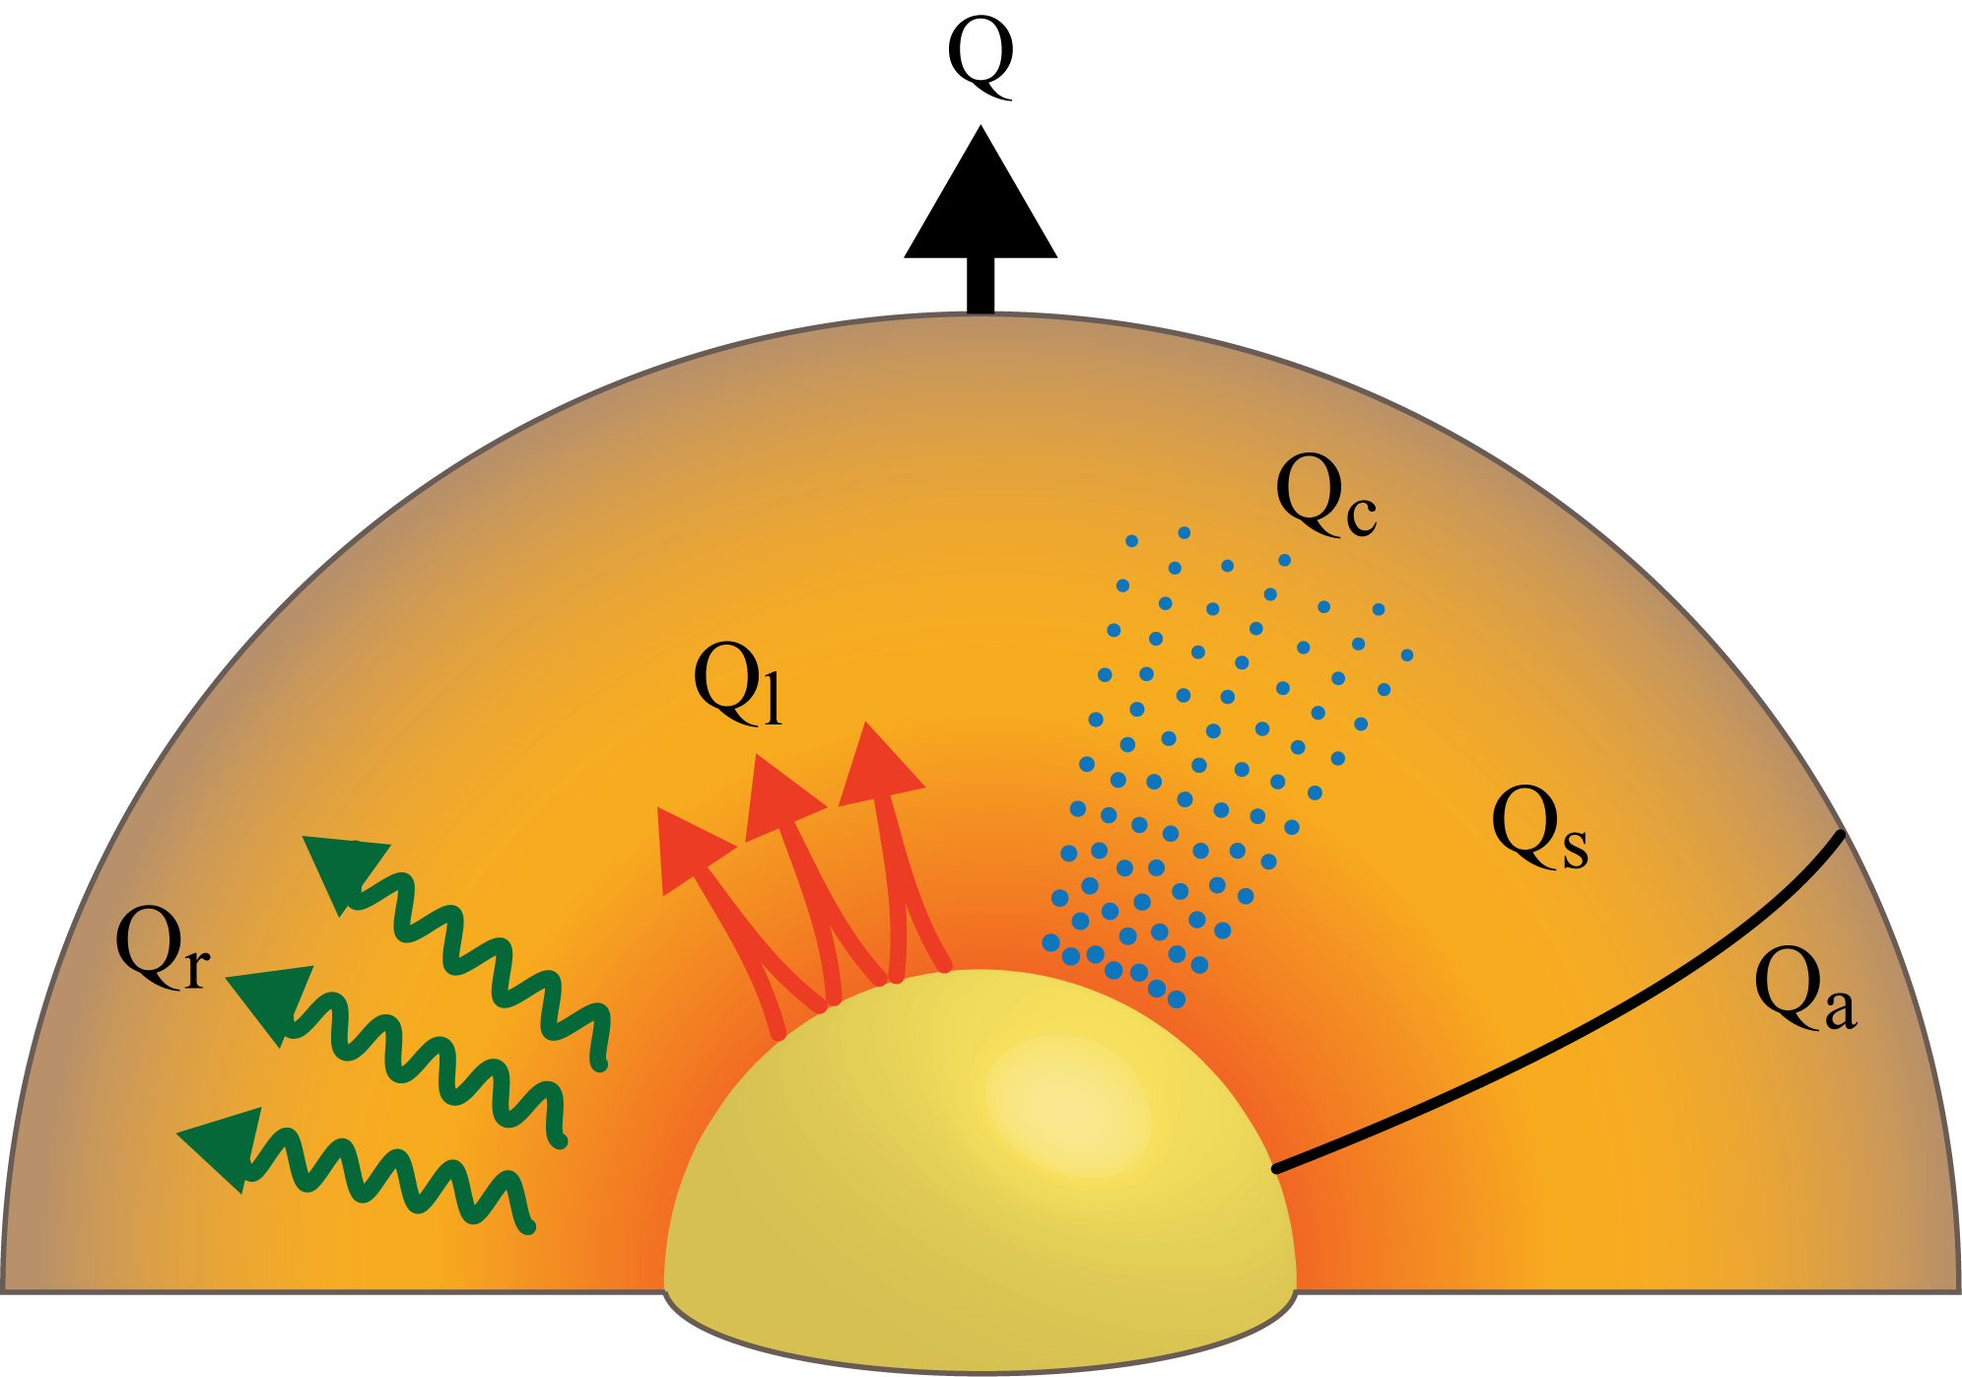


$Q_{CMB}$ and Temperature in Time
$$Q_{cmb}$$
Gubbins et al (2004); Nimmo (2015); Labrosse (2015) Davies (2015)
Outer core
Inner core
secular
gravitational
precipitation
$$Q_{cmb}=Q_{s}+Q_{L}+Q_{c}+Q_{r}+Q_{P}=A\frac{dT_{c}}{dt}+Q_{r}+Q_{p}$$
latent
radiogenic
Core cooling rate ($dT_{c}/dt$) determined from $Q_{cmb}$ (imposed by mantle convection)

Slide 7
$Q_{CMB}$ and Temperature in Time
$$Q_{cmb}$$
Gubbins et al (2004); Nimmo (2015); Labrosse (2015) Davies (2015)
Outer core
Inner core
secular
gravitational
precipitation
$$Q_{cmb}=Q_{s}+Q_{L}+Q_{c}+Q_{r}+Q_{P}=A\frac{dT_{c}}{dt}+Q_{r}+Q_{p}$$
latent
radiogenic
$$E_{J}\left(B\right)+E_{a}\left(k\right)=E_{s}+E_{L}+E_{g}+E_{r}+E_{P}=B\frac{dT_{c}}{dt}+E_{r}+E_{P}$$

Slide 8
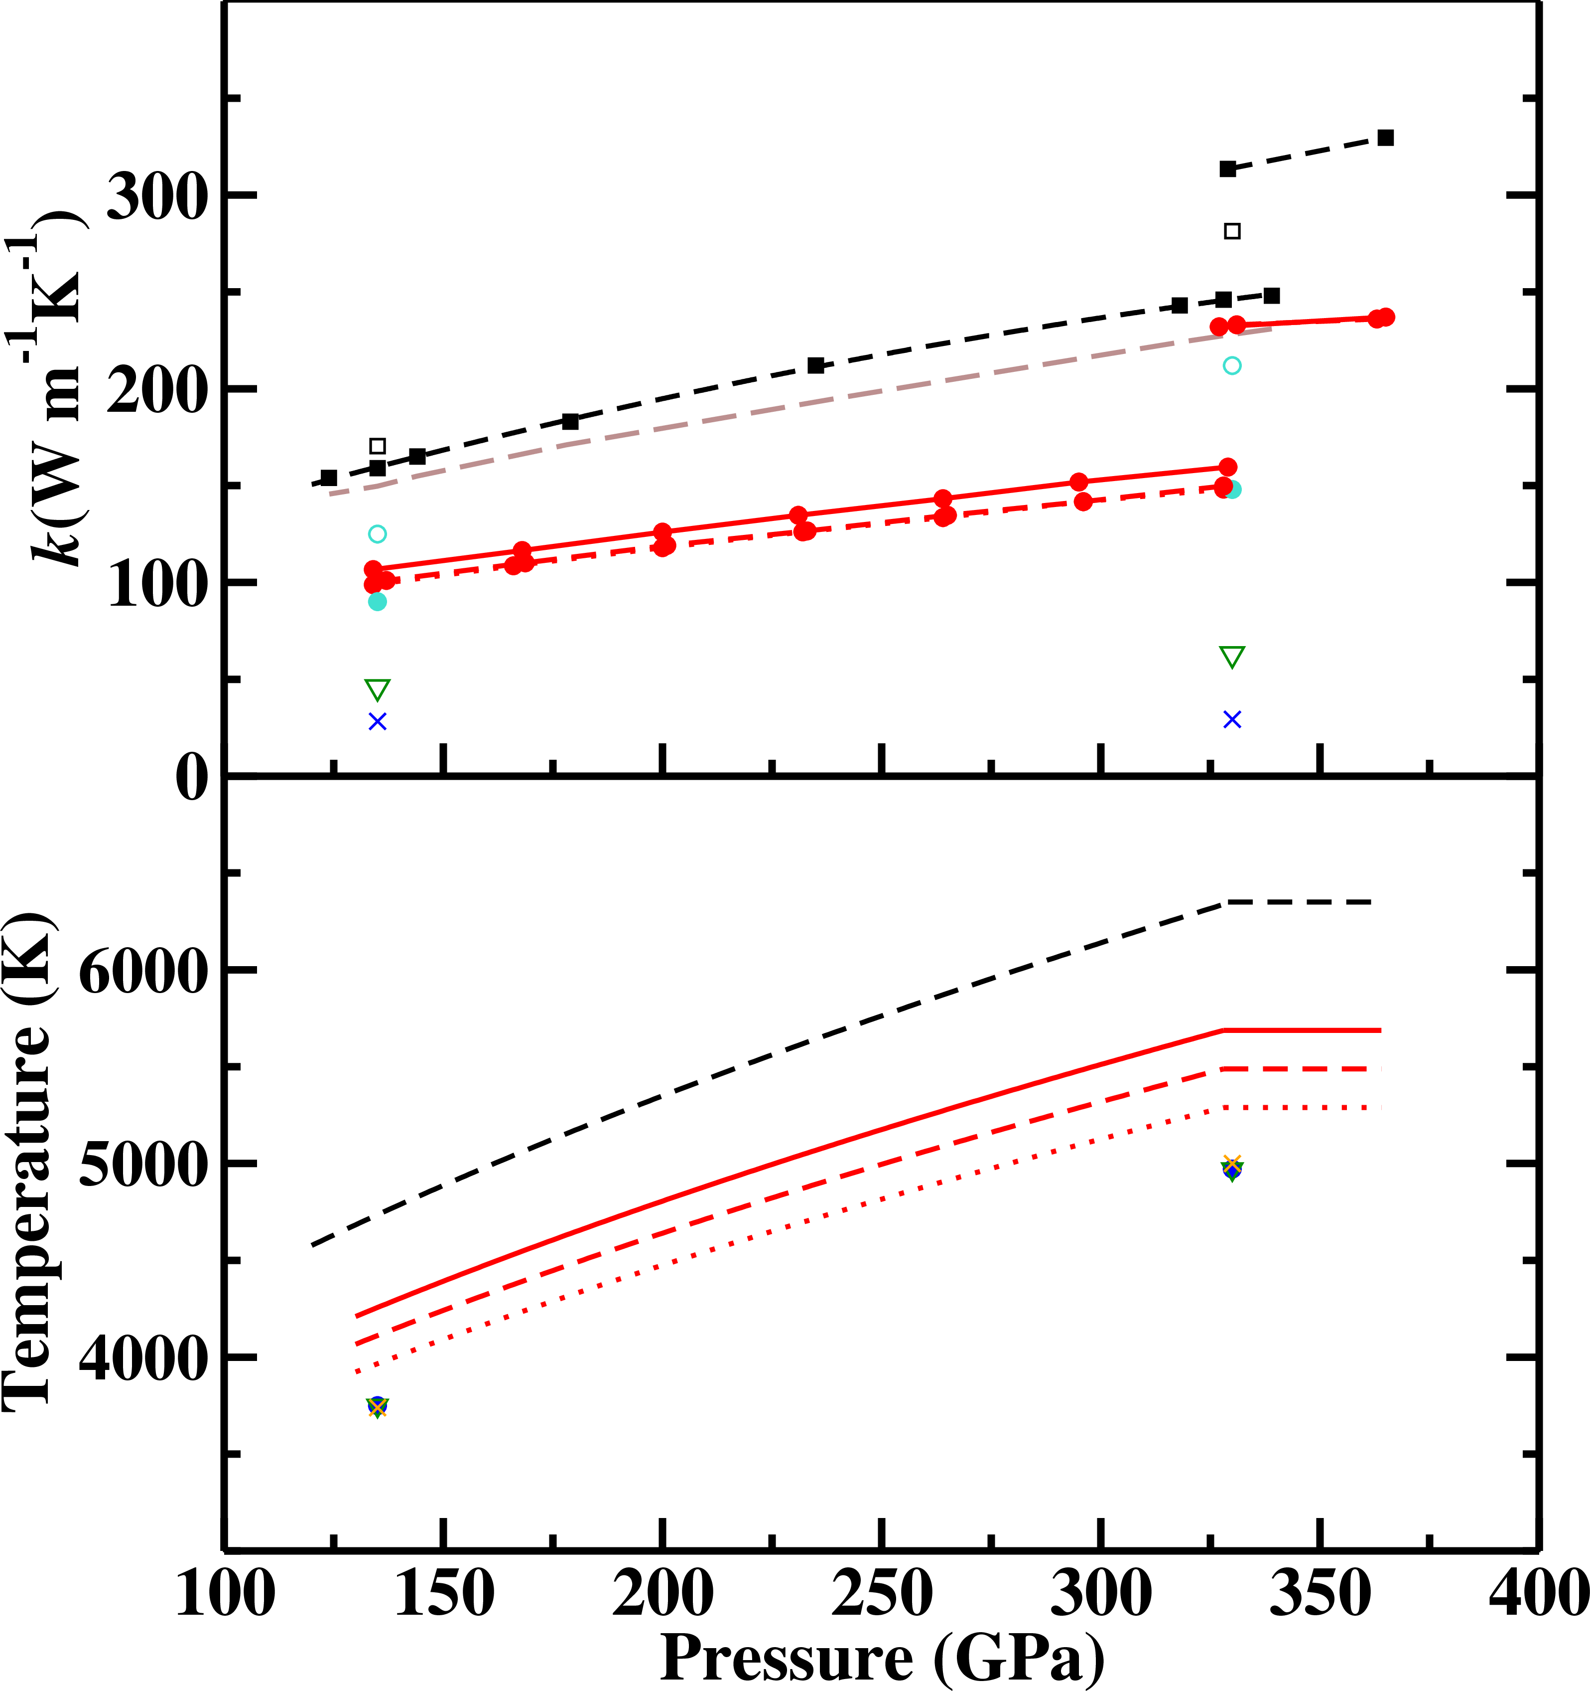

Thermal Conductivity ($k$)
Core-mantle boundary
Inner core boundary
Pure Fe:
Pozzo et al (2012) [Also Gomi et al (2013); Ohta et al (2016)]
De Koker et al (2012)
Mixtures:
Pozzo et al (2013);
76.8%Fe–23.2%O Gomi et al (2013, Open)
77.5%Fe–22.5%Si Gomi et al (2013, Closed)
“Low” values
Stacey & Anderson (2001)
Stacey & Loper (2007)
Konopkova et al (2016)
Xu et al (2018, hcp iron)
‘High’ k values are 2-3 times larger than ‘low’ values
k varies significantly with depth
Notes:
Konopkova inferred 18-44

Slide 9

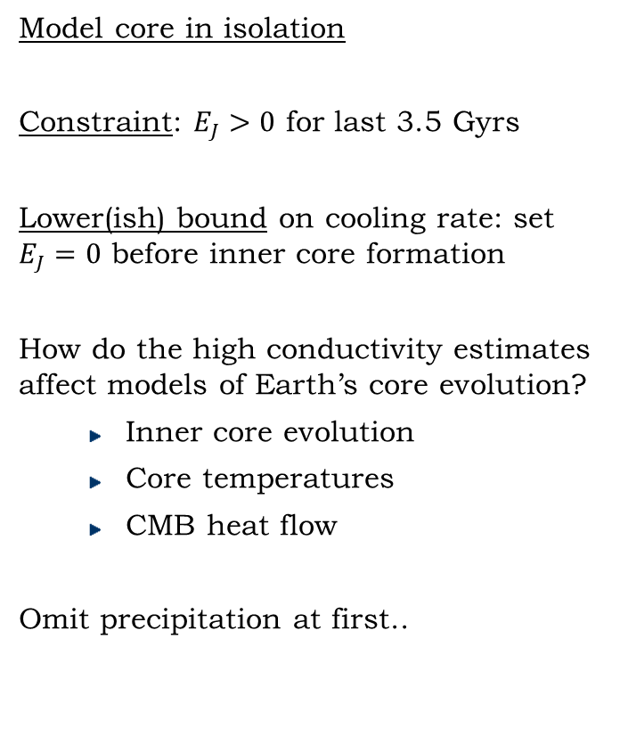
Aims and Basic Setup
Model core in isolation
Constraint: $E_{J}>0$ for last 3.5 Gyrs
Lower(ish) bound on cooling rate: set $E_{J}=0$ before inner core formation
How do the high conductivity estimates affect models of Earth’s core evolution?
  Inner core evolution
  Core temperatures
  CMB heat flow
Omit precipitation at first..
$$Q_{cmb}$$
Outer core
Inner core
$$Q_{cmb}=A\frac{dT_{c}}{dt}+Q_{r}+Q_{P}$$
$$E_{J}\left(B\right)+E_{a}\left(k\right)=B\frac{dT_{c}}{dt}+E_{r}+E_{P}$$

Slide 10
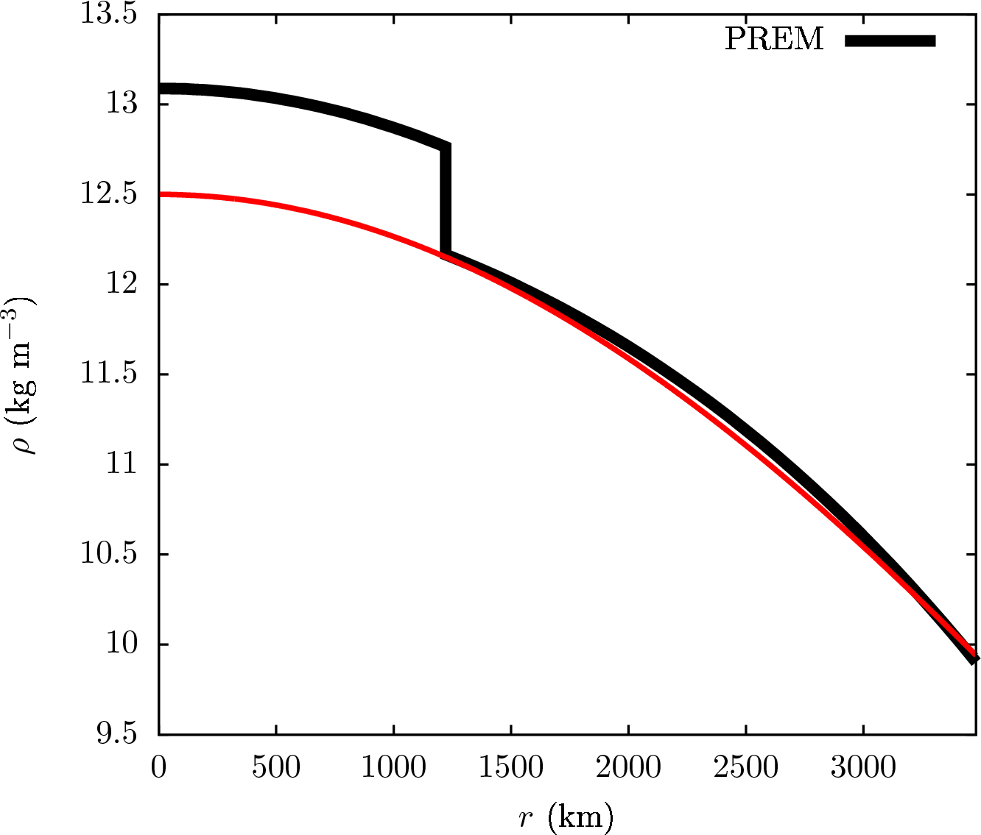
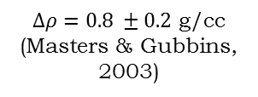
The Core Model
$∆ρ=0.8 ±0.2$ g/cc (Masters & Gubbins, 2003)
Inner core boundary
Notes:
Point out that old estimates of k were off the scale!
Also highlight my authorship.

Slide 11
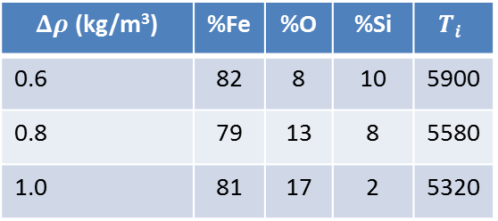
The Core Model
$∆ρ=0.8 ±0.2$ g/cc (Masters & Gubbins, 2003)
Inner core boundary
$Δρ$ (kg/m³) | %Fe | %O | %Si | $$T_{i}$$
0.6 | 82 | 8 | 10 | 5900
0.8 | 79 | 13 | 8 | 5580
1.0 | 81 | 17 | 2 | 5320
Alfe et al (2002); Gubbins et al (2015)
Notes:
Point out that old estimates of k were off the scale!
Also highlight my authorship.

Slide 12
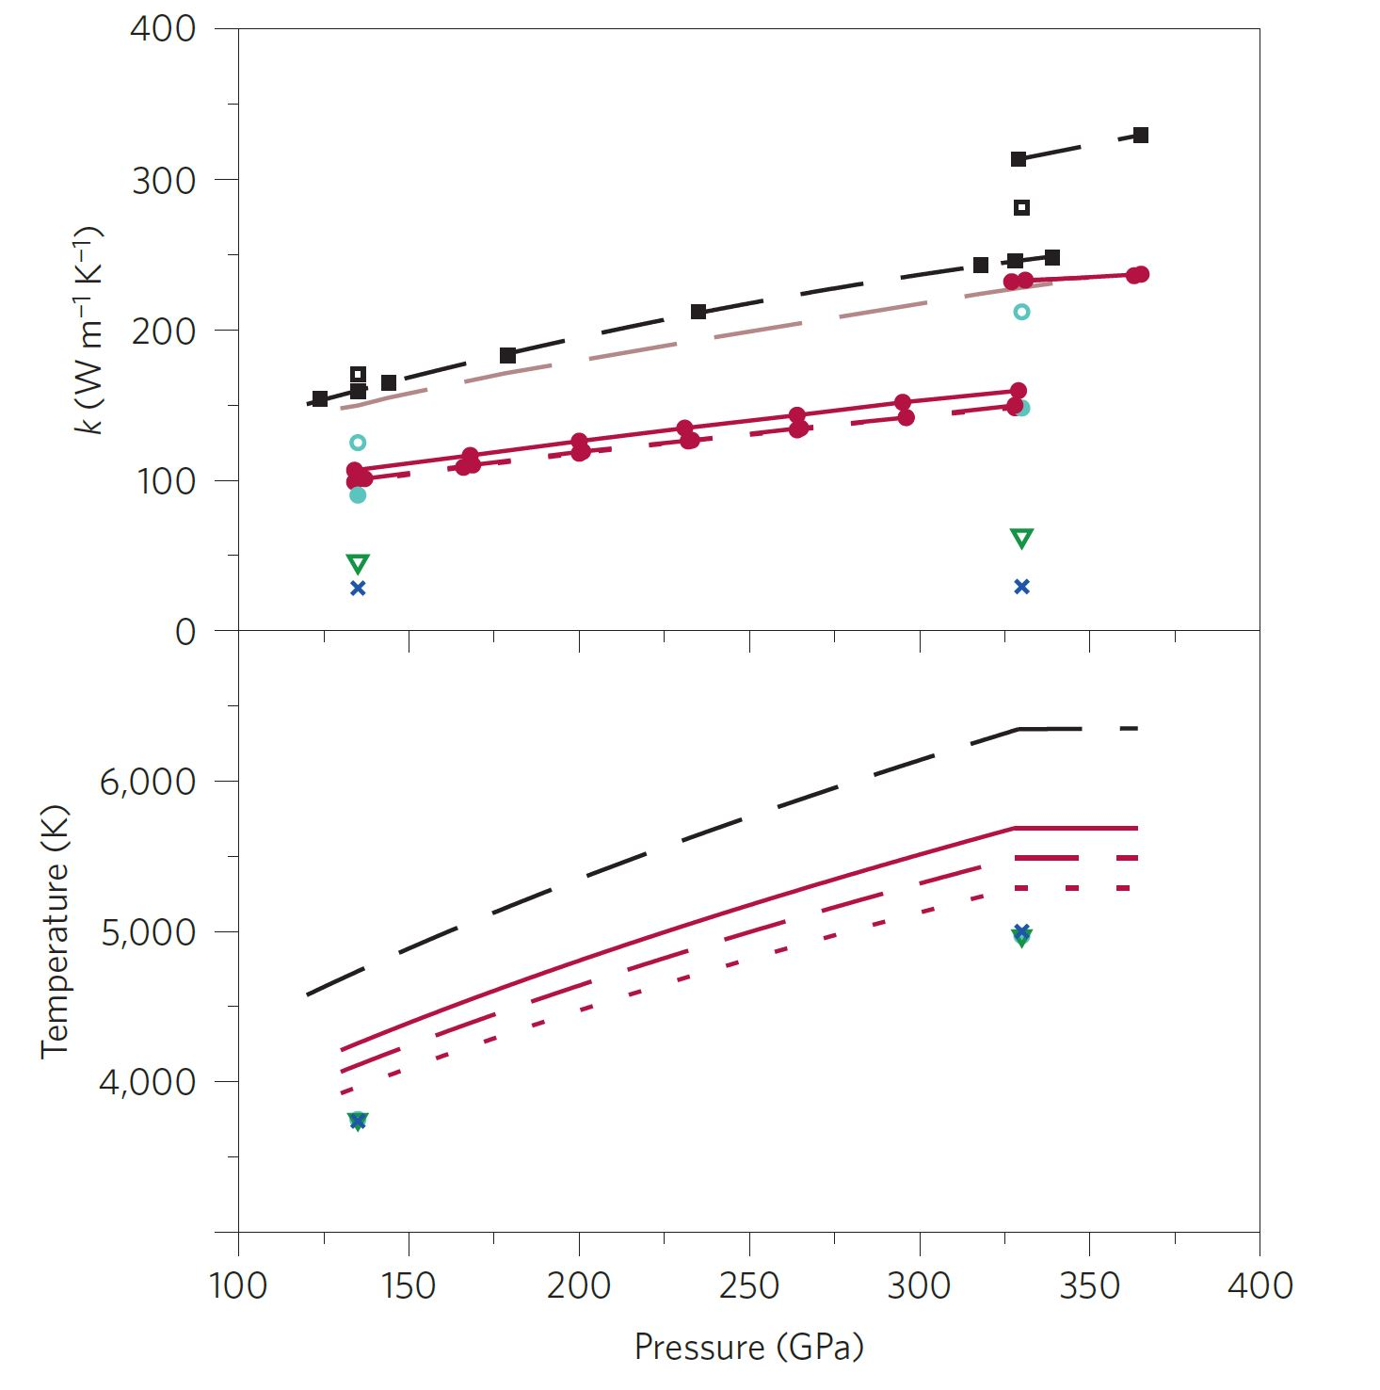
The Core Model
Pure Fe: Pozzo et al (2012); De Koker et al (2012) Mixtures: Pozzo et al (2013); Gomi et al (2013)
Stacey & Anderson (2001)
Stacey & Loper (2007)
$∆ρ=0.8 ±0.2$ g/cc (Masters & Gubbins, 2003)
Inner core boundary
$Δρ$ (kg/m³) | %Fe | %O | %Si | $$T_{i}$$
0.6 | 82 | 8 | 10 | 5900
0.8 | 79 | 13 | 8 | 5580
1.0 | 81 | 17 | 2 | 5320
Alfe et al (2002); Gubbins et al (2015)
Notes:
Point out that old estimates of k were off the scale!
Also highlight my authorship.

Slide 13
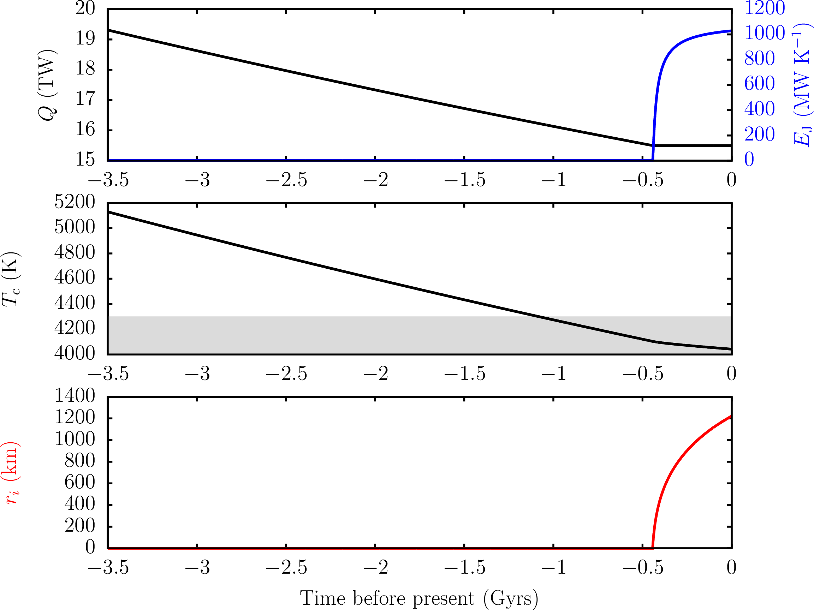
Example
Lower mantle solidus T (Andrault et al, 2011)
Davies (2015, PEPI)
Notes:
Considering only the present day omits a key piece of information: we have had a field for the last 3.5Gyr.
Another constraint is that, prior to formation of the inner core, the total cmb flux must exceed the conducted flux.
This calculation is constrained to just give enough power to generate a field for the last 3.5Gyr.
Key implications:
present-day heat-flux must be high, >6-9TW.
The core is very hot at early times => lower mantle melting
The inner core is younger than previous estimates.

Slide 14
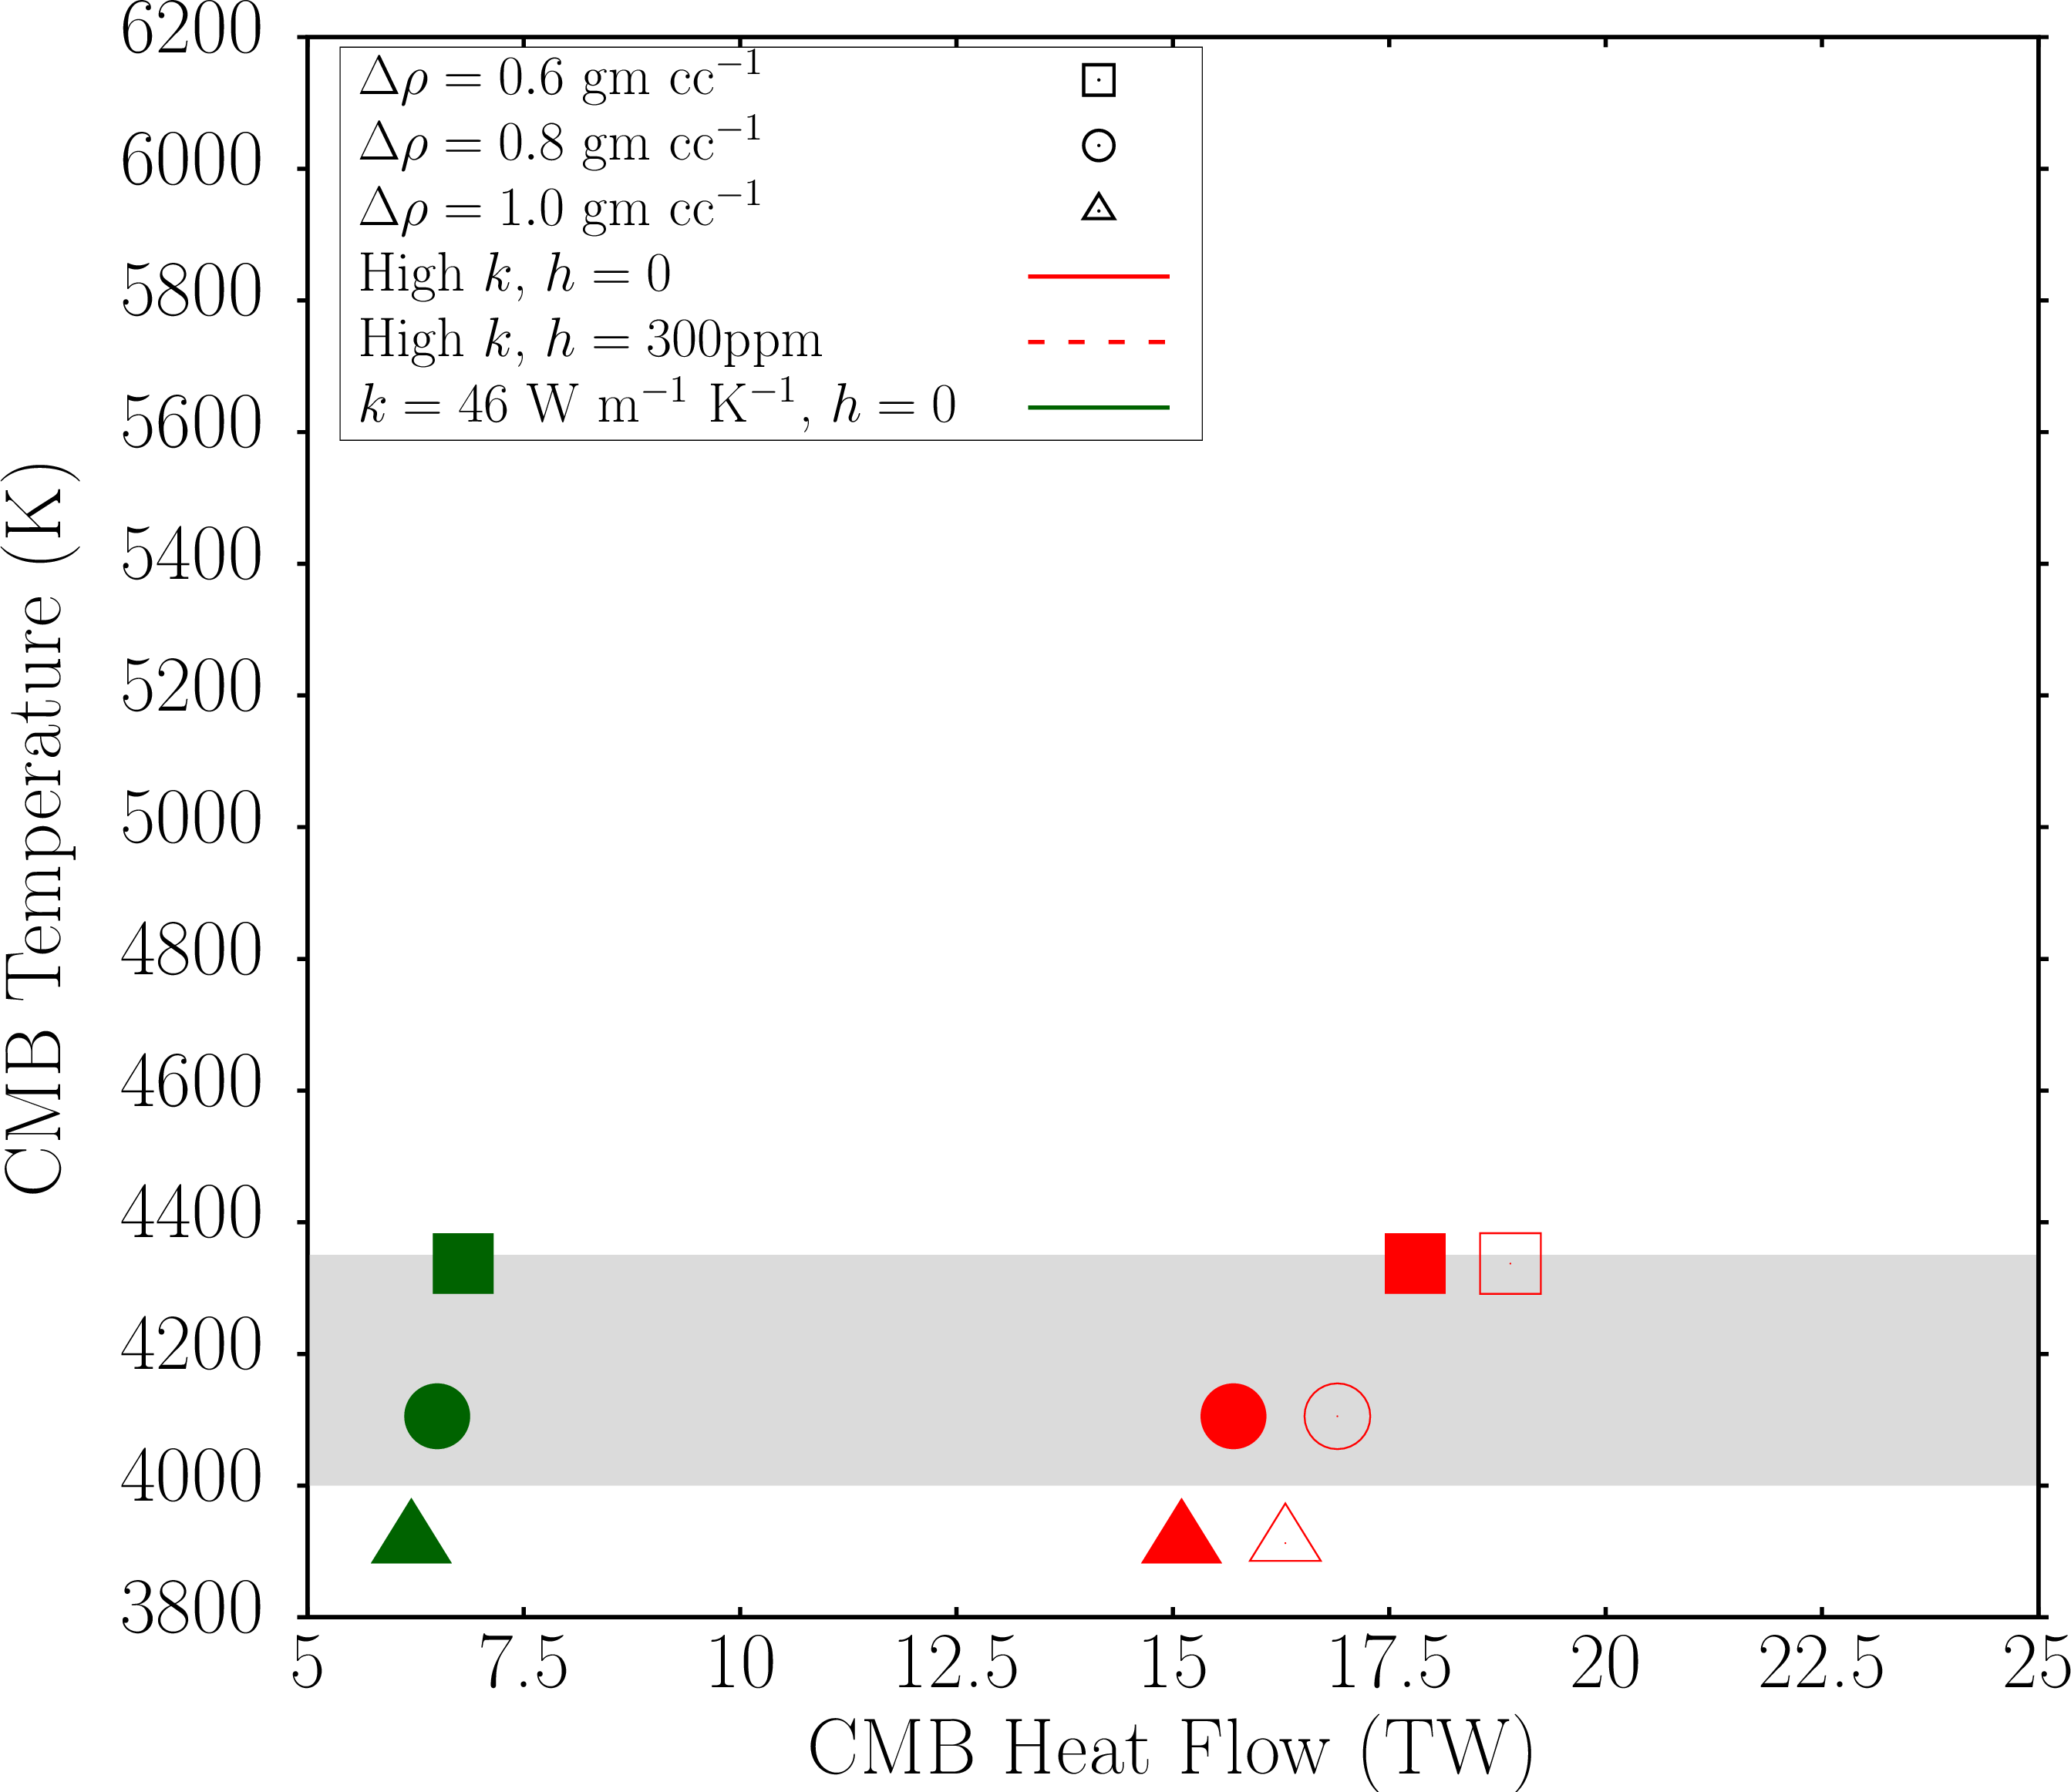
Davies et al, (Nat. Geosci., 2015)

Slide 15
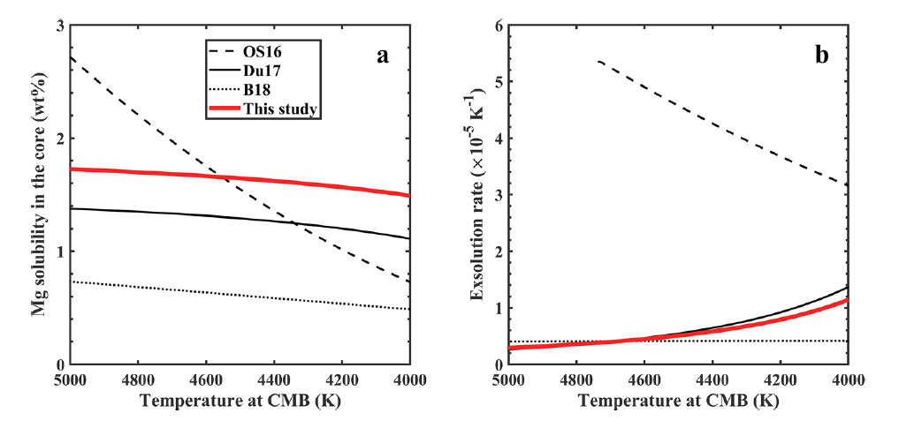
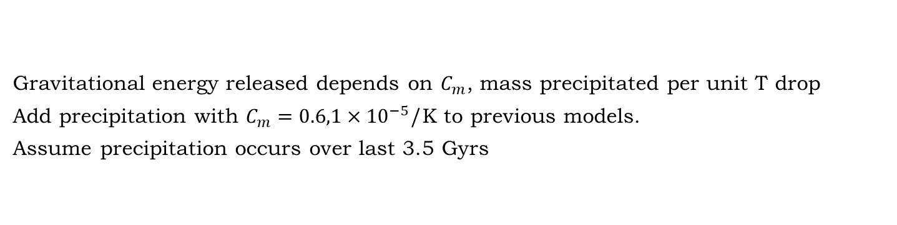
Precipitation
Du et al (2019)
Gravitational energy released depends on $C_{m}$, mass precipitated per unit T drop
Add precipitation with $C_{m}=0.6,1×{10}^{−5}$/K to previous models.
Assume precipitation occurs over last 3.5 Gyrs
Notes:
Considering only the present day omits a key piece of information: we have had a field for the last 3.5Gyr.
Another constraint is that, prior to formation of the inner core, the total cmb flux must exceed the conducted flux.
This calculation is constrained to just give enough power to generate a field for the last 3.5Gyr.
Key implications:
present-day heat-flux must be high, >6-9TW.
The core is very hot at early times => lower mantle melting
The inner core is younger than previous estimates.

Slide 17
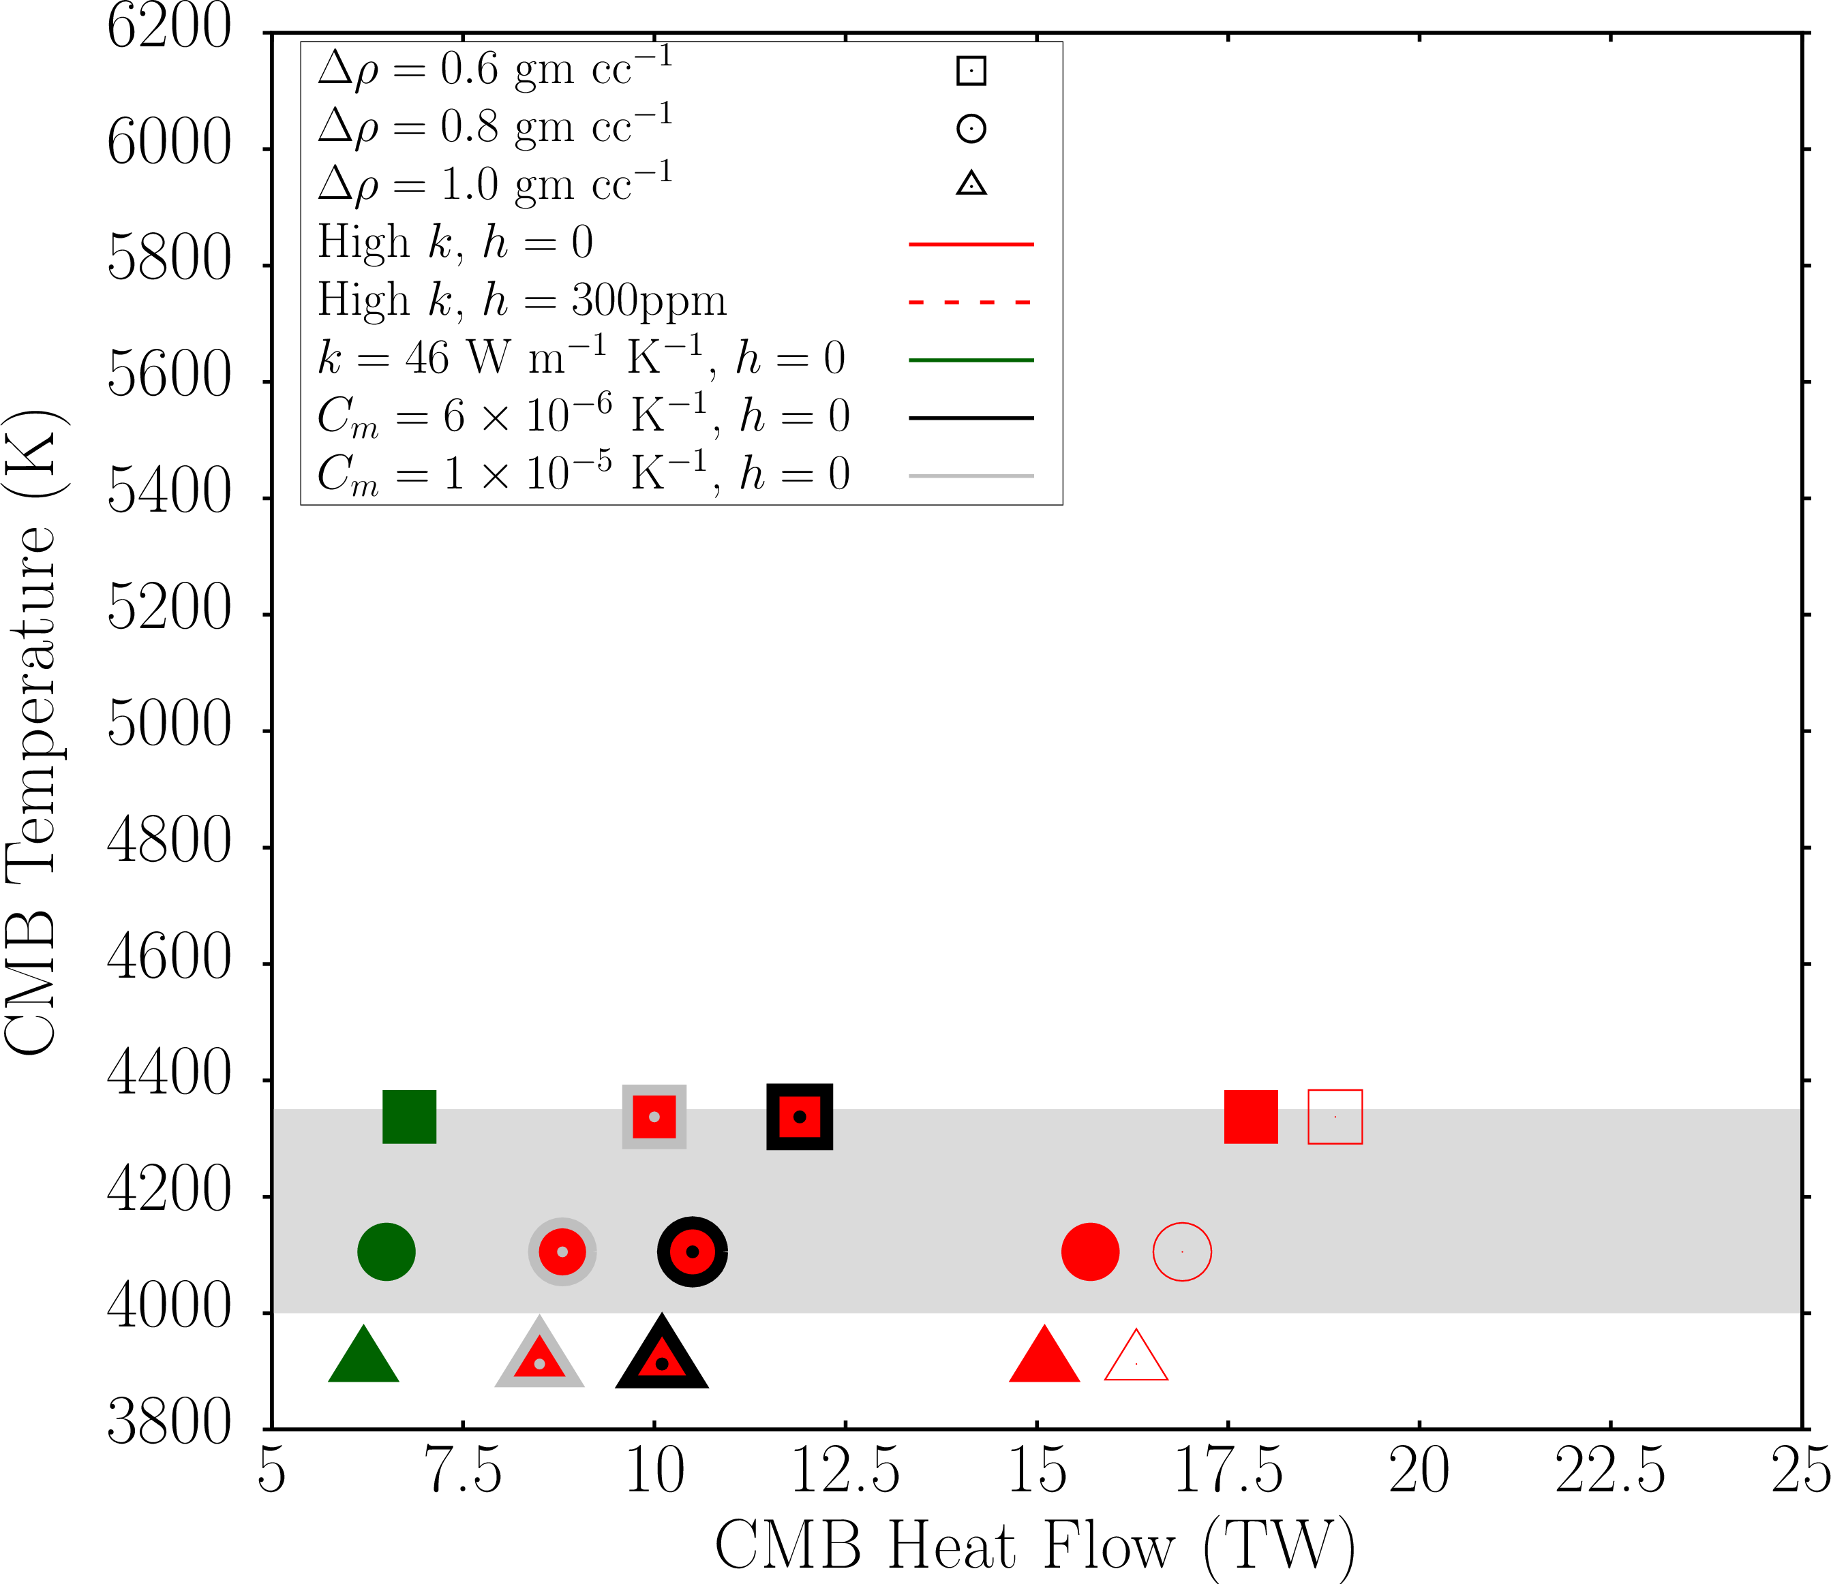

Slide 18
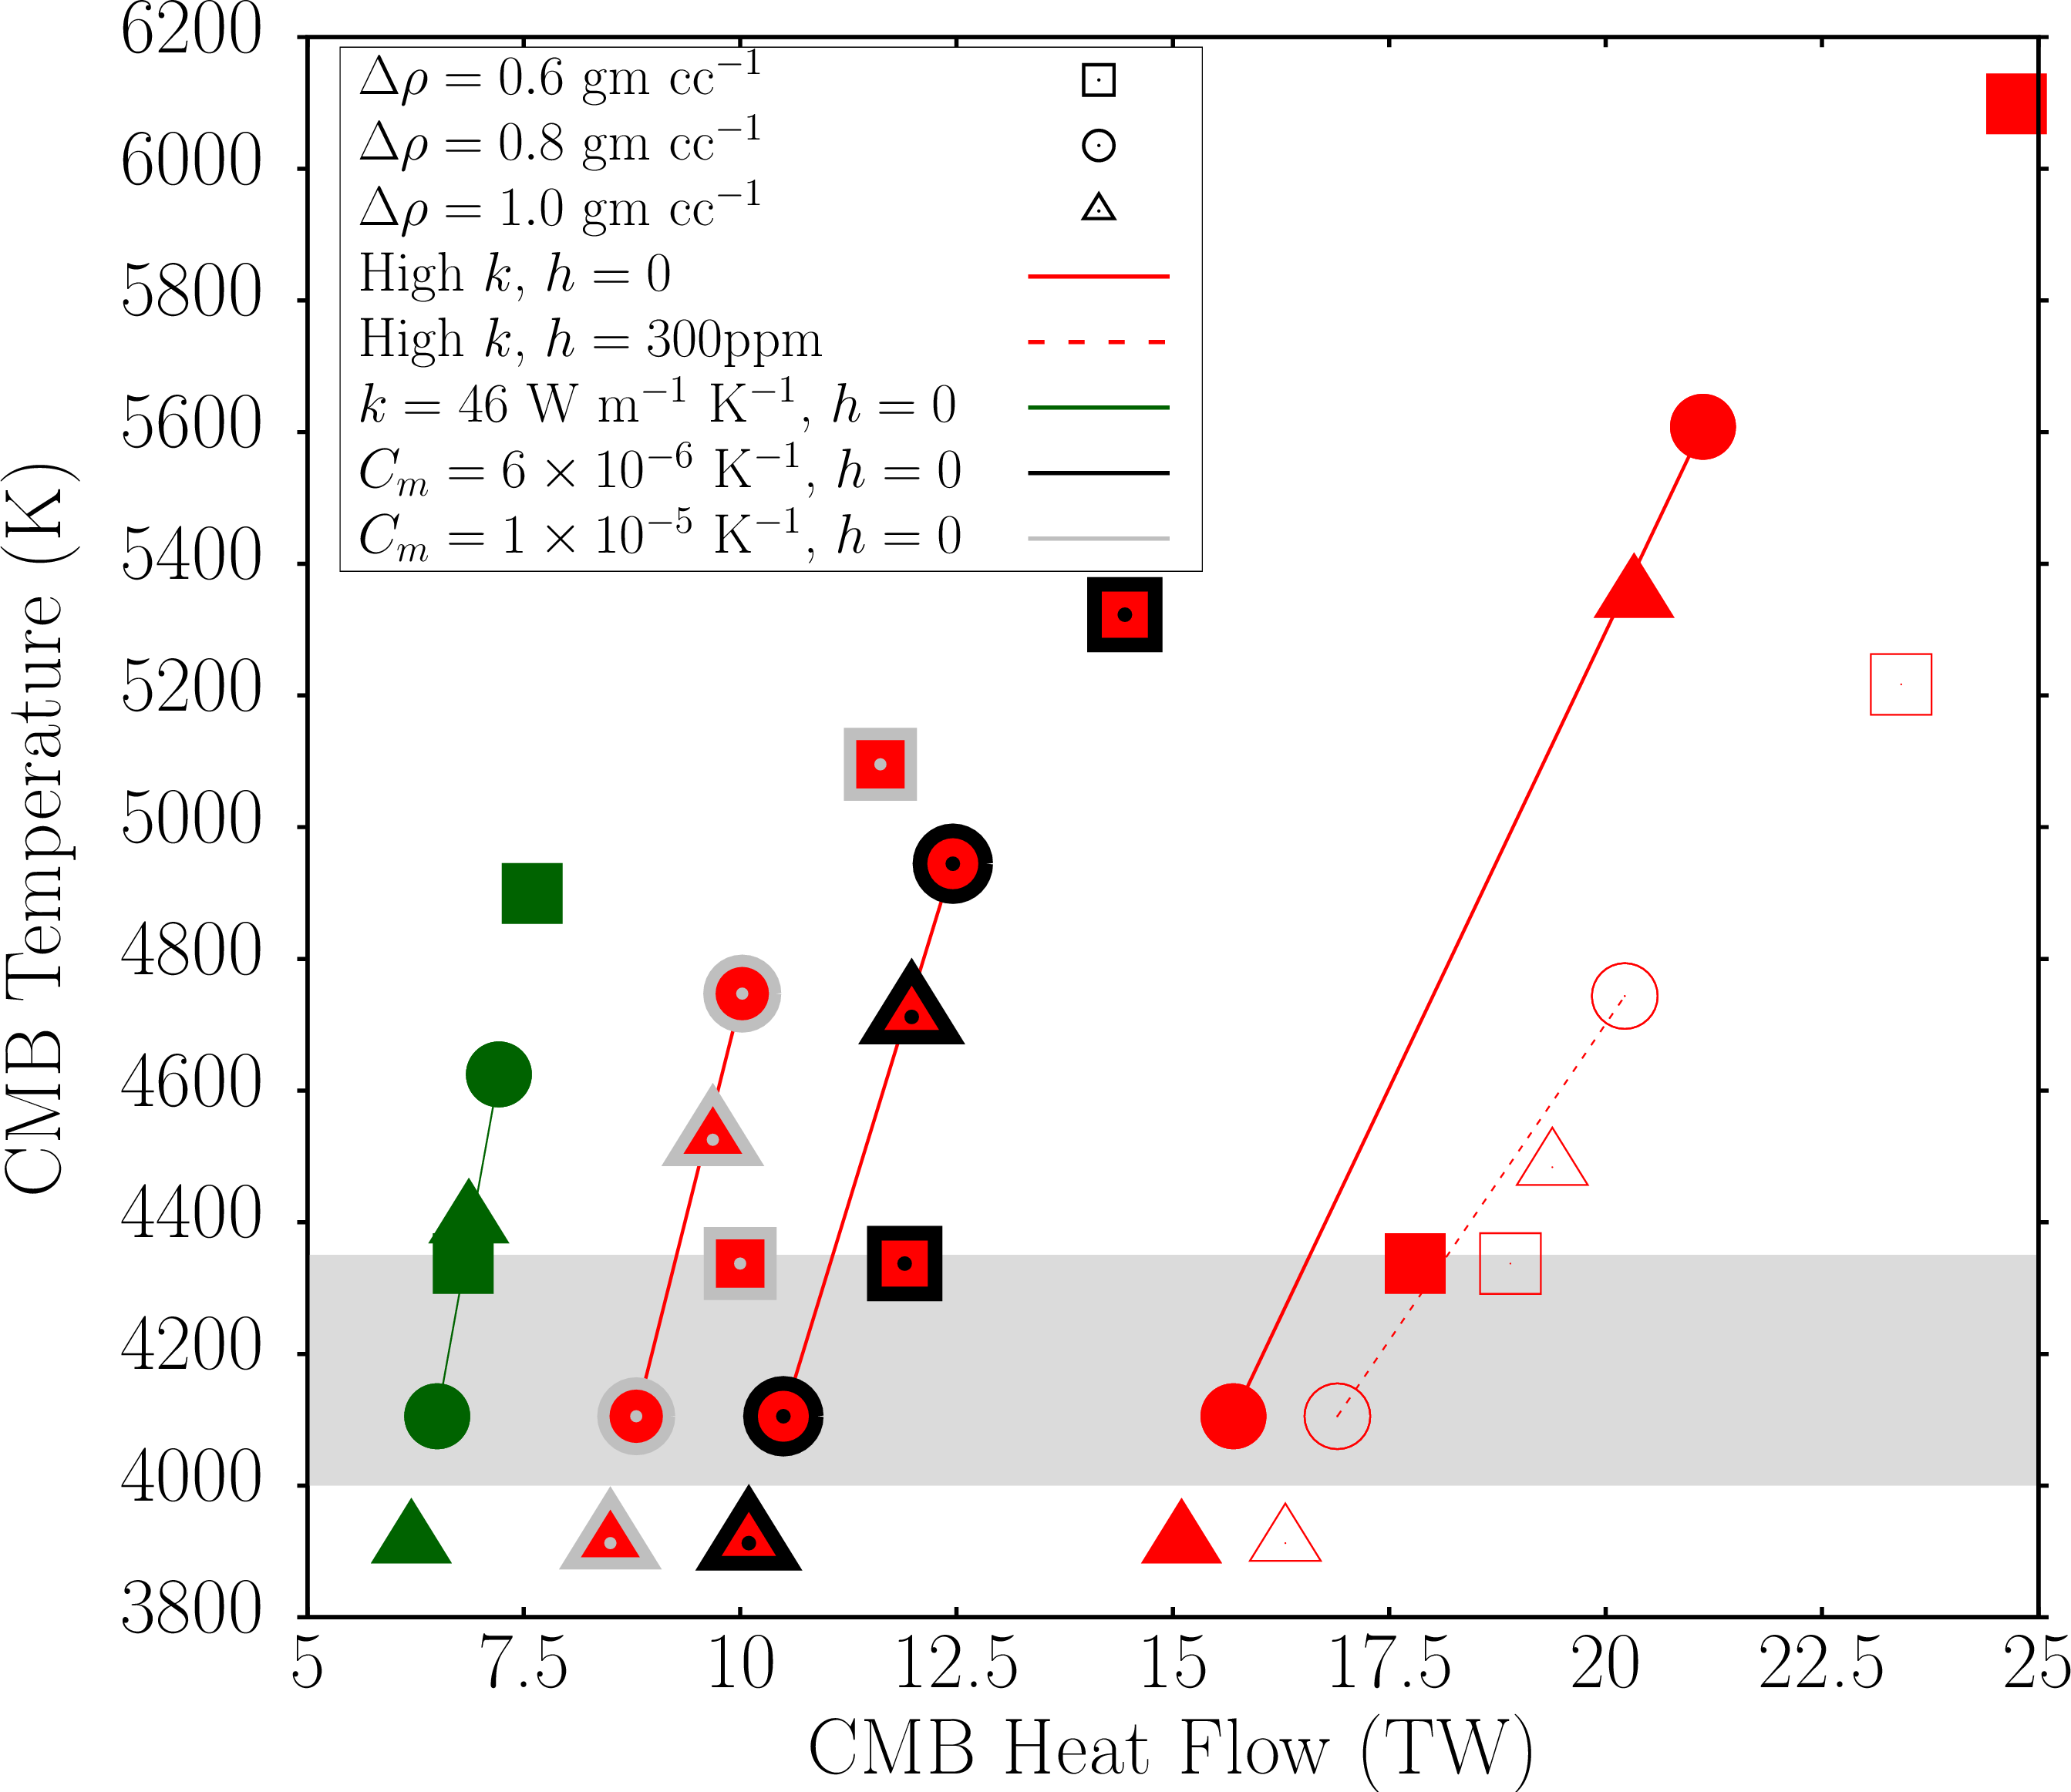

Slide 19
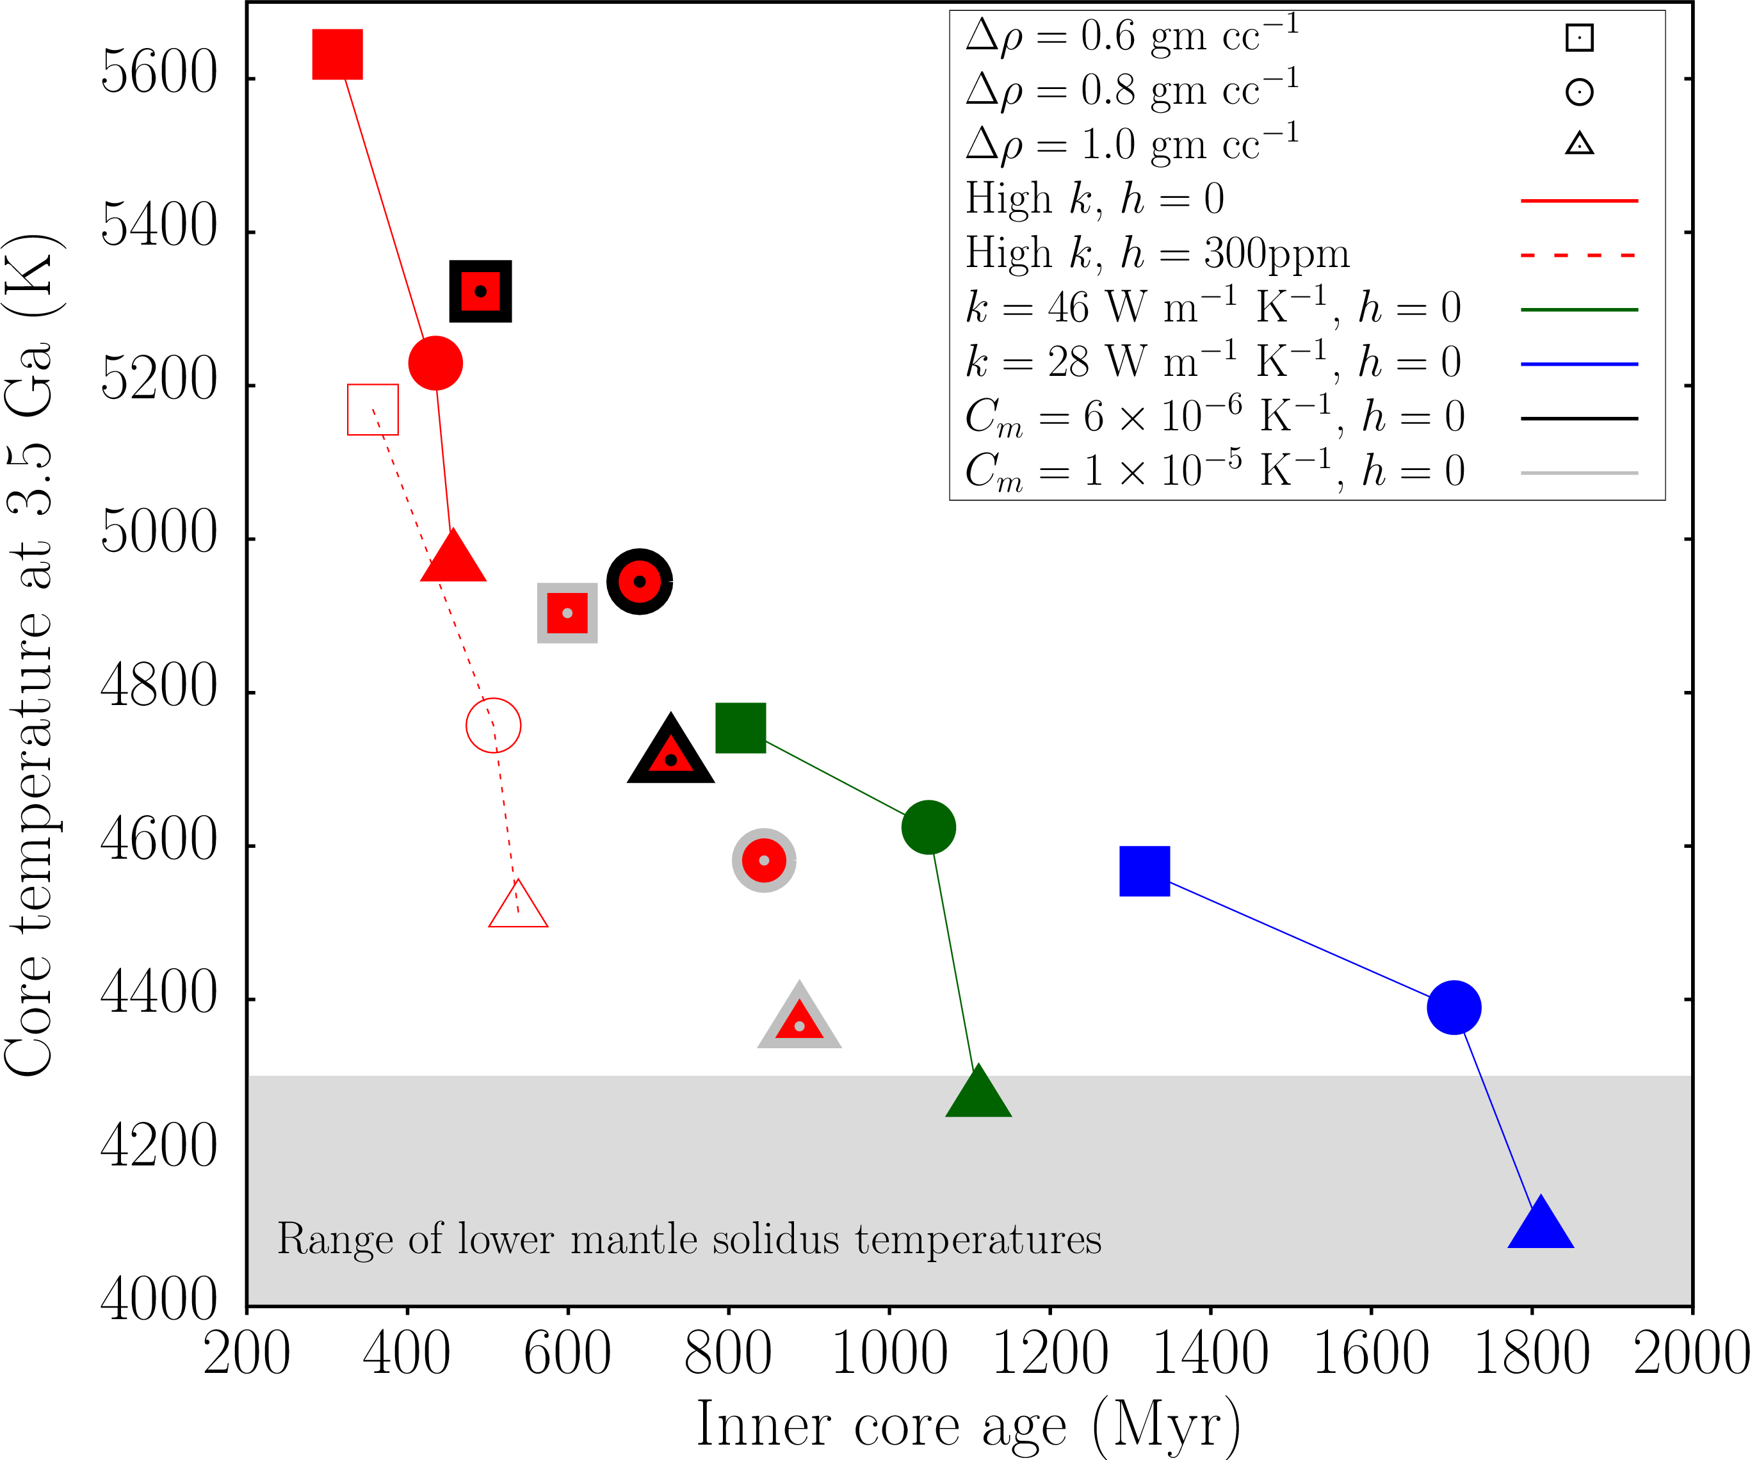
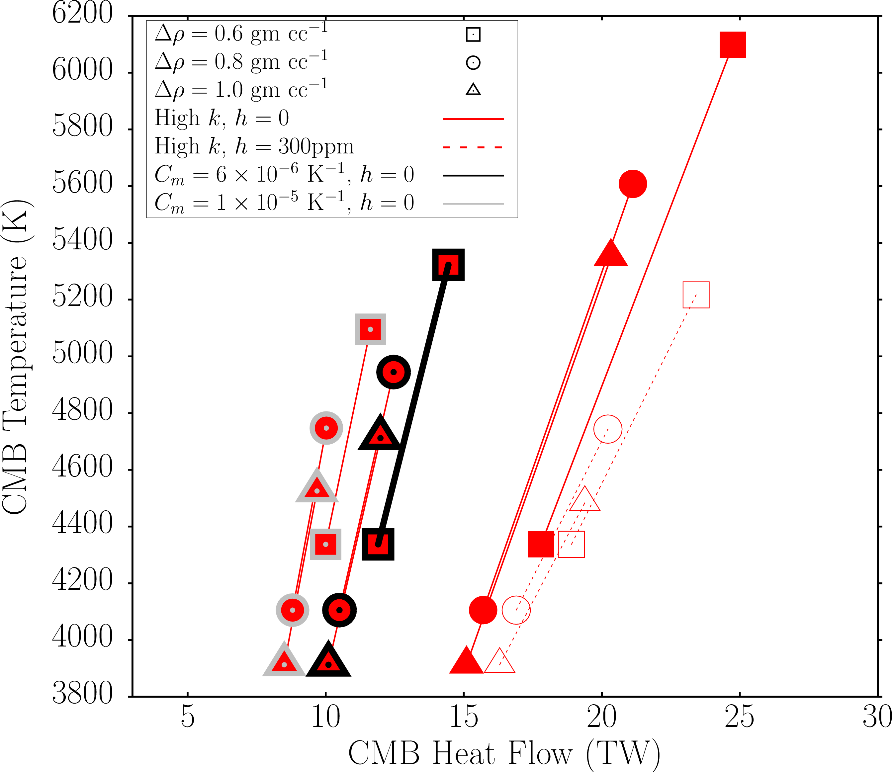
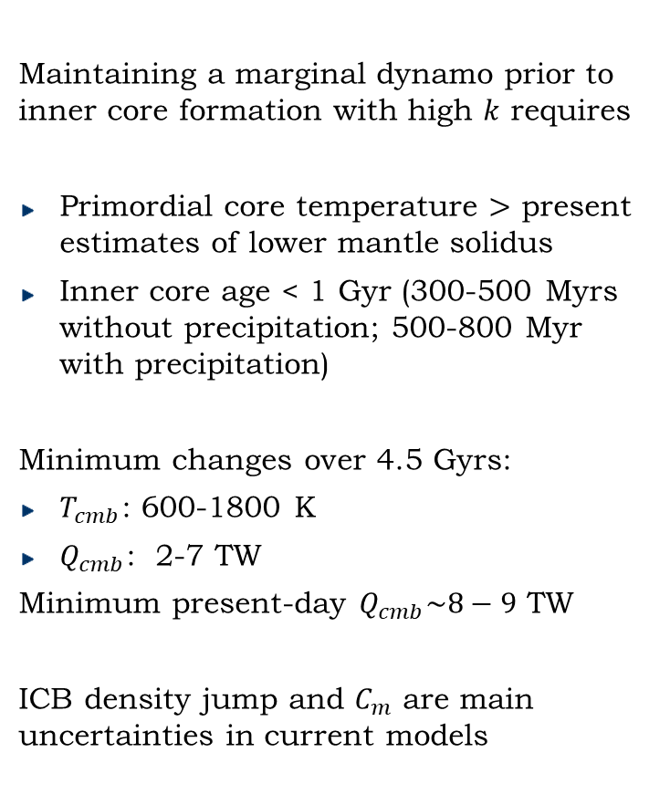
Conclusions
Maintaining a marginal dynamo prior to inner core formation with high $k$ requires
Primordial core temperature $>$ present estimates of lower mantle solidus
Inner core age < 1 Gyr (300-500 Myrs without precipitation; 500-800 Myr with precipitation)
Minimum changes over 4.5 Gyrs:
$T_{cmb}$: 600-1800 K
$Q_{cmb}$: 2-7 TW
Minimum present-day $Q_{cmb}\sim 8−9$ TW
ICB density jump and $C_{m}$ are main uncertainties in current models
Notes:
Here, point out:
Not all of the heat is available – thermal diffusion.
The core cools over time and so the adiabat moves to lower and lower T
The adiabat first intersects the meltin curve at the centre of the Earth
“I” find the position of the ICB using the adiabat and melting temperature.

