Slide 1
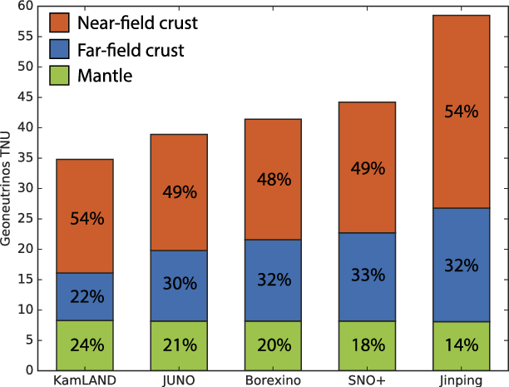
Crust Modeling with Quantitative and Objective
Uncertainty Estimation
Nozomu Takeuchi (University of Tokyo), Kenta Ueki (JAMSTEC)
Tsuyoshi Iizuka (U of Tokyo), Sanshiro Enomoto (U of Tokyo & U of Washington)
Crust modeling is critical to retrieve
mantle chemistry.
Need uncertainty estimation.
This Study
We developed the framework for
probabilistic modeling.
Sramek et al. (2016)

Slide 2
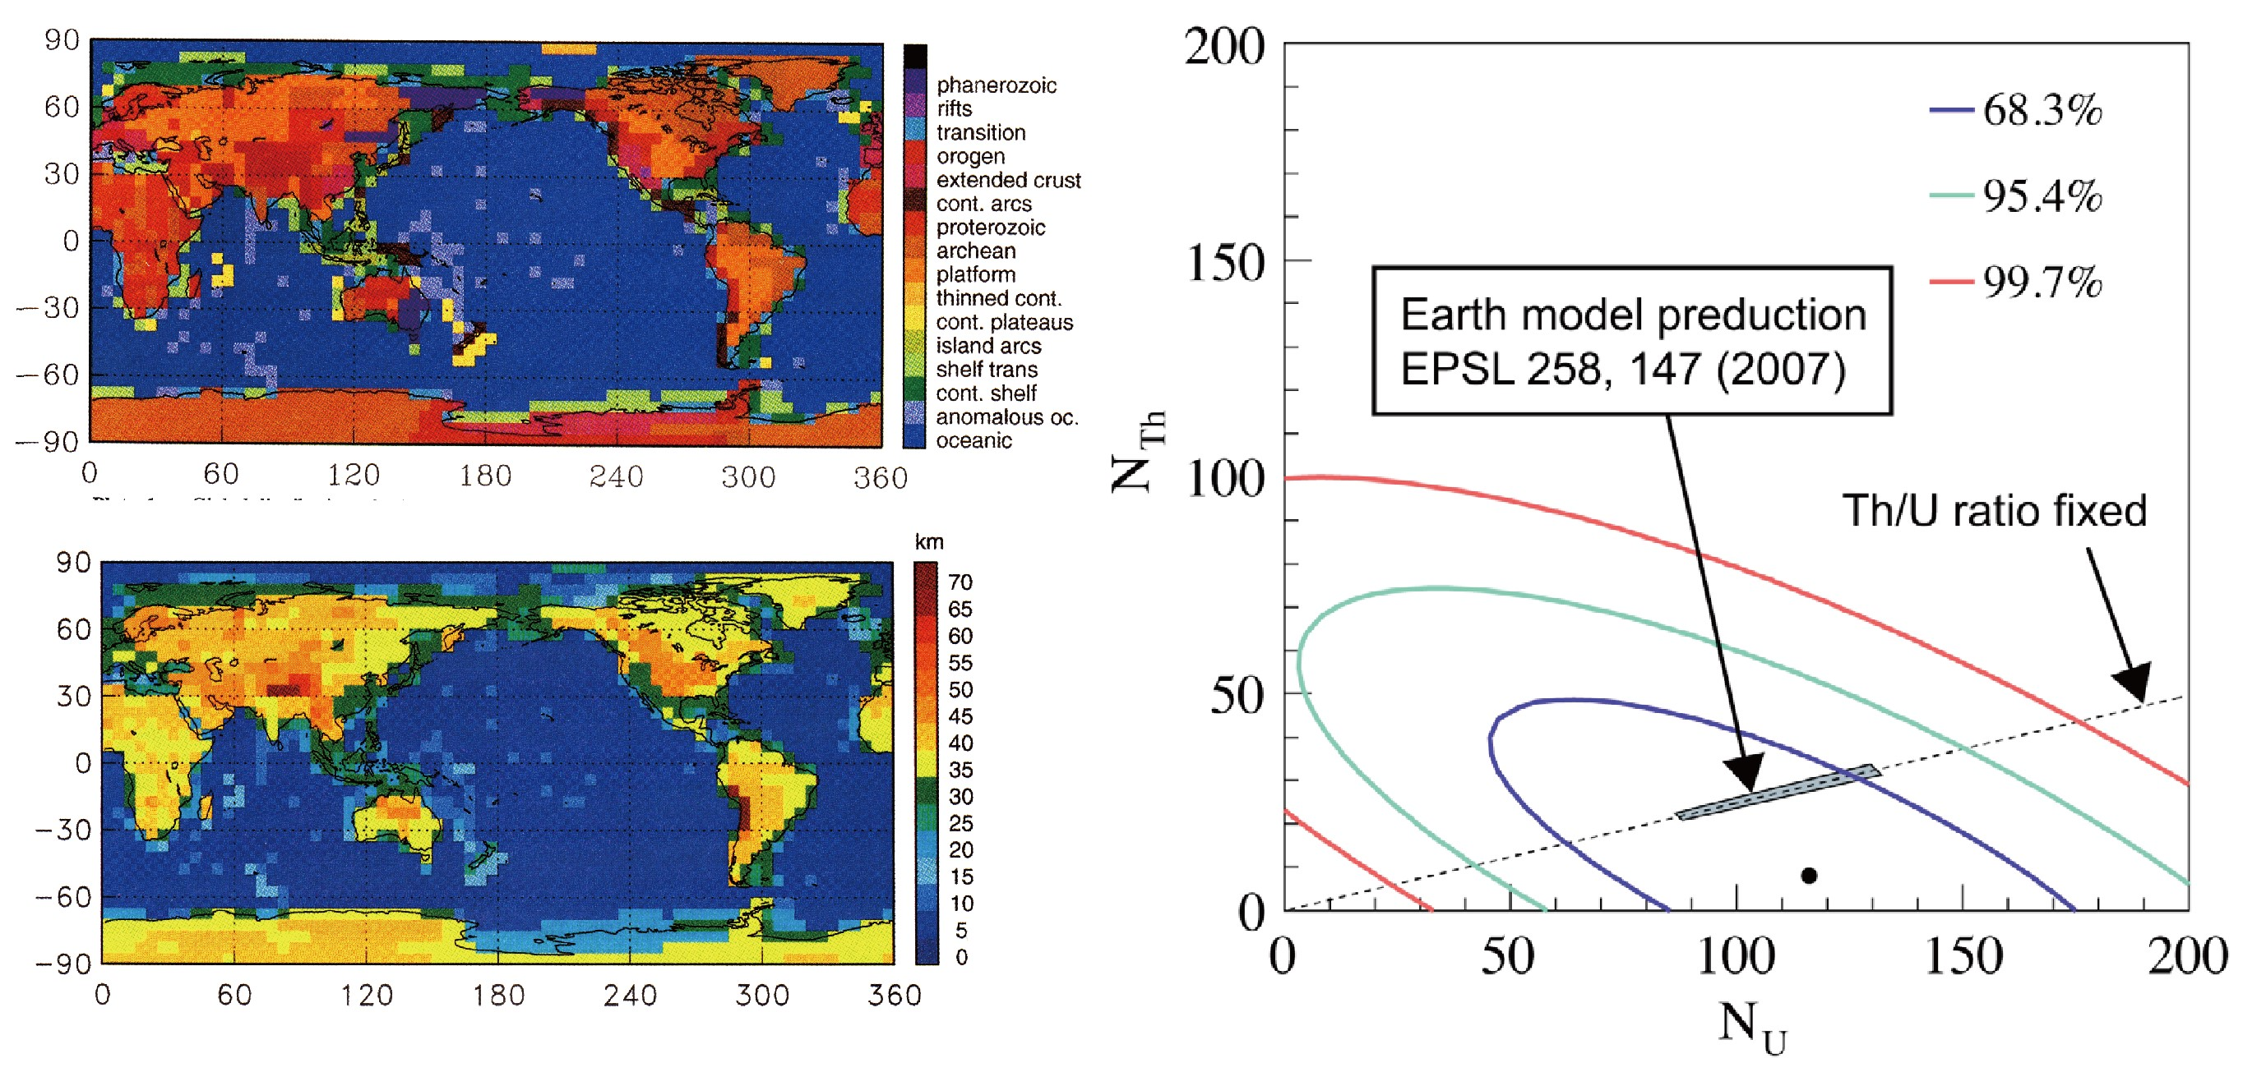
Difference between Earth and Physical Models
Earth Model
Physical Model
Geologic Province (Model)
Crustal Thickness (based on Province)
subjective definition (categorization)
collection of most likely values
(no error estimation)
probabilistic description

Slide 3
Flowchart of Our Probabilistic Crust Modeling
probabilistic U & Th concentration
for each lithology
probabilistic lithology Map
probabilistic compositional map
probabilistic geo-neutrino
flux simulation

Slide 4
Flowchart of Our Probabilistic Crust Modeling
probabilistic U & Th concentration
for each lithology
probabilistic lithology Map
This Talk
Ueki
probabilistic compositional map
probabilistic geo-neutrino
flux simulation
Enomoto

Slide 5
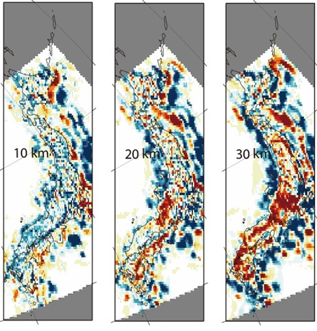
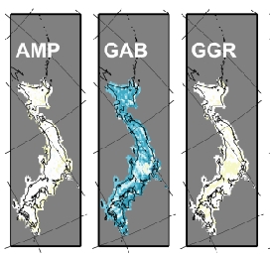
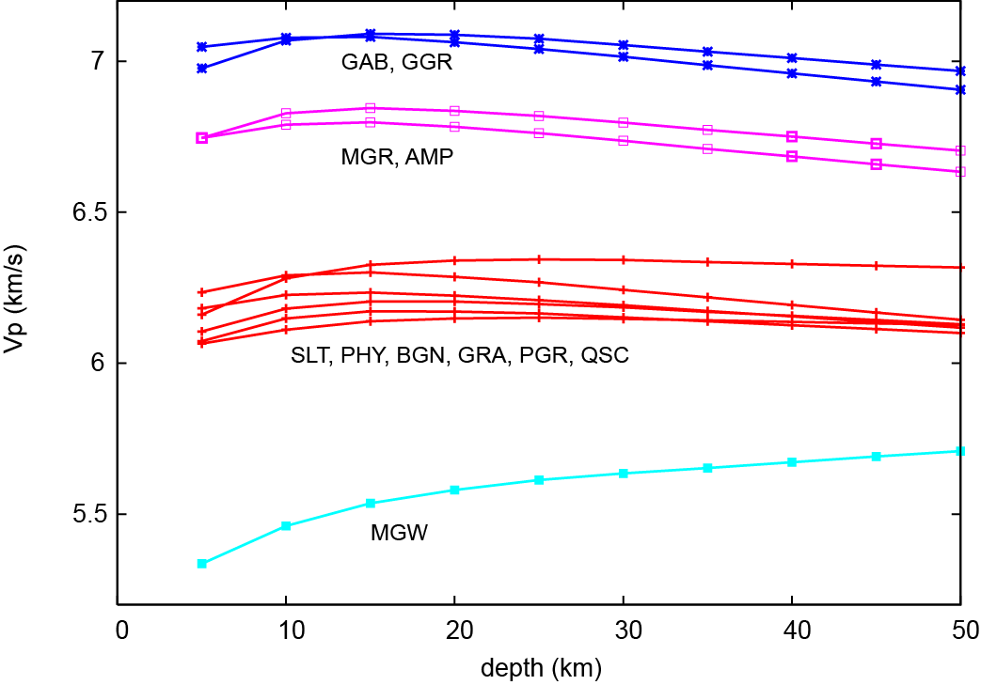
Inference of Probabilistic Lithology Map
Input
Output
Seismic Velocity Map
Seismic Velocity of Each Lithology
Probabilistic Lithology Map
(with errors)
(with errors)
30km

Slide 6
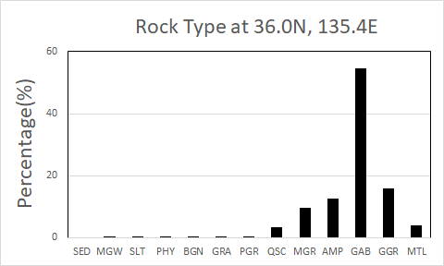
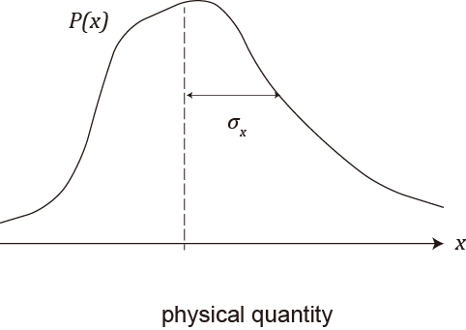
Probability Distribution in the Lithology Map
PDF for Usual Physical Quantity
PMF for Lithology
Probability (%)
rock type for a certain location

Slide 7
Bayesian Inference of Probabilistic Lithology Map
Previous Study
geological
insight
geological
insight
Geologic Province
Seismic Velocity
Map
upper crust
middle crust
lower crust
Lithology Map
seismic velocity
of each lithology
This Study
probabilistic lithology prior
Seismic Velocity
Map
Probabilistic
Lithology Map
seismic velocity
of each lithology

Slide 8
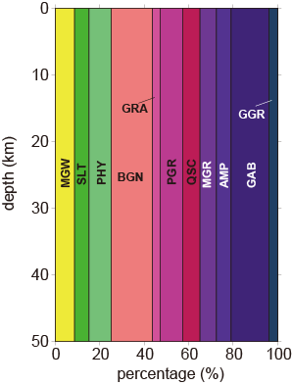



Key Features for Obtaining Probabilistic Model
Use of Probabilistic
Geological Segmentation
Incorporation of Local Features
into the Prior
The point is in the sedimentary layer at the probability of
$$P \left( V_{p}^{obs}<5.0 \right)$$
The point is in the mantle at the probability of
$$P \left( V_{p}^{obs}≥7.5 \right)$$
The point is in the crust at the probability of
$$P \left( {5.0≤V}_{p}^{obs}<7.5 \right)$$

Slide 9
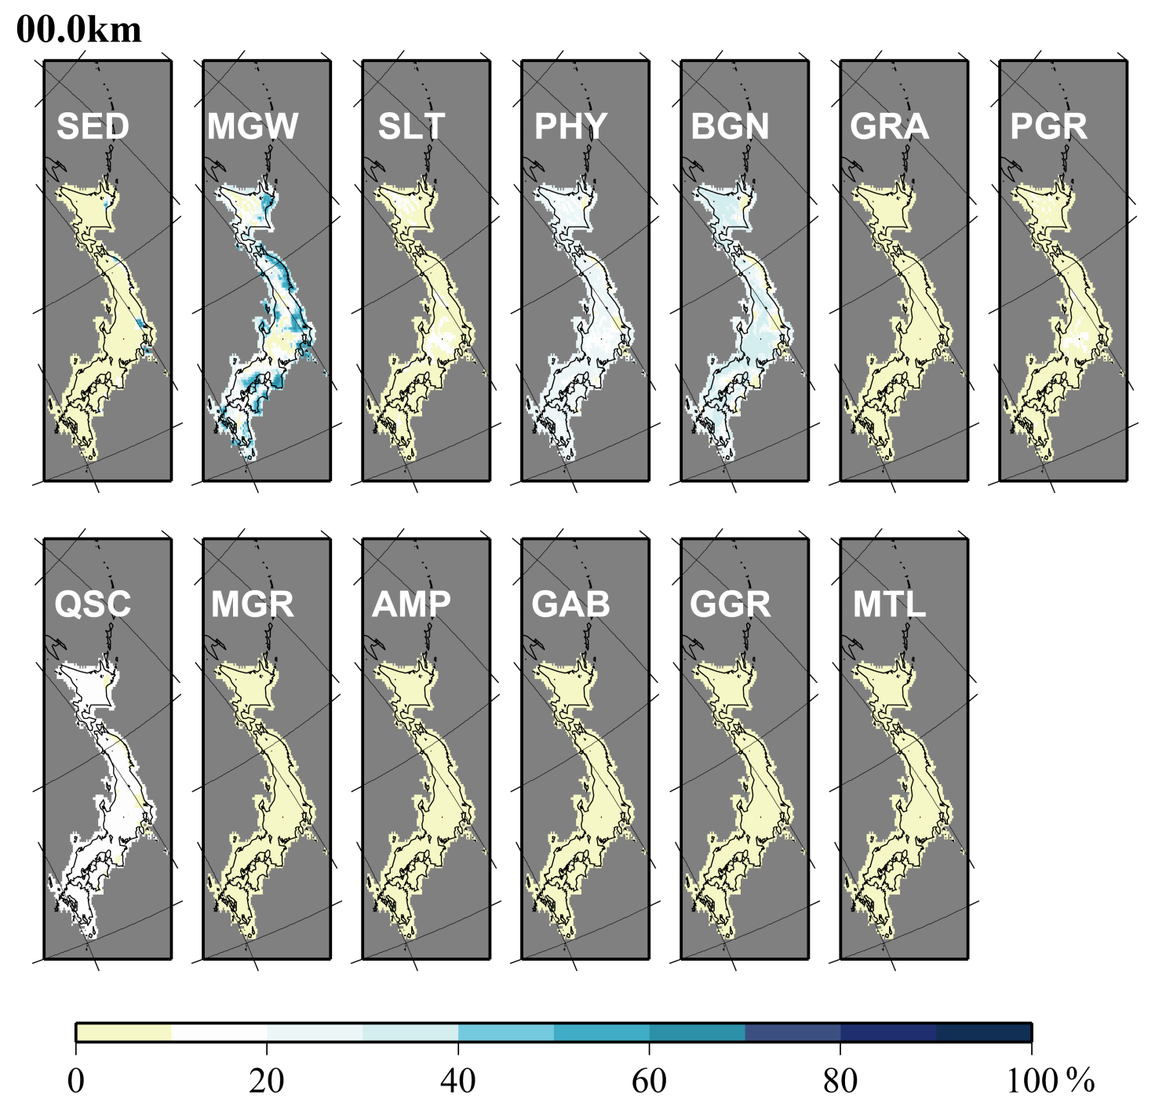

Slide 10
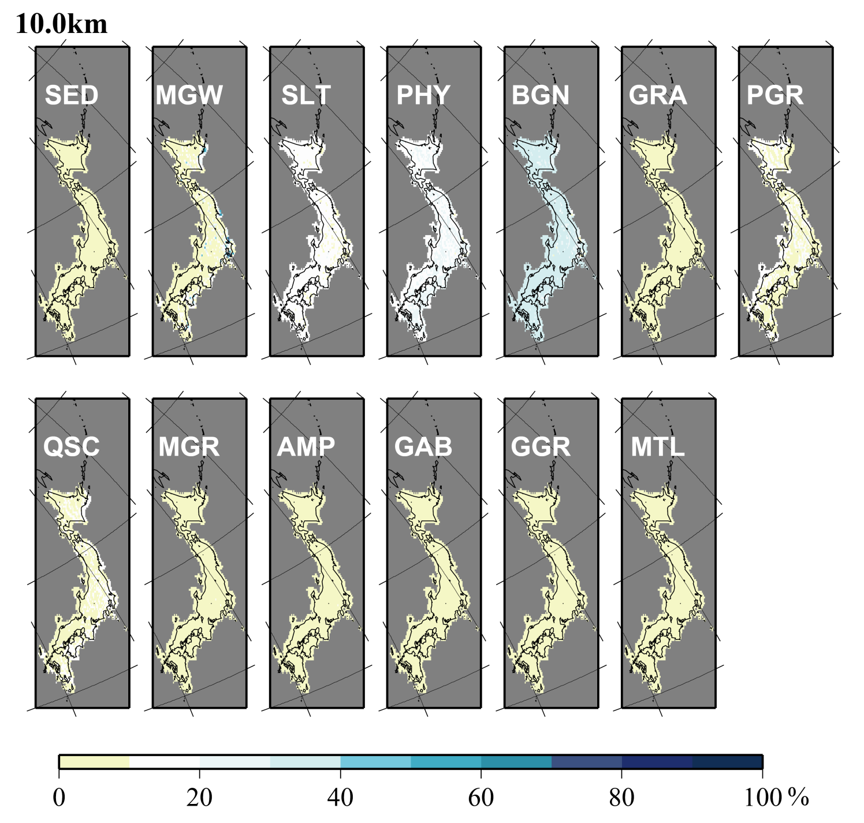

Slide 11
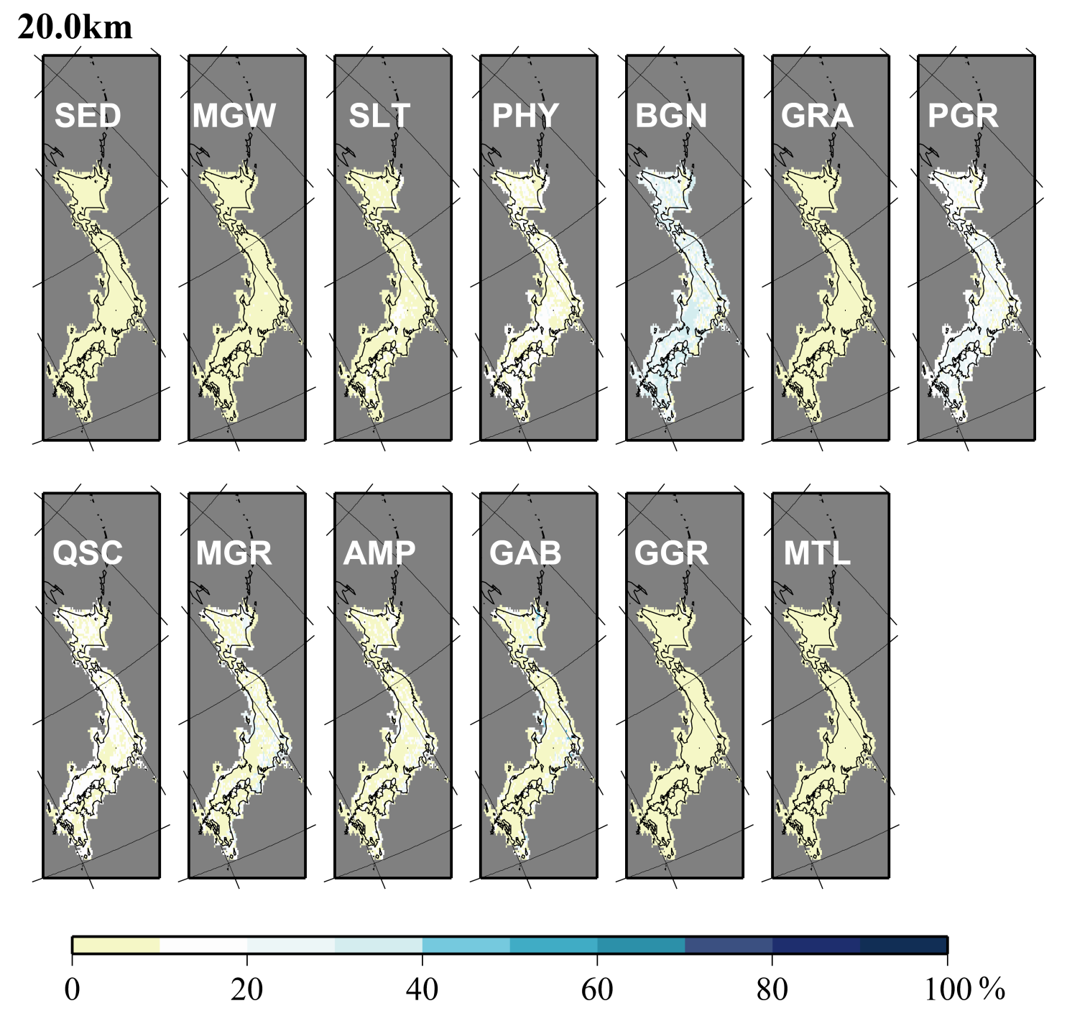

Slide 12
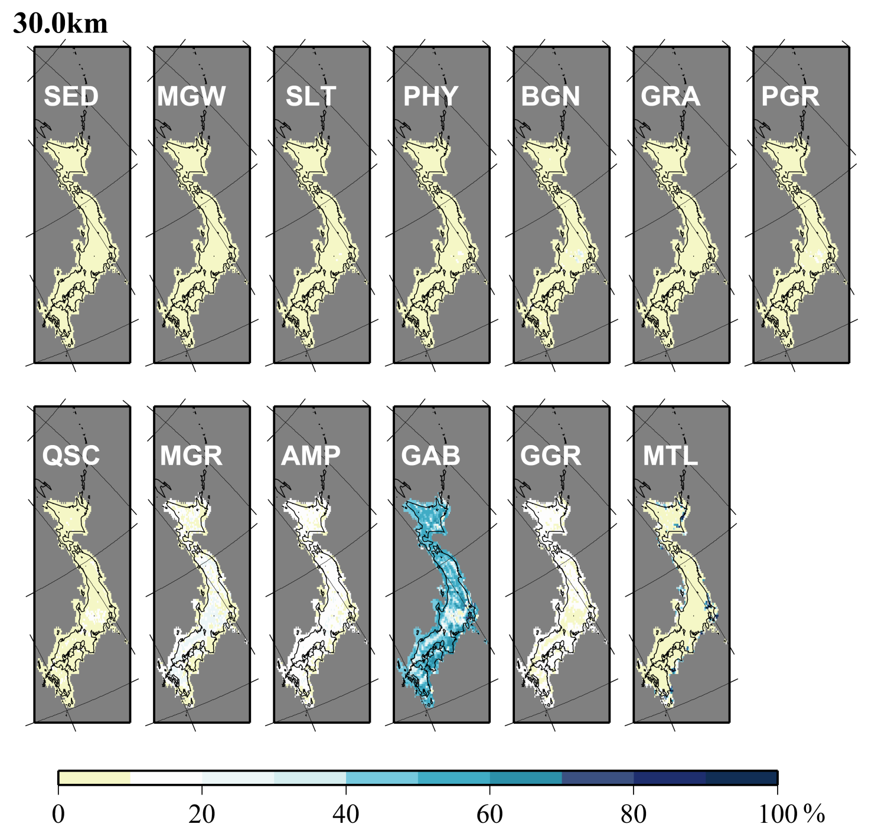

Slide 13
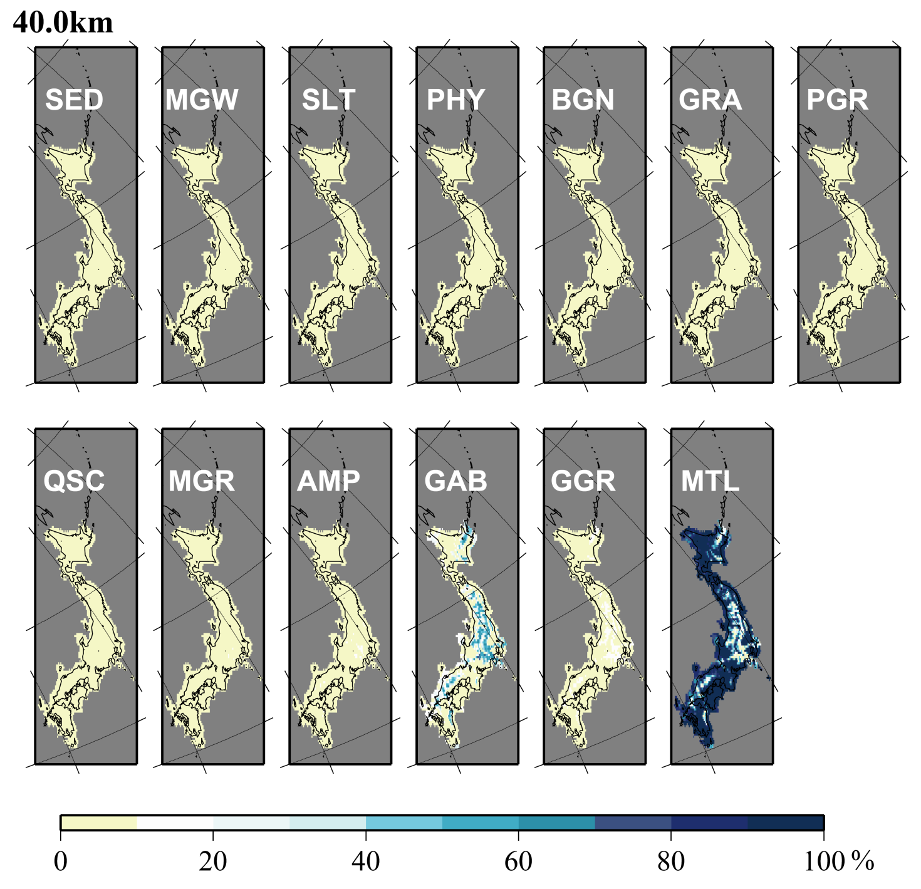

Slide 14
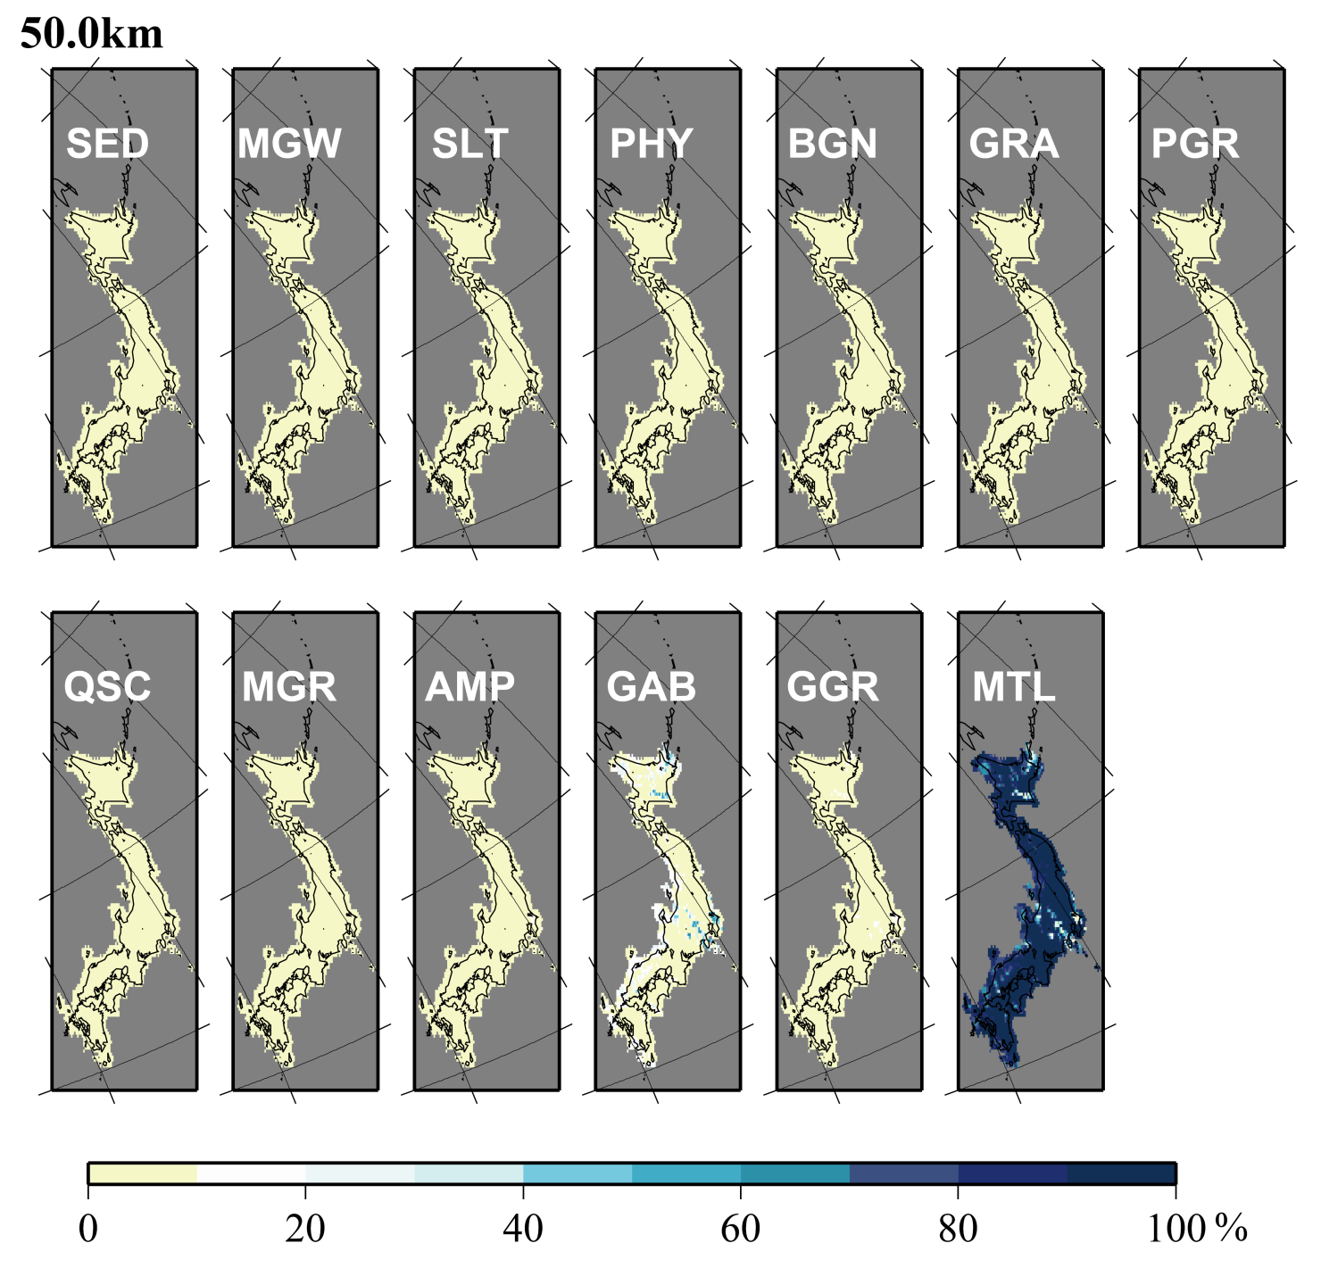

Slide 15
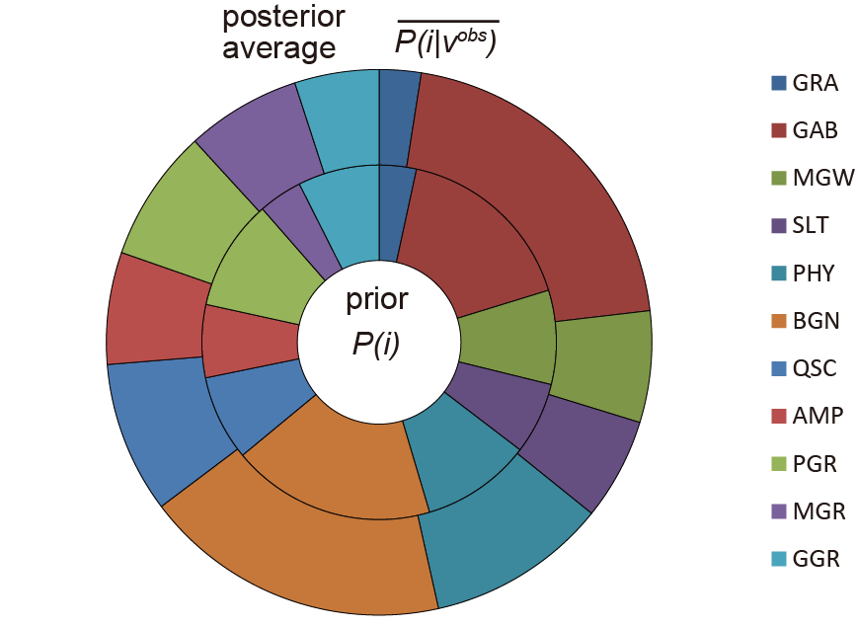
Plausibility of Hidaka Prior
Relative Frequencies of Each Lithology

Slide 16
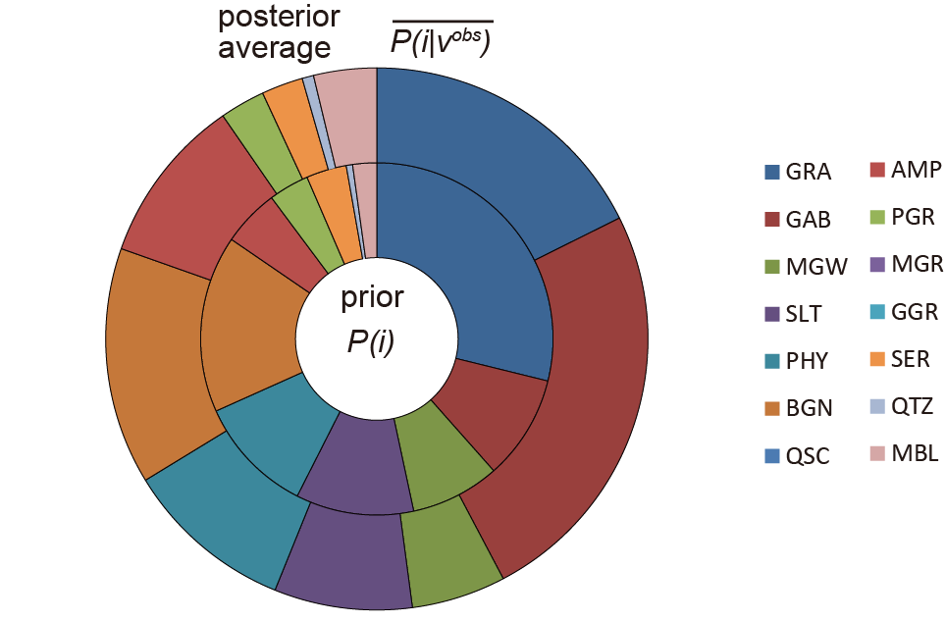
Plausibility of Hidaka Prior
Relative Frequencies of Each Lithology
Distance p.65 of Enomoto
Hidaka Prior
Cascades Prior

Slide 17
Distance between Hidaka Prior and Posterior
Hidaka Prior
Cascades Prior
Kullback-Leibler divergences
Hidaka Prior
Hidaka Posterior
0.02
0.55
0.35
0.38
Cascade Prior
Cascade Posterior
0.14

Slide 18
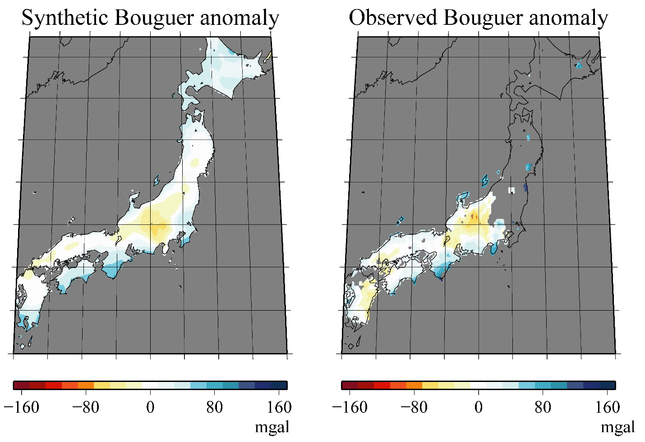
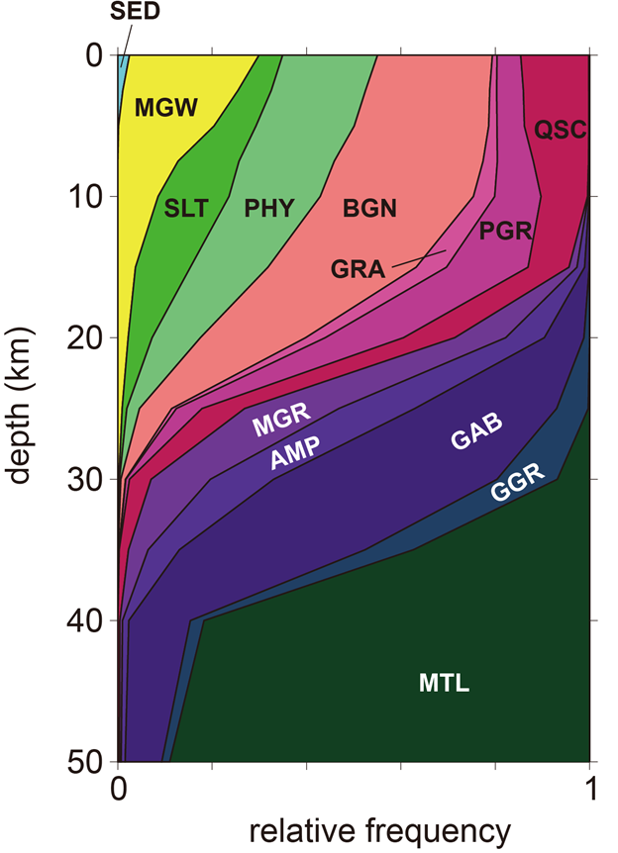
Significant Work by Seismic Data
Reasonable Reproduction of
Vertical Lithological Variation
Reasonable Reproduction of
the Observed Gravity Data
prior
posterior average

Slide 19
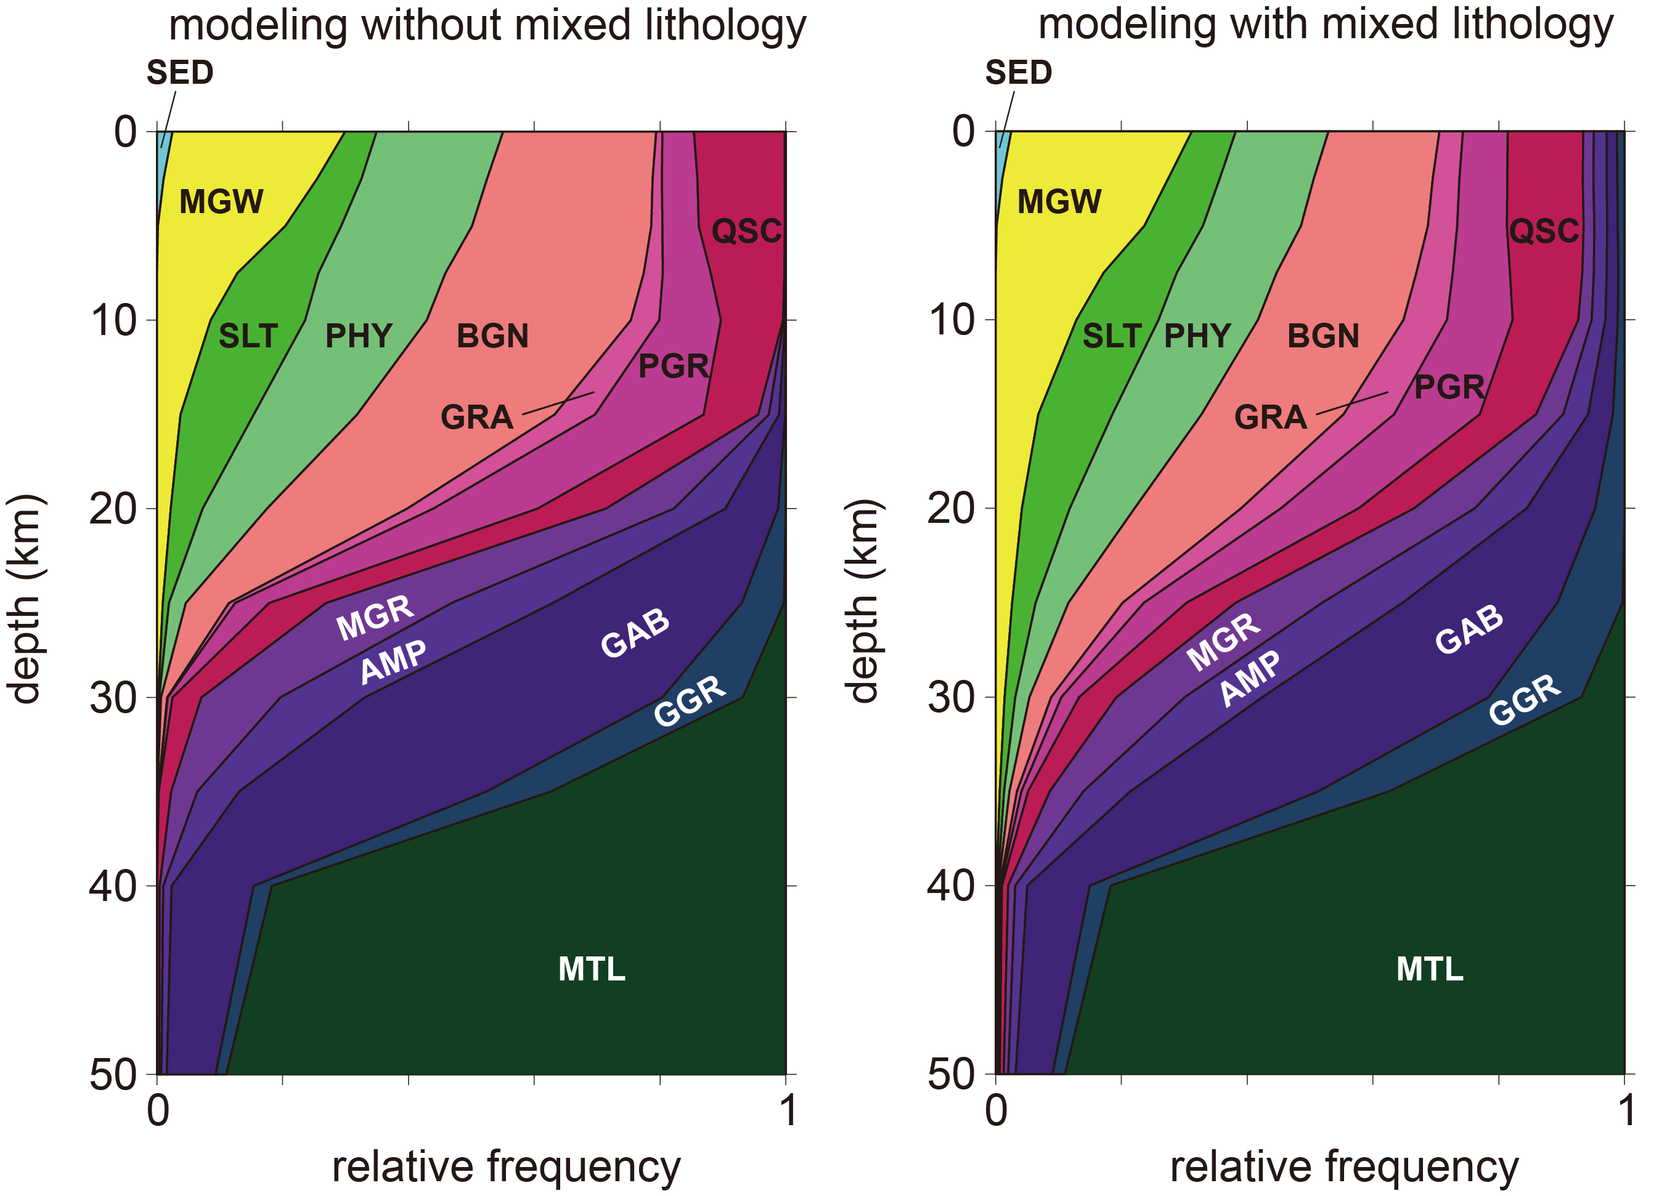
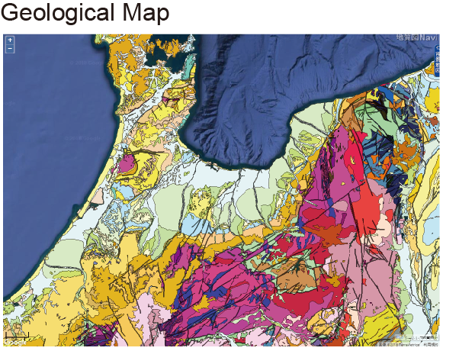
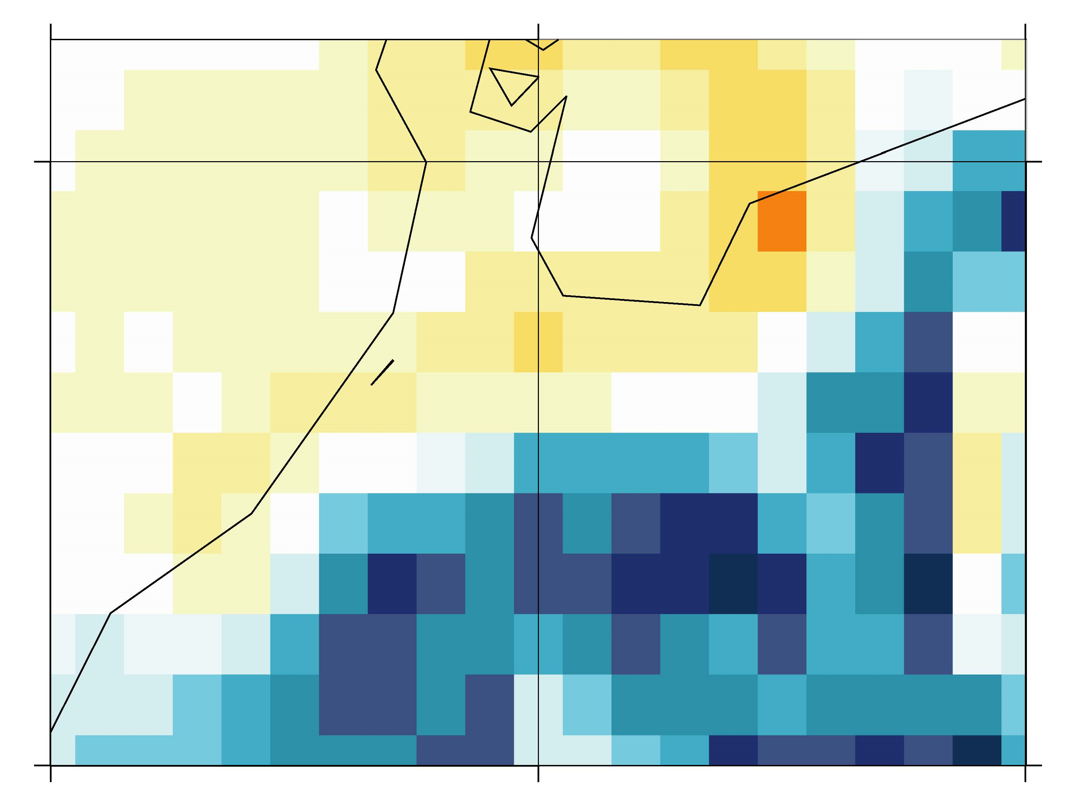
Effects of Mixed Lithology
Scale Length of Lithological Distribution
and Tomographic Resolution
Tomography

Slide 20
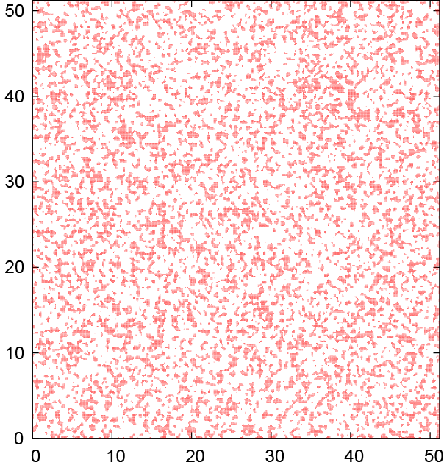
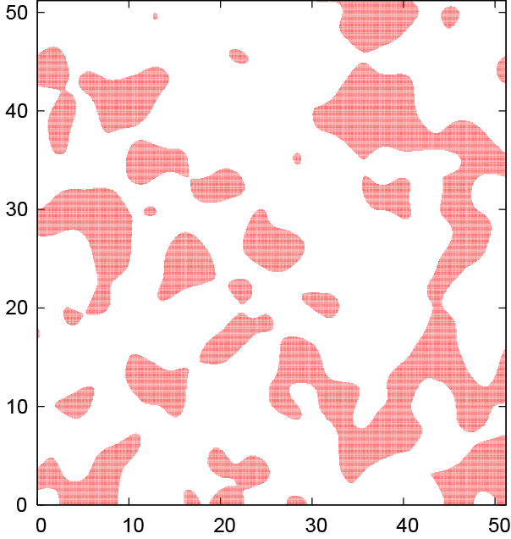
Utilization of Constraints on Spatial Correlation (On Going…)
Instances of Lithology Distribution
Lithological Distribution
for the rock type of relative frequency = 30%.
Correlation Length = 0.3
Correlation Length = 3.0
has certain correlation length.
reduces the uncertainties in geo-neutrino flux simulation.
(Enomoto-san’s Talk)

Slide 21
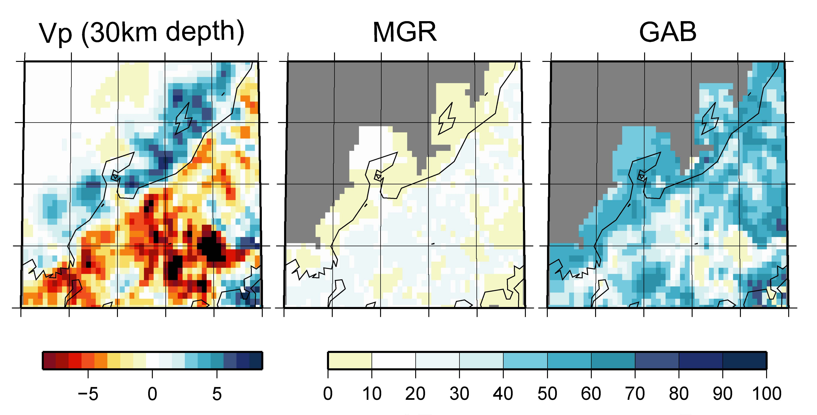
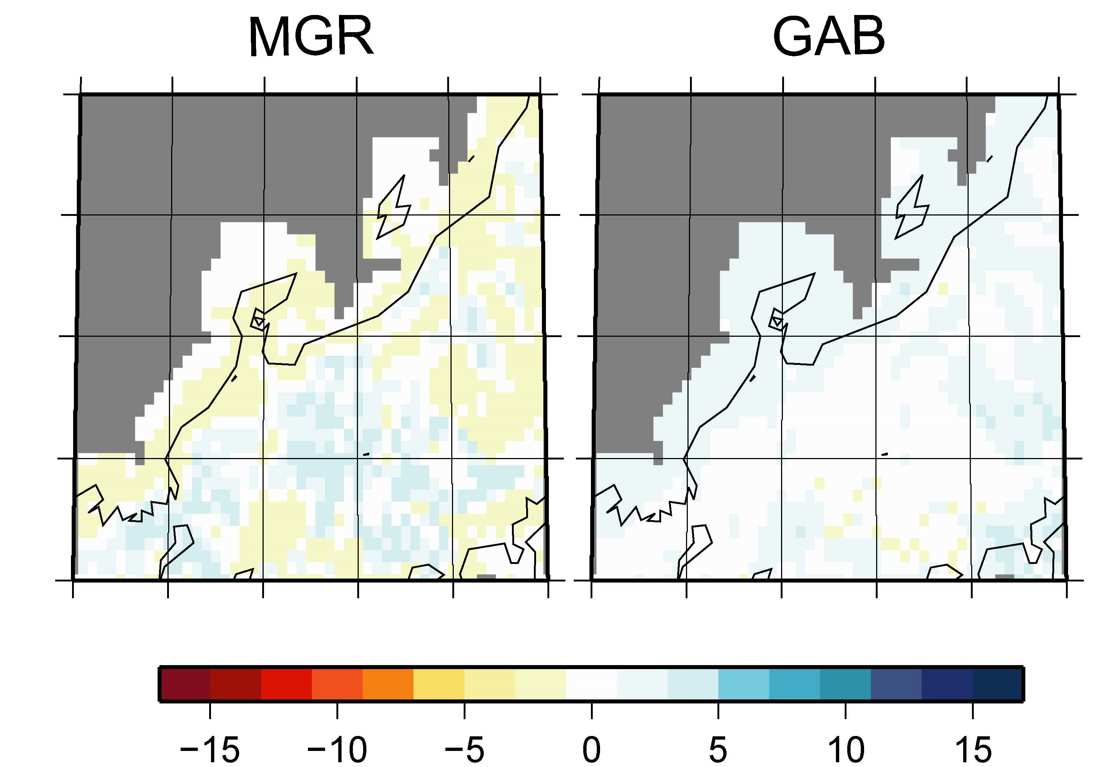
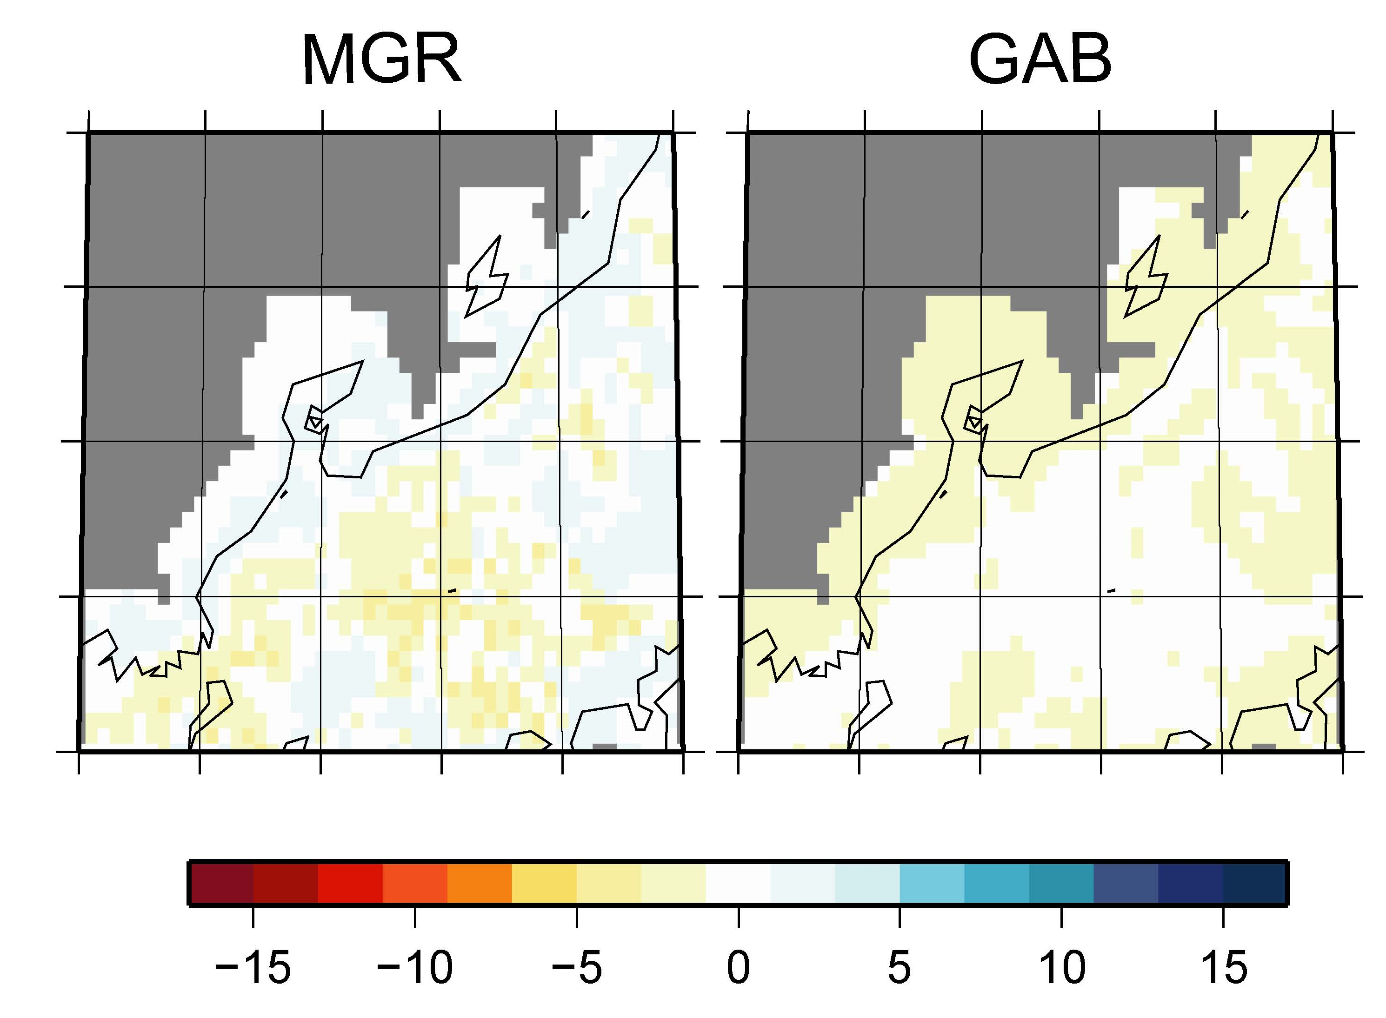


Effects of Temperature Errors
Our Posterior
Case for
Case for
$$σ_{temp}^{2}=0$$
$$2 σ_{temp}^{2}$$

Slide 22
Conclusion
Developed the framework for probabilistic and objective inference
of lithology map.
Uncertainties of the lithology map are also estimated.
Plausible lithology distribution was obtained
from the seismic data without geoscientific
data processing.

