Slide 1
JULOC：A local 3-D high-resolution crustal model in South China for forecasting geoneutrino measurements at JUNO
Zhiwei Li, Ran Han, Ruohan Gao, Andong Wang, Yufeng Li, Yufei Xi, Jingao Liu, Xin Mao, Yao Sun, Ya Xu
JULOC: JUNO LOcal Crust (C also stand for Chinese Group)
2019-10-22 Prague

Slide 2
Outline
Introduction
Methods
Multi-scale crustal model in South China
3.1 Ambient noise tomography of local crustal model
3.2 Receiver function imaging with dense array
3.3 Ambient noise tomography with dense array
3.4 Ambient noise tomography of South China Sea
4. Summary

Slide 3
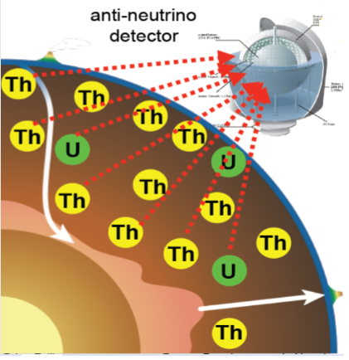
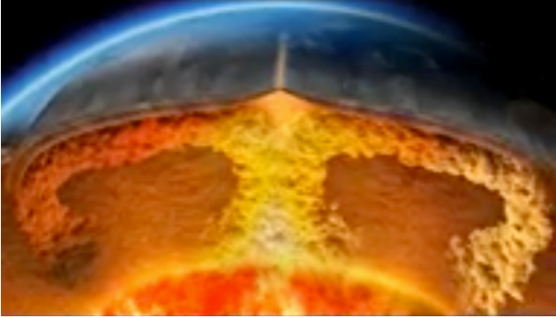
Different compositional models of BSE individually predicted different mantle geoneutrino fluxes. The detector cannot separate the mantle contribution from the crust contribution.
1. Introduction
To test different compositional models of the mantle, an accurate estimation of the crust geoneutrino flux based on the 3-D crust model in advance is necessary.
Bulk Silicate Earth
(BSE) models
Low Q
~10TW
Middle Q
~20TW
High Q
~30TW
Hybrid Earth’s engine

Slide 4
A local 3-D crustal Model, including layering，density and 3-D Abundance

Slide 5
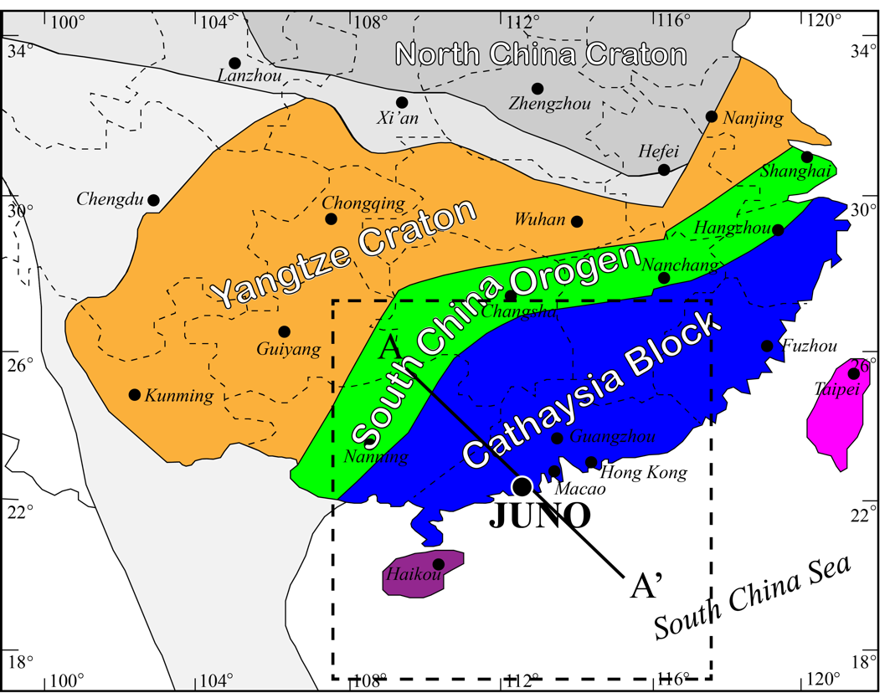

Study Area
JUNO is located at continental margin, geologically complex.
The Cathaysia and Yangtze Blocks.
Crust thickness varies between ~7-40 km, decreases southward, from about 30 km along the coast to 7-8 km in the central basin
JUNO: ~22ºN, 112.5ºE 17-27ºN, 107.5-117.5ºE (10ºx10º)

Slide 6
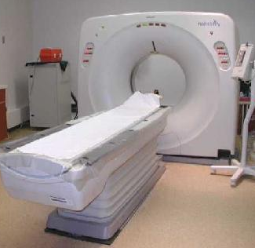
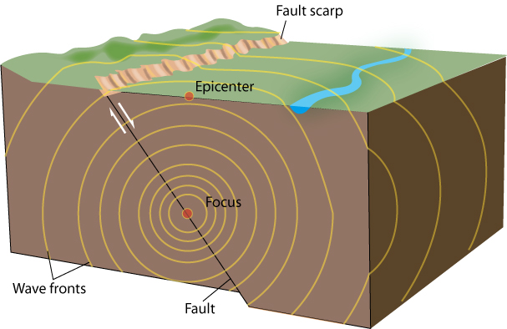
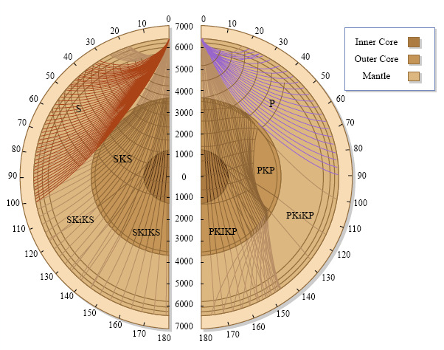
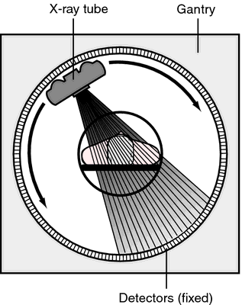
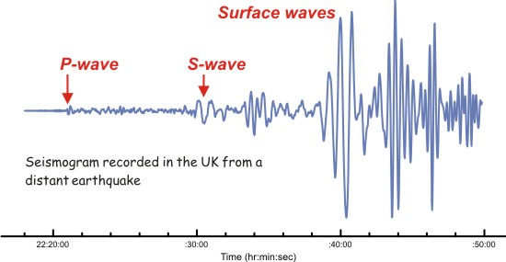
2. Methods
Seismic method is the most effective method to image the 3-D structure of the Earth
Seismic tomography of the Earth

Slide 7
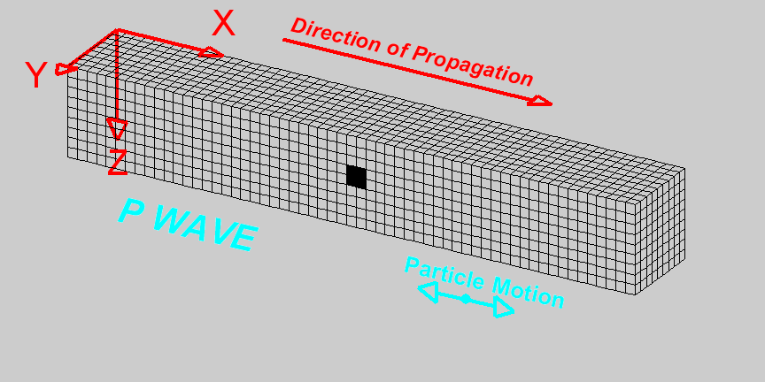
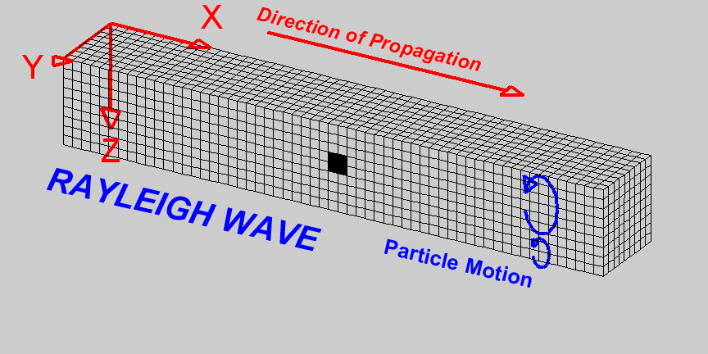
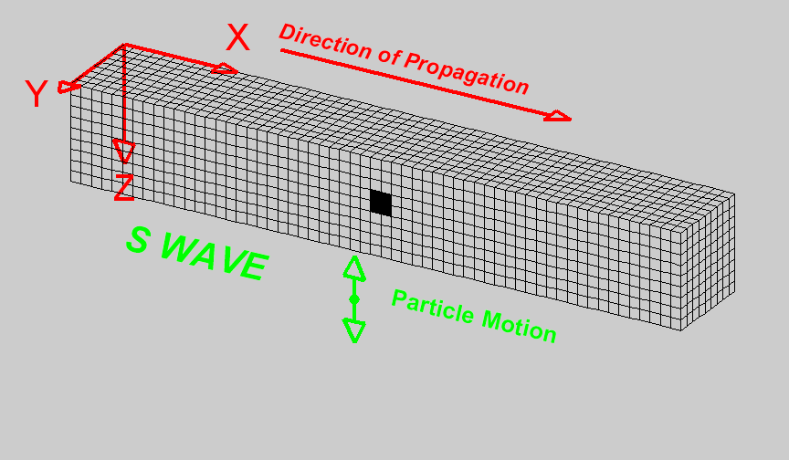
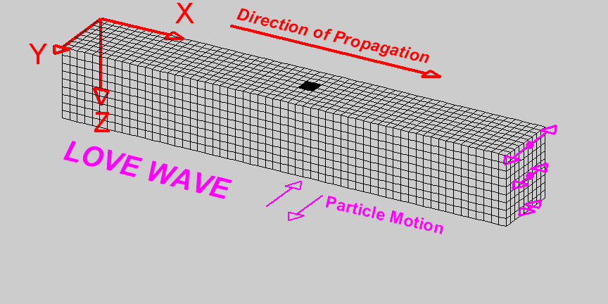
Seismic body wave and surface wave
can be used to imaging the 3-D structures of the Earth.

Slide 8
Seismic methods for imaging crustal structures
1) Seismic refraction/reflection profile (layering, Vp)
2) Earthquake traveltime tomography (Vp, Vs)
3) Ambient noise surface wave tomography (Vs)
4) Ambient noise tomography with dense array (Vs to 5 km depth)
5) Receiver function imaging with dense array (Vs and Moho)

Slide 9
1) Seismic refraction/reflection profile (layering, Vp)
highest resolution, but very expensive, TNT explosion/vibrator are needed.
No more new seismic reflection profiles in South China.
Yu et al 2018
South China
Hao et al 2014

Slide 10
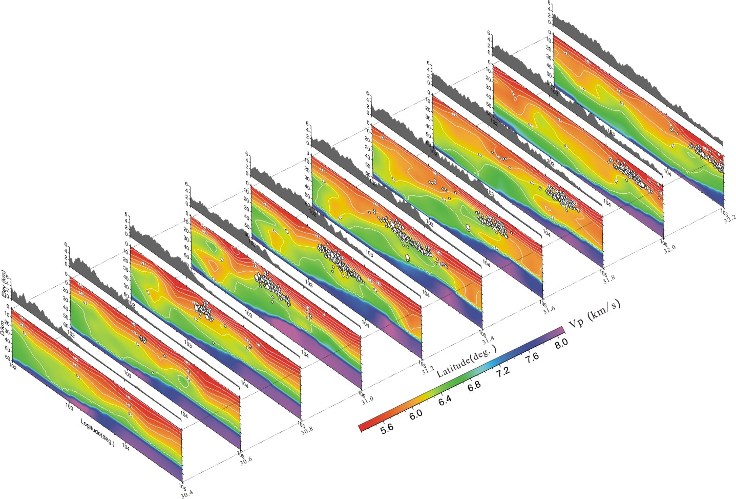
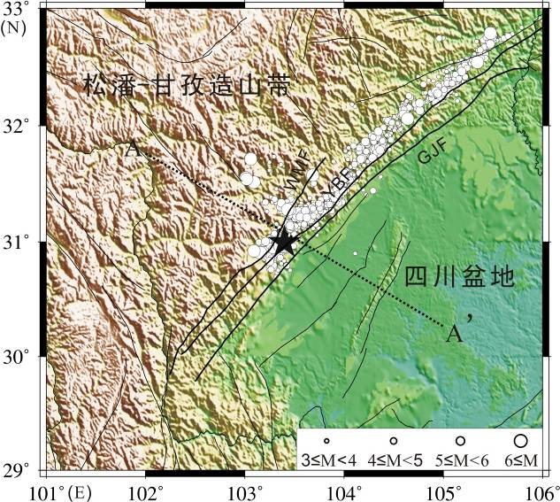
2) Earthquake traveltime tomography (Vp, Vs)
Low-cost, high-resolution seismic imaging method, both Vp and Vs structures can be obtained.
but need enough local earthquake and seismic stations.
Earthquake tomography in east margin of Tibetan Plateau

Slide 11
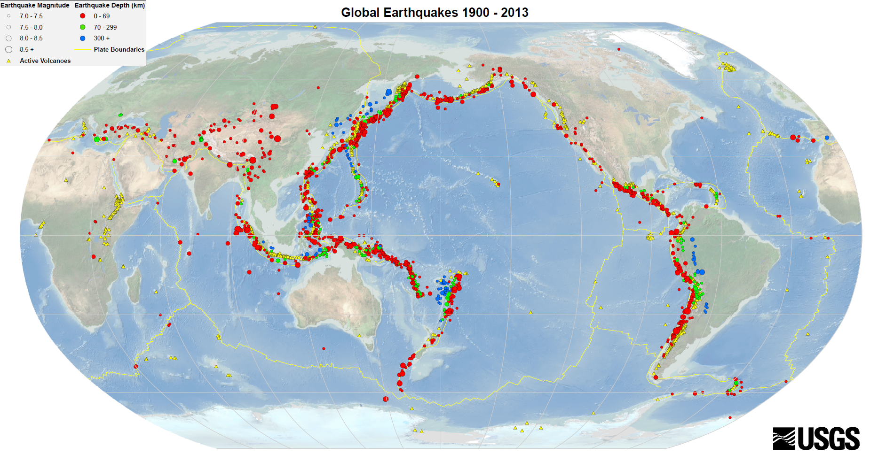
In south China, no enough local earthquakes or regional earthquake in surrounding areas for earthquake tomography
KamLAND
JUNO
M>7 Earthquake distribution in the last 100 years

Slide 12
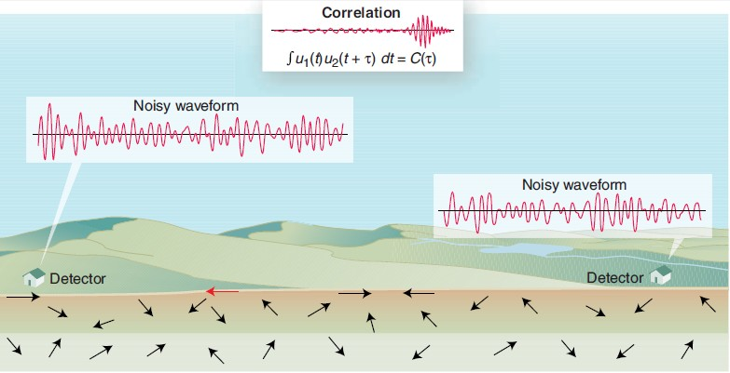
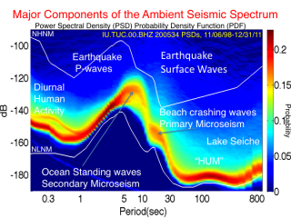
3) Seismic ambient noise tomography (Vs)
Seismic surface waves can be obtained with seismic ambient noise data, expecting high-resolution 3-D crustal model beneath seismic array.
Weaver., 2005, Science

Slide 13
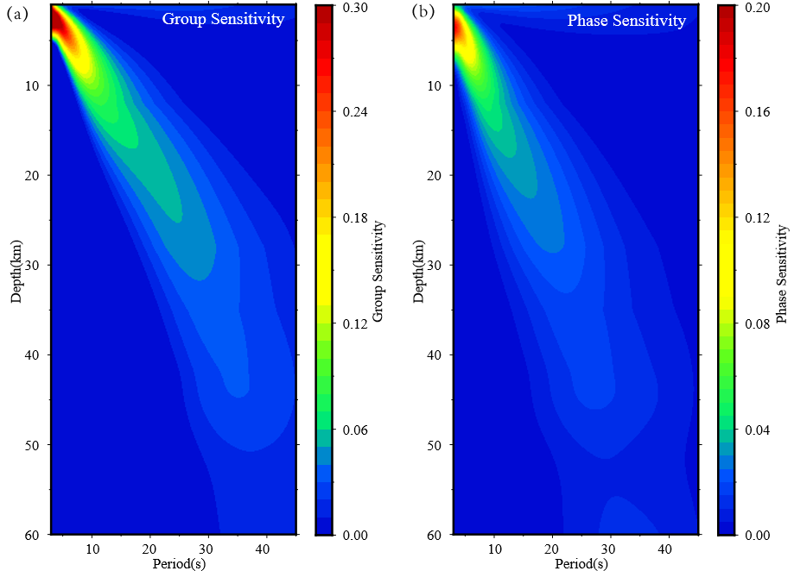
Sensitivity kernel of surface waves to the crustal structures
4~ 45 sec surface waves have good constraints of Vs down to ~ 50 km.

Slide 14
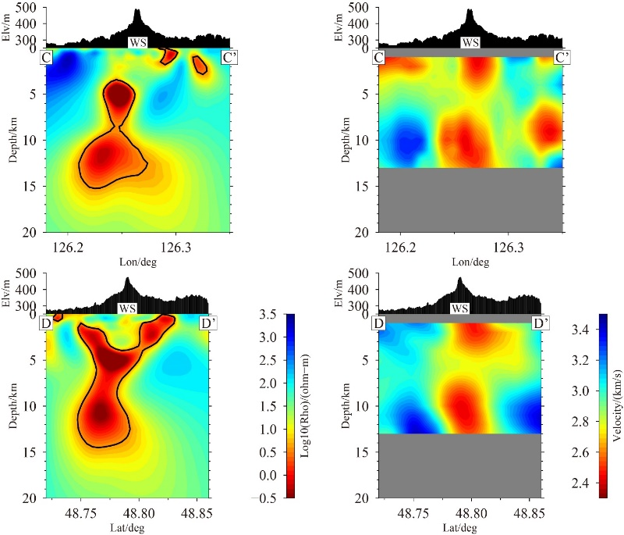
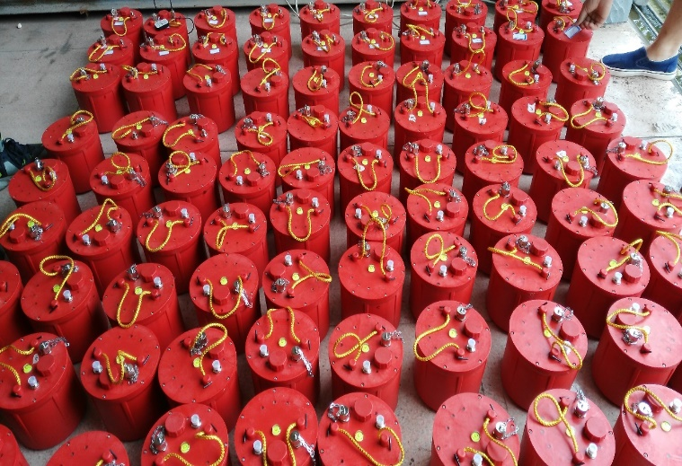
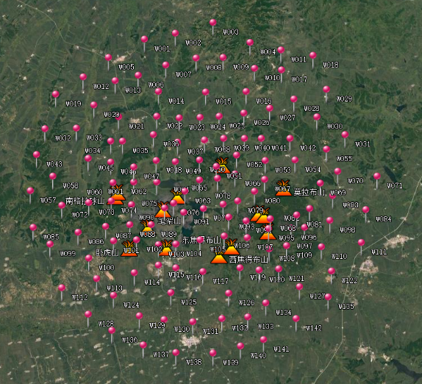
4) Ambient noise tomography with dense array
(Vs to 5 km depth)
With dense seismic array (~ a few km interstation distance), short period surface waves can be extracted from ambient noise. Shallow Vs down to ~ 5 km depth can be imaged.
Low-cost 3-C seismometer

Slide 15
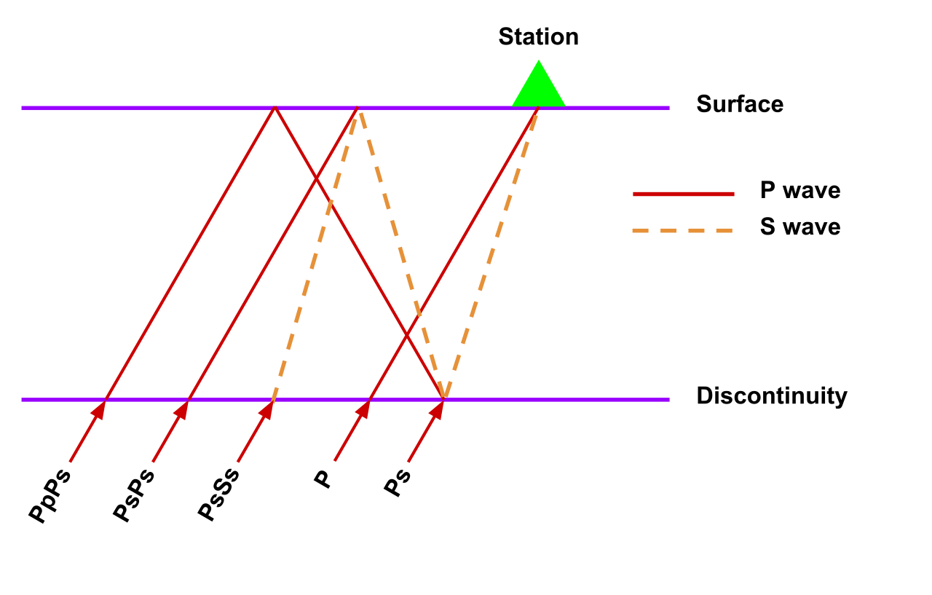
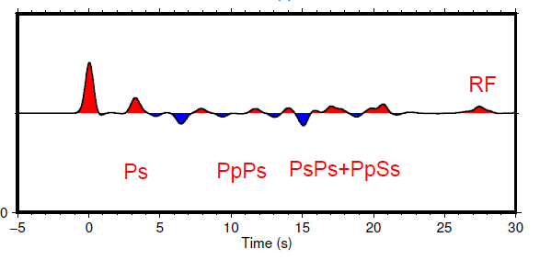
5) Receiver function imaging with dense array (Vs and Moho)
Receiver functions (RFs) are time series, computed from three-component seismograms, which show the relative response of Earth structure near the receiver.
RFs can provide good constraints on Vs and Moho of crust.

Slide 16
Empirical relations for crustal velocity and density
Brocher, 2005 BSSA

Slide 17
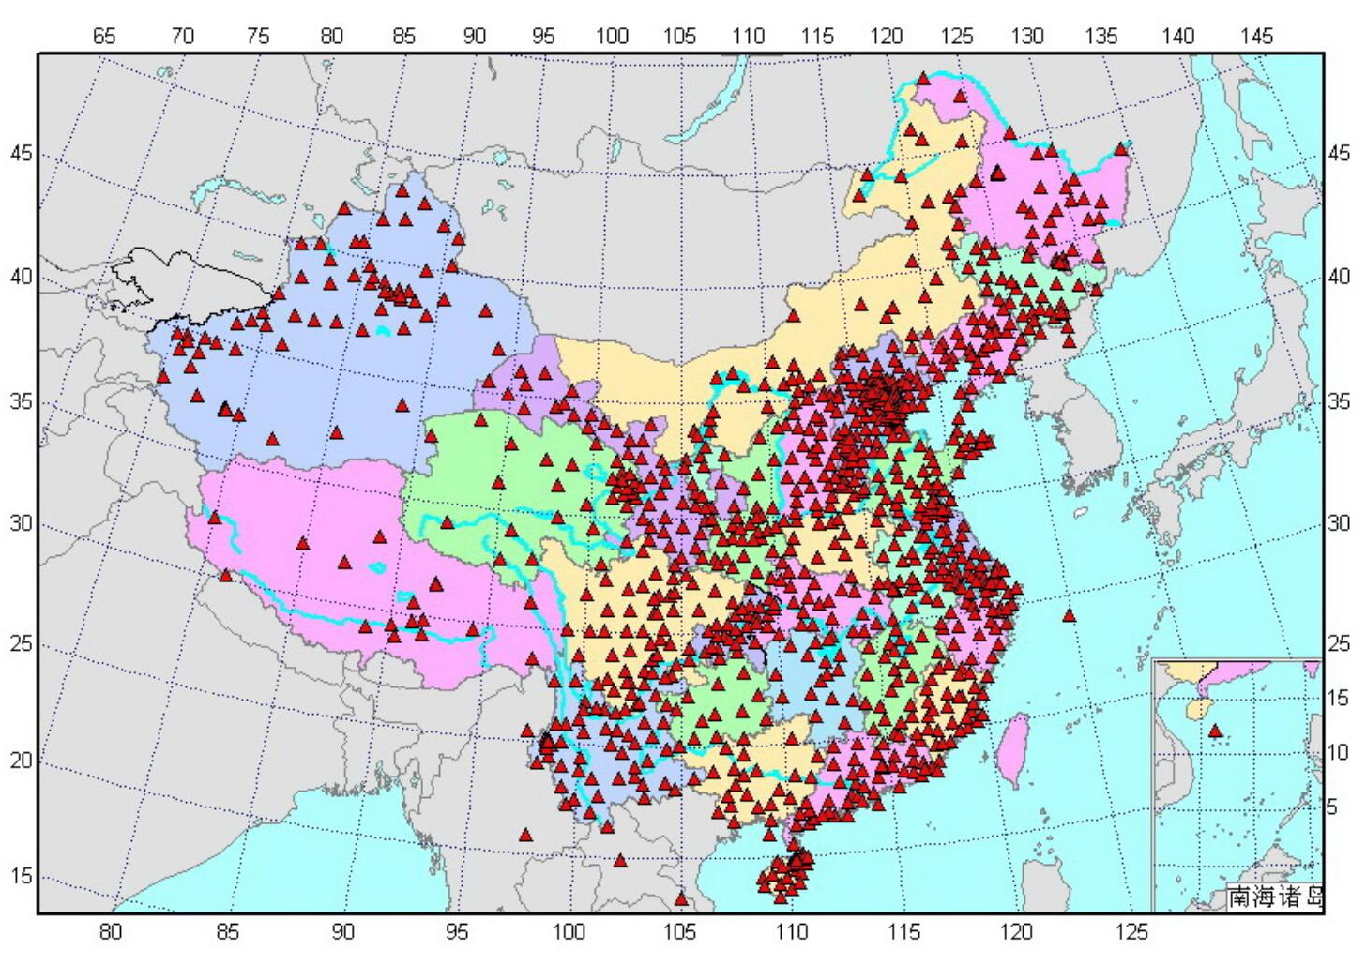
3. Multi-scale crustal model in South China
~1000 seismic stations in China
~ 450 stations in and around South China, ~ 70 km interstation distance

Slide 18
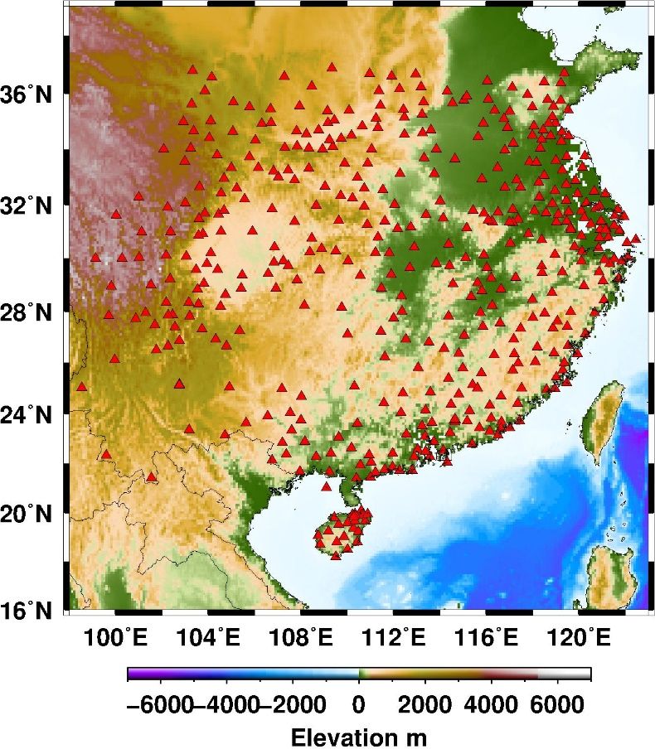
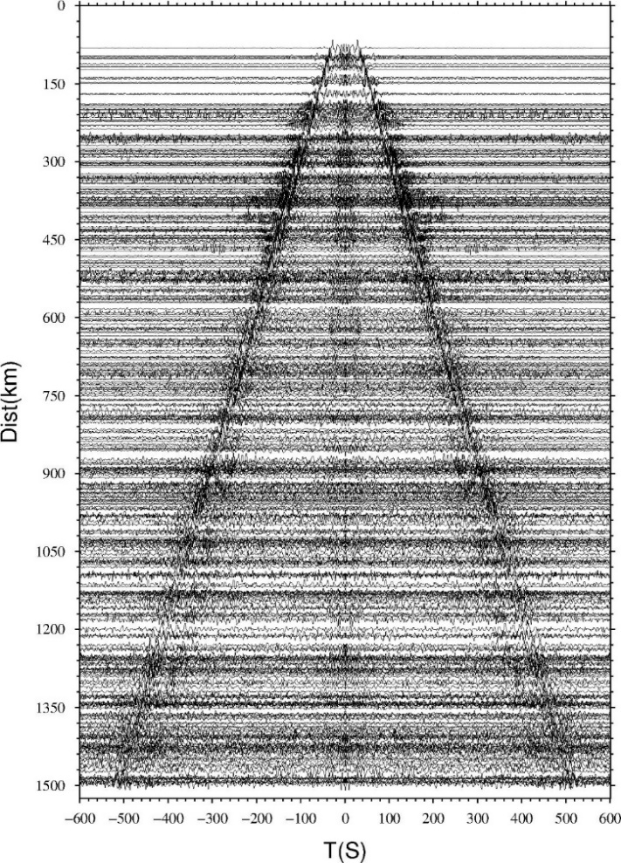
3.1 Ambient noise tomography of local crustal model
With continuous seismic waveforms from 450 seismic stations in South China, ~ 100,000 noise cross-correlation functions (NCF) are obtained to extract the surface wave dispersions.
450 broadband seismic stations
Clear surface waves are obtained

Slide 19
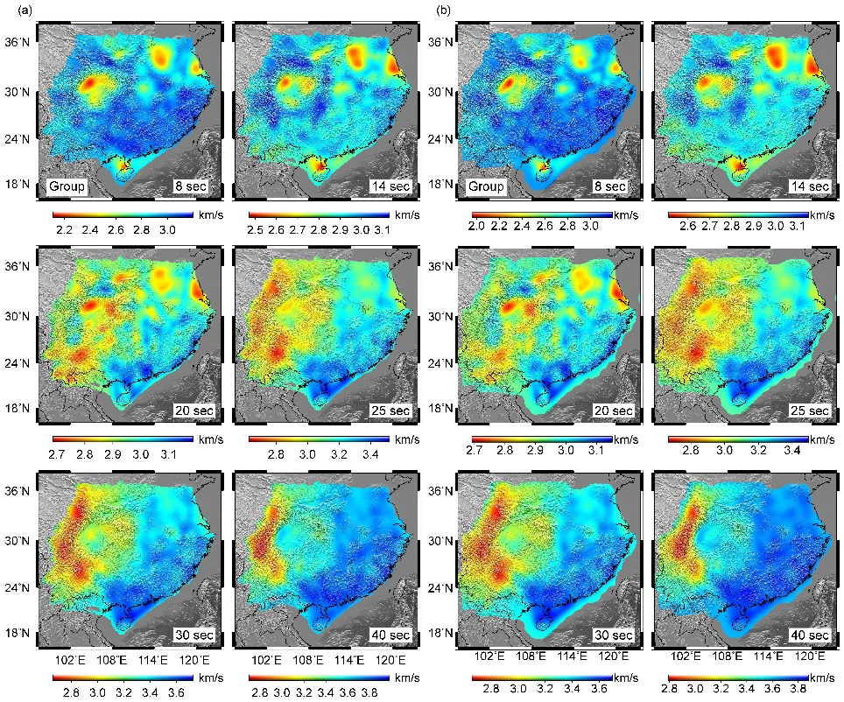
Observed Group velocity
Predict Group velocity

Slide 20
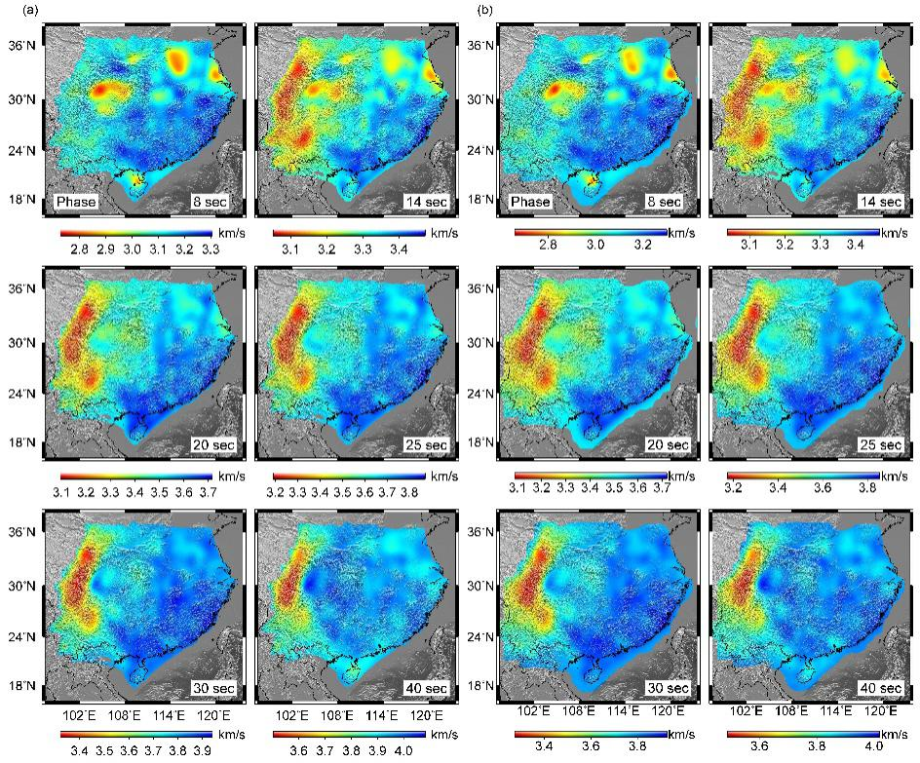
Observed Phase velocity
Predict Phase velocity

Slide 21
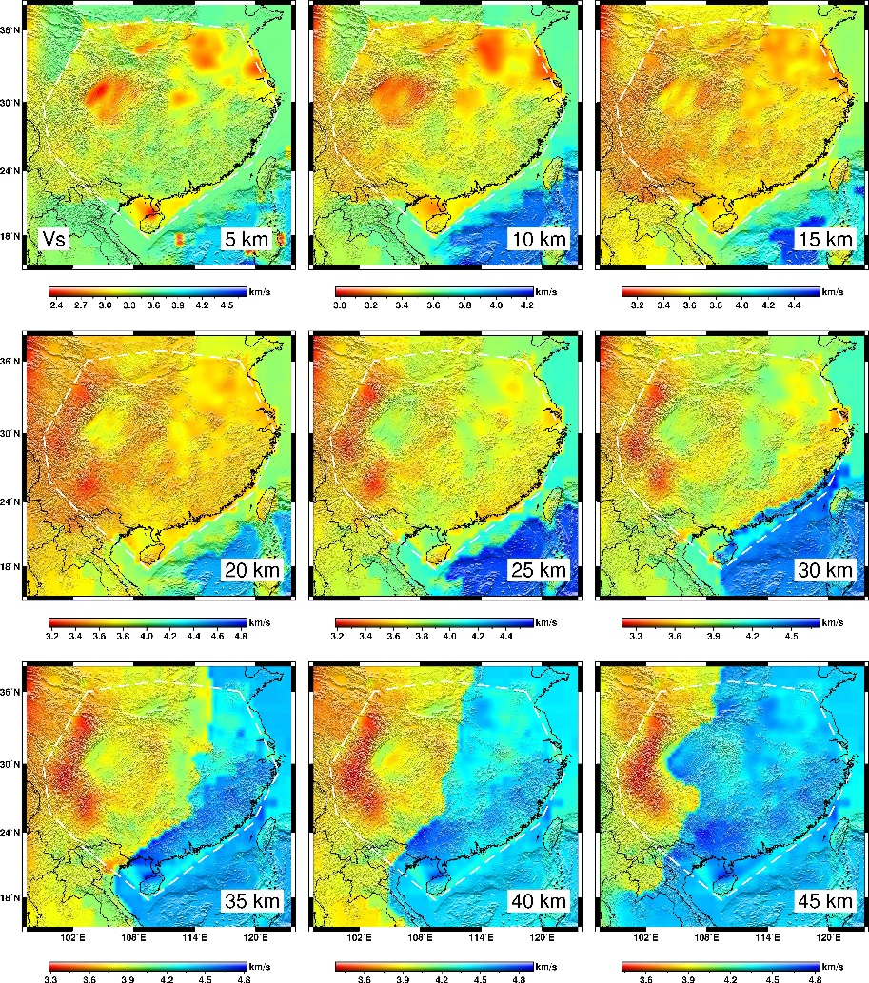
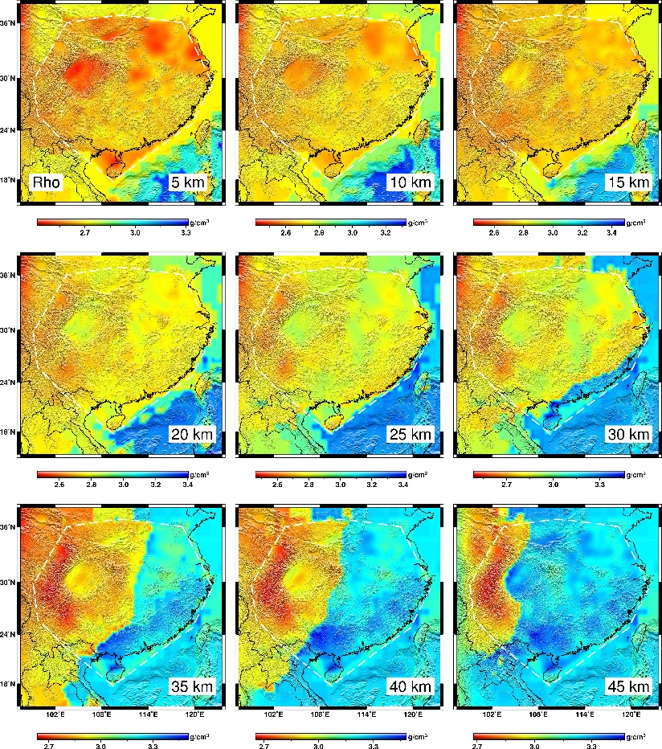
3-D high-resolution Vs structures in the South China
spatial resolution: ~ 40 km in horizontal and 3~4 km in vertical directions.

Slide 22

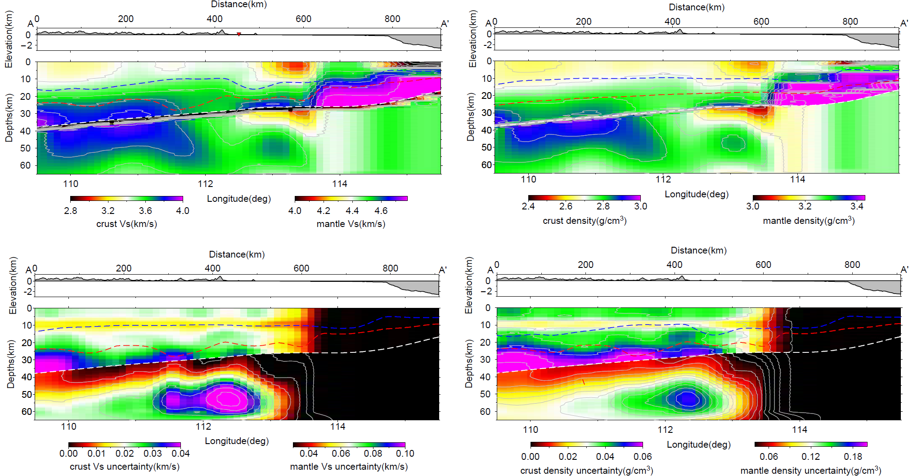
Cross-sections for shear-wave velocity and density structures in NW-SE directions through the JUNO site
White dashed lines are Moho from gravity and DSS.
uncertainties for Vs and density structures

Slide 23
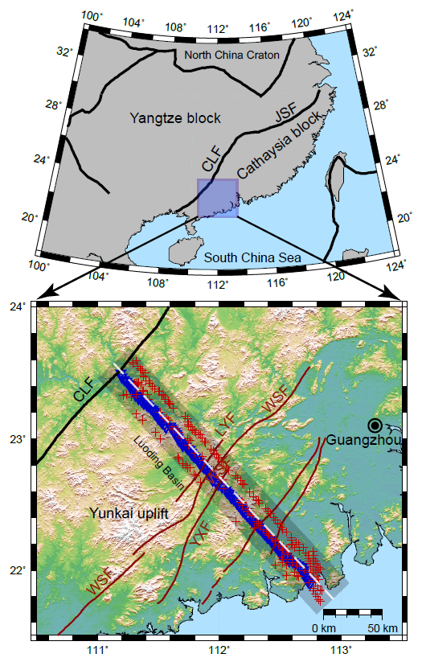
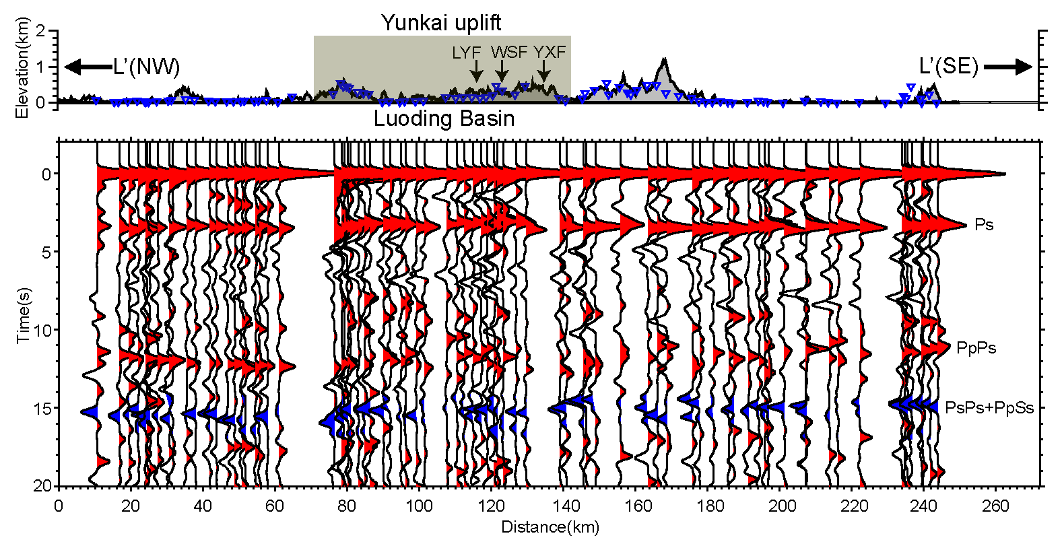
3.2 Receiver function imaging with dense array
260 km profile with 110 seismometers and ~ 2.5 km interstation distances crossing JUNO.
spatial resolution: 2~3 km in both horizontal and vertical directions

Slide 24
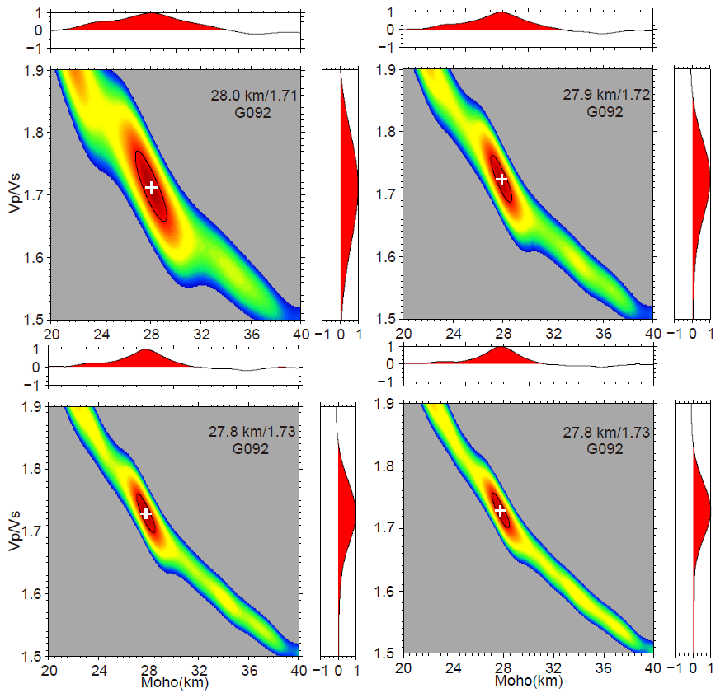
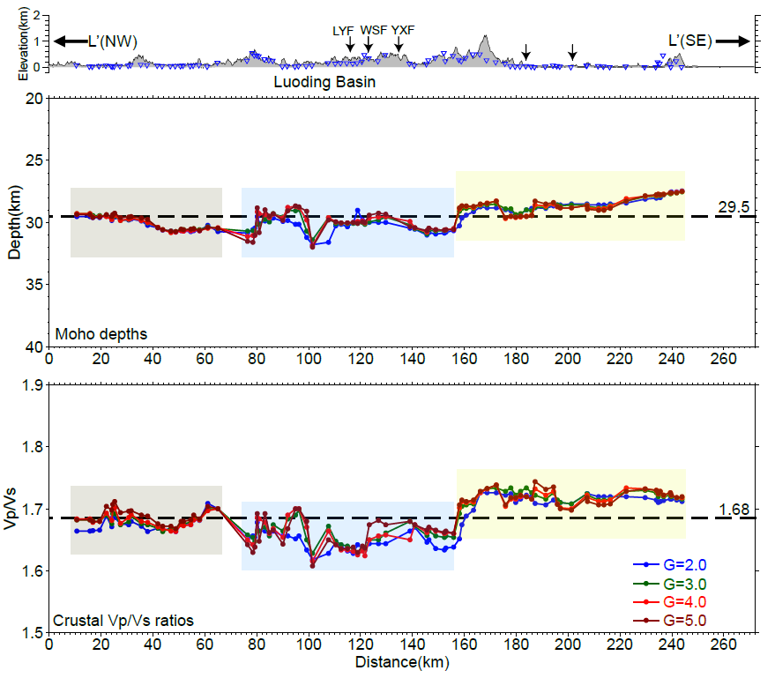
H-k method for crustal thickness and average Vp/Vs along profile

Slide 25
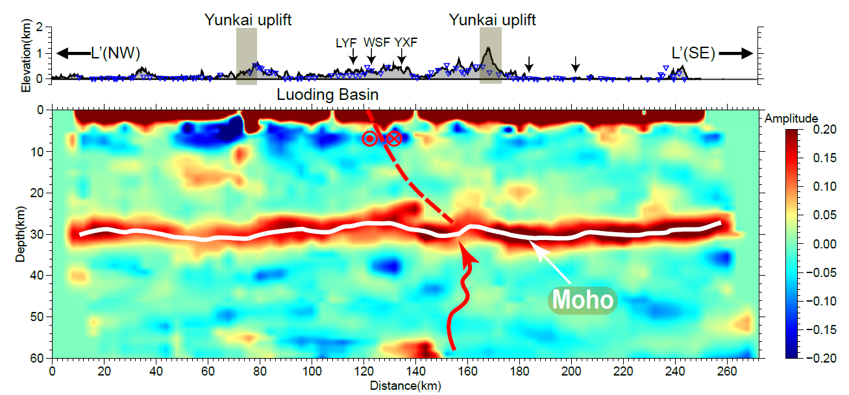
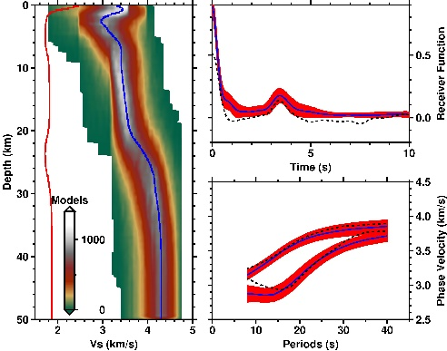
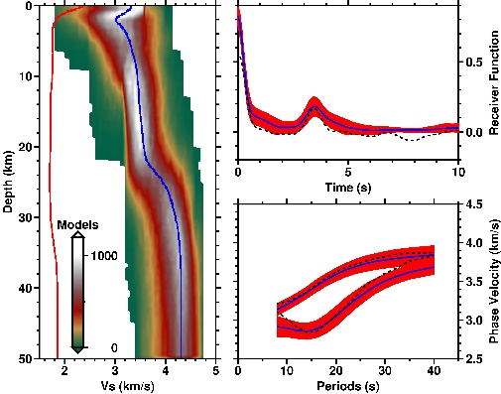
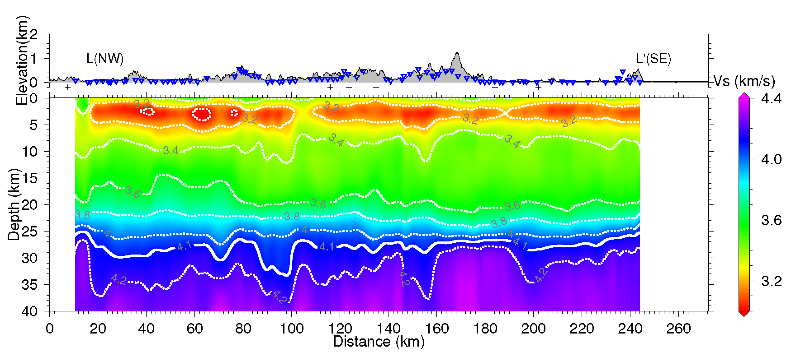
common conversion point stacking, and joint inversion of surface wave and RFs for 2-D crustal structures.

Slide 26
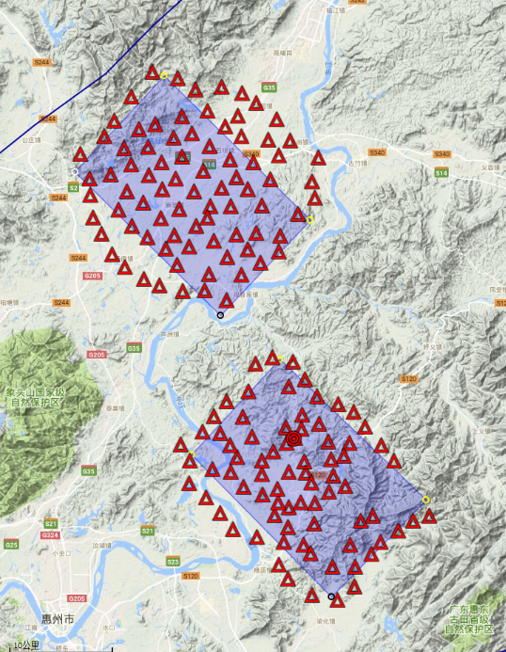
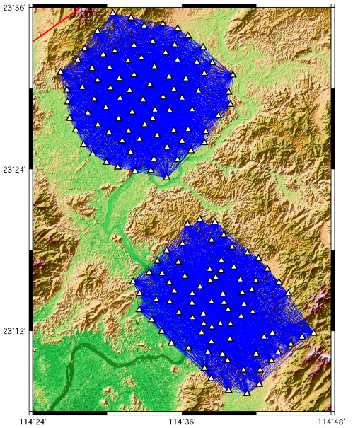
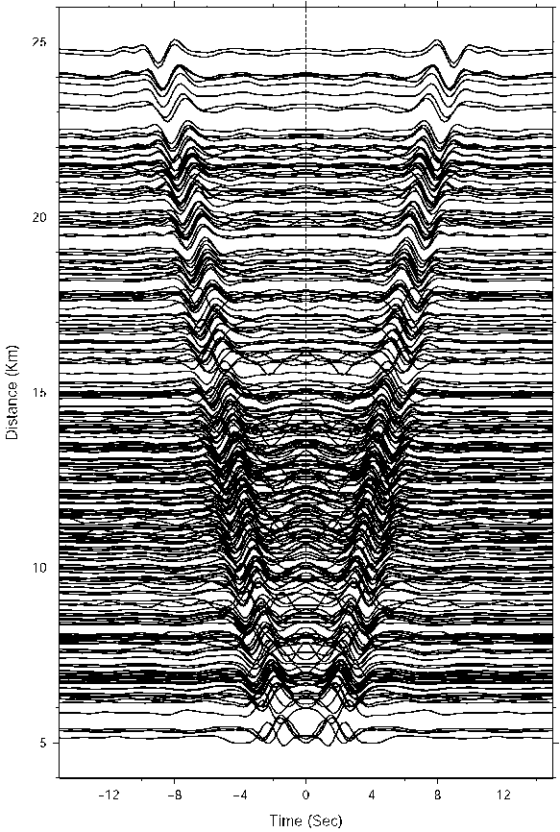
3.3 Ambient noise tomography with dense array
Two dense arrays ~ 100 km away from JUNO (Huizhou, Guangdong).
Small basin structures are obtained with high-resolution (~ 1 km)
20 km

Slide 27
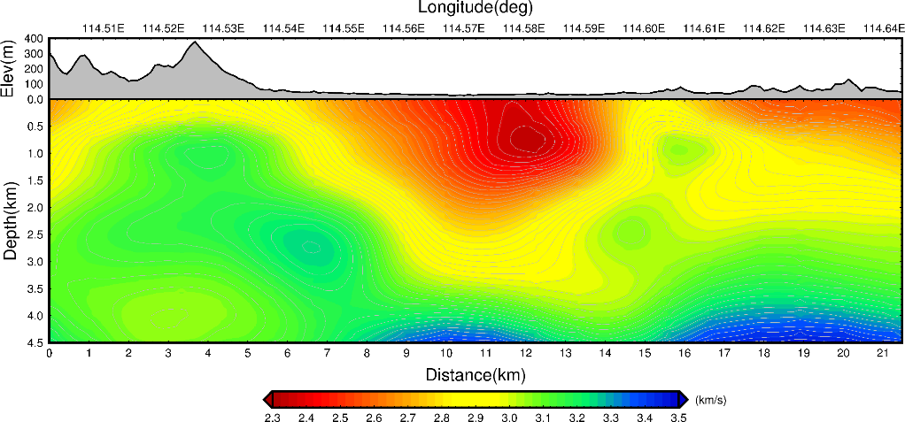
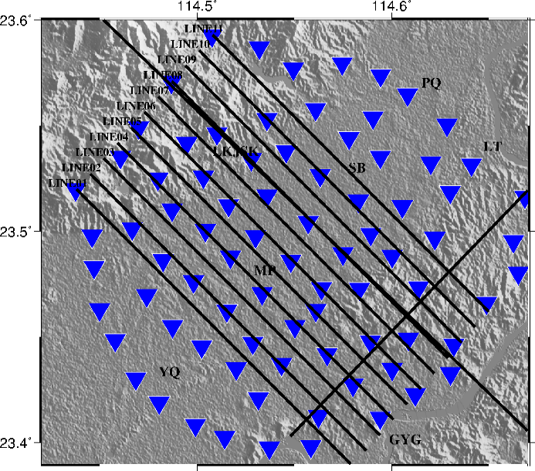
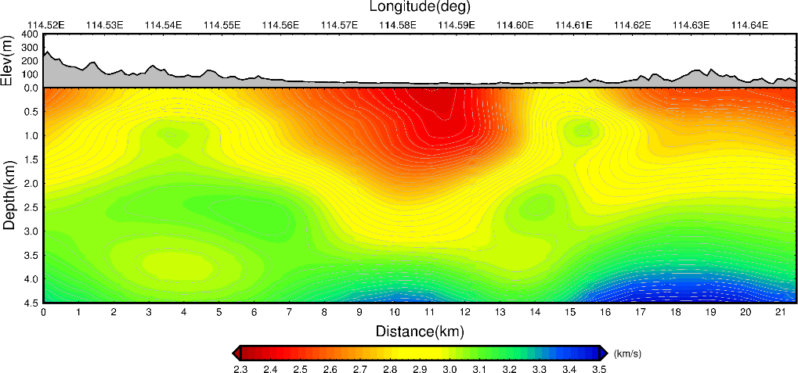
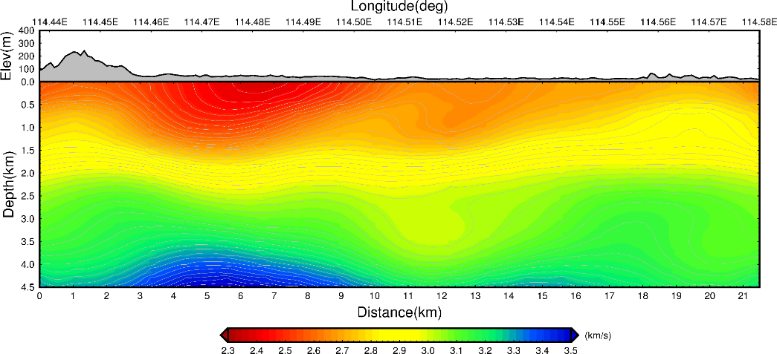
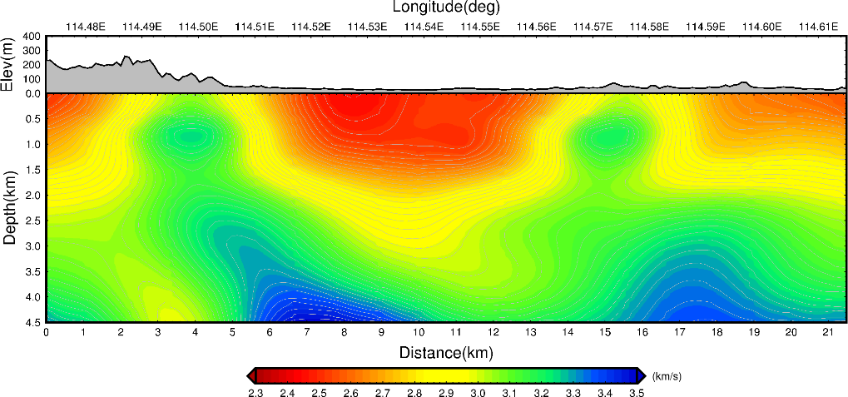
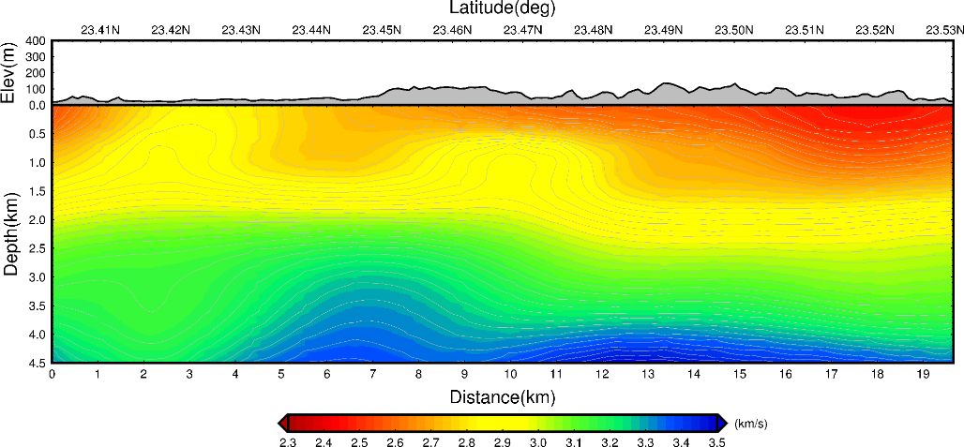
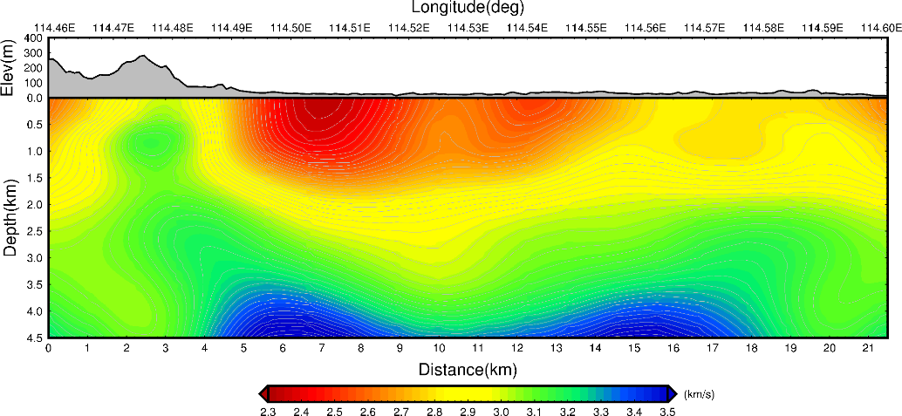
basement

Slide 28
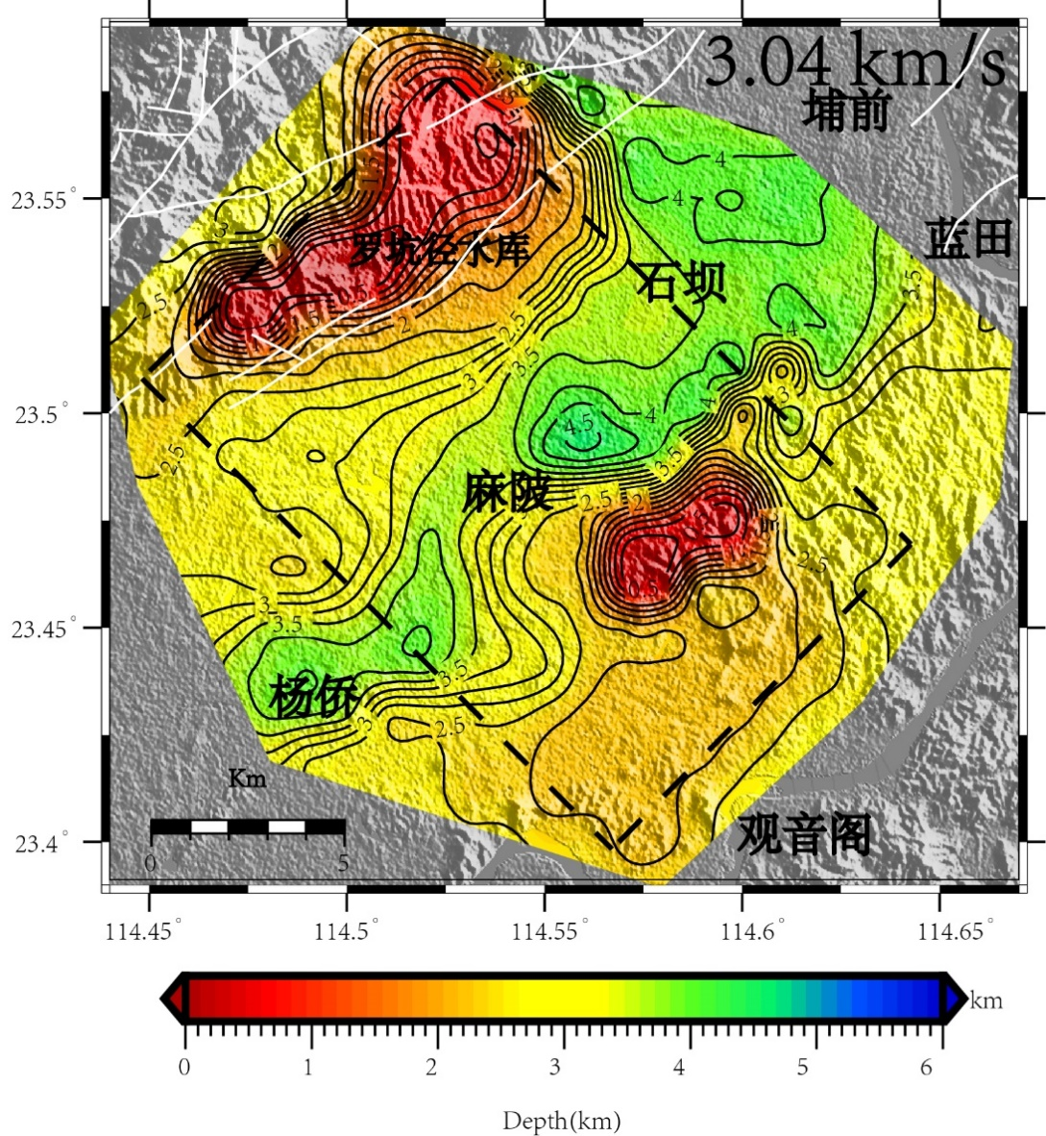
Basin basement estimated from isosurface of Vs beneath dense array

Slide 29


3.4 Ambient noise tomography of South China Sea
Large-scale surface wave tomography, ~ 300 km horizontal resolution
Deep to 60 km. A model better than CRUST1.0 for South China Sea.

Slide 30

Vs model deep to 60 km depth.

Slide 31

Cross-sections of Vs model
dashed line: CRUST1.0 Moho; solid line: Moho in this study

Slide 32
4. Summary
Local high-resolution (~ 40 km) crustal model in South China is obtained with data from ~ 450 seismic stations, higher resolution than CRUST1.0 global model.
Local models for crust and sediment basins with much higher resolution can be obtained by deploying more dense temporary seismometers.
we are planning to update the local crust model by joint inversion with more geophysical data (e.g., seismic and gravity data). Testing algorithms in Sichuan basin, then apply to South China.

Slide 33


Trials of joint inversion of seismic and gravity data in Sichuan Baisn
Seismic data only
Joint inversion
Real model

Slide 34
Thanks!

Slide 35
Backup

Slide 36
Why a new local model for South China
Global CRUST1.0 model has low-resolution (~1°x1 °, ~ 100 km). it also is a compiled model based on many independent models. A new local refined 3-D crustal model with higher resolution is needed for South China around the JUNO.
New Moho depth from Bouguer gravity inversion

Slide 37


Using Automatic Frequency-Time Analysis method (AFTAN)，totally 41,041 dispersion curves are extracted from 76,689 Rayleigh wave dispersion curves after quality control.
Dispersion curves of Rayleigh waves
Numbers of dispersion curves at 4-45 s

Slide 38



Surface wave tomography with Fast March Method (FMM)
Resolution is better than ~50 km for most areas.
Checkerboard resolution tests for 0.8x0.8 degree
Spatial resolution

Slide 39


Better crustal thickness model is used to build starting model for 3-D Vs model inversion.
Crustal thickness from CRUST1.0 model
Crustal thickness model in this study

Slide 40


Consistency shows the inverted 3-D model can fit the observations pretty good.
Group velocity from data
Group velocity from inverted 3-D model

Slide 41


Phase velocity from data
Phase velocity from inverted 3-D model

Slide 42

Using bootstrap method to evaluate the model uncertainty. It is less than ~ 1% for most areas at depths from 0 ~ 60 km.
S波模型的均方差分布图

Slide 43





Uncertainties along the vertical cross sections.

Slide 44



The Density Uncertainty
The density uncertainty are from Vs uncertainty by Error Propagation
Vs uncertainty distribution
Density uncertainty distribution
The uncertainty of depth is not considered for this moment

Slide 45


Slide 46
This Study
Global Average
 | U (ppm) | Th (ppm)
Upper Crust | 3.2 | 15
Middle Crust | 0.5 | 1.8
Lower Crust | 0.07 | 0.2
 | U (ppm) | Th (ppm) | Reference
Upper Crust | 2.7 | 10.5 | R&G, 2003, 2014
Middle Crust | 1.3 | 6.5 | R&G, 2003, 2014
Lower Crust | 0.2 | 1.2 | R&G, 2003, 2014

Slide 47

Data points in each cell

Slide 48



Error estimate
(Strati et al., 2017)
n ≥ 10
n < 10

Slide 49


Error estimate
(Strati et al., 2017)
每个格子的误差部分关联，部分独立

