Slide 1


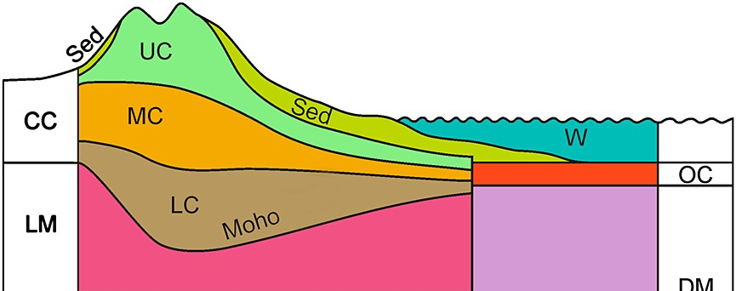
Geoneutrino Contributions from the Deep Lithosphere
Laura Sammon
University of Maryland, USA
lsammon@umd.edu

Slide 2
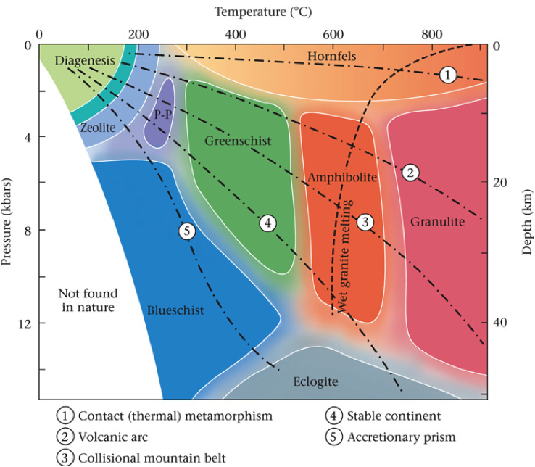
The Deep Lithosphere
Crust
^
Continental
Middle + lower continental crust
  Lower 2/3 or lower 1/2 of the continental crust
  Medium to high grade metamorphic materials
  Facies ≠ composition
Huang et al., 2013

Slide 3
From Composition to Geoneutrinos
Geophysical + Geochemical Inversions
Seismic Velocities
SiO₂ + Density
A straight forward process…
…but one with many steps
Geoneutrino Signal
[Th]
[U]

Slide 4


How do you describe a crust you can’t see?
Geochemically
Seismologically
Make a model

Slide 5
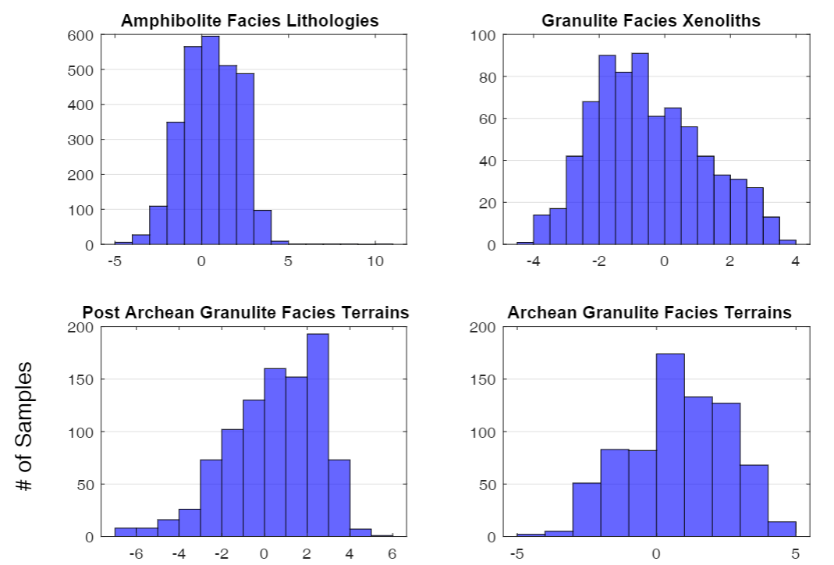
Geochemistry
Range of U and Th concentrations
  8 – 10 orders of magnitude
  Log normal?
What causes variation?
Ln[U]

Slide 6
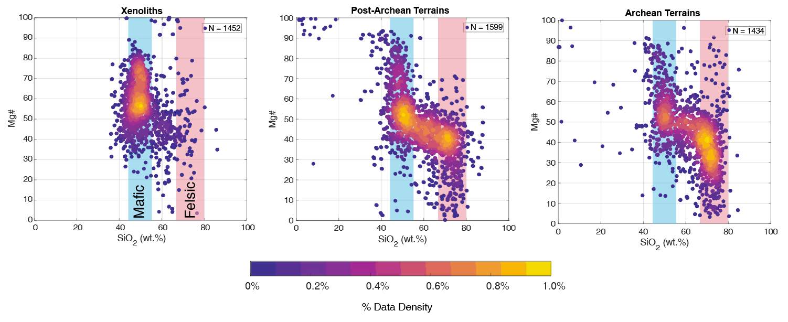
Geochemistry
Granulite Facies Lithologies

Slide 7
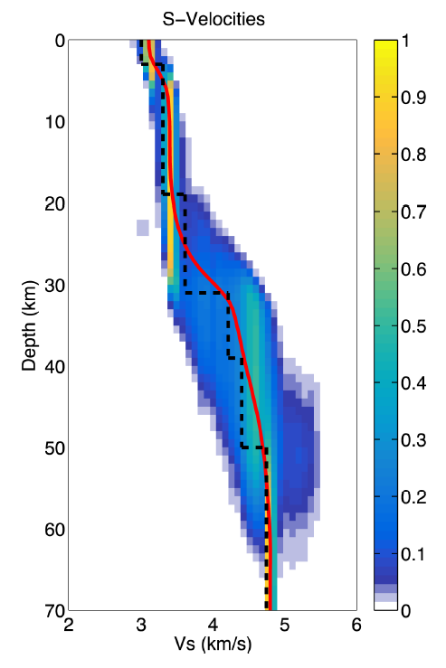
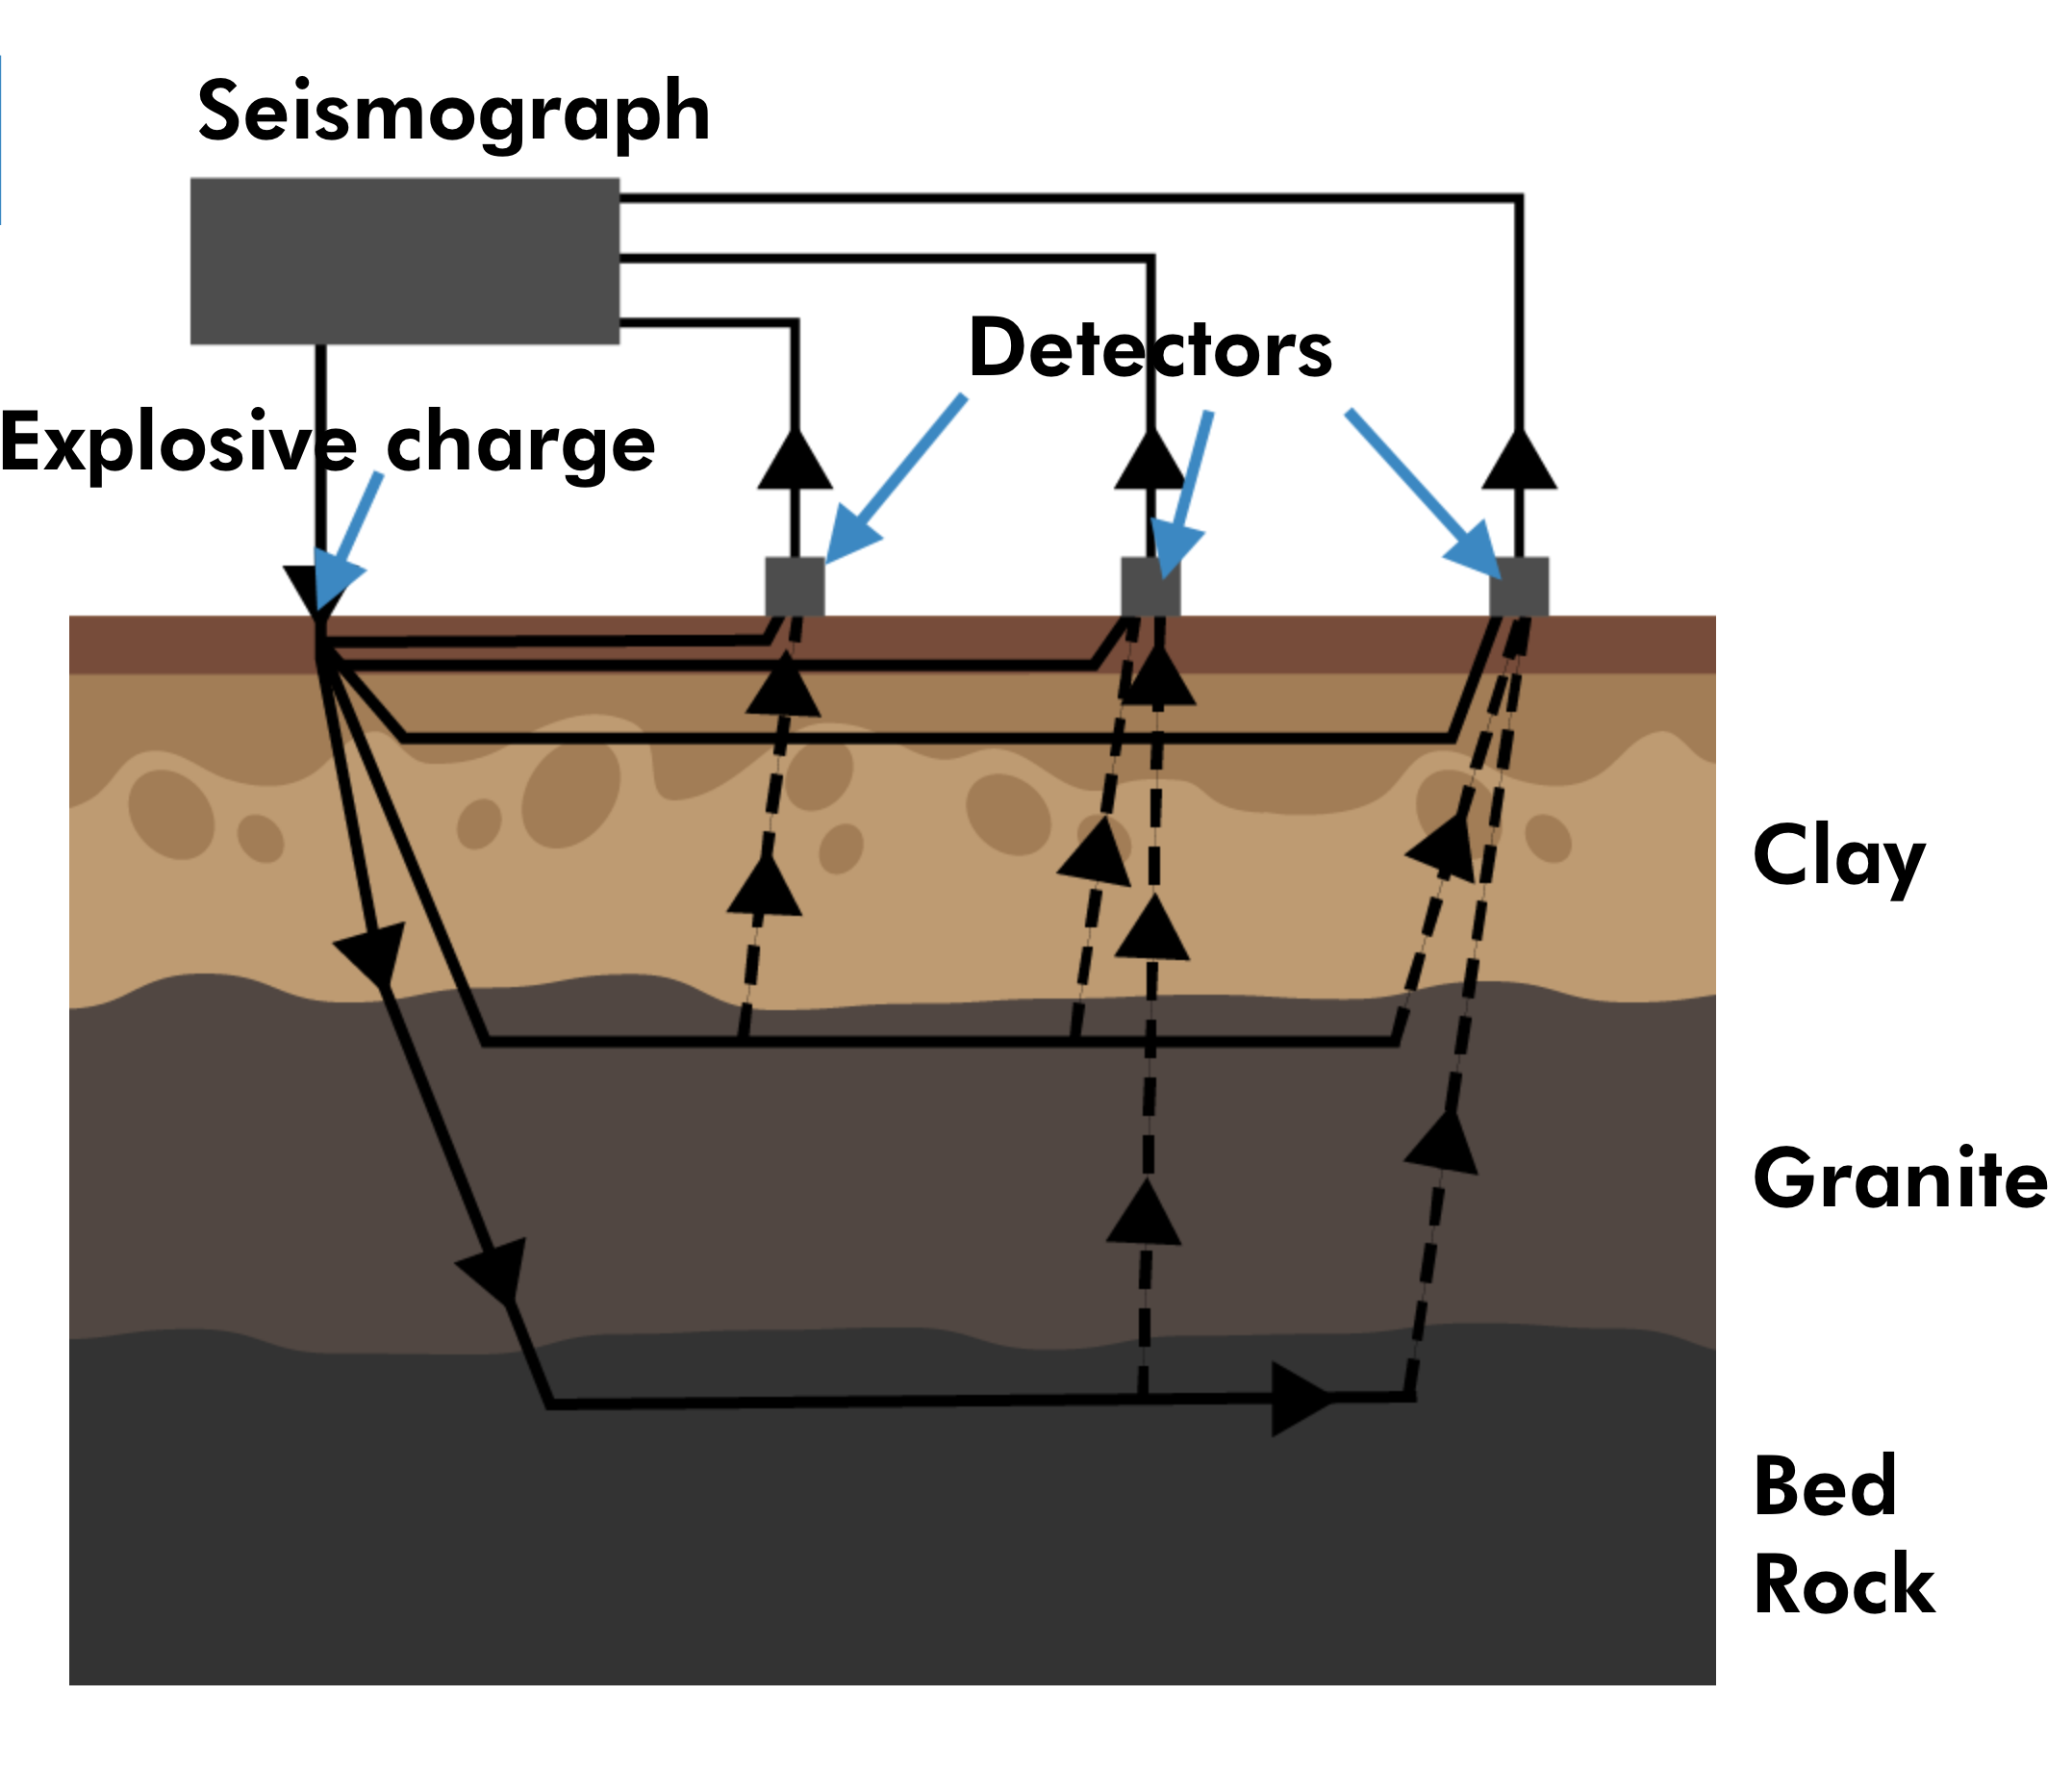
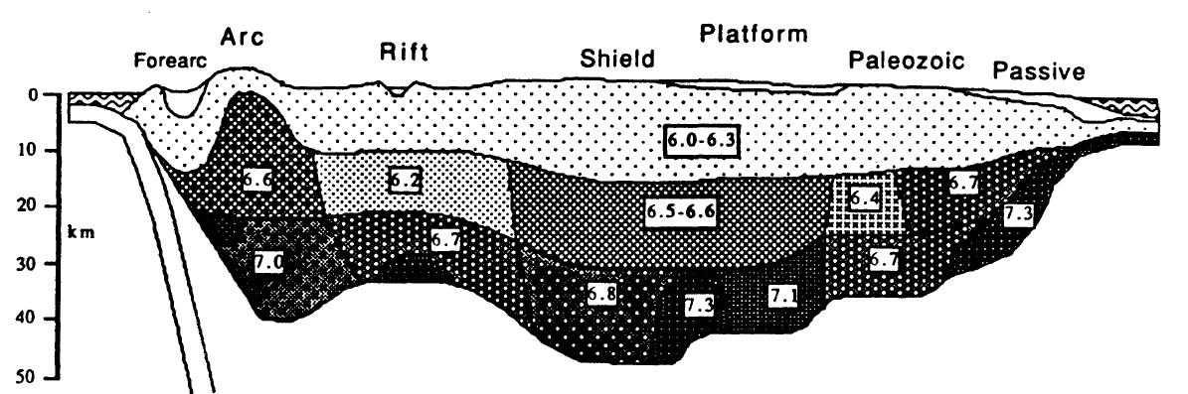
Seismology
P-waves, S-waves, dispersion waves
Materials have characteristic wave velocities
Variation with depth
Different layers
Nonunique
Gao & Lekic (2018)
Education Technology Office – University of Toronto
Holbrook et al. (1992)

Slide 8
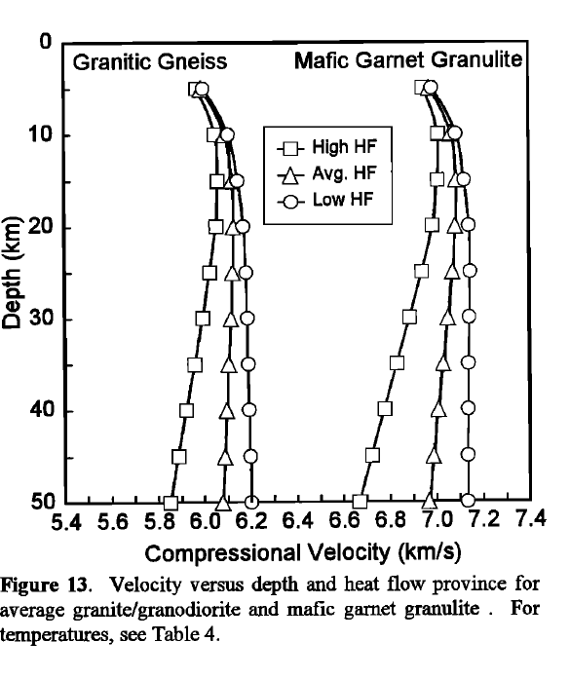
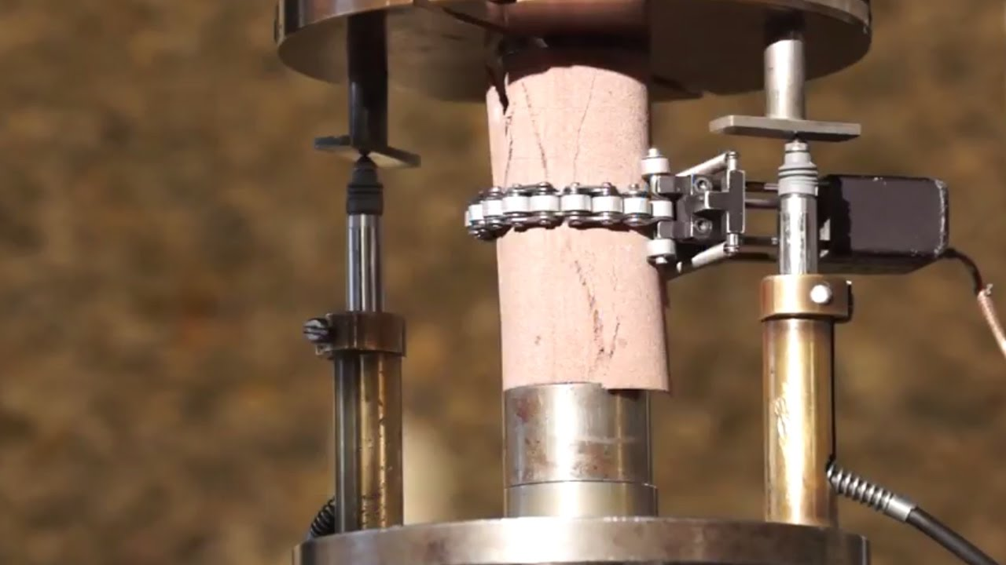
Seismic Velocities to Compositions
Experiments relate composition to seismic velocity, physical properties
Observed dependence on temperature

Slide 9
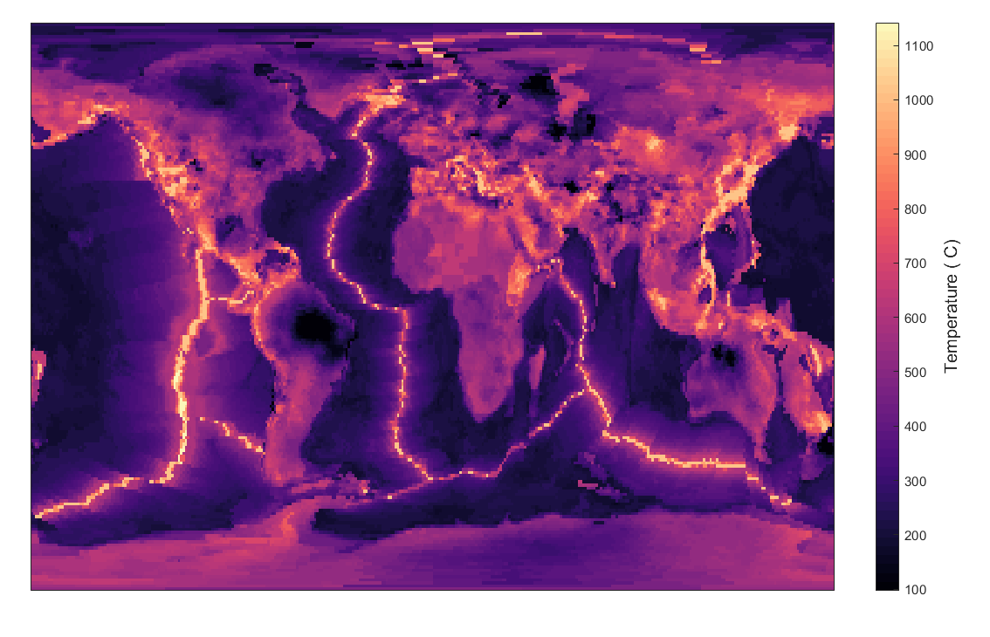
Temperature
Why is temperature important?
Vp, Vs are temperature dependent!
  More sensitive to T than P
W.I.P.

Slide 10
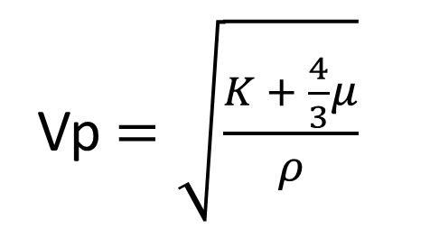
Pressure
Temperature
Composition
Vp $=\sqrt{\frac{K + \frac{4}{3}μ}{ρ}}$
Mineralogy
Perple_X

Slide 11
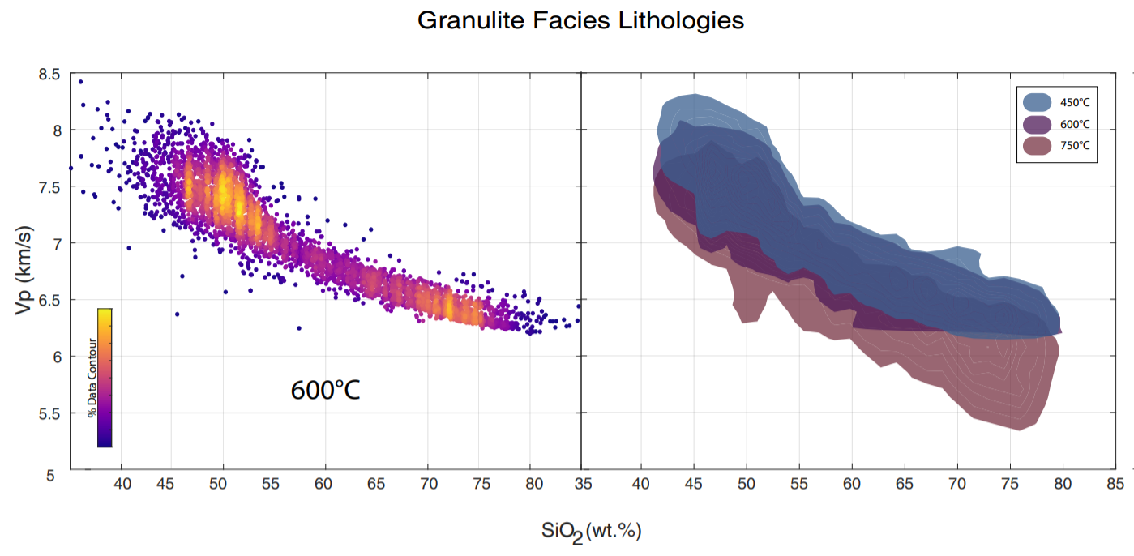
Seismic Velocities to Compositions

Slide 12
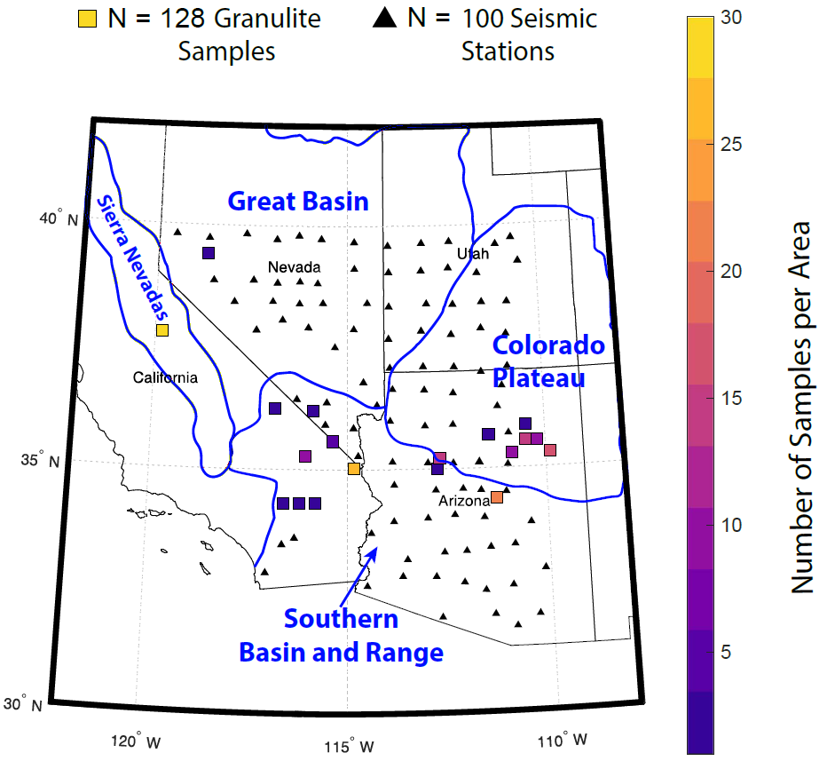
Example 1
Bain and Range, SW US
Extended crust, 25 – 40 km
Hot, 650 – 950 °C
Compare USArray inversions to calculated velocities
What compositions produce Vs that overlaps with seismic data?
Gao & Lekic (2019)

Slide 13
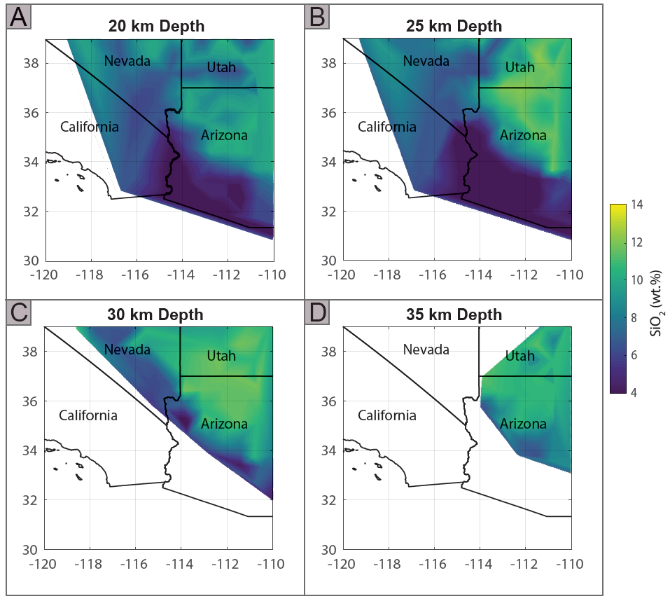
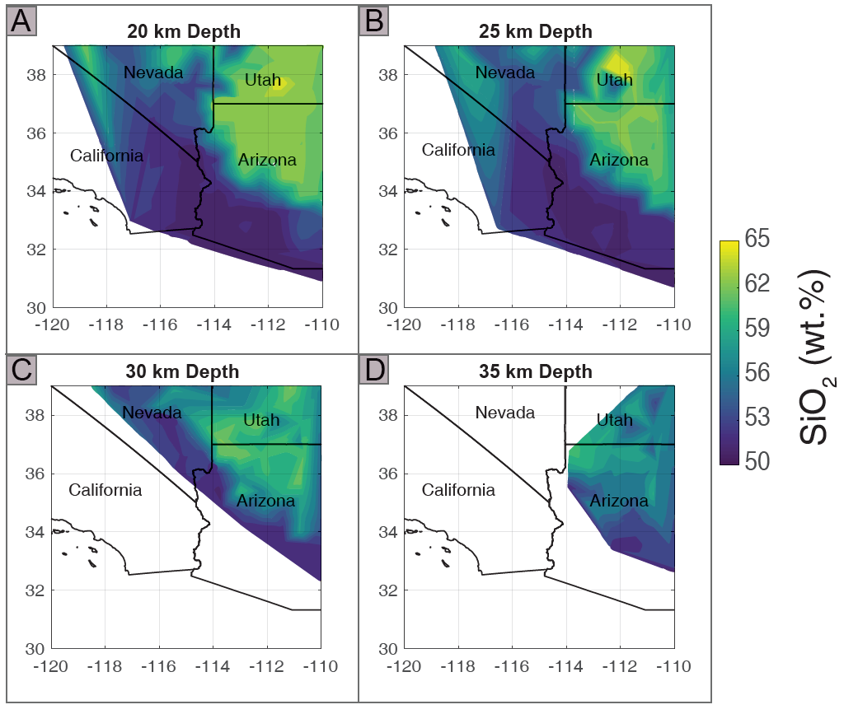
Example 1
SiO₂ gradient!
Uncertainties!

Slide 14
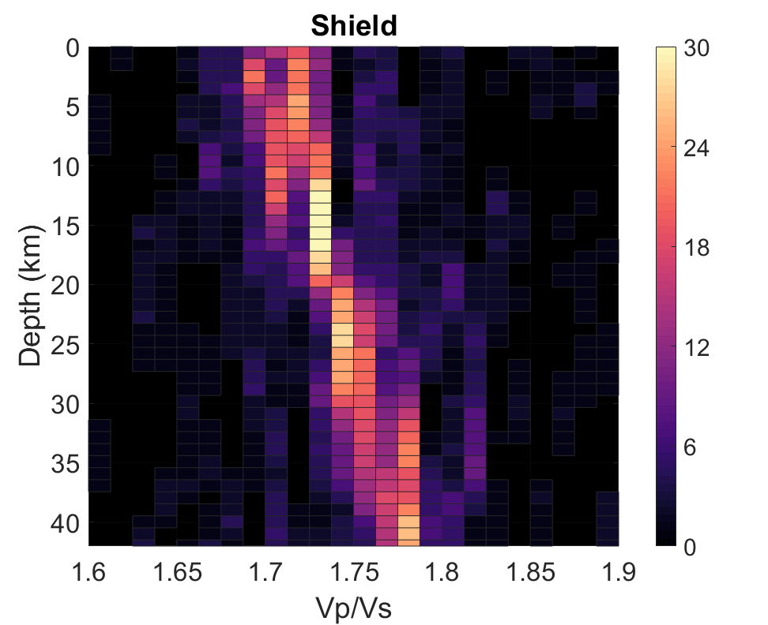
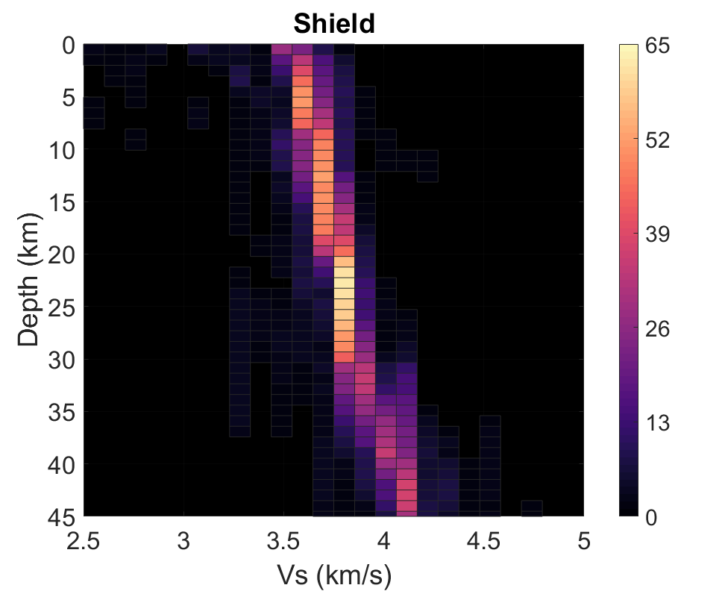
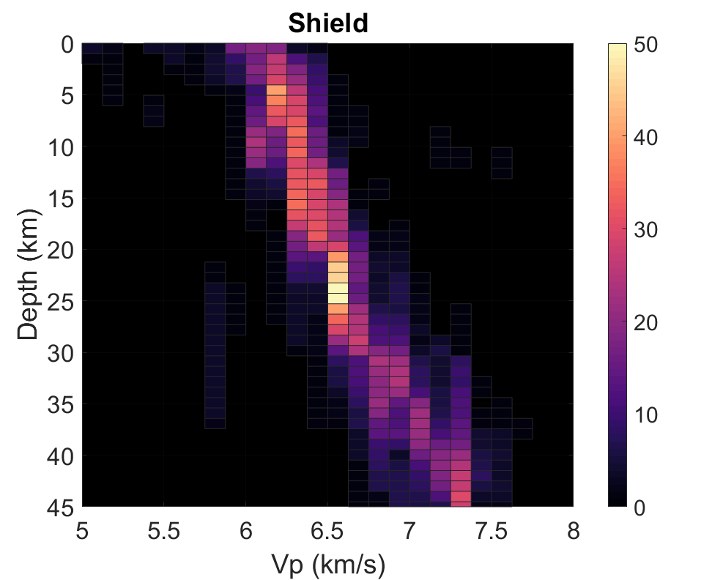
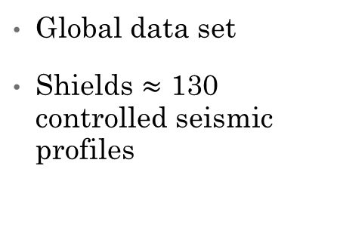
Example 2
Global data set
Shields $≈$ 130 controlled seismic profiles
Use Vs, Vp, & ratio when available
Group similar crust types/tectonic regimes

Slide 15
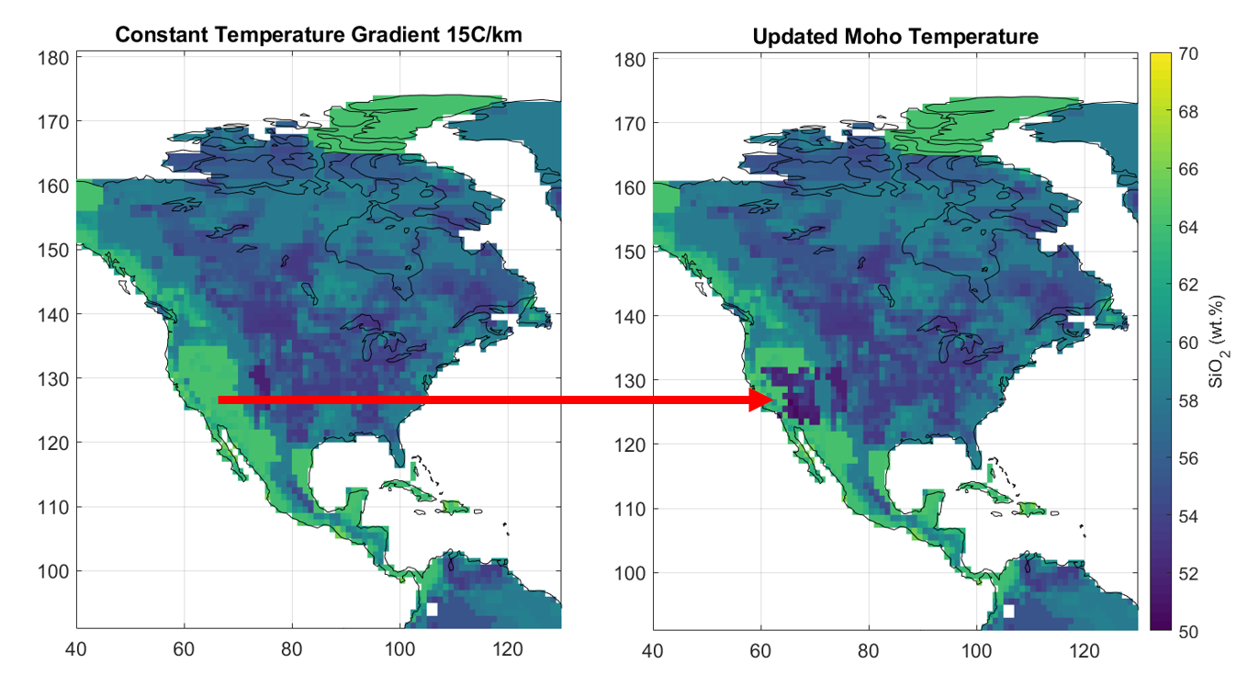
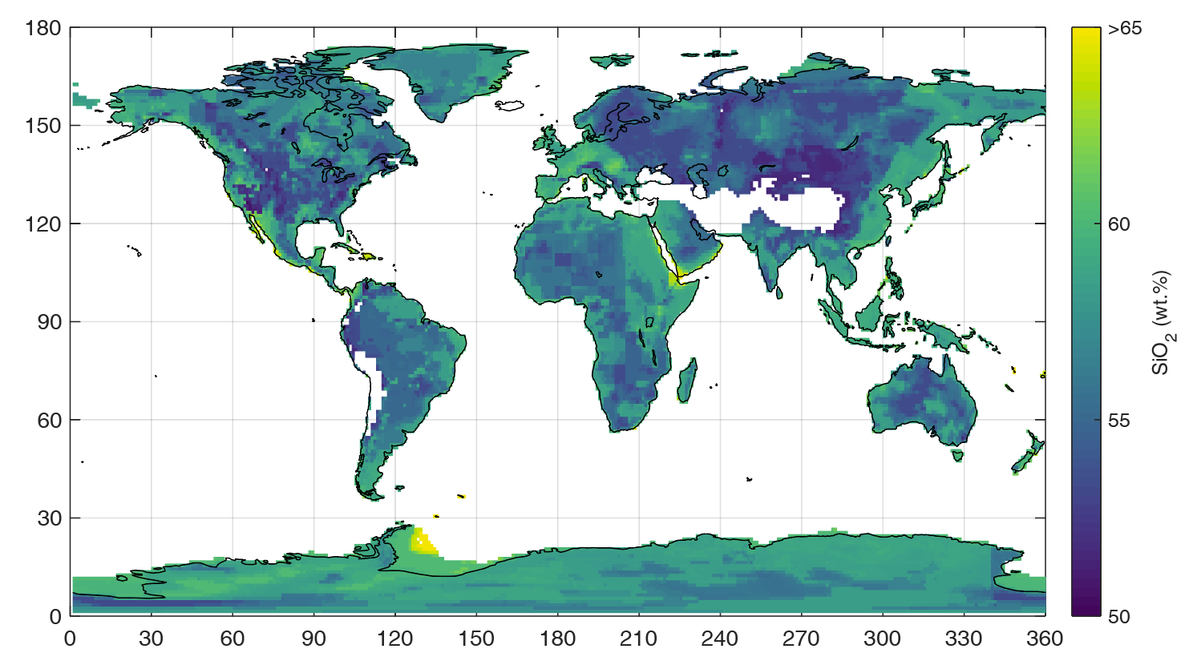
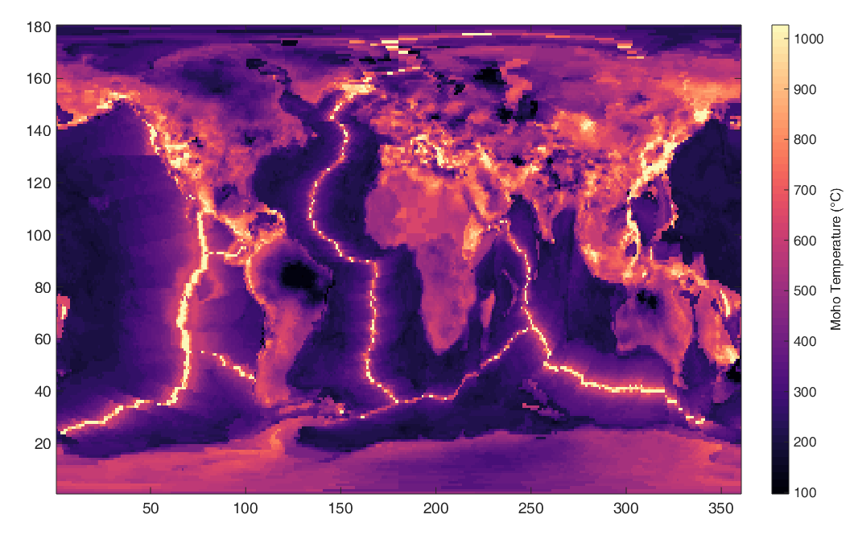
Example 2
Median Lower Crust SiO₂
Preliminary
-140 -120 -100 -80 -60
-140 -120 -100 -80 -60

Slide 16
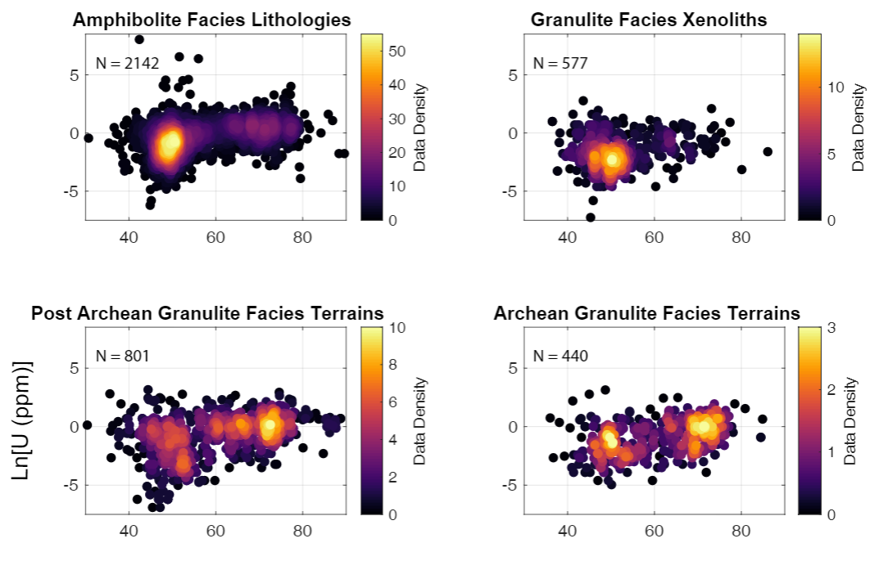
SiO₂ to U
U correlated to SiO₂
Increase in mean/median SiO₂ ≡ increase in U
Bivariate probability analysis
Distribution of U for range of SiO₂

Slide 17
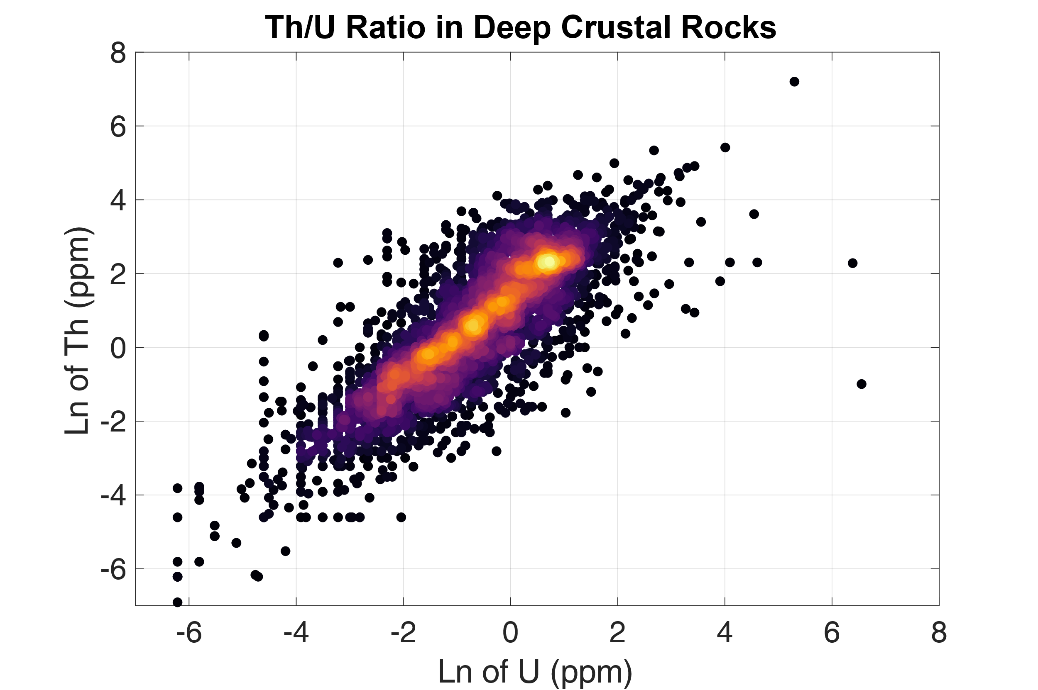
U to Th
Fixed chondritic Th/U ratio
Refractory lithophile elements
Similar behavior except in cases of ore deposits, marine & water
Th/U doesn’t fractionate between BSE reservoirs (Wipperfurth et al. 2018)

Slide 18
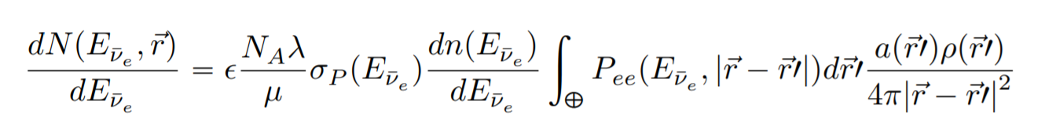
U, Th, Density to Geoneutrino Flux
Mass of U and Th near detector calculated from
  Concentration in specific rock types
  Density
U, Th have specific decay energies

Slide 19
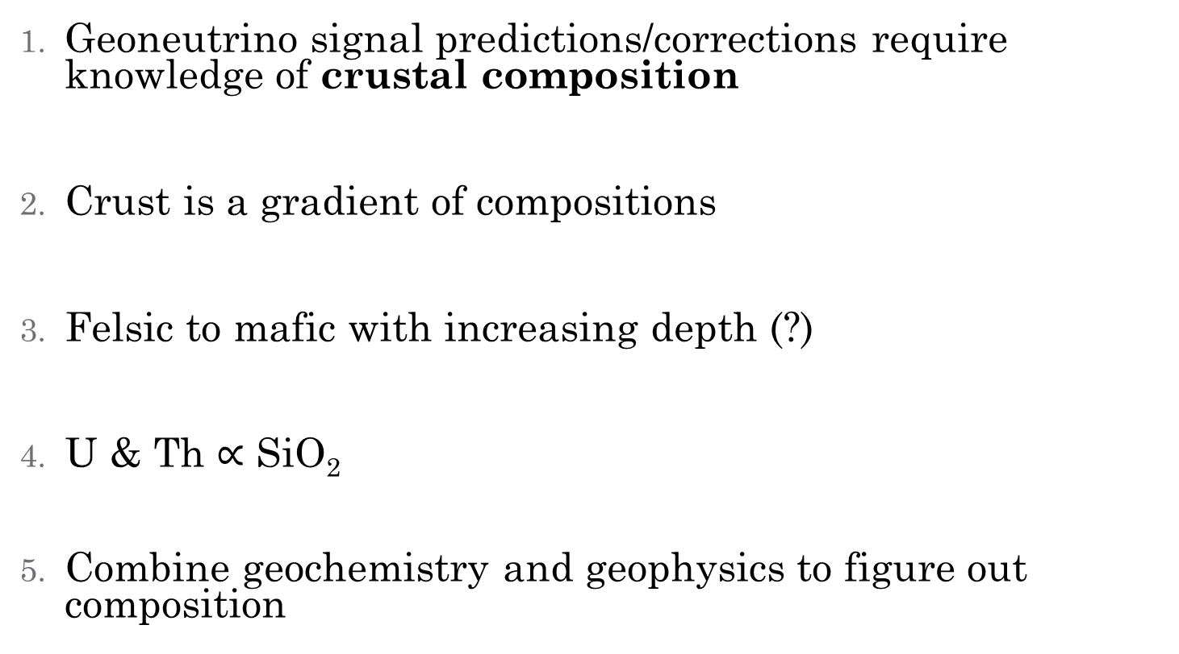
Conclusions
Geoneutrino signal predictions/corrections require knowledge of crustal composition
Crust is a gradient of compositions
Felsic to mafic with increasing depth (?)
U & Th $∝$ SiO₂
Combine geochemistry and geophysics to figure out composition
“Man, a mere inhabitant of the earth, cannot overstep its boundaries! But though he is confined to its crust, he may penetrate into all its secrets.” - Jules Verne

Slide 20
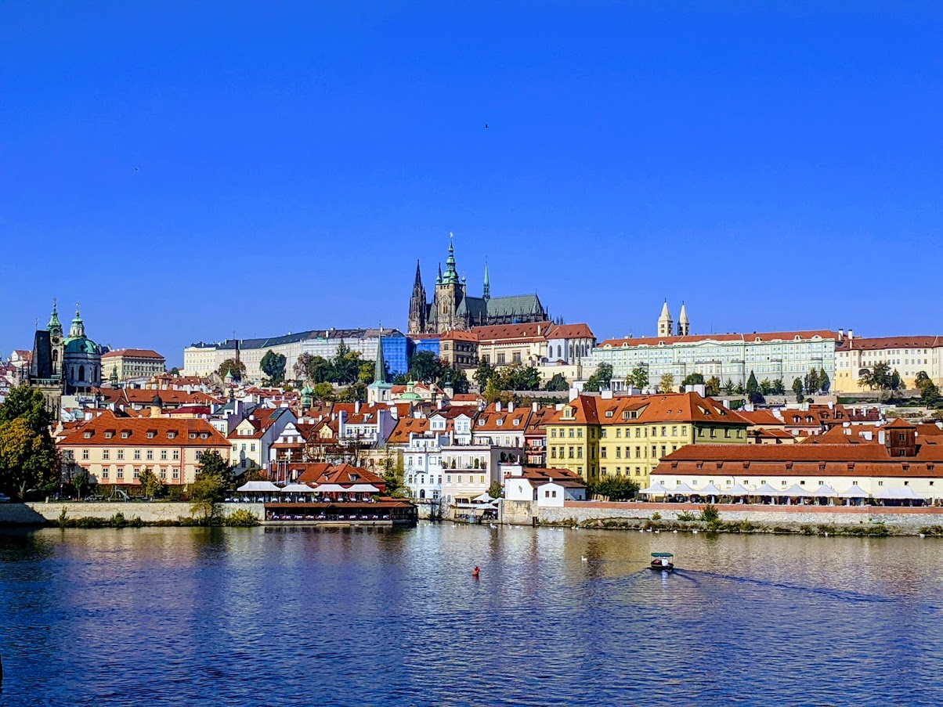


Acknowledgements
Ondřej Šrámek & Charles University
Bill McDonough
Walter Mooney
Chao Gao
Scott Wipperfurth
Geoneutrino group

