Slide 1
Out-of-time-ordered Correlators as
Quantum Chaos Indicators
Jakub Novotný, Pavel Stránský
Physical Review E 107, 054220 (2023)
UNCE Seminar
UNCE/SCI/013
1st June 2023

Slide 2


Outline:
u(3) algebraic model
Classical chaos
Lyapunov exponent $λ_{cl}$
Fraction of regularity $f_{reg}$
Quantum chaos
Out-of-time-Ordered Correlator (OTOC)
Quantum Lyapunov exponent $λ_{cl}$
Wiggliness

Slide 3
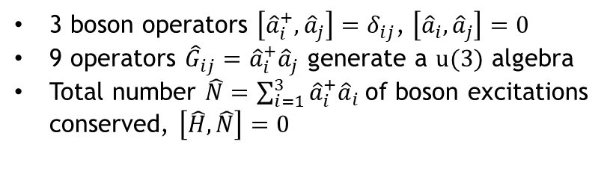
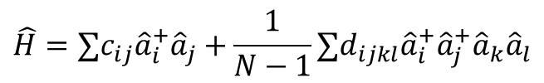
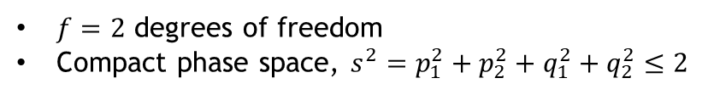
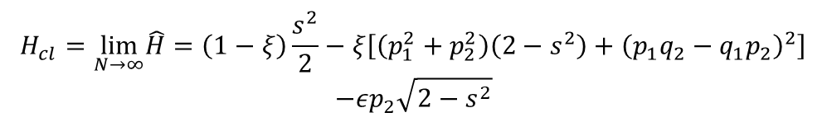
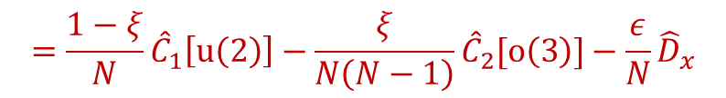
u(3) algebraic model of collective many-body dynamics
Systems
a) Bending modes of linear polyatomic molecules
b) Three-mode BEC
water
heavy water
hydrogen cyanide
D. Larese, F. Pérez-Bernal, F. Iachello, J. Mol. Struct. 1051, 310 (2013)
L.I. Plimak, C. Weiß, R. Walser, W.P. Schleich, Opt. Commun. 264, 311 (2006)
Model
M.H. Andreson et al., Sci. Rep. 269, 198 (1995)
$$\hat{H}=∑c_{ij}{\hat{a}}_{i}^{+}{\hat{a}}_{j}+\frac{1}{N−1}∑d_{ijkl}{\hat{a}}_{i}^{+}{\hat{a}}_{j}^{+}{\hat{a}}_{k}{\hat{a}}_{l}$$
3 boson operators $\left[{\hat{a}}_{i}^{+},{\hat{a}}_{j}\right]=δ_{ij}$, $\left[{\hat{a}}_{i},{\hat{a}}_{j}\right]=0$
9 operators ${\hat{G}}_{ij}={\hat{a}}_{i}^{+}{\hat{a}}_{j}$ generate a $u(3)$ algebra
Total number $\hat{N}=\sum_{i=1}^{3}{{\hat{a}}_{i}^{+}{\hat{a}}_{i}}$of boson excitations conserved, $\left[\hat{H},\hat{N}\right]=0$
$$=\frac{1−ξ}{N}{\hat{C}}_{1}\left[u\left(2\right)\right]−\frac{ξ}{N\left(N−1\right)}{\hat{C}}_{2}[o\left(3\right)]−\frac{ε}{N}{\hat{D}}_{x}$$
Classical limit
$$H_{cl}=\lim_{N→∞}\hat{H}=\left(1−ξ\right)\frac{s^{2}}{2}−ξ\left[\left(p_{1}^{2}+p_{2}^{2}\right)\left(2−s^{2}\right)+{\left(p_{1}q_{2}−q_{1}p_{2}\right)}^{2}\right]$$
$$−εp_{2}\sqrt{2−s^{2}}$$
$f=2$ degrees of freedom
Compact phase space, $s^{2}=p_{1}^{2}+p_{2}^{2}+q_{1}^{2}+q_{2}^{2}≤2$
1/9

Slide 4
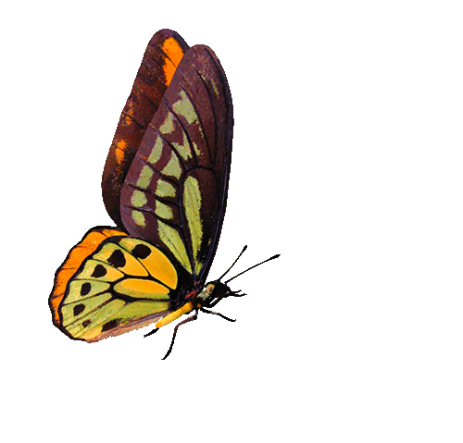
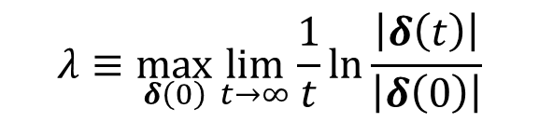




Classical chaos: Instability of trajectories
Stable (regular, quasiperiodic) trajectories
Unstable (chaotic) trajectories
$$δ(0)$$
$$δ(0)$$
$$\left|δ\left(t\right)\right|∝t^{α}$$
$$\left|δ\left(t\right)\right|∝e^{λt}$$
At most polynomial divergence…
Exponential divergence…
… of neigbouring trajectories
$$λ≡\max_{δ\left(0\right)}{\lim_{t→∞}\frac{1}{t}}\ln{\frac{\left|δ\left(t\right)\right|}{\left|δ\left(0\right)\right|}}$$
Instability quantified by the Lyapunov exponent
Local property (characterises individual trajectories)
2/9

Slide 5
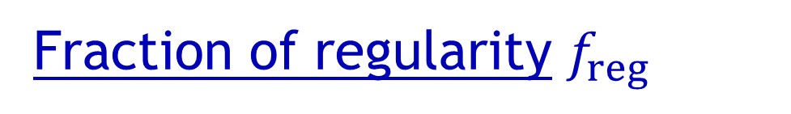

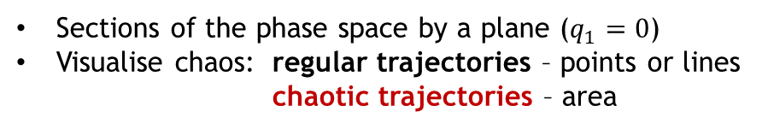
Fraction of regularity $f_{reg}$
Measure or regular trajectories in the energy hypersurface of the phase space
Global property of the system at a given energy
Poincaré sections
Sections of the phase space by a plane ($q_{1}=0$)
Visualise chaos: regular trajectories – points or lines chaotic trajectories – area
$$ε=0.4$$
Regular islands
Chaotic sea
3/9
J. Novotný, P. Stránský, Phys. Rev. E 107, 054220 (2023)

Slide 6
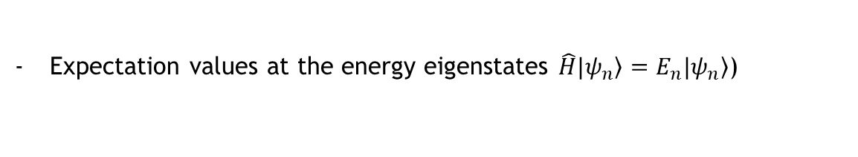
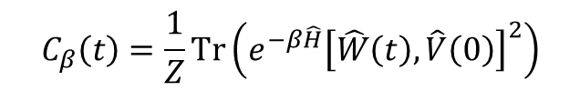
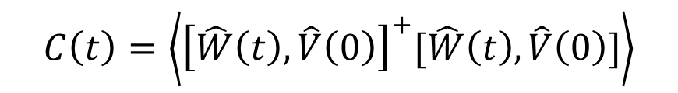

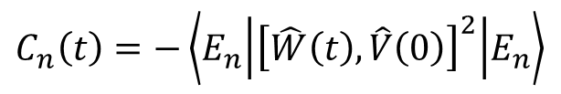

Out-of-Time-Ordered Correlators (OTOCs)
4-point correlation functions of two quantum operators (observables) taken at different times
$$C\left(t\right)=\left\langle {\left[\hat{W}\left(t\right),\hat{V}\left(0\right)\right]}^{+}[\hat{W}\left(t\right),\hat{V}\left(0\right)]\right\rangle$$
Heisenberg picture $\hat{W}\left(t\right)=e^{i\hat{H}t}\hat{W}\left(0\right)e^{−i\hat{H}t}$
$$=−\left\langle {\left[\hat{W}\left(t\right),\hat{V}\left(0\right)\right]}^{2}\right\rangle$$
Alternative definition: $C\left(t\right)=\left\langle {\hat{W}}^{+}\left(t\right){\hat{V}}^{+}\left(0\right)\hat{W}\left(t\right)\hat{V}(0)\right\rangle$
Introduced as a semiclassical tool to study superconductivity
Time evolution in the study of quantum chaos
Suitable for many-body systems
A. Larkin, Y. Ovchinnikov, Sov. Phys. JETP 28, 1200 (1969)
Thermal OTOC
$$C_{β}\left(t\right)=\frac{1}{Z}Tr\left(e^{−β\hat{H}}{\left[\hat{W}\left(t\right),\hat{V}\left(0\right)\right]}^{2}\right)$$
Relevant for the AdS-CFT studies in black holes
Relation between black-hole horizon geometry and chaos
S. H. Shenker, D. Stanford, Black holes and the butterfly effect, JHEP2014, 67
J. Maldacena, S.H. Shenker, D. Stanford, A bound on chaos, JHEP2016, 106
$$C_{n}\left(t\right)=−\left\langle E_{n} | {\left[\hat{W}\left(t\right),\hat{V}\left(0\right)\right]}^{2} | E_{n}\right\rangle$$
Microcanonical OTOC
Expectation values at the energy eigenstates $\hat{H}|\left.ψ_{n}\right\rangle =E_{n}|\left.ψ_{n}\right\rangle$)
K. Hashimoto, K. Murata, R. Yoshii, JHEP2017, 138
Other OTOCs
- OTOCs in coherent states, FOTOCs, …
4/9

Slide 7
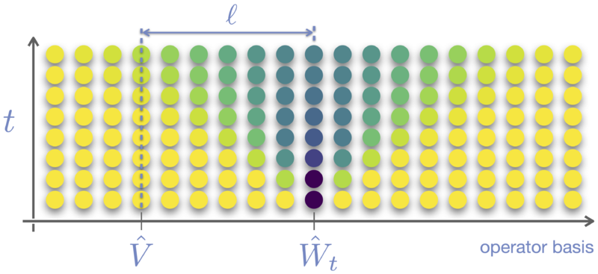



Relativistic systems
OTOCs and related topics
Butterfly effect cone
Spin chain with local interaction
Light cone
$$\hat{W}\left(t\right)=\sum_{k=0}^{∞}{\frac{{\left(it\right)}^{k}}{k!}}[\hat{H},…\left[\hat{H},\hat{W}\right]…]$$
- spread of quantum information (information scrambling) in quantum systems with local operators
$$C\left(t,x\right)∼e^{λ\left(t−t_{E}−\frac{\left|x\right|}{v_{B}}\right)}$$
$$λ≤2πT$$
Thermalization
- An isolated, unitary evolving quantum system, acquire thermal properties if chaotic
Many-body localization
- Logarithmic propagation cone (instead of linear)
Quantum information and entropy
- Direct relation between the Rényi entropy and OTOCs
5/9
I. García-Mata, R. Jalabert, D.A. Wisniacki, Scholarpedia 18, 55237 (2023)
J. Maldacena, S.H. Shenker, D. Stanford, A bound on chaos, JHEP2016, 106

Slide 8




OTOC Dynamics
$t_{E}∝\frac{1}{λ_{cl}}\ln{N}$ (Ehrenfest time)
$${\left[{\hat{D}}_{x}\left(t\right),{\hat{D}}_{x}\left(0\right)\right]}^{2}$$
Short times
$$C(t)=\left\langle {\left[{\hat{x}}_{i}\left(t\right),{\hat{x}}_{j\left(0\right)}\right]}^{2}\right\rangle ∼e^{2λt}$$
$${\left\{x_{i}\left(t\right),x_{j}\left(0\right)\right\}}^{2}∼e^{2λ_{cl}t}$$
Quantum Lyapunov exponent
Observed in plethora of systems (both one-body systems and many-body systems):
A. Larkin, Y. Ovchinnikov, Sov. Phys. JETP 28, 1200 (1969)
E.B. Rozenbaum, S. Ganeshan, V. Galitski, Phys. Rev. Lett. 118, 086801 (2017)
J. Chávez, B. Lopez-del-Caprio, M.A. Bastarrachea, P. Stránský, S. Lerma, L.F. Santos, J.G. Hirsch, Phys. Rev. Lett. 122, 024101 (2019)
S. Pilatowsky, J. Chávez, M.A. Bastarrachea, P. Stránský, S. Lerma, L.F. Santos, J.G. Hirsch, Phys. Rev. E 101, 010202(R) (2020)
…
6/9

Slide 9







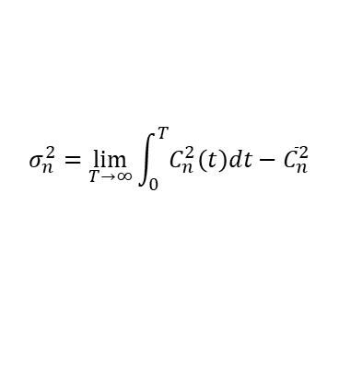
OTOC Dynamics
$t_{E}∝\frac{1}{λ_{cl}}\ln{N}$ (Ehrenfest time)
$${\left[{\hat{D}}_{x}\left(t\right),{\hat{D}}_{x}\left(0\right)\right]}^{2}$$
Short times
Long (asymptotic) times
$$C(t)=\left\langle {\left[{\hat{x}}_{i}\left(t\right),{\hat{x}}_{j\left(0\right)}\right]}^{2}\right\rangle ∼e^{2λt}$$
Mean value:
$${\left\{x_{i}\left(t\right),x_{j}\left(0\right)\right\}}^{2}∼e^{2λ_{cl}t}$$
$${\overline{C}}_{n}=\lim_{T→∞}{\int_{0}^{T}{C_{n}\left(t\right)dt}}$$
Quantum Lyapunov exponent
$$E$$
Variance:
$$ε=0.4$$
$$σ_{n}^{2}=\lim_{T→∞}{\int_{0}^{T}{C_{n}^{2}\left(t\right)dt}}−{\overline{C}}_{n}^{2}$$
$$E$$
Wiggliness:
Classical $f_{reg}$
$$ν_{n}=\frac{σ_{n}}{{\overline{C}}_{n}}$$
Smoothing in energy is necessary
7/9
J. Novotný, P. Stránský, Phys. Rev. E 107, 054220 (2023)

Slide 10
Wiggliness of various OTOC operators
8/9

Slide 11
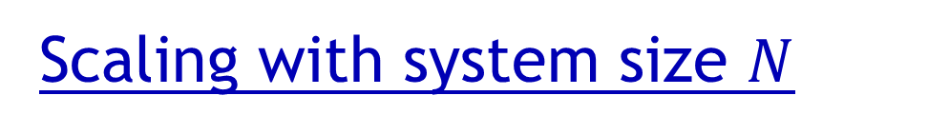
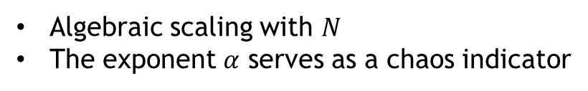

Scaling with system size $N$
$$\overline{ν}\left(E,N\right)=N^{α\left(E\right)}e^{−β\left(E\right)}$$
Algebraic scaling with $N$
The exponent $α$ serves as a chaos indicator
9/9

Slide 12




Summary:
Local properties
Global properties
Classical chaos
Trajectory
Phase space
Lyapunov exponent $λ_{cl}$
Fraction of regularity $f_{reg}$
Quantum chaos
Out-of-Time-Ordered Correlator
OTOC short-time dynamics
OTOC long-time dynamics
Quantum Lyapunov exponent $λ$
Wiggliness $ν$
Applications for the wiggliness:
Systems allowing for following and controlling their time evolution
Systems with small size (Ehrenfest time too small to reveal the initial exponential divergence of the OTOCs)
Small energy resolution
Stability of individual eigenstates

