Slide 1

Complex
Difficult
times
Pavel Cejnar
Malá Skála 2023

Slide 2
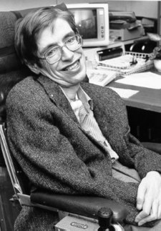
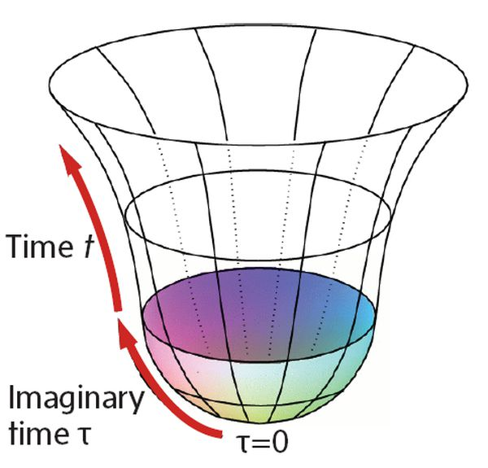





Complex
01
times
$$T_{I}$$
$$≡Im T$$
$$T∈ℂ$$
Hawking’s imaginary-time cosmology
Globe & Mail
$$T_{R}$$
$$≡Re T$$
0

Slide 3
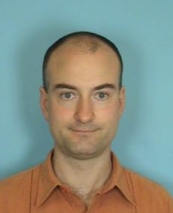
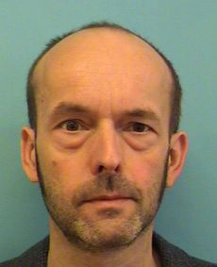

Complex
02
times
$$T_{I}$$
$$≡Im T$$
$$T∈ℂ$$
$$T_{R}$$
$$≡Re T$$
0

Slide 4
Complex
02
times
$$T_{I}$$
$$≡Im T$$
$$T∈ℂ$$
$$T_{R}$$
$$≡Re T$$
0

Slide 5
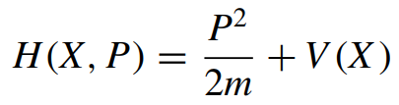
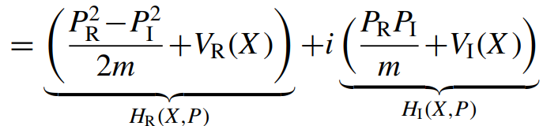

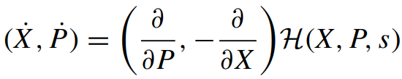
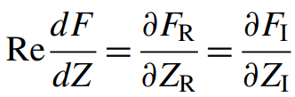
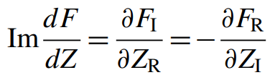


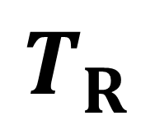

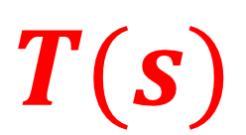
Complex-time classical mechanics
03
$$T_{I}$$
Cauchy-Riemann conditions
$$T(s)$$
$$T_{R}$$
0

Slide 6
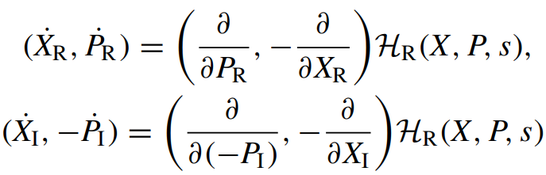
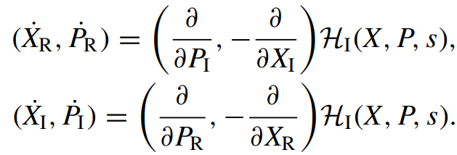

Complex-time classical mechanics
04
$$T_{I}$$
$$⟺$$
$$T(s)$$
$$T_{R}$$
0

Slide 7
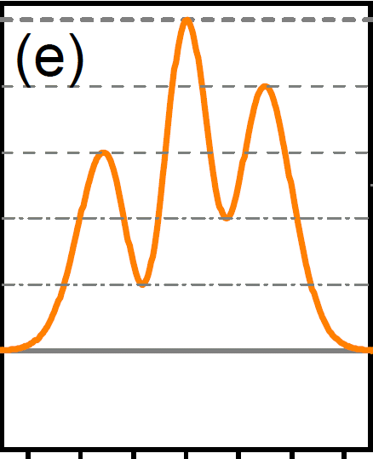
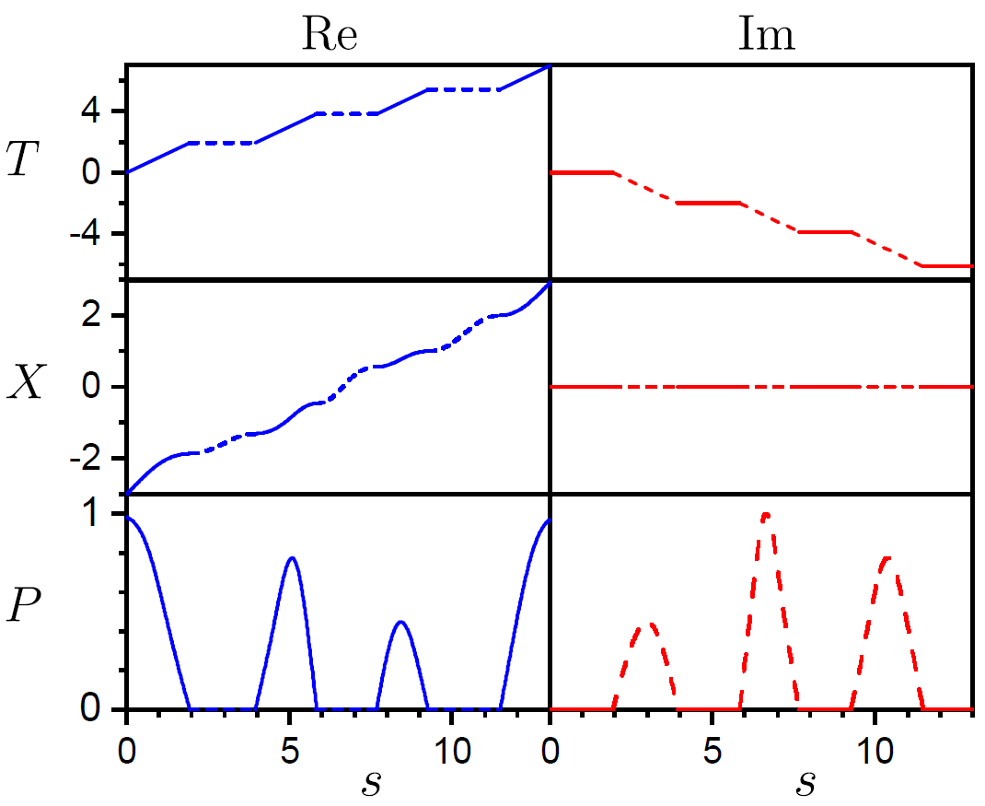
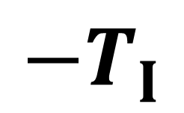












Classical tunneling trajectories
$$V(x)$$
05
$$VV$$
Look for keywords: instanton, Wick rotation …
$$E$$
1
2
3
4
$${−T}_{I}$$
4
I
II
III
III
$$x$$
3
$$ReT$$
$$ImT$$
II
2
$$ReX$$
$$ImX$$
I
1
$$T_{R}$$
$$ReP$$
$$ImP$$
0
1
2
3
4
I
II
III
$$S$$
$$S$$

Slide 8
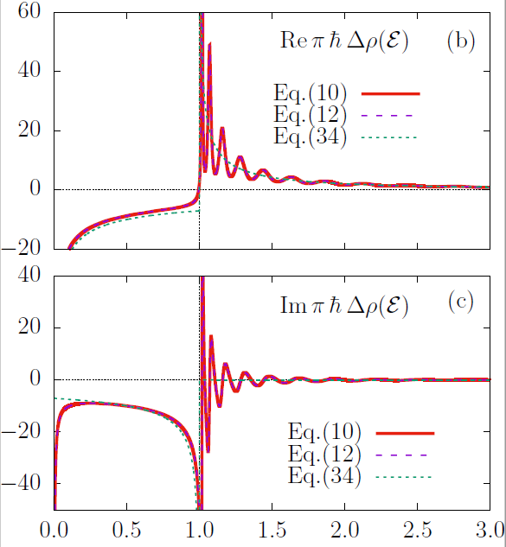

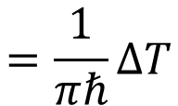

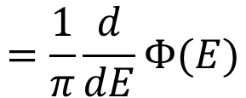


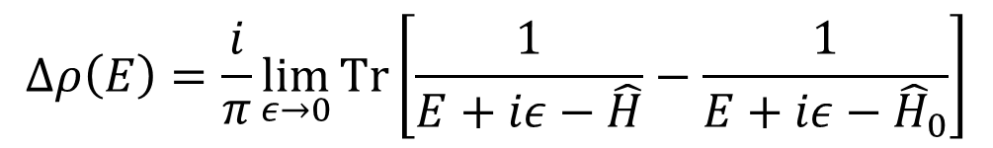
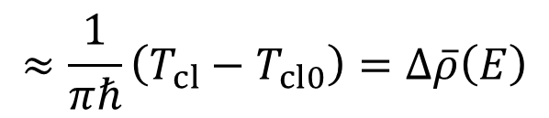


$$E/E_{0}$$
$$x_{0}$$
Tunneling semiclassics
$$\frac{ℏ^{2}}{2mE_{0}x_{0}^{2}}=1.8∙{10}^{−3}$$
06
1
The genuinely quantum process of tunneling allows for a semiclassical description !
transmission amplitude
$$𝒯\left(E\right)=e^{iΦ\left(E\right)}$$
rectangular barrier
(1)
(1)
complex continuum density of states
(2)
$$∆ρ\left(E\right)=\frac{i}{π}\lim_{ε→0}{Tr\left[\frac{1}{E+iε−\hat{H}}−\frac{1}{E+iε−{\hat{H}}_{0}}\right]}$$
(3)
(2)
complex tunneling phase
$$E/E_{0}$$
$$=\frac{1}{π}\frac{d}{dE}Φ(E)$$
smoothed (semiclassical) continuum density of states
(3)
complex tunneling time
$$=\frac{1}{πℏ}ΔT$$
$$≈\frac{1}{πℏ}\left(T_{cl}−T_{cl0}\right)=∆\overline{ρ}\left(E\right)$$
complex extension of Eisenbud-Wigner time shift (1948,1955): difference of classical times of flight of the tunneling and free particles
(1)
(2)
(3)
P.C., P. Stránský, M. Šindelka, M. Kloc,
PRL 125, 020401 (2020), PRA 103, 062207 (2021)
$$E/E_{0}$$

Slide 9
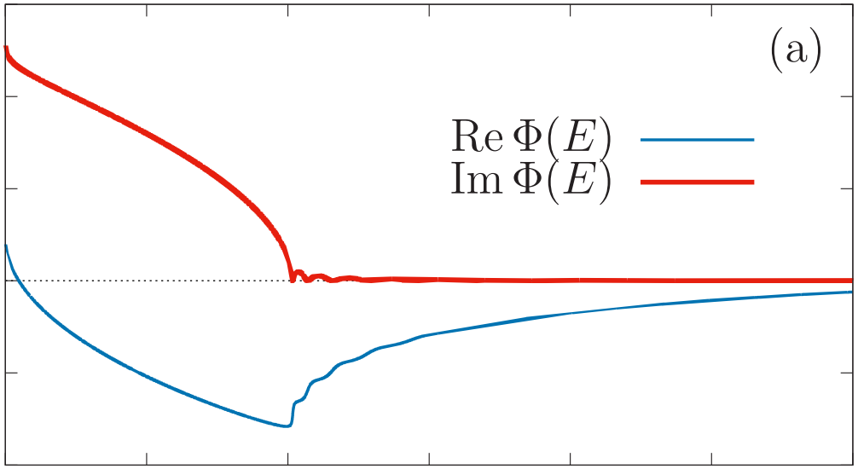
$$E/E_{0}$$
$$x_{0}$$
Tunneling semiclassics
$$\frac{ℏ^{2}}{2mE_{0}x_{0}^{2}}=1.8∙{10}^{−3}$$
06
1
The genuinely quantum process of tunneling allows for a semiclassical description !
transmission amplitude
$$𝒯\left(E\right)=e^{iΦ\left(E\right)}$$
rectangular barrier
(1)
(1)
complex continuum density of states
(2)
$$∆ρ\left(E\right)=\frac{i}{π}\lim_{ε→0}{Tr\left[\frac{1}{E+iε−\hat{H}}−\frac{1}{E+iε−{\hat{H}}_{0}}\right]}$$
(3)
(2)
complex tunneling phase
$$E/E_{0}$$
$$=\frac{1}{π}\frac{d}{dE}Φ(E)$$
smoothed (semiclassical) continuum density of states
(3)
complex tunneling time
$$=\frac{1}{πℏ}ΔT$$
$$≈\frac{1}{πℏ}\left(T_{cl}−T_{cl0}\right)=∆\overline{ρ}\left(E\right)$$
complex extension of Eisenbud-Wigner time shift (1948,1955): difference of classical times of flight of the tunneling and free particles
(1)
(2)
(3)
P.C., P. Stránský, M. Šindelka, M. Kloc,
PRL 125, 020401 (2020), PRA 103, 062207 (2021)
$$E/E_{0}$$

Slide 10
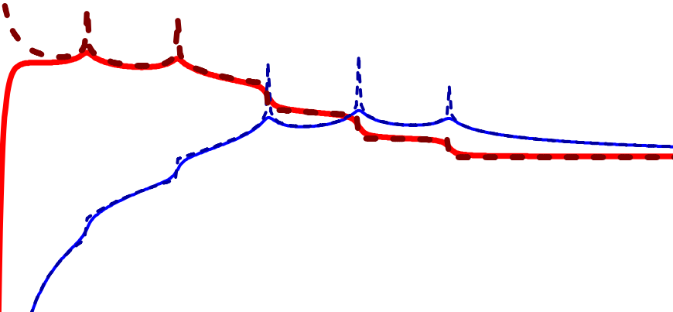
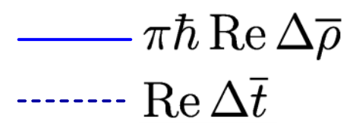
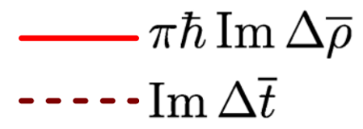



Tunneling semiclassics
e
07
$$V(x)$$
$$VV$$
The genuinely quantum process of tunneling allows for a semiclassical description !
d
transmission amplitude
$$𝒯\left(E\right)=e^{iΦ\left(E\right)}$$
c
1
2
3
4
(1)
complex continuum density of states
I
II
III
$$∆ρ\left(E\right)=\frac{i}{π}\lim_{ε→0}{Tr\left[\frac{1}{E+iε−\hat{H}}−\frac{1}{E+iε−{\hat{H}}_{0}}\right]}$$
b
a
(2)
$$x$$
complex tunneling phase
$$=\frac{1}{π}\frac{d}{dE}Φ(E)$$
(3)
complex tunneling time
$$=\frac{1}{πℏ}ΔT$$
$$≈\frac{1}{πℏ}\left(T_{cl}−T_{cl0}\right)=∆\overline{ρ}\left(E\right)$$
$$T$$
tunneling singularities due to stationary points of the potential
$$T$$
P.C., P. Stránský, M. Šindelka, M. Kloc,
PRL 125, 020401 (2020), PRA 103, 062207 (2021)
c
d
$$E$$
a
b
e

Slide 11
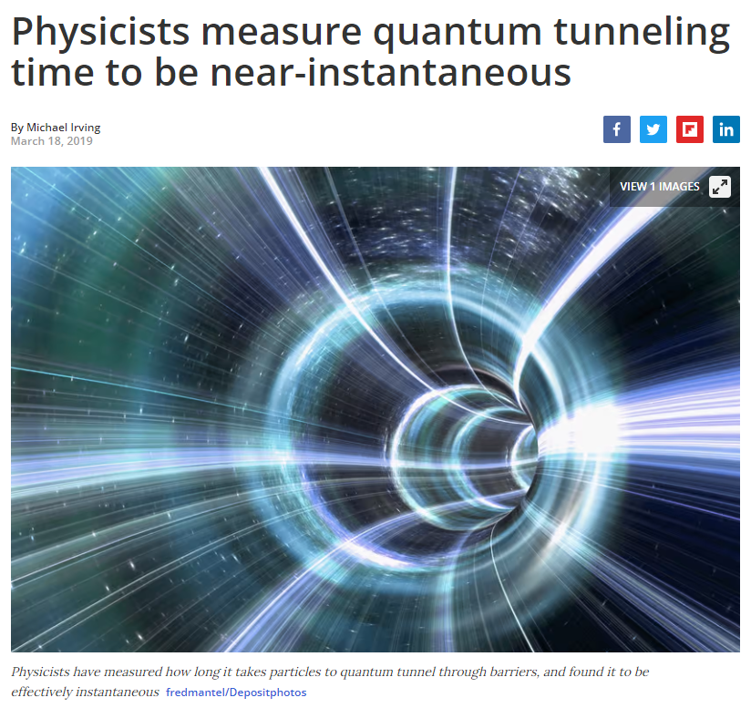

Problem of tunneling time
08
How long does the particle spend in the forbidden region of the potential? Many experiments indicate that the tunneling time is very small, close to zero…
$${−T}_{I}$$
4
III
3
II
2
I
1
$$T_{R}$$
0

Slide 12
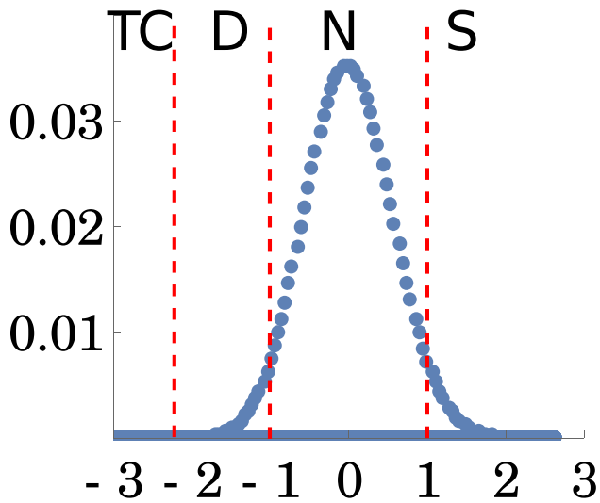
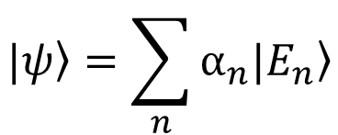

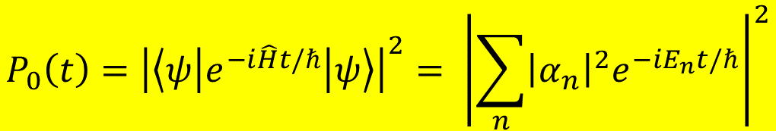




Quantum survival probability
09
$$\left.|ψ\right\rangle =\sum_{n}{α_{n}\left.|E_{n}\right\rangle }$$
Quantum evolution of the survival probability of an initial state
$$P_{0}\left(t\right)={\left|\left\langle ψ | e^{−i\hat{H}t/ℏ} | ψ\right\rangle \right|}^{2}= {\left|\sum_{n}{{{\left|α_{n}\right|}^{2}e}^{−iE_{n}t/ℏ}}\right|}^{2}$$
$${\left|α_{n}\right|}^{2}$$
Im
$$log⁡P0$$
$$E_{n}$$
0
$${{\left|α_{i}\right|}^{2}e}^{−iE_{i}t/ℏ}$$
Re
$$log⁡(t/t0)$$
Example: M. Kloc, P. Stránský, P. C., PRA 98, 013836 (2018)

Slide 13
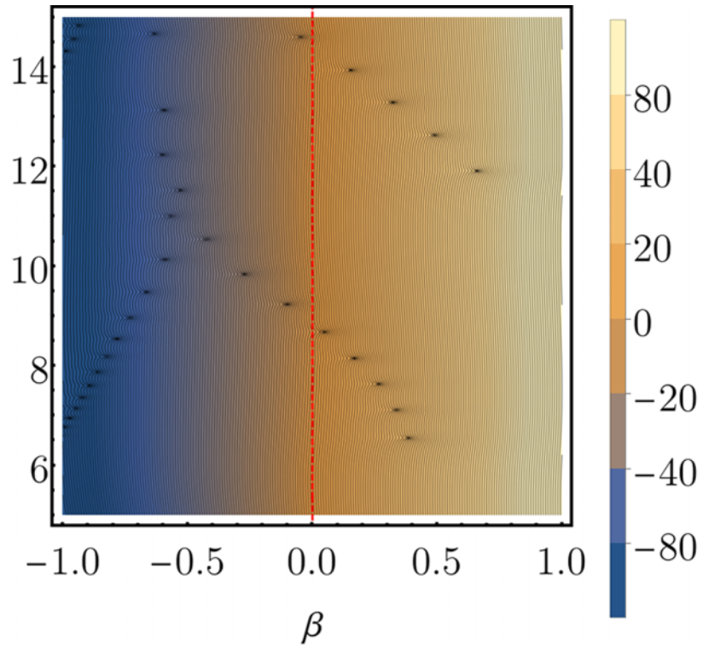
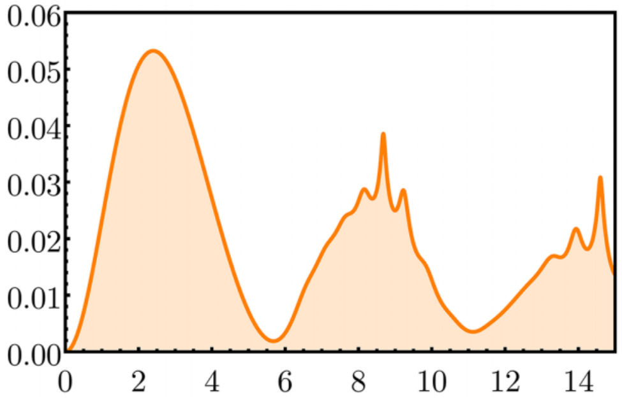





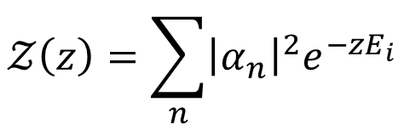
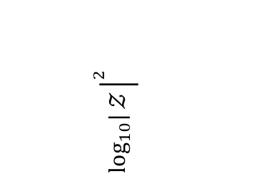


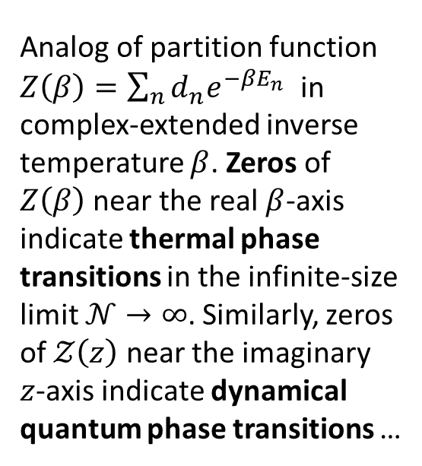

Quantum survival probability in complex time
10
Quantum survival amplitude in complex-extended time
0.05
0
$$t$$
$$𝒵\left(z\right)=\sum_{n}{{\left|α_{n}\right|}^{2}e^{−zE_{i}}}$$
${\left|𝓩\left(z\right)\right|}^{2}$
$$\log_{10}|{𝒵}{\left.​\right|}^{2}$$
$$t$$
$$r(t)≡$$
$$z=β+it∈ℂ$$
$$−\frac{1}{𝒩}\log_{10}{P_{0}(t)}$$
Analog of partition function $Z\left(β\right)=\sum_{n}{d_{n}e^{−βE_{n}}}$ in complex-extended inverse temperature $β$. Zeros of $Z\left(β\right)$ near the real $β$-axis indicate thermal phase transitions in the infinite-size limit $𝒩→∞$. Similarly, zeros of $𝒵\left(z\right)$ near the imaginary $z$-axis indicate dynamical quantum phase transitions …
$$𝒵\left(z\right)=0$$
real time
$$β$$
Example: Á.L. Corps, P. Stránský, P. C., PRB 107, 094307 (2023)

Slide 14
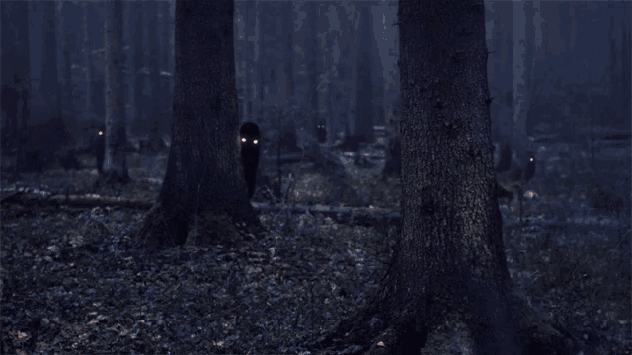

11
Thank you!
https://tenor.com/view/ghost-forest-spooky-gif-8926095

