Slide 1

forward particle physics – past, present and future
Tomáš Sýkora
Institute of Particle and Nuclear Physics
Faculty of Mathematics and Physics

Slide 2
hep-ex>arXiv:2207.12246
what are relevant (= meaningful) question [what is (the definition of) art? – the sculpture in Troja…]
what are (really!) relevant problems? [nothing(?) in particle physics…] (Veltman and non-commutative field theory)
how the answers to these questions depend on time? [a new discovery opens new gates…]
is there some set of “invariants”?
probably these questions themselves belong to such set…
from my perspective a man should never stop to ask such questions but, sure…
we should try to formulate questions more concretely (=“usefully”, ;-)) set

Slide 3
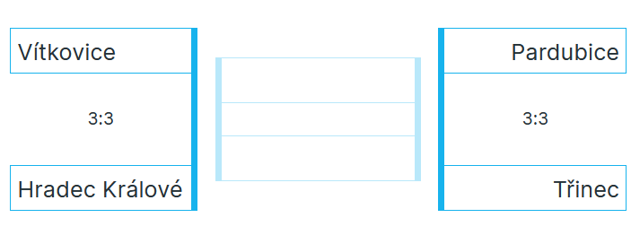

Slide 4
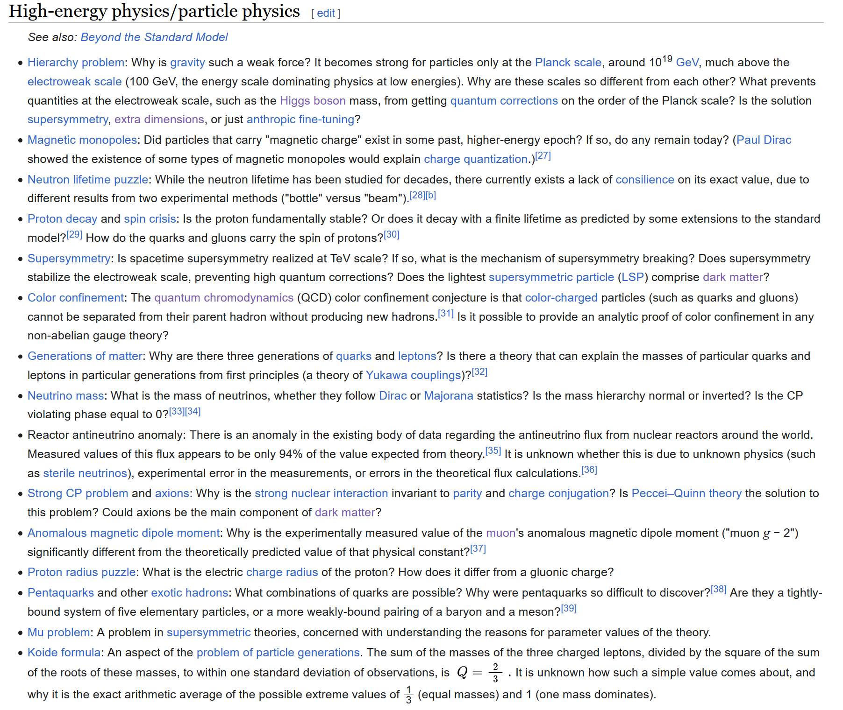
hep-ex>arXiv:2207.12246
https://en.wikipedia.org/wiki/List_of_unsolved_problems_in_physics
many of these problems are subjects of work of our department
I will talk only about the work related(!) to problems in red

Slide 5
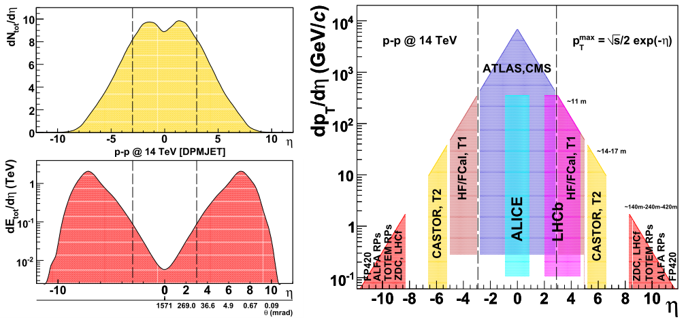

hep-ex>arXiv:2207.12246
flows (p-p)
https://doi.org/10.48550/arXiv.0806.0883

Slide 6
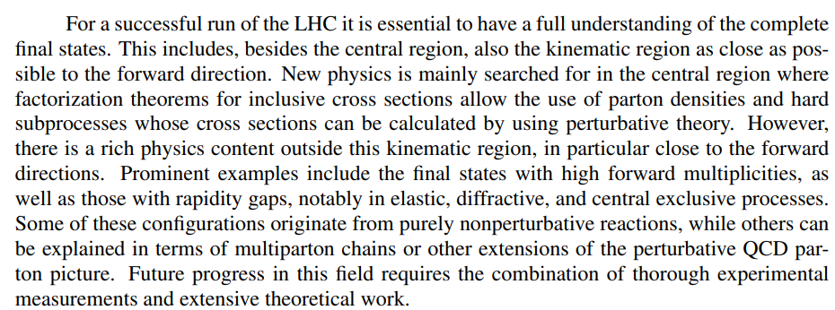
hep-ex>arXiv:2207.12246
what can we learn from forward region?
1611.05079.pdf (arxiv.org)

Slide 7
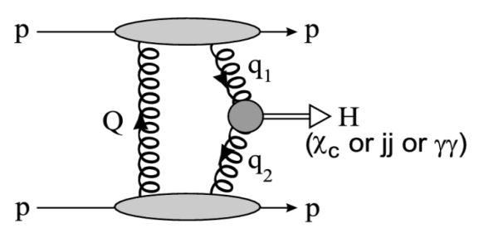
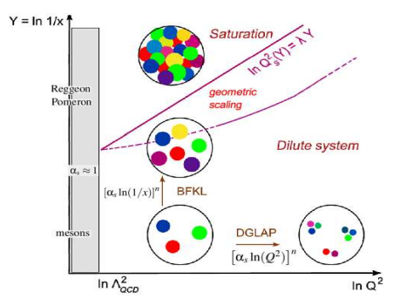
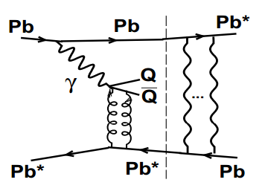
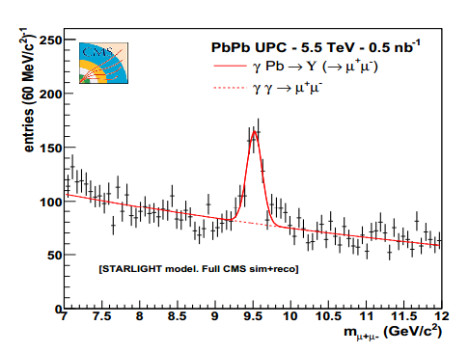
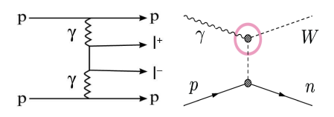
hep-ex>arXiv:2207.12246
hm, could you be more specific? (2008!)
elastic and diffractive collisions
  central exclusive production [l.i.t.] (heavy particles & resonances) pp → p ⊕ X ⊕ p where X stands for a fully measured system like jet-jet, l⁺l⁻, γγ, H, W⁺W⁻, ... and ’⊕’ represents Large Rap-Gap (Δη ≥ 4)
  low-x QCD
  structure functions, factorization violation, parton
  saturation, non-linear QCD evolution, small-x PDFs,
  multi-parton scattering
  models of hadron interactions for high energies –
  cosmic showers, measurement of dE/dη, dN/dη
  for p-p, p-A and A-A interactions,
  ultra peripheral collisions
electroweak interactions
anomalous coupling constants

Slide 8
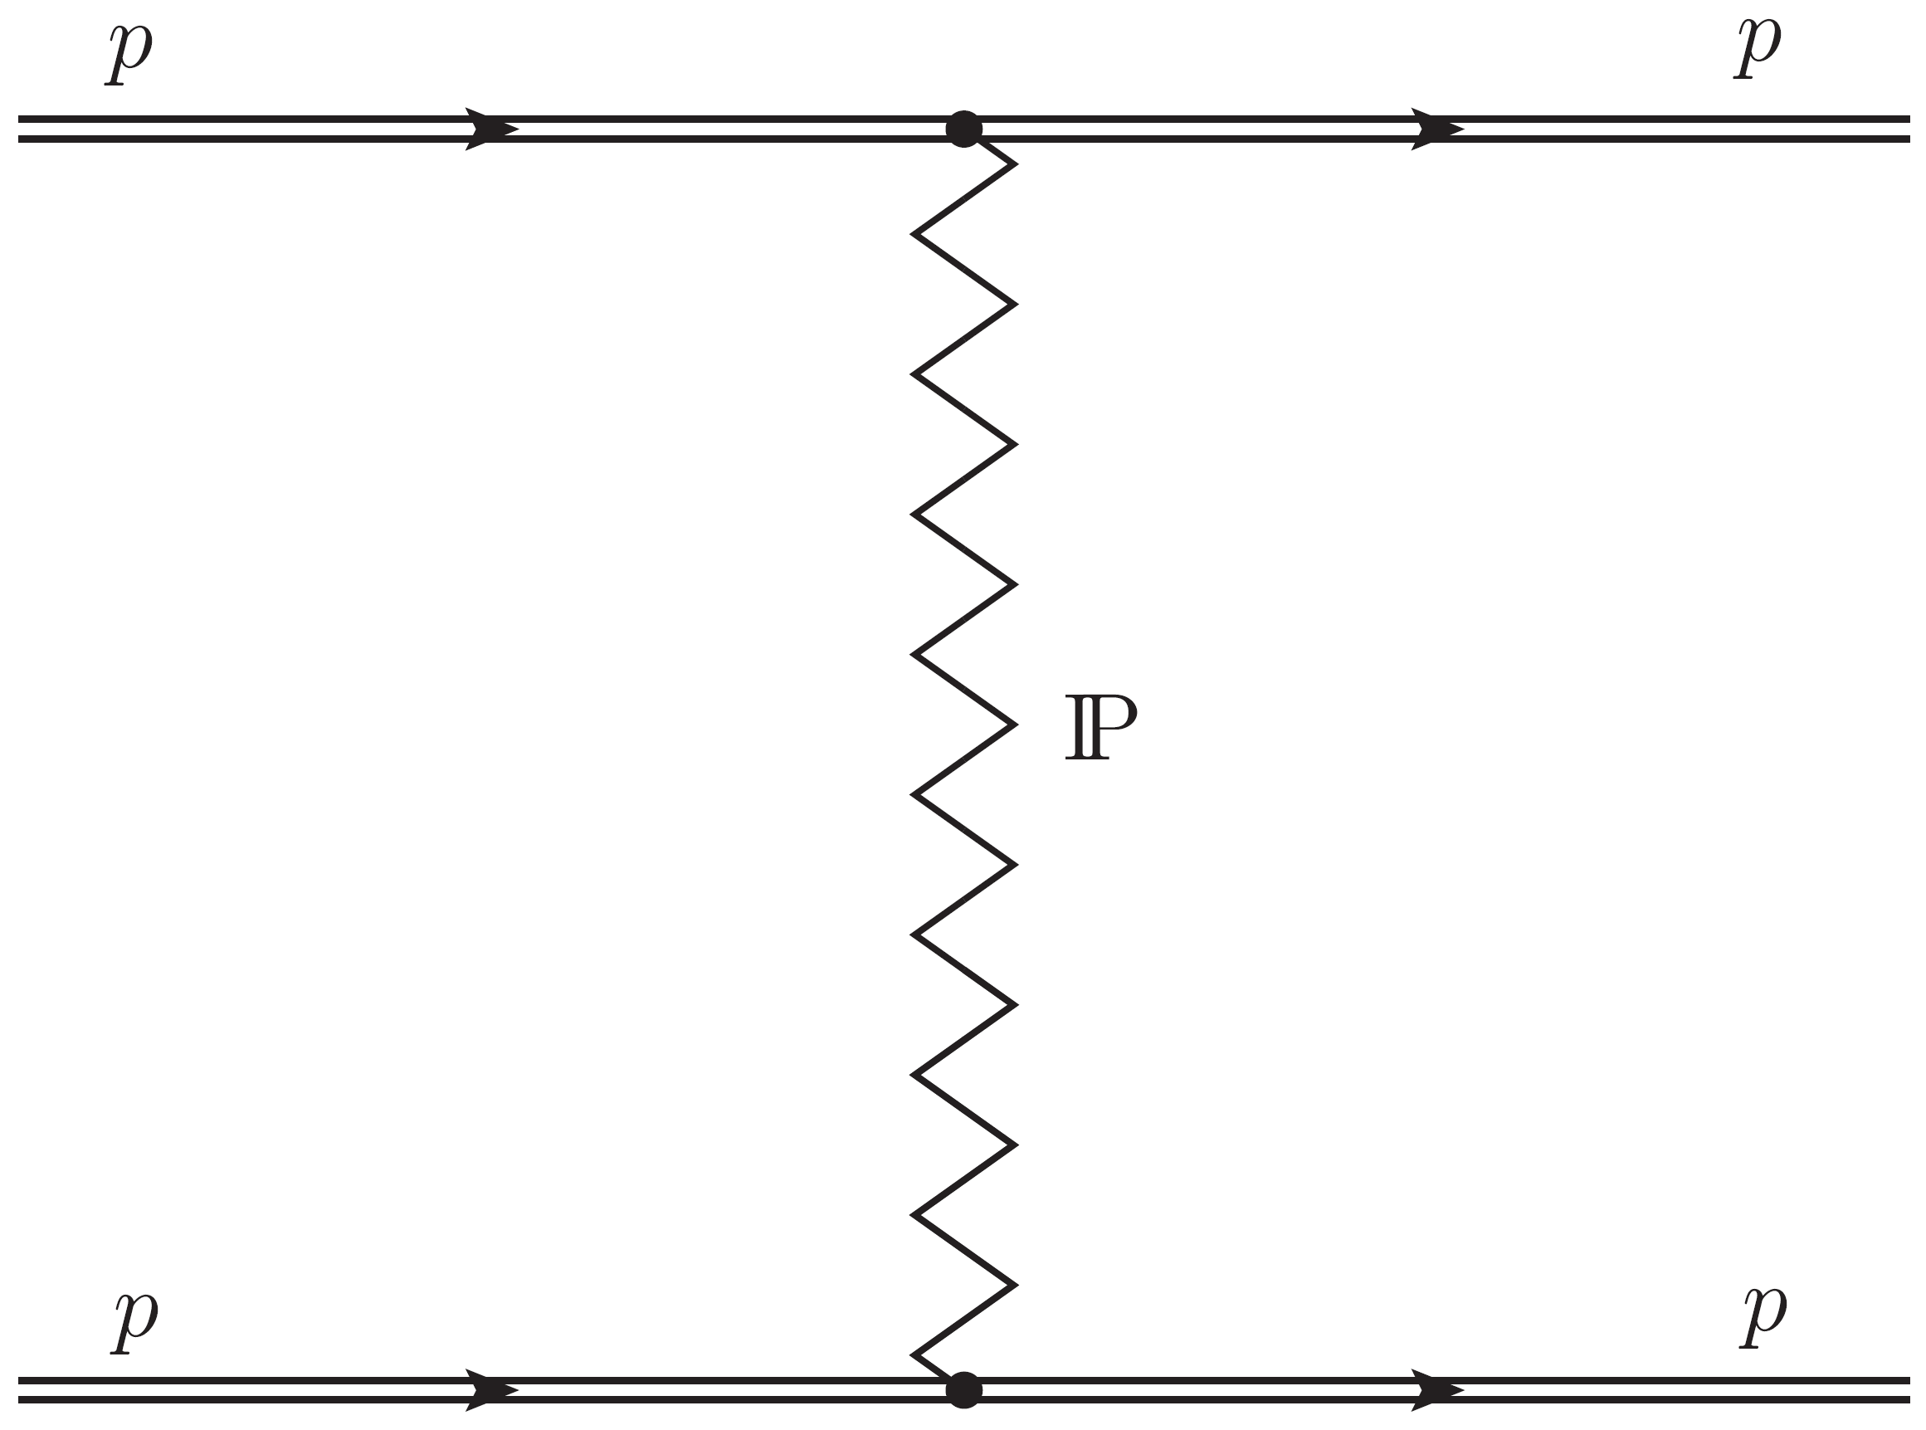














hep-ex>arXiv:2207.12246
kinematics
$$p_{4}$$
$$p$$
$$p$$
$$p$$
$$p$$
$$θ$$
$$p_{1}$$
$$p$$
$$p_{2}$$
$$p$$
$$p_{3}$$
$$p$$
$$p$$
Mandelstam variables, invariants
$$s={(p_{1}+p_{2})}^{2}$$
$t={(p_{1}−p_{4})}^{2}≅−{\left(p_{0}θ \right)}^{2}$, $\left|\vec{p_{1}}\right|=\left|\vec{p_{2}}\right|=\left|\vec{p_{4}}\right|=p_{0}$

Slide 9
hep-ex>arXiv:2207.12246
proton structure (low x)

Slide 10
hep-ex>arXiv:2207.12246
total cross section σ_{tot} of proton-proton interaction

Slide 11
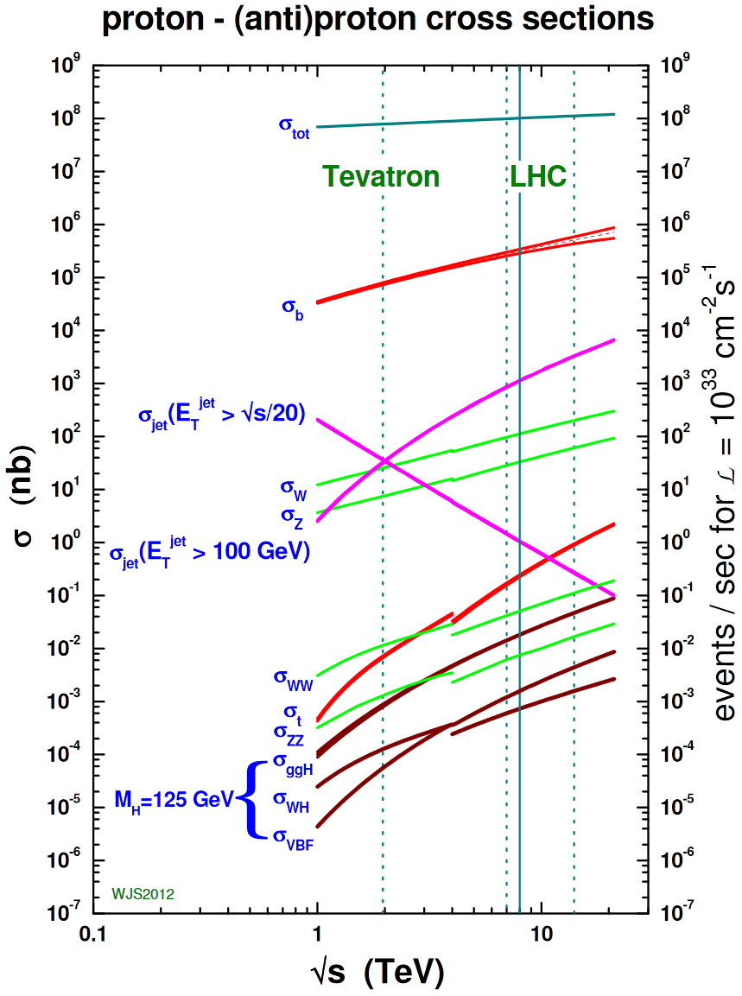
hep-ex>arXiv:2207.12246
total cross section σ_{tot} of proton-proton interaction
σ_{tot} of p-p interaction is a fundamental quantity giving the upper bound on probability (cross section) of any process in p-p collisions
σ_{tot} is not calculable in the framework of perturbative QCD;
Regge model is used in HEP generators to describe kinematic area where perturbative QCD cannot be applied
optical theorem
black disk limit
Pomeranchuk theorem

Slide 12
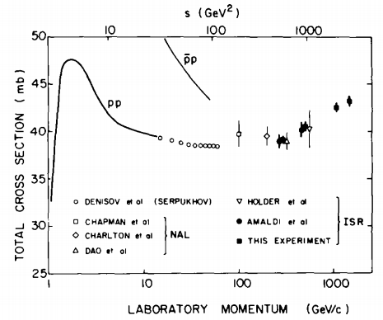
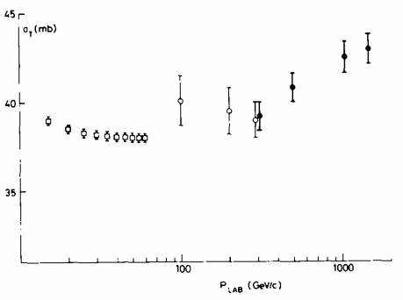
hep-ex>arXiv:2207.12246
ISR (past)
ISR – rise of σ_{tot} was observed first time
U. Amaldi et al., Phys. Lett. B 44 (1973) 192
S.R. Amendolia et al., Phys. Lett. B 44 (1973) 119
would the total cross section continue to rise with ln(s) or rather ln²(s)?

Slide 13

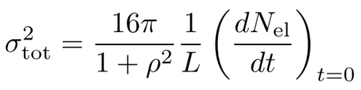
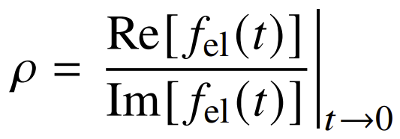
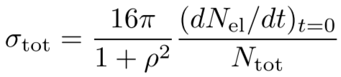
σ_{tot} and σ_{el} – optical theorem
direct (ρ-independent; see below) measurement of σ_{tot} = N_{tot} /L,
where N_{tot} is total number of events with interaction, L is luminosity, is nontrivial; (due to the limited acceptance, model dependence)
traditional way (ISR) of σ_{tot} measurement – via elastic cross section measurement and the use of optical theorem
σ_{tot} = σ_{el} + σ_{inel}
σ_{inel} = σ_{inel} _{diffractive} (σ_{SD} + σ_{DD} + …) + σ_{non} _{diffractive}
where f_{el} is elastic amplitude
luminosity dependent measurement,
N_{X} - number of events of X∈(el, tot, inel, …) type
luminosity independent measurement

Slide 14
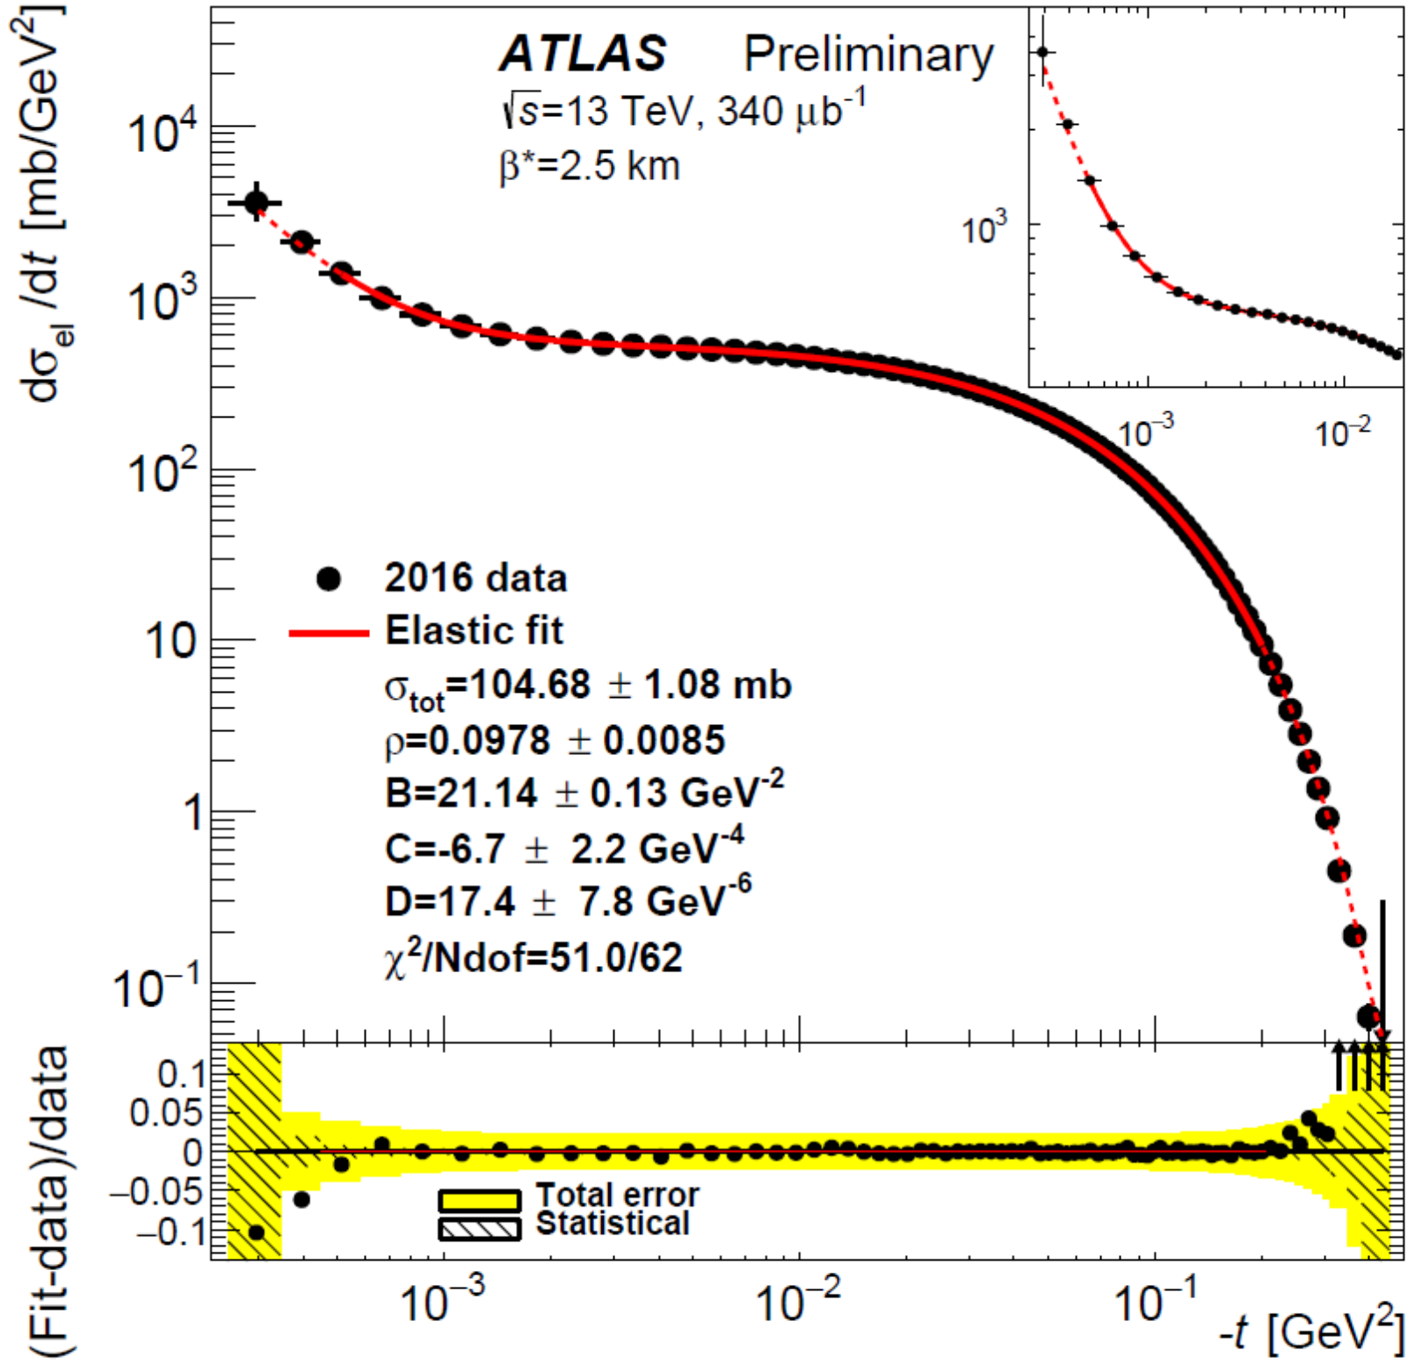
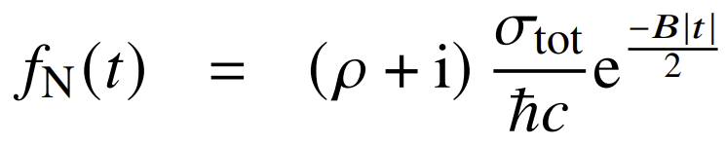
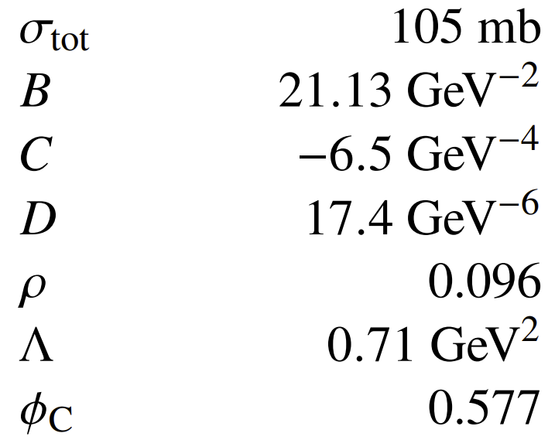
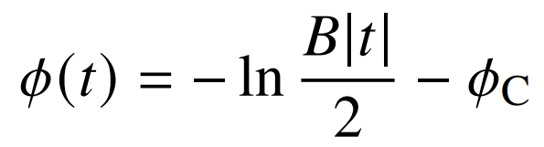
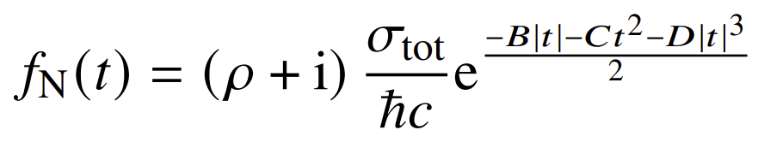
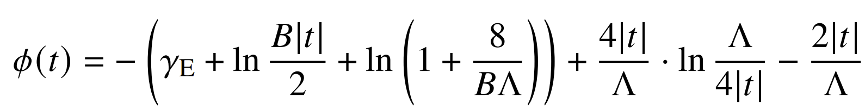

differential elastic cross section – results
physics parameters are extracted from a profile fit
to the cross section including experimental systematic uncertainties
fit function – nuclear part depends on considered models (next slide)
the main uncertainties are related to the luminosity and to the alignment;
for ρ also theoretical uncertainties are important
$t ϵ [\text{2.5}\text{ · }{\text{10}}^{−4}, 4.6 \text{· }{\text{10}}^{−1}]$GeV²

Slide 15
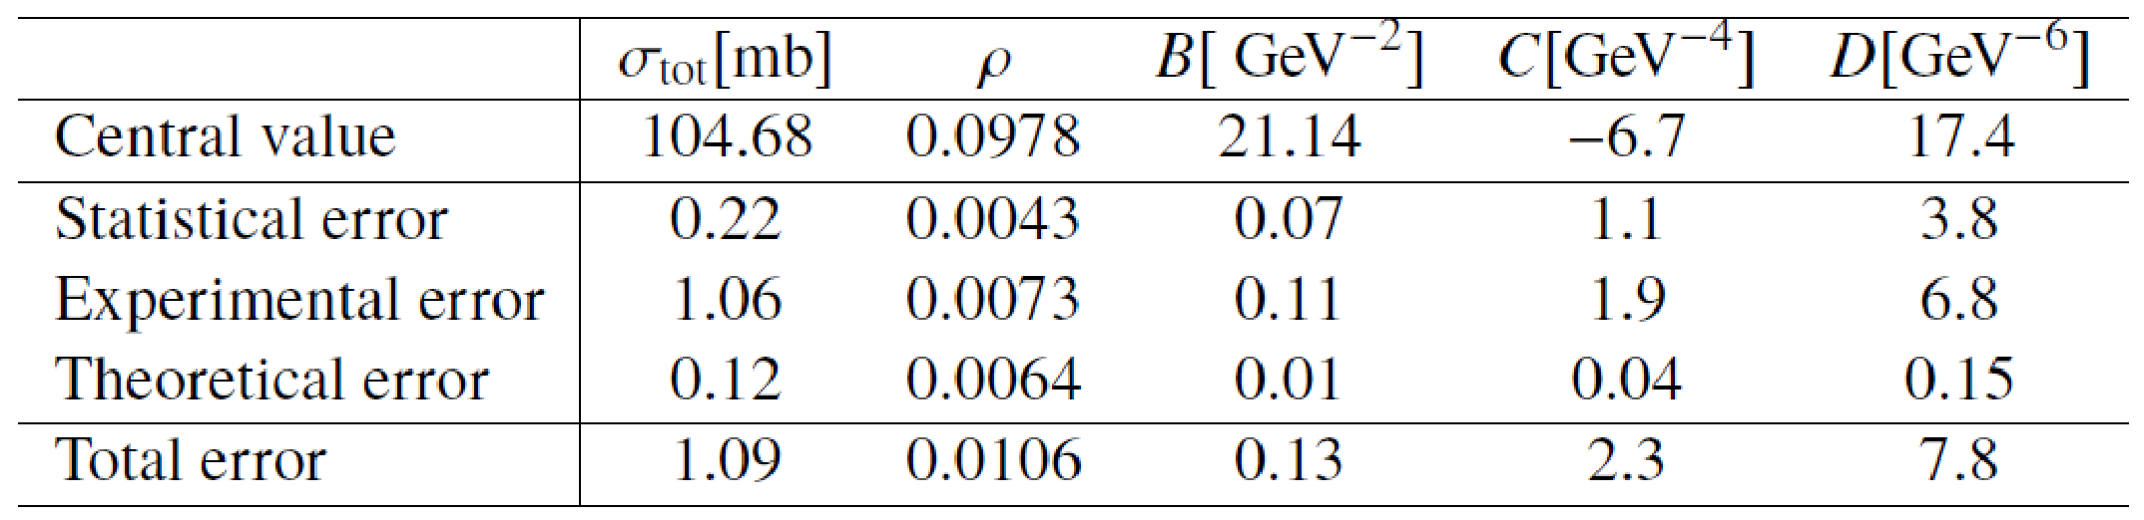
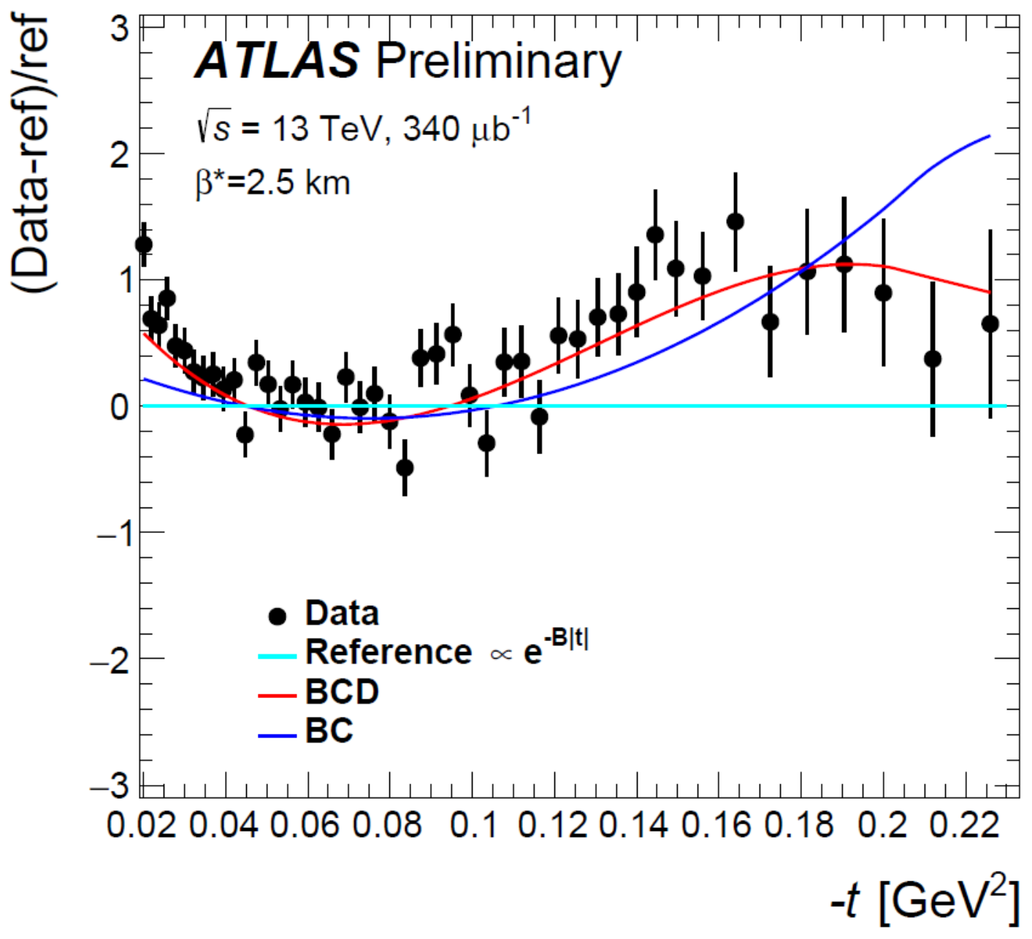
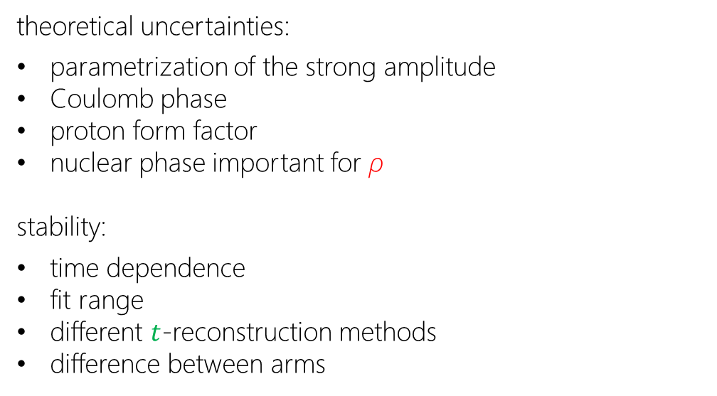
theoretical (model) uncertainties
theoretical uncertainties:
parametrization of the strong amplitude
Coulomb phase
proton form factor
nuclear phase important for ρ
stability:
time dependence
fit range
different $t$-reconstruction methods
difference between arms

Slide 16
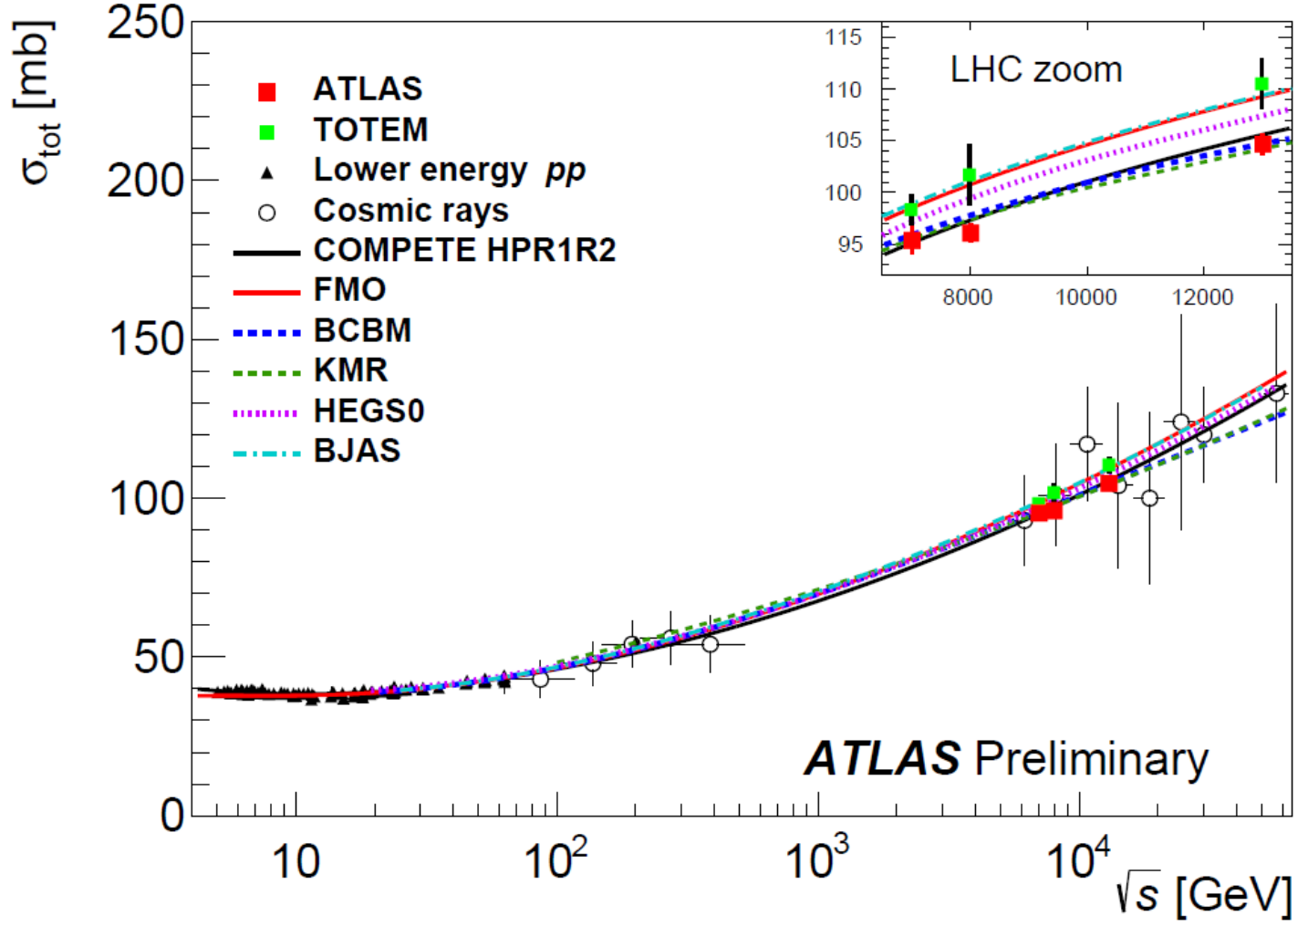
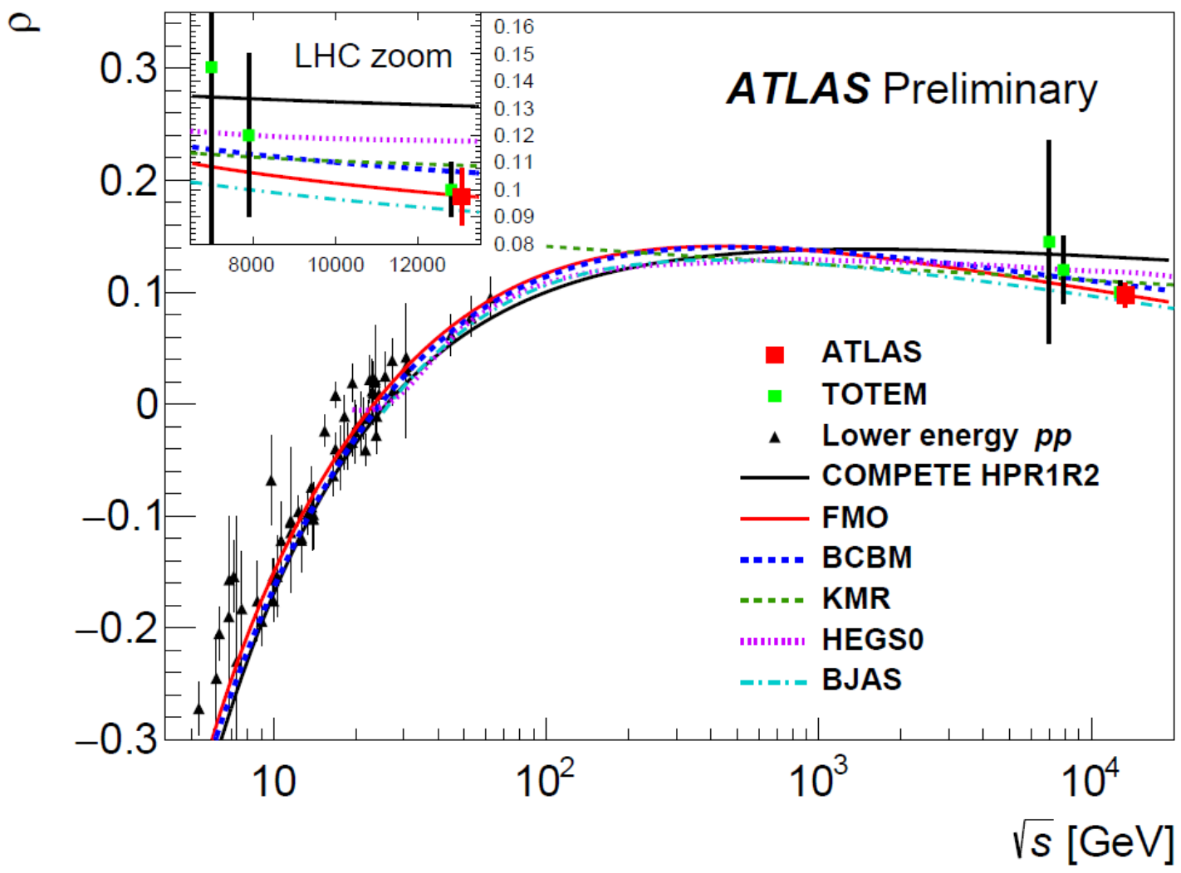
hep-ex>arXiv:2207.12246
arXiv:2207.12246 [hep-ex], accepted for publication in EPJC
behavior of σ_{tot} and ρ as function of collision energy (now)
several models were investigated for the evolution of σ_{tot} and ρ as function of collision energy;
σ_{tot} and ρ connected via dispersion relations
the canonical evolution model, COMPETE, is disfavored as it predicts the value of ρ ≈ 0.13
the model with an Odderon and tuned to TOTEM data is not in a good agreement with corresponding ATLAS σ_{tot} result
the damped amplitude model is in the best agreement with ATLAS data
ALFA and TOTEM difference in σ_{tot} about 2.2 σ (similar trend seen at 7 and 8 TeV)

Slide 17
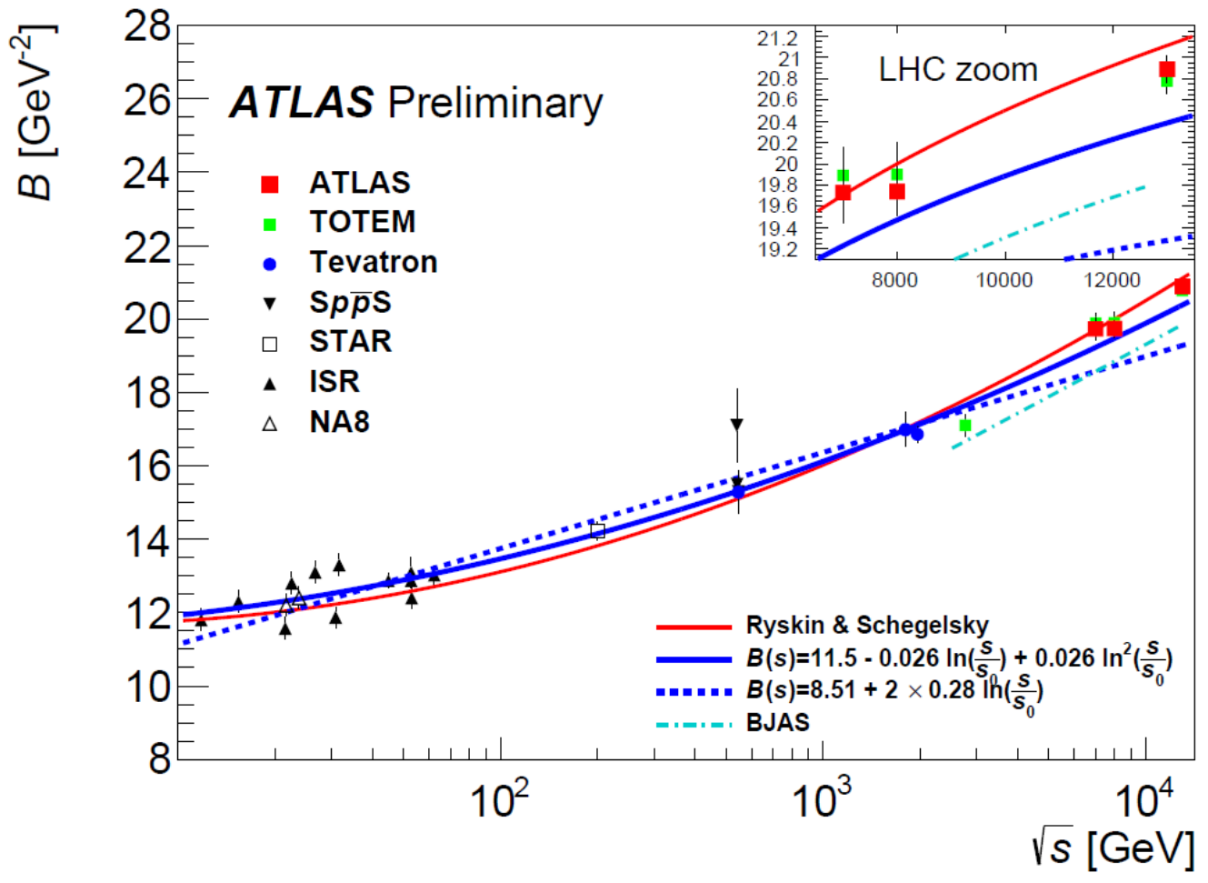
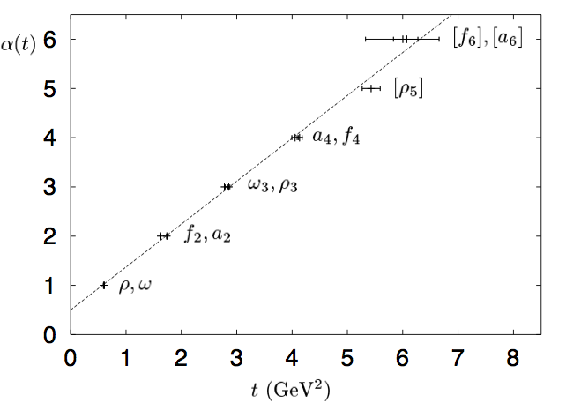
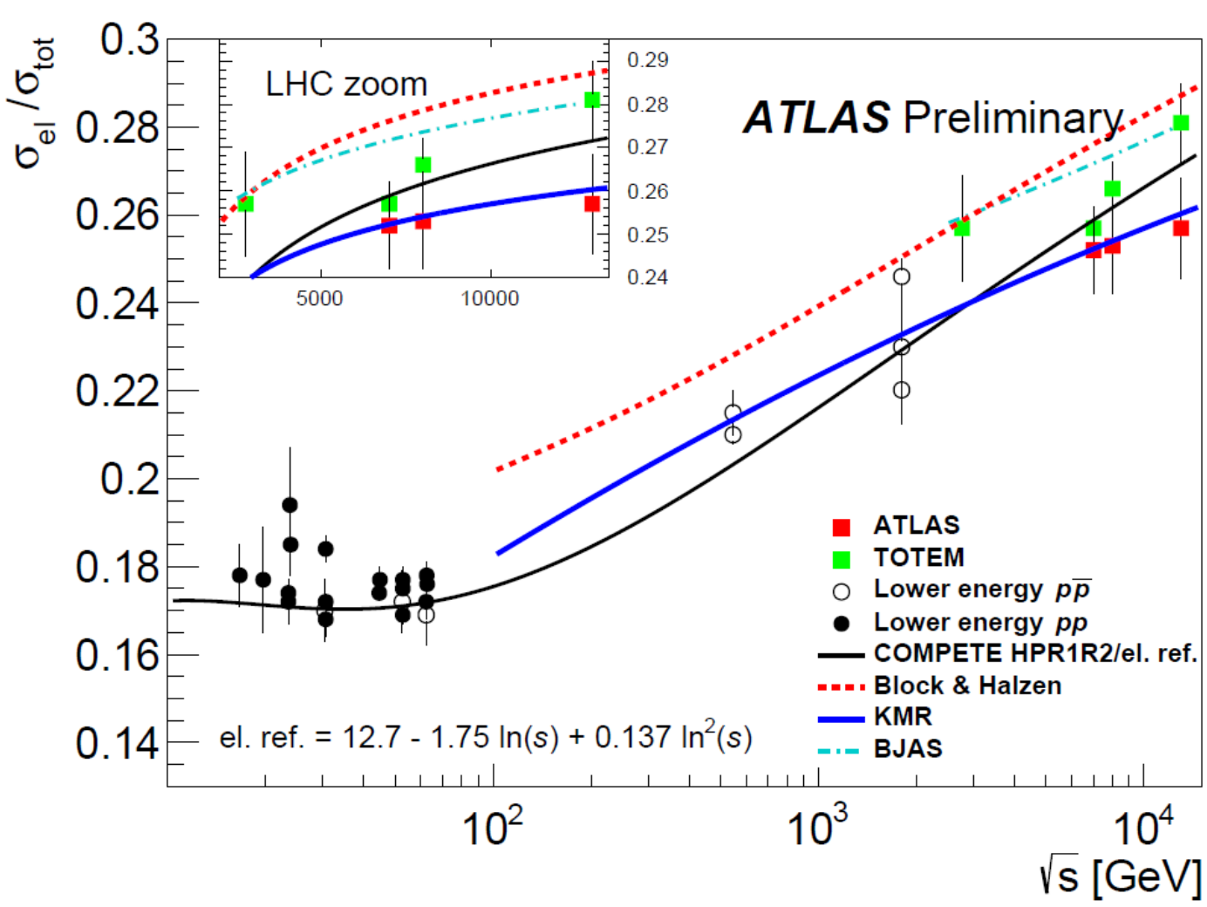


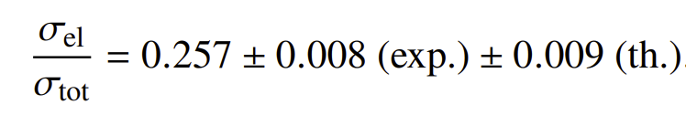

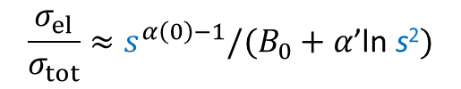

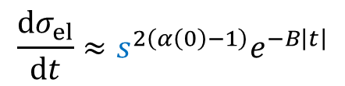


hep-ex>arXiv:2207.12246
evolution of B; σ_{el}/σ_{tot} ratio
using optical theorem and Regge theory we can write
where $α$(0) is so-called intercept of a Regge trajectory
$$σ_{tot} ≈s^{α\left(0\right)−1}$$
$$\frac{{dσ}_{el}}{dt}≈s^{2\left(α\left(0\right)−1\right)}e^{−B\left|t\right|}$$
$B=B_{0}+2α$’ln s
shrinkage of the forward cone
then:
$$\frac{σ_{el}}{σ_{tot}}≈s^{α\left(0\right)−1}/(B_{0}+α\text{’}\text{ln} \text{s}\text{2})$$
measurement at $\sqrt{s}=$ 13 TeV gives:
for some recent discussion see e.g. Soft Pomeron in light of the LHC correlated data

Slide 18
hep-ex>arXiv:2207.12246
a bit more…

Slide 19
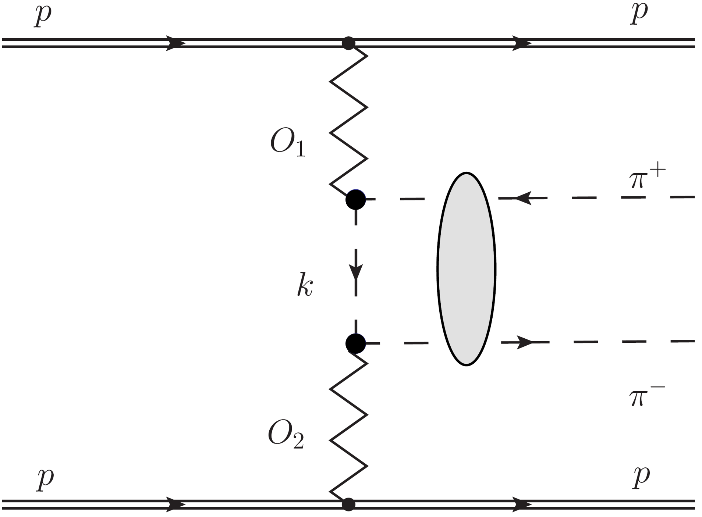
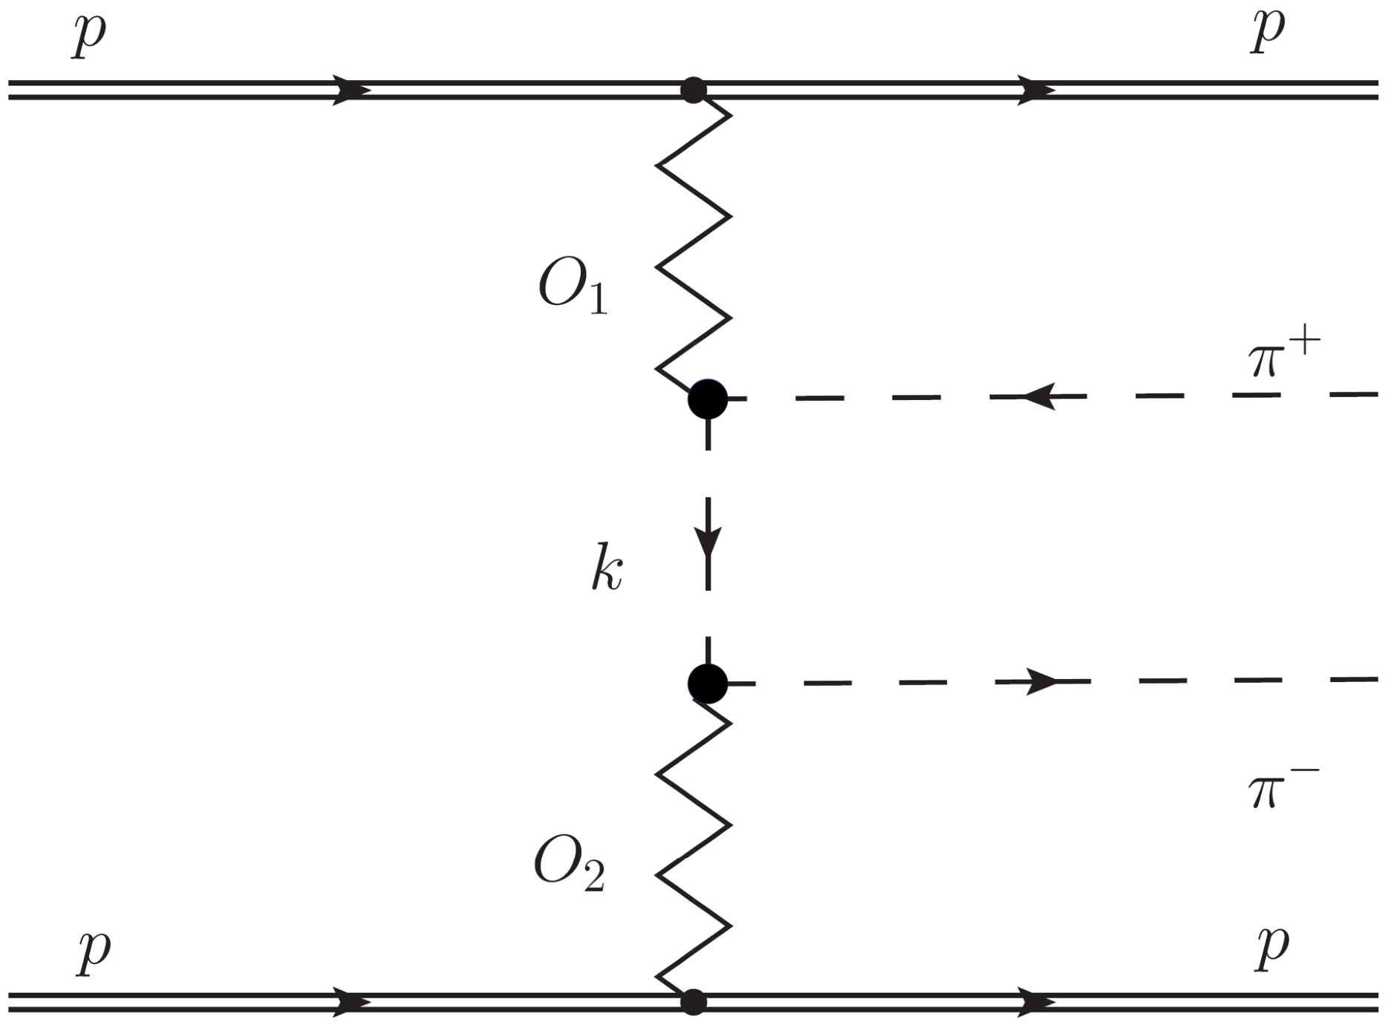
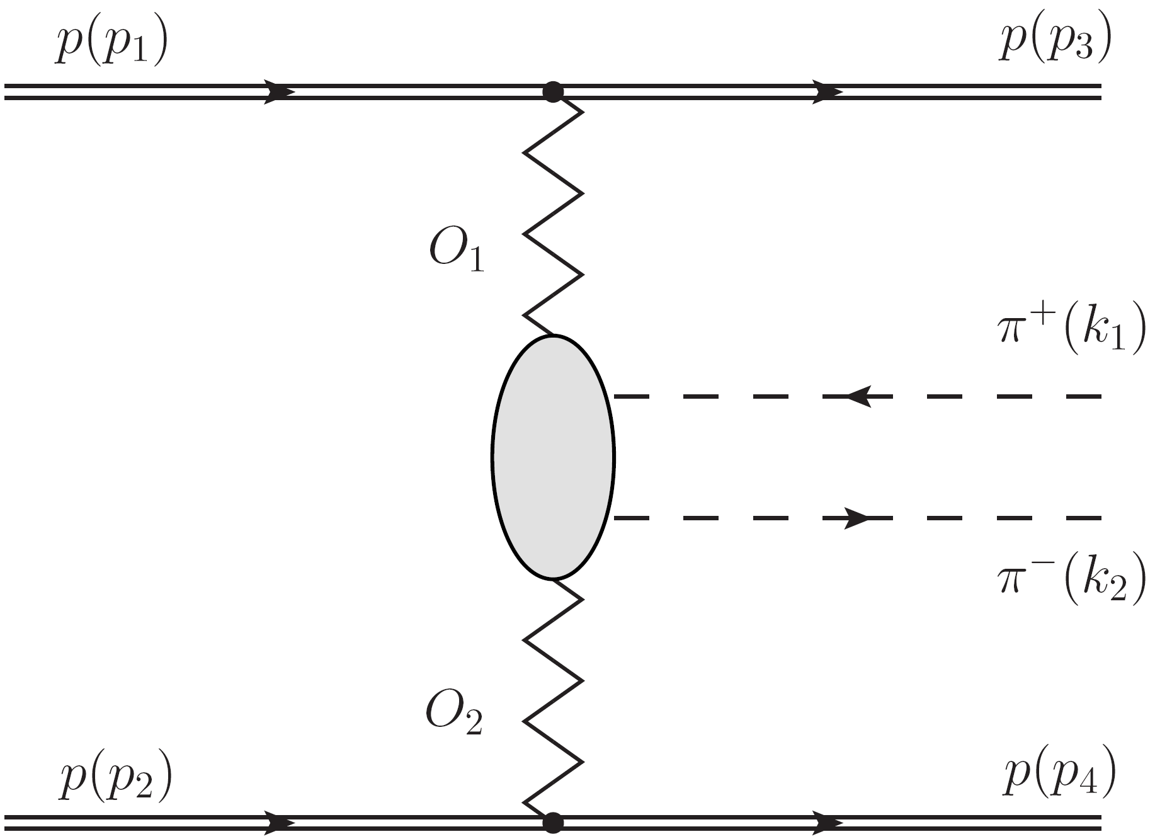
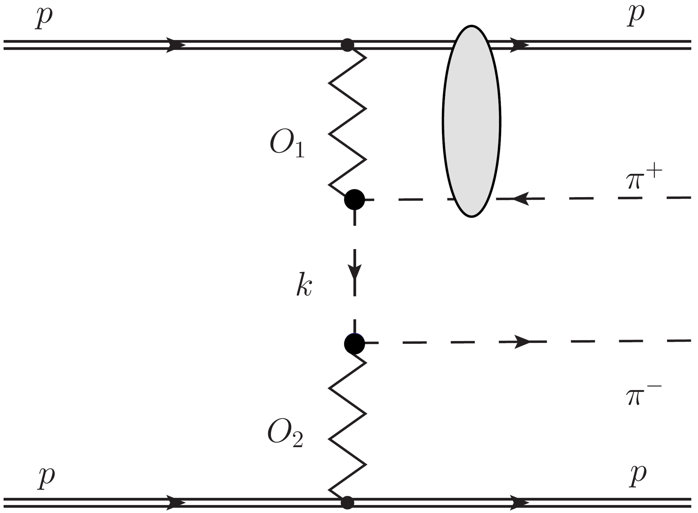
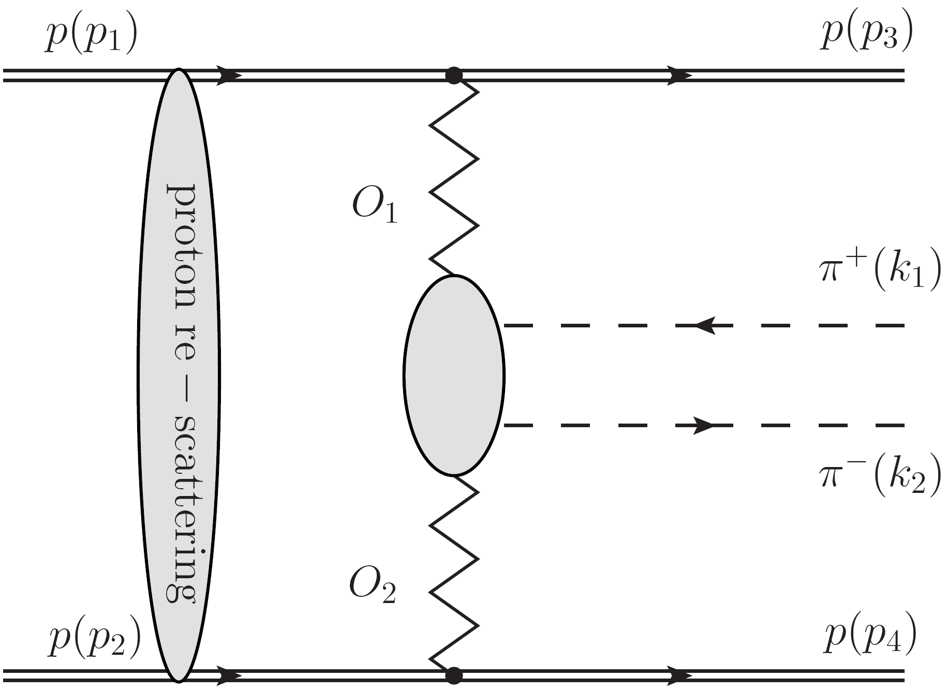
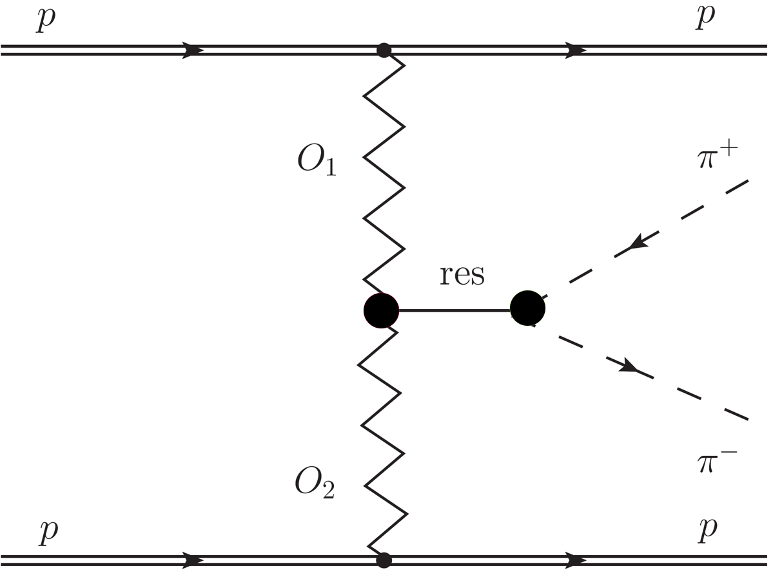
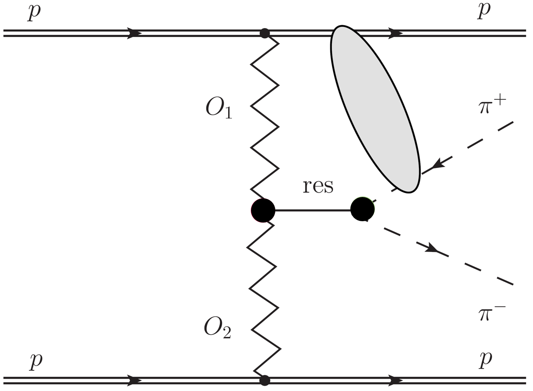
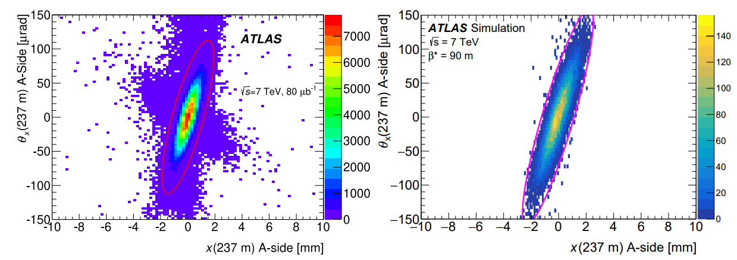


hep-ex>arXiv:2207.12246
exclusive pion pair $π^{+}π^{−}$ production
elastic:
$π^{+}π^{−}$:
.
.
.
interference
very similar, very small t and ξ → non-perturbative process

Slide 20
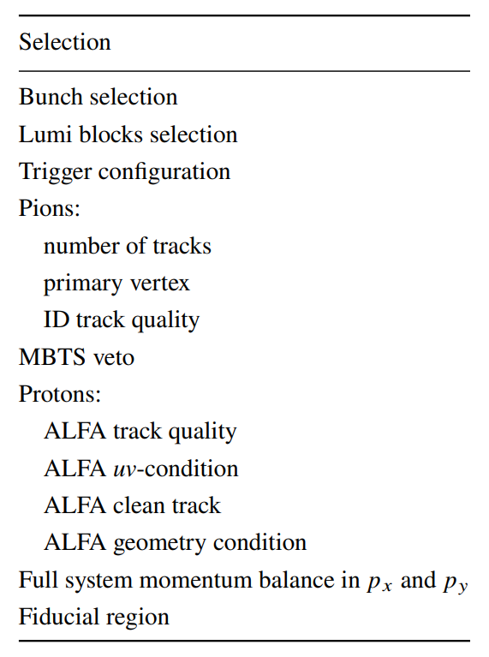
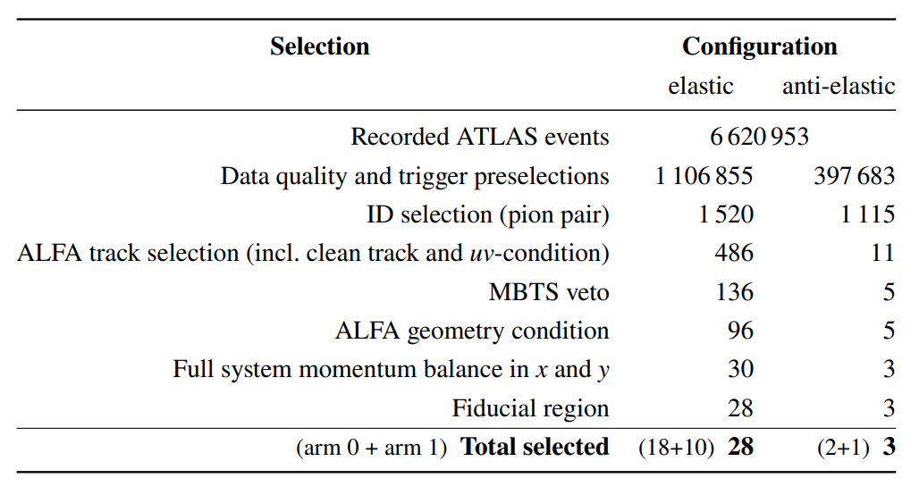
arXiv:2212.00664 [hep-ex], accepted for publication in EPJC
data selection and cut flow
data samples, the same as for ATLAS Collaboration, Measurement of the total cross section from elastic scattering in pp collisions at √𝑠 = 7 TeV with the ATLAS detector, Nucl. Phys. B 889 (2014) 486, arXiv: 1408.5778 [hep-ex]
the present analysis used also the same proton reconstruction criteria – bunch group, data quality, selections on the reconstructed track and geometrical deflection, beam-screen and edge conditions (see Table 2) – together with the detector alignment
fiducial region:

Slide 21
hep-ex>arXiv:2207.12246
diffraction

Slide 22
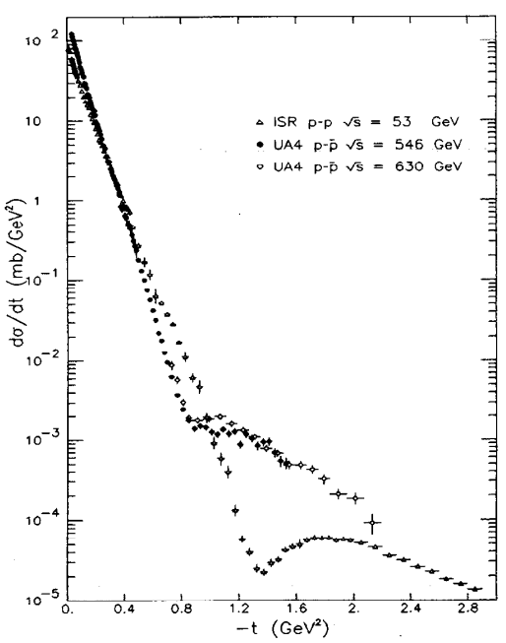
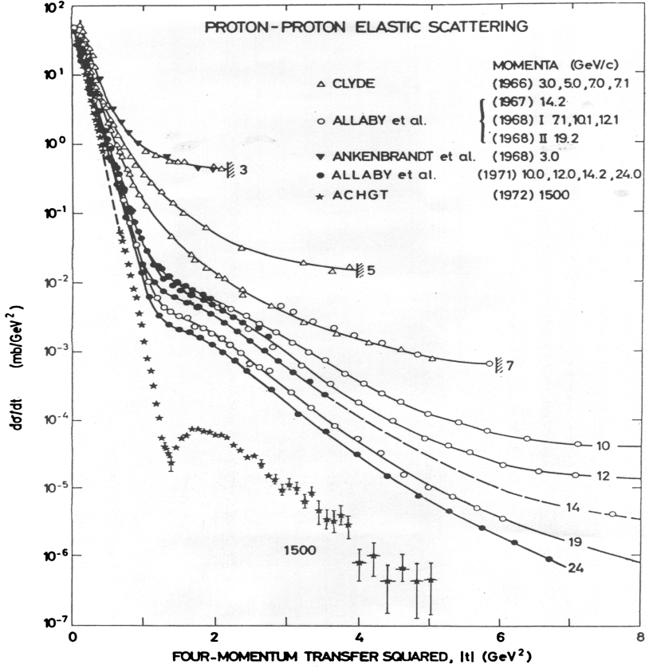
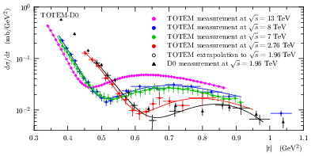
hep-ex>arXiv:2207.12246
differential cross sections
observations

Slide 23
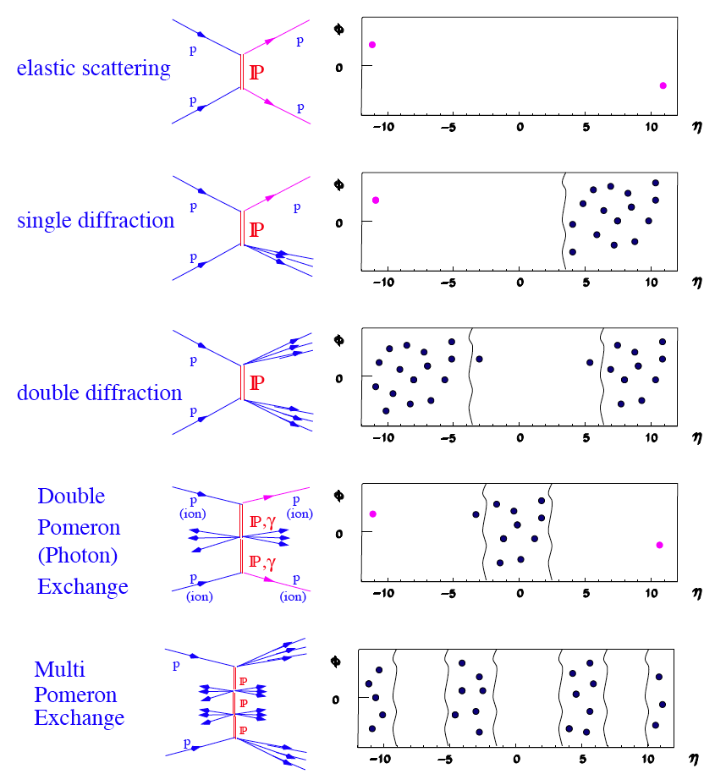

hep-ex>arXiv:2207.12246
event topologies
elastic events are the subset of diffractive events; diffractive like pattern was actually observed in elastic collisions

Slide 24
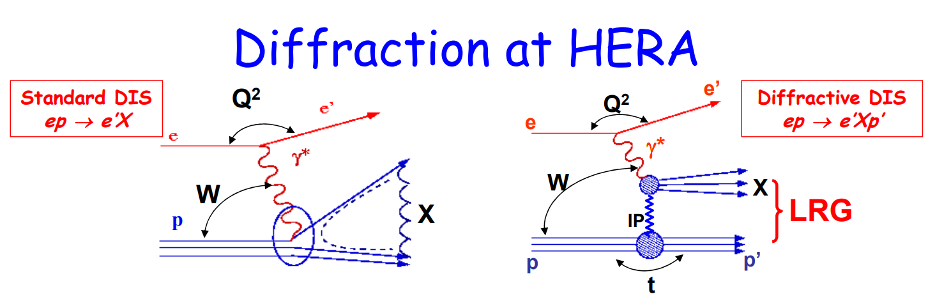
hep-ex>arXiv:2207.12246
HERA and diffraction
1992, H1, ZEUS, HERMES and HERA-B, √s = 318 GeV
HARD diffraction!
V. Sola, Moriond QCD 2010
30 June 2007 at 11:23 pm, HERA was shut down; analyses still ongoing

Slide 25
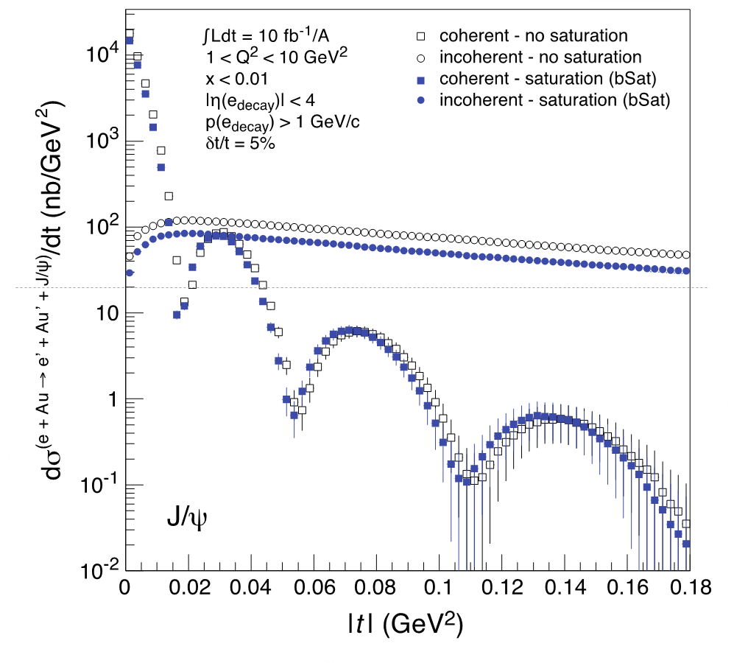


hep-ex>arXiv:2207.12246
why diffraction?

Slide 26

hep-ex>arXiv:2207.12246
https://indico.cern.ch/event/1199314/contributions/5240564/attachments/2621916/4534048/EIC.DIS2023.eca.pptx
“HERA” physics is not dead…

Slide 27

hep-ex>arXiv:2207.12246
start of
building
2025

Slide 28




The EIC Physics
How are the sea quarks and gluons, and their spins, distributed in space and momentum inside the nucleon?
How do the nucleon properties emerge from them and
their interactions?
How do color-charged quarks and gluons, and colorless jets, interact with a nuclear medium?
How do the confined hadronic states emerge from these quarks and gluons?
How do the quark-gluon interactions create nuclear binding?
How does a dense nuclear environment affect the quarks and gluons, their correlations, and their interactions?
What happens to the gluon density in nuclei? Does it saturate at high energy, giving rise to a gluonic matter with universal properties in all nuclei, even the proton?
gluon
emission
gluon recombination
?
=

Slide 29






EIC: The Path to Imaging Quarks and Gluons
Wigner function
4+1-D
not related by
Fourier transf.
2+1-D
transv. mom. dep. PDF
impact par. dep. PDF
generalized PDF
semi-inclusive DIS
exclusive processes
1-D
parton densities
form factor
There are many reasons why one wants to have a 3d picture of nucleons and nuclei
collective effects are one of them.
Obtaining a full picture is definitely an other one

Slide 30

hep-ex>arXiv:2207.12246
back to slide 7

Slide 31

Oldrich Kepka

Slide 32
hep-ex>arXiv:2207.12246
hadronization
[is there anything(!) looking exciting? (at ATLAS)]

Slide 33

the correlation between like-sign (LS) hadrons is consequence of coherent hadron emission
linked to attempt to understand the shape of a QCD string in 3d and stabilization of the end of the parton shower cascade: B. Andersson, G. Gustafson, J. Hakkinen, M. Ringner and P. Sutton, “Is there screwiness at the end
of the QCD cascades?” JHEP 09 (1998), p. 014
it was deduced, on the basis of optimal packing of non-collinear gluon emissions, that the shape of the QCD string should be, at the end, helix-like
one dimensional string -> 3d string & quantum tunneling -> gluon splitting to quark-antiquark pair
fragmentation generates intrinsic transverse momentum that depends on the folding of the string and implies azimuthal correlations between hadrons
azimuthal correlations compatible with the helical shape of the QCD string have been observed by ATLAS
Phys. Rev. D 86, 052005, 2012
the helix model was refined in Š. Todorova-Nová, “Quantization of the QCD string with a helical structure”, Phys.Rev. D89902 (2014) 015002 & “Baryon production in the quantized fragmentation of helical QCD string”, Phys.Rev. D104 (2021) 034012
idea

Slide 34





string fragmentation
Phys. Rev. D 89 (2014), p. 015002
3d fragmentation model enables cross talk between break-up vertices; causal constraints imposed on the fragmentation, the mass spectrum of light mesons is reproduced, if string breaks in regular multiple of ΔΦ intervals
a fit of mass spectrum predicts rather narrow radius of the helix, κR = 68±2 MeV, where κ ˷ 1 GeV/fm is the string tension, and ΔΦ = 2.82±0.06 rad, i.e. almost back-to-back
A
B
rad
$$m^{AB}=κR\sqrt{{\left(Φ^{B}−Φ^{A}\right)}^{2}−{\left(2\sin{\frac{Φ^{B}−Φ^{A}}{2}}\right)}^{2}}$$
$$=κR\sqrt{{\left(nΔΦ \right)}^{2}−{\left(2\sin{\frac{nΔΦ}{2}}\right)}^{2}}$$
for the definition od kinematics variables – see backup

Slide 35


rank and anomalous production of LS pairs
$$Q\left(p_{i},p_{j}\right)= \sqrt{−{\left(p_{i}−p_{j}\right)}^{2}}=2p_{T}\left|\sin{\frac{rΔΦ}{2}}\right|$$
where $p_{i},p_{j}$ are 4-momenta of particles in the considered pair
rank variable r characterizes the relation, due to ordering within the helix, between products
r
calculated in the limit of locally homogeneous string field
adjacent
local charge conservation ->
production of pairs of pions with
LS charge for r = 2, 4, …
and
OS for r = 1, 3, …
region Q < 100 MeV is occupied by pairs with r = 2 -> production of LS pairs – it is the prediction of the model

Slide 36


quantized string parameters from pp, p+Pb and Pb+Pb data
ATLAS-CONF-2022-055
a good agreement between pp data at various collision energies
an excellent agreement between p-p and HI data
we can say:
quantized fragmentation capable to explain ALL data previously associated with Bose-Einstein interference
anomalous production of close LS pions strongly suggests it is a hadronization effect

Slide 37




observable sensitive to local evolution of fragmentation function
(for color-adjacent hadrons)
z⁺, z⁻ fractions of longitudinal partons of a hadron (a or b)
the “check” of how the approximations works
a way to distinguish between rank 0 and rank 1 contributions
isotropic decays (r = 0) independent from ζ and produce a vertical band

Slide 38




quantized fragmentation, signature of long chains found in Pb+Pb – the first observation
ATLAS-CONF-2022-055
the observation of long pion chains demonstrates the predictive power of the model and validates the whole framework

Slide 39
hep-ex>arXiv:2207.12246
instantons
[is there anything(!) looking exciting? (at ATLAS, LHC, …)]
Radek Vavřička (Matthias Schott; seminar: light through wall…)

Slide 40

hep-ex>arXiv:2207.12246

Slide 41

hep-ex>arXiv:2207.12246

Slide 42

hep-ex>arXiv:2207.12246

Slide 43

hep-ex>arXiv:2207.12246

Slide 44

hep-ex>arXiv:2207.12246

Slide 45

hep-ex>arXiv:2207.12246
to make measurement real – teams, students
detectors
AFP Time-of-Flight Jakub Bucko
CERN Summer Studente Programme 2023
Easy Tracker - the tool for imaging charged particle trajectories in an accelerator and its further development
ATLAS Forward Proton Time-of-Flight subdetector – detector testbed studies
Searches for QCD instantons with forward proton tagging - feasibility study

Slide 46

hep-ex>arXiv:2207.12246
to make measurement real – teams, students…
Martin Vavřík (Ferreira Natal Da Luz, Pedro Hugo)
X17 physics -> kTeV, g-2, instantons,…

Slide 47
hep-ex>arXiv:2207.12246
what to take away?

Slide 48
Pardubice – Hradec Králové 23 km
Třinec – Vítkovice 43 km
Zlín – Vsetín 33 km
náhoda?

Slide 49

hep-ex>arXiv:2207.12246
should we have a look at solid state physics…? (motivation)
higgs, …, non-abelian realization?

