Slide 1
Dipole resonances, neutron skins
and nuclear Equation of State
František Knapp
IPNP, Charles University, Prague
14 .4. 2023 Malá Skála

Slide 2
Outline
Collective states in nuclei
dipole excitations, pygmy modes, polarizability
Neutron skin thickness
Nuclear Equation of State

Slide 3
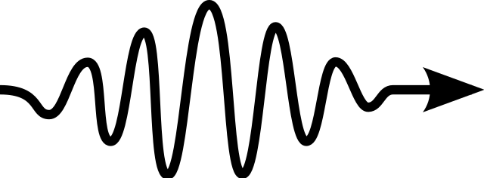
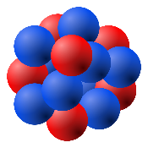
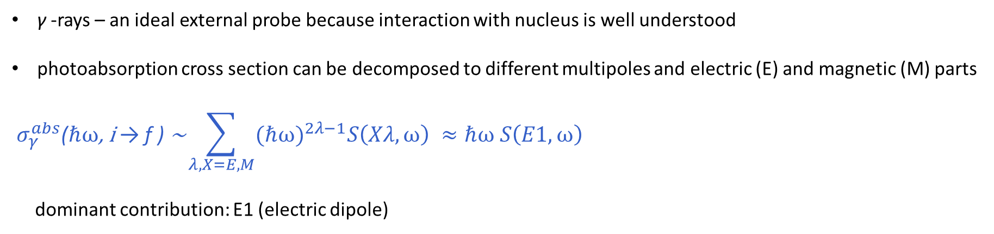
Nuclear collective vibrations
$\text{γ}$-rays – an ideal external probe because interaction with nucleus is well understood
photoabsorption cross section can be decomposed to different multipoles and electric (E) and magnetic (M) parts
$${ σ}_{γ}^{abs}\text{(}\text{ℏ}\text{ω}\text{, }\text{i} \text{→ }\text{f} \text{) }\text{∼}\sum_{λ,X=E,M}{{\text{(}\text{ℏ}\text{ω}\text{)}}^{2λ−1}S\left(Xλ,\text{ω}\right) ≈\text{ℏ}\text{ω} S\left(E1,\text{ω}\right)}$$
dominant contribution: E1 (electric dipole)
Isovector electric dipole (IV E1)
Isoscalar and isovector electric quadrupole (E2)
Scissor magnetic dipole (orbital M1)
ℏω
→ isoscalar or isovector type

Slide 4
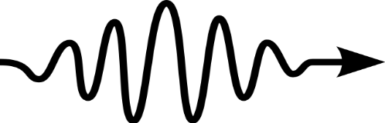

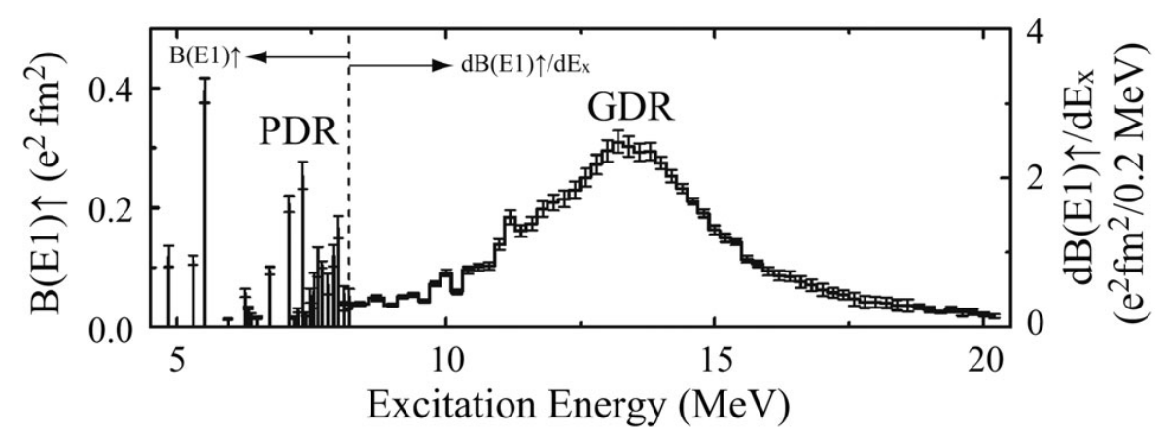
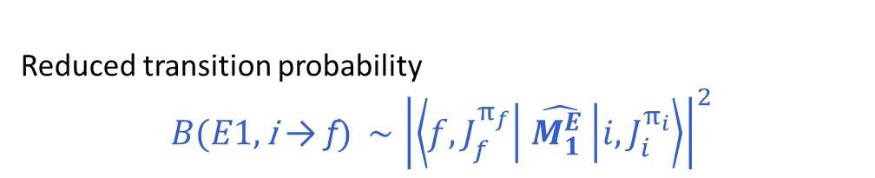

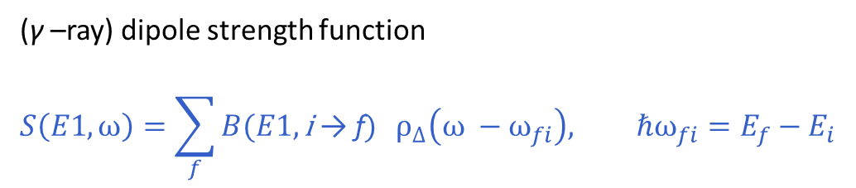
Electric dipole excitations
$$\hat{H}={\hat{H}}_{nuc}+{\hat{H}}_{int}$$
periodic perturbation
with frequency ω
ℏω
Reduced transition probability
$B(E1,\text{i} \text{→ }\text{f})$ $∼{\left|\left\langle f,J_{f}^{π_{f}} | \hat{M_{1}^{E} } | i,J_{i}^{π_{i}}\right\rangle \right|}^{2}$
dipole operator
nuclear states calculated in some many-body approximation scheme
($\text{γ}$–ray) dipole strength function
$$S\left(E1,\text{ω}\right)=\sum_{f}{B(E1,\text{i} \text{→ }\text{f}) } ρ_{∆}\left(\text{ω} −{\text{ω}}_{fi}\right), {\text{ℏ}\text{ω}}_{fi}=E_{f}−E_{i}$$
A. Tamii et al., Eur. Phys. J. A 50 (2) (2014) 28.

Slide 5
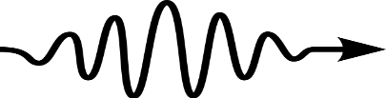
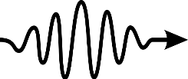



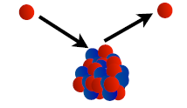
Tools for studying dipole response
Electromagnetic probes
real photons
photonuclear (γ,γ‘) or photon scattering
virtual photons
Coulomb excitations: target nucleus e.g. via (p,p‘)
radioactive beam (exotic nuclei)
Hadronic probes
(⍺,⍺‘γ)
(¹⁷O, ¹⁷O‘γ)

Slide 6
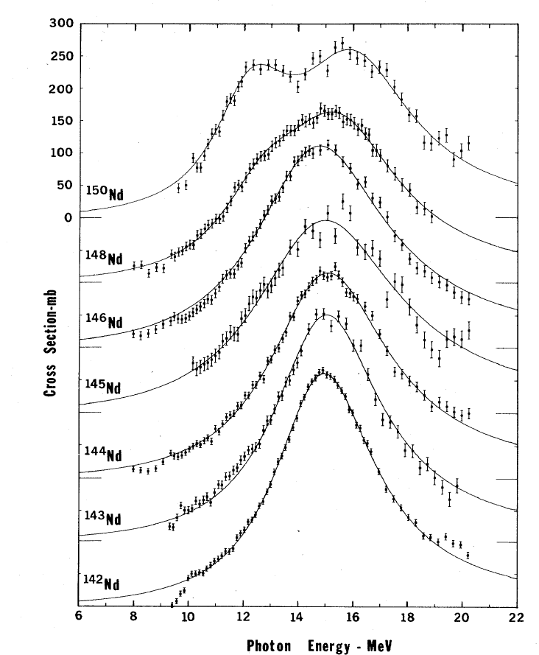
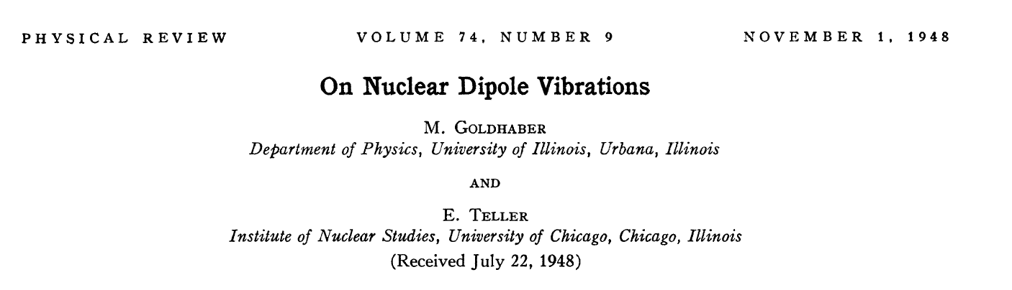
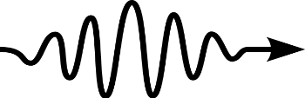
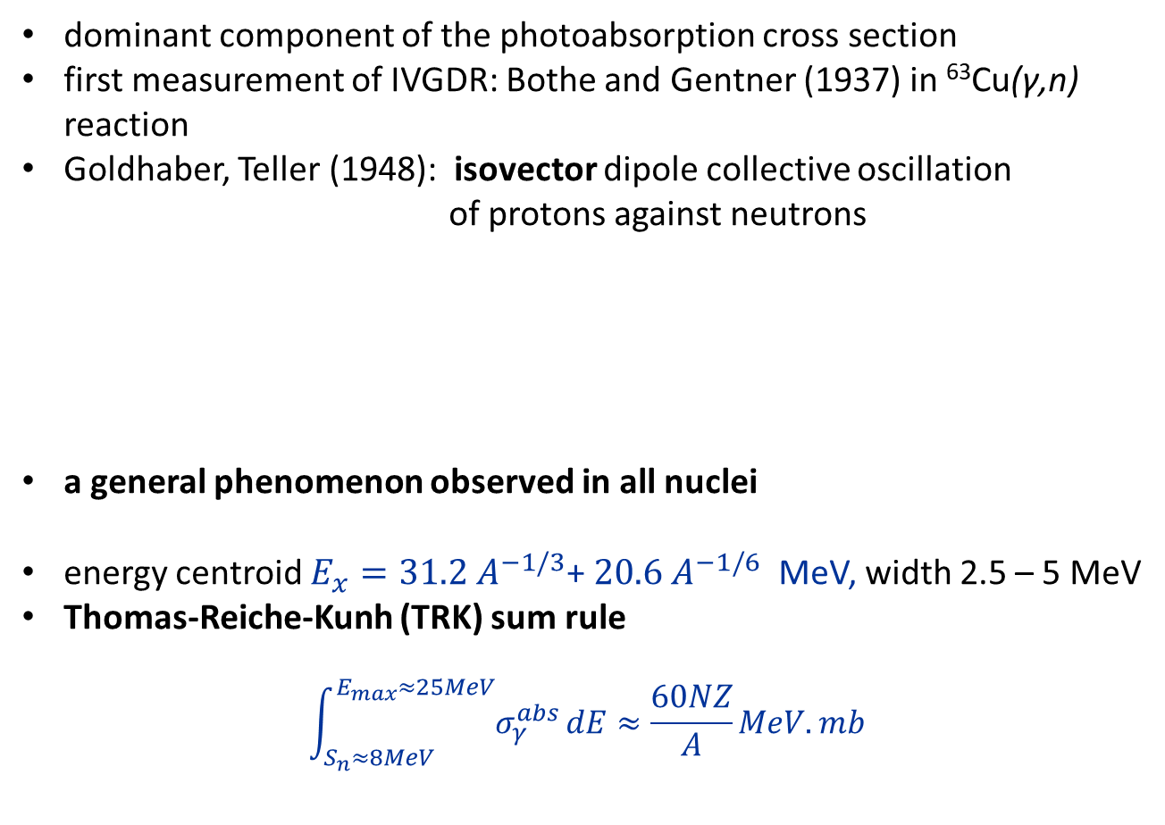
Isovector giant dipole resonance (IVGDR)
dominant component of the photoabsorption cross section
first measurement of IVGDR: Bothe and Gentner (1937) in ⁶³Cu(γ,n)
reaction
Goldhaber, Teller (1948): isovector dipole collective oscillation
of protons against neutrons
a general phenomenon observed in all nuclei
energy centroid $E_{x}=31.2 A^{−1/3}$+ $20.6 A^{−1/6}$ MeV, width 2.5 – 5 MeV
Thomas-Reiche-Kunh (TRK) sum rule
$$\int_{S_{n}≈8MeV}^{E_{max}≈25MeV}{σ_{γ}^{abs}}dE≈\frac{60NZ}{A}MeV.mb$$
in deformed nuclei splitting into two components
B.L. Berman and S.C. Fultz, Rev. Mod. Phys. 47, 713 (1975).

Slide 7
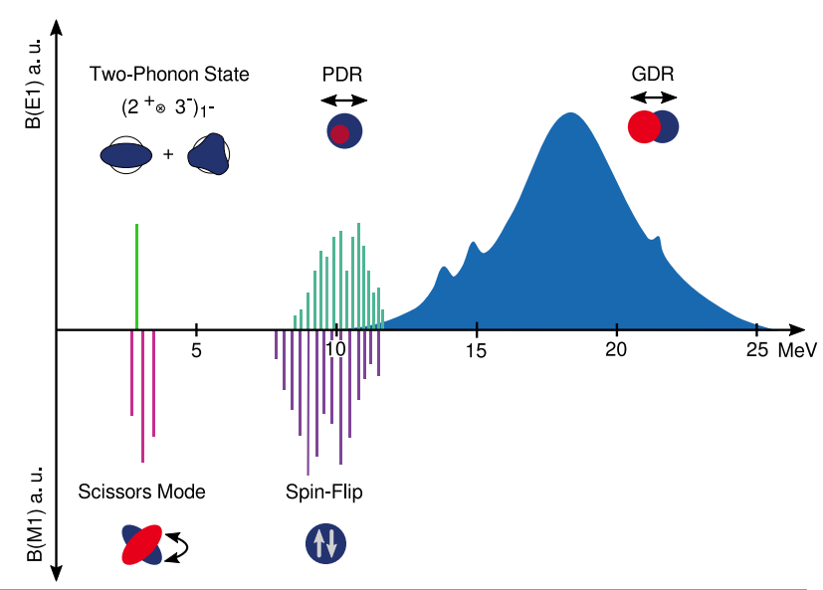
Nuclear dipole response
Giant resonances → coherent motion of many nucleons → large transition probabilities (B(E1))
collectivity → TRK sum rule
(quasi) harmonic vibrations
low-lying 2-phonon vibrations
oscillations of shape (density)
Pygmy dipole resonance (PDR)
soft mode around S_{n}
observed in neutron-rich nuclei
exhausts small fraction of TRK (less then %)
oscillation of neutron skin against
symmetric pn core?
Giant dipole resonance (GDR)
high frequency collective oscillation of
protons against neutrons
exhausts TRK sum rule
Courtesy of I. Brandherm

Slide 8
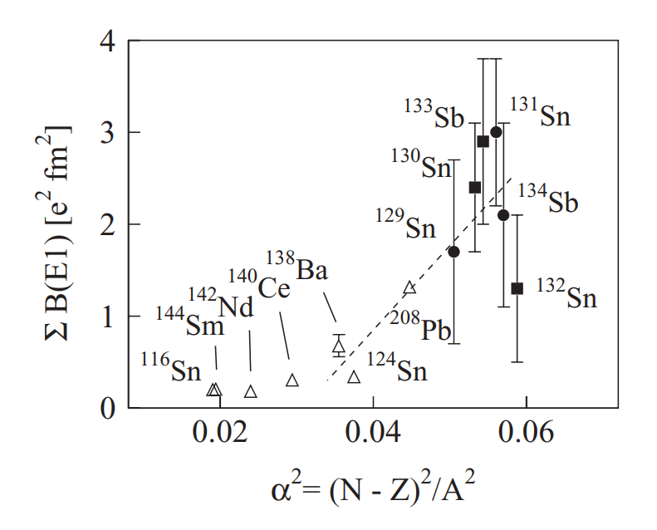
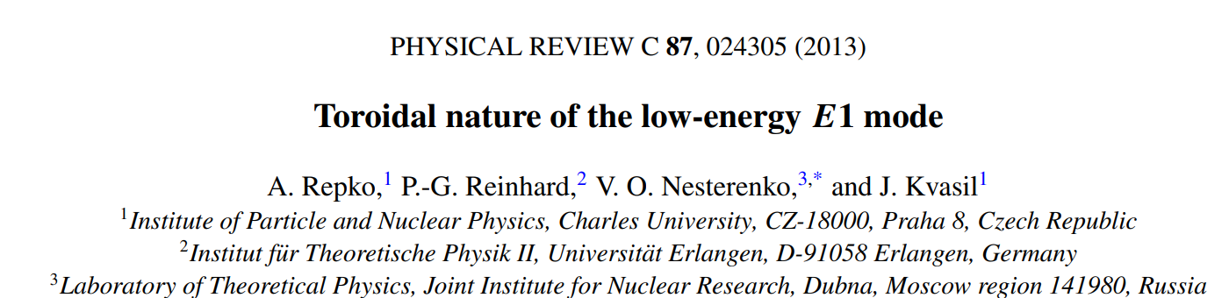
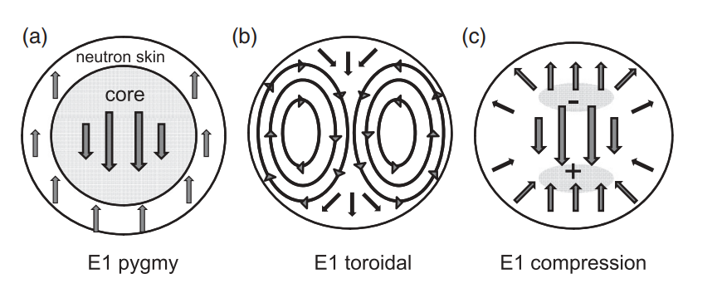
Pygmy dipole resonance
enhancement on the low-energy tail of the GDR observed in neutron-rich nuclei
concentrated around the neutron separation energy
related to nuclear dipole polarizability and neutron skin thickness
„traditional“ macroscopic picture → oscillation of pn symmetric core against neutron skin questioned by Repko et al. → compressional and toroidal collective motion
A. Klimkiewicz et al., Phys. Rev. C 76, 051603(R), (2007).

Slide 9
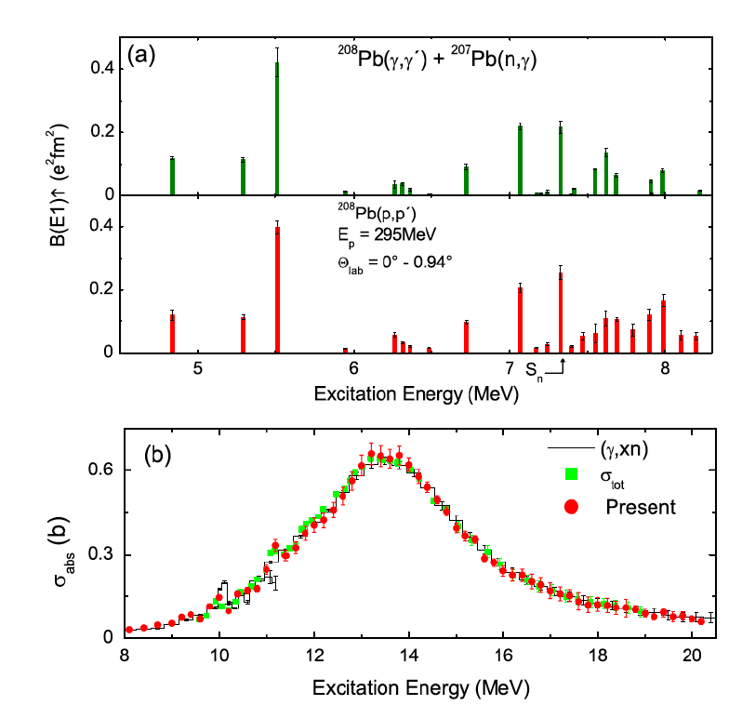
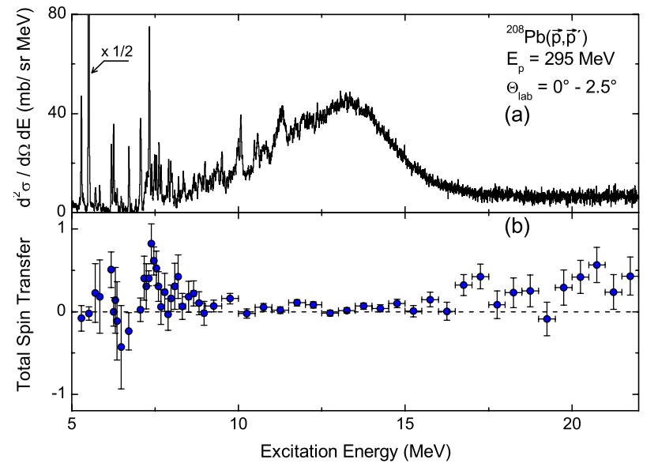
Nuclear dipole response
For some nuclei complementary measurements exist, good example is ²⁰⁸Pb
Low-lying discrete states (bellow S_{n})
Fine structure of GDRs
RCNP Osaka
Tamii et al. Phys. Rev. Lett. 107, 062502 (2011)

Slide 10
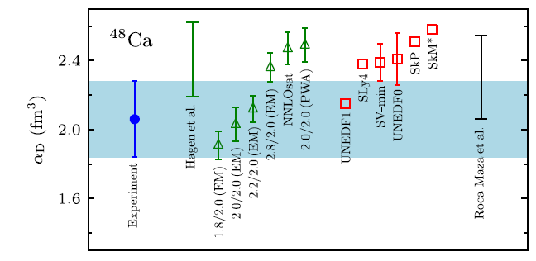
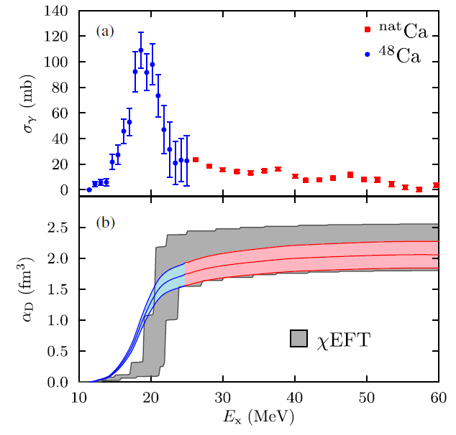




Dipole polarizability
response to an external static electric field $E$
→ electric dipole moment $p$
electric dipole polarizability $⍺_{D}$
strength function (or photoabsorption cross section) → dipole polarizability
important contribution from PDR (neutron-rich systems)
Why is $⍺_{D}$useful?
correlation with neutron skin thickness → nuclear structure
neutron skin thickness sensitive to symmetry energy
important for understanding of neutron matter → neutron stars
$$E$$
$$p$$
$$⍺_{D}=\frac{p}{E}∼\int{\frac{S\left(E1,\text{ω}\right)}{\text{ω}}d\text{ω} ∼}\int{\frac{{ σ}_{γ}^{abs, E1 }\left(\text{ω}\right)}{{\text{ω}}^{2}}d\text{ω} }$$
ab initio!
Birkhan et al., Phys. Rev. Lett 118, 252501 (2017)

Slide 11
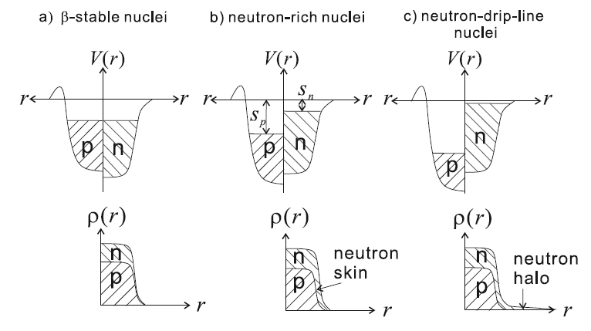

Neutron skin thickness
charged radii and densities well measured
electron scattering → information about size,
surface thickness, saturation density, (e.g. rms charged radius of ²⁰⁸Pb is known with error 0.02%).
(not?)surprisingly neutron densities are not known very
precisely
hadronic probes suffer from large uncertainties (reaction mechanisms, „unknown“ interaction)
neutron-rich nuclei → development of neutron skin
How large is the neutron skin?
Auman T. , Nakamura T., Phys. Scr. T152, 014012(2013).
${∆r}_{np}=\sqrt{\left\langle r_{ N}^{2}\right\rangle }−$ $\sqrt{\left\langle r_{P}^{2}\right\rangle }$

Slide 12
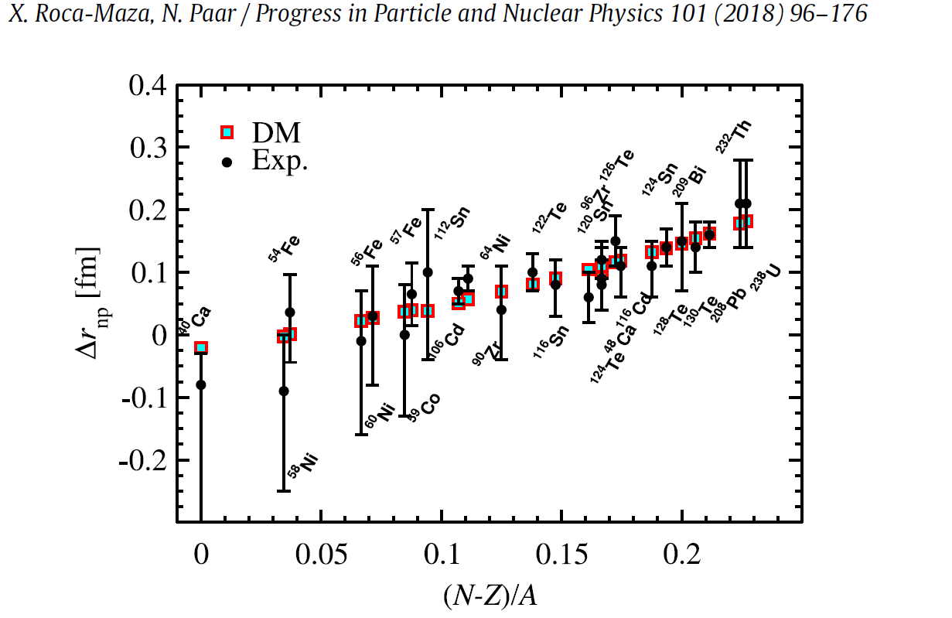
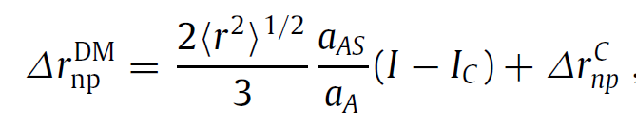



Neutron skin thickness
Simplified droplet model (DM) → approximately linear increase of neutron skin thickness with pn asymmetry
importance of symmetry energy (at the surface and in the core)
In real world, it is more complicated (e.g. shell effects …)
measurements from antiprotonic atoms
A. Trzcińska et al., Phys. Rev. Lett. 87, 082501(2001)
competition between surface tension and symmetry
energy difference at core (high density) and surface
(low density)

Slide 13
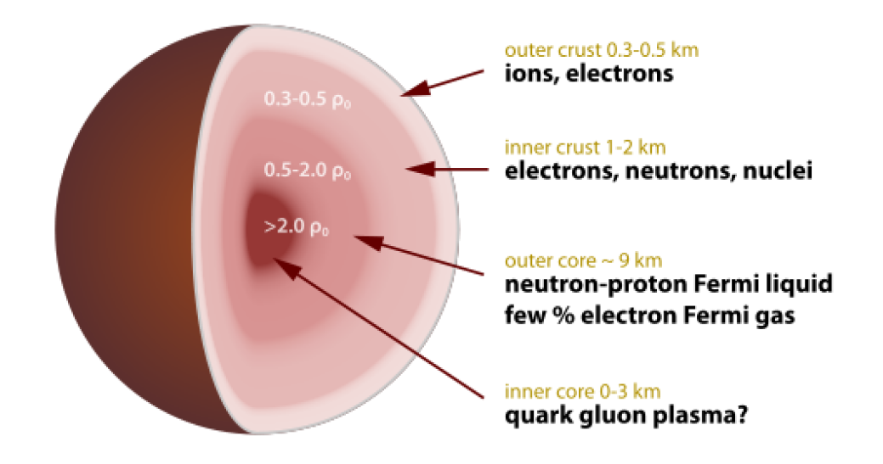
Nuclear Equation of state (EoS)
EoS describes relationships between the energy, pressure, temperature, density and proton-neutron asymmetry.
stellar mass depends on EoS at the highest densities
radius is sensitive to properties of the EoS in the vicinity of nuclear matter saturation density

Slide 14
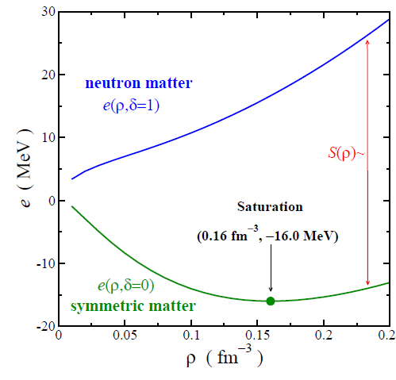
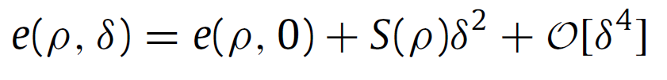
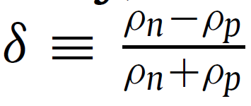
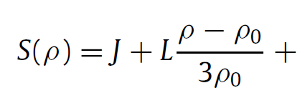


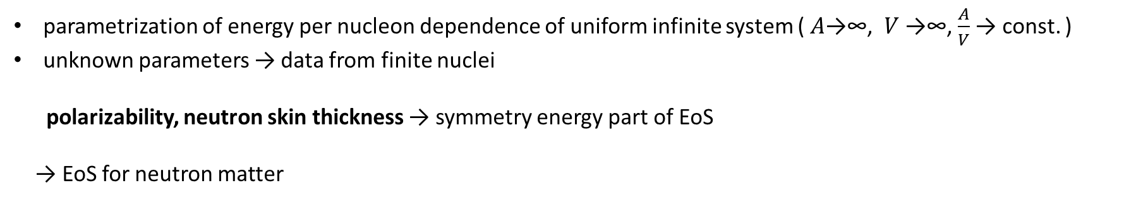
Nuclear Equation of state (EoS)
parametrization of energy per nucleon dependence of uniform infinite system ( $A$→∞, $V$→∞, $\frac{A}{V}$ → const. )
unknown parameters → data from finite nuclei
polarizability, neutron skin thickness → symmetry energy part of EoS
→ EoS for neutron matter
~L
Saturation density
parametrization of symmetry energy
Pressure of neutron matter
X. Roca-Maza, N. Paar, Progress in Particle and Nuclear Physics 101 (2018) 96–176

Slide 15
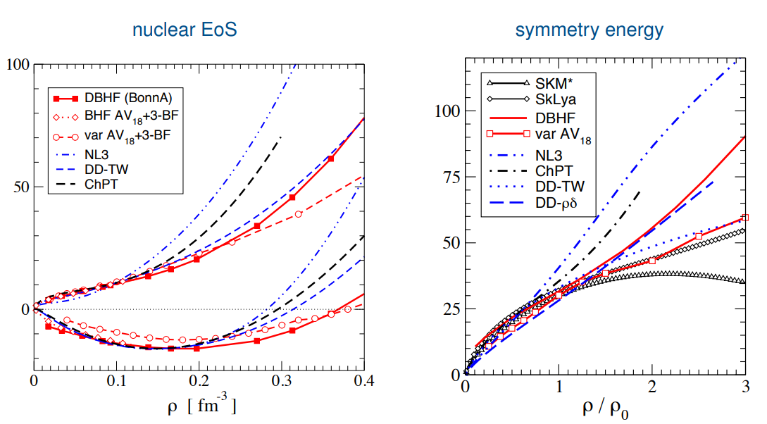
Nuclear Equation of state (EoS)
different models → different predictions
J. Wambach INTERNATIONAL SCHOOL OF NUCLEAR PHYSICS, Erice 2014

Slide 16
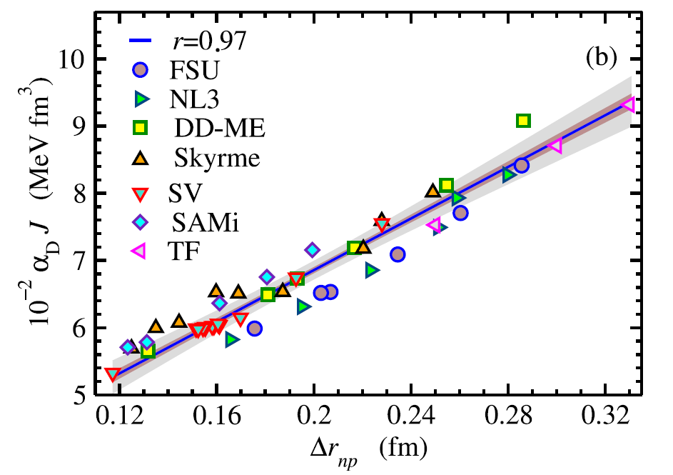
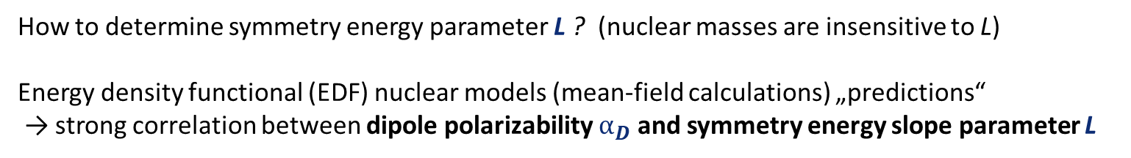

Symmetry energy parameters in EoS
How to determine symmetry energy parameter L ? (nuclear masses are insensitive to L)
Energy density functional (EDF) nuclear models (mean-field calculations) „predictions“
→ strong correlation between dipole polarizability $⍺_{D}$ and symmetry energy slope parameter L
²⁰⁸Pb
EDFs : set of microscopic models developed
for precise description of bulk properties
across the chart
$$⍺_{D}∼\int{\frac{{ σ}_{γ}^{abs, E1 }\left(\text{ω}\right)}{{\text{ω}}^{2}}d\text{ω} }$$

Slide 17
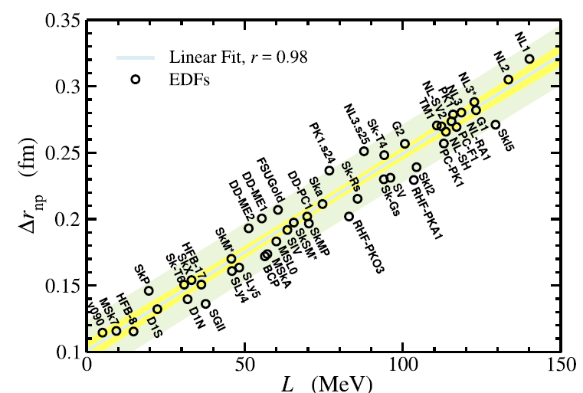
Symmetry energy parameters in EoS
… and strong correlation between neutron skin thickness ${∆r}_{np}$, and symmetry energy slope parameter L
²⁰⁸Pb
How to determine (measure)
neutron skin thickness?

Slide 18
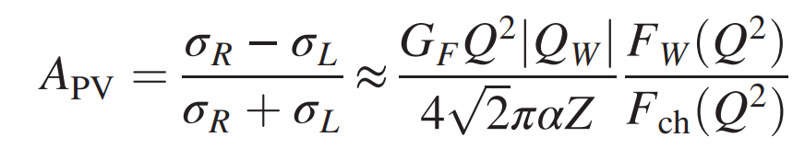
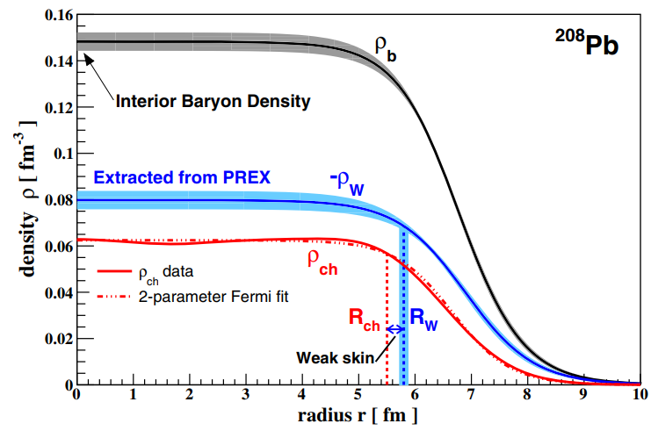

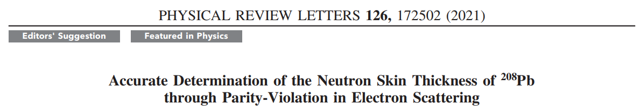
Pb Radius EXperiment and Ca Radius EXperiment @JLAB
goal: determination of neutron skin thickness with minimal model-dependence
electroweak parity violating measurements of elastic scattering of longitudinally polarized electrons from ²⁰⁸Pb (PREX) and ⁴⁸Ca(CREX)
weak coupling of proton to Z⁰ → sensitive to neutron distribution
→ neutral weak formfactor extraction from parity violation asymmetry
→ „neutron“ radius
≈ 10⁻⁷

Slide 19
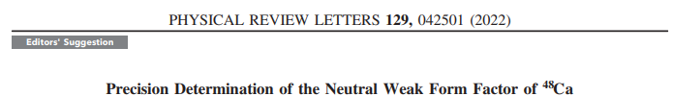

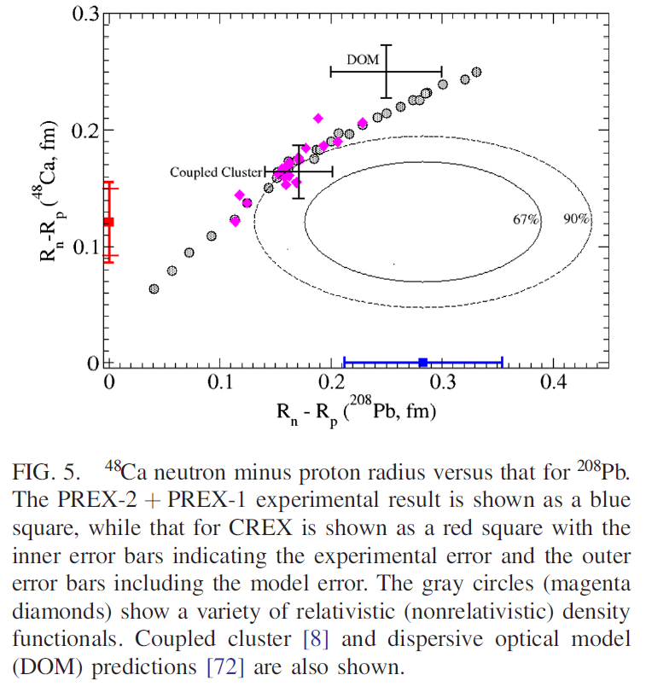
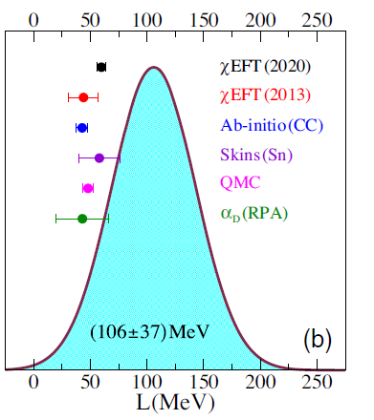
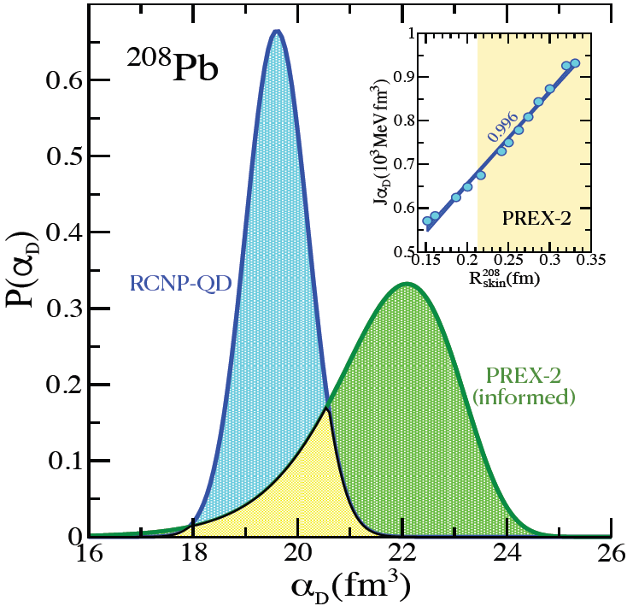
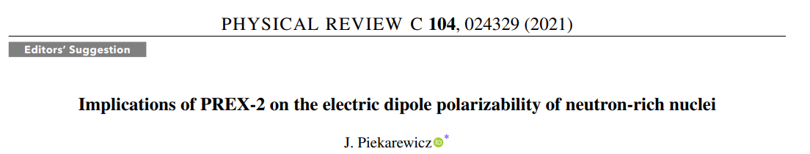
Pb Radius EXperiment and Ca Radius EXperiment @JLAB
“some tension” between nuclear models and PREX-II data…
CREX → smaller value of neutron skin in ⁴⁸Ca.
PREX-II data → stiff symmetry energy
dipole polarizability, ab-initio, EFT
→ more soft

Slide 20
Summary
laboratory experiments + theory useful for a determination of some fundamental nuclear properties
dipole polarizability, neutron skin thickness
→ constraints on parameters of EoS → neutron matter properties
nuclear dipole excitations unique determination of dipole polarizability
measuring of neutron skin → parity-violating electron scattering
linking neutron stars with properties of nuclei

