Slide 1
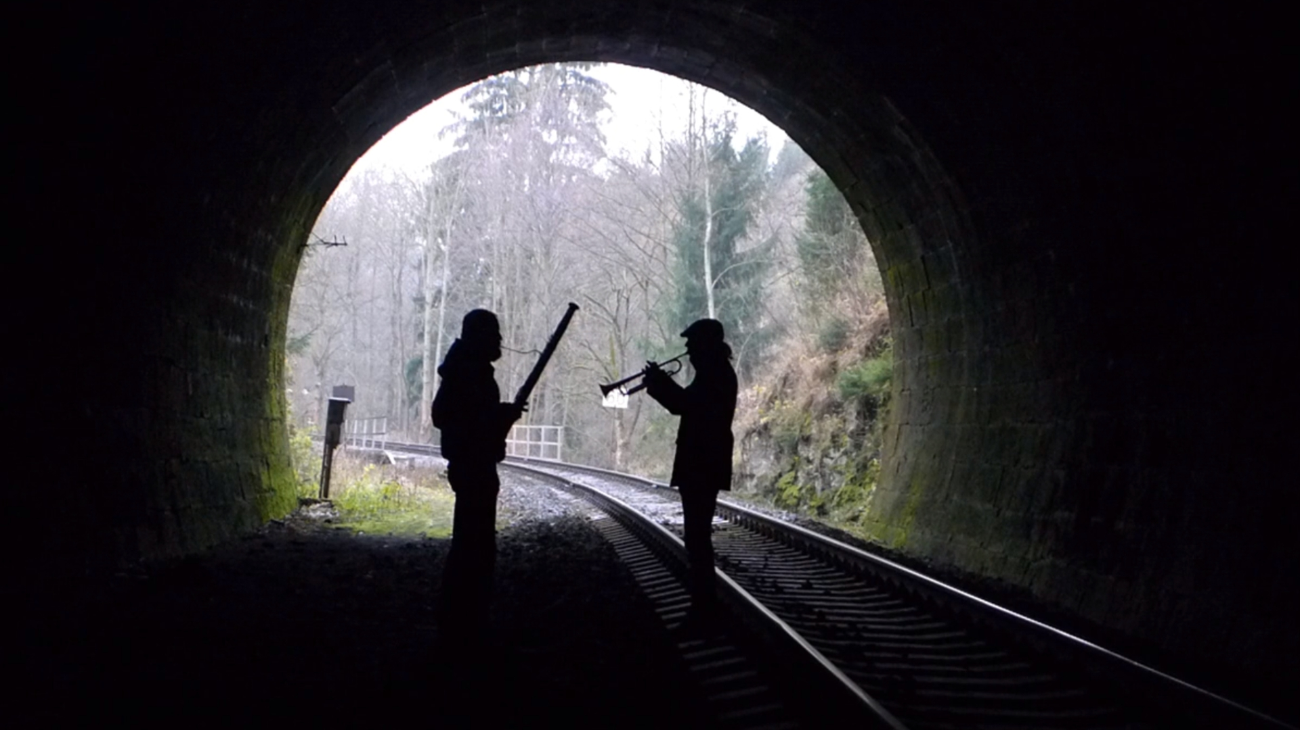
Complex time and Critical effects
in
Quantum tunnelling
Collaborators:
Pavel Cejnar (IPNP)
Milan Šindelka (IPP CAS)
Michal Kloc (IPNP, Uni Basel)
Pavel Stránský
Physical Review Letters 125, 020401 (2020)
Physical Review A (submitted 2021)
IPNP Seminar
Presentation available at http://pavelstransky.cz/publications/PavelStransky_IPNP2021.pptx
24 March 2021

Slide 2
Outline
Motivation
Theory
  Continuum level density
  Complex scaling method
  Complex time shift
  ESQPT-like singularities in the continuum LD
Numerical results
Summary and conclusions

Slide 3
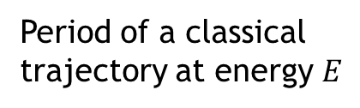
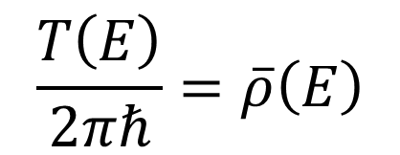

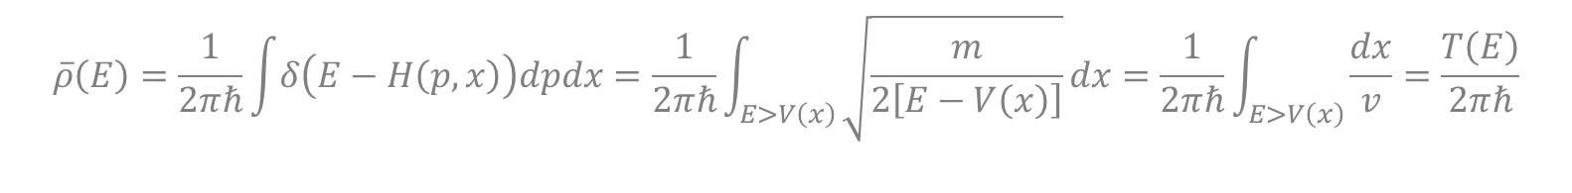
Motivation
A 1DoF bound system with discrete spectrum:
Period of a classical trajectory at energy $E$
$$\frac{T\left(E\right)}{2πℏ}=\overline{ρ}\left(E\right)$$
Smooth quantum level density
Weyl formula
$$\overline{ρ}\left(E\right)=\frac{1}{2πℏ}\int{δ\left(E−H\left(p,x\right)\right)dpdx}=\frac{1}{2πℏ}\int_{E>V\left(x\right)}{\sqrt{\frac{m}{2\left[E−V\left(x\right)\right]}}dx}=\frac{1}{2πℏ}\int_{E>V\left(x\right)}{\frac{dx}{v}}=\frac{T\left(E\right)}{2πℏ}$$
Proof:
$$H=\frac{p^{2}}{2m}+V\left(x\right)$$

Slide 4
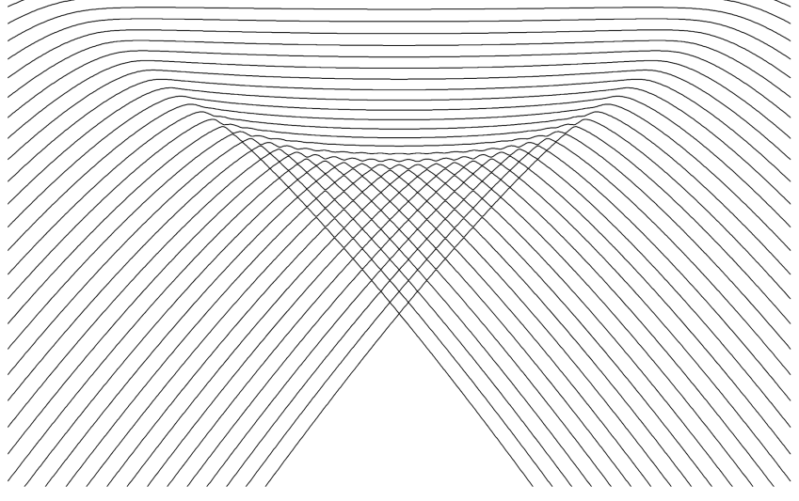
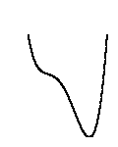
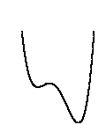
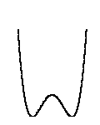
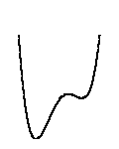
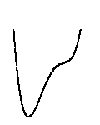



Motivation
A 1DoF bound system with discrete spectrum:
Period of a classical trajectory at energy $E$
$$\frac{T\left(E\right)}{2πℏ}=\overline{ρ}\left(E\right)$$
Smooth quantum level density
Example: CUSP system $V_{λ}(x)=x^{4}−x^{2}+λx$
Quantum level dynamics
$$E$$
λ
Quantum Phase Transition
$$V(x)$$
$$x$$

Slide 5
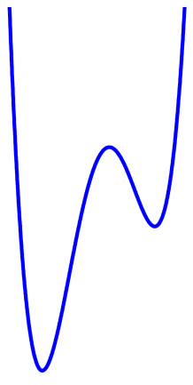
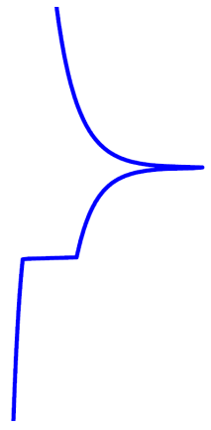




Motivation
A 1DoF bound system with discrete spectrum:
Period of a classical trajectory at energy $E$
$$\frac{T\left(E\right)}{2πℏ}=\overline{ρ}\left(E\right)$$
Smooth quantum level density
Example: CUSP system $V_{λ}(x)=x^{4}−x^{2}+λx$
Potential
Quantum level dynamics
$$E$$
$r=1 →$ log divergence
$r=0 →$ jump up
$$x$$
$$\overline{ρ}$$
λ
Critical phenomena
Quantum Phase Transition
Excited-state quantum phase transitions (ESQPT)
$$V(x)$$
P. Cejnar, P. Stránský, M. Macek, M. Kloc, J. Phys. A: Math. Theor. 54, 133001 (2021)
$$x$$

Slide 6





Motivation
A 1DoF bound system with discrete spectrum:
Period of a classical trajectory at energy $E$
$$\frac{T\left(E\right)}{2πℏ}=\overline{ρ}\left(E\right)$$
Smooth quantum level density
To what extent is this formula valid for “continuum states” (resonances) in unbound systems?
$$E$$
$$ψ\left(x\right)=e^{+\frac{ipx}{ℏ}}+α\left(E\right)e^{−\frac{ipx}{ℏ}}$$
$$ψ\left(x\right)=β\left(E\right)e^{+\frac{ipx}{ℏ}}$$
$$V(x)$$
Multibarrier tunnelling potential
$$x$$

Slide 7
Theory

Slide 8
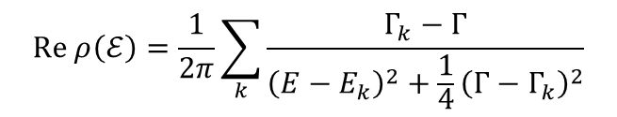
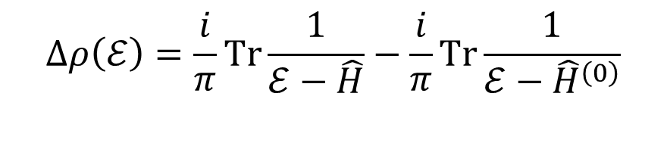
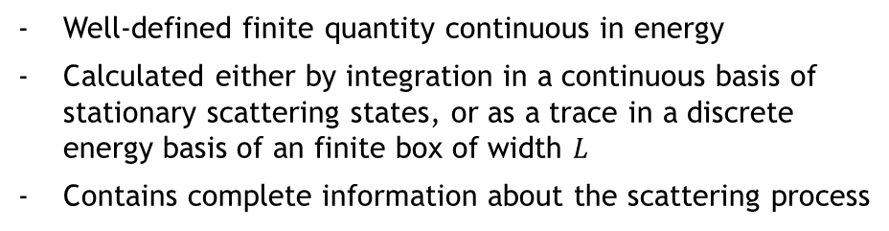


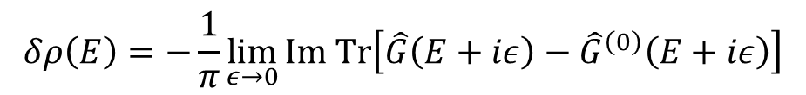

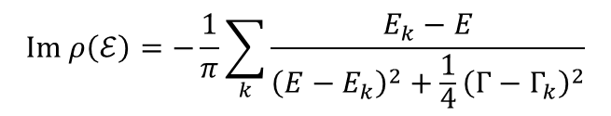
Level density
Green operator
$$ρ\left(E\right)=\sum_{k}{δ\left(E−E_{k}\right)}=\lim_{ε→0+}\sum_{k}{\frac{1}{π}\frac{ε}{{\left(E−E_{k}\right)}^{2}+ε^{2}}}=−\frac{1}{π}\lim_{ε→0+}{Im Tr }\hat{G}\left(E+iε\right)$$
Continuum level density
Well-defined finite quantity continuous in energy
Calculated either by integration in a continuous basis of stationary scattering states, or as a trace in a discrete energy basis of an finite box of width $L$
Contains complete information about the scattering process
$$δρ\left(E\right)=−\frac{1}{π}\lim_{ε→0}{Im Tr\left[\hat{G}\left(E+iε\right)−{\hat{G}}^{\left(0\right)}\left(E+iε\right)\right]}$$
System with interaction
Free particle
A.T. Kruppa, Phys. Lett. B 431, 237 (1998)
A.T. Kruppa, K. Arai, Phys. Rev. A 59, 3556 (1999)
Complex extension
$$ℰ=E−\frac{i}{2}Γ$$
$$Re ρ\left(ℰ\right)=\frac{1}{2π}\sum_{k}{\frac{Γ_{k}−Γ}{{\left(E−E_{k}\right)}^{2}+\frac{1}{4}{\left(Γ−Γ_{k}\right)}^{2}}}$$
$$Δρ\left(ℰ\right)=\frac{i}{π}Tr\frac{1}{ℰ−\hat{H}}−\frac{i}{π}Tr\frac{1}{ℰ−{\hat{H}}^{\left(0\right)}}$$
2D dipole structure
$$Im ρ\left(ℰ\right)=−\frac{1}{π}\sum_{k}{\frac{E_{k}−E}{{\left(E−E_{k}\right)}^{2}+\frac{1}{4}{\left(Γ−Γ_{k}\right)}^{2}}}$$
$$ρ\left(ℰ\right)$$
$$ρ^{\left(0\right)}\left(ℰ\right)$$
Some of the states can be interpreted as resonances.

Slide 9






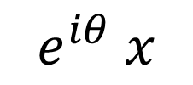

Complex scaling method
N. Moiseyev, Phys. Rep. 302, 211 (1998)
Rotation of the real coordinate into the complex plane
Similarity nonunitary transformation
$${\hat{S}}_{θ}=e^{i\frac{θ}{2}} e^{−θ \frac{\hat{x}\hat{p}}{ℏ}}$$
$$x$$
$$e^{iθ} x$$
$$0≤θ<\frac{π}{4}$$
$${\hat{S}}_{θ}\hat{x}{\hat{S}}_{θ}^{−1}=e^{iθ}\hat{x}$$
$${\hat{S}}_{θ}\hat{p}{\hat{S}}_{θ}^{−1}=e^{iθ}\hat{p}$$
… reveals all the resonances living in the sector $2E\tan{2θ}≥Γ$, while the rest of the resonances stay hidden in the rotated continuum
$${\hat{S}}_{θ}\hat{H}{\hat{S}}_{θ}^{−1}=e^{−2iθ}\frac{\hat{p}}{2m}+V\left(e^{iθ} \hat{x}\right)$$
Example: Gaussian barrier
$$V\left(x\right)=e^{−x^{2}}$$
Bounded in an infinite potential well of width $L→∞$

Slide 10
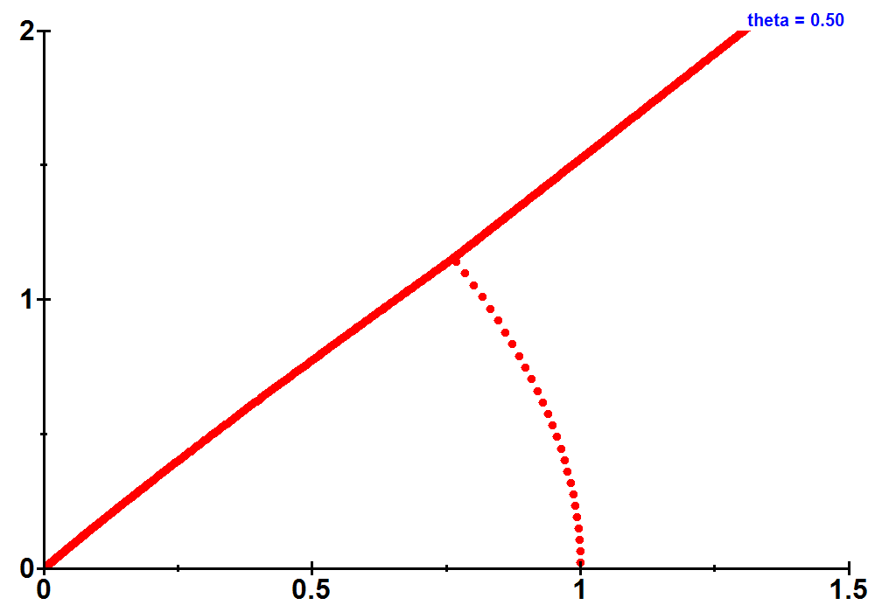
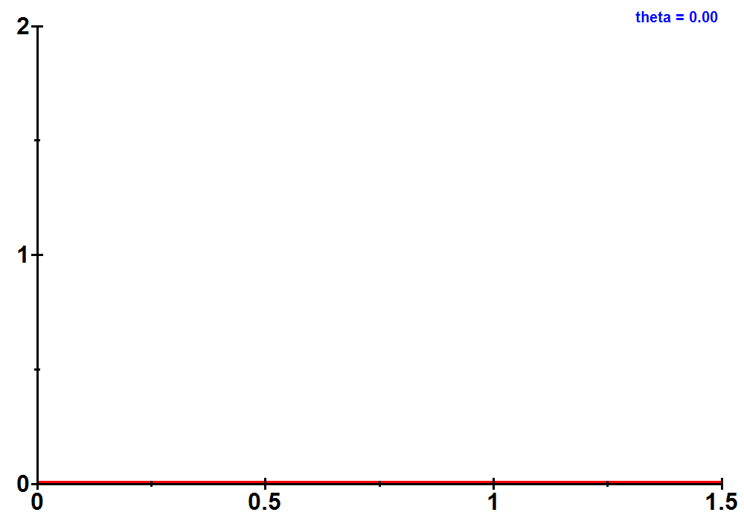


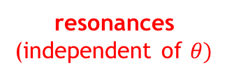
Complex scaling method
N. Moiseyev, Phys. Rep. 302, 211 (1998)
Rotation of the real coordinate into the complex plane
Similarity nonunitary transformation
$${\hat{S}}_{θ}=e^{i\frac{θ}{2}} e^{−θ \frac{\hat{x}\hat{p}}{ℏ}}$$
$$x$$
$$e^{iθ} x$$
$$0≤θ<\frac{π}{4}$$
$${\hat{S}}_{θ}\hat{x}{\hat{S}}_{θ}^{−1}=e^{iθ}\hat{x}$$
$${\hat{S}}_{θ}\hat{p}{\hat{S}}_{θ}^{−1}=e^{iθ}\hat{p}$$
… reveals all the resonances living in the sector $2E\tan{2θ}≥Γ$, while the rest of the resonances stay hidden in the rotated continuum
$${\hat{S}}_{θ}\hat{H}{\hat{S}}_{θ}^{−1}=e^{−2iθ}\frac{\hat{p}}{2m}+V\left(e^{iθ} \hat{x}\right)$$
Example: Gaussian barrier
rotated continuum
$$V\left(x\right)=e^{−x^{2}}$$
$$Γ$$
resonances
(independent of $θ)$
Bounded in an infinite potential well of width $L→∞$
$$E$$

Slide 11
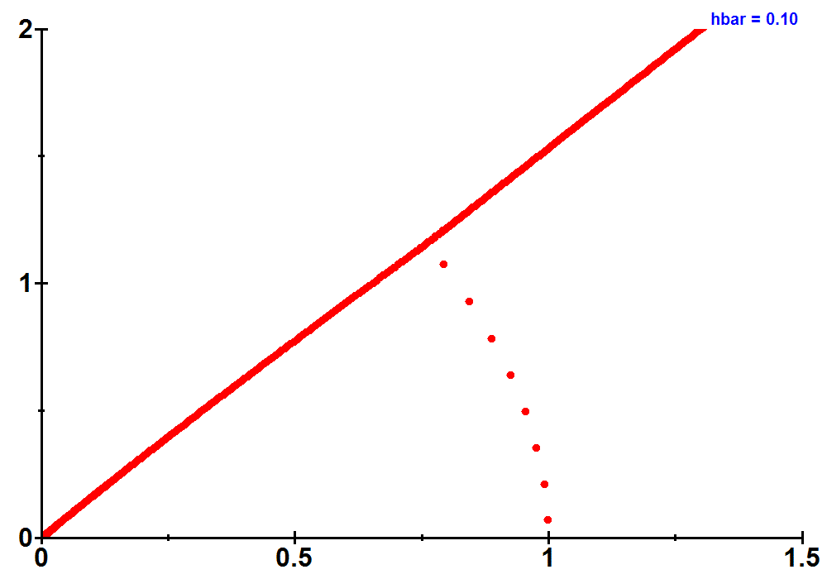
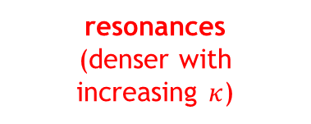

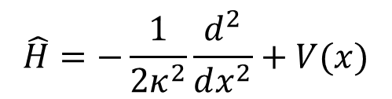
System size and semiclassical limit
$$\hat{H}=−\frac{1}{2κ^{2}}\frac{d^{2}}{dx^{2}}+V(x)$$
$κ^{2}≡\frac{m}{ℏ^{2}}$ - size parameter
Semiclassical limit approached when $κ→∞.$
Example: Gaussian barrier
$$V\left(x\right)=e^{−x^{2}}$$
$$Γ$$
resonances
(denser with increasing $κ$)
Bounded in an infinite potential well of width $L→∞$
$$E$$

Slide 12
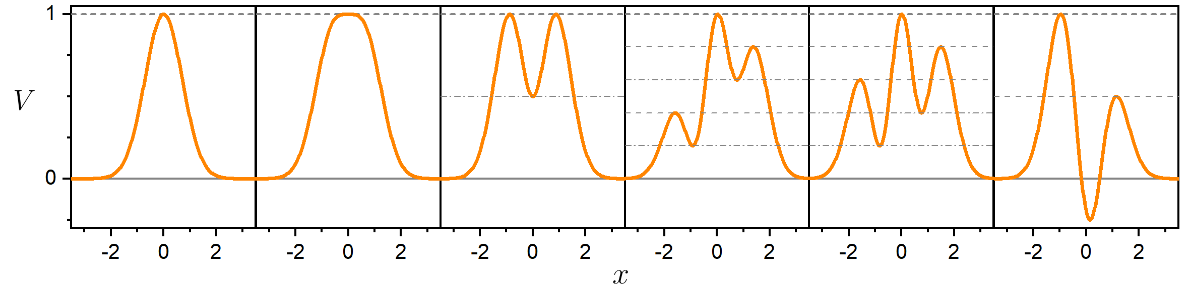
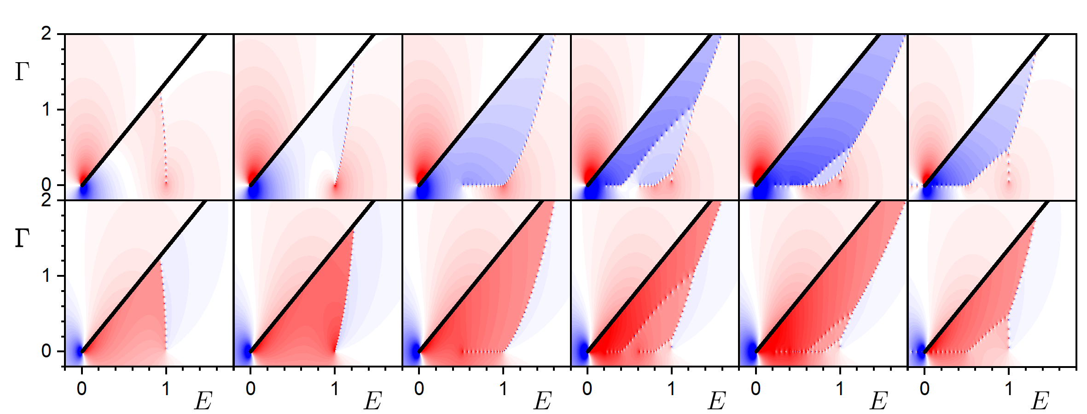
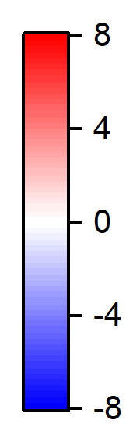




Results
Gauss
Supergauss
Symmetric
Bound states
$$πℏ Re Δρ(ℰ)$$
$$θ=0.3$$
$$ℏ=0.03$$
$$πℏ Im Δρ(ℰ)$$
$$𝓔=E+i0$$

Slide 13




But why should be the level density so interesting?
$$ψ\left(x\right)=e^{+\frac{ipx}{ℏ}}+α\left(E\right)e^{−\frac{ipx}{ℏ}}$$
$$ψ\left(x\right)=β\left(E\right)e^{+\frac{ipx}{ℏ}}$$
$$V(x)$$
$$=\left|β\left(E\right)\right|e^{+\frac{ipx}{ℏ}+iφ\left(E\right)}$$
… It contains complete information about the behaviour of the transmitted wave.

Slide 14

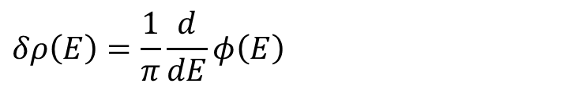



Continuum phase shift
$$φ=Re Φ$$
$$V$$
$$δρ\left(E\right)=\frac{1}{π}\frac{d}{dE}φ\left(E\right)$$
R.D. Levin, Quantum Mechanics of Molecular Rate Processes (Clarendon Press, Oxford, 1969)
N. Moiseyev, Non-Hermitian Quantum Mechanics (Cambridge University Press, Cambridge UK, 2011)
$$x$$
Complex extension
$$Δρ\left(E\right)=\frac{1}{π}\frac{d}{dE}Φ\left(E\right)=\frac{1}{π}\frac{d}{dE}φ\left(E\right)−\frac{i}{π}\frac{d}{dE}\ln\left|β\left(E\right)\right|$$
$$\ln{β=Im Φ}$$
Transmission probability and phase shift can be obtained by integrating the complex continuum level density.

Slide 15
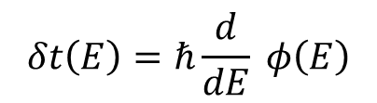
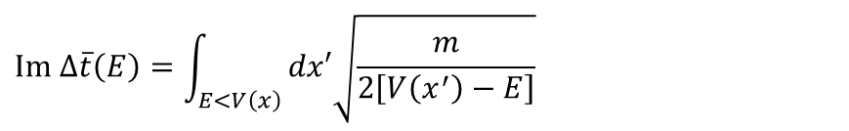
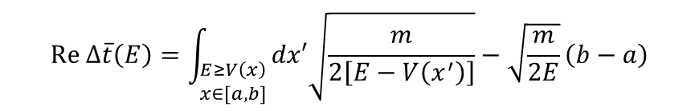
Eisenbud-Wigner Time shift
- the simplest definition of time delay of the transmitted particle during quantum tunnelling.
$$δt\left(E\right)=ℏ\frac{d}{dE} φ\left(E\right)$$
E.P. Wigner, Phys. Rev. 98, 145 (1955)
D. McLaughlin, J. Math. Phys. 13, 1099 (1972)
Complex extension
$$Δt\left(E\right)=ℏ\frac{d}{dE} Φ\left(E\right)=πℏ δρ\left(E\right)=δt\left(E\right)−i\frac{ℏ}{2}\frac{d}{dE}{\left|\ln{β\left(E\right)}\right|}^{2}$$
Semiclassical WKB approximation
$$Re Δ\overline{t}\left(E\right)=\int_{\begin{aligned}E≥V\left(x\right) \\ x∈[a,b]\end{aligned}}{dx′\sqrt{\frac{m}{2\left[E−V\left(x^{′}\right)\right]}}}−\sqrt{\frac{m}{2E}}\left(b−a\right)$$
Periods of trajectories in the allowed / forbidden regions
$$Im Δ\overline{t}\left(E\right)=\int_{E<V\left(x\right)}{dx′\sqrt{\frac{m}{2\left[V\left(x^{′}\right)−E\right]}}}$$
- solution of the classical equations of motion inside the potential barrier (instanton-like approach to the tunnelling problem)
S. Coleman, Phys. Rev. D 15, 2929 (1977)

Slide 16




Eisenbud-Wigner Time shift
Complex classical dynamics
$$X=X_{R}+iX_{I}$$
$$P=P_{R}+iP_{I}$$
$$T=T_{R}+iT_{I}$$
- the simplest definition of time delay of the transmitted particle during quantum tunnelling.
$$δt\left(E\right)=ℏ\frac{d}{dE} φ\left(E\right)$$
E.P. Wigner, Phys. Rev. 98, 145 (1955)
D. McLaughlin, J. Math. Phys. 13, 1099 (1972)
Dynamics given by a solution of complex Hamilton equations of motion
Complex extension
An orbit parametrised by $s∈ℝ$
$$Δt\left(E\right)=ℏ\frac{d}{dE} Φ\left(E\right)=πℏ δρ\left(E\right)=δt\left(E\right)−i\frac{ℏ}{2}\frac{d}{dE}{\left|\ln{β\left(E\right)}\right|}^{2}$$
No unique prescription for $T\left(s\right),X\left(s\right),P\left(s\right)∈ℂ$
$$T_{I}$$
?
Semiclassical WKB approximation
$$Re Δ\overline{t}\left(E\right)=\int_{\begin{aligned}E≥V\left(x\right) \\ x∈[a,b]\end{aligned}}{dx′\sqrt{\frac{m}{2\left[E−V\left(x^{′}\right)\right]}}}−\sqrt{\frac{m}{2E}}\left(b−a\right)$$
Periods of trajectories in the allowed / forbidden regions
$$Im Δ\overline{t}\left(E\right)=\int_{E<V\left(x\right)}{dx′\sqrt{\frac{m}{2\left[V\left(x^{′}\right)−E\right]}}}$$
- solution of the classical equations of motion inside the potential barrier (instanton-like approach to the tunnelling problem)
$$T_{R}$$
S. Coleman, Phys. Rev. D 15, 2929 (1977)

Slide 17

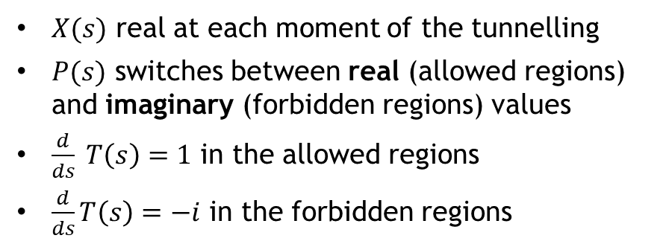


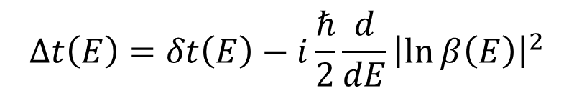


Complex time shift
$$Δt\left(E\right)=δt\left(E\right)−i\frac{ℏ}{2}\frac{d}{dE}{\left|\ln{β\left(E\right)}\right|}^{2}$$
$X(s)$ real at each moment of the tunnelling
$P(s)$ switches between real (allowed regions) and imaginary (forbidden regions) values
$\frac{d}{ds} T\left(s\right)=1$ in the allowed regions
$\frac{d}{ds}T\left(s\right)=−i$ in the forbidden regions
J. Le Deunff, A. Mouchet, Phys. Rev. E 81, 046205 (2010)
$$T_{I}$$
$$E$$
real motion
$$T_{R}$$
tunnelling
$$V(x)$$
$$x, s$$

Slide 18
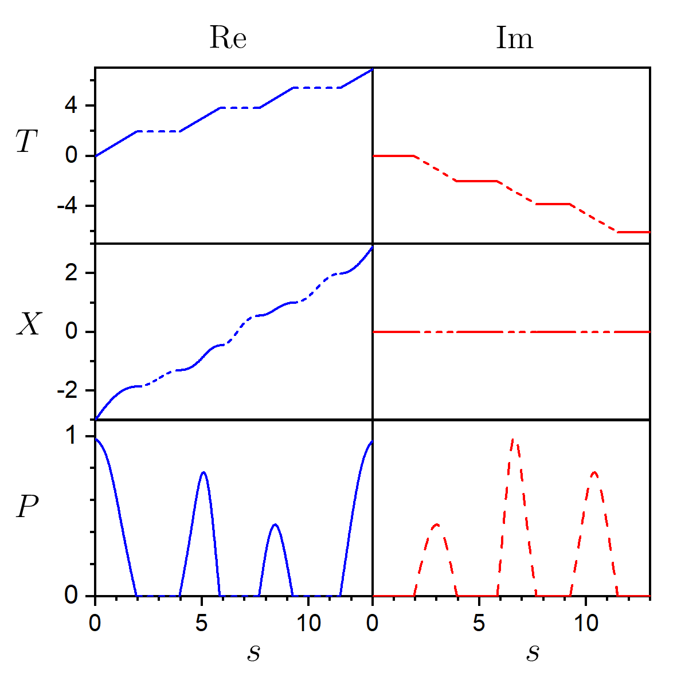
Complex time shift
$$Δt\left(E\right)=δt\left(E\right)−i\frac{ℏ}{2}\frac{d}{dE}{\left|\ln{β\left(E\right)}\right|}^{2}$$
$X(s)$ real at each moment of the tunnelling
$P(s)$ switches between real (allowed regions) and imaginary (forbidden regions) values
$\frac{d}{ds} T\left(s\right)=1$ in the allowed regions
$\frac{d}{ds}T\left(s\right)=−i$ in the forbidden regions
J. Le Deunff, A. Mouchet, Phys. Rev. E 81, 046205 (2010)
$$E$$
$$V(x)$$
$$x, s$$
…And what happens at energies of the stationary points?

Slide 19




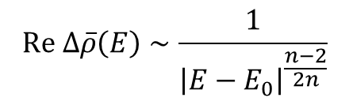
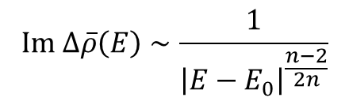
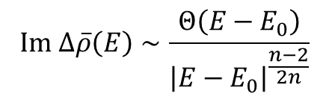

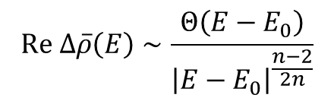


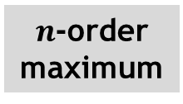

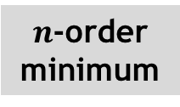

ESQPT-type singularities
- Calculated via a local expansion around a stationary point of the potential $V\left(x_{0}\right)=E_{0}$
logarithmic divergence
Nondegenerate stationary points
Quadratic minimum
jump up
$$Im Δ\overline{ρ}\left(E\right)∼−\ln\left|E−E_{0}\right|$$
$$Re Δ\overline{ρ}\left(E\right)∼Θ\left(E−E_{0}\right)$$
$$E_{0}$$
$$E$$
$$E_{0}$$
$$E$$
logarithmic divergence
Quadratic maximum
jump down
$$Re Δ\overline{ρ}\left(E\right)∼−\ln\left|E−E_{0}\right|$$
$$Im Δ\overline{ρ}\left(E\right)∼−Θ\left(E−E_{0}\right)$$
$$E_{0}$$
$$E$$
$$E_{0}$$
$$E$$
Degenerate stationary points
$n$-order minimum
$$Re Δ\overline{ρ}\left(E\right)∼\frac{Θ\left(E−E_{0}\right)}{{\left|E−E_{0}\right|}^{\frac{n−2}{2n}}}$$
$$Im Δ\overline{ρ}\left(E\right)∼\frac{1}{{\left|E−E_{0}\right|}^{\frac{n−2}{2n}}}$$
$$E_{0}$$
$$E$$
$$E_{0}$$
$$E$$
$n$-order maximum
$$Re Δ\overline{ρ}\left(E\right)∼\frac{1}{{\left|E−E_{0}\right|}^{\frac{n−2}{2n}}}$$
$$Im Δ\overline{ρ}\left(E\right)∼\frac{Θ\left(E−E_{0}\right)}{{\left|E−E_{0}\right|}^{\frac{n−2}{2n}}}$$
$$E_{0}$$
$$E$$
$$E_{0}$$
$$E$$

Slide 20
Gauss
Supergauss
Symmetric
With bound states

Slide 21






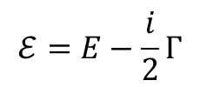
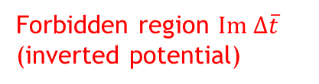



Quantum resonances
Summary
$$ℰ=E−\frac{i}{2}Γ$$
$$Re Δρ\left(ℰ\right)$$
$$Γ$$
Tunnelling 1D system
Complex phase shift
Complex scaling
Phase shift $φ$
$$Im Δρ\left(ℰ\right)$$
Transmission probability $β$
Complex level density
$$Γ$$
Smoothening (semiclassical limit)
$$E$$
Classical orbits
Allowed region $Re Δ\overline{t}$
ESQPT-like analysis of critical effects
Forbidden region $Im Δ\overline{t}$ (inverted potential)
Complex tunnelling time
$$E$$

Slide 22
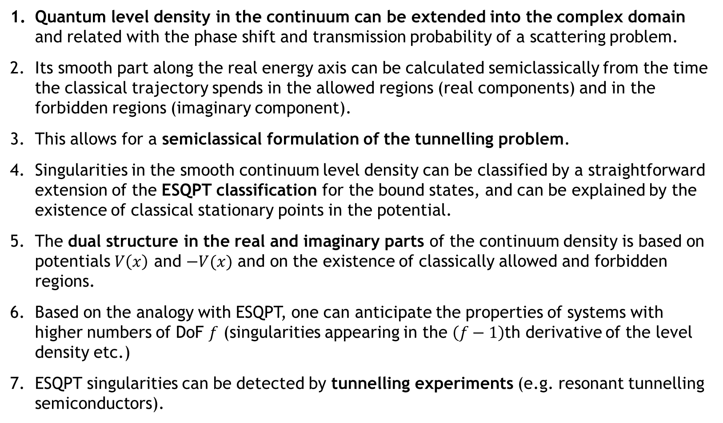
Conclusions
Quantum level density in the continuum can be extended into the complex domain and related with the phase shift and transmission probability of a scattering problem.
Its smooth part along the real energy axis can be calculated semiclassically from the time the classical trajectory spends in the allowed regions (real components) and in the forbidden regions (imaginary component).
This allows for a semiclassical formulation of the tunnelling problem.
Singularities in the smooth continuum level density can be classified by a straightforward extension of the ESQPT classification for the bound states, and can be explained by the existence of classical stationary points in the potential.
The dual structure in the real and imaginary parts of the continuum density is based on potentials $V\left(x\right)$ and $−V(x)$ and on the existence of classically allowed and forbidden regions.
Based on the analogy with ESQPT, one can anticipate the properties of systems with higher numbers of DoF $f$ (singularities appearing in the $\left(f−1\right)$th derivative of the level density etc.)
ESQPT singularities can be detected by tunnelling experiments (e.g. resonant tunnelling semiconductors).

Slide 23
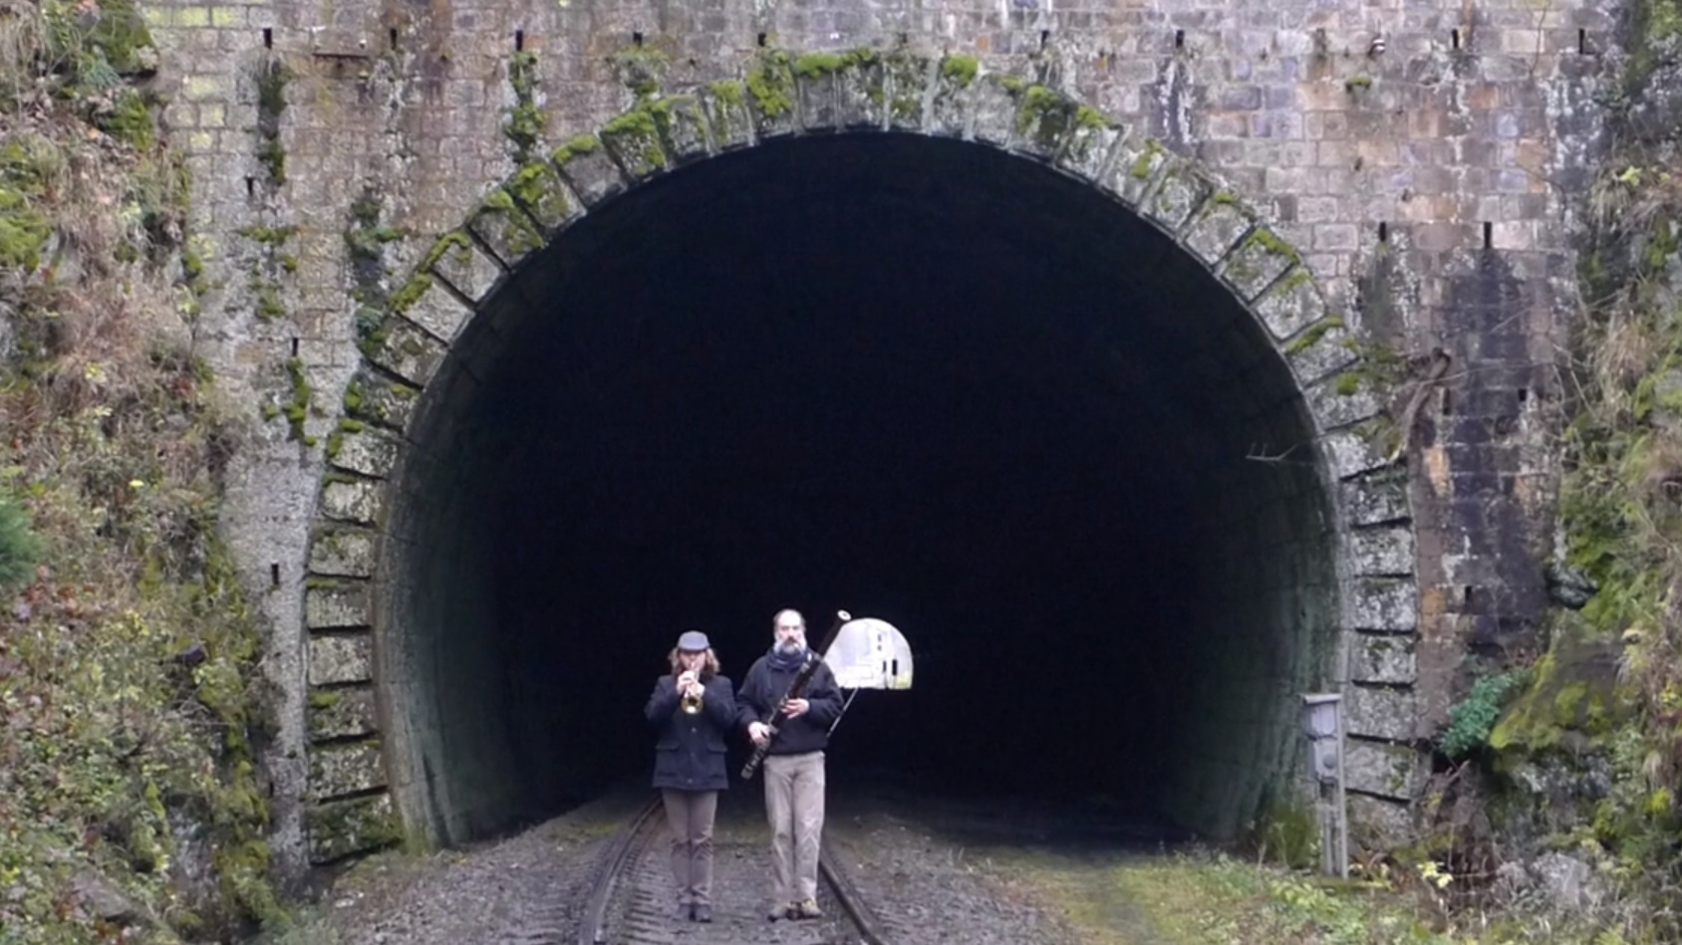
Thanks
for your attention
http://pavelstransky.cz/tunnel.mp4

