Slide 1
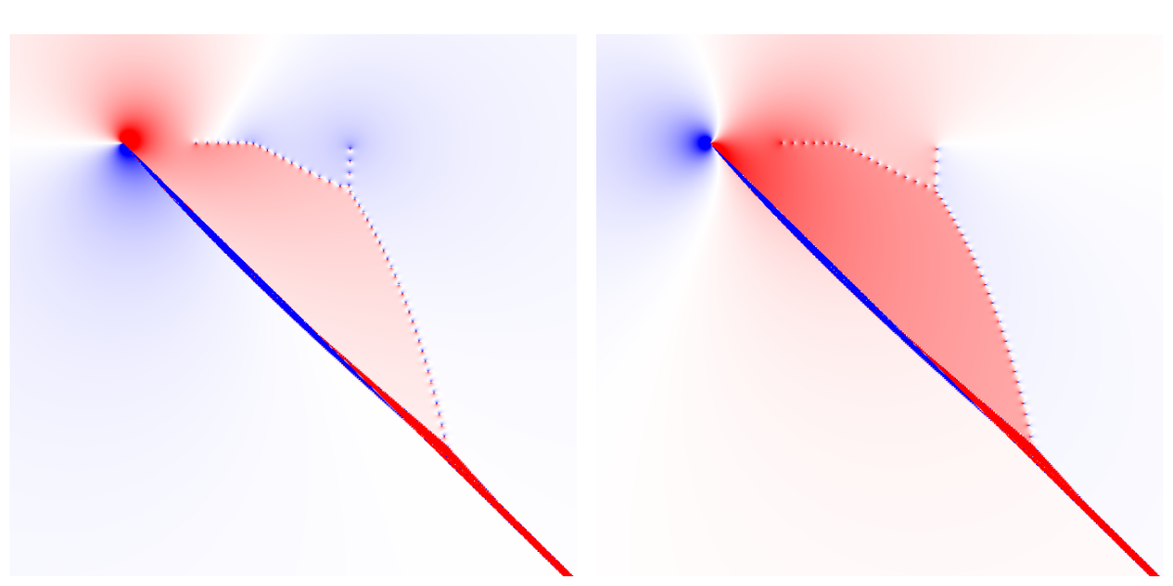
Complex density
of continuum states
Pavel Stránský
Published in:
Milan Šindelka (IPP CAS)
Michal Kloc (IPNP, Uni Basel)
Pavel Cejnar (IPNP)
Physical Review Letters 125, 020401 (2020)
UNCE Seminar
UNCE/SCI/013
3 December 2020

Slide 2
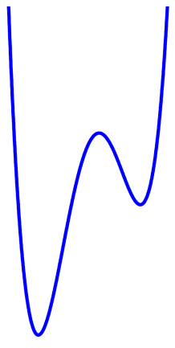
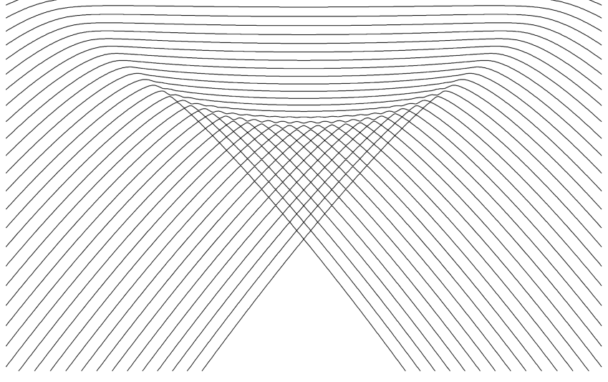
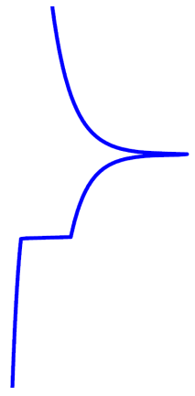
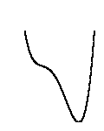
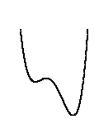
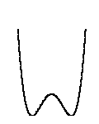
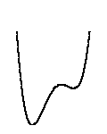
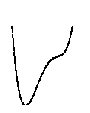



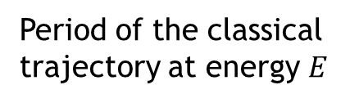

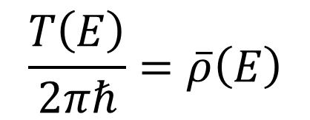
Motivation
- 1DoF bound system with discrete spectrum:
Period of the classical trajectory at energy $E$
$$\frac{T\left(E\right)}{2πℏ}=\overline{ρ}\left(E\right)$$
Smooth quantum level density
Example: CUSP system
Potential
Quantum level dynamics
E
$k=1 →$ log divergence
$k=0 →$ jump up
$$x$$
$$\overline{ρ}$$
λ
Excited-state quantum phase transitions
$$V(q)$$

Slide 3
Motivation
- 1DoF bound system with discrete spectrum:
Period of the classical trajectory at energy $E$
$$\frac{T\left(E\right)}{2πℏ}=\overline{ρ}\left(E\right)$$
Smooth quantum level density
Can this formula be extended to the density of “continuum states” (resonances)?

Slide 4
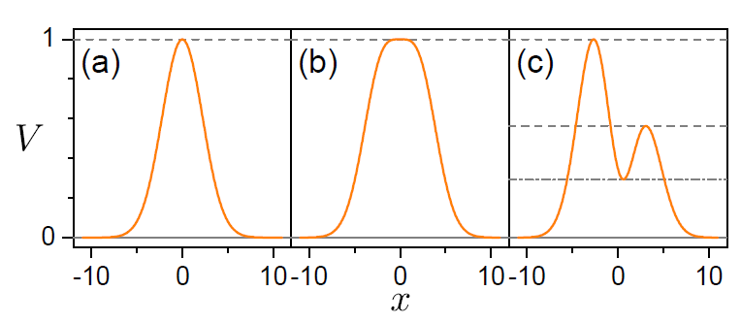

Model 1DoF Hamiltonians
Gaussian
Supergaussian
Double-barrier
Stationary points
$$V\left(x\right)=\left(A+Bx+Cx^{2}\right)e^{−ηx^{2}}$$

Slide 5
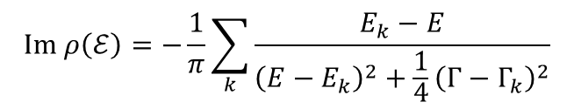
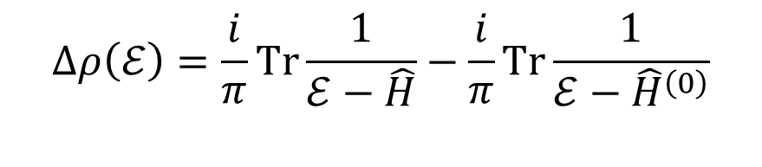
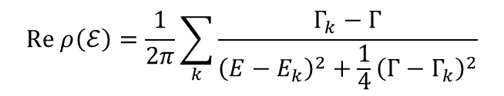
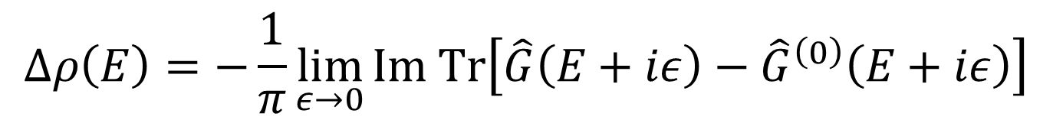


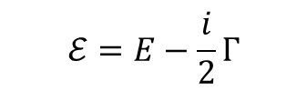
Continuum level density
Green operators
$$Δρ\left(E\right)=−\frac{1}{π}\lim_{ε→0}{Im Tr\left[\hat{G}\left(E+iε\right)−{\hat{G}}^{\left(0\right)}\left(E+iε\right)\right]}$$
System with interaction
Free particle
Complex extension
A.T. Kruppa, Phys. Lett. B 431, 237 (1998)
A.T. Kruppa, K. Arai, Phys. Rev. A 59, 3556 (1999)
$$Δρ\left(ℰ\right)=\frac{i}{π}Tr\frac{1}{ℰ−\hat{H}}−\frac{i}{π}Tr\frac{1}{ℰ−{\hat{H}}^{\left(0\right)}}$$
$$ℰ=E−\frac{i}{2}Γ$$
$$ρ\left(ℰ\right)$$
$$ρ^{\left(0\right)}\left(ℰ\right)$$
$$Re ρ\left(ℰ\right)=\frac{1}{2π}\sum_{k}{\frac{Γ_{k}−Γ}{{\left(E−E_{k}\right)}^{2}+\frac{1}{4}{\left(Γ−Γ_{k}\right)}^{2}}}$$
Dipole structure
$$Im ρ\left(ℰ\right)=−\frac{1}{π}\sum_{k}{\frac{E_{k}−E}{{\left(E−E_{k}\right)}^{2}+\frac{1}{4}{\left(Γ−Γ_{k}\right)}^{2}}}$$

Slide 6

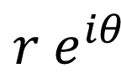


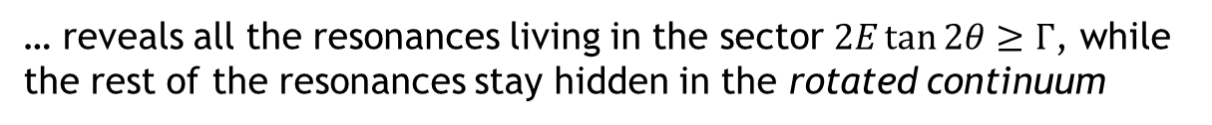

Complex scaling
N. Moiseyev, Phys. Rep. 302, 211 (1998)
Rotation of the real coordinate into the complex plane
$$x$$
$$r e^{iθ}$$
$$0≤θ<\frac{π}{4}$$
… reveals all the resonances living in the sector $2E\tan{2θ}≥Γ$, while the rest of the resonances stay hidden in the rotated continuum
Gaussian barrier
$$θ=\frac{1}{4}$$
$$θ=\frac{1}{2}$$
rotated continuum
resonances

Slide 7
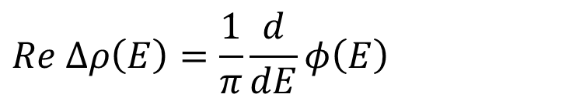
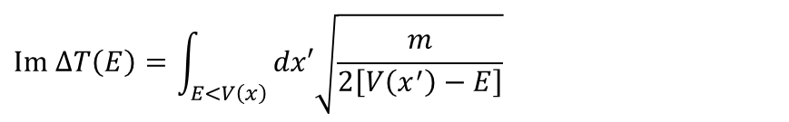
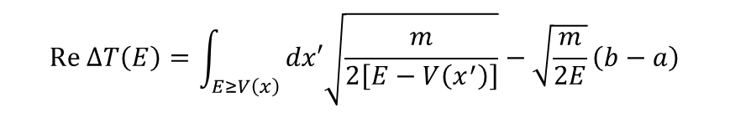
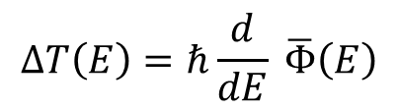
Continuum phase shift
$$Re Δρ\left(E\right)=\frac{1}{π}\frac{d}{dE}φ\left(E\right)$$
R.D. Levin, Quantum Mechanics of Molecular Rate Processes (Clarendon Press, Oxford, 1969)
N. Moiseyev, Non-Hermitian Quantum Mechanics (Cambridge University Press, Cambridge UK, 2011)
Complex extension
Transmission coefficient
$$Δρ\left(E\right)=\frac{1}{π}\frac{d}{dE}Φ\left(E\right)=\frac{1}{π}\frac{d}{dE}φ\left(E\right)−\frac{i}{π}\frac{d}{dE}ln⁡A(E)$$
Time shift
$$ΔT\left(E\right)=ℏ\frac{d}{dE} \overline{Φ}\left(E\right)$$
(complex extension of the Eisenbud-Wigner tunelling time)
E.P. Wigner, Phys. Rev. 98, 145 (1955)
D. McLaughlin, J. Math. Phys. 13, 1099 (1972)
$$Re ΔT\left(E\right)=\int_{E≥V\left(x\right)}{dx′\sqrt{\frac{m}{2\left[E−V\left(x^{′}\right)\right]}}}−\sqrt{\frac{m}{2E}}\left(b−a\right)$$
$$Im ΔT\left(E\right)=\int_{E<V\left(x\right)}{dx′\sqrt{\frac{m}{2\left[V\left(x^{′}\right)−E\right]}}}$$
Periods of trajectories in the allowed / forbidden regions

Slide 8
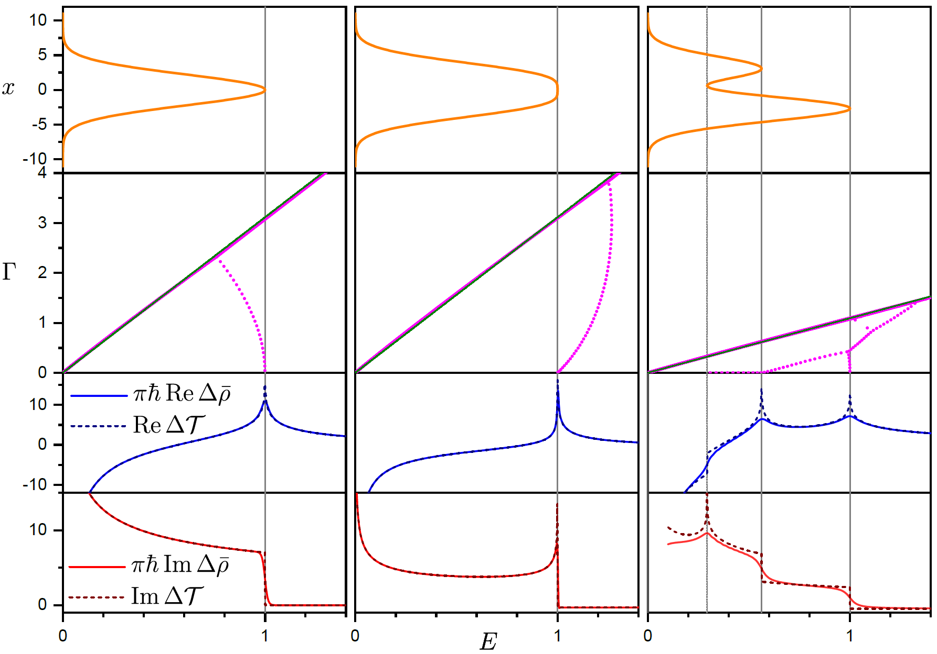
Results

Slide 9




Results
Perfect coincidence between the complex level density and the time shift:
$$Δ\overline{ρ}\left(E\right)=\frac{1}{πℏ}ΔT\left(E\right)$$

Slide 10
Conclusions
Quantum level density in the continuum can be extended into the complex domain and connected with complex time.
The smooth real part gives the time the particle spends in the classically allowed regions of the potential.
The smooth complex part gives the time the particle spends in the classically forbidden regions.
The singularities in the smooth level density induces by the ESQPTs are explained by the type of the stationary points of the Hamiltonian (real part) and inverted Hamiltonian (imaginary part).
Thanks for your attention

