Slide 1

OTOCs & CHaozzz
Pavel Stránský
www.pavelstransky.cz
Outline:
1. Classical chaos
2. Quantum chaos
3. OTOCs (Otočky)
4. Examples
Off-site meeting, IP NP, Little Rock
12th April 2019

Slide 2
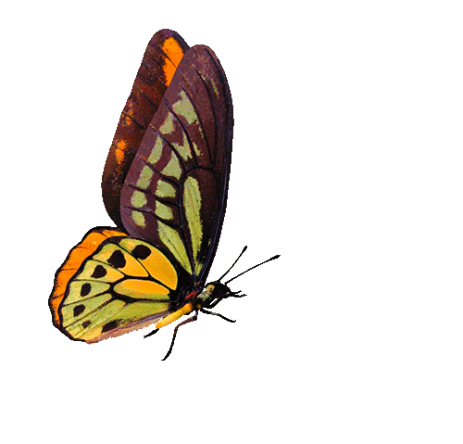

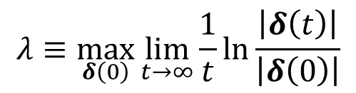



Classical chaos: Instability of trajectories
$$λ≡\max_{δ\left(0\right)}{\lim_{t→∞}\frac{1}{t}}\ln{\frac{\left|δ\left(t\right)\right|}{\left|δ\left(0\right)\right|}}$$
Quantified by the Lyapunov exponent
Stable (regular, quasiperiodic) trajectories
Unstable (chaotic) trajectories
$$δ(0)$$
$$δ(0)$$
$$\left|δ\left(t\right)\right|∝t^{α}$$
$$\left|δ\left(t\right)\right|∝e^{λt}$$
At most polynomial divergence
Exponential divergence
(of a bunch of neigbouring trajectories)

Slide 3
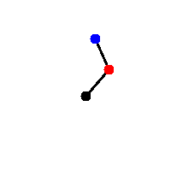
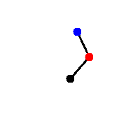
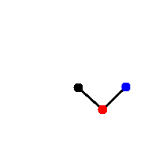




Classical chaos: Instability of trajectories
$$λ≡\max_{δ\left(0\right)}{\lim_{t→∞}\frac{1}{t}}\ln{\frac{\left|δ\left(t\right)\right|}{\left|δ\left(0\right)\right|}}$$
Quantified by the Lyapunov exponent
Stable (regular, quasiperiodic) trajectories
Unstable (chaotic) trajectories
Integrability
Hamiltonian:
$$H=H\left(q_{1},…,q_{f},p_{1},…,p_{f}\right)$$
Conservative system:
$$E=H=const.$$
$$δ(0)$$
$$δ(0)$$
$$\left|δ\left(t\right)\right|∝t^{α}$$
Integrals of motion:
$$I_{j}=I_{j}\left(q_{1},…,q_{f},p_{1},…p_{f}\right)=const.$$
$$\left|δ\left(t\right)\right|∝e^{λt}$$
(connected with additional symmetries)
At most polynomial divergence
$${\left\{I_{j},I_{k}\right\}}_{Poisson}=0$$
Exponential divergence
(of a bunch of neigbouring trajectories)
Number of independent integrals of motion
=
number of degrees of freedom
Integrable system:
All trajectories quasiperiodic

Slide 4
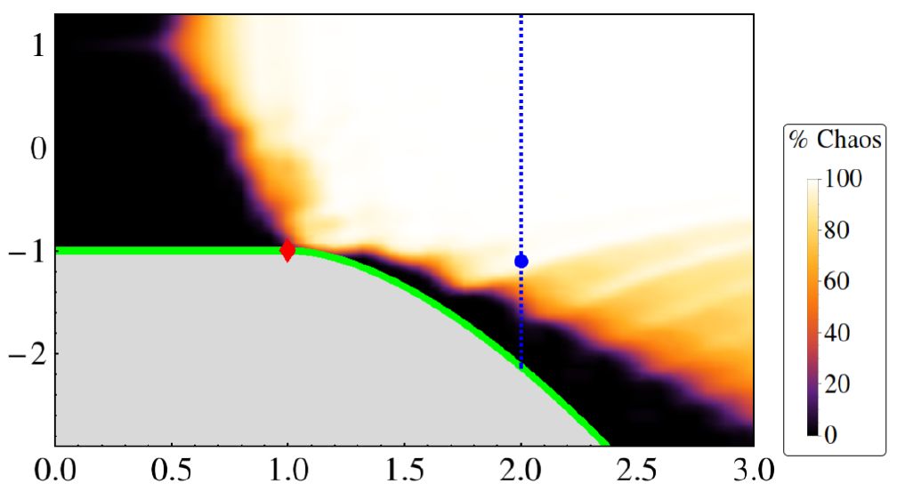

Map of chaos
(general behaviour in a low-dimensional classical system)
$$E$$
External parameter(s)

Slide 5

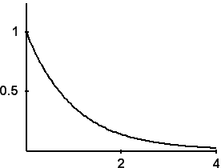
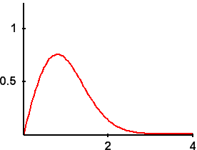
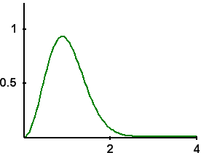
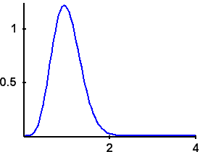





Quantum chaos: Correlations in spectra
Schrödinger equation is linear quantum suppression of chaos
No trajectories, no phase space
Energy spectra
$$E$$
INTEGRABLE system
CHAOTIC systems
Modeled by ensembles of Gaussian matrices
High interaction between levels
Spectral rigidity
Nearest-neigbour spacing distribution
Poisson
GOE
GUE
GSE
$$P(s)$$
$$∼e^{−s}$$
$$∼s^{α}e^{−s^{2}}$$
$$s$$

Slide 6
Any connection?

Slide 7


Out-of-Time Ordered Commutator
$$C\left(t\right)≡−\left\langle {\left[\hat{W}\left(t\right),\hat{V}\left(0\right)\right]}^{2}\right\rangle$$
1. A special choice $\hat{W}≡\hat{q}$, $\hat{V}≡\hat{p}$ leads, performing the classical limit, to
$${\left(\frac{1}{iℏ}\left[\hat{q}\left(t\right),\hat{p}\left(0\right)\right]\right)}^{2}→{\left\{q\left(t\right),p\left(0\right)\right\}}_{Poisson}=\frac{∂q\left(t\right)}{∂q\left(0\right)}∼e^{λt}$$
Exponential divergence of the OTOC in chaotic states expected.
A. Larkin, Y.N. Ovchinnikov, Quasiclassical method in the theory of superconductivity, J. Exp. Theor. Phys. 28, 1200 (1969)

Slide 8
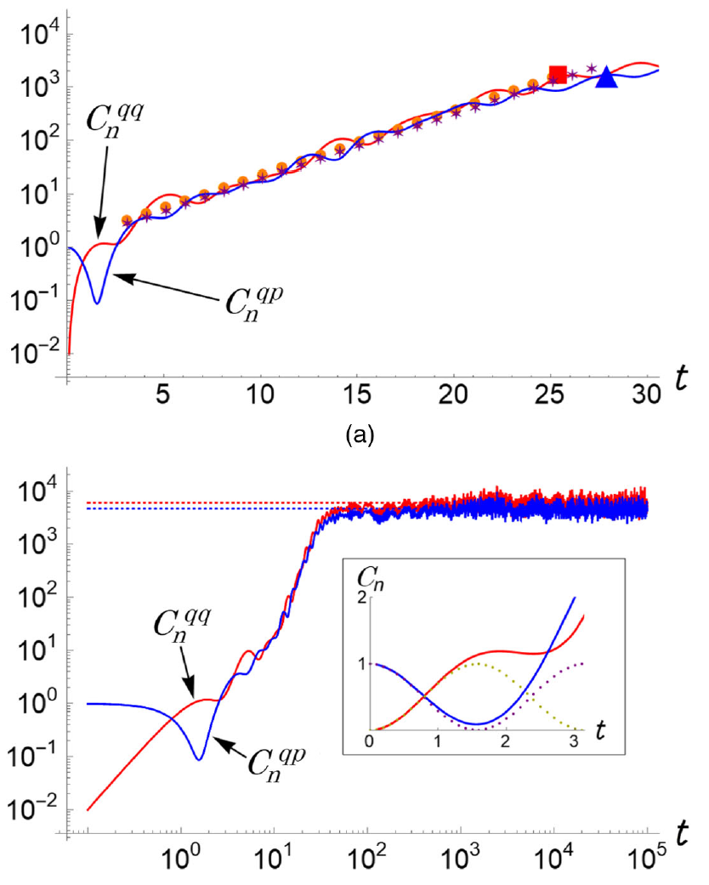
OTOC for chaotic states
Ehrenfest (scrambling) time
Exponential rise
Short-time universal behaviour
Dissipation (collision) time
Saturation

Slide 9
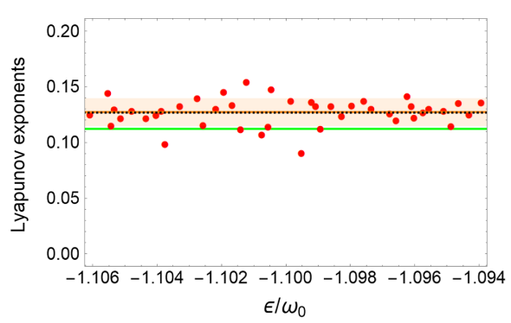
OTOC for chaotic states
Ehrenfest (scrambling) time
Exponential rise
Short-time universal behaviour
Dissipation (collision) time
Quantum Lyapunov exponent
Saturation

Slide 10
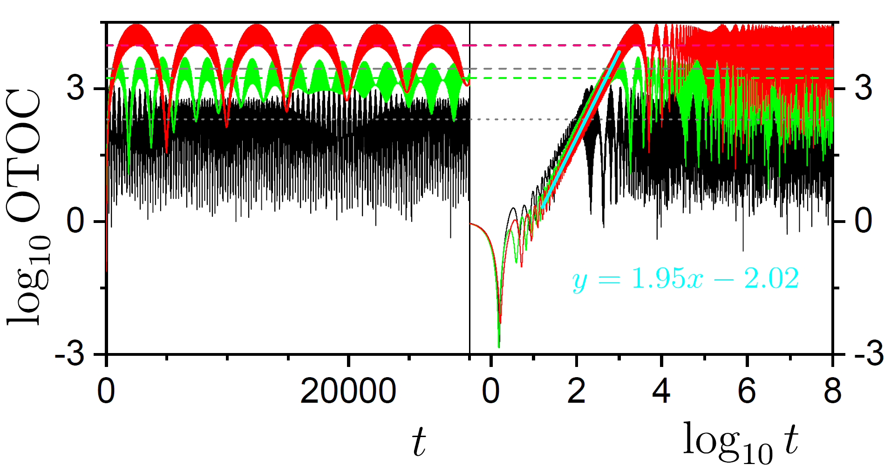
OTOC for regular states
Short-time universal behaviour
Strong recurrences
(no saturation / thermalization)
Polynomial rise

Slide 11
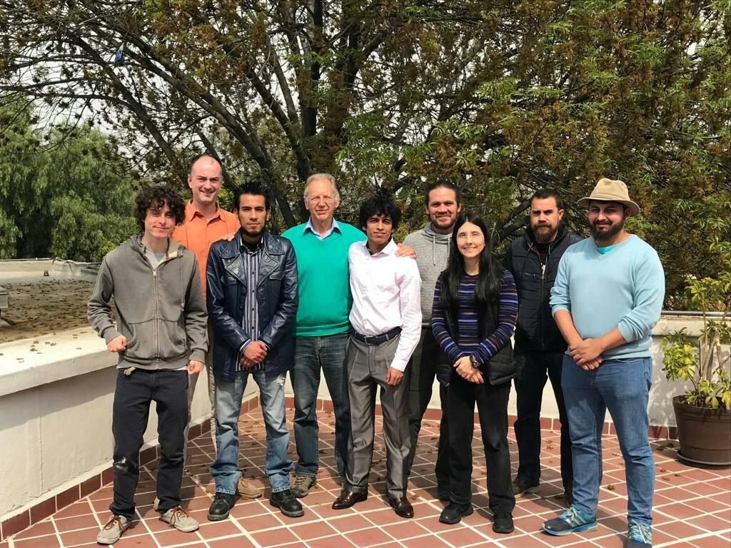
January 2019
J. Chávez-Carlos, B. López-del-Caprio, M.A. Bastarrachea-Magnani, P. Stránský, S. Lerma-Hernández, L.F. Santos, J. Hirsch
Quantum and classical Lyapunov exponents in atom-field interaction systems
Physical Review Letters 122, 024101 (2019)

Slide 12
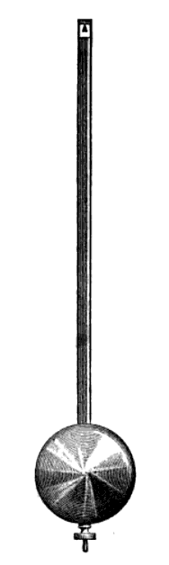
Isolated unstable trajectories
Pendulum
All trajectories periodic except for the separatrix
(having positive Lyapunov exponent)
Classical physics - impossible to prepare (measure) the unstable trajectory
Quantum physics – OTOC is sensitive to the unstable trajectory in a wider energy window!
E.B. Rozenbaum, L.A. Bunimovich, V. Galitski, Quantum chaos in classically non-chaotic systems, arXiv:1902.05466

Slide 13


Out-of-Time Ordered Commutator
$$C\left(t\right)≡−\left\langle {\left[\hat{W}\left(t\right),\hat{V}\left(0\right)\right]}^{2}\right\rangle$$
1. A special choice $\hat{W}≡\hat{q}$, $\hat{V}≡\hat{p}$ leads, performing the classical limit, to
$${\left(\frac{1}{iℏ}\left[\hat{q}\left(t\right),\hat{p}\left(0\right)\right]\right)}^{2}→{\left\{q\left(t\right),p\left(0\right)\right\}}_{Poisson}=\frac{∂q\left(t\right)}{∂q\left(0\right)}∼e^{λt}$$
Exponential divergence of the OTOC in chaotic states expected.
A. Larkin, Y.N. Ovchinnikov, Quasiclassical method in the theory of superconductivity, J. Exp. Theor. Phys. 28, 1200 (1969)
2. A special choice $\hat{W}≡e^{iφ\hat{G}}$, $\hat{V}≡\left|\left.ψ_{0}\right\rangle \left\langle ψ_{0}\right.\right|$ leads to the Fidelity OTOC
$$F\left(t\right)≡\frac{C\left(t\right)}{φ^{2}}=var \hat{G}(t)$$
Experimentally accessible
Easy to perform large-scale semiclassical calculations
R.J. Lewis-Swan, A. Safavi-Naini, J.J. Bollinger, A.M. Rey, Unifying scrambling, thermalization and entanglement through measurement of fidelity out-of-time-order correlators in the Dicke model, Nature Communications 10, 1581 (2019)

Slide 14
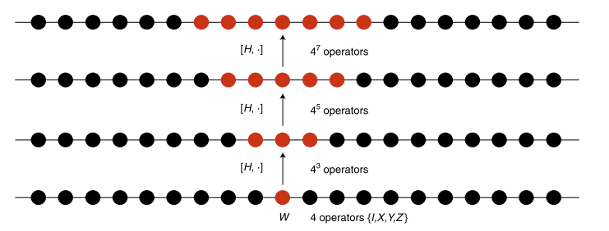




Out-of-Time Ordered Commutator
$$C\left(t\right)≡−\left\langle {\left[\hat{W}\left(t\right),\hat{V}\left(0\right)\right]}^{2}\right\rangle$$
Out-of-Time-Ordered Correlator
$$c\left(t\right)≡\left\langle {\hat{W}}^{+}\left(t\right){\hat{V}}^{+}\left(0\right)\hat{W}\left(t\right)\hat{V}\left(0\right)\right\rangle$$
Overlap between two vectors:
$$|\left.ψ_{1}\left(t\right)\right\rangle =\hat{W}\left(t\right)\hat{V}\left(0\right)\left.|ψ_{0}\right\rangle$$
$$|\left.ψ_{2}\left(t\right)\right\rangle =\hat{V}\left(0\right)\hat{W}\left(t\right)\left.|ψ_{0}\right\rangle$$
$$W\left(t\right)=e^{i\hat{H}t}\hat{W}e^{−i\hat{H}t}=\sum_{l=0}^{∞}{\frac{{\left(il\right)}^{l}}{l!}}[\hat{H},…,\left[\hat{H},\hat{W}\right],…]$$
B. Swingle, Unscrambling the physics of OTOCs, Nature Physics 14, 988 (2018)

Slide 15

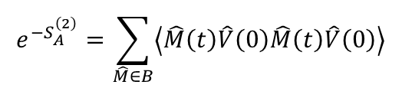



Fundamental OTOC literature
S.H. Shenker, D. Stanford, Black holes and the butterfly effect, JHEP 2014:067
- For operators separated in space $c\left(t,x\right)∼e^{\left[λ\left(t−t^{∗}−\frac{\left|x\right|}{v_{B}}\right)\right]}$
Butterfly velocity
Gauge gravity duality: Black holes in asymptotically AdS spaces are dual to strongly coupled many-body quantum systems. Chaotic nature of quantum many-body systems characterized by OTOCs are related to the collision of shock waves close to the black hole horizon.
P. Hosur, X.L. Qi, D.A. Roberts, B. Yoshida, Chaos in quantum channels, JHEP 2016:004
J. Maldacena, S.H. Shenker, D. Stanford, A bound on chaos, JHEP 2016:106
Bound for Lyapunov exponent: $λ≤\frac{2π}{β}$
K. Hashimoto, K. Murata, R. Yoshii, OTOCs in quantum mechanics, JHEP 2017:138
E.B. Rozenbaum, S. Ganeshan, V. Galitski, Lyapunov exponent and OTOC’s growth rate in a chaotic system, Physical Review Letters 118, 086801 (2017)
R. Fan, P. Zhang, H. Shen, H. Zhai, OTOC for many-body localization, Science Bulletin 62, 707 (2017)
Relation between Rényi entropy of a subsystem and OTOC:
$$S_{A}^{\left(2\right)}=Tr_{B}{\hat{ρ}}_{AB}^{2}$$
$$e^{−S_{A}^{\left(2\right)}}=\sum_{\hat{M}∈B}{\left\langle \hat{M}\left(t\right)\hat{V}\left(0\right)\hat{M}\left(t\right)\hat{V}\left(0\right)\right\rangle }$$
$\hat{V}=\hat{O}e^{−β\hat{H}}{\hat{O}}^{+}$ an arbitrary operator
E.B. Rozenbaum, S. Ganeshan, V. Galitski, Universal Level Statistics of the OTOC, arXiv:1801.10591
Lyapunovian: operator with GOE level statistics and OTOC expectation value

